Slide 1
Pencil Code User Meeting 2019. Aalto University

Slide 2
Introduction
MHD turbulence during the early universe (radiation dominated)
Generation of primordial magnetic fields during phase transitions, e.g., electroweak phase transition
First order phase transition bubble nucleation leading to turbulent plasma motions
Generation of GW stochastic background due to MHD stresses
Detection by LISA detector

Slide 3
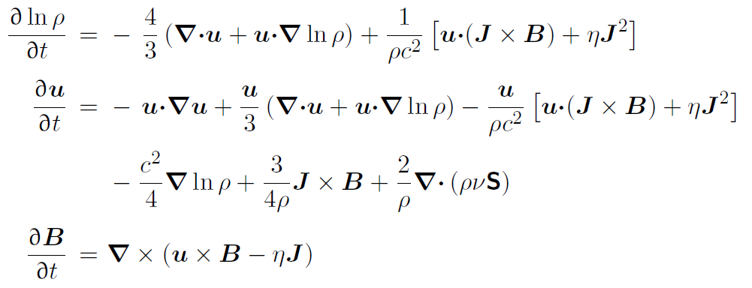
MHD equations

Slide 4
Gravitational wave equation
FRLW metric perturbations
Stress-energy tensor

Slide 5
Normalized GW Equation

Slide 6
Transverse and Traceless projection
TT projection
Projection operator

Slide 7
Polarization modes
+ mode
x mode

Slide 8
Two approaches to solve GW equation
SPECIAL=gravitational_waves_hij6
3rd order RK scheme
2nd order in time
SPECIAL=gravitational_waves_hTXk
$$ω=ck$$

Slide 9

Spectral diagnostics
Characteristic GW amplitude $h_{rms}$
GW energy density $Ω_{GW}$

Slide 10
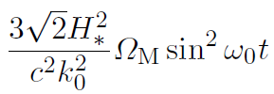
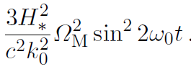
Analytic case: Beltrami field
Initial magnetic field
Non-expanding universe

Slide 11
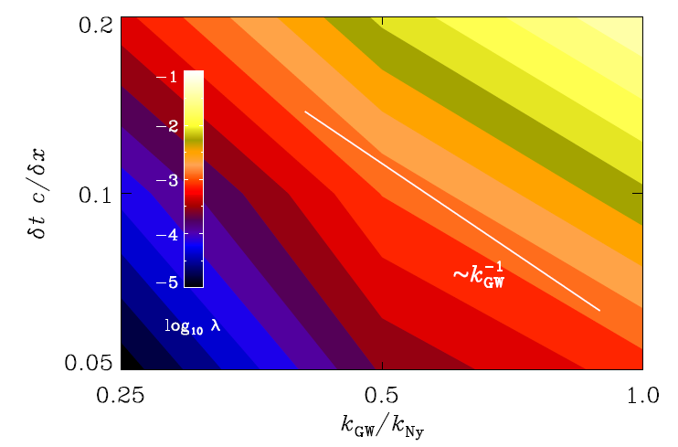
Solution using Pencil Code

Slide 12
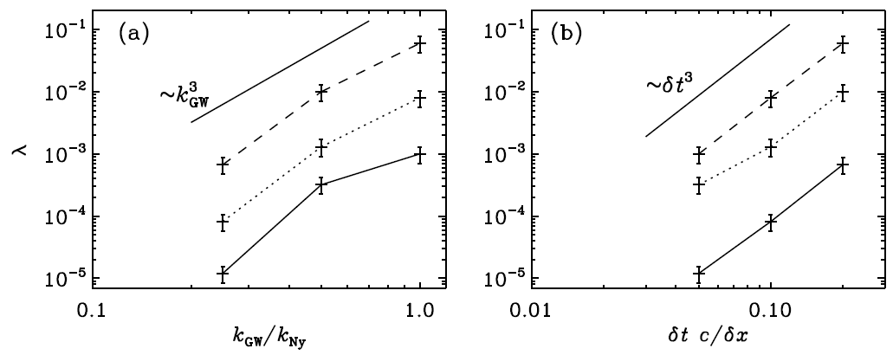
Solution using Pencil Code

Slide 13
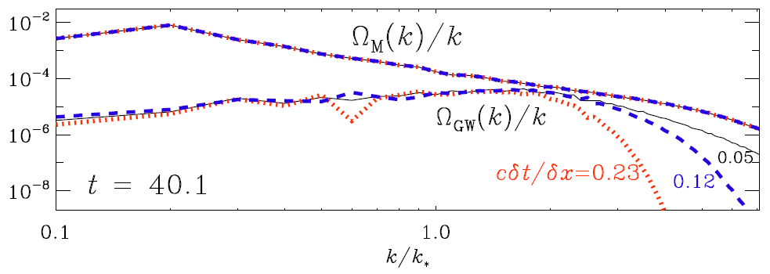
Turbulent magnetic field (gravitational_waves_hij6)

Slide 14
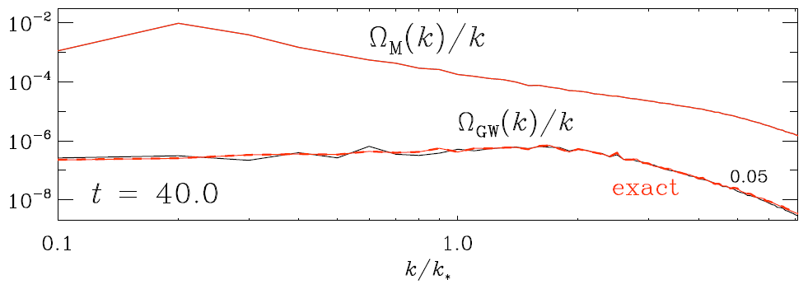
Turbulent magnetic field (gravitational_waves_hXTk)

Slide 15
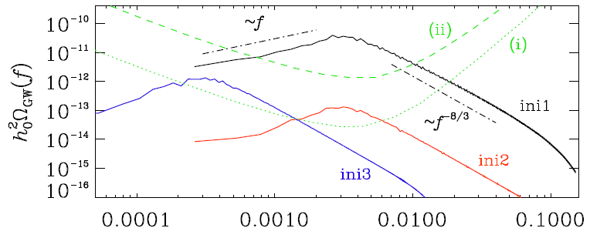
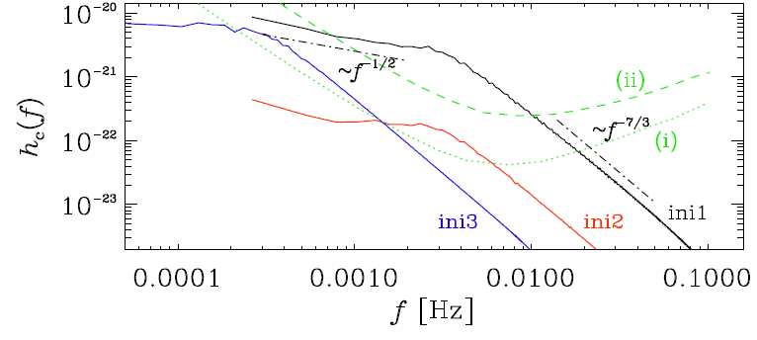
Detection by LISA

