Slide 1

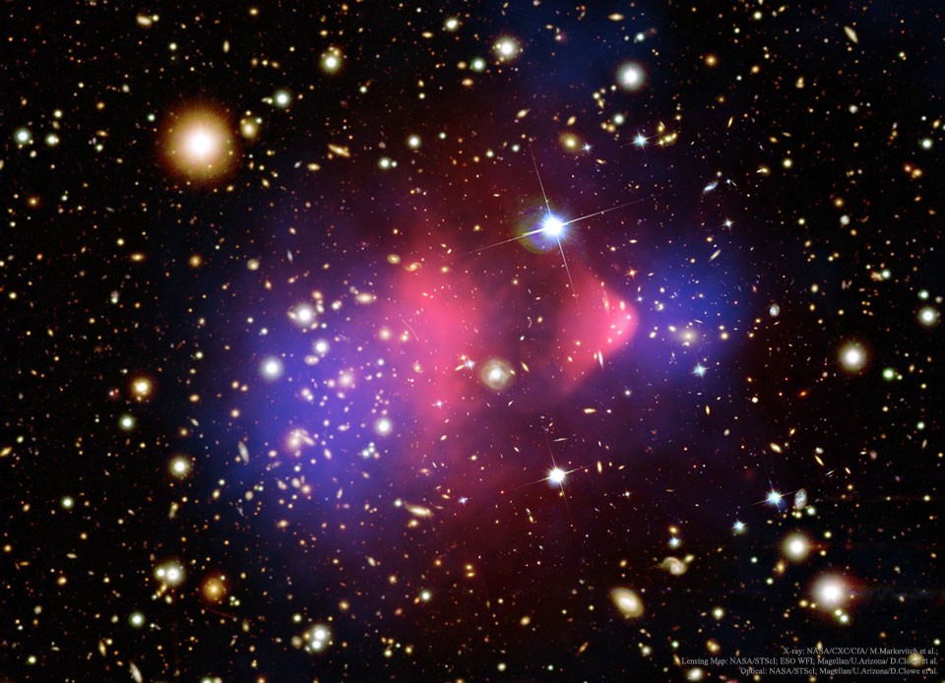
Spin-1 Thermal Targets for Dark Matter Searches at Fixed Target Experiments arXiv:2307.XXXX
Taylor R. Grayª
In collaboration with Riccardo Catenaª
ªChalmers University of Technology
Supported by a research grant from the Wallenberg foundation
Fysikdagarna 2023

Slide 2
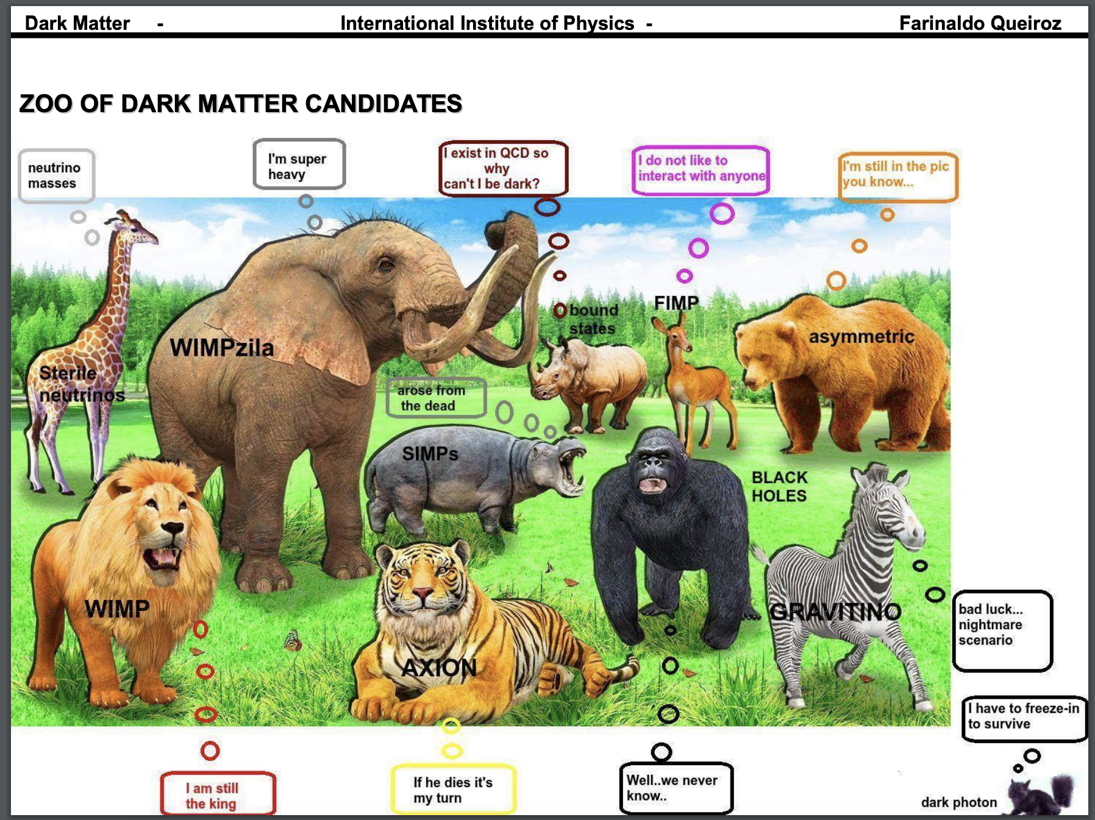

Was once in thermal equilibrium w SM
mass: ~ MeV – GeV
interacts w SM via a new hypothetical dark mediator particle
Direct detection can’t catch me…
Sub-GeV DM
F. Queiroz

Slide 3








Sub-GeV Dark Matter
Thermal equilibrium between DM and SM in the early universe.
Thermal DM Window
$m_{χ}$ (GeV)
$${10}^{−30}$$
$${10}^{−20}$$
$${10}^{−10}$$
$${10}^{0}$$
$${10}^{10}$$
$${10}^{20}$$
sub-GeV
WIMPs
$$m_{χ}$$
KeV
MeV
GeV
TeV
Sub-GeV DM is largely experimentally unexplored..
  Out of reach of nuclear recoil direct detection exps
DM produced through freeze-out near weak scale
GeV-TeV scale thermal DM already widely tested
Notes:
`

Slide 4
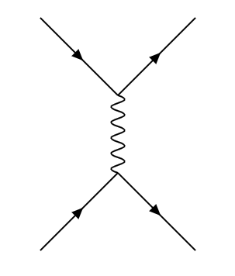
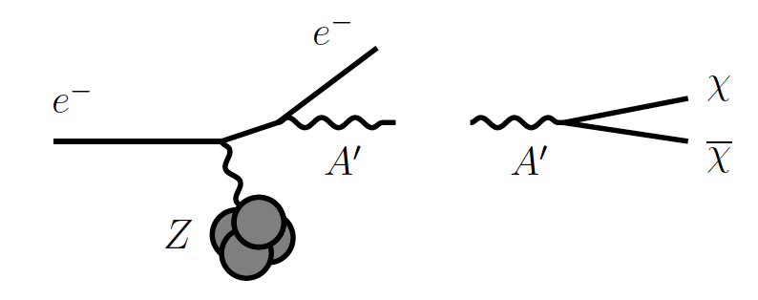


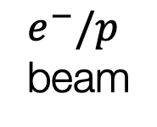






Sub-GeV Dark Matter
Fixed Target
Detector
Fixed target experiments can probe sub-GeV DM
Future fixed target experiments such as LDMX will reach new sensitivities in the sub-GeV mass range.
$e^{−}/p$ beam
$$A′$$
$$χχ$$
$$χ$$
$$χ$$
$$A^{′}$$
$$e^{−}$$
$$e^{−}$$

Slide 5
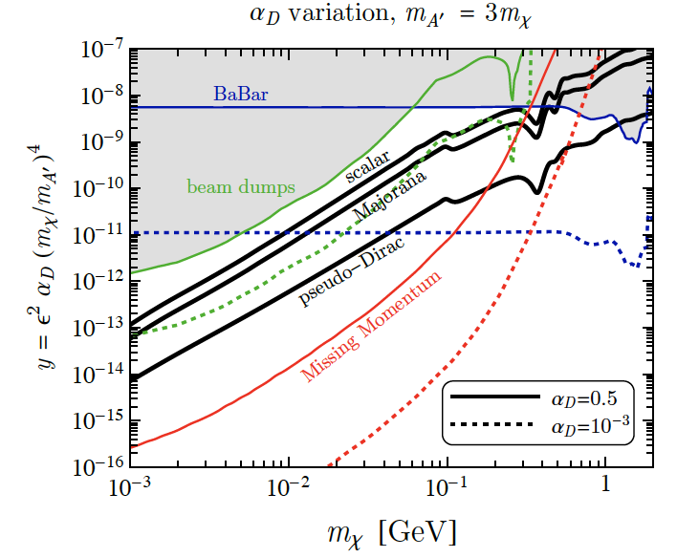
Sub-GeV Dark Matter
Fixed target experiments can probe sub-GeV DM
Future fixed target experiments such as LDMX will reach new sensitivities in the sub-GeV mass range.
How about spin-1 DM?
Spin-0
LDMX
Spin-1/2
arXiv:1807.0170

Slide 6


The Goal
Broaden the existing studies on sub-GeV DM at fixed target experiments
We consider,
  a set of simplified spin-1 DM candidates which have a dark photon mediator
  2. a renormalizable, UV complete SIMP spin-1 DM model with two mediators
$$X,A′$$
$$X,A^{′},X_{3}$$

Slide 7
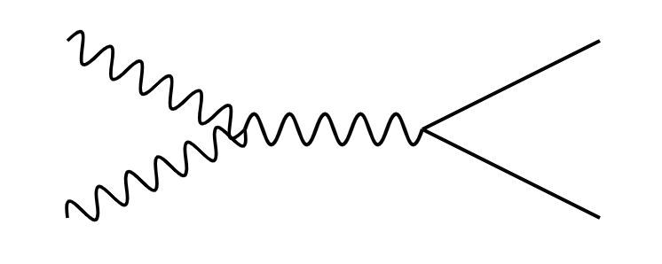
Simplified Spin-1 Dark Matter Models with a Dark Photon Mediator
$b_{5}$: real
$b_{6}$: complex
$b_{7}$: complex
$h_{3}$: real
$$X$$
$$f$$
$$h_{3}≡εe$$
$$A′$$
$$X^{†}$$
$$\overline{f}$$
$f$: SM leptons and quarks (excluding neutrinos)
If ${2m}_{X}<m_{A′}$ s-channel dominates DM annihilations.

Slide 8
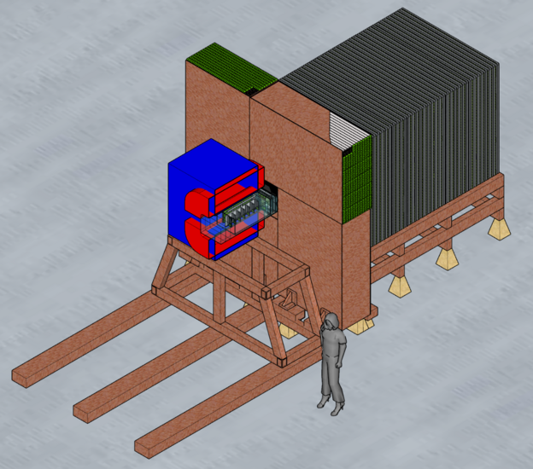
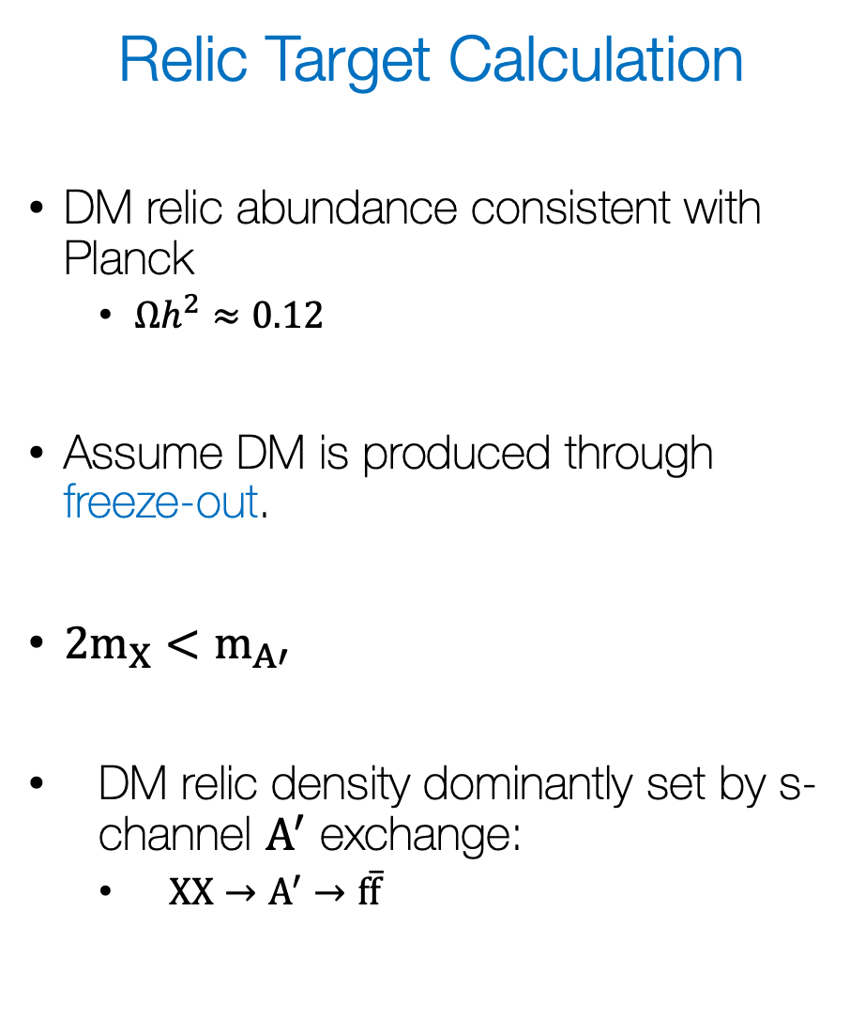
Relic Target Calculation
DM relic abundance consistent with Planck
  $Ωh^{2}≈0.12$
Assume DM is produced through freeze-out.
${2m}_{X}<m_{A′}$
DM relic density dominantly set by s-channel $A^{′}$ exchange:
  $XX→A^{′}→f\overline{f}$
Experimental Reach
Place 90% CL exclusions and projections on parameter space.
(LDMX)

Slide 9

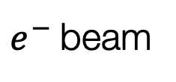

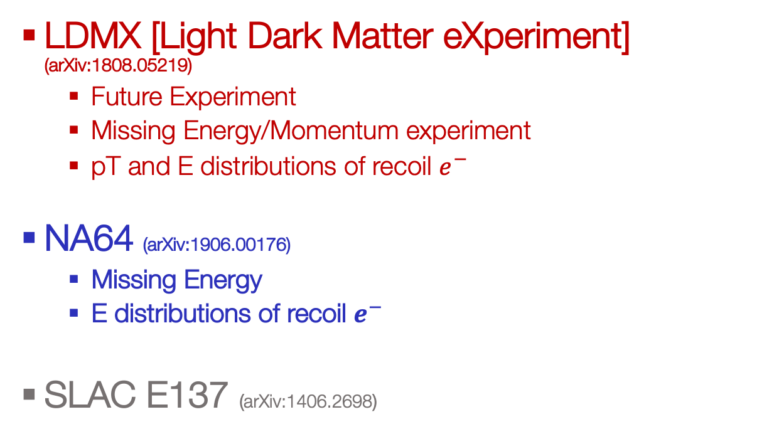



Limits/Projections
Fixed Target
Electron Dark-Bremsstrahlung
+ (In)Visible Decay
Detector
$e^{−}$ beam
$$A′$$
$$χχ$$
$$χ$$
$$χ$$
LDMX [Light Dark Matter eXperiment] (arXiv:1808.05219)
  Future Experiment
  Missing Energy/Momentum experiment
  pT and E distributions of recoil $e^{−}$
NA64 (arXiv:1906.00176)
  Missing Energy
  E distributions of recoil $e^{−}$
SLAC E137 (arXiv:1406.2698)
$$A^{′}$$
$$e^{−}$$
$$e^{−}$$

Slide 10
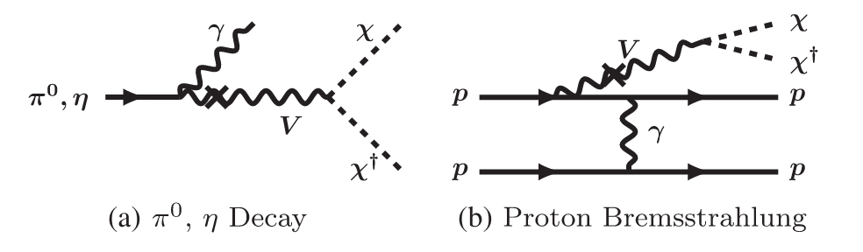


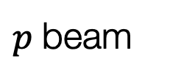
Limits/Projections
Fixed Target
Proton Beam Dumps with Downstream DM Detector
BdNMC software
Detector
$p$ beam
$$A′$$
$$χχ$$
$$χ$$
$$χ$$
$$A^{′}$$
LSND (arXiv:1107.4580)
  DM-electron scattering
MiniBooNE (arXiv:1702.02688)
  DM-electron/nucleon scattering
$${N/e}^{−}$$
$${N/e}^{−}$$

Slide 11
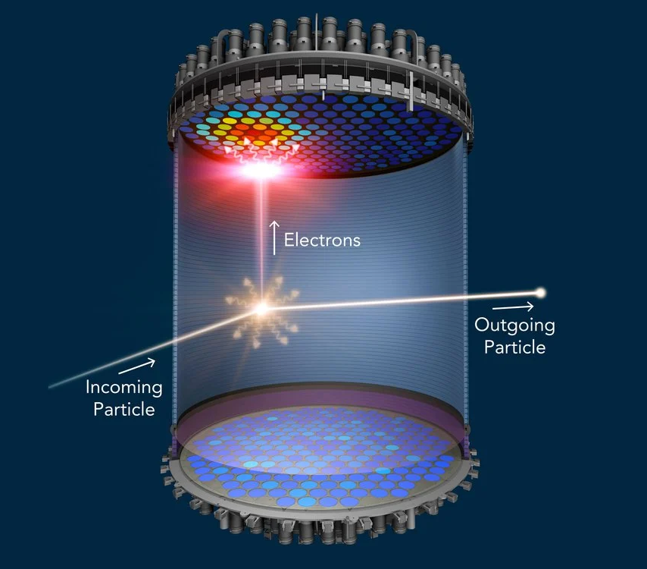






Limits/Projections
Direct Detection (arXiv:2210.07305)
Monophoton Searches
$$e^{+}e^{−}→γA^{′}, A^{′}→XX$$
$$χ$$
$$χ$$
$$A^{′}$$
Edelweiss
Sensei
Xenon1T
Xenon10
BaBar (arXiv:1702.03327)
Belle II
  Future experiment
$$e^{−}$$
$$e^{−}$$

Slide 12
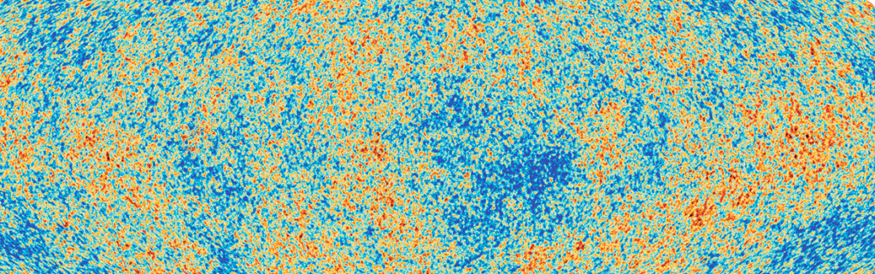
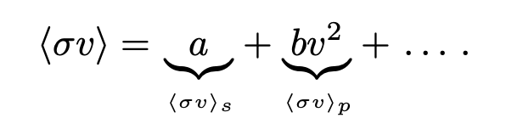
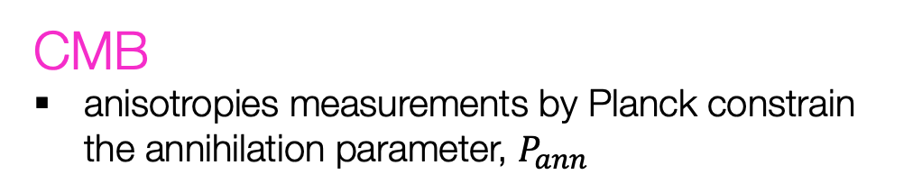
Energy Injection
Limits/Projections
DM
SM
DM
SM
CMB
anisotropies measurements by Planck constrain the annihilation parameter, $P_{ann}$
IGM temperature
Lyman-α forest measurements, we require that the energy injected into the IGM does not overheat it at late times
(Planck 2018)

Slide 13
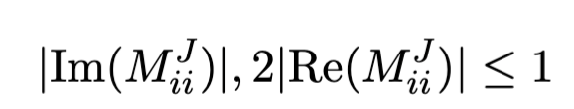






Limits/Projections
Unitarity Violation
If the matrix elements in the theory are too large at tree level, additional fields or higher order diagrams are needed to restore unitarity of the S matrix.
  Need to be careful of this for the simplified spin-1 DM models…
  But, the renormalizable and UV complete SIMP spin-1 DM model by construction does not violate unitarity!
$$χ$$
$$χ$$
$$A^{′}$$
$$e^{−}$$
$$e^{−}$$
arXiv:1510.02110: simplified $DM$
arXiv:2303.08351: spin-1 $DM$ self scattering

Slide 14
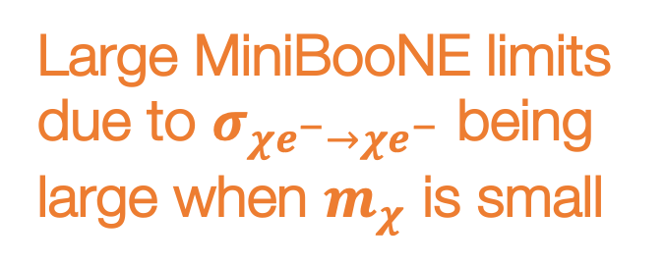
Strong Limits on Spin-1 Relic Targets
Large MiniBooNE limits due to $σ_{χe^{−}→χe^{−}}$ being large when $m_{χ}$ is small
Ruled out by current experiments and CMB respectively..

Slide 15

Spin-1 DM is the first to be probed by LDMX!
Invisible vector meson decay
Let's now consider a UV complete model where unitarity is not violated!

Slide 16


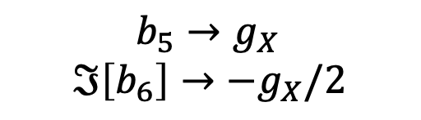



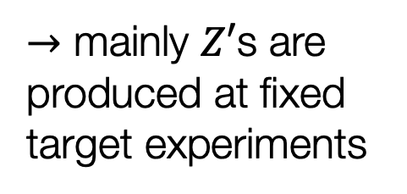

SIMP Spin-1 Dark Matter with $Z′$ and $X_{3}$ as mediators
$b_{5}→g_{X}$
$$ℑ\left[b_{6}\right]→−g_{X}/2$$
$$X_{+}X_{−}→f\overline{f}$$
processes setting the relic density
$$→$$
$$X_{+}X_{+}X_{−}→X_{+}{\tilde{X}}_{3}$$
$→$ mainly $Z′$s are produced at fixed target experiments
$X_{+}X_{−}→{\tilde{X}}_{3}$ ${\tilde{X}}_{3}$
Dominant since $g_{X}≫eϵ$
arXiv:1904.04109

Slide 17
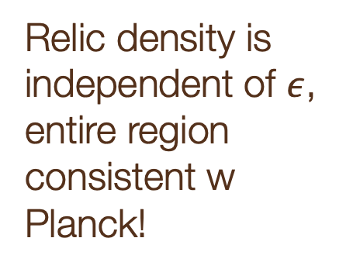
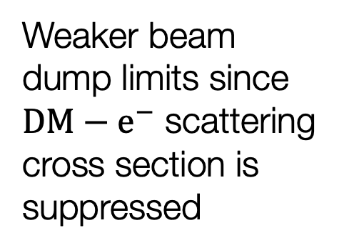
Weaker beam dump limits since $DM−e^{−}$ scattering cross section is suppressed
Relic density is independent of $ε$, entire region consistent w Planck!

Slide 18
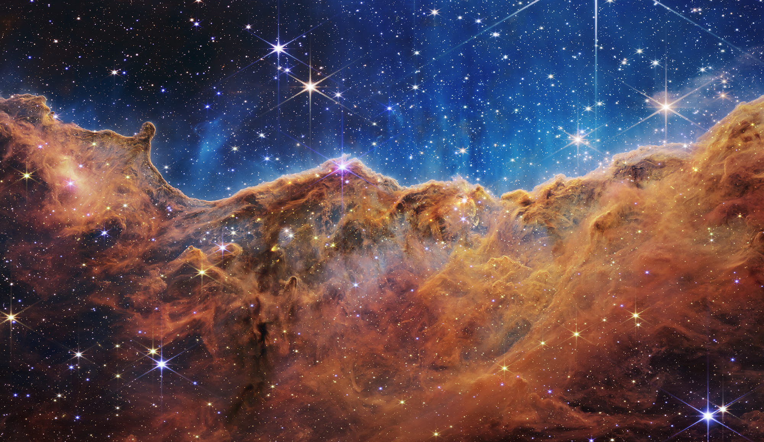
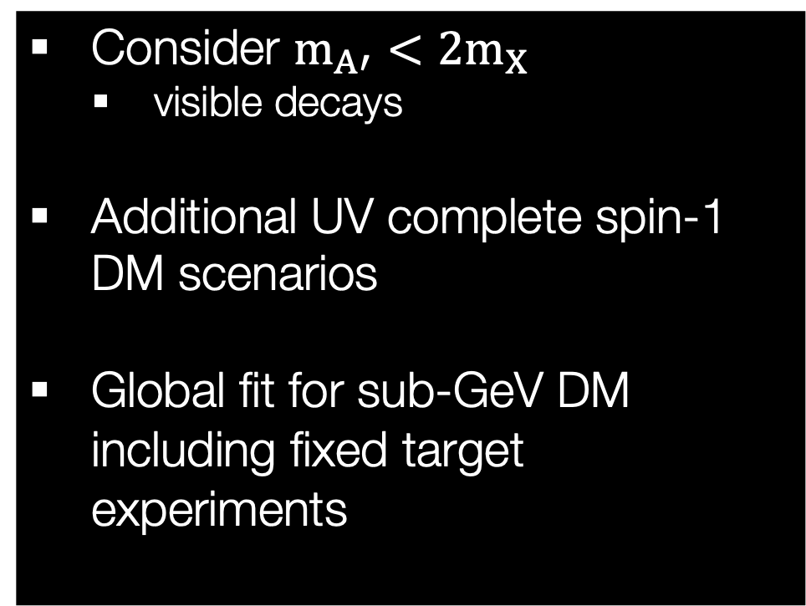
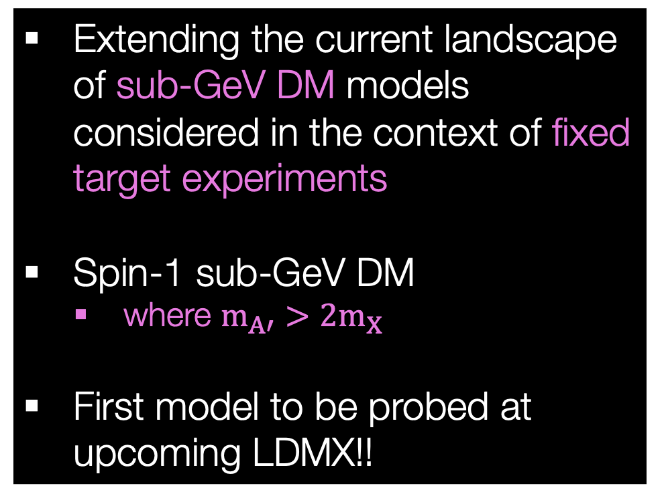
Summary
Future
Extending the current landscape of sub-GeV DM models considered in the context of fixed target experiments
Spin-1 sub-GeV DM
  where $m_{A′}>2m_{X}$
First model to be probed at upcoming LDMX!!
Consider $m_{A′}<2m_{X}$
  visible decays
Additional UV complete spin-1 DM scenarios
Global fit for sub-GeV DM including fixed target experiments

Slide 19
Backup Slides

Slide 20
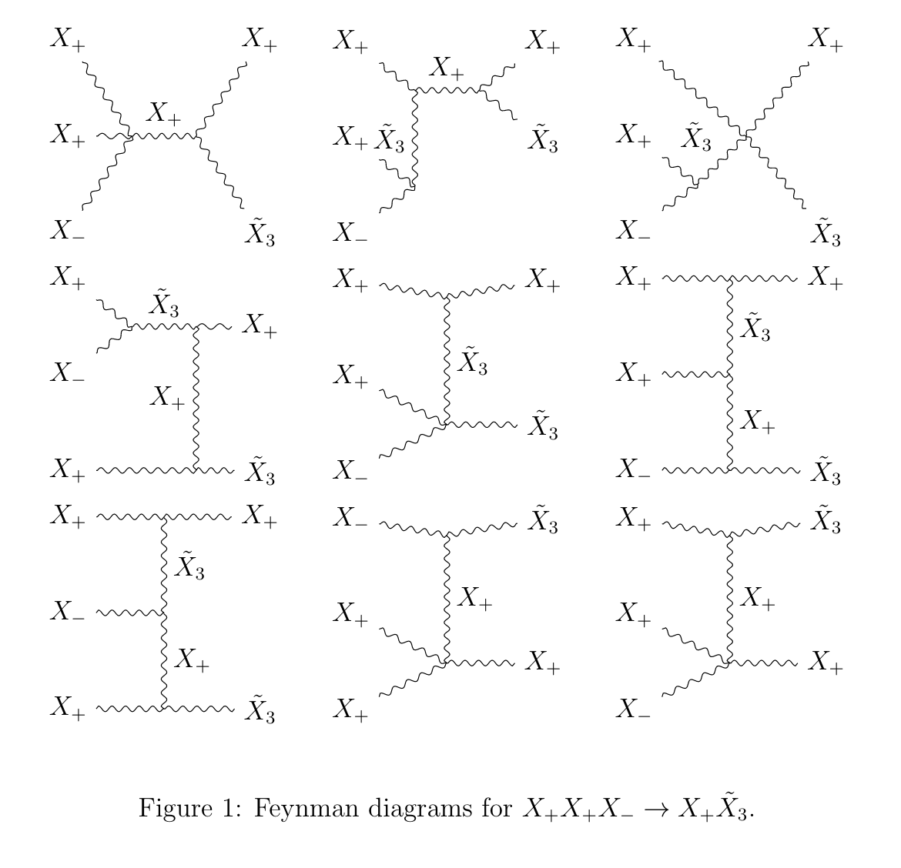
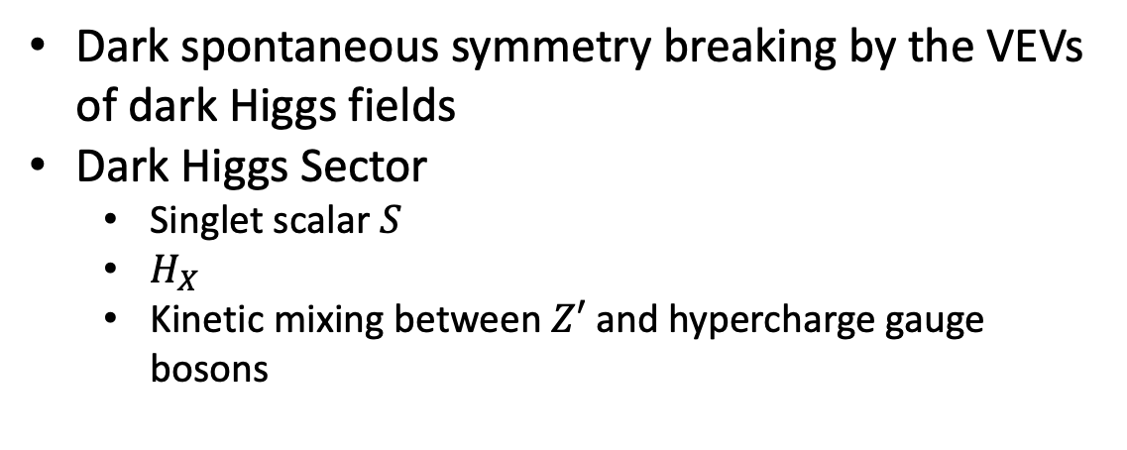
SIMP spin-1 DM
Dark spontaneous symmetry breaking by the VEVs of dark Higgs fields
Dark Higgs Sector
  Singlet scalar $S$
  $H_{X}$
  Kinetic mixing between $Z′$ and hypercharge gauge bosons

Slide 21
Relic Targets of DM Models
Muon channel becomes allowed
Hadronic resonances

Slide 22
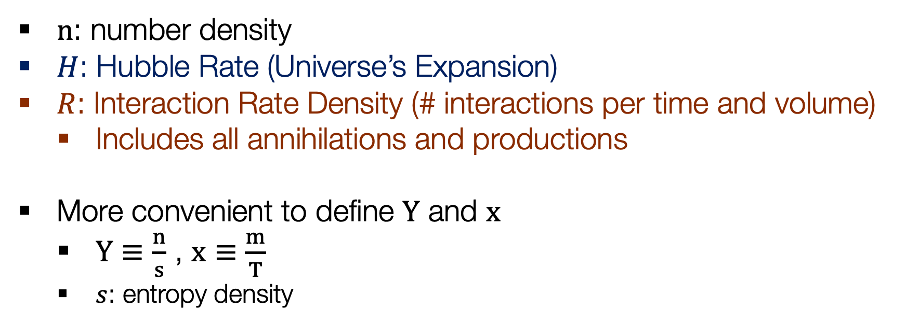
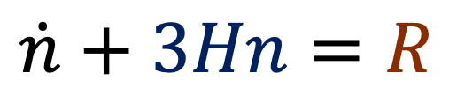
Calculating Dark Matter Abundance
The Boltzmann Equation
$$\dot{n}+3Hn=R$$
Universe’s Expansion
Particle Physics
$n$: number density
$H$: Hubble Rate (Universe’s Expansion)
$R$: Interaction Rate Density (# interactions per time and volume)
  Includes all annihilations and productions
More convenient to define $Y$ and $x$
  $Y≡\frac{n}{s}$ , $x≡\frac{m}{T}$
  $s$: entropy density

Slide 23
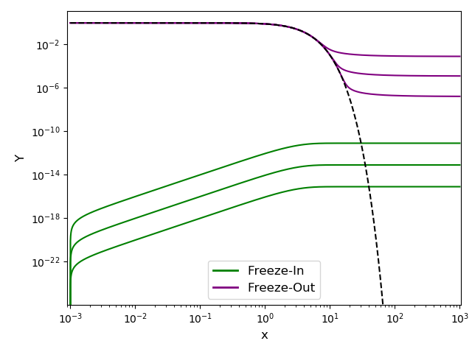
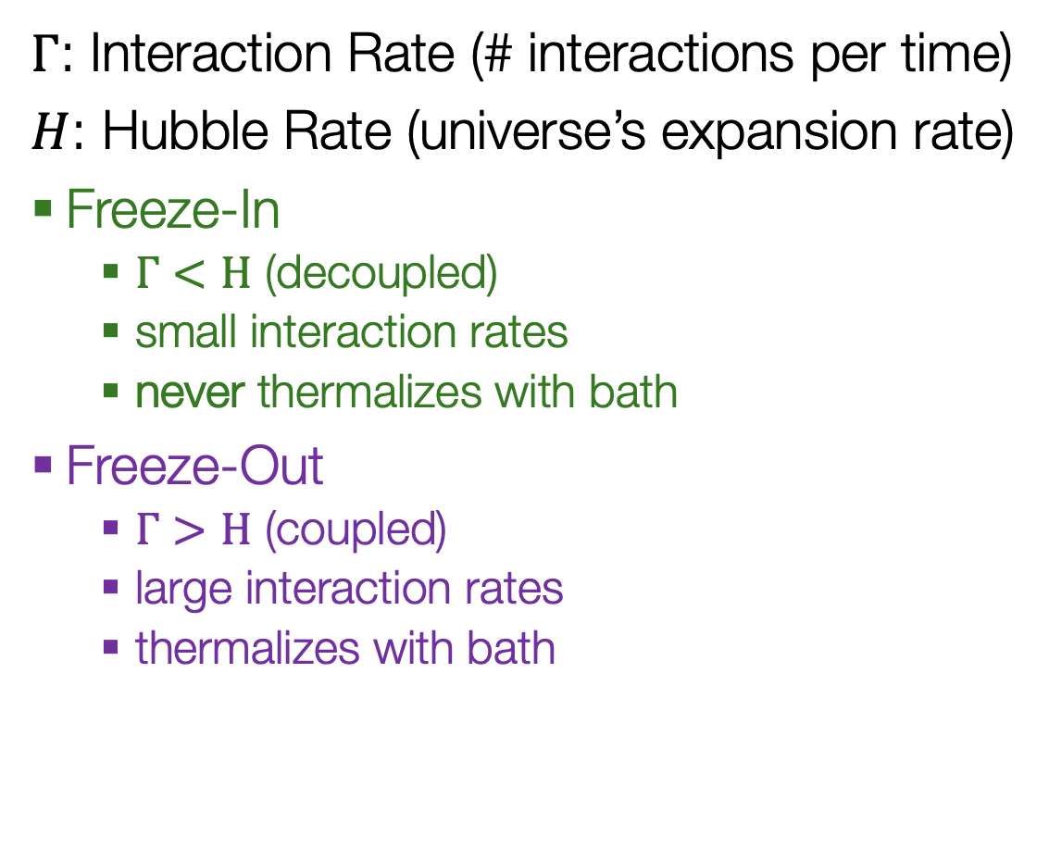

Ways of Producing Dark Matter
$Γ$: Interaction Rate (# interactions per time)
$H$: Hubble Rate (universe’s expansion rate)
Freeze-In
  $Γ<H$ (decoupled)
  small interaction rates
  never thermalizes with bath
Freeze-Out
  $Γ>H$ (coupled)
  large interaction rates
  thermalizes with bath
This work!
$→$Increasing Coupling

Slide 25
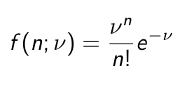
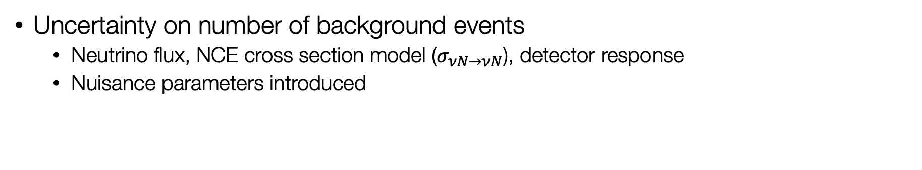
Confidence Intervals
(I’m sorry to the Bayesian statistics supporters in the audience)
x% CL: If experiment is repeated many times, the intervals include the true parameter x% of the time
Counting experiment, take Poisson distribution:
Uncertainty on number of background events
  Neutrino flux, NCE cross section model ($σ_{νN→νN}$), detector response
  Nuisance parameters introduced

Slide 26
Experiments

Slide 27
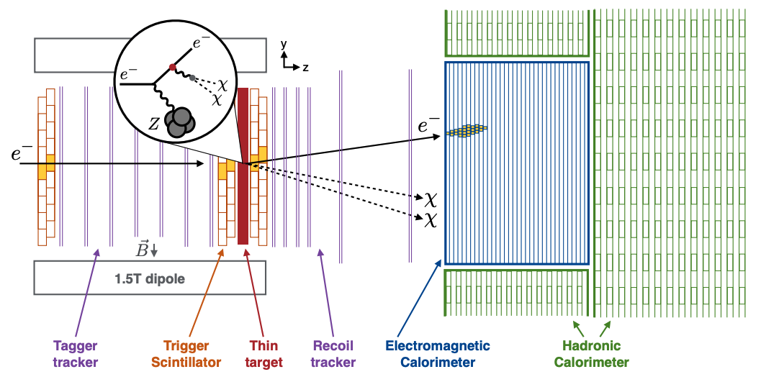
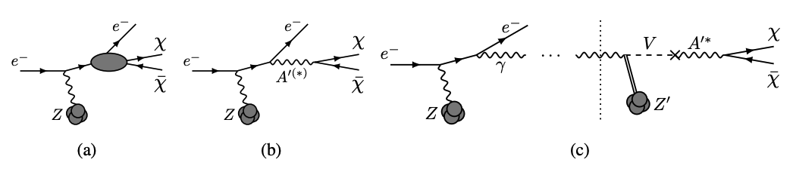
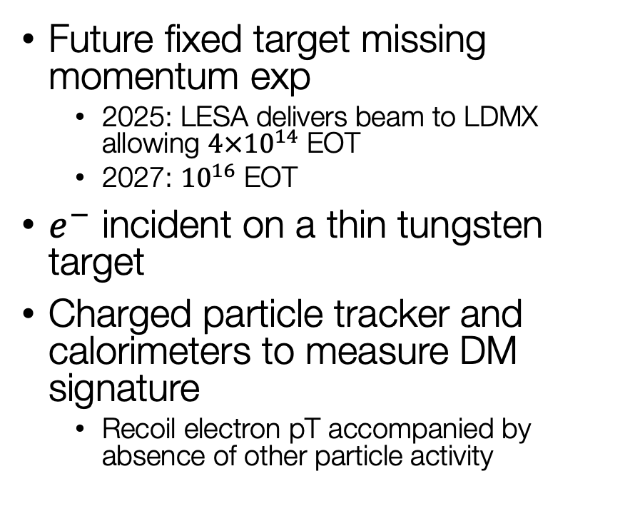
Light Dark Matter eXperiment (LDMX)
Future fixed target missing momentum exp
  2025: LESA delivers beam to LDMX allowing $4×{10}^{14}$ EOT
  2027: ${10}^{16}$ EOT
$e^{−}$ incident on a thin tungsten target
Charged particle tracker and calorimeters to measure DM signature
  Recoil electron pT accompanied by absence of other particle activity

Slide 28
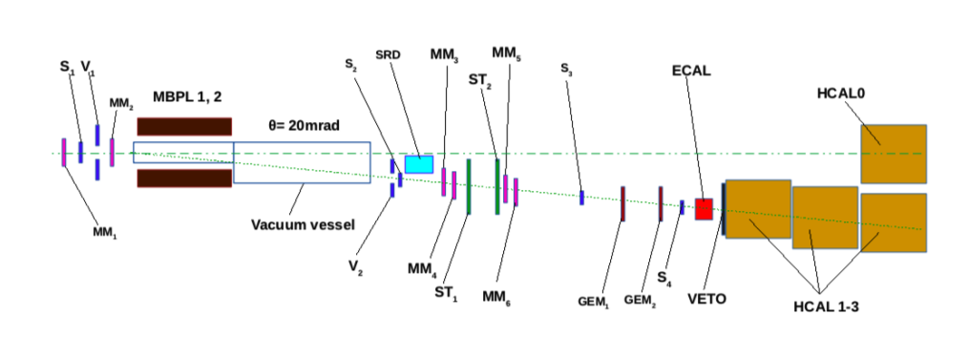
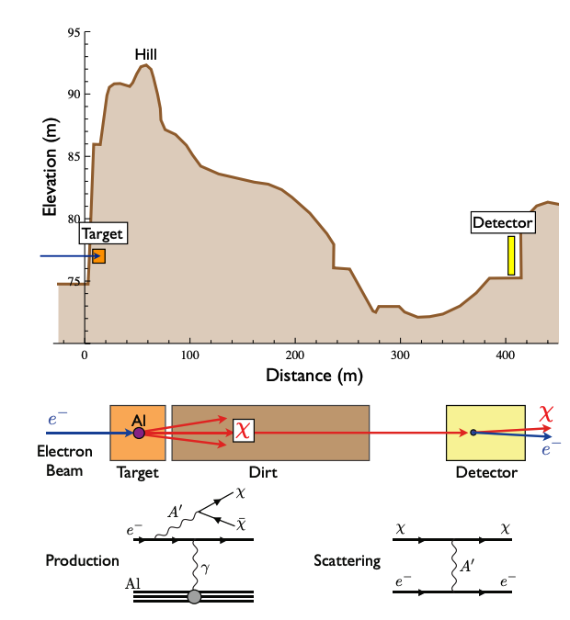
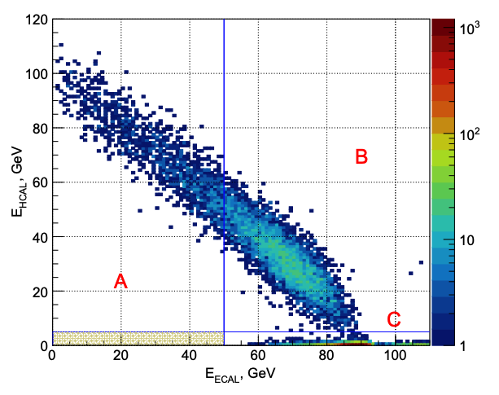
Electron Beam Dumps
E137
arXiv:1406.2698
DM produced from electron-target collisions
20 GeV beam incident on a set of aluminum plates interlaced with cooling water.
Downstream detector
NA64
arXiv:1710.00971
100 GeV electron beam incident on a lead target
Event: single electron produced and missing energy

Slide 29
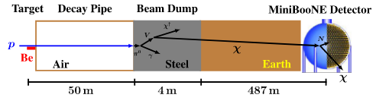
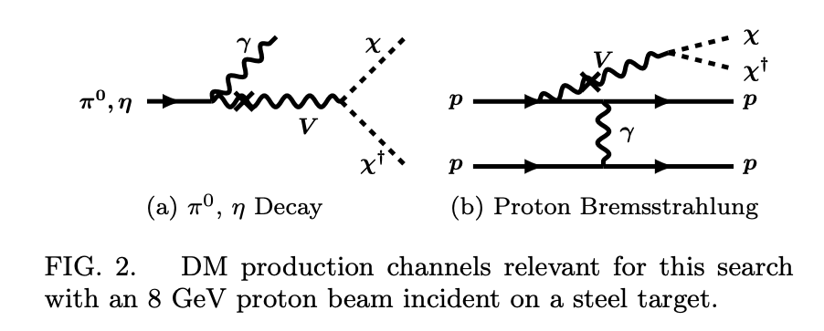
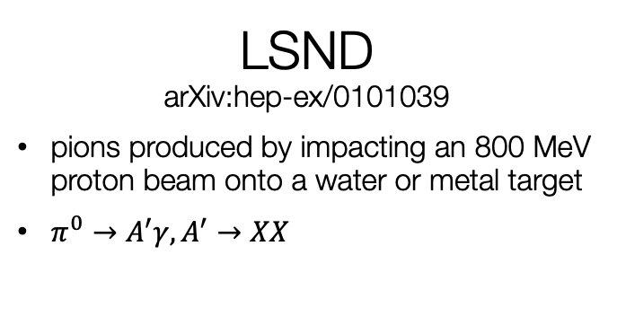
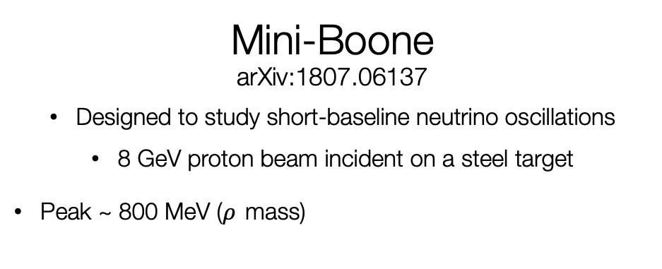
Proton Beam Dumps arXiv:1107.4580
Mini-Boone
arXiv:1807.06137
Designed to study short-baseline neutrino oscillations
8 GeV proton beam incident on a steel target
Peak ~ 800 MeV ($ρ$ mass)
DM scatterings mimic neutrino scatterings!
(Neutral current-like scatterings)
LSND
arXiv:hep-ex/0101039
pions produced by impacting an 800 MeV proton beam onto a water or metal target
$π^{0}→A^{′}γ,A^{′}→XX$

Slide 30

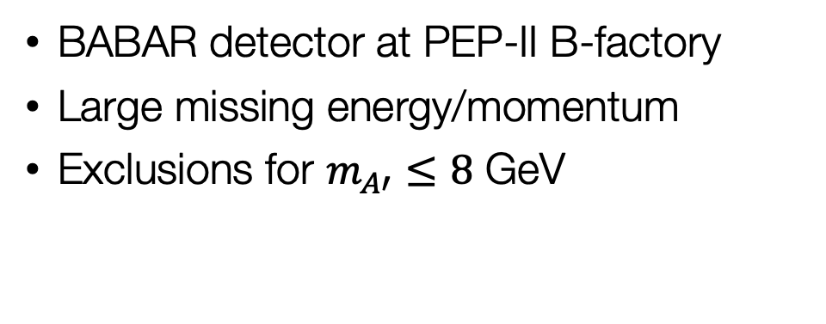


arXiv:1702.03327
Monophoton Searches
Search for single photon events in $e^{+}e^{−}$collision data
$$e^{+}e^{−}→γA^{′}, A^{′}→XX$$
Belle-II
arXiv:1808.10567
Experiment operated at SuperKEKB
First data taken in 2019, more to come..
7 GeV electrons with 4 GeV positrons
BABAR detector at PEP-II B-factory
Large missing energy/momentum
Exclusions for $m_{A′}≤8$ GeV

Slide 31
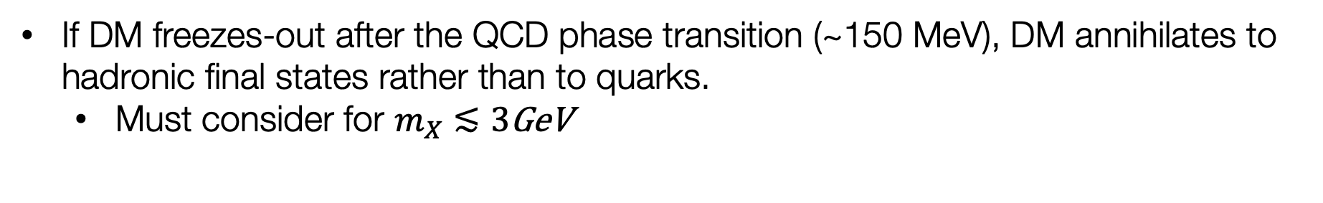
Hadronic Resonances
If DM freezes-out after the QCD phase transition (~150 MeV), DM annihilates to hadronic final states rather than to quarks.
  Must consider for $m_{X}≲3$GeV

