Slide 1
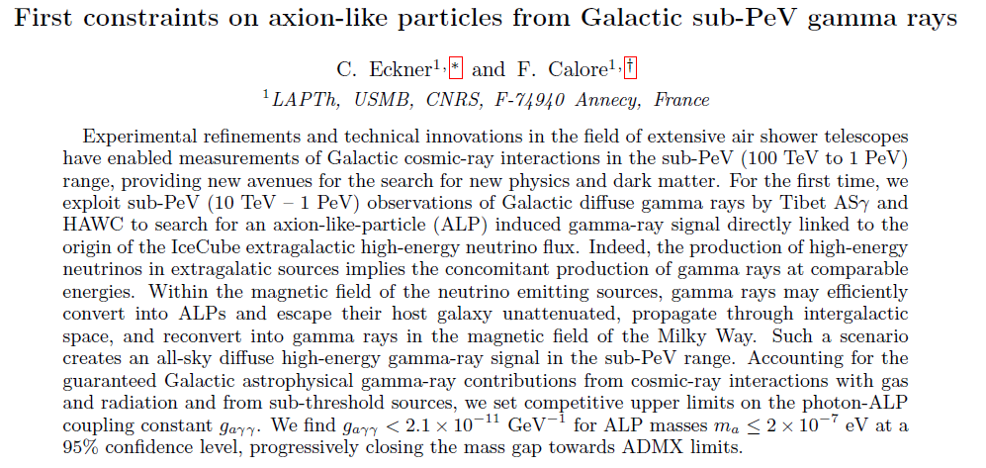
BSM meeting
Pedro de la Torre Luque
12/05/2022

Slide 2
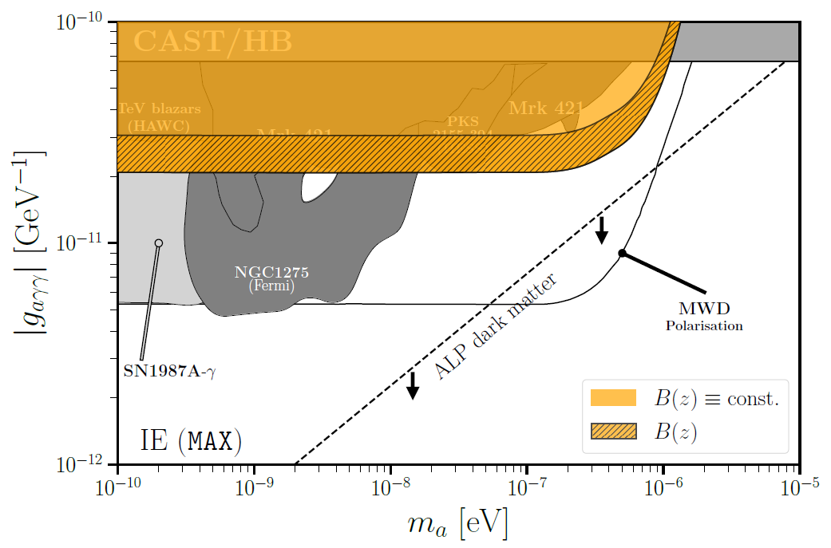
Main result and rationale
Eckner & Calore 2022 arXiv: 2204.12487
Derive new axion DM constraints from sub-PeV diffuse gamma rays
Study the background
Truly diffuse emission (mainly p-p interactions)
Unresolved sources
ALP production at gamma-ray sources.
Compute gamma-ray emission from neutrino observations
Compute conversion ALP-γ at source B
Compute reconversion at Galactic B
Obtain the limits
Compare to HAWC and TIBET-Asγ data
Notes:
Primakoff effect

Slide 3
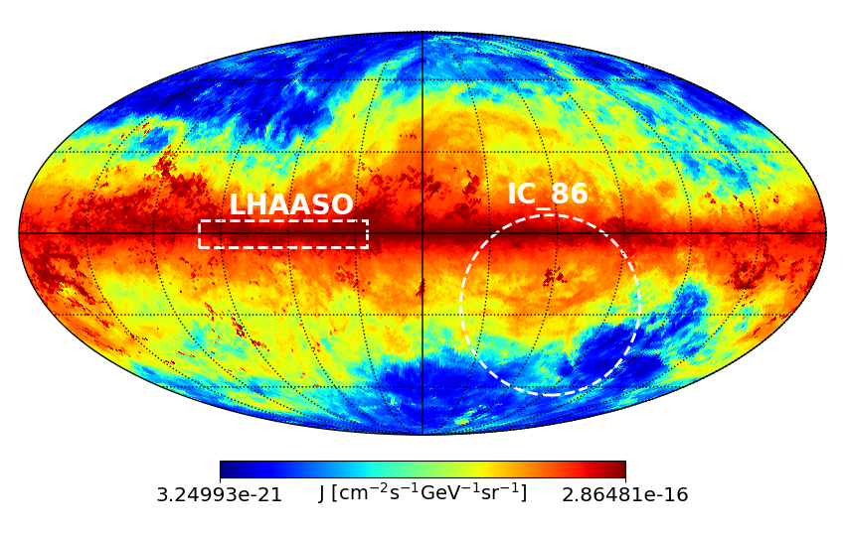
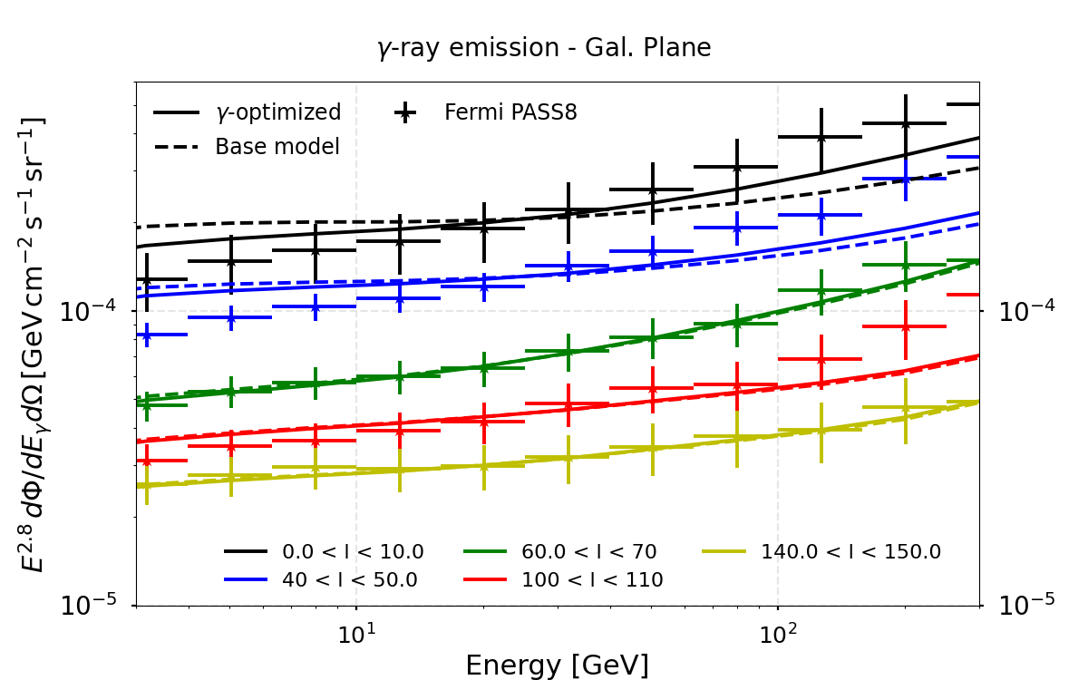
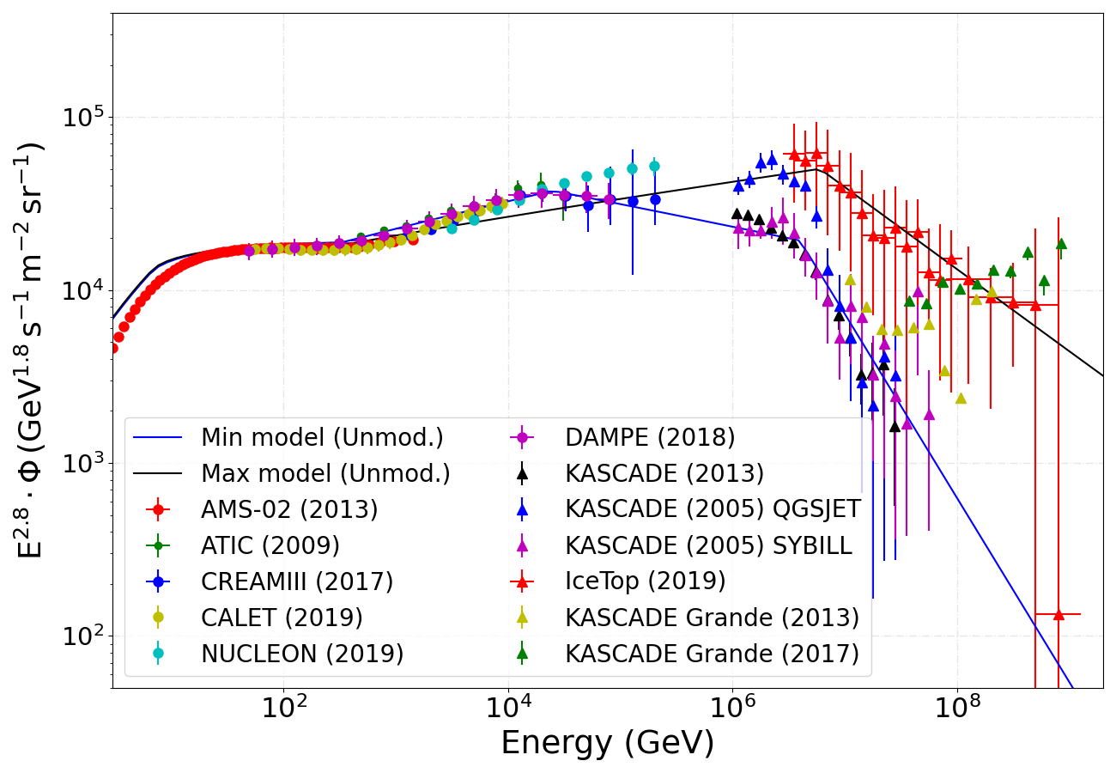
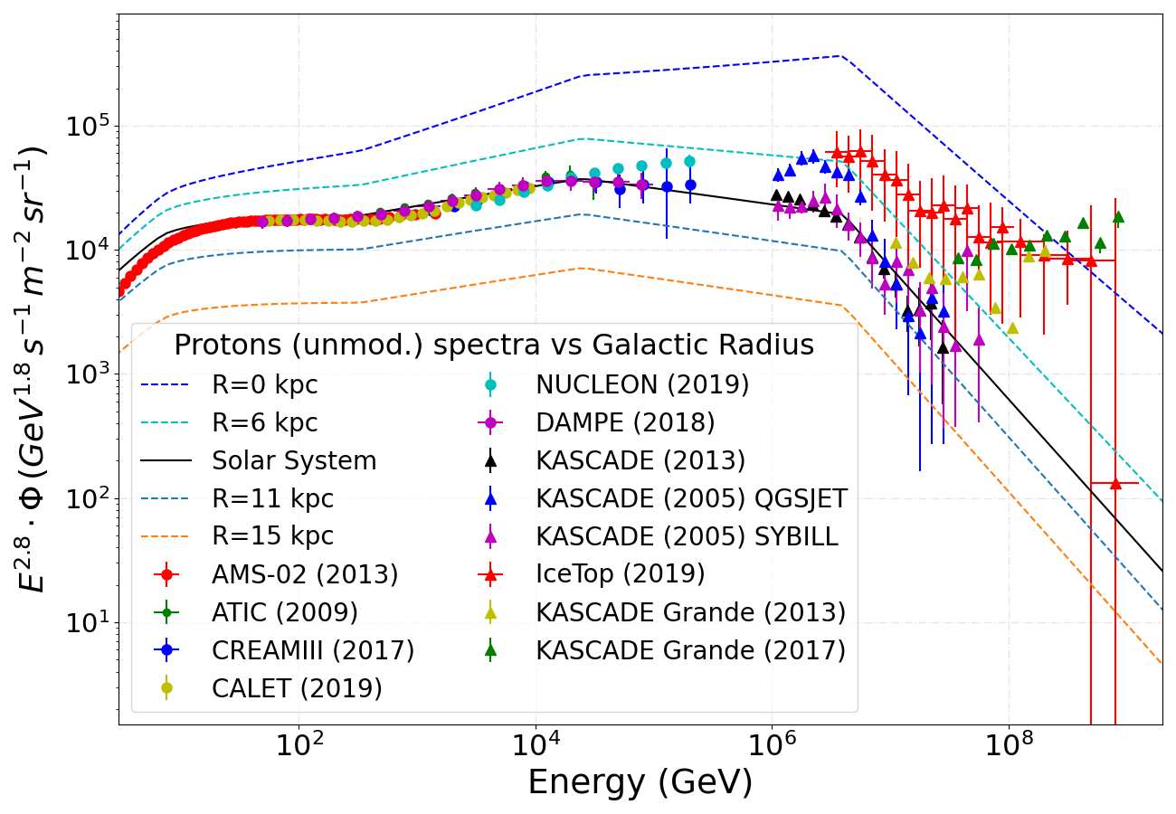
Galactic diffuse gamma-ray emission
P.D.L. et al arXiv: 2203.15759
A simple scenario of inhomogeneous propagation allows us to reproduce gamma-ray observations at different ROI around the galactic plane. Systematic uncertainties in the modelling of CR flux are considered under two models

Slide 4
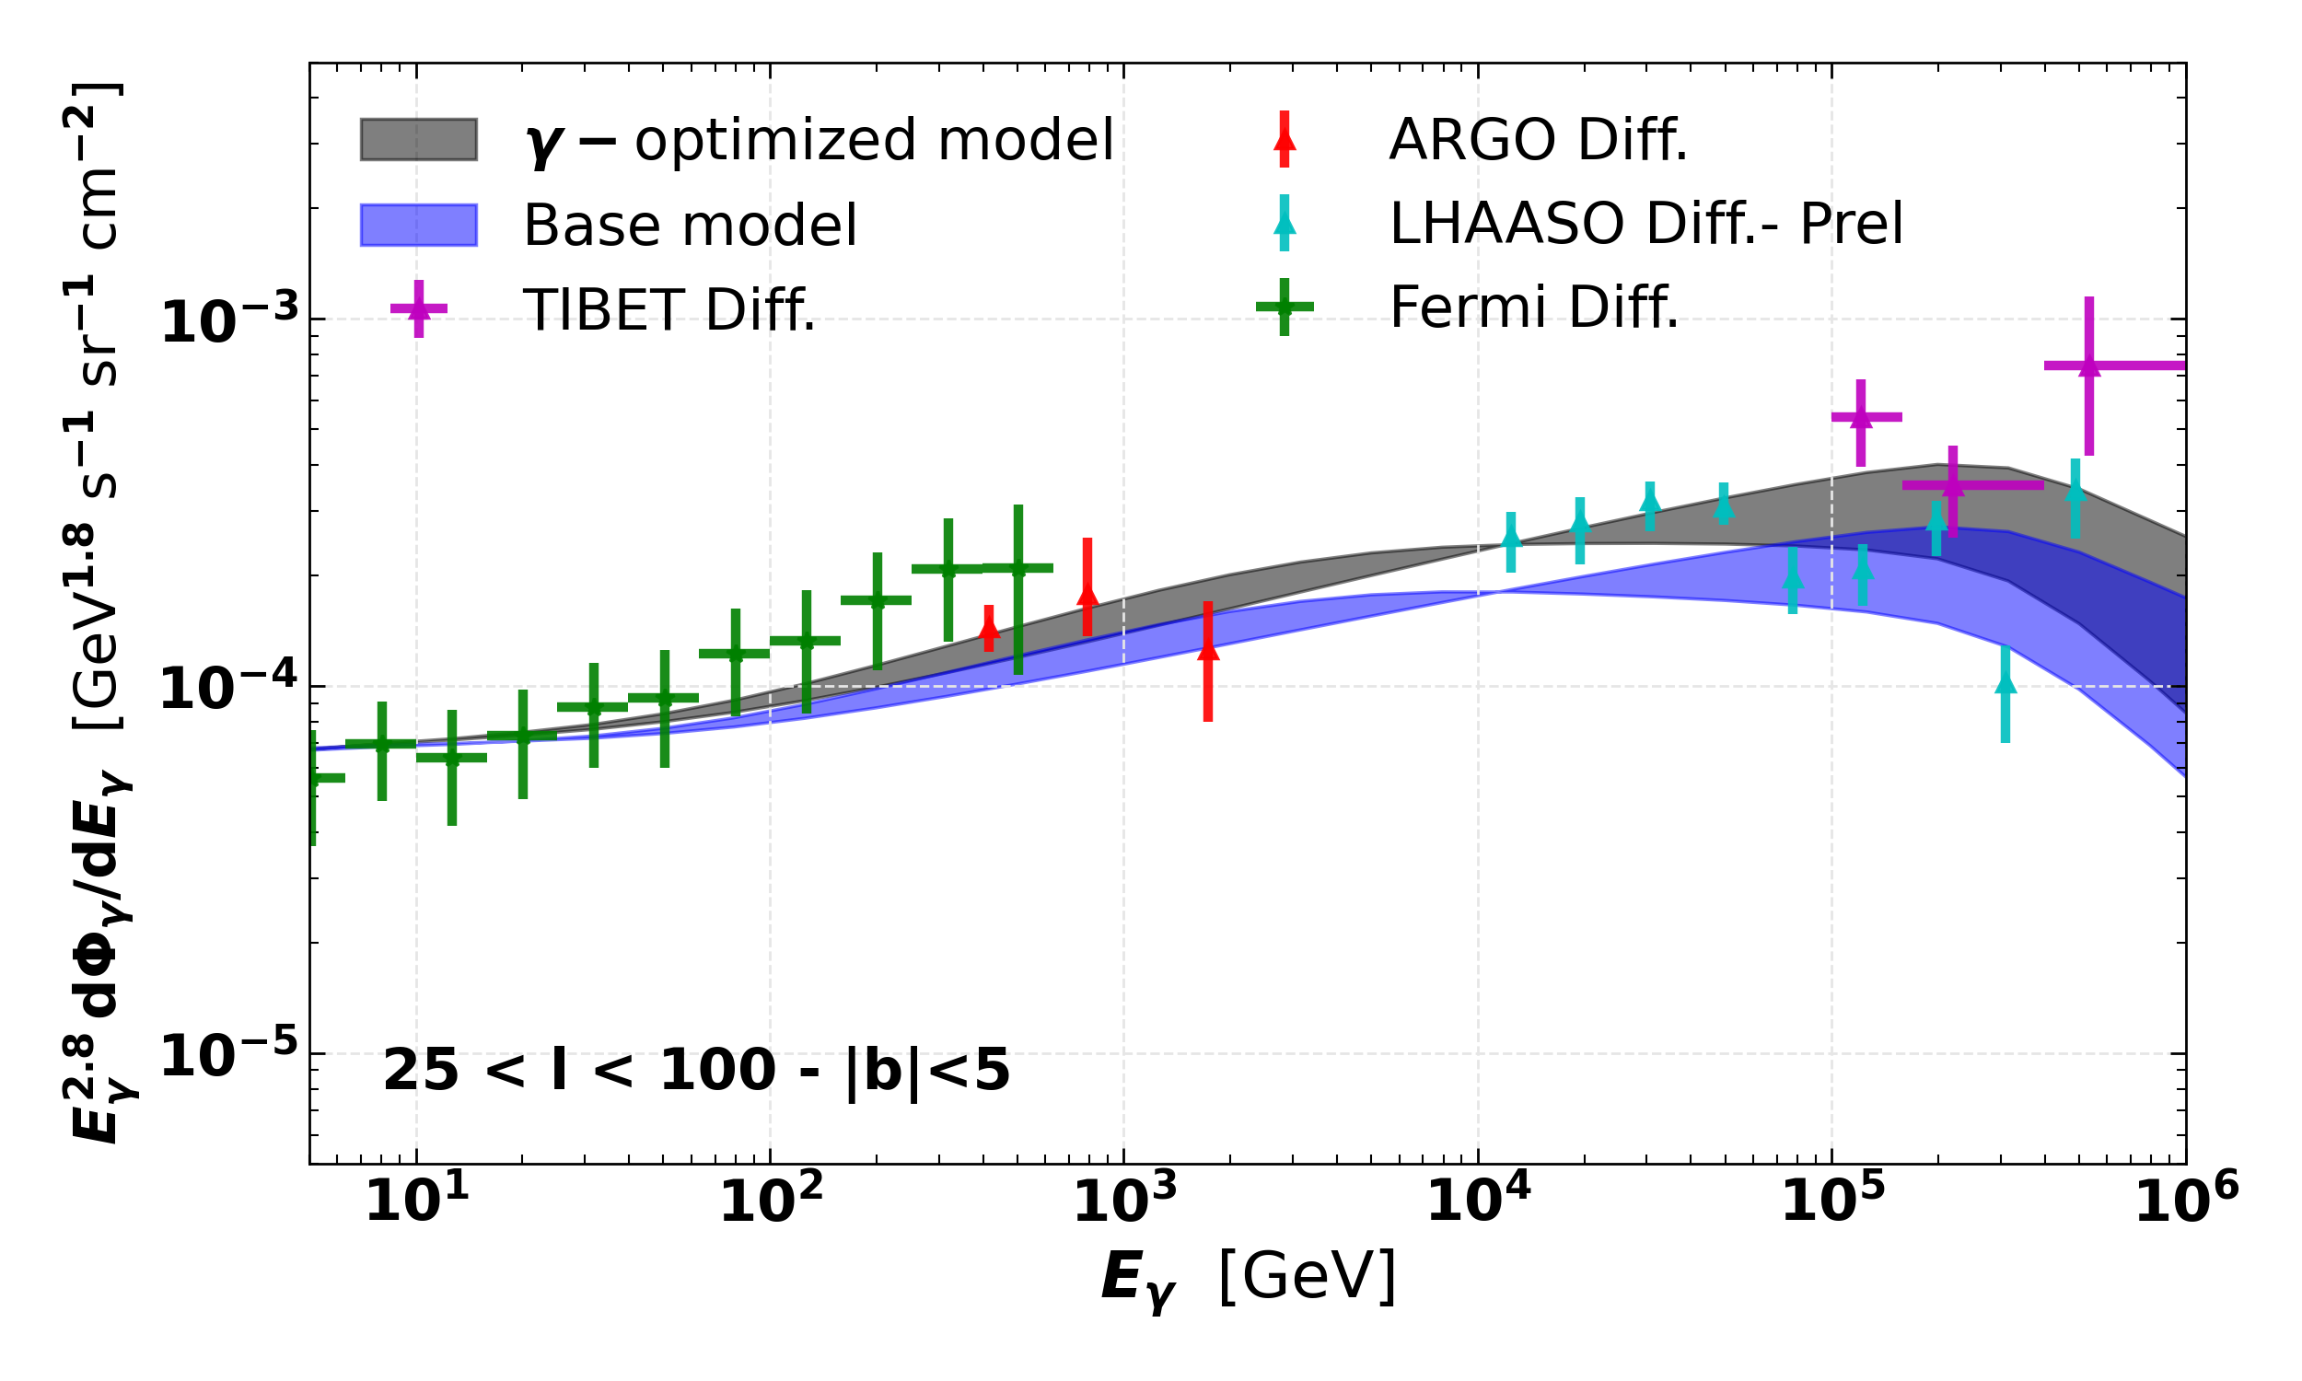
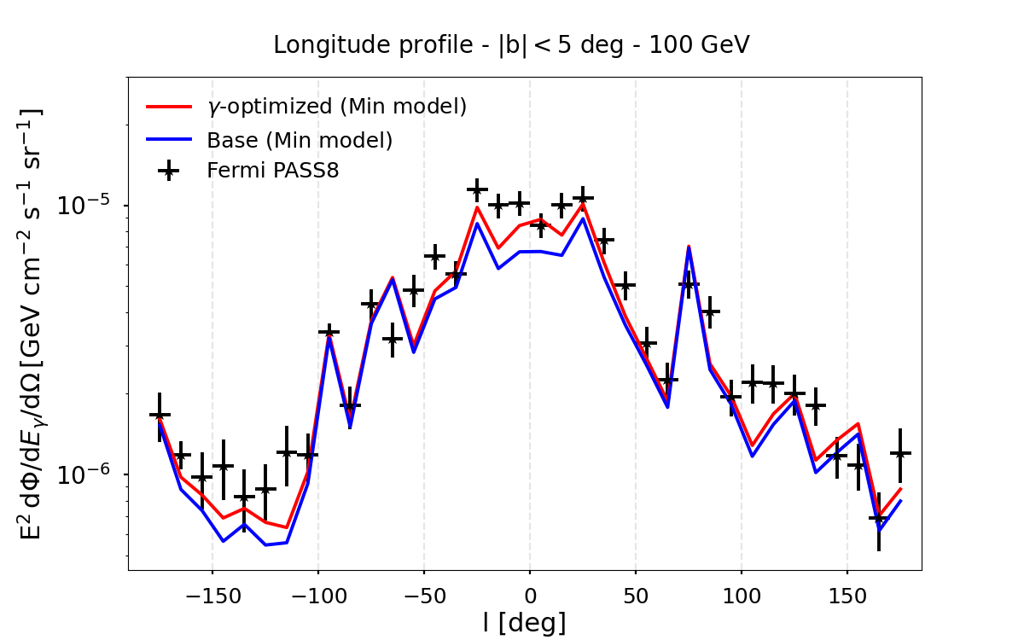
Galactic diffuse gamma-ray emission
P.D.L. et al arXiv: 2203.15759
This is the model that the authors consider for the truly diffuse emission detected by the HAWC and TIBET-ASγ

Slide 5
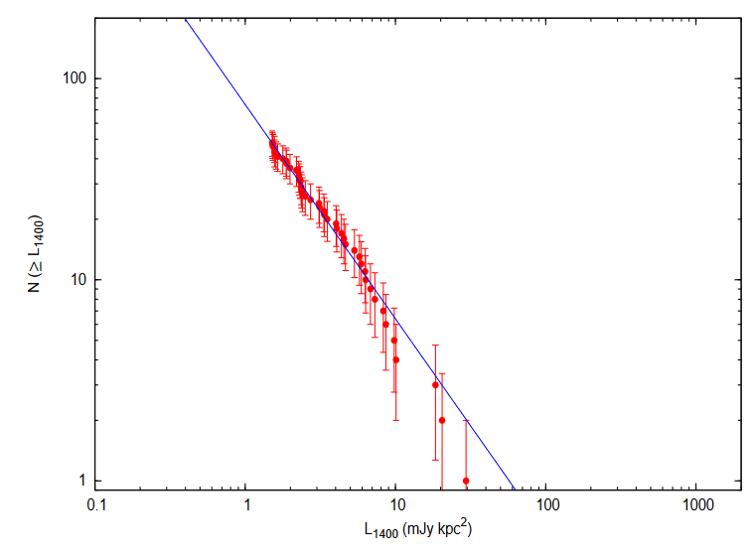
Unresolved gamma-ray emission: Sources below the detection threshold of the detectors
Cataldo et al 2020 ApJ 904 85
The first goal is to compute the number of sources per unit of flux, $\frac{dN}{dΦ}$, and its integral
*
Bagchi, Lorimer AIP Conf. Proc., 1357, 173-176 (2011)
Lorimer et al., MNRAS(2006) 372, 2, 777–800
~
~~
Then, the flux is related to the luminosity by
Notes:
Probability that a pulsar has a given luminosity

Slide 6
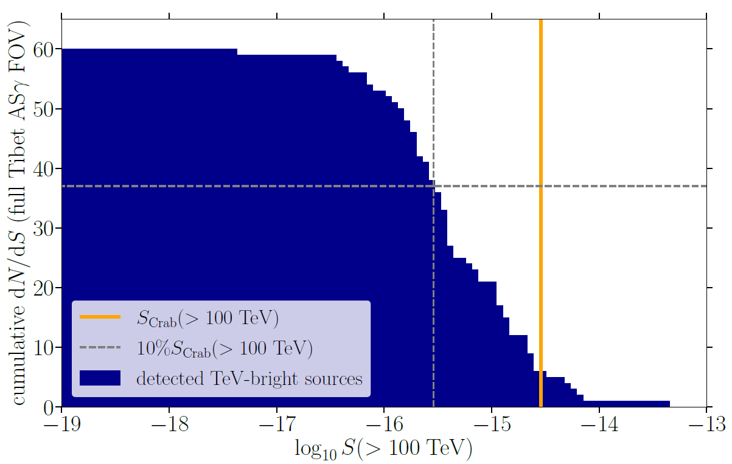
Unresolved gamma-ray emission: Sources below the detection threshold of the detectors
Different for each detector: Threshold is evaluated from the observed events in a know ROI
Generalization of an average injection spectrum of all sources emitting at the energies of interest (TeVCat, 2HWC)

Slide 7
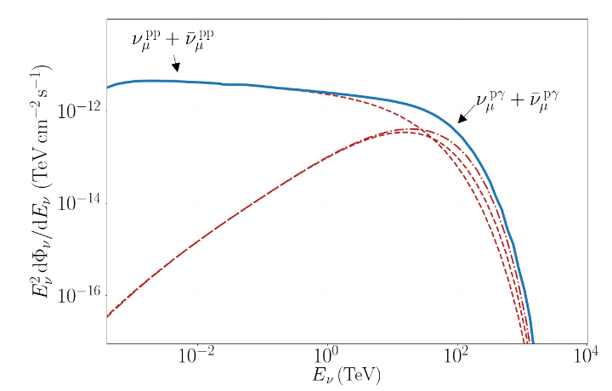
Cumulative gamma-ray flux from ALP-photon conversion
Based on ArXiv:1712.01839
and ArXiv:1511.01530
Determination of the neutrino flux from sources
Relation gamma-neutrino flux
Fit to neutrino flux based on the HESE and cascades IceCube samples
Normalization is fixed by requiring that the cumulative differential neutrino flux at Earth yields the value from the HESE sample.
$$p+(p, γ) →π±,π0$$
Kantzsas et al, in preparation
This is the flux of gamma-rays that can produces ALPs!!
Notes:
HESE: High energy starting event sample (7.5 years)
CASCADE sample is 6 years

Slide 8
Cumulative gamma-ray flux from ALP-photon conversion
Carried our with the publicly available code gammaALPs
Evaluation of gamma rays converted into ALPs
Dispersion relation within extragalactic sources depends on the interstellar radiation fields, magnetic field strength and the electron density. These properties are generalized from prototypical nearby star-forming galaxies.
IRFs include CMB, ultraviolet, optical and IR fields.
Electron density is fixed to be 0.05 cc at z=0 (See ArXiv: 1912.08962) with redshift dependence as:
“Average” magnetic field structure and intensity extracted from the CHANG-ES survey → X-shaped structure
They model the magnetic halo of the sources to be spherically symmetric and extending up to 10 kpc from its center, assuming a coherence length of the magnetic field of L₀ = 1 kpc *
|B| = 5 $±$3 μG at z=0 → From a sample of 21 star-forming galaxies (ArXiv:1104.2427)
(Schober et al 2016 ApJ 827 109)
Notes:
Star-formation rate density

Slide 9
Cumulative gamma-ray flux from ALP-photon conversion
Carried our with the publicly available code gammaALPs
Evaluation of gamma rays converted into ALPs
Evolution of the regular magnetic field with z is very relevant for the final constraints.
Two approaches adopted to bracket the uncertainties:
No change of the magnetic field strength with z and L(z) = L₀/(1+z)
The coherence length evolves with z as before, and the magnetic field as:
Domain model approximation (Mirizzi and Montanino JCAP12(2009)004):
Conversion probability is evaluated for a series of cells with fixed length with respect to the photon/ALP propagation direction (towards our line of sight). In each cell the components of the magnetic field are drawn from a Gaussian distribution with zero mean and variance , such that
, with H as the galaxy height
(Schober et al 2016 ApJ 827 109)

Slide 10
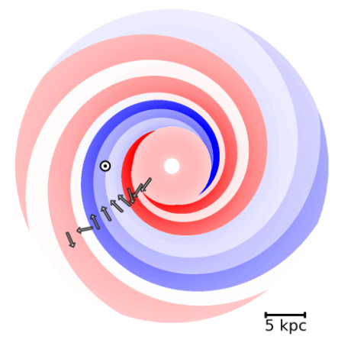
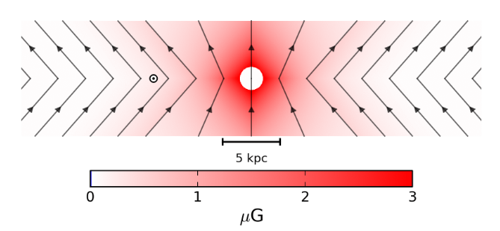
Cumulative gamma-ray flux from ALP-photon conversion
ALPs reconverted in the Milky Way’s magnetic field
Domain model approximation is used again. Jansson and Farrar Galactic magnetic model (Jansson and Farrar 2012 ApJ 757 14).

Slide 11
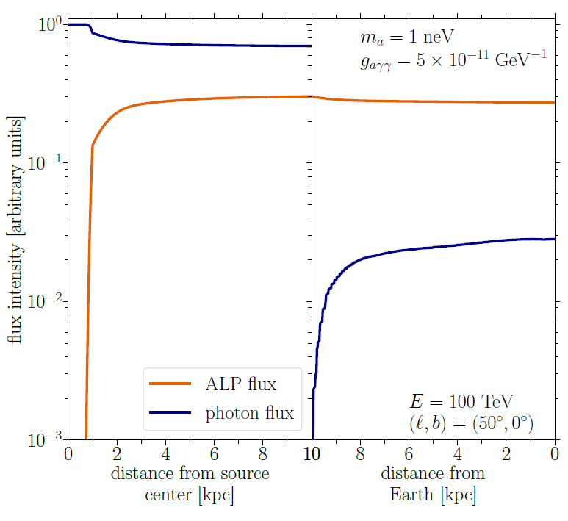
Cumulative gamma-ray flux from ALP-photon conversion
ALP-photon conversion from extra-galactic gamma-ray sources
Example source at z=1
The gamma-ray flux in the intermediate region is expected to be completely attenuated
Integration along the line-of-sight in the direction of l=50◦ and b=0◦
$$Φ=ΦALP Pγa$$
Notes:
Conversion probability

Slide 12
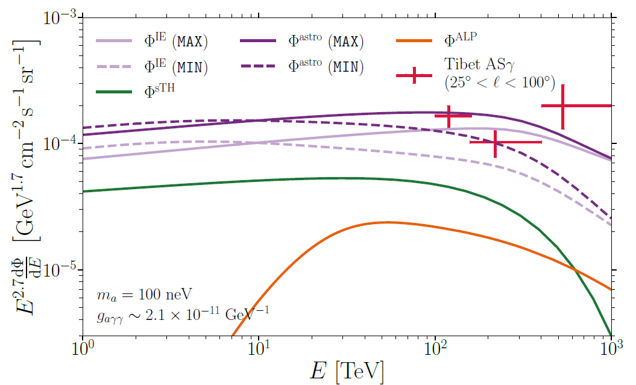
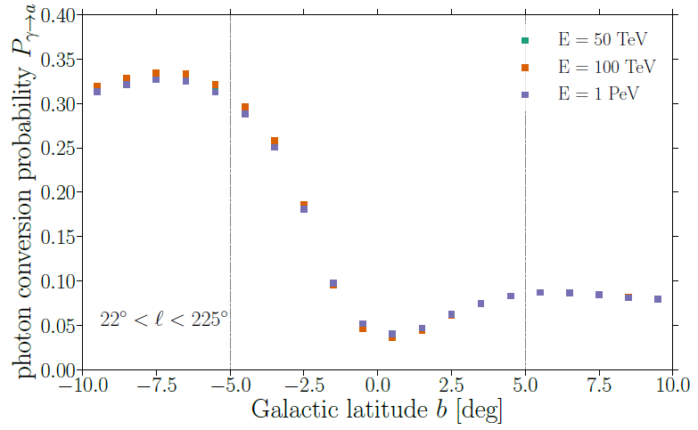
Spectral energy distribution: TIBET region
|b| < 5◦, 25◦ < l < 100◦
Conversion of Galactic gamma-rays is also considered through an effective photon survival probability
Non-negligible contribution of reconverted photons above tens of TeV (up to 10% of the total flux)

Slide 13
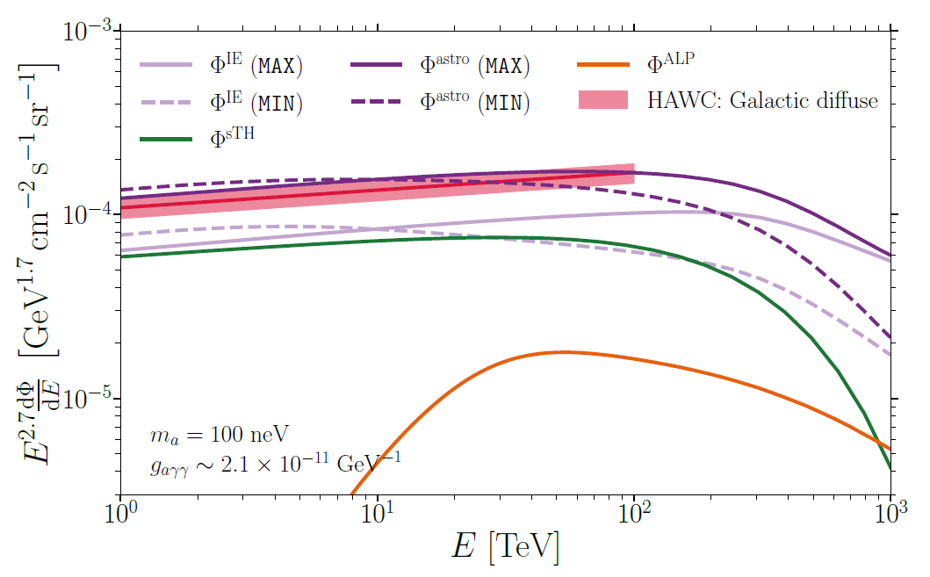
Spectral energy distribution: HAWC region
|b| < 4◦, 43◦ < l < 73◦
Conversion of Galactic gamma-rays is computed for this ROI
They estimate that the average loss of gamma rays is only around 4% in the ROI of Tibet or HAWC, in the energy band from 10 TeV to 1 PeV.
The ALP-conversion contribution is significant again, of around 10% of the total flux above 20 TeV

Slide 14
STATISTICAL FRAMEWORK – upper limits
Combined maximum likelihood analysis
With θ as a normalization that directly depends on m_{a} and g_{aγγ}. k represents the energy bins. σ refers to the statistical variance, where upper errors are taken in case of asymmetric errors. *
For HAWC, they bin the power-law provided by the collaboration in 5 log-spaced bins from 10 to 100 TeV.
Upper limits are set using the log-likelihood ratio test:

Slide 15
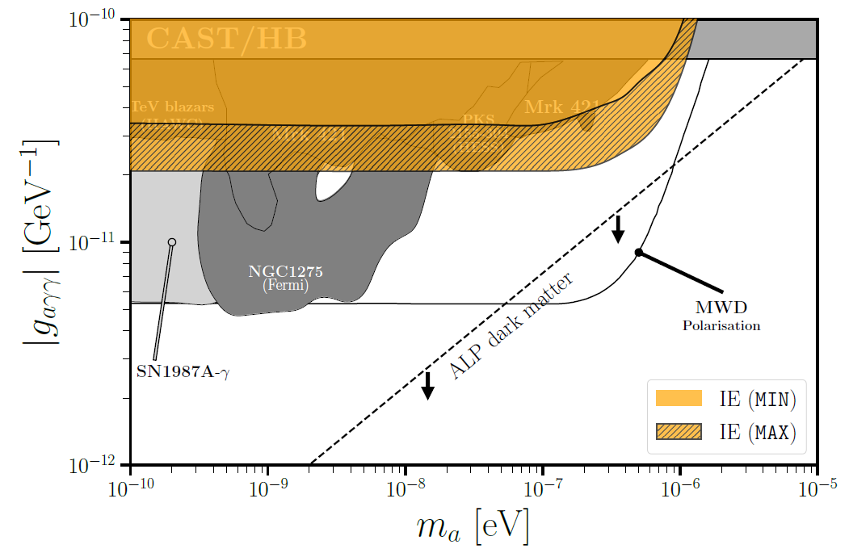
ALPS Constraints – Comparison from diffuse models
Case of magnetic field strength evolving with z
The constraints obtained from the MAX model improve some limits at m_{a} > 10⁻⁸ eV
Considering only one ROI in the analysis make the limits to weaken by a factor ~2.
Other factors like uncertainties caused by the star-formation rate density evolution, , change the limits by around 2%

Slide 16
ALPS Constraints – Comparison from B(z) evolution
Case of MAX diffuse model
Magnetic field evolution affects the limits by around 50%
These are conservative limits, which could be even a ~20% better
A way to improve our limits is to search for observations at high latitudes, where the diffuse (and source) emission is suppressed (see Neronov et al., A&A 653, L4 (2021) ).

Slide 17
Main result and conclusion
Eckner & Calore 2022 arXiv: 2204.12487
Derive new axion DM constraints from sub-PeV diffuse gamma rays
The derived constraints demonstrate to be competitive with many recent astrophysical constraints, all of them covered by high uncertainties in the description of the background gamma-ray fluxes.
Given that the uncertainties in the data analysed are still very high (and systematic uncertainties not fully included) this constitutes a proof of principle that shows the potential importance of these kind of observations

Slide 18
BACK-UP

Slide 19
