Slide 1


Antigenic evolution and evolutionary consequences of vaccination against SARS CoV-2
Igor M. Rouzine
Institute of Evolutionary Physiology and Biochemistry RAS
Peter the Great Polytechnical University of St Petersburg

Slide 2
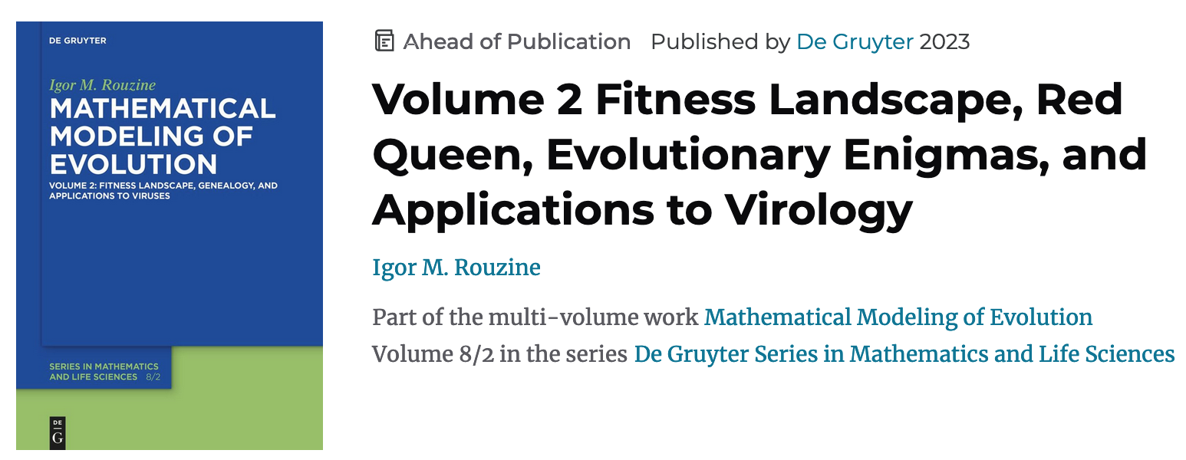
Rouzine & Rozhnova (2023) Evolutionary implications of SARS-CoV-2 vaccination for the future design of vaccine strategies [perspective]. Communications Medicine, in print
Rouzine & Rozhnova (2018) PLOS Pathogens

Slide 3
Rapidly evolving viruses

Slide 4
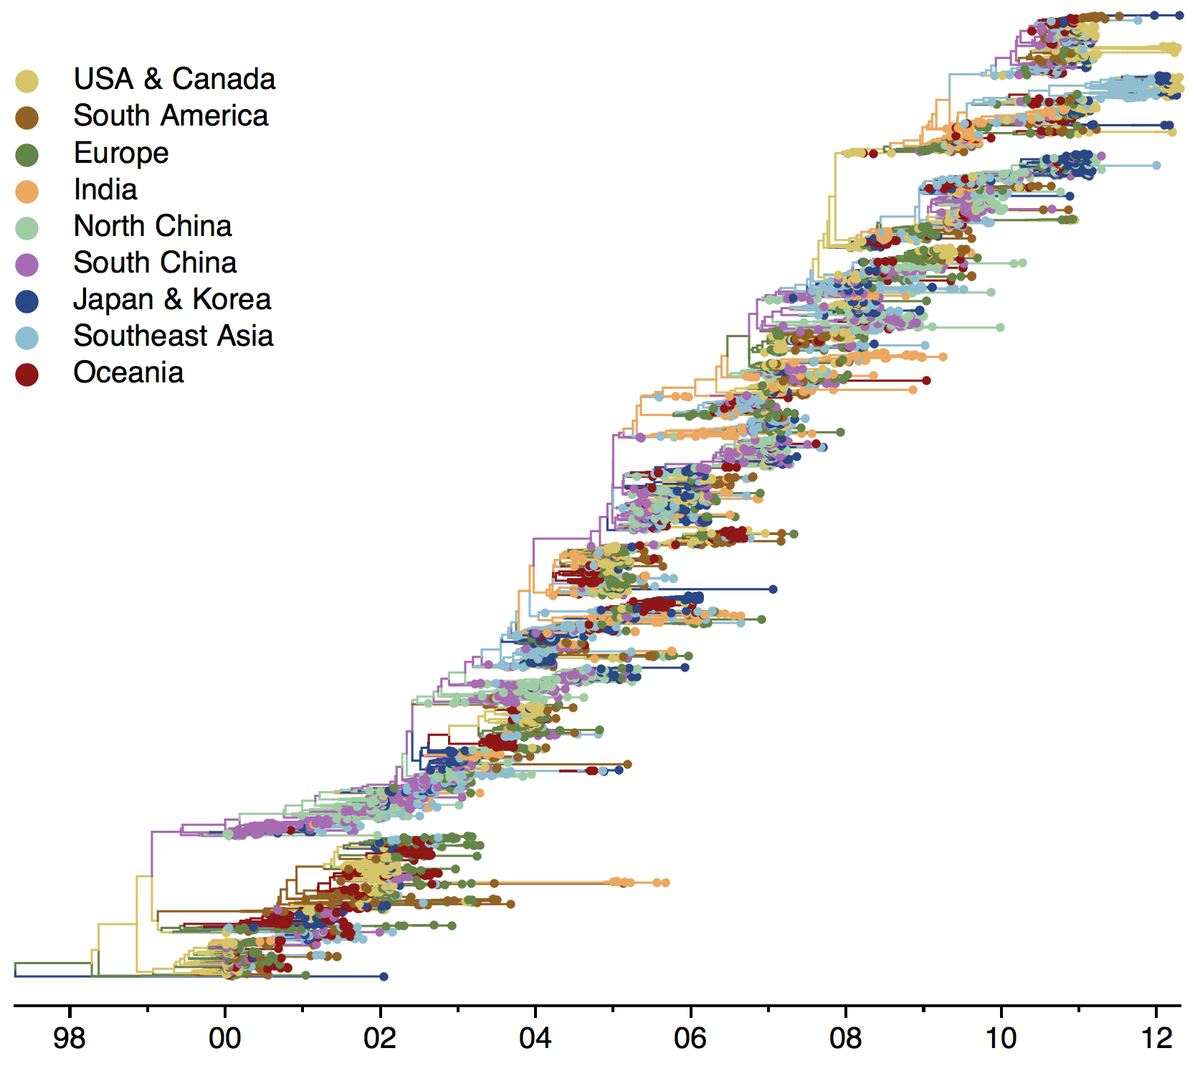
Influenza А virus evolution
x
Bedford et al 2018

Slide 5
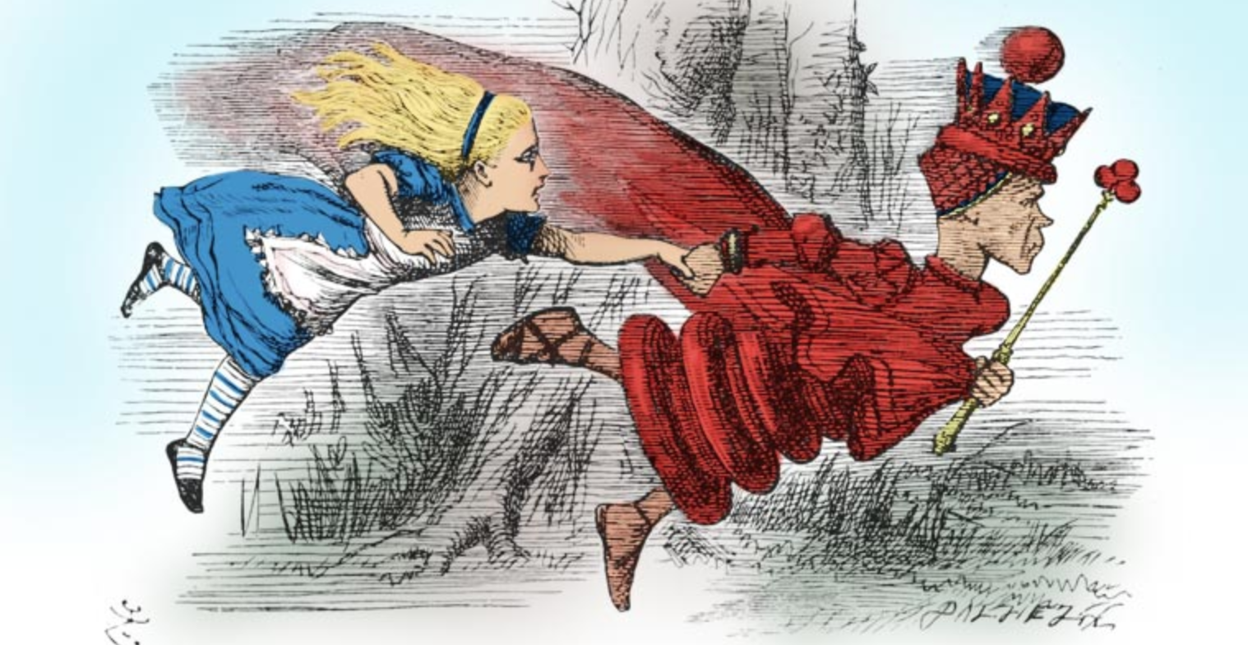
Red Queen effect
Now, here, you see, it takes all the running you can do, to keep in the same place
“Through the Looking-Glass” Lewis Caroll

Slide 6
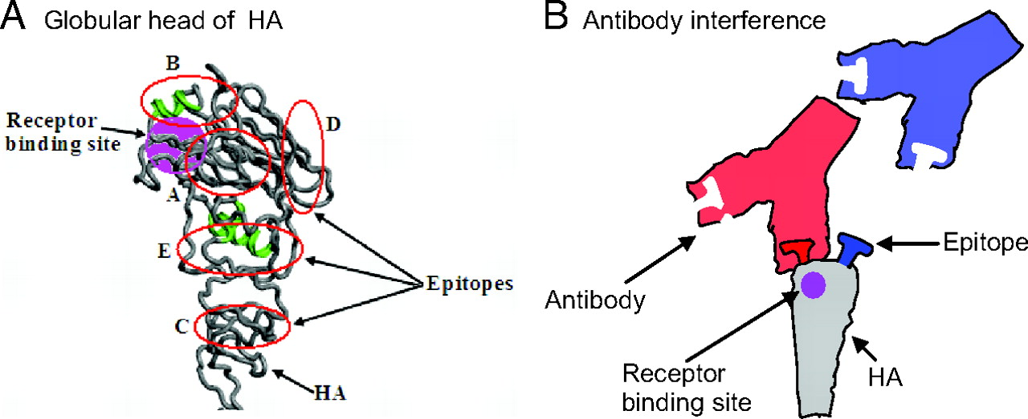
Epitopes but not RBS evolve easily: low cost of resistance mutation
Hemaglutinin protein in influenza virus A

Slide 7
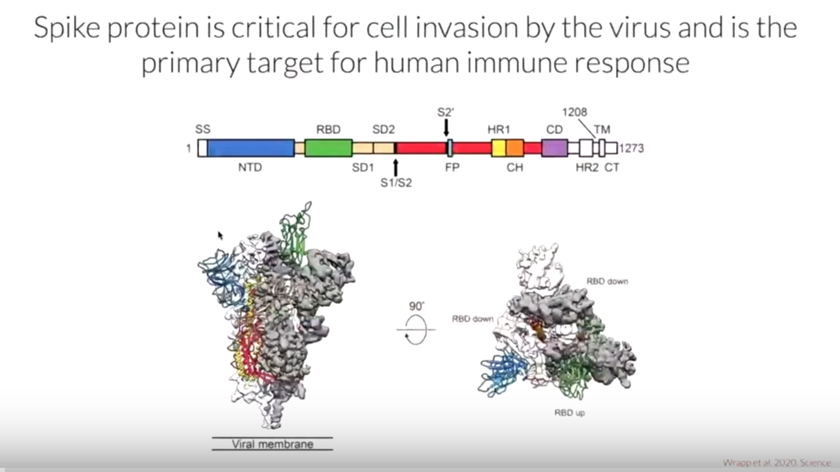
The spike of SARS CoV-2
Epitope
Epitope
Epitope
Epitope
Trevor Bedford https://www.youtube.com/watch?v=Men9WDWvK9E

Slide 8
Question
Which biological parameters determine the speed of evolution in epitopes, genetic diversity, fraction of infected, and time to the most recent common ancestor?

Slide 9
Central assumptions of the model
Location of epitopes in genome are fixed between individuals (neutralizing Ab: true)
The cost of epitope mutation to virus replication is negligible: virus evolved this way
Recognition loss per mutation is small, but not negligible
Every adult was infected at least once (long-term epidemics)
The above works for several respiratory viruses within a population and the Ab but not CTL response to HIV within a host. For SARS CoV2 within a population , it remains to be tested
Long-term evolution, no seasonal variation

Slide 10
Cross-immunity function: how easy is to infect?
Examples: K(x) = x/(a+x),
K(x)=1-exp(-x/a)
1
Maximal chance of infection
Cross-immunity function, K (x)
0.5
Half-length of immunity
a
Antigenic distance between the new and old strain, x_{new}-x_{old}

Slide 11
Infected-recovered model
Lin et al 2003
Rouzine & Rozhnova 2018
Antigenic coordinate x along the trunk of the tree
Recovered density r(x), infected density i(x)
K(x-y) cross immunity function
infection
recovery
R₀ is the basic reproduction number in a naive population

Slide 12





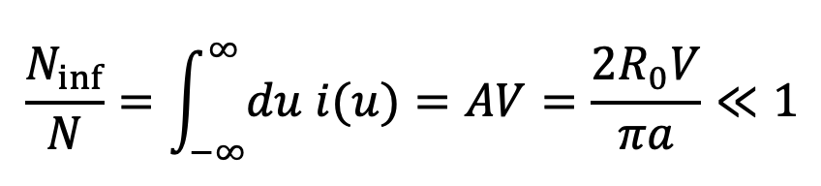

Traveling wave solution of the two equations
- infected individual density in antigenic coordinate
- recovered individual density in antigenic coordinate
- relative antigenic coordinate in the moving reference frame
- average substitution rate (wave speed)
Substituting to the equations
and neglecting mutation term
- δ(u) Dirac delta-function
total fraction of the infected
gives A

Slide 13
Analysis and modeling agree

Slide 14
Traveling wave
recovered
infected
Antigenic distance along the tree trunk, x

Slide 15
Remains to obtain:
  Substitution rate V
  Infected density i(x)
  Time to most recent ancestor T_{MRCA}

Slide 16
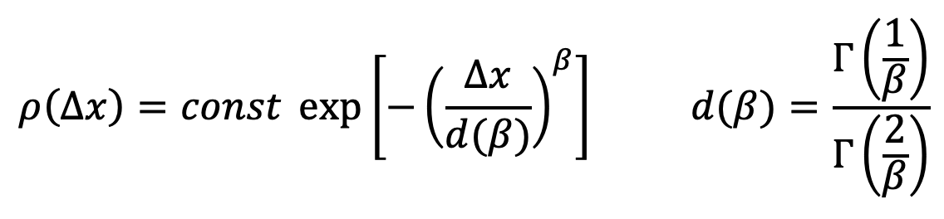
Adding the factor of mutation
One nucleotide substitution, antigenic coordinate x → x + Δx
Δx > 0 varies between Ab binding sites
mean(Δx)=1
An example of distribution density:
Examples: β = 1, β = 2

Slide 17
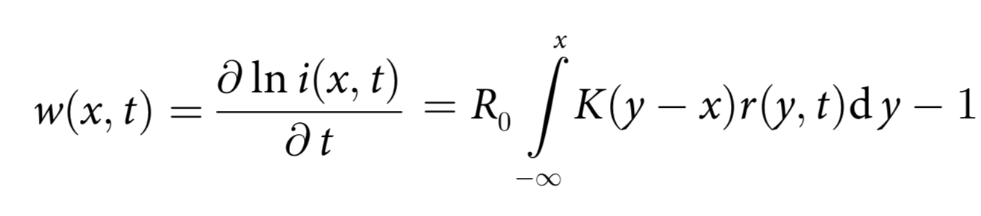
Fitness landscape
Fitness w is the average number of secondary infections from one infected person
Asymptotics
relative genetic coordinate in the moving reference system
Rouzine & Rozhnova 2018

Slide 18
Average selection coefficient
Antigenic mutation x → x + Δx, mean(Δx) =1
w = σ u
Average selection coefficient (fitness change per mutation)
1
0.5
K(x)=1-exp(-x/a)
K(x) = x/(a+x),
Selection
Crossimmunity
Reproduction number

Slide 19
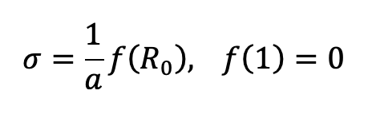
The general form of the effective selection coefficient
depends on the shape of cross-immunity K(x)
Rouzine & Rozhnova 2018
is robust to the model assumptions about immune memory:
Yan, L., Neher, R. A. & Shraiman, B. I. Phylodynamic theory of persistence, extinction and speciation of rapidly adapting pathogens. Elife 8, doi:10.7554/eLife.44205 (2019)
Marchi, J., Lassig, M., Walczak, A. M. & Mora, T. Antigenic waves of virus-immune coevolution. Proc Natl Acad Sci U S A 118, doi:10.1073/pnas.2103398118 (2021).

Slide 20
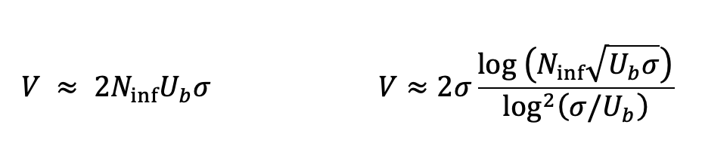
One-locus and multi-locus approach
N_{inf} U_{b} << 1
N_{inf} U_{b} >> 1
No recombination
clonal inteference
Rouzine et al 2003, 2008
Desai et al 2007
Good et al 2012
Recombination makes evolution faster
Rouzine & Coffin 2005; 2007; 2010
Neher et al 2010; 2013
Weissman & Hallatschek 2014

Slide 21
Analysis is confirmed by simulation
Rouzine & Rozhnova (2018)
Lines: Analysis. Symbols: Simulation
β=1: Exponential distribution of fitness effect
β=2: Gaussian distribution
Substitution rate, V

Slide 22
Average time to the most recent common ancestor for a random pair of virus genomes
Neher and Hallatschek 2013
Desai et al 2012
up to a numeric factor

Slide 23
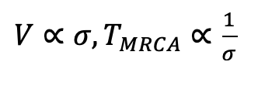
Experimental confirmation #1
The result explains the observation that T_{MRCA} and V vary strongly between strains, but the product V T_{MRCA} does not.
R₀ varies strongly between strains and locations, but σ(R₀) cancels out

Slide 24
Results and fitting
Rouzine & Rozhnova, 2018
Input parameters
  cross-immunity distance a
  mutation probability U_{b}
  population size N
  basic reproduction number R₀
  transmission period t_{trans}
Predicted by the model
  T_{MRCA}
  substitution rate V
  infected fraction N_{inf}/N
All parameters but a and U_{b} are known from experiment
a = 14
U_{b} = 3 10⁻⁴
fitting a and U_{b}
Both H1N1 and H2N3

Slide 25
Experimental confirmation #2
All the estimates agree with those from earlier simulation:
Bedford, T. et al. 2014, 2015
a = 14 is observed in horses

Slide 26
Tree and 2D plane: 1D path formed automatically
t₁ =170
t₂=250
t₃=350 wk
Infected
Recovered
current
extinct
trunk
U_{b} = 0.01, N = 10⁸, R₀ =2.6, a=7, SD[x] =0.33
U_{b} = 0.001, N = 10⁸, R₀ = 3, a = 10

Slide 27
Multiple dimensions: why loops and old memory cells are not important
Total epitope of 60 aminoacids, each can change to 10 chemically distinct variants, hence, dimensionality ~600/2 = 300
During random walk, the probability of returning back is ~ 1/300
Due to variant competition, the quasi-1D path is self-repulsing, so it is even less
Hence, loops are rare and genetic space is effectively a tree
Hence, older memory cells not from the last infection are negligible
Yan, Neher & Shraiman 2019: old memory is important.
An artifact of the popular mean-field approximation used (Gog et al.): each person shares all his memory with all others—exaggerates the old memory role.

Slide 28
Effect of vaccinаtion on epitope evolution

Slide 29
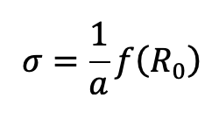

Vaccination effect on immune pressure
Not updated vaccine is ineffective
No immune pressure
Periodically updated vaccine is effective
Extra immune pressure
K(u)=1
K(u)=0.3
100 boosts
Antigenic distance, x
Antigenic distance, x

Slide 30
Effect of vaccine on immune pressure overcomes the decrease in infected population
N_{inf} U_{b} << 1
N_{inf} U_{b} >> 1
recovered + vaccinated
recovered + vaccinated

Slide 31
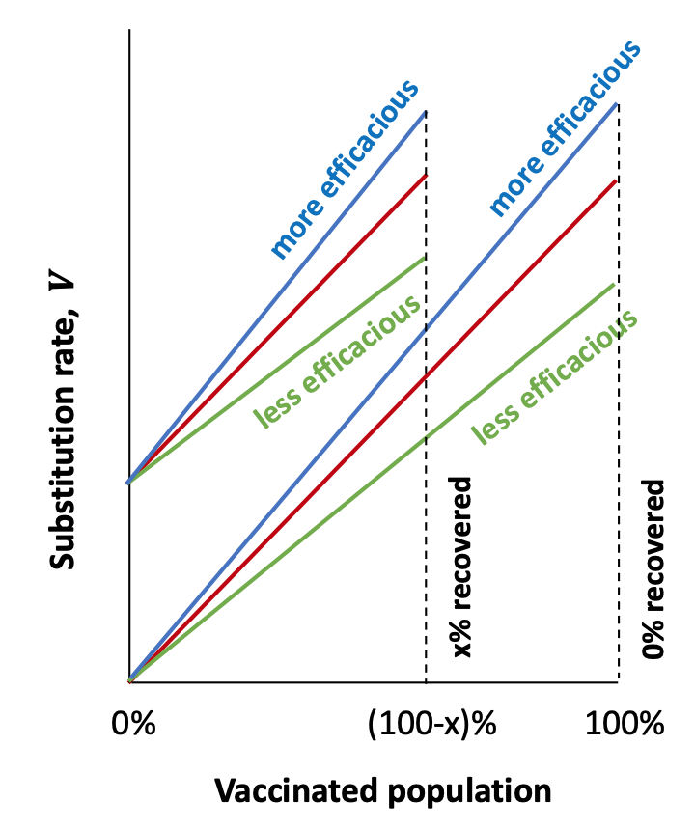
Effects of natural and vaccine immunity add

Slide 32
Future development
  Finite mutation cost & finite recognition loss K(x)
  Batorsky & Rouzine 2014
  Epistatic interaction
  Difficulty: stochastic linkage effects in multi-locus system obscure epistasis
  Popular QLE approximation of Kimura neglects genetic linkage (large N), recomb. vs epistasis
  Neher & Shraiman 2011
  Measure fitness landscape from DNA data using a new high-fidelity method
  Barlukova & Rouzine PLOS Computational Biology 2021
  Pedruzzi & Rouzine PLOS Pathogens 2021
  Likhachev & Rouzine STAR Protocols 2023
  Recombination in multi-locus
  Rouzine 2005; 2007
  Neher et al 2013
  Weissman & Hallatschek 2014
  Rouzine 2023, preprint

Slide 33
Future development of vaccine design
Optimization for renewal of vaccine vector? Not too old, not too new.
CTL vaccine: high average mutation cost, differ between individuals
Live evolving vaccine, e.g., based on defective interfering particles
  Andino lab at UCSF Cell 2021
  Weinberger lab at Gladstone Institute Cell 2021
  Vignuzzi lab at Pasteur Institute

Slide 34

Thank you!

