Slide 1
Multi-scale and multi-strain

Slide 2
Multi-scale and multi-strain
What do you expect when we say "multi-scale"?
What do you expect when we say "multi-strain"?

Slide 3
Multi-scale and multi-strain
What do you expect when we say "multi-scale"?
What do you expect when we say "multi-strain"?
Why multi-scale and multi-strain in the same discussion?
  They are different, but many points of contact
  Exceptions: full cross-immunity (competing strains), re-infection (flu)
  Exceptions: other scales (households, within-host cells/patches)

Slide 4
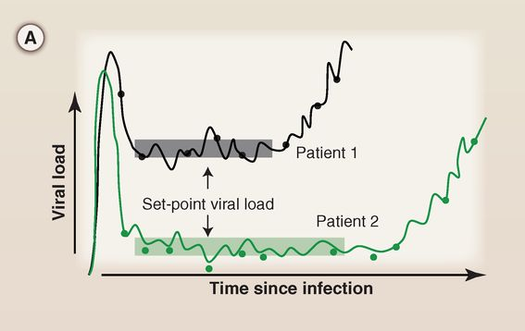
HIV untreated infection
Fraser, Lythgoe et al (2014), Science

Slide 5
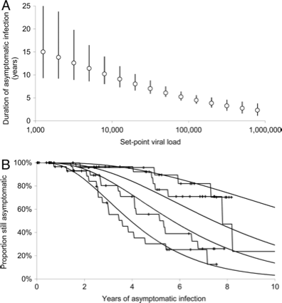
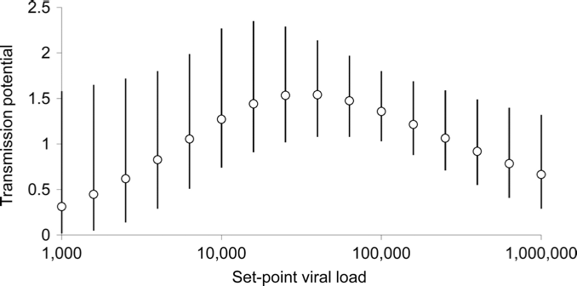
Set-point viral load (SPVL)
Predicts infectivity
Transmission potential = overall infectivity
Predicts duration of asymptomatic stage
Fraser et al (2007), PNAS

Slide 6
Evolution of SPVL
SPVL is highly heritable
Steadily increasing for 25 years
Now seems to have plateaued
The current mean value is very close to maximum transmission potential
1.5
Transmission potential
0
10²
10⁴
10⁶
Set-point viral load
Fraser et al (2007), PNAS

Slide 7
HIV transmission potential
1.5
Transmission potential
0
10²
10⁴
10⁶
Set-point viral load

Slide 8
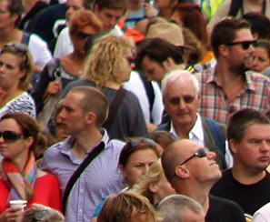
HIV transmission potential
Long-sighted evolution
1.5
Transmission potential
Optimal for virus transmission
0
10²
10⁴
10⁶
Set-point viral load

Slide 9
HIV transmission potential
Long-sighted evolution
1.5
Transmission potential
Optimal for virus transmission
0
10²
10⁴
10⁶
Set-point viral load
Low replicative capacity
High replicative capacity

Slide 10
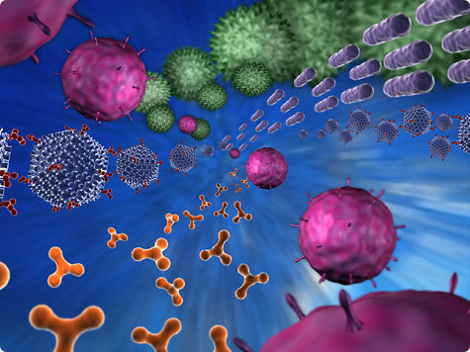
HIV transmission potential
Long-sighted evolution
1.5
Transmission potential
Optimal for virus transmission
0
10²
10⁴
10⁶
Set-point viral load
Short-sighted evolution

Slide 11
Between-host scale
“EPIDEMIOLOGY”
Viral load
Infectiousness
Severity
Pathogen clearance
Test positivity
Dose response
Re-infection
“EVOLUTION”
Pathogen evolution
Resistance
Multiple strains/pathogens
Co-infection
Within-host scale
Notes:
Challenges:
§Terminology
§Lots of choices – conclusions driven by assumptions
§Lack of biological knowledge / data
§Lack of a general theory / good modelling tools

Slide 12
Between-host scale
“EPIDEMIOLOGY”
Viral load
Infectiousness
Severity
Pathogen clearance
Test positivity
Dose response
Re-infection
“EVOLUTION”
Pathogen evolution
Resistance
Multiple strains/pathogens
Co-infection
What do you mean by “multiscale”? Which scales?
Your motivation – Why? Where is it needed?
Your examples?
What modelling techniques?
Challenges?
Numerical / statistical needs?
Within-host scale
Notes:
Challenges:
§Terminology
§Lots of choices – conclusions driven by assumptions
§Lack of biological knowledge / data
§Lack of a general theory / good modelling tools

Slide 13
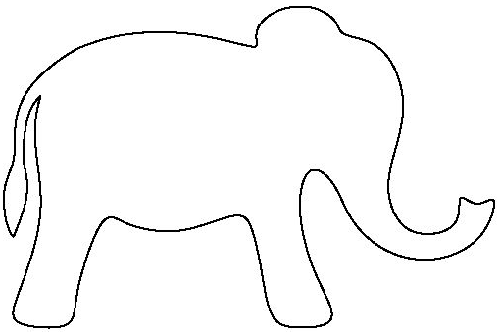
Limitations of ODEs
ODEs are extremely useful and easy to use
But have many limitations:
  Oversimplified emergence of resistance:
  Time-scale separation argument:
  Secondary infection (superinfection):
r
I_{S}
I_{R}
λ_{a}
I_{a}
λ_{b}
?
S
I_{ab}
?
λ_{b}
I_{b}
λ_{a}
?
Notes:
Time-scale separation argument, when applicable, still leads to ODEs that are hard to study analytically.
Who in this audience has even come across an ODE model with 2 or more strains where you had to integrate the equations numerically to study the steady states? Why is a general theory still lacking?

Slide 14
Time-since-infection models
Function to describe infectivity in terms of time-since-infection
We can also use a random version of it:
  General enough to encompass all previous cases
Drawbacks:
  Harder to study (PDEs or integral equations/DDEs)
  Computationally intensive to integrate
  Require initial conditions on an interval (the support of )
Notes:
Most of the time is unimodal, but later I’ll show you more “exotic” examples where it’s not

Slide 15
Why using TSI?
More general

Slide 16
Why using TSI?
More general

Slide 17
Why using TSI?
More general
Closer to biology / experiments:
  Detailed time evolution of infection is deemed important
  Complex / long infectivity profiles (e.g. HIV)
  Available data

Slide 18
Why using TSI?
More general
Closer to biology / experiments:
  Detailed time evolution of infection is deemed important
  Complex / long infectivity profiles (e.g. HIV)
  Available data

Slide 19
Superinfection data
Laurie et al (2015), JID

Slide 20
Why using TSI?
More general
Closer to biology / experiments:
  Detailed time evolution of infection is deemed important
  Complex / long infectivity profiles (e.g. HIV)
  Available data
Suitable to encapsulate complex within-host (WH) dynamics

Slide 21
Why using TSI?
More general
Closer to biology / experiments:
  Detailed time evolution of infection is deemed important
  Complex / long infectivity profiles (e.g. HIV)
  Available data
Suitable to encapsulate complex within-host (WH) dynamics

Slide 22
Gilchrist & Sasaki (2002)
First example: Gilchrist & Sasaki (2002)
  Within-host dynamics: pathogen load
  level immunity
  Between-host
  dynamics:
  Link:
Gilchrist & Sasaki (2002), J Theor Biol
Notes:
The link between the scales is still an issue!

Slide 23
Example
Model: specific + aspecific immunity
  pathogen load
  level of specific immunity
  (constant) level of aspecific immunity
Pugliese & Gandolfi (2008), Math Biosc

Slide 24
Why using TSI?
More general
Closer to biology / experiments:
  Available data
  Detailed time evolution of infection is deemed important
  Complex / long infectivity profiles (e.g. HIV)
Suitable to encapsulate complex within-host (WH) dynamics
Can enhance understanding of more complex models

Slide 25
Why using TSI?
More general
Closer to biology / experiments:
  Available data
  Detailed time evolution of infection is deemed important
  Complex / long infectivity profiles (e.g. HIV)
Suitable to encapsulate complex within-host (WH) dynamics
Can enhance understanding of more complex models

Slide 26
Why using TSI?
More general
Closer to biology / experiments:
  Available data
  Detailed time evolution of infection is deemed important
  Complex / long infectivity profiles (e.g. HIV)
Suitable to encapsulate complex within-host (WH) dynamics
Can enhance understanding of more complex models
Harder to study, so it requires more thinking about which assumptions are really responsible for the results we see

Slide 27
Why using TSI?
More general
Closer to biology / experiments:
  Available data
  Detailed time evolution of infection is deemed important
  Complex / long infectivity profiles (e.g. HIV)
Suitable to encapsulate complex within-host (WH) dynamics
Can enhance understanding of more complex models
Harder to study, so it requires more thinking about which assumptions are really responsible for the results we see

Slide 28
Growing literature on numerical methods
for time-since-infection models (continuous time)

Slide 29
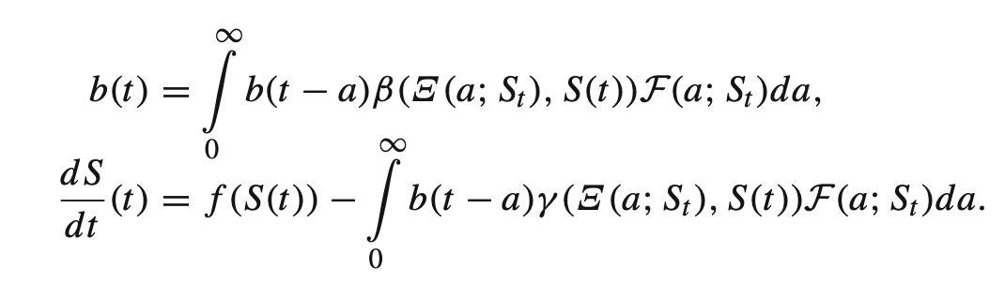
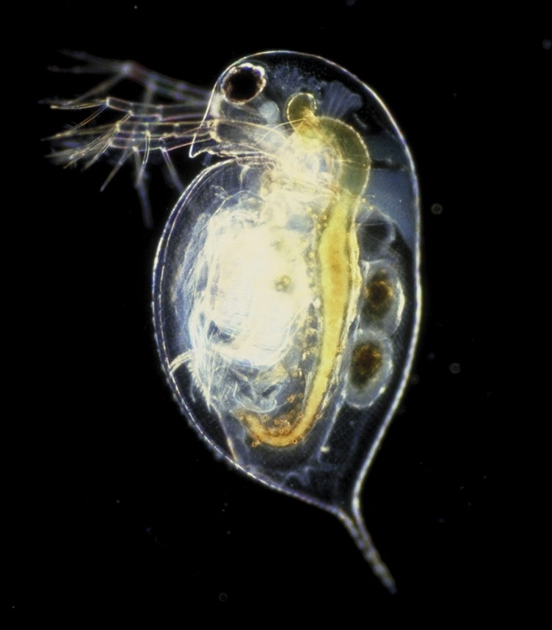
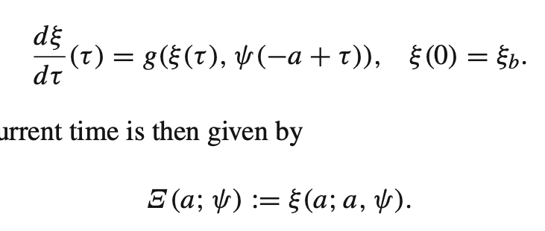
Structured models in ecology
Daphnia: individual-level physiological growth + population-level model
Diekmann et al, JMB, 2010, ‘Daphnia revisited’

