Slide 1

Model-based evaluation of post-pandemic vaccination strategies to reduce severe burden of COVID-19 in patients with chronic diseases
Ilse Westerhof, PhD candidate
Nordita workshop, June 2, 2023
University Medical Center Utrecht, The Netherlands
i.westerhof-4@umcutrecht.nl

Slide 2
2nd year PhD candidate in infectious disease epidemiology
Background in Infectious disease and international public health
Previous work
Household study (part of my PhD)
COVID-19 antigen testing pilot in secondary schools
PhD Project
1. Household transmission and disease severity
2. Vaccination strategies for post-pandemic period

Slide 3

Project
VERDI (SARS-CoV-2 variants Evaluation in pRegnancy and paeDIatrics cohorts)
Project that prioritizes pregnant women, children and high-risk populations in research on new SARS-CoV-2 variants of concern.
funded by the European Union.
Funding Oslo visit: Scholarship program iAPOGEE "International Alliance for PharmacoGenetic Epidemiology Excellence”.

Slide 4


Acknowledgements
UMC Utrecht
Ganna Rozhnova
Patricia Bruijning
University of Oslo
Angela Lupattelli
Hedvig Nordeng
With valueble input from Hilde Kjelgaard Brustad, Jørgen Eriksson Midtbø, and Francesco Di Ruscio (FHI Norway)

Slide 5
Outline
Aim project
Norway and the data analyses
Compartmental model

Slide 6
Background
Different burden of severe COVID-19 disease over time
Mass vaccination
Elderly and persons with chronic disease most at risk (Fekadu, 2021)

Slide 7
Aim
to investigate SARS-CoV-2 post-pandemic vaccination strategies to decrease the burden of severe COVID-19 disease in groups with chronic disease in Norway next winter season.

Slide 8
Approach
  Very detailed data from Norway to parametrize the model
  Compartmental model
  One winter season
  Different vaccination strategies
  Primary outcome
  Number of hospitalizations in different age and chronic disease groups
  Secondary outcomes
  ICU with invasive ventilation
  Mortality

Slide 9


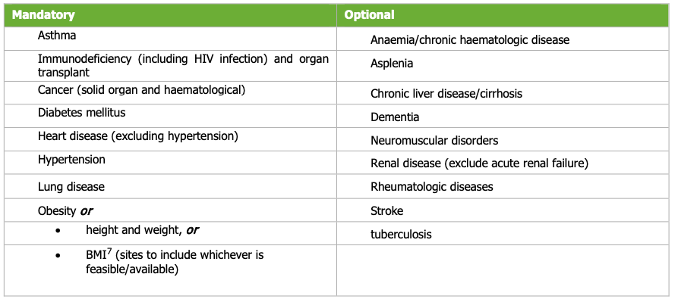
Chronic disease classification
Risk groups | Explanation
High risk | These comorbidities include having received an organ transplant, immunodeficiency, hematological cancer in the last five years, other active cancers, ongoing or recently discontinued treatment for cancer (especially immunosuppressive therapy, radiation therapy to the lungs or cytotoxic drugs), neurological or neuromuscular diseases that cause impaired cough or lung function, Down syndrome and chronic kidney disease, or significant renal impairment.
Medium risk | This includes chronic liver disease or significant hepatic impairment, immunosuppressive therapy as in autoimmune diseases, diabetes, chronic lung disease including cystic fibrosis and severe asthma which have required the use of high dose inhaled or oral steroids within the past year, obesity, dementia, chronic heart and vascular disease (with the exception of high blood pressure) and stroke.
Low risk | People with none of the diseases/conditions mentioned above.
High risk | Moderate risk
Classification used for multiple European studies

Slide 10
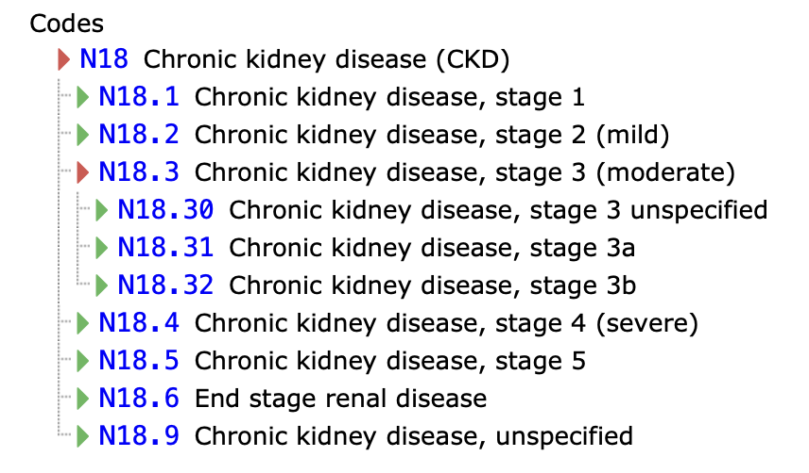
Definitions for data analyses
Chronic disease classification
ICPC-2 codes = International Classification of Primary Care
ICD-10 codes = International Classification of Diseases/diagnoses
ATC code = medication
Note, codes specifically requested by the University of Oslo were accessible for the project.
For example ICD-10 codes for Chronic Kidney disease
Confirmed COVID-19
COVID-19 infections (ICD-10)
Hospitalization and invasive ventilation
COVID-19 as the primary cause (ICD-10)
Mortality
COVID-19 (ICD-10) in their death report

Slide 11
Norway and the data analyses
Notes:
Describe COVID-19 disease burden in the Norwegian population over time to inform future modelling exercises.

Slide 12



Study population
2021 statistics
5 415 166 inhabitants
Children and adolescents
1-5 year old: 290 630
6-12 year-old: 448 573
13-15 year-old: 192 510
Births: 53 134

Slide 13






non-identifiable data files to University of Oslo TSD
➔ No data yet about 2022 (Omicron)
Data Source 2
Norwegian Patient Registry
(outpatient and inpatient ICD-10 diagnosis)
Data Source 1
The National Registry
Norwegian population
(Age, sex, birth, death, migration)
Entire Norwegian population between 01.01.2016 to 31.12.2021 of any age
Data Source 3
Norway Control and Payment of Health Reimbursement
(Primary GP visits (ICPC))
Overview
burden of COVID-19 disease
Data Source 4
Norwegian Immunisation Registry (SYSVAK)
Data Source 5
Medical Birth Registry of Norway
Data Source 6
Norwegian Prescription Registry
Data Source
Cause of Death Registry

Slide 14

Risk groups for severe COVID-19

Slide 15

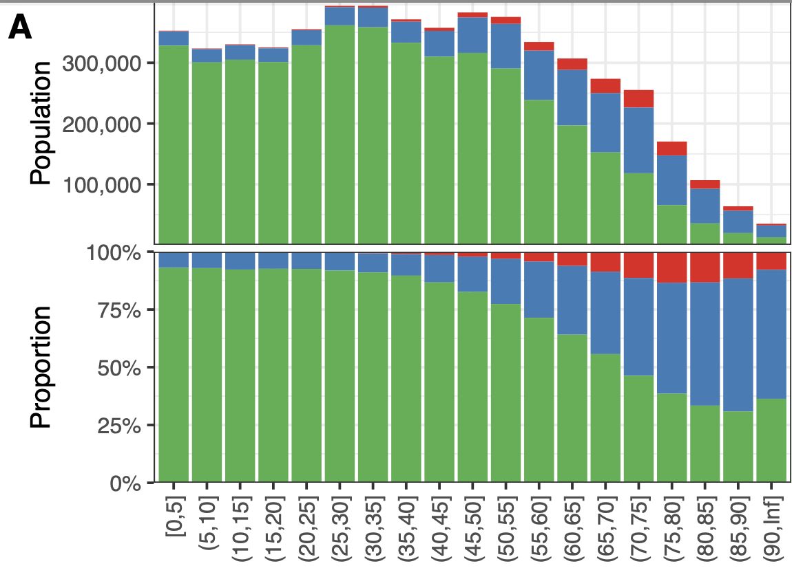
Chronic disease groups at baseline (Jan 2021)
High + moderate = 20,6%
High + moderate = 27,4%
ECDC includes more chronic diseases than FHI.
  Classifications might include less relevant chronic disease codes

Slide 16

Immunity against COVID-19

Slide 17
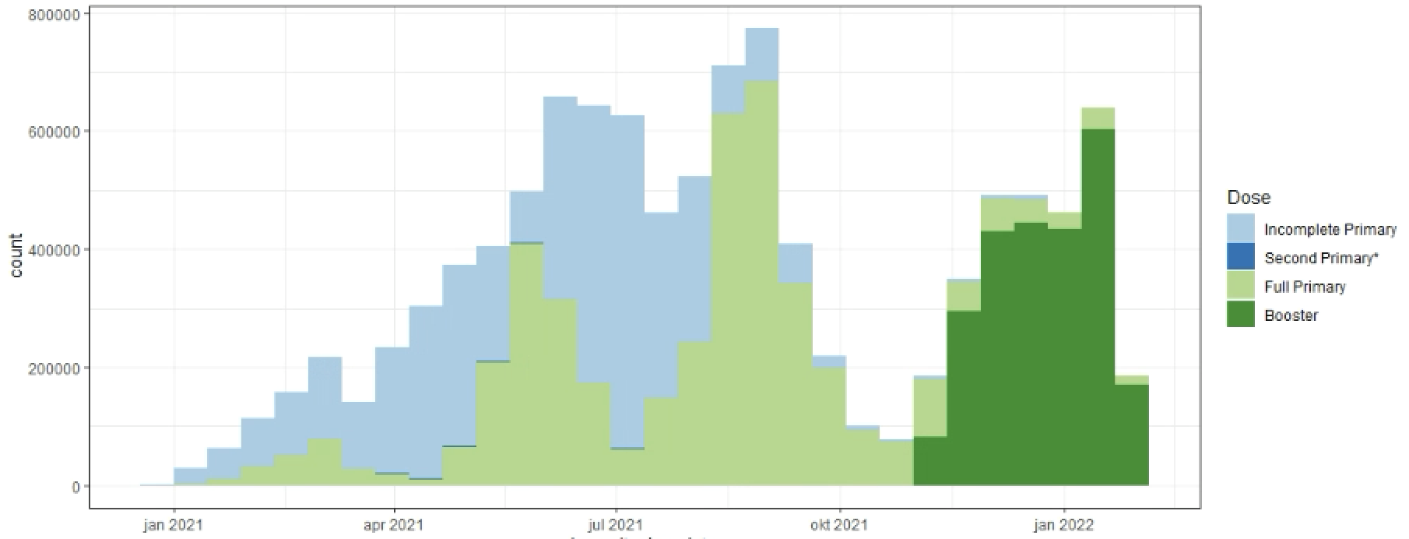
Provided vaccinations
Vaccinated
Jan 2021
April 2021
Jul 2021
Oct 2021
Jan 2022
Notes:
Trail coordination board (denmark) evaluation vacc eff
Days between vacc overleggen with other groups

Slide 18
Vaccine status January 2022
Age group | Immunity
≤4 | 5%
5-12 | 18%
13-49 | 84%
≥50-64 | >92%
Immunity
Hybrid and booster vaccinated
Booster vaccinated
Unvaccinated

Slide 19

SARS-CoV-2 Disease burden

Slide 20
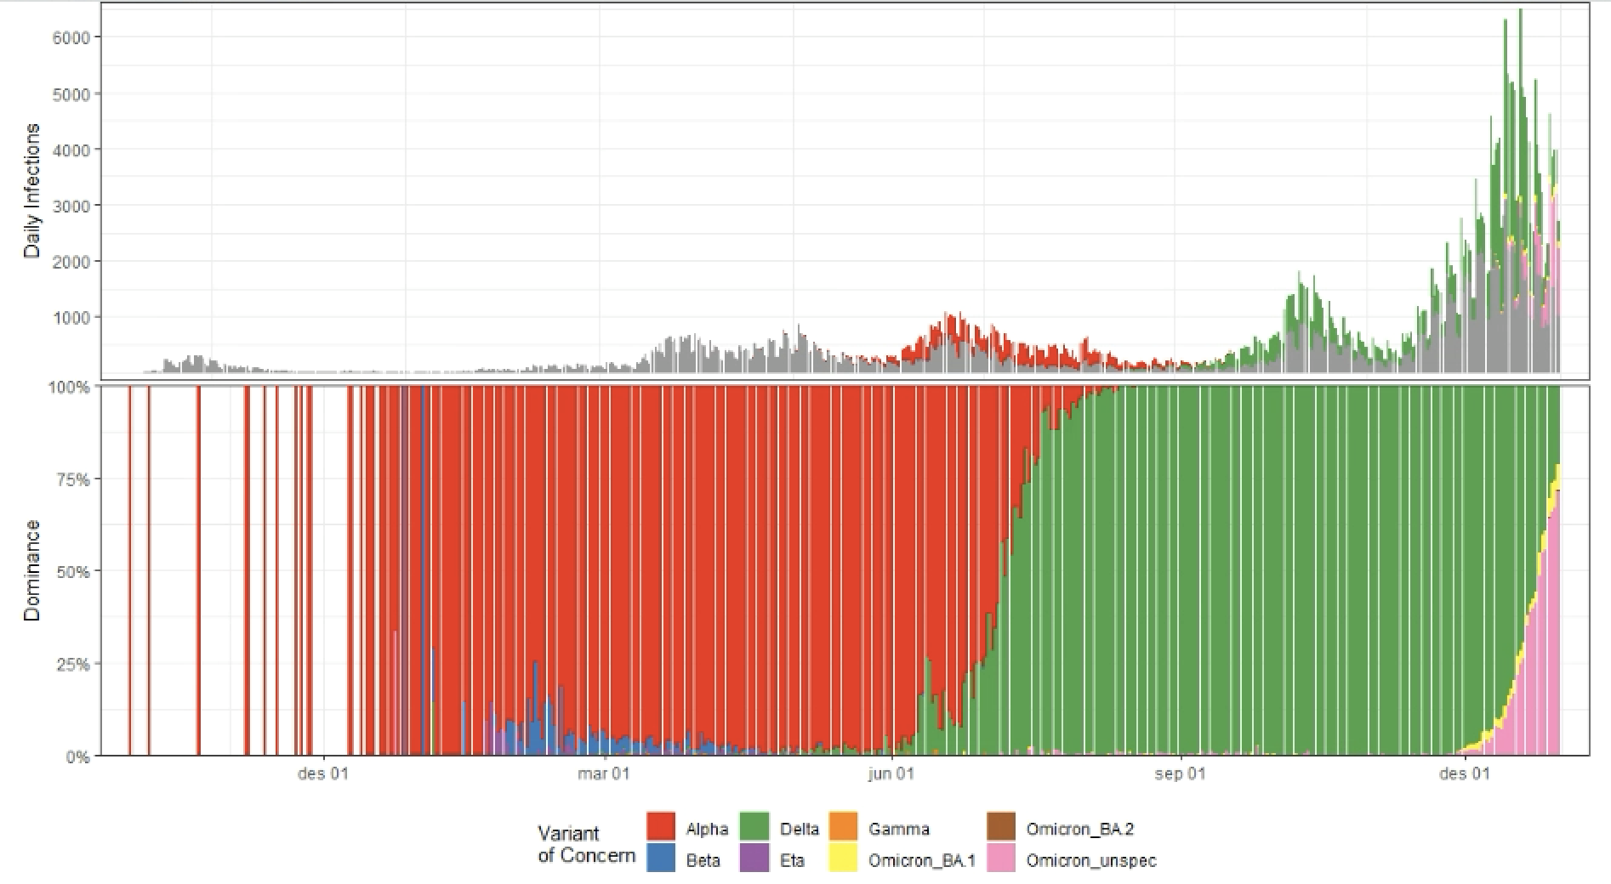
Confirmed infections and VoC
50-55% under detection (Røsok et al., 2021, FHI COVID-19 modelling team)
Grey = Not sequenced or other VoC
Infections
Dominance
Dec 2020
March 2020
June 2020
Sept 2020
Dec 2021

Slide 21
Disease burden caused in 2020 and 2021
Delta
Omicron
Hospitalizations
N= 7035
Invasive
ventilation
N= 698
Mortality
N= 1390
Notes:
Note that end dec 2020 vaccinations became available.

Slide 22
Burden increased with chronic disease category
Infections
Infections
Hospitalizations
Hospitalizations
General population (Jan 2021)
18.1% (Rate Ratio 0.7)
18.1% (Rate Ratio 0.7)
45.2% (Rate Ratio 1.6)
45.2% (Rate Ratio 1.6)
Invasive ventilation
Mortality
Invasive ventilation
27.4% in high- and moderate risk category
70.0% (Rate Ratio 2.6)
76.9% (Rate Ratio 2.8)
70.0% (Rate Ratio 2.6)
➔ Distribution of chronic conditions for Alpha and Delta appr. Similar.
Notes:
~90 % of the deaths were with covid as primary cause

Slide 23
Most frequent comorbidity groups among age ≥65
Crude Rate ratio (versus general population Jan 2021)
 | Hospitalizations
Comorbidity | Proportion with chronic disease | Rate ratio
Immunodeficiency | 4.4% | 5.2
Lung Disease | 25.2% | 2.5
Renal disease | 15.4% | 2.4
Dementia | 6.9% | 2.1
Diabetes | 26.3% | 2.1
Rheumatologic disease | 3.2% | 1.9
Asthma | 17.3% | 1.9
Anaemia | 8.9% | 1.8
Cardiovascular disease | 37.6% | 1.7
Stroke | 6.5% | 1.6
Rate ratio = $\frac{\% comorbidity among hospitalised because ofCOVID−19}{\% comorbidity among general population}$

Slide 24
Most frequent comorbidity groups among age ≥65
Crude Rate ratio (versus general population Jan 2021)
 | Hospitalizations
Comorbidity | Proportion with chronic disease | Rate ratio
Immunodeficiency | 4.4% | 5.2
Lung Disease | 25.2% | 2.5
Renal disease | 15.4% | 2.4
Dementia | 6.9% | 2.1
Diabetes | 26.3% | 2.1
Rheumatologic disease | 3.2% | 1.9
Asthma | 17.3% | 1.9
Anaemia | 8.9% | 1.8
Cardiovascular disease | 37.6% | 1.7
Stroke | 6.5% | 1.6
Mortality
Proportion with chronic disease | Rate ratio
4.0% | 4.8
22.8% | 2.2
17.0% | 2.7
19.5% | 6.0
19.7% | 1.6
1.9% | 1.1
10.3% | 1.2
9.1% | 1.6
40.1% | 1.8
7.0% | 1.8
Rate ratio = $\frac{\% comorbidity among hospitalised because ofCOVID−19}{\% comorbidity among general population}$

Slide 25
Hospitalization - Duration in days (mean; SD)
 | Wildtype / Alpha variant |  | Delta
Age group | n | Mean (SD) | n | Mean (SD)
≤4 | 23 | 7.2 (13.7) | 40 | 3.0 (3.9)
5-12 | 11 | 4.1 (3.4) | 16 | 5.4 (3.3)
13-18 | 28 | 5.5 (7.1) | 22 | 5.0 (5.5)
19-49 | 1365 | 6.7 (9.3) | 677 | 6.4 (9.0)
50-64 | 1501 | 10.8 (13.7) | 530 | 8.6 (10.1)
≥65 | 1645 | 11.9 (15.6) | 1127 | 9.1 (9.7)
All | 4573 | 9.9 (13.5) | 2412 | 8.1 (9.1)
Overall a decrease in hospitalization duration

Slide 26
Compartmental model

Slide 27

Compartmental model
Data driven the approach
  parameters obtained from Norwegian registries and Norwegian contact matrices.
Perhaps (demographic) stochasticity
Timescale for analyses (one winter season)
Adaptation of the epidemiological models from our previous work
    stratified by age to age, chronic disease and immunity
Applicable/useful to other countries

Slide 28
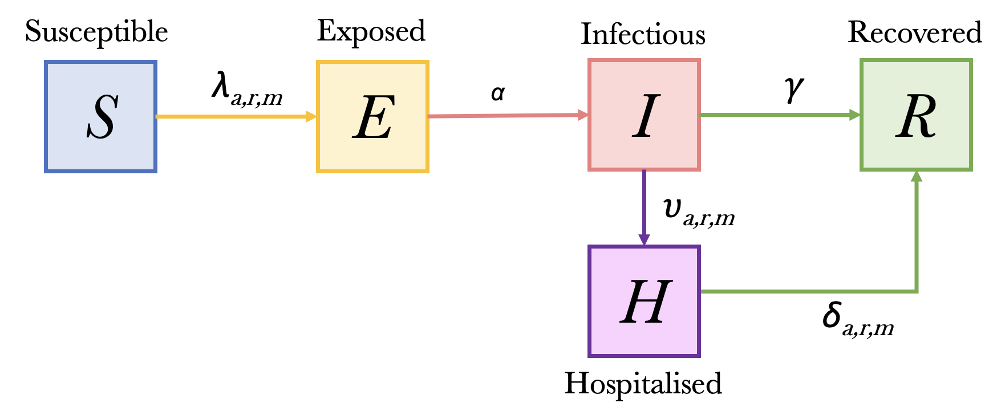
Compartmental model

Slide 29
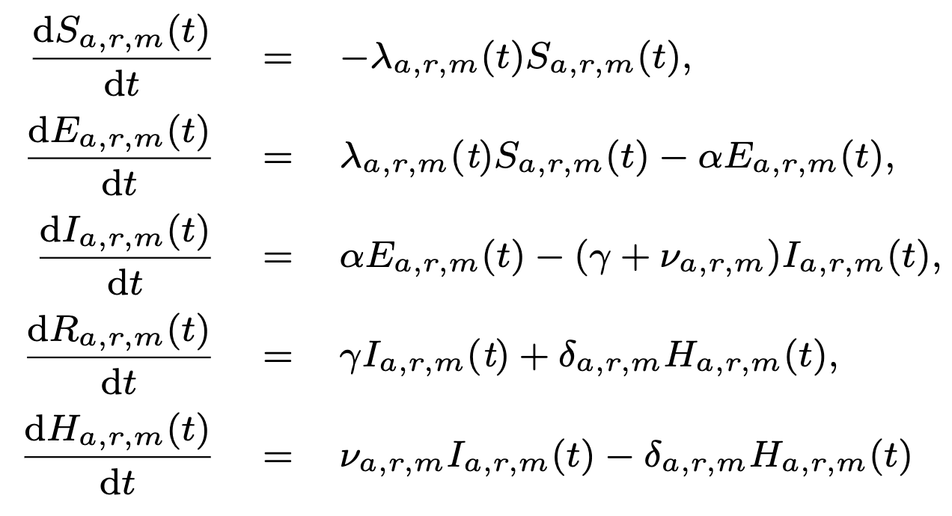
Model equations

Slide 30
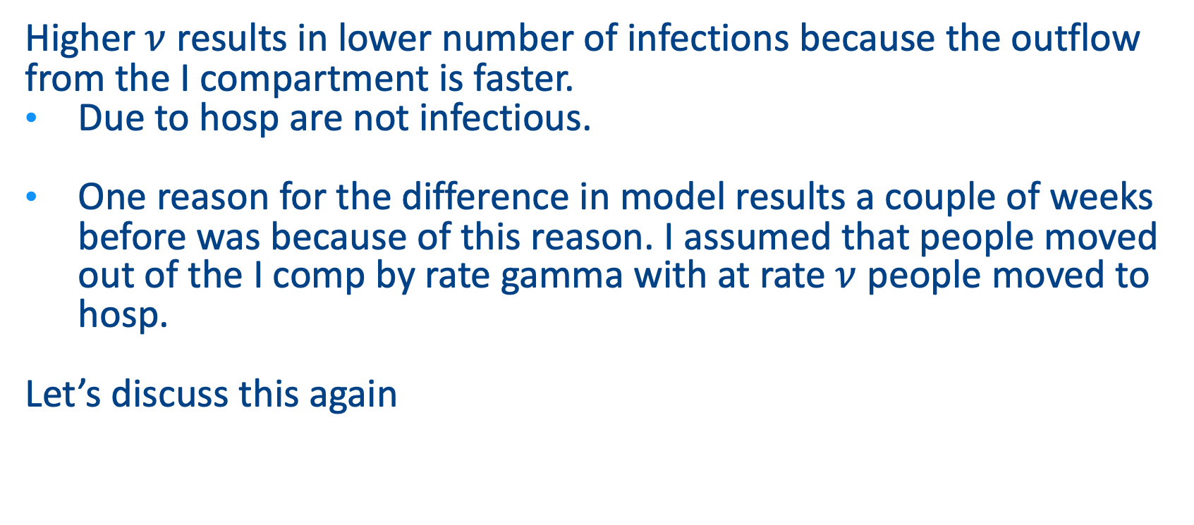
Discussion w Ganna
Higher $ν$ results in lower number of infections because the outflow from the I compartment is faster.
Due to hosp are not infectious.
One reason for the difference in model results a couple of weeks before was because of this reason. I assumed that people moved out of the I comp by rate gamma with at rate $ν$ people moved to hosp.
Let’s discuss this again

Slide 31
Vaccination Strategies
Baseline scenario. Children aged <5 years have gradually increasing moderate immunity, and the rest of the population has moderate immunity.
Entire Norwegian population with ’high + moderate risk’.
Full Norwegian elderly (65+) population.
Elderly (65+) and high(+ moderate)-risk populations.
Perhaps strategies for specific chronic disease groups
Notes:
Baseline scenario. Children aged <5 years have gradually increasing moderate immunity, and the rest of the population has moderate immunity.
Entire Norwegian population with ’high + moderate risk’. This could be an effective strategy to prevent hospitalisations and deaths, as these groups are at higher risk of severe disease. Vaccinating these groups may also help to reduce the overall burden on the healthcare system during the winter months.
Full Norwegian elderly (65+) population. This could be an effective strategy to prevent hospitalisations and deaths, as this group is at the highest risk of severe disease. Vaccinating this group may also help reduce the healthcare system’s burden during the winter months.
Full Norwegian adult and elderly (20+) population. This could be an effective strategy to prevent a surge in cases, as adults are most likely to become infected and transmit the virus. This strategy may also help to protect vulnerable populations by reducing the overall number of cases.
Elderly (65+) and high risk populations. These groups are at a higher risk of severe illness and death from COVID-19 and may benefit from booster shots to maintain immunity levels and protection against new variants.

Slide 32
Protection against infection due to immunity
Leaky vaccine with
Efficacy against infection and hospitalization
Vaccine match with variant
Everyone vaccinated at start of season, no waning
Classes with different ‘initial’ immunity states
    Naïve (newborns)
    Moderate immunity (infection/vaccination >6 months ago)
    High immunity (recent infection/vaccination)
    Perhaps more immunity classes to imitate the immune states

Slide 33
Parameters
Description (unit)
Constant parameters Effective reproduction number (R_{e}) Latency period (α) Infectious period (γ) Hospitalization duration (δ) | 1.2, 2 & 3.5 3 days 3 days 6.8 days
Description (unit)
Initial values Number exposed Number infections Number susceptible | 0.01% 0.01% 99.98%
Assumption: No differences in susceptibility and infectivity for age and risk groups.

Slide 34
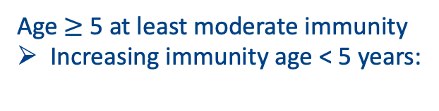
Parameters
Vaccine effectiveness
Against infection Against Hospitalization | Immunity High Moderate Low Immunity High Moderate Low | 61% 26% 0% 80% 40% 0%
Age $≥$ 5 at least moderate immunity
Increasing immunity age < 5 years:

Slide 35
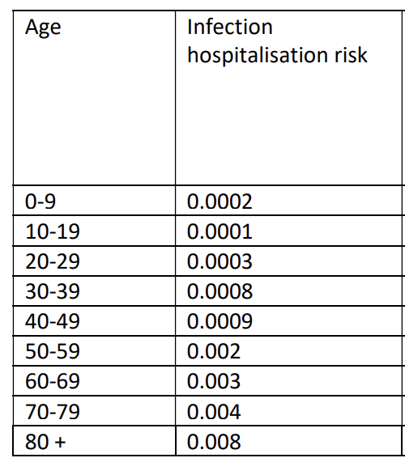
Age and risk specific hospitalization rate
FHI estimated age-specific hospitalisation rates.
Scaled to risk group distribution from the registry data

Slide 36
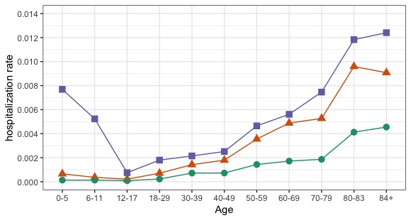
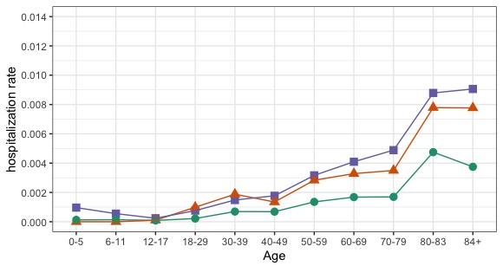
Age and risk specific hospitalization rate
Low risk Moderate risk High risk
➔ Classification matters for the hospitalization rates

Slide 37
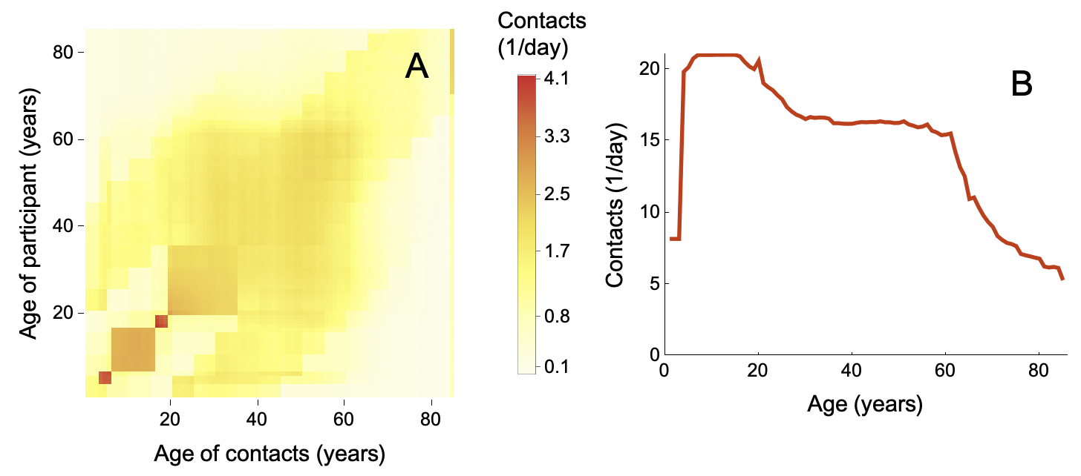
Age-specific contact matrices for Norway (Mistry et al.)
We assume no differences for the risk- and immunity groups.

Slide 38
Preliminary results
Baseline scenario. Children aged <5 years have gradually increasing moderate immunity, and the rest of the population has moderate immunity.
Entire Norwegian population with ’high risk’.
Entire Norwegian population with ’high + moderate risk’.
Full Norwegian 85+ population.
Full Norwegian 65+ population.
Notes:
Baseline scenario. Children aged <5 years have gradually increasing moderate immunity, and the rest of the population has moderate immunity.
Entire Norwegian population with ’high + moderate risk’. This could be an effective strategy to prevent hospitalisations and deaths, as these groups are at higher risk of severe disease. Vaccinating these groups may also help to reduce the overall burden on the healthcare system during the winter months.
Full Norwegian elderly (65+) population. This could be an effective strategy to prevent hospitalisations and deaths, as this group is at the highest risk of severe disease. Vaccinating this group may also help reduce the healthcare system’s burden during the winter months.
Full Norwegian adult and elderly (20+) population. This could be an effective strategy to prevent a surge in cases, as adults are most likely to become infected and transmit the virus. This strategy may also help to protect vulnerable populations by reducing the overall number of cases.
Elderly (65+) and high risk populations. These groups are at a higher risk of severe illness and death from COVID-19 and may benefit from booster shots to maintain immunity levels and protection against new variants.

Slide 39
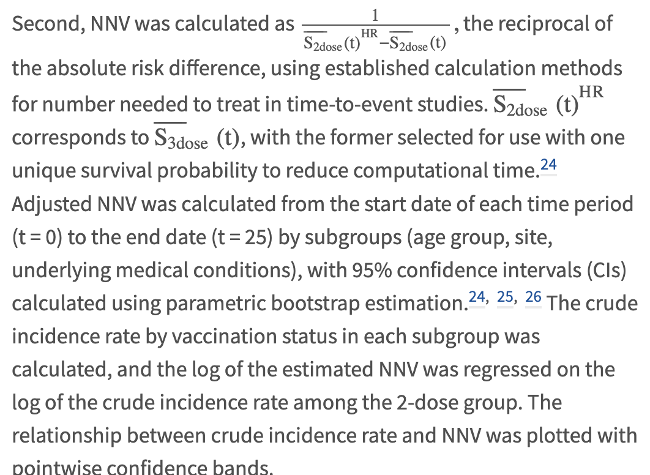
Number needed to vaccinate to prevent one hospitalization

Slide 41
Preliminary Modelling results

Slide 42
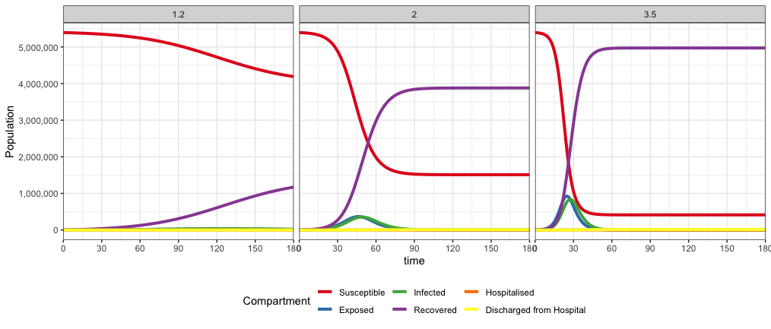
Results – baseline by Effective reproduction number

Slide 43
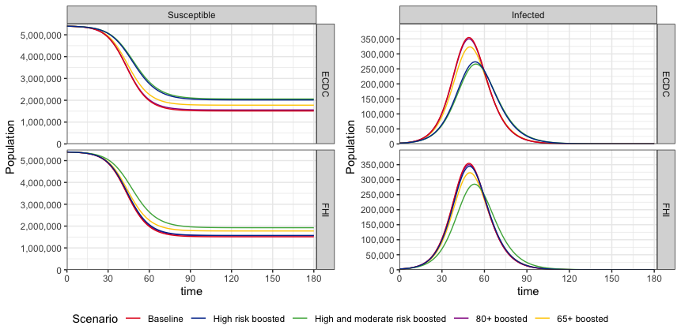
Vaccination of high/moderate risk groups, best strategy to reduce infections
R_{e} = 2
R_{e} = 2

Slide 44
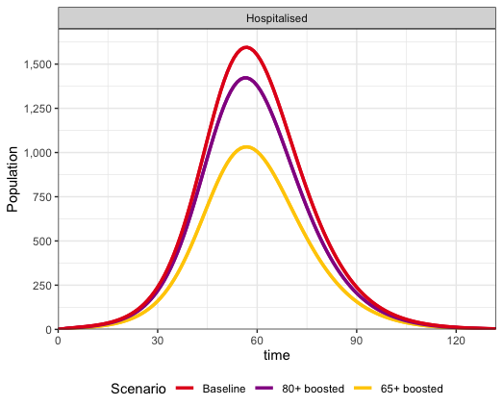
Vaccinating 65+ reduces hospitalisations by 35%
Vaccinating 65+ (18.2% of population)
▼ 34.9% hospitalizations in season
▼ 35.3% hospitalizations at peak
Vaccinating 80+ (N= 4.4%)
▼ 11.2% hospitalizations in season
▼ 10.9% hospitalizations at peak
R_{e} = 2
Re = 2

Slide 45
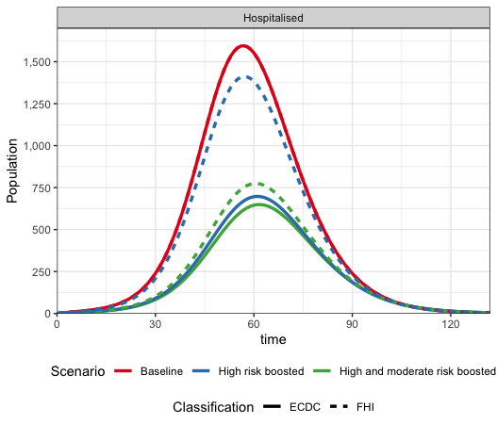
Results – Comparison strategies by Risk classification
Vaccinating ECDC high-risk population reduces hospitalisations more than vaccinating FHI high/moderate-risk population.
FHI high-risk (3.4% of population)
▼ 10.7% hospitalizations in season
▼ 11.5% hospitalizations at peak
FHI moderate/high-risk (21.6% of population)
▼ 47.3% hospitalizations in season
▼ 51.4% hospitalizations at peak
ECDC high-risk and moderate/high-risk (26.3-28.3% of population)
▼ 51.9-54.7% hospitalizations in season
▼ 56.3-59.3% hospitalizations at peak
Re = 2

Slide 46
Conclusions
Chronic disease group classification matters
The distribution of Chronic disease groups for the disease burden was appr. similar during wild type/Alpha variant and Delta variant period.
Data about 2022 needed to understand the importance of vaccination and variant
      We will adapt the parameters to this and literature

Slide 47
Discussion
What risk group classification do you use?
What initial immunity?
What are the most relevant scenarios?

Slide 48
Acknowledgements
UMC Utrecht
Ganna Rozhnova
Patricia Bruijning
University of Oslo
Angela Lupattelli
Hedvig Nordeng
With valueble input from Hilde Kjelgaard Brustad, Jørgen Eriksson Midtbø, and Francesco Di Ruscio (FHI Norway)

