Slide 1


Estimating transmission trees while allowing for multiple introductions
Bastiaan Van der Roest, Martin Bootsma, Egil Fischer, Don Klinkenberg and Mirjam Kretzschmar
UMC Utrecht, Utrecht University and RIVM
b.r.vanderroest-2@umcutrecht.nl

Slide 2
Notes:
Introduction to myself and the rest of the team

Slide 3
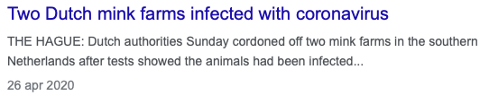
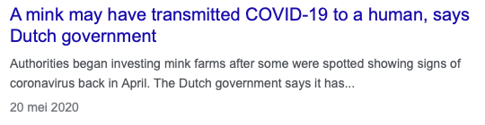
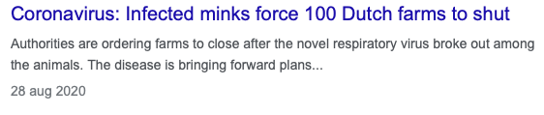
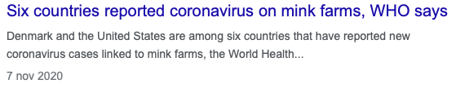
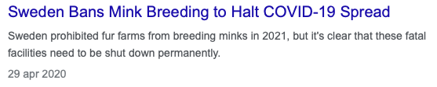

Slide 4




SARS-CoV-2 in mink farms in Netherlands
SARS-CoV-2 outbreak among humans
Simultaneously outbreak among mink farms
      First case April 23, 2020
      63 farms infected between April and November 2020
      All Dutch farms (128) culled in January 2021
Transmission routes

Slide 5
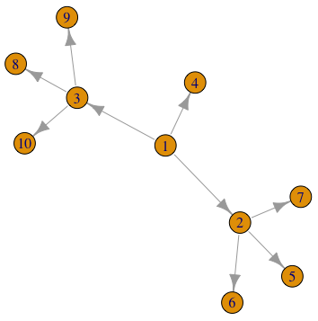
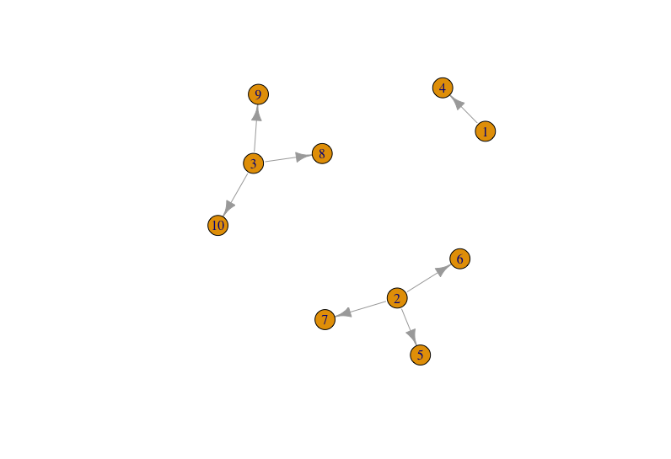
Preventing spread of an outbreak

Slide 6
Available data
Epidemiological data:
      Day of detection (sampling time)
      Risk factors host
      (Geographical) distance
      Generation time interval
Genetic data of pathogen (sequence data)
      Single nucleotide polymorphisms (SNPs)

Slide 7
Phylogenetic analysis

Slide 8
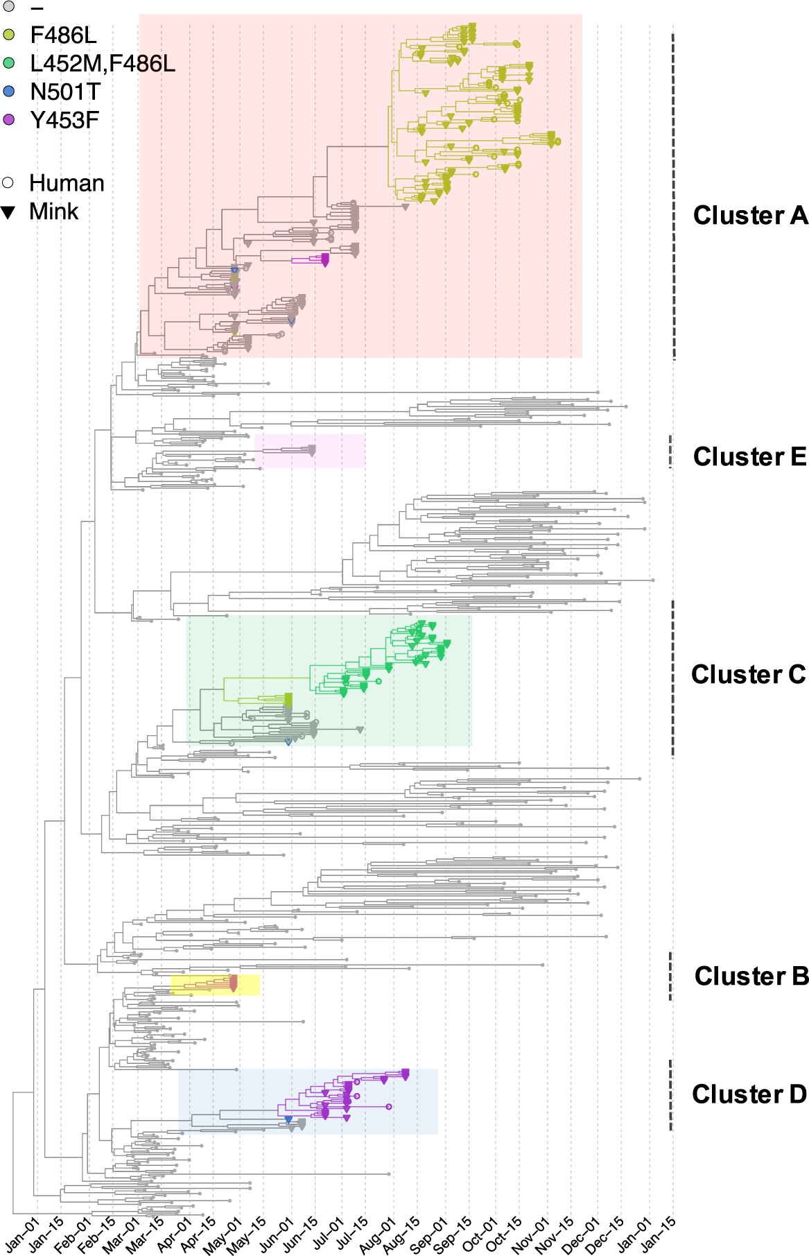
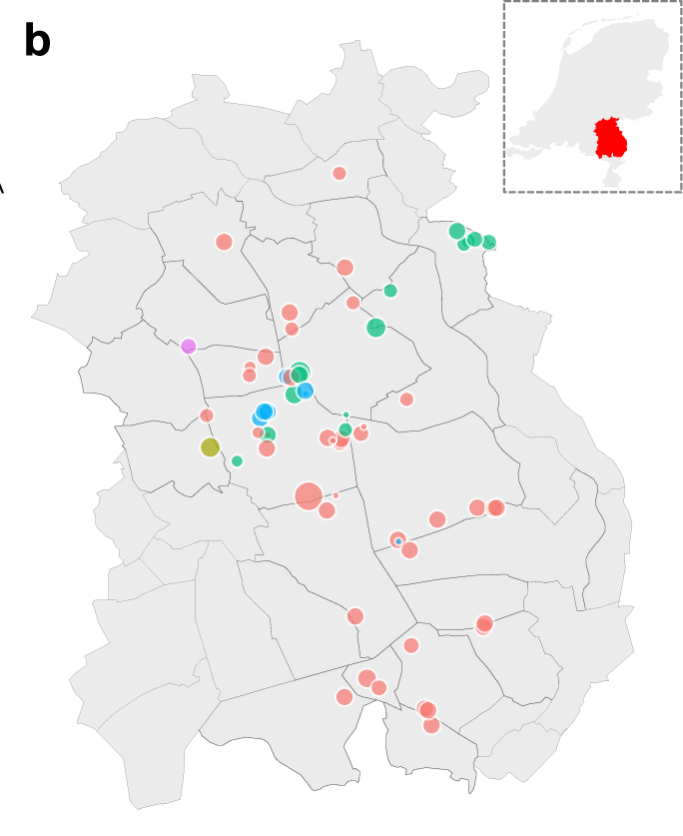
Phylogeny of mink farms¹
¹ Lu et al Nature Comm (2021)

Slide 9
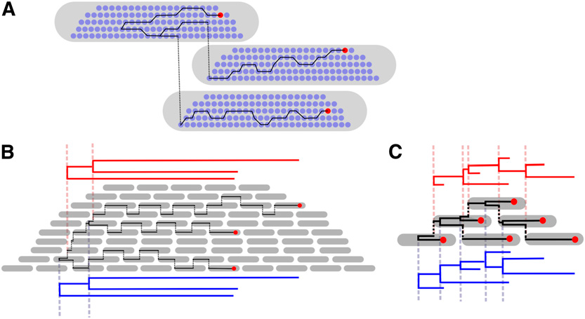
Phylogenetic tree is NOT transmission tree
Sparse sampling
Dense sampling
Ypma et al Genetics (2013)
Notes:
Schematic for viral dynamics. Throughout the figure, time progresses from left to right. Hosts are depicted as gray pods, virus particles as blue dots, and sampled virus particles as red dots. (A) The timing of coalescence of viral lineages depends on within-host viral dynamics. Virus (blue) numbers within hosts (gray) rapidly increase at onset of infection and decrease near the end of the infection, influencing coalescent rates. A possible ancestry between sampled viruses (red) is given in black. Although the initial host infects the latter two, the sampled viruses from these latter two are more closely related, as they coalesce with each other before coalescing with the virus sampled from the initial host. (B) When viruses are sampled from only a few hosts in a large outbreak, the timing of the coalescence of the sampled viruses is nearly identical to the timing of transmission immediately following the coalescence. The timing of coalescent events is mainly governed by interhost infection dynamics, and the phylogenetic tree derived from the sequences (blue) is very similar to the one derived when internal node times are equated with transmission times (red). (C) When viruses are sampled from all hosts in an outbreak, coalescent times and transmission times are very different. The phylogenetic tree derived when approximating coalescent times by transmission times (red) is very different from the actual phylogenetic tree (blue).

Slide 10
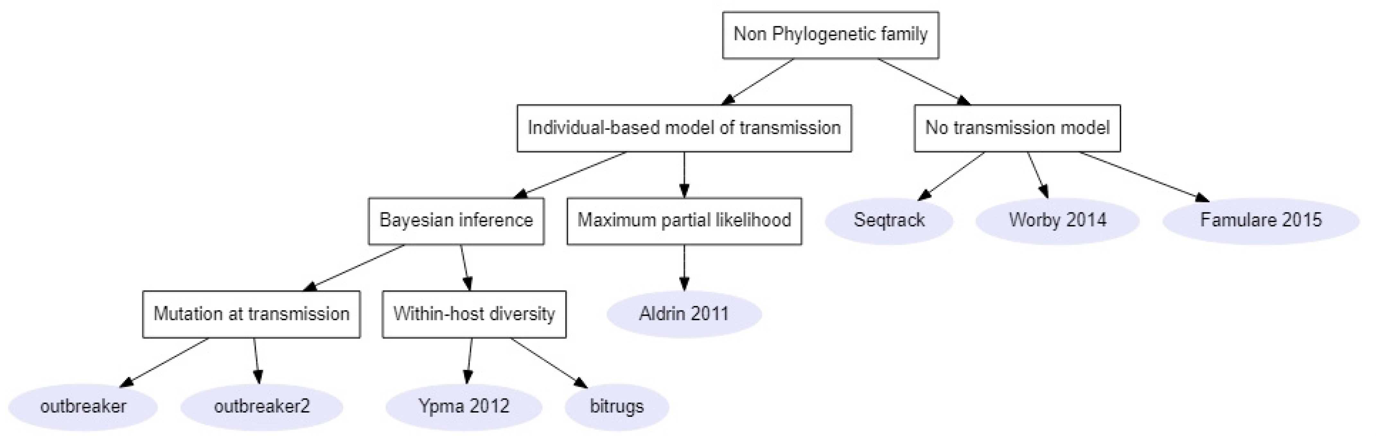
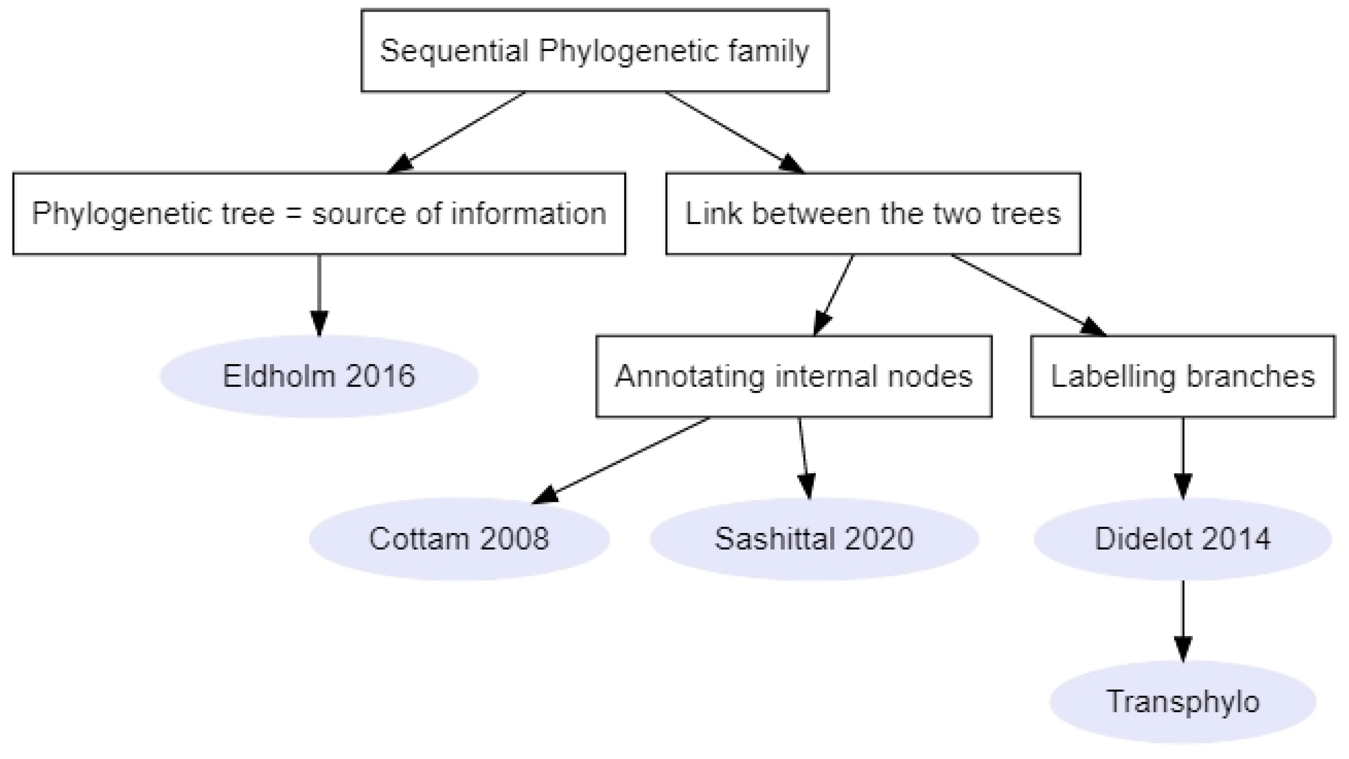
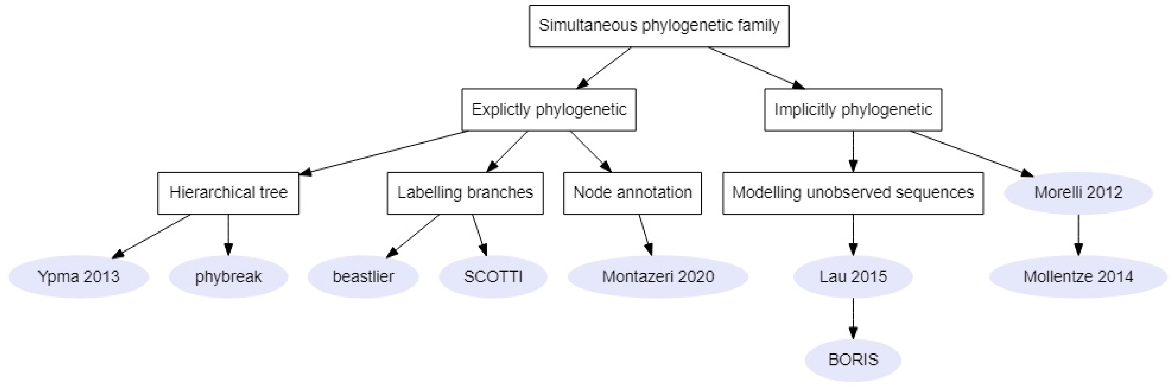
Genetic + Transmission methods
Duault et al. Pathogens (2022)

Slide 11
Phybreak

Slide 12
The phybreak model
Outbreak analysis with sequence data
Seems specific, but still many possible settings...
    Norovirus outbreak during a youth camp
    Legionnaires' disease linked to a water tower
    MRSA on intensive care unit
    H7N7 influenza on poultry farms
...and many possible datasets (even with only sequences)
    environmental samples
    longitudinal sampling
    WGS, MLST, short-reads

Slide 13
Phybreak: model
Role of the model:
    Serves to link the data to what we want to know
        Link sequences + sampling times to who infected whom
    Exact description of how the data were generated
      What happened during the outbreak, resulting in the data
    Output
      Who infected whom
      Additional stuff:
        infection times
        generation interval distribution
        mutation rate
Notes:
Additional stuff could be interesting or be used as model validity

Slide 14
Phybreak: model
Consequence of "what we want to know" = "who infected whom"
    Host-to-host infections (persons, farms, …)
    All cases should have been observed (or at least, most)
    Most cases should have been sampled
What if you use phybreak nevertheless?
    Know how to interpret the results => know the model!!
Many datasets not suitable for phybreak!

Slide 15
Description previous model¹
Likelihood based:
  Four submodels describe how the data were generated
    Epidemiological
      Change of exact transmission times, infectors, …
    Detection
      Chance that detections occurred at observed moments
    Phylogenetic tree
      How are the observed sequences related to each other
    Genetic
      Change of mutation over phylogenetic tree that match observations
Klinkenberg et al. PLoS Comp Bio (2017)

Slide 16
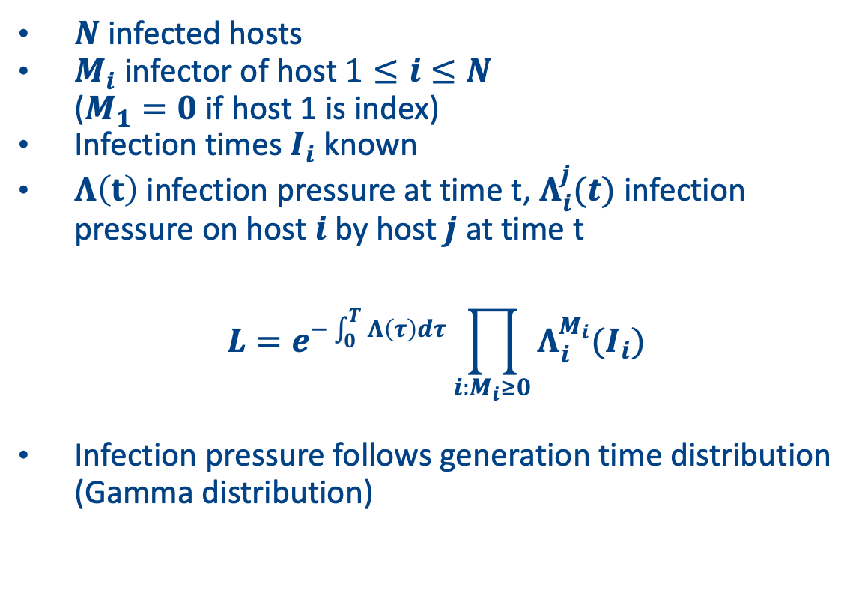
1. Epidemiological
    $N$infected hosts
    $M_{i}$ infector of host $1≤i≤N$
    ($M_{1}=0$ if host 1 is index)
    Infection times $I_{i}$ known
    $Λ\left(t\right)$ infection pressure at time t, $Λ_{i}^{j}(t)$ infection pressure on host $i$ by host $j$ at time t
    $$L=e^{−\int_{0}^{T}{Λ\left(τ\right)dτ}}\prod_{i:M_{i}≥0}{Λ_{i}^{M_{i}}(I_{i})}$$
    Infection pressure follows generation time distribution (Gamma distribution)
5
2
6
3
1
4
Notes:
The infection is transmitted directly from host-to-host
All cases are infected by another case in the dataset, or an external source, in phybreak terminology the 'history host’
Each case was equally infectious
The outbreak has come to an end
Each case could have been the source for each other case
Infection times
new introductions at fixed rate (after first index case)
time between infection of case & its infector follows generation interval distribution

Slide 17
Description previous model¹
Likelihood based:
  Four submodels describe how the data were generated
    Epidemiological
    Detection
Klinkenberg et al. PLoS Comp Bio (2017)

Slide 18
2. Detection
    First sample of host determines moment of detection
    Time between infection and detection Gamma distributed
5
2
6
3
1
4

Slide 19
Description previous model¹
Likelihood based:
  Four submodels describe how the data were generated
    Epidemiological
    Detection
    Phylogenetic tree
Klinkenberg et al. PLoS Comp Bio (2017)

Slide 20
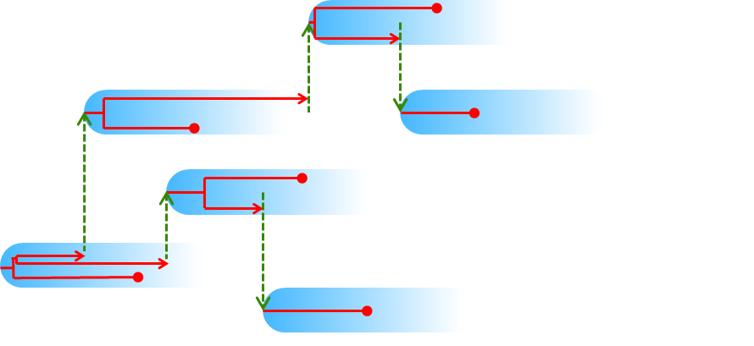
3. Phylogenetic tree
One phylogenetic tree
    by linking 'minitrees' in each host

Slide 21
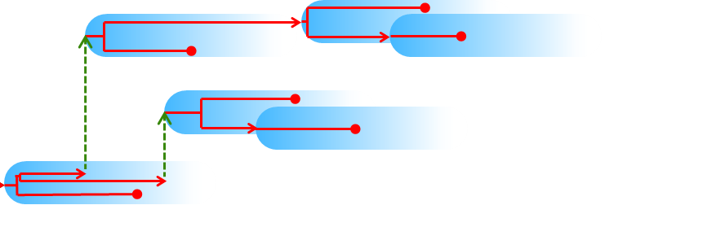
3. Phylogenetic tree
One phylogenetic tree
    by linking 'minitrees' in each host

Slide 22
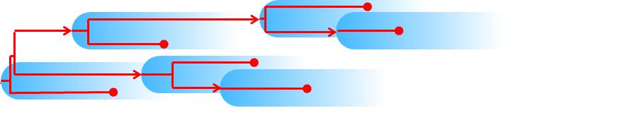
3. Phylogenetic tree
One phylogenetic tree
    by linking 'minitrees' in each host

Slide 23
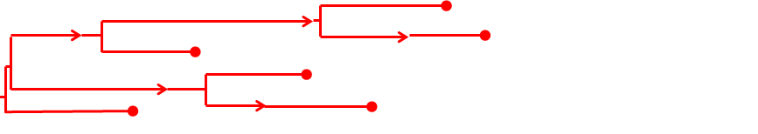
3. Phylogenetic tree
One phylogenetic tree
    by linking 'minitrees' in each host
Consequence
    Clonal evolution (SNPs)
    No recombination/reassortment

Slide 24
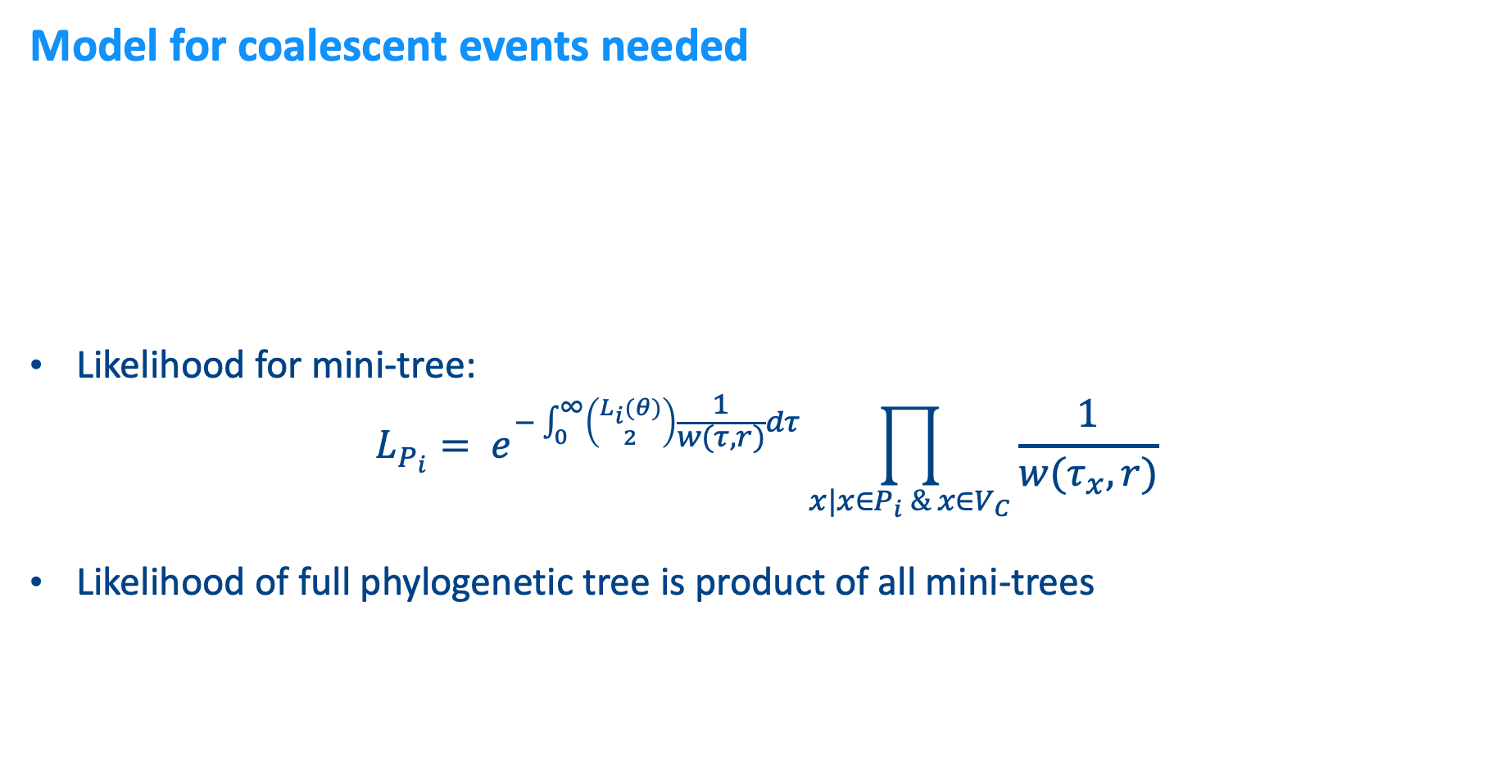
3. Phylogenetic tree
Model for coalescent events needed
    Likelihood for mini-tree:
    $$L_{P_{i}}= e^{−\int_{0}^{∞}{\left({L_{i}(θ) \atop 2}\right)\frac{1}{w(τ,r)}dτ}}\prod_{x|x∈P_{i} \& x∈V_{C}}{\frac{1}{w(τ_{x},r)}}$$
    Likelihood of full phylogenetic tree is product of all mini-trees
pathogen population size
Coalescence rate ~ within-host dynamics
w(τ) = rτ
time since infection
Notes:
First part likelihood is probability to not have coalescent events during intervals in which there are two or more lineages, the second term is the product of coalescent rates at the coalescent nodes.

Slide 25
Description previous model¹
Likelihood based:
  Four submodels describe how the data were generated
    Epidemiological
    Detection
    Phylogenetic tree
    Genetic
Klinkenberg et al. PLoS Comp Bio (2017)

Slide 26
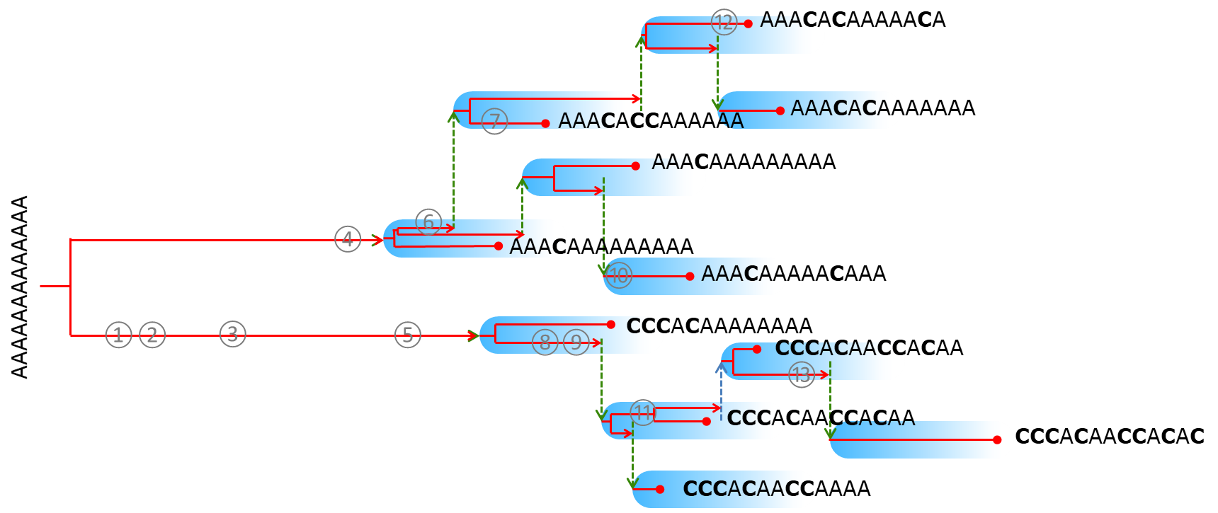
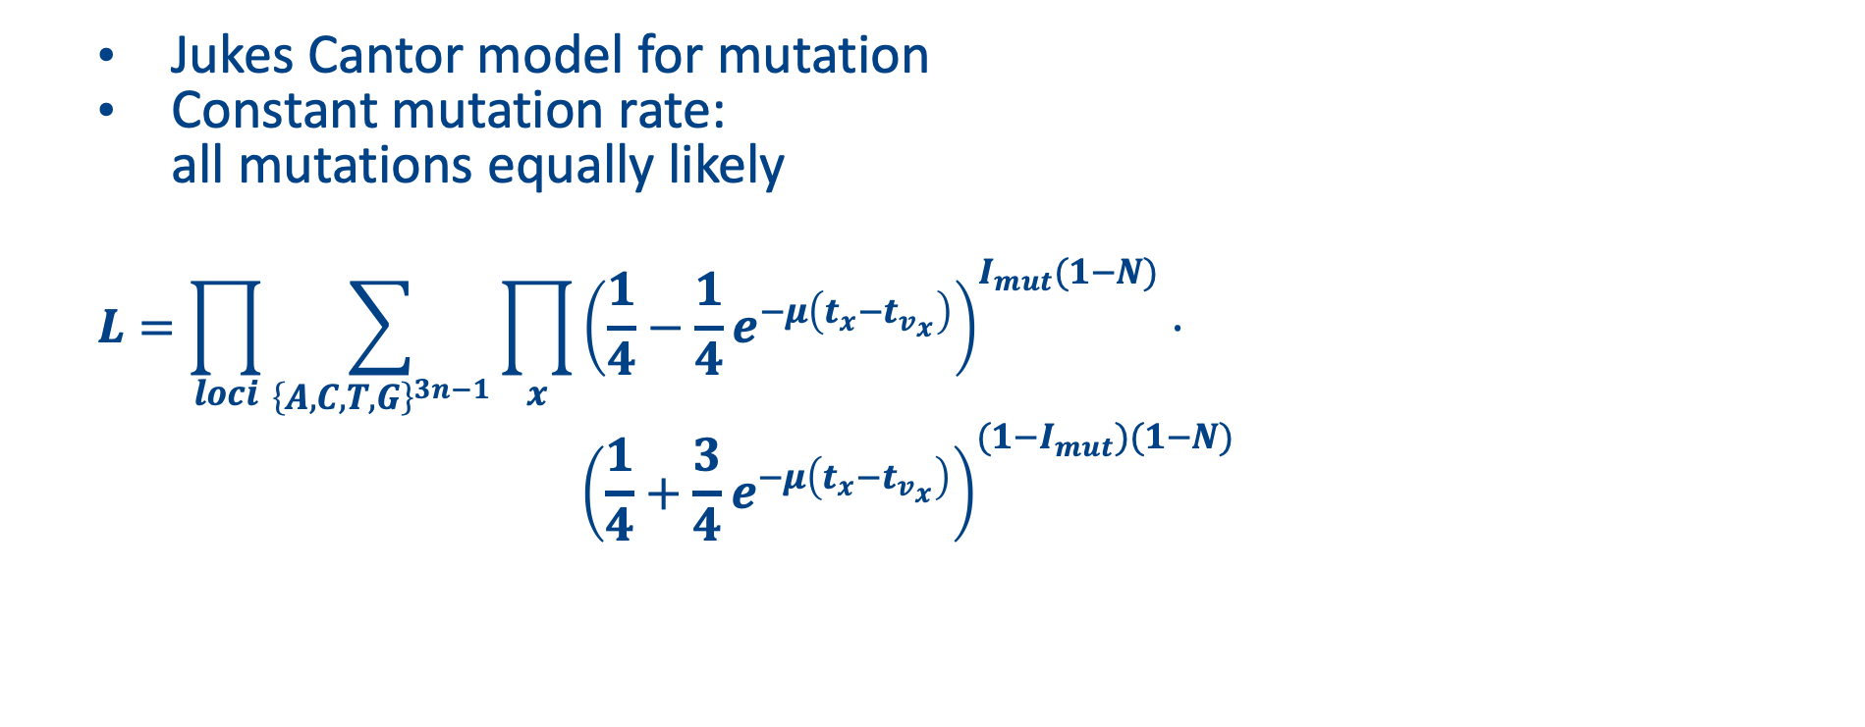
4. Genetic
    Jukes Cantor model for mutation
    Constant mutation rate:
    all mutations equally likely
    $$L=\prod_{loci}{\sum_{{\left\{A,C,T,G\right\}}^{3n−1}}{\prod_{x}{{\left(\frac{1}{4}−\frac{1}{4}e^{−μ\left(t_{x}−t_{v_{x}}\right)}\right)}^{I_{mut}(1−N)}⋅}}}$$
    $${\left(\frac{1}{4}+\frac{3}{4}e^{−μ\left(t_{x}−t_{v_{x}}\right)}\right)}^{(1−I_{mut})(1−N)}$$
Notes:
Phylogenetic tree does not describe differences between sequences
it describes distance between samples 'in time'
how often has the pathogen been replicated?
how often could a mutation have taken place?
Phybreak choice for mutation model: Jukes-Cantor
each mutation (site & nucleotide) equally likely

Slide 27
Multiple introductions

Slide 28
Preventing spread of an outbreak

Slide 29
History of lineages
History host

Slide 30
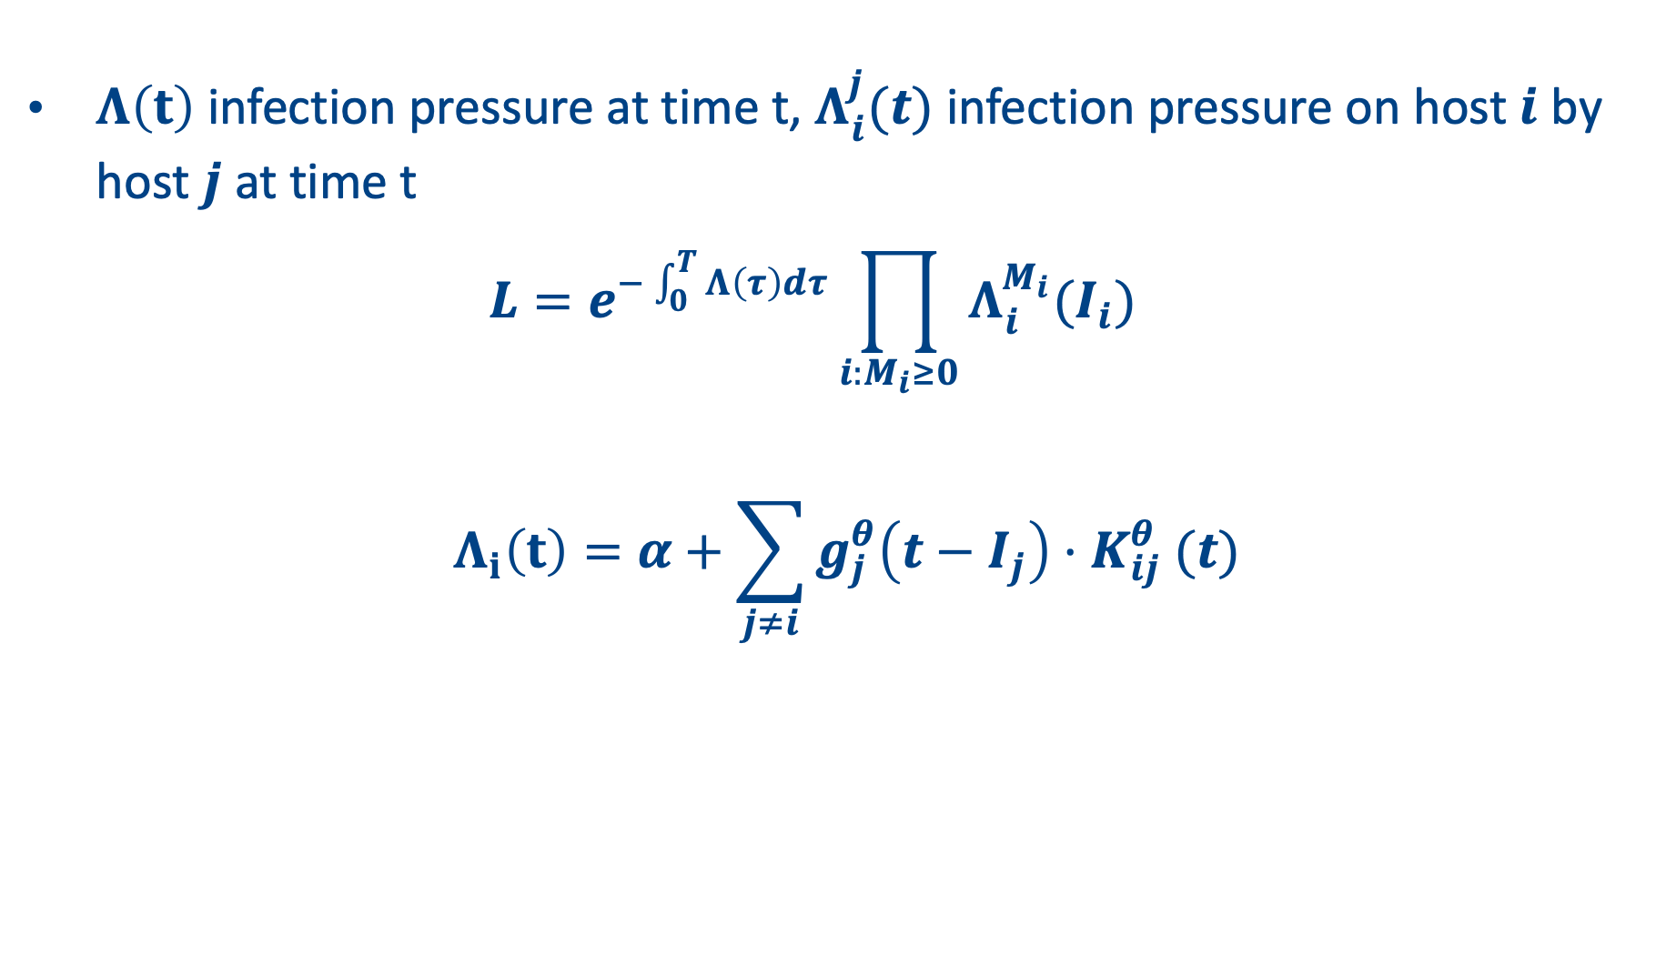
1. Epidemiological likelihood
    $Λ\left(t\right)$ infection pressure at time t, $Λ_{i}^{j}(t)$ infection pressure on host $i$ by host $j$ at time t
    $L=e^{−\int_{0}^{T}{Λ\left(τ\right)dτ}}\prod_{i:M_{i}≥0}{Λ_{i}^{M_{i}}(I_{i})}$
    $$Λ_{i}\left(t\right)=α+\sum_{j≠i}{g_{j}^{θ}\left(t−I_{j}\right){⋅K}_{ij}^{θ}(t)}$$
Connectivity from host j to host i:
Spatial distance
Contact data
Introduction rate from history host
Notes:
K is number of introductions, lambda is infection rate from external population

Slide 31
Overall overview

Slide 32
Simulation study

Slide 33
Simulation study
Simulate outbreak
20 hosts, 1 sequence/host
Vary in genetic variability (via coalescent rate in history host)
Vary in number of introductions
Infer outbreak
Use sequences and sampling times from simulated outbreak
Infer transmission tree and parameter values
Compare
Compare simulated and inferred outbreak:
Number of introductions
Correctly identified infectors

Slide 35
Inference of mink farms transmission tree

Slide 36
Five genetic clusters
Lu et al. (2021)

Slide 37
13 transmission clusters

Slide 38
Overlap in transmission clusters

Slide 39
Discussion

Slide 40
Put into perspective
Outbreaker2
      No phylogenetic tree
      Mutation at transmission
      Multiple introductions by missing links
Transphylo
      Sequential inference of transmission tree
      Multiple introductions by missing links

Slide 41
Discussion
Multiple introductions per host
Open population (hospital)
More detailed description of history host
Additional epidemiological data:
      Geographic distance
      Contact data

Slide 42
Take home messages
Who infected whom?
Person-to-person infections (or farm-to-farm)
All cases have been observed (or at least, most)
Most cases have been sampled
Clonal evolution (point mutations)
No recombination/reassortment
Use when
Advantages
Find transmission chains and starting positions in genetic clusters of hosts
Research question
No need for external source population to distinguish clusters

Slide 43
Acknowledgements
Netherlands Centre for One Health (NCOH)

