Slide 1

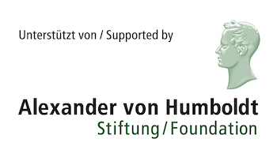


On the inclusion of environmental drivers in dynamical models
NORDITA, 8th June 2023
Joacim Rocklöv, Alexander von Humboldt Professor
Heidelberg Institute of Global Health & Interdisciplinary Centre for Scientific Computing &
Guest Professor, Department of Public Health and Clinical Medicine, Umea University

Slide 2
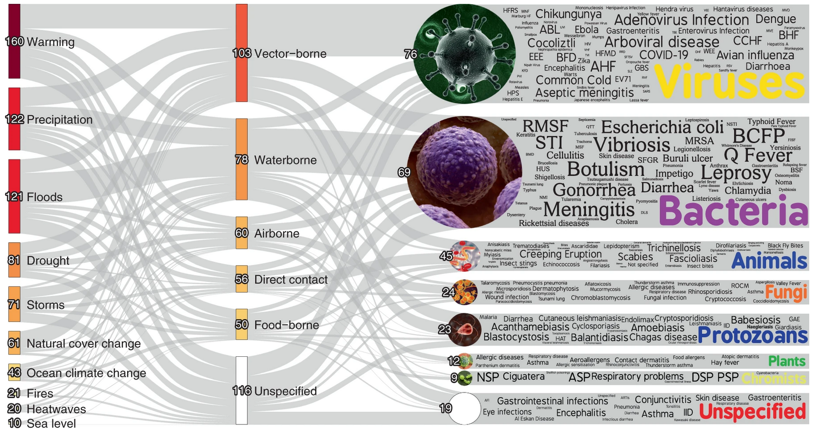
Over half of known human pathogenic diseases can be aggravated by climate change
Source: Mora et al (2022). Nature Climate Change
Notes:
Here we display the pathways in which climatic hazards, via specific transmission types, result in the aggravation of specific pathogenic diseases. The thickness of the lines is proportional to the number of unique pathogenic diseases. The colour gradient indicates the proportional quantity of diseases, with darker colours representing larger quantities and lighter colours representing fewer. Numbers at each node are indicative of the number of unique pathogenic diseases (caveats in Supplementary Information 1).

Slide 3
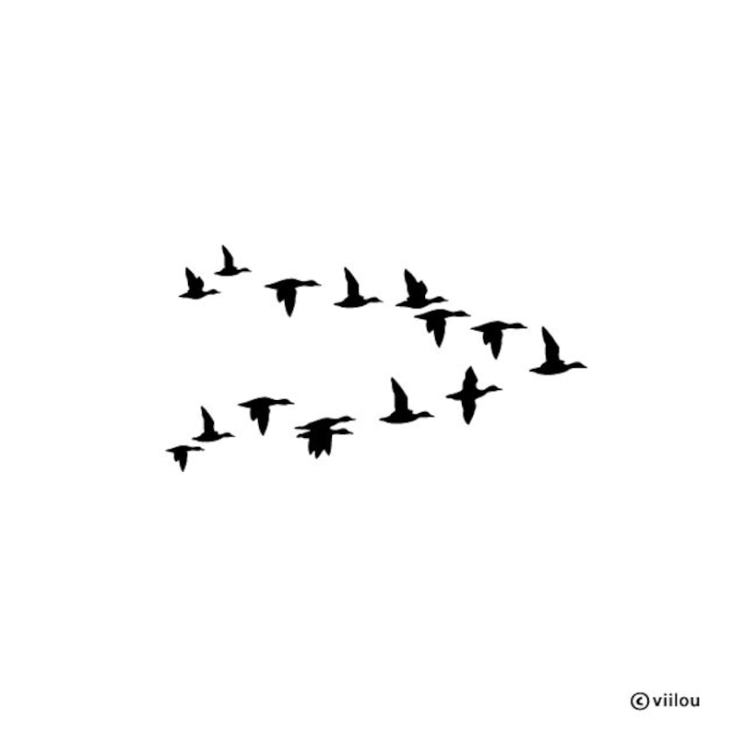
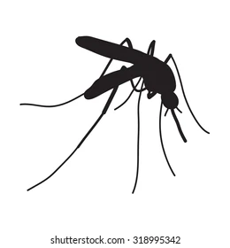
Climate change and land use drive zoonoses through alteration of disease ecology
Climate change alters biogeophysical factors on:
  reservoir host population dynamics, spatial structures, and reservoir host infection dynamics,
  community ecology and ecosystem functioning,
  exposure of humans and livestock to zoonotic pathogens, and
  pathogen survival, adaptation and evolution
Land use and deforestation increases risk zoonoses and novel infections through changing reservoir host population and infection dynamics

Slide 4
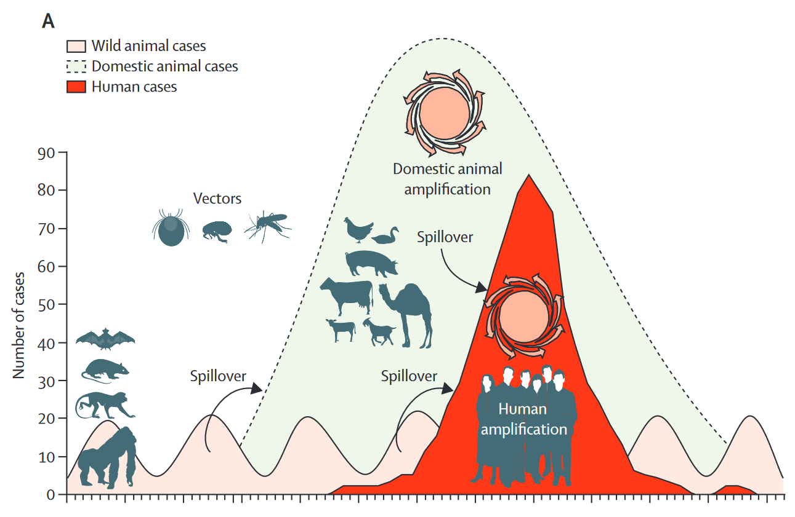
Indicators for integrated surveillance and predictions “upstream” the health sector
Notes:
Here we display the pathways in which climatic hazards, via specific transmission types, result in the aggravation of specific pathogenic diseases. The thickness of the lines is proportional to the number of unique pathogenic diseases. The colour gradient indicates the proportional quantity of diseases, with darker colours representing larger quantities and lighter colours representing fewer. Numbers at each node are indicative of the number of unique pathogenic diseases (caveats in Supplementary Information 1).

Slide 5
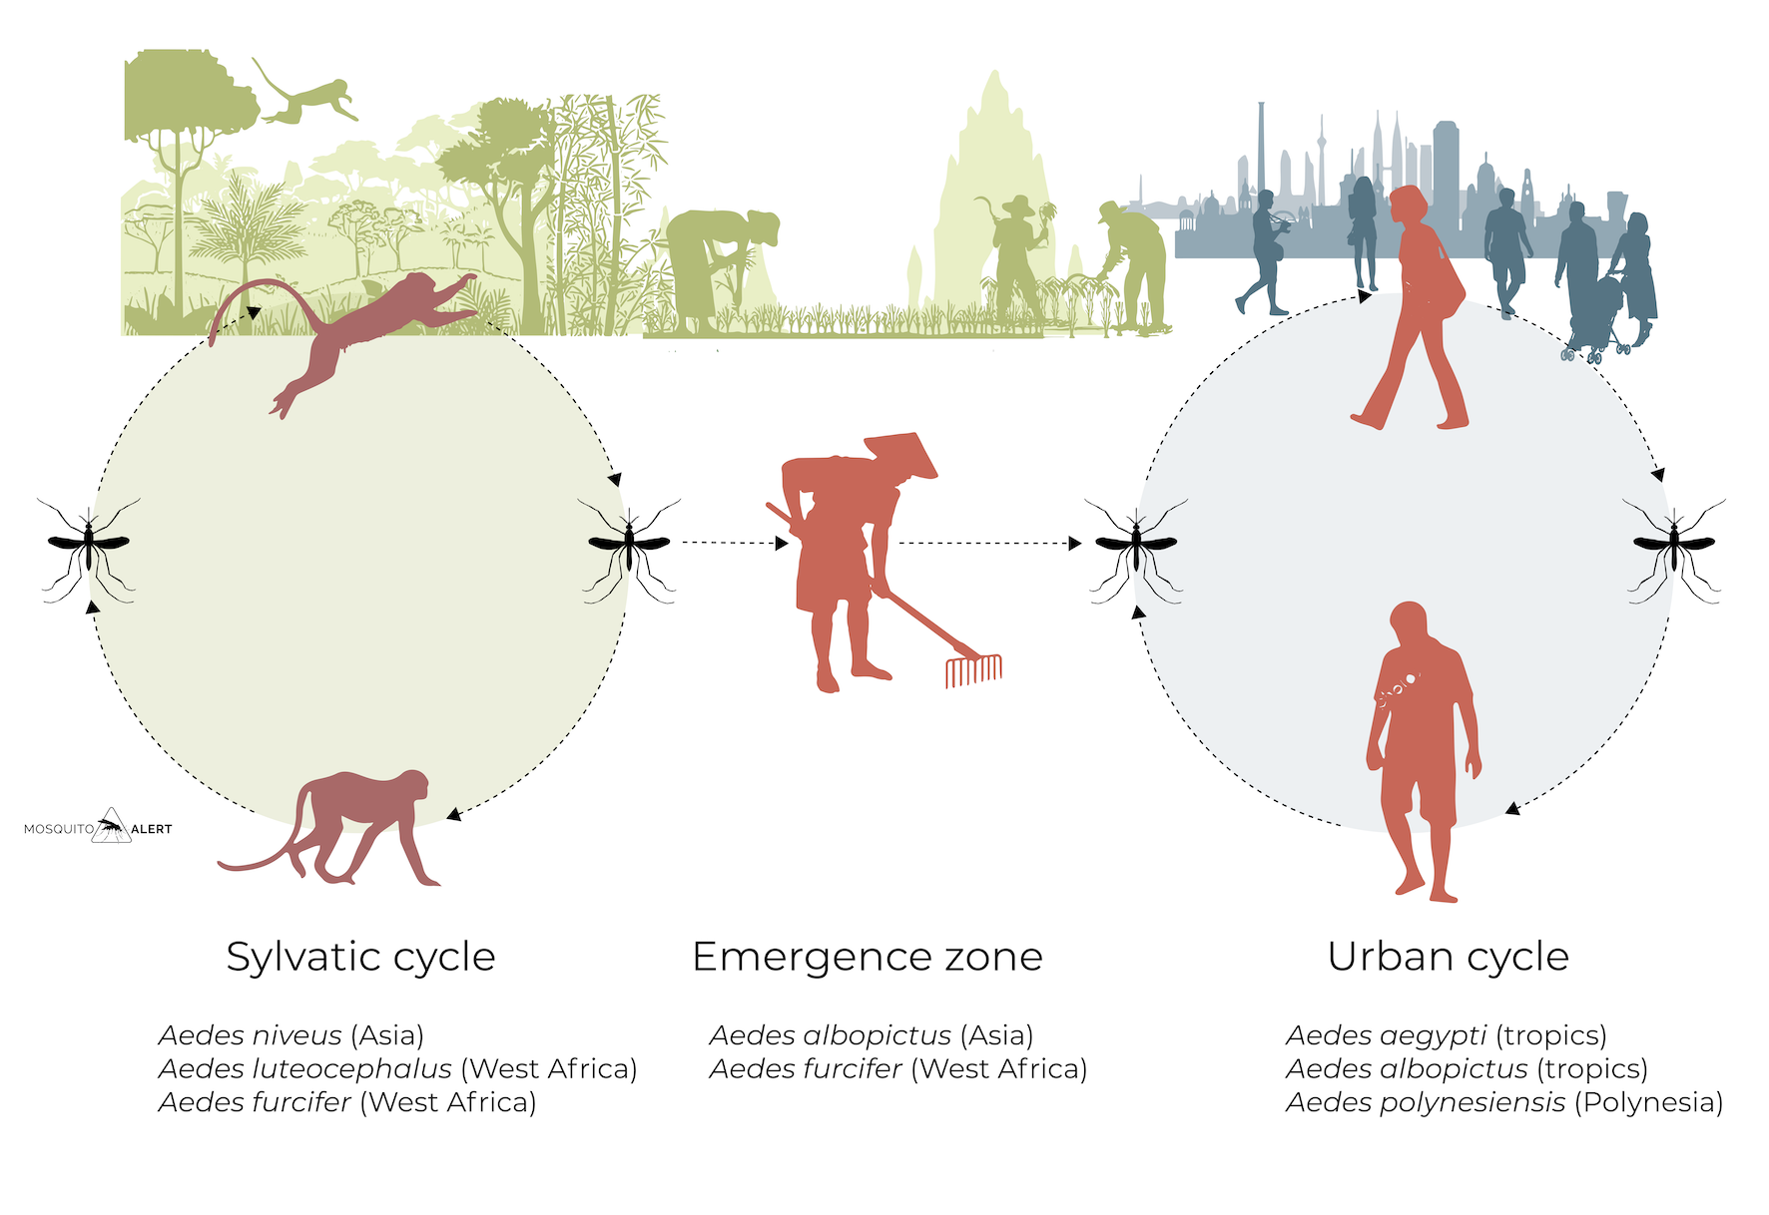
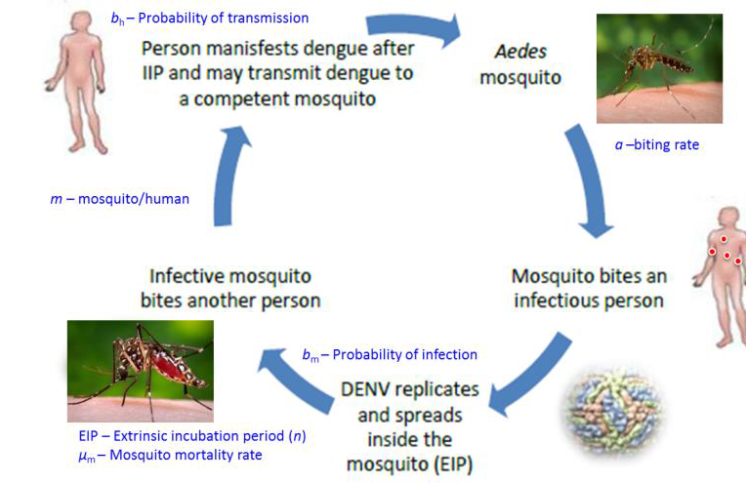
Dengue
Notes:
This indicator shows the vectorial capacity (VC) of two mosquito vectors that transmit dengue fever - Aedes aegypti and Aedes albopictus. VC is the average daily rate of subsequent cases in a susceptible population resulting from one infected case, is calculated using a formula including the vector to human transmission probability per bite, the human infectious period, the average vector biting rate, the extrinsic incubation period and the daily survival period.
The second highest VC for both dengue vectors was recorded in 2017, with the 2012-2017 average 7.2% and 9.8% above baseline for Aedes aegypti and Aedes albopictus, respectively (Figure 7). This continues the upward trend of climate suitability for transmission of dengue, with nine of the ten most suitable years occurring since 2000.
Figure: Changes in global vectorial capacity for the dengue virus vectors Aedes aegypti and Aedes albopictus 1950-2017.

Slide 6
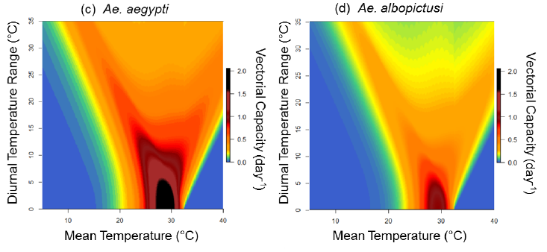
Vectorial Capacity (V)
rV
rV

Slide 7
Predicted change (%) in R₀ for dengue driven by climate trends
R₀ (%)
Arboviruses, i.e. dengue, are expanding
Climate is an important driver of dengue
Almost every year, new record in predicted R₀
www.lancetcountdown.org
Notes:
This indicator shows the vectorial capacity (VC) of two mosquito vectors that transmit dengue fever - Aedes aegypti and Aedes albopictus. VC is the average daily rate of subsequent cases in a susceptible population resulting from one infected case, is calculated using a formula including the vector to human transmission probability per bite, the human infectious period, the average vector biting rate, the extrinsic incubation period and the daily survival period.
The second highest VC for both dengue vectors was recorded in 2017, with the 2012-2017 average 7.2% and 9.8% above baseline for Aedes aegypti and Aedes albopictus, respectively (Figure 7). This continues the upward trend of climate suitability for transmission of dengue, with nine of the ten most suitable years occurring since 2000.
Figure: Changes in global vectorial capacity for the dengue virus vectors Aedes aegypti and Aedes albopictus 1950-2017.

Slide 8
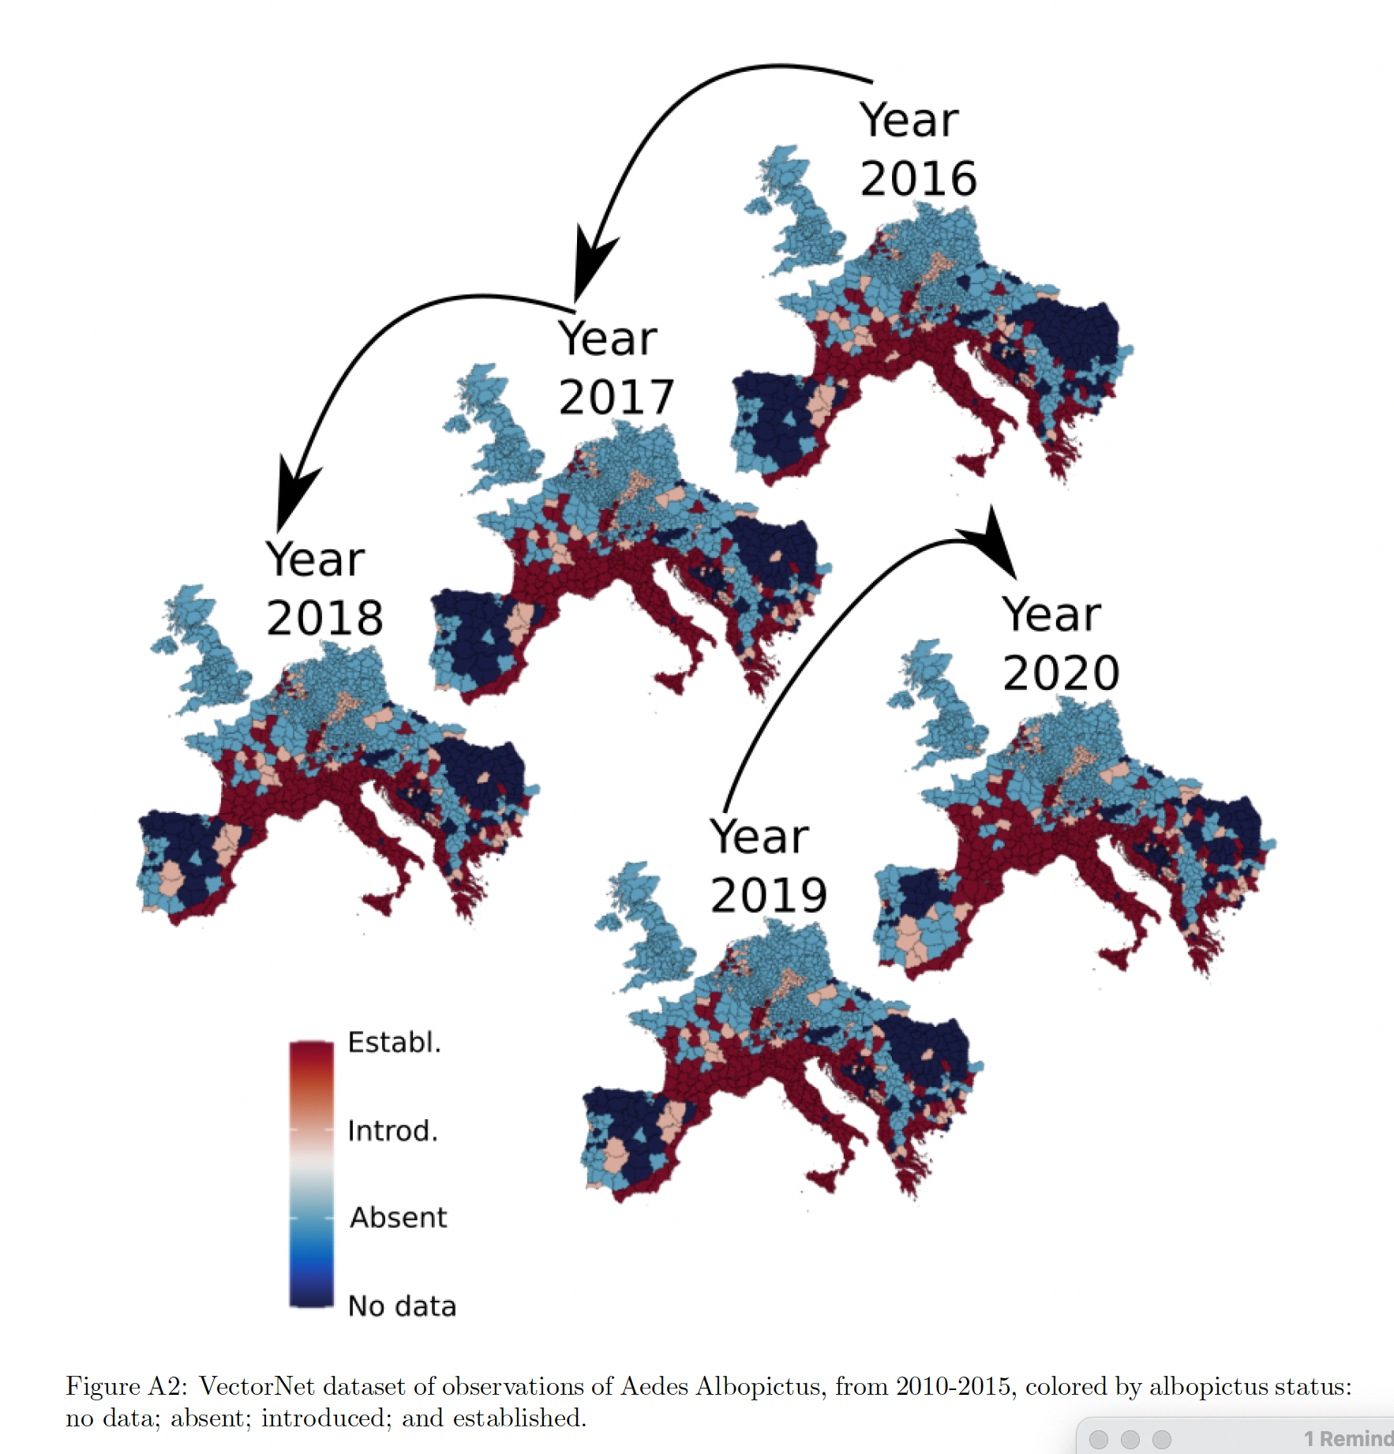
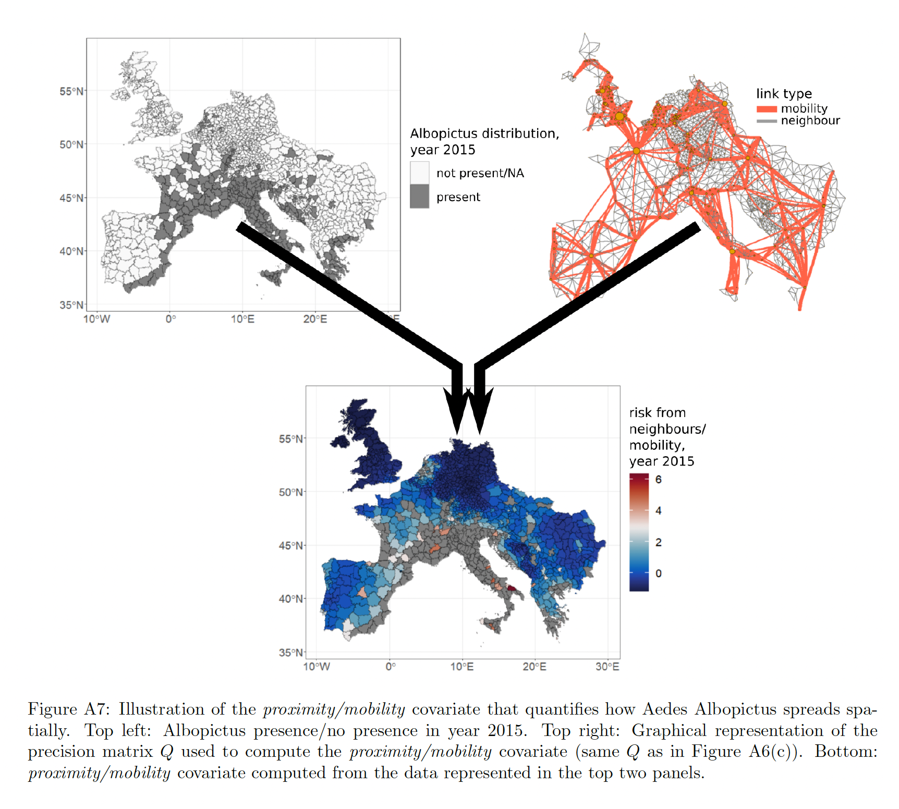
Notes:
This indicator shows the vectorial capacity (VC) of two mosquito vectors that transmit dengue fever - Aedes aegypti and Aedes albopictus. VC is the average daily rate of subsequent cases in a susceptible population resulting from one infected case, is calculated using a formula including the vector to human transmission probability per bite, the human infectious period, the average vector biting rate, the extrinsic incubation period and the daily survival period.
The second highest VC for both dengue vectors was recorded in 2017, with the 2012-2017 average 7.2% and 9.8% above baseline for Aedes aegypti and Aedes albopictus, respectively (Figure 7). This continues the upward trend of climate suitability for transmission of dengue, with nine of the ten most suitable years occurring since 2000.
Figure: Changes in global vectorial capacity for the dengue virus vectors Aedes aegypti and Aedes albopictus 1950-2017.

Slide 9
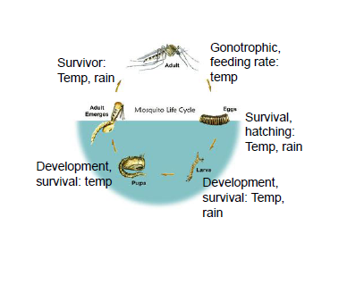
Estimating global abundance of Aedes aegypti in relation to climate change
potential no. of aedes aegypti, the vector of dengue, zika, chikungunya
Rapid increase in the past 3 decades coinciding with increased disease burdens
Continued increase until 2040 if climate change is mitigated approx. according to the Paris agreement
The change over the next 20-30 years need to be adapted to
Liu-Helmersson J.. Estimating past, present, and future trends in the global distribution and abundance of the arbovirus vector Aedes aegypti under climate change scenarios. Frontiers in public health.
Notes:
This indicator shows the vectorial capacity (VC) of two mosquito vectors that transmit dengue fever - Aedes aegypti and Aedes albopictus. VC is the average daily rate of subsequent cases in a susceptible population resulting from one infected case, is calculated using a formula including the vector to human transmission probability per bite, the human infectious period, the average vector biting rate, the extrinsic incubation period and the daily survival period.
The second highest VC for both dengue vectors was recorded in 2017, with the 2012-2017 average 7.2% and 9.8% above baseline for Aedes aegypti and Aedes albopictus, respectively (Figure 7). This continues the upward trend of climate suitability for transmission of dengue, with nine of the ten most suitable years occurring since 2000.
Figure: Changes in global vectorial capacity for the dengue virus vectors Aedes aegypti and Aedes albopictus 1950-2017.

Slide 10
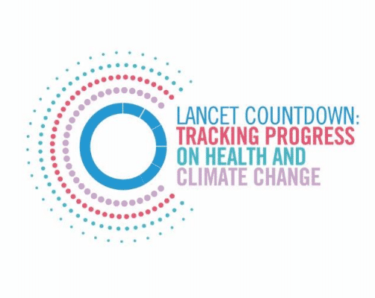


Climate suitability of Dengue, Chikungunya and Zika and Urban heat Island impact
Pratik Singh
Climate sensitive infectious diseases lab
Notes:
Good afternoon everybody
I am Julian, presenting today with my colleague Pratik. We are both mathematicians doing a PhD in Heidelberg in the group of Joacim Rocklöv. For our thesis we both work on modelling mosquito-borne diseases just for different diseases, thus have significant overlap in our interest and therefore joint forces on the project we are presenting today which has the title “…”. Before Pratik will present on the methodological part of our work I will start by giving some background information.

Slide 11
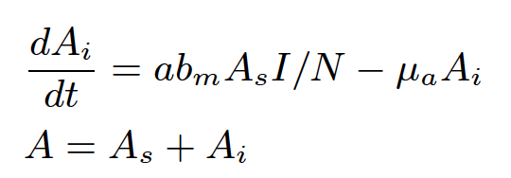
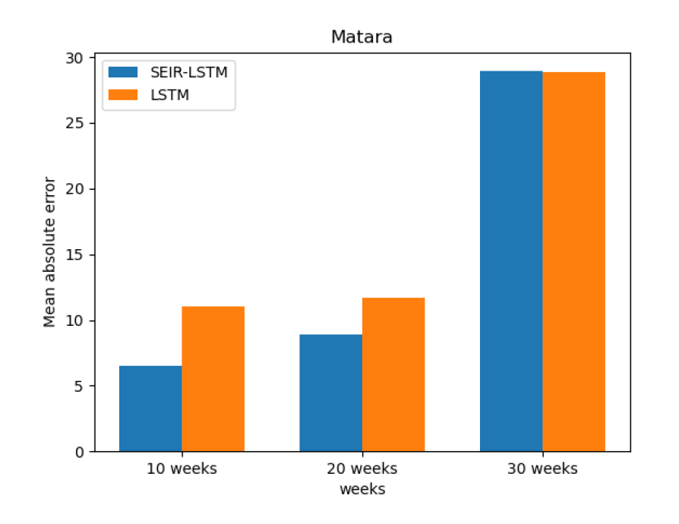

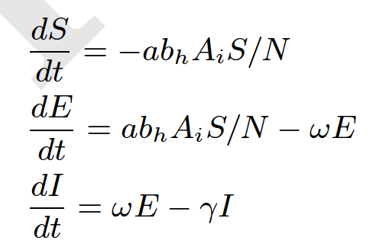
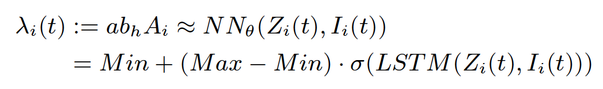
Hybrid neural network SEIR meta-population model incl. mobility of dengue in 24 districts of Sri Lanka
Preliminary results
- forecast on test data
Yichao Liu

Slide 12
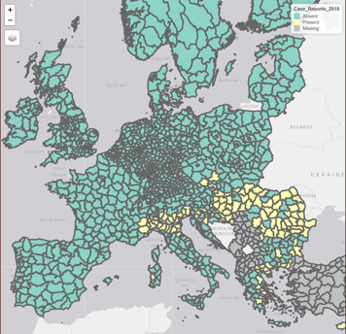
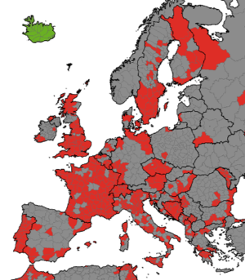
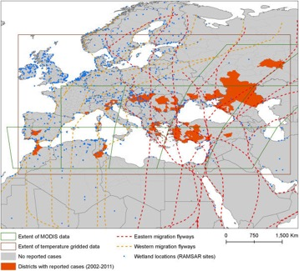
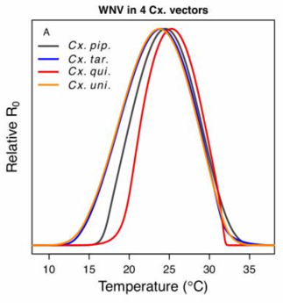
West Nile Virus outbreaks
Native culex
Bird migration routes
WNF outbreaks in 2018
Bird migration routes
WNF R₀
Shocket MS et al. Transmission of West Nile and five other temperate mosquito-borne viruses peaks at temperatures between 23 C and 26 C. Elife. 2020 Sep 15;9:e58511.

Slide 13
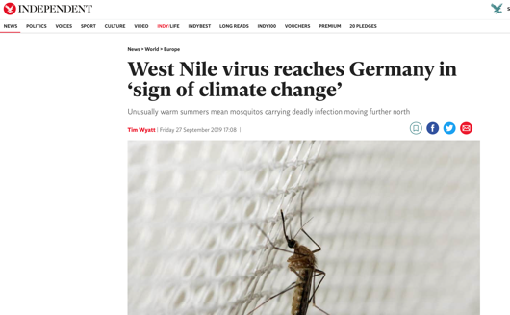
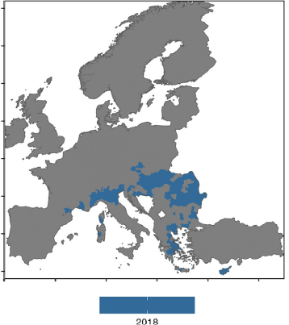
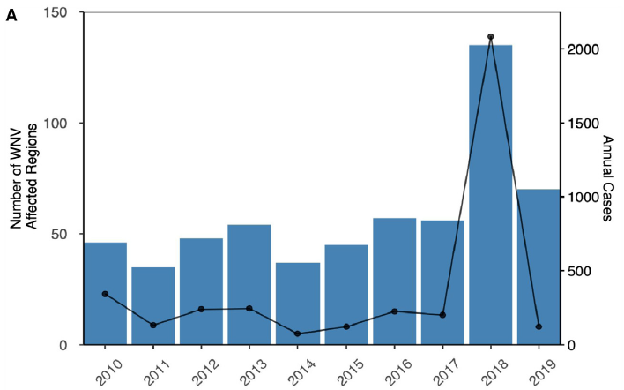
Farooq Z, Rocklöv J, Wallin J, Abiri N, Sewe MO, Sjödin H, Semenza JC. Artificial intelligence to predict West Nile virus outbreaks with eco-climatic drivers. The Lancet Regional Health-Europe. 2022 Jun 1;17:100370.

Slide 14

Zia Farooq, Umea uni
The model, trained on 2010-2017 data, achieved an AUC score of 0.97 and 0.93 when tested with 2018 and 2019 data
Overall, positive summer/spring temperatures anomalies, lower water availability index (NDWI), and drier winter conditions were found to be the main determinants of WNV-outbreaks across Europe.
The climate trends of the preceding year in combination with eco-climatic predictors of the first half of the year showed predictive ability of the entire transmission season
Farooq Z, Rocklöv J, Wallin J, Abiri N, Sewe MO, Sjödin H, Semenza JC. Artificial intelligence to predict West Nile virus outbreaks with eco-climatic drivers. The Lancet Regional Health-Europe. 2022 Jun 1;17:100370.
Notes:
This indicator shows the vectorial capacity (VC) of two mosquito vectors that transmit dengue fever - Aedes aegypti and Aedes albopictus. VC is the average daily rate of subsequent cases in a susceptible population resulting from one infected case, is calculated using a formula including the vector to human transmission probability per bite, the human infectious period, the average vector biting rate, the extrinsic incubation period and the daily survival period.
The second highest VC for both dengue vectors was recorded in 2017, with the 2012-2017 average 7.2% and 9.8% above baseline for Aedes aegypti and Aedes albopictus, respectively (Figure 7). This continues the upward trend of climate suitability for transmission of dengue, with nine of the ten most suitable years occurring since 2000.
Figure: Changes in global vectorial capacity for the dengue virus vectors Aedes aegypti and Aedes albopictus 1950-2017.

Slide 15
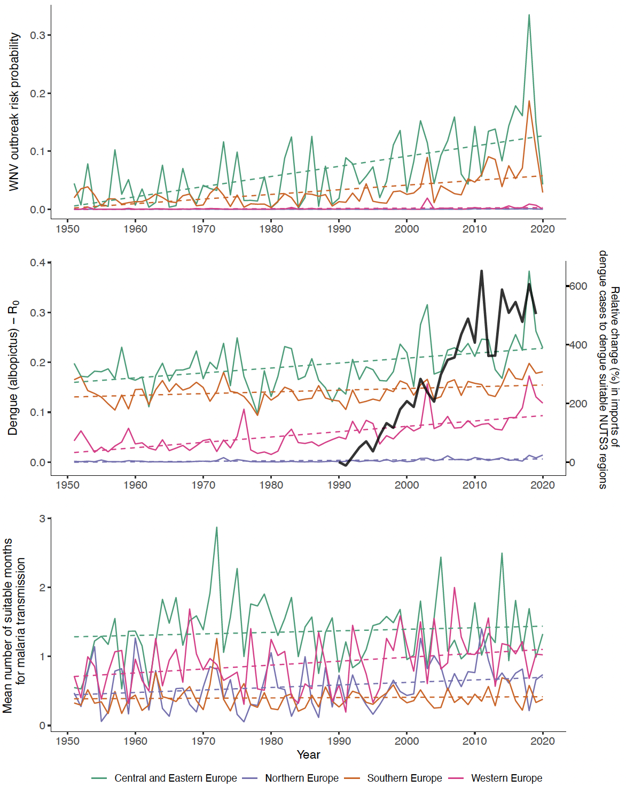
Predicted change in WNV in European regions
In press, Lancet countdown Europe on climate change and health.
Notes:
This indicator shows the vectorial capacity (VC) of two mosquito vectors that transmit dengue fever - Aedes aegypti and Aedes albopictus. VC is the average daily rate of subsequent cases in a susceptible population resulting from one infected case, is calculated using a formula including the vector to human transmission probability per bite, the human infectious period, the average vector biting rate, the extrinsic incubation period and the daily survival period.
The second highest VC for both dengue vectors was recorded in 2017, with the 2012-2017 average 7.2% and 9.8% above baseline for Aedes aegypti and Aedes albopictus, respectively (Figure 7). This continues the upward trend of climate suitability for transmission of dengue, with nine of the ten most suitable years occurring since 2000.
Figure: Changes in global vectorial capacity for the dengue virus vectors Aedes aegypti and Aedes albopictus 1950-2017.

Slide 16
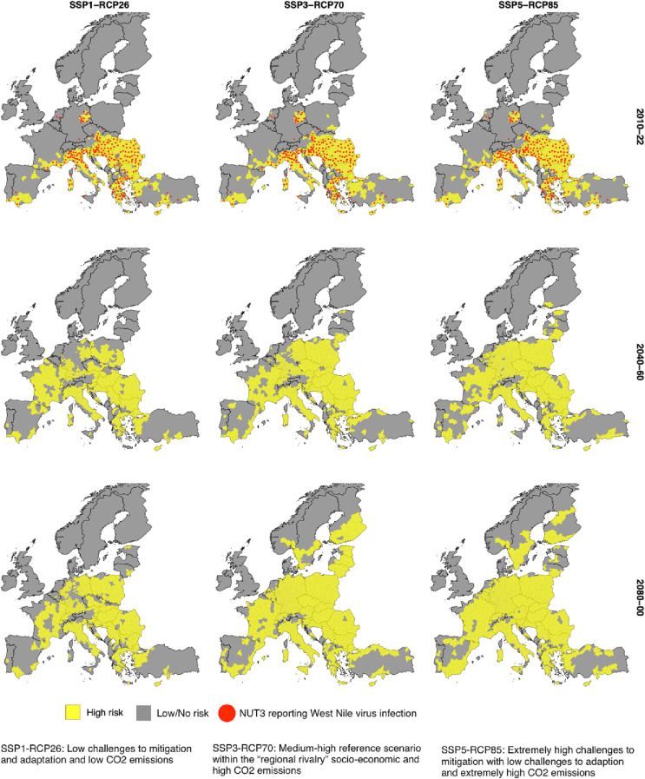
Projection of areas at risk of WNV in Europe
Current time
Mid 21th century
Late 21th century

Slide 17
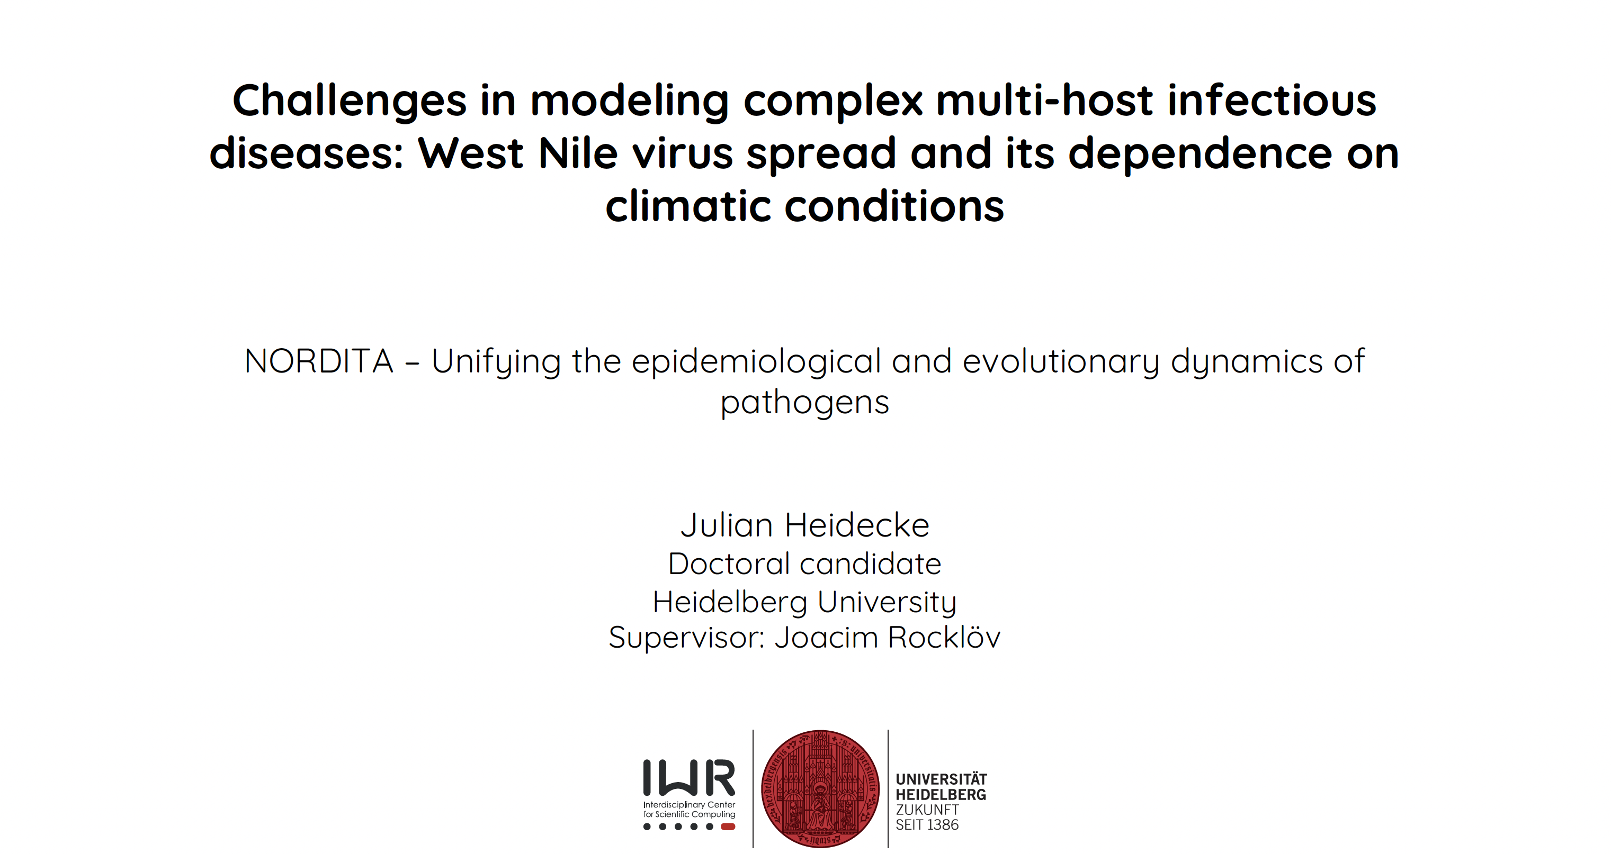

Julian is developing dynamic models for WNV for insights & adaptation/prepardness

Slide 18
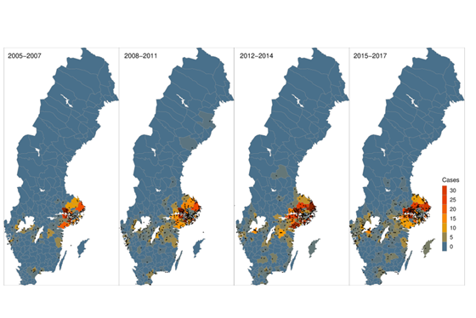

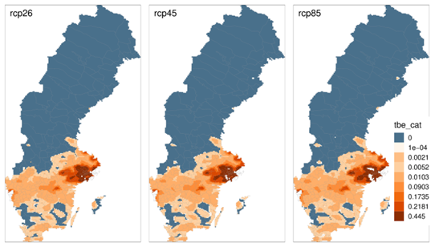
TBE incidence in Sweden
Case predictions based on climate, roe deer, population, etc
Sewe Maquines, Umea uni
Future RCM, demographic
projections

Slide 19
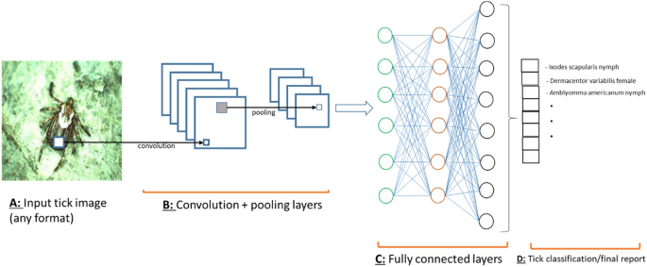

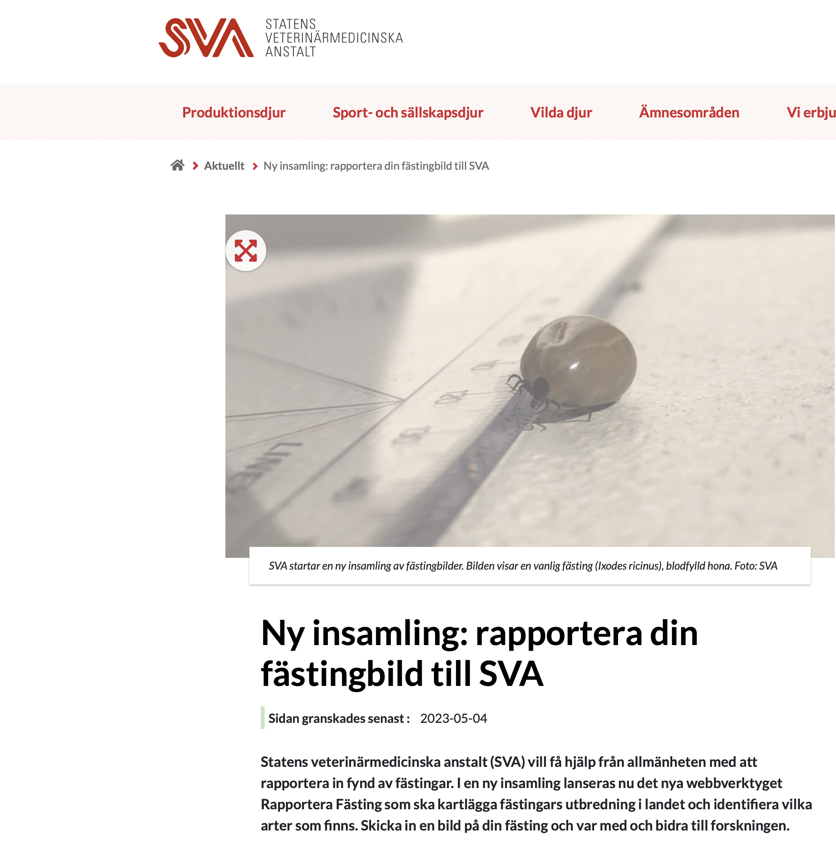
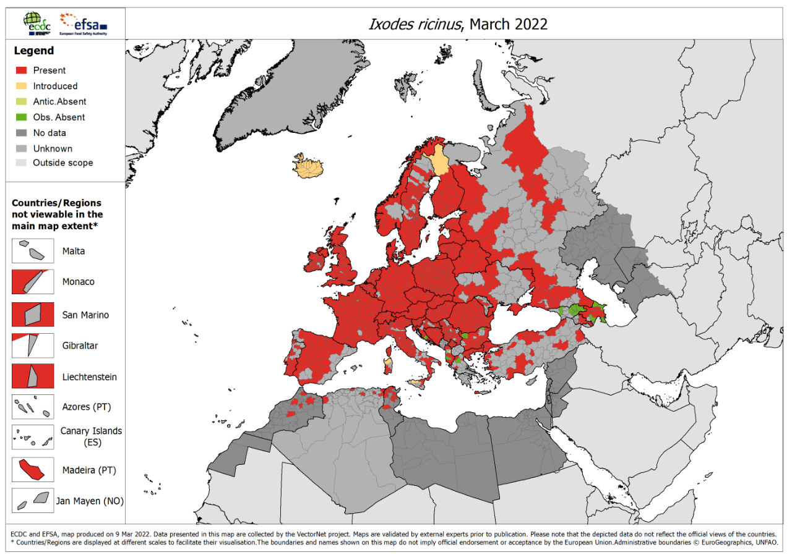
Lyme/TBE modelling
Najmeh Abiri, Lund Uni

Slide 20
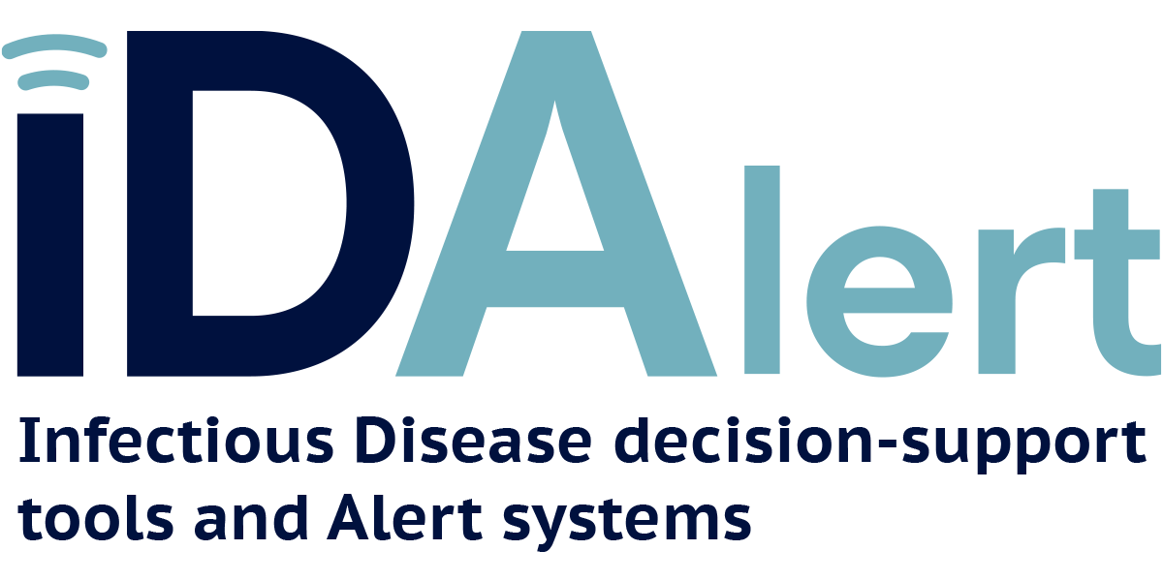
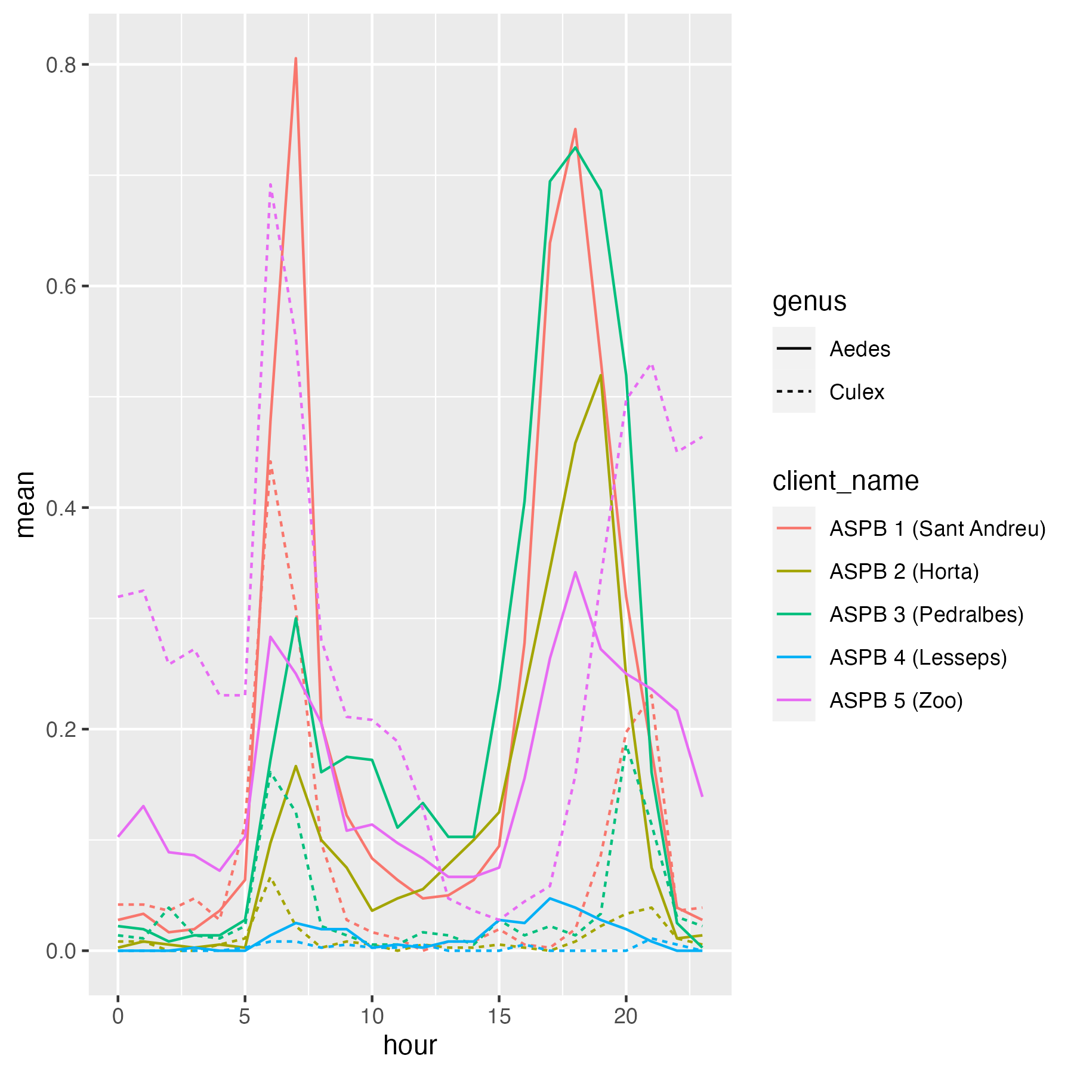
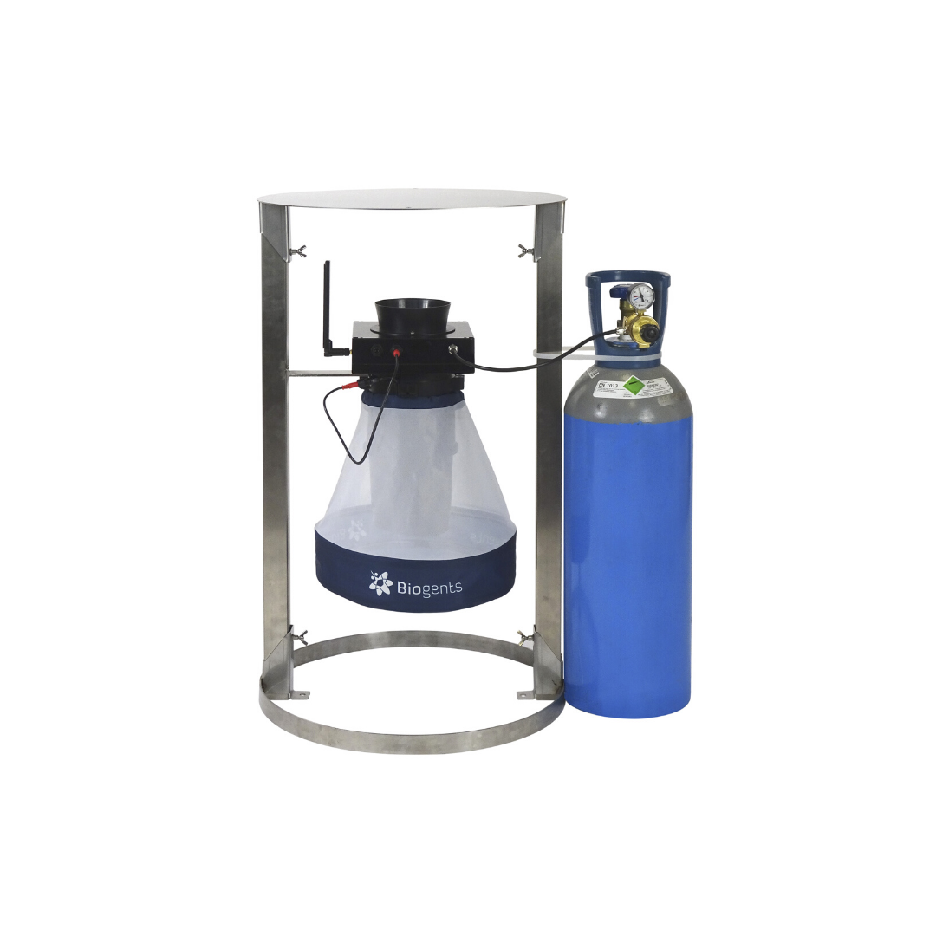
Barcelona Aedes albopictus
Smart traps
https://idalertproject.eu
20

Slide 21
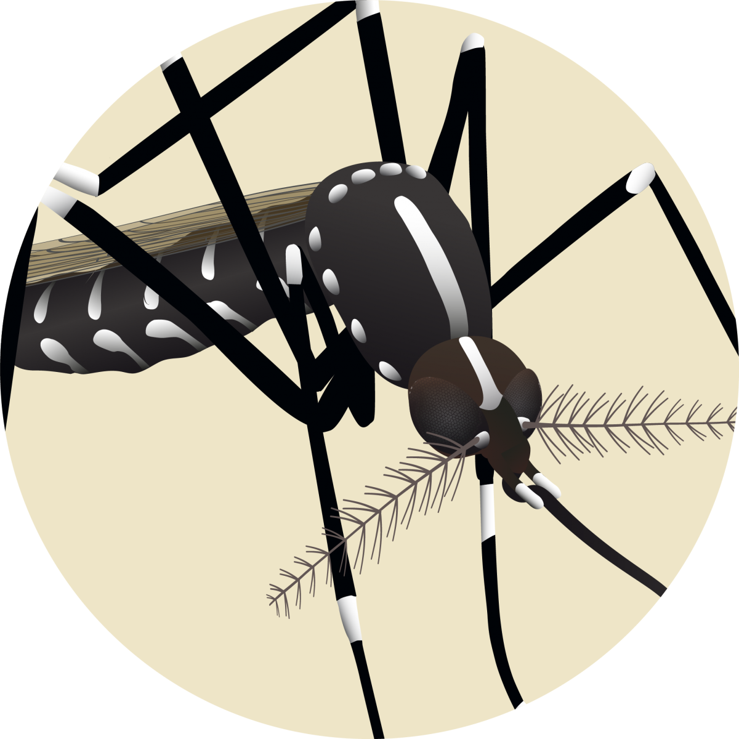
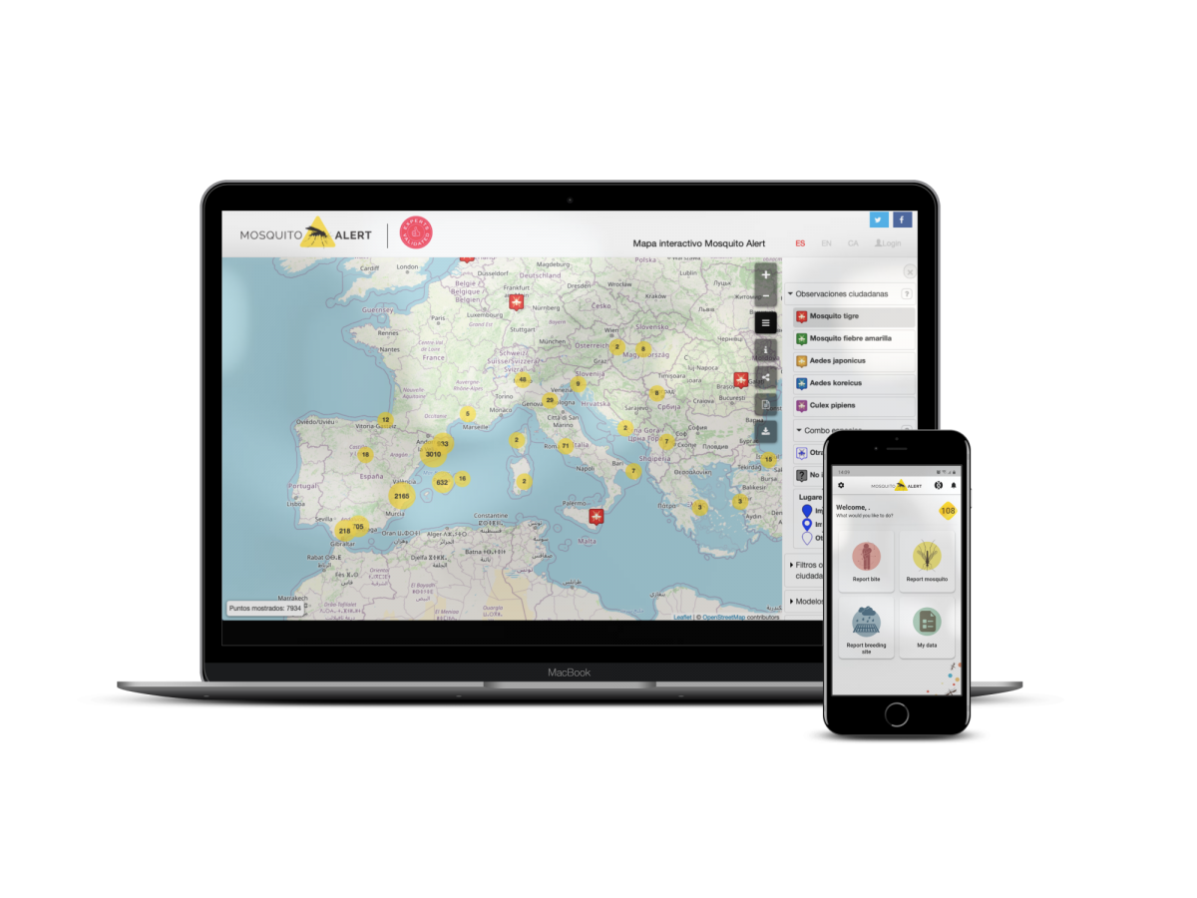
21

Slide 22
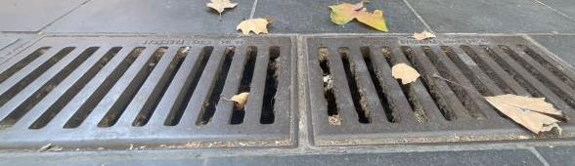
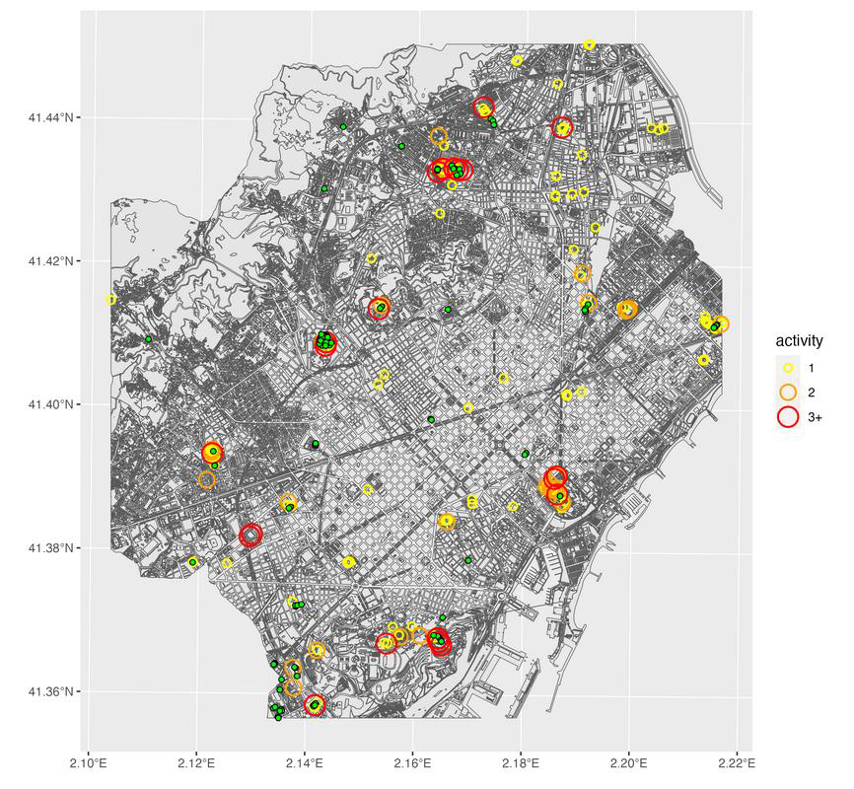

Randomized Trial
Barcelona
22

Slide 23
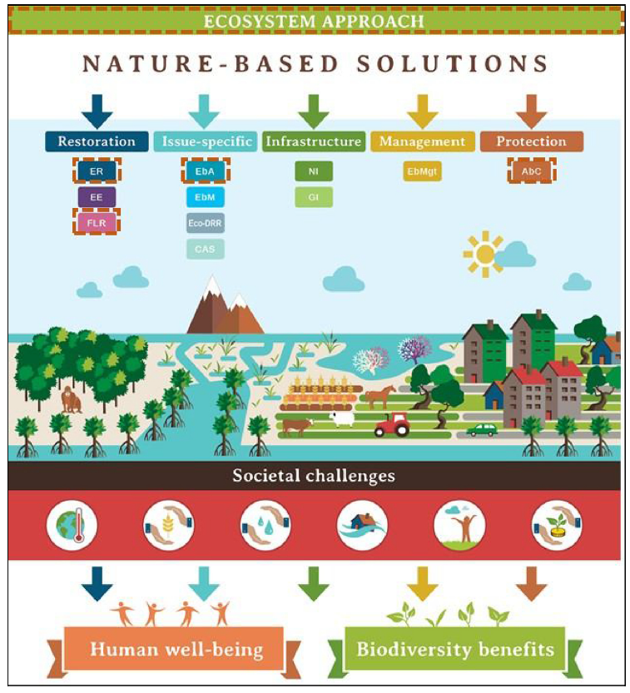

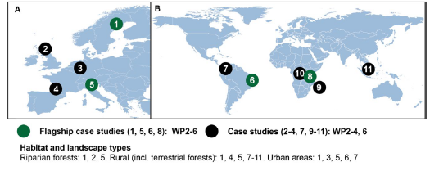
NbS umbrella
https://www.beprep-project.eu
Identification of best practices for biodiversity recovery and public health interventions to prevent future epidemics and pandemics
Restoration
Infrastructure
Management
Protection/conservation
Source: Cohen-Shacham et al (2019)
Notes:
The NBS concept, as reported by Escobedo et al. (2019), is the evolution of terms
used previously to express similar ideas. NbS can be considered an umbrella concept covering a range of
ecosystem-based approaches that address specific or multiple societal
challenges (Cohen-Shacham et al., 2016; Fig. 1, lower circles), while
simultaneously providing human well-being and biodiversity benefits.
For convenience, approaches that nest under NbS can be placed into
five categories (see conceptual representation in Fig. 1):
• Restorative (Ecological restoration, Forest landscape restoration,
Ecological engineering); • Issue-specific (Ecosystem-based adaptation; Ecosystem-based mitigation;
Ecosystem-based disaster risk reduction; Climate adaptation
services); • Infrastructure (Natural infrastructure; Green infrastructure); • Management (Integrated coastal zone management; Integrated
water resources management); • Protection (Area-based conservation approaches, including protected
area management and other effective area-based
NbS vary in three important ways, which influence the range of benefits that they provide for people.
(i) They cover a spectrum of interventions from protecting or restoring diverse natural ecosystems to creating new managed or
hybrid ‘grey-green’ approaches [15].While healthy natural forests, grasslands andwetlandsmaystoremore carbon than theirmanaged
equivalents (e.g. owing to greater soil depth, age and structural diversity [16]), managed and hybrid systems such as city
parks or green roofs contribute to urban cooling, storm-water management, and bring mental and physical health benefits [17].
(ii) NbS vary in the extent to which they support biodiversity, which in turn affects their resilience, i.e. their capacity to resist
and recover from perturbation and maintain the flow of ecosystem services. NbS that protect and restore natural ecosystems
and/or make use of diverse native species can play a key role in securing climate change mitigation and adaptation services,
while also contributing to cultural ecosystem services such as inspiration and learning from nature. By contrast, NbS that do
not harness ecological principles and support biodiversity (such as those involving non-native monocultures) are more vulnerable
to environmental change in the long term and may also produce trade-offs among ecosystem services (e.g. carbon
storage, erosion control and water supply, as demonstrated in the Loess Plateau, table 1).
(iii) NbS differ in how much they are designed and implemented by local communities [18]. EbA places particular emphasis on
this; it is a participatory community-based climate adaptation strategy which may include sustainable management, conservation
and restoration of ecosystems, as part of an overall adaptation strategy that takes into account the multiple social,
economic and cultural benefits for local communities [19].
By specifically aiming to address broad societal goals such as human wellbeing, including poverty alleviation and socioeconomic
development, NbS differ from traditional biodiversity conservation and management approaches. However, to be
resilient (and hence sustainable), NbS must be implemented in such a way as to support biodiversity and people
What of these can we explore??

Slide 24

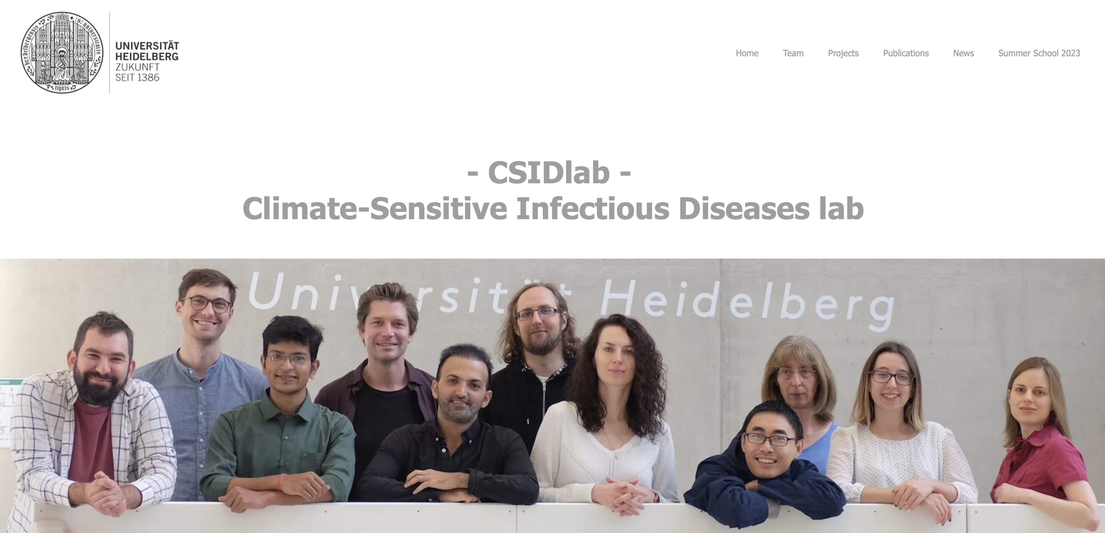
Thank You!
https://csidlab.iwr.uni-heidelberg.de

