Slide 1

Effects of targeted screening for acute and early HIV infection on the transmission dynamics of HIV in MSM in the Netherlands
The model
June 8 2023
Alexandra Teslya

Slide 2
Project
Title: Prospects of HIV elimination among Dutch MSM by targeted screening for acute HIV infection, partner notification, and immediate ART initiation
Funder: Aidsfonds; Grant P-53902
Principal investigator: Ganna Rozhnova
Appointed researcher: Alexandra Teslya

Slide 3
Collaborators
Amsterdam UMC
Maartje Dijkstra
EMIS Board
Axel Schmidt
Kai Jonas
GGD Amsterdam
Maarten Schim van der Loeff
Janneke Heijne
SHM
Ard van Sighem
UMC Utrecht
Ganna Rozhnova
Mirjam Kretzschmar
Alexandra Teslya
Notes:
Stichting HIV Monitoring (SHM), the Dutch HIV monitoring foundation,
Look up GGD exactly

Slide 4
Thank you
Epidemiology modeling team (UMC Utrecht, Utrecht University, lead by Prof Kretzschmar)
Martin Bootsma
Kim Romijnders
Marloes Brinkhuis

Slide 5
Outline
Background and research question
The model
First outputs
Outlook

Slide 6
Background

Slide 7
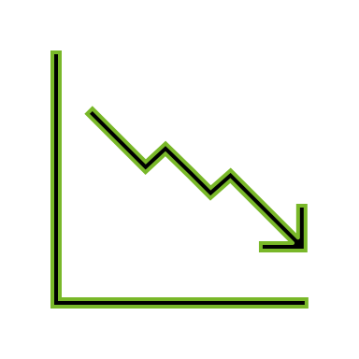
HIV in MSM in The Netherlands: recent developments
Men who have sex with men (MSM) constituted 59% of new HIV diagnoses in 2021
Intervention strategies targeting reduced incidence included:
  Pre-Exposure Prophylaxis (PrEP) programs
  Rapid screening programs with prompt initiation of Antiretroviral Therapy (ART)
A decrease in incidence was observed within this population
  UNAIDS’ 95-95-95 targets were successfully achieved within the MSM group
To further reduce transmission, intervention strategies need to be refined for enhanced effectiveness
Notes:
Results. Before implementation of the AHI strategy, the proportion of AHI among HIV diagnoses was 0.6% (5/876); after implementation
this was 11.0% (15/137). Median time (in days) to viral suppression during periods 1, 2, 3a, and 3b was 584 (interquartile
range [IQR], 267–1065), 230 (IQR, 132–480), 95 (IQR, 63–136), and 55 (IQR, 31–72), respectively (P < .001).

Slide 8
Origin of new infections
Individuals in acute and early stages of HIV infection (AEHI)
Late presenters
Notes:
Results. Before implementation of the AHI strategy, the proportion of AHI among HIV diagnoses was 0.6% (5/876); after implementation
this was 11.0% (15/137). Median time (in days) to viral suppression during periods 1, 2, 3a, and 3b was 584 (interquartile
range [IQR], 267–1065), 230 (IQR, 132–480), 95 (IQR, 63–136), and 55 (IQR, 31–72), respectively (P < .001).

Slide 9
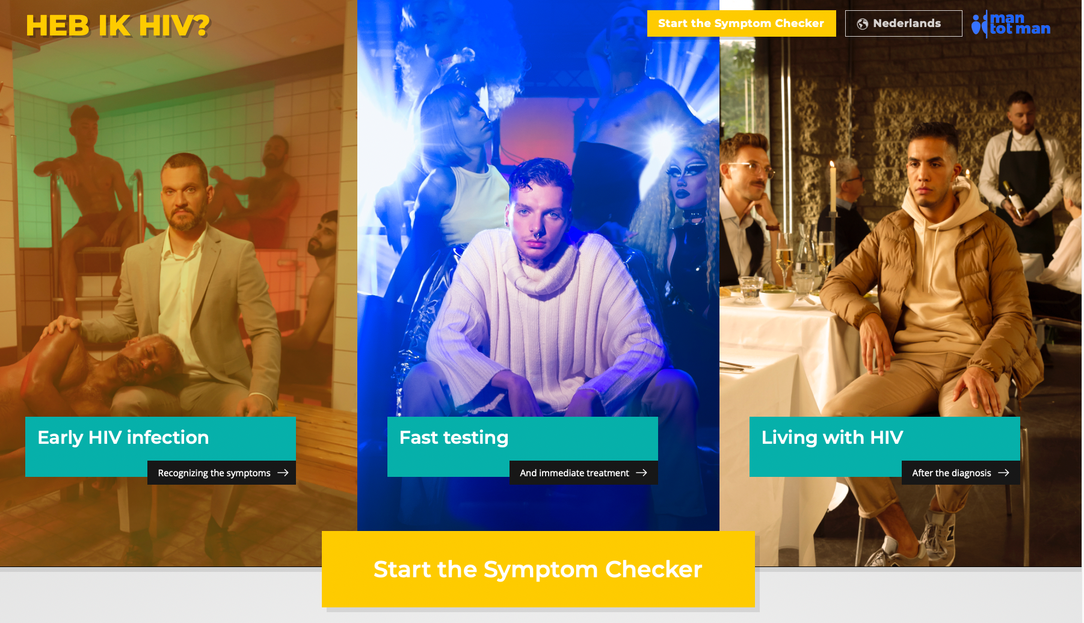
AHI strategy
(part of HTEAM initiative)
Amsterdam, The Netherlands
Aim: to increase the detection among AEHI individuals and fast track linkage to care with overall goal of decreasing the period between infection and suppression (3.2 years, 2021)
Outcome: the percentage of AEHI increased individuals from 0.6% to 11% [1]
Conclusions: Strategy combining media campaign (awareness), rapid diagnosis, and immediate cART initiation to find and treat Acute and Early HIV-infected (AEHI) individuals is feasible and effective¹
Notes:
H-TEAM" is known to refer to an initiative aimed at tackling HIV in Amsterdam, the Netherlands. The acronym stands for "HIV Transmission Elimination AMsterdam", a collaboration of healthcare providers and community-based organizations dedicated to halting the spread of HIV in the city. The H-TEAM initiative develops strategies to reduce HIV through prevention, early diagnosis, and treatment
The online intervention aimed to increase
awareness for AHI among Amsterdam MSM, help
them self-identify AHI symptoms, and increase their behavioral
motivation to test
This included a dedicated website
(www.hebikhiv.nl/en) with a self-administered screening
tool based on a pragmatic AHI risk score [30]. MSM who reported
condomless anal intercourse in the previous 3 months
and AHI symptoms could download a referral letter to the
AHI strategy. Next to this online referral, MSM could also
be referred by their general practitioner or during routine
STI screening at the STI clinic; eligibility was assessed with
the pragmatic AHI risk score at health providers’ discretion
[30]. Although the campaign was specifically designed for
the AHI strategy, wider dissemination took place, and MSM
in SOC and health providers likely have also been exposed to
the campaign part of the strategy.
The AHI strategy’s testing procedures included simultaneous
rapid antibody (Alere Determine HIV 1/2, Alere Inc), Ag/Ab
(LIAISON XL Murex, Diasorin), and qualitative point-of-care
HIV RNA testing (GeneXpert, Cepheid), and same-visit delivery
of results. MSM identified with AEHI were immediately
referred to an HIV treatment center to initiate cART within
24 hours.
Before implementation of the AHI strategy, the proportion of AHI among HIV diagnoses was 0.6% (5/876); after implementation
this was 11.0% (15/137).

Slide 10
Question
Can increased screening of AEHI combined with immediate initiation of antiretroviral therapy (ART) help to further reduce the onward transmission?
By how much should the uptake of screening increase and how can it be combined with other interventions (partner notification and PrEP)?
Which individual characteristics/events constitute a robust proxy of who should be targeted for the screening?

Slide 11
Tools
Stochastic agent-based model of HIV transmission in the population of MSM
  Incorporates heterogeneities of interest (partner change rate, condom usage, screening rate and uptake of PrEP)
Base structure: pair-formation model with two types of partnerships coupled with STI transmission framework
Framework expanded based on the available data
  -- EMIS-2017
  -- ACS
  -- The MSM Network Study
  -- CBS Netherlands
  -- SHM

Slide 12
The model

Slide 13
Progress
Initial model development
Development of HIV transmission framework
EMIS-2010 data analysis
Update to the model
Sexual network formation
Procurement of ACS and EMIS-2017 data sets -> November 2022
Data analysis -> March 2022
Update to the model
Sexual network formation
Age- and behavior-dependent uptake of biomedical treatments
Model finalized
Parametrization
Development of calibration procedures
Direct estimation of model parameters
First set of the simulations
Calibration of the model
Feedback between behavior and treatments

Slide 14
Main components
  Demographic processes (inflow and outflow of individuals to the population, ageing)
  Sexual network dynamics
    steady relationships sexual network (acquisition and loss)
    non-steady relationships sexual network (acquisition and loss)
  HIV transmission + baseline interventions
    Diagnosis and cART
    PrEP programme
  Additional interventions
    Targeted screening of AEHI individuals and immediate initiation of ART
    PN combined with PrEP
Notes:
1. Do I say anywhere what a steady partnership is?

Slide 15
Population
  Men who have sex with men (MSM)
  Age of sexual activity (15-75)
  Anal intercourse events (intercourse or AI)

Slide 16
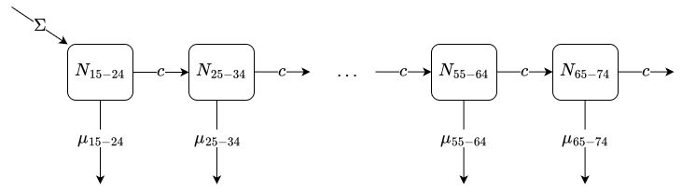

Demographic processes
Entrance (the time of sexual debut, 15 years)
Exit (cut-off age limit of 75 years, background mortality rate)
Without HIV dynamics the population size fluctuates around a steady state
  Balanced entrance and exit rates

Slide 17
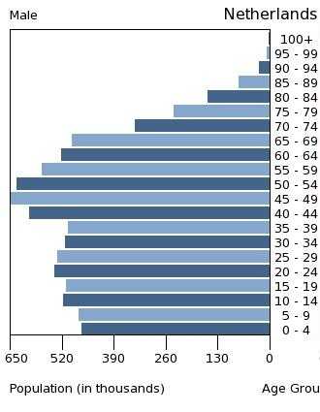
Demographic dynamics, parametrization
Population size: 10,000
Mortality: age-dependent (Central Bureau voor de Statistiek, CBS), directly applied, set point
Age distribution at the start of the simulation: males in the Netherlands 2014
Entrance rate is calculated based on the steady state of the analog deterministic model
  Set point, subject to sensitivity analysis

Slide 18
Pair formation model + uncurable STI
Single individuals
X_{S}(t)
X_{I}(t)
σ
σ
σ
σ
Transmissionrate β
P_{SS}(t)
P_{SI}(t)
P_{II} (t)
Pairs

Slide 19

The model, sexual dynamics
Two types of partnerships: steady and non-steady
Steady:
  Long-term
  Serial monogamy
  Everyone has the same intrinsic propensity to enter
Non-steady:
  Brief
  Unlimited number of partners
  Different intrinsic propensities to acquire partners + age distributed

Slide 20
The model, sexual dynamics
Frequency of anal intercourse:
  Type of partnership
  Duration of partnership (if steady)
  Age
Condom use dependent on
  Age
  Steady state status
  Propensity to acquire non-steady partners
  Type of partnership

Slide 21
The model, sexual dynamics, parametrization
Sources: EMIS-2017, Amsterdam Cohort Studies, The MSM Sexual Network (Amsterdam),

Slide 22
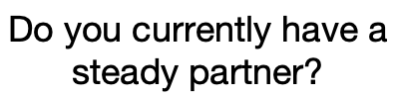
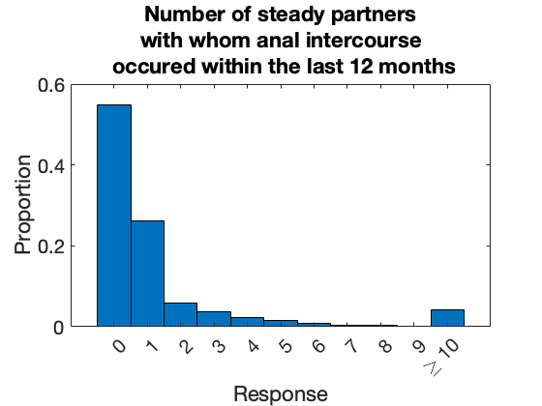
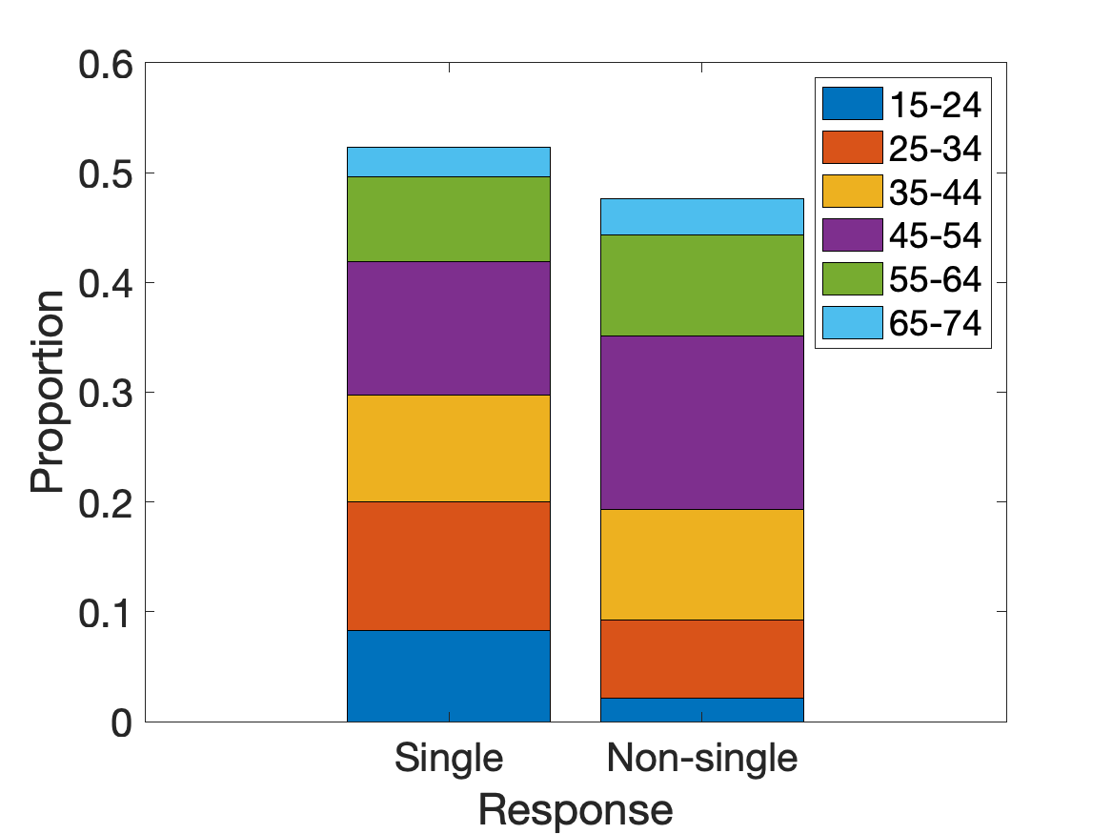
The model, sexual dynamics, parametrization
EMIS-2017

Slide 23
The model, sexual dynamics, parametrization
The Network study

Slide 24
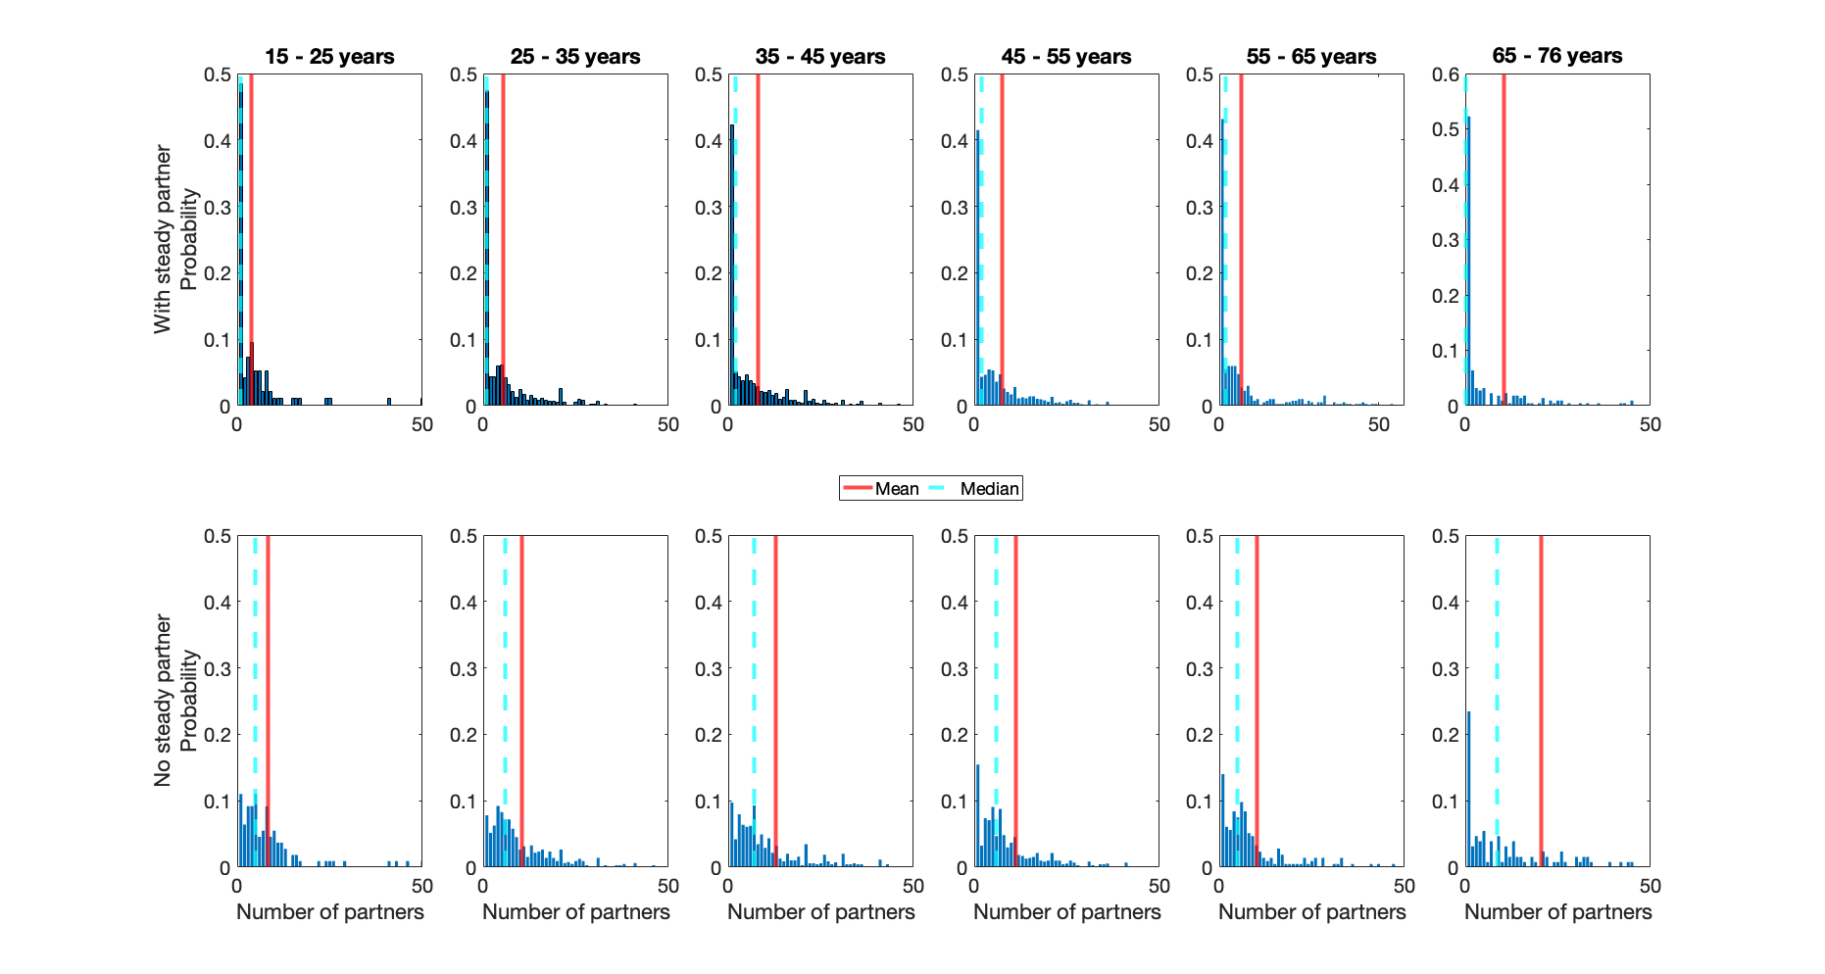
The model, sexual dynamics, parametrization
ACS

Slide 25
The model, sexual dynamics, parametrization
Directly calculated from the data, distributions
  Condom use (ACS)
  Frequency of anal intercourse (The Network study)
  Dependency of acquisition rate of non-steady partners on steady partners (ACS)
Taken from the literature (Reitsema et al 2020)
  Distribution of non-steady partnerships durations
  Age-assortativity mixing

Slide 26
The model, sexual dynamics, parametrization
Duration of steady partnerships
Average rate of steady/non-steady partner acquisition
Model calibrated against the data
  Steady state distribution of steady partners (ACS), number of steady/non-steady partners within the last 6/12 months (EMIS-2017, ACS)
  Right now: point estimates, optimization method (Nelder-Mead) + coarse Latin Hyper Cube Sampling

Slide 27
The model: HIV transmission + baseline interventions

Slide 28
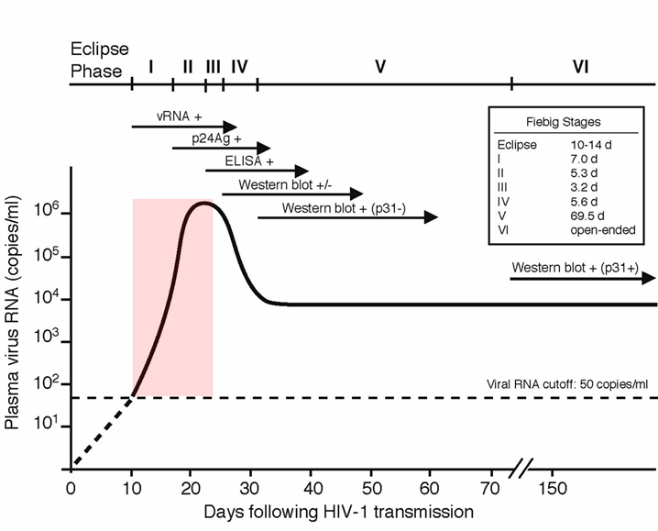
Fiebig classification
acute
early
Modified from Fiebig AIDS 2003
symptoms
Slide CREDIT: Targeted screening and immediate start of treatment for acute HIV infection among MSM in Amsterdam by Dijkstra 2019

Slide 29
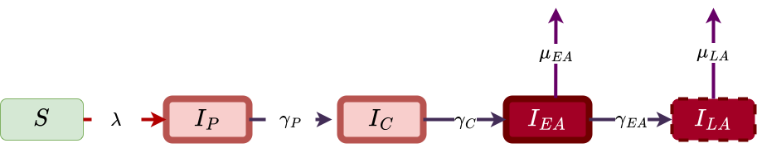
HIV dynamics : classic framework

Slide 30
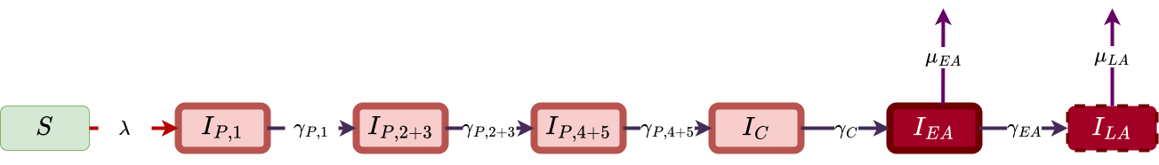
HIV dynamics : extended framework

Slide 31
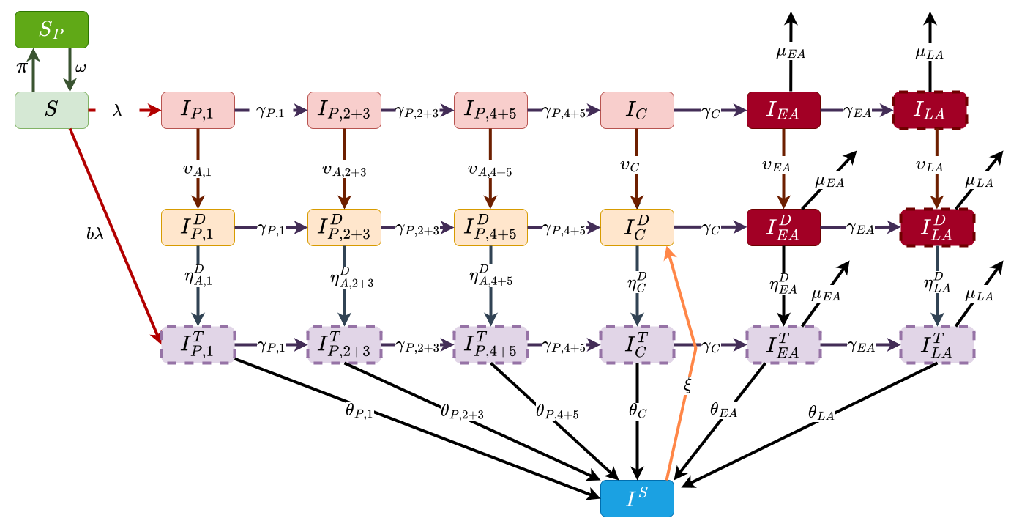
HIV dynamics with diagnosis, cART and PrEP
PrEP
Diagnosed
Started treatment, not yet suppressed
Suppressed

Slide 32
Data
EMIS 2017
Amsterdam Cohort Studies (ACS)
STI clinics
Stitchting HIV Monitoring (SHM)
CBS Netherlands
StatLine

Slide 33
Simulations: calibration of transmission dynamics
Pop size 5,000 individuals
Burn in 1 year: sexual network dynamics (non-steady partnerships)
Calibration time 2015-2021 (6 years)
Scenario exploration duration: 10 years
# trajectories: 40

Slide 34
Simulations: proceedings inside trajectory
Initialization
of the population + calibration
Main loop
Recording of the data

Slide 35
Simulations: proceedings inside trajectory
Seeding of the population into age bands
Creation of steady partnerships (to match population state found in data)
Seeing propensity to acquire casual partners
Letting simulation run for a months to collect the statistics of acquisition of non-steady partners
Initialization
of the population + calibration
Main loop
Recording of the data

Slide 36
Simulations: proceedings inside trajectory
Demographic: Ageing, Death, Entrance of new individuals
Sexual network: creation and dissolution of steady and non-steady partnerships
HIV processes: (once) seed infection, removal due to AIDS, advancement to the next infectious stage, infection, PrEP uptake/dropout, diagnosis, treatment initiation, suppression, dropout
Initialization
of the population + calibration
Main loop
Recording of the data

Slide 37
Outputs

Slide 38
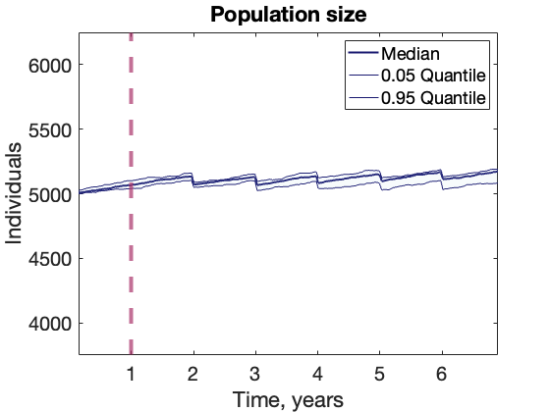
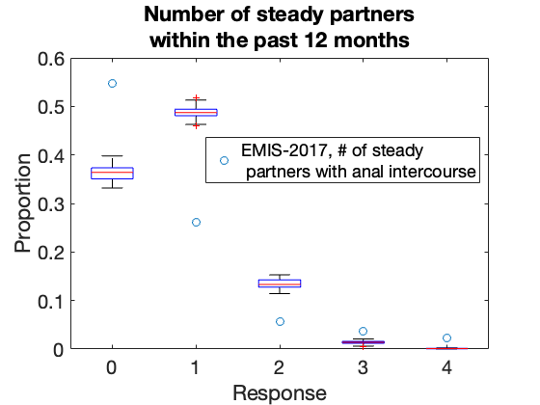
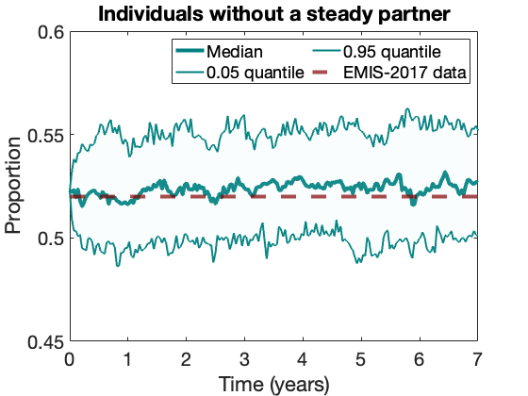
Demographics + sexual network
Notes:
Add the distribution of the partnership durations if time permeats – form the main module, single trajectory

Slide 39
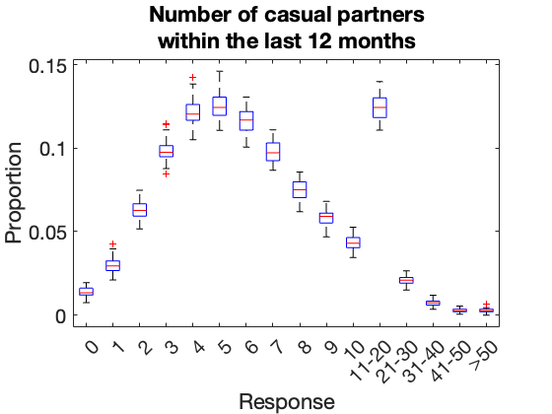
Sexual network: casual partnerships
Notes:
Add the distribution of the partnership durations if time permeats – form the main module, single trajectory

Slide 40
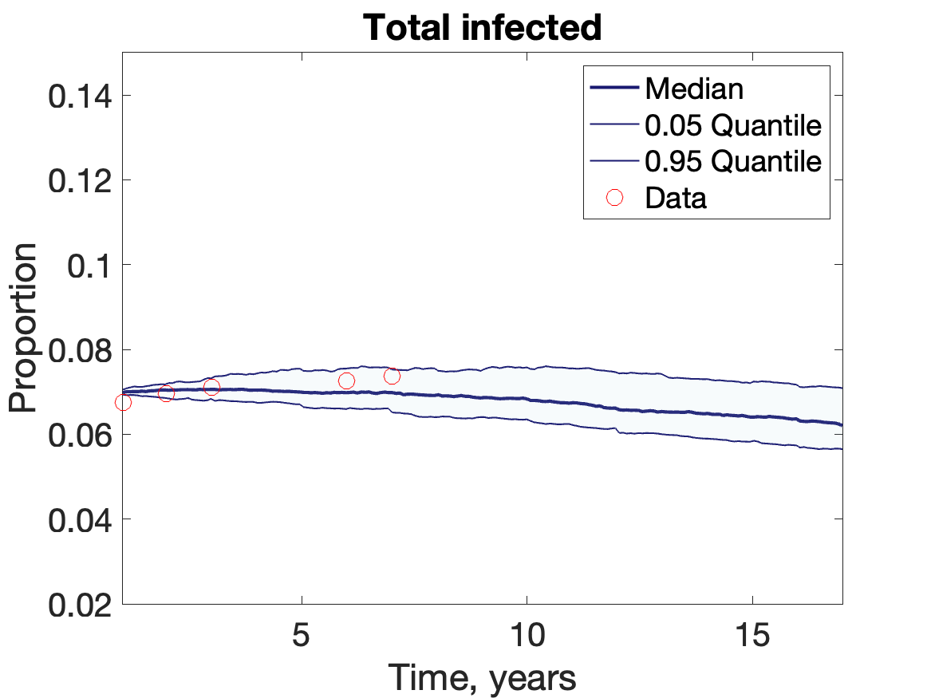
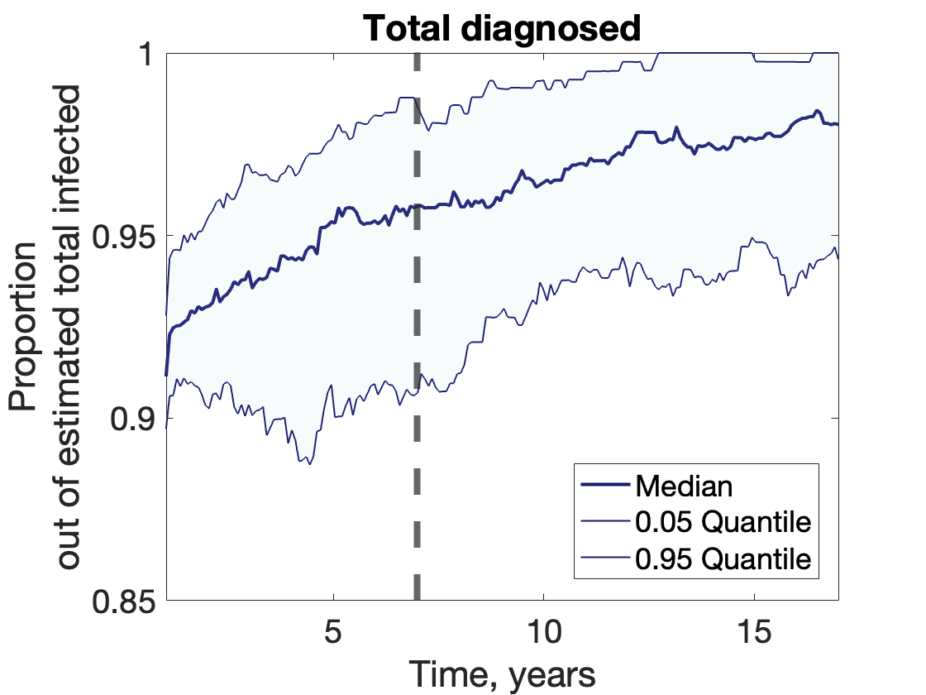
Infection dynamics:
Notes:
This and the next two re-run for higher infection probability and burn in of demographics and sexual network first

Slide 41
What is next

Slide 42
  Scenario exploration
Q1: What is a good proxy to use to detect AHI individuals?
Investigate who infects who: age, sexual activity, infection status

Slide 43
  Scenario exploration
Q2: How scaling up of targeted screening of AEHI individuals combined with other interventions affects transmission and burden of the disease?
Effects of targeted screening on its own
Supplementing with partner notification for these who are positive
Supplementing with PrEP to these who are negative or if positive to their negative partners

Slide 44
Thank you!

