Slide 1
Stochastic Importation of Variants of Concern in a Population with Heterogeneous Immunity
Jacob Curran-Sebastian
NORDITA 2023, Stockholm

Slide 2
Background
The emergence of SARS-CoV-2 in December 2019 as well as novel variants of concern put a focus on border controls as a defence against importing infected cases into a population.
Border controls are known to have only limited effectiveness in delaying the ingress of cases (e.g. Hollingsworth et al., 2006).
This puts a focus on both pharmaceutical and non-pharmaceutical interventions in terms of reducing transmission and delaying the establishment of novel pathogenic strains.

Slide 3
Background
We are interested in estimating the duration of the early, stochastic growth phase of an epidemic.
Interventions (pharmaceutical and non-pharmaceutical) have the effect of delaying the growth of an outbreak.
We want to quantify the temporal uncertainty in an outbreak.
  Useful for policy makers planning interventions.
  Quantify uncertainty in outcomes of interest, such as the peak timing.

Slide 4
Main Questions
When has a novel pathogenic strain become established in a population?
When should we switch from a stochastic to a deterministic model?

Slide 5
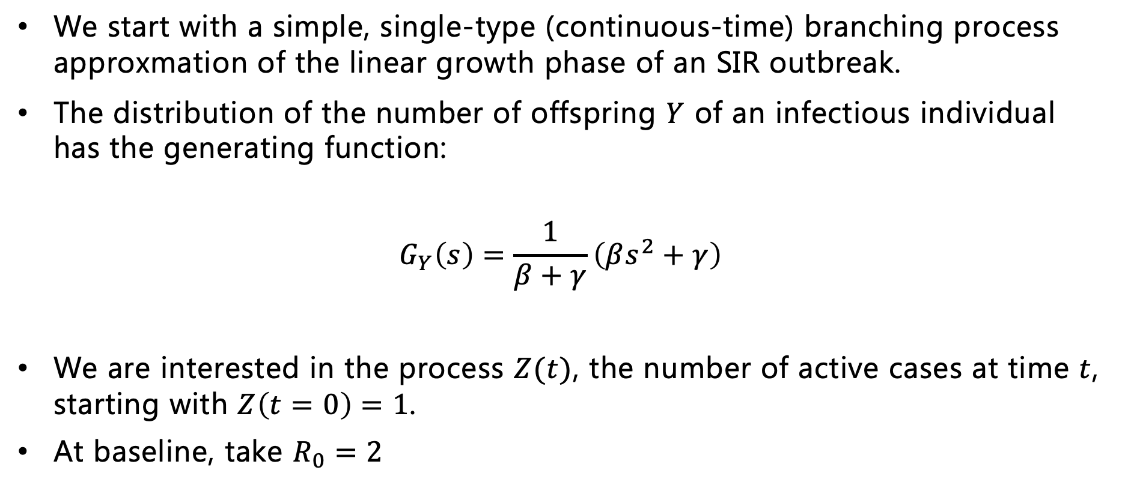
Simple SIR branching process model
We start with a simple, single-type (continuous-time) branching process approxmation of the linear growth phase of an SIR outbreak.
The distribution of the number of offspring $Y$ of an infectious individual has the generating function:
$$G_{Y}\left(s\right)=\frac{1}{β+γ}\left(βs^{2}+γ\right)$$
We are interested in the process $Z(t)$, the number of active cases at time $t$, starting with $Z\left(t=0\right)=1$.
At baseline, take $R_{0}=2$

Slide 6
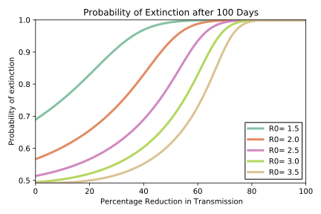
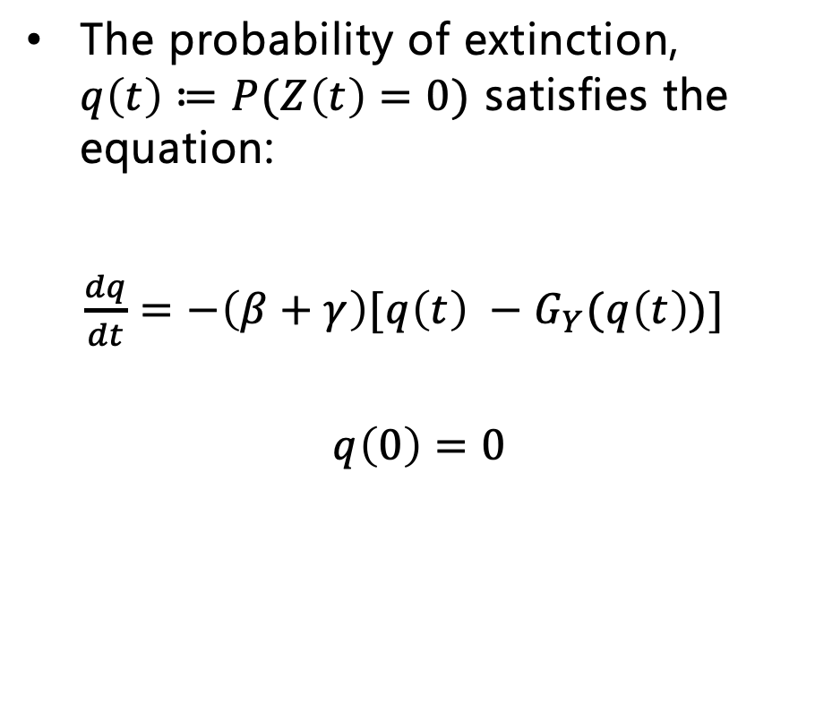
Probability of Extinction
The probability of extinction, $q\left(t\right)≔P(Z\left(t\right)=0)$ satisfies the equation:
$\frac{dq}{dt}=−\left(β+γ\right)[q\left(t\right) −G_{Y}(q\left(t\right))]$
$$q\left(0\right)=0$$

Slide 7
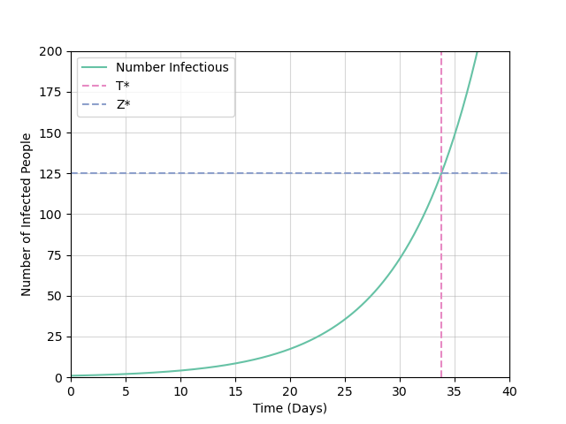
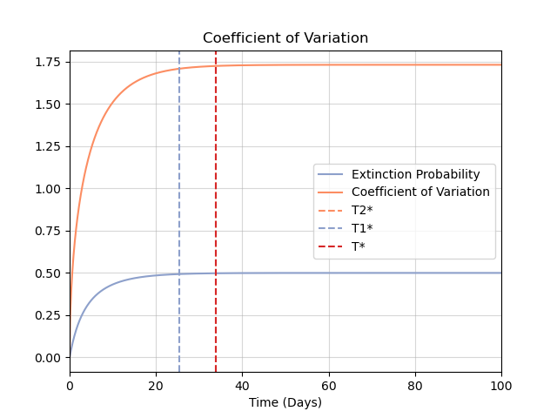
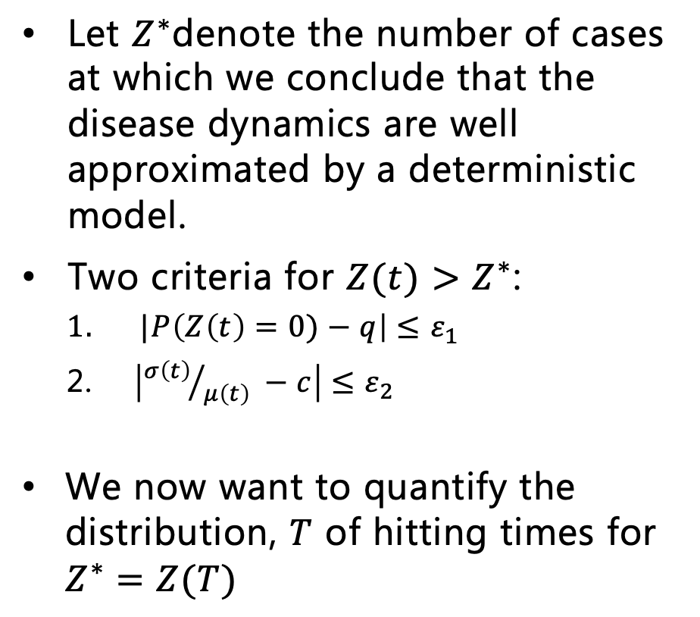
Time to establishment of a novel strain
Let $Z^{∗}$denote the number of cases at which we conclude that the disease dynamics are well approximated by a deterministic model.
Two criteria for $Z(t)$ $>Z^{∗}$:
  $|P\left(Z\left(t\right)=0)−q\right|≤ε_{1}$
  $\left|{σ\left(t\right)}/{μ\left(t\right)} −c\right|≤ε_{2}$
We now want to quantify the distribution, $T$ of hitting times for $Z^{∗}=Z(T)$

Slide 8
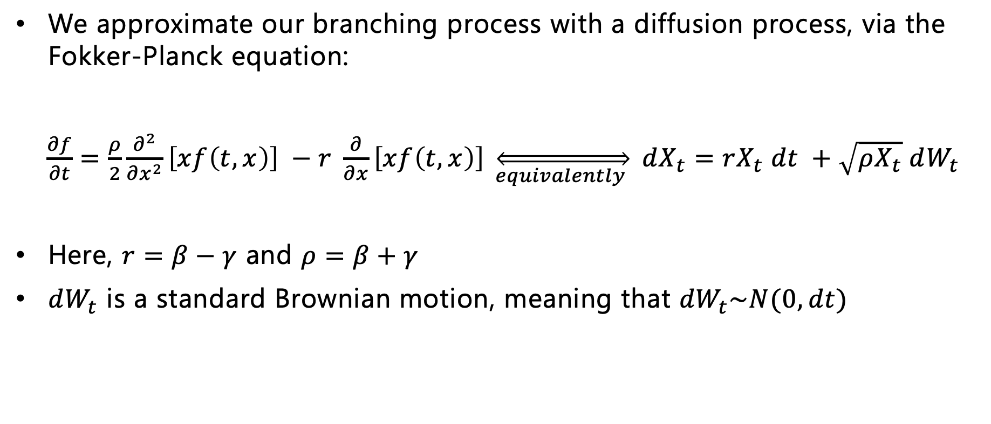
Feller Diffusion Approximation
We approximate our branching process with a diffusion process, via the Fokker-Planck equation:
$\frac{∂f}{∂t}=\frac{ρ}{2}\frac{∂^{2}}{∂x^{2}}\left[xf\left(t, x\right)\right] −r \frac{∂}{∂x}\left[xf\left(t, x\right)\right] \overset{⇔}{equivalently } dX_{t}=rX_{t} dt +\sqrt{ρX_{t}} dW_{t}$
Here, $r=β−γ$ and $ρ=β+γ$
$dW_{t}$ is a standard Brownian motion, meaning that ${dW}_{t}\sim N(0, dt)$

Slide 9
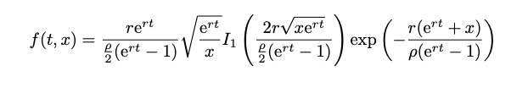
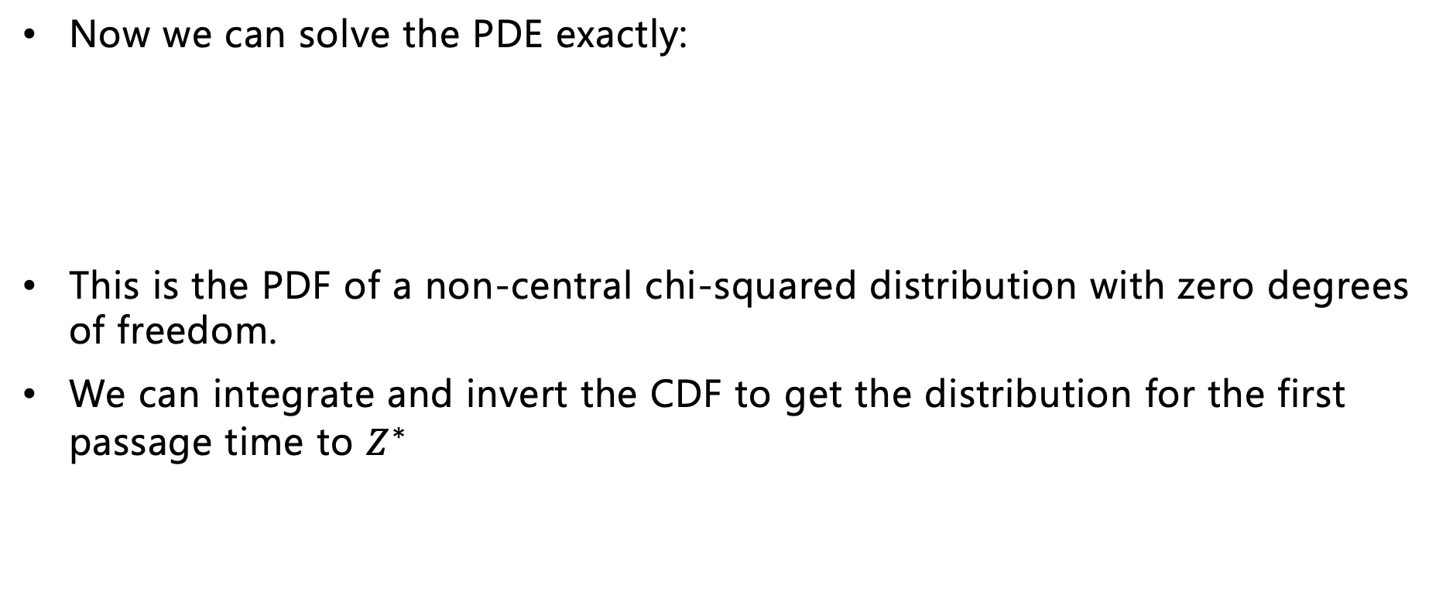

Feller Diffusion Approximation
Now we can solve the PDE exactly:
This is the PDF of a non-central chi-squared distribution with zero degrees of freedom.
We can integrate and invert the CDF to get the distribution for the first passage time to $Z^{∗}$
$$U\left(t, Z^{∗}\right)=1 − \frac{F(t,Z^{∗})}{1 − P(X_{t}=0)}$$

Slide 10
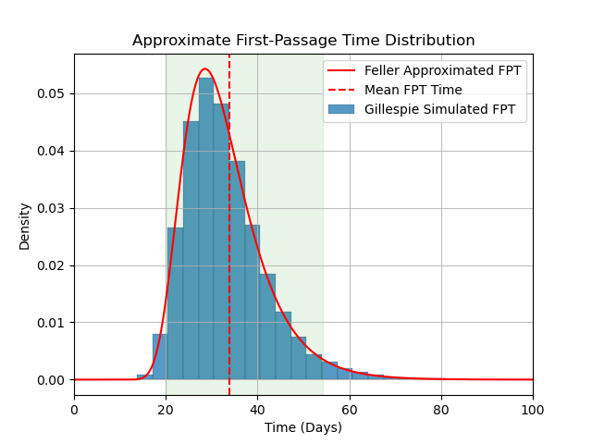
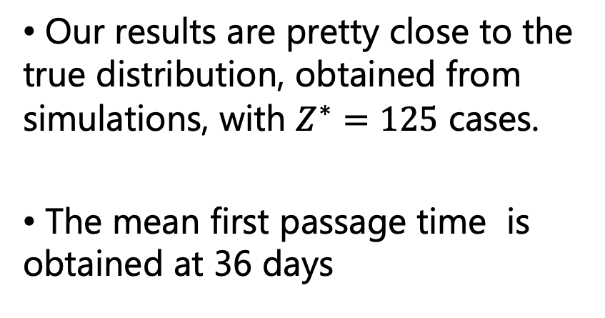
Approximate FPT distribution
Our results are pretty close to the true distribution, obtained from simulations, with $Z^{∗}=125$ cases.
The mean first passage time is obtained at 36 days

Slide 11
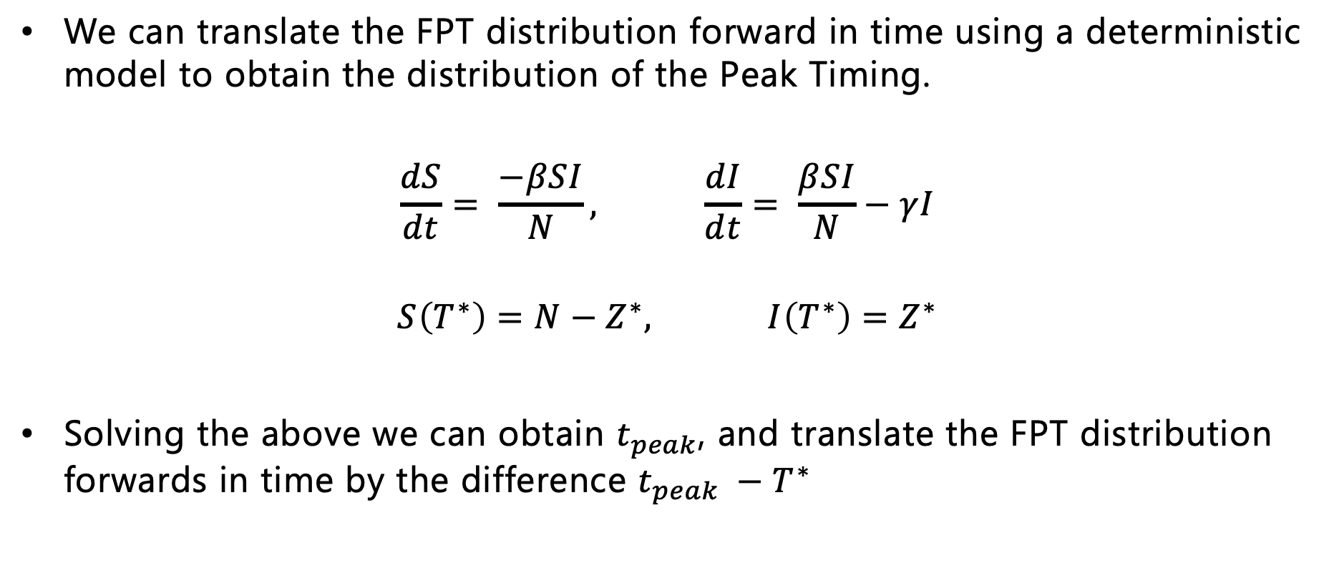
Translation to Peak Timing Distribution
We can translate the FPT distribution forward in time using a deterministic model to obtain the distribution of the Peak Timing.
$$\frac{dS}{dt}= \frac{−βSI}{N}, \frac{dI}{dt}= \frac{βSI}{N}−γI$$
$$S\left(T^{∗}\right)=N−Z^{∗}, I\left(T^{∗}\right)=Z^{∗}$$
Solving the above we can obtain $t_{peak}$, and translate the FPT distribution forwards in time by the difference $t_{peak} −T^{∗}$

Slide 12
Results

Slide 13
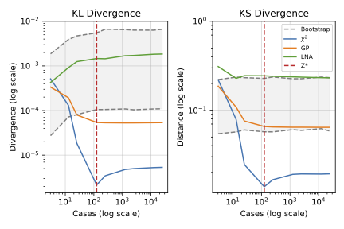
Results

Slide 14
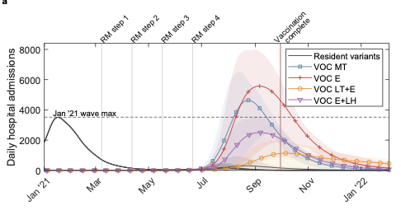
Multi-type process
We can make our model a bit more realistic and still obtain good approximations to the FPT distribution.
We now want to model the arrival of a novel variant of concern into a partially immune population.
Our question remains how can we quantify the time to establishment and when can we switch to a deterministic model?

Slide 15

Model
We model an outbreak in the UK population with 4 different kinds of immunity profiles, or 4 types-at-birth :
Vaccinated
Previously Infected
Vaccinated
Not Previously Infected
Not Vaccinated
Previously Infected
Not Vaccinated
Not Previously Infected

Slide 16

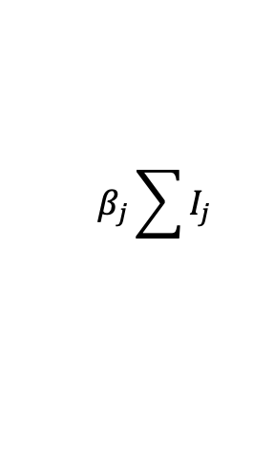


Model
Each ‘type’ $j$in the population has a relative susceptibility to the new variant, which we denote $ψ_{j}$, and makes up a fraction $f_{j}$ of the population.
Each infectious individual (of any type) has baseline infection rate $β$ and infects a susceptible individual at a rate $β_{j}=f_{j}ψ_{j}β$ .
We also have a pre-infectious exposed period.
$$S_{j}$$
𝑆_𝑗
$$I_{j}$$
𝐼_𝑗
$$R_{j}$$
𝑅_𝑗
$$E_{j}$$
𝐸_𝑗
$$β_{j}\sum{I_{j}}$$
$$σ$$
$$γ$$

Slide 17
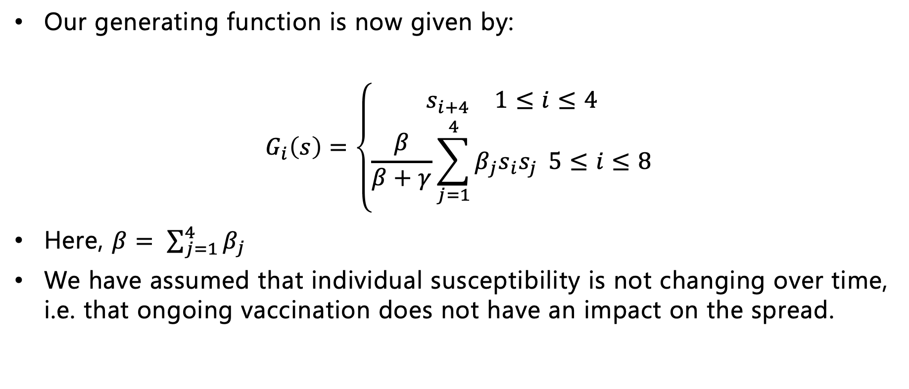
Multi-Type Feller Diffusion
Our generating function is now given by:
$$G_{i}\left(s\right)=\left\{\begin{aligned}s_{i+4} 1≤i≤4 \\ \frac{β}{β+γ}\sum_{j=1}^{4}{β_{j}s_{i}s_{j}} 5≤i≤8\end{aligned}\right.$$
Here, $β= \sum_{j=1}^{4}{β_{j}}$
We have assumed that individual susceptibility is not changing over time, i.e. that ongoing vaccination does not have an impact on the spread.

Slide 18
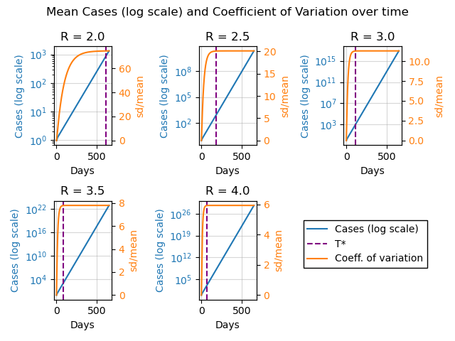
Departure from stochasticity
We then consider the ”departure from stochasticity” for the multi-type process in an analogous way to the single-type process.

Slide 19
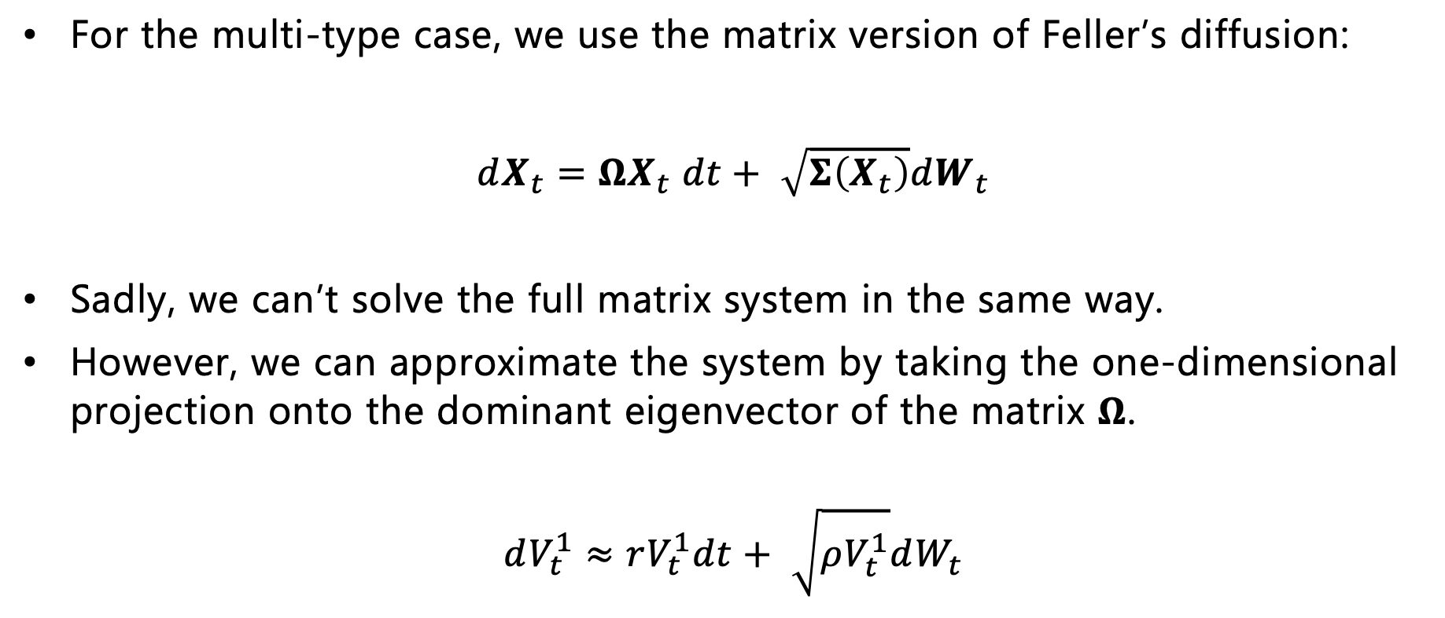
Multi-Type Feller Diffusion
For the multi-type case, we use the matrix version of Feller’s diffusion:
$dX_{t}=ΩX_{t} dt+ \sqrt{Σ\left(X_{t}\right)}dW_{t}$
Sadly, we can’t solve the full matrix system in the same way.
However, we can approximate the system by taking the one-dimensional projection onto the dominant eigenvector of the matrix $Ω$.
$$dV_{t}^{1}≈rV_{t}^{1}dt+ \sqrt{ρV_{t}^{1}}dW_{t}$$

Slide 20
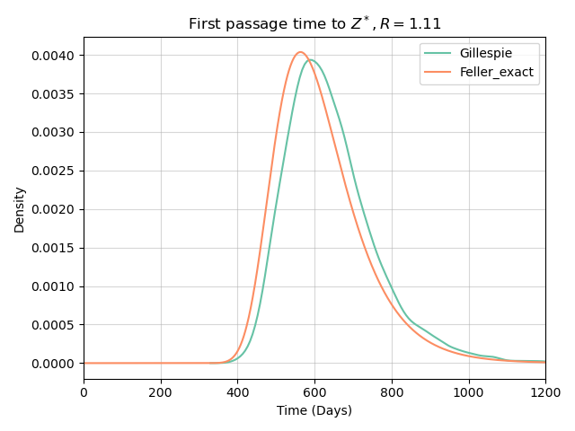
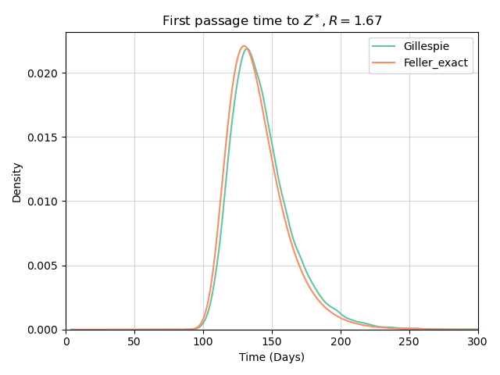
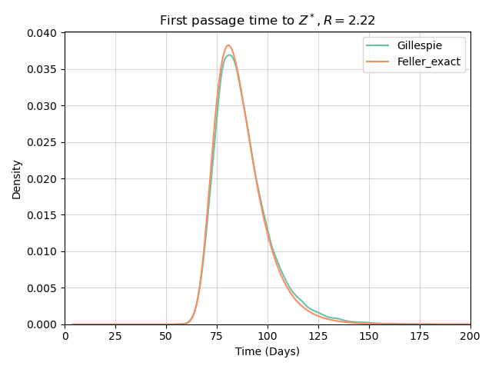
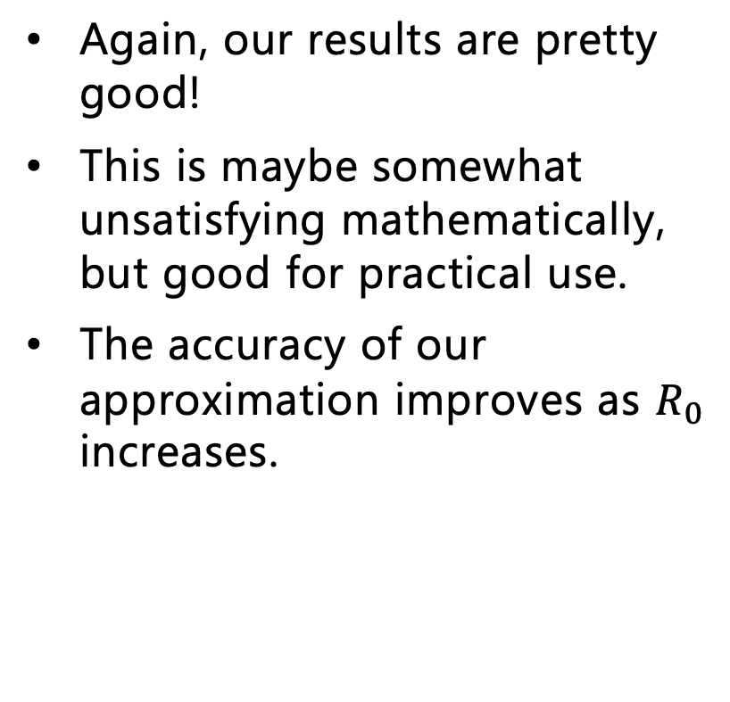
Results
Again, our results are pretty good!
This is maybe somewhat unsatisfying mathematically, but good for practical use.
The accuracy of our approximation improves as $R_{0}$ increases.

Slide 21
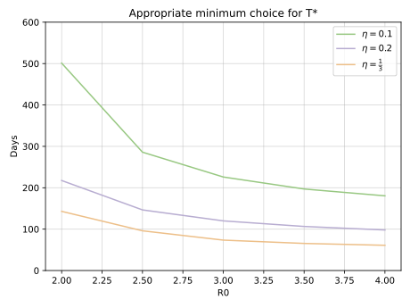
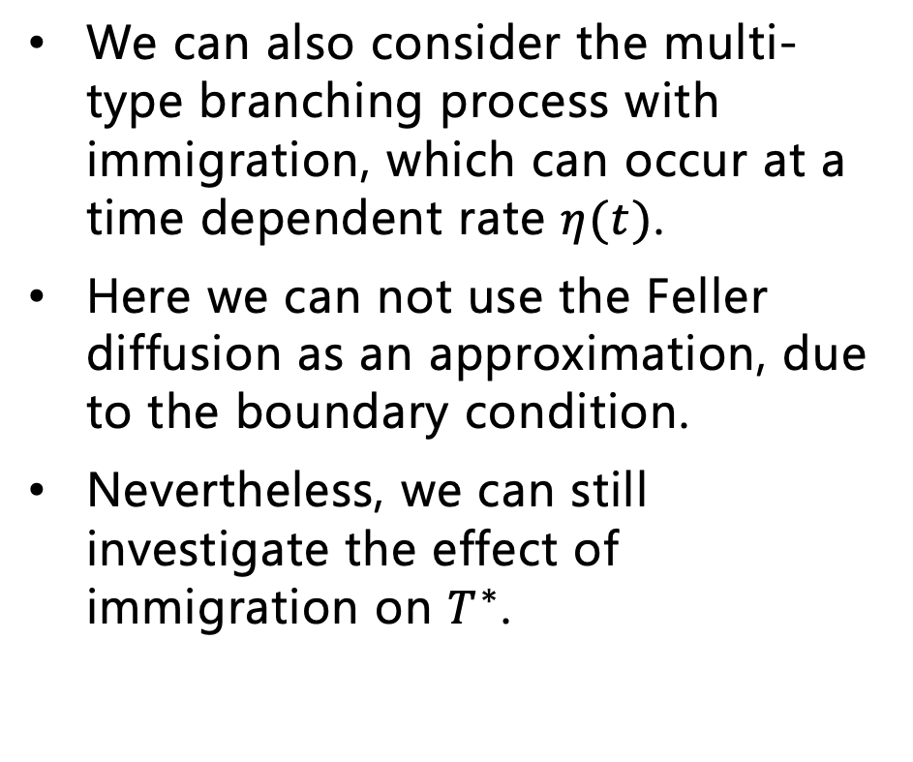
Incorporating Immigration as a Poisson Process
We can also consider the multi-type branching process with immigration, which can occur at a time dependent rate $η(t)$.
Here we can not use the Feller diffusion as an approximation, due to the boundary condition.
Nevertheless, we can still investigate the effect of immigration on $T^{∗}$.

Slide 22
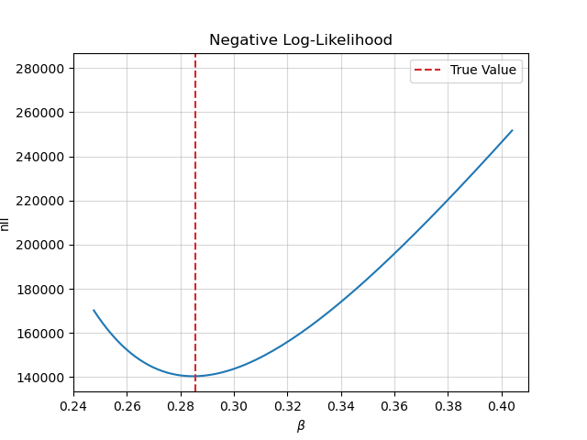
Current and Future Work
Given that we have a distribution for the first passage time, we can fit this model to data.
This works well for the simple SIR model but is more difficult for the multi-type model due to the one-dimensionalisation.
We can also deal with censored data using this approach.

Slide 23
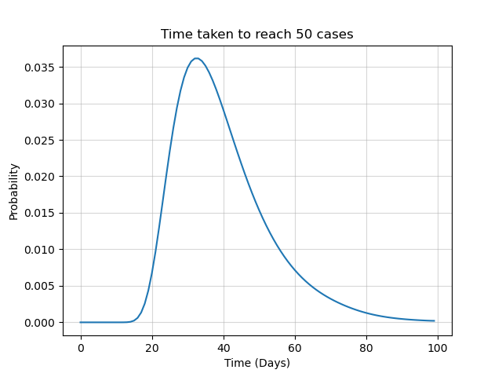
Developing the model – Ongoing Work
This framework is easily extendable to Bellman-Harris processes, which allow for non-exponential recovery rates.
I am also interested in developing results for FPT distributions for a more general Crump-Mode-Jagers process.
Applications outside of infectious diseases – particularly in phylogenetics and ecology.

Slide 24
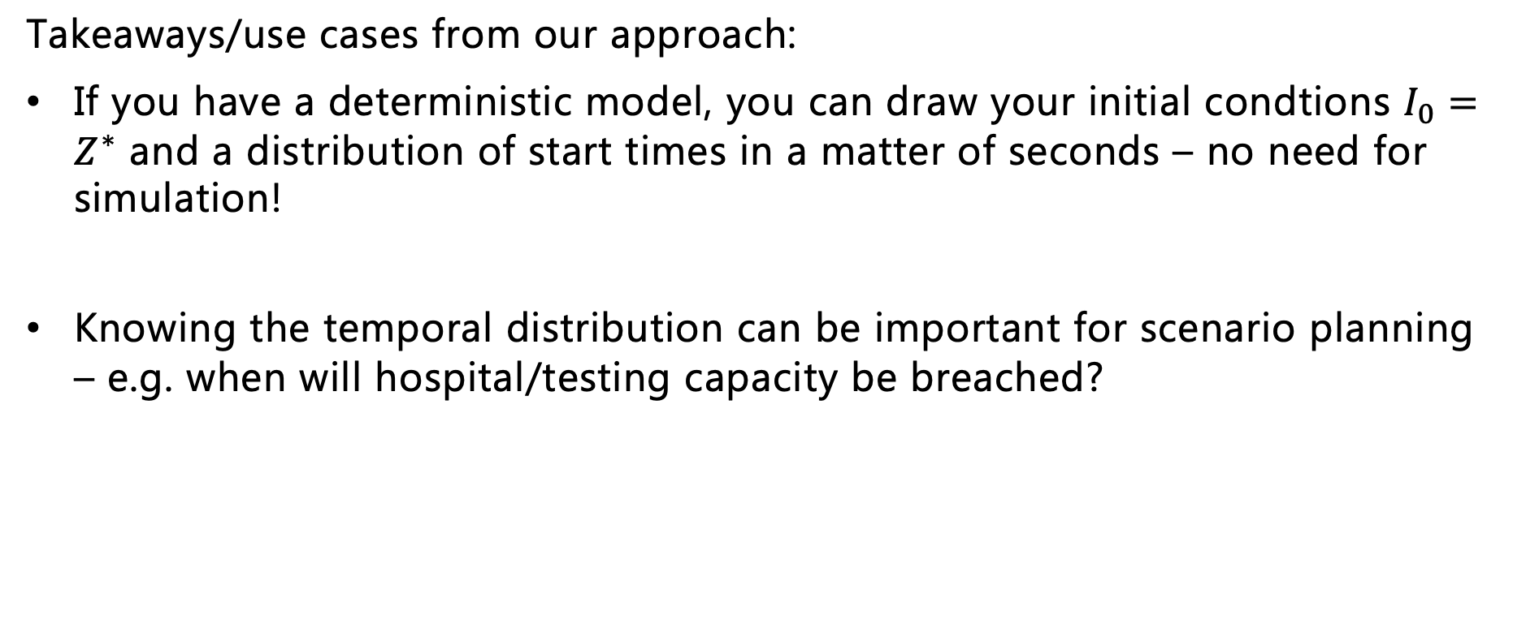
Conclusions
Takeaways/use cases from our approach:
If you have a deterministic model, you can draw your initial condtions $I_{0}=Z^{∗}$ and a distribution of start times in a matter of seconds – no need for simulation!
Knowing the temporal distribution can be important for scenario planning – e.g. when will hospital/testing capacity be breached?

Slide 25

Summary
We have obtained analytical results for approximating the First Passage Time distribtuion for SIR and multitype models.
We get insight into the temporal distribution at a fraction of the computational cost, compared with simulation.
We can then construct hybrid stochastic and deterministic models.
These provide insight for epidemic scenario planning.
Thank you for listening!
Link to preprint

