Slide 1

Climate suitability of Dengue, Chikungunya and Zika and Urban heat Island impact
Pratik Singh
Doctoral Student
Climate sensitive infectious diseases lab
led by Joacim Rocklöv

Slide 2
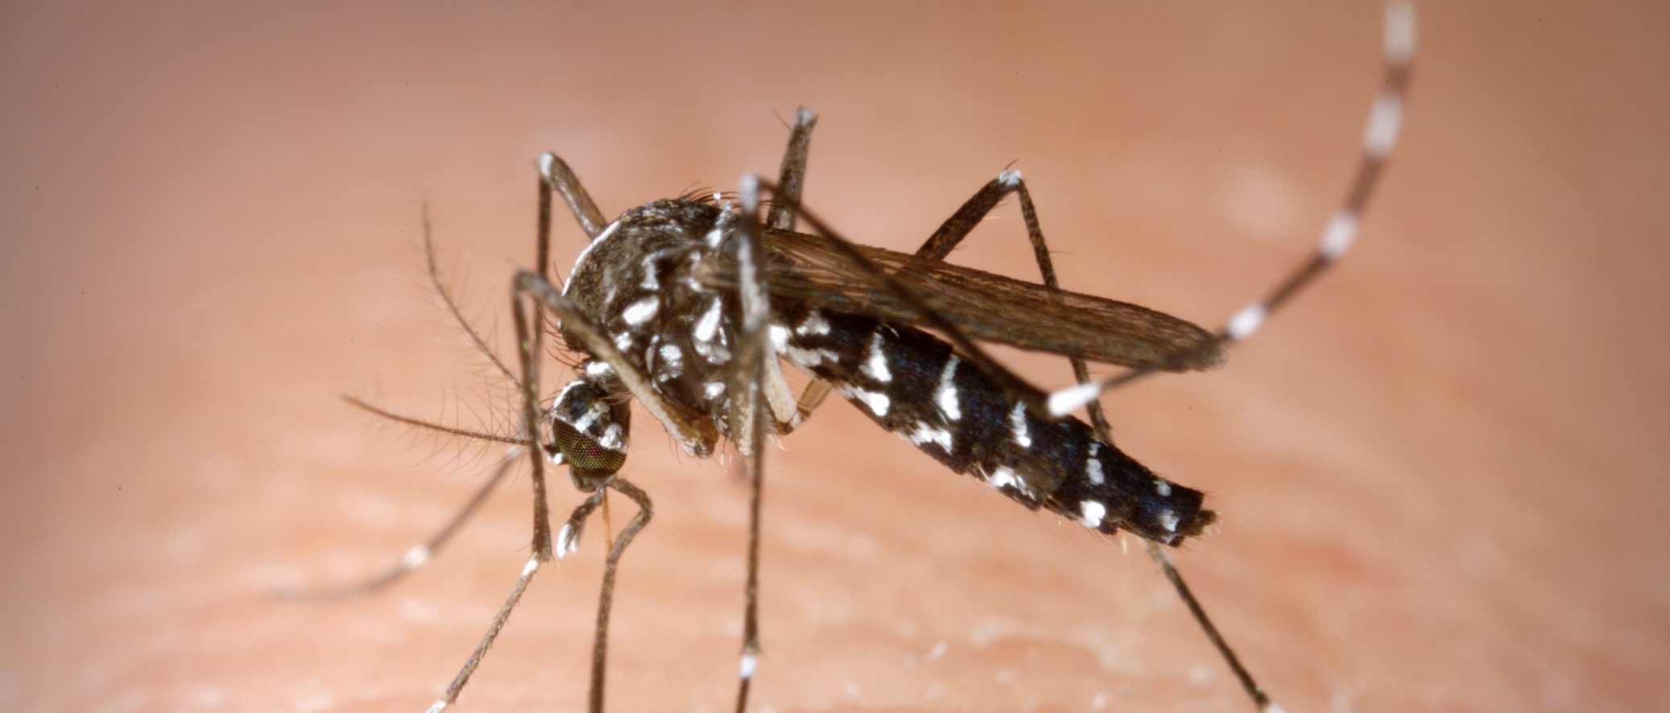
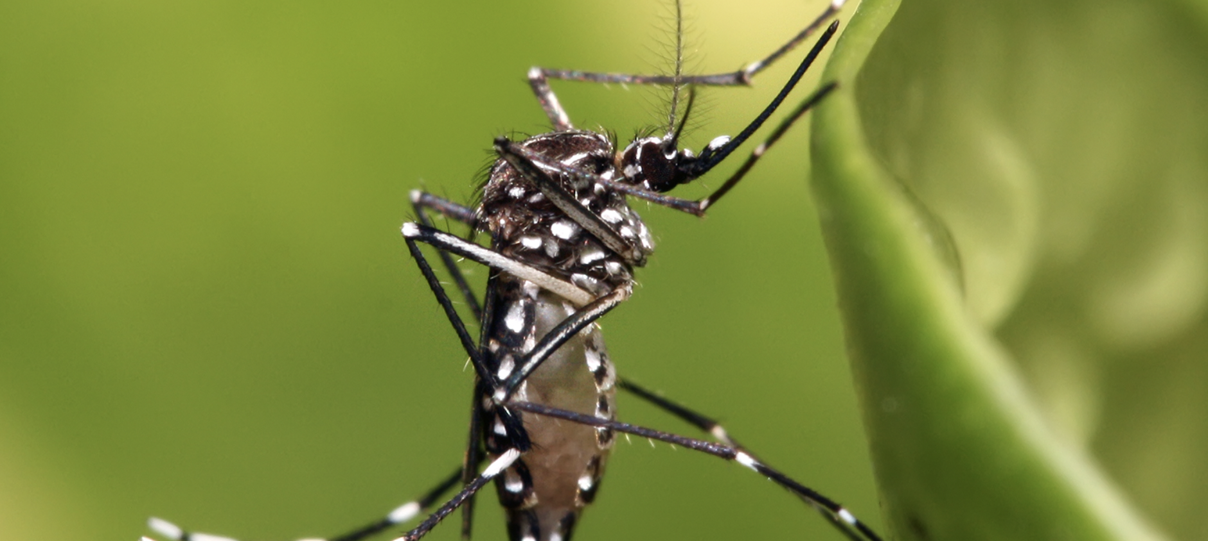
Aedes Albopictus
Temperate species
Fresh water mosquito
Established in Europe
Responsible for DENV, CHIKV etc.
Aedes
Aegypti
Tropical and subtropical species
Also, Responsible for DENV, CHIKV
Not the main concern in temperate zones currently
Image source - Wikipedia
Notes:
Aedes Aegypti – Found mostly in tropical regions, high temperature resistance, not much concerning to Europe but rising temperature can make it to Europe and will probably soon will be our concern,

Slide 3
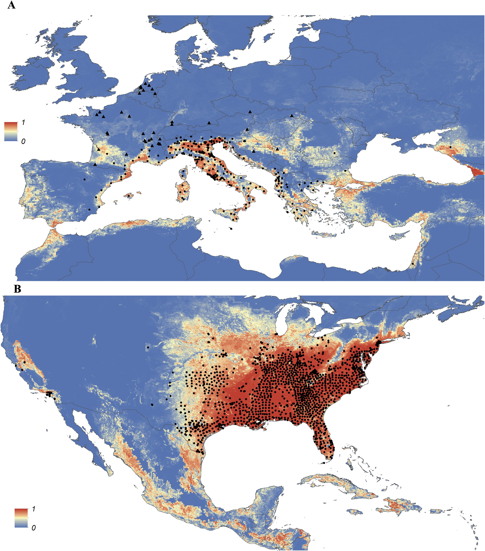
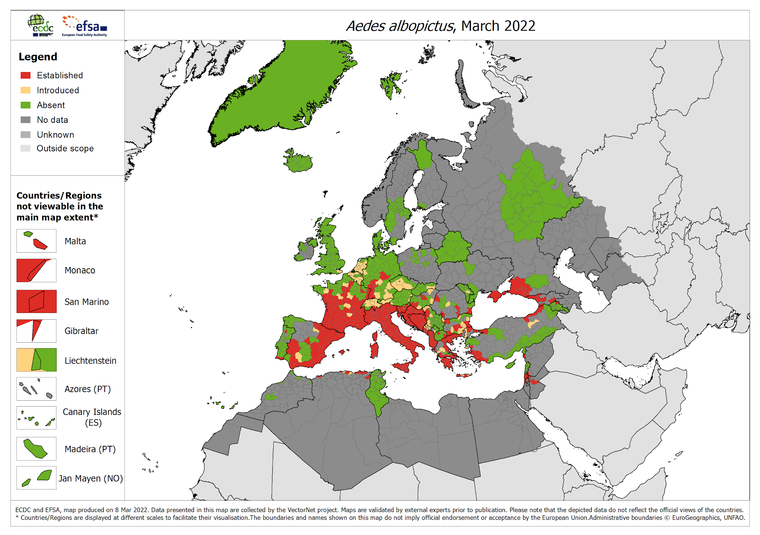
Aedes Albopictus distribution in Europe
Year 2015
Kraemer et al. 2015 (elife, https://doi.org/10.7554/eLife.08347)
Notes:
The distribution of Aedes Albopictus in Europe, the distribution in 2020 is now increased compared to 2016.

Slide 4
Overview
Model Formulation
Model Challenges and Future direction
Model Results
Model and UHI’s

Slide 5
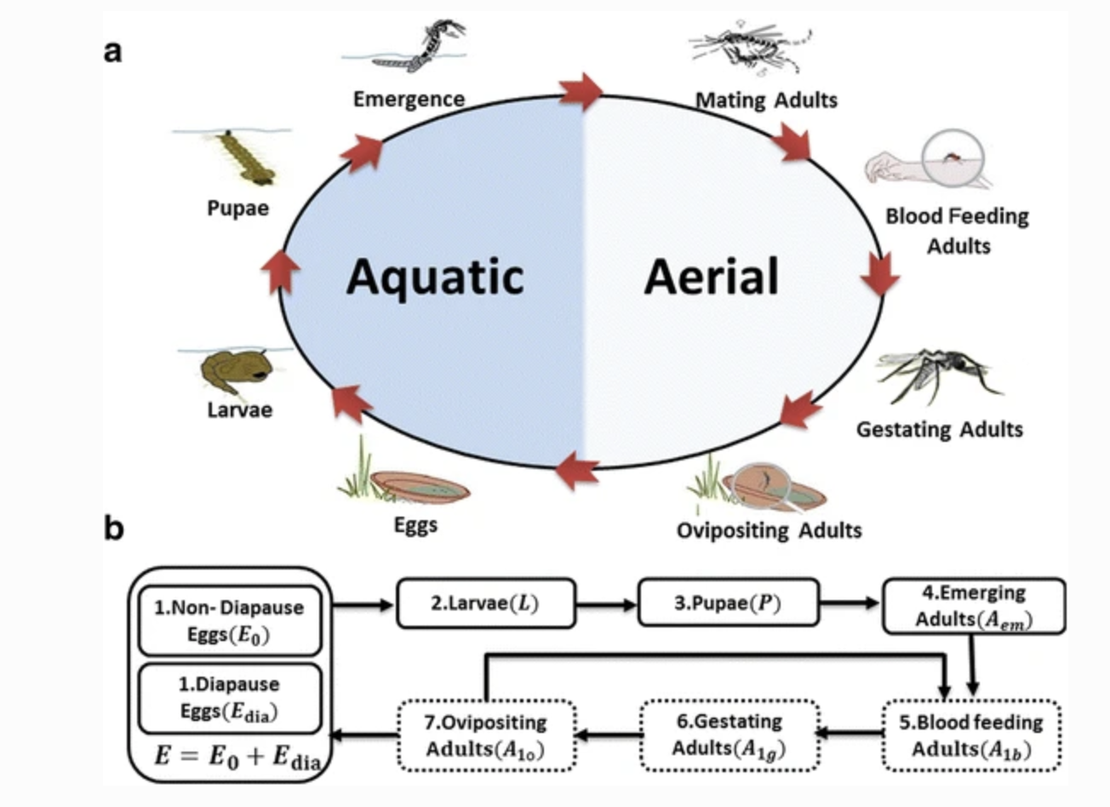


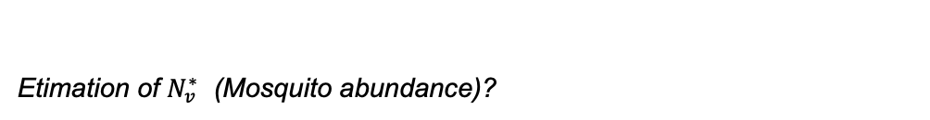
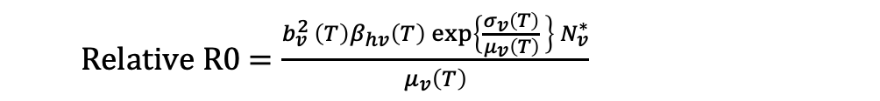
Another widely used temperature sensitive Vectorial Capacity model (Dietz 1993, Mordecai 2013)
$$VC= \frac{b_{v}^{2 }\left(T\right)β_{hv}\left(T\right) exp\left\{\frac{σ_{v}\left(T\right)}{μ_{v}\left(T\right)} \right\} N_{v}^{∗}}{μ_{v}\left(T\right) N_{h}}$$
R0 = $\frac{VC .{ β}_{vh}}{γ_{h}}$
Relative R0 $=\frac{b_{v}^{2 }\left(T\right)β_{hv}\left(T\right) exp\left\{\frac{σ_{v}\left(T\right)}{μ_{v}\left(T\right)} \right\} N_{v}^{∗}}{μ_{v}\left(T\right)}$
Etimation of $N_{v}^{∗}$ (Mosquito abundance)?
Figure source – Jia et al. 2016

Slide 6
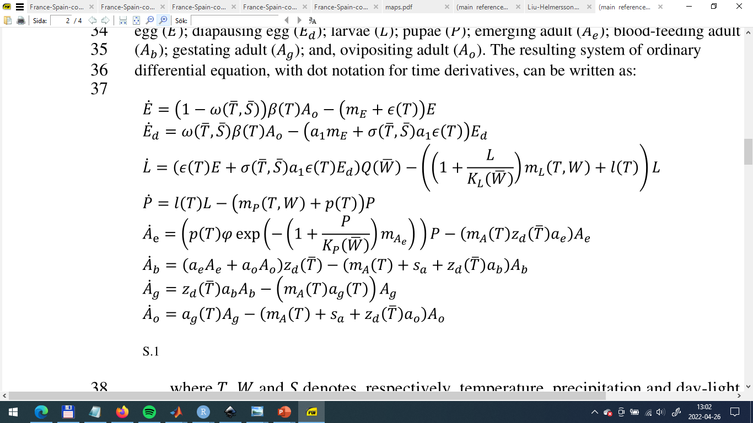
Climate suitability from process-based model:
Life stages, depends on
  temperature
  precipitation
  latitude (day-light length)
  Population density (>500 people per km^2)
Laboratory data is applied to estimate the corresponding temperature dependent trait functions.
Rainfall and daylight functions are obtained from other literatures and are not treated as external factors not entomological factors.

Slide 7
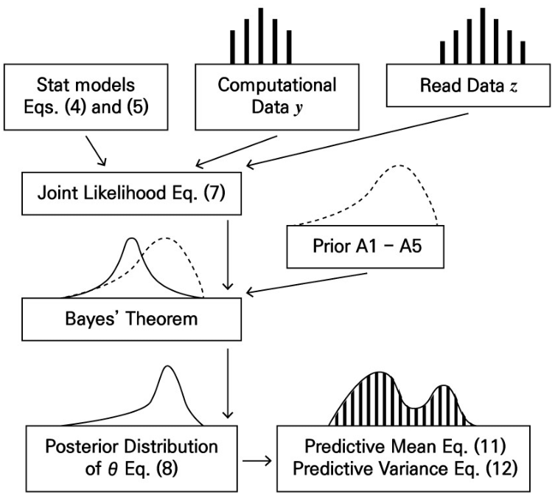
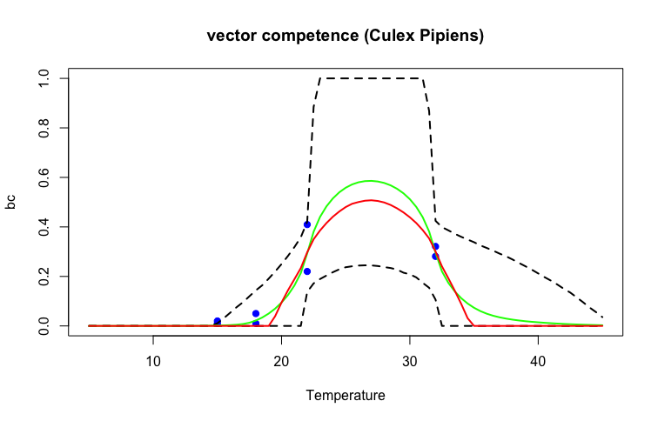
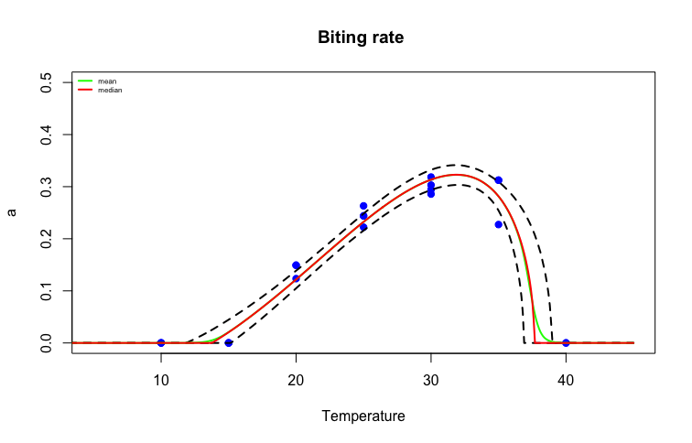
Temperature
Sensitive data
Trait
Ex - EFGC
Temperature
Sensitive data
Models (Quadratic or Briere)
L
Prior Information
Bayes’ theorem
JAGS
Posterior Distribution
(MCMC algorithm)
Predictive Statistics with CI

Slide 8
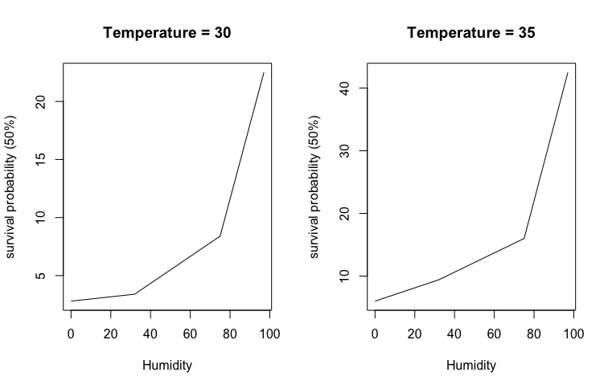
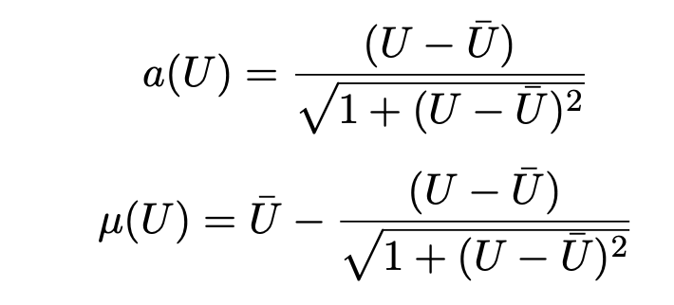
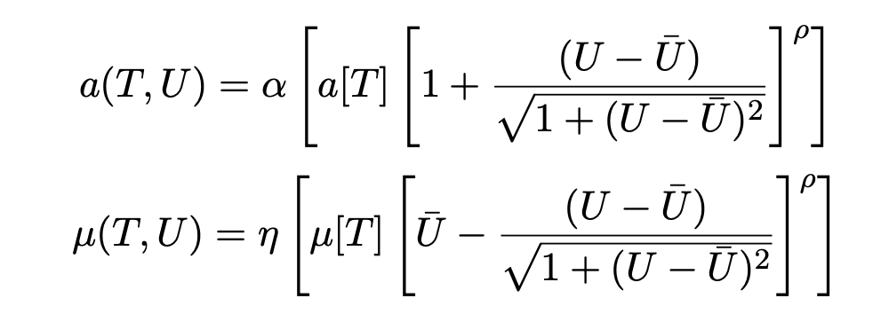
Humidity incorporation
Uri Obolski et al. (2019)
Notes:
We normalise the time series of humidity to [0,1], and use the mean normalised values (u ̄) as reference for extreme deviations from the expected local tendencies [9, 10]. Humidity is assumed to increase the vector biting rate (av) [11] while decreasing the adult mosquito mortality rate (μv ) [12].
These expressions include the multiplicative coefficients (α,η,ρ) to which we generally refer to as scaling ecological factors. It allows us the baseline values to differe from laboratory condition and does not uler the climatic variation.
In practice, the effect of temperature on these parameters can be considered to be the same as observed under laboratory conditions if η,α ≈ 1; weaker if η,α <1; and stronger if η,α >1. The exponential coefficient ρ allows instead to modulate the strength by which adult mosquito mortality and biting rate react to deviations from local mean humidity. In practice, the effect of humidity is switched off when ρ ≈ 0 and made stronger when ρ >1.

Slide 9
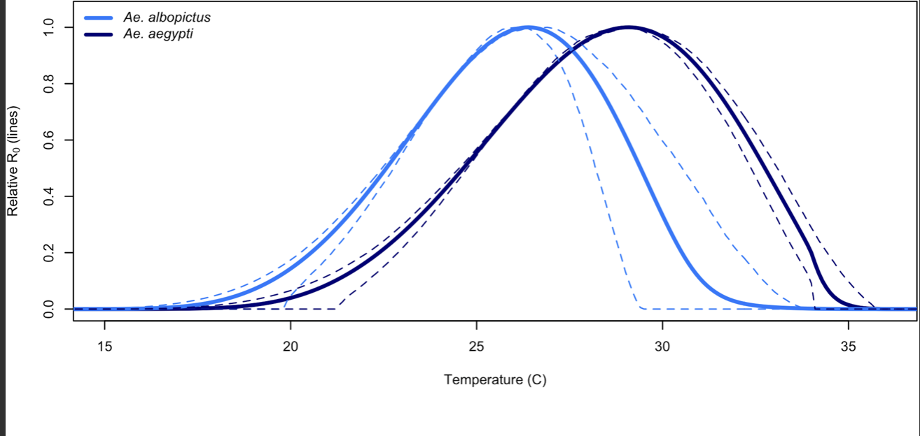
Optimal Temperature of transmission
Optimal Temperature of Aedes Albopictus transmission = 26.8°C (95% CI: 25.2–27.4°C)
Transmission extremes - Lower 17.3°C (95% CI: 14.6–21.2°C) and Upper 34.9°C (95% CI: 34.1–35.6°C)
Optimal Temperature of Aedes Aegypti transmission = 29.7°C (95% CI: 28.4–29.8°C),
Transmission extremes – Lower 16.1°C (95% CI: 13.2–19.9°C) at Upper 31.9°C (95% CI: 29.4–33.7°C)

Slide 10
Overview
Model Formulation
Model Challenges and Future direction
Model Results
Model and UHI’s

Slide 11
Workflow
Temperature-trait-curves
Gridded climate data
R₀ model
Gridded R₀
Relative mosquito abundance

Slide 12
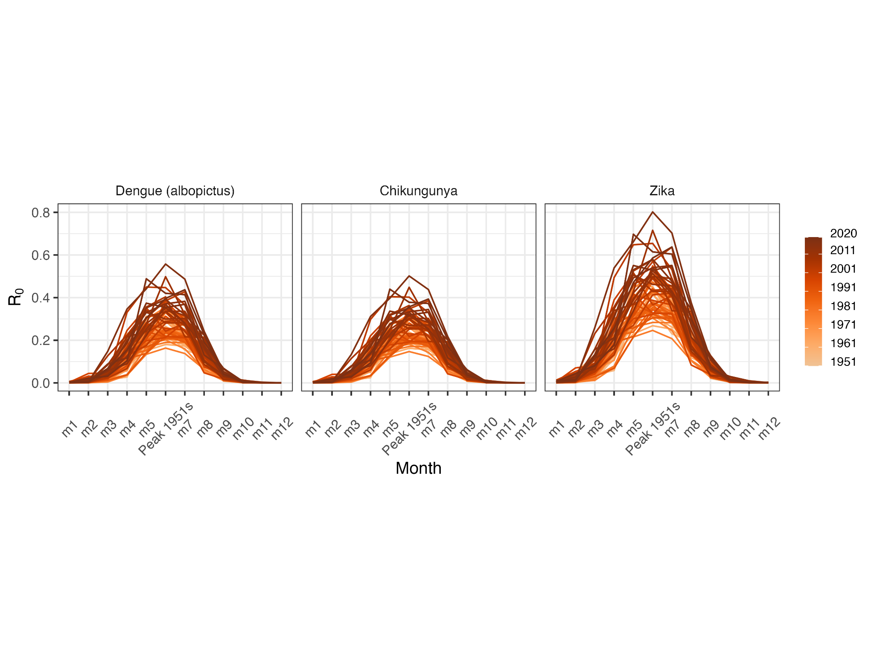
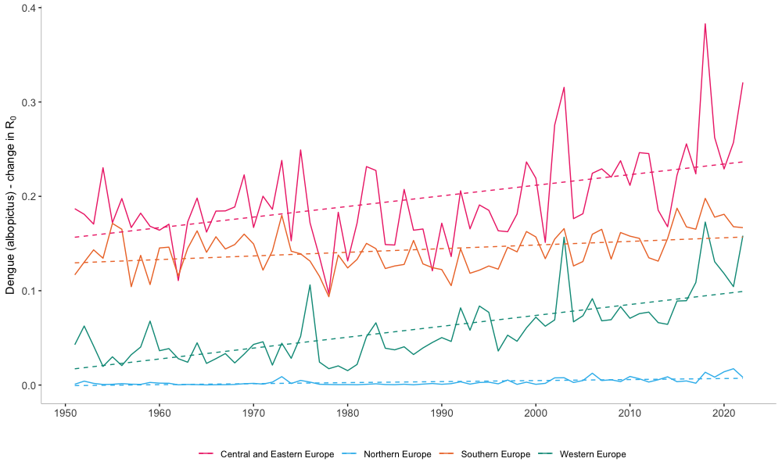
Risk (Basic Reproduction number)

Slide 13
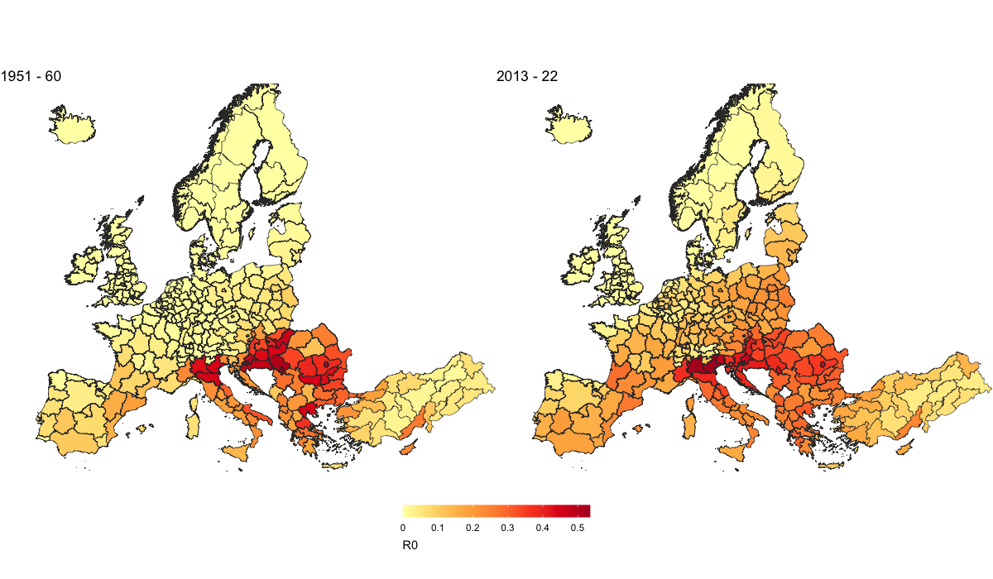
Risk (Basic Reproduction number)

Slide 14
Overview
Model Formulation
Model Challenges and Future direction
Model Results
Model and UHI’s

Slide 15
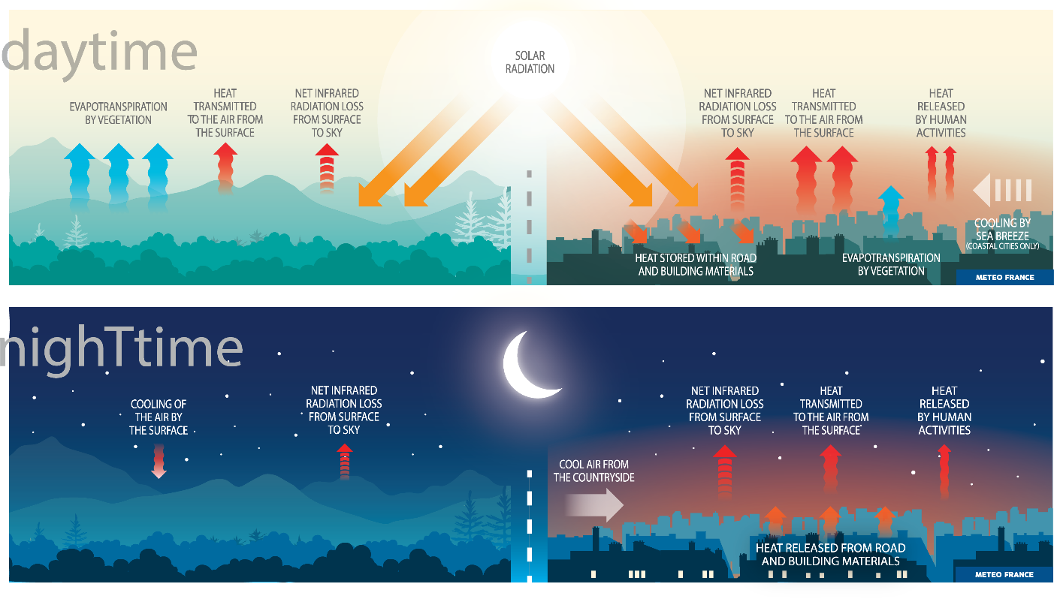
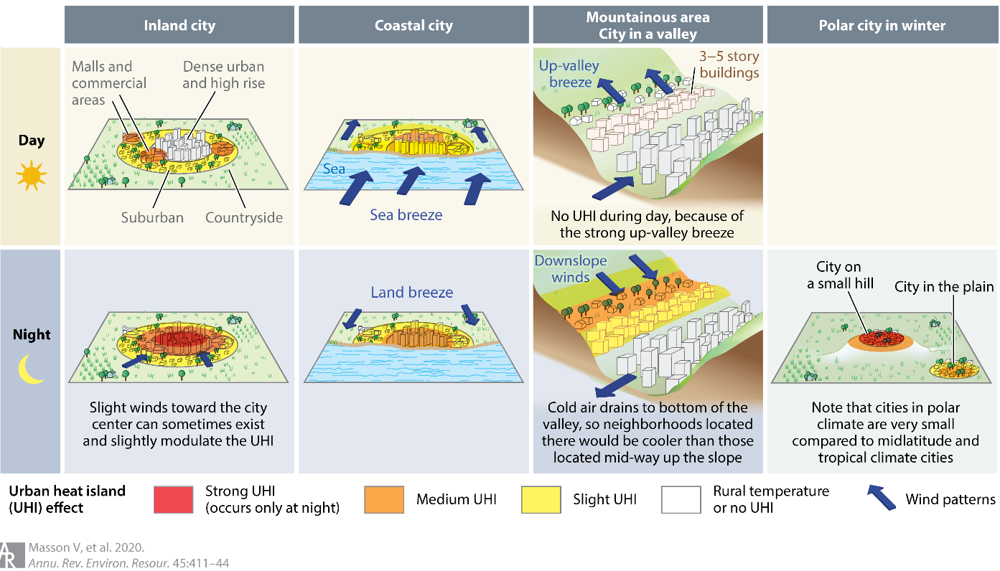
Urban heat island (UHI) effect
Characteristics
Urban areas warmer than rural surroundings
Difference usually larger at nights
Most notable during summer and winter
Alteration of local wind and precipitation patterns
Vary with local wind patterns and landscape/city characteristics
Causes
Impervious surfaces in urban spaces absorb more solar radiation and have high heat capacity
🡪 heat up quickly during day, cool down slowly during night
Lack of evapotranspiration and shade
Tall buildings provide multiple surfaces for reflection and absorption of sunlight and block winds
Notes:
The physical processes that lead to UHIS are complicated but simply speaking they result mainly from…
In contrast to rural or natural areas ….
Impervious surfaces found in urban spaces: roads, building, parking lots made of concrete, asphalt etc.
Lack of vegetation cover leads to lack of evapotranspiration and shade
Lage: Location/located at coast …

Slide 16
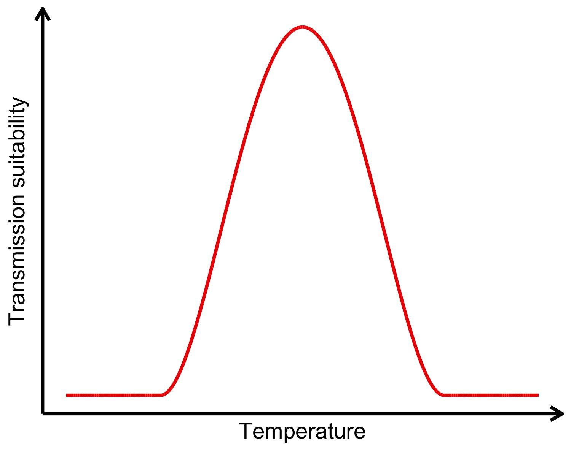
Role of urban heat islands in mosquito-borne disease (MBD) transmission?
Mosquito-pathogen traits directly temperature-dependent
Resulting transmission risk patterns well studied at macroclimatic scale
Important vector species have adapted to urban spaces
🡪 How do microclimates in urban spaces moderate transmission potential?
🡪 Is there a bias when using aggregated temperature data?
Cities make up majority of people
🡪 Understanding MBD risk at city scale important to target surveillance & control
Two worrying MBD developments in Europe
Expansion of Aedes Albopictus
Partially attributed to climate change creating suitable conditions
Do UHIs increase outbreak risk resulting from these processes?
Study impact of and Aedes Albopictus-DENV systems
Notes:
The two disease systems provide interesting comparison because of their different response to temperature.
For this study we are contrasting how transmission potential of Culex pipiens vs Aedes Albopictus contrast over rural to urban climates
Nonlinear temperature-risk relationship may lead to bias when applied to averaged/aggregated data
Both processes present topics of interest in light of climate change since they have been partially linked
Presents risk of outbreaks and even establishment of tropical diseases
Motivate reason to consider both species at same time
+ whats our hypothesis
Both are well adapted to urban (although differently)
Data is available
Mosquitoes of concern in temperate zones
The provide interesting comparison because of different
Response to temperature

Slide 17
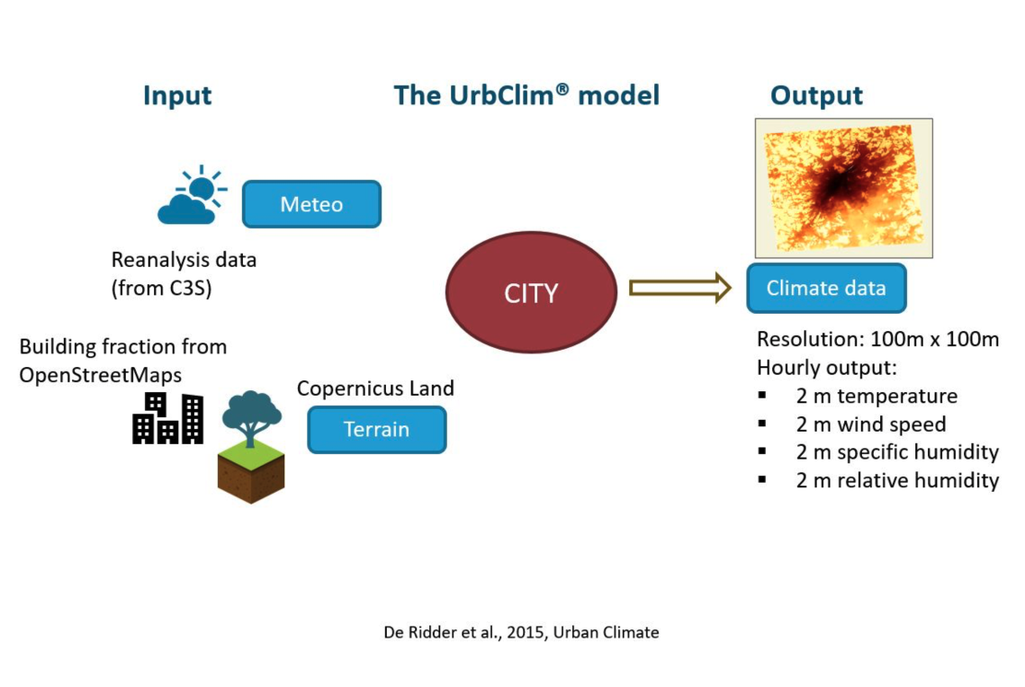
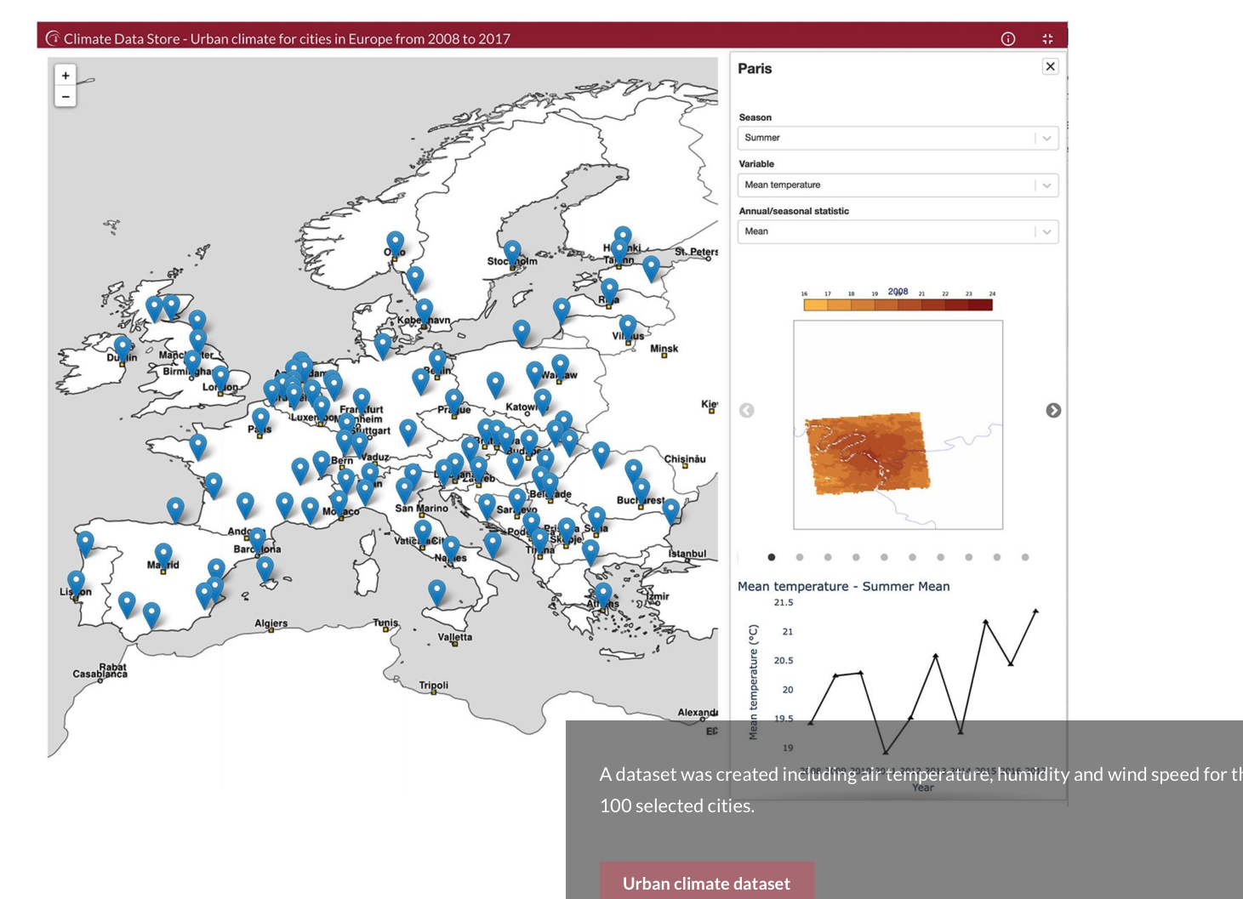
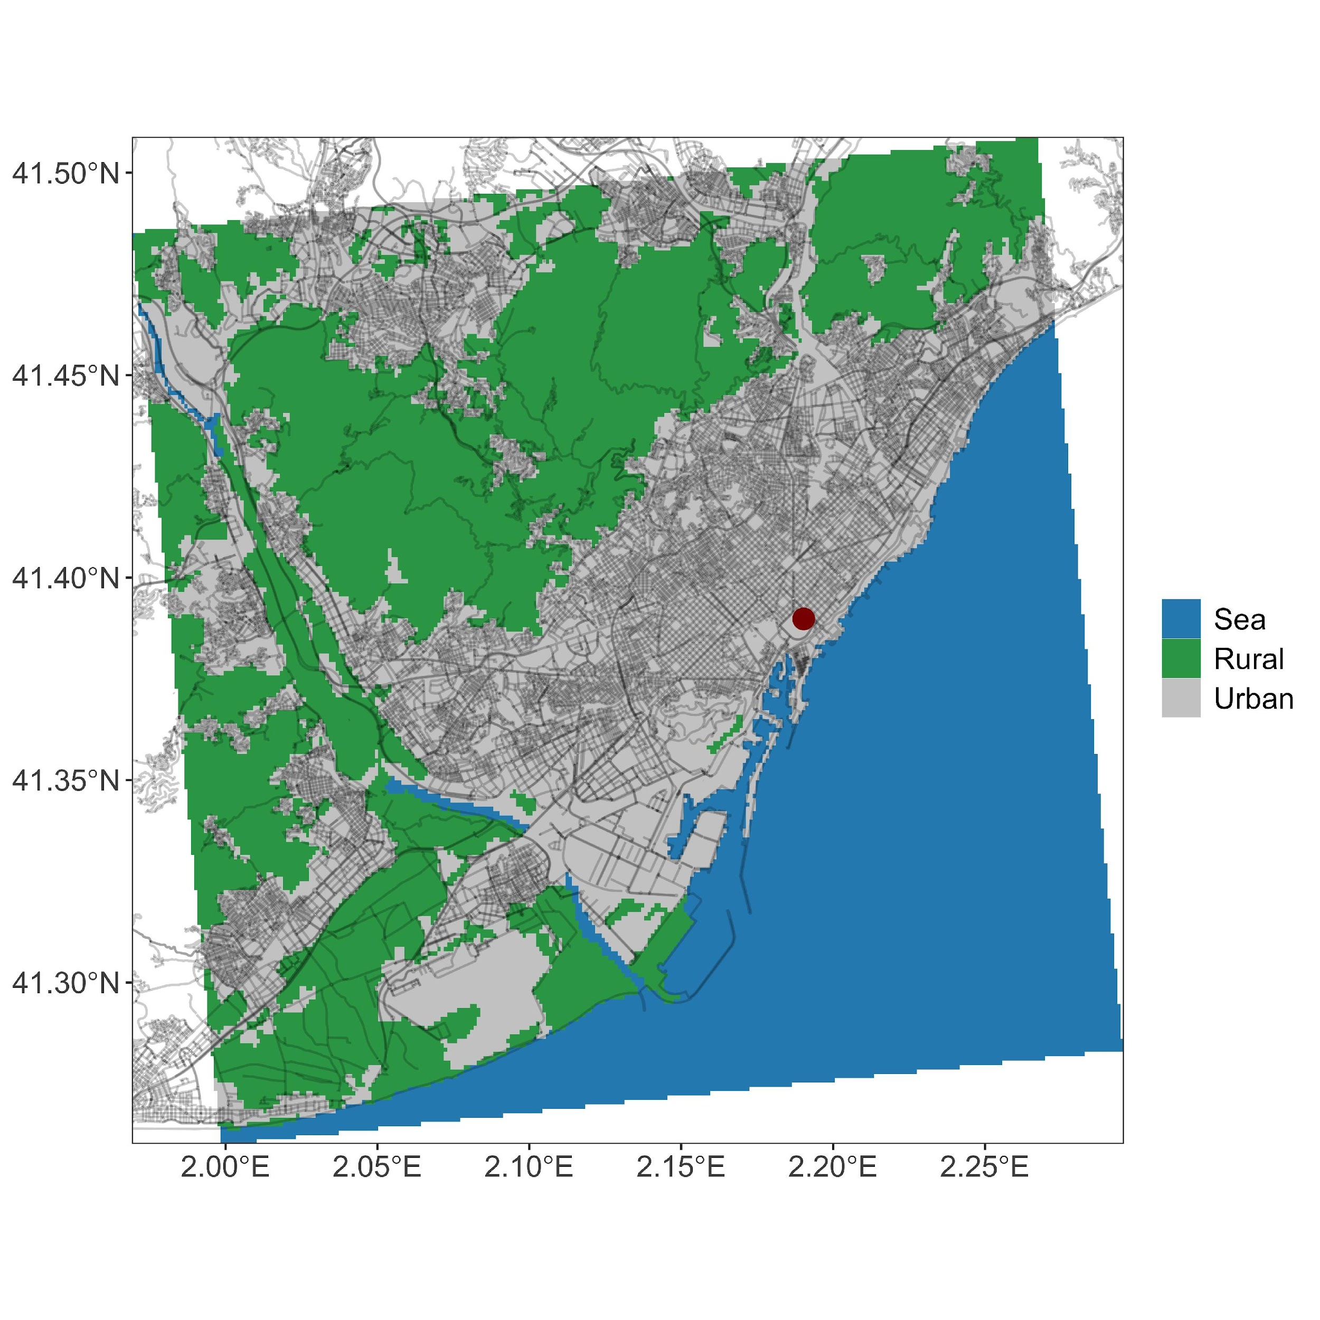
Data
ECMWF – Climate variables for cities in Europe from 2008 to 2017
Auxiliary data
Rural-urban mask
Land-sea mask
Notes:
Produced using the urban climate model UrbClim, specifically designed to study UHI
Model scales down large-scale weather conditions accounting for the impact of urban development on weather patterns (temperature, wind, humidity)
In calculations local terrain and surface data influence the heat flux and evaporation
Hourly output, 100m resolution
Simulated area comprises city and immediate surroundings
Has been subject to exhaustive evaluation
Inputs: large scale meteorological data (ERA5), description of terrain: 5 different land use classes (4 urban), vegetation (NDVI), soil sealing (amount of sealing in each grid cell), digital elevation model, anthropogenic heat flux:
the amount of heat produced by city and inhabitants (traffic exhaust, air-conditioning etc.)

Slide 18
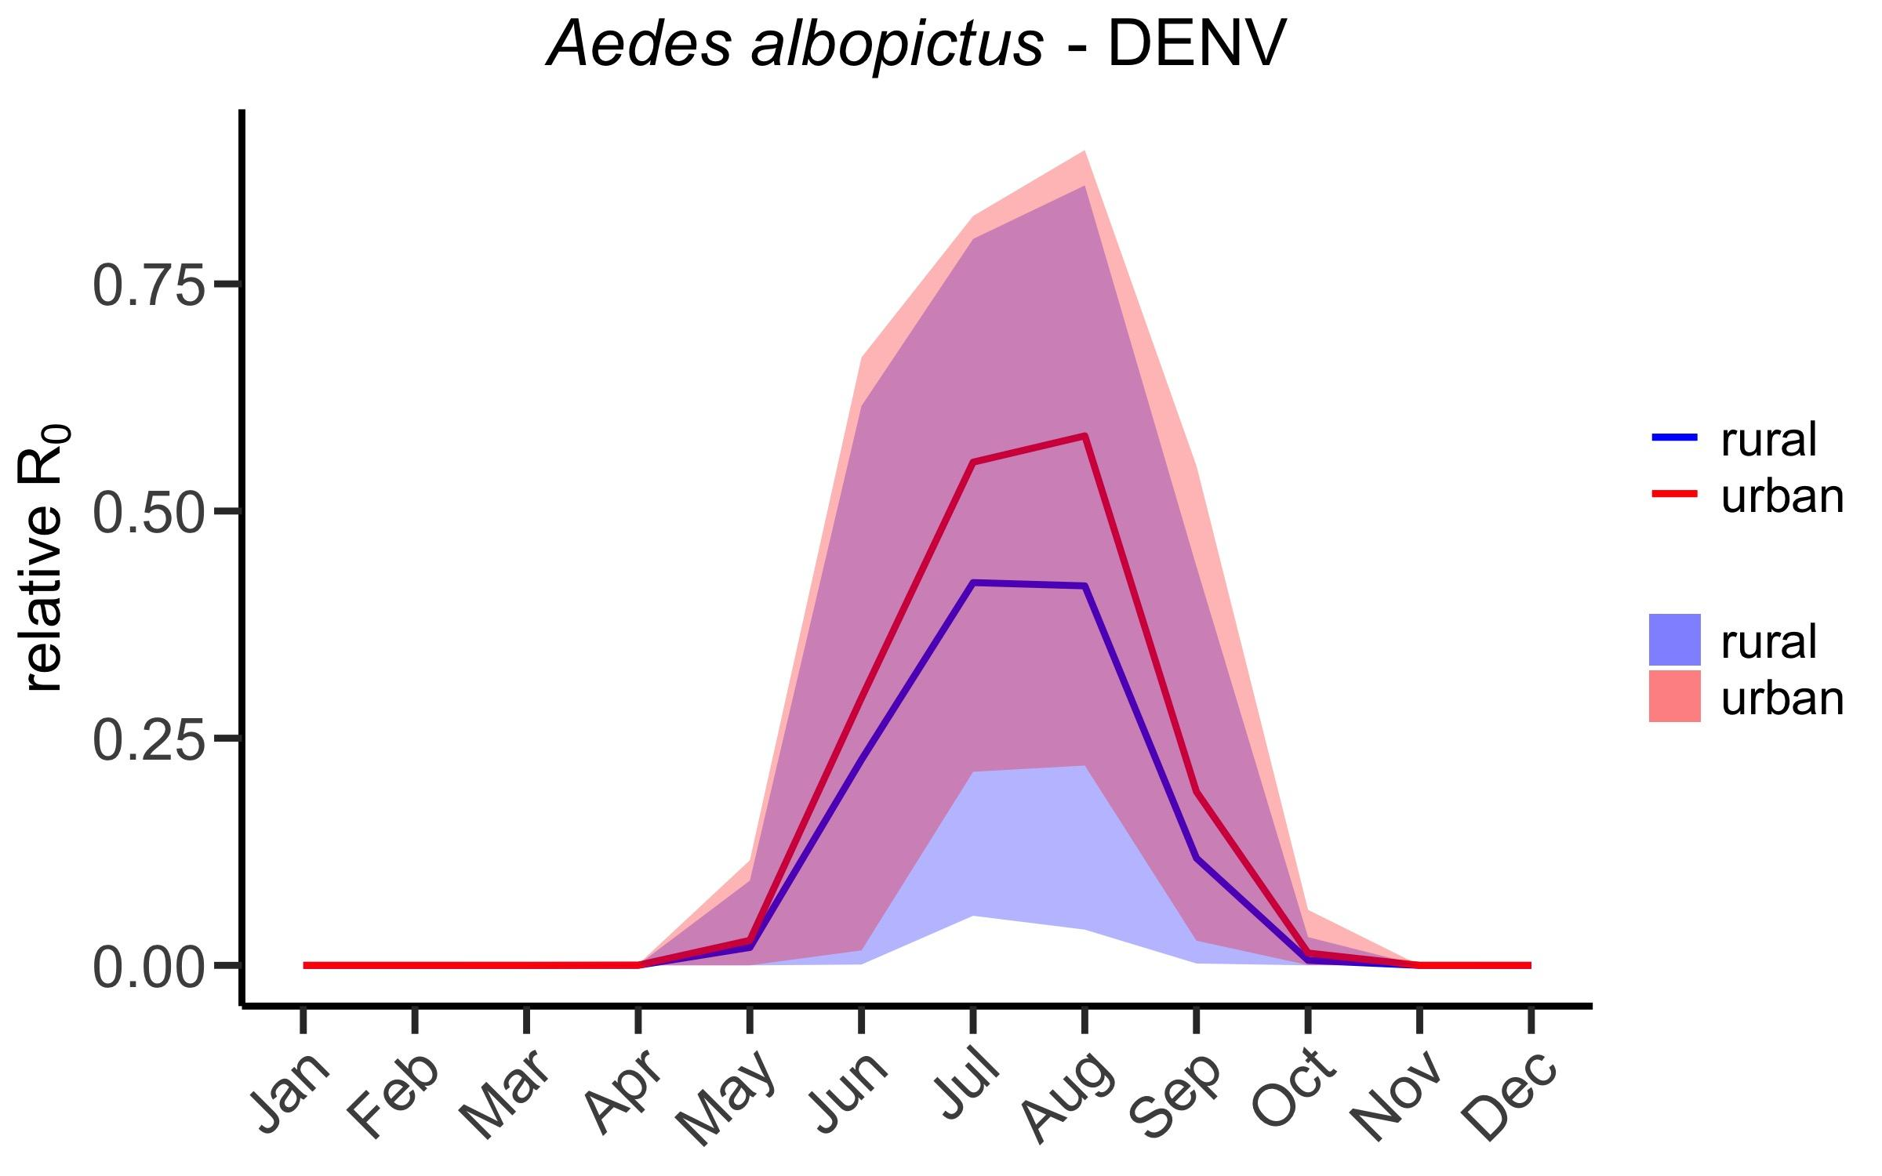
Results
High suitability for Aedes Albopictus pathogen-mosquito systems June-September
Generally higher suitability in urban areas
Summer minimum R₀ of albopictus-DENV very low in rural areas
Notes:
Currently, still in explorative stage but already made interesting observations
Low rel R0 for Albo may lead to interuptions of transm. Cycle currently hindering sustained DENV outbreaks 🡪 During specific hours of the day rel R0 almost zero indicating no transmission potential
Lines show mean rel R0 in urban vs rural for the respective months
Ribbons show average minimum and maximum in rel R0 throughout day for the specific month

Slide 19

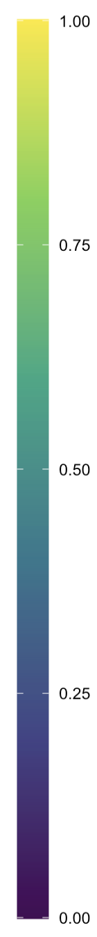
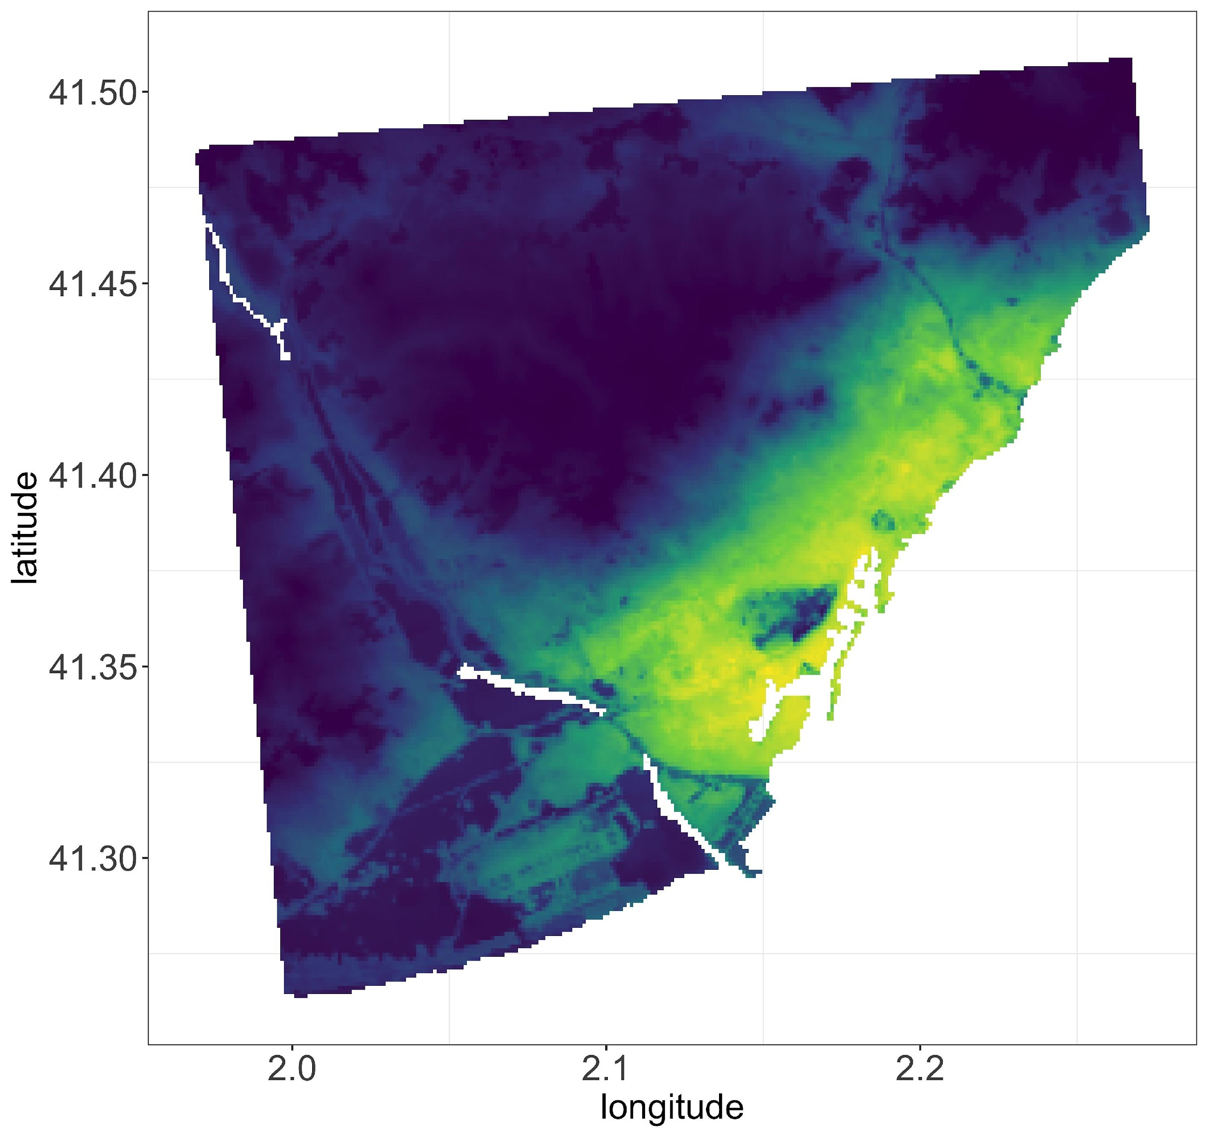
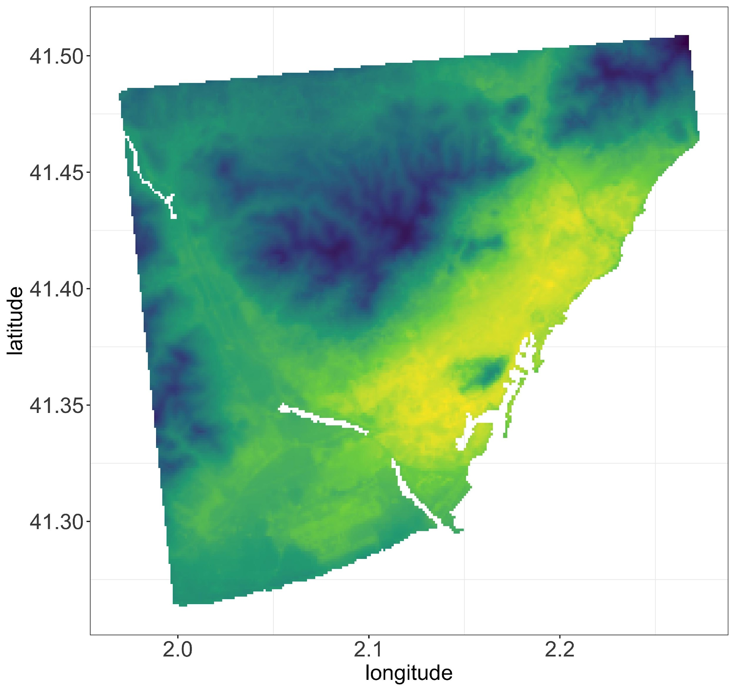
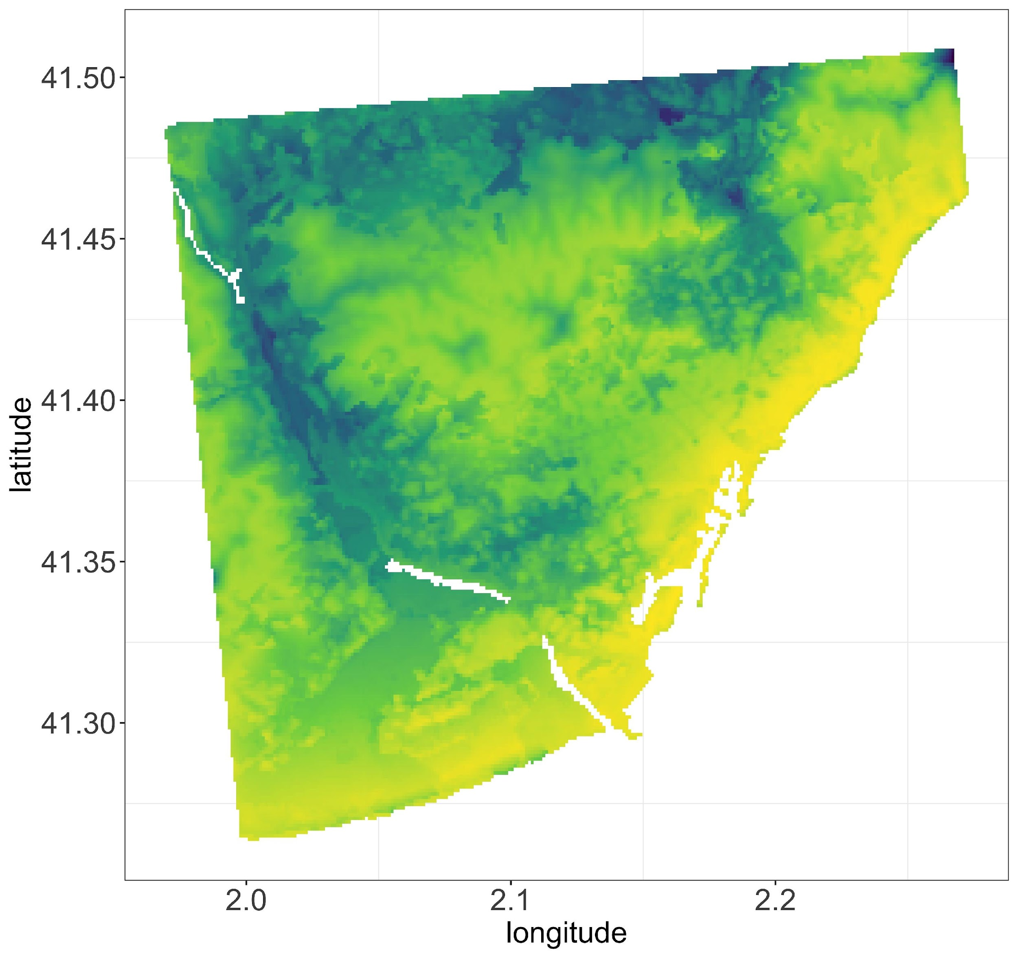
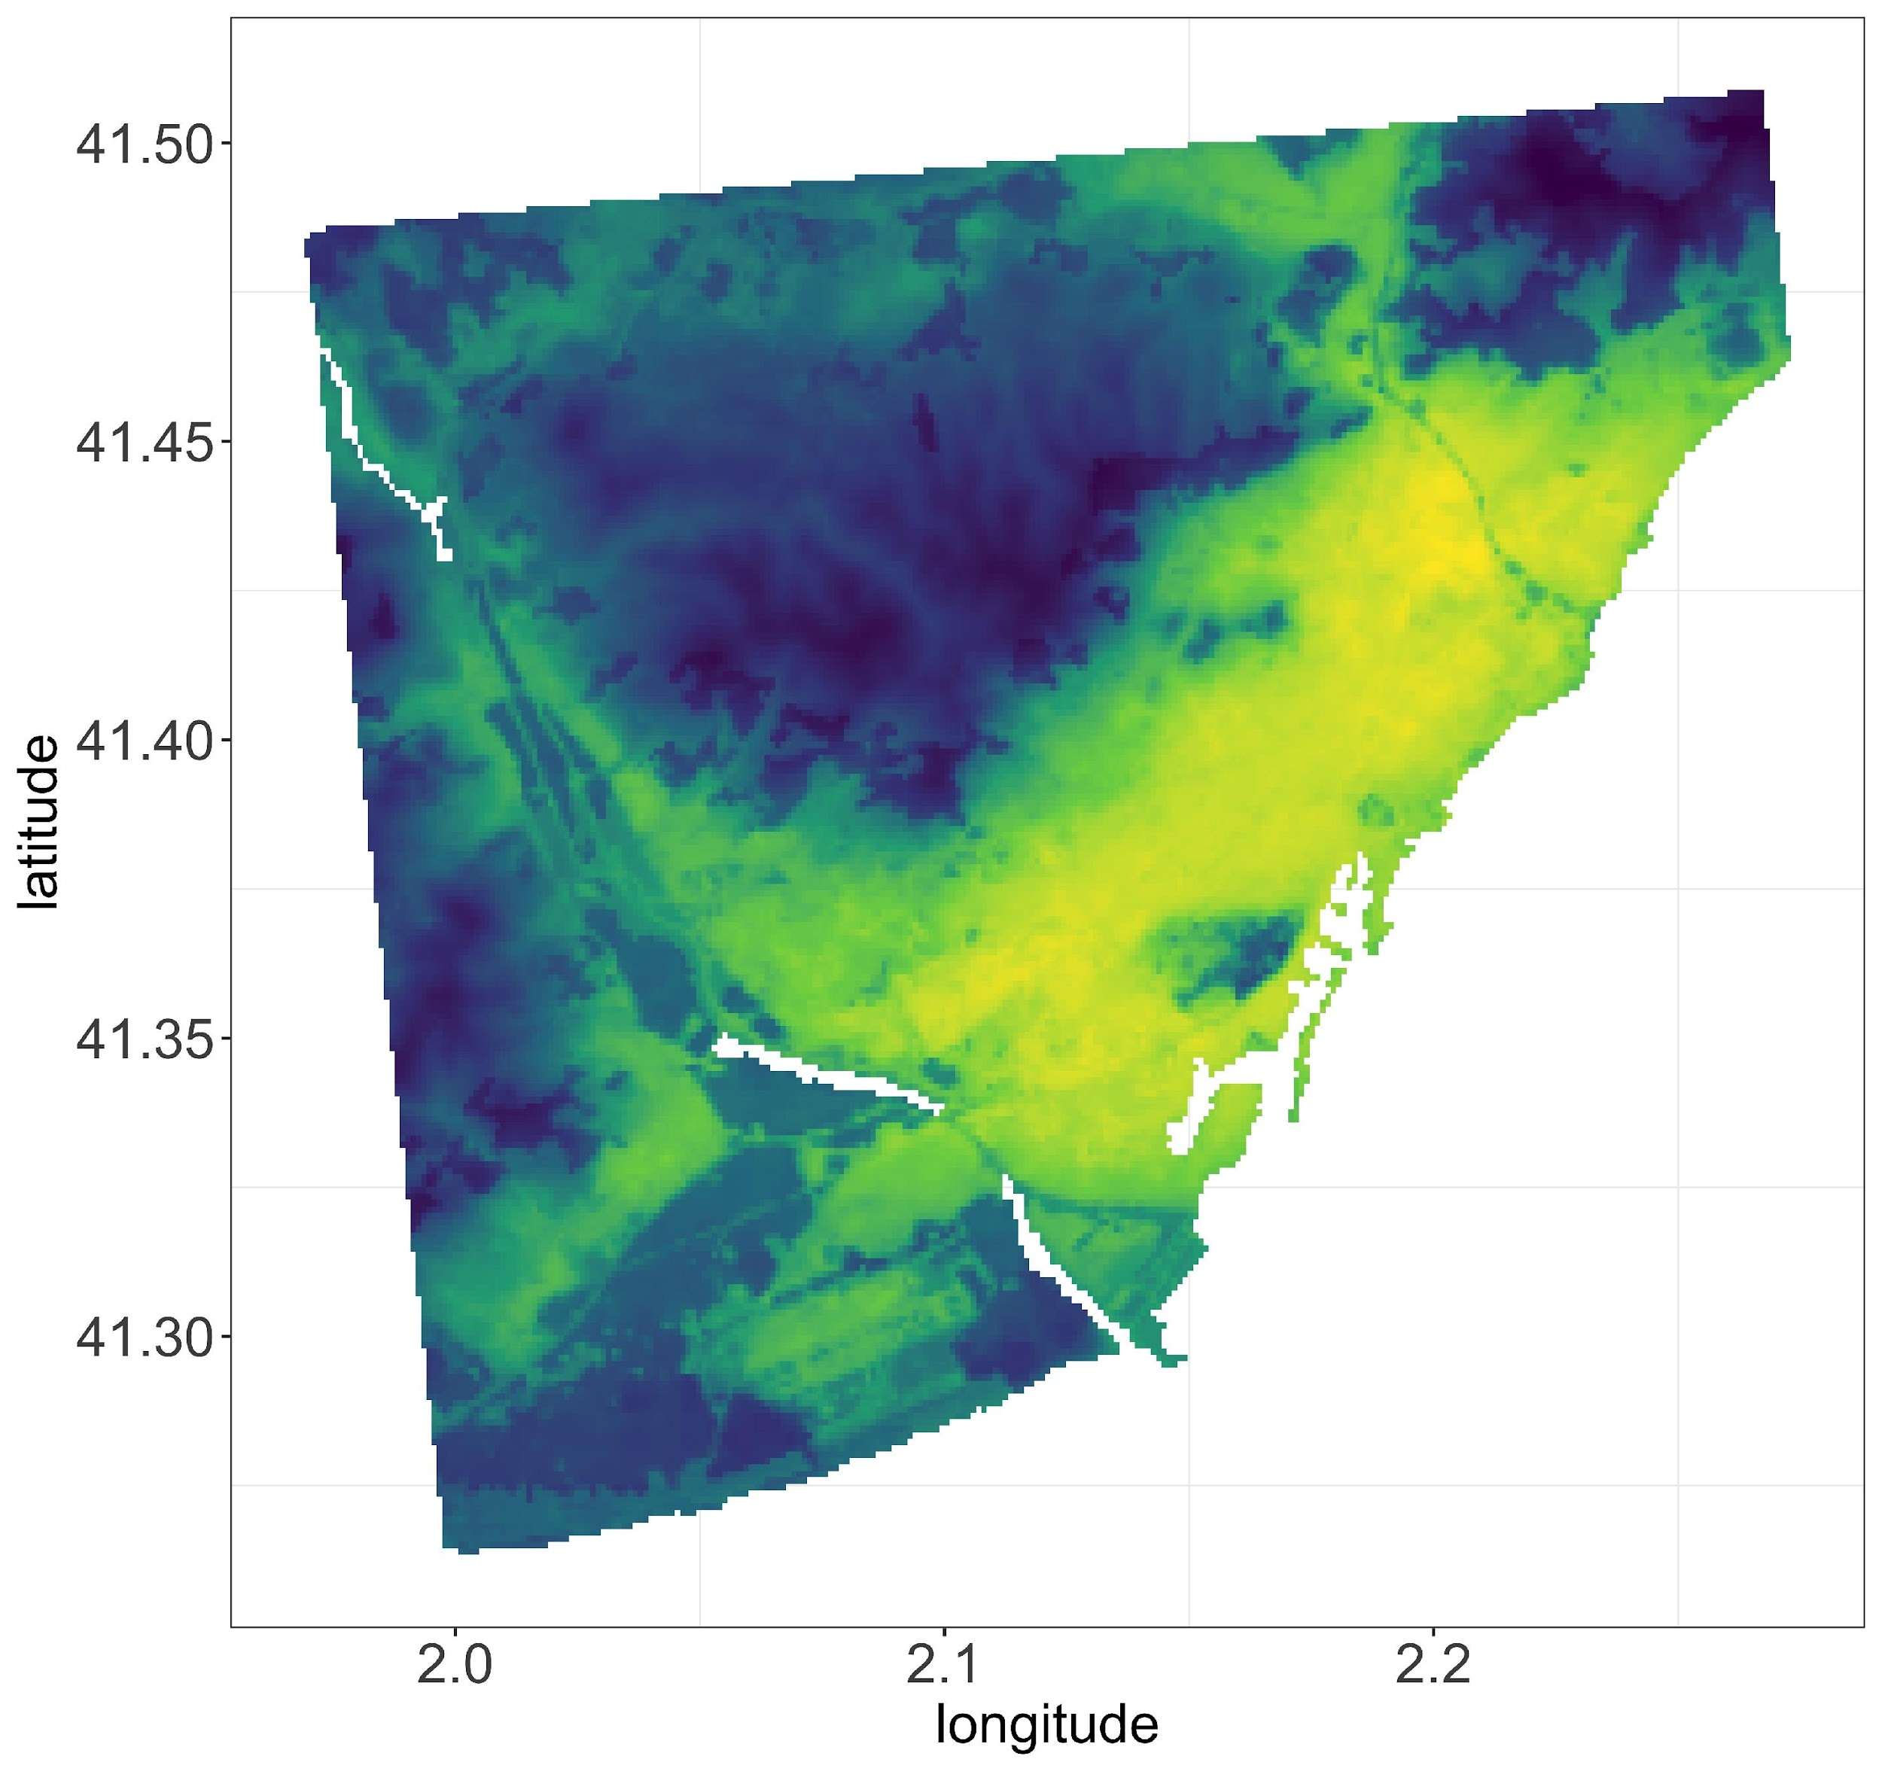
August
Night
(1am-4am)
Morning
(7am-10am)
Day
(1pm-4pm)
Evening
(7pm-10pm)
Aedes Albopictus
Dengue
Urban heat Island climate data at different time events in Barcelona
Strong variation of spatial risk over day
Geographical features have distinct impact
Notes:
WNV-pipiens:
overall higher suitability during night in august but during day in September (when looking at these specific hours)!
August day super unsuitable during day in urban
September super unsuitable during night because of cold in rural
Elevation can be refugia (see eg Pip during day)

Slide 20
Overview
Model Formulation
Model Challenges and Future direction
Model Results
Model and UHI’s

Slide 21

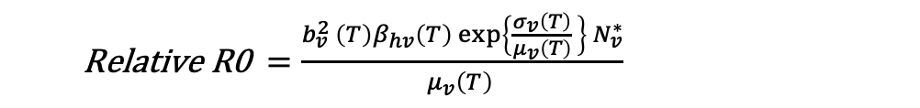
How much is the risk?
We can predict the risk in the future but are still uncertain about the risk.
Absolute R0 $= \frac{b_{v}^{2 }\left(T\right)β_{hv}\left(T\right) exp\left\{\frac{σ_{v}\left(T\right)}{μ_{v}\left(T\right)} \right\} N_{v}^{∗}}{μ_{v}\left(T\right) N_{h}}$
Relative R0 $=\frac{b_{v}^{2 }\left(T\right)β_{hv}\left(T\right) exp\left\{\frac{σ_{v}\left(T\right)}{μ_{v}\left(T\right)} \right\} N_{v}^{∗}}{μ_{v}\left(T\right) }$
$$\frac{{ β}_{vh}}{γ_{h}}$$
The idea is to compare the absolute R0 value to the actual basic reproduction number from real dengue outbreak from different parts of the world.
The original model was calibrated to calculate the abundance of Aedes Albopictus per hectare (Y).
Accounted the population correction term to mosquito to human density ratio.
Y * f(p, $\frac{a}{b}$, c) = $\frac{g\left(p, c\right)∗a }{b}$
Where,
a = the number of breeding sites per human, and
b = the average number of breeding sites per hectare
g(p, c) = $\frac{p^{2}}{c^{2}+p^{2} }$, increasing sigmoidal function that captures the viability of domesticated mosquito populations in relation to human population density
Capture Recapture method to estimate mosquito abundance?
Notes:
We know that there is a risk but how much is the risk?

Slide 22
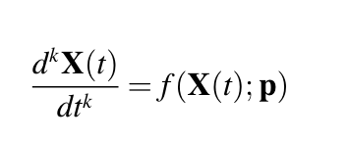
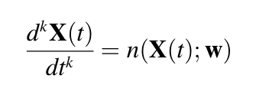
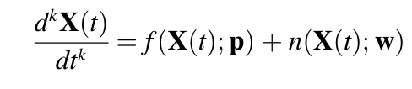
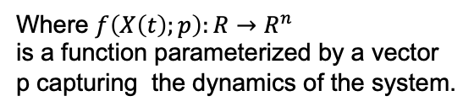
Modelling Approaches -
Mechanistic ODE Model
Where $f\left(X\left(t\right);p\right):R→R^{n}$
is a function parameterized by a vector
p capturing the dynamics of the system.
Data driven approach
Hybrid Modelling approach

Slide 23
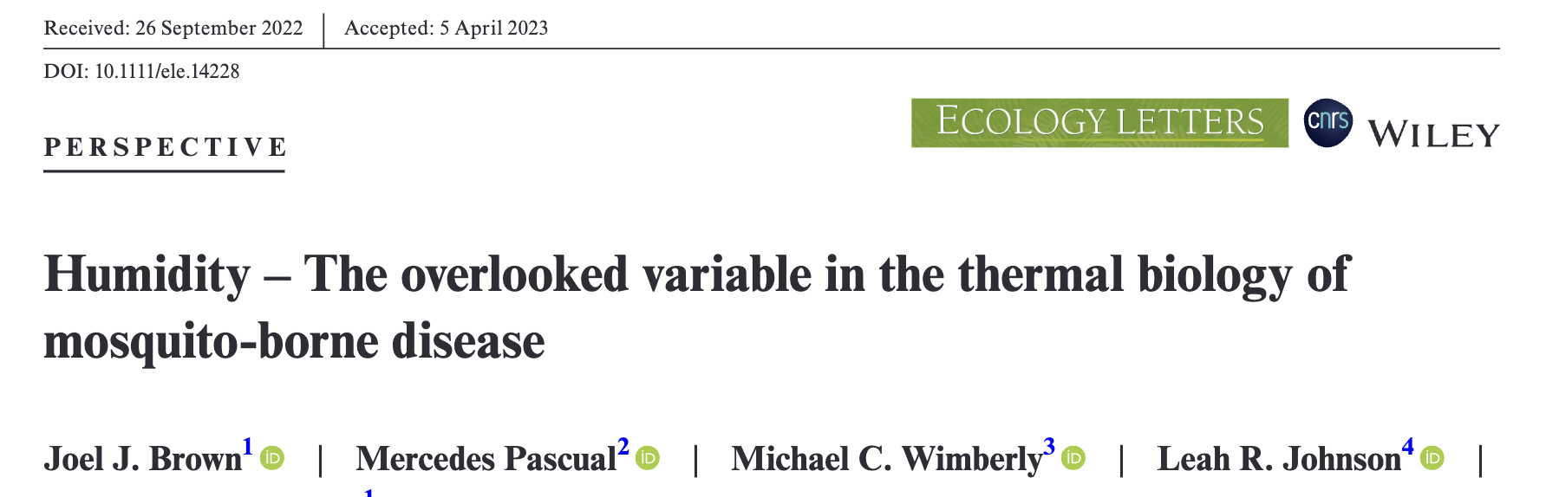

Stochastcity
The model perform quite well for larger area but for smaller region, a stochastic approach
will be much useful
The climatic data by copernicus datsource is with a resolution is 9 km but ECMWF Urban rural
climate data data is on 100m * 100m
On a small scale there will be a lot more stochasticity will be in human population and even the mosquito
population
And the Data?
Relative humidity is not an additive factor but an interactive factor
The humidity impact on mosquito traits is not well understood and will require more data
Notes:
Our assumption that mosquito population remains in that grid will be wrong.

Slide 24
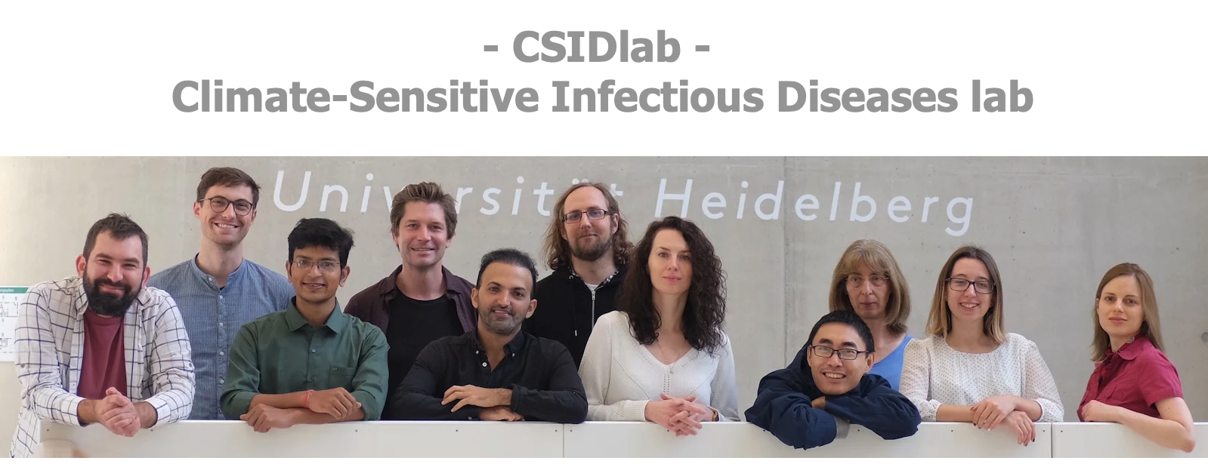
Thank you!

