Slide 1

Within-host Virus Evolution
Katrina Lythgoe
Notes:
I’m new (director) to the CDT so I’ll be learning with you!
But not new to the CDT – been running the two-week infectious disease module, this you’ll do this at the beginning of next term before you make decisions on your 2 rotation (Got new new co-lead, jasmine). BDI, and Oxford more generally, world leaders in infectious disease. You will be taught by the best in the world!
I’m a group leader at the BDI, and my work is specifically on virus evolutionary dynamics - so this picture here – Sars-Cov-2 – been working a lot on that!
In the program it says I’m in NDM – which is correct for the next week – but as of next week I’ll be in the dept biol. But still based here. If you have any questions about Biology, or if any of the research undertaken there.
And also a tutorial fellow at Brasenose college.
Any questions – particularly infectious disease, biology, let me know

Slide 2
Why should we care?

Slide 3
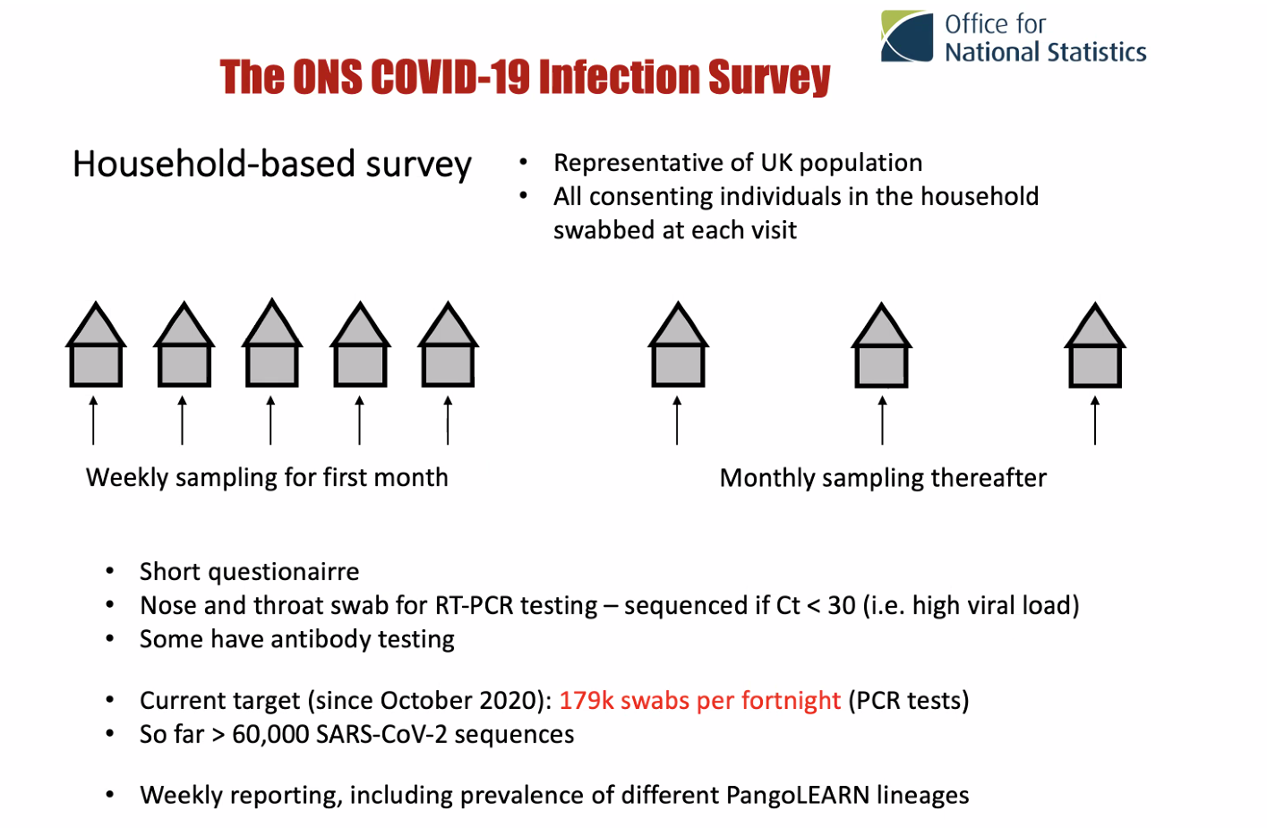

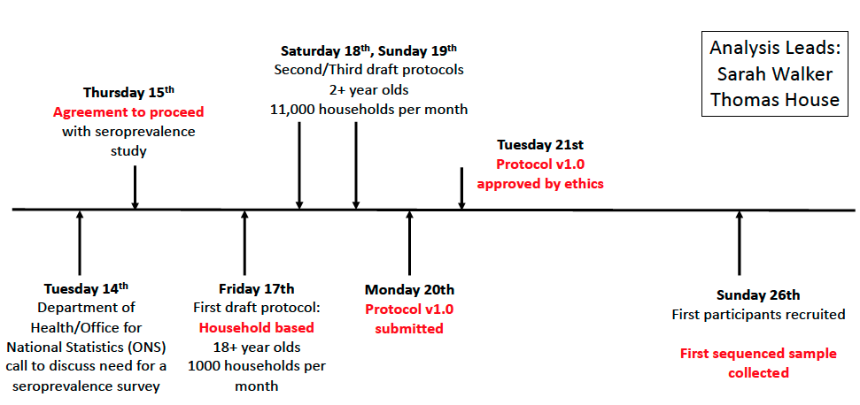
A brief history of the ONS COVID-19 Infection Survey (ONS-CIS)
April 2020

Slide 4




The ONS COVID-19 Infection Survey
person 1
person 2
This is both a:
Household-based survey (so we can look at transmission)
Longitudinal survey (so we can look at infection history)
Notes:
Sequencing as part of the cog-uk consortium

Slide 5





ONS Covid-19 Infection Survey
Pre-December 2020 a proportion of samples sequenced
Since December 2020 ambition to sequence all samples with Ct<30
(including retrospective sequencing of samples where possible)
Since December 2020 weekly reporting given breakdown of sequenced samples:
Sarah Walker, Katrina Lythgoe, Tanya Golubchik
Over 125K sequences with >50% coverage from 26th April 2020 to 14th March 2023
April 2020 –
Dec 2020
Dec 2020 –
June 2021
July 2021
August 2021 –
April 2022
April 2022 –
March 2023
Sequencing as part of the COG-UK consortium

Slide 6
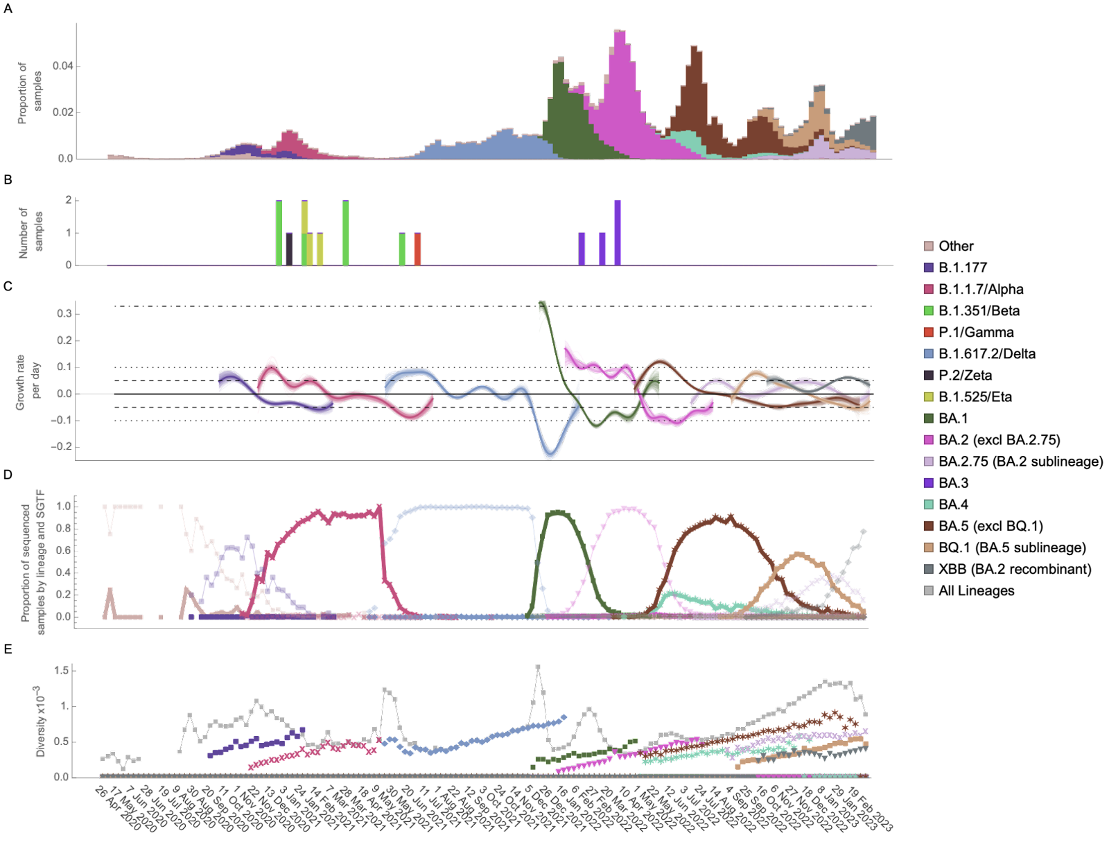
ONS Covid-19 Infection Survey

Slide 7
ONS Covid-19 Infection Survey

Slide 8
ONS Covid-19 Infection Survey

Slide 9
Sars-CoV-2 has saltatory leaps

Slide 10
Sars-CoV-2 has saltatory leaps
Leading hypothesis:
New major variants arise as a result of within-host evolution

Slide 11
Understanding within-host viral evolution

Slide 12
What are viruses?
Very small infectious agents that replicate inside living cells

Slide 13
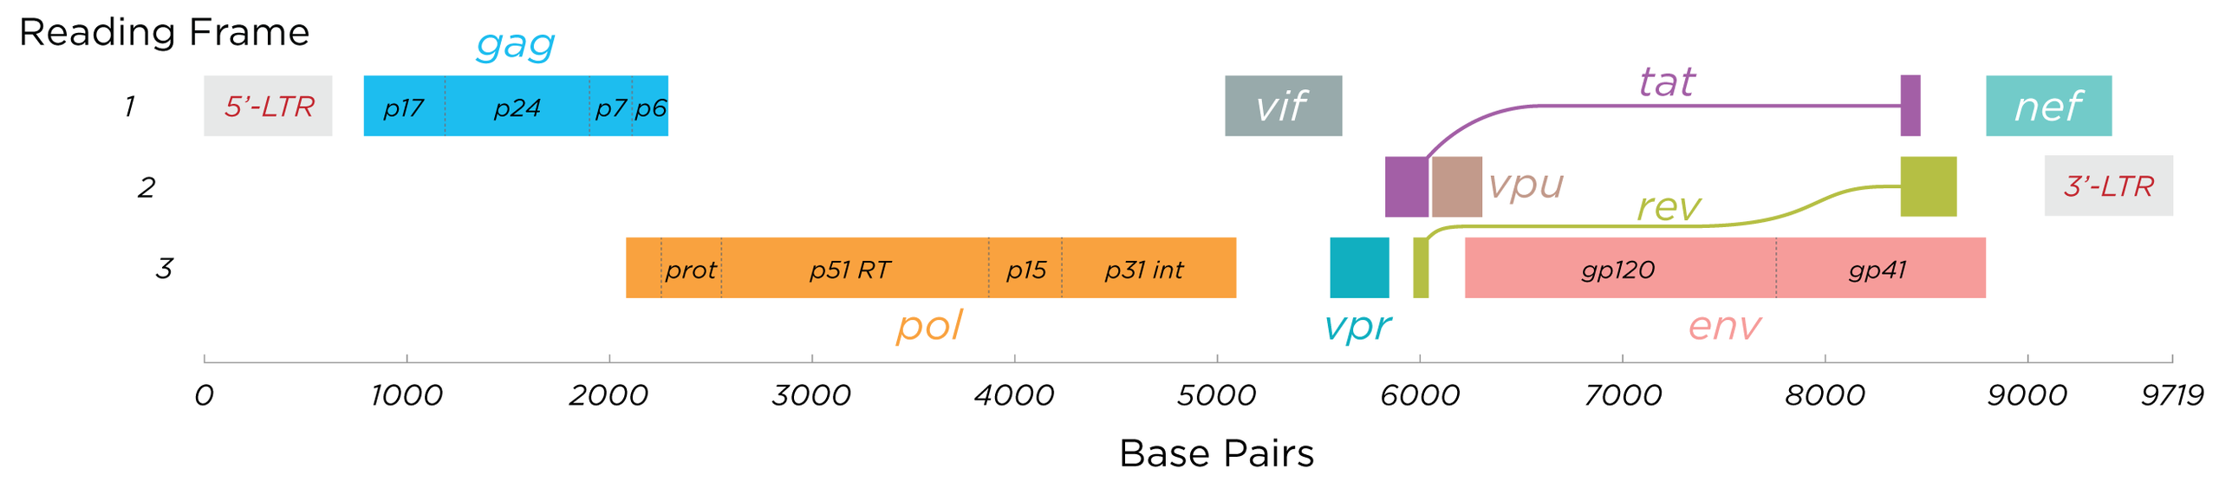
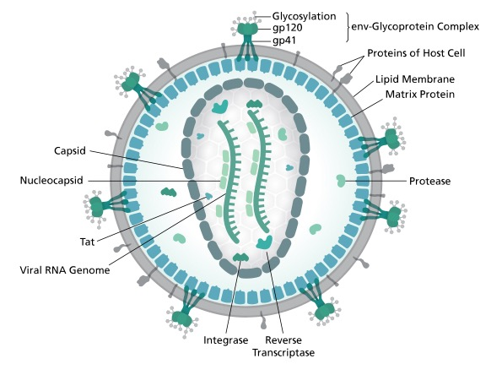
The HIV genome

Slide 14
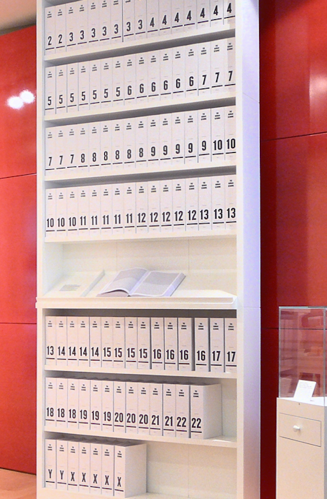

The Human Genome vs Viral Genomes
Human Genome ~ 3 billion letters (109 books)
HIV-1 ~10 thousand letters (~ 3 pages)
SARS-CoV-2 ~30 thousand letters (~ 10 pages)

Slide 15
What are viruses?
Very small infectious agents that replicate inside living cells
New diversity generated by mutation and recombination at the point of viral replication

Slide 16


Viruses evolve at (at least) two scales
Within-Host Scale
Population Scale
Selection pressure to maximise
within-host fitness
Selection pressure to maximise
between-host fitness (transmission)
Notes:
What maximized wh fitness may not maximise bh fitness

Slide 17
How do we measure viral evolution?

Slide 18
Next-generation sequencing approaches
Virus genomes in sample
Generate a ‘whole-genome consensus’ genome, used for between-host evolution studies
window
Used for within- and between-host evolutionary studies
Used for within- evolutionary studies
Targeted portions of the genome are sequenced and aligned
Whole-genome sequencing: viral genomes are fragmented, sequenced, and aligned

Slide 19
Within-host versus between-host viral genomics
Within-host
Multiple sequences from the same individual, at different times
Between-host
Consensus sequences from different individuals, at different times, with different individuals sequences at each time point

Slide 20
HIV-1 evolution at the within- and between-host scales
Within host (Envelope)
Between host
The shape of the HIV-1 phylogeny differs within- versus between-host
HIV-1 has a faster rate of evolution within-host than between-host
Lemey et al. AIDS 2006

Slide 21
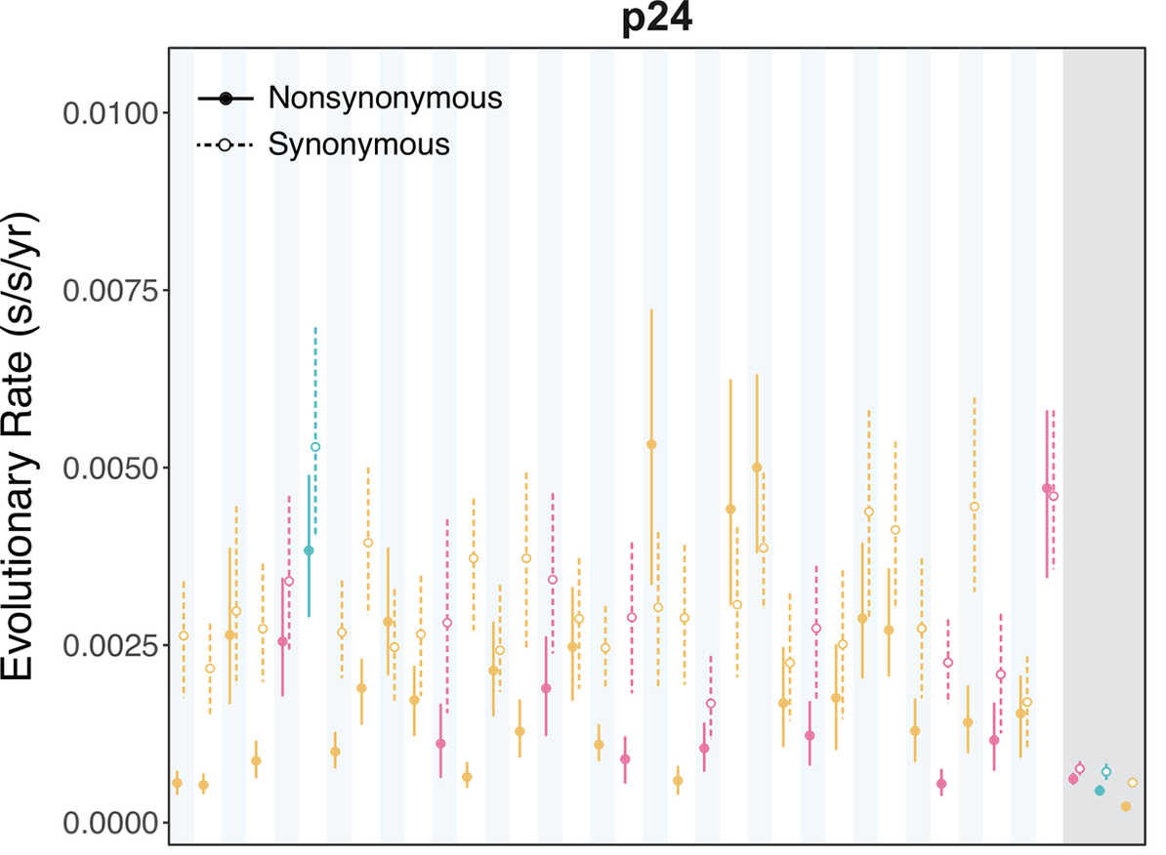
Short reads can mean much more uncertainty
Capsid (targeted by antibodies)
Data from 34 HIV-1 infected individuals serially sampled for about 5 years an living in Uganda
Evolutionary rates determined using BEAST
Raghwani et al (2018) PLoS Pathogens
Within-host rates of evolution
Within-host rates of evolution

Slide 22
Viruses evolve at (at least) two scales
Within-Host Scale
Population Scale
Selection pressure to maximise
within-host fitness
Selection pressure to maximise
between-host fitness (transmission)
Notes:
What maximized wh fitness may not maximise bh fitness

Slide 23
Viruses evolve at (at least) two scales
Within-Host Scale
Population Scale
Evolution will depend on:
Mutation rate (per viral replication)
Within-host viral generation time
Selection
Population Structure
Selection pressure to maximise
between-host fitness (transmission)
Notes:
What maximized wh fitness may not maximise bh fitness

Slide 24
Viruses evolve at (at least) two scales
Within-Host Scale
Population Scale
Evolution will depend on:
Mutation rate (per viral replication)
Within-host viral generation time
Selection
Population Structure
Selection pressure to maximise
between-host fitness (transmission)
Notes:
What maximized wh fitness may not maximise bh fitness

Slide 25
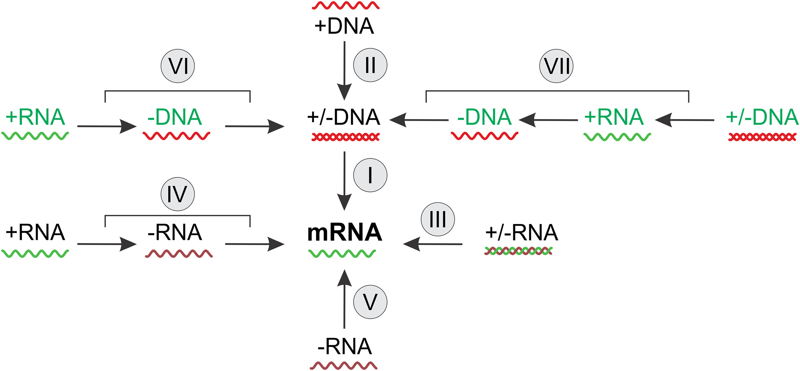
The Baltimore Classification of Viruses
(proposed by David Baltimore in 1971)
Retroviruses (e.g. HIV)
Uses reverse transcriptase to replicate
Error prone, so high mutation rate
e.g. Hepatitis B Virus
Uses reverse transcriptase to replicate
Error prone, so high mutation rate
Classification based on the route of information transmission from the genome to mRNA, from which virus proteins are translated
e.g. Coronaviruses incl. SARS-CoV-2
Uses RNA-Dependent RNA Polymerase (RdRp) to replicate (error prone)
e.g. Influenza
Uses RdRp
(error prone)
Koonin et al. (2021) Microbiology & Molecular Biology Reviews e00053-21

Slide 26
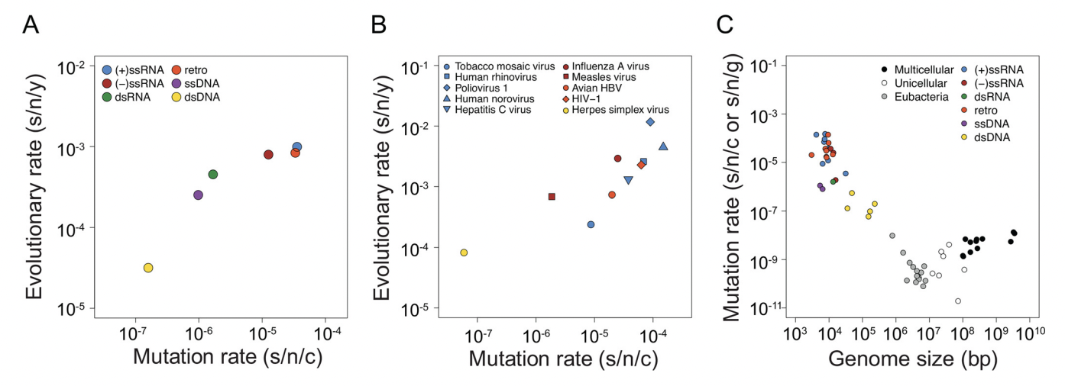
Relationship between genome size, mutation rate, and substitution rate within the viruses
Peck & Lauring (2018) Journal of Virology https://doi.org/10.1128/JVI.01031-17
The high substitution rates of many viruses mean they evolve on ecological timescales

Slide 27
Viruses evolve at (at least) two scales
Within-Host Scale
Population Scale
Evolution will depend on:
Mutation rate (per viral replication)
Within-host viral generation time
Selection
Population Structure
Selection pressure to maximise
between-host fitness (transmission)
Notes:
What maximized wh fitness may not maximise bh fitness

Slide 28
Hepatitis B virus has a long viral generation time
eAg-negative
eAg-positive
62 days (similar to in vitro estimates)
26 days
infection
proliferation
cell death/cure
Lythgoe et al. Virus Evolution 2021

Slide 29
Viruses evolve at (at least) two scales
Within-Host Scale
Population Scale
Evolution will depend on:
Mutation rate (per viral replication)
Within-host viral generation time
Selection
Population Structure
Selection pressure to maximise
between-host fitness (transmission)
Notes:
What maximized wh fitness may not maximise bh fitness

Slide 30
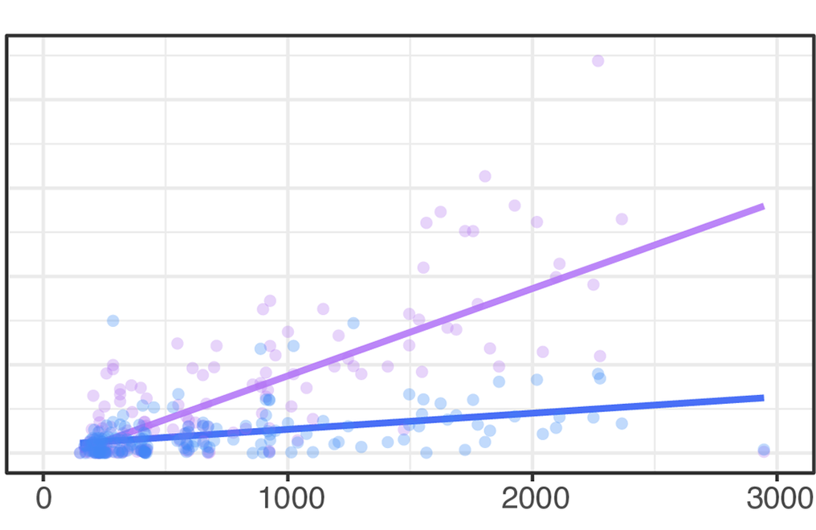
Evidence for selection during the course of HIV-1 infection
Envelope (targeted by antibodies)
Data from 34 HIV-1 infected individuals serially sampled for about 5 years an living in Uganda
Raghwani et al (2018) PLoS Pathogens
Divergence
Time since infection

Slide 31
Selected during chronic HIV-1 infection
Escape from T-cells (or reversions)
Data from 34 serially sampled HIV infected individuals
Selected mutations typically involve evasion from host immunity
Mutations that are selected for in some individuals are selection against in others
Escape from antibodies (or reversions)
Illingworth et al (2020) PLoS Pathogens 16(6): e1008171

Slide 32
Viruses evolve at (at least) two scales
Within-Host Scale
Population Scale
Evolution will depend on:
Mutation rate (per viral replication)
Within-host viral generation time
Selection
Population Structure
Selection pressure to maximise
between-host fitness (transmission)
Notes:
What maximized wh fitness may not maximise bh fitness

Slide 33
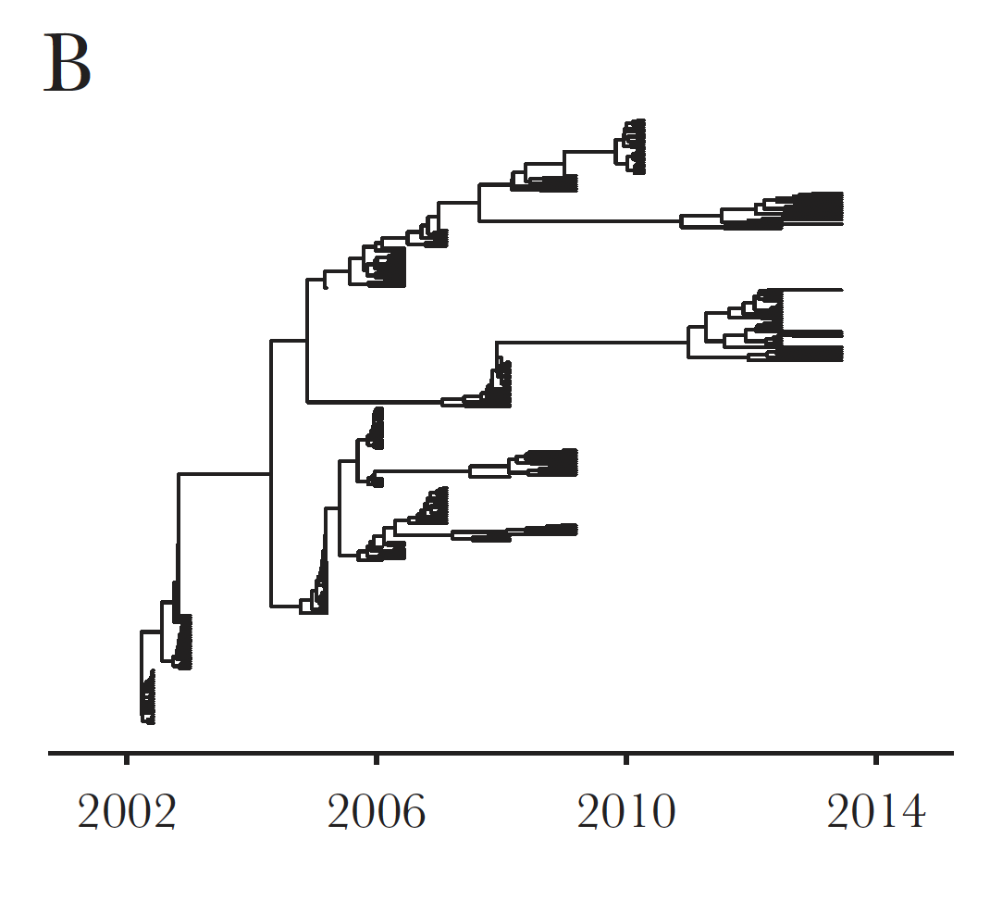
Within-Host Population Structure of Hepatitis C virus
Raghwani et al. JID 2019

Slide 34
Viruses evolve at (at least) two scales
Within-Host Scale
Population Scale
Selection pressure to maximise
within-host fitness
Selection pressure to maximise
between-host fitness (transmission)
Notes:
What maximized wh fitness may not maximise bh fitness

Slide 35
Viruses evolve at (at least) two scales
Within-Host Scale
Population Scale
Relative importance of population scale evolution will depend on:
Rate of within-host viral evolution
Between-host viral generation time
Selection pressure to maximise
within-host fitness
Selection pressure to maximise
between-host fitness (transmission)
Notes:
What maximized wh fitness may not maximise bh fitness

Slide 36
Three classifications of viral infections
Acute infection
e.g. Influenza, SARS-CoV-2
Viral load
Latent persistent infection
e.g. Herpes Simplex Virus
Viral load
Chronic persistent infection
e.g. HIV, Hepatitis B Virus, Hepatitis C Virus
Viral load
Time since infection

Slide 37
Three classifications of viral infections
Acute infection
e.g. Influenza, SARS-CoV-2
Viral load
Latent persistent infection
e.g. Herpes Simplex Virus
Viral load
Chronic persistent infection
e.g. HIV, Hepatitis B Virus, Hepatitis C Virus
Viral load
Time since infection

Slide 38
Saltatory Leap in SARS-CoV-2

Slide 39
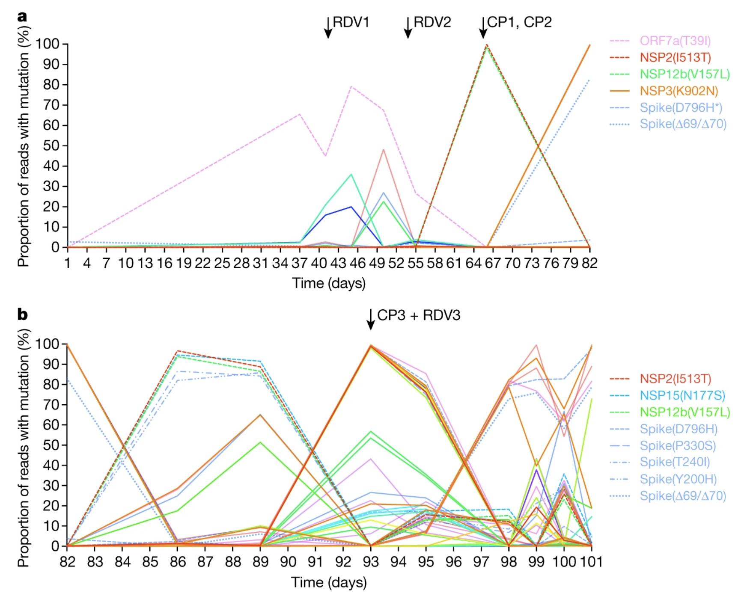
'Acute’ infections can become chronic in immunocompromised individuals
Kemp et al (2021) Nature 592: 277–282

Slide 40
Can we Identify Persistent Infections in the ONS?
ONS-CIS is a longitudinal survey
-> Can identify long infections or re-infections
Weekly sampling for first month
Monthly sampling thereafter
Person 1
Person 2

Slide 41
Persistent Infections
Persistent infection if:
Two sequenced samples at least 26 days apart
Both samples of the same major lineage (Alpha, Delta, BA.1 or BA.2)
Share at least one rare mutation
We defined rare mutations as those observed in 400 or fewer ONS-CIS samples of that major lineage -> false positive rate of ~ 0 - 3%
Ghafari et al. MedRxiv

Slide 42
Alpha persistent infections
Alpha re-infections
Ghafari et al. MedRxiv

Slide 43
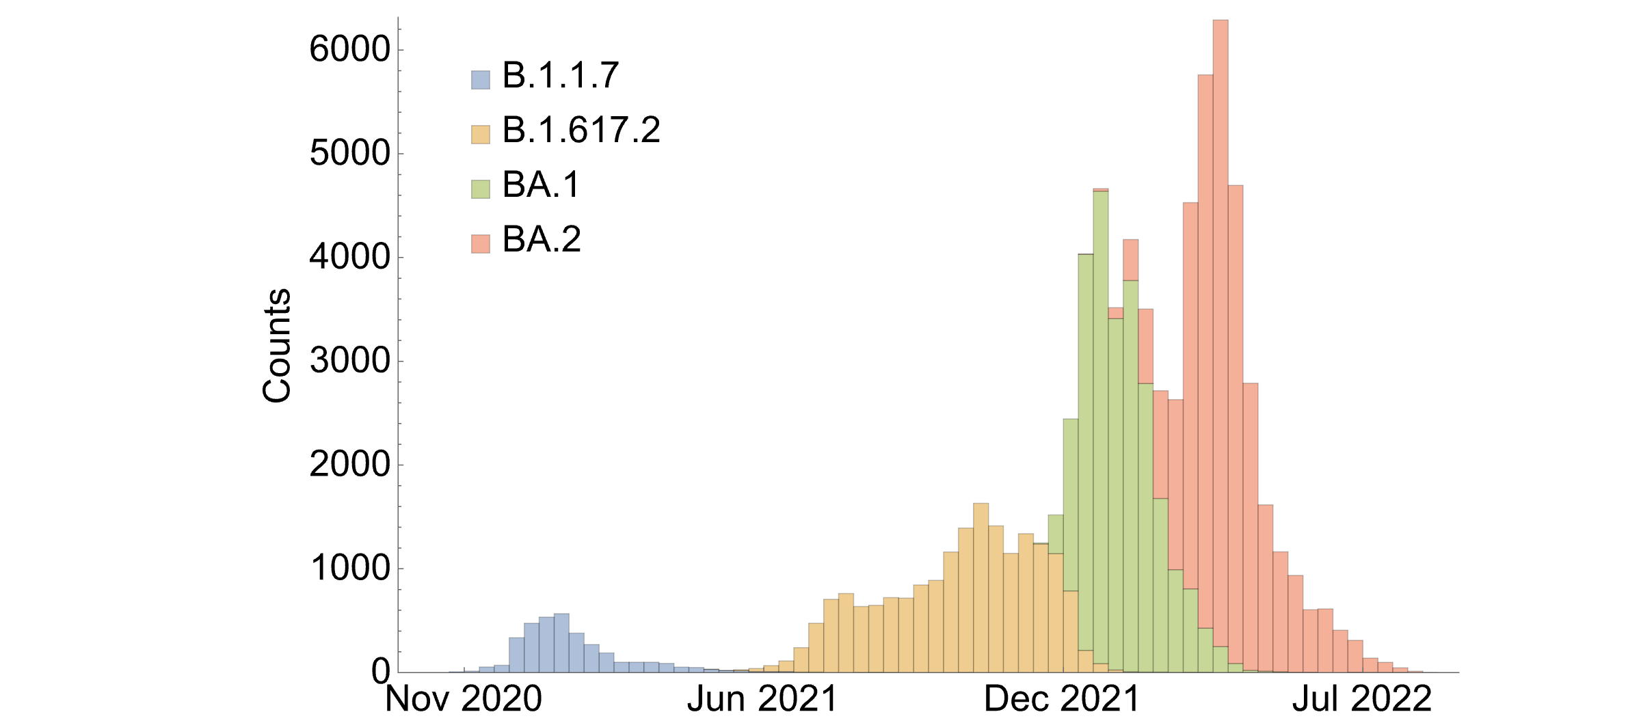
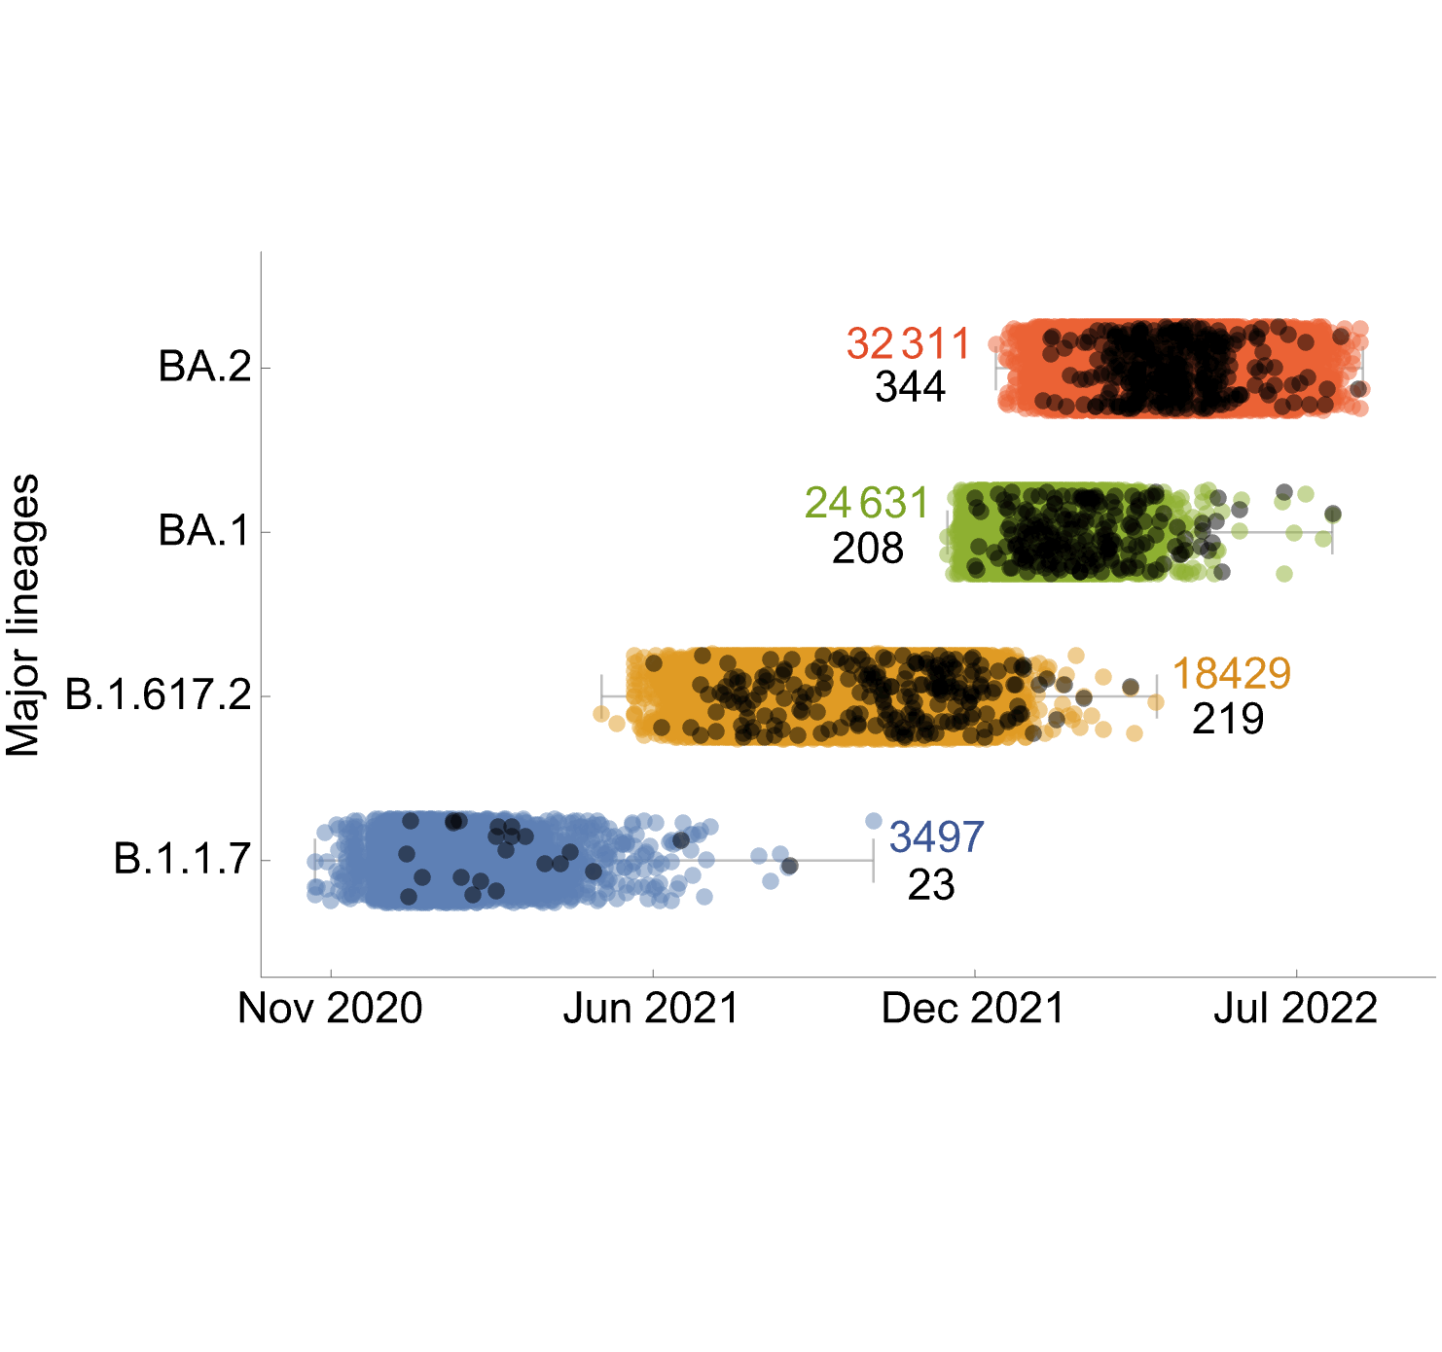
Persistent Infections
381 persistent infections lasting 26 – 200 days
Some persist after the lineage has gone extinct
Ghafari et al. MedRxiv

Slide 44
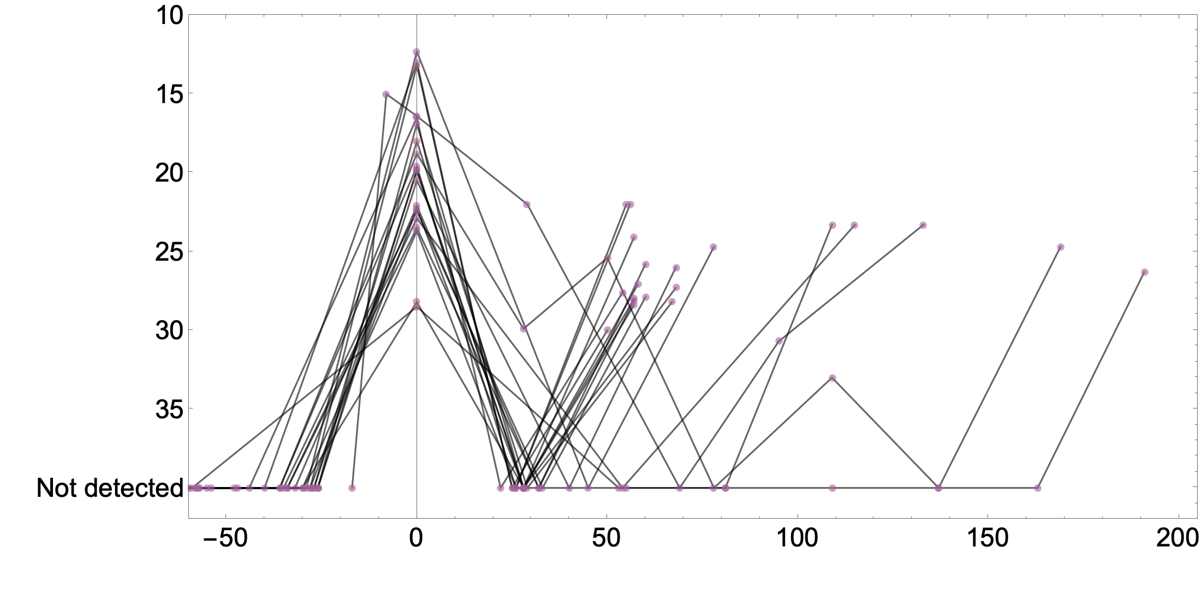
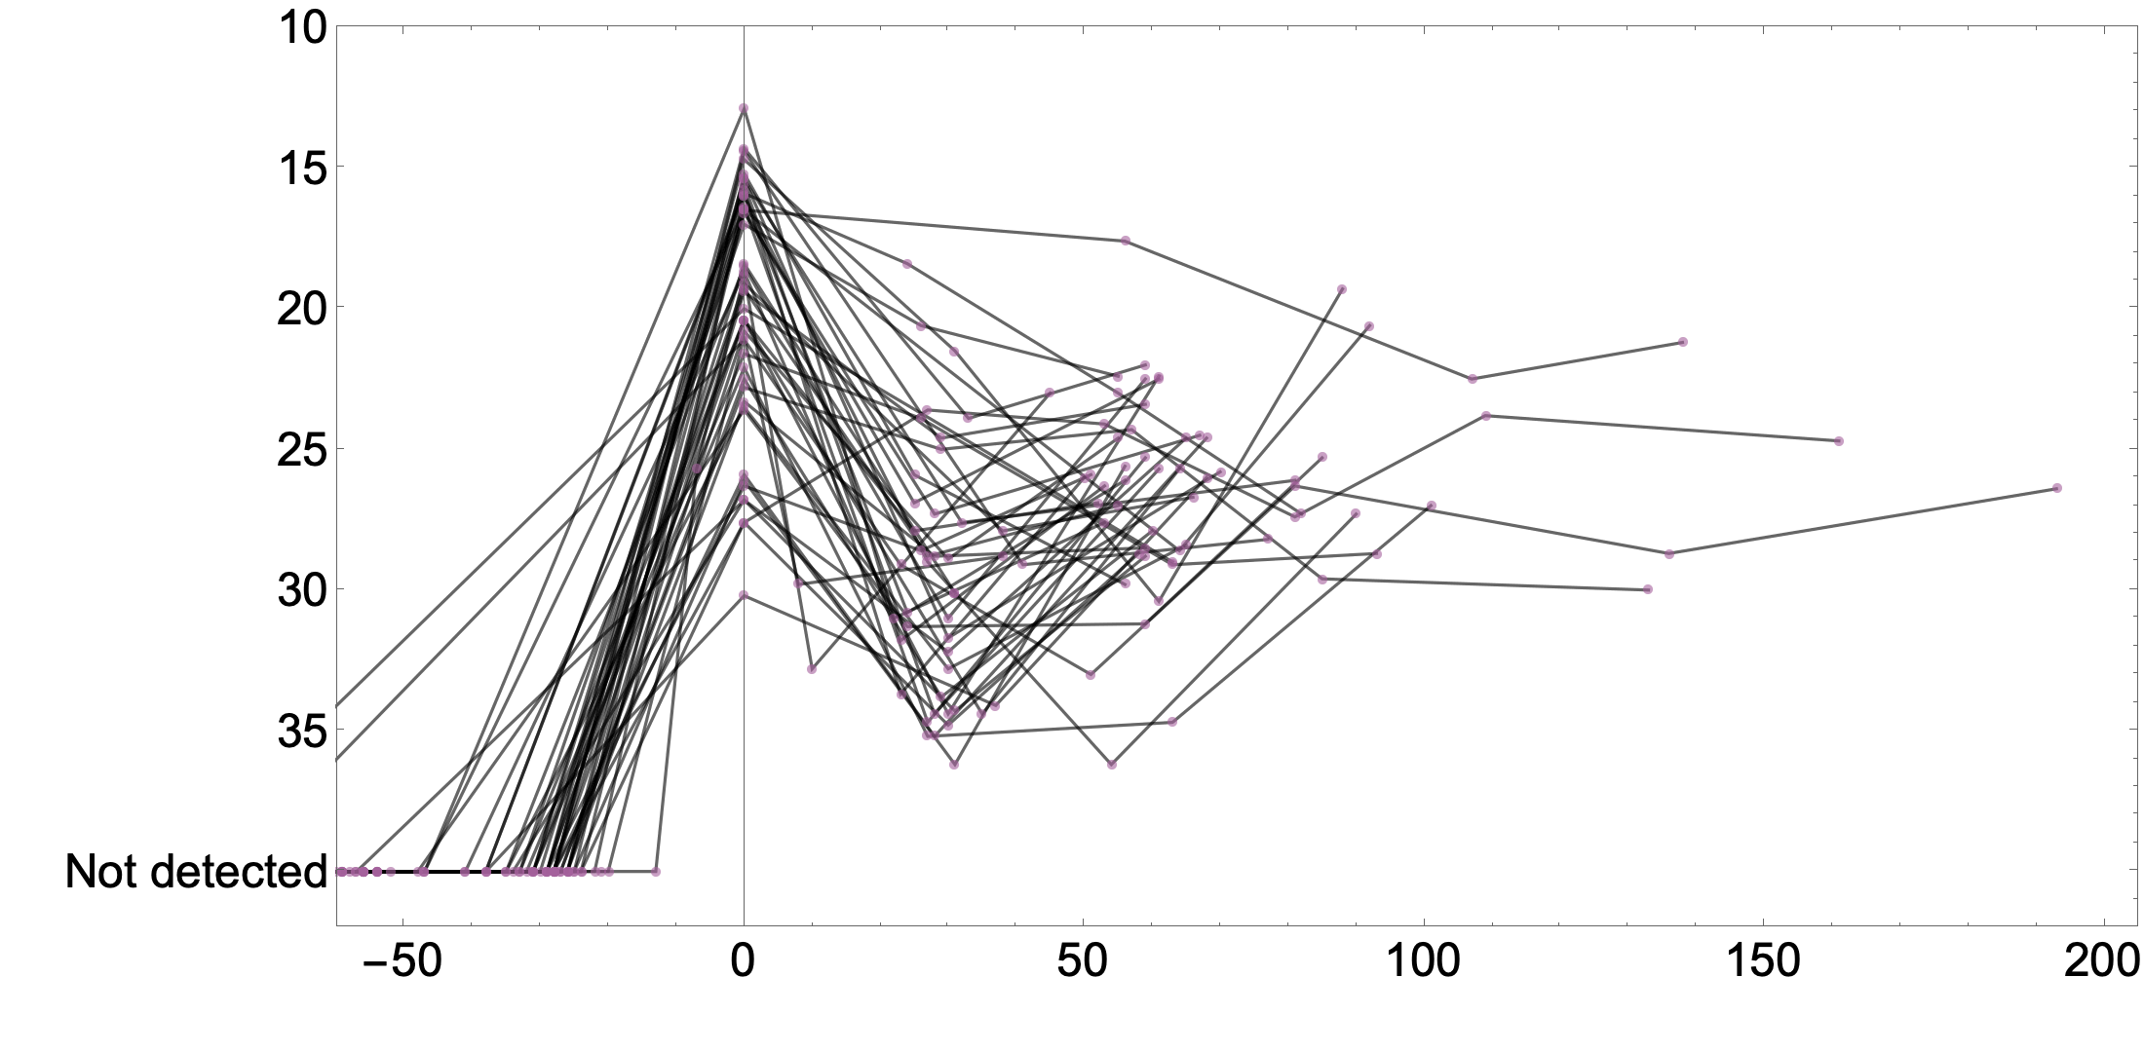
Viral load trajectories for persistent infections
Ct value
Days since first sequence, t
Days since first sequence, t
Ghafari et al. MedRxiv

Slide 45
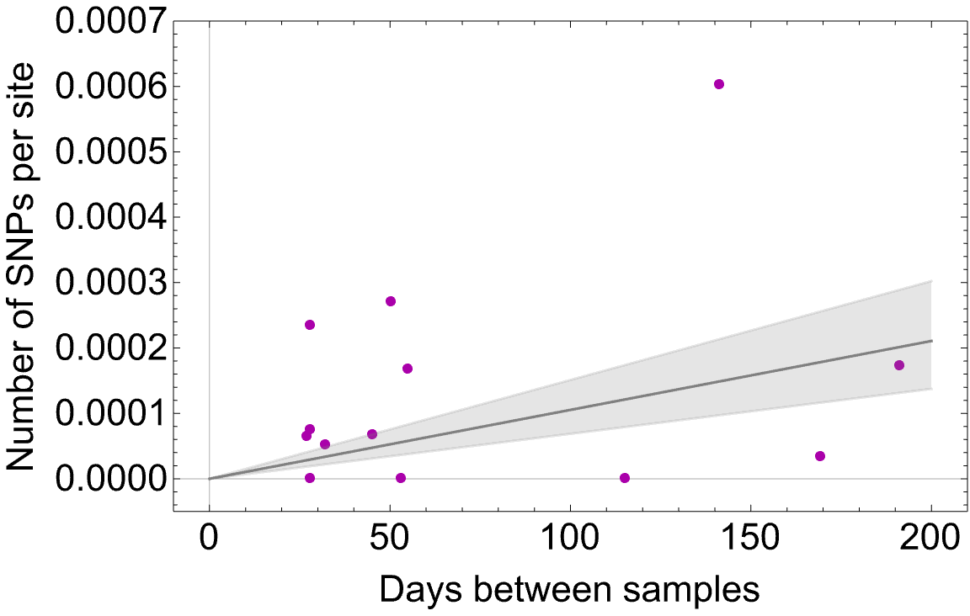
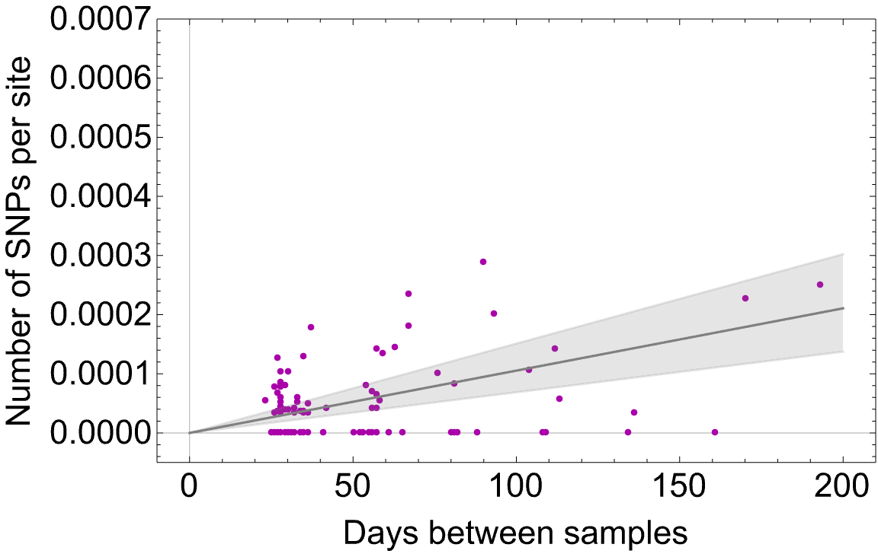
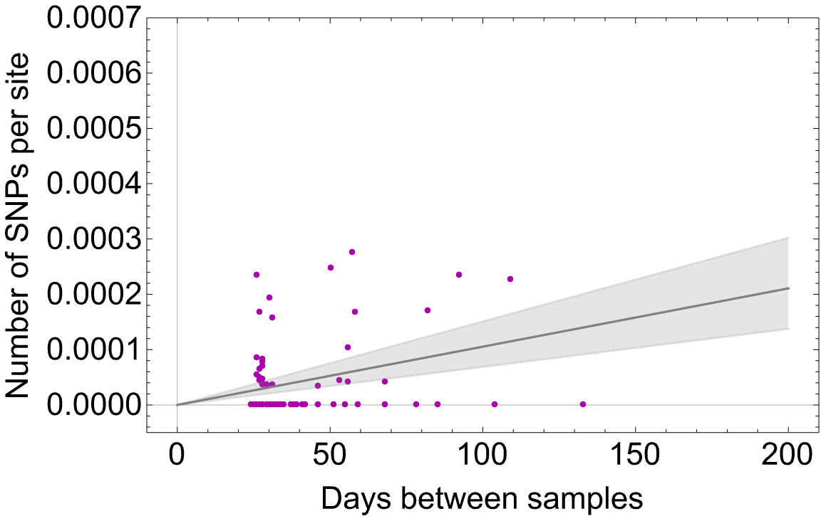
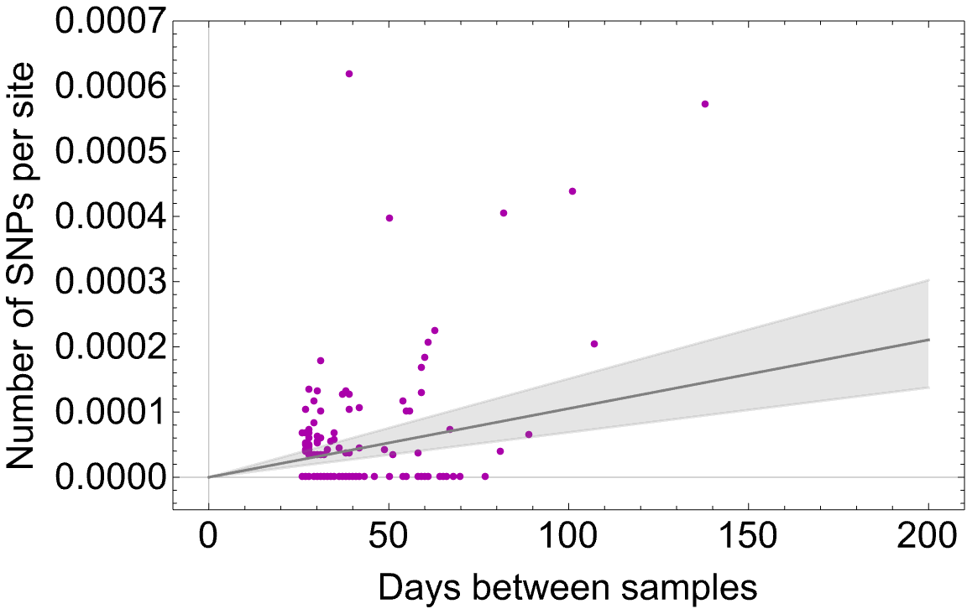

Persistent Infections: Differing rates of viral evolution
B.1.1.7
BA.1
pairs from persistent infections
between-host rate
(2.5 $−$ 5.5 x 10⁻⁴ s/s/y)
B.1.617.2
BA.2
Ghafari et al. MedRxiv

Slide 46
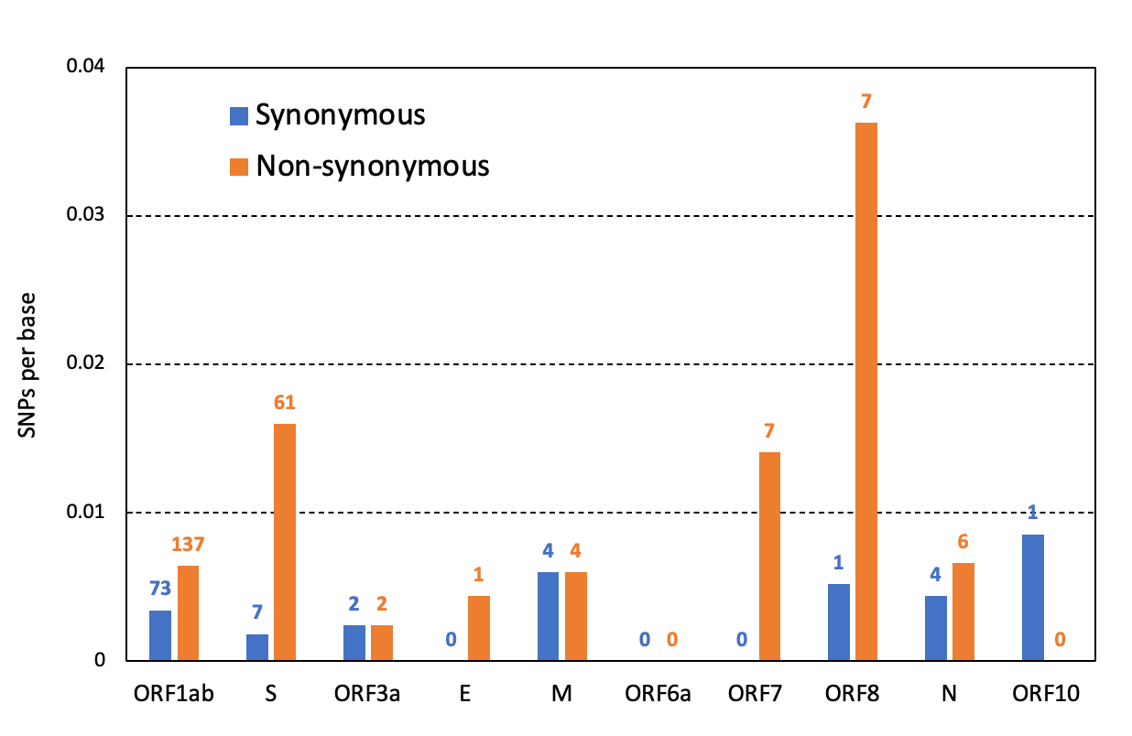
Persistent Infections: signs of adaptive evolution
Ghafari et al. MedRxiv

Slide 47
Convergent evolution recurrent mutations
We catalogued 317 unique mutations acquired during 381 persistent infections.
Gene | Mutation | Individuals | Description
Spike | T547K | 2 | Lineage-defining for BA.1 (identified in 2 persistent infections with BA.2)
Spike | L452R | 2 | Lineage-defining for Delta, BA.4/5; recurrent in immunocompromised patients
Spike | T376A | 2 | Lineage-defining for BA.2/4/5 (identified in 2 persistent infections with BA.1)
Spike | T95I | 1 | Lineage-defining for BA.1; recurrent in immunocompromised patients
Spike | G446V/D | 2 | Target site for several monoclonal antibodies
Spike | D215G | 1 | Lineage-defining for Beta (identified in 1 persistent infection with BA.2)
ORF1ab | L5905F | 2 | Commonly found in Mu, AY.4, and B.1.1.519
ORF1ab | T4175I | 2 | Commonly found in BA.2 (identified in 2 persistent infections with BA.1)
ORF1ab | T1638I | 2 | Recurrent in immunocompromised patients
ORF8 | I121L | 1 | Recurrent in immunocompromised patients
Harari et al. Nat Med 2022
Cox et al. Nat Rev Microbiol 2022
Wilkinson et al. Virus Evol 2022

Slide 48
Saltatory Leap in SARS-CoV-2

Slide 49
Viruses evolve at (at least) two scales
Within-Host Scale
Population Scale
Selection pressure to maximise
within-host fitness
Selection pressure to maximise
between-host fitness (transmission)
Notes:
What maximized wh fitness may not maximise bh fitness

Slide 50



Acknowledgements
Nuffield Department of Medicine – Big Data Institute; and Wellcome Centre for Human Genetics, Oxford University
  Matthew Hall, Tanya Golubchik, Helen Fryer, Mahan Ghafari
  Steve Kemp, Luca Ferretti, Mariateresa de Cesare, George MacIntyre-Cockett, Laura Thomson, Newton Otecko, Catrin Moore, Amy Trebes, Paolo Piazza, Angie Green, Angela Lee, David Buck, John Todd, Lucie Abeler-Dörner, David Bonsall, Christophe Fraser
COVID-19 Genomics UK Consortium (COG-UK)
  Sam Nicholls, Sharon Peacock, COG-UK sequencing site partners
  Oxford University Hospitals Trust: Anita Justice, Rob Shaw, David Eyre, Derrick Crook, Tim Peto, Monique Andersson
  Basingstoke and North Hampshire Hospitals: Nathan Moore, Emma Wise, Matilde Mori, Nick Cortes, Jessica Lynch, Stephen Kidd
  MRC-University of Glasgow Centre for Virus Research (CVR): Ana Filipe, James Shepherd, Shirin Ashraf, Emma Thomson
  Public Health Wales and Cardiff University – Tom Connor
BMRC Research Computing, University of Oxford
  Robert Esnouf, Adam Huffman and ResComp team
ONS COVID-19 Infection Survey
Ian Diamond, Sarah Walker (Chief Investigator & Academic Lead)
Thomas House (Manchester), Hannah Finselbach (ONS),
Ruth Studley, Emma Rourke, Duncan Cook,
Jessica Lee (DHSC), Georgia Hale (DHSC)
Wellcome Sanger Institute Covid-19 Surveillence Team
Jeff Barrett
Northumbria University
Darren Smith, Matthew Bashton, Andrew Nelson, Matthew Crown,
Clare McCann, Gregory Young, Rui dos Santos, Zack Richards,
Adnan Tariq
HIV, HCV and HBV Within-host evolution
Jayna Raghwani, Christophe Fraser, Oliver Pybus, Robin Tompson, Chris Wymant, Helen Fryer, Andy Redd, Thomas Quinn, Lorenzo Pellis
Patients and staff of the Rakai Health Sciences Program
Notes:
To be filled in

