Slide 1


Inference of fitness landscape from genomic data
Igor M. Rouzine
Institute of Evolutionary Physiology and Biochemistry RAS
Peter the Great Polytechnical University of St Petersburg

Slide 2



Special thanks to
Gabriele Pedruzzi, postdoc
Ayuna Barlukova, postdoc
Alessandra Carbone, Director

Slide 3
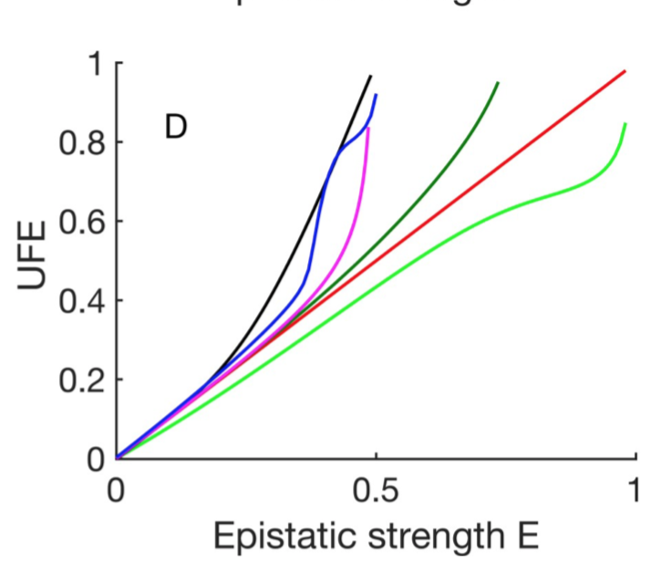
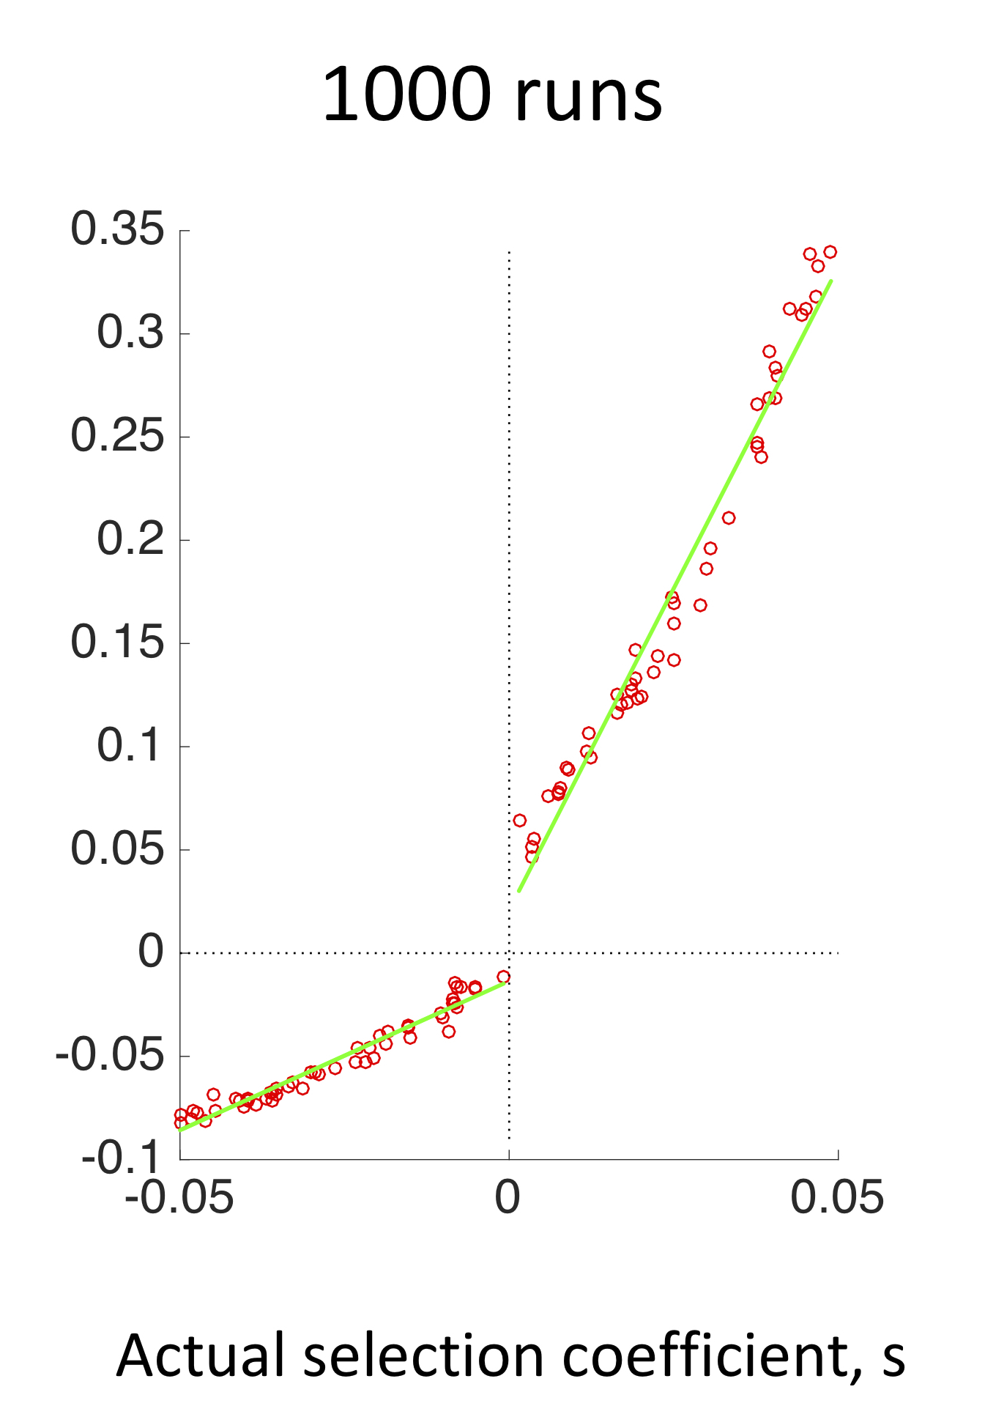
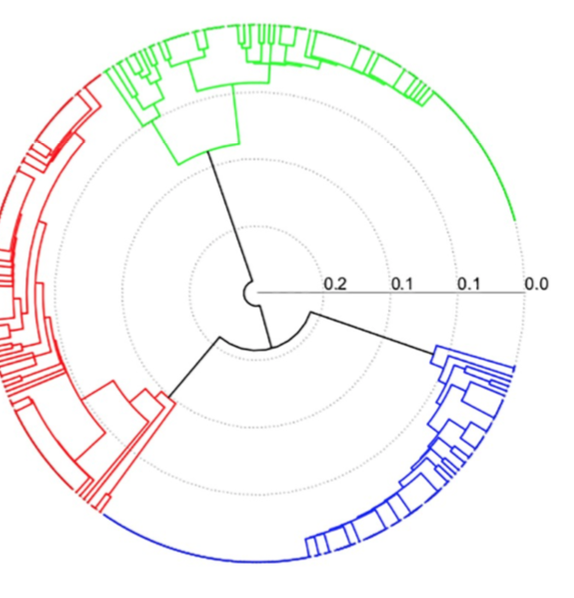
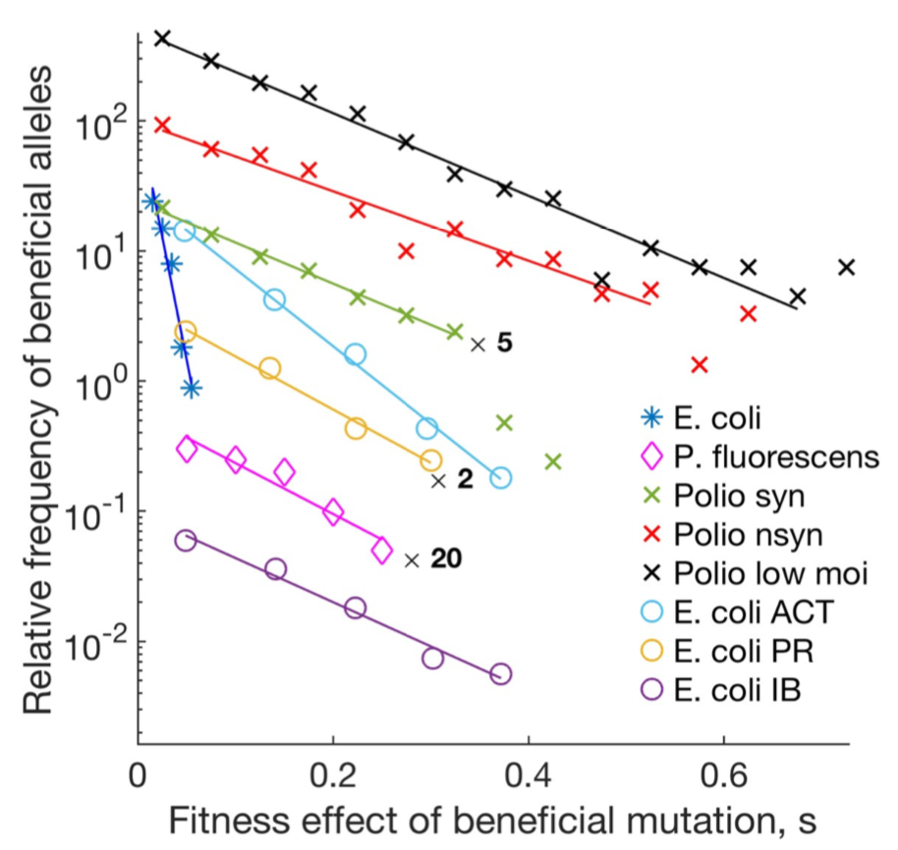
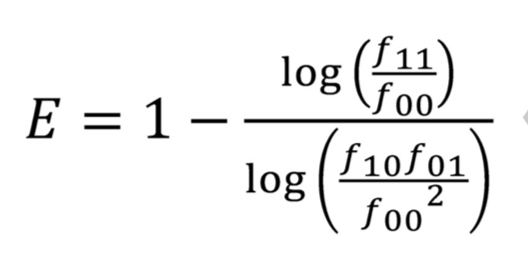
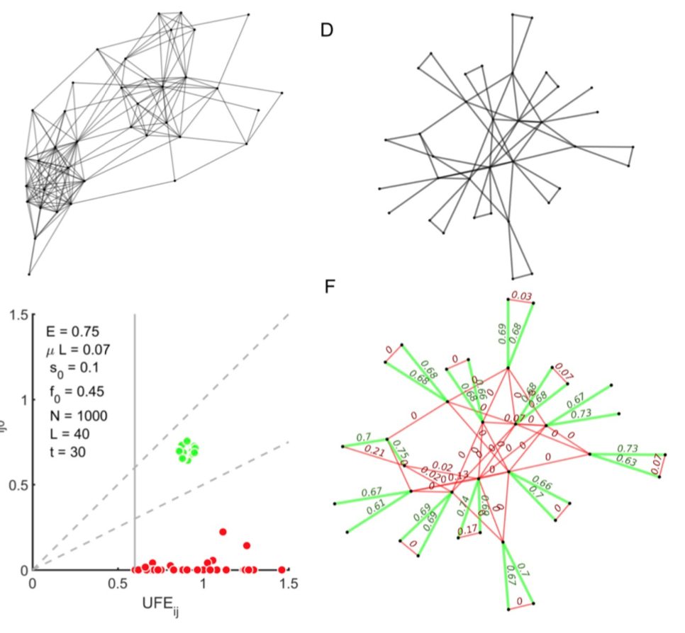
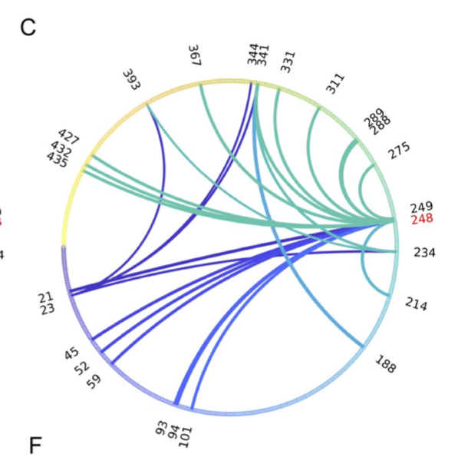
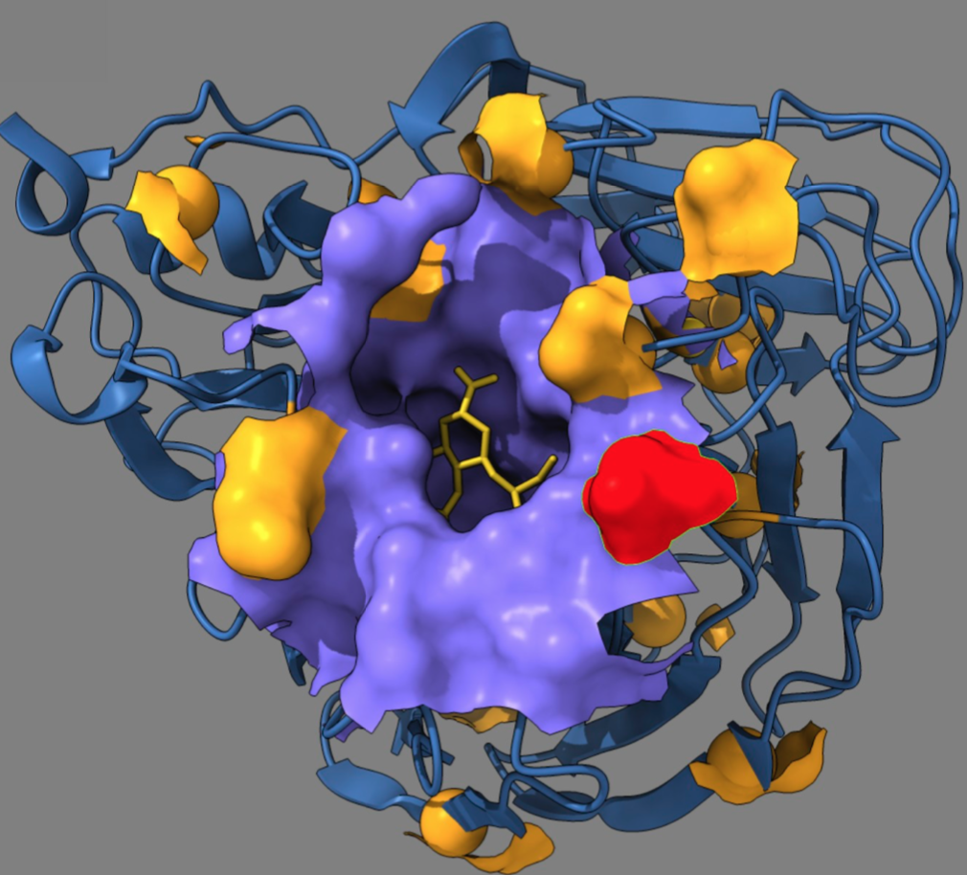
Different loci have common ancestors
Hence, linkage disequilibrium, Hill-Robertson effect, clonal interference, background selection
Footprint of epistasis
Masked by linkage
Universal mutation density
Inference of selection
Scaled inferred s
How to unmask epistasis
2009 Influenza A
H1N1, NA
Allosteric
compensation
Pedruzzi, Barlukova & Rouzine PLOS Comp Bio 2018
Pedruzzi & Rouzine PLOS ONE 2019
Pedruzzi & Rouzine PLOS Pathogens 2021
Barlukova & Rouzine PLOS Comp Bio 2021
Likhachev & Rouzine STAR Protocols 2023

Slide 4
Epistasis as Yeti: hide and seek
Search for pairwise genetic interactions is computationally routine, but addressing the statistical problems of detecting epistasis remains a big challenge.
Most reports of epistasis influencing human complex traits that exist in the literature raise concerns regarding their validity
There is mounting evidence against the existence of pairwise epistatic effects influencing human complex traits that are sufficiently large for detection in standard single-sample genome-wide association studies (GWASs).
Wei, Hemani, and Haley 2014, Nature Reviews Genetics

Slide 5
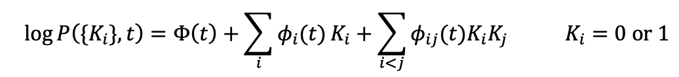
QLE approximation: a perturbation expansion at high recombination rate
1. Large population size, deterministic approximation neglecting random genetic drift
2. Selection with epistasis + mutation + strong recombination
Distribution of genotypes:
Kimura 1965
Barton & Turelli 1991, 1994
Neher & Shraiman 2011
Stochastic linkage due to common ancestors:
a finite population effect

Slide 6
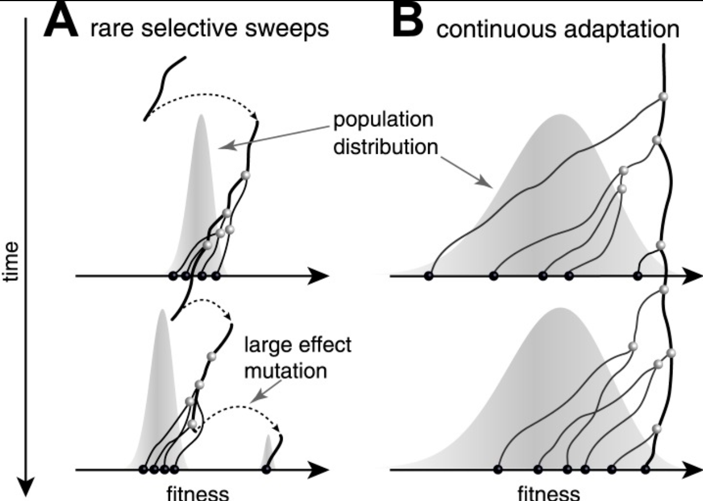
Tree-based fitness ranking
newer lineages have
higher fitness
Neher, Russell, Shraiman 2014

Slide 7
High-fidelity epistasis detection
The war against genetic linkage

Slide 8
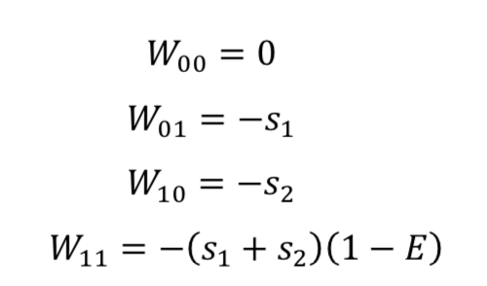
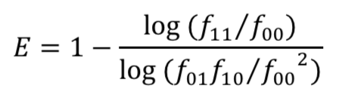
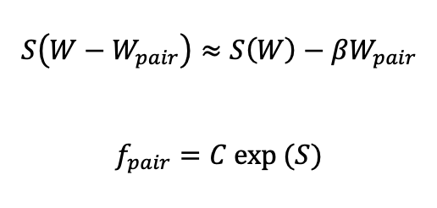
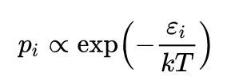
An epistatic pair in a genome
Multilocus models:
A slow narrow traveling wave in fitness W
W_{pair}
W−W_{pair}
Pair fitness
Universal footprint of epistasis
Entropy in slow adaptation
E
NB: Boltzman/Gibbs distribution
-s₁ -s₂
WT locus
Epistatic interaction
Mutated locus
Rest of genome

Slide 9
The 2nd law in action: another method
k₁ singles
k₂ doubles
E
-s₁ -s₂
L loci
Universal footprint of epistasis
W = W(k₁, k₂)
S =S(k₁, k₂)
Minimize S at W = const

Slide 10
Simulation confirmation
t=10
t=200
t=750
UFE estimate of E
Epistatic site pair
Non-epistatic pair
Epistatic strength, E
Epistatic strength, E
Epistatic strength, E
t=1000
E=1.0
UFE estimate of E
L = 100
s₀ = 0.05
N = 2000
μL = 0.2
Allele frequency, f
0.33
0.67
0
Epistatic strength, E
Time in generations

Slide 11
Topology complication
k₁
k₂
b₂ = 1
k₁
k₂
k₃
b₃ = 3
W = W(k₁, k₂, k₃, ...)
S =S(k₁, k₂, k₃, ...)
Minimize S at W = const
k₁
k₂
k₃
b₃ = 2
k₄
k₃
k₂
b_{i} = i-1
k₄
b_{i} = i-1

Slide 12
Topology correction
A
B
Formal correlator
UFE =
C
D
Isolated pairs
Double archs
Triple archs
Long chain
Binary tree
Mutant frequency f
UFE
Epistatic strentgh E

Slide 13
Topology shuffle
=
+
+
b₃ = 3
b₃ = 2
Entropy and fitness are additive!

Slide 14
Needle in a haystack situation
10²
10⁰
t=0
All pairs
Epistatic
10²
10⁰
t=5
UFE =
10²
10⁰
t=10
r₁₁, r₁₀ Pearson correlator
t=25
10²
10⁰
t=50
10²
10⁰
-1 0 1
-1 0 1
-1 0 1
r₁₁
r₀₁
UFE

Slide 15
Failure of combination
A
B
C
E=0 t=10
E=0.75 t=10
E=0.75 t=30
Pearson coefficient r₁₁
UFE
UFE
UFE

Slide 16
Role of recombination
% Detection UFE
r = 0 M= 0
0.1 5
0.2 5
0.5 5
0.5 50
% False positive UFE
Time, generation
Time, generation

Slide 17
Divergence of population
Population 1
Population 3
Population 2

Slide 18
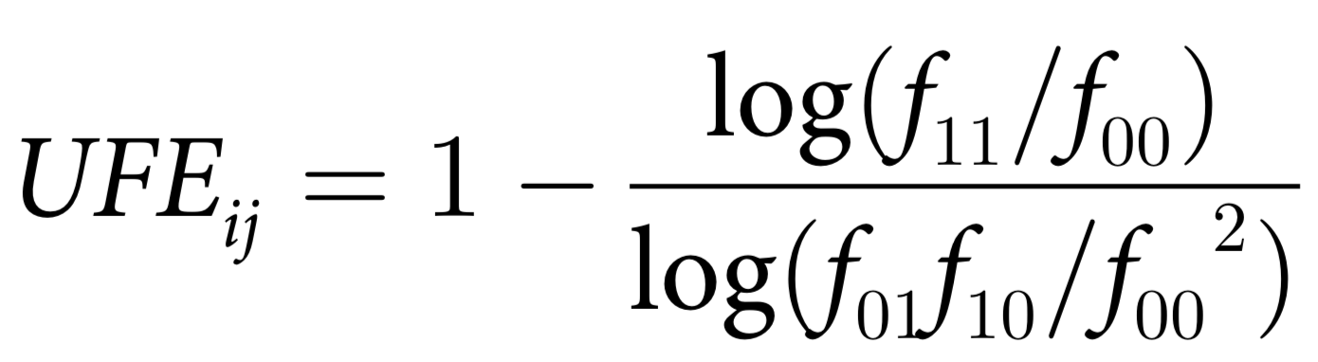
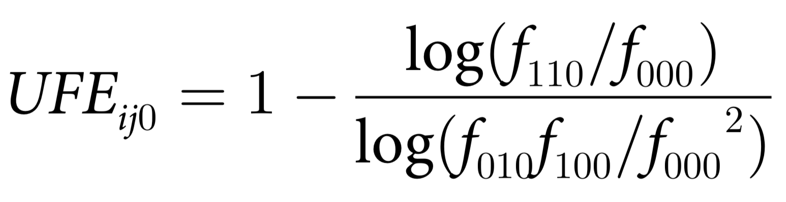
Cure to desperation
Simulated evolution
Epistasis
Indirect
Linkage
t > 3/s
00101011000
01010011001
00110010011
Epistasis
Selection
Mutation
Random
drift
Average f_{ij}
over ensemble
Two-locus correlation analysis
i
j
s₀=0.1
μL=0.07
f₀=0.45
N=1000
L=400
t=30
UFE_{ij0}
E=0.75
Three-locus correlation analysis
0
0
i
j
0
0
0
UFE_{ij}

Slide 19
indirect
direct
direct

Slide 20
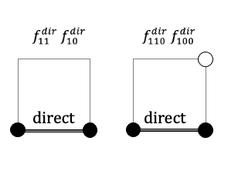
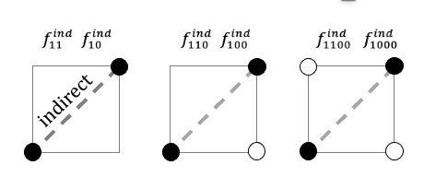
Squares: 4-locus correlation
1
UFE_{ind}
UFE⁰_{dir}
UFE⁰_{ind}
UFE_{dir}
Correlation measure, UFE
UFE⁰⁰_{ind}
Epistatic strength, E

Slide 21
Swine flu revelation
344
341
340
393
398
285
427
435
248
15 bonds
234
21
23
214
78
93
94
(A H1N1 2009 pandemics strain compared to pre-2009 strain)

Slide 22
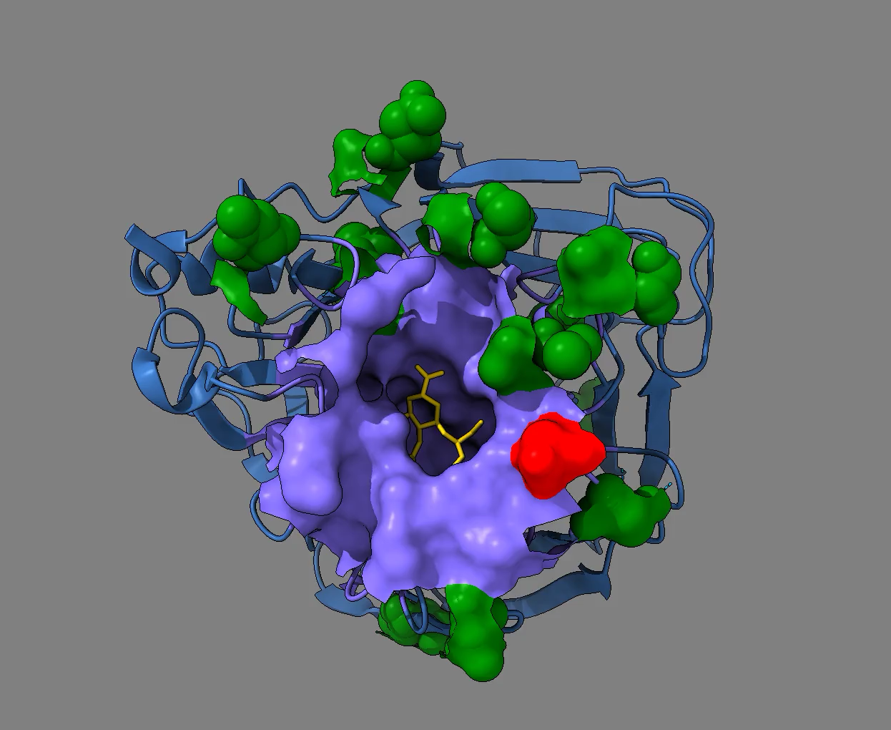
Allosteric compensation

Slide 23
Inference of selection coefficients

Slide 24



Density of mutations
density x
fixation prob.
allele freq. x
intrinsic
x 5
Relative frequency of beneficial alleles
E. coli
P. fluorescencs
x 2
Polio syn
Polio nonsyn
x 20
Polio low moi
The 2nd law strikes again:
E. coli ACT
E. coli PR
E. coli IB
Fitness effect of beneficial mutation s

Slide 25
Simulation interpretation
t=0
t=15
t=20
1
20
40
60
80
100
Sampled genomes
t=30
t=50
1
20
40
60
80
100
Sampled genomes
Number of genomes
t=50
15
3
0
Site rank in s
Rescaled fitness

Slide 26
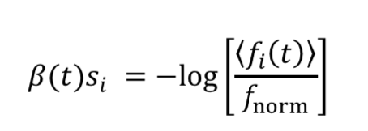
Ranking and normalization
Near steady state
Failure!
Far from steady state
t=60
t=40
t=750
Rescaled selection coefficient β(t) s_{i}
t=1000
Ranking in s_{i}
t=20
no focal point
t=500
Ranked genomic site m_{i}

Slide 27
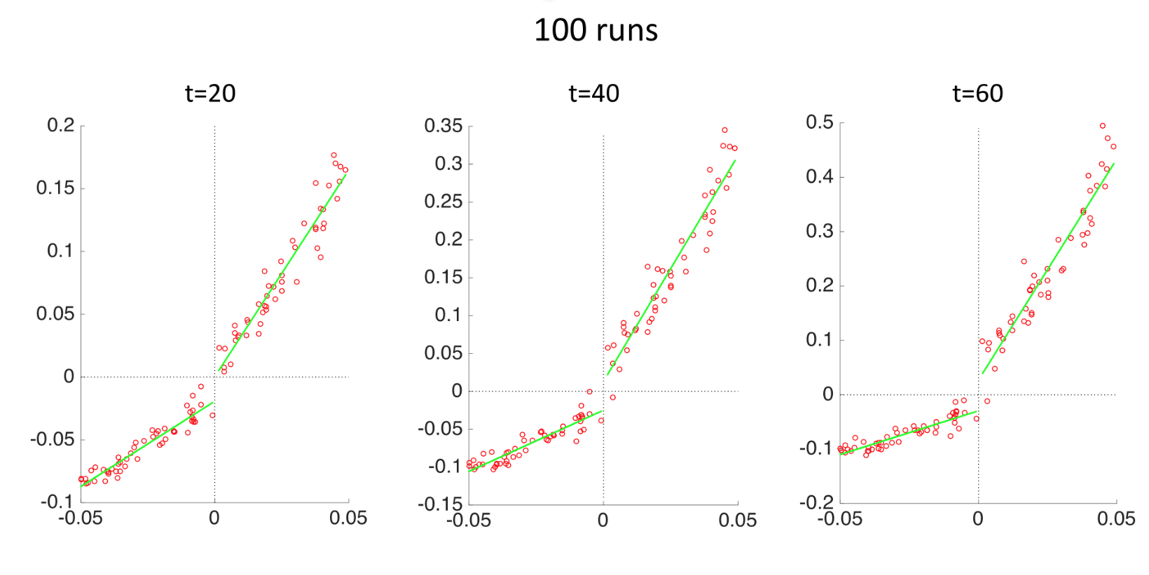
Accuracy verification
Inferred selection coefficient, a.u.
Actual selection coefficient

Slide 28
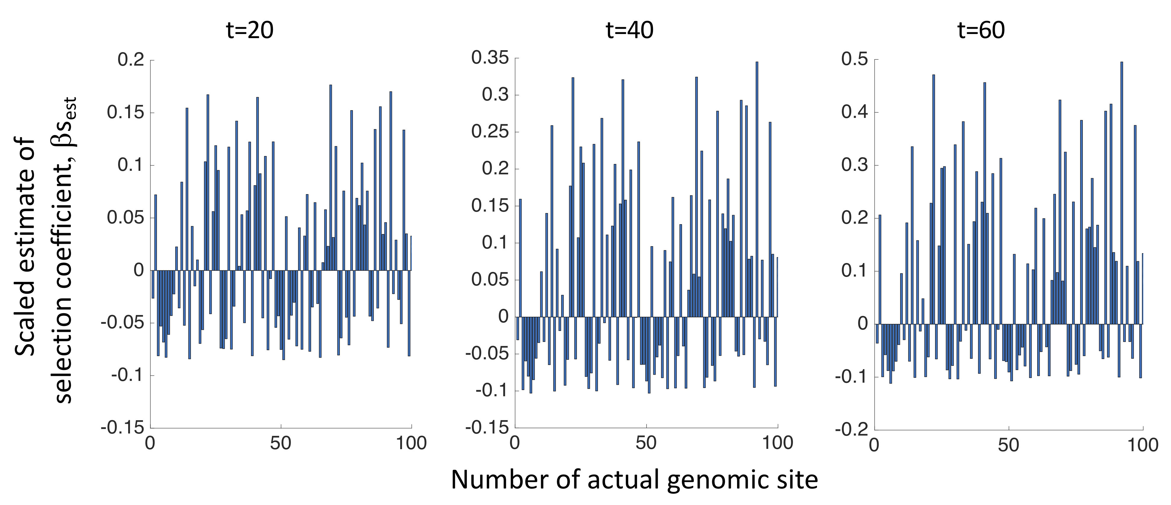
Final results presentation

Slide 29
Final conclusions
1. UFE measures epistasis independently on other parameters
2. Linkage hides fitness landscape
2. Detection is rescued by averaging over populations and 3–locus or 4-locus correlation
3. Universal mutation spectrum leads to the linkage-independent inference of s

