Slide 1
Multi-scale time-since-infection models
in evolutionary epidemiology
Lorenzo Pellis¹, Helena Stage¹,
Katrina Lythgoe², Christophe Fraser²
¹ School of Mathematics, University of Manchester, UK
² Big Data Institute, University of Oxford, UK
Unifying the epidemiological and evolutionary dynamics of pathogens
June 20, 2023
NORDITA program, Stockholm, Sweden

Slide 2
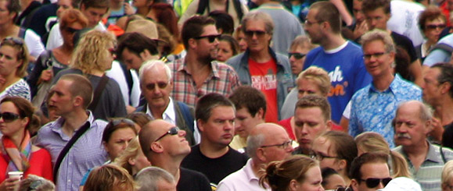

Evolutionary epidemiology
Unified view of the epidemiology and evolution of pathogens
Ultimate aim:
Design intervention strategies that will slow down, or avoid altogether, the evolution of drug resistance and virulence
Notes:
We are very far from that aim still…
Reasons: lack of a general enough mathematical theory that can make use of data at both scales
TSI models could go some way in addressing this problem

Slide 3
Motivation
The need for multi-scale models

Slide 4
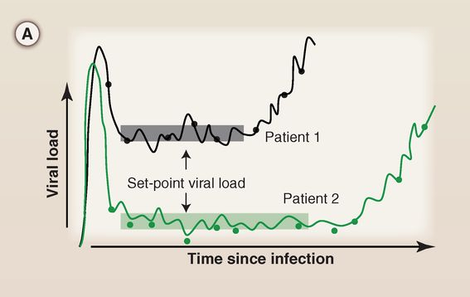
HIV untreated infection
Fraser, Lythgoe et al (2014), Science

Slide 5
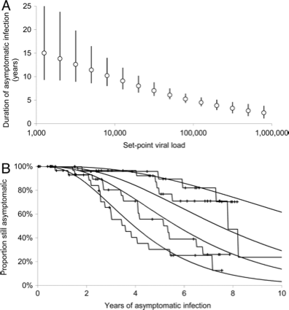
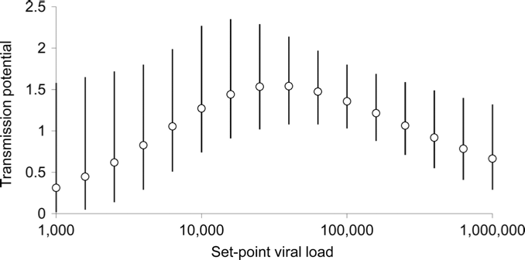
Set-point viral load (SPVL)
Predicts infectivity
Transmission potential = overall infectivity
Predicts duration of asymptomatic stage
Fraser et al (2007), PNAS

Slide 6
Evolution of SPVL
SPVL is highly heritable
Steadily increasing for 25 years
Now seems to have plateaued
The current mean value is very close to maximum transmission potential
1.5
Transmission potential
0
10²
10⁴
10⁶
Set-point viral load
Fraser et al (2007), PNAS

Slide 7
HIV transmission potential
1.5
Transmission potential
0
10²
10⁴
10⁶
Set-point viral load

Slide 8
HIV transmission potential
Long-sighted evolution
1.5
Transmission potential
Optimal for virus transmission
0
10²
10⁴
10⁶
Set-point viral load

Slide 9
HIV transmission potential
Long-sighted evolution
1.5
Transmission potential
Optimal for virus transmission
0
10²
10⁴
10⁶
Set-point viral load
Low replicative capacity
High replicative capacity

Slide 10
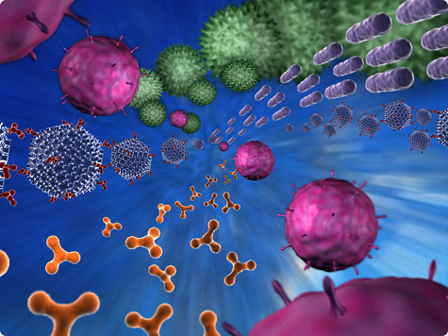
HIV transmission potential
Long-sighted evolution
1.5
Transmission potential
Optimal for virus transmission
0
10²
10⁴
10⁶
Set-point viral load
Short-sighted evolution

Slide 11
Challenges
Why so hard to develop multi-scale models?

Slide 12
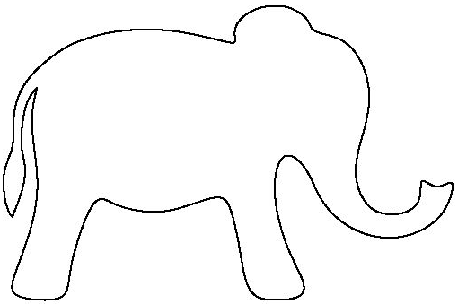
Limitations of ODEs
ODEs are extremely useful and easy to use
But have many limitations:
  Oversimplified emergence of resistance:
  Time-scale separation argument:
  Secondary infection (superinfection):
r
I_{S}
I_{R}
λ_{a}
I_{a}
λ_{b}
?
S
I_{ab}
?
λ_{b}
I_{b}
λ_{a}
?
Notes:
Time-scale separation argument, when applicable, still leads to ODEs that are hard to study analytically.
Who in this audience has even come across an ODE model with 2 or more strains where you had to integrate the equations numerically to study the steady states? Why is a general theory still lacking?

Slide 13
Time-since-infection models
Function to describe infectivity in terms of time-since-infection
We can also use a random version of it:
  General enough to encompass all previous cases
Drawbacks:
  Harder to study (PDEs or integral equations/DDEs)
  Computationally intensive to integrate
  Require initial conditions on an interval (the support of )
Notes:
Most of the time is unimodal, but later I’ll show you more “exotic” examples where it’s not

Slide 14
Why using TSI?
More general

Slide 15
Why using TSI?
More general

Slide 16
Why using TSI?
More general
Closer to biology / experiments:
  Detailed time evolution of infection is deemed important
  Complex / long infectivity profiles (e.g. HIV)
  Available data

Slide 17
Why using TSI?
More general
Closer to biology / experiments:
  Detailed time evolution of infection is deemed important
  Complex / long infectivity profiles (e.g. HIV)
  Available data

Slide 18
Superinfection data
Laurie et al (2015), JID

Slide 19
Why using TSI?
More general
Closer to biology / experiments:
  Detailed time evolution of infection is deemed important
  Complex / long infectivity profiles (e.g. HIV)
  Available data
Suitable to encapsulate complex within-host (WH) dynamics

Slide 20
Why using TSI?
More general
Closer to biology / experiments:
  Detailed time evolution of infection is deemed important
  Complex / long infectivity profiles (e.g. HIV)
  Available data
Suitable to encapsulate complex within-host (WH) dynamics

Slide 21
Gilchrist & Sasaki (2002)
First example: Gilchrist & Sasaki (2002)
  Within-host dynamics: pathogen load
  level immunity
  Between-host
  dynamics:
  Link:
Gilchrist & Sasaki (2002), J Theor Biol
Notes:
The link between the scales is still an issue!

Slide 22
Example
Model: specific + aspecific immunity
  pathogen load
  level of specific immuntity
  (constant) level of aspecific immunity
Pugliese & Gandolfi (2008), Math Biosc

Slide 23
Why using TSI?
More general
Closer to biology / experiments:
  Available data
  Detailed time evolution of infection is deemed important
  Complex / long infectivity profiles (e.g. HIV)
Suitable to encapsulate complex within-host (WH) dynamics
Can enhance understanding of more complex models

Slide 24
Why using TSI?
More general
Closer to biology / experiments:
  Available data
  Detailed time evolution of infection is deemed important
  Complex / long infectivity profiles (e.g. HIV)
Suitable to encapsulate complex within-host (WH) dynamics
Can enhance understanding of more complex models

Slide 25
HIV within-host patch model
Susceptible CD4+ T cells
Site of HIV replication
CTLs
Lythgoe, Blanquart, Pellis & Fraser (2016), PLoS Biology

Slide 26
HIV within-host patch model
Susceptible CD4+ T cells
Site of HIV replication
CTLs
Lythgoe, Blanquart, Pellis & Fraser (2016), PLoS Biology

Slide 27
HIV within-host patch model
Susceptible CD4+ T cells
Site of HIV replication
CTLs
Lythgoe, Blanquart, Pellis & Fraser (2016), PLoS Biology

Slide 28
HIV within-host patch model
Susceptible CD4+ T cells
Site of HIV replication
CTLs
storage
Lythgoe, Blanquart, Pellis & Fraser (2016), PLoS Biology

Slide 29
Full equations

Slide 30
Analytical approximation
If immigration of infected cells is negligible (after the first seeding):
Within-patch dynamics
lead to a rate at which a patch infect other patches:
Dynamics
Patch reproduction number:
If there is no infection

Slide 31
Within-patch dynamics
3 possible outcomes:
No or small burst of infection ( )
Disease-free equilibrium (DFE)
Short but big enough burst ( )
Shifting-mosaic steady state (SMSS)
Reaching endemic equilibrium ( )
Full equilibrium (FE)

Slide 32
Full equilibrium VS SMSS
FE
SMSS

Slide 33
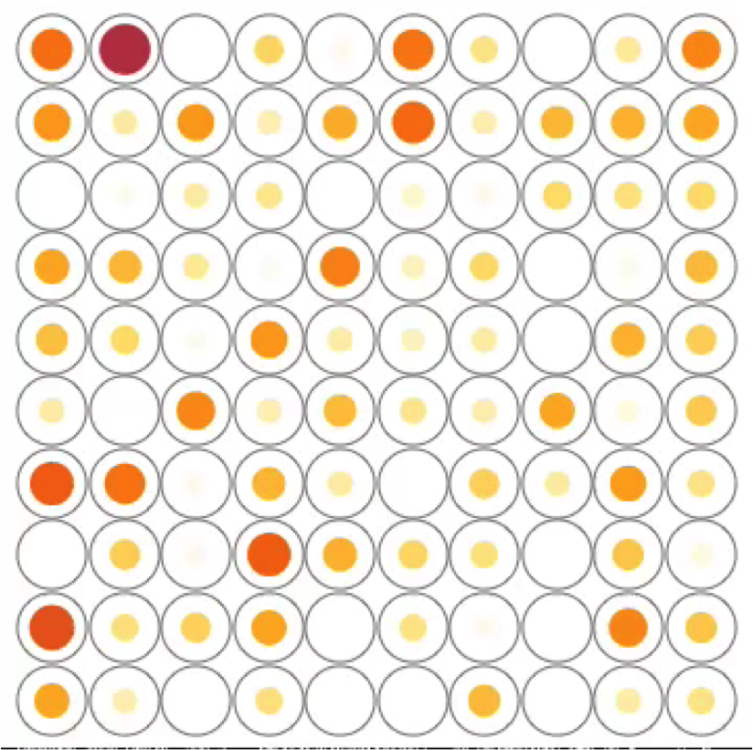
SMSS dynamics

Slide 34
Why using TSI?
More general
Closer to biology / experiments:
  Available data
  Detailed time evolution of infection is deemed important
  Complex / long infectivity profiles (e.g. HIV)
Suitable to encapsulate complex within-host (WH) dynamics
Can enhance understanding of more complex models
  Harder to study, so it requires more thinking about which assumptions are really responsible for the results we see

Slide 35
Why using TSI?
More general
Closer to biology / experiments:
  Available data
  Detailed time evolution of infection is deemed important
  Complex / long infectivity profiles (e.g. HIV)
Suitable to encapsulate complex within-host (WH) dynamics
Can enhance understanding of more complex models
  Harder to study, so it requires more thinking about which assumptions are really responsible for the results we see

Slide 36
HIV transmission potential
Long-sighted evolution
1.5
Transmission potential
Optimal for virus transmission
0
10²
10⁴
10⁶
Set-point viral load
Short-sighted evolution

Slide 37
Population structure
Deterministic model
All susceptibles identical
Homogeneous mixing
Vital dynamics:

Slide 38
Population structure
Deterministic model
All susceptibles identical
Homogeneous mixing
Vital dynamics:
Total
birth rate

Slide 39
Population structure
Deterministic model
All susceptibles identical
Homogeneous mixing
Vital dynamics:
Total
birth rate
Per-capita
death rate

Slide 40
Infection spread
SI model
Infection caused by a single virion
Type- case = infected with a virus of strain
Infector strain SPVL infectiousness and duration
rate at which type- case transmit strain

Slide 41
Infection spread
SI model
Infection caused by a single virion
Type- case = infected with a virus of strain
Infector strain SPVL infectiousness and duration
rate at which type- case transmit strain

Slide 42
Infection spread
SI model
Infection caused by a single virion
Type- case = infected with a virus of strain
Infector strain SPVL infectiousness and duration
rate at which type- case transmit strain

Slide 43
Infection spread
SI model
Infection caused by a single virion
Type- case = infected with a virus of strain
Infector strain SPVL infectiousness and duration
rate at which type- case transmit strain

Slide 44
Equations
Dynamics:
Equilibrium:
incidence of type- cases
duration of life of type- cases
= Next-Generation Matrix

Slide 45
Overview of assumptions
Structural assumptions:
  No external events
  No secondary infection / superinfection

Slide 46
Equations
Dynamics:
Equilibrium:
incidence of type- cases
duration of life of type- cases
= Next-Generation Matrix
Lythgoe*, Pellis* & Fraser (2013), Evolution

Slide 47
Overview of assumptions
Structural assumptions:
  No external events
  No secondary infection / superinfection
Implications:
  Can use a time-since-infection framework
  Can use a next-generation matrix (NGM) approach
  Within- and between-host levels are linked
  But no “full” feedback loop (no evolving population immunity)

Slide 48
Overview of assumptions
Structural assumptions:
  No external events
  No secondary infection / superinfection
Implications:
  Can use a time-since-infection framework
  Can use a next-generation matrix (NGM) approach
  Within- and between-host levels are linked
  But no “full” feedback loop (no evolving population immunity)
Other assumptions that can be relaxed:
  Single-virion infection (easy)
  All-identical susceptibles (hard)

Slide 49
Equations
Dynamics:
Equilibrium:
incidence of type- cases
duration of life of type- cases
= Next-Generation Matrix
Lythgoe*, Pellis* & Fraser (2013), Evolution

Slide 50

Extensions
Complex within-host dynamics
time since infection
de-novo resistance
transmission
transmission
co-transmission

Slide 51

Extensions
Complex within-host dynamics
Heterogeneous host population
time since infection
de-novo resistance
transmission
transmission
co-transmission
transmission
evolving population immunity profile
secondary infection

Slide 52
Extensions
Complex within-host dynamics
Heterogeneous host population
time since infection
de-novo resistance
transmission
transmission
co-transmission
transmission
evolving population immunity profile
secondary infection
Why do we need secondary infection?
  Anti-microbial resistance (emergence + transmitted drug resistance)
  Co-circulation of multiple infections (e.g. HIV and HSV-2)
  HIV has high secondary infection rates [Redd et al. (2014), JID and (2014), AIDS]
  Data is becoming available [Laurie et al. (2015), JID and (2017), JID]

Slide 53
Finding the endemic equilibria
Dynamics:
Endemic equilibria:

Slide 54
Conclusions

Slide 55
Conclusions
Evolutionary epidemiology needs multi-scale models:
  Conflicting evolutionary forces at different scales
  Technical challenges:
  ODEs have limitations, PDEs / integral equations more flexible
  Integral equations are expensive to solve numerically
My group’s contribution:
  Finding the endemic equilibrium as a fixed-point problem
  Provide an iterative map to compute it numerically
  Study when multiple equilibria exist

Slide 56

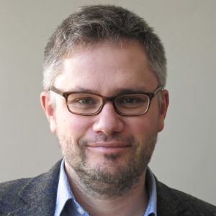

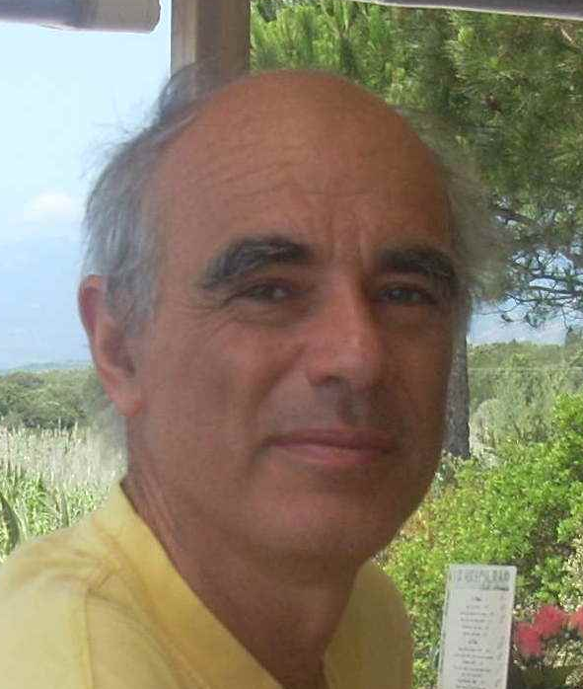





Acknowledgements
Katrina Lythgoe Christophe Fraser Matt Keeling Andrea Pugliese
Helena Stage Liz Buckingham-Jeffery

Slide 57
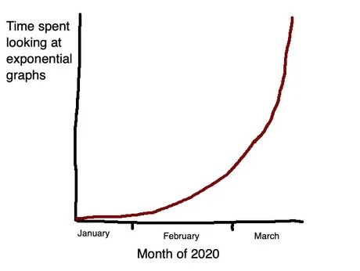
Acknowledgements
2021
2022
2023
Thank you all!

