Slide 1


A Fitness Landscape Model for Understanding Within-Host Evolution of SARS-CoV-2 Chronic Infections
Amber Coats
NORDITA
06/22/2023

Slide 2
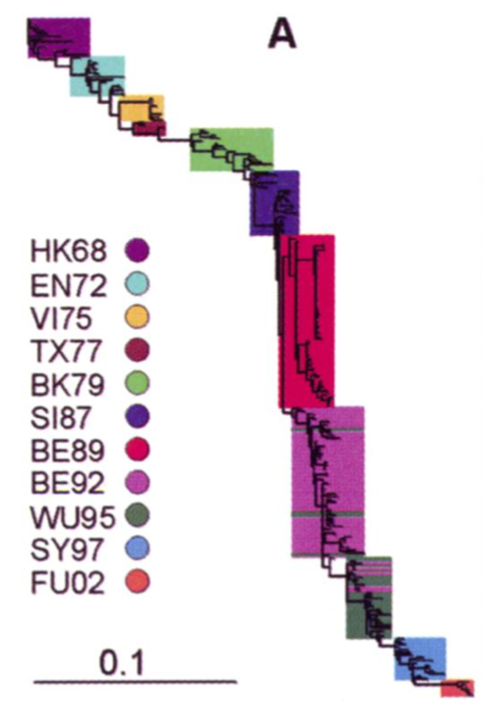
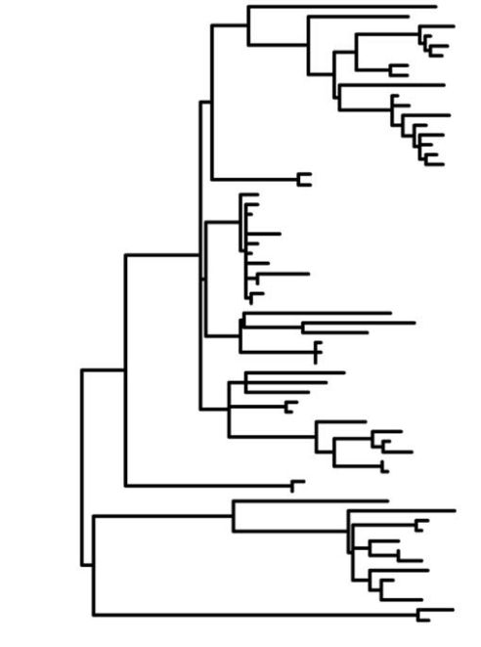
Population-Level Acute Viral Infections are typically either Antigenically Static or Display Continuous Antigenic Turnover
No Antigenic Evolution
Continuous Antigenic Turnover
Measles, N
Influenza HA1

Slide 3
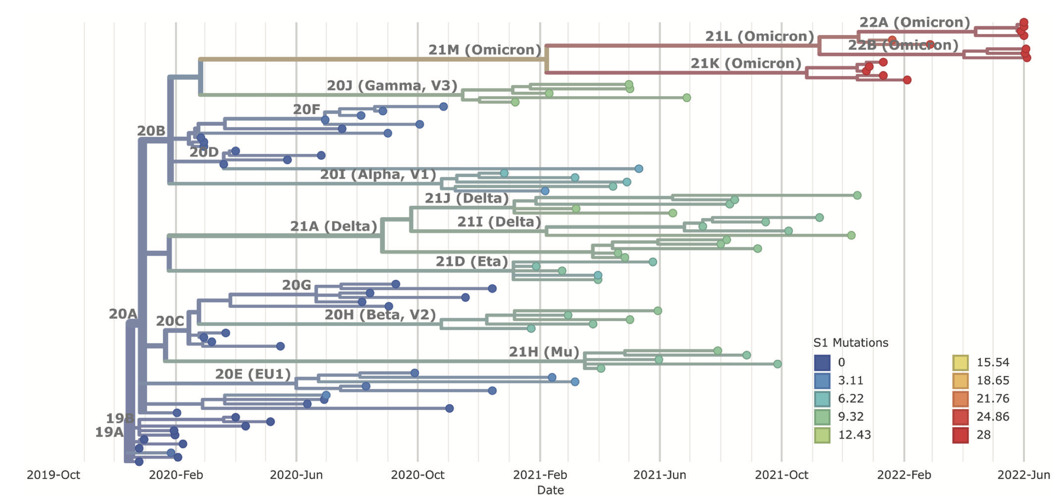
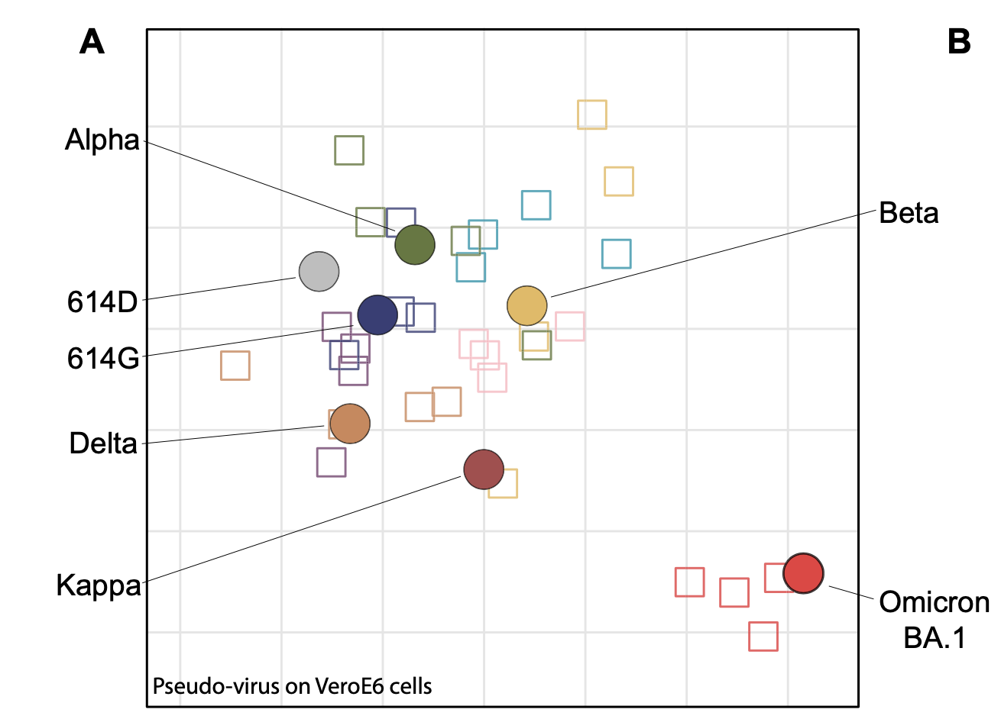
In SARS-CoV-2, Omicron Occurred on a Long Internal Branch and Displayed Significant Antigenic Divergence
Vidian et al 2022 ERHM, Myktyn et al 2022 Science Immunology

Slide 4
Other SARS-CoV-2 VOCs that did not Display Much Antigenic Evolution also Mapped to Long Internal Branches
Vidian et al 2022 ERHM, Myktyn et al 2022 Science Immunology

Slide 5



There are Three Hypotheses for the Emergence of VOCs
Animal Reservoir
Unsampled Population
Chronic Infections

Slide 6
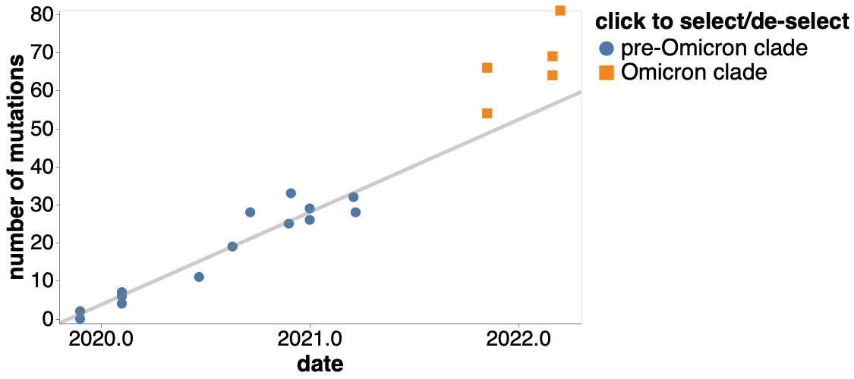
Supporting Evidence for Chronic Infections
Omicron displayed higher substitution rate than expected if evolution occurred at the population level
Nucleotide Divergence (whole genome)
Number of Mutations
Weigand et al 2022 Viruses

Slide 7
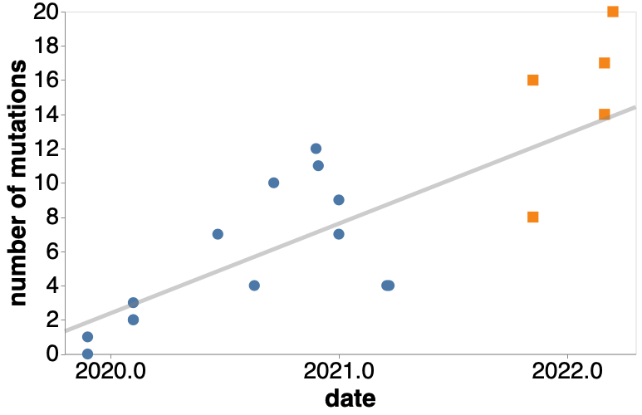
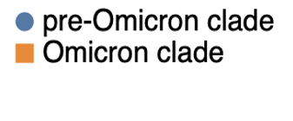
Supporting Evidence for Chronic Infections
Omicron displays a lack of acceleration for synonymous mutations, which means this acceleration in divergence is due to nonsynonymous mutations.
Synonymous Divergence (whole genome)
Nucleotide Divergence (whole genome)
Number of Mutations
Number of Mutations
Bloom 2022

Slide 8
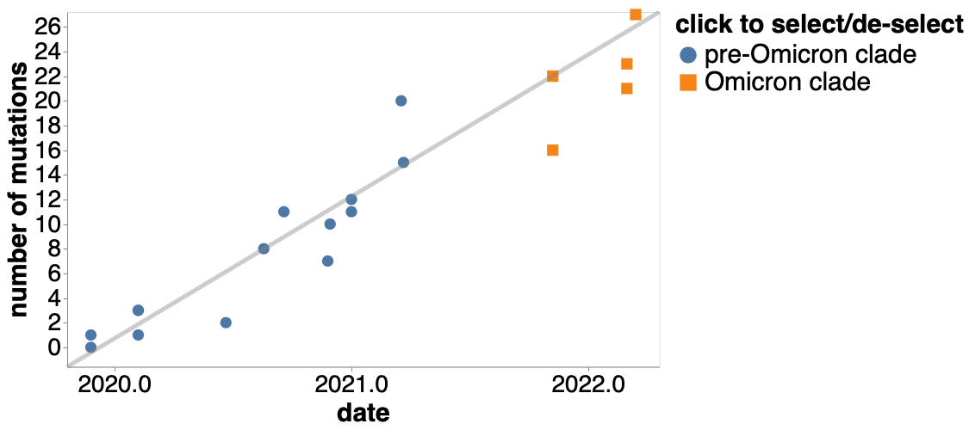
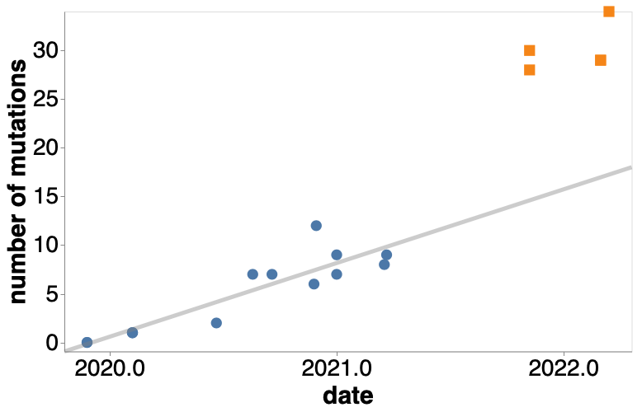
Supporting Evidence for Chronic Infections
Omicron displays enrichment in Antigenic Mutations, which would be expected from Chronic Infection as its source.
Non-Spike Amino Acid Divergence
Spike Amino Acid Divergence
Bloom 2022

Slide 9
We Develop and Analyze a Model to Understand Chronic Infection Evolutionary Dynamics and the Factors that Impact these Patterns
Given the Role of Chronic Infections in VOC Emergence…

Slide 10
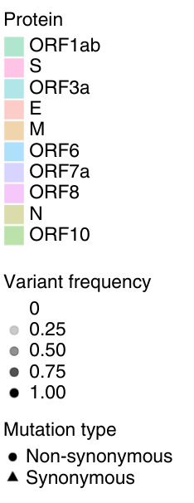
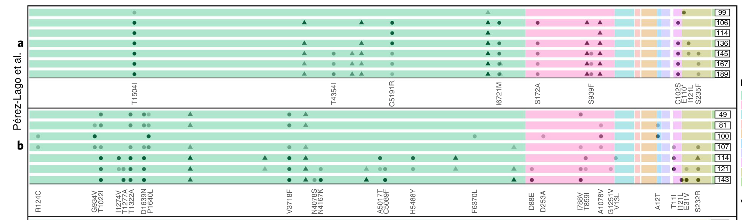
Evolutionary Patterns in Chronic Infections
Chronic infections display heterogeneous patterns of antigenic evolution
Genome Position
Harari et al 2022 Nature Medicine

Slide 11
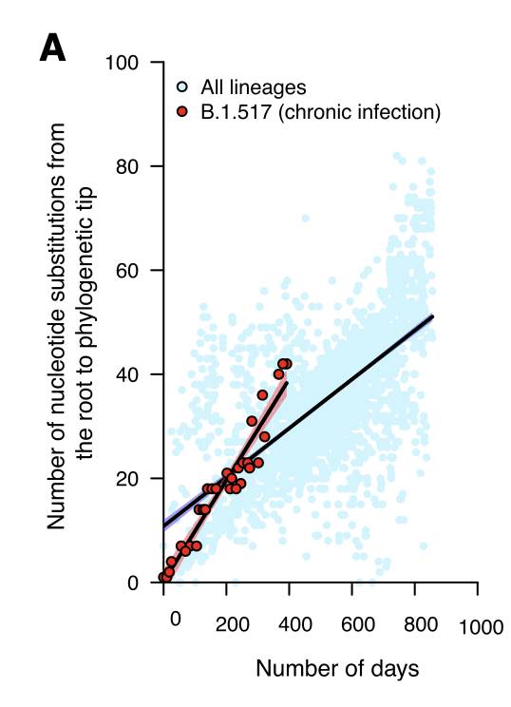
Evolutionary Patterns in Chronic Infections
SARS-CoV-2 evolves more rapidly in chronic infections than at the population level.
Chaguza et al 2023 Cell Reports

Slide 12
Within-Host Evolution Model
We model the viral genome as the gene coding for the dominant antigenic protein (e.g. spike) and assume no recombination occurs
Synonymous
L=850
Phenotypic
L=2550
Antigenic
L=200
Pleiotropic
L=200
Nucleotides Sites of Length, L = 3800

Slide 13
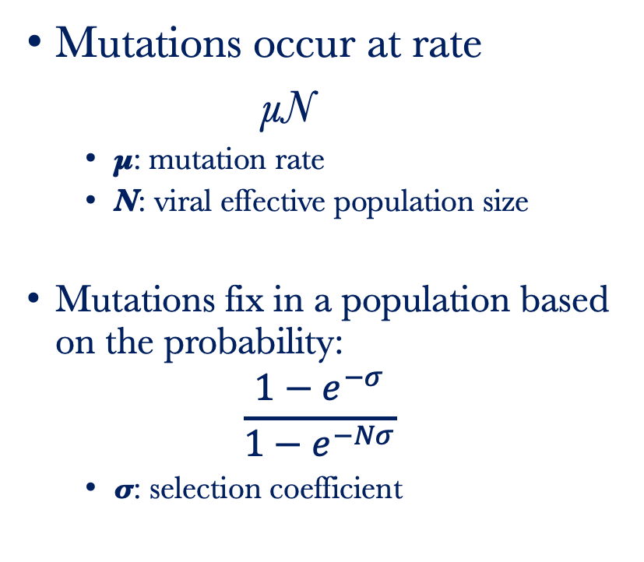
Within-Host Model
Mutations occur at rate
μN
  μ: mutation rate
  N: viral effective population size
Mutations fix in a population based on the probability:
$$\frac{1−e^{−σ}}{1−e^{−Nσ}}$$
  σ: selection coefficient
Synonymous
Phenotypic
Antigenic
Pleiotropic
000000000
00000
0000
000000
L = 9
L = 5
L = 4
L = 6
time = t
000000000
00000
0000
001000
Total L = 24
Viral Populations are assumed to be monomorphic and move from one genotype to the next over time.

Slide 14
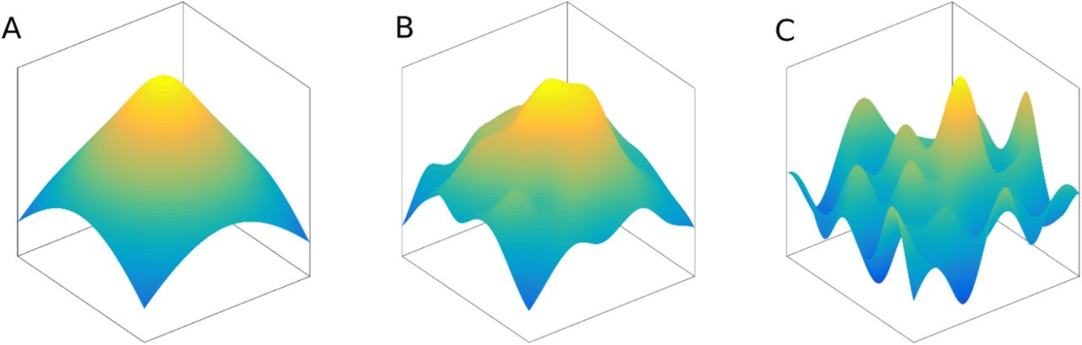




The Rough Mount Fuji Landscape
$$F\left(G_{i}\right)=−cD\left(G_{ref},G_{i}\right)−η(G_{i})$$
$$F\left(G_{i}\right)=−cD\left(G_{ref},G_{i}\right)−η(G_{i})$$
$$F\left(G_{i}\right)=−cD\left(G_{ref},G_{i}\right)−η(G_{i})$$
$$F\left(G_{i}\right)=−cD\left(G_{ref},G_{i}\right)−η(G_{i})$$
c = 100
c = 2
c = 0
When looking across fitness landscapes, we linearly transform the landscapes to ensure the mean and variance of the fitness values stay the same.
Obolski et al 2017 Rep. Prog. Phys. , Aita et al 2000 Biopolymers, Neidhart et al 2014 Genetics

Slide 15
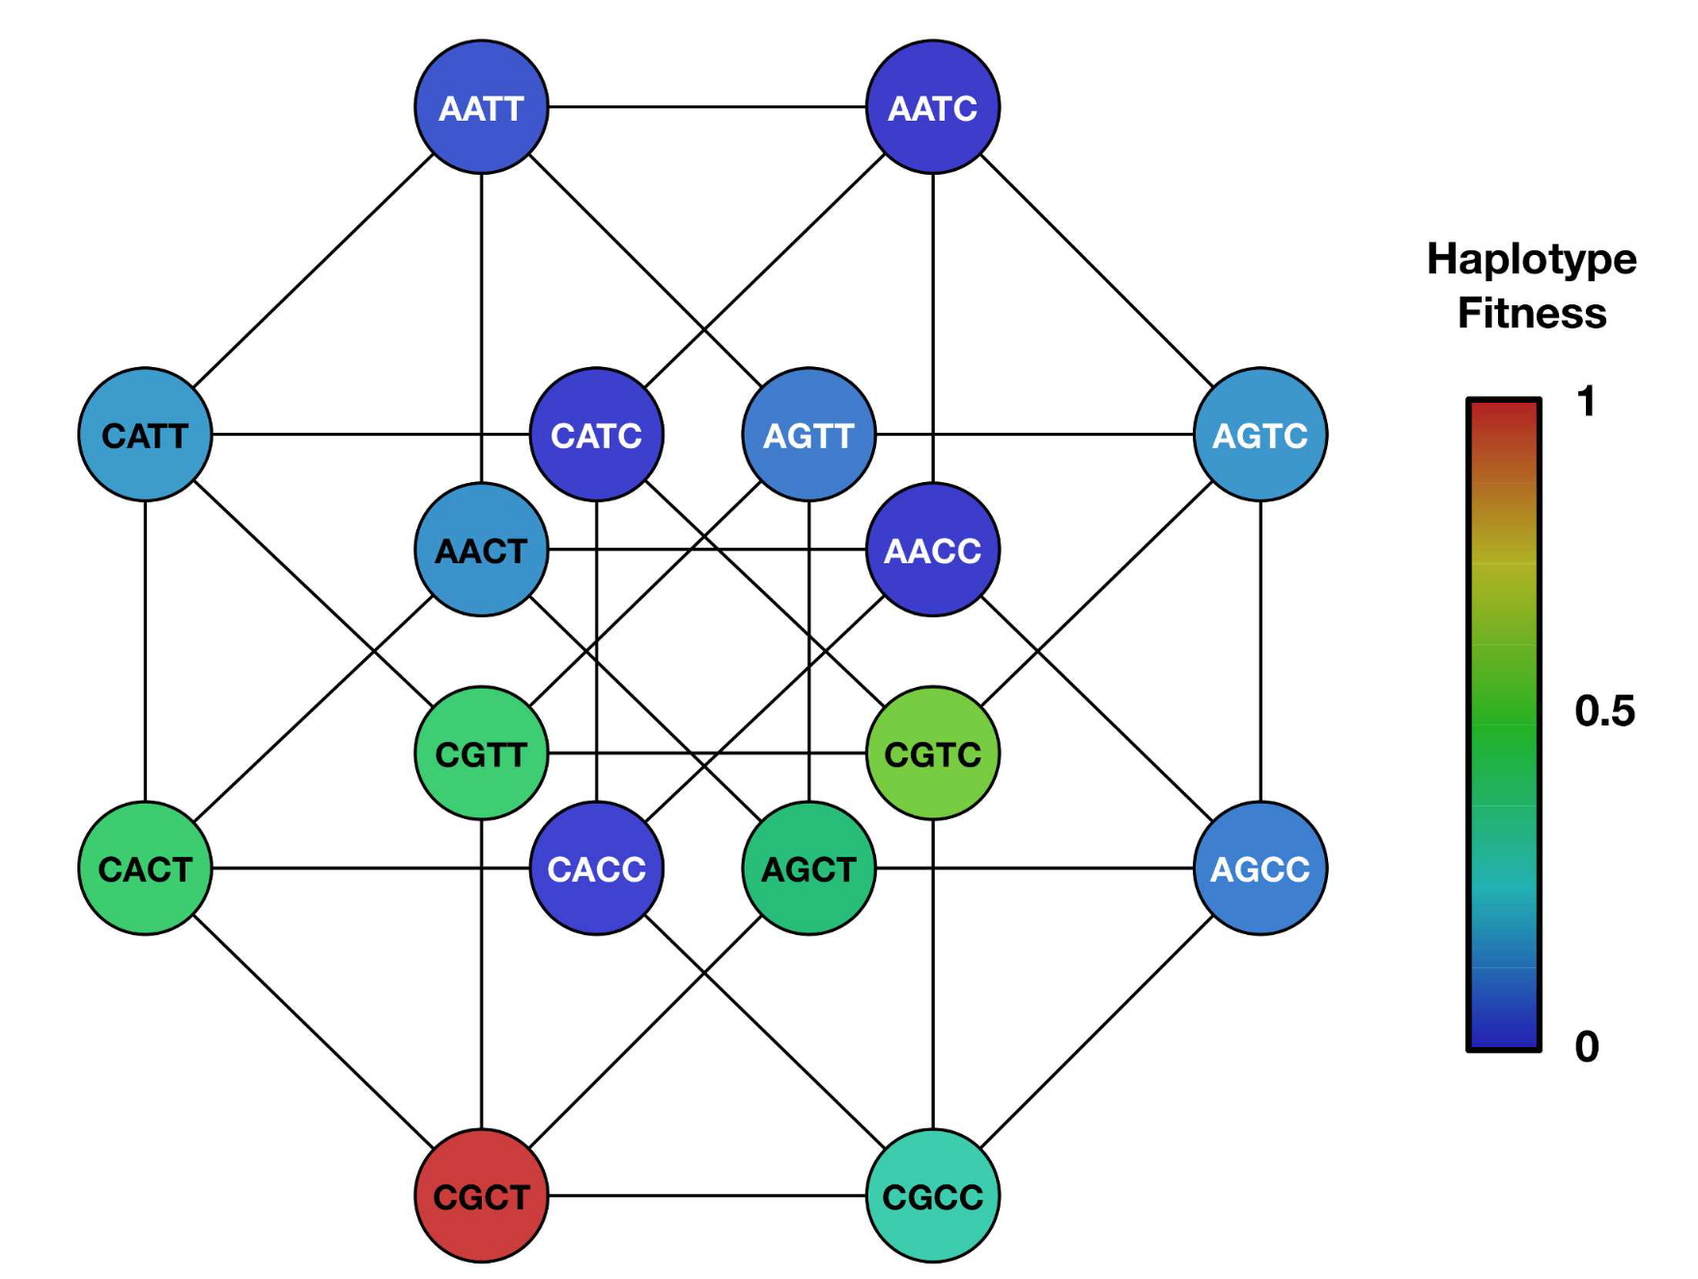
Various Within-Host Evolution Fitness Landscapes
Phenotypic (RMF) Fitness
Antigenic Fitness
Pleiotropic Fitness
0000
0001
0000
0001
0000
0001
1000
1001
0010
0011
1000
1001
0010
0011
1000
1001
0010
0011
0100
0101
0100
0101
0100
0101
1010
1011
1010
1011
1010
1011
1100
1101
0110
0111
1100
1101
0110
0111
1100
1101
0110
0111
1110
1111
1110
1111
1110
1111

Slide 16
Using the RMF Landscape, we aimed to determine how each parameter impacts Within-Host Evolution

Slide 17
Increases in the Effective Population Size Decreases the Strength of Genetic Drift and Increases the Efficacy of Selection
Simulated using an L=20 (100% phenotypic) , c =1, μ=1
N = 10
N = 60
N = 100

Slide 18
Viral Populations can get stuck at local fitness peaks on rugged landscapes
Simulated using an L=20 (100% phenotypic) , N=100, μ=1
c = 0.75
c = 1
c = 2

Slide 19
Pleiotropic Mutations Depress the Fitness Landscape and allow the Viral Population to Traverse Fitness Valleys
Simulated using L=20, N=60, c=1, μ=1, c_antigenic=0.05
50% Phenotypic,
50% Antigenic, 0% Pleiotropic, 0% Synonymous
0% Phenotypic,
0% Antigenic, 100% Pleiotropic, 0% Synonymous

Slide 20
Conclusions
As the population size increases, genetic drift becomes less impactful, and the viral population is able to reach a higher fitness peak easier via selection.
As the ruggedness of the landscape increases, it becomes harder for the viral population to reach the optimal fitness peak. Instead, viral populations often get stuck at a local fitness peak.
Pleiotropic mutations depress the fitness landscape and allow viral populations to traverse fitness valleys that would have otherwise caused them to get stuck at local fitness peaks.
Antigenic evolution facilitates phenotypic evolution through pleiotropic mutations.

Slide 21
How do the RMF Results help us Interpret the Patterns Found in Chronic Infections?
Patterns in chronic infections include:
  Heterogeneous substitution rates across individuals
  Some recurrent mutations across patients
    There are high numbers of substitutions that affect ACE2 binding or viral packaging (phenotypic mutations)
    There are high numbers of antigenic mutations (most commonly occurring in the receptor binding domain (Antigenic)
    There are mutations that affect ACE2 binding and are immune escape mutations (pleiotropic)
The Rough Mount Fuji Fitness Landscape model under a rugged fitness landscape parameterization can quantitatively reproduce these patterns (with more quantitative work to come)

Slide 22
Future Directions
Scaling up the number of sites (L) to simulate within-host evolution using for the entire spike gene.
Extending this model to allow for multiple lineages to co-circulate within a single prolonged infection.
We aim to infer the parameters of the RMF model by statistically interfacing these models with chronic infection data (approach TBD)
We plan to develop population-level models with both active and chronic infections to address the following questions
  When do chronic infections contribute to population-level evolution?
  Will SARS-CoV-2 evolutionary patterns end up being similar to that of Influenza A Virus in the future? Or chronic infections always be the source of VOCs?

Slide 23
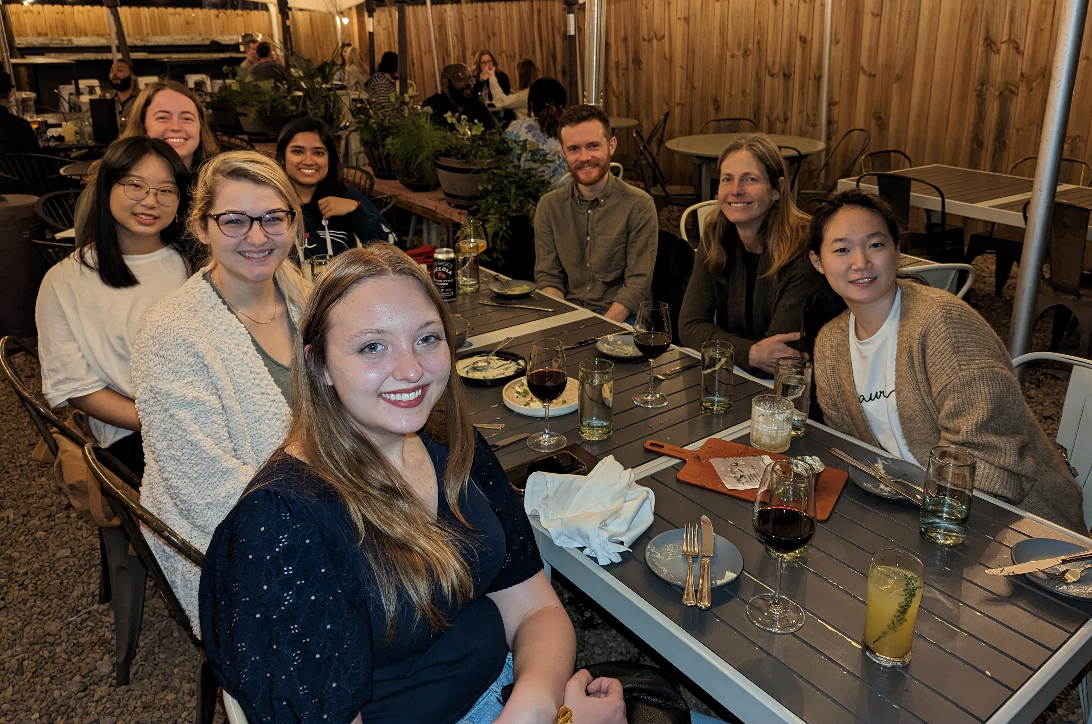
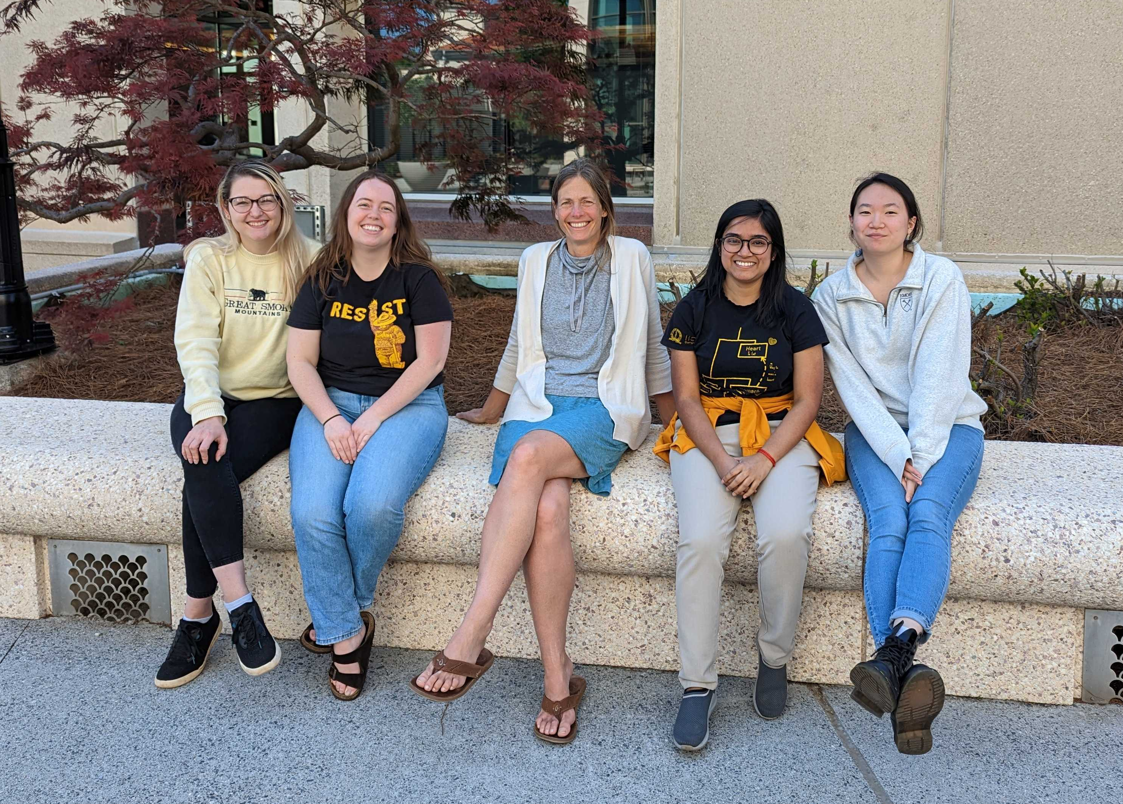



Acknowledgments
Koelle Lab
Katia Koelle
Yeongseon Park
Ananya Saha
Elizabeth Somsen
Rita Wang
Theresa Shi
Funding Sources
T32 AI138952

