Slide 1
Superstring Amplitudes From Threshold Effects to Soft Theorems and Back?
Raffaele Marotta
INFN
Di Vecchia-80 Fest: Nordita, Stockholm May 15-16

Slide 2
Plan of the talk
1994. The beginning: Threshold corrections in string theories.
Back to ……
2015. Soft Theorems in Field and String Theories

Slide 3
The beginning: String Thresholds
In grand unification theories, the low energy gauge interactions are unified in a single gauge theory SU(5), SO(10) or $E_{6}$ that is spontaneously broken at the energy scale $M_{GUT}\sim {10}^{14}−{10}^{19}$ GeV.
The low-energy coupling constants are related to the gauge coupling${ g}_{a} a=1,2,3$ of the unifying group $g_{GUT}$ by the Georgi-Quinn- Weinberg equation

Slide 4
String theories unify all the known interactions, and the three-level predictions of string unification are similar to GUT predictions
The threshold corrections in string theory take in account the effects of massive particles on the renormalization group equation. These are obtained by considering the string partition function in the presence of a constant background gauge field $A_{μ}=−\frac{1}{2}F_{μυ}X^{υ}$
multiloop bosonic Green’s function (h is the genus of the world-sheet)

Slide 5
At 1-loop in closed (heterotic) string
$ω_{2}$is the prime form, $τ$ the modular parameter of the world-sheet torus and $Z_{4}$ the four-dimensional partition function.
The extension at multiloop of this identity was very difficult to achieve and we started a 1-loop analysis of the field theory limit of string amplitudes.
Alberto Lerda’s talk.
Vadim S. Kaplunovsky, One loop threshold effects in string unification, hep-th/9205070.
H. Georgi, H. R. Quinn and S. Weinberg, Phys. Rev. Lett. 33 (1974), 451.

Slide 6
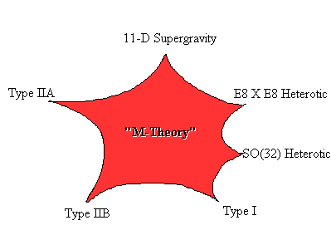
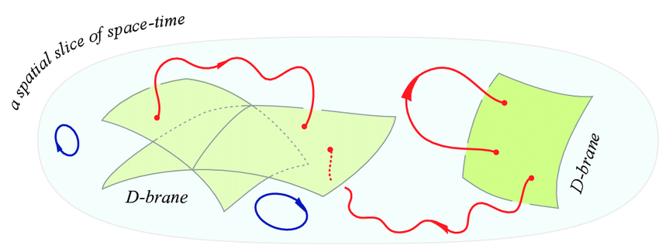
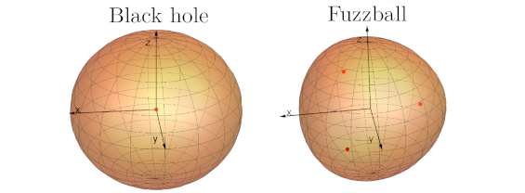
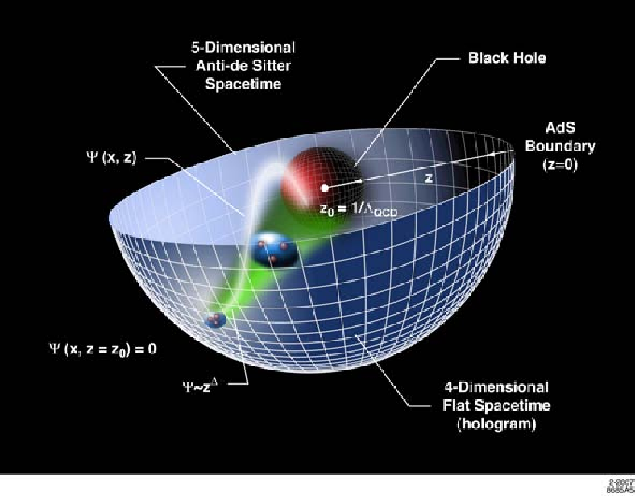

Slide 7
Soft Theorems
in
Field and String Theories
P. Di Vecchia, R.M. , M. Mojaza JHEP 05 (2015) 137.
P. Di Vecchia, R. M., M. Mojaza, JHEP 12 (2015) 150
P. Di Vecchia, R. M., M. Mojaza, Fortsch.Phys. 64 (2016) 389-393
P. Di Vecchia, R.M. , M. Mojaza, J. Nohle, Phys. Rev D93 (2016) n.8, 080515.
P. Di Vecchia, R. M., M. Mojaza,JHEP 06 (2016) 054.
P. Di Vecchia, R. M., M. Mojaza, JHEP 12 (2016), 020.
P. Di Vecchia, R. M., M. Mojaza,JHEP 09 (2017),001
P. Di Vecchia, R. M., M. Mojaza, JHEP 10(2017)017
P. Di Vecchia, R. M., M. Mojaza, JHEP 01 (2019) 038
P. Di Vecchia, R.M., M. Mojaza, Phys. Rev. D 100 (2019) 4, 041902.

Slide 8
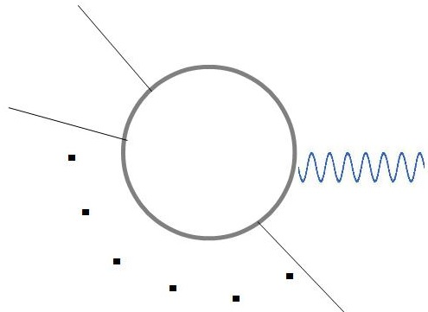
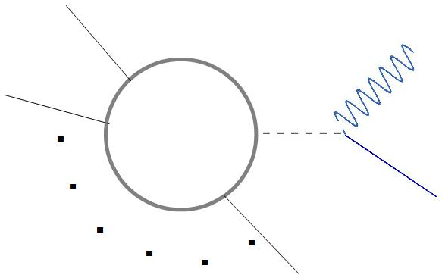
What are Soft theorems?
It is well know that scattering amplitudes in the deep infrared region (or soft limit) satisfy interesting relations.
Low’s theorem: Amplitudes with a soft photon are determined from the corresponding amplitude without the soft particle
$$p_{1}$$
$$p_{1}$$
$$p_{2}$$
Soft-photon
$$q→0$$
$$=\sum_{I=1}^{n}{ }$$
$$p_{i}$$
$$p_{n}$$
Soft-photon polarization
$e_{i}$ charge of the particle $i$
smooth in the soft limit
Notes:
La carica elettrica-

Slide 9
Weinberg: Amplitudes involving gravitons and matter particles show and universal behavior when one graviton becomes soft.
They were recognized to be a consequence of the gauge invariance
Soft-Photon
Soft-graviton

Slide 10
The interest in the argument was renewed by a proposal of A. Strominger (JHEP 07 (2014) 152) and T. He, V. Lysov, P. Mitra and A. Strominger (JHEP 05 (2015) 151) asserting that soft theorems are nothing but the Ward identities of the BMS symmetry of asymptotic flat metrics.
A. Strominger and F. Cachazo proposed that 4D three level graviton amplitudes have a universal behavior through the second subleading order in the soft-graviton momentum. (F. Cachazo, A. Strominger:arXiv:1404.4091)
These considerations were extended to gluons through the subleading order. The soft-gluon theorem arises as the Wad identity of a two dimensional Kac-Moody type symmetry. ( T. He, V. Lysonv, P. Mitra, A. Strominger, JHEP 05 (2015) 151 )
These theorems to subleading order for gluons and sub-subleading order for gravitons have been proved in arbitrary dimensions by using Poincarré and on-shell gauge invariance of the amplitudes. (J. Broedel, M. de Leeuw, J. Plefka, M. Bosso , Phys.Rev.D 90 (2014) 6, 065024 and Z. Bern, S. Davies, P. Di Vecchia, and J. Nohle, Phys.Rev.D 90 (2014) 8, 084035)

Slide 11
In these new soft theorems $n+1$-point amplitudes with a soft graviton or gluon are obtained acting on $n$-point amplitude with universal soft operators.
Soft-particle momentum
Only for soft- gravitons
Graviton soft operators
Gluon soft operators
$ε$ is the polarization of the soft particle and $J_{i}$ total angular momentum (orbital+spin) of the matter particles.
Notes:
Da cambiare eleminare operatori soffici e mettere da soft therem to lagrangian

Slide 12
String theory is also a powerful tool to get field theory amplitudes. There are few diagrams at each order of the perturbative expansions that are represented as complex integrals on the string moduli space.
Single and double soft limit can be “easily” studied on amplitudes involving $n$ arbitrary external states.

Slide 13
Amplitudes in Bosonic, Heterotic and Superstring theories
In closed bosonic and superstring theory amplitudes with a graviton or a dilaton with soft momentum $q$ and $n$ hard particles with momentum $k_{i}$are obtained from the same two index tensor
$z_{l}$ are complex coordinates parametrizing the insertion on the string world-sheet of the hard state vertex operators
$F^{μν}$ is a function of all Koba-Nielsen variables having pole for $z\sim z_{i}$
Model dependent $n$ points amplitude
$z$ Koba-Nielsen variable of the soft particle
Notes:
F is model dependent and contain all the information about the interaction of the soft particle with the matter hard particles.

Slide 14
One soft-graviton and n-hard particles
Soft-graviton amplitude is obtained by saturating the n+1-amplitude with the polarization:
$S^{(0)}$ is the standard Weinberg leading soft behavior.
$S^{(1)}$ in bosonic and superstring theory is:

Slide 15
Subsubleading order is different in bosonic, heterotic and superstring amplitudes.
The colons denotes that the action of one operator on the other is excluded.
String correction.
The expression is the same both for soft graviton and dilaton.
String corrections are present only in the bosonic and heterotic amplitudes. They are due to coupling between the dilaton and the Gauss-Bonnet term which is present in the bosonic string effective action but not in its supersymmetric extension.
Notes:
Terms which are gauge invariant by itselves.

Slide 16
Kalb-Ramond soft theorem
Soft-Kalb-Ramond amplitude is obtained by saturating the n+1-amplitude with the polarization:
The leading divergent term doesn’t contribute because is symmetric in the two free indices and one gets:
Gauge invariance follows from the following identity:

Slide 17
Once used in the subleading expression of the amplitude, gives:
Sub-subleading soft theorem for the antisymmetric tensor is still an open problem!

Slide 18
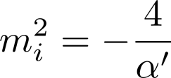
Soft-theorem for the gravity dilaton.
Soft-dilaton amplitude is obtained by saturating the n+1- string amplitude with a soft graviton/dilaton with the dilaton projector:
D is the space-time dimension
The soft behavior with $n$-hard Tachyons is:
$n$-tachyon amplitude:

Slide 19
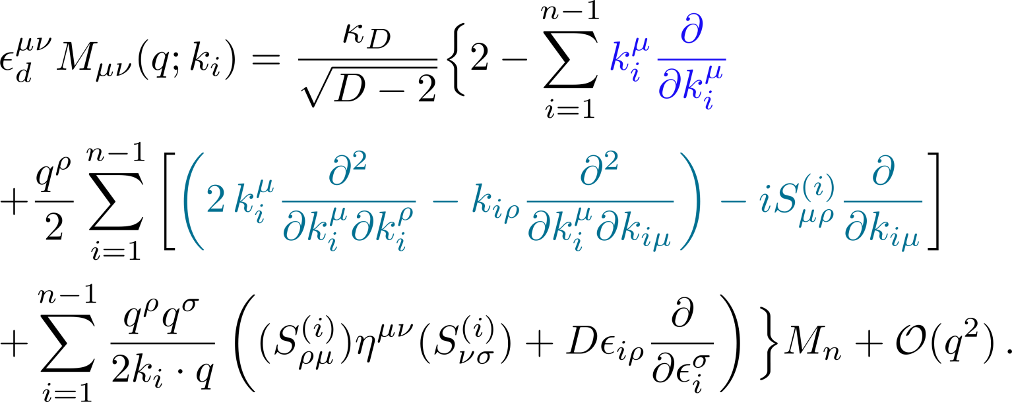
Similarly, the soft-behavior with $n$-hard massless particles, is:
It can be obtained via gauge invariance from a string-inspired three-point vertex describing graviton/dilaton interactions.
No-string corrections in the soft-dilaton behavior.
Universal, it is the same in bosonic, heterotic and superstring theories.
It depends on the scale and special conformal generators in D-dimensions. Why?
Scale transformation generator
Special conformal transformation generator

Slide 20
Multiloop extension
The $h$-loop amplitude involving one graviton/dilaton and $n$-tachyons in bosonic string is:
It has been obtained with the formalism of the N-string vertex that has the advantage of not requiring the external states to be on the mass shell.
[Di Vecchia, Pezzella, Frau, Hornfeck, Lerda, Sciuto, Nucl. Phys. B322(1989),317; Petersen and Sidenius Nucl Phys. B301 (1988) 247; Mandelstam, (1985)]

Slide 21
The $h$-loops string Green’s function:
$ω^{μ}\left(z\right),$ $E(z,w)$ and $τ_{IJ}$ are the abelian differentials, the Prime-form and the period matrix, respectively.
$V_{i}^{−1}\left(z\right)=w_{i}$ are local coordinates defined around the punctures $w_{i}$. On-shell the amplitude will not depend on these local coordinates.
Under world-sheet reparametrization $|{V′}_{i}\left(0\right)|^{2}$ transform as the inverse of the metric. In the conformal gauge $ρ dz d\overline{z}$ $|{V′}_{i}\left(0\right)|^{2}$= $\frac{1}{ρ(z_{i})}$
The string Green-function satisfies:
The Gauss-Bonnet theorem :
Genus

Slide 22
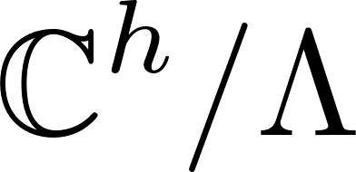
The Jacobian variety is the torus with:
$\left(a_{I}, b_{I}\right), I=1,…h,$are the homology cycles.
The Jacobian variety is a Kähler manifold and its Kähler form is: [Jost, Geometry and Physics; D’Hoker, Green , Pioline, Comm. Math Phys. 366, Isuue 3, (2019) 927]
The pull-back, under the embedding (Abelian map) $\vec{ξ}=\int_{z_{0}}^{z}{\vec{ω}}$ , of the Kähler form, defines the metric:

Slide 23
This identity fixes $ρ$ only up to multiplication by holomorphic functions and a constants i.e. $ρ=\tilde{ρ}e^{−f\left(z\right)−\overline{f}\left(\overline{z}\right)+c}$. It also implies
Since $f, \overline{f}$ and $c$ are arbitrary, we can fix them by imposing
becomes invariant around the homology cycles and it coincides with the Arakelov Green’s function.
By using the properties of the Arakelov Green’s function, all the integrals are calculable and one can see that the graviton soft theorem is the same as at three level.
Arakelov-type Green’s function

Slide 24
The dilaton soft-theorem becomes:
Because of the dependence of $h, w$e cannot immediately write the all-loop soft behaviour.

Slide 25
However from the scaling properties:
we deduce,
Getting the loop independent expression:

Slide 26
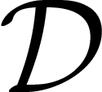
Spontaneosly breaking of the Conformal Symmetry
A conformal transformation of the coordinates is an invertible mapping, $x→x′$, leaving the metric invariant up to a local scale factor:
$$g_{μν}→ Λ\left(x\right)g_{μν}$$
The group is an extension, with dilatations, $,$ and special conformal transformations, , of the Poincaré group which belong to $Λ=1.$
Infinitesimally, the group transforms the space-time coordinates as follows:
D : space-time dimension

Slide 27
For D>2 and in flat space, the generators are:
The Nöther currents associated to the dilatations and special conformal transformations are conserved, because of the traceless of the improved energy momentum tensor:

Slide 28
Let’s consider now a situation where the conformal symmetry is spontaneously broken due to a scalar field getting a nonzero vev:
$v$ is the only scale mass of the theory and the vacuum remains invariant under the Poincaré group.
When the conformal group is spontaneously broken to the Poincaré group, although the broken generators are the dilatations and the special conformal transformations, only one massless mode, the Dilaton $ξ(x)$ , is needed.
The dilaton couples linearly to the trace of the energy momentum tensor:
$d_{φ}$ is the scaling dimension of the field
I. Low and A.V. Manohar hep-th/0110285
Space-time dimension

Slide 29
Soft-Theorems follows from the Ward-identities of the spontaneously broken symmetry.
In a theory invariants under some global transformation, the starting point is the derivative of the matrix element of Nöther currents and scalar fields $φ(x_{i})$ .
$T^{∗}$denotes the $T$-product with the derivatives placed outside of the time-ordering symbols.
Single soft theorem is obtained by considering only one current:
If the currents is unbroken, , and one gets the usual Ward-identity of conserved symmetries.
Notes:
Il gruppo conforme è una symmetria dello spazio tempo ma è globale perche I parametrui della trasformazione sono globali. Ex. Speciali conformi. x’=(x^\mu-b^\mu x^2)/(1- 2 b_\mu x^\mu+b^2 x^2) be’ un parametro globale

Slide 30
For spontaneously broken scale
and special conformal transformations
Through the LSZ reduction formula that translate the relation between correlation functions in a relation between amplitudes

Slide 31
The Gravity dilaton and the Nambu-Goldstone boson of the broken conformal symmetry satisfy similar soft theorems. Why?
The Ward identities satisfied by the perturbative multiloop string amplitudes are similar to those CFT correlators in momentum space. Maybe there are more general solutions of these Ward identities valid not only for small values of the string coupling constant$g_{s}$

Slide 32
Conclusions
We can go back to 1994 and compute the threshold corrections in string theory.
We can go back to the future, starting new journeys.
Thank you for this long friendship and happy birthday!

