Slide 1
The impact of magnetic fields on r-process nucleosynthesis in proto-neutron star winds
Dhruv Desai
Advisors: Prof. Brian Metzger
Prof. Daniel Siegel
Monday September 4, 2023

Slide 2
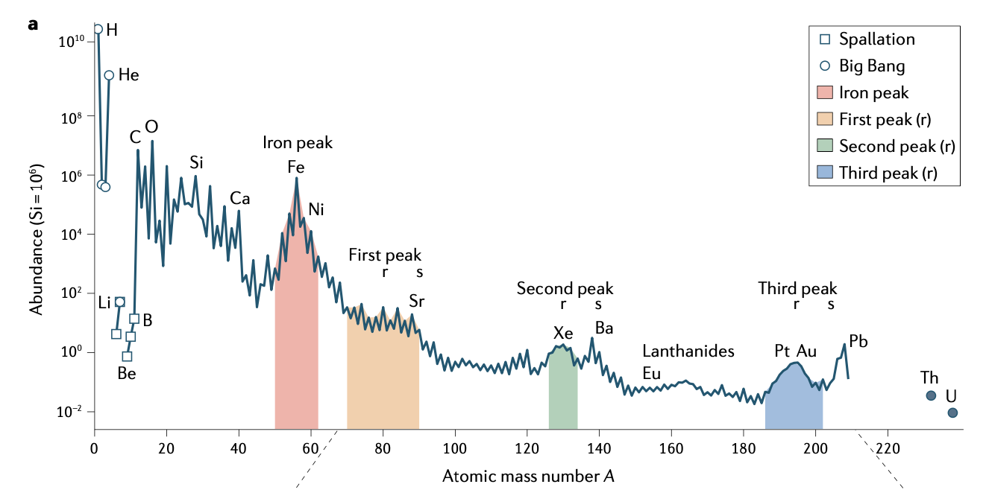
Where do the heavy elements come from?
Outline
The need for an alternative nucleosynthesis process
The r-process: mechanism, conditions required
Candidates (core-collapse supernovae, mergers) & observational constraints
Neutrino-driven winds following core-collapse supernovae
Impact of rapid rotation
Impact of strong magnetic fields
Summary & future directions
Observed Solar Abundance
Atomic mass number →
Siegel 2022, Nature
?

Slide 3
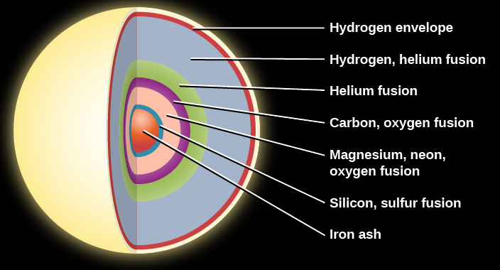
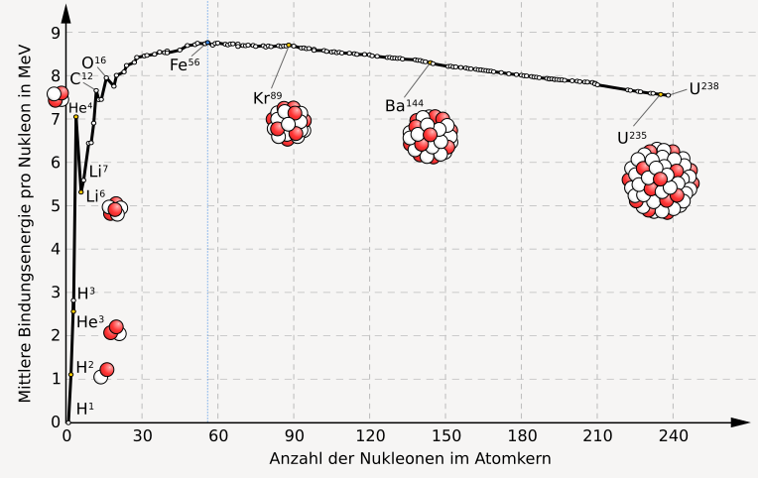
The synthesis of elements
(massive stars)
Big bang: H, He, Li
Fe-group elements produced in interiors of stars, supernovae
densities, temperatures sufficiently high for nuclear statistical equilibrium
Most tightly bound
nuclei
Credit: UCF
Easier to unbind at high densities, temperatures
Binding energy
How are these elements produced?
Where?
More energetically favorable
Atomic Mass Number
Credit: Wikipedia
Notes:
We don’t know the site, but we know something about the process, which can tell us about conditions required, which can point to possible sites

Slide 4
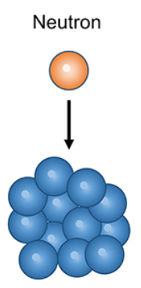
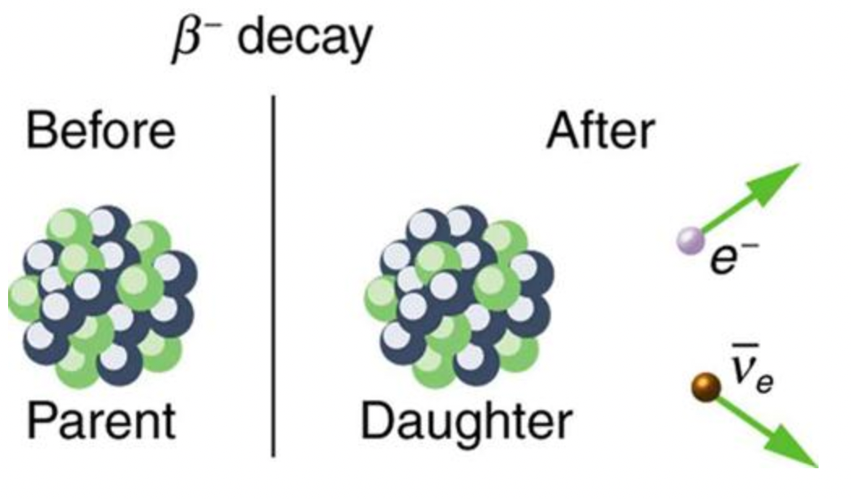
Neutron capture increases atomic number
Key: neutrons can overcome electric Coulomb barrier, allowing build-up to heavy elements
Example: the s-process
timescale of neutron-capture much longer than that of beta-decay
Observed, nuclear physics well-understood (in valley of stability)
1. Nucleus captures neutron
2. Nucleus beta-decays
Path of s-process nuclei
…
Proton number
seed nucleus
Credit: texasgateway.org
Neutron number

Slide 5
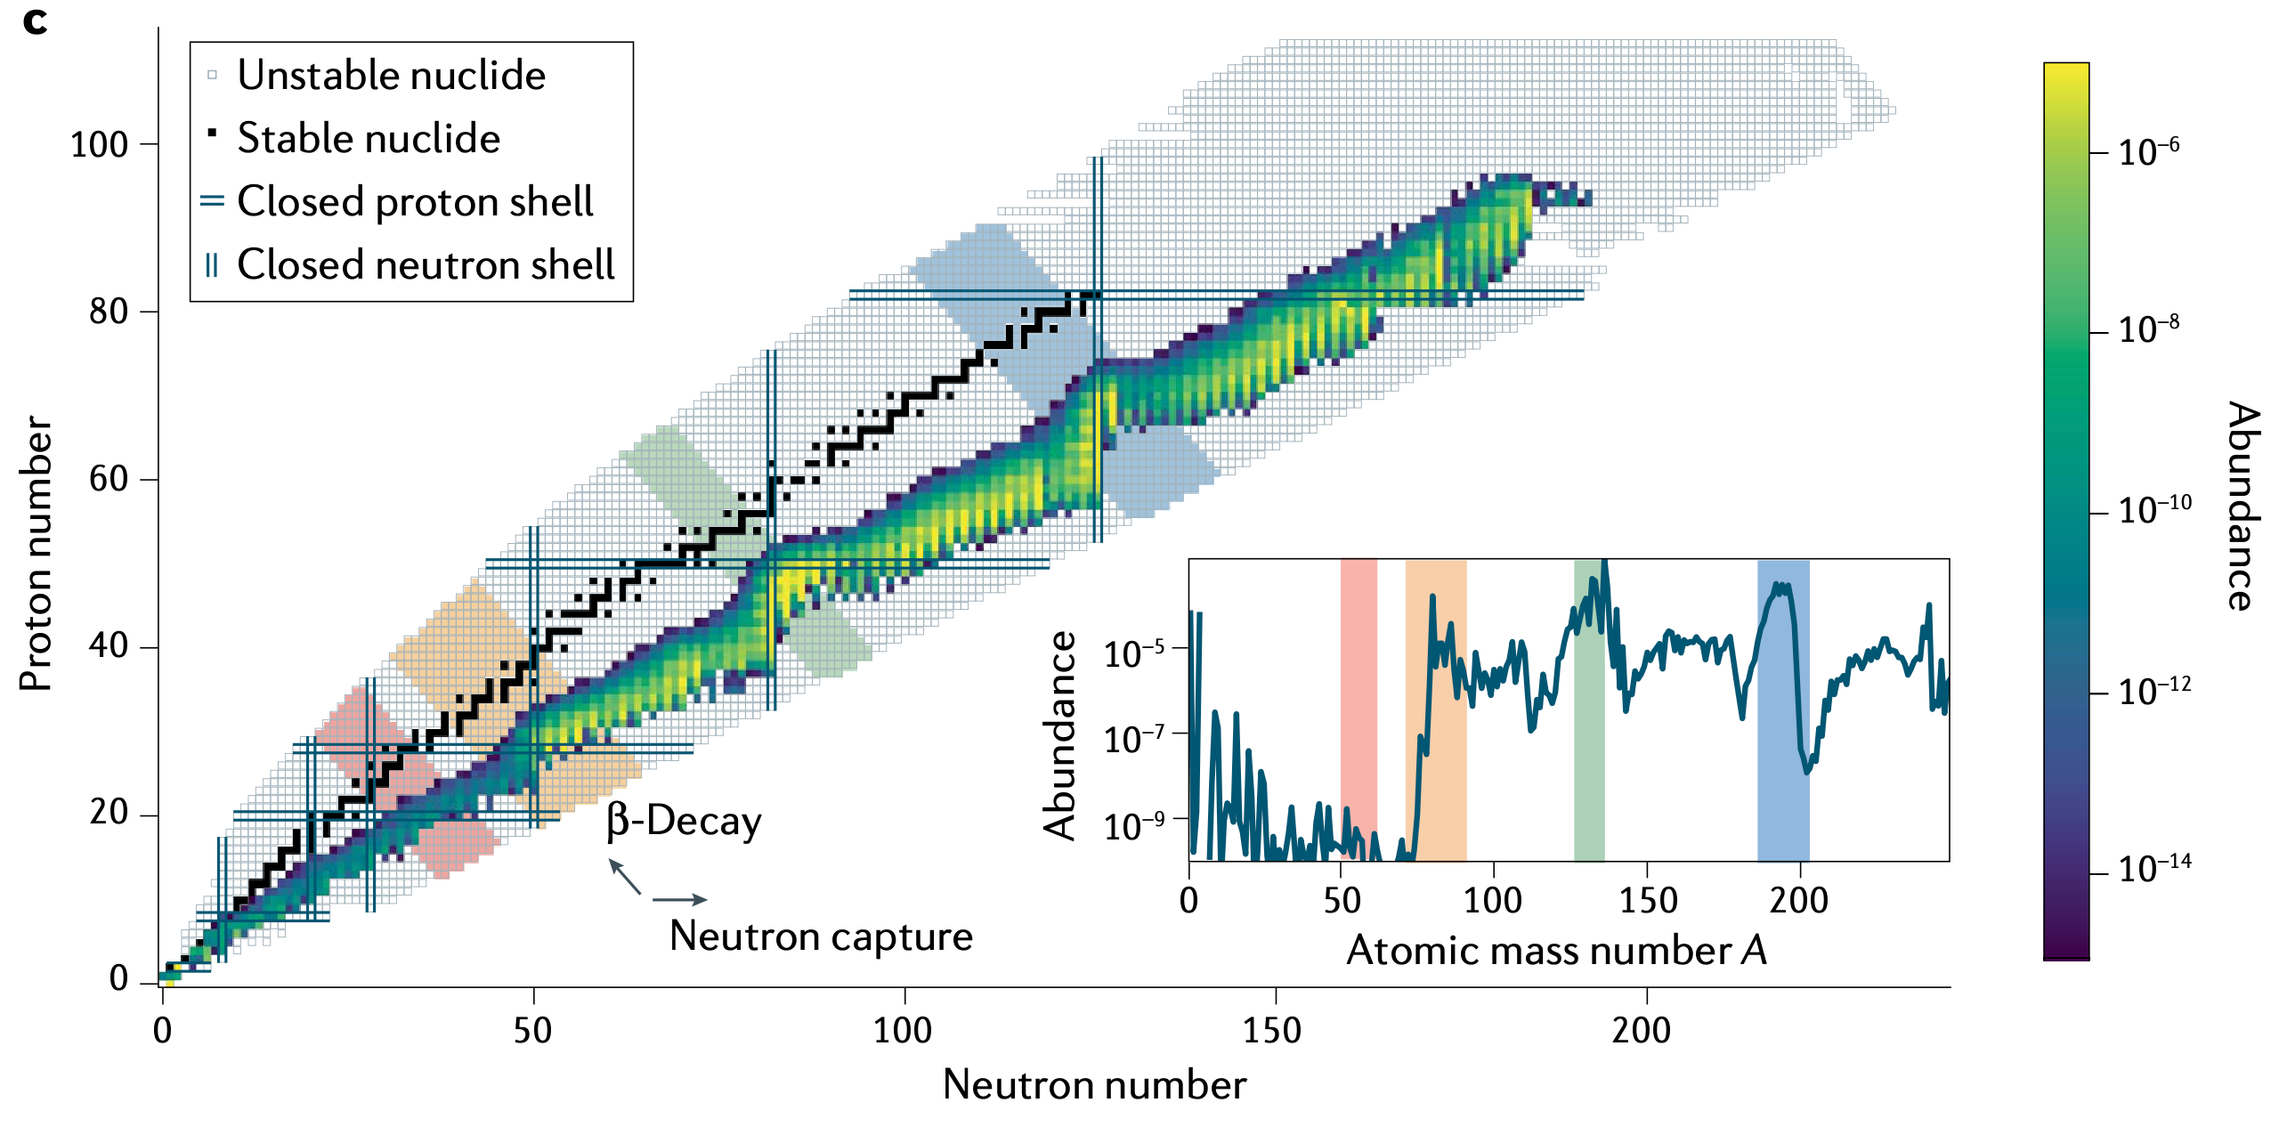
r-process nucleosynthesis less well-understood
Stable nuclei
1. Nuclei capture many neutrons rapidly 2. Neutron-rich nuclei beta-decay to stability at the end
Proton number →
Unstable neutron-rich nuclei
Path of r-process nuclei
Neutron number →
Siegel 2022, Nature
Proton number
…
Nuclear physics of unstable nuclei not well understood
The r-process requires…
Timescales shorter than beta decay ~few ms (rapid)
Many free neutrons captured onto seed nuclei:
i.e., high neutron-to-seed ratio (lots of n, or few seeds)
Neutron number

Slide 6
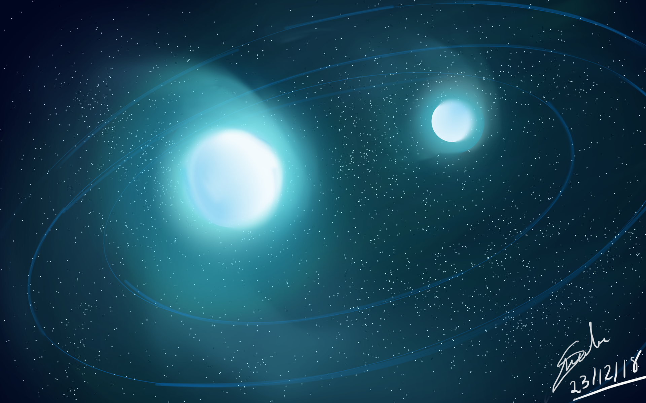
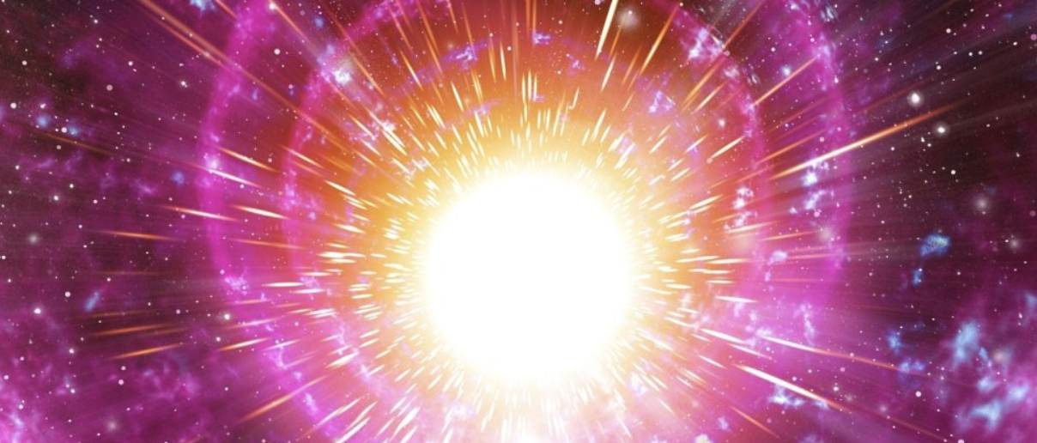
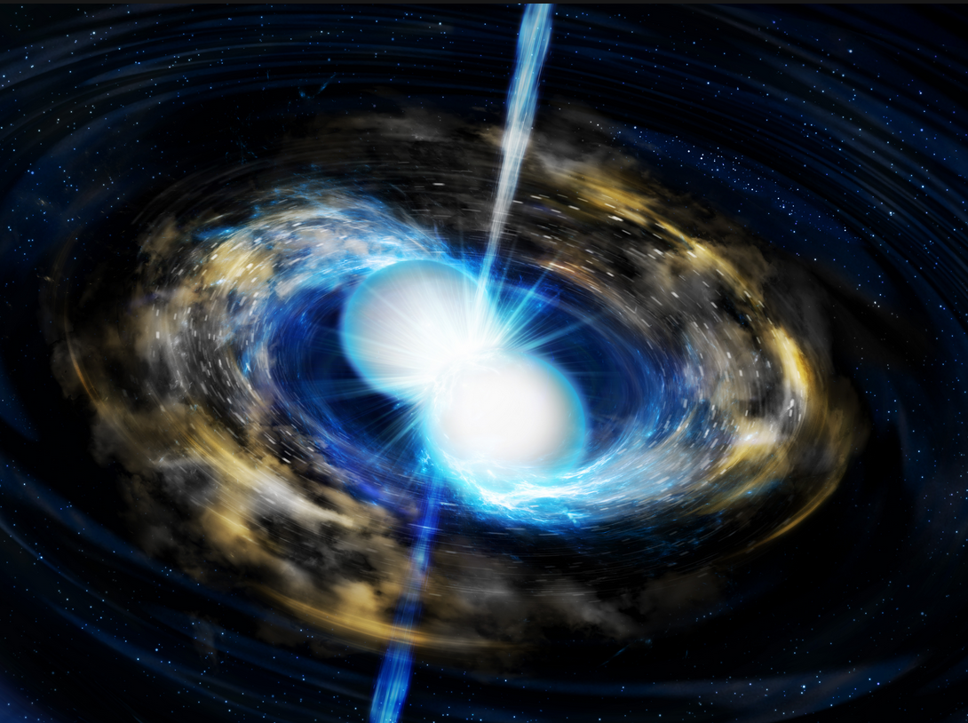
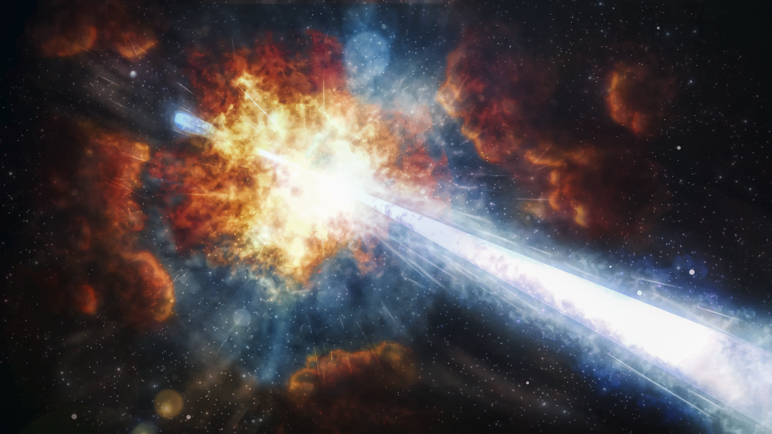
Two candidate astrophysical sites of the r-process
Core-collapse supernovae
Compact object mergers
Aug 17, 2017:
First detection of a neutron star merger
kilonova detection: direct evidence of radioactive heating from the r-process
first direct evidence for an r-process site
Credit: Soheb Mandhai
Credit: Mehau Kulyk/Science Photo Library/Getty Images
Occurs at the end of massive star’s life
May form neutron star upon collapse – source of neutrons
r-process site not confirmed
Credit: Tohoku University
Credit: Soheb Mandhai

Slide 7
Observational constraints on the r-process
Evidence for prompt r-process enrichment (in tension with merger delay-time) (e.g., Cote et al. 2017, Siegel et al. 2019, Ji et al. 2023)
Evidence that r-process is rare (incompatible with ordinary supernovae)
From dwarf galaxies (e.g., Ji et al. 2016)
if frequent, plutonium expected to build up to higher levels than observed in the seabed (e.g., Hotokezaka et al. 2015, Wallner et al. 2021)
➔ motivation to study rare supernovae
Birth of galaxy
r-process enrichment
event
Detection: r-process elements in old stars (~10 Myr)
first mergers occur much later (~100 Myr)
See Anna Frebel’s 2018 Annual Review, or Frebel & Ji 2023 for more details

Slide 8
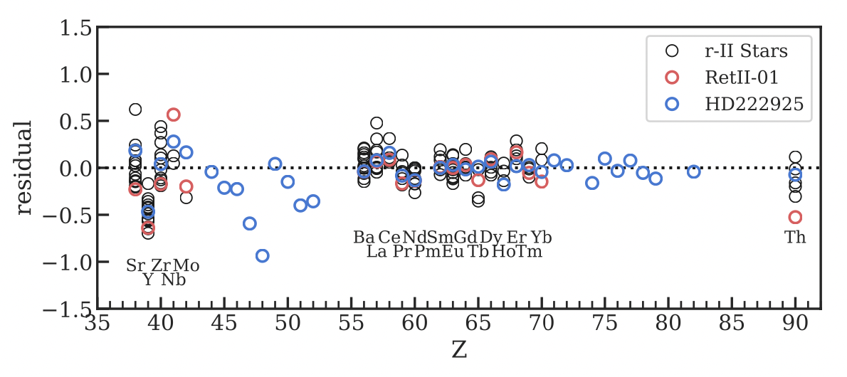
Significant scatter in observed 1st peak abundances from old stars
Frebel & Ji 2023
Nucleosynthesis process responsible?
s-process, alpha captures?
light r-process: “Lighter Element Primary Process” (LEPP)
Suggests multiple sources of heavy element enrichment
1st peak
Fe peak
2nd
r-process
peak
3rd r-process
peak
Siegel 2022, Nature
Observed:
scatter
Robust pattern

Slide 9
Challenges in determining astrophysical site
Uncertainties in…
Nuclear experiment/theory, which reveal properties of unstable neutron-rich isotopes
Nucleosynthesis network calculations which determine conditions required for abundances
Magnetohydrodynamical simulations of likely astrophysical sites responsible for r-process
Observations of r-process abundances e.g., in Milky Way halo stars, and of transients: enrichment as a function of galactic evolution
Radiation transport simulations, which use detailed atomic physics of r-process nuclei to predict light curves of transients
Siegel 2022, Nature

Slide 10
Neutrino-driven winds from core-collapse supernovae
Notes:
Label the surfaces, explain them

Slide 11
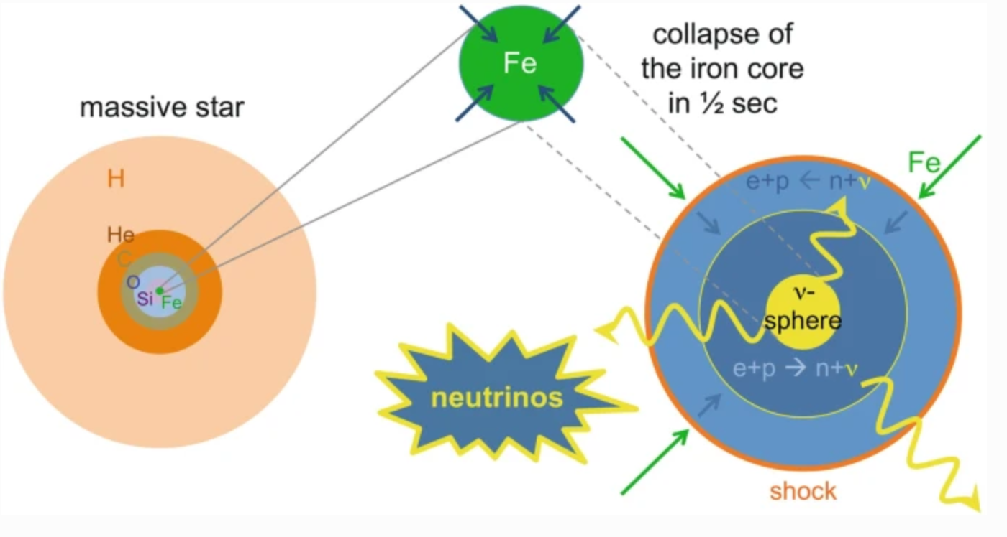
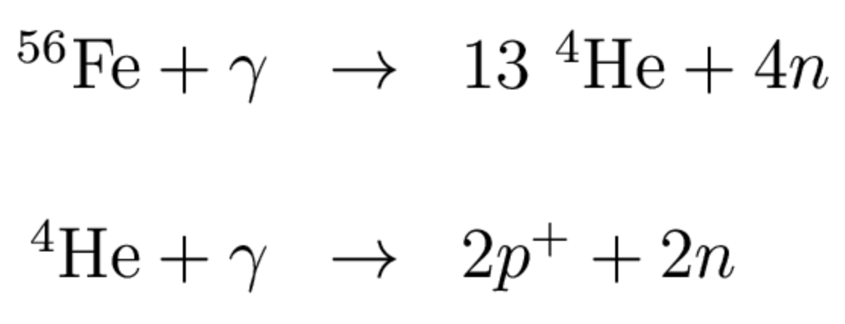
Winds occur in the aftermath of a core-collapse supernova (CCSN)
Fusion stops
Core collapses
Outer layers bounce, are ejected
t~500 ms: contracting PNS formed
Proto-neutron star
Handbook of Supernovae (2017)
Notes:
PNSs are formed in the aftermath of a CCSN.
for context, here's a massive star, green is the Iron core which during SN collapses and through the following reactions becomes a ball of neutrons we call the PNS.
we assume it's a successful explosion, so outer layers are ejected after bouncing off the core, but we're not studying SN mechanism.
additionally, neutrinos are produced, and based on Iron binding energy and total mass, ~1e52 erg energy is released through neutrinos
they diffuse out, and reabsorption drives a wind.
the remnant may be rotating, magnetized.

Slide 12
Gravitational energy released in the form of neutrino emission
Handbook of Supernovae (2017)
Approximate energy released:
Neutron star mass
Neutrinos diffuse out of PNS, free-stream from neutrinosphere
Neutrinos of all species produced; only electron neutrino/antineutrinos interact with matter outside PNS
Neutron star radius
Notes:
PNSs are formed in the aftermath of a CCSN.
for context, here's a massive star, green is the Iron core which during SN collapses and through the following reactions becomes a ball of neutrons we call the PNS.
we assume it's a successful explosion, so outer layers are ejected after bouncing off the core, but we're not studying SN mechanism.
additionally, neutrinos are produced, and based on Iron binding energy and total mass, ~1e52 erg energy is released through neutrinos
they diffuse out, and reabsorption drives a wind.
the remnant may be rotating, magnetized.

Slide 13
gain layer
Net neutrino absorption drives baryonic wind
Heating (𝝂-absorption)
Cooling (𝝂-emission)
Dominant interactions:
Cooling ~ T⁶ ~ r ^{–6}
neutrinosphere
<
|Heating rate|
Heating ~ r ^{–2}
PNS
15
50
neutrinosphere
Radius (km)
gain layer with net positive heating forms

Slide 14
Initially neutron-rich matter experiences ~10 neutrino absorptions before unbinding Initial conditions erased, even numbers of n, p (Y_{e}~0.5)
Two primary effects in the gain layer due to neutrino irradiation
Heating (entropy boost)
Protonization (Y_{e} : 0.1→ 0.5) because
Neutrino/antineutrino energies & luminosities are similar
Note: (2) is unfavorable for the r-process
How about (1)?
Heating (𝝂-absorption)
Cooling (𝝂-emission)
x10
PNS

Slide 15
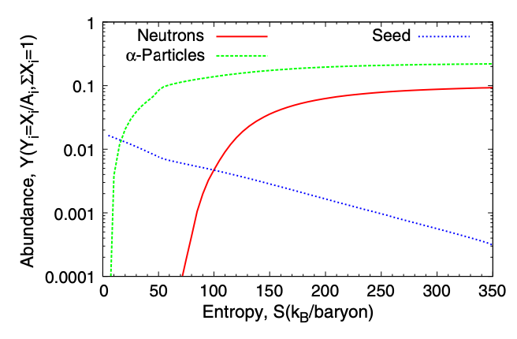
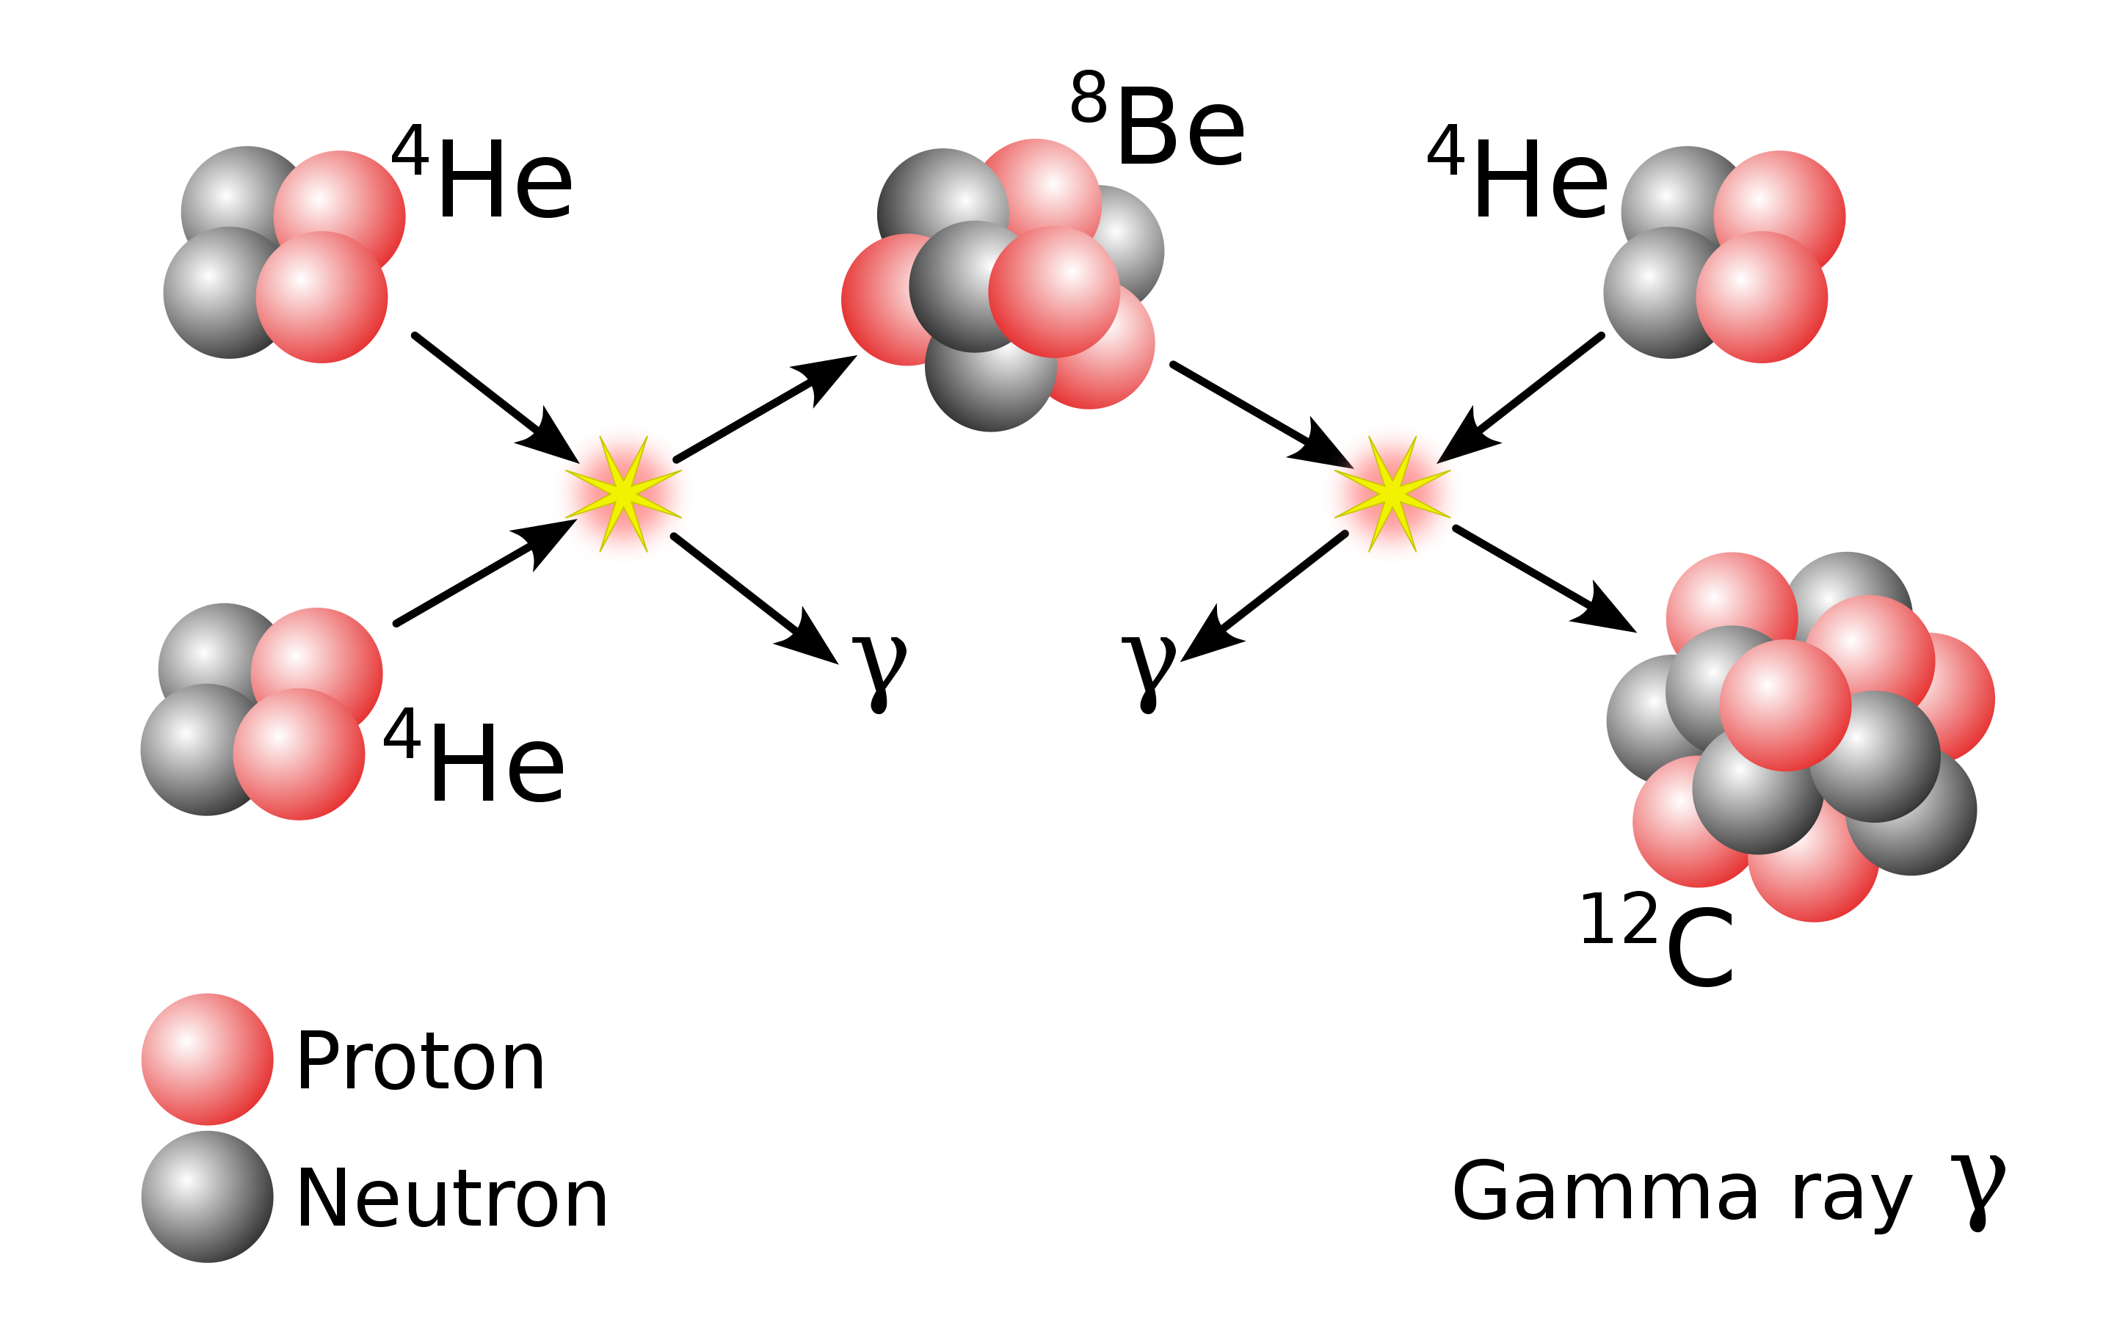
Wind conditions may suppress seed formation ➔ favorable for r-process conditions
Cowan 2021
Seeds must form via a triple-alpha process
(but Be decays quickly)
⁸Be Unstable at low densities
neutrons
Ratio favorable for the r-process
Abundance
seeds
100
Entropy (k_{B} bar⁻¹)
If reaction timescales are shorter than expansion timescales, triple-alpha process proceeds
❌ Combination of low densities and fast expansion suppresses reaction. i.e., high entropies: (s ~T³/𝜌 ~ const.)
- alpha-rich freeze-out
Under right combinations of
Entropy
neutron-richness
expansion speeds
neutron-to-seed ratio remains high; r-process occurs
Notes:
Neutron-to-seed ratio over plot

Slide 16
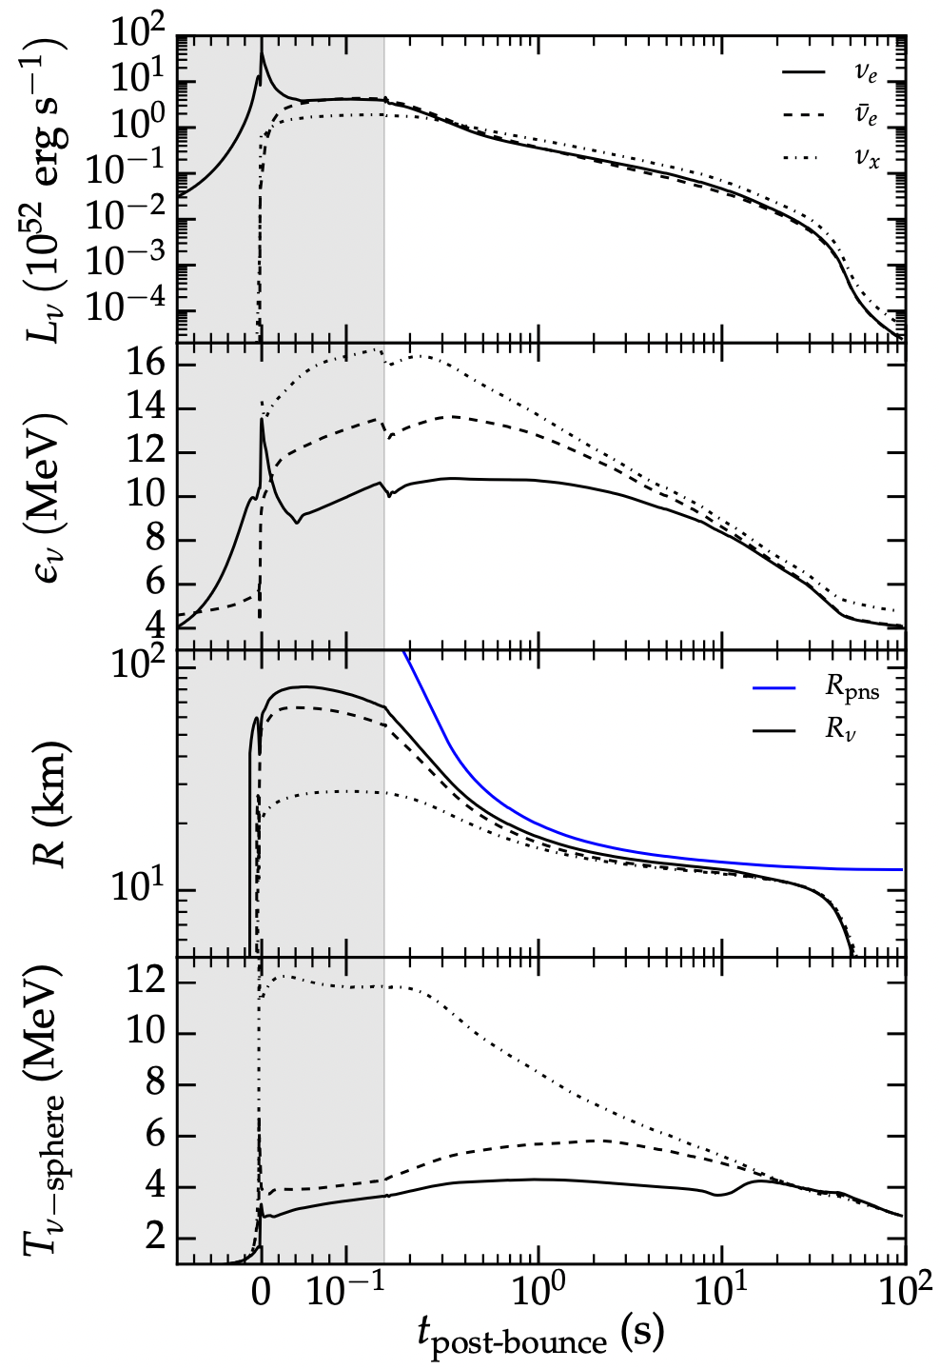
Neutrino properties dictate wind properties
We simulate just one snapshot, e.g. here
cooling curves computed self-consistently from core-collapse simulations
Neutrino properties ~2s after bounce:
L ~ 10⁵¹ erg s⁻¹
E ~ 10-20 MeV
R_{𝝂}~10 km (where optical depth ~ 1 )
These luminosities drive a wind via reabsorption
Roberts & Reddy (2017)
Notes:
Here we have cooling curves from self-consistent core-collapse simulations.
Time on the x-axis, vs neutrino and PNS properties on y-axis during core-collapse.
We focus on a slice of time ~2 seconds after the bounce, when PNS is not really contracting anymore. R~10km.
energies/luminosities observations error bars

Slide 17
Previous works
Analytic/Semi-analytic solutions studying how wind properties depend on neutrino properties (e.g., Qian & Woosley 96, Cardall & Fuller 97, Hoffman+97)
Self–consistent simulations of winds starting from core-collapse (e.g., Witti+94, Mosta et al. 15, Roberts et al. 16 etc.)
Includes detailed physics, but can only study a handful of initial conditions
various simplifying assumptions (e.g., Otsuki+00, Thompson+01, Arcones & Montes 11)
spherically symmetric, non-rotating winds
Neutrino luminosities put in by hand
Variations of the neutrino-driven wind with additional heating sources (e.g., Metzger+07, Thompson & ud-Doula 18, Nevins & Roberts 2023)
Concluded: Difficult to produce 2nd - 3rd peak elements

Slide 18
Our aim
We simulate a hot PNS with self-consistent neutrino transport which achieves a steady-state wind solution.
2. To isolate effects of rotation, magnetic fields
1. To map
Roberts & Reddy (2017)
Wind properties: Mass loss rate, entropy, composition
Neutrino
properties
Conducive to r-process?
Time
Not determined self-consistently from CCSN sim, but is *an idealized, controlled environment*

Slide 19
Methodology
Evolution code
GRMHD code (Siegel & Metzger 2018)
Tabulated SFHo nuclear EOS (Steiner+2013)
M0 scheme for neutrino transport (Radial equations which evolve neutrino mean energies/number densities along radial rays)
Emission and absorption included (Radice+16)
Initial conditions
1.4 solar mass NS
Hot: T_{c}~20 MeV, chosen to reproduce steady state neutrino emission
Metric determined at initial time step; not evolved further
Grid setup
Cartesian grid with static mesh refinement
M0 grid is spherical
Simulations evolved for ~150ms. Steady-state achieved at ~80 ms
30km, 𝛥x≈225m
6 levels
total
1000 km

Slide 20
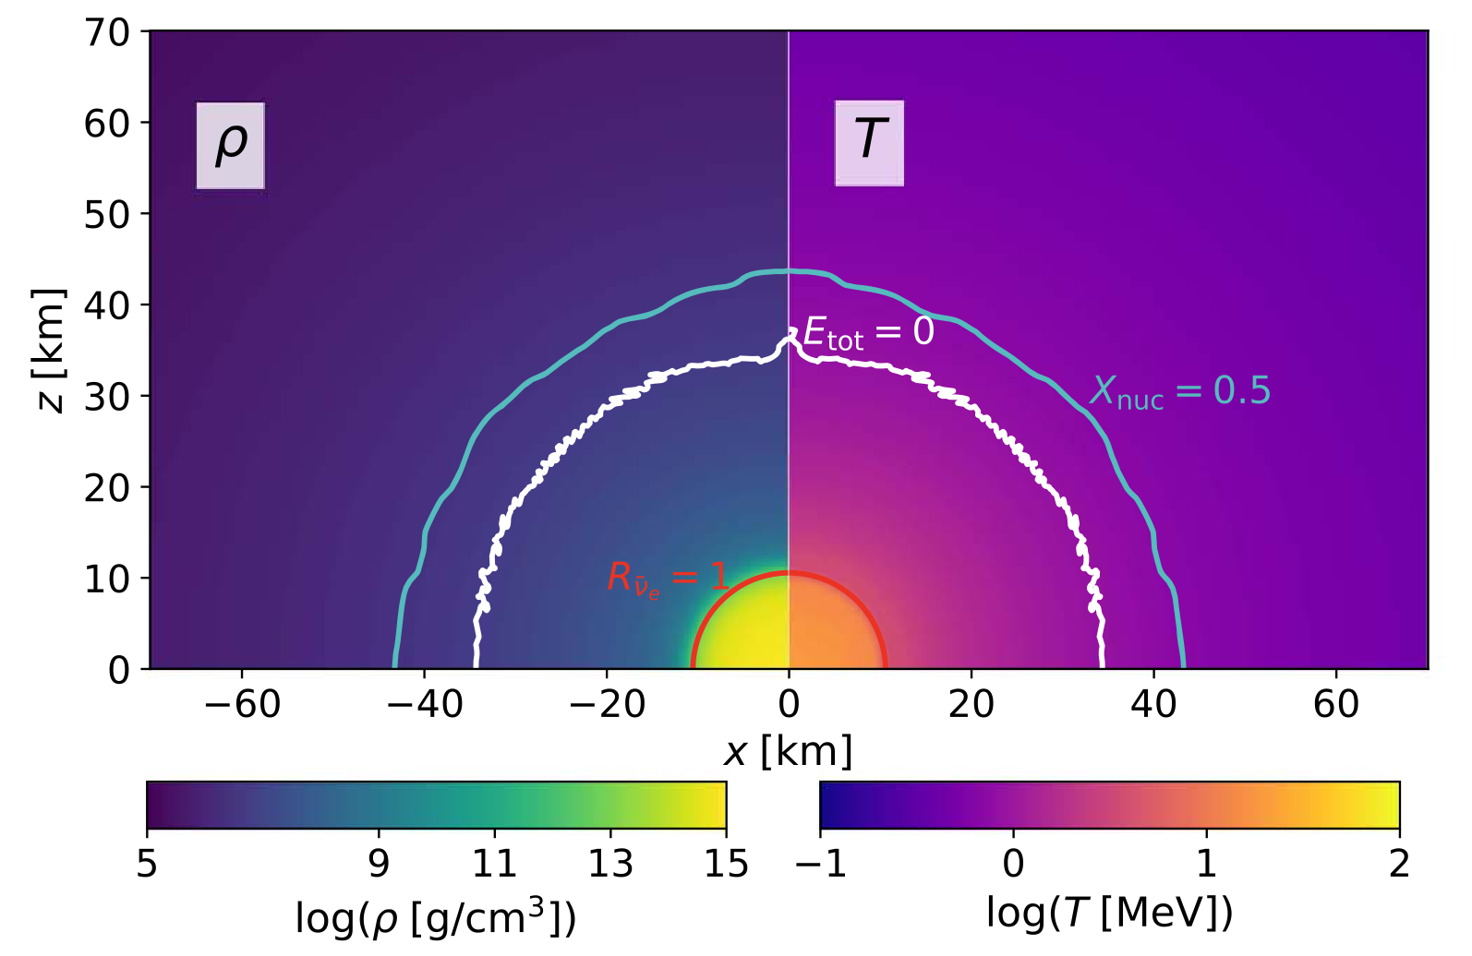
Results: Unmagnetized PNS
density
temperature
Seed formation
Wind gravitationally unbound
neutrinosphere
Desai+2022
Notes:
Label the surfaces, explain them

Slide 21
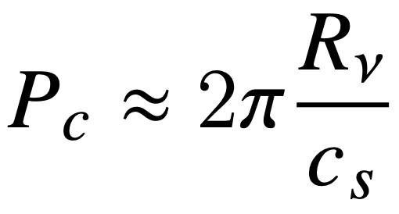
Criterion for rotation to impact the wind
Speed of sound (isothermal):
Rotation speed @ neutrinosphere radius is comparable to the sound speed
Blackbody neutrino luminosity:
In terms of neutrino properties:
Wind dynamics impacted for rotation periods less than ~3 ms
Desai+2022
Notes:
Label the surfaces, explain them

Slide 22
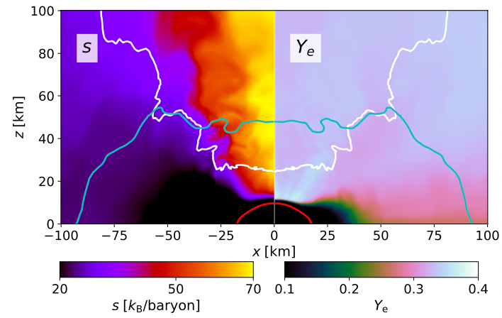
Non-rotating
Results
Rapidly rotating
(P ~ 1 ms)
≈ 0.35
≈ 0.35
(polar value)
Y_{e} ≈ 0.30
(equatorial value)
Desai+2022
10% more neutron-rich in mid-plane
Mass loss rate 10x higher in mid-plane
Notes:
Label the surfaces, explain them

Slide 23
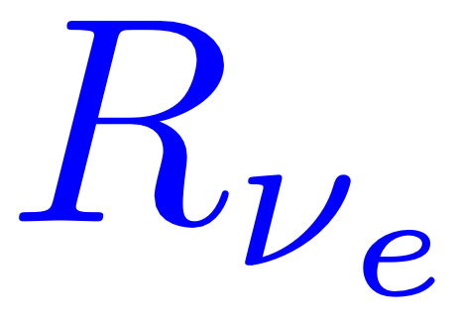
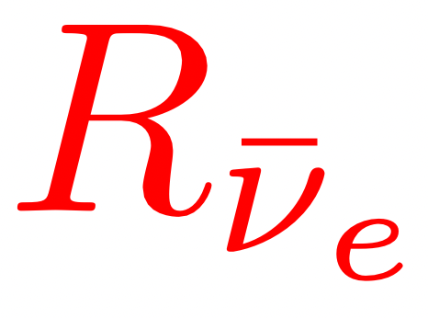
Neutrinosphere geometry in Spherically symmetric winds
More neutrons than protons
Electron neutrinos diffuse out to further radii before they can escape

Slide 24
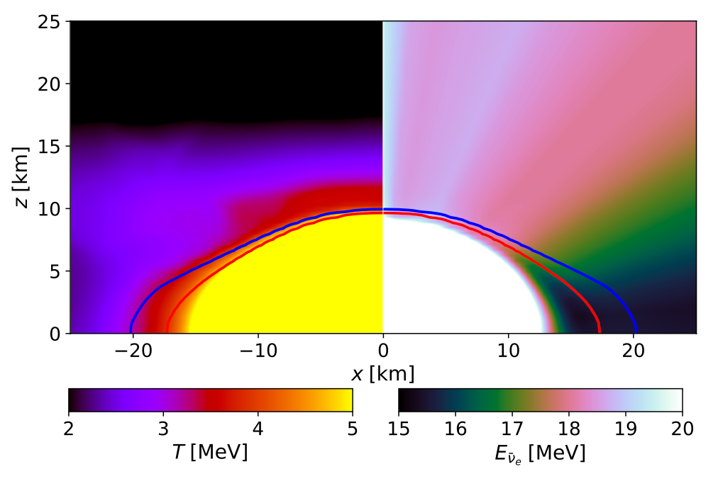
Centrifugal effects alter equatorial wind properties
2. Has greater relative difference in neutrino energies emitted
Desai+2022
Compared to the pole, the equator…
Greater relative difference in neutrino cross-sections ∝ E²
1. Is cooler
Balance shifts to a more neutron-rich wind
Entropy suppressed
^{larger cross section!}

Slide 25
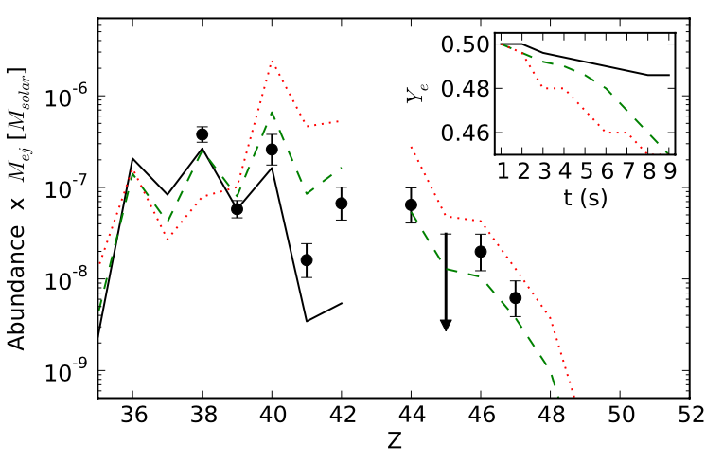
Rapidly rotating PNS wind as a source of LEPP elements?
True Y_{e} for ordinary PNS winds unknown
Rapidly rotating PNSs likely produced from energetic SNe, ~10% of all core-collapse SNe
Mass loss rate boosted by factor of 10
→ competitive with ordinary CCSN yields
Conclusion: Even if non-rotating PNS winds not conducive to r-process, 10% reduction in Y_{e} in rotating winds may allow for LEPP production compared to ordinary non-rotating PNSs
Arcones & Montes 2011
2nd
r-process
peak
LEPP
elements
Fe peak
Siegel 2022

Slide 26
The effects of magnetic fields
Notes:
Label the surfaces, explain them

Slide 27
Criterion for magnetic fields to impact the wind
Magnetic pressure is comparable to fluid pressure at base of wind
Fluid pressure (radiation-dominated):
Blackbody neutrino luminosity:
In terms of neutrino properties:
Wind dynamics impacted for magnetic field strengths greater than ~10¹⁵ G
Desai+2022
Notes:
Label the surfaces, explain them

Slide 28
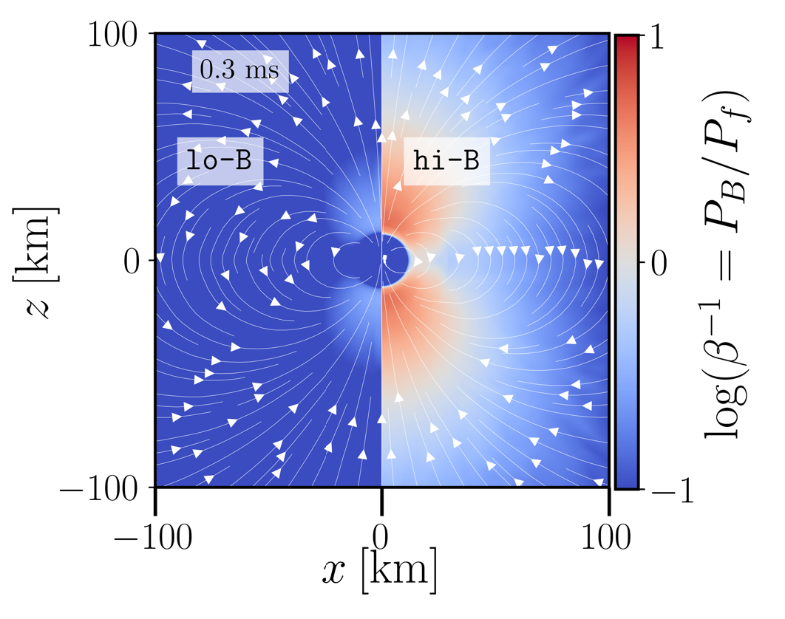
PNS with a strong dipole magnetic field
Initial conditions
Spherical wind achieves steady state
Dipole magnetic field threading PNS initialized
Simulation run for ~60 ms
Desai+2023 (accepted)

Slide 29
Magnetohydrodynamics (MHD)
Magnetic field evolution governed by:
→ Flux freezing: fluid flow is coupled to magnetic field lines
Fluid dynamics governed by:
If fluid pressure > magnetic pressure: magnetic field lines follow fluid motion
If magnetic pressure > fluid pressure: fluid motion confined to magnetic field lines

Slide 30
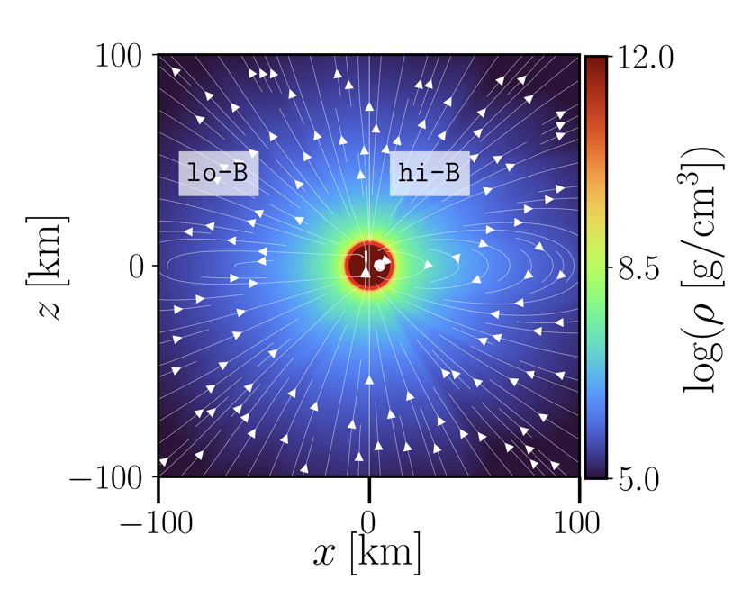
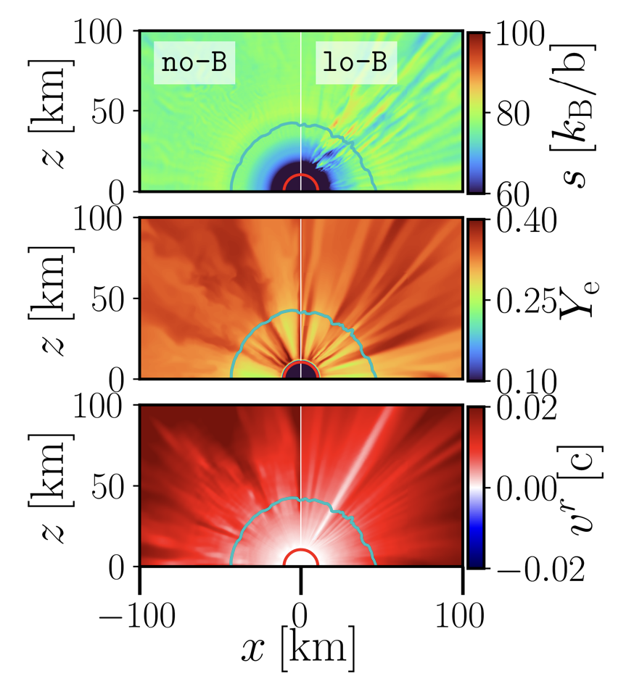
Results: Dynamics and properties of the wind
t~60 ms
B
Split monopole-like (radial field lines)
dipole-like
Low magnetized, unmagnetized winds have very similar properties
Desai+2023 (accepted)

Slide 31
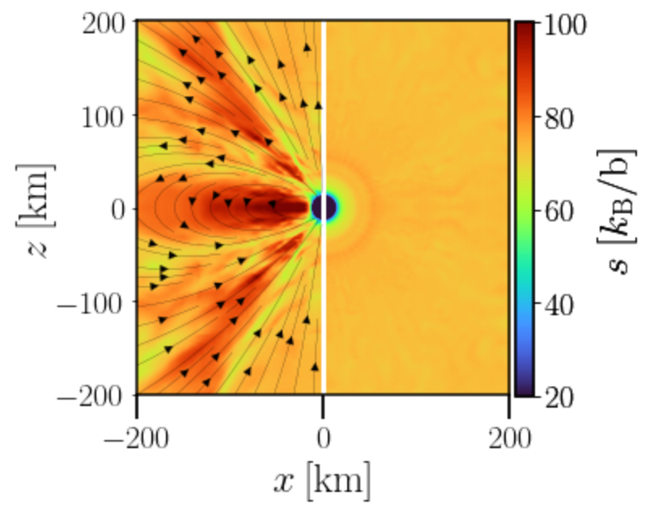
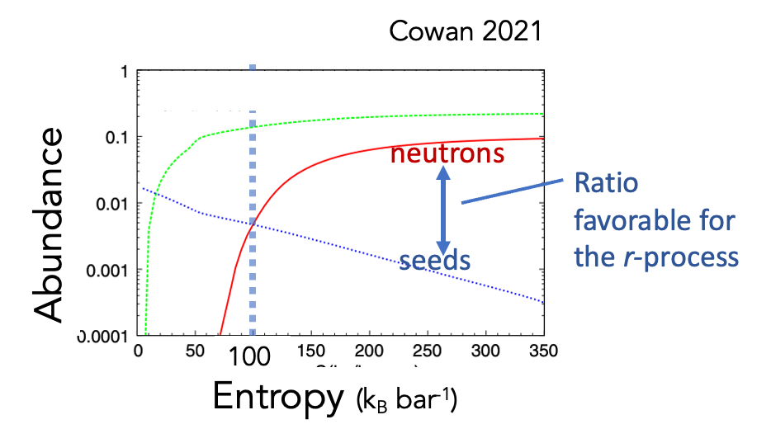
magnetized unmagnetized
Trapped zone in the magnetized model: Entropy grows
For L_{𝝂} ≈ 3e51 erg s⁻¹ :
Matter trapped by magnetic field in the equator receives additional heating
entropy~100 k_{B}/baryon
B~10¹⁵ G
B = 0 G
Recall:
entropy~70 k_{B}/baryon
Desai+2023 (accepted)

Slide 32
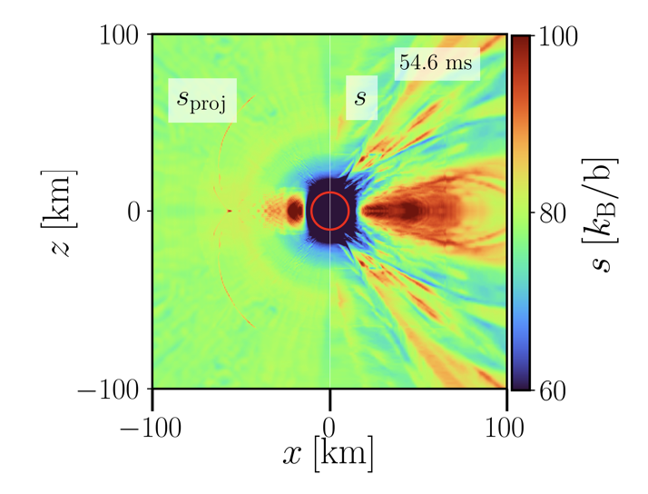
Fluid should heat up until fluid pressure nears magnetic pressure (e.g., Thompson & ud-Doula 18)
Entropy growth rate in line with analytic estimates
B~10¹⁵ G
B = 0 G
Projected entropy growth based on difference between initial magnetic & fluid pressures, and heating rate
Entropy in our simulation
Desai+2023 (accepted)

Slide 33
Conclusion: Strong ordered magnetic field increases entropy ➔ may enable alpha-rich freeze-out mechanism in ~0.5% of material
Entropy growth sufficient for some 2nd peak r-process element production
Histogram
(Equatorial region)
Desai+2023 (accepted)
2nd peak
3rd peak
Amount of material
B~10¹⁵ G
B = 0 G
r-process ‘figure of merit’
(entropy, neutron-richness,
expansion speed )
via alpha-freezeout channel
Desai+2023 (accepted)

Slide 34
Variations of the neutrino-driven wind: our takeaways
Rapid rotation
Neutrino energies altered in equator ➔ more neutron-rich outflows
Rapidly rotating PNSs (from energetic Type Ic broad line supernovae) may be ONE site of LEPP element production
Strong magnetic fields
Flux freezing ➔ material trapped in equator, experiences additional heating (consistent with previous findings)
Highly magnetized, slowly rotating PNSs may produce small amounts of 2nd peak elements
LEPP?
2nd
r-process
peak
Siegel 2022, Nature

Slide 35
Variations of the neutrino-driven wind: our takeaways
Previous work: purely rapid-rotation may result in 10% more neutron-rich winds from energetic CCSNe – site of LEPP element production? (Desai+22)
Strong magnetic fields (Desai+23)
Flux freezing ➔ material trapped in equator, experiences additional heating (consistent with previous findings)
Highly magnetized (slowly rotating) PNSs may produce small amounts (< 1%) of 2nd peak elements
LEPP?
2nd
r-process
peak
Siegel 2022, Nature

Slide 36
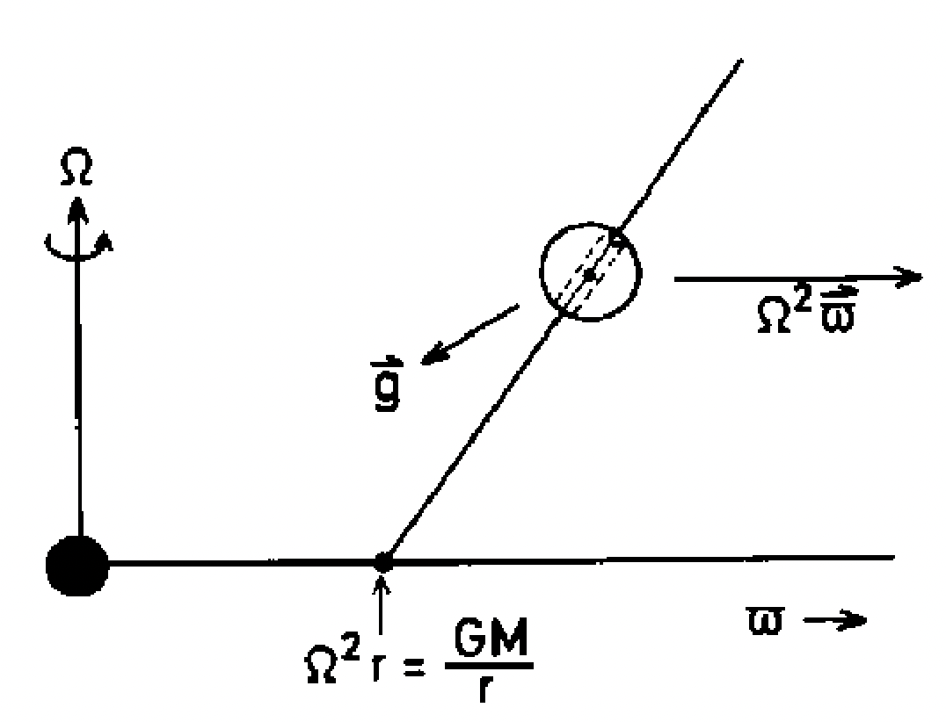
Future directions: exploring the parameter space
Magnetar outflows
Rotation + magnetic fields may significantly impact r-process viability
Applicable to energetic supernovae
Like ‘beads on a wire’,
Material can be flung out relativistically, remaining neutron-rich
Spruit 1996
Notes:
Can blue kilonova ejecta be explained by a combination of these effects

Slide 37
Future directions: remnants of neutron star mergers
Hot rapidly-rotating neutron star + disk
How does the picture change?
Explore same parameter space, but with:
Disks of varying mass
Can the previous kilonova observation be explained by neutrino irradiation? (e.g., Metzger et al. 2018)
Pipeline to explain future kilonovae?
Goal: Map observations to points in the parameter space
Notes:
Can blue kilonova ejecta be explained by a combination of these effects

Slide 38
Thank you! Questions?
Notes:
Can blue kilonova ejecta be explained by a combination of these effects

Slide 39
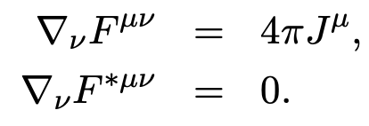
Evolution equations in the 3+1 formalism
Primitive variables evolved:
Must be converted to conservative form
Conserved variables and fluxes attained from conservation equations
Lepton number conservation:
Baryon number conservation:
Energy conservation:
Momentum conservation:
Induction equation arises from GR Maxwell’s equations:
Notes:
Can blue kilonova ejecta be explained by a combination of these effects

