Slide 1
NORDITA Master Program:
Advanced Topics in Electrodynamics
Master Course at the University of Iceland
Habib Rostami
June 13, 2023

Slide 2
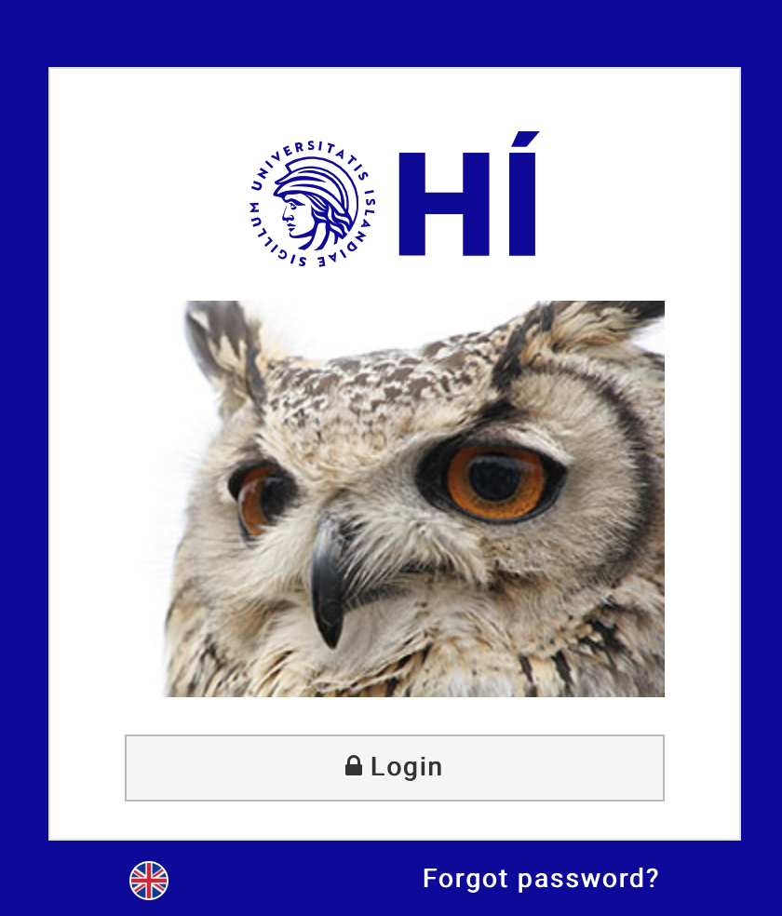
Prior the course
Check University Email
Log in to University of Iceland email account regularly
Monitor for updates on deadlines and Canvas support information
Course Aim and Learning Outcome
Review the initial aim and learning outcomes
Make necessary modifications or approve as is
Develop Course Timetable
Establish start and end dates for the 14-week course
Schedule lecture sessions
Schedule exercise sessions
Set a date for the midterm exam if you want to have it
Ensure all dates are included in the timetable on Ugla
Create Course Syllabus
Outline course objectives, content, and policies
Upload the syllabus to Canvas

Slide 3
Prior the course
Design Assessment Scheme
Determine grading breakdown (e.g., assignments, exams, participation) Upload assessment scheme to Canvas
Find a Teaching Assistant (TA)
Search for a TA to support exercise sessions
Develop Lecture Notes
Create detailed notes for each lecture
Ensure content aligns with course objectives and learning outcomes
Design Exercises and Homework
Develop exercises to reinforce lecture content
Create homework assignments for students to complete outside of class

Slide 4
During the course
Schedule Lecture Classes
Four classes per week
Duration: 40 minutes each
Schedule Exercise Classes
Two classes per week
Duration: 40 minutes each
Develop Missing Content
Create any lecture notes not yet developed
Develop problem sheets for exercise classes
Conduct Midterm Assessments
Administer midterm exams or assessments
Provide Feedback
Evaluate midterm assessments
Offer feedback to students to guide improvement
Note: Remember to communicate clearly with students and provide them with all the necessary resources they need to succeed in the course.

Slide 5
After the final exam
Mark Student Scripts
Review and grade student exam papers
Publish Results
Release marking results within 2 weeks post-exam
Prepare for Makeup Exam
Create and provide exam sheets for students taking the makeup exam

Slide 6
Teaching assistant for exercise sessions
Fall 2021: Dr. Tamari Meshveliani (local PhD Student)
Fall 2022: Dr. Helgi Sigurdsson (local PostDoc)
Task of TA is to run weekly excersise sessions and check student solusions of problem sheets and to give them feedback.
I provided problem sheets to student and TA.

Slide 7
Advanced Topics in Electrodynamics
Credits: 10 credits
Min. grade: 6,0
Level: Undergraduate and Graduate
Academic Year: 2021-2022 and 2022-2023
Lessons/teaching sessions (40 min. each):
Total lect./general classes 56, divided on 14 weeks
Preceding Courses / Prerequisites:
Required preparation: EÐL302G Classical Mechanics
Required preparation: EÐL401G Electromagnetism 1 Classical mechanics and electromagnetism

Slide 8
Start and end of teaching
Fall 2021:
START lecture on Aug 31
END lecture on Nov 25
Final Exam date is set by the examination office:
December 13, 2021: 09:00-12:00
Fall 2022:
START lecture on Aug 23
END lecture on Nov 25
Final Exam date is set by the examination office:
December 5, 2022: 09:00-12:00

Slide 9
Aim and Learning outcome

Slide 10
Required and sumplementary textbooks
PDF files are avilable from SU library

Slide 11
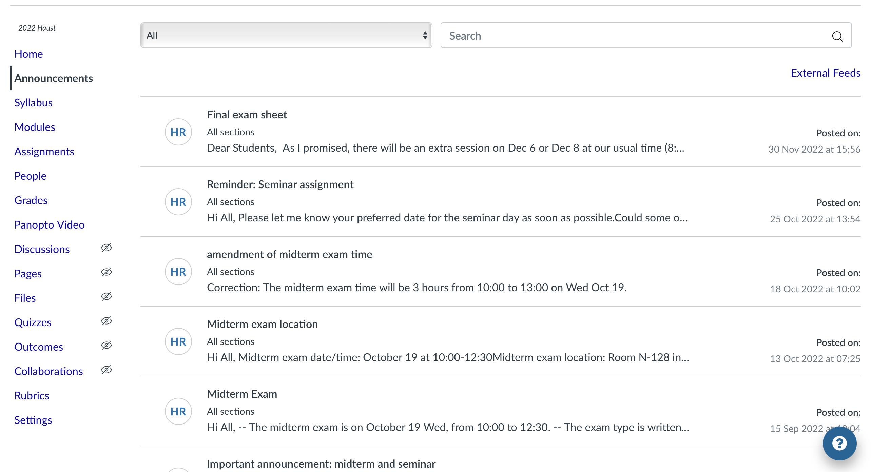
Annuncement on Canvas

Slide 12
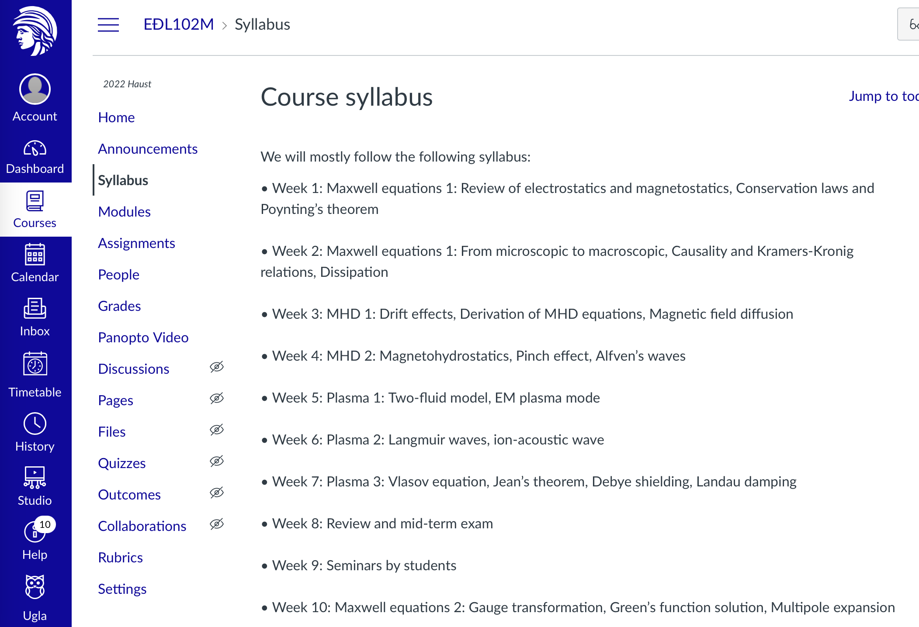
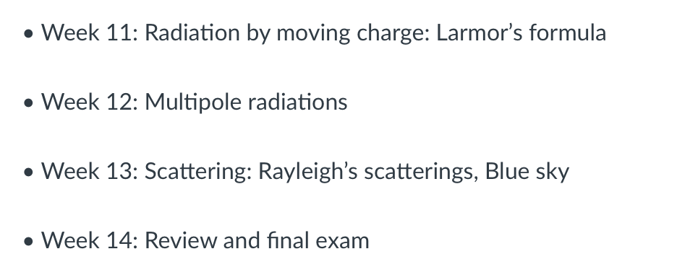
Add course sylabous on Canvas

Slide 13
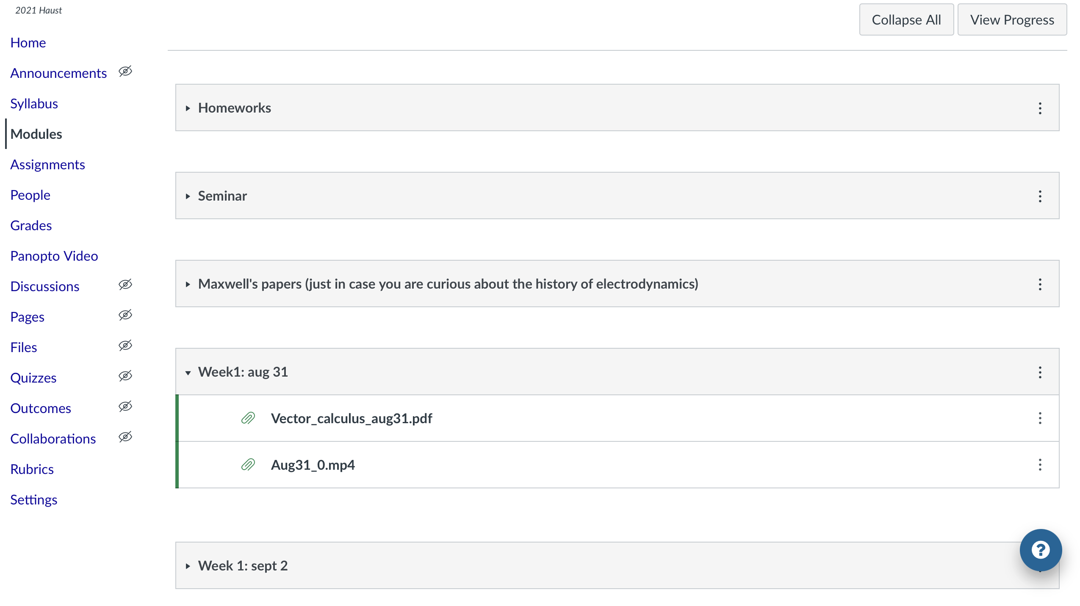
Creat Modules and upload course materials

Slide 14
People: Fall 2021

Slide 15
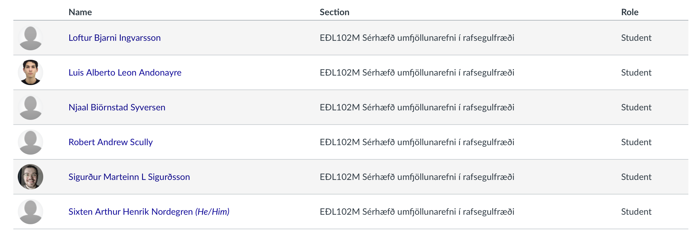
People: Fall 2022

Slide 16
Assessment scheme
Assignments: 2021-2022
60% final written exam
20% seminar (20 min long seminar)
20% mid term written exam
0% problem sheet/homework
Assignments: 2022-2023
50% final written exam
20% seminar (20 min long seminar)
30% mid term written exam
0% problem sheet/homework

Slide 17
Student 20min seminars
few example seminar topics:
Plasma applications
Pulse propagation: what is a soliton?
Review of Vlasov original paper on kinetic theory of plasma
Magnetic monopole
Auroral plasma physics

Slide 18
Online teaching via Zoom
Recorded and Shared Sessions
Recorded all class sessions
Shared video recordings with students via Dropbox
Shared Lecture and Class Notes
Distributed corresponding lecture notes and class notes to students
Utilized both Canvas and Dropbox for sharing
Enhanced Engagement with Live Calculations
Conducted teaching sessions with live calculations
Used an iPad for real-time demonstrations to enhance engagement

Slide 19
Example of lecture notes format
225 pages
PDF format

Slide 20
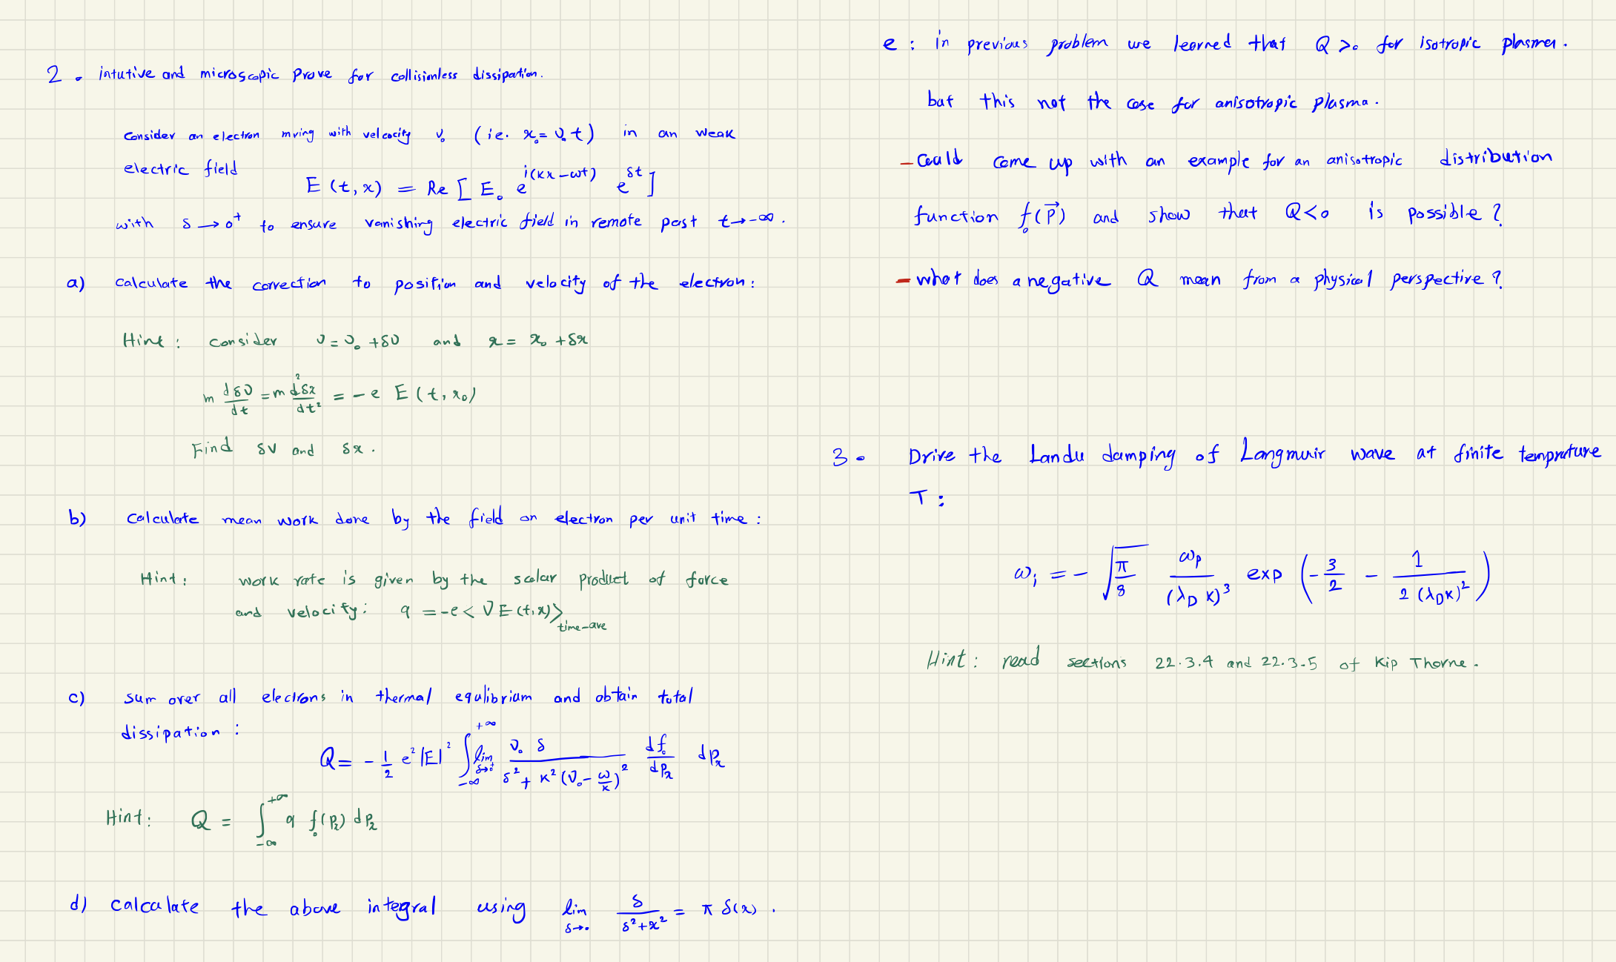
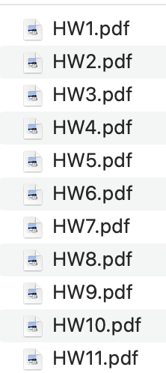
Example of problem sheet

Slide 21
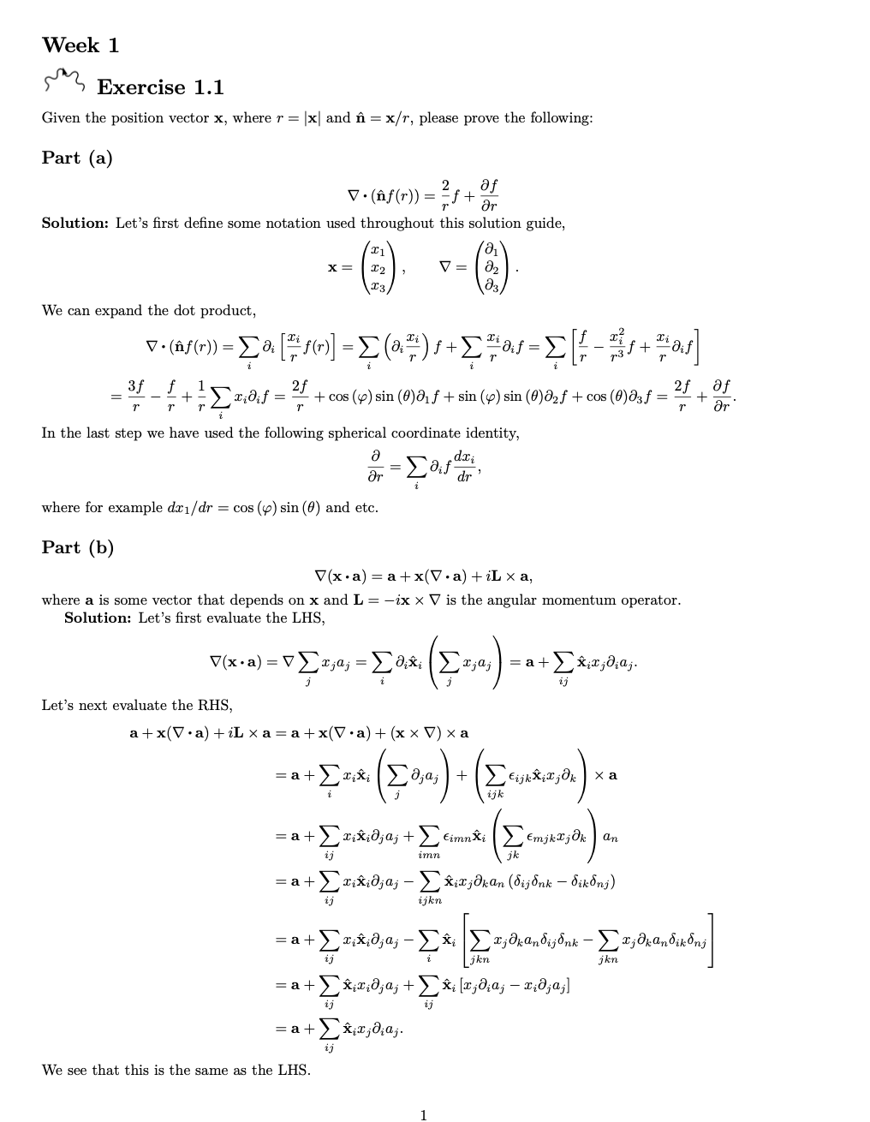
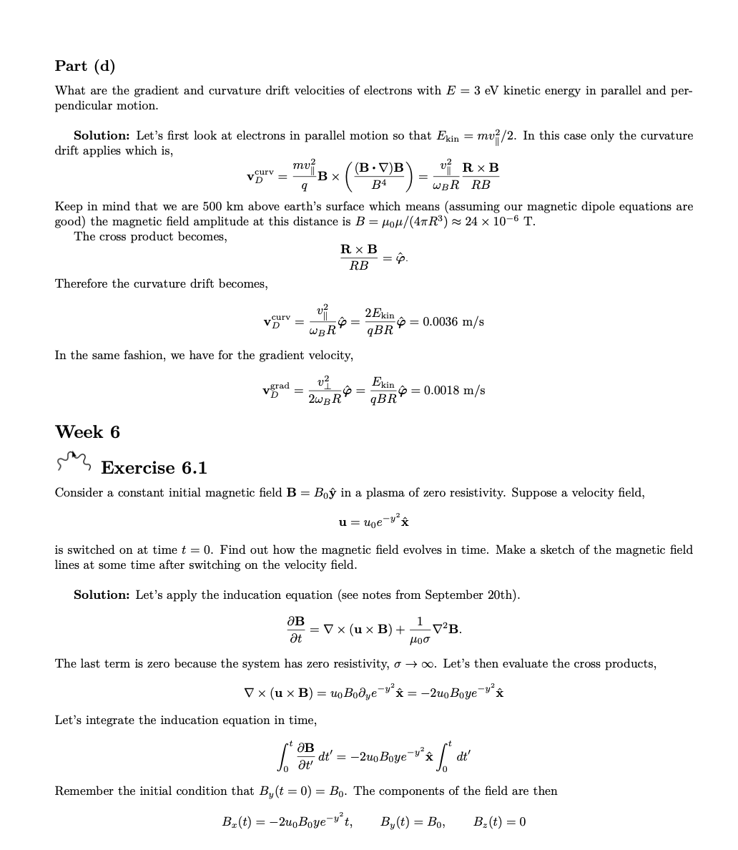
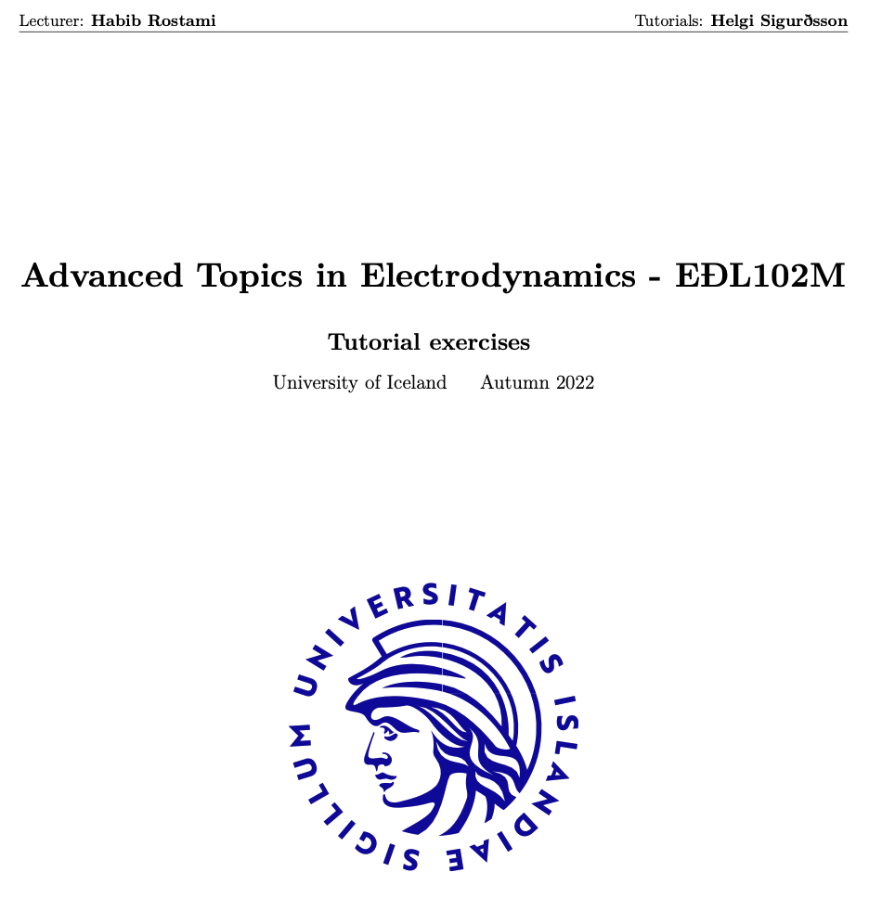
TA run exercise sessions

Slide 22
On-site (in person) teaching
I tried in-person teaching for two weeks in November 2021
In-Person Sessions
Conducted four sessions in person
Midterm Feedback
Provided in-person feedback to students regarding their midterm performance
Covered Expenses
Travel, food, and accommodation costs are covered for the duration of the sessions

Slide 23
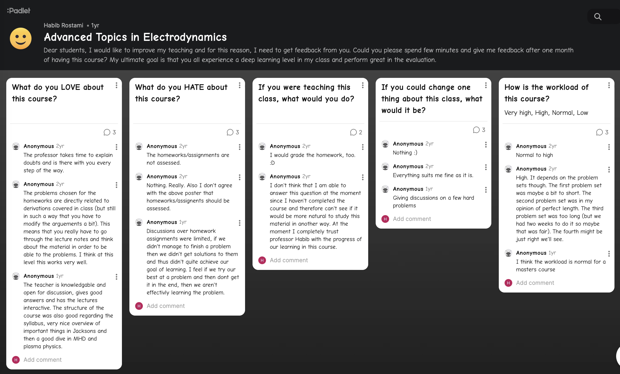
Midterm informal student feedback

Slide 24
Summary
I highly recommend volunteering as a teacher in the NORDITA Master Program if you're looking to gain valuable experience and enhance CV.
Thank you!

