Slide 1
What´s up in the Nordic Countries
Presented by Barbro Åsman
With the help of
Valentina Giangreco Puletti, Carol Norberg, Sara Strandberg, Maren Malling +
many more

Slide 2
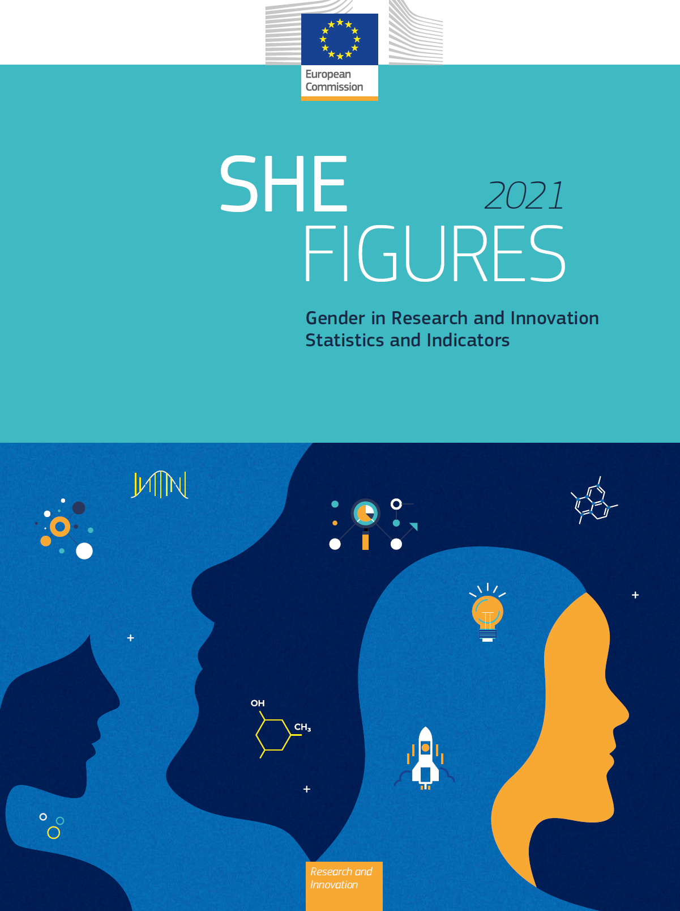
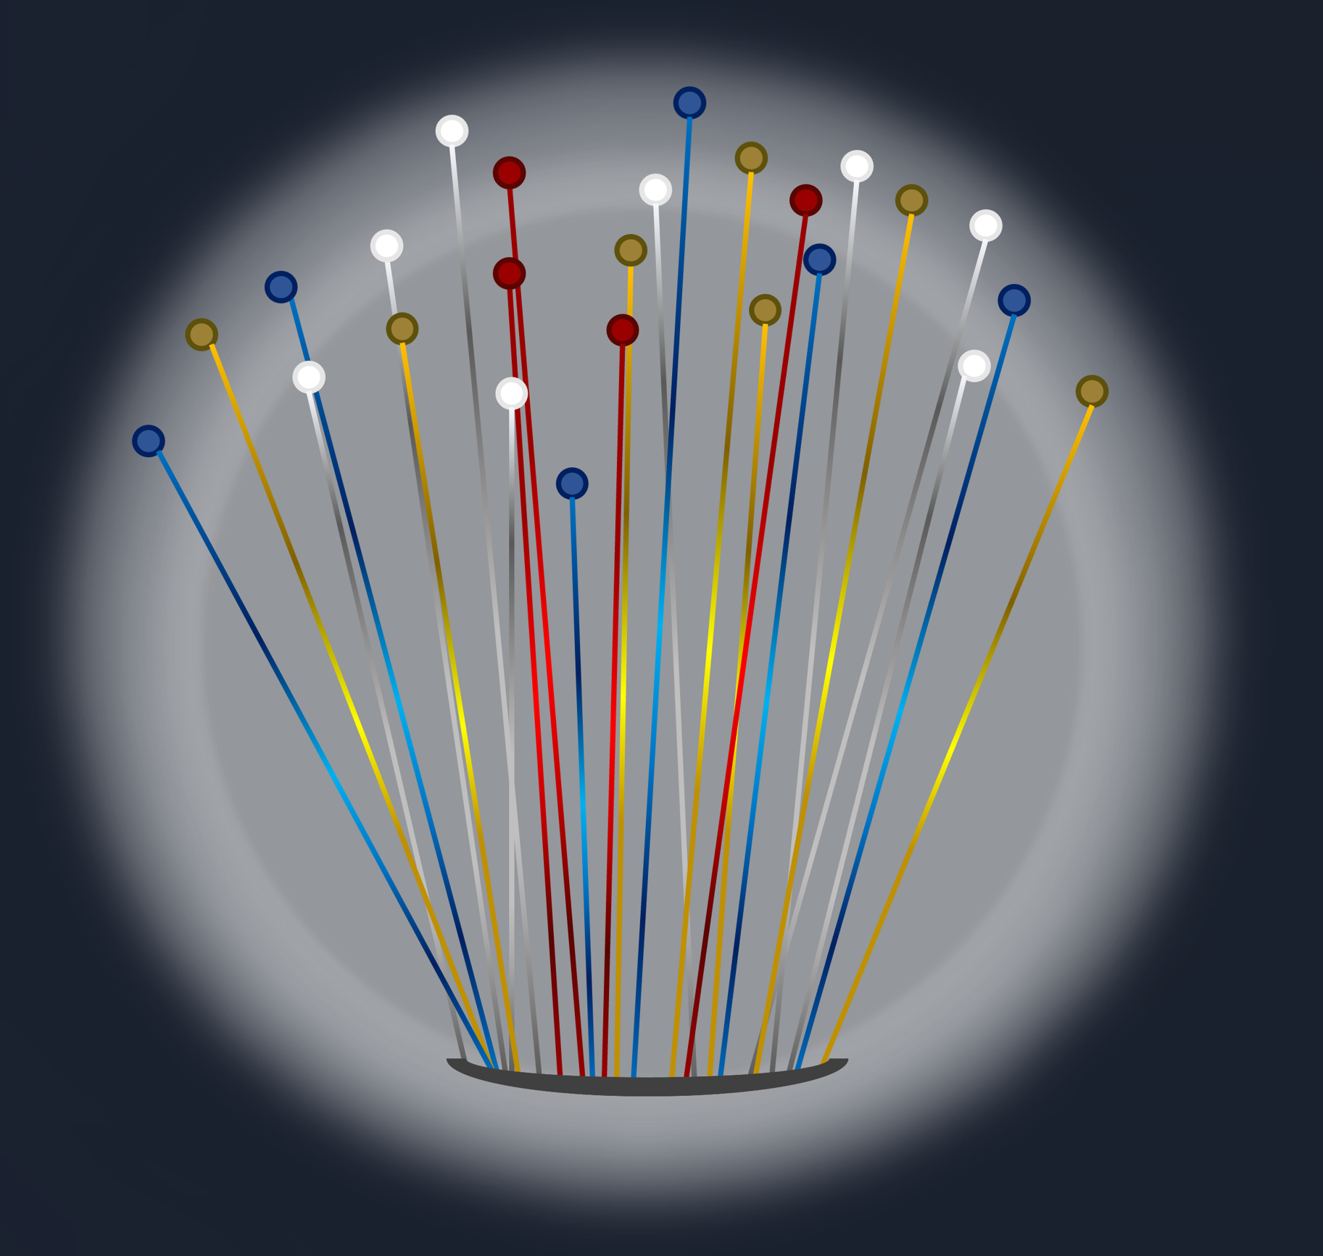
Data are mainly collected from:
https://euraxess.ec.europa.eu/worldwide/lac/report-she-figures-2021-gender-research-and-innovation
Conferences organized by NORNDiP
Nordic Network for Diversity in Physics
https://www.norndip.net/
https://www3.weforum.org/docs/WEF_GGGR_2023.pdf

Slide 3
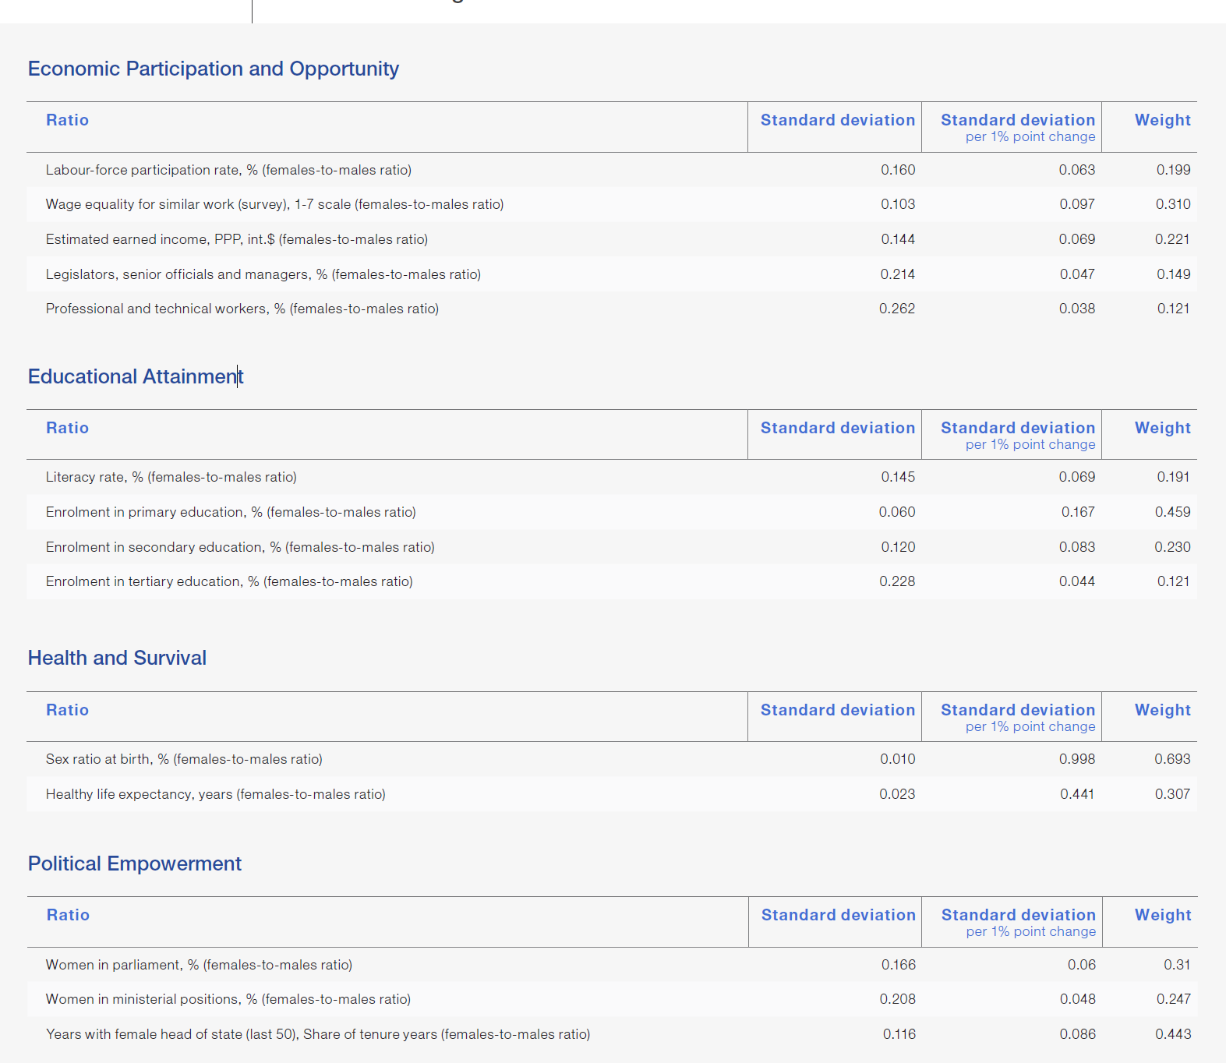
What is the Global Gender Gap Index?
The Global Gender Gap Index examines the gap between men and women across four fundamental categories
Data is collected for 146 countries
and presented in
https://www3.weforum.org/docs/WEF_GGGR_2023.pdf

Slide 4
Gender Gap Subindex
High Index -> Small Gap

Slide 5
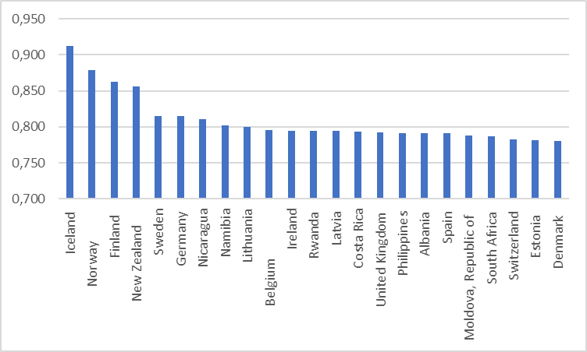
Gender Gap index in the countries with the highest index
High Index -> Small Gap
1
2
3
5
1

Slide 6
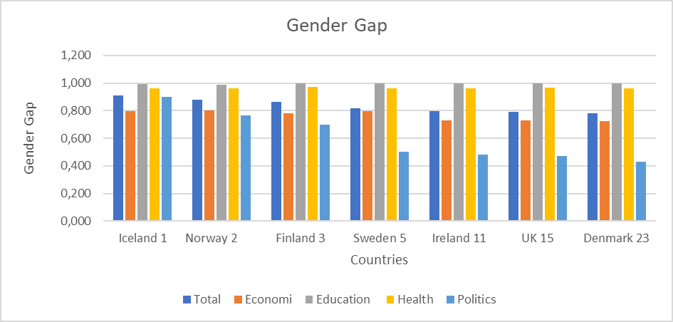
Gender Gap in seven countries divided into subindex
High Index -> Small Gap

Slide 7
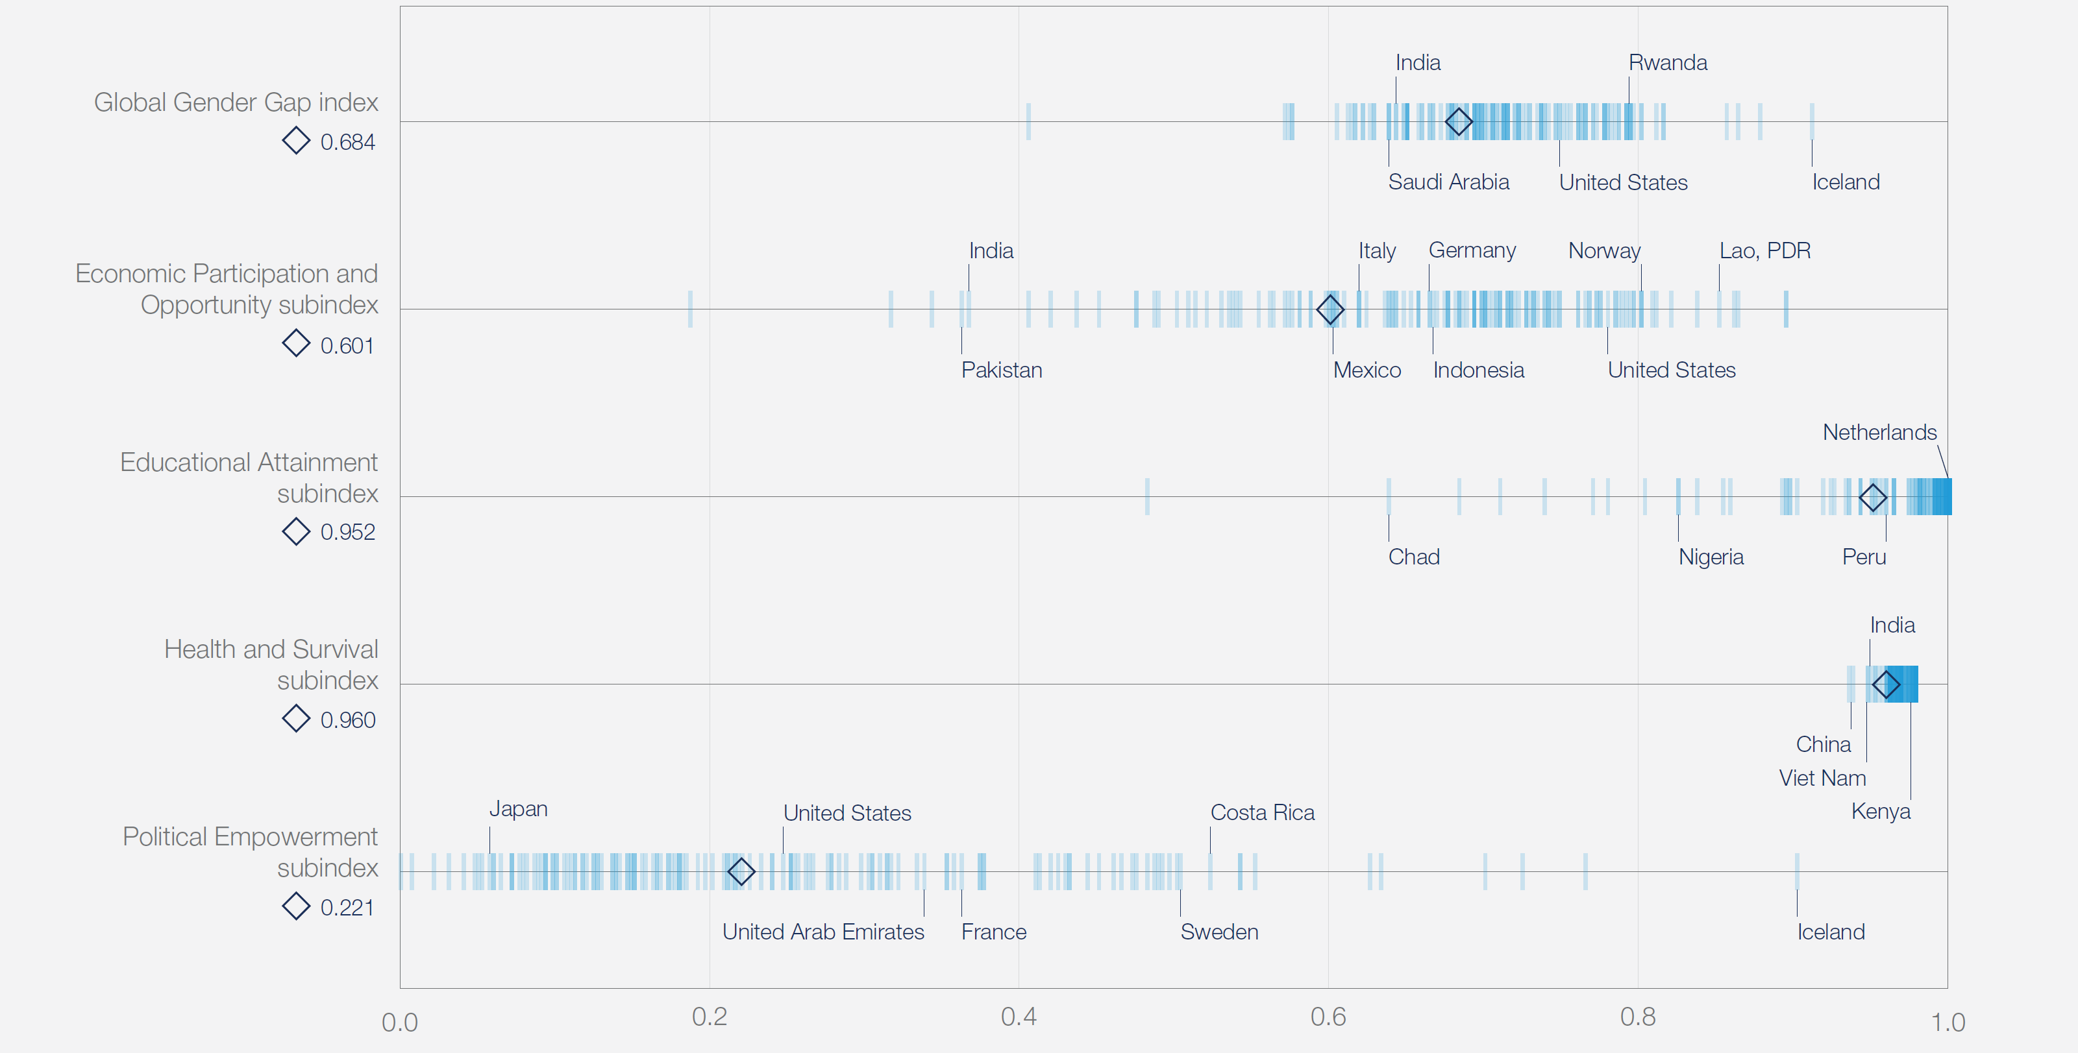
Gender Gap in all countries divided into subindex
Finland
Norway

Slide 8
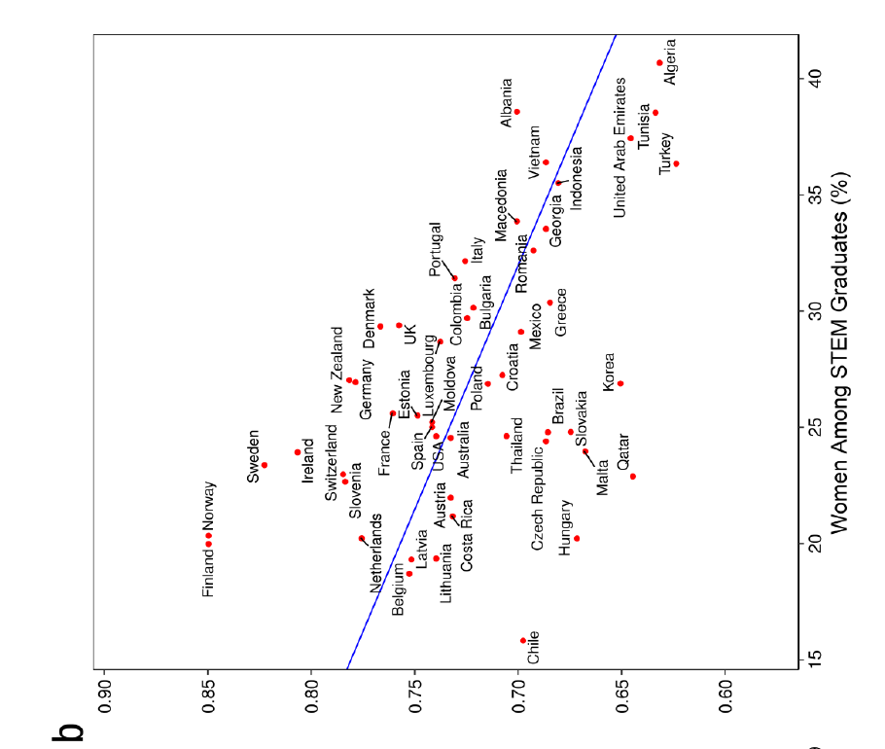
Gender Gap index vs Women among STEM Graduates
Figure from
G. Stoet and D. C. Geary,
Psychological Science, 29,
581 (2018)
Gender Gap Index

Slide 9
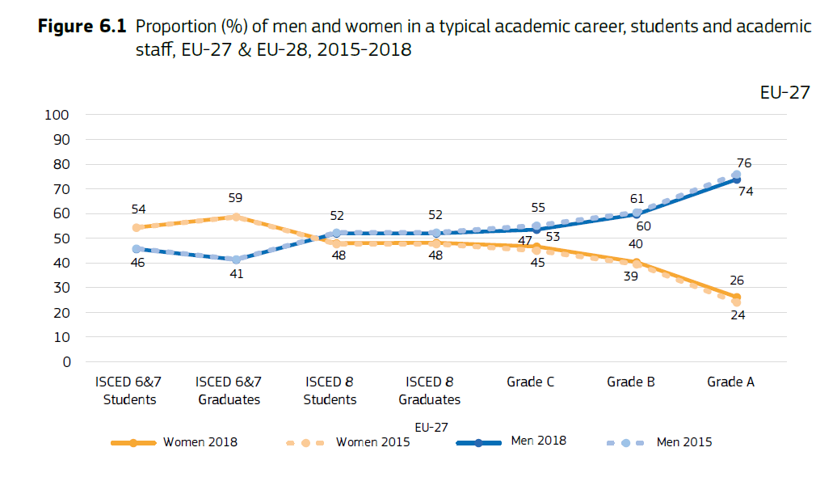
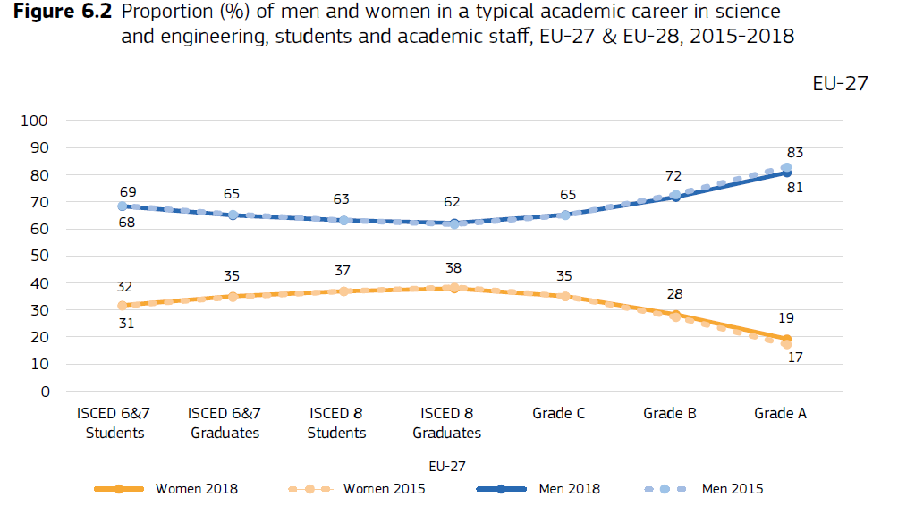
The Academic Career
From She Figures 2021

Slide 10
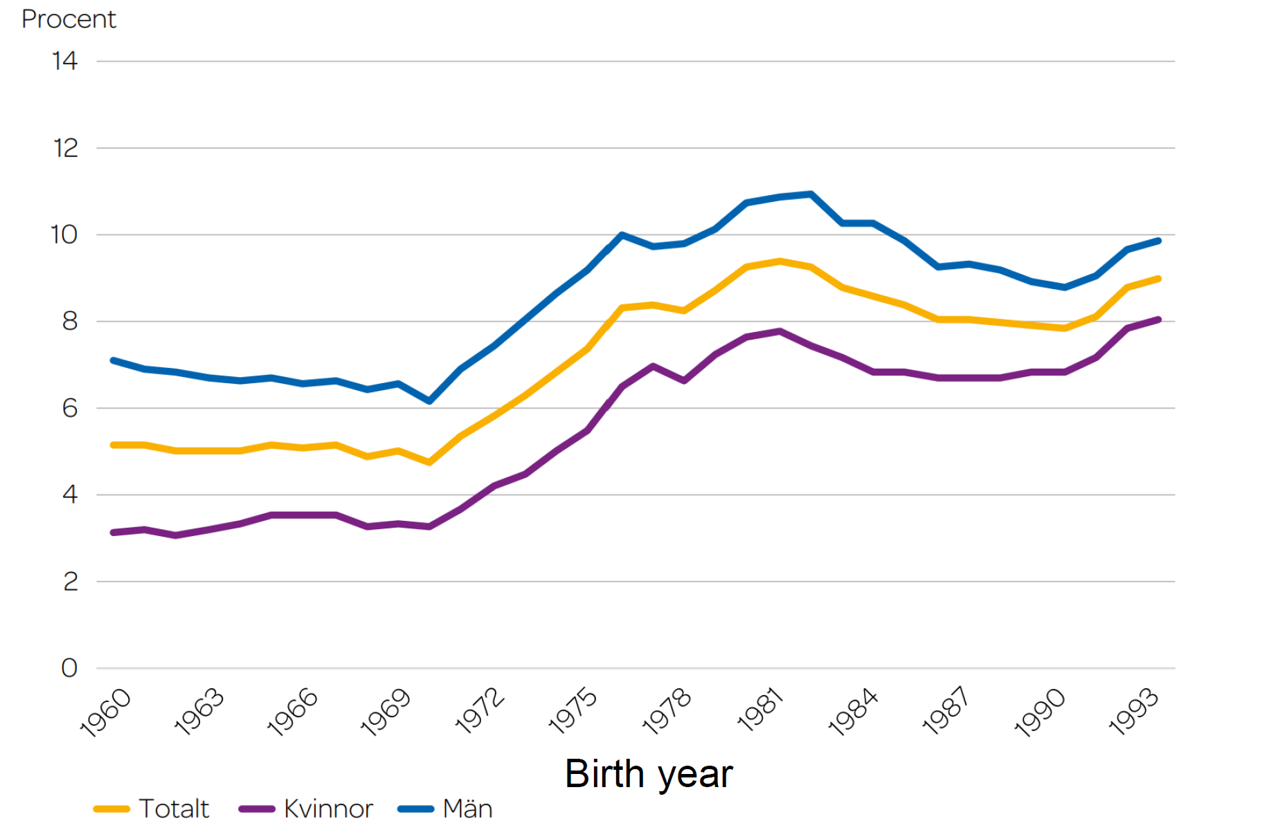
Started Higher Education at 25 or earlier
Higher Education-beginners
Started long programs at 25 or earlier
Talk by Tomas Brage, NORDIP conference 2022
https://indico.cern.ch/event/1151332/timetable/

Slide 11
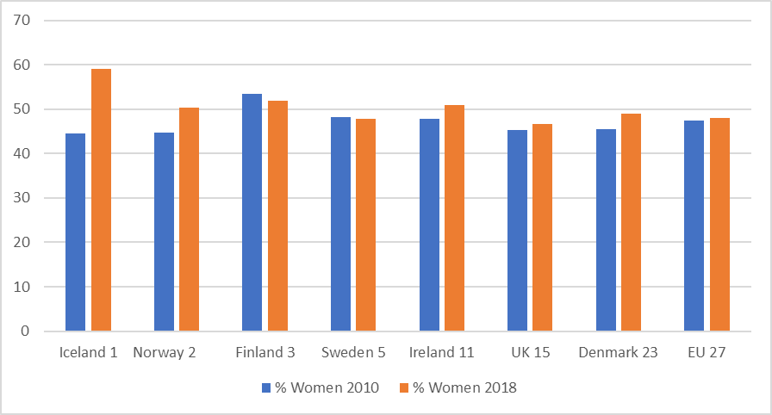
Proportion (%) of women among doctoral graduates

Slide 12
Starting PhD Students
% women 2018
Natural science 39,6
Engineering
31.7
Talk by Donatella , Puglisi, Norndip conference 2019,
https://indico.cern.ch/event/808632/timetable/#all

Slide 13
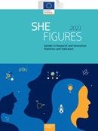
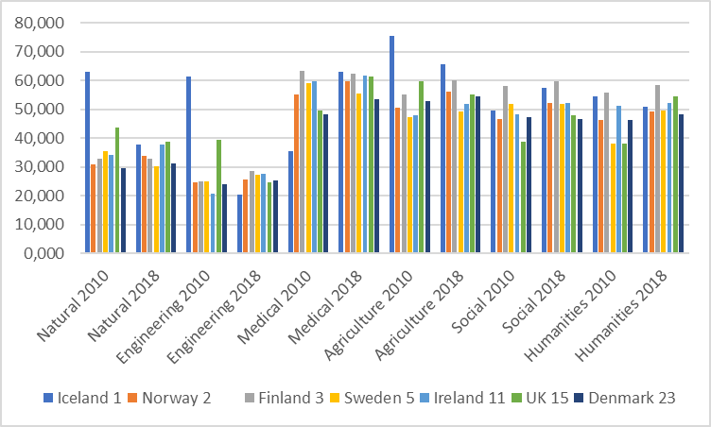
Percentage of women among researchers for different subjects, countries and years

Slide 14
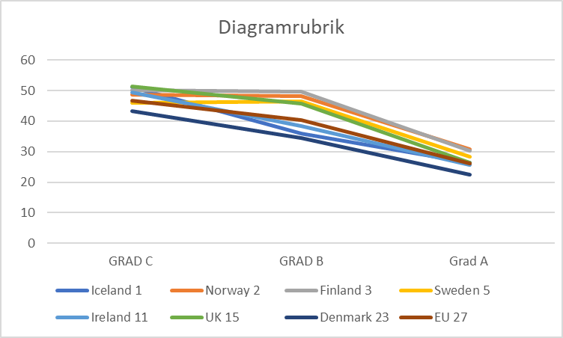
Propotion (%) of women in grad C, B and A
2018

Slide 15
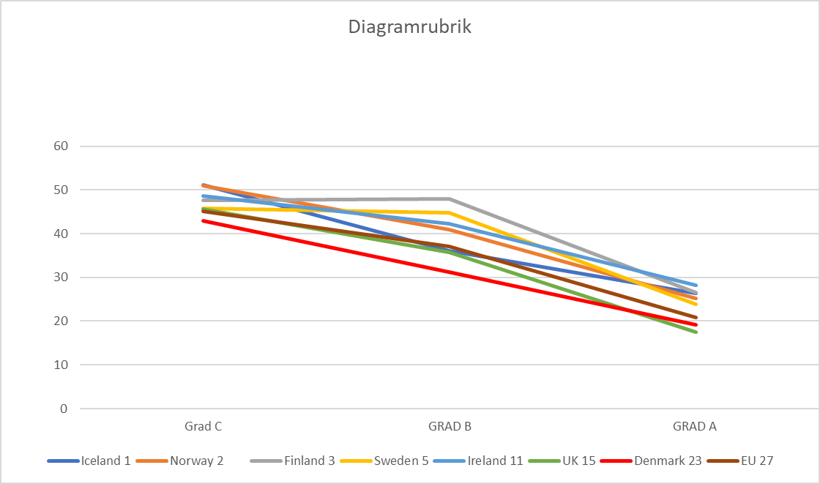
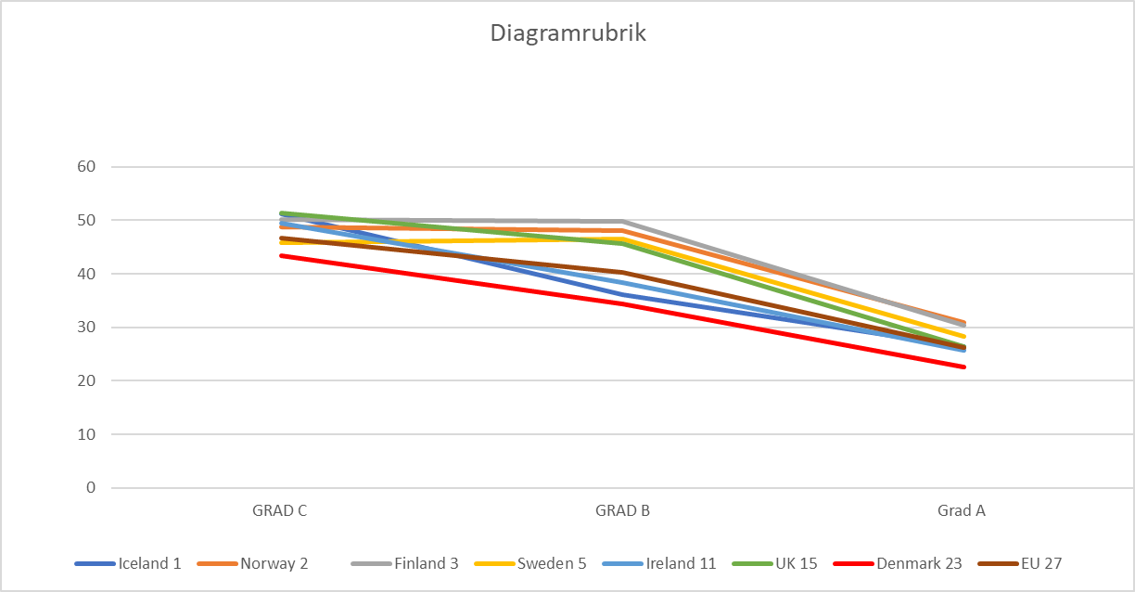
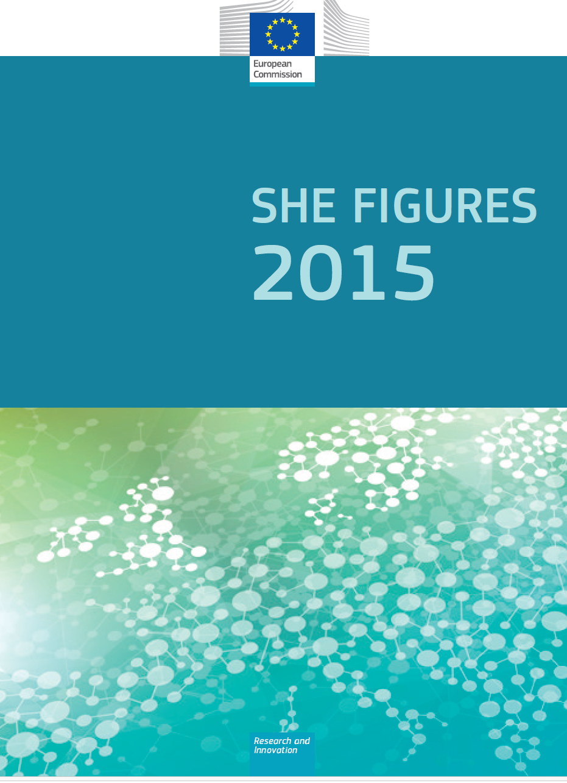
Propotion (%) of women in grad C, B and A
2013
2018

Slide 16
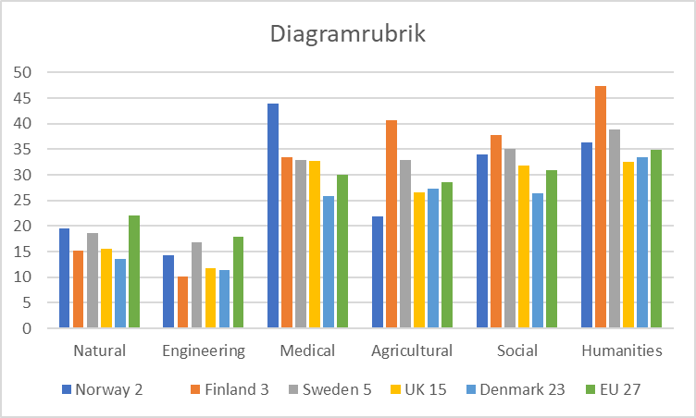
Percentage of women among full professors
2018

Slide 17
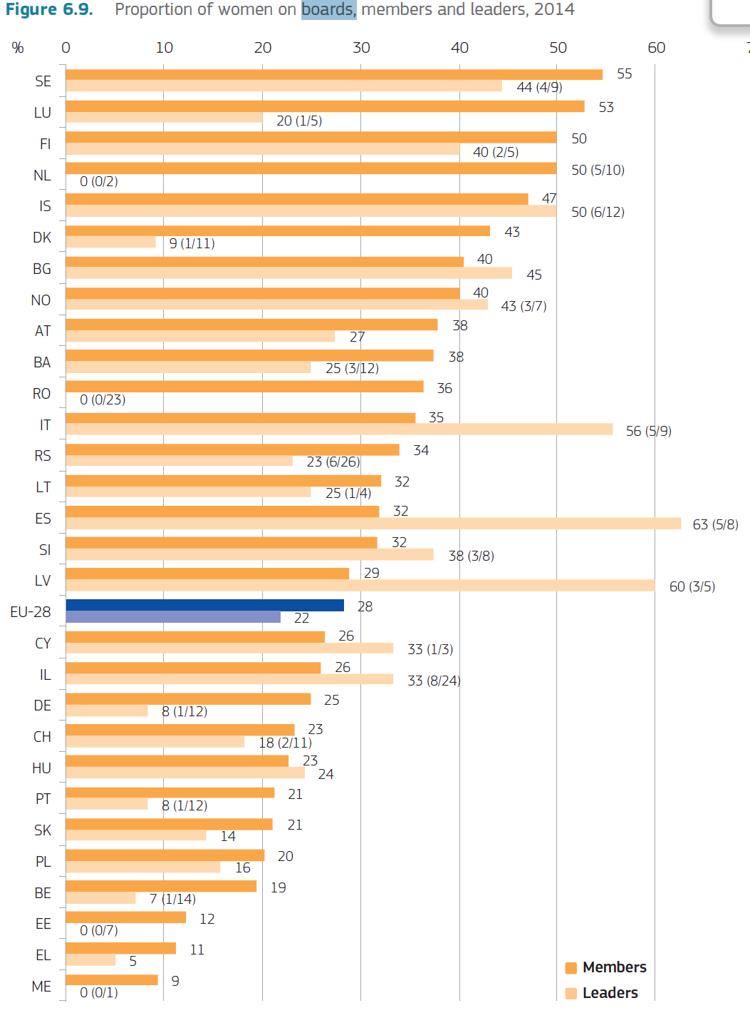
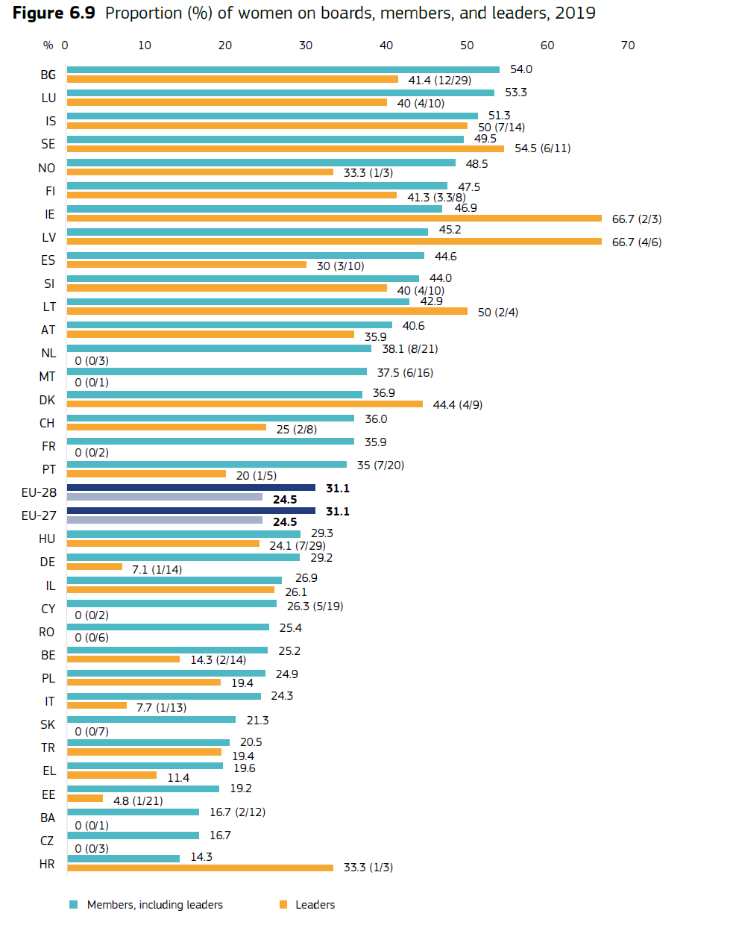
Proportion of women on boards, members and leaders

Slide 18
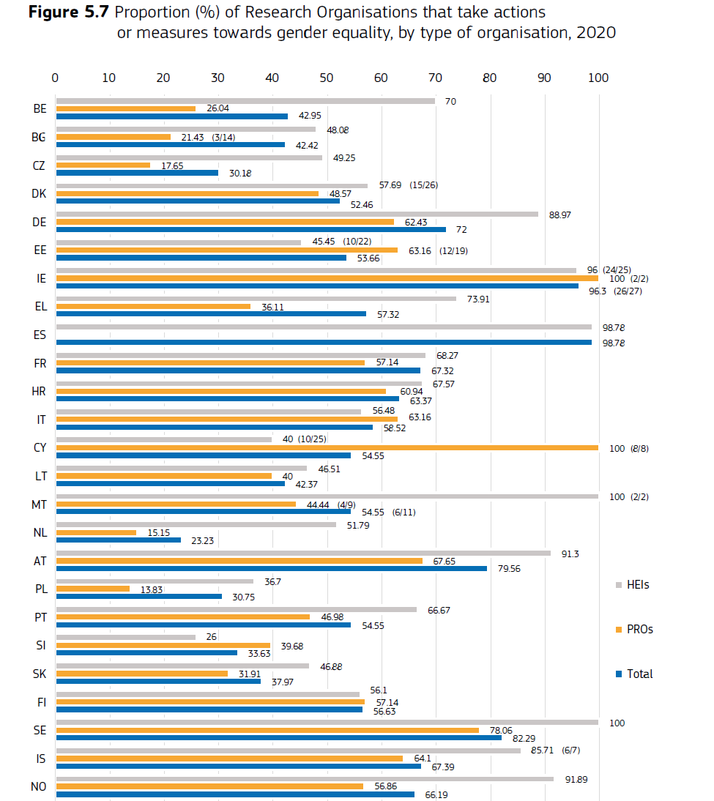
public research organisations
higher education institutions
public research organisations

Slide 19
The Academic Career
From She Figures 2021

Slide 20
Gender and STEM courses - Examples
Lund University course on Gender in Science and Technology (Students and teachers)
KTH-course Gender and STEM (Teachers)
Lund course on Scientific Literacy (Teachers)
Physics and Gender – Nordforsk supported for all Nordic countries (everybody that can apply!): https://www.lunduniversity.lu.se/lubas/i-uoh-lu-MNXB03
Gender and Science, Stockholm University

Slide 21
Examples of activities to improve:
Recruitments:
a) Calling women for adjunct positions
b) Departments hiring women faculty in permanent positions during
2015-2018 have 50% of their salaries covered for three years.
Retainment and Advancement:
a) Offering qualification scholarships and mentoring to qualify as
full professor (extra research teams, less teaching, mentoring)
b) Starting packages for recently hired women faculty
Talk by Anna Lipniacka, NORDIP conference 2019

Slide 22
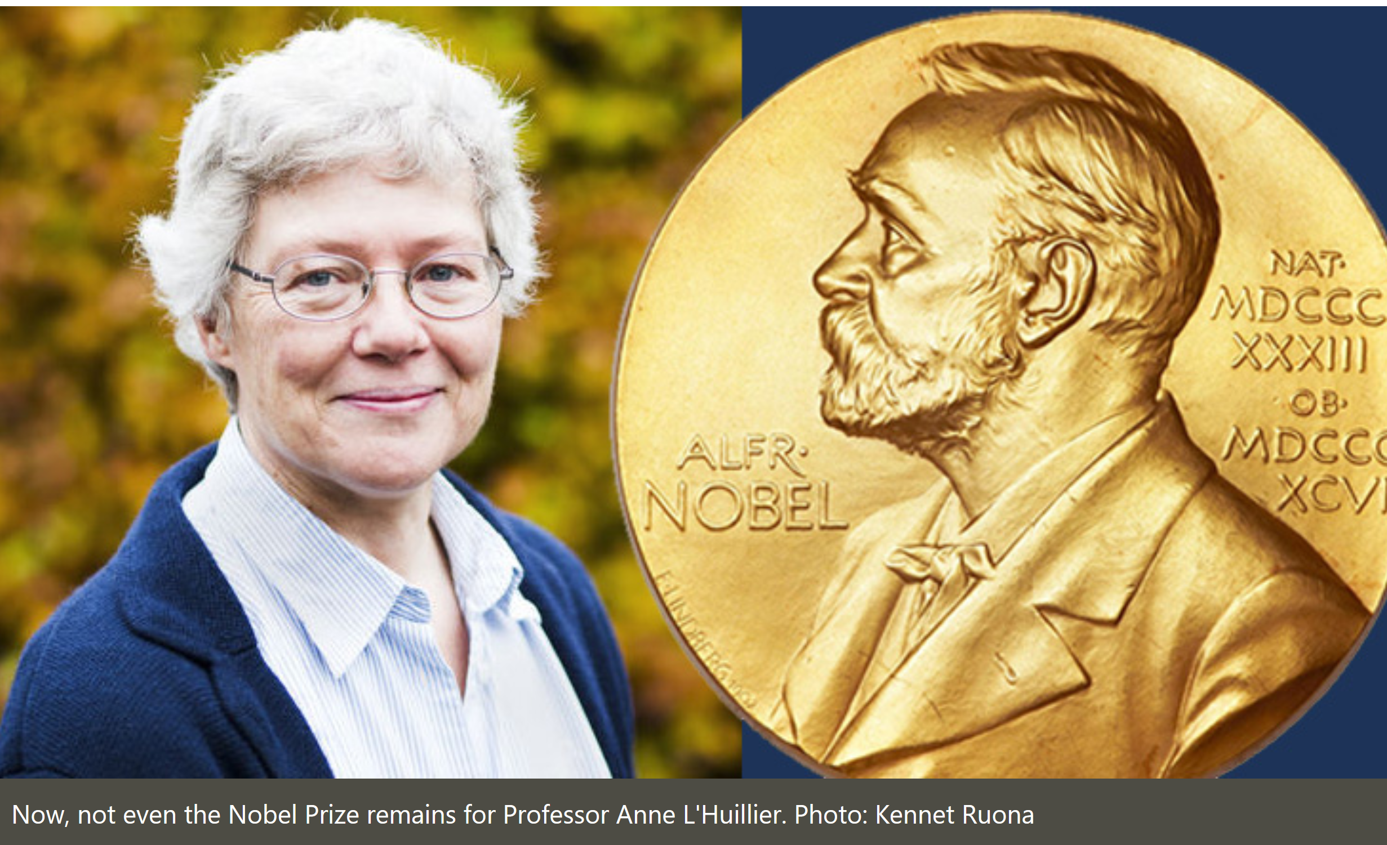
Earmarked Professorships – 1990th
Nobel prize in Physics
2023
Anne L'Huillier

Slide 23
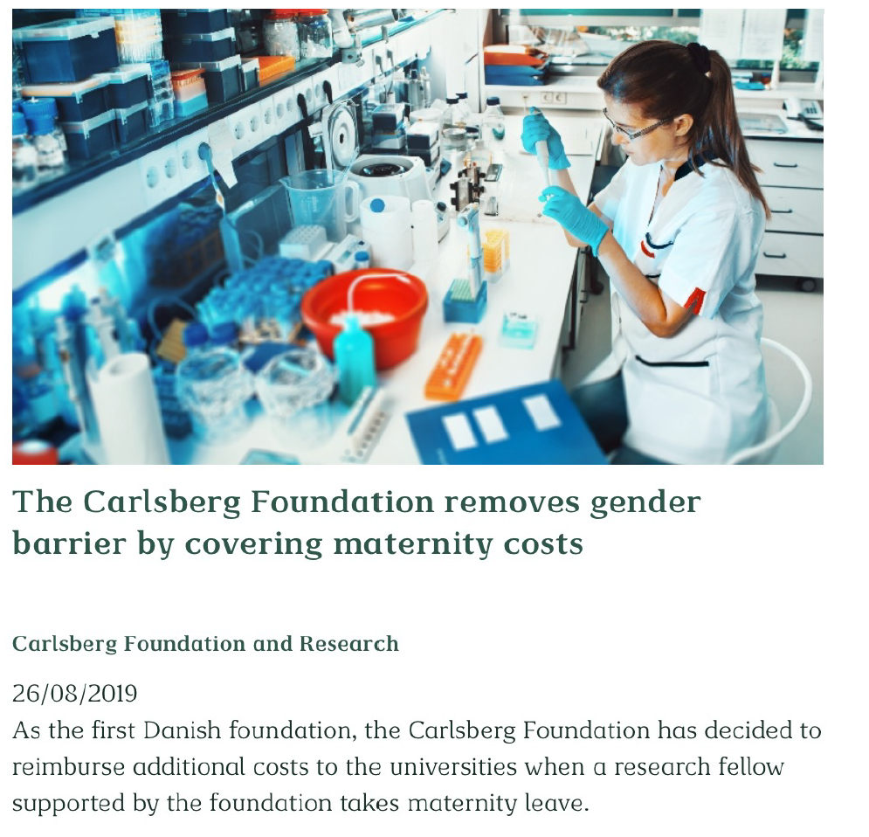
Initiatives by Foundations
Villium Fonden
Carlsberg Foundation
Talk by Crista Gall, NORDIP conference 2022
https://indico.cern.ch/event/1151332/timetable/

Slide 24
Examples of actions to increase awareness
Front (Female reseachers on Track) seminars for leaders on all
levels on gender issues (UO)
Introduced gender equality observers in evaluation panels (VR)
A seminar series on “Equal Opportunities and Unconscious Bias” (UU)
Training workshops for observers in career processes (LU)
Talk by Tomas Brage, NORDIP conference 2022
https://indico.cern.ch/event/1151332/timetable/

Slide 25
About Harassment - Example
Helsinki Association of Women Researchers conducted a survey on sexual harassment (2018): the importance of low threshold contact was obvious. (Similar surveys are also conducted here at Fysikum and at Lund University)
Every toilet in Kumpula Campus has a note with contact information.
An upset person can look for more information in a quiet place.
Talk by Katja Lauri, NORDIP conference 2023
https://indico.cern.ch/event/1262020/

Slide 26
Systemic work – Examples
GENIE at Chalmers University of Technology
https://www.chalmers.se/en/about-chalmers/Chalmers-for-a-sustainable-future/initiatives-for-gender-equality/gender-initiative-for-excellence
An equal KTH (Royal Institute of Technology)
https://www.kth.se/en/om/equality
Similar system at Lund University Science Faculty
Talk by Tomas Brage, NORDIP conference 2022
https://indico.cern.ch/event/1151332/timetable/

Slide 27
Research on gender issues in higher education institutes – Examples
The Umeå Centre for Gender Studies has a graduate school that offers
co-funding for doctoral students doing gender-related research in other fields.
Gender equality measures at Nordic higher education institutions – what works. (Linne University)
FRONT (Female reseachers on Track) is to find permanently solutions how to improve the female representation in scientific- and leadership top positions, “Gender Equality in Academia – from Knowledge to change” by Ö. Gullvåg Holter and L. Snickare (Oslo University)

Slide 28
Some thoughts about initiatives:
About funding:
+ Good with funding for various diversity initiatives
- But lack of stable funding for all diversity initiatives
By law all administrative committees need ~ 40% women:
+ Women hopefully get more power
- With few women they also get an extra administrative burden.
which impact their research work
Earmark founding women:
+ Good with more funding
- Women might only get this kind of funding

Slide 29
Thanks

Slide 30
Backup

Slide 31
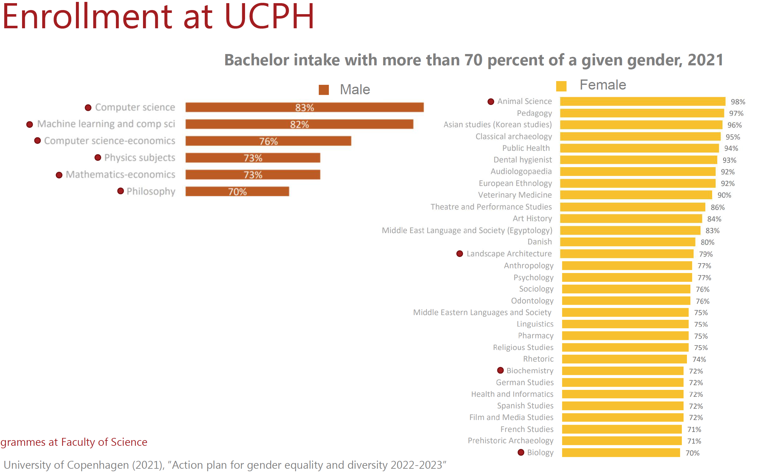
Figures from University of Copenhagen

Slide 32
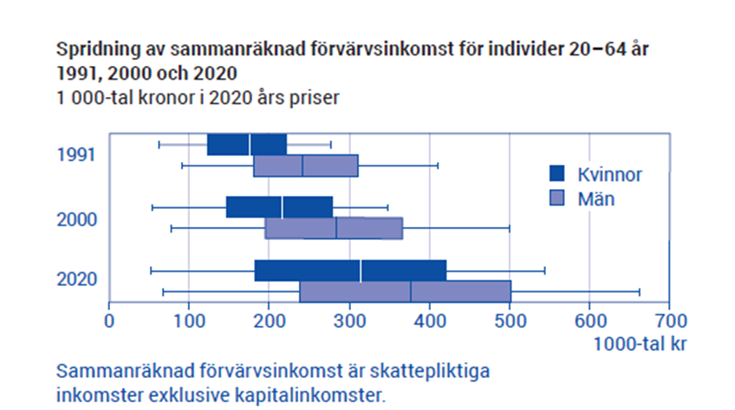
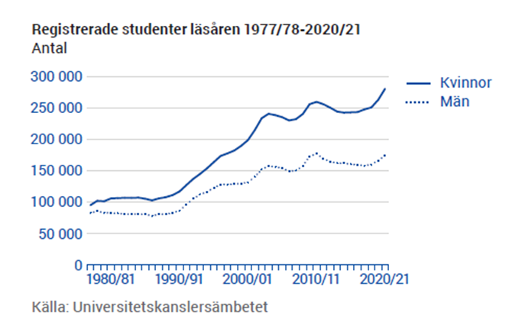
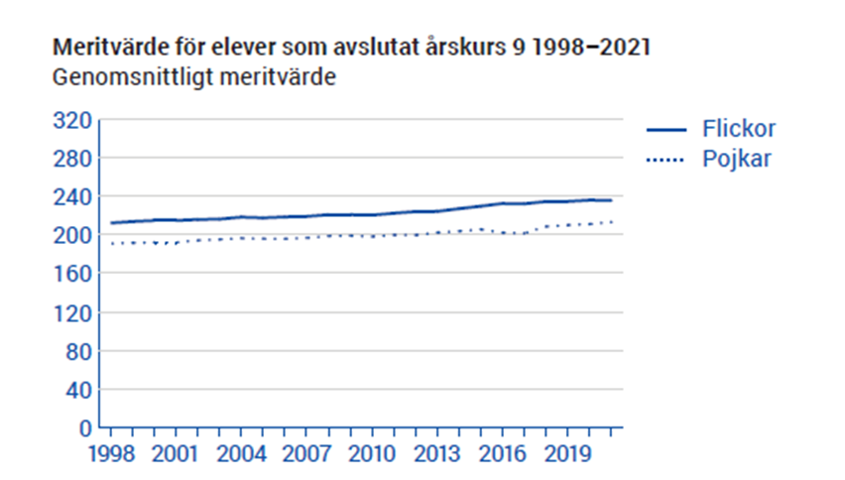
Sweden 2023
Plocka nått ur detta

Slide 33
Sweden 2023
Diagram

