Slide 1
Gender Initiative for Excellence GENIE at CHALMERS
Chalmers.se/verapodden
Maria Saline
Coordinator Genie, Central equality coordinator
2023-10-16

Slide 2
WHY GENIE?
2018:
2018, Swedish Univ.
#1 Risk for Chalmers
#MeToo + stories
Chalmers foundation investments
Female
Male % full professors
Data from SCB, Swedish Statistical bureau
Notes:
2018 open call for faculty – highest risk
MeToo 3 large projects…TRACS, CHAIR and GENIE

Slide 3
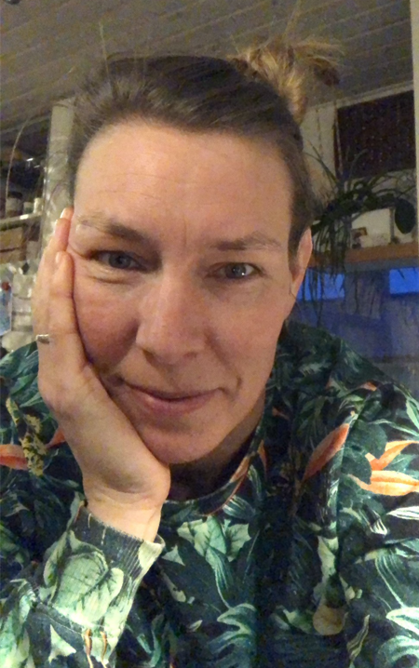
What is Genie?
…strategy to increase success and excellence at Chalmers!
1. Money: 300 MSEK (30 M Euro) 2. Long term: 10 years, 2019-2028
3. Initiated and lead by faculty
Goals:
Increased female faculty 40% female professors 2028
Eliminate structural and cultural barriers that hamper women's careers.
Create an workenvironment, which is inclusive, diverse and supports excellence in research and education.
LEADERS 2019-2022;
Pernilla Wittung-Stafshede, Maria Saline Mary Sheeran

Slide 4
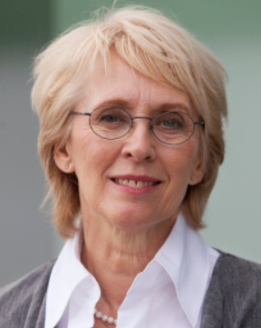
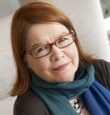
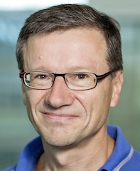
Genie organization 2022-2024
Advisory group
Paul Walton, (York University) Interim leader sept 2023-feb 2024
Lena Gustafsson (Umeå Univ. Chalmers)
Liisa Husu, (Örebro University)
Peter Sestoft (IT Univ. Copenhagen)
Steering group
Chalmers president
Thomas Nilsson (Prefect rep.)
Anders Johansson (Faculty rep.)
Head of Student union
Angela Hillemyr (Head of HR)
Photo: Pernilla Wittung-Stafshede

Slide 5
Big picture of the concept
GENIE
Central actions
Various funding initiatives;
Direct female recruitments (assistent prof. –> full prof.)
- Support to current faculty
- visiting researchers
- conference attendance,
education, awareness-rainsing, mentorship…
Measure/analyze
- Gender-divided data from Chalmers databases
- follow PhD student, culture-questions in employee survey,
- key measures (KPI)
Local efforts in departments
Help with concrete and tailored actions
Financial support
- Guidance and feedback.
Culture is key
Create a working group at each department
Combination of female recruitment and support, and long-term systemic actions for cultural changes
Top-down and bottom-up
Getting majority onboard is key

Slide 6
Result by now
GENIE
Central actions
Recruitments:
3 Professor (K, E2 and IMS)
1 Bitr. Professor (MC2)
1 Docent (TME)
9 Assistant professors
15 Postdocs
3 PhD-students
4 internal support
16 Visiting researchers
Meassure/analyze
Gender divided data 2018 -2022.
“Why women leave – Chemistry” (non-events)
Bibliomentry gender divided
Activities at the departments
Connected to Chalmers Rules of Procedure: ‘academic household work’
Added 7 questions to the empoyee-survey 2018-2022
Collect and share good examples
Genie representative/inst. (13)
Network of PhD students – DrGenie
Support fo existing faculty:
30 project (Gender+excellence)
Mentorship, student networks (CWA) individual support. Leadership courses
Education:
Culture change course, EDI in undergraduate edu. Leaders “walk the talk, program: “inclusive outstanding research environments”
Seminars and outreach
Articles, events, podd and seminars
Plans and goals for GE work into yearly Operational Plan –how to follow up?
Toolbox with ideas on what to do + reference and links
Course on cultural change 6 moduls (about 4 days)

Slide 7
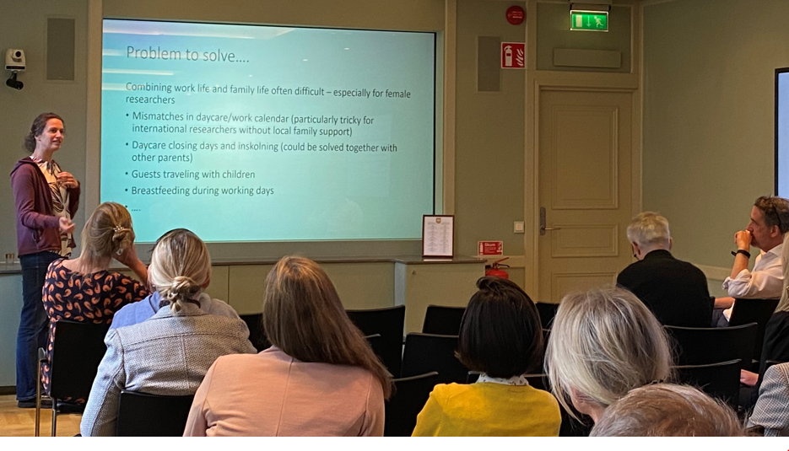
Intern Open call project 2020-2022
Funding excellence coupled to gender
30 projects sharing 23 MKr
The right to the city – intersectional perspectives on the gendered nature of urban space ACE
Advancement of Chalmers Research in Offshore Renewable Energy M2
Chalmers Undergraduate Research Initiative CURIE K
More female students with top grades - Elimination of gender differences in introductory programming M2
Gender education at CTH: How, when and where? TME
Platform for Gender Initiatives in Distributed Quantum Machine Learning E2+MC2
Measuring and modelling polarized synchrotron emission from runaway electrons in fusion exps F
Family Room MC2
Diagnosis of balance disorders, gender balanced E2
Tasting science in the making: Promoting gender diversity in the academic pipeline by involving undergraduate students in research E2+K
Support to join international team in astrochemistry SEE
Preparing a future Swedish satellite mission SEE
Differences in the design and ageing of a vehicle battery depending on whether men or women are the dominating drivers E2
Women in architecture leadership: “the new normal” or future amnesia? ACE
The formation and evolution of massive galaxies in the early universe SEE
Radio gals and new ways to B SEE
Analysis of gender bias in texts from Chalmers and other Swedish texts CSE
Robust and Explainable Neural Networks:Transparency of Decision Processes MV+CSE
BELONG — educate women in Data Science for success in leadership roles CSE+MV
Cryptography meets Verifiable Quantum Computation CSE+MC2
Using sunlight to catalyse demanding reactions K
Scientific communication and cognition: Thinking outside box CLS
A terahertz imaging postdoc: catalyzer for bio terahertz group MC2
Chalmers Astrophysics & Space Sciences Summer Research Fellowships SEE+K+GU
Iron dependence of the cyclooxygenase pathway - A female perspective BIO
Personal mobility and development for Selpi M2
Gender-fair Education in Practical and Project Work in Computer Science CSE
Molecular engineering of sustainable bionanocomposites: from interface design to new reactive melt processing approaches IMS
Education for gender equal future; piloting ecological masculinities TME
AI-Enhanced Digital Twin for Weld’s fatigue cracks ACE

Slide 8
Status at Chalmers 2023
Broad calls, 50% each gender to interview, Genie´s presence…
Role and no people by sept 2023. For 2023, data from sept, other years from december. Data from Qlickview, pensionage 67 years old

Slide 9
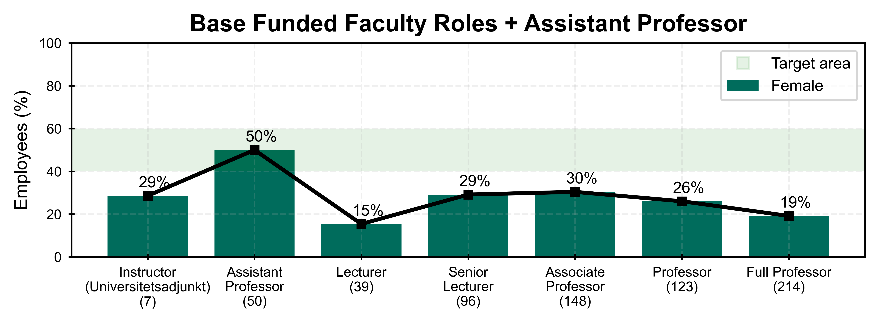
Gender proportion
Overall by role
Data from the 13 departments at Chalmers (Qlikview) and shared departments with GU (Primula) October 2022.
2023-10-16
Chalmers University of Technology
9

Slide 10
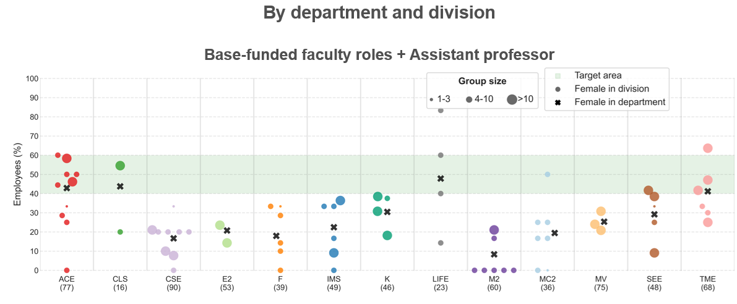
Gender proportion over the University
Data from ”gender report 2022” www.chalmers.se/genie

Slide 11
Successes and Challenges first 4,5 years
Successes
Built trust for Genie
Academic agenda in focus
Improved awareness
Increased engagement
Hired great women to faculty
Visibility is positive for Chalmers reputation
Challenges
Female percentages not changed yet (except Assist Prof level)
Hindered by bigger university problems
Not easy get leaders/faculty to prioritize and take responsibility
Want to help, but excluded from early insights
Everyone is part in creating our culture – need to engage give credit for the work
Article about the Genie project:
Saline, M., Sheeran, M., & Wittung-Stafshede, P. (2021). A large ‘discovery’ experiment: Gender Initiative for Excellence (Genie) at Chalmers University of Technology. QRB Discovery, 2, E5. doi:10.1017/qrd.2021.3

Slide 12
Logotype

