Slide 1
Career opportunities
Stockholm
Magdalena Zych magdalena.zych@fysik.su.se
RQI circuit Stockholm 17 Nov 2023

Slide 2
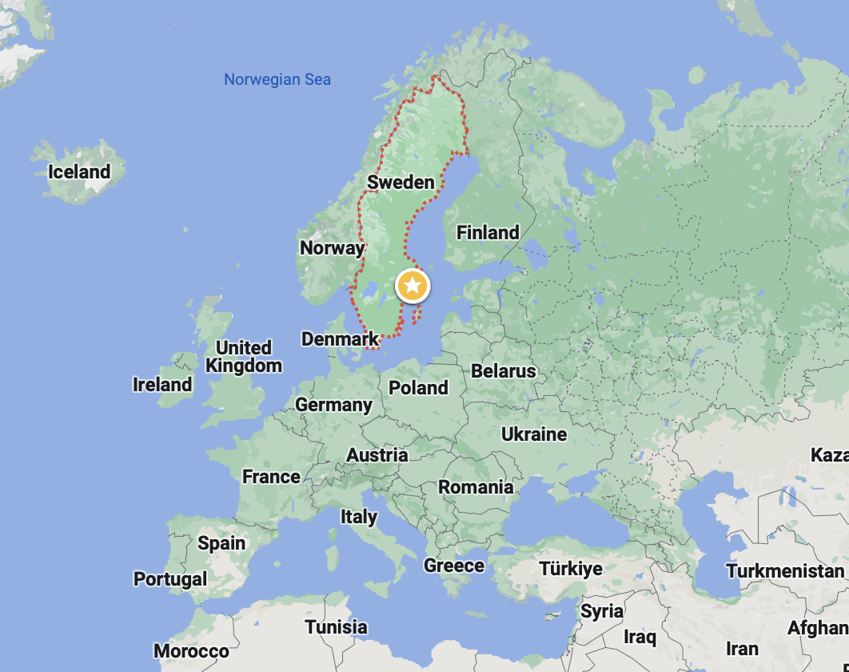
Fysikum and Nordita – where we are

Slide 3
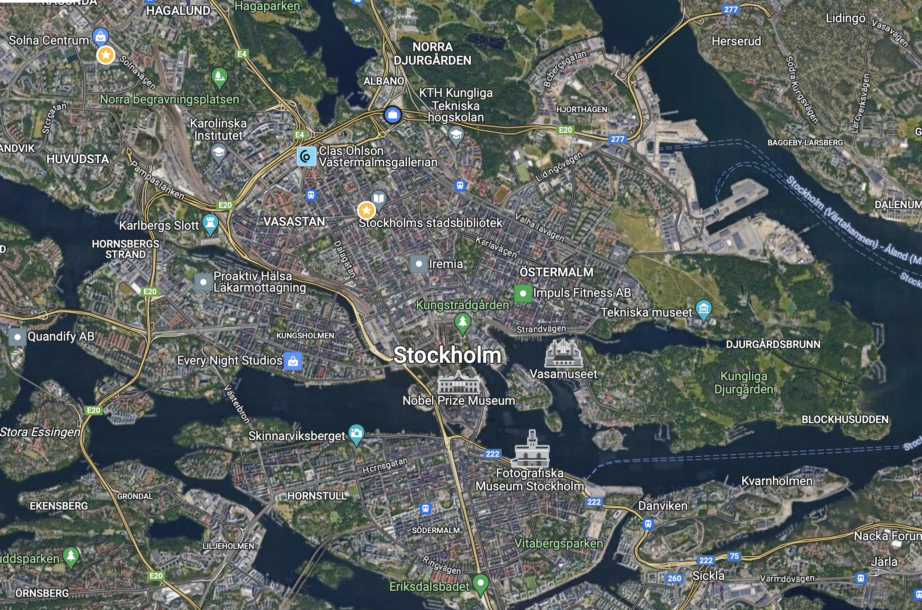
Fysikum and Nordita – where we are

Slide 4
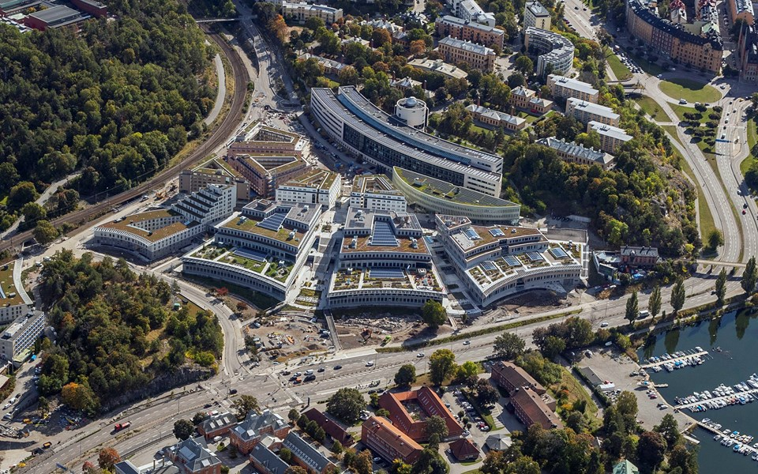
Fysikum and Nordita – where we are
F
N

Slide 5
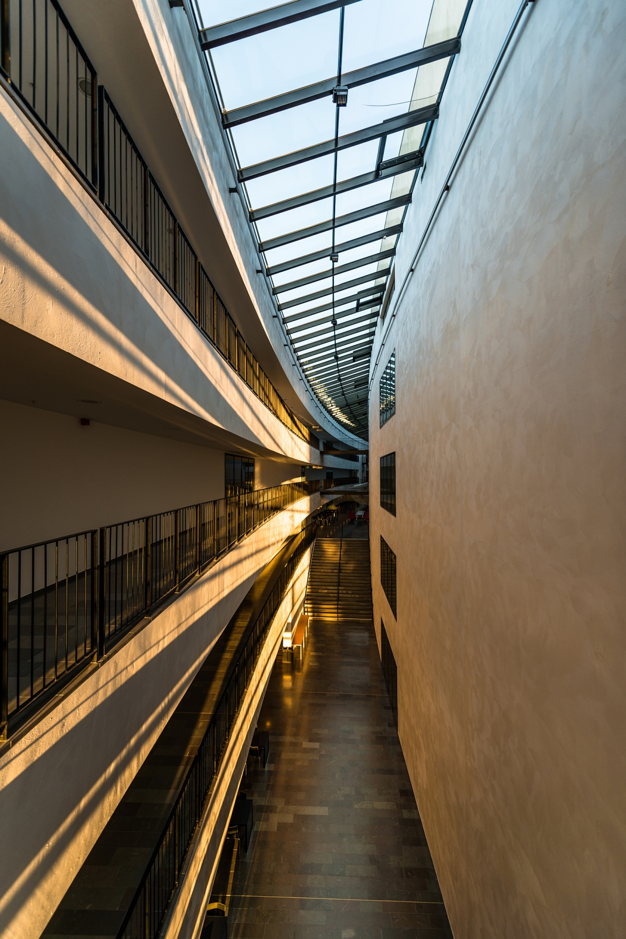
AlbaNova University Center -- Stockholm Center for Physics, Astronomy and Biotechnology
Stockholm University (SU) & Royal Institute of Technology (KTH)
Fysikum (SU Department of Physics )
NORDITA (Nordic Institute for Theoretical Physics)
Oskar Klein Centre – centre for cosmology, astro- & particle physics
…

Slide 6
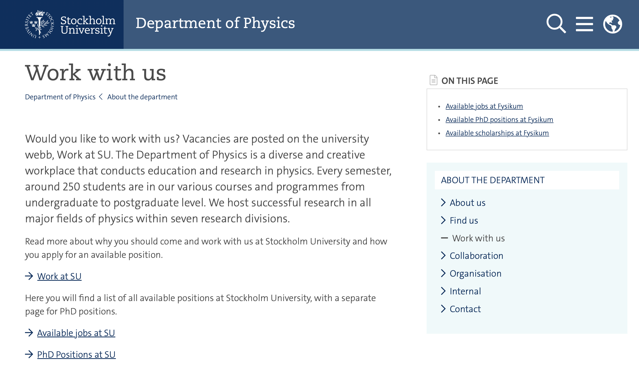
PhD opportunites
Duration: 4 years (up to 1 year extension if doing teaching/service)
PhD students are normally employed
Median* salary over 4 years (Fysikum): 30 000 SEK/month**
Fysikum (SU Department of Physics )
No departmental/university PhD scholarships
positions opened by the individual groups’
Contact prospective supervisors
Monitor open calls
* salary increases after completing 50% and 80% of PhD requirements
** is adjusted each year by a few percent;

Slide 7
PhD opportunites
NORDITA (Nordic Institute for Theoretical Physics)
Short-term visiting PhD scholarships
Expected to be 1-2 months (but may be longer)
Application deadlines: 10 May & 10 November each year
Offers support for travel and accommodation
Contact prospective supervisor(s) – postdocs & faculty from NORDITA
* salary increases after completing 50% and 80% of PhD requirements
** is adjusted each year by a few percent;

Slide 8
Post-doctoral opportunities
Fysikum (SU Department of Physics )
salary 39 000 SEK/month
duration 2+1 year
Contact prospective supervisor(s)
Monitor open calls
Check for cut-offs (must be within 3 years of PhD at deadline)

Slide 9
Post-doctoral opportunities
NORDITA (Nordic Institute for Theoretical Physics)
Nordita fellows → employed to pursue independent research
Nordita postdocs → employed on a particular project
Positions may reopen for 2026

Slide 10
Post-doctoral opportunities
NORDITA (Nordic Institute for Theoretical Physics)
Nordita fellows → employed to pursue independent research
Nordita postdocs → employed on a particular project
Positions may reopen for 2026

Slide 11
Post-doctoral opportunities – selected external funding
‘outgoing’ fellowships
Eligibility:
Swedish citizens or permit holders (obtained PhD from Sweden)
within 3 years from PhD
Conditions
3 years abroad + possibility of extra 2 years in Sweden
salary ($$ depending on host country)
'startup grant' of 400 000 SEK
Deadline
31 January

Slide 12
Post-doctoral opportunities – selected external funding
‘outgoing’ fellowships
'incoming' fellowships
Eligibility:
foreign researchers (no longer than 9 months in Sweden at appl. deadline)
within 5 years from PhD
Conditions
duration: 3--24 months
tax-free scholarship: 28 000 SEK/month
Reimburses actual travel expenses
Deadline
1 October
Application is submitted by the host at Swedish institution!

Slide 13
Post-doctoral opportunities – selected external funding
‘outgoing’ fellowships
'incoming' fellowships
visiting researchers
Eligibility:
foreign senior researchers
At least 5 years from PhD
Conditions
duration: 1--12 months
Amount: no fixed sum “intended as a contribution to the additional costs incurred by the guest (travel, dual residence, health insurance, etc.)”
Deadline
10 March and 1 October
Application is submitted by the host at Swedish institution!

Slide 14
Post-doctoral opportunities – selected external funding
International postdoc
Eligibility:
Local researchers (PhD from a Swedish university)
within 2 years from PhD
Conditions
duration: 18–36 months
Grant amount 1 150 000 SEK/year
Can apply for additional 50 000 SEK/year (in total) for one or more accompanying family members
Deadline
January/February
Swedish Research Council
Application is submitted with a Swedish administering organization

Slide 15
Post-doctoral opportunities – selected external funding
International postdoc
VR Starting grant
Eligibility:
Any researcher between 2 & 7 years from PhD
Conditions
duration: 4 years
Grant amount 1 000 000 SEK /year
Deadline
March/April
Swedish Research Council
Application is submitted with a Swedish administering organization

Slide 16
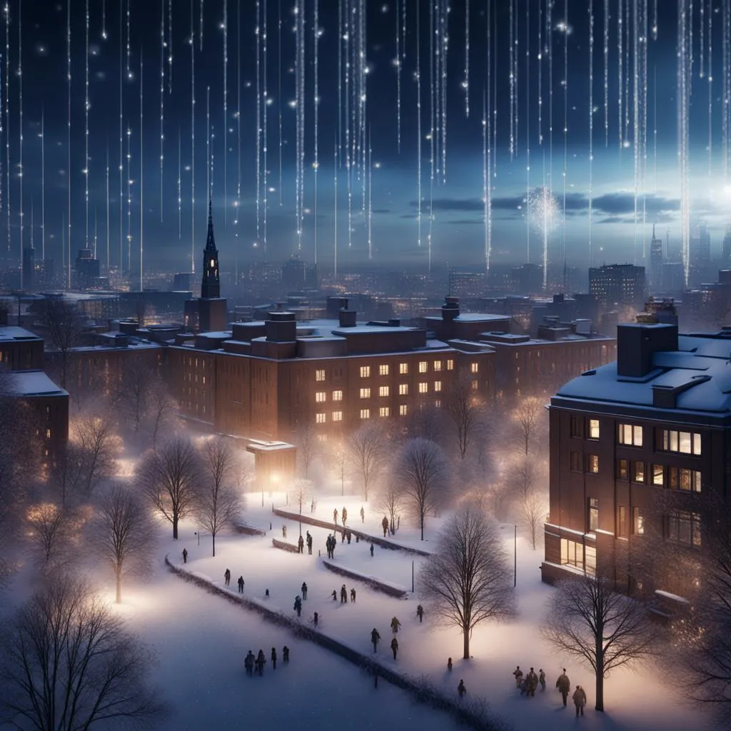
summary information and links: at RQI-circuit Stockholm page → here
Quantm snowflakes over Alabano according to NighCafe AI

