Slide 1
Hard Condensed Matter Theory of Quantum Matter (TQM)

Slide 2
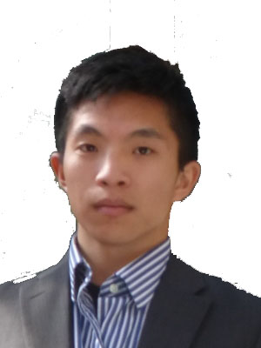
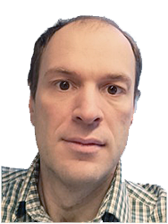
P. Wong
J. Schaltegger
D. Kuzmanovski
Dynamical Order
A. Tyner
A. Pathapati
Dark Matter Detection
Material Informatics
Organic Materials
Database (OMDB)
M. Stålhammar
O. Mansikkamäki
Alexander
Balatsky
I. M. Khaymovich
H. Yerzhakov
Superconductivity
Ergodicity Breaking Phases
TQM AREAS

Slide 3
M. Stålhammar
Superconductivity –
current without Joule heating
magnetic-field repulsion
paired electrons
H. Yerzhakov
Superconductivity
Alexander
Balatsky
TQM AREAS
Taken from MRI questions

Slide 4
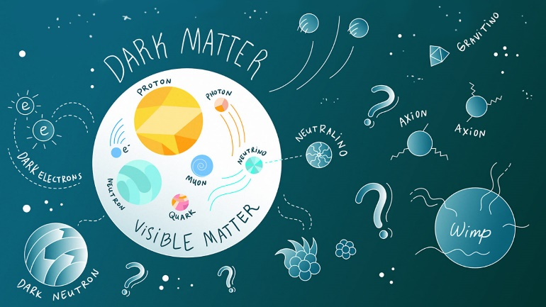
J. Schaltegger
Dark matter –
source of Universe expansion
interacts with us via gravity
dominates over usual matter
Dark Matter Detection
Alexander
Balatsky
TQM AREAS

Slide 5
D. Kuzmanovski
P. Wong
Dynamical order –
tunable phase transitions or
new order parameter due to (quantum) dynamics
Dynamical Order
Alexander
Balatsky
TQM AREAS

Slide 6
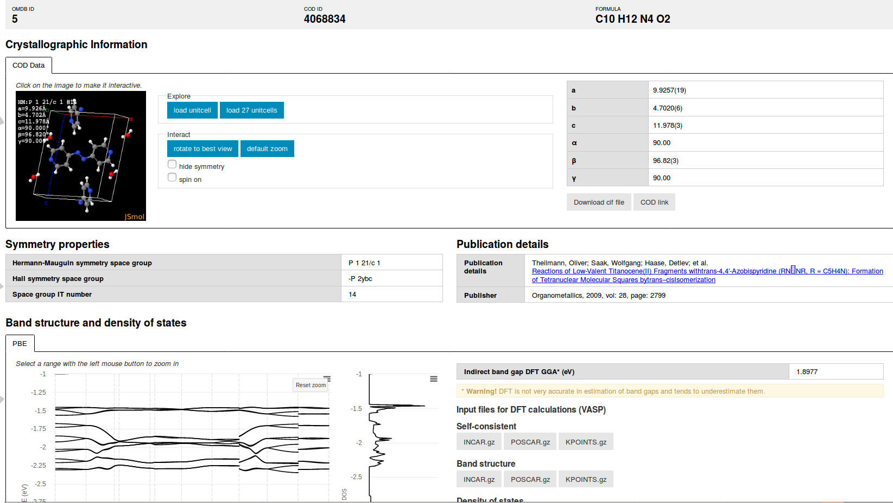
A. Tyner
Material informatics –
way to find new materials
machine-learning techniques
A. Pathapati
Material Informatics
Organic Materials
Database (OMDB)
Alexander
Balatsky
TQM AREAS

Slide 7
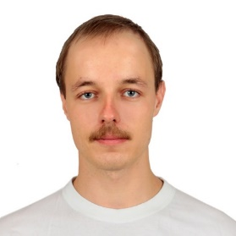
Ergodicity breaking phases
Homepage: for more info
NORDITA Ass. Prof. in TQM group
Thermalization
Ivan Khaymovich
Nonequilibruim
Thermalization to equilibrium
Isolated system
P(E)
P(E)
- ?
E
E
Thermalization or Ergodicity

Slide 8
Ergodicity breaking phases
Homepage: for more info
NORDITA Ass. Prof. in TQM group
Non-ergodicity
Ivan Khaymovich
Some other Nonequilibruim state
Nonequilibruim
Thermalization to equilibrium
Isolated system
P(E)
P(E)
- ?
E
E
Ergodicity breaking

Slide 9
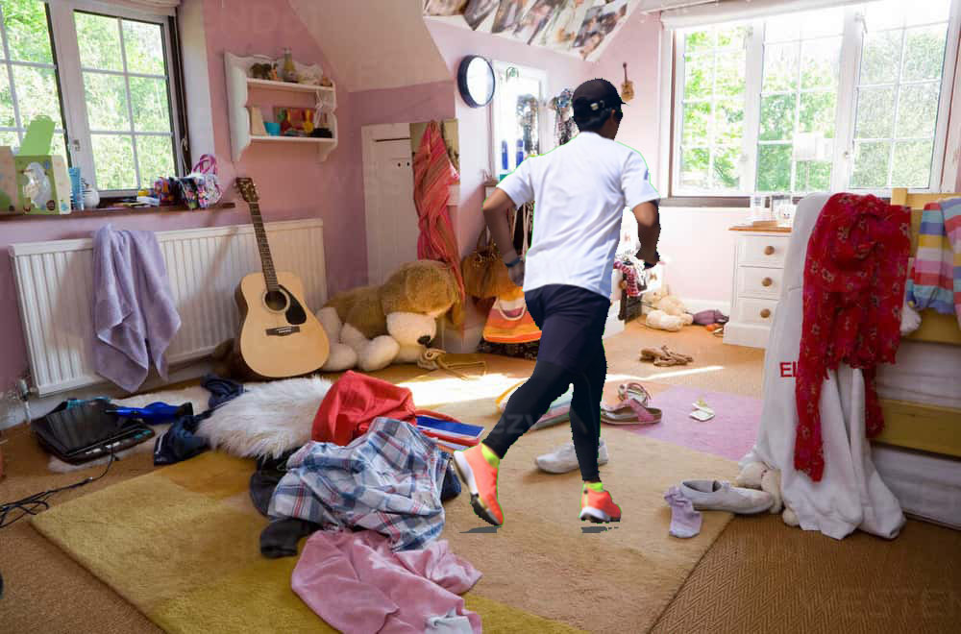
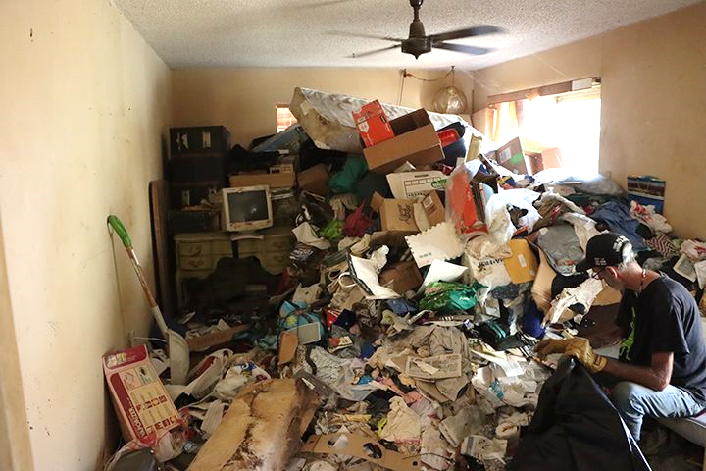
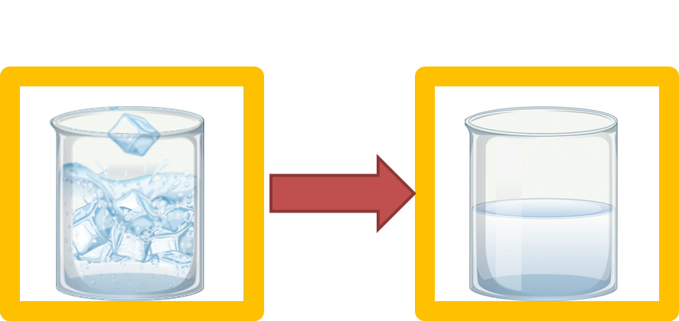
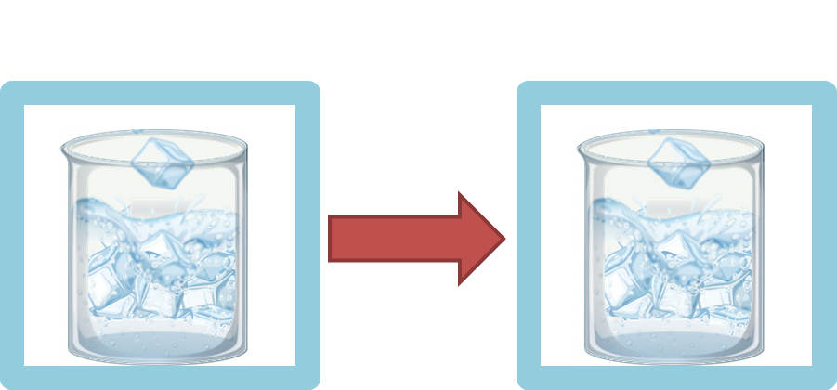
Ergodicity breaking phases
Homepage: for more info
NORDITA Ass. Prof. in TQM group
Disorder
Ivan Khaymovich
ergodic metal non-ergodic phase insulator
disorder

Slide 10
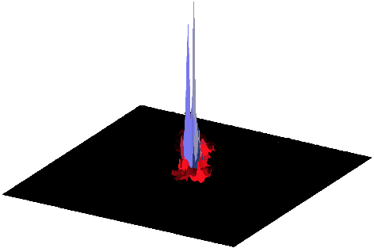
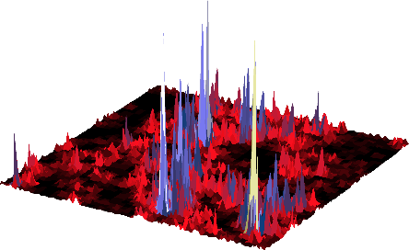
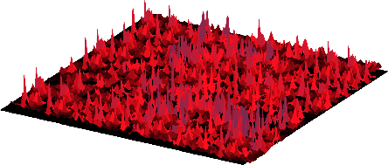
Ergodicity breaking phases
Homepage: for more info
NORDITA Ass. Prof. in TQM group
States
Ivan Khaymovich
ergodic metal non-ergodic phase insulator
disorder
Ergodic states
(Multi)fractal states
Localized states
|ψ|²
|ψ|²
|ψ|²

Slide 11
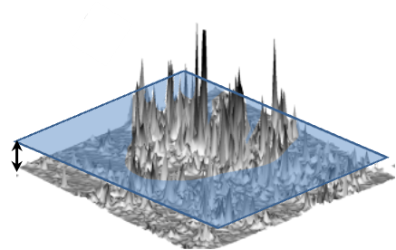
Ergodicity breaking phases
Homepage: for more info
NORDITA Ass. Prof. in TQM group
Multifractality
Ivan Khaymovich
ergodic metal non-ergodic phase insulator
disorder
Motivation?

Slide 12
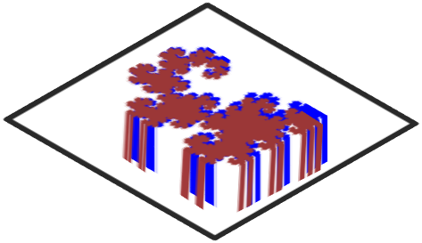
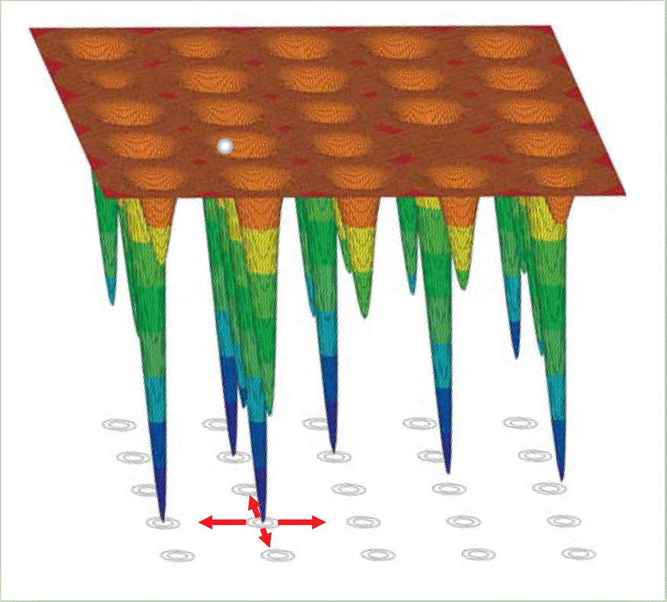
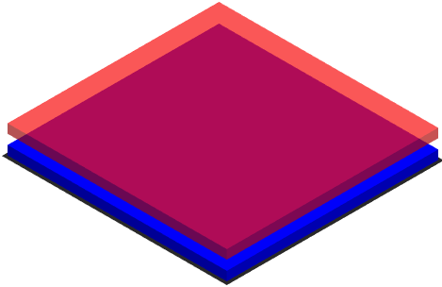
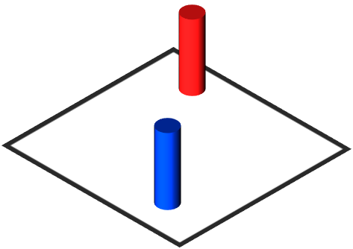
Ergodicity breaking phases
Homepage: for more info
NORDITA Ass. Prof. in TQM group
Motivation
Ivan Khaymovich
Onsager’s prize 2021
Basko, Aleiner, Altshuler, AoP (2006)
Serbyn, Papic, Abanin PRL (2013)
Oganesyan, Huse, PRB (2014)
Many-body localization – fundamental ergodicity breakdown, quantum memory applications
$$W$$
Mace, Alet, Laflorencie, PRL’19; De Tomasi, IMK et al., PRB (2021)
Superconductivity enhancement
Speed-up of Grover algorithm $→$ Quantum annealing, machine learning, cryptography
Google Quantum Artificial Intelligence lab:
PRX (2020); arXiv:1807.04792; arXiv:1907.01609;
Hu et al., arXiv:1806.08706
Kravtsov, IMK et al., arxiv(2020), IMK et al. PRR (2020)
Feigel’man et al., PRL (2007)
Zhao et al., Nat. Phys. (2019)

Slide 13
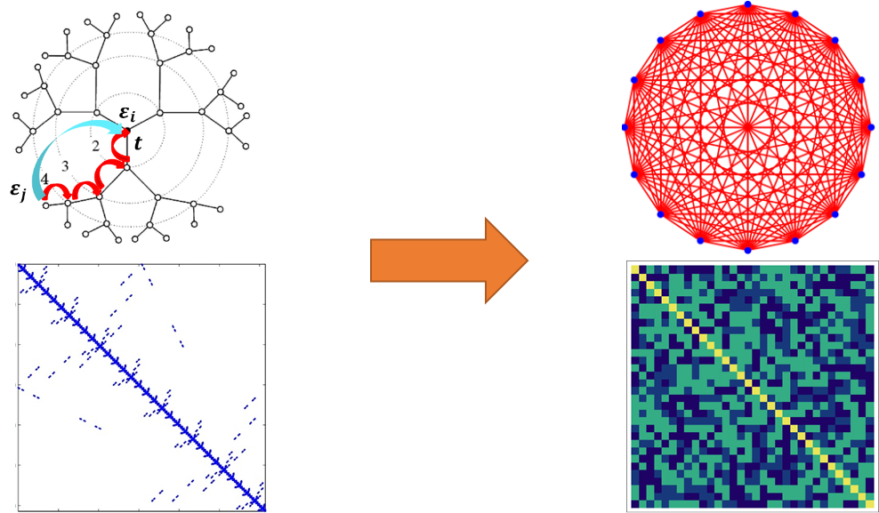
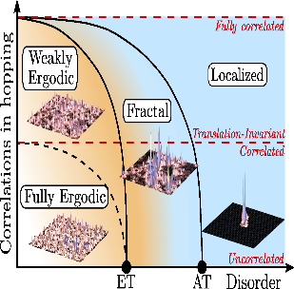
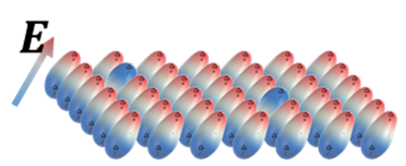
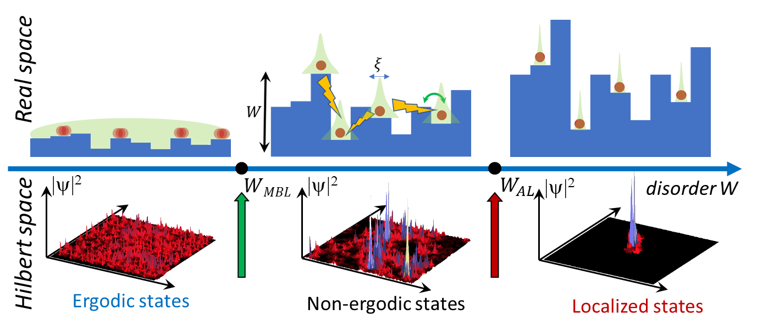
Ergodicity breaking phases
Homepage: for more info
NORDITA Ass. Prof. in TQM group
Ivan Khaymovich
Random-matrix theory: - Multifractal phases -Mapping to many-body models
Long-range systems: - Integrability, correlations,
- non-Hermitian/open models
- Localization and multifractality
-
Many-body systems: - Many-body localization vs Hilbert-space multifractality,
- Multifractality/entanglement
- Deviations from ETH
Welcome to Nordita!

