Slide 1
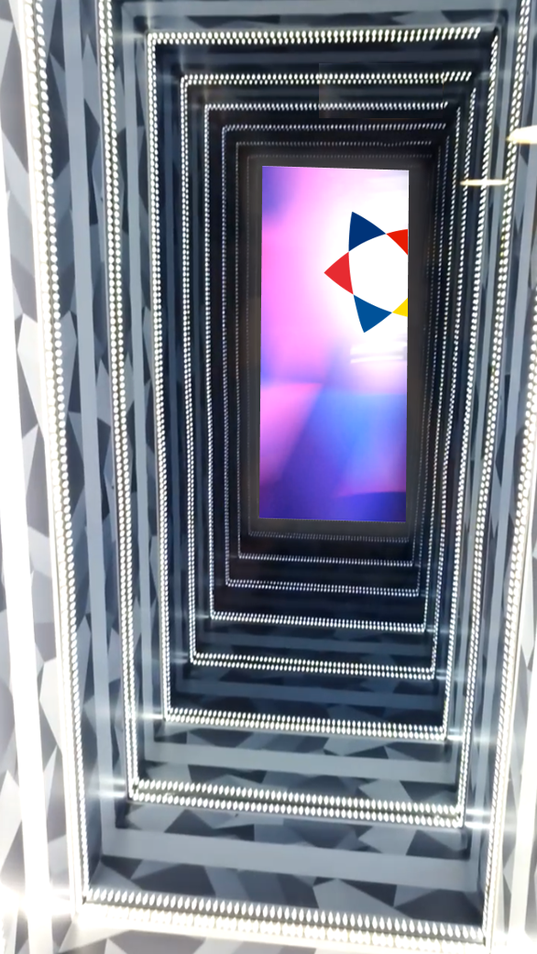
DAY OF OPEN DOORS
"You know what the issue is with this world? Everyone wants a magical solution to their problem, and everyone refuses to believe in magic.“
L. Carrol “Alice in Wonderland”

Slide 2
COUNTRIES
Norway
Iceland
Danmark
Sweden
Finland

Slide 3
HISTORY
Hosts:
1957 – Copenhagen
2007 – KTH, Stockholm
2015 – Stockholm Uni
Co-funded by

Slide 4
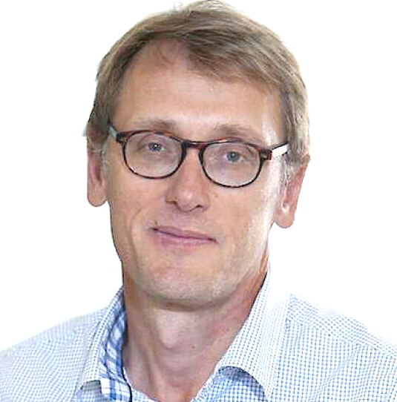
K. Zarembo
High-energy physics
F. Wilczek
A. Brandenburg
WINQ
Quantum Information and networks
Astrophysics
J. Wettlaufer
N. Obers
Director’19-23
M. Fogelström
Director’24-..
A. Balatsky
Soft Condensed Matter
Hard Condensed matter
Theory of Quantum matter
STRANDS

Slide 5
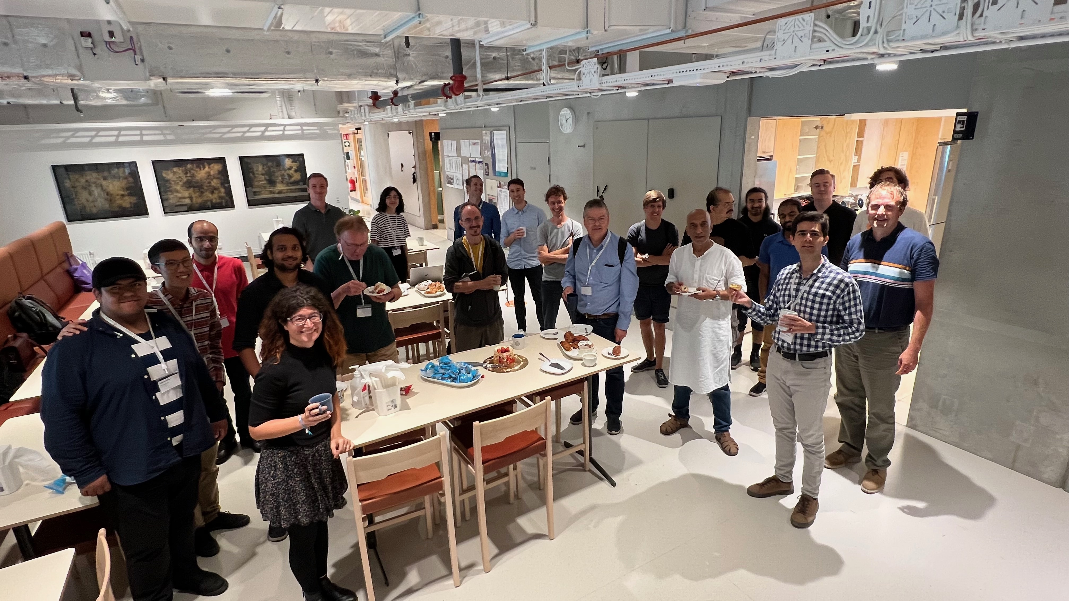
STAFF
1 Director
4 Professors
11 Assistant professors
27 Postdoc fellows
7 PhD students
3 MSc students
- we need more! ☺

Slide 6
VISITORS
Annual Winter School (various topics)
Bi-annual Masterclass
3-4-week programs: 6-8/year
Conferences: 8-10/year
Colloquium: 1/month
Seminars: (nearly) every day
Few hundreds of visitors

Slide 7
TEACHING
2021 – Icelandic Master program
2024 – SU Master program
Annual Winter School (strands),
Bi-annual Masterclass,
Several Summer Schools…

Slide 8
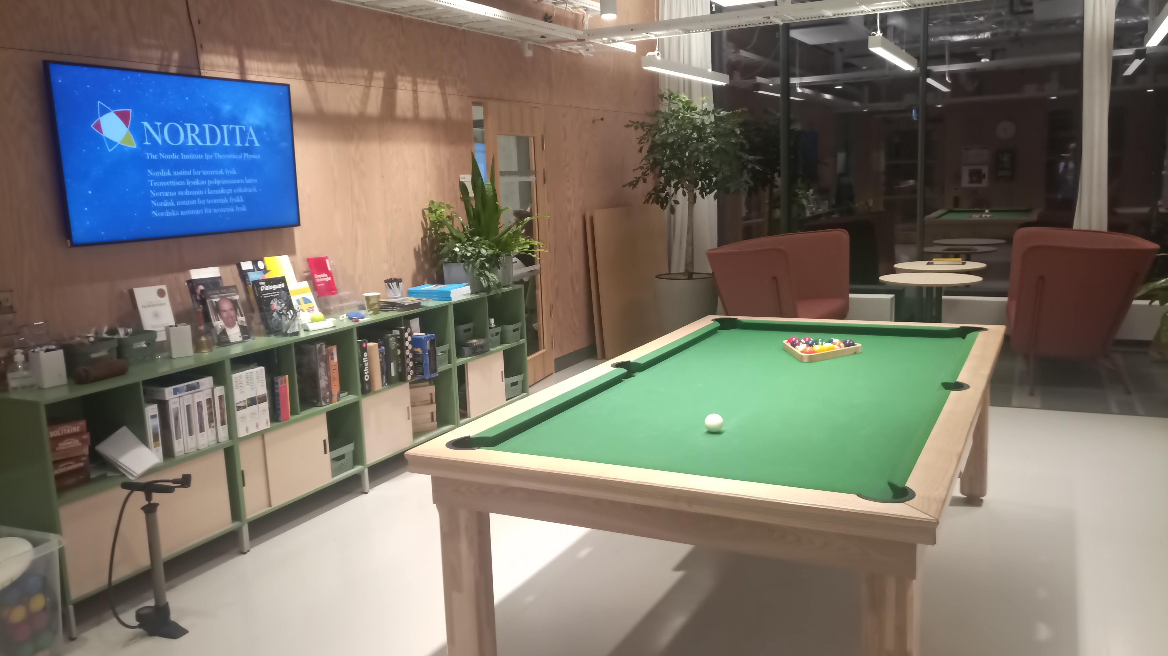
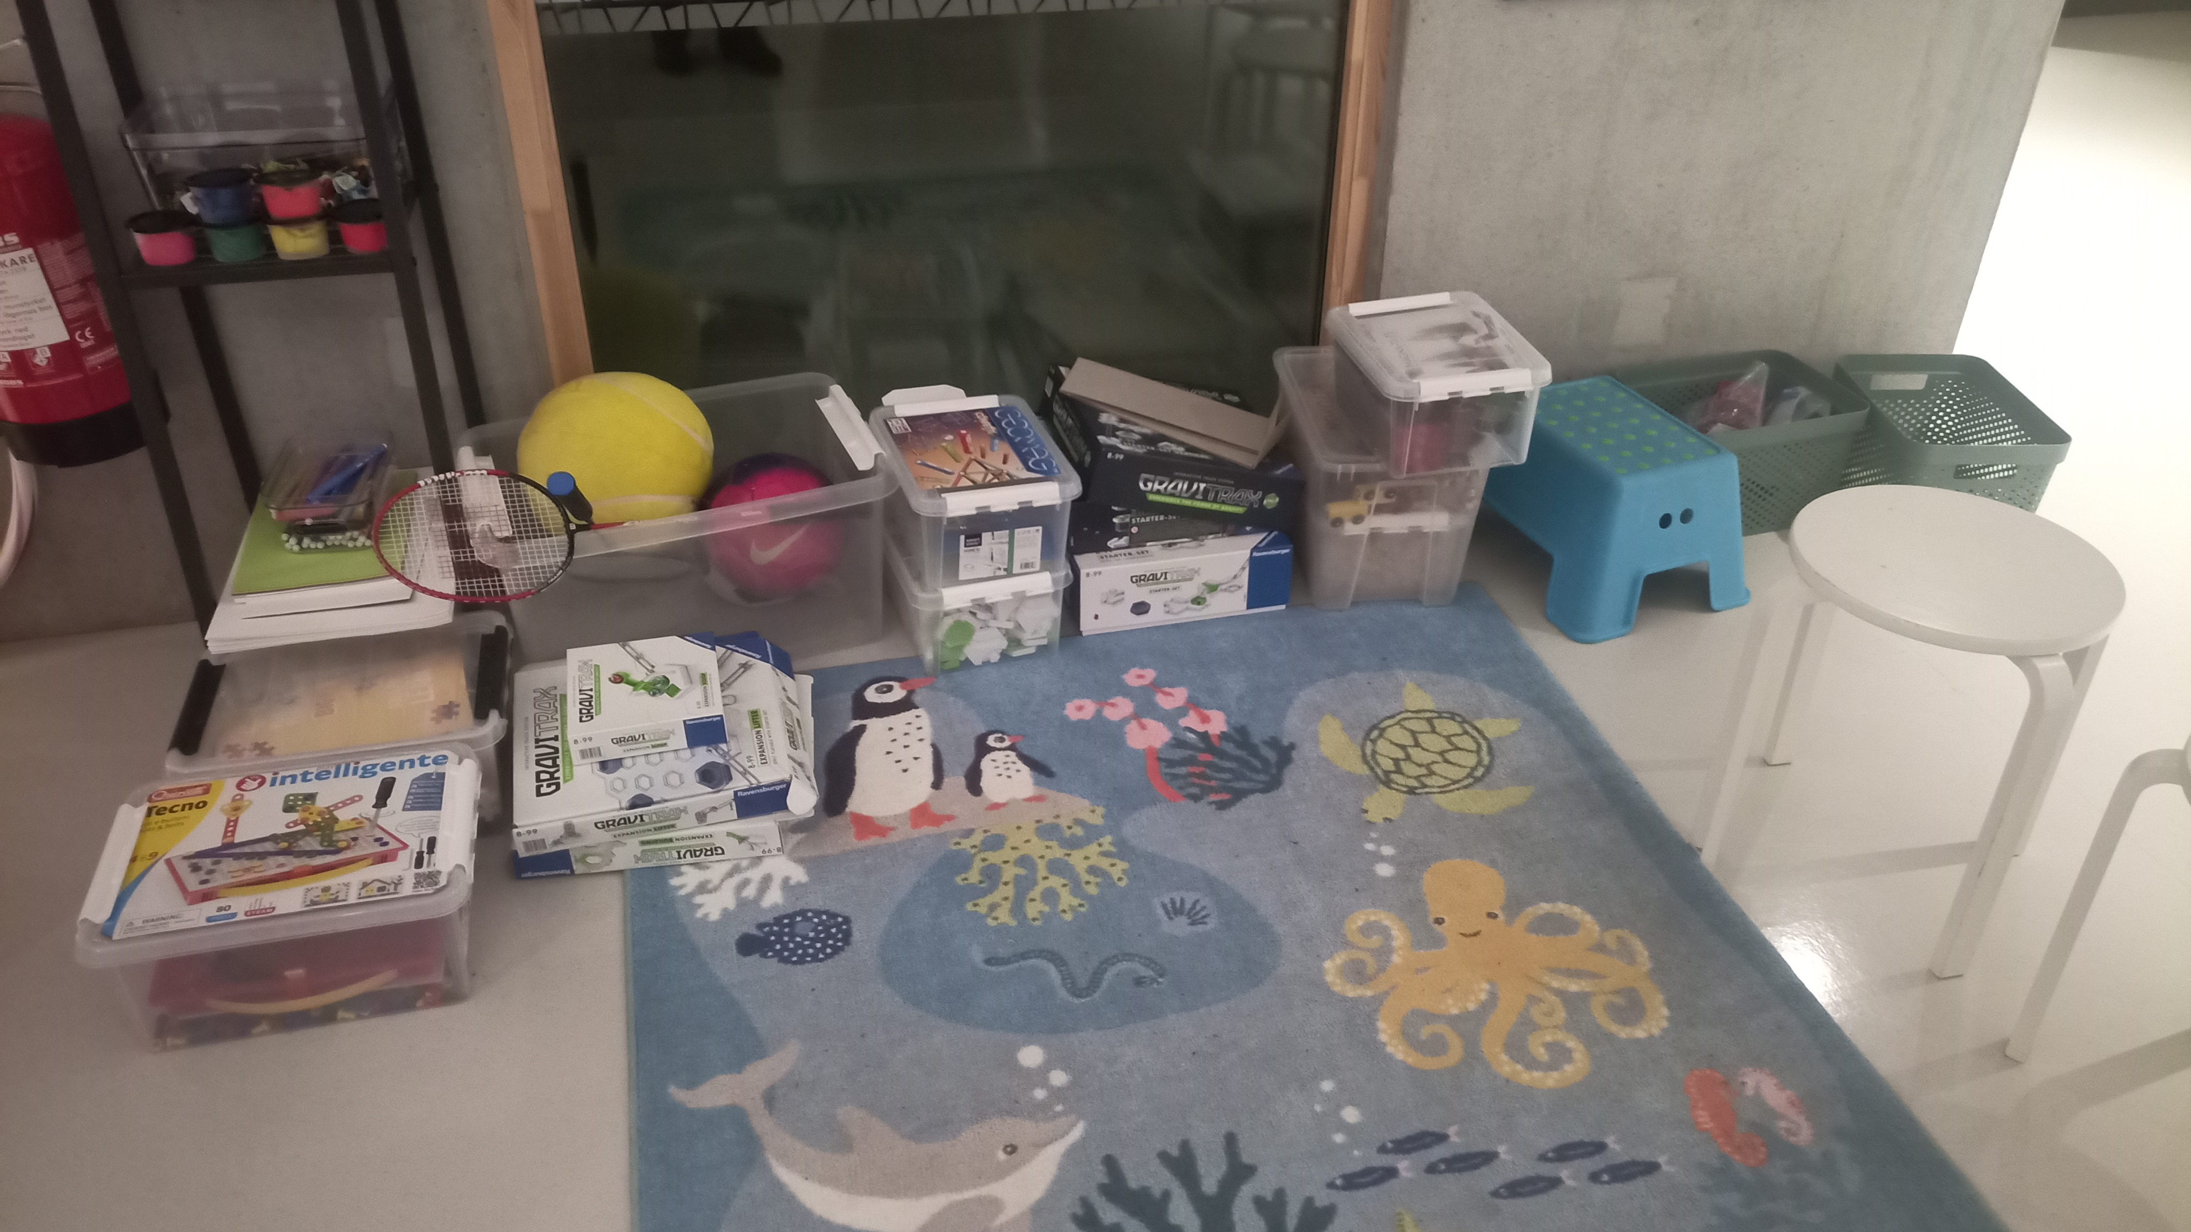
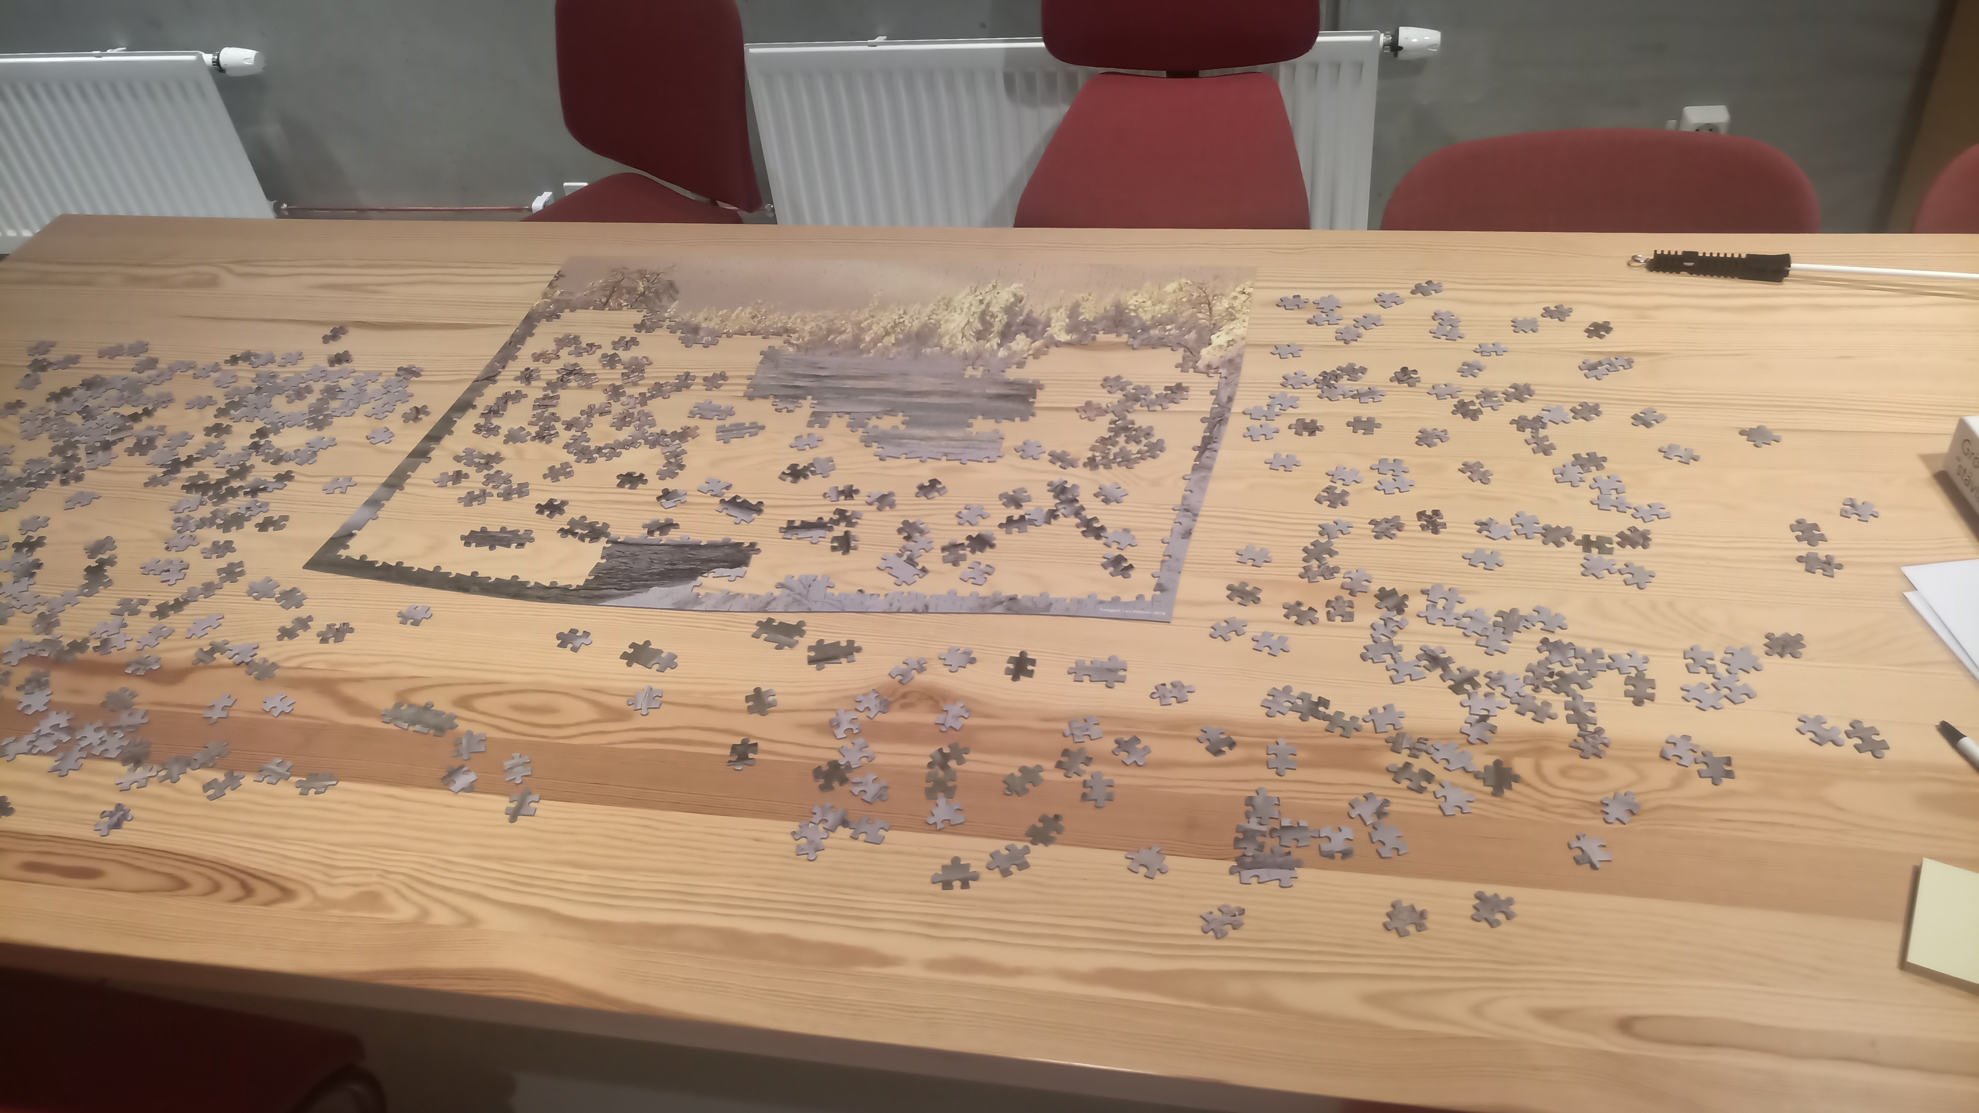
LABS
Classical mechanics lab
Brainstorming puzzles
Magnetic lab

Slide 9
DAY OF OPEN DOORS
Welcome to Nordita!

