Slide 1
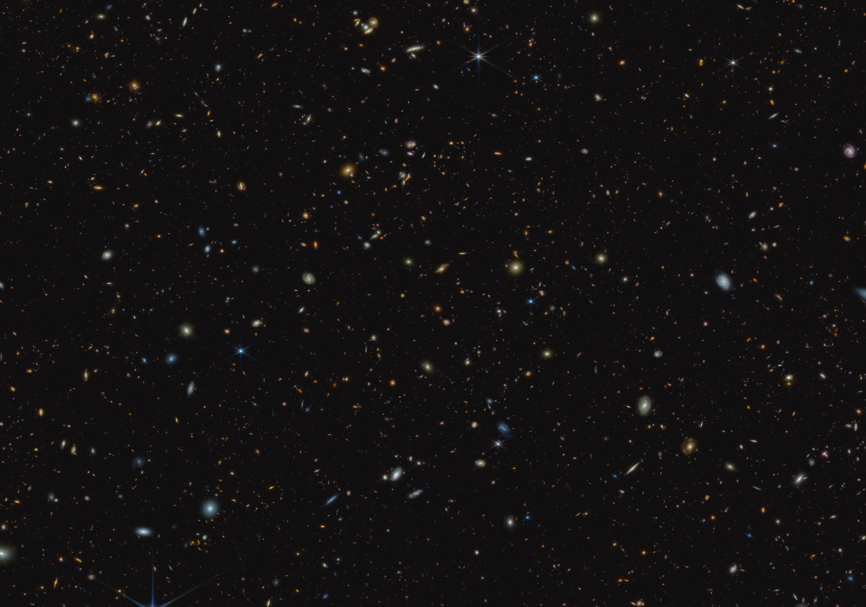


Constraining galaxy close pair fractions and merger rates from Cosmic Noon to Cosmic Dawn using deep JWST observations
Dávid Puskás – University of Cambridge, KICC
Sandro Tacchella, Roberto Maiolino, JADES collaboration
dp670@cam.ac.uk
Cosmic Dawn at High Latitudes, Stockholm – 27th June 2024

Slide 2
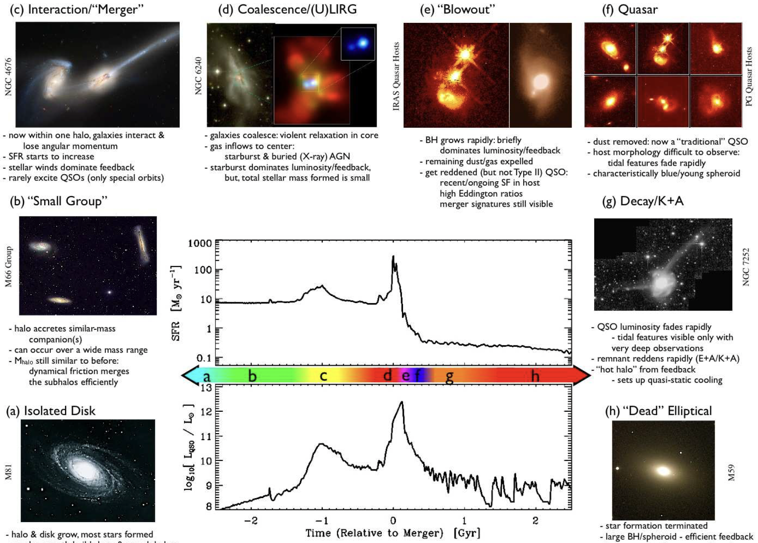
Introduction
Galaxies can grow their stellar mass by forming stars from cold gas
merging with other galaxies
Measuring merger rates is much more difficult
Vital to understand mass-buildup and role in
  – Morphological evolution (bulge formation)
  – Triggering star formation
  – LyC emission (S. Mascia, I. Kostyuk’s talk)
  – Triggering Ly-𝛼 emission (C. Witten’s talk)
  – Quenching star formation (later stage)
  – Correlation with SMBH mergers ➝ GW
Quantifying rate of occurrence
  ➝ merger rate
Hopkins+08
Dávid Puskás
Cosmic Dawn at High Latitudes, Stockholm – 27th June 2024
1

Slide 3
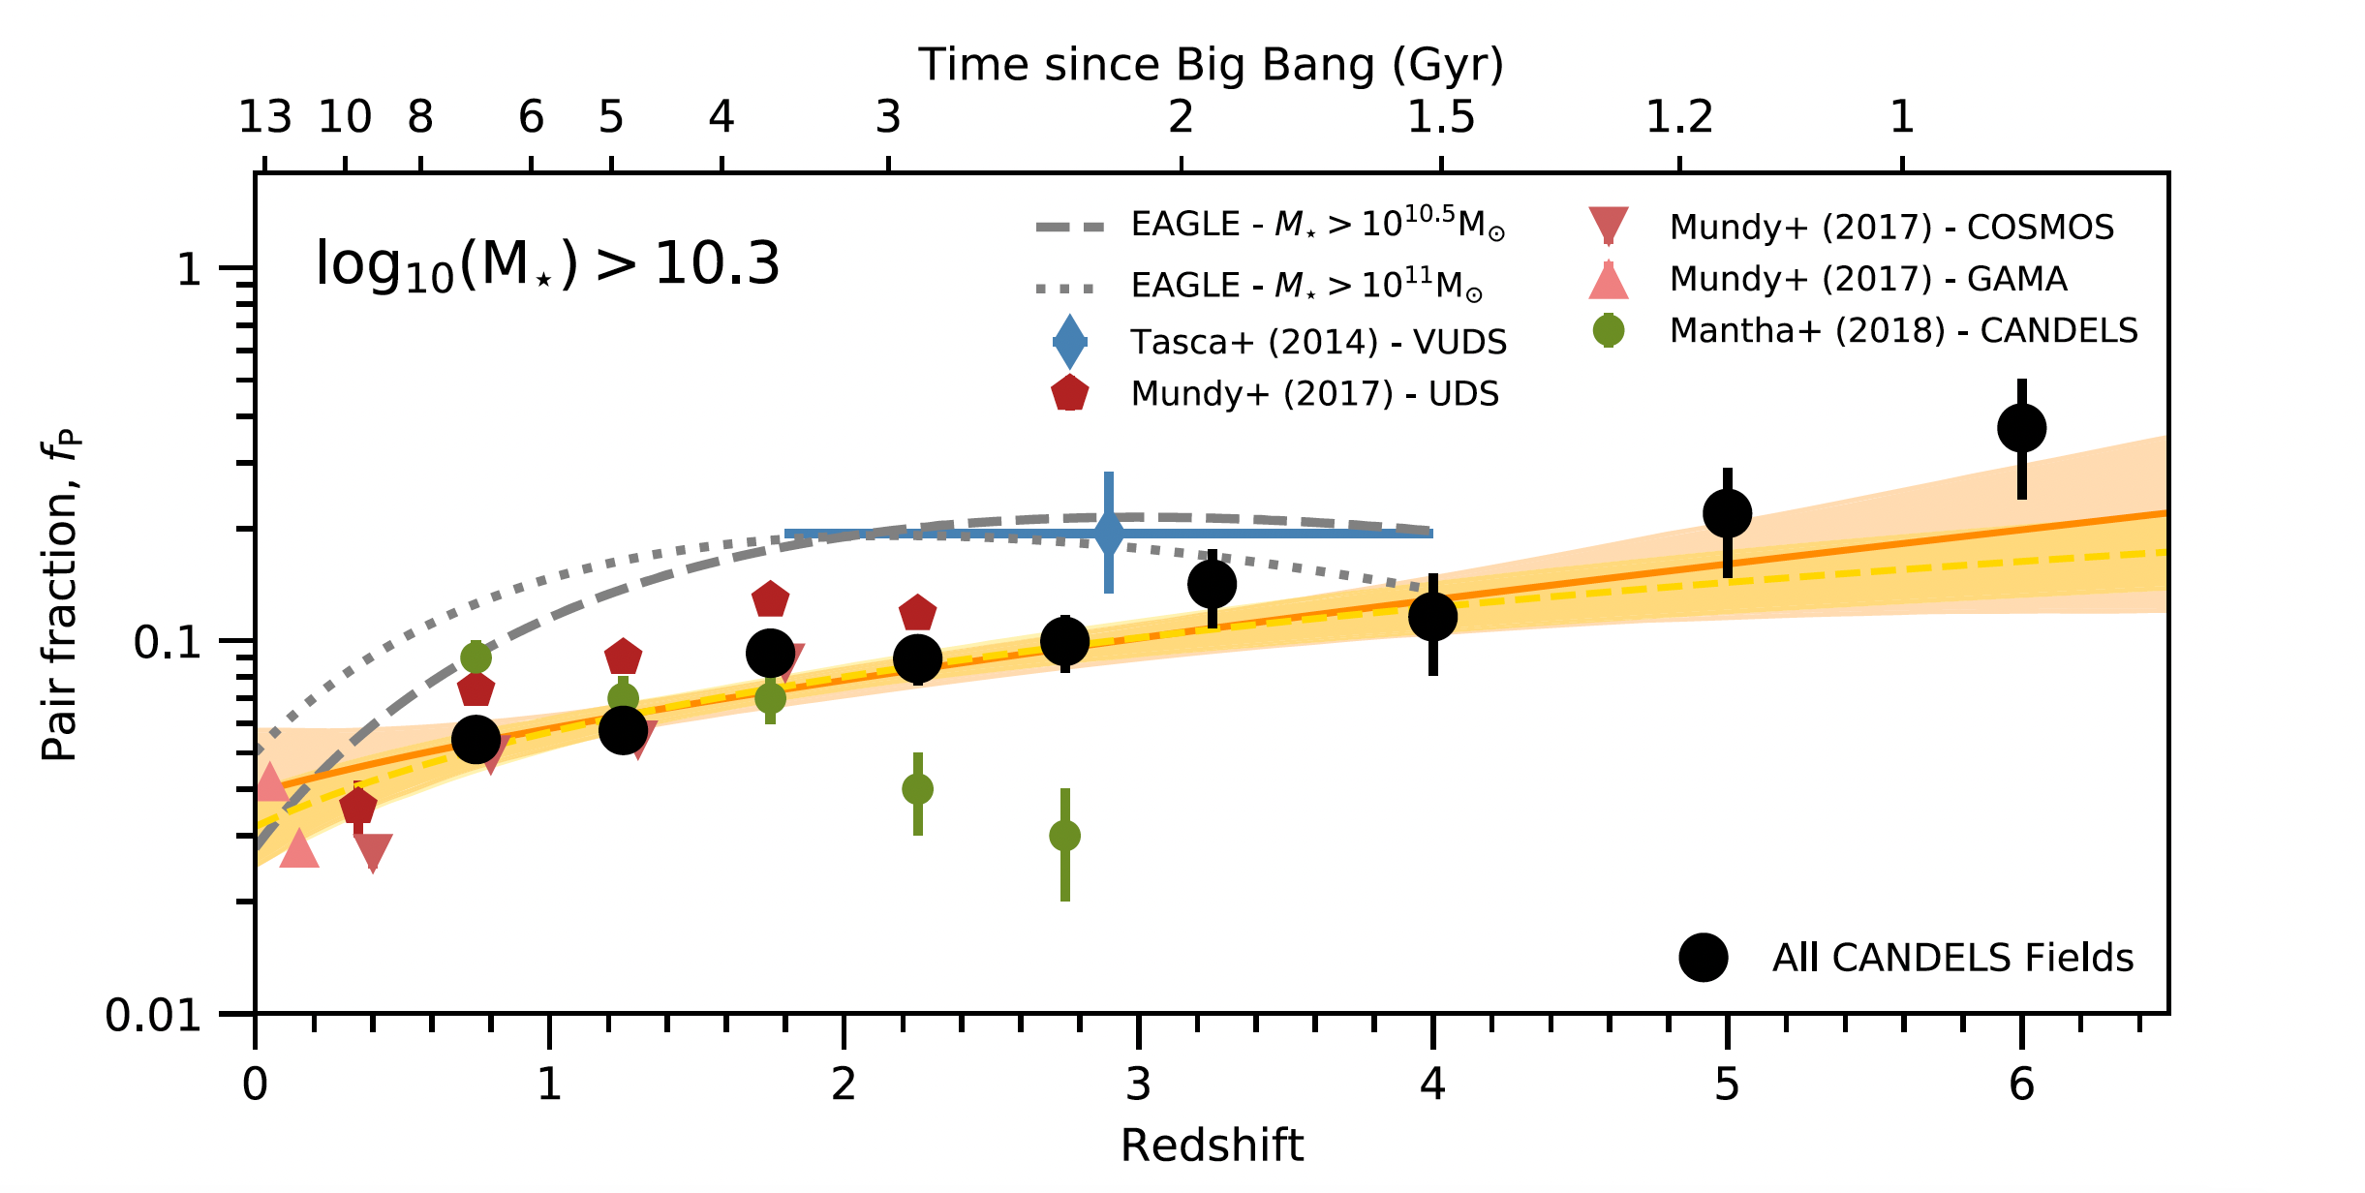
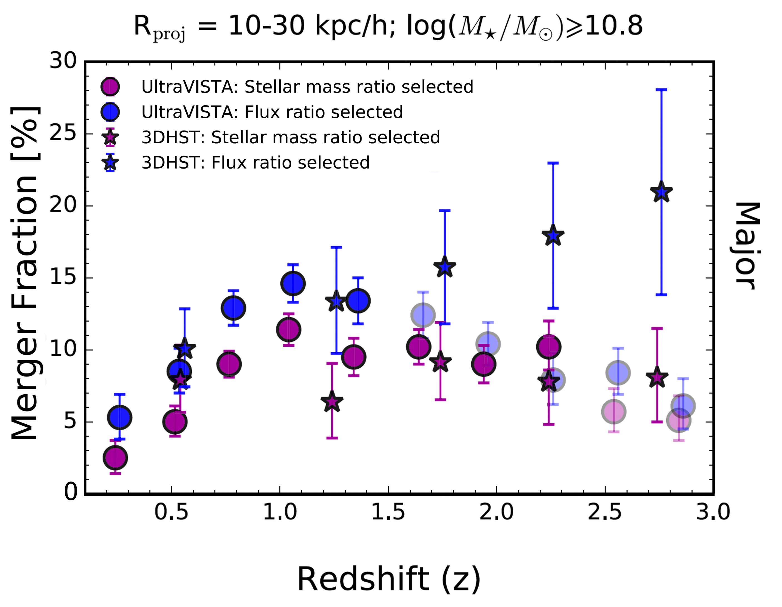


Pair fraction and merger rate
Major merger
Minor merger
Methods for studying mergers
  Counting close pairs
  Observing morphological disturbances
Close pair method
Simulations: major halo and galaxy merger rate increases with redshift (Fakhouri+10)
Previously: pair fractions up to z∼6 (Man+16, Mundy+17, Mantha+18, Duncan+19, Conselice+22)
$$μ=1:1−1:4$$
$$μ=1:4−1:10$$
Duncan+19
Man+16
Dávid Puskás
Cosmic Dawn at High Latitudes, Stockholm – 27th June 2024
2

Slide 4
Aims and objectives
Explore the galaxy major merger history at z ∼ 3 – 9 (most previous studies up to z ∼ 6)
Use JADES NIRCam data with unprecedented photometric depths (probing down to log M⋆∼7)
Focus on measuring the galaxy pair fraction (major mergers)
  ➝ apply probabilistic close-pair methodology
  ➝ construct a mass complete sample
  ➝ galaxies with major companions
Assuming a timescale
  ➝ Calculate merger rate
Determine their evolution with redshift
Dávid Puskás
Cosmic Dawn at High Latitudes, Stockholm – 27th June 2024
3

Slide 5

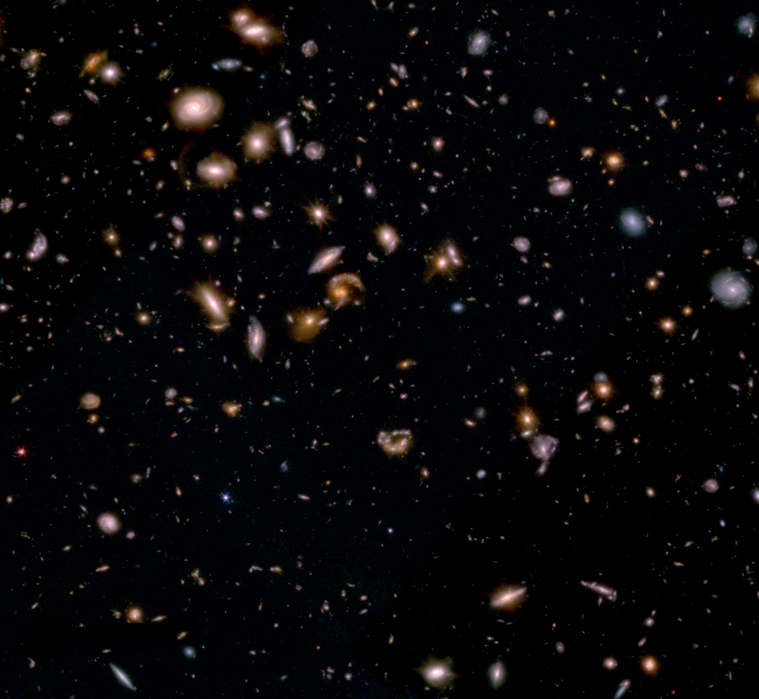
JADES Collaboration
JWST Advanced Deep Extragalactic Survey
Large GTO program – NIRCam, NIRSpec, MIRI
Largest deep survey program of JWST
Will ultimately cover over 100 arcmin²
Cycle 1: 770 hr in GOODS-South and GOODS-North
DR2 (Eisenstein+23) in October 2023
DR3 (d’Eugenio+24) in April 2024
300 000 sources, 5500 spectroscopic redshifts
https://jades-survey.github.io/viewer/
Dávid Puskás
Cosmic Dawn at High Latitudes, Stockholm – 27th June 2024
4

Slide 6
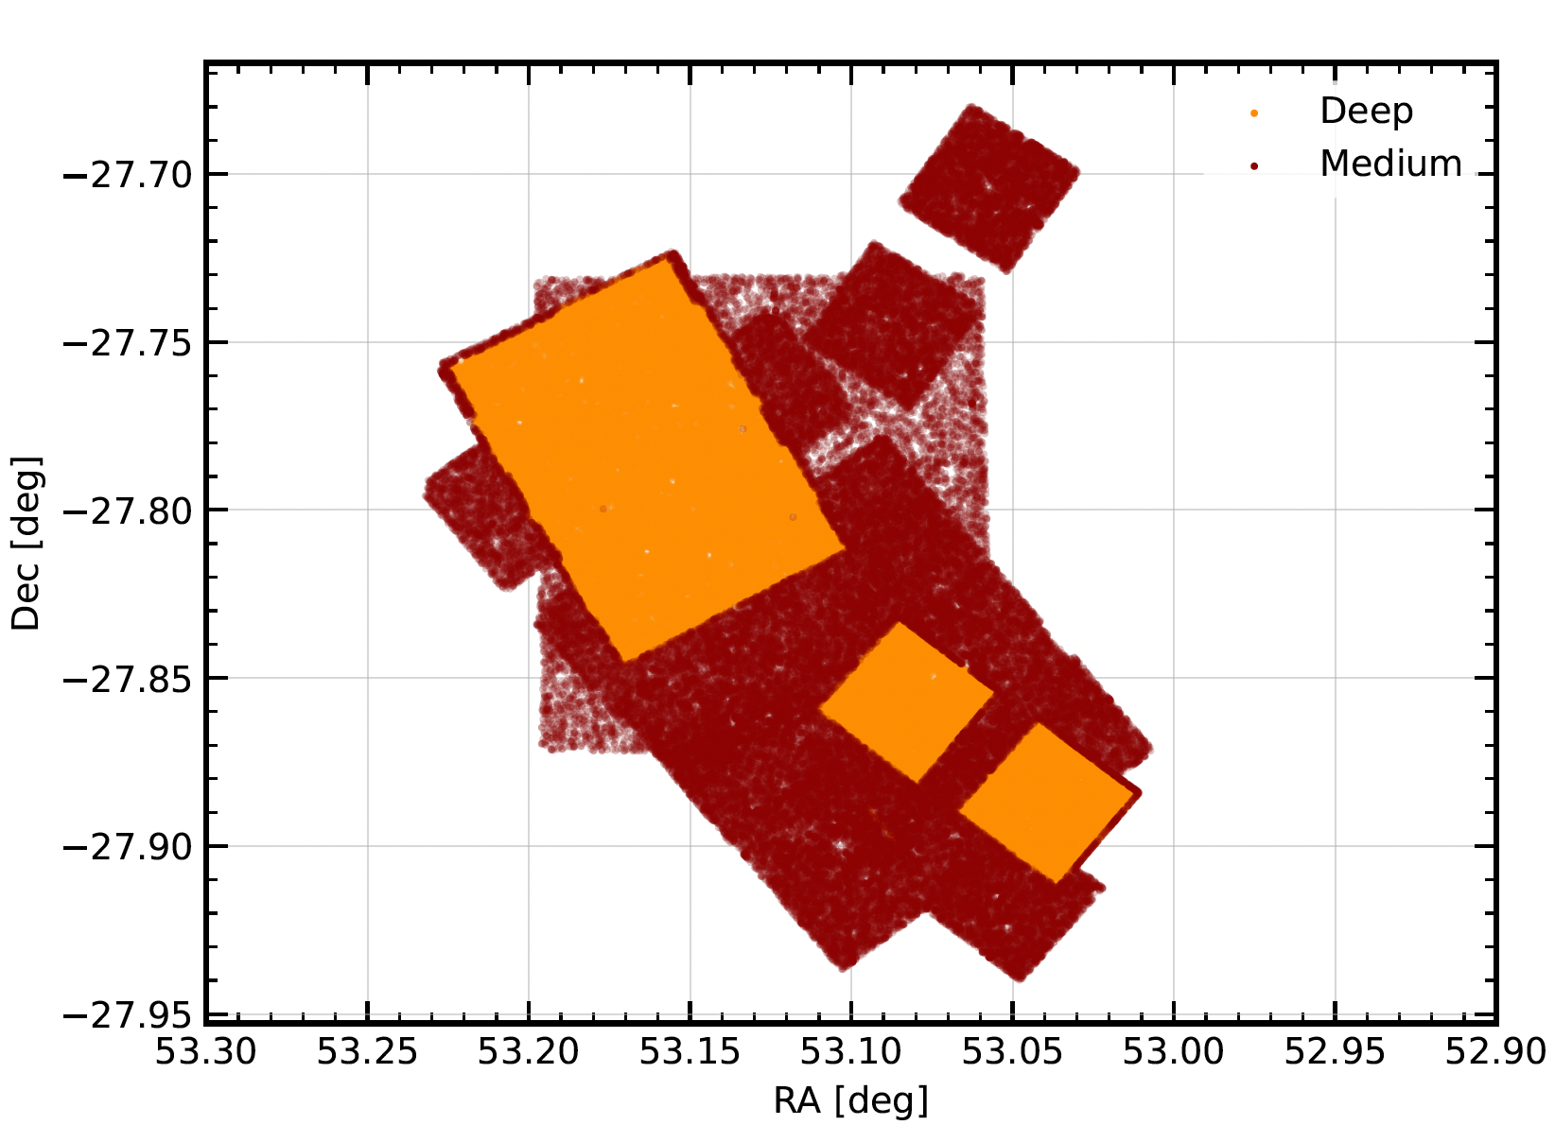
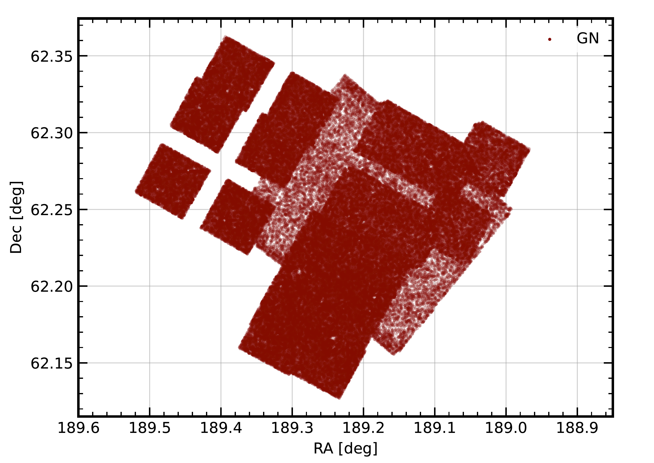
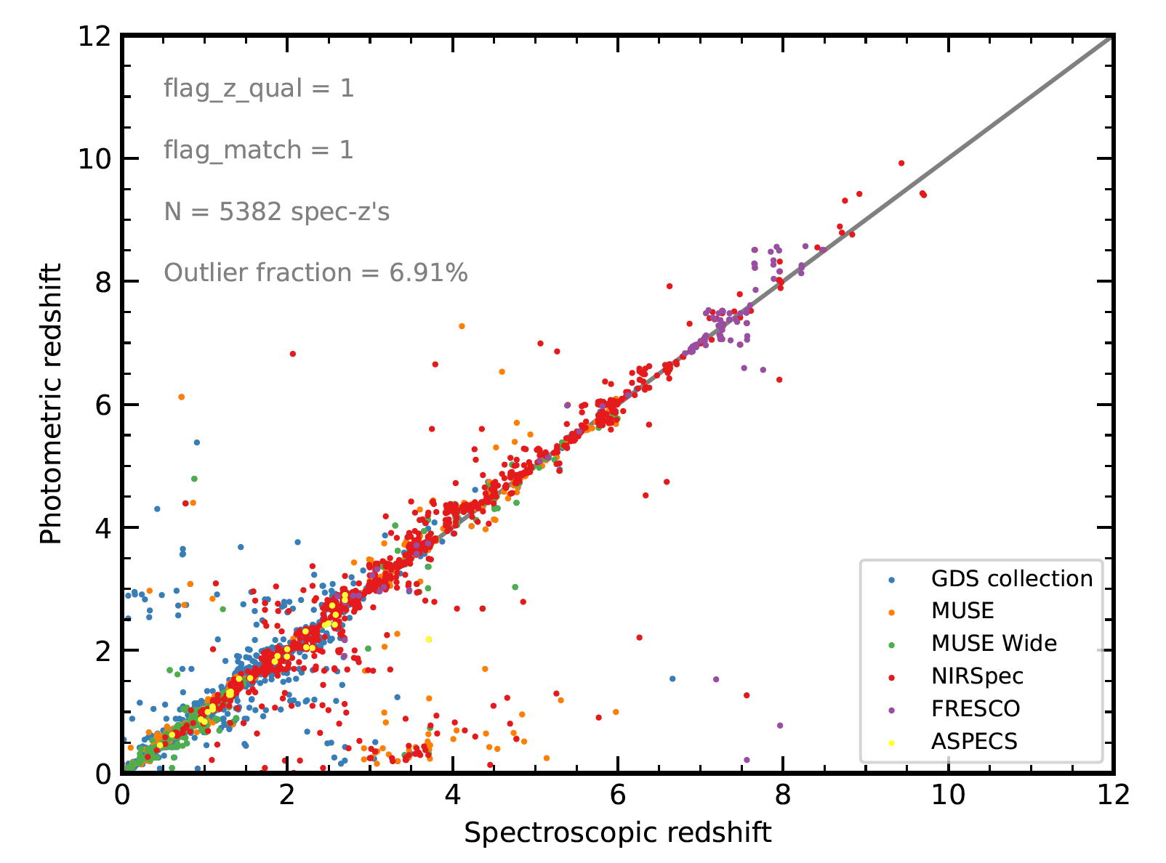
Data: GS-Deep, GS-Medium, GN
1. GOODS-South (Deep/Medium)
  – NIRCam, NIRSpec (Rieke+23, Bunker+23b)
  – HST Ultra Deep Field (Beckwith+06)
  – MUSE Ultra/Extremely Deep Field (Bacon+23)
  – FRESCO (Oesch+23)
  2. GOODS-North
Photometric redshifts: EAzY (Brammer+08)
– Bayesian approach posterior probability distribution
– Comparison with spectroscopic redshifts
Stellar masses: SED-fitting
– eazy-py: template fitting
– Prospector (Johnson+21): continuity SFH
Dávid Puskás
Cosmic Dawn at High Latitudes, Stockholm – 27th June 2024
5

Slide 7
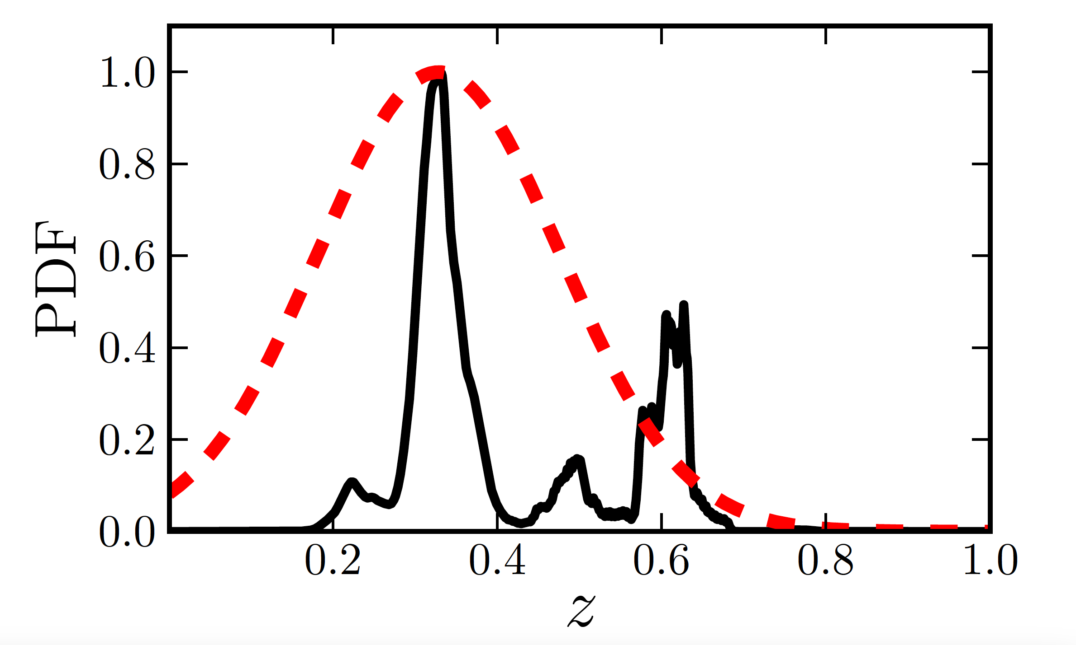
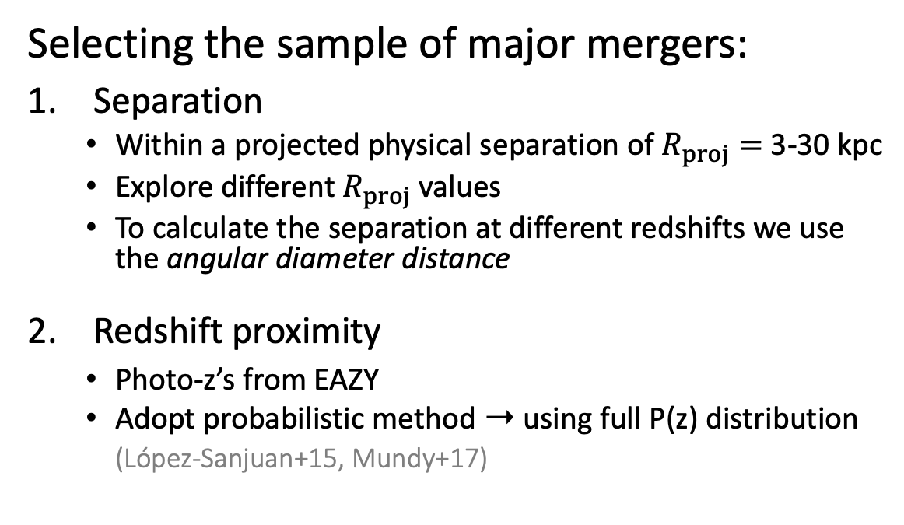
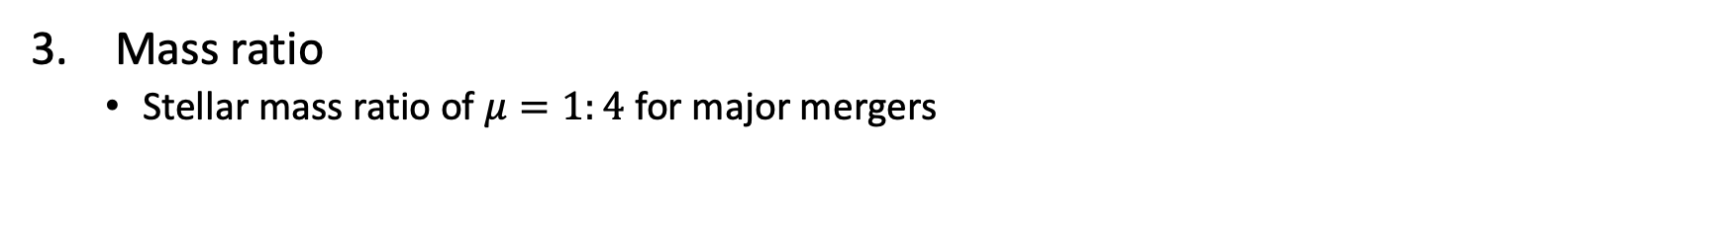
Method
Selecting the sample of major mergers:
Separation
  Within a projected physical separation of $R_{proj}=$ 3-30 kpc
  Explore different $R_{proj}$ values
  To calculate the separation at different redshifts we use the angular diameter distance
Redshift proximity
  Photo-z’s from EAZY
  Adopt probabilistic method ➝ using full P(z) distribution
  (López-Sanjuan+15, Mundy+17)
López-Sanjuan+15
Mass ratio
  Stellar mass ratio of $μ=1:4$ for major mergers
Dávid Puskás
Cosmic Dawn at High Latitudes, Stockholm – 27th June 2024
6

Slide 8
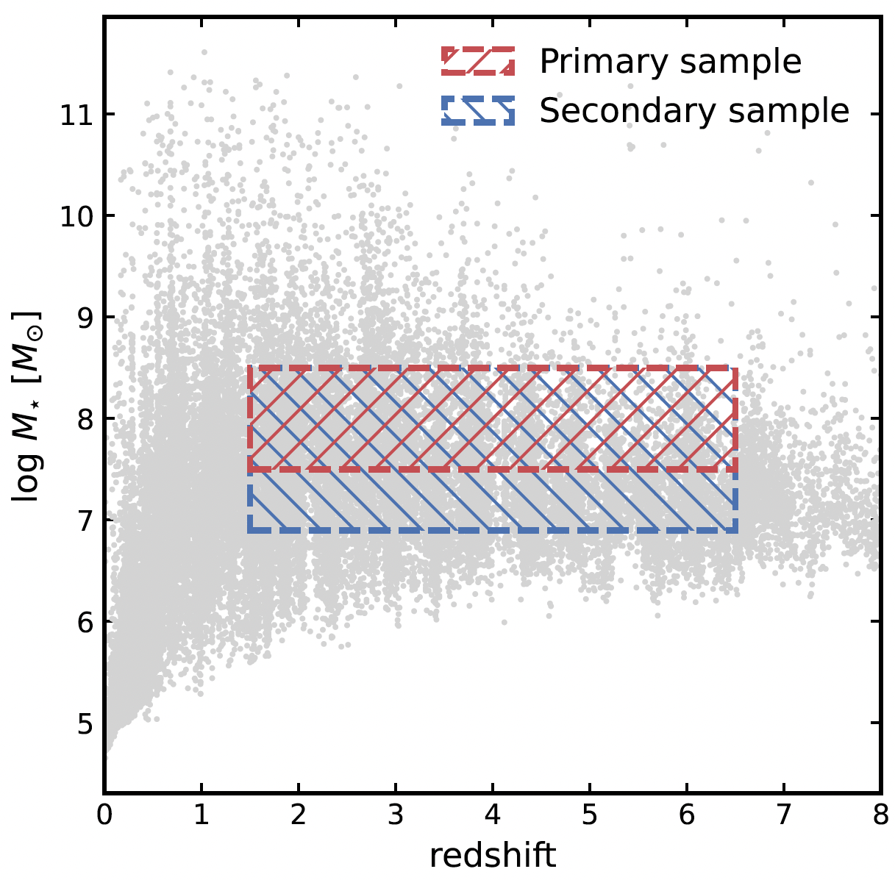
Steps of merger selection code
1. Select an initial primary sample by stellar mass criteria
Selecting a primary sample (massive galaxies) ➝ selection mask
Define constant stellar mass bins (M^{min}, M^{max})
Have to be above the mass completeness limit
2. Select a secondary sample of potential pairs
Selection mask for secondary sample of major/minor mergers (corresponding to the primary sample)
𝜇 is the mass ratio ➝ 1:4 for major mergers
Dávid Puskás
Cosmic Dawn at High Latitudes, Stockholm – 27th June 2024
7

Slide 9
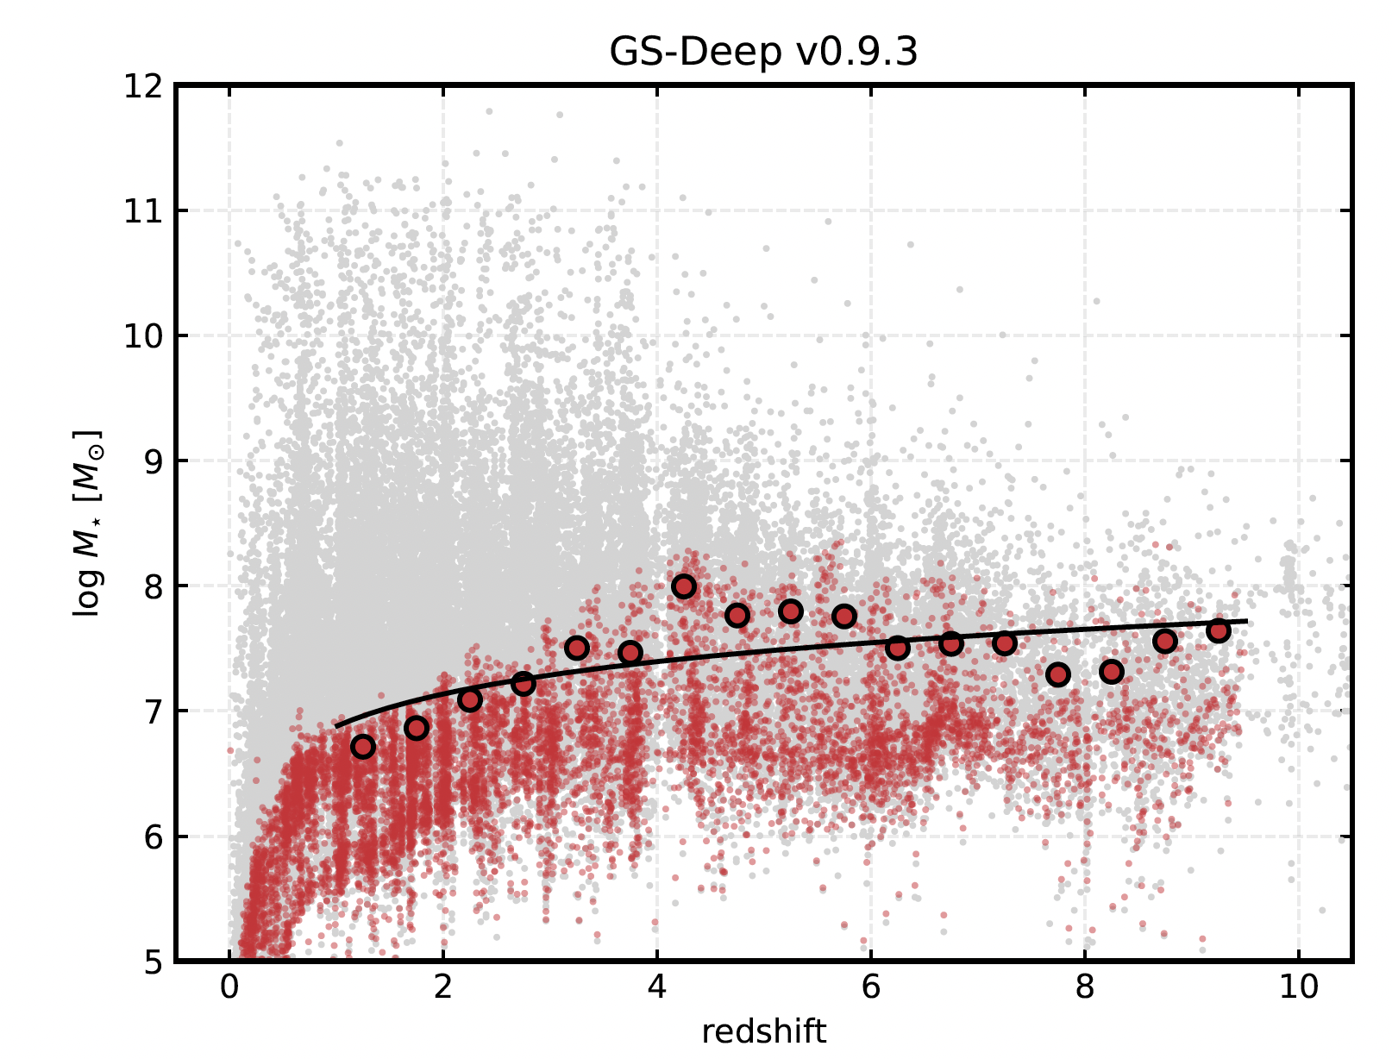
Stellar mass completeness
  Method by Pozetti et al. (2010)
  Estimate the 5𝜎 point-source flux limit from mosaic
  Calculate the 90% completeness limit
  Mass completeness limit: 7 < log M_{lim}/M⨀ < 8
  Depends on SNR cut and M⋆ used
Dávid Puskás
Cosmic Dawn at High Latitudes, Stockholm – 27th June 2024
8

Slide 10
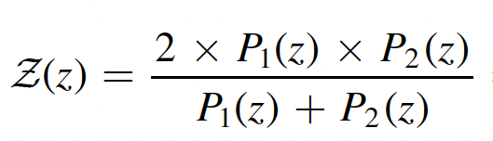
Steps of merger selection code
3. Angular proximity
Angular separation mask to select objects that are nearby on the plane of sky
Based on angular diameter distance ➝ redshift dependent mask
Current choice: r_{p}^{min} = 3 kpc and r_{p}^{max} = 30 kpc
4. Redshift probability function
Combined redshift probability function based on the photo-z posteriors P₁(z) and P₂(z) is given by:
Z(z) ➝ number of fractional close pairs at redshift z for the projected pair studied
Needs to be integrated between z_{min} and z_{max} to get a probability in a z bin
Dávid Puskás
Cosmic Dawn at High Latitudes, Stockholm – 27th June 2024
9

Slide 11
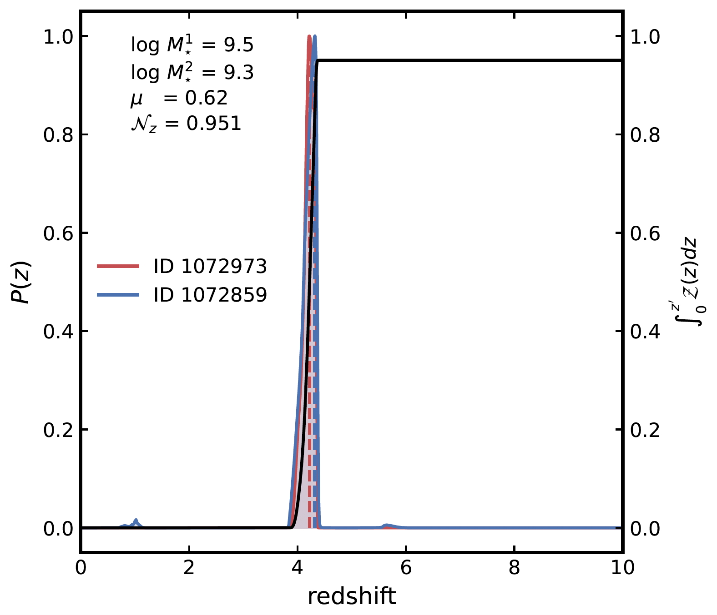
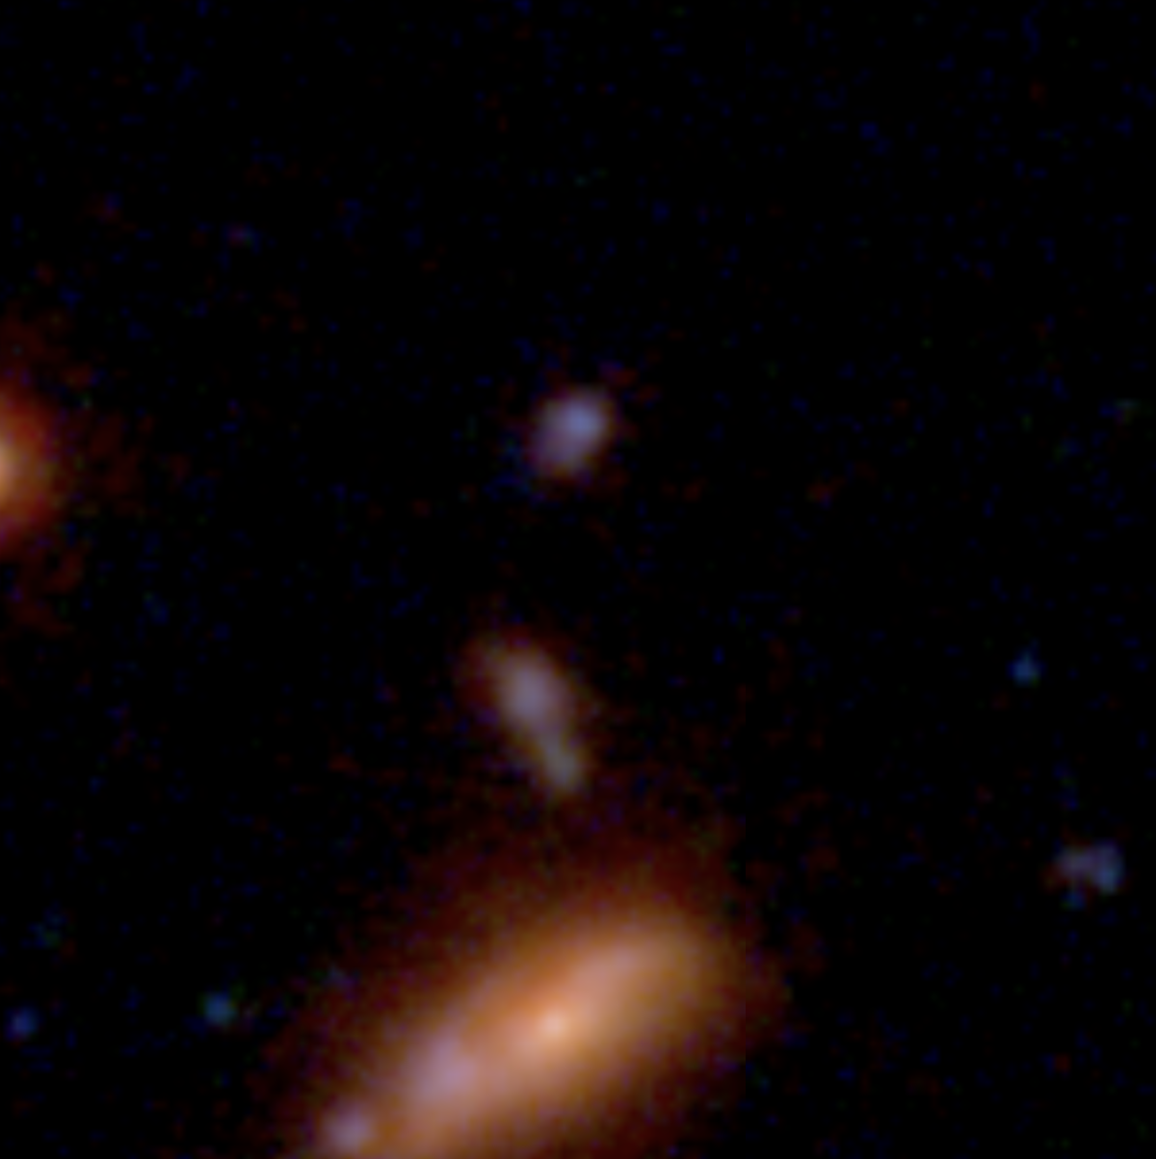
Examples
0.15"
Dávid Puskás
Cosmic Dawn at High Latitudes, Stockholm – 27th June 2024
10

Slide 12
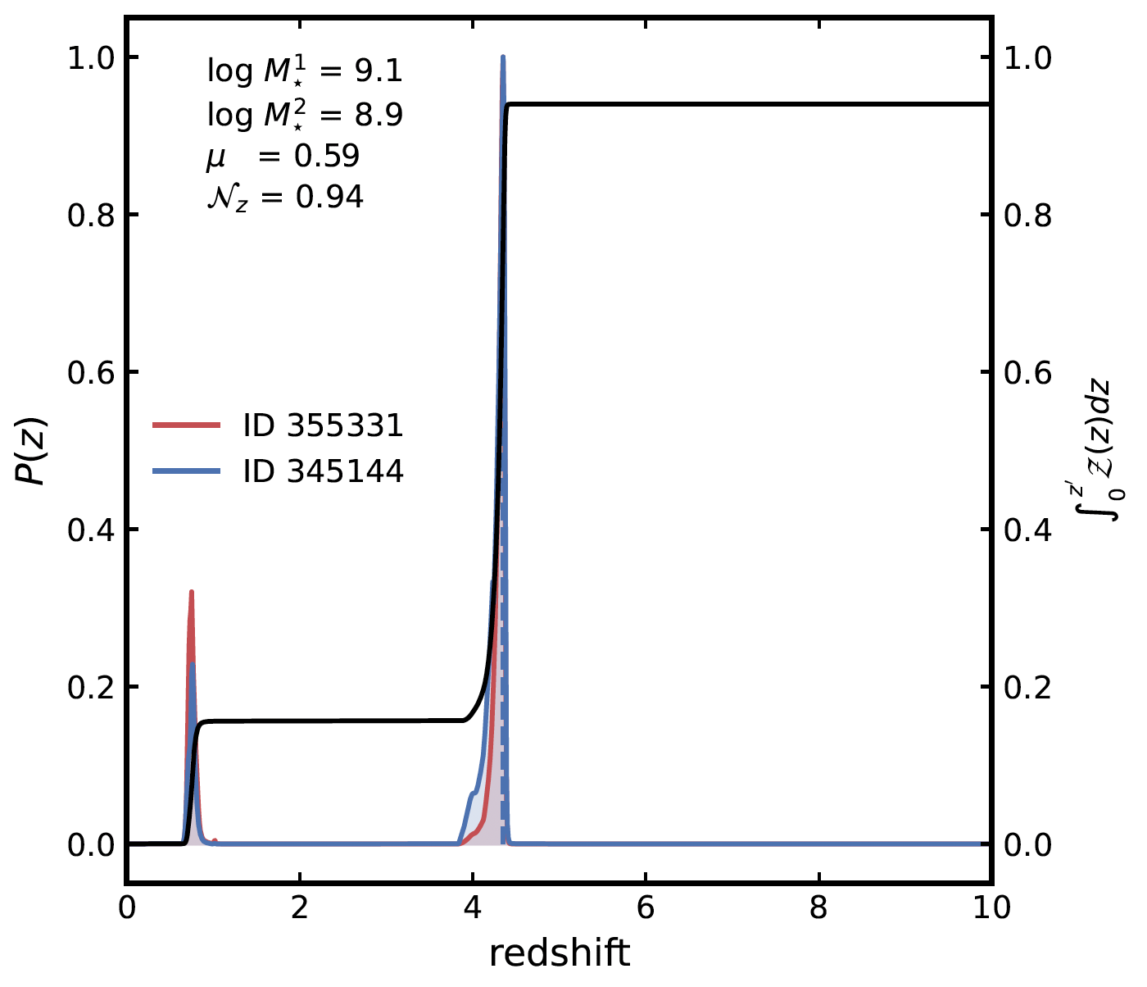
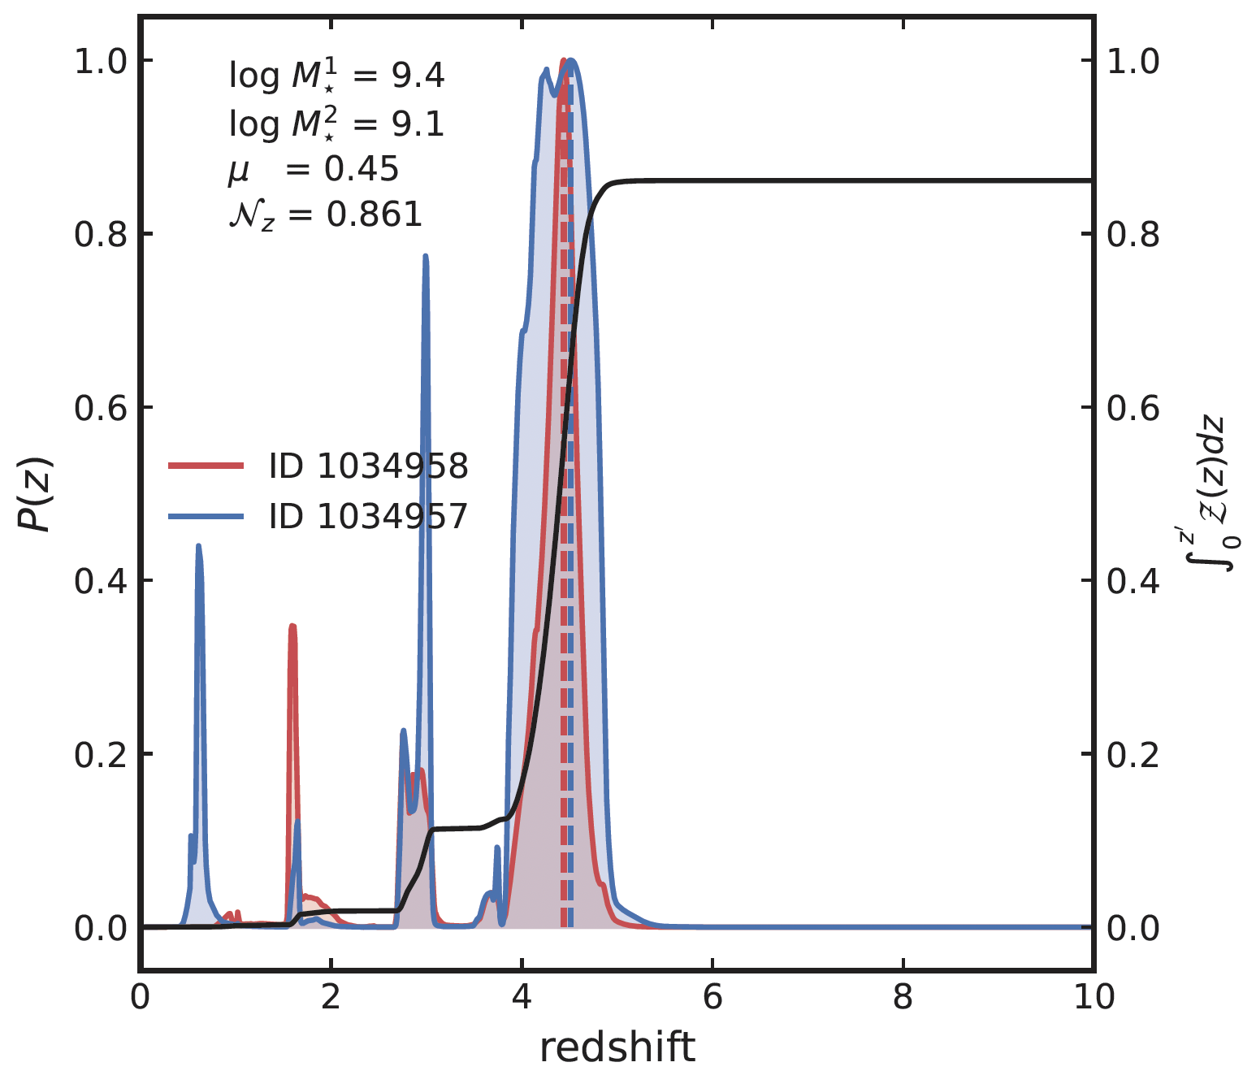
Examples
Dávid Puskás
Cosmic Dawn at High Latitudes, Stockholm – 27th June 2024
11

Slide 13

Steps of merger selection code
5. Pair probability function (PPF)
Combining the selection masks and the redshift probability function
Pair probability function for each potential companion around targets in the primary sample:
We need to evaluate this function for all potential pairs for some initially selected sample (objects around the primary sample satisfying mass and proximity criteria)
6. Additional weights
Account for photo-z quality, mass (in)completeness, and masked areas (galaxies near survey boundaries)
Dávid Puskás
Cosmic Dawn at High Latitudes, Stockholm – 27th June 2024
12

Slide 14
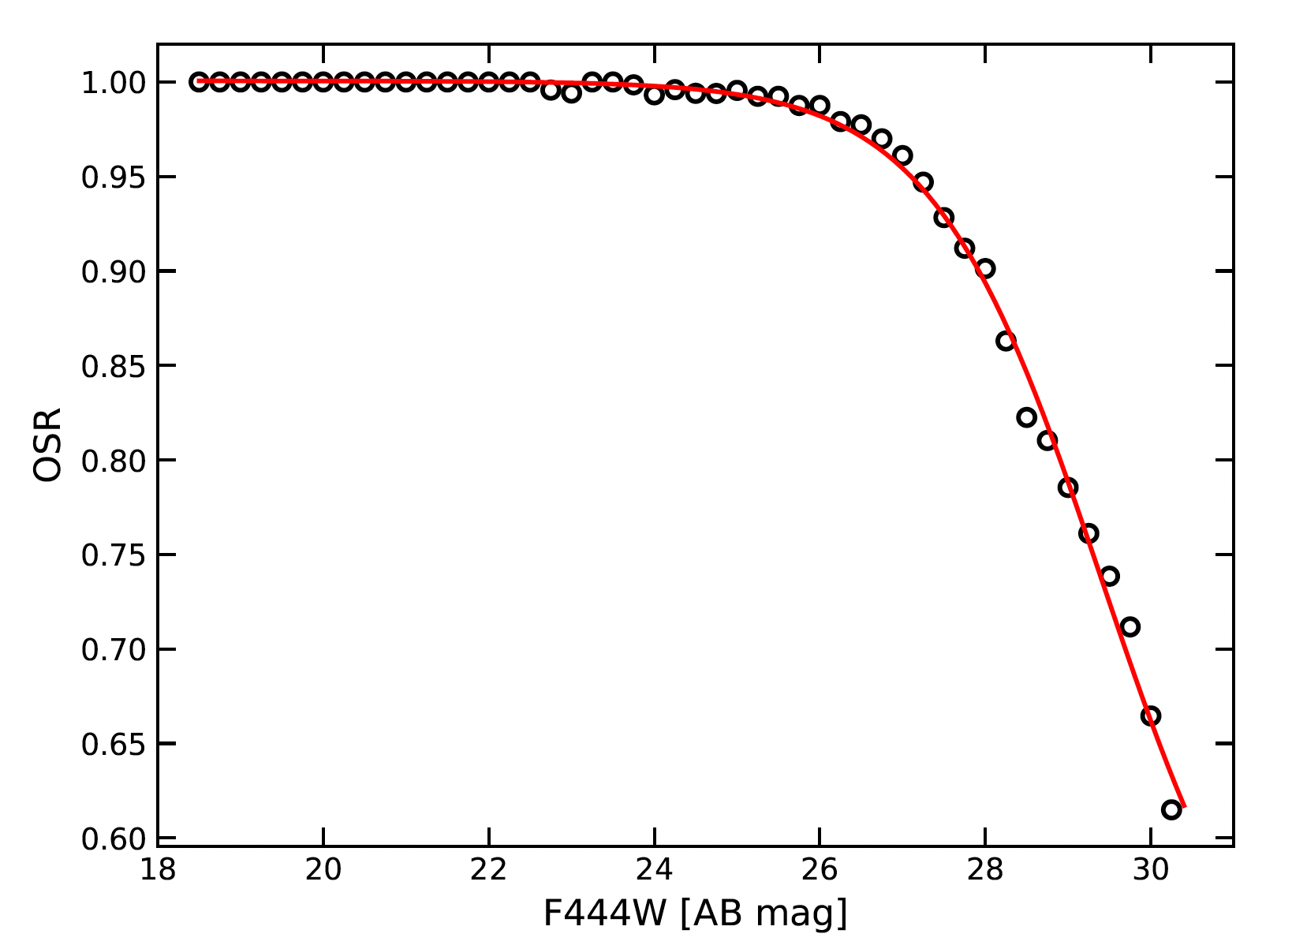
Odds sampling rate (OSR)
  a) Photometric redshift quality
  Odds quality parameter (O):
  ➝ proxy for photo-z accuracy
  ➝ related with the confidence of z_{peak}
  Derive high quality samples with better accuracy
  The OSR is defined as the ratio of galaxies with O>0.3 with respect to the total number of galaxies
The interpolated curve ➝ OSR(m) for each galaxy
Dávid Puskás
Cosmic Dawn at High Latitudes, Stockholm – 27th June 2024
13

Slide 15
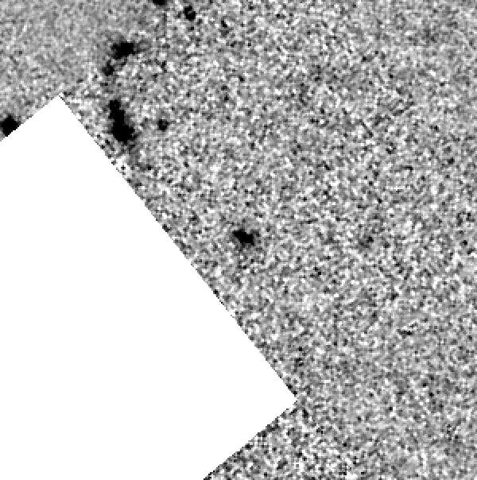
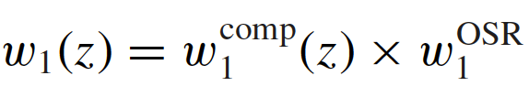
Mass completeness and area weights
  b) Stellar mass incompleteness
  Account for potentially missing galaxies due to closeness to mass completeness limit
  ➝ Mass completeness weight for the primary/secondary galaxy
  c) Area weight
  Accounting for missing area at boundaries
  Combined total weights
0.3"
Dávid Puskás
Cosmic Dawn at High Latitudes, Stockholm – 27th June 2024
14

Slide 16
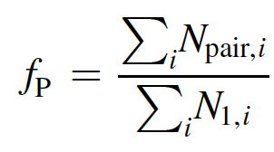
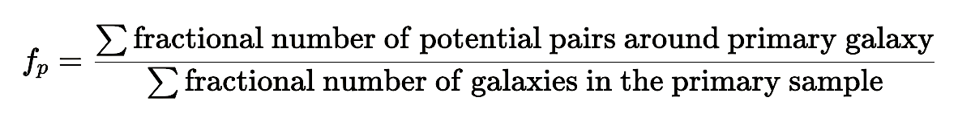
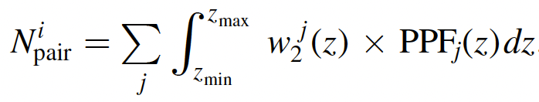
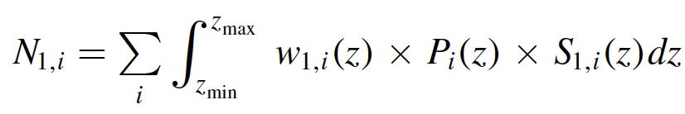
Steps of merger selection code
7. Final integrated pair fractions
Total integrated pair fraction for a given photo-z bin (with bounds at z_{min} and z_{max})
For each galaxy i in the primary sample, the (fractional) number of associated pairs is given by:
The corresponding primary galaxy contribution (weighted) is:
or
Dávid Puskás
Cosmic Dawn at High Latitudes, Stockholm – 27th June 2024
15

Slide 17
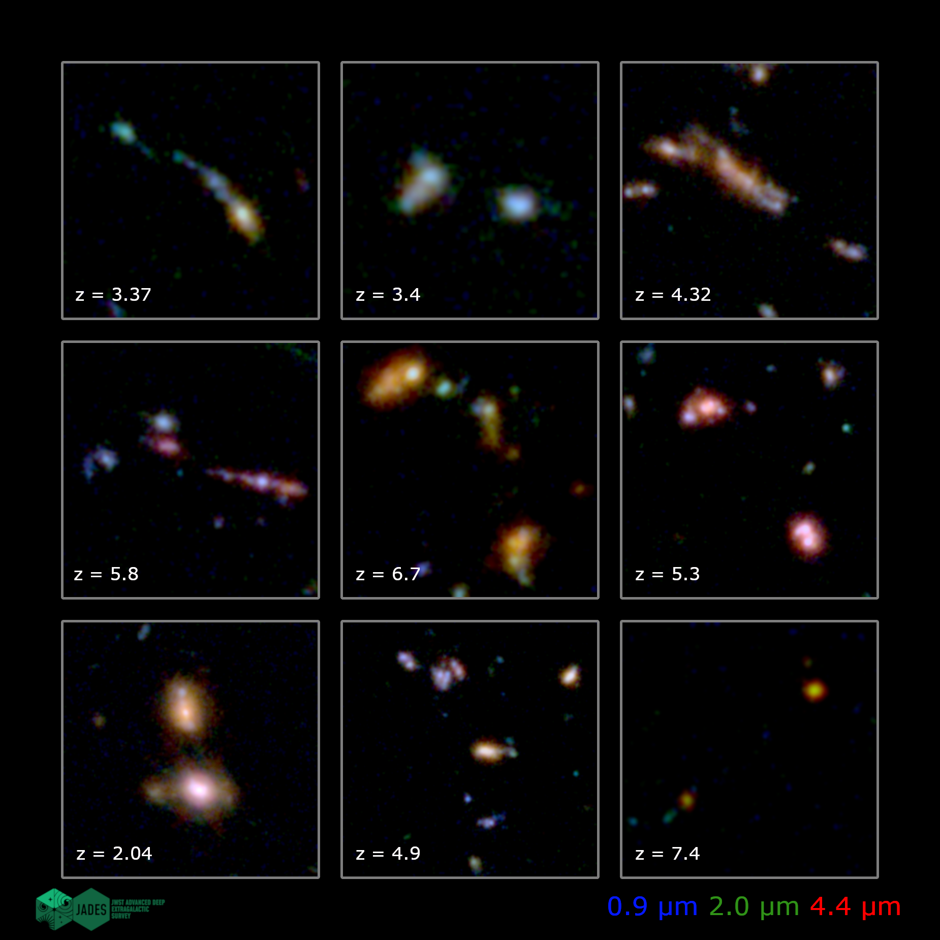
Dávid Puskás
16

Slide 18
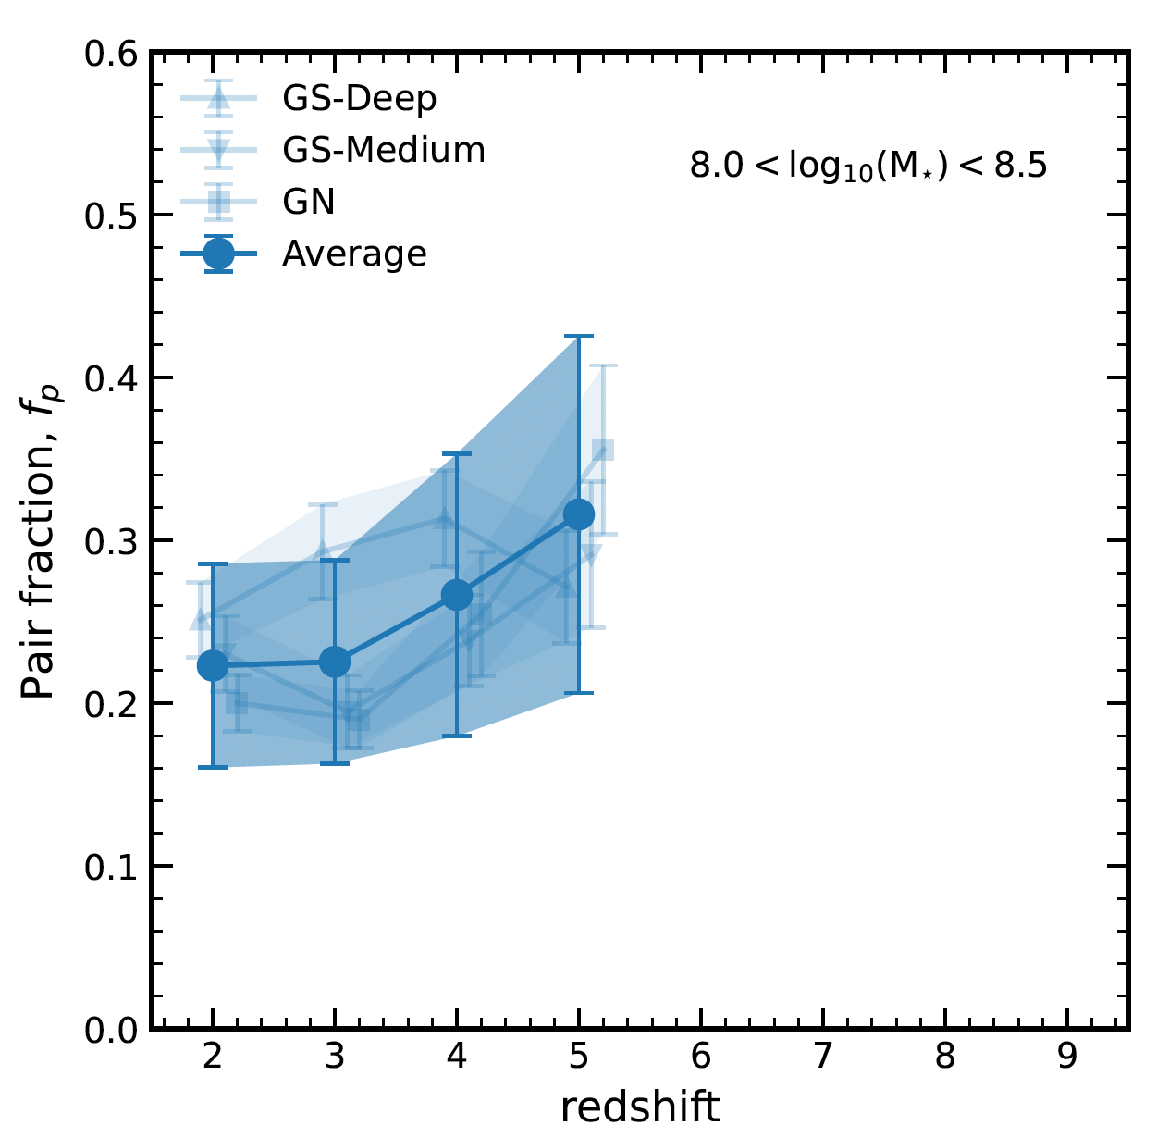
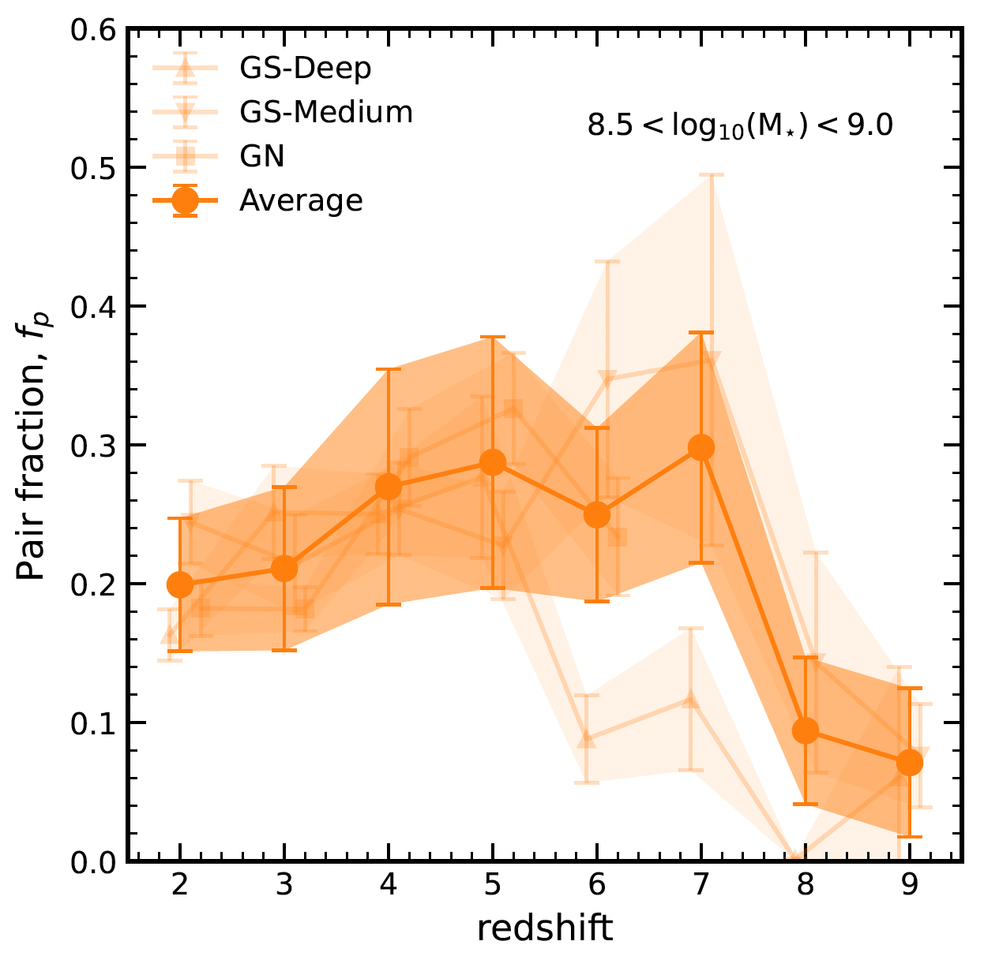
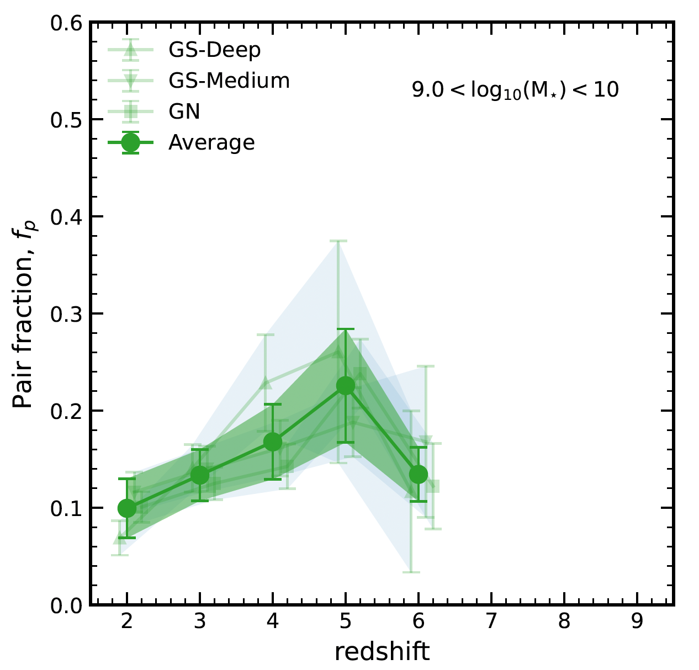
Pair fractions
Estimating errors: bootstrapping method (random sampling with replacement)
Standard error of N independent realisations (50 resamples)
Three different tiers: GS-Deep, GS-Medium, GN ➝ Average
Dávid Puskás
Cosmic Dawn at High Latitudes, Stockholm – 27th June 2024
17

Slide 19
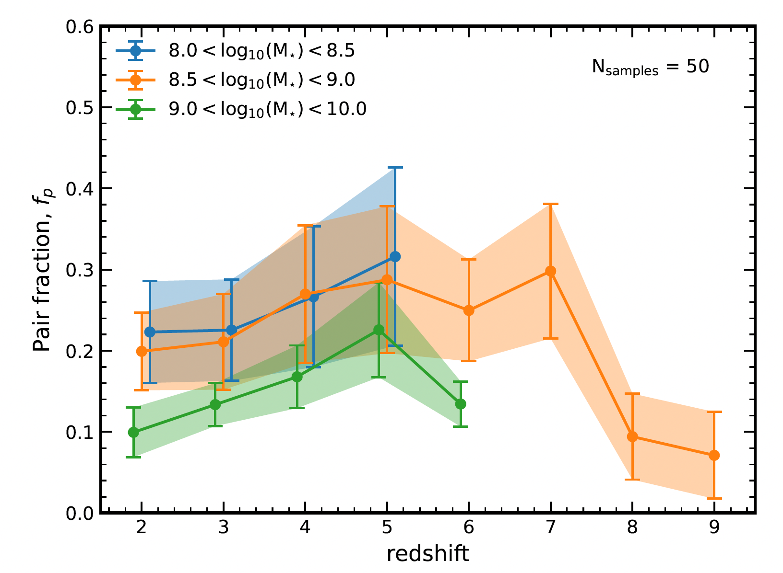
Pair fractions
Increasing pair fractions up to z ∼ 5
Flattening/turnover beyond z ∼ 5
Incompleteness might still affect results close to the limit (especially in the low M⋆ bin)
Good agreement with literature values, but hard to compare due to differing bins and methods
Dávid Puskás
Cosmic Dawn at High Latitudes, Stockholm – 27th June 2024
18

Slide 20
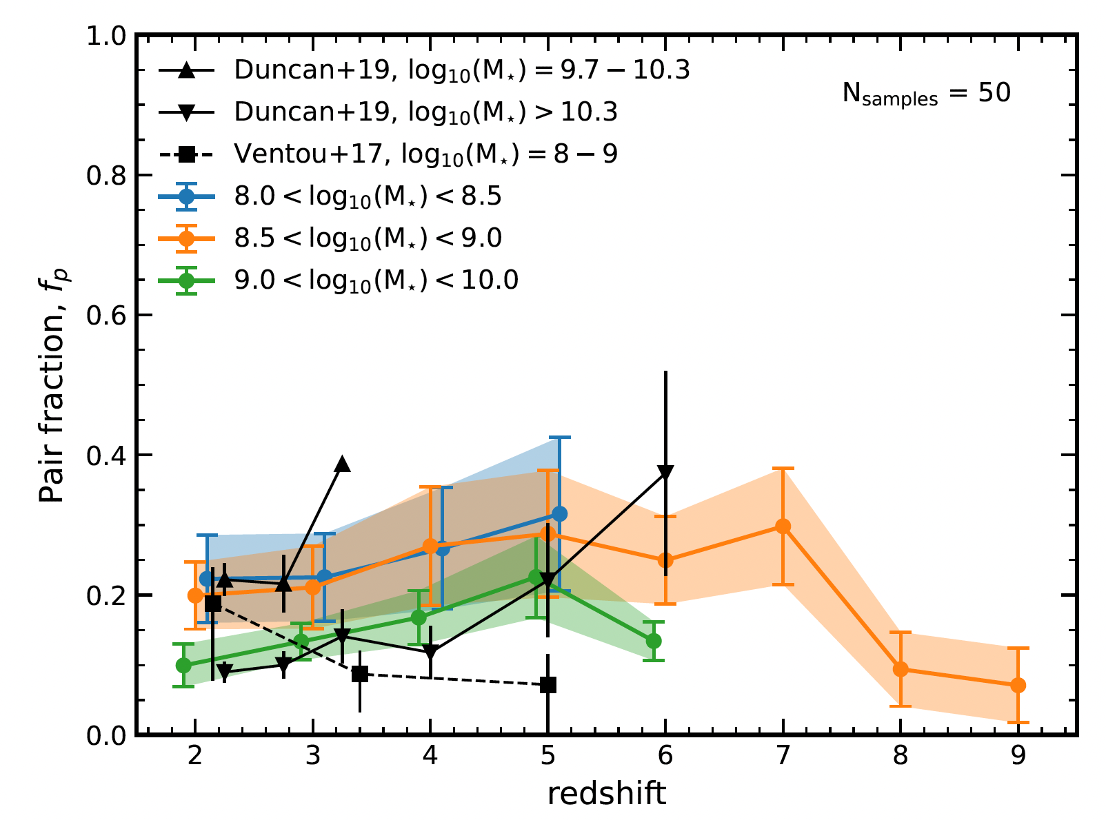
Pair fractions
Increasing pair fractions up to z ∼ 5
Flattening/turnover beyond z ∼ 5
Incompleteness might still affect results close to the limit (especially in the low M⋆ bin)
Good agreement with literature values, but hard to compare due to differing bins and methods
Dávid Puskás
Cosmic Dawn at High Latitudes, Stockholm – 27th June 2024
18

Slide 21
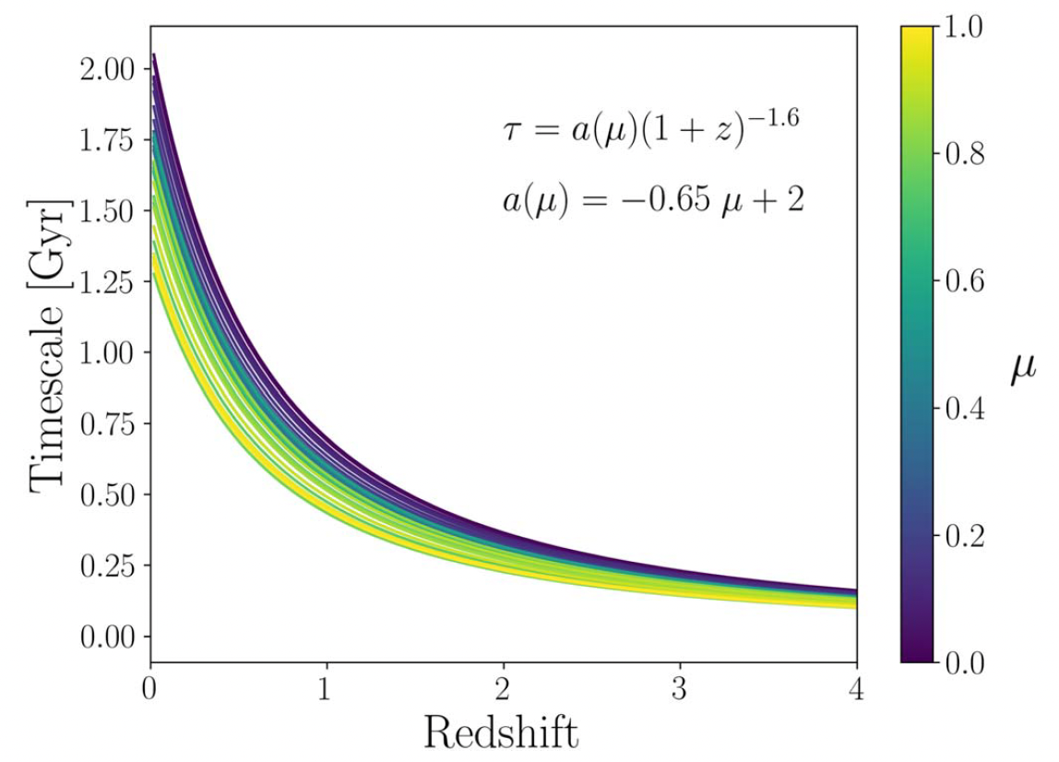
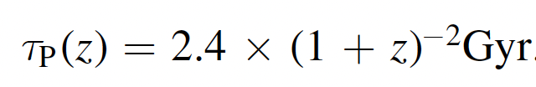

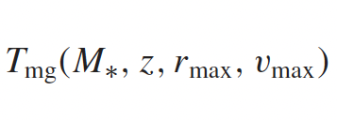

Merger timescales
To convert the pair fractions to merger rates we need to assume a timescale
  Simple version based on the Hubble time:
  $$0.1t_{H}(z)$$
Snyder et al. (2017)
Conselice et al. (2022): power law depending on 𝜇
  Husko et al. (2022): Planck Millennium simulation
Conselice + 22
Dávid Puskás
Cosmic Dawn at High Latitudes, Stockholm – 27th June 2024
19

Slide 22
Merger timescales
To convert the pair fractions to merger rates we need to assume a timescale
  Simple version based on the Hubble time:
  $$0.1t_{H}(z)$$
Snyder et al. (2017)
Conselice et al. (2022): power law depending on 𝜇
  Husko et al. (2022): Planck Millennium simulation
Conselice + 22
Dávid Puskás
Cosmic Dawn at High Latitudes, Stockholm – 27th June 2024
19

Slide 23
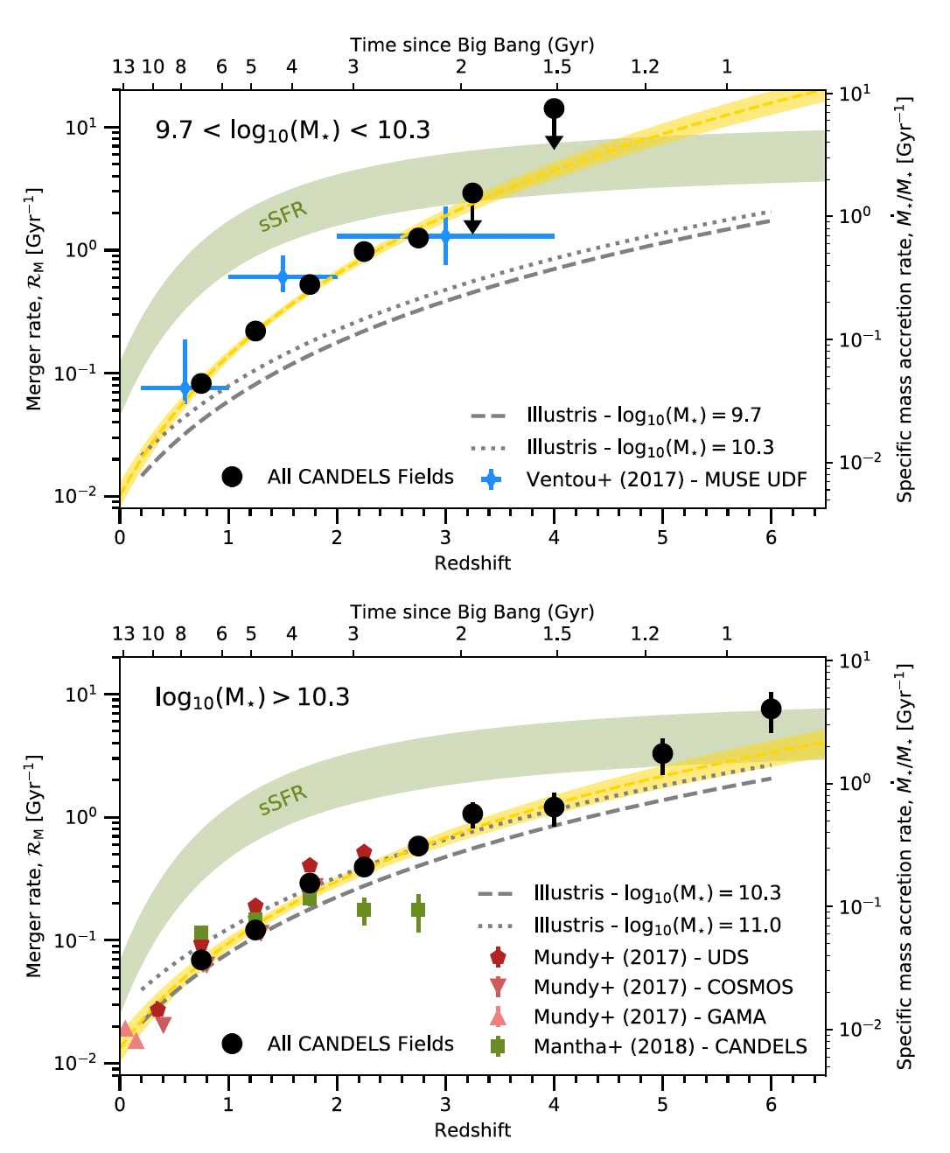
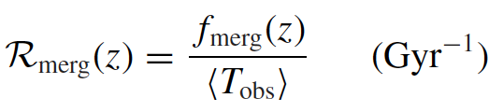
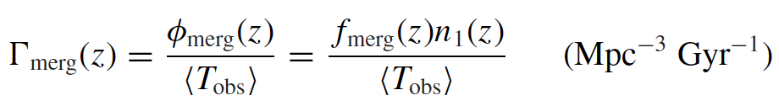
Merger rate and merger rate density
The merger rate per (massive) galaxy is defined as:
The merger rate density is defined as:
Simulations: major halo-halo and galaxy-galaxy merger rate increases with redshift (Fakhouri+10)
Duncan+19
Dávid Puskás
Cosmic Dawn at High Latitudes, Stockholm – 27th June 2024
20

Slide 24
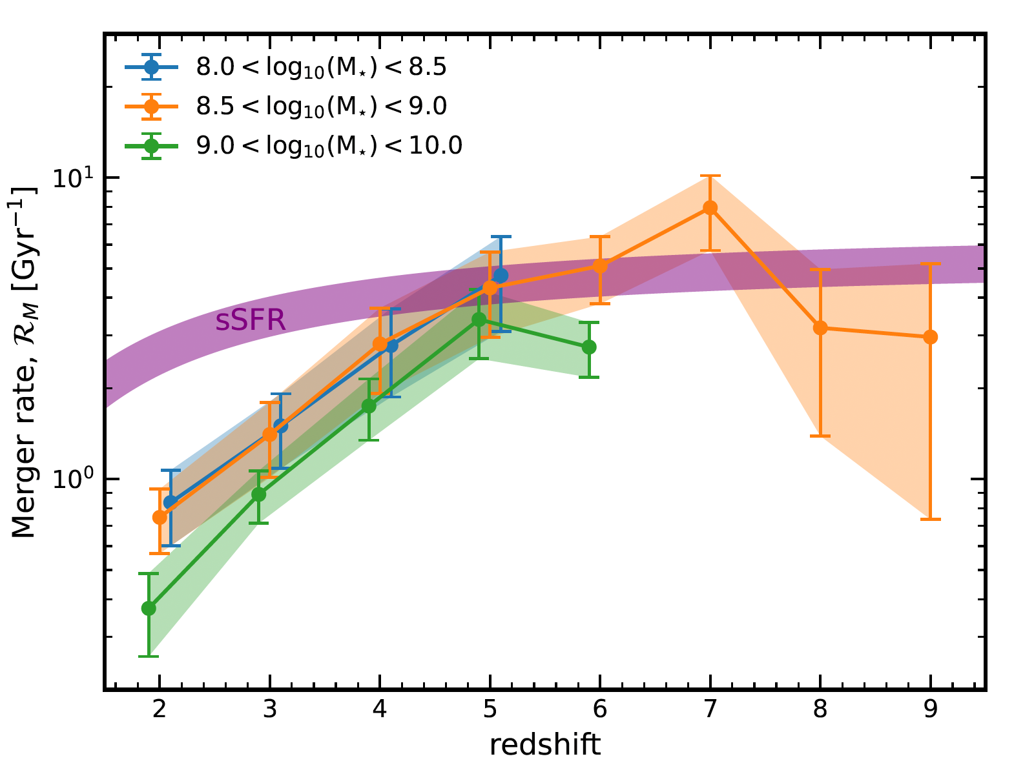
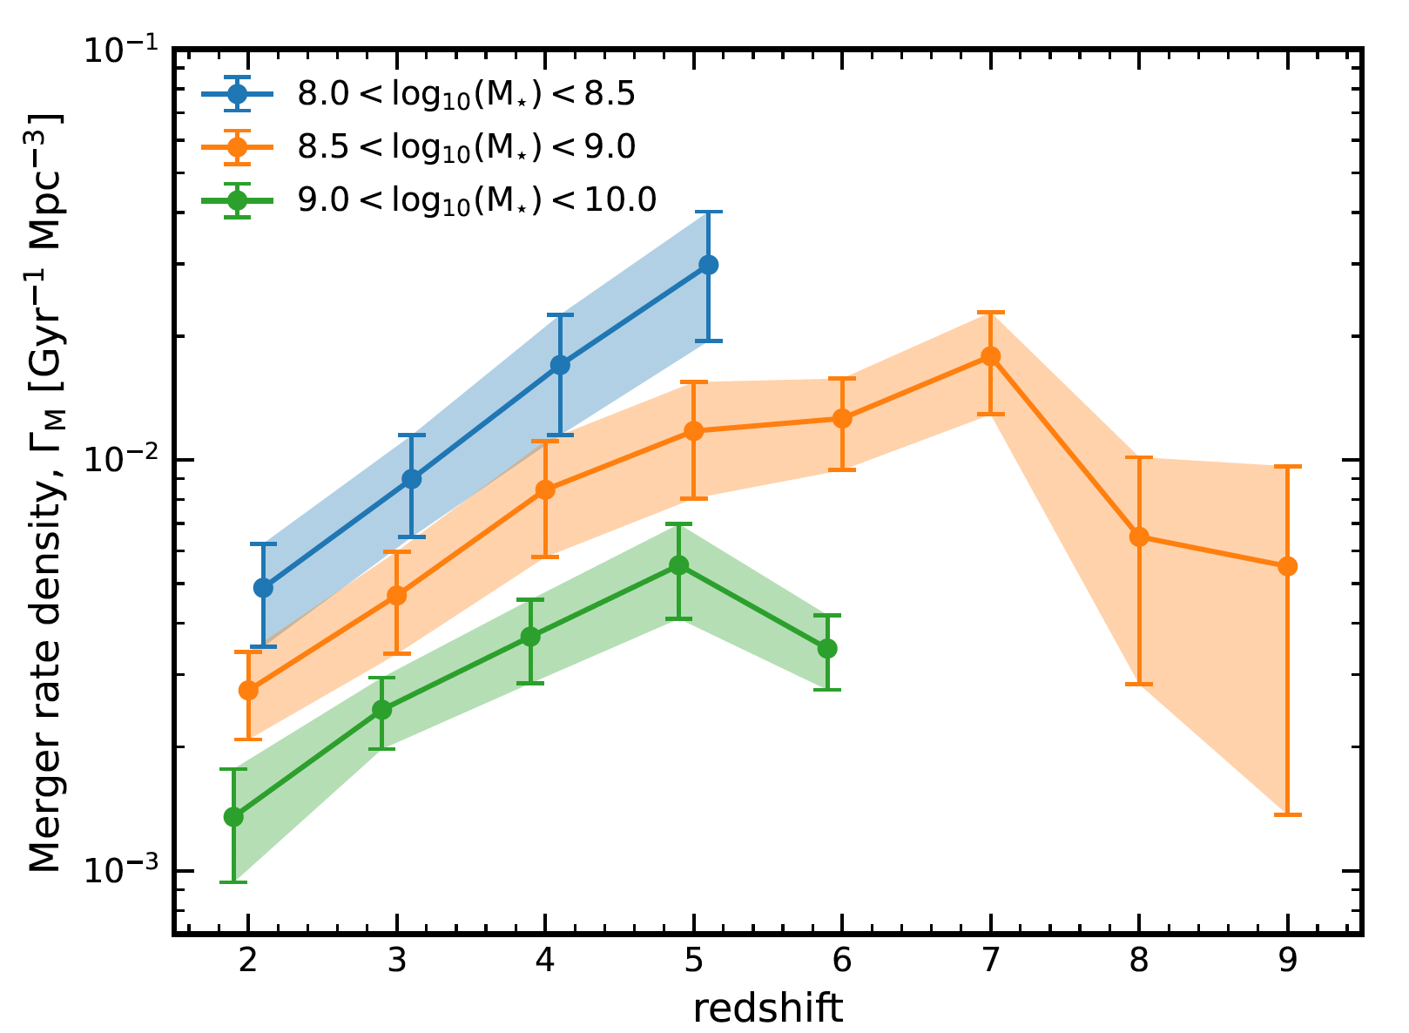
Merger rate and merger rate density
Dávid Puskás
Cosmic Dawn at High Latitudes, Stockholm – 27th June 2024
21

Slide 25
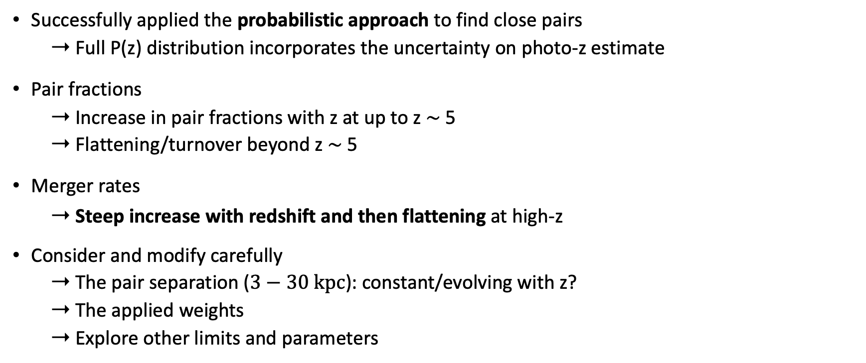
Summary and further work
Successfully applied the probabilistic approach to find close pairs
  ➝ Full P(z) distribution incorporates the uncertainty on photo-z estimate
Pair fractions
  ➝ Increase in pair fractions with z at up to z ∼ 5
  ➝ Flattening/turnover beyond z ∼ 5
Merger rates
  ➝ Steep increase with redshift and then flattening at high-z
Consider and modify carefully
  ➝ The pair separation ($3−30 kpc$): constant/evolving with z?
  ➝ The applied weights
  ➝ Explore other limits and parameters
Dávid Puskás
Cosmic Dawn at High Latitudes, Stockholm – 27th June 2024
22

