Slide 1
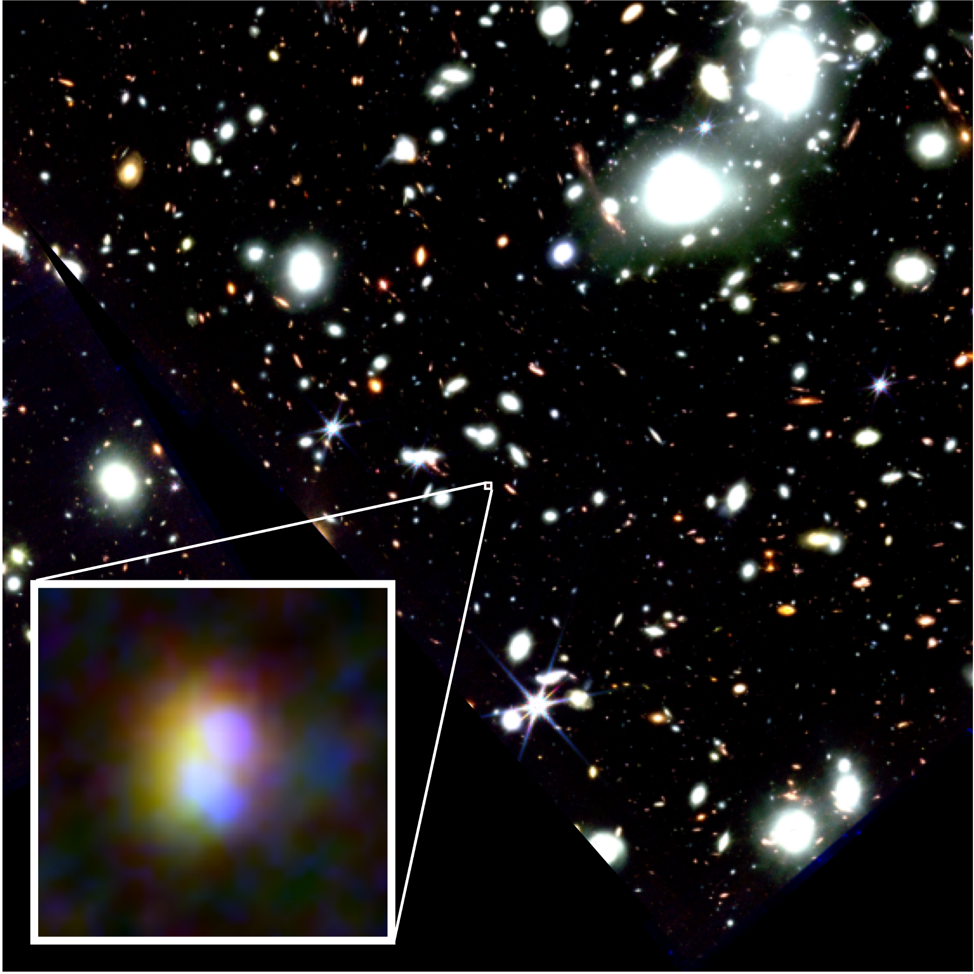
Nitrogen-Rich, Dense, and
Highly-Ionized Gas in z>6 Galaxies
Yuki Isobe
JSPS Fellow
Waseda /
Cambridge from Sep.
Collaborator:
M. Ouchi, N. Tominaga, K. Watanabe, K. Nakajima,
H. Umeda, H. Yajima, Y. Harikane, H. Fukushima, Y. Xu, Y. Ono, Y. Zhang
NASA, ESA, CSA, Isobe et al.
Notes:
JSPS Fellow based in Waseda University and also in Cambridge from Sep
Today I‘d like to talk about our recent JWST studies on chemical abundances and electron densities of high-z galaxies.

Slide 2
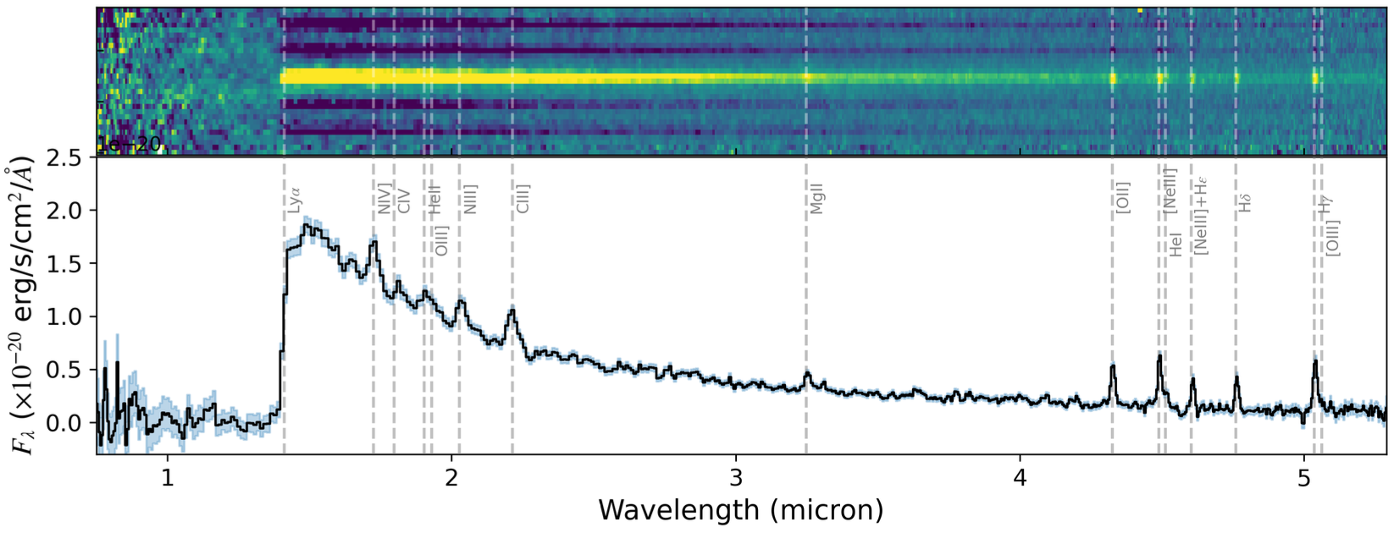
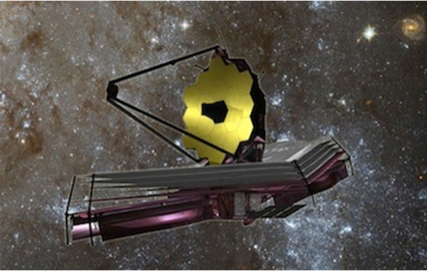
Star Formation in the Early Universe
JWST
GN-z11
©︎NASA/ESA/CSA
Bunker+23
Notes:
You know, JWST has opened a new window on high-z galaxies.
It was sensational that we saw this beautiful spectrum of GN-z11 at z=10.6.
It detected several key emission lines, which led to many discoveries about early star formation.

Slide 3
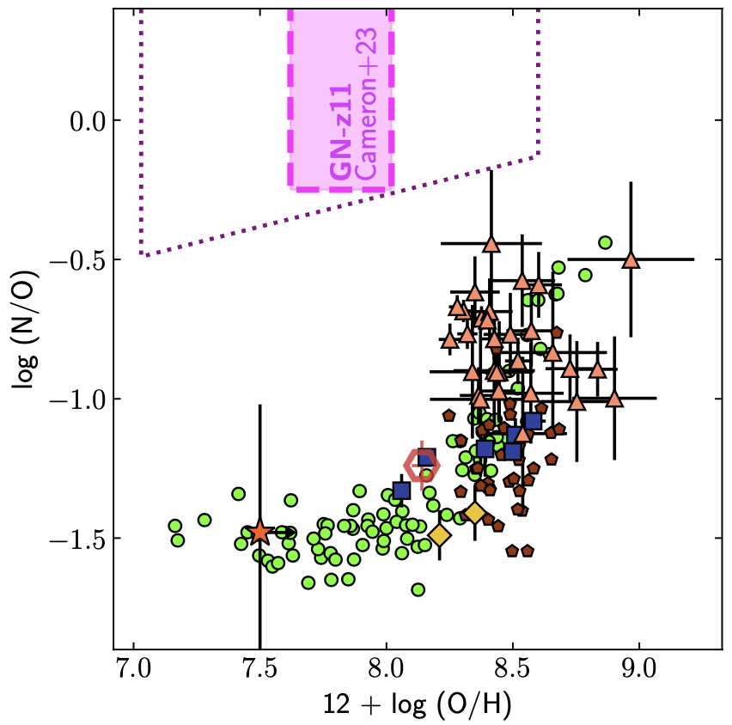
Star Formation in the Early Universe
GN-z11
Early CNO cycle?
AGB stars
w/ normal SFH
failed to explain
Solar
AGB star
CCSN
N/O evolution model
(Vincenzo+16)
Local
Cameron+23
Isobe PhD thesis
Notes:
First, its nitrogen lines are too strong.
Cameron+ measured an N/O ratio of GN-z11, and as shown in this figure, GN-z11 (magenta) has a very high N/O ratio beyond the solar abundance (dashed line here), and far beyond the N/O ratios of local galaxies (green) at a given metallicity.
It seems to be originated from CNO cycle in the early stages of galaxy formation, but it’s tough for AGB stars with normal SFH to explain especially at z>6.

Slide 4
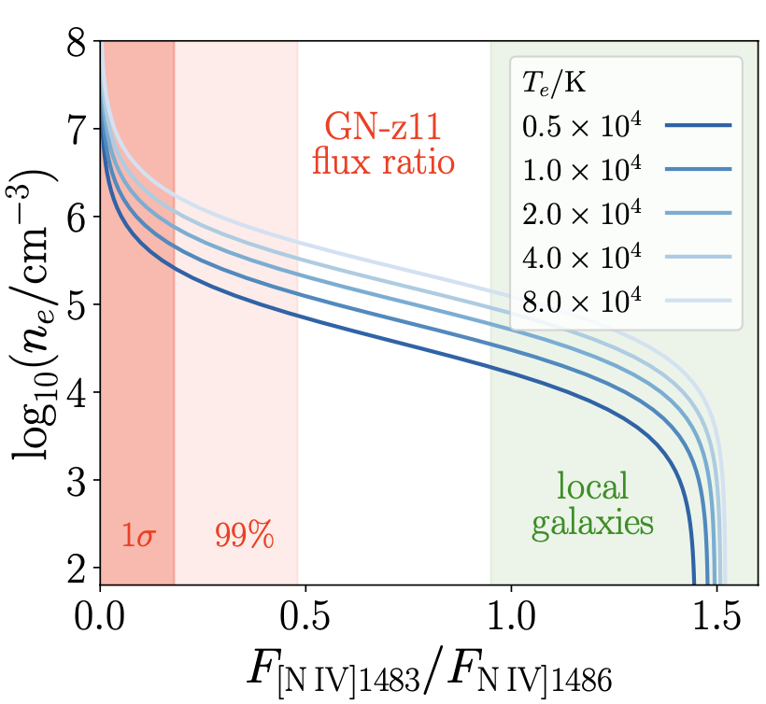
Star Formation in the Early Universe
Early CNO cycle?
Solar
Other supersolar N/O galaxies?
n_{e} increases with z?
Local
Cameron+23
Senchyna+24
Notes:
The line ratio of NIV] doublet is also interesting.
This figure shows electron density as a function of the NIV] doublet ratio.
Senchyna+ showed that the flux ratio of GN-z11 (red) suggests electron density roughly higher than 106 cm-3, and also higher than those of local galaxies (green).
The question is, is GN-z11 alone?
I mean, any other supersolar N/O galaxies at high-z?
And does electron density increase with z?

Slide 5
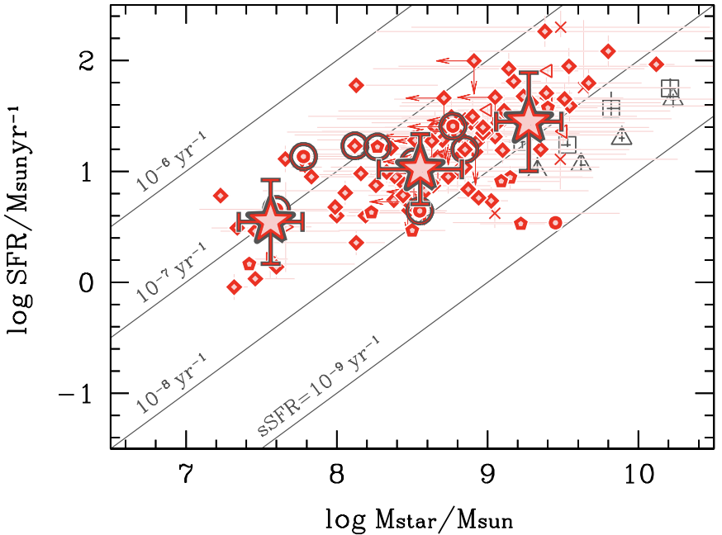
Data and Sample
Thanks to the NIRSpec public surveys
ERO (Pontoppidan+22)
GLASS (Treu+22)
CEERS (Finkelstein+22)
Data reduction by Nakajima+23
111 galaxies at z = 4–10
z = 5-6 main sequence
(Santini+17)
Nakajima+23
sample
Nakajima, Ouchi, YI+23
Notes:
To tackle with these questions, we use the public NIRSpec data as many as possible when the time of paper writing.
Thanks to ERO, GLASS CEERS teams, we could gather hundreds of galaxy spectra.
Reducing the data again, lead by Kimihiko, in a unified way, we identified 111 galaxies at z=4-10.
As shown in this figure of M-SFR relation, our sample, red, are distributed around the blue line representing z=5-6 SFMS.
So we basically see typical star-forming galaxies at high-z.

Slide 6
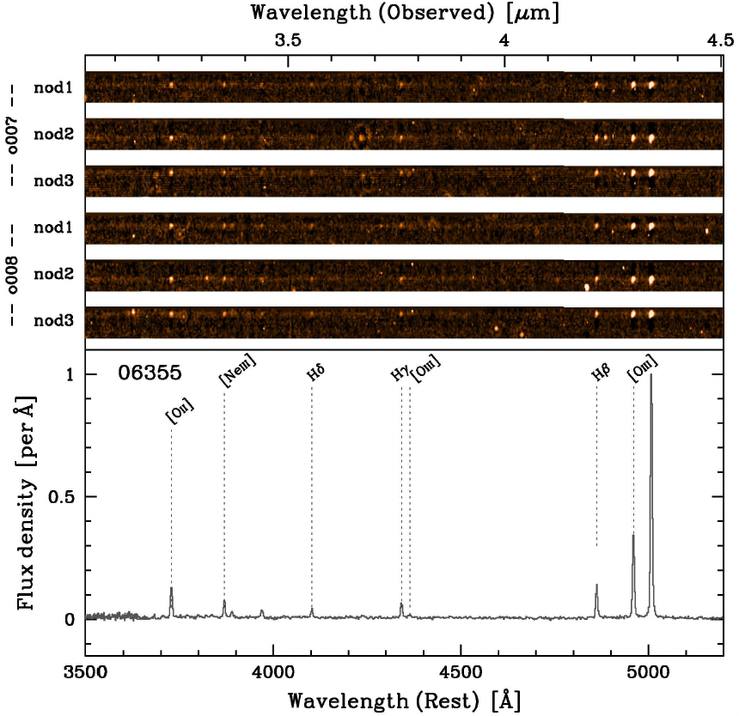
Data and Sample
Thanks to the NIRSpec public surveys
ERO (Pontoppidan+22)
GLASS (Treu+22)
CEERS (Finkelstein+22)
Data reduction by Nakajima+23
111 galaxies at z = 4–10
z = 5-6 main sequence
(Santini+17)
Nakajima+23
sample
14 galaxies
w/ [OII]
→ Electron density
Nakajima, Ouchi, YI+23
Nakajima, Ouchi, YI+23
Notes:
An example of the reduced spectra is shown here, and we identify 14 galaxies having [OII] doublet with high S/N > 10, which is helpful to investigate electron densities.

Slide 7
Redshift Evolution of Election Density
Deriving LSFs for
careful [OII] separation
Pre-JWST
observations
[OII]3726
[OII]3729
Total
Isobe+23b
Berg+12; Davies+21;
Swinbank+19; Kaasinen+17;
Davies+21; Kashino+17;
Sanders+16; Steidel+14
Isobe+23b
Notes:
To carefully separate the [OII] doublet, we derive line spread functions from planetary nebula spectra.
Here is our fitting result, using a Gaussian convolved by the LSF.
In this way we measured [OII] line ratios and derive electron densities.
Here we show redshift evolution of electron density.
These blue and green data points are pre-JWST results taken from the literature.
JWST pushes this observation limit from z~3 to…

Slide 8
Redshift Evolution of Election Density
This work
Deriving LSFs for
careful [OII] separation
indiv.
Pre-JWST
observations
Increase!
median
*Conclusion doesn’t change
w/ 2 gals at z~9-10
(Boyett+24, Abdurro’uf+24)
[OII]3726
[OII]3729
Total
Isobe+23b
Berg+12; Davies+21;
Swinbank+19; Kaasinen+17;
Davies+21; Kashino+17;
Sanders+16; Steidel+14
Isobe+23b
Notes:
…z~9 as shown by the red circles.
The smaller ones are the individual galaxy measurements, and the larger ones are median values of each individual measurement at z<6 and z>6, respectively.
These lower-z references are based on stacked spectra or median values of each sample, so let’s see these median values to compare.
We find that electron densities are likely to increase from z=0-1 to 1-3 and 4-9.
I briefly checked that this conclusion doesn’t change by adding the recent 2 reports by Boyett+ and Abbdruf+ at z=9-10.

Slide 9
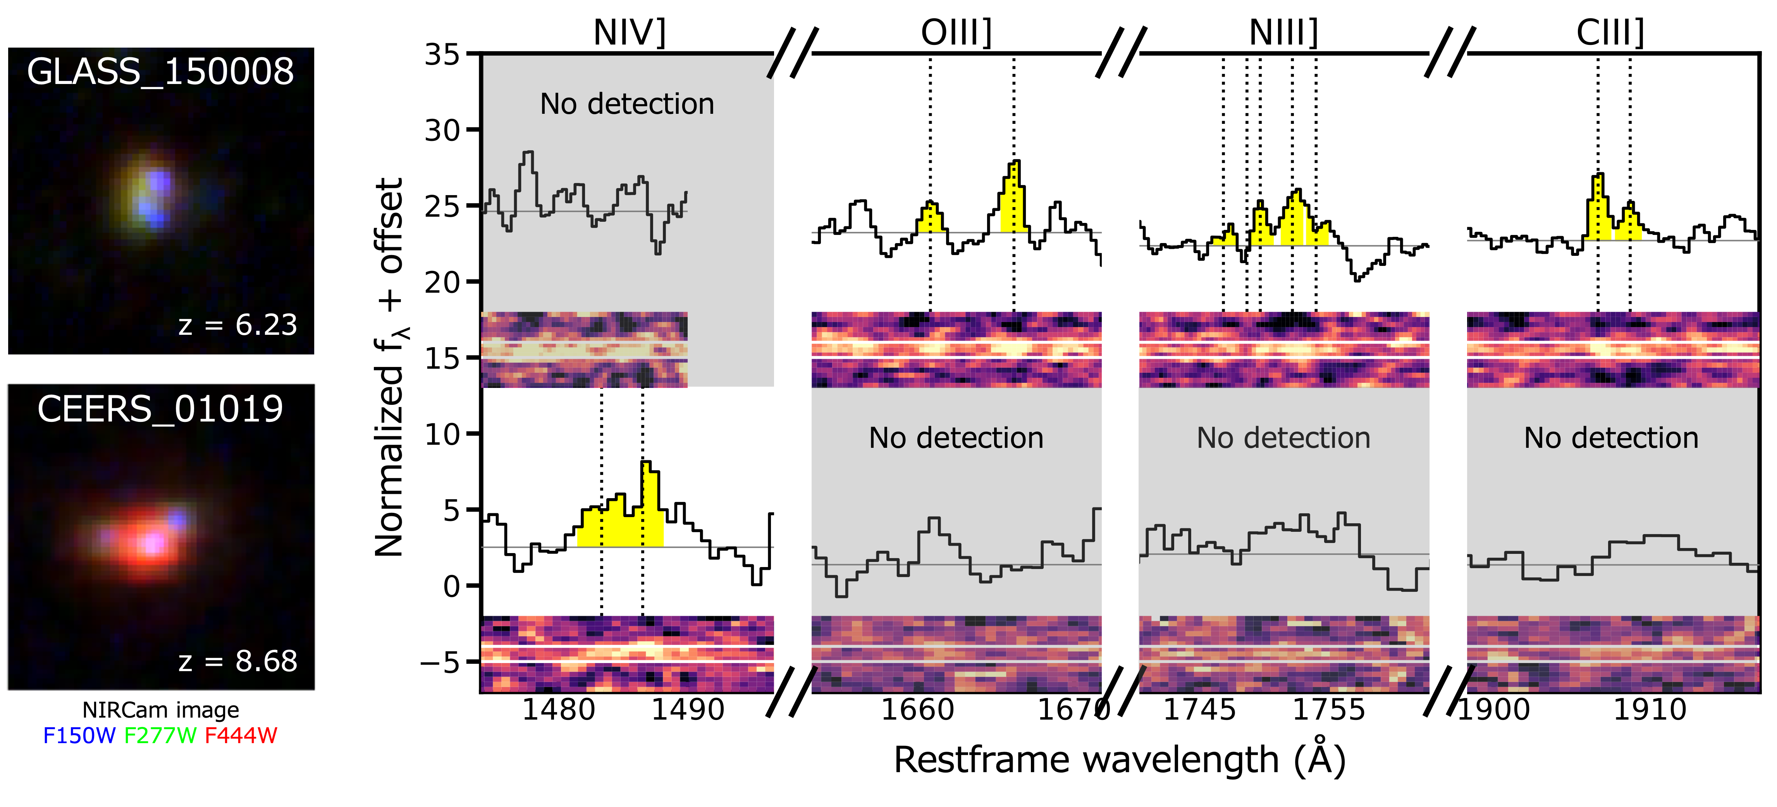
Nitrogen Line Search
From 70 of Nakajima+23 sample galaxies
→ Found 2!
[Fe III]4658
Hβ
Fe²⁺/H⁺
Fe/H
Isobe+23c
Notes:
Electron densities of high-z galaxies are likely to be different from those of low-z galaxies, but what about chemical abundances?
We search for rest-UV NIII] and NIV] lines in 70 of Nakajima+ sample galaxies w/ grating observations.
And finally we found 2 galaxies.
Here I show their NIRCam images and spectra around rest-UV emission lines.
We find one galaxy from GLASS @ z=6.2, with NIII], and another galaxy from CEERS @ z=8.7, with NIV] detections.

Slide 10
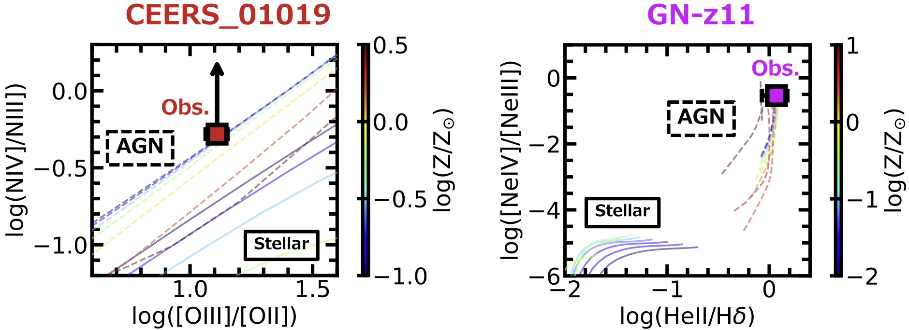
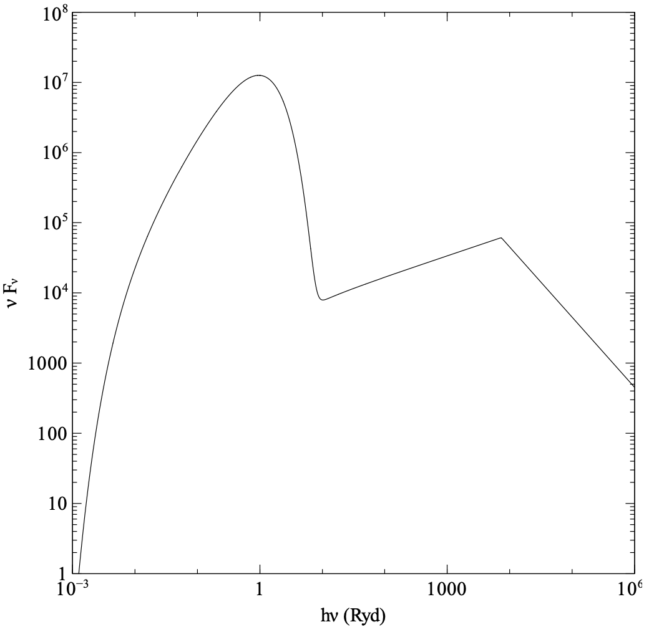
Non-stellar Hard Emission?
Notes:
Before deriving N/O, we should consider the possibility of AGN for these galaxies because different incident radiation should change ionization corrections.
This figure compares the observed NIV]/NIII] and [OIII]/[OII] ratios of the CEERS galaxy with those predicted by the young massive stellar population (solid) and AGN (dashed).
These curves are color-coded by metallicity as in the color bar.
We find that the CEERS galaxy have a high NIV]/NIII] ratio at a given [OIII]/[OII], which is not reproduced by the stellar radiation.
The situation is pretty similar to the case of GN-z11, which is reported to have high-ionization lines.
As in this figure, we have confirmed that the observed [NeIV]/[NeIII] and HeII/Hd are too high to reproduce by the stellar radiation.
On the other hand, we find AGN models that can explain these high-ionization lines.
These galaxies are also reported to have other AGN signature such as broad lines, so these 2 galaxies could be AGNs.
%On the other hand, we find AGN models provided by cloudy mainly characterized by black-body temperature and high-energy power law.

Slide 11
Non-stellar Hard Emission?
Fluxes from Maiolino+23
Isobe+23c
cf. Scholtz+23
Hard to explain w/ stellar models
↔︎ Explainable AGN models exist
cf. other AGN signature: Larson+23, Maiolino+23
Notes:
Before deriving N/O, we should consider the possibility of AGN for these galaxies because different incident radiation should change ionization corrections.
This figure compares the observed NIV]/NIII] and [OIII]/[OII] ratios of the CEERS galaxy with those predicted by the young massive stellar population (solid) and AGN (dashed).
These curves are color-coded by metallicity as in the color bar.
We find that the CEERS galaxy have a high NIV]/NIII] ratio at a given [OIII]/[OII], which is not reproduced by the stellar radiation.
The situation is pretty similar to the case of GN-z11, which is reported to have high-ionization lines.
As in this figure, we have confirmed that the observed [NeIV]/[NeIII] and HeII/Hd are too high to reproduce by the stellar radiation.
On the other hand, we find AGN models that can explain these high-ionization lines.
These galaxies are also reported to have other AGN signature such as broad lines, so these 2 galaxies could be AGNs.
%On the other hand, we find AGN models provided by cloudy mainly characterized by black-body temperature and high-energy power law.

Slide 12
N/O vs. 12+log(O/H)
GN-z11 (Cameron+23)
2 other supersolar N/O gals
at z > 6!
Isobe+23c
Notes:
So we assume the AGN radiation for the CEERS galaxy and GN-z11 to derive (or revisit) N/O ratios.
Here we show our derived N/O ratios as a function of metallicity.
Regarding GN-z11, we confirm that GN-z11 still has a supersolar N/O ratio under the assumption of the AGN radiation.
The important thing is that, both the GLASS galaxy and the CEERS galaxy have supersolar N/O ratios.
So GN-z11 is not alone!
I mean, there are 2 other supersolar N/O galaxies at z>6!
%Compared with the local references like star-forming galaxies shown by the gray symbols, these 3 galaxies have significantly high N/O ratios at a given metallicity.
%When deriving N/O and metallicity, we assume both the stellar and AGN radiation for the CEERS galaxy, while the stellar radiation for the GLASS galaxy.
%We also revisit N/O ratio of GN-z11 in the same manner as the CEERS galaxy

Slide 13
C/N vs. 12+log(O/H)
Watanabe(incl.YI)+23
CCSN
Maeder+15
CNO equil.
Containing much
CNO-cycle processed gas
Isobe+23c
Notes:
Then what is the origin?
N/O is likely to be enhanced by the CNO cycle.
But if so, we should investigate C/N ratio because the CNO cycle produces low C/N.
So we derive C/N ratios of the 3 galaxies using CIII]/NIII] or CIII]/NIV].
Interestingly, these 3 galaxies have C/N ratios roughly 1 dex below the solar abundance.
Also, the cyan shaded region shows CCSN yields, and the brown one shows chemical composition at the equilibrium of CNO cycle.
These 3 galaxies have C/N ratios far below than those of the CCSN yields but close to the CNO-cycle equilibrium gas composition
This indicates that these 3 galaxies largely contain CNO-cycle processed gas.

Slide 14
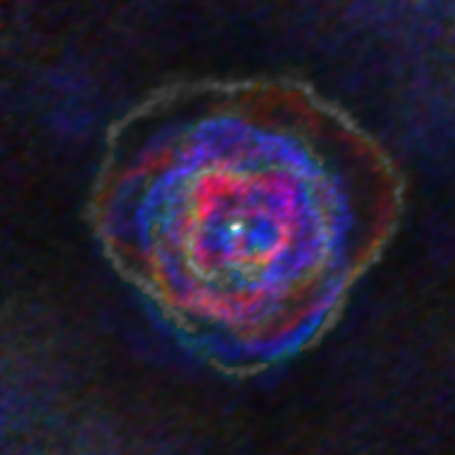
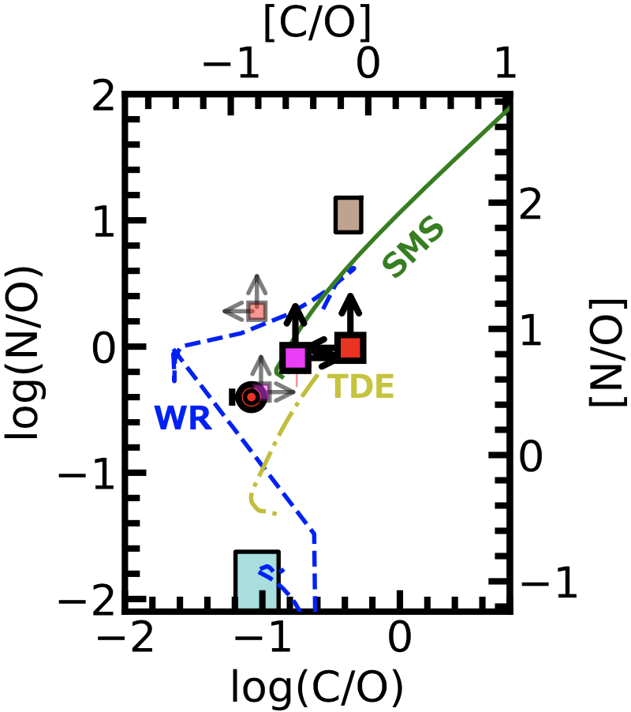
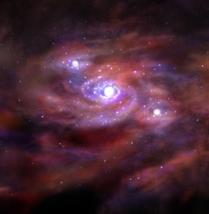
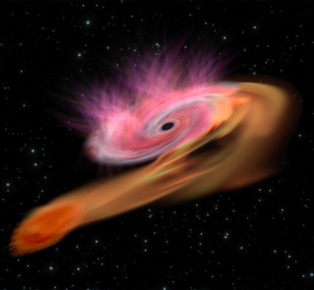
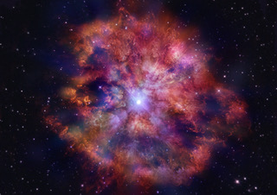
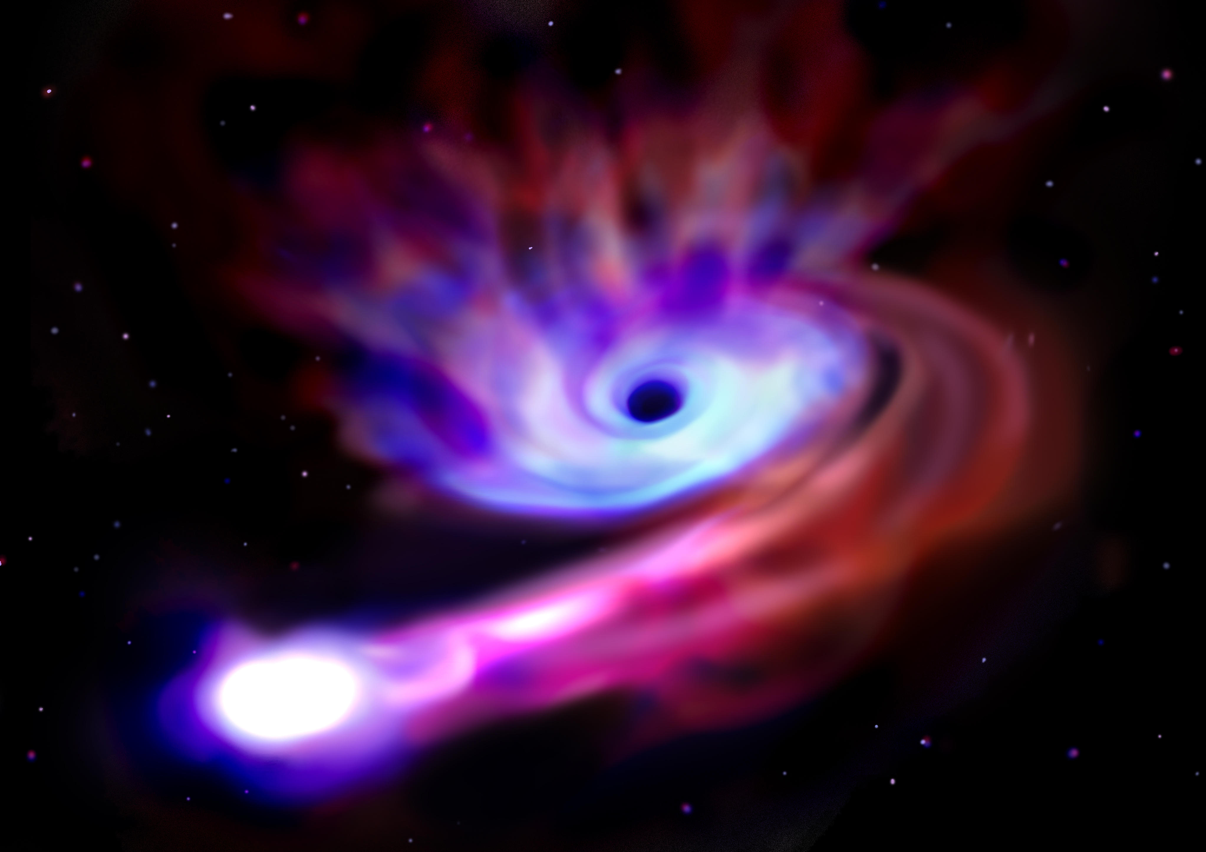
©︎L. Decin, ESO/ALMA
Early CNO-cycle Enrichment Scenario
Chemical enrichment models
(Watanabe+23,prep) w/
・Supermassive star
(10⁵ M⊙; Nagele&Umeda23)
・Wolf-Rayet star
(25-120 M⊙; Limongi&Chieffi18)
・Tidal Disruption Event
(9-40 M⊙; Watanabe+prep)
can explain
See Kuria’s talk
Black hole
Star
ESA/C. Carreau
©︎ICRR, Naho Wakabayashi
©︎ICRR, Naho Wakabayashi
©︎ICRR, Naho Wakabayashi
Isobe+23c
Notes:
As discussed, it’s hard to explain the CNO-cycle enrichment in the early universe as long as assuming AGB stars and the typical star-formation history.
One possible explanation to solve this problem is to assume CNO-cycle gas suppliers before CCSNe eject much oxygen.
My collaborator, Kuria Watanabe, is working on the construction of chemical enrichment models, and we plot our observations of N/O vs. C/O with her models of CNO-cycle gas suppliers, such as supermassive stars, Wolf-Rayet stars, and tidal disruption events.
We find that all these models can explain the observed high N/O ratios, so we confirm that these objects are candidates of the origin of high N/O ratios at high z.
In the next talk, Kuria will discuss this part more, so please don’t miss her talk.
この高いN/Oの起源を探るため、イントロで紹介したSMS, WR星、TDEをそれぞれ含む化学進化モデルを天文台の渡辺さんに作成してもらったところ図上の緑、青、黄
それぞれ遠方銀河の観測点を説明可能であることが分かった
このことからSMS, WR, TDEの存在を示唆

Slide 15
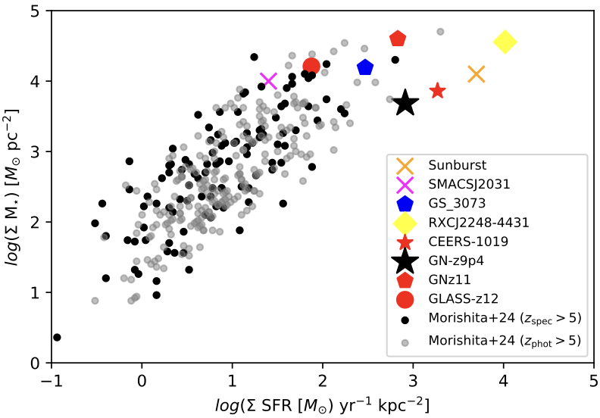
N/O Study Update
For further discussions…
Globular cluster
(GC) star
(Carretta+05)
Supersolar-N/O
gals at z≳6
Schaerer+24
Isobe+23c
7 supersolar N/O gals at z≳6!
(Cameron+23, Senchyna+23, Isobe+23c,
Marques-Chaves+24, Topping+24,
Castellano+24, Ji+24, Schaerer+24)
Associated w/
dense star formation?
(cf. Ji+24, Yanagisawa+24)
Link to GC formation?
(cf. Senchyna+24)
See Hajime’s talk
Notes:
The major part of my talk is stopped here, but I’d like to talk a bit more about updates on N/O studies to help further discussions.
After the release of our paper, the number of supersolar N/O galaxies has been 7 at z>6.
Also, as shown in this figure, these supersolar N/O galaxies also have high Σ* and ΣSFR.
This might suggest that high N/O ratio is associated with dense star formation.
The interesting thing is that the supersolar N/O galaxies have similar CNO abundances to those of stars in globular clusters, which also require high density to form and survive.
This suggests the link to globular cluster formation with nitrogen enhancement.
In the next session, Hajime will discuss this point more using his simulation.

Slide 16
Summary
Increasing trend of n_{e}(OII)
from z = 0 to z = 4–9
2 supersolar-N/O galaxies at z>6
Low C/N suggestive of
early CNO-cycle enrichment
Isobe+23b
See also Kuria and Hajime’s talk!
Isobe+23c

Slide 17
Thank you for listening!

Slide 18
Redshift Evolution of Election Density
This work
r_{e} ∝ (1 + z)⁻¹
~
n_{e} ∝ (1 + z)²
∝ (1 + z)¹
SFG
Compact galaxy disk?
(& reduction?)
Berg+12; Davies+21;
Swinbank+19; Kaasinen+17;
Davies+21; Kashino+17;
Sanders+16; Steidel+14
Isobe+23b
Notes:
We also discuss the origin of this trend by investigating what kind of evolutionary trend our results follow.
We find that our results lie on the gray shaded region corresponding to the gap between the evolutionary relations of (1+z) and (1+z)^2 relations.
The (1+z)^2 relation can be explained by the compact galaxy disk toward high-z, which roughly prop to (1+z)-1 as shown in this redshift evolution of effective radius of SFG.
But our results lie slightly below the relation.
So there might be something reducing the n_e such as high temperature of ISM due to lower metallicity at higher redshift.

Slide 19
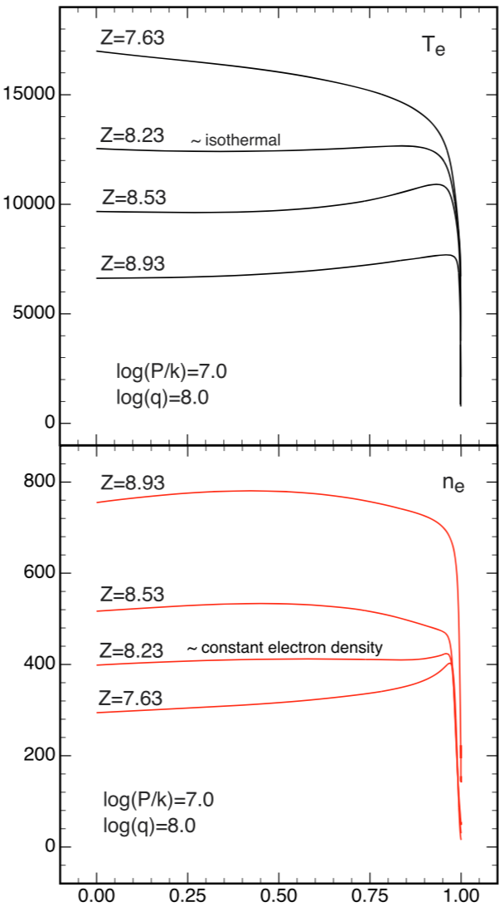
Redshift Evolution of n_{e}
Low Z
T_{e} (K)
High Z
Plane-parallel
const. pressure
(Kewley+19)
High Z
n_{e} ∝ (1 + z)¹
n_{e} (cm⁻³)
Low Z
Norm. radius
Kewley+19
Low metallicity can reduce n_{e}?
Isobe+23
Notes:
However, the ne values of the JWST galaxies are smaller than those predicted by the (1+z) squared relation, so there can be something reducing the ne value.
One possible contributor is the high electron temperature originating from the low metallicity toward high z.
These panels show ne and Te values with different metallicities based on plane-parallel constant-pressure model of Kewley+19.
As you can see the top panel, Te increases with lower Z, and thus ne decreases.

Slide 20
AGB Star Model w/ Normal SFH
Hard to explain
Instead…
O expelled out? (D’Antona+24)
AGB star
N/O evolution model (Vincenzo+16)
Universe age at galaxy formation ≥ 0 yr
CCSN
Isobe PhD thesis
Notes:
CNOサイクルを経たガスの起源を探る
まずAGB星の寄与を議論
AGB星を含むV16のN/O進化モデルを赤方偏移の関数で
境界線:銀河形成時の宇宙年齢を0歳としたモデル
それより宇宙年齢が上の時代で形成したと仮定するモデルはlow-zにシフトするのでグレーの領域にくる
今回観測された遠方銀河はモデルでは説明できないほど高いN/Oで遠方に存在
出現までに時間がかかるAGB星では説明が難しいことを示唆

Slide 21
Paper V

Slide 22
Paper V

