Slide 1
Stacking PANCAKEZ
sPectroscopic Analysis with NirspeC stAcKs in the Epoch of reioniZation
Kelsey Glazer (she/her) ✦ University of California Davis ✦
June 28th, 2024
Notes:
Hi, I’m Kelsey and I am a graduate student at UC Davis. I’d like to thank the awesome people who organized this conference etc etc.

Slide 2
Low-Ionization Species (LIS) Absorption Lines
Metal ions with ionization potentials that trace HI
$$f_{c}=1$$
$$f_{c}<1$$
$=LyC$ photon
SiII
SiII
$$f_{esc}^{LyC}=1−f_{c}$$
HI
HI Cloud
SiII
HI
SiII
HI
SiII
SiII
Flux
Flux
$$f_{c}$$
0
$$1260Å$$
0
$$1260Å$$
Wavelength
Wavelength
Notes:
Ideally we would like to measure f_c from a neutral hydrogen transition. Lya would be the brightest line but it’s line profile is incredibly messy. LIS lines are used as a proxy for HI covering but it is
Lya emission – we know where its coming from we just don’t know
Lya emission is hard to interpret – we know where its coming from but we don’t know what’s powering it.
Si ii is the dominant ion of silicon in H i gas, this is approximately equal to the covering fraction of H i (provided that
it is enriched with Si) which impedes the escape of ionizing radiation.
Mention, we would love to do this in EoR when escapeing is important.

Slide 3
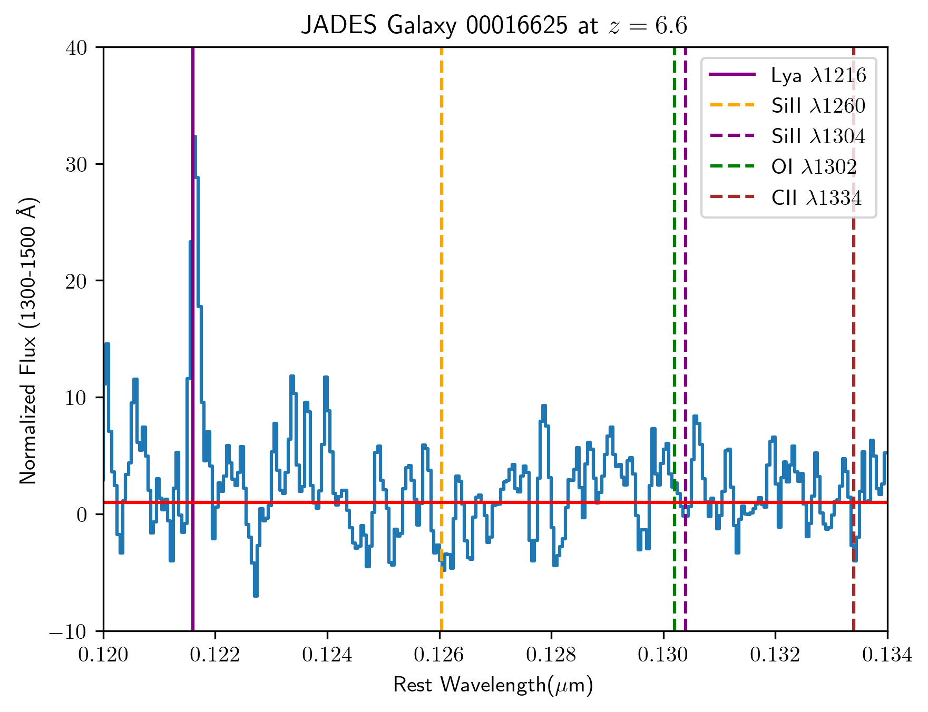
LIS lines at $z≳6$
Sources are faint with sufficiently high noise making it hard to observe features in individual spectra
Stack spectra
Notes:
the *continuum* is weak faintness of the UV continuum. The error bar you can
it is because the high-z galaxies are faint, so that any absorption features acting on the continuum is difficult to observe.

Slide 4
My Sample
We use 3 JWST surveys: JADES, CEERS, and AURORA
232 galaxies with $z_{spec}≥6$ and $R≥1000$ rest-UV spectra
158 galaxies with $z_{spec}$ remeasured with Hβ+[OIII]
51 galaxies with suitable SNR
$<z_{spec}> =6.97$ !!
 | # of galaxies $z_{spec}≥6$ | # of galaxies w. Hβ+[OIII] | # of galaxies w. suitable SNR
JADES | 182 | 127 | 39
CEERS | 37 | 20 | 7
AURORA | 13 | 11 | 5
TOTAL | 232 | 158 | 51
AURORA - Assembly of Ultradeep Rest-optical Observations Revealing Astrophysics
Notes:
AURORA - Assembly of Ultradeep Rest-optical Observations Revealing Astrophysics
bullet point format might work better
Main points —> we have a decent # of galaxies with appropriate critera
Current Sample 51 galaxies with z>6 spec and suitable SNR.
Suitable redshift, well enough measured, and higher resolution spectra and continuum SNR is suitable for stacking. Drawn from these three surveys.
Put shout out big thanks to everyone behind the surveys for making the data publicly available. We really appreciate they’ve made the data available.

Slide 5
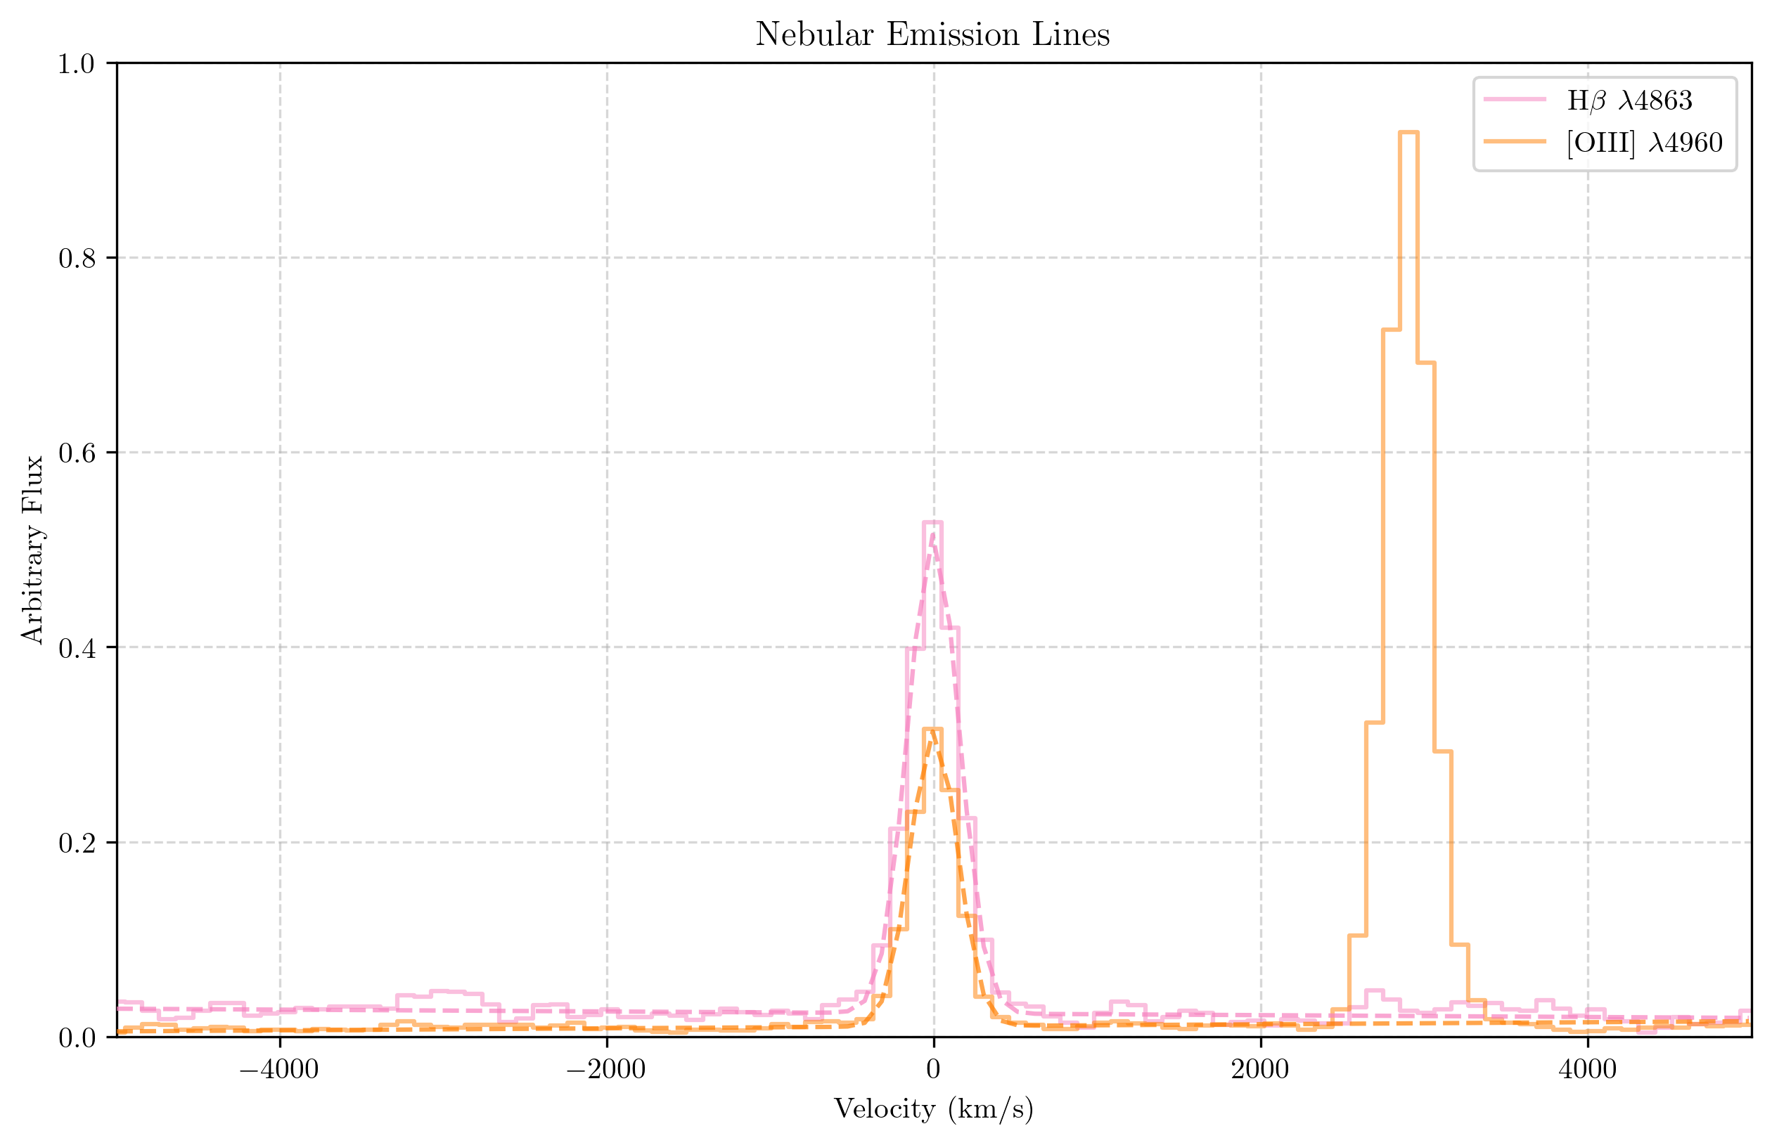
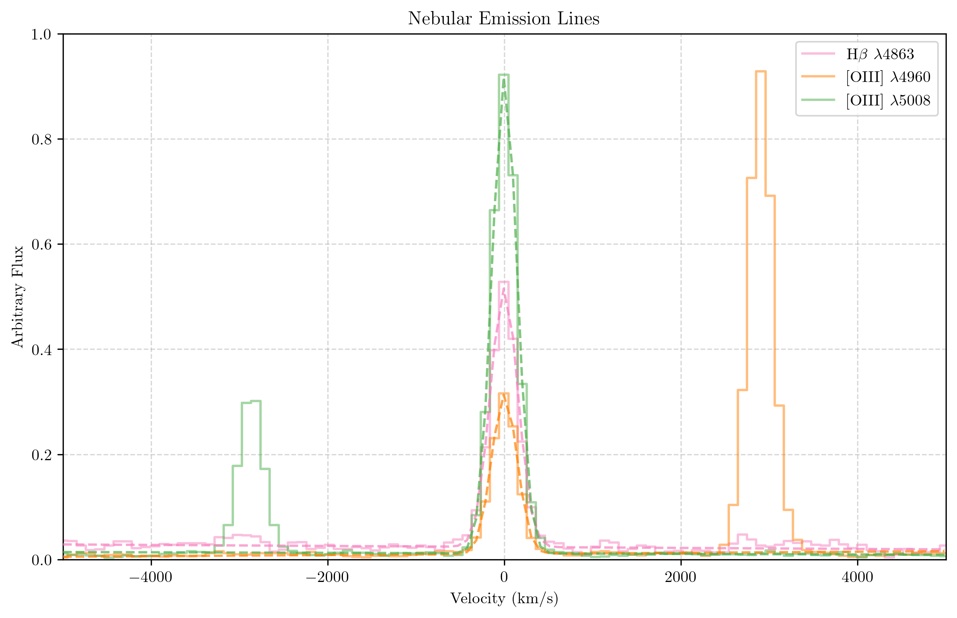
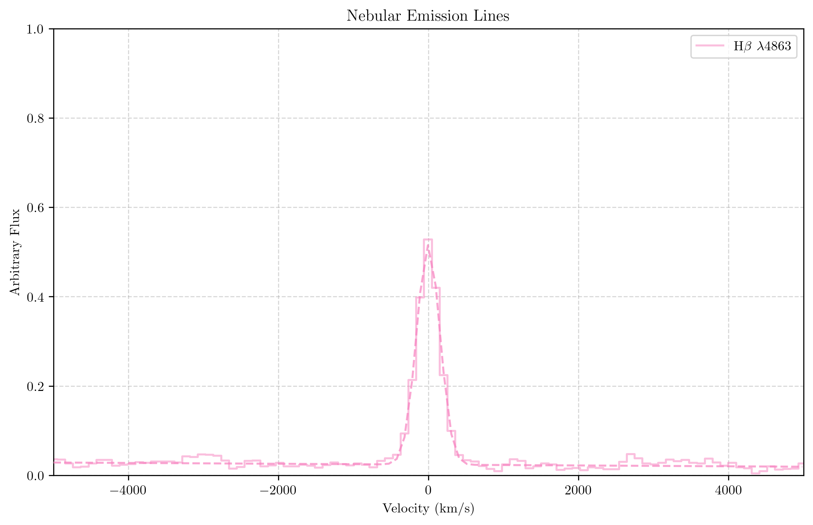
Redshifts from Nebular Emission Lines
Hβ+[OIII] emission lines in composite spectrum
Notes:
we want to make sure the redshift is accurate so we remeasured all redshifts from the grating spectra… nebular redshift! Nebular+grating spectrum redshift.
Nebular redshift = systemic redshift (+/- 15km/s)
FWHM of nebular emission lines are roughly the same to the resolution of NIRSpec which means giving more confidence (redshift error is tight).
We have precise systemic redshifts —> FWHM is comparable to the resolution of the instrument.
If your redshifts weren’t as precise, you’d see a FWHm that is significantly larger than resolution.
Could even quote the FWHM of the absorption line composite, , here’s the approximate
LIS lines, we can tell that we have some velocity spectra resolution.

Slide 6
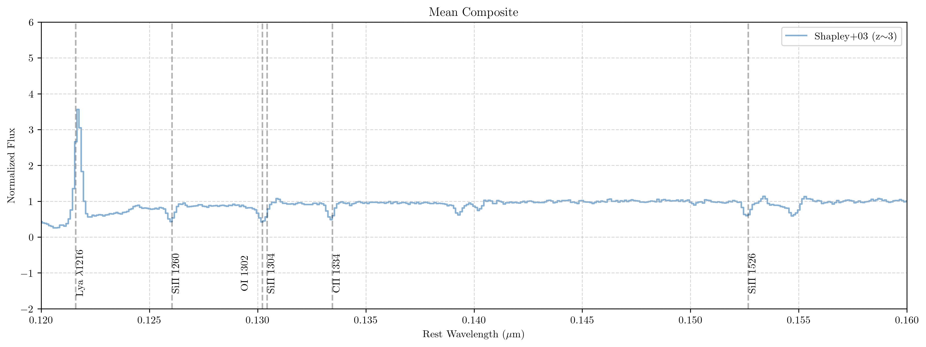
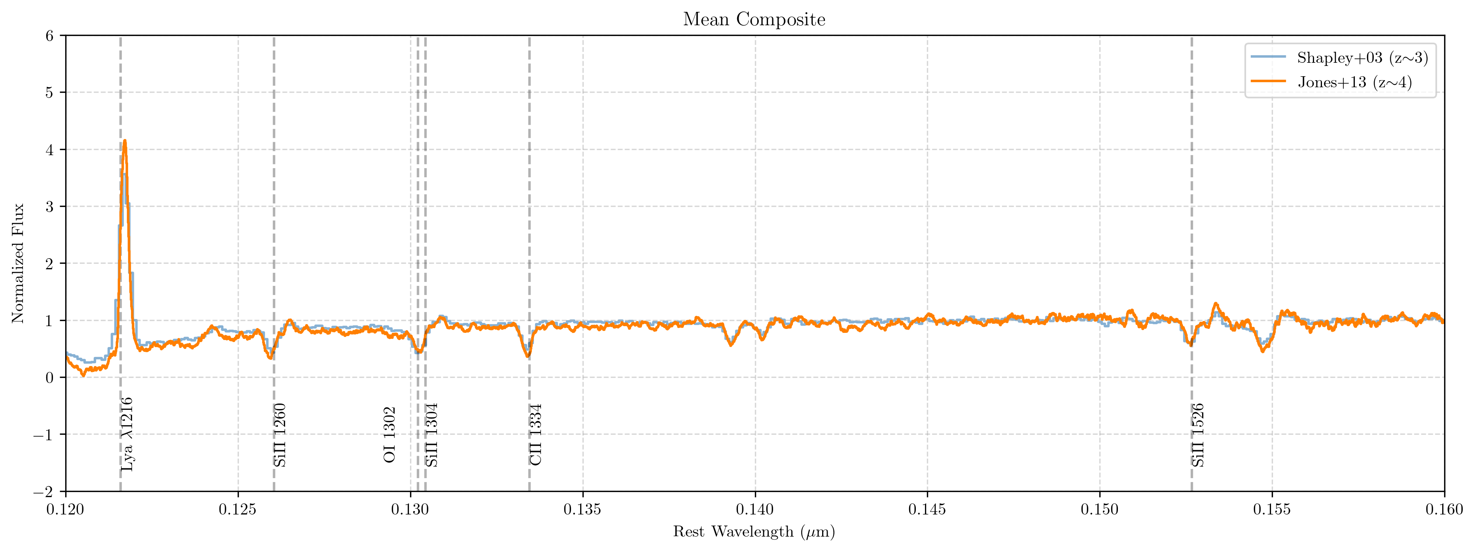
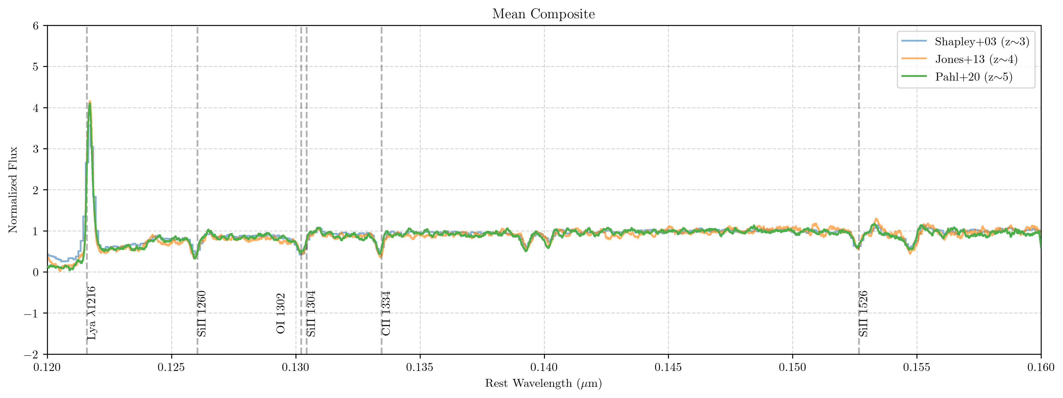
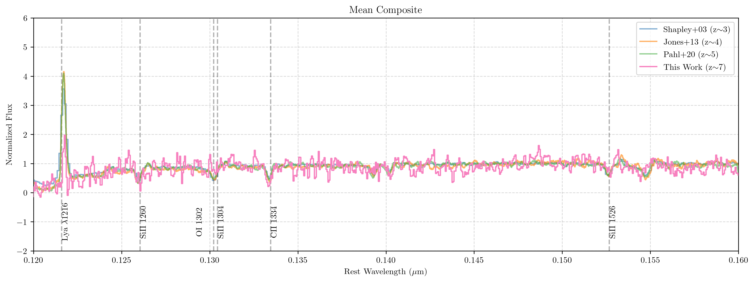
Composite Spectrum
How do we compare to lower-z studies?
Lyα suppression in EoR
Continuum shape consistent
First time we are able to probe EoR for LIS features !!
Notes:
Shapley03 —> 811 LBG spectra
Jones13 —> 3 grav lens LBG z~4 DEIMOS grating R~3.5Å
Pahl20 —> 160 spec (DEIMOS)
Glazer —> 51 Galaxies (Nirspec medium grating) put z~7 for me.
Continuum shapes are really consistent with each other (fair comparison)
make lya suppression a big point. First thing that sticks out but it’s a noisy spectrum, but this is in the reionization era. You can see the suppression of Lya, we are probing this in EoR for the first time. Which is very exciting.
We can see individual ISM abs lines detected.
Big point: broadly similar with suppression of Lya. Being able to do this at z~7 in the EoR.

Slide 7
What Are We Learning?

Slide 8
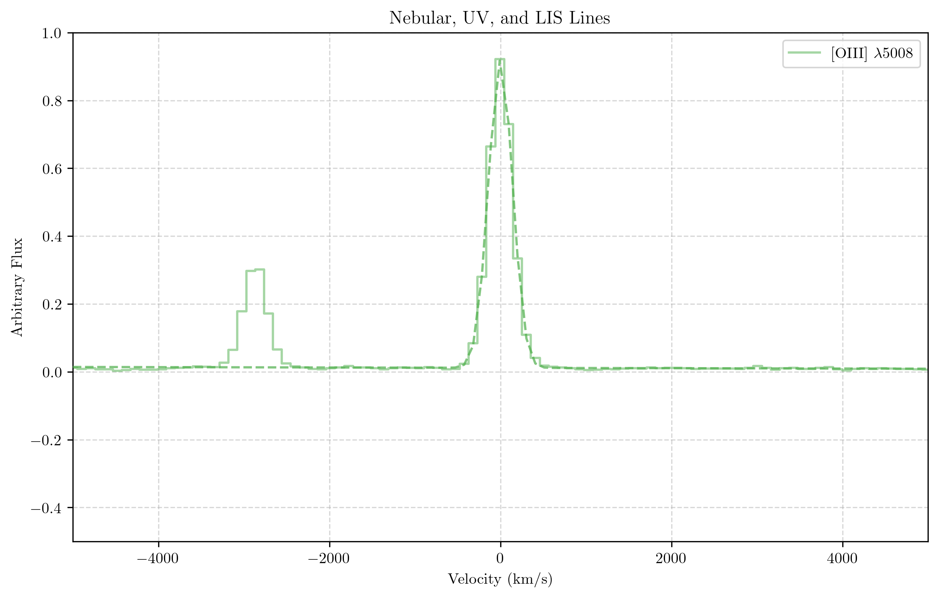
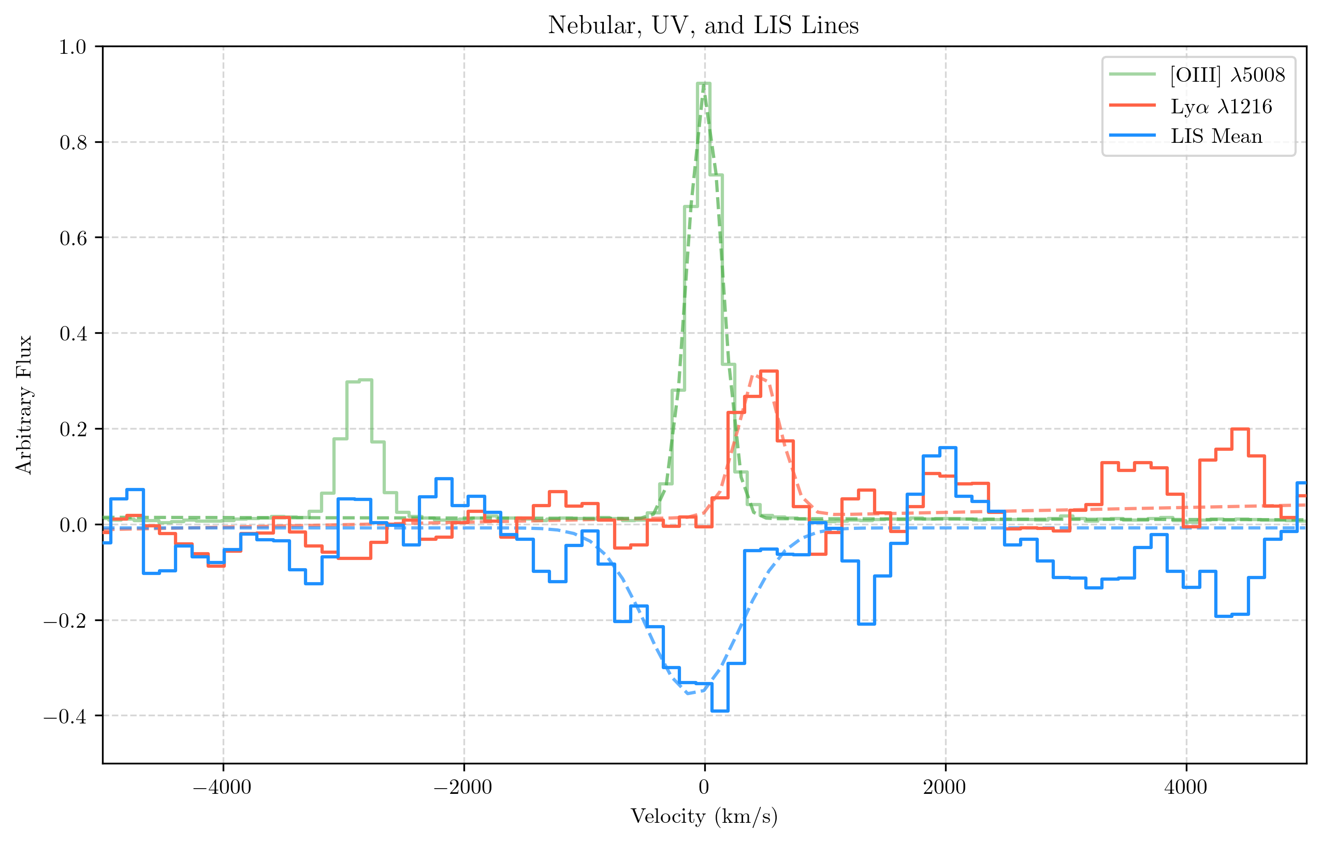
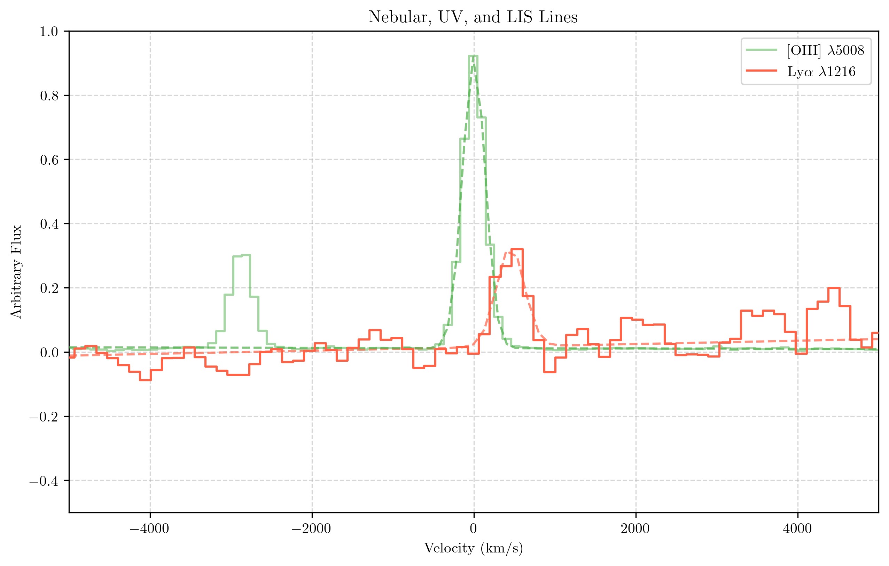
Centered nebular emission lines
Redshifted Lyα emission
LIS absorption asymmetric shape
Blueshifted LIS absorption ($\sim 100 km/s$)
Notes:
First point: nebular redshift is very center. Gives us confidence individual nebular redshift is precise. Nebular redshift is +/- 15 km/s from systemic but
Second point: LIS line is broader than nebular emission. You can see a broader tail on the lbue side and the centroid is slightly blueshifted from 0 so signitures outflows that are witnessed at low-z
We detect ISM abs out to ~100km/s
You can see it’s broader than nebular emission
Really clear outflow signature
Ignore gaussian fit, looks steeper on redshift size… asymmetric fit that blue shifted size, you can see the blue shifted extent showing outflow.

Slide 9
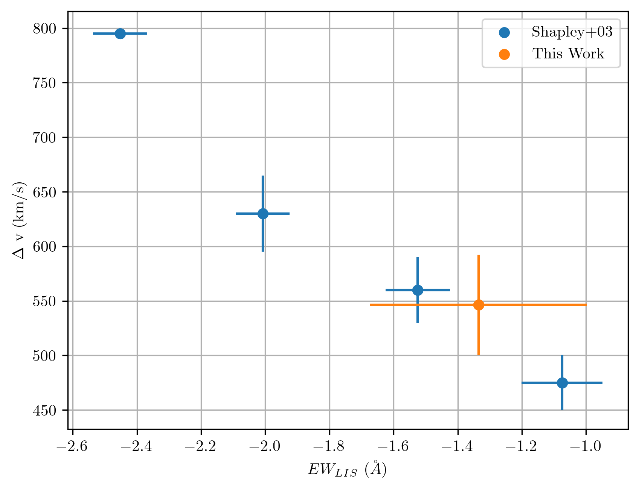
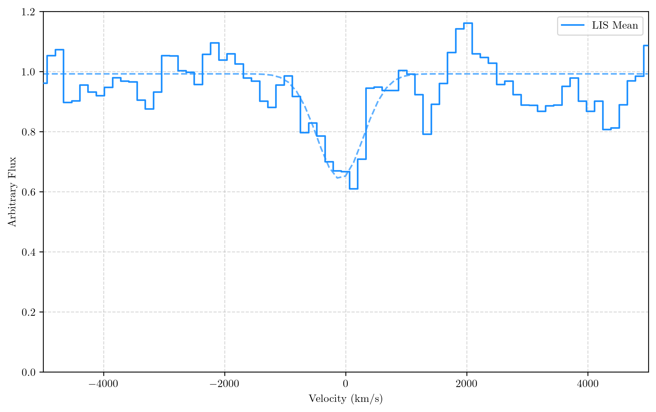
Implications for Covering Fraction
$$f_{c}<1$$
$=LyC$ photon
SiII
SiII
Flux
$$f_{c}$$
Blue: $z\sim 3$
Orange: $z\sim 7$
HI
SiII
HI
SiII
HI
0
$$1260Å$$
Wavelength
$$f_{c}$$
Stronger LIS absorption
Weaker LIS absorption
Observed LIS absorption at $<z_{spec}> =6.97$
Weak absorption → potentially large ionizing $f_{esc}$!
Notes:
separate the Lya velocity as a function of EW. Lya velocity as function of LIS EW (whether or not we follow Shapley)
ADD here , tying this back into motivation. JUST LIS 0 flux and 1 flux (normalized)
Something like —> plot of Stacked LIS composite. Show picket fence cartoon with actual LIS absorption from the data. Here’s my data, here’s the cartoon version of what we are understanding. What can we say. If absorption was really strong, then there isn’t a lot of ionizing radiation escaping, but if it’s weak and abs lines aren’t near 0, it’s certainly possible for ionized channels for radiation to escape. And then Show this plot,
This plot is on the Lower EW end that’s associated with lower covering faction, which is associated with higher escape fraction… not exactly 1:1 because we have composite but it is following the trend we see at lower redshift.
What is this telling us about EoR galaxies, what are we learning about their outflows.
ΔV —> suggesting stronger outflows?
note the difference in redshift. E.g. blue text “z ~ 3” and orange text “z ~7”
WLIS marginally increases with increasing ∆vem−abs,
though the difference is not significant, and may arise as a result
of the strong correlation between Lyα and the interstellar absorption lines

Slide 10
Summary
Stacking PANCAKEZ offers the first ever LIS line probe of EoR galaxies!! $<z_{spec}> =6.97$
Clear signatures of outflowing gas which follow similar trends seen at lower-z
LIS absorption is relatively weak, suggesting a low covering fraction of HI gas and compatible with substantial ionizing escape fraction.
Notes:
bullet points under to just highlight
Stacking analysis 50+ galaxies at z_mean = 7.blah blah blah in EoR <— this is exciting!!!!
Clear signatures of outflowing velocity following similar trends we see at lower redshift.
EW is relatively low suggesting low covering fraction which indicates Plausible to have modest ionizing escape fractions. Don’t over interpret, but connecting LIS lines strength and profile to the covering fraction.
At very high redshifts, theortical modes show galaxy Star formation from metal poor gas
Plot of LIS average absorption from refernces against mine…. Points would be 1. Velocity offset is similar meaning that SF recipie, outflow, feedback, is not significantly different that lower z, 2. Metal enrichment (depth of the covering fraction ) is also very similar.

Slide 11
Extra Slides
Notes:
bullet points under to just highlight
Stacking analysis 50+ galaxies at z_mean = 7.blah blah blah in EoR <— this is exciting!!!!
Clear signatures of outflowing velocity following similar trends we see at lower redshift.
EW is relatively low suggesting low covering fraction which indicates Plausible to have modest ionizing escape fractions. Don’t over interpret, but connecting LIS lines strength and profile to the covering fraction.
At very high redshifts, theortical modes show galaxy Star formation from metal poor gas
Plot of LIS average absorption from refernces against mine…. Points would be 1. Velocity offset is similar meaning that SF recipie, outflow, feedback, is not significantly different that lower z, 2. Metal enrichment (depth of the covering fraction ) is also very similar.

Slide 12
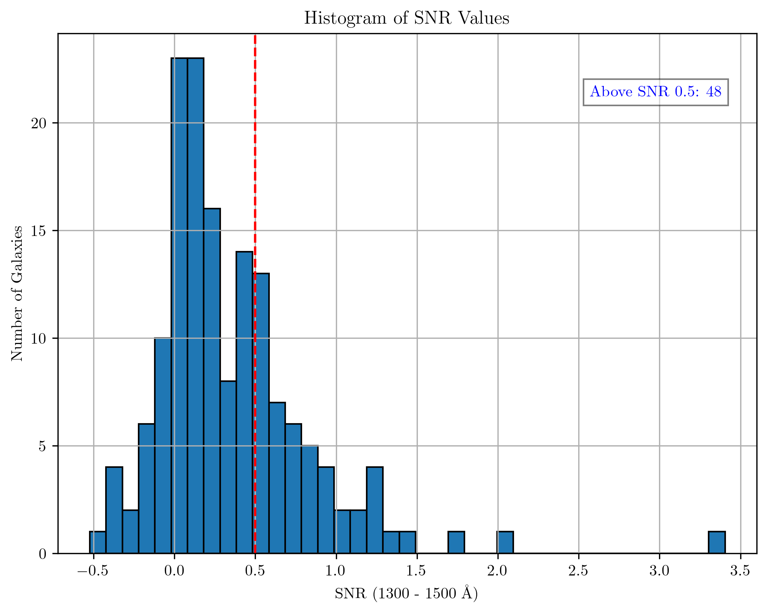
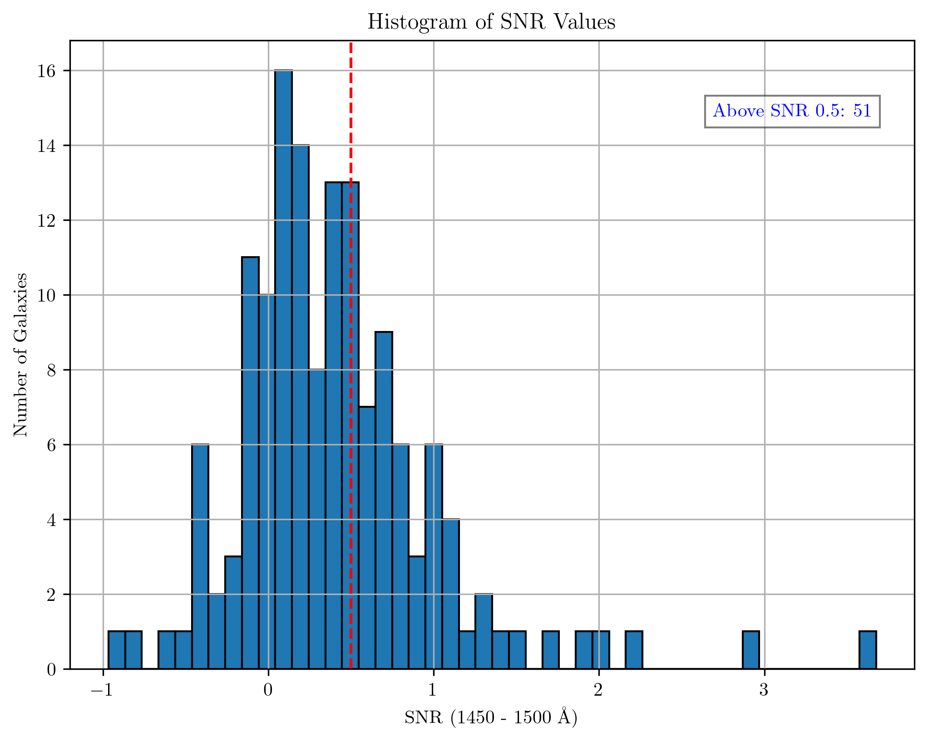
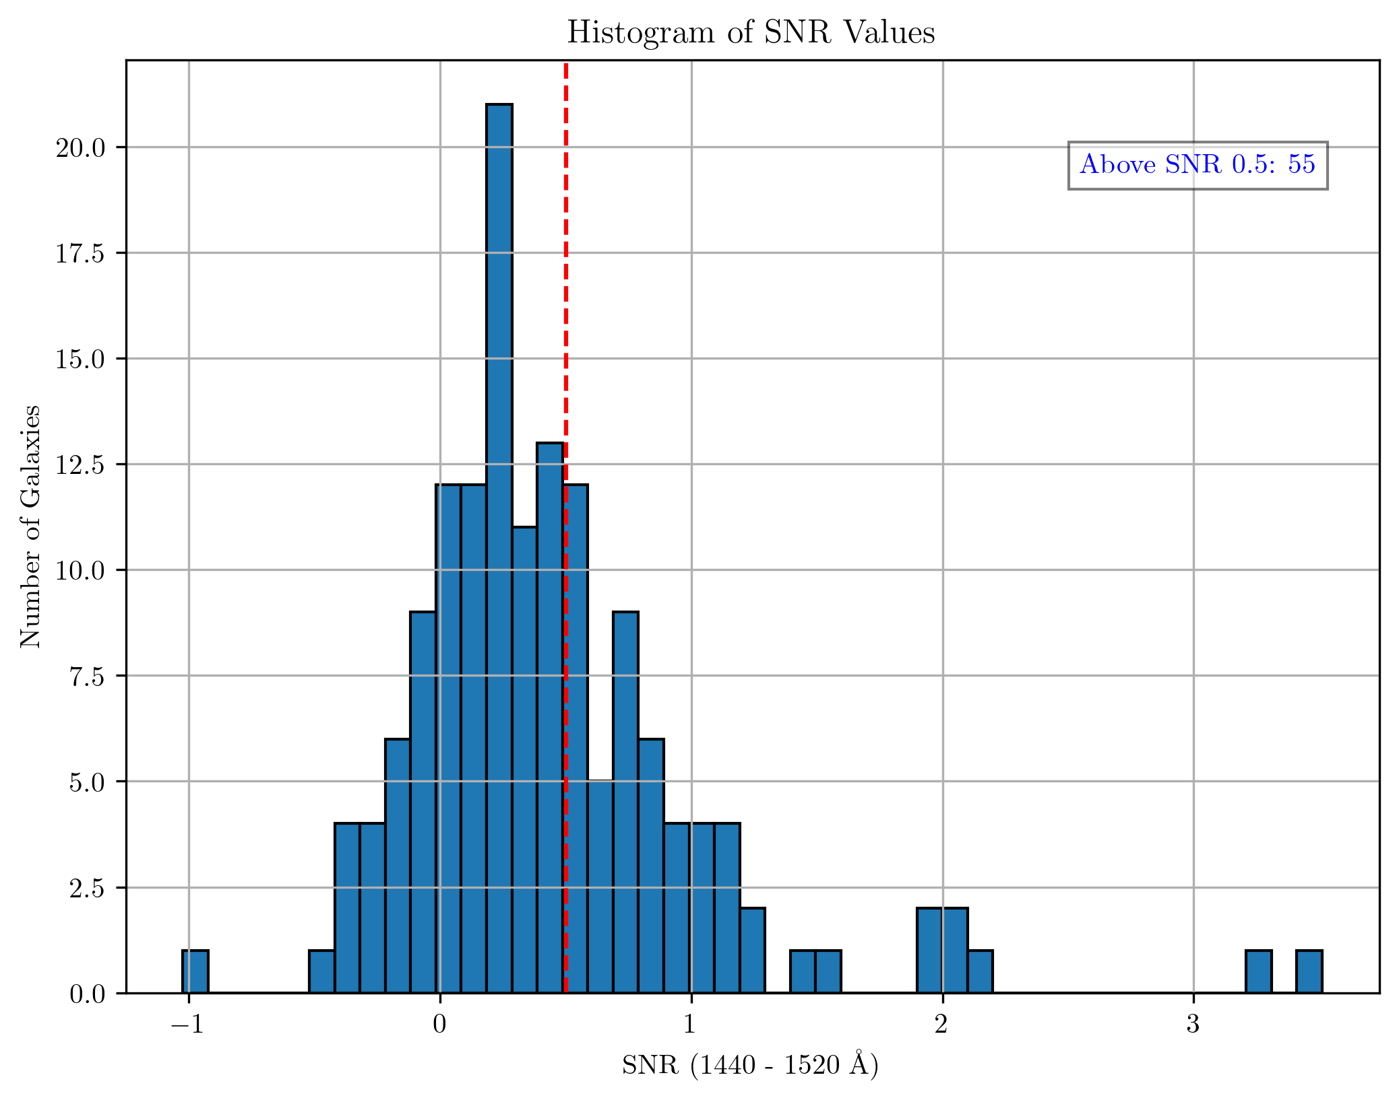
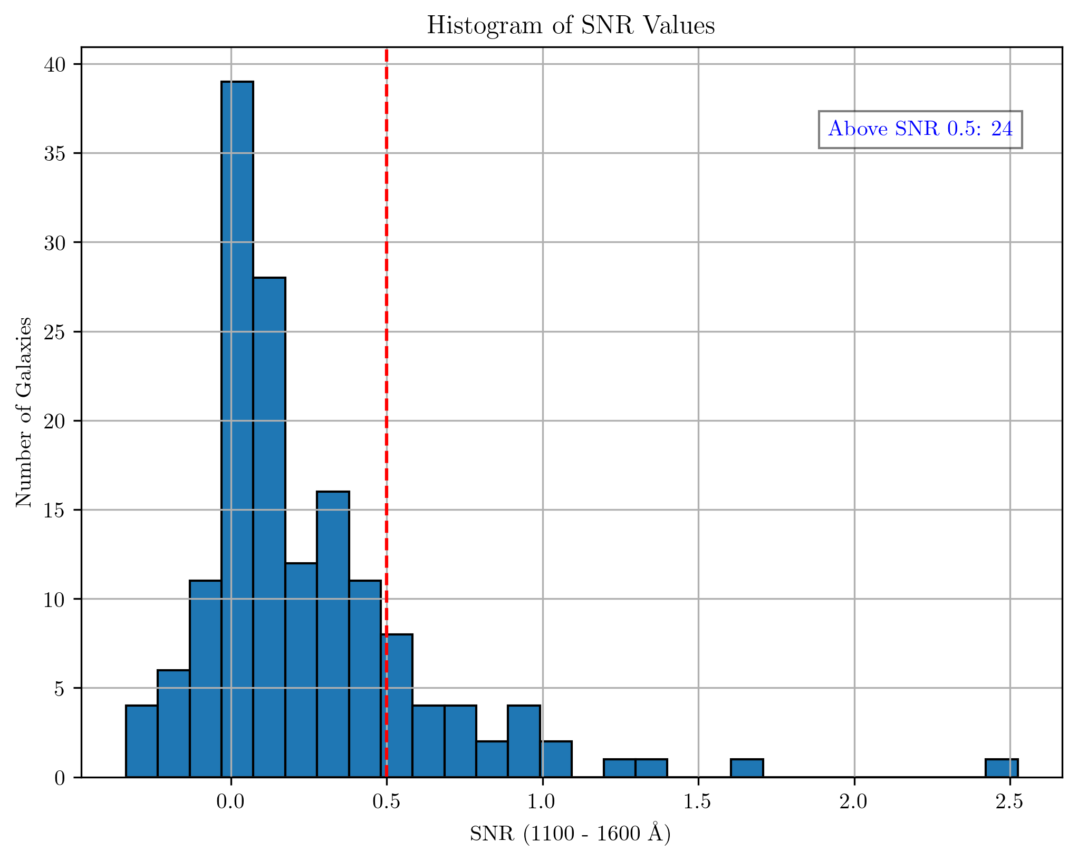

Slide 13
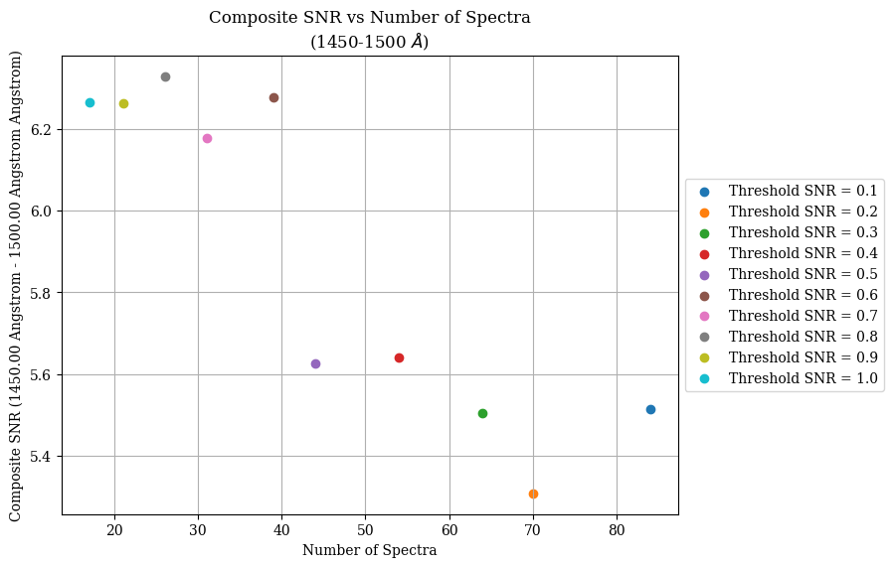

Slide 14
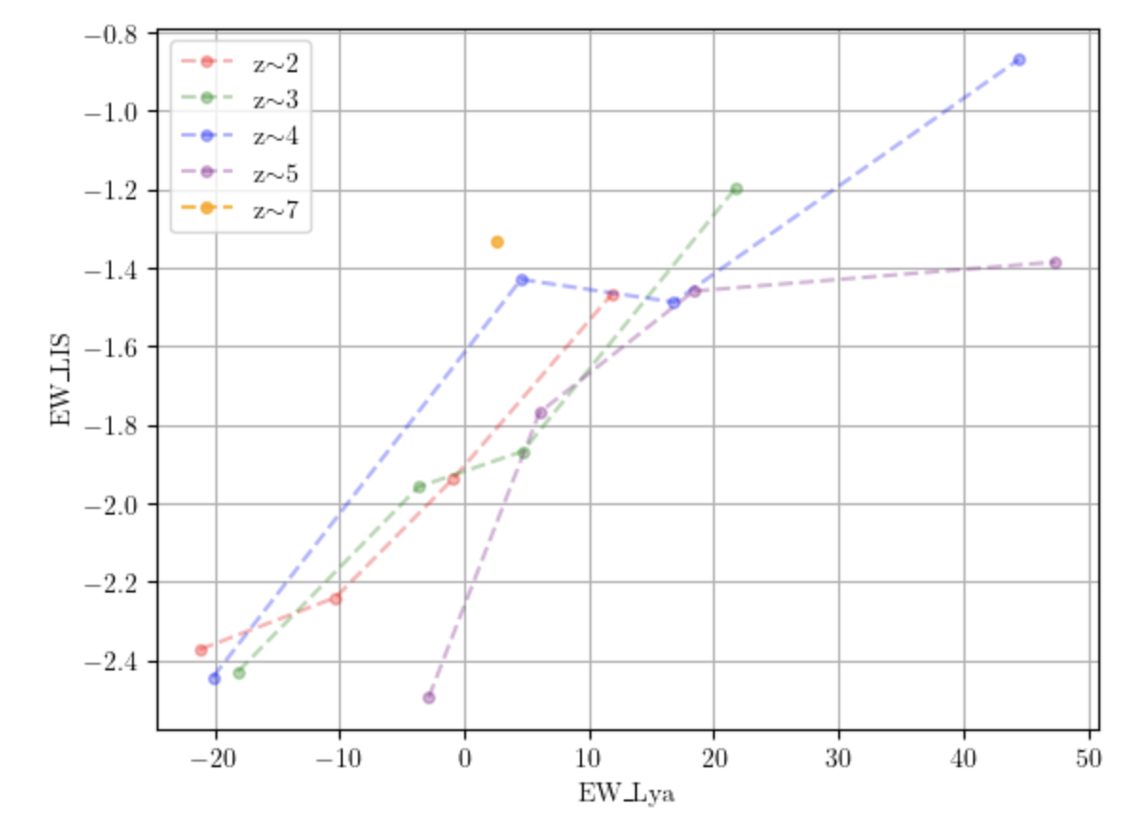

Slide 15
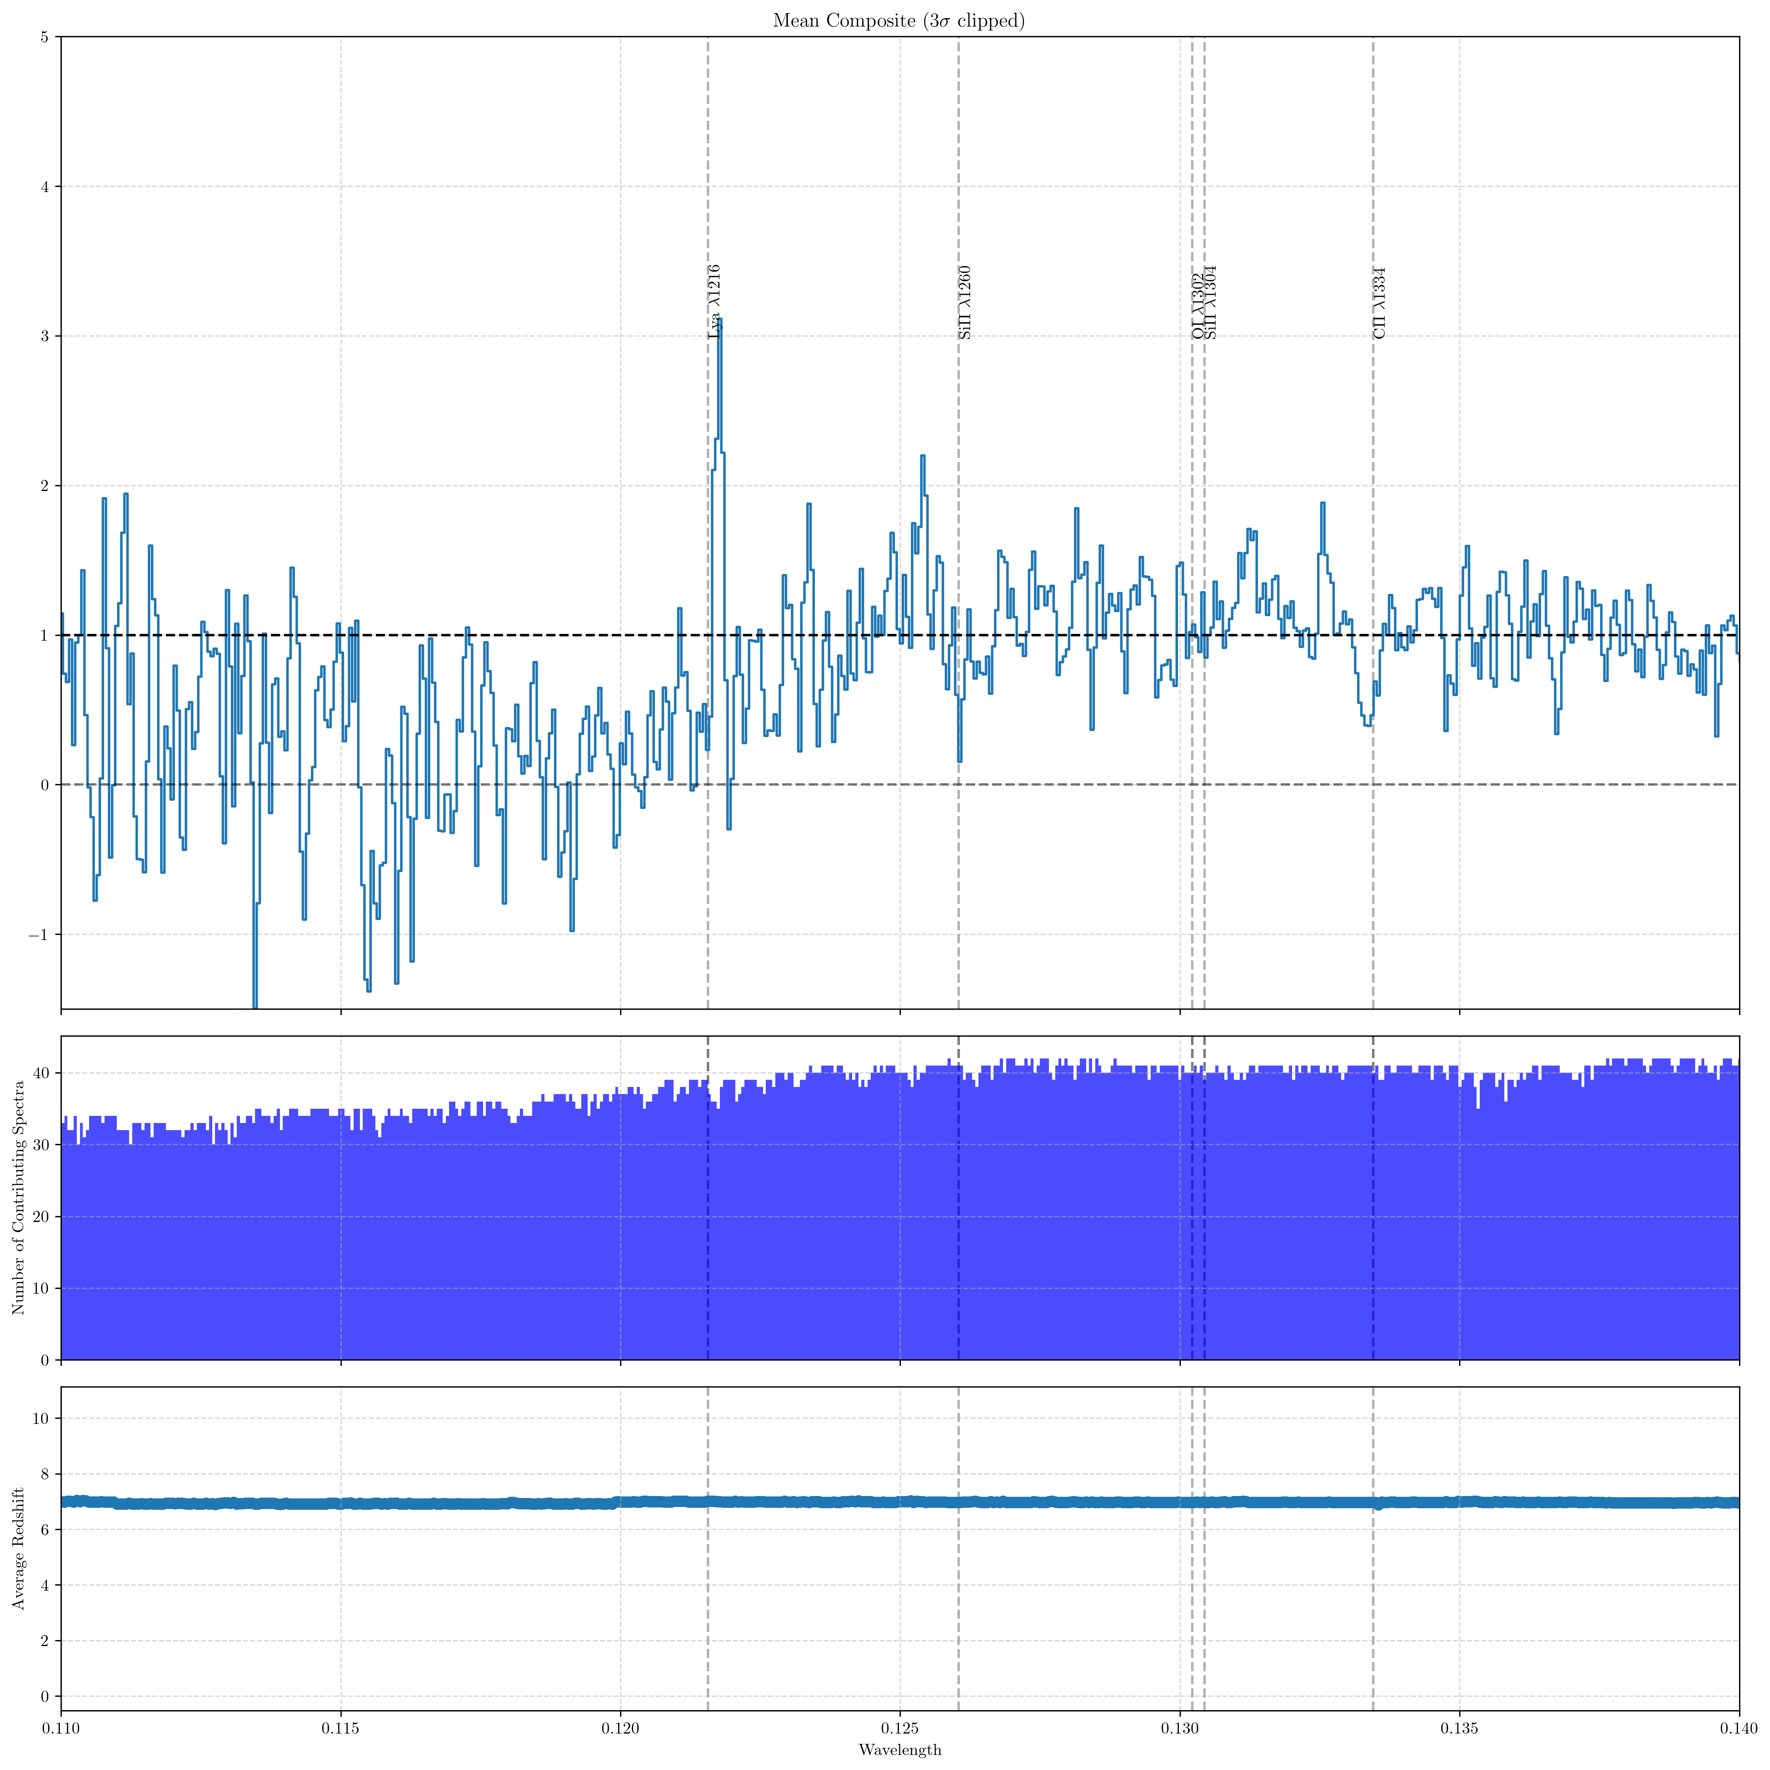
Notes:
Frac
Spectral coverage drops at bluer end, sigma clipping
Separate out what is the actual total before sigma clipping vs how many was rejected in the sigma clipping.

Slide 16
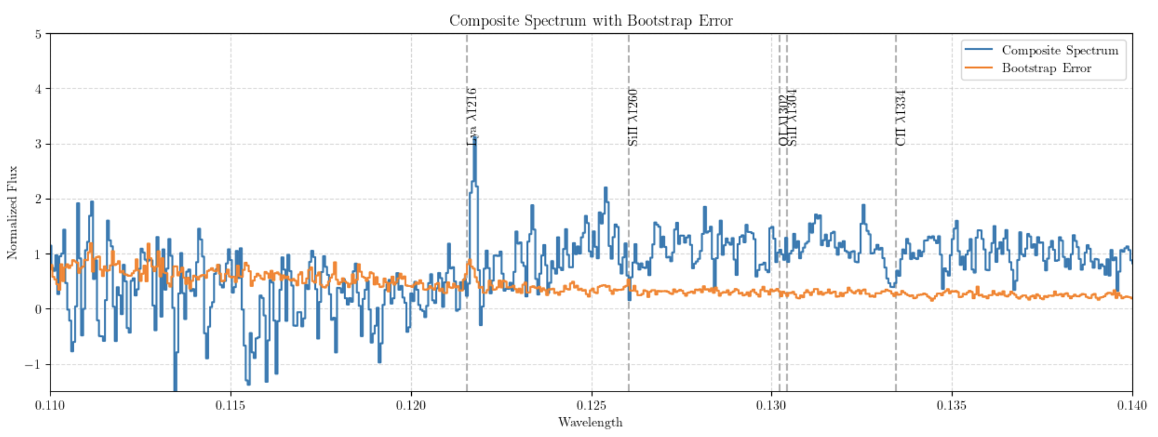

Slide 17
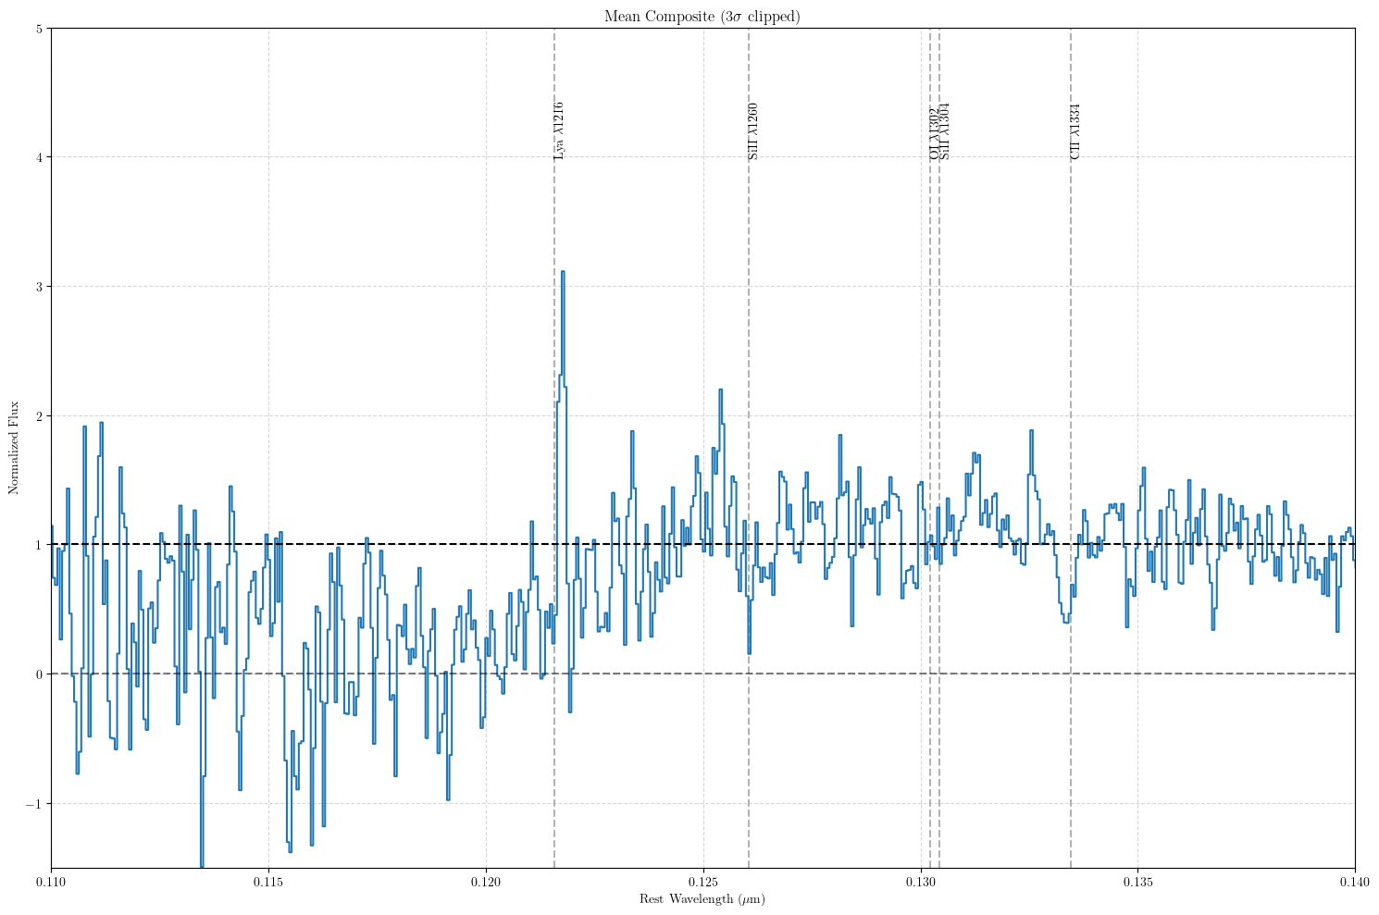

Slide 18
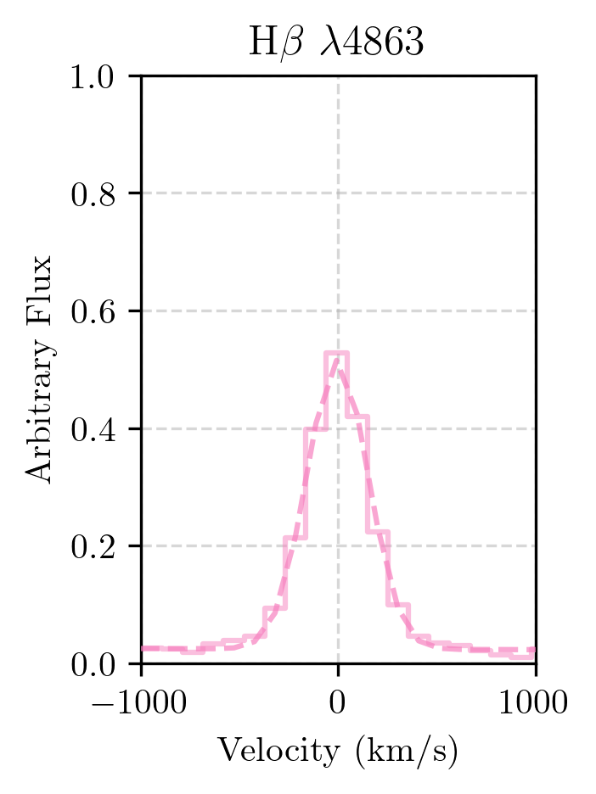
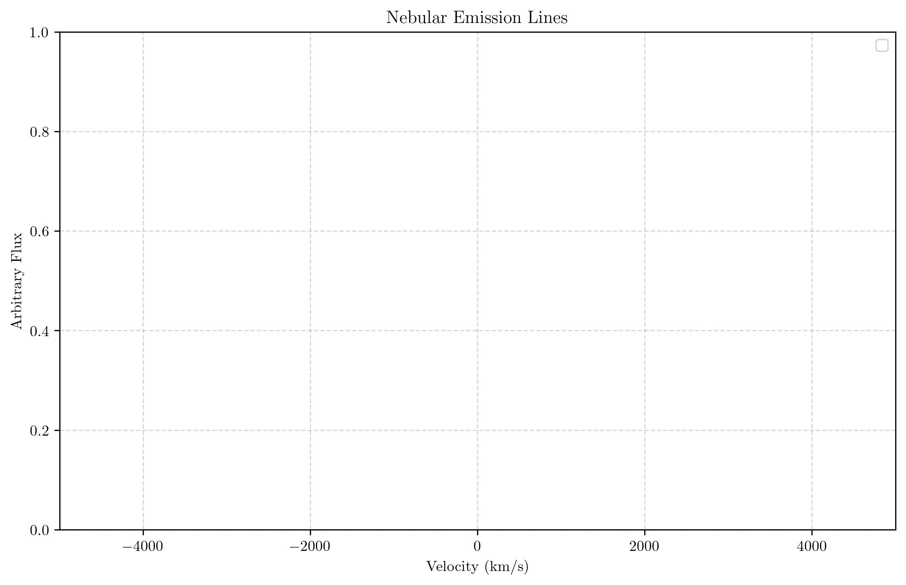
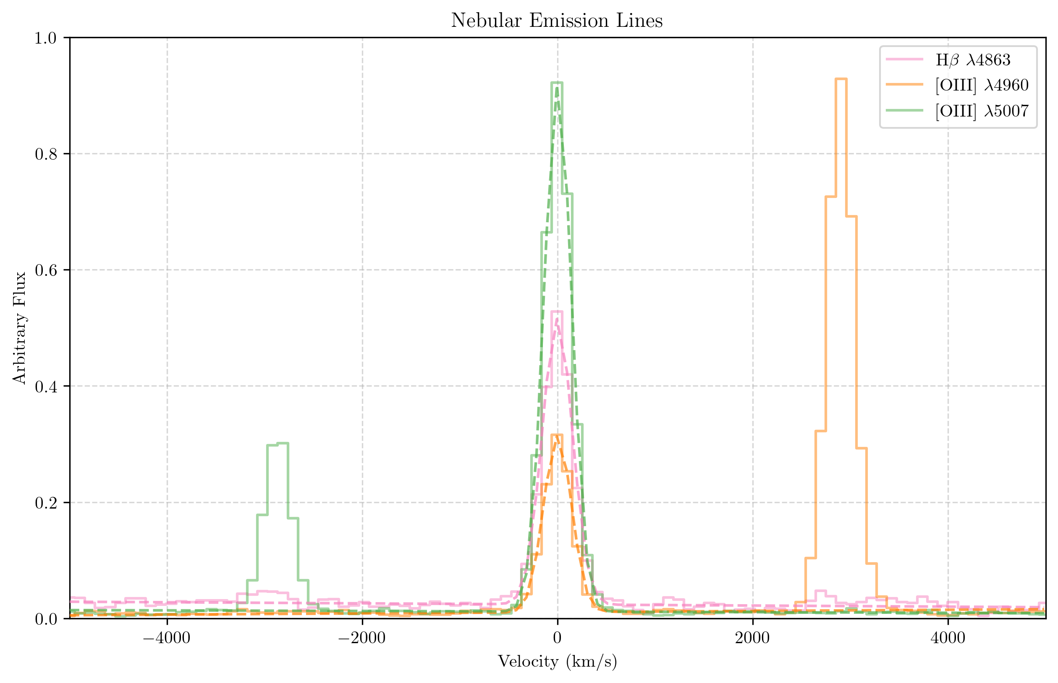
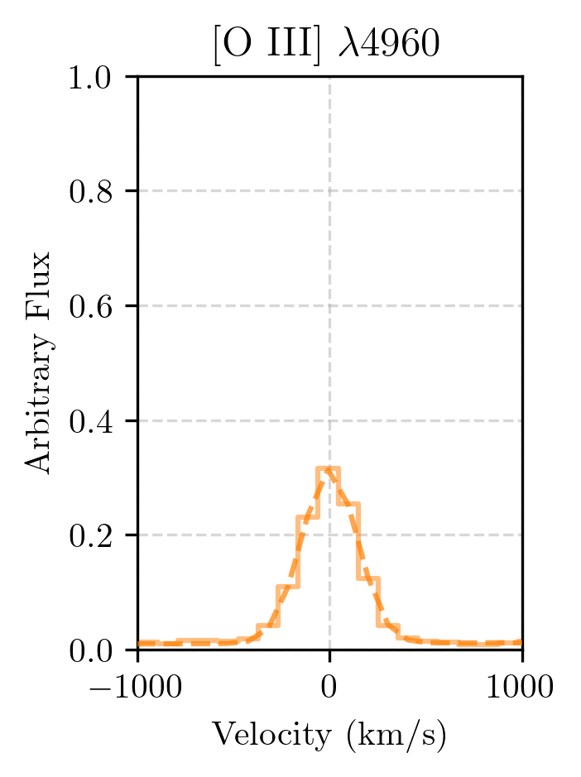
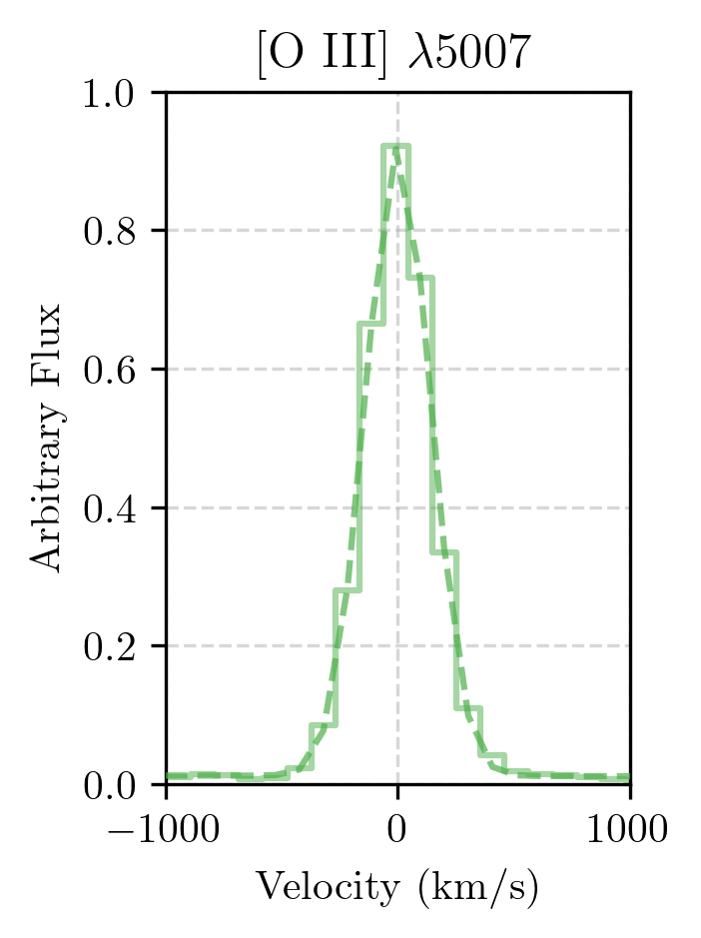
Nebular Emission Lines: $Hβ+[OIII]$
$$v≈−3±2km/s$$
$$v≈−1±1km/s$$
$$v≈1±0.7km/s$$
Notes:
change 5007 —> 5008 (for vacuum)
This the stacked composite
FWHM of nebular emission lines are roughly the same to the resolution of NIRSpec which means giving more confidence (redshift error is tight).

