Slide 1
Towards (more) accurate predictions of the 21-cm signal
Aurel Schneider
Institut für Astrophysik, Universität Zürich
Lecture 2 — Radiation

Slide 2
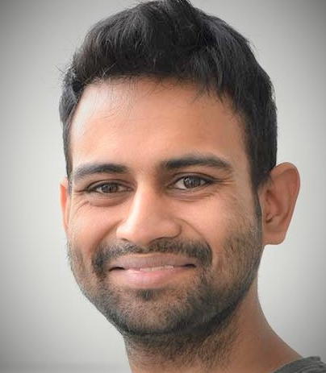
Towards (more) accurate predictions of the 21-cm signal
Aurel Schneider
Institut für Astrophysik, Universität Zürich
Timothée
Schaeffer
Sambit
Giri
Lecture 2 — Radiation

Slide 3
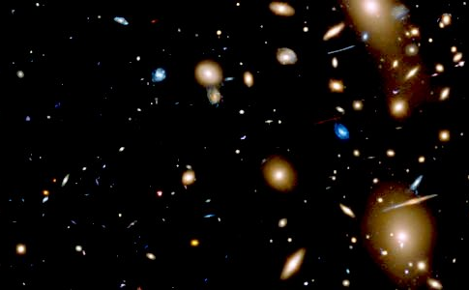
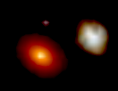
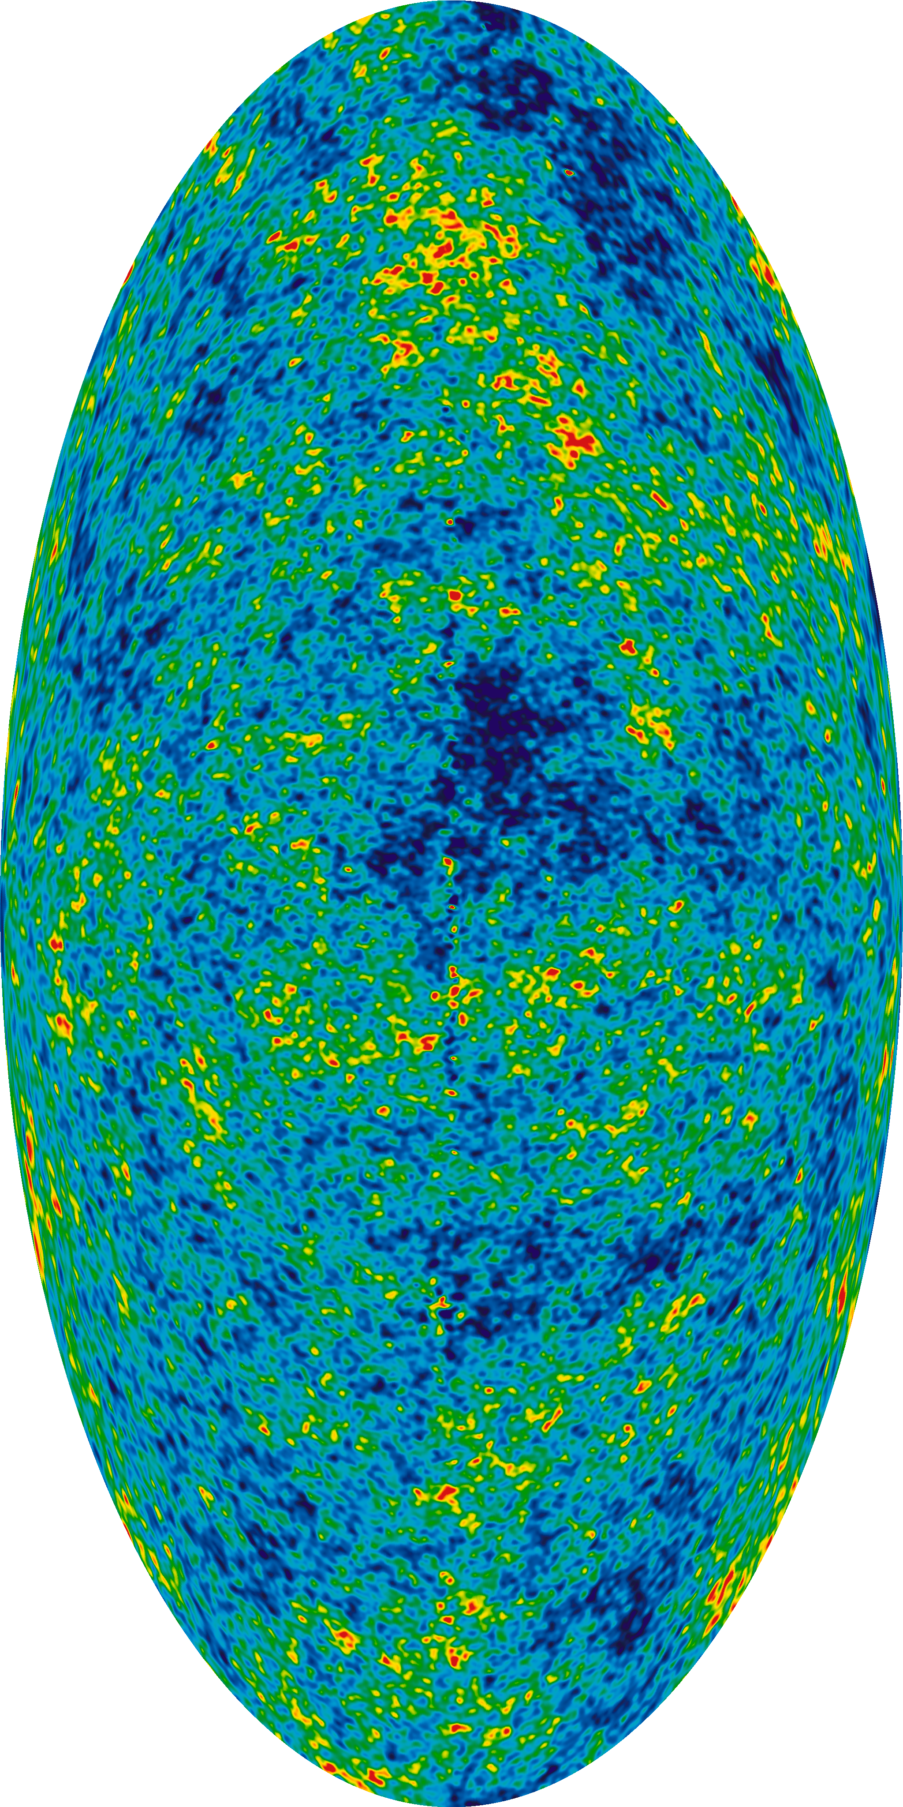
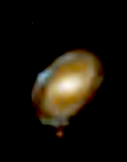
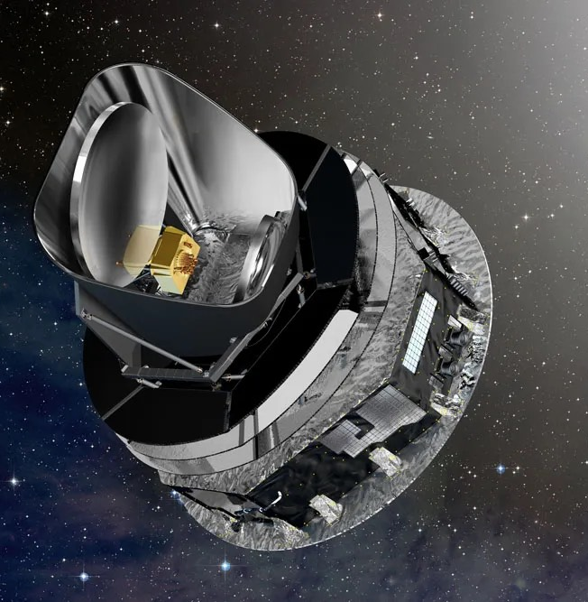
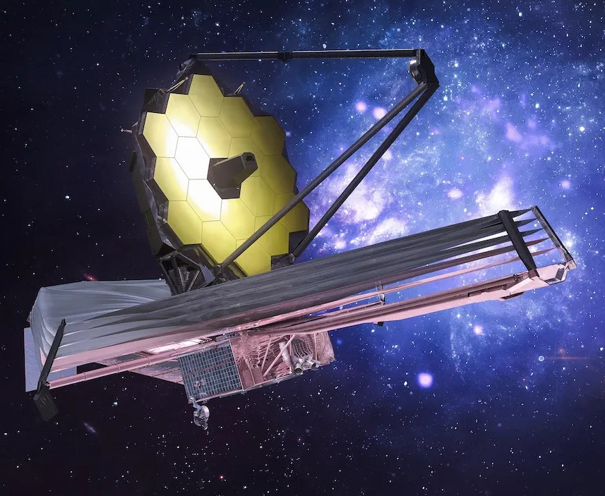
Why the signal is interesting
z = 1100
30
6
0
t = 0.38 Myr
100 Myr
1 Gyr
13.7 Gyr
galaxy surveys
Planck
higher-z galaxies
Euclid
CMB
James Webb

Slide 4
Why the signal is interesting
z = 1100
30
6
0
Square Kilometre Array Telescope
galaxy surveys
Planck
higher-z galaxies
Euclid
CMB
James Webb

Slide 5
Why the signal is interesting
z = 1100
30
6
0
Reionization
dTb
Ly-alpha
radiation
Heating
First stars appear
X-ray heating
First galaxies ionise the universe

Slide 6
An extremely promising signal!

Slide 7
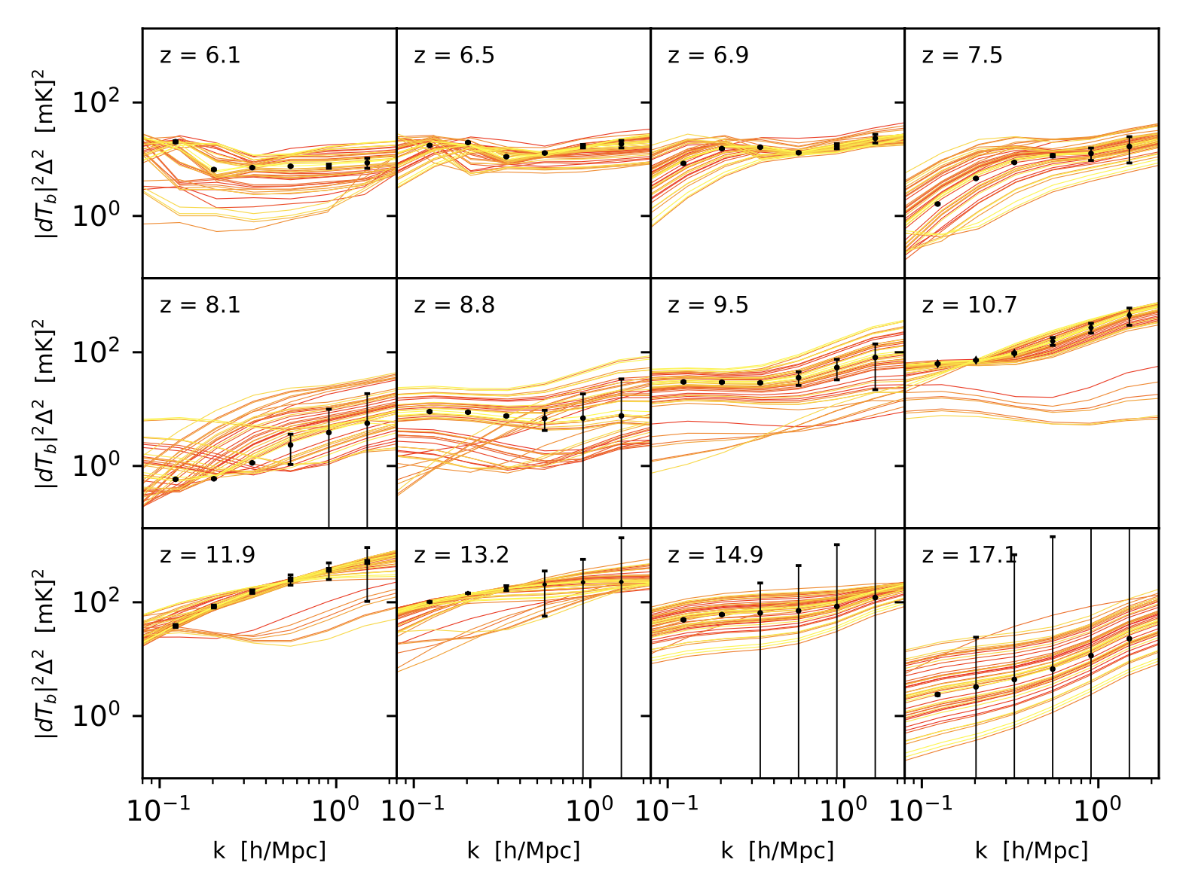
An extremely promising signal!
Forecast for SKA-Low
Assuming: 1000h observing time.
Including: instrumental noise, sample variance, foreground avoidance.
Inference analysis: 6 cosmological and 7 astrophysical parameters
AS, Schaeffer, Giri (2023)

Slide 8
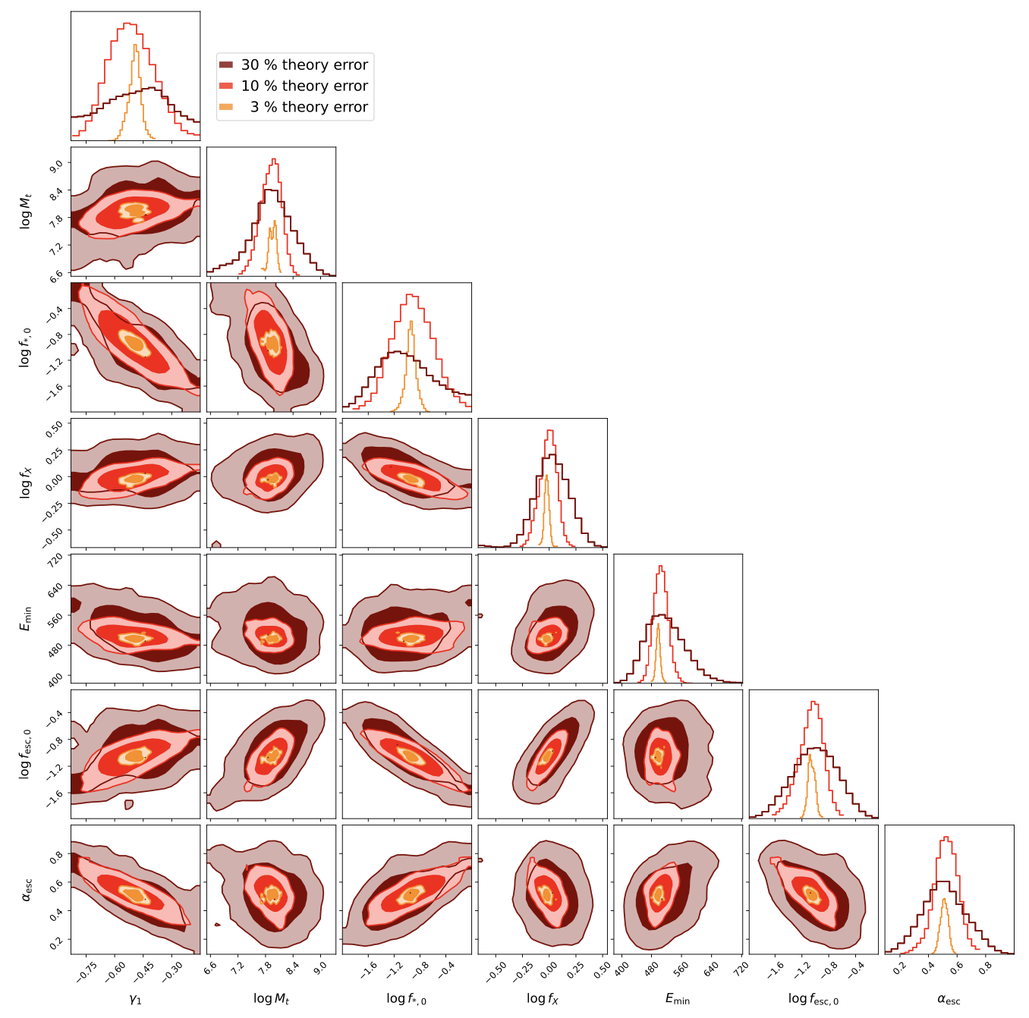
An extremely promising signal!
Forecast for SKA-Low
Assuming: 1000h observing time.
Including: instrumental noise, sample variance, foreground avoidance.
Inference analysis: 6 cosmological and 7 astrophysical parameters
Astrophysics
AS, Schaeffer, Giri (2023)
30 % theory error
10 % theory error
3 % theory error

Slide 9
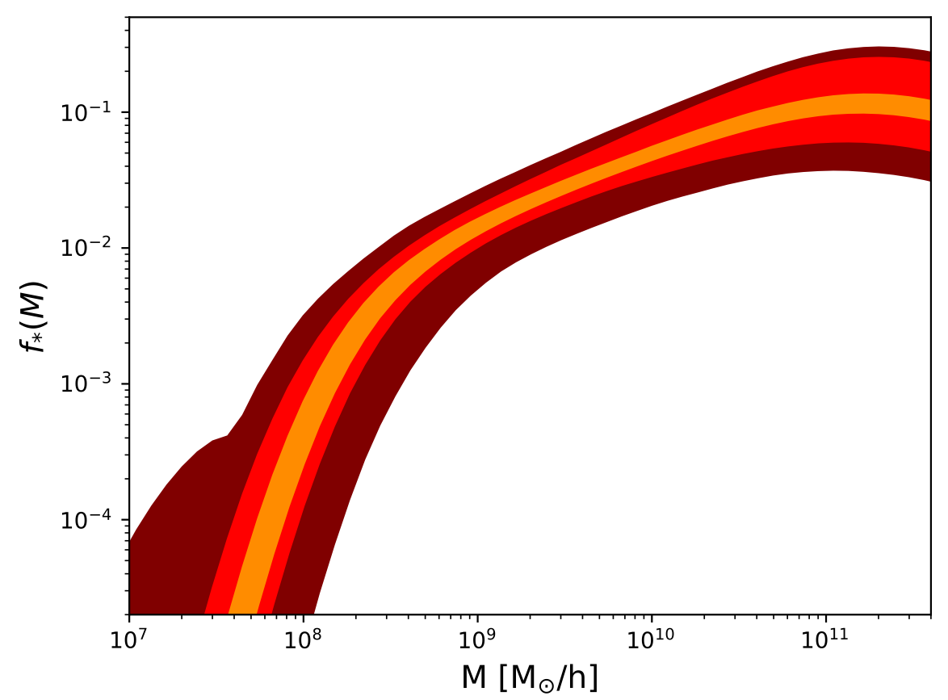
An extremely promising signal!
Forecast for SKA-Low
Assuming: 1000h observing time.
Including: instrumental noise, sample variance, foreground avoidance.
Inference analysis: 6 cosmological and 7 astrophysical parameters
Stellar-to-halo ratio
30 % theory error
10 % theory error
3 % theory error

Slide 10
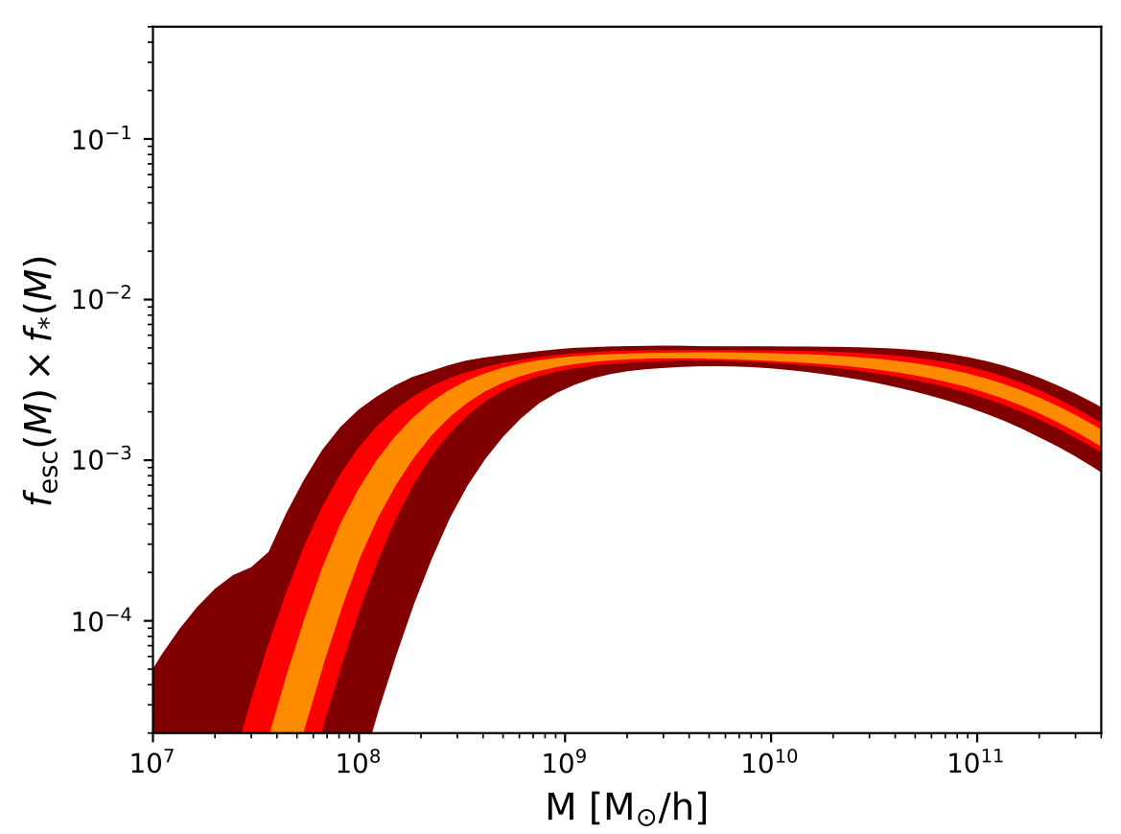
An extremely promising signal!
Forecast for SKA-Low
Assuming: 1000h observing time.
Including: instrumental noise, sample variance, foreground avoidance.
Inference analysis: 6 cosmological and 7 astrophysical parameters
fesc-to-halo ratio
30 % theory error
10 % theory error
3 % theory error

Slide 11
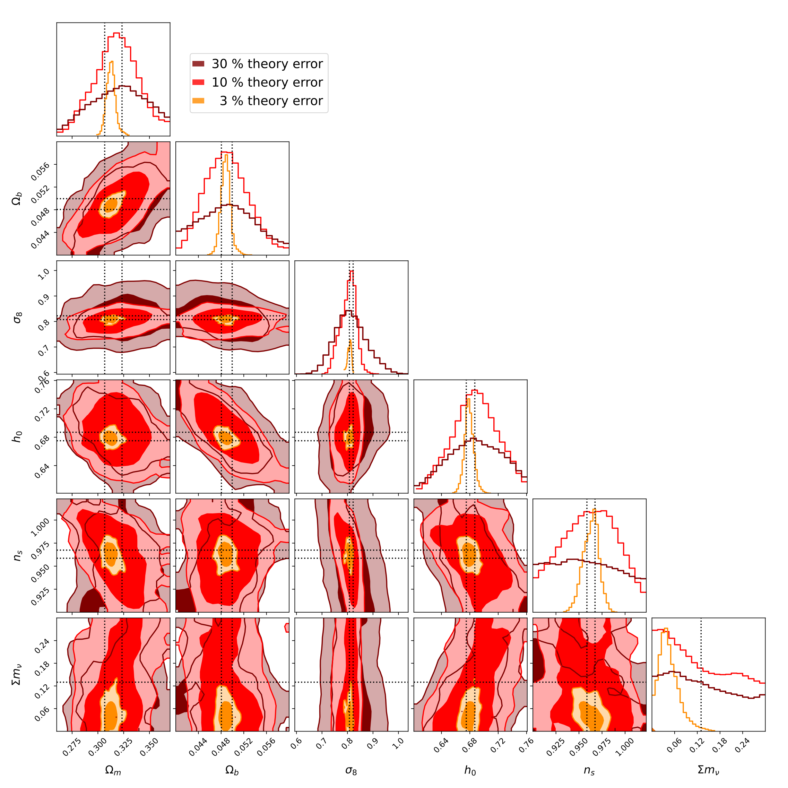
An extremely promising signal!
Forecast for SKA-Low
Assuming: 1000h observing time.
Including: instrumental noise, sample variance, foreground avoidance.
Inference analysis: 6 cosmological and 7 astrophysical parameters
Cosmology
30 % theory error
10 % theory error
3 % theory error

Slide 12
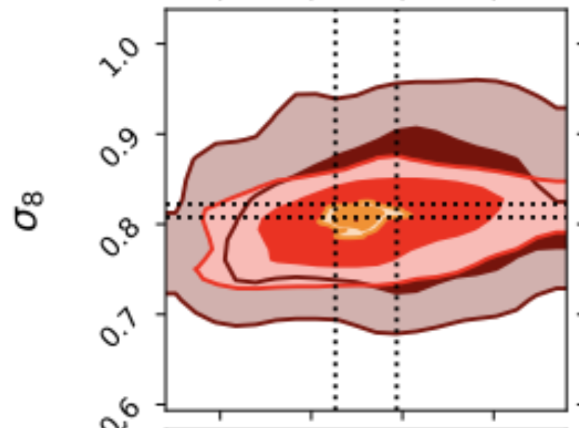
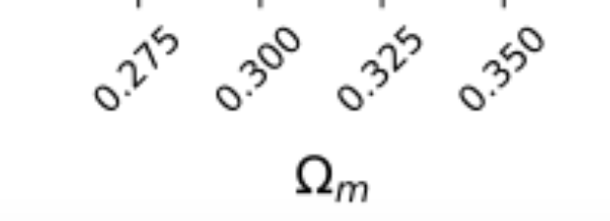
An extremely promising signal!
Forecast for SKA-Low
Assuming: 1000h observing time.
Including: instrumental noise, sample variance, foreground avoidance.
Inference analysis: 6 cosmological and 7 astrophysical parameters
Cosmology
S8 tension
30 % theory error
10 % theory error
3 % theory error

Slide 13
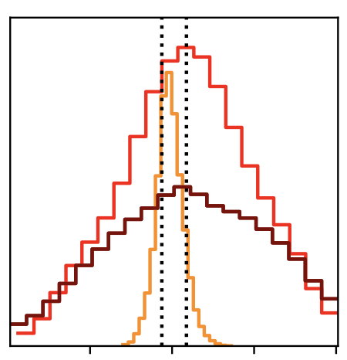
An extremely promising signal!
Forecast for SKA-Low
Assuming: 1000h observing time.
Including: instrumental noise, sample variance, foreground avoidance.
Inference analysis: 6 cosmological and 7 astrophysical parameters
H0 tension
30 % theory error
10 % theory error
3 % theory error

Slide 14
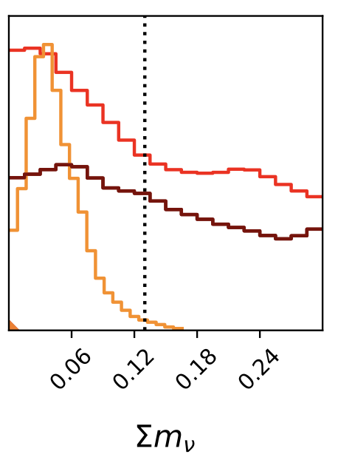
An extremely promising signal!
Forecast for SKA-Low
Assuming: 1000h observing time.
Including: instrumental noise, sample variance, foreground avoidance.
Inference analysis: 6 cosmological and 7 astrophysical parameters
Neutrino masses
30 % theory error
10 % theory error
3 % theory error

Slide 15
Hence … development and improvement of prediction tools !

Slide 16
Simulations / Codes (incomplete)
21cmFAST
Ramses-RT (Sphinx)
Furlanetto-approach
Amber
CRASH
Enzo+Moray (Renaissance)
Micro21cm
Astreus
BEoRN-HM
BEoRN
C2-Ray
Arepo-RT (Thesan)
Zeus
SimFast21
Grizzly
Ramses-Cudaton (CoDa)
Analytical predictions
Semi-numerical sims
Radiative transfer on N-body
Radiative-transfer-hydro sims
Notes:
Simulation landscape (from analytical methods, fast approximative) to full RT hydro sims (that are in principle the most accurate but very computationally expensive)
BEORN lies in-between which means it can be used to run simulations within minutes. This is important to probe the vast parameter space.
The different methods are complementary. Full hydro sims can be used to calibrate faster methods that are then used to perform statistical analyses.

Slide 17
BEORN: Simulating the 21-cm signal
Based on N-body (or hydro) simulation outputs.
Schaeffer, Giri & AS (2023)

Slide 18
BEORN: Simulating the 21-cm signal
Based on N-body (or hydro) simulation outputs.
Source model (dependent on halo mass).
Schaeffer, Giri & AS (2023)

Slide 19
BEORN: Simulating the 21-cm signal
Based on N-body (or hydro) simulation outputs.
Source model (dependent on halo mass).
Radiation and temperature profiles (including look-back effects).
Schaeffer, Giri & AS (2023)

Slide 20
BEORN: Simulating the 21-cm signal
Based on N-body (or hydro) simulation outputs.
Source model (dependent on halo mass).
Radiation and temperature profiles (including look-back effects).
Ionisation profiles with redistribution of photons for overlapping regions (photon conservation).
Schaeffer, Giri & AS (2023)

Slide 21
Varying Pop III star formation
BEORN
… varying $f_{∗}(M)$

Slide 22
Varying Pop III star formation
BEORN
… varying $f_{∗}(M)$
… varying $f_{X}(M)$

Slide 23
Varying Pop III star formation
BEORN
… varying $f_{∗}(M)$
… varying $f_{X}(M)$
… varying $f_{esc}(M)$

Slide 24
Varying Pop III star formation
Some lessons learned on the way …

Slide 25
Varying Pop III star formation
Some lessons learned on the way …
Saturated spin temperature approximation is often problematic.

Slide 26
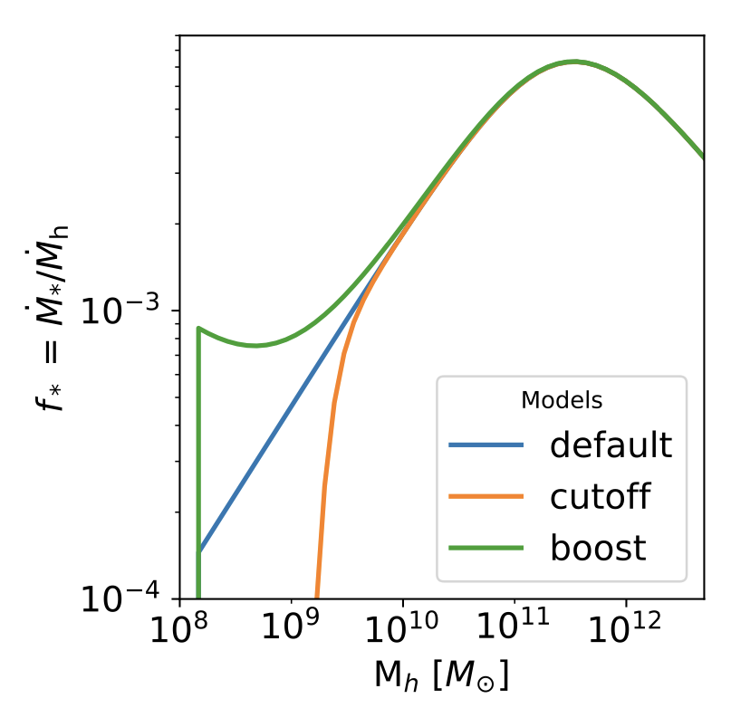
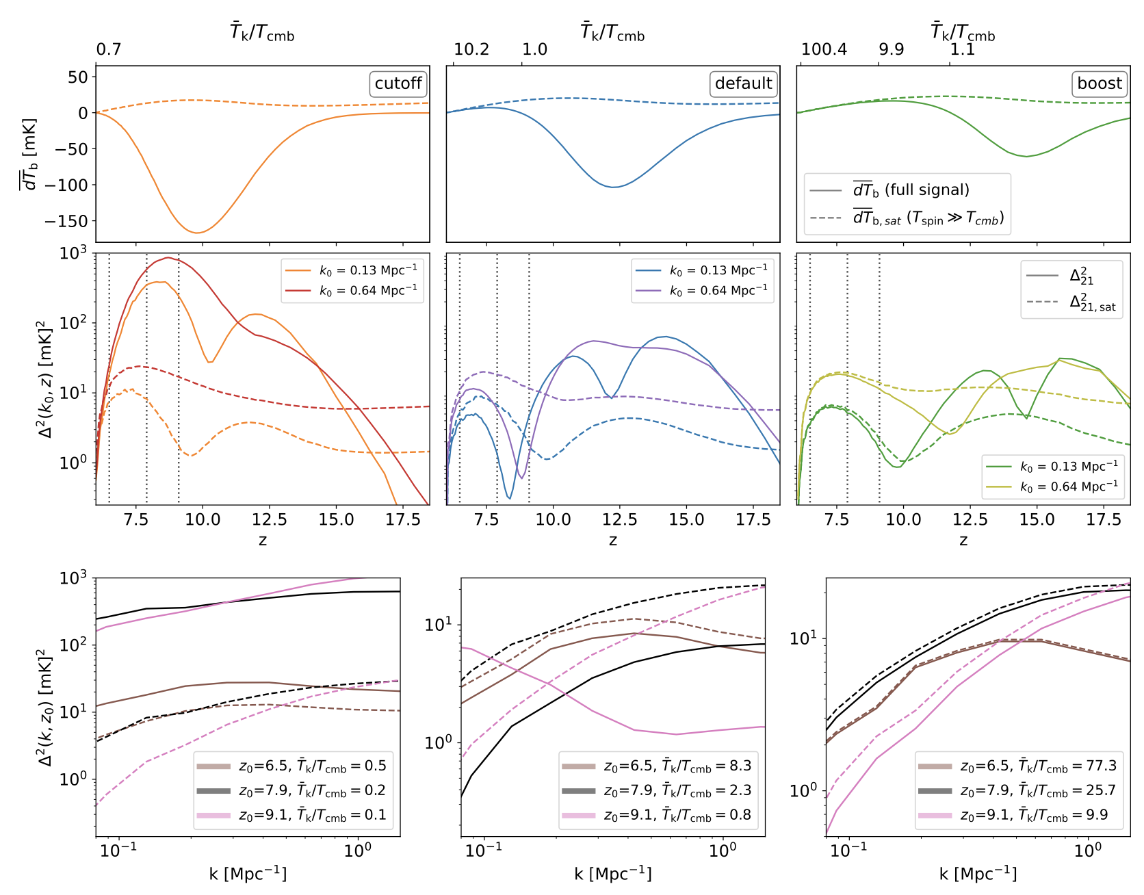
Varying Pop III star formation
Some lessons learned on the way …
Saturated spin temperature approximation is often problematic.
Schaeffer, Giri & AS (2024)

Slide 27
Varying Pop III star formation
Some lessons learned on the way …
Saturated spin temperature approximation is often problematic.
Schaeffer, Giri & AS (2024)

Slide 28
Varying Pop III star formation
Some lessons learned on the way …
Neutral universe approximation for the cosmic dawn is not very good either.

Slide 29
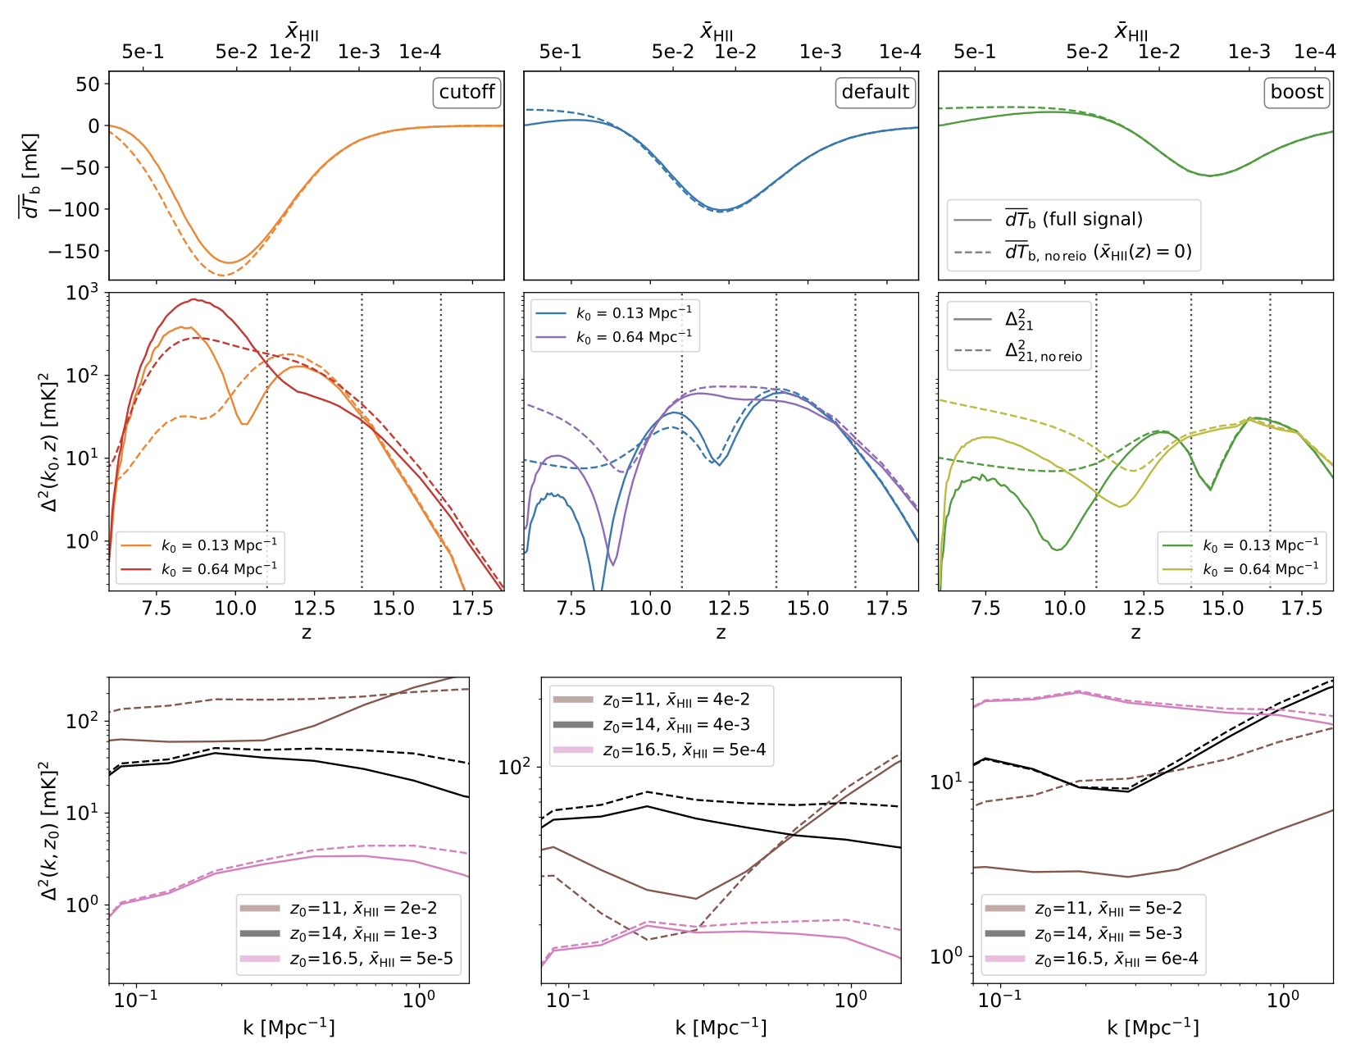
Varying Pop III star formation
Some lessons learned on the way …
Neutral universe approximation for the cosmic dawn is not very good either.
Schaeffer, Giri & AS (2024)

Slide 30
Varying Pop III star formation
Some lessons learned on the way …
Neutral universe approximation for the cosmic dawn is not very good either.
Schaeffer, Giri & AS (2024)

Slide 31
Varying Pop III star formation
Some lessons learned on the way …
Analytical methods based in perturbative approaches (instead of maps) are not precise.

Slide 32
Varying Pop III star formation
Some lessons learned on the way …
Analytical methods based in perturbative approaches (instead of maps) are not precise.
default
boost
cutoff
Schaeffer, Giri & AS (2024)

Slide 33
Summary
The 21cm signal fills up a significant fraction of the co-moving universe.
It a promising probe … for astrophysics and cosmology.
Spin temperature is often not fully saturated.
Reionisation starts surprisingly early (affecting the signal at cosmic dawn).
Lecture 2 — Radiation

