Slide 1
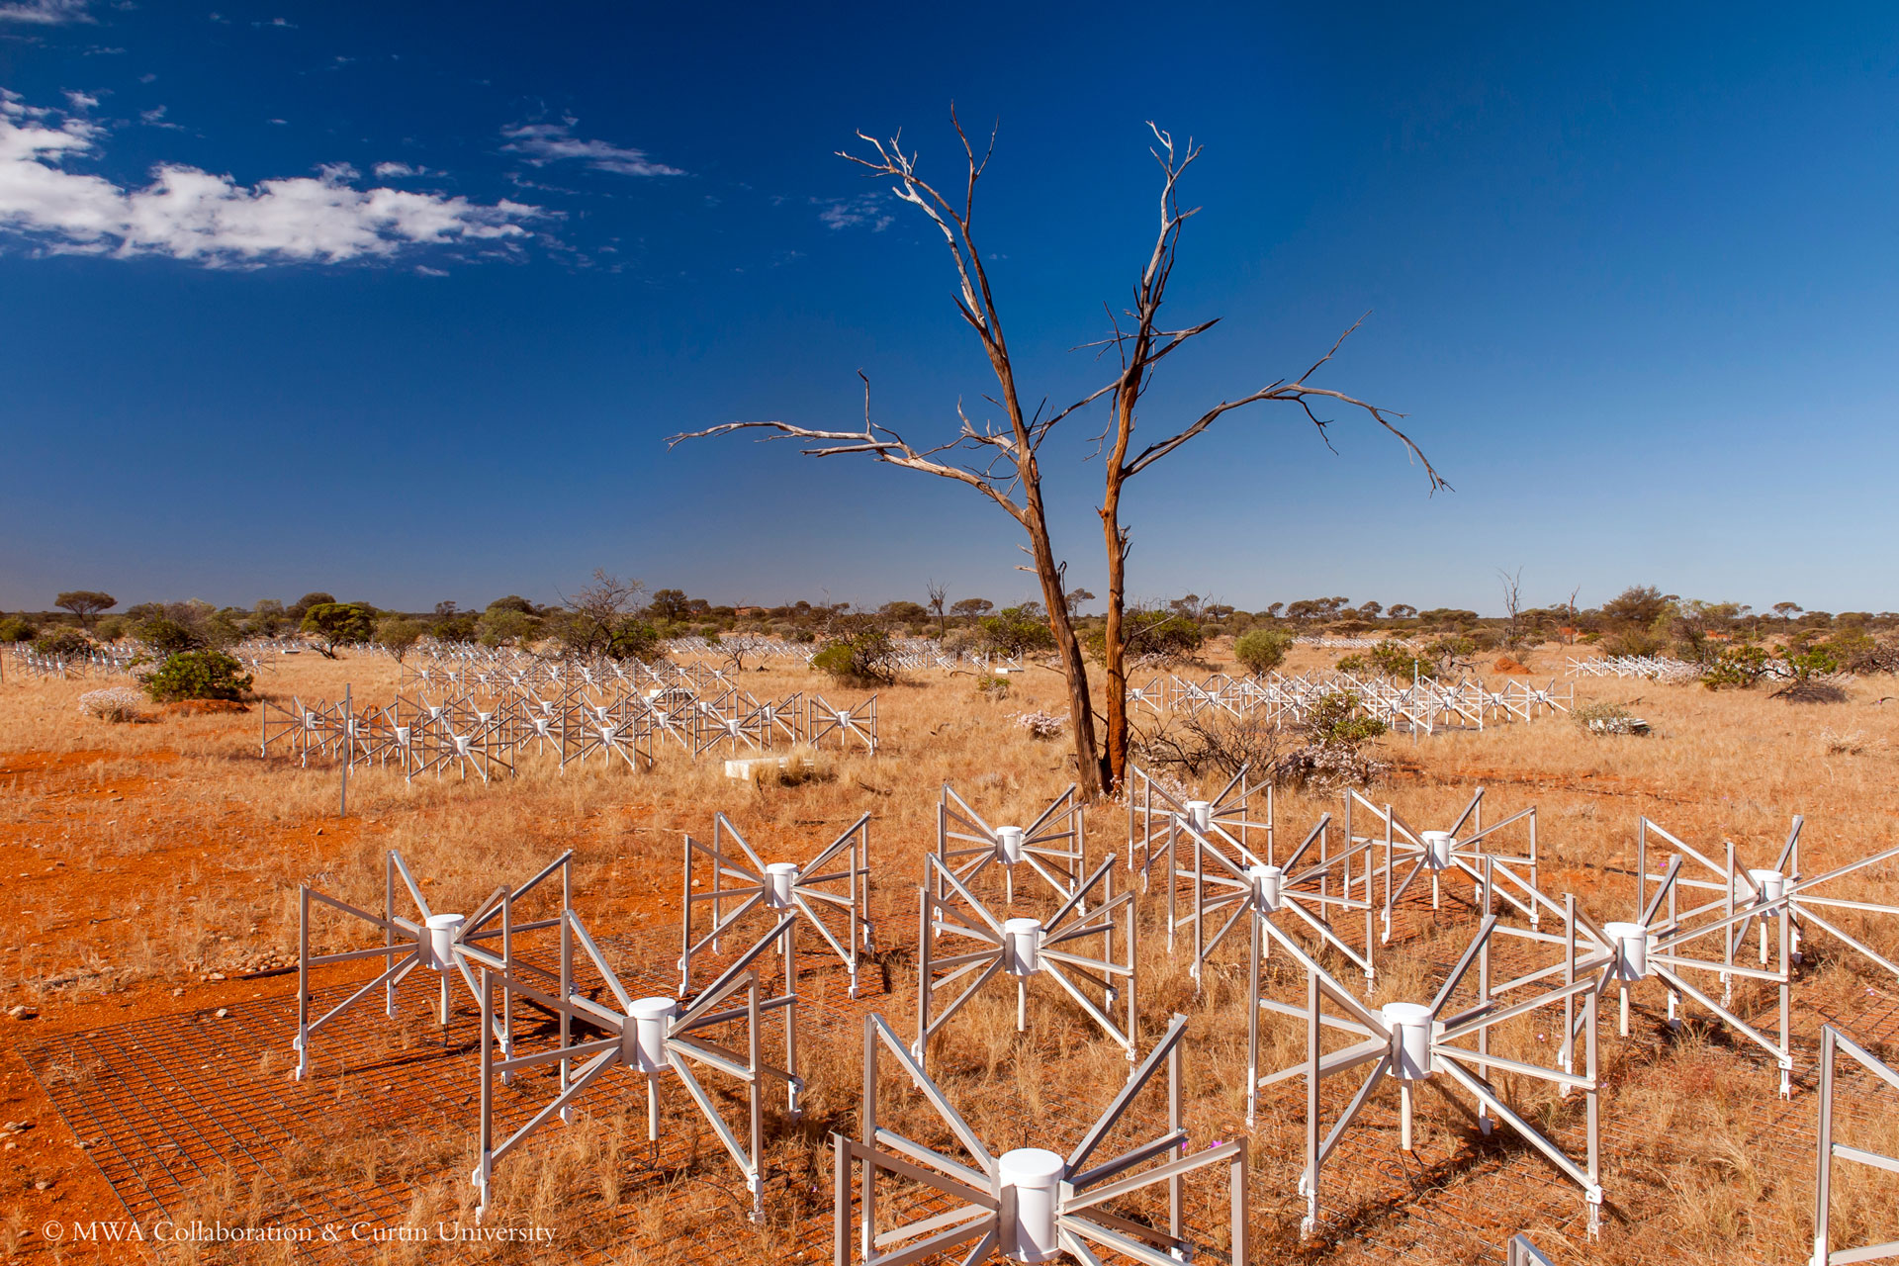
Latest 21cm results from the Murchison widefield array
Cathryn Trott, on behalf of the Australia-based MWA EoR group
We acknowledge the Wajarri Yamatji people as the traditional owners of the Observatory site
Inyarrimanha Ilgari Bundara

Slide 2






Mwaeor Australia-based team

Slide 3
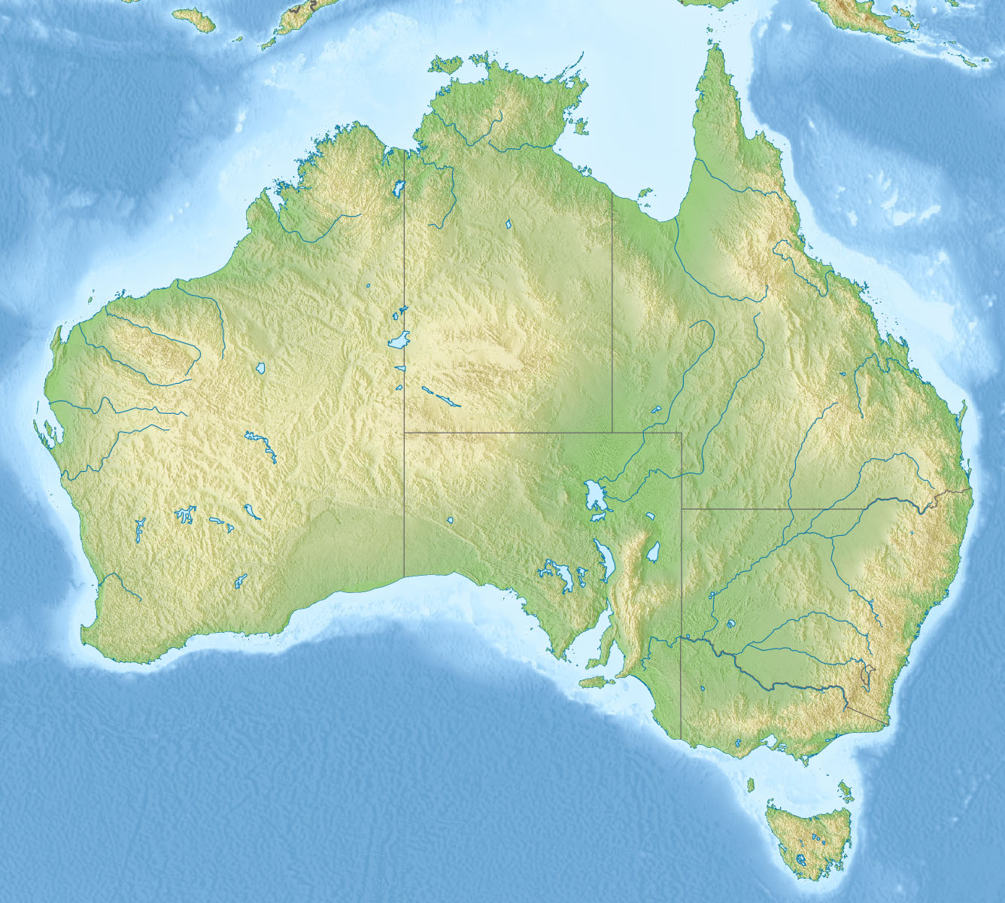
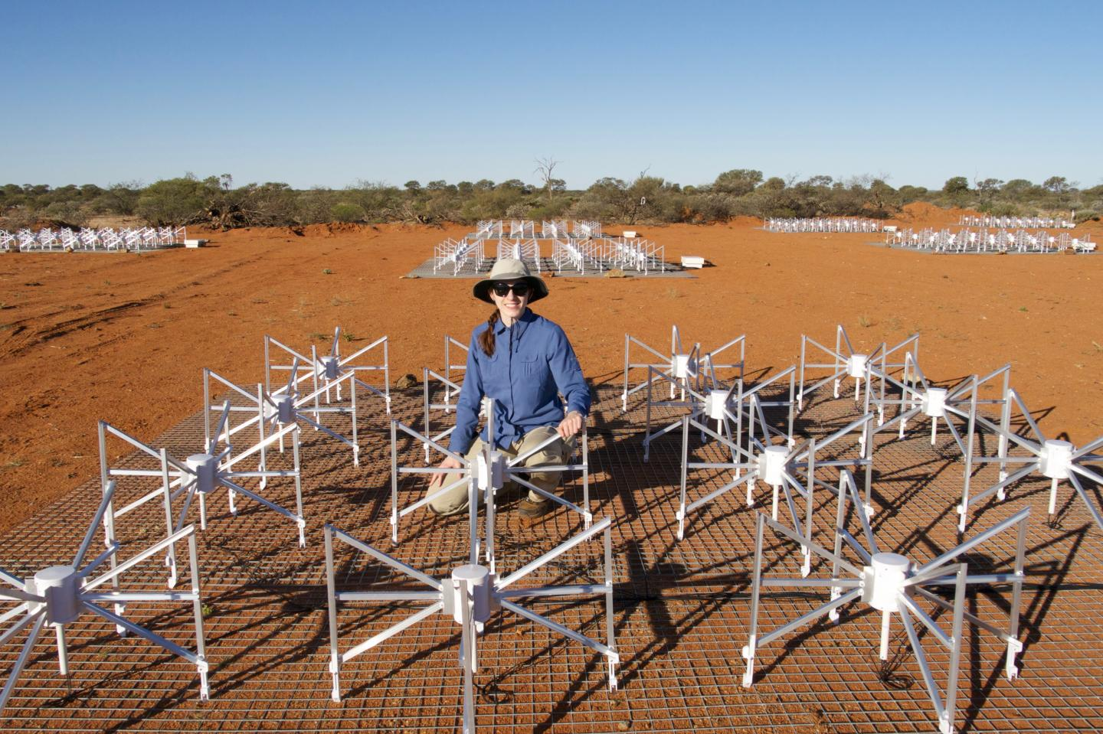
the murchison widefield array
Inyarrimanha Ilgari Bundara
256 “tiles” of 16 dipoles in a uniform grid
145 tiles can be correlated simultaneously
80 – 300 MHz
z = 17 – 4 (6.5 – 9.2)
Angular scales of 1 arcmin – 5 degrees (150 MHz)
Observations: 2013 - 2023

Slide 4
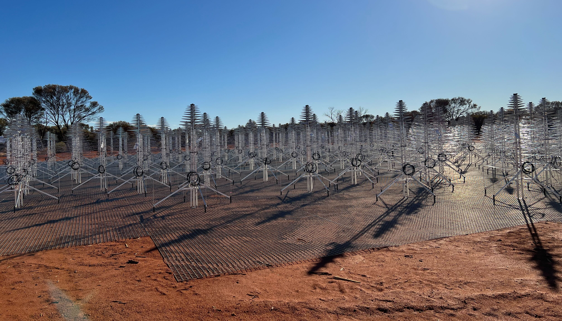
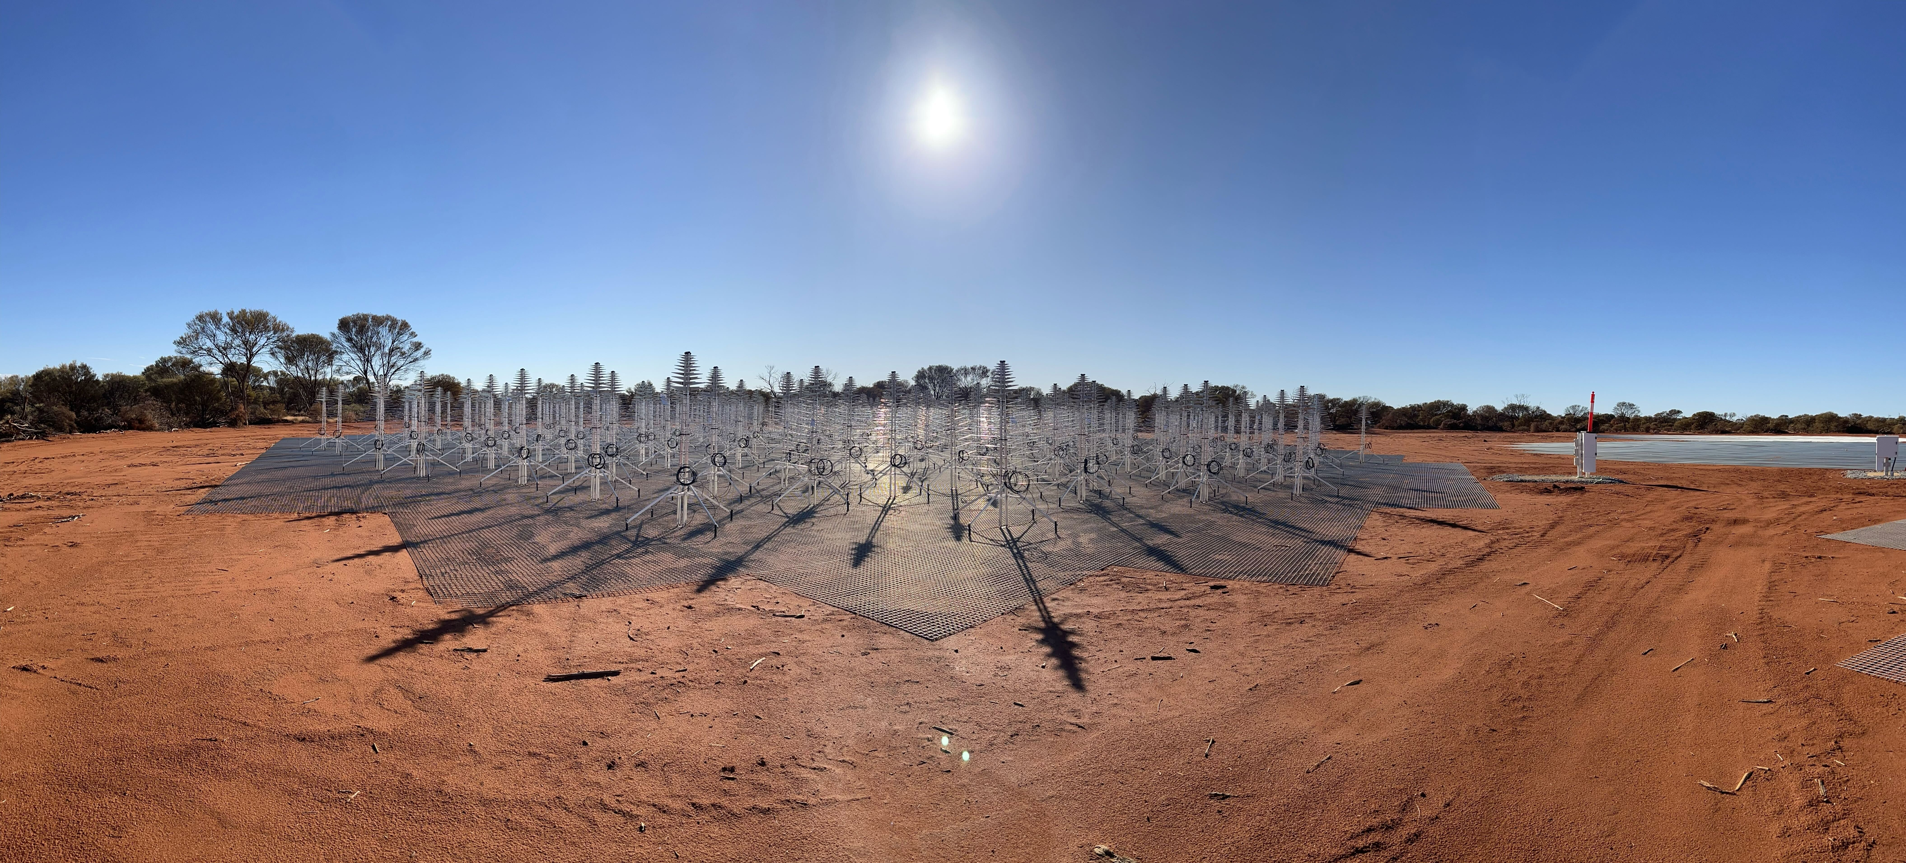
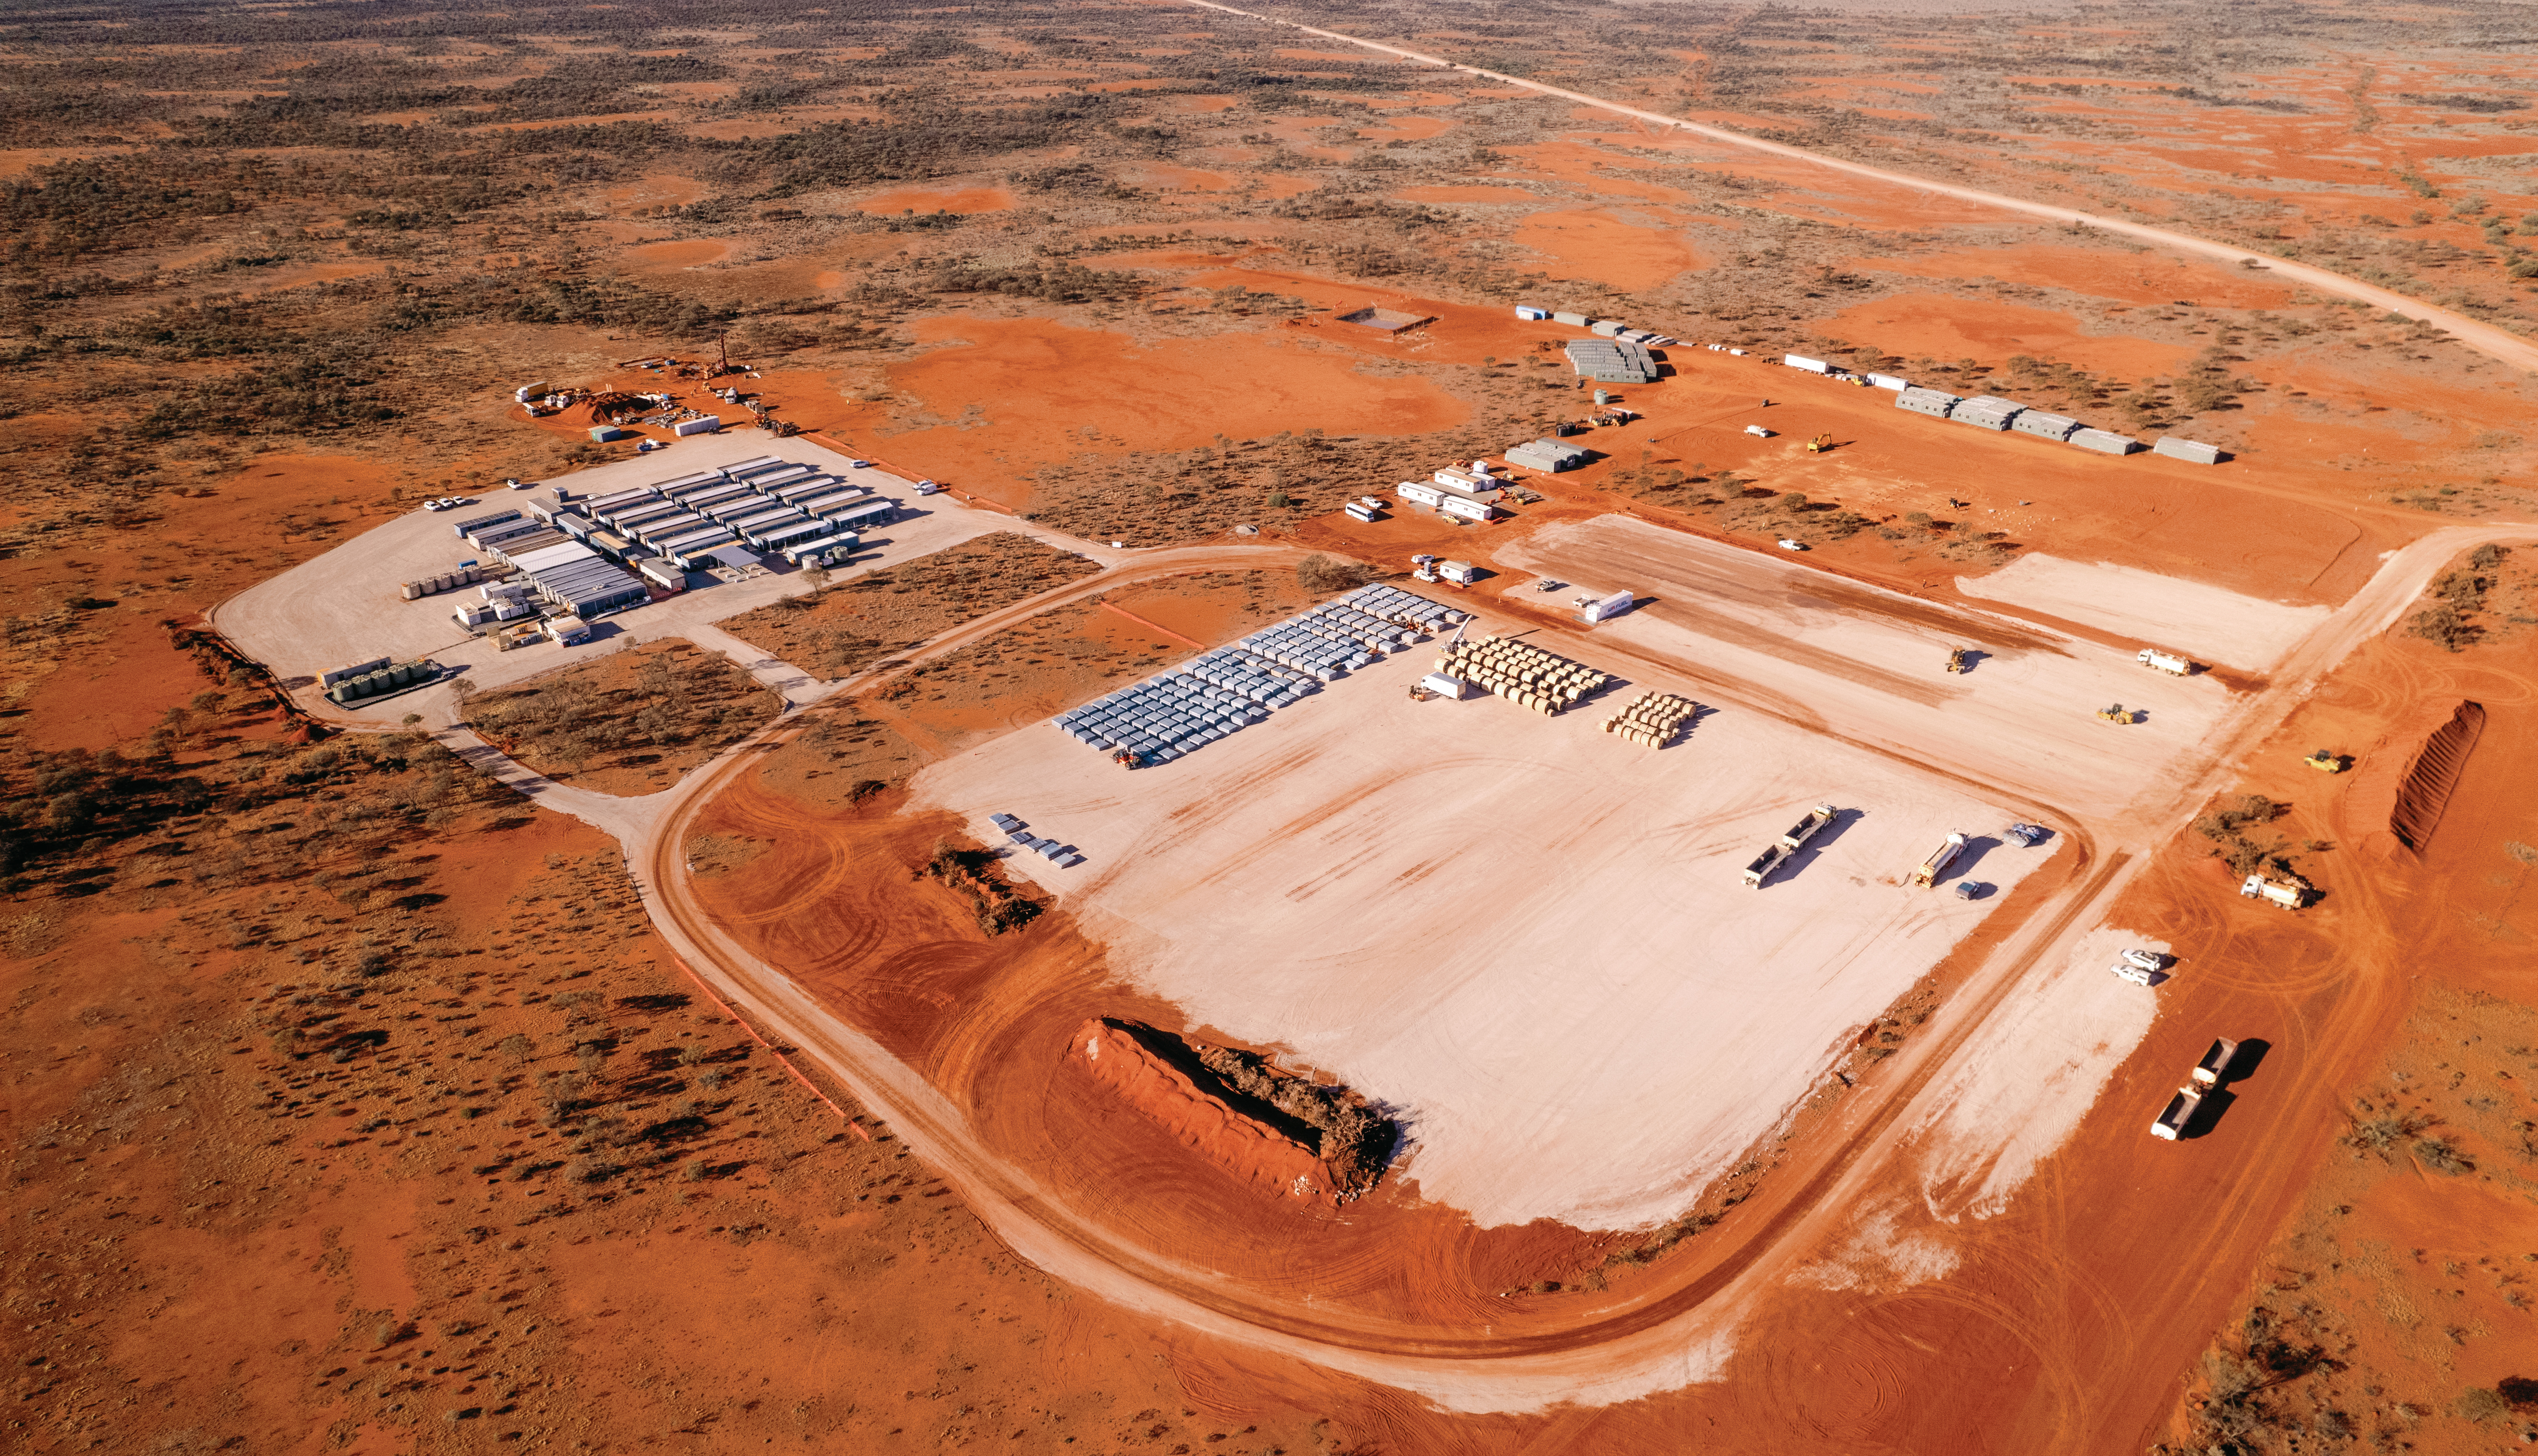
Diversion: SKA-Low update

Slide 5


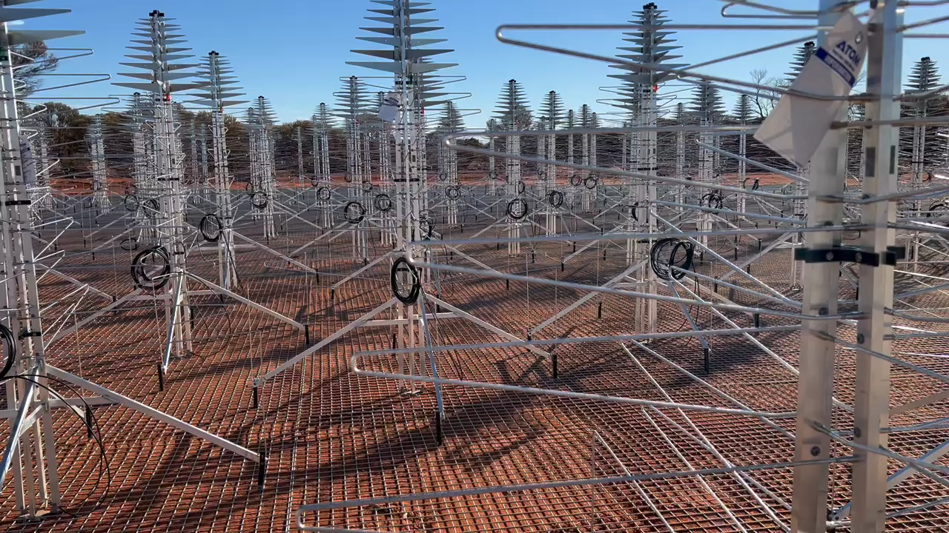
The first station – last month
Credit: Sarah Pearce

Slide 6
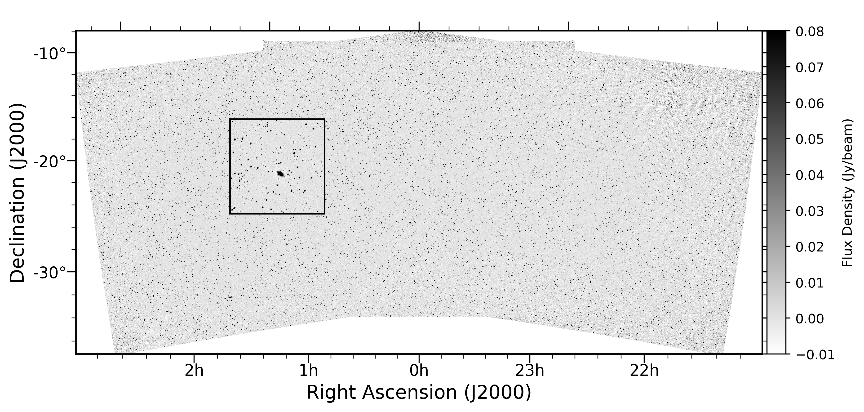

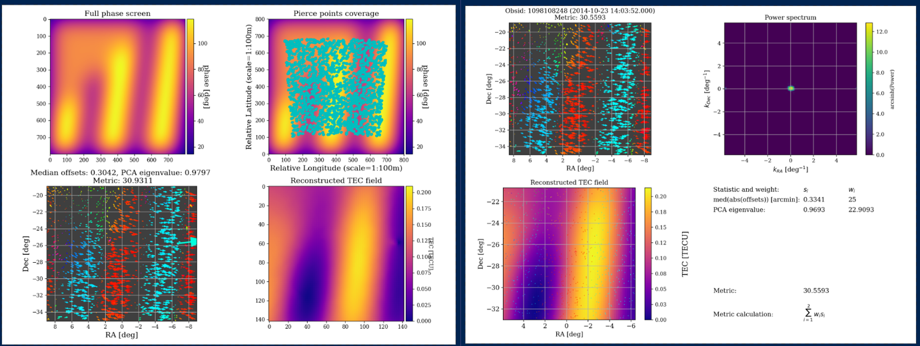
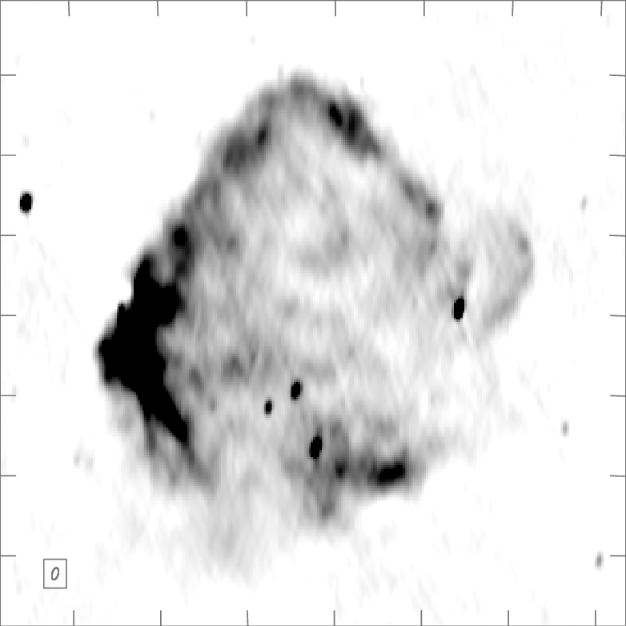
MWA background work
SKY
IONOSPHERE
TELESCOPE
ANALYSIS
Full end-to-end simulations

Slide 7
MWA background work
SKY
IONOSPHERE
TELESCOPE
ANALYSIS
Joseph et al 2018;
Chokshi et al 2021;
Chokshi et al 2024;
Barry et al 2024;
Selvaraj et al 2024a,b
Lynch et al 2021;
Cook et al 2022;
Kriele et al 2020
McKinley et al 2022
Barry et al 2019a, b;
Trott et al 2020;
Rahimi et al 2021;
Jordan et al 2024
Nunhokee et al 2024
Jordan et al 2017;
Trott et al 2017
Full end-to-end simulations
Line et al 2024a, 2024b

Slide 8
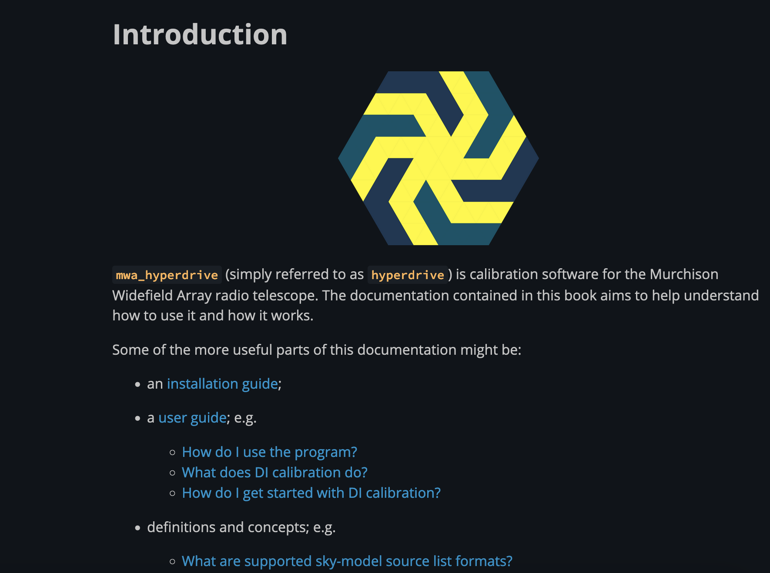
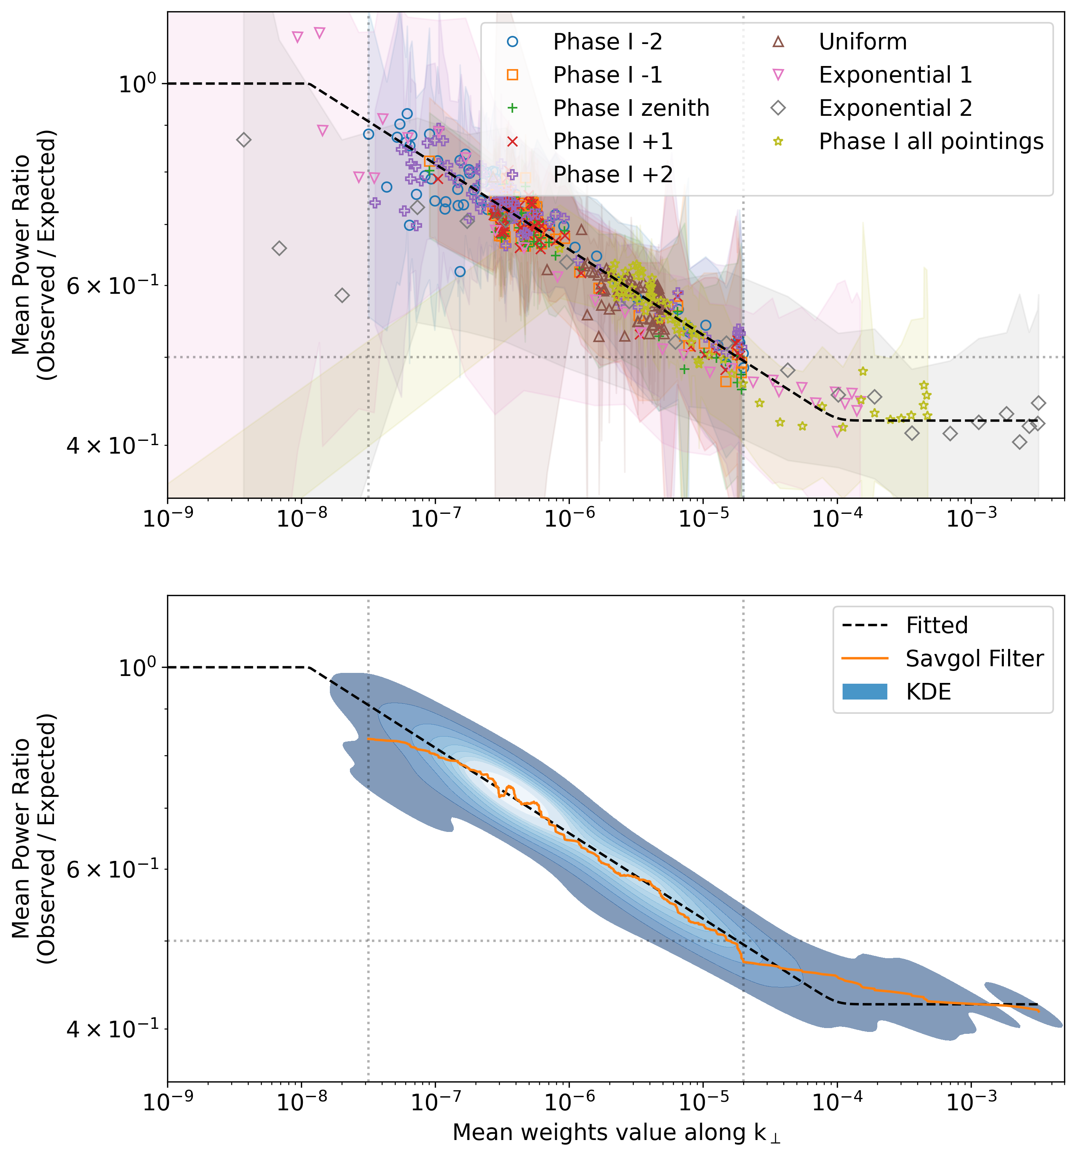
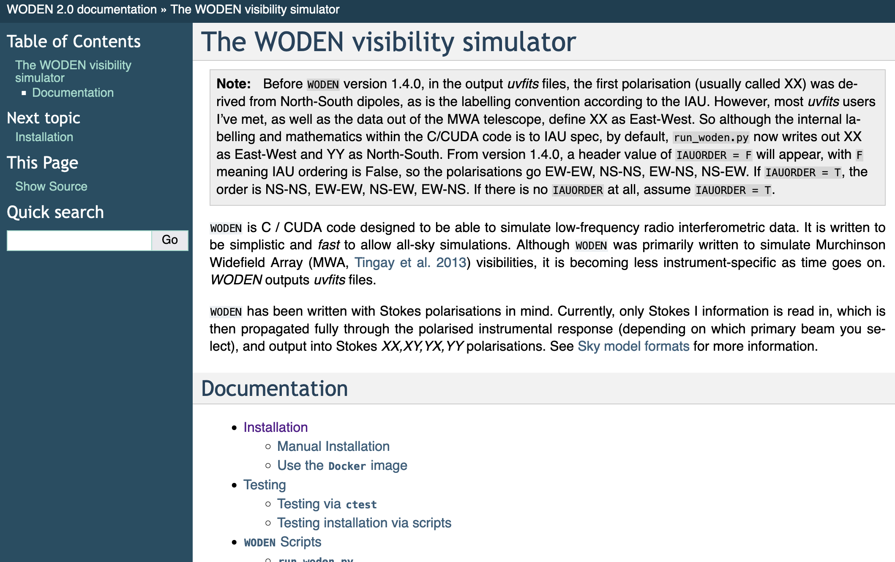

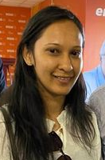
updated tools: calibration, sky model, QA metrics, e2e simulations
What have we learned from simulations?
The top cause of leakage is an incomplete sky model;
Jordan, et al (2024, in review), Line et al (2024a, b), Nunhokee et al (2024)

Slide 9
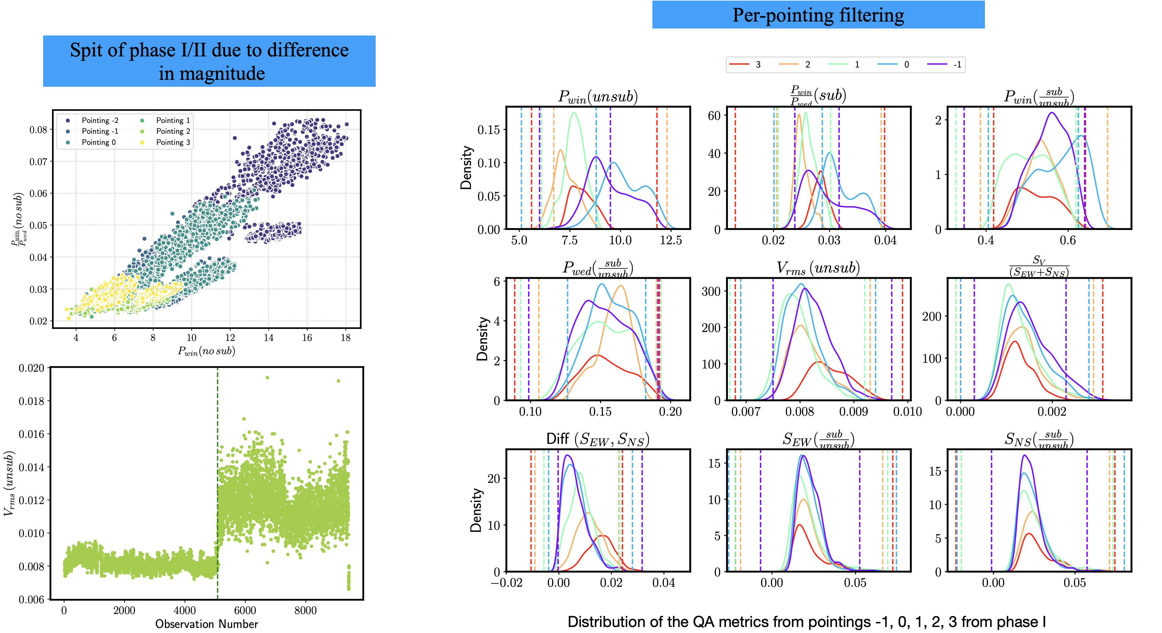
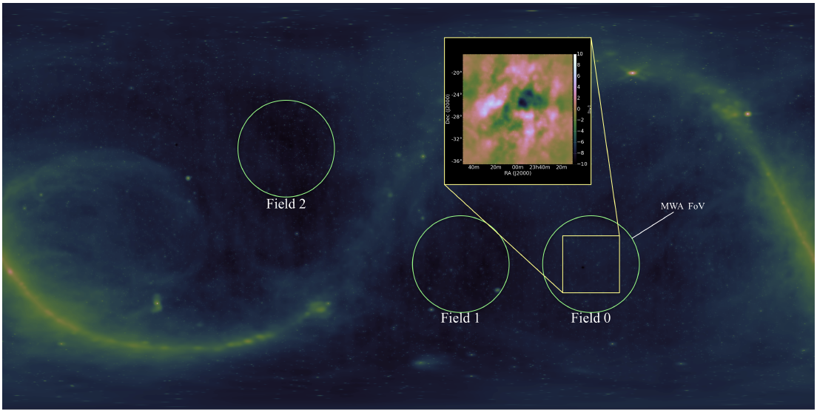
MWA data qA → 650 hours of eor0 high-band
EoR0 field: RA = 0h, Dec = -27 deg
167-197 MHz (z = 6.2 – 7.1)

Slide 10
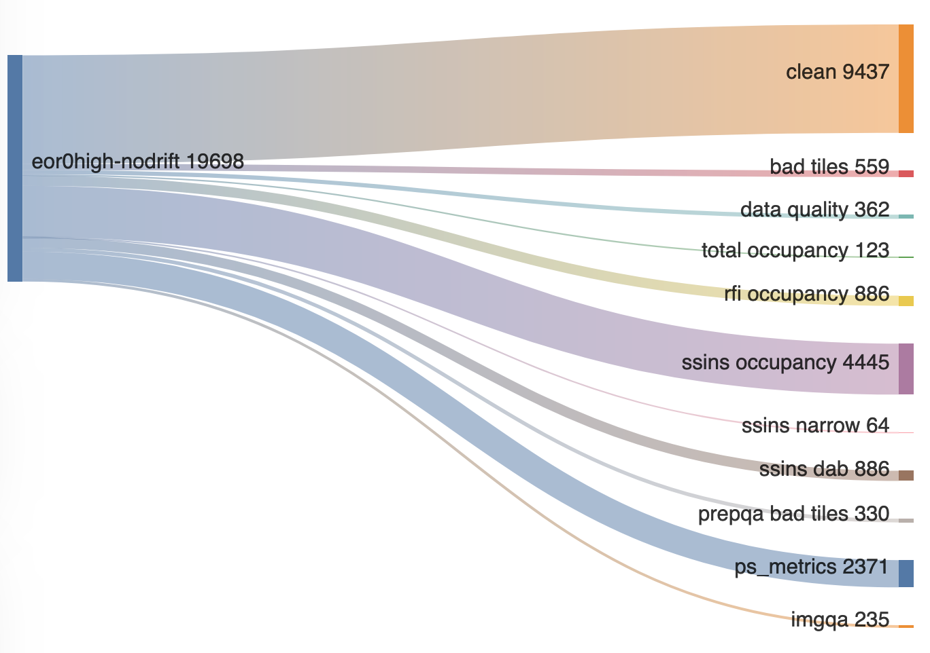
MWA data qA → 650 hours of eor0 high-band
200-300 hours data pass QA

Slide 11

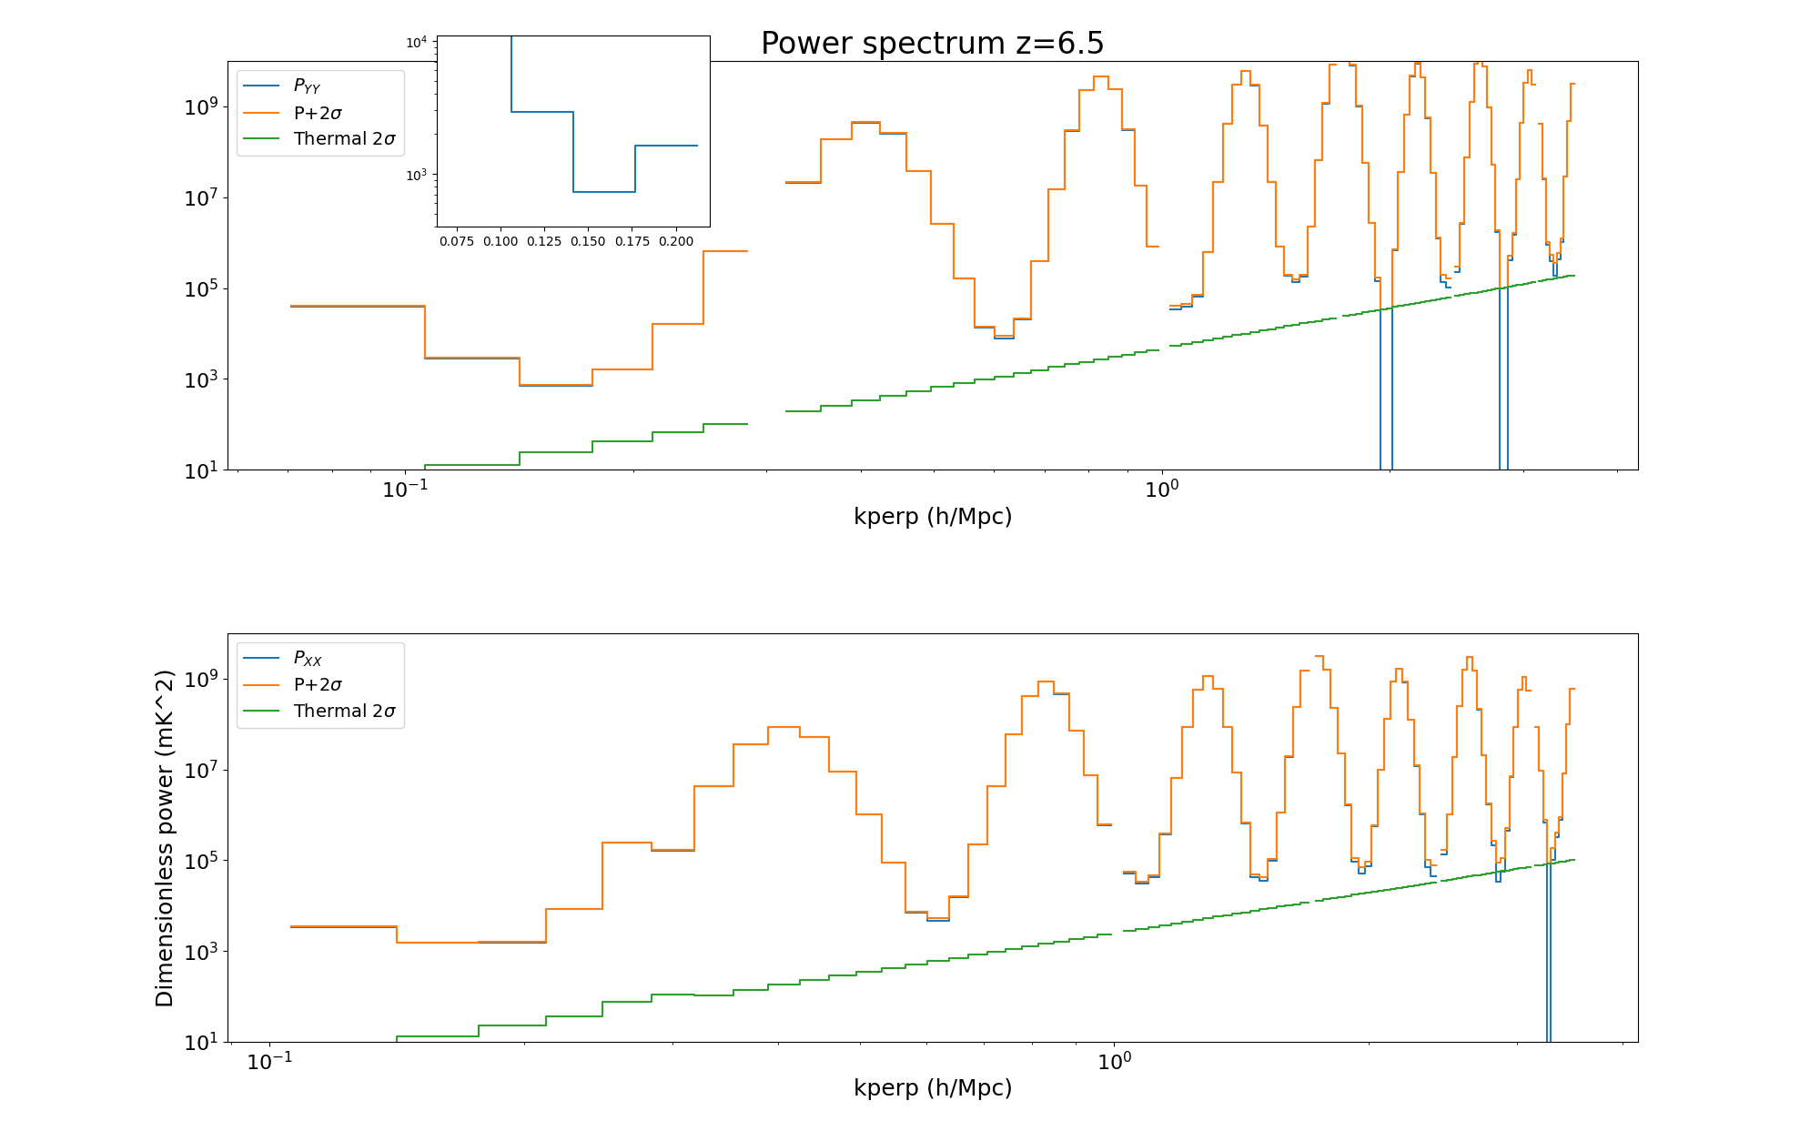
Z=6.5 results – yy and XX pol
221 hours
YY (North-South) polarisation produces cleaner results
P (<2σ) = (27 mK)²
k = 0.17 h/Mpc

Slide 12
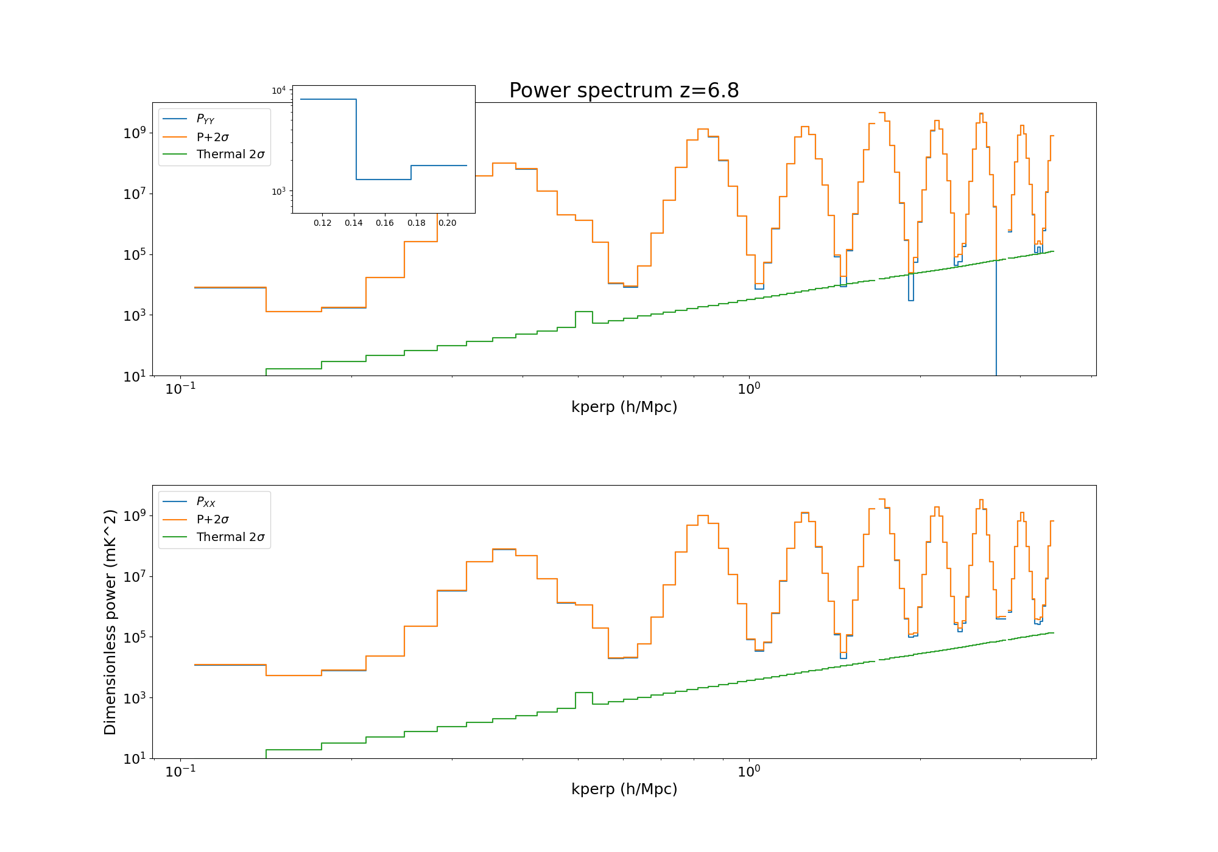
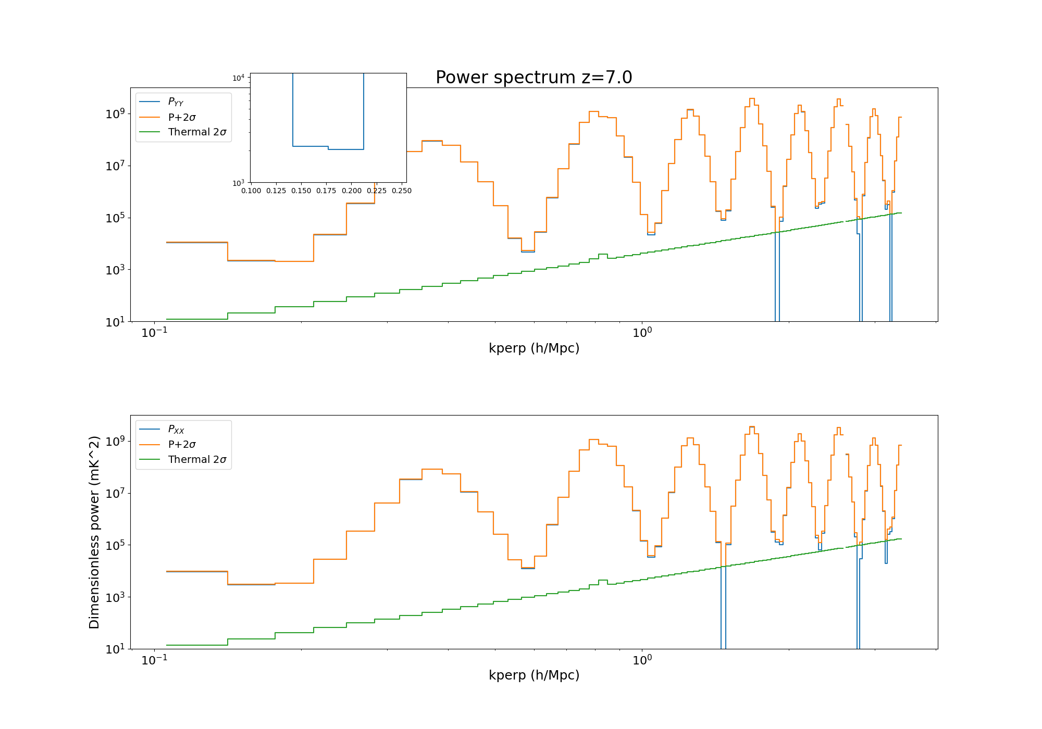
interim results z=6.8, 7.0
z=6.8
268 hours
P (<2σ) = (35.9 mK)²
k = 0.18 h/Mpc
z=7.0
268 hours
P (<2σ) = (45.3 mK)²
k = 0.21 h/Mpc

Slide 13
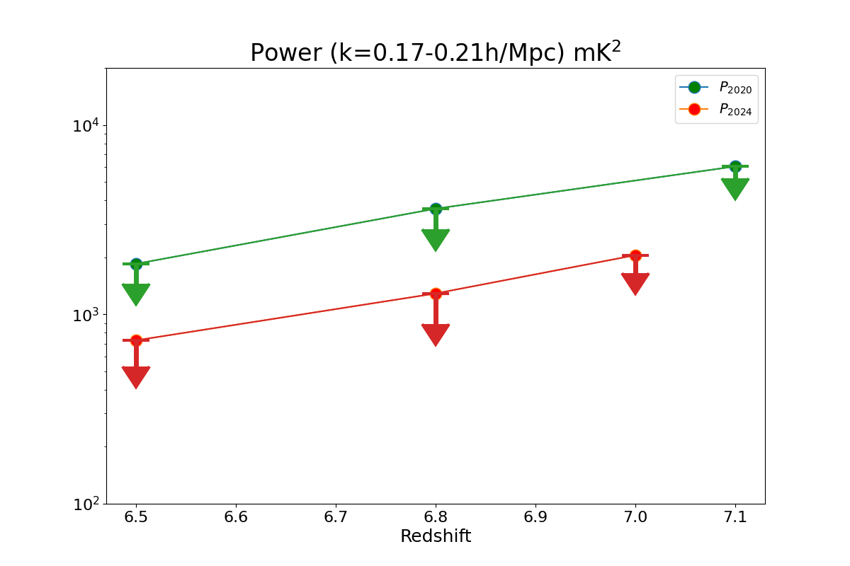
interim results z=6.5, 6.8, 7.0

Slide 14
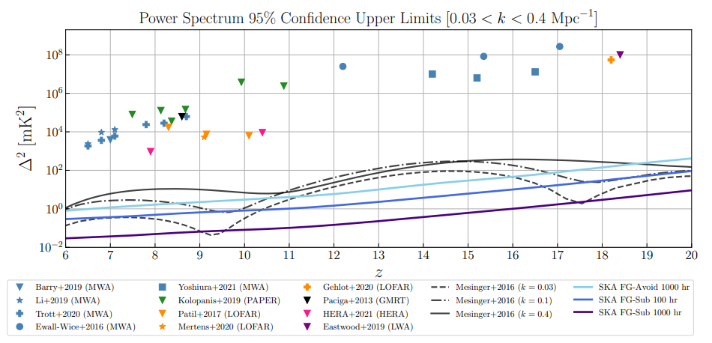
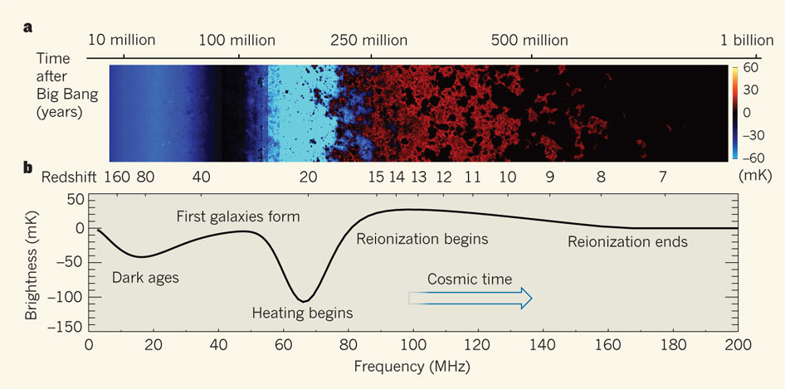
published results
HERA Collaboration

Slide 15
published results
HERA Collaboration

Slide 16
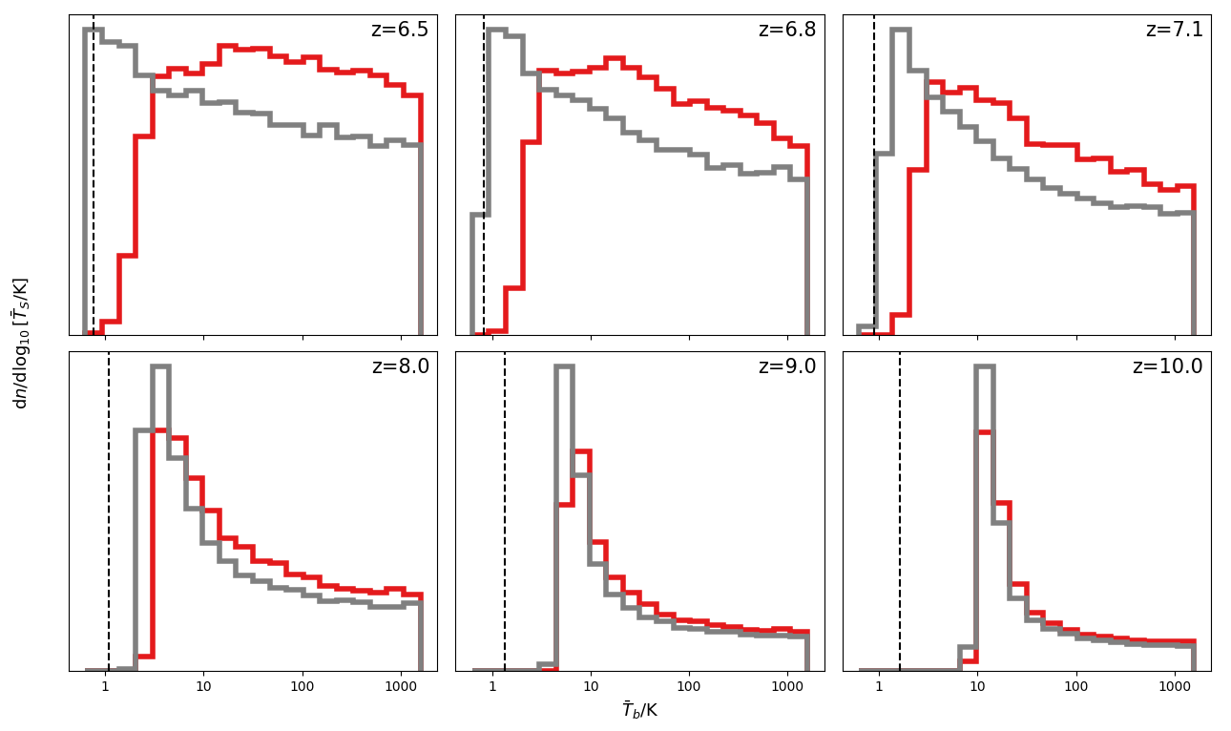
Ts posterior
Yuxiang Qin – UMelb/ANU
Dashed lines are adiabatic cooling threshold.
MWA show first evidence of heated IGM at z=6 – 7
I also got xHI-Ts 2D posteriors, which don’t say anything more

Slide 17
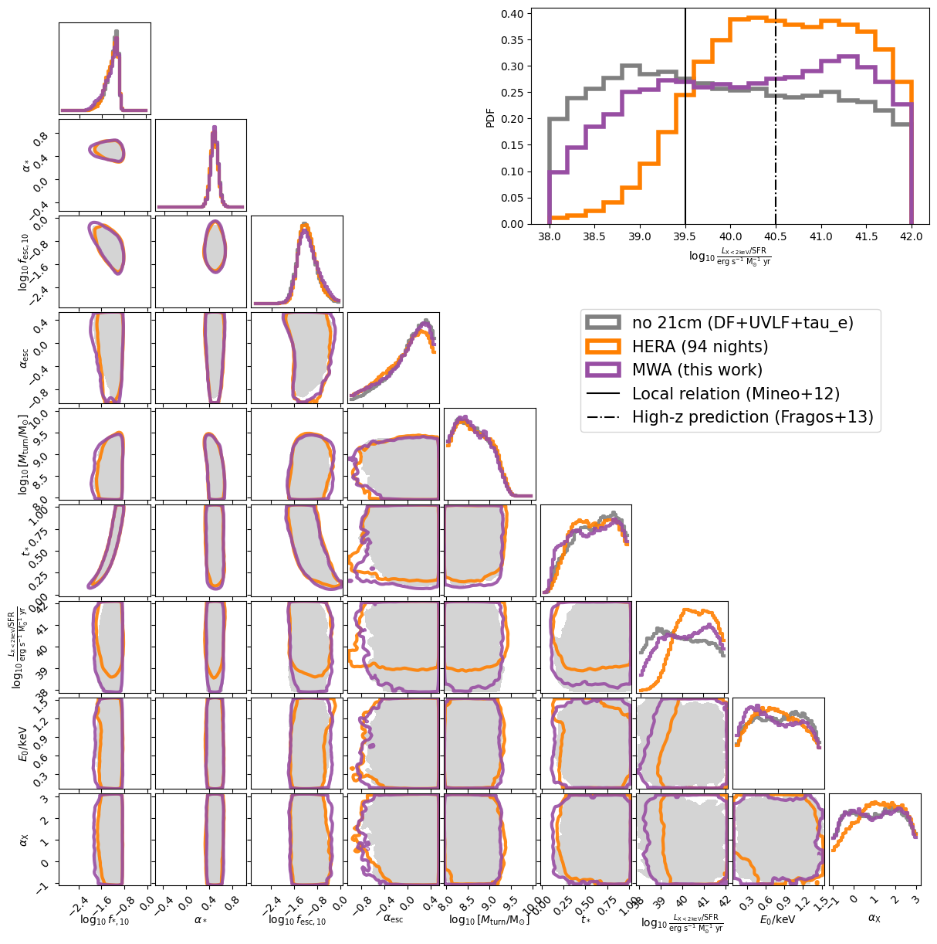
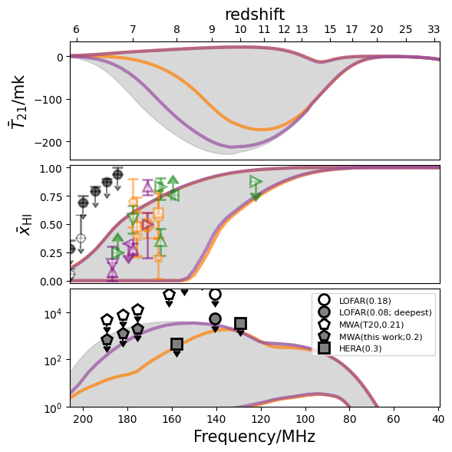
Evolution of the 21cm global signal, large-scale power and xHI as well as parameter posterior
Showing only 2-98 percentiles for 2Ds

Slide 18
summary, next steps
Updated sky model, calibration software, pipeline validation, QA triaging of data
Improved 2020 results by a factor of ~3.5 to produce the deepest limits at z < 7.0
Continuing to work on data to improve these results
Published HERA data still providing better astrophysical constraints under a late reionization model
MWA’s huge FOV makes EoR science very difficult
HERA/LOFAR/SKA’s smaller FOV are much more aligned for 21cm observations
SKA-Low construction is progressing well!

Slide 19
MWA background work
Hyperdrive calibration software (Jordan et al 2024)
Extended source and point source sky model improvements via LoBES (Lynch et al 2021, Cook et al 2022, McKinley et al 2022)
WODEN end-to-end simulation tool (Line et al 2024a, 2024b)
Broad suite of QA tools being applied to data (Nunhokee et al 2024)

Slide 20
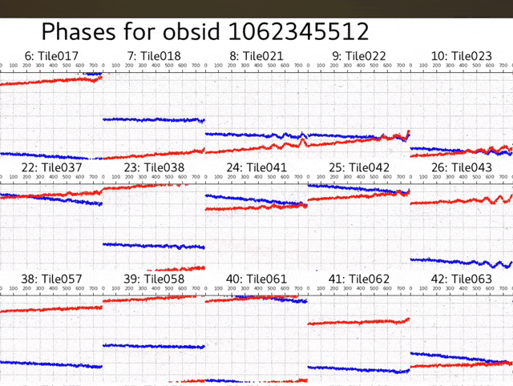
updated calibration software: hyperdrive
Chris Jordan, et al (2023, submitted)

Slide 21
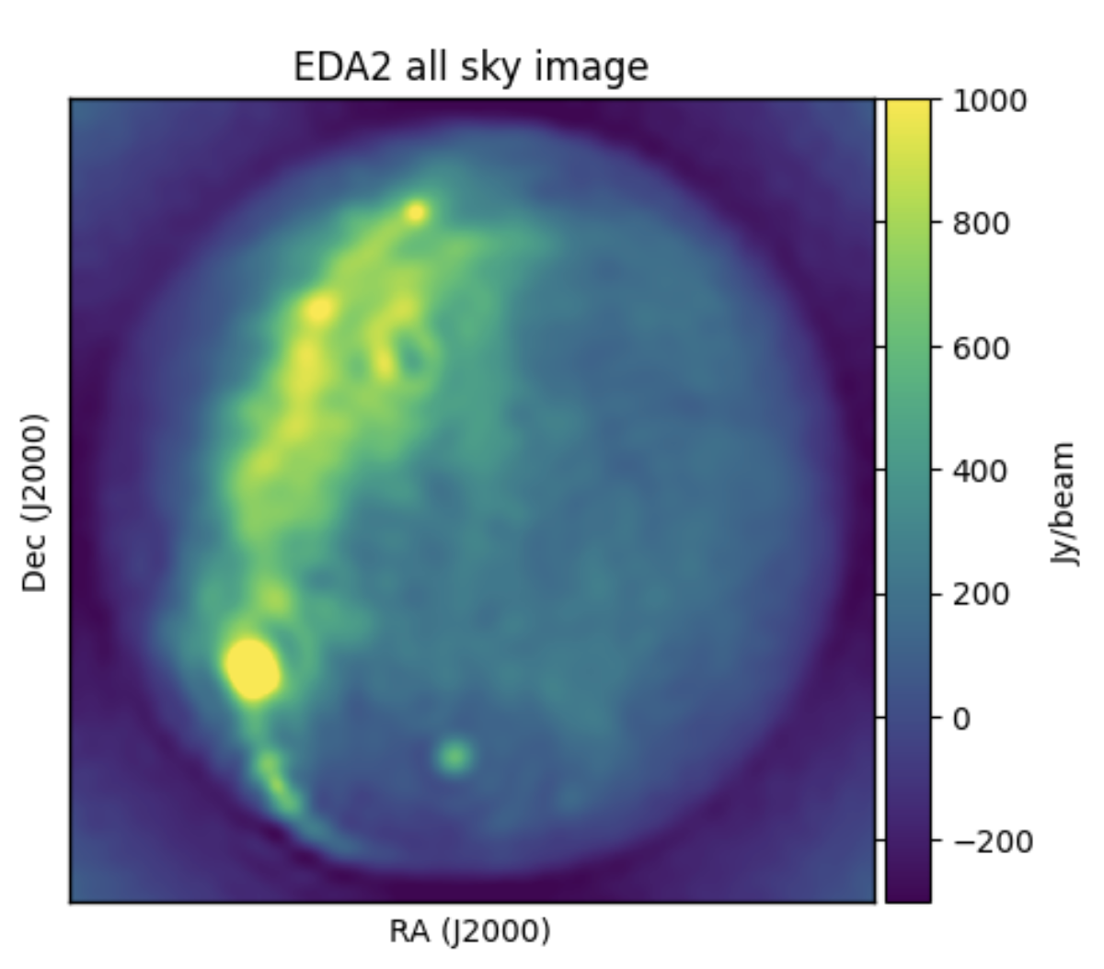
simulation software: woden – validation + largest systematics

Slide 22
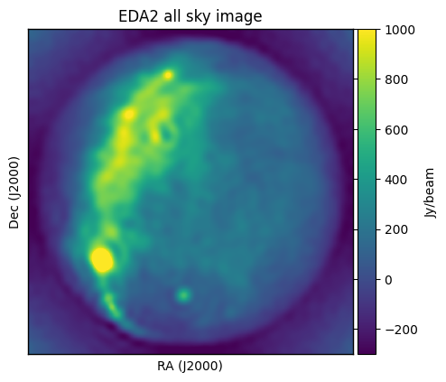
MWA background work
What have we learned from simulations?
(i) we have need to subtract more than 90% of all discrete flux, in the absence of instrumental effects (also, Barry et al);
(ii) we need to model and remove diffuse emission;
(iii) the single greatest cause of leakage is an incomplete sky model;
(iv) cable reflections, flagged channels and gain errors, impart comparable systematic power to each other

Slide 23
MWA data quality assessment
Nextflow pipeline extracts ~20 QA metrics from each 2-min observation
Nunhokee et al (2024, in review)

Slide 24
MWA data quality assessment

Slide 25
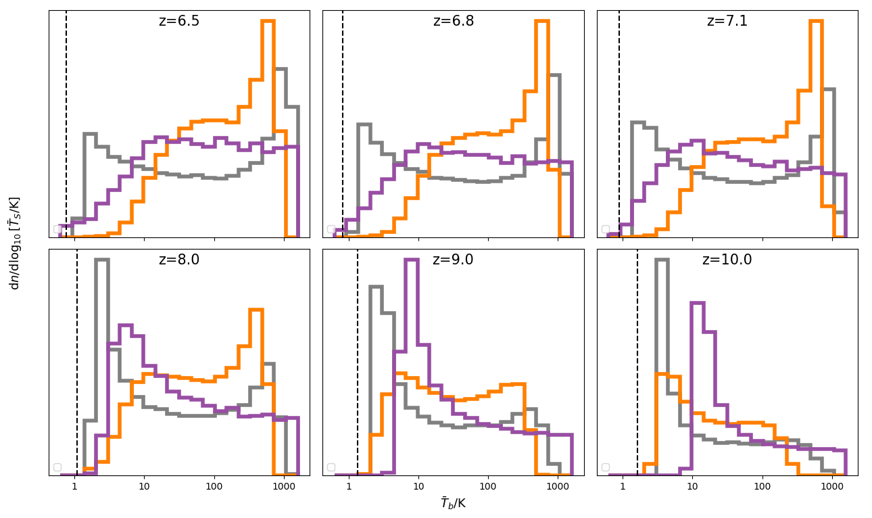
Ts
Showing only 2-98 percentiles
MWA
HERA
no 21cm

