Slide 1
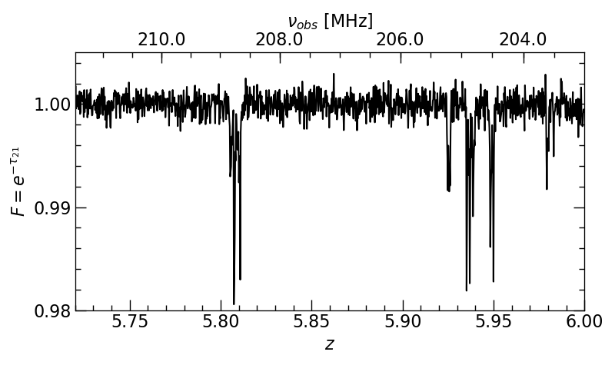

Prospects of a statistical detection of the 21-cm forest and its potential to constrain the cosmic heating and reionization history
TomÁŠ ŠoltinskÝ, girish kulkarni, shriharsh tendulkar

Slide 2
What is 21-cm forest?

Slide 3
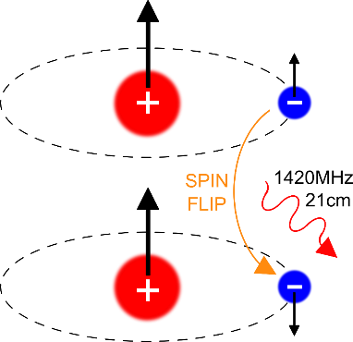
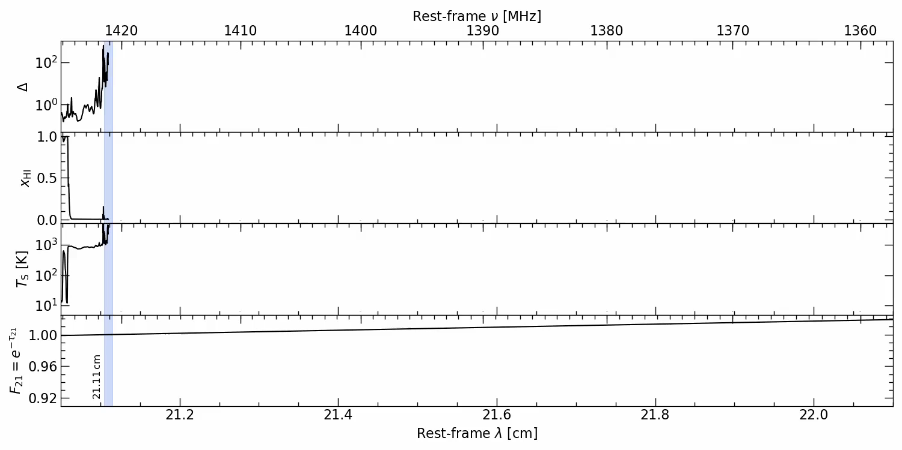
21-cm forest
Overdensity
HI fraction
Gas
temperature [K]
21-cm flux
(spectrum)

Slide 4
21-cm forest - complementary
To other 21-cm line observables:
- only requirement is a high signal-to-noise spectrum
- in principle less complicated to detect
- challenge is the abundance of radio-bright sources
To the Lyα forest:
- probe neutral, dense and cold hydrogen
- z>6
Carilli et al. 2002
(Simulated spectrum)

Slide 5
21-cm forest - what can it probe?
Astroparticle – nature of dark matter (Shimabukuro et al. 2014, 2020, Shao et al. 2023)
– neutrino mass (Shimabukuro et al. 2014)
– primordial black holes (Villanueva-Domingo et al. 2021)
Structures – minihalos (Furlanetto et al. 2006, Meiksin 2011, Kadota et al. 2022)
Supermassive black hole growth models – quasar lifetimes (Šoltinský et al. 2023)
State of the IGM – ionization and thermal (Xu et al. 2011, Ciardi et al. 2013, Šoltinský et al. 2021)

Slide 6
Why now?

Slide 7
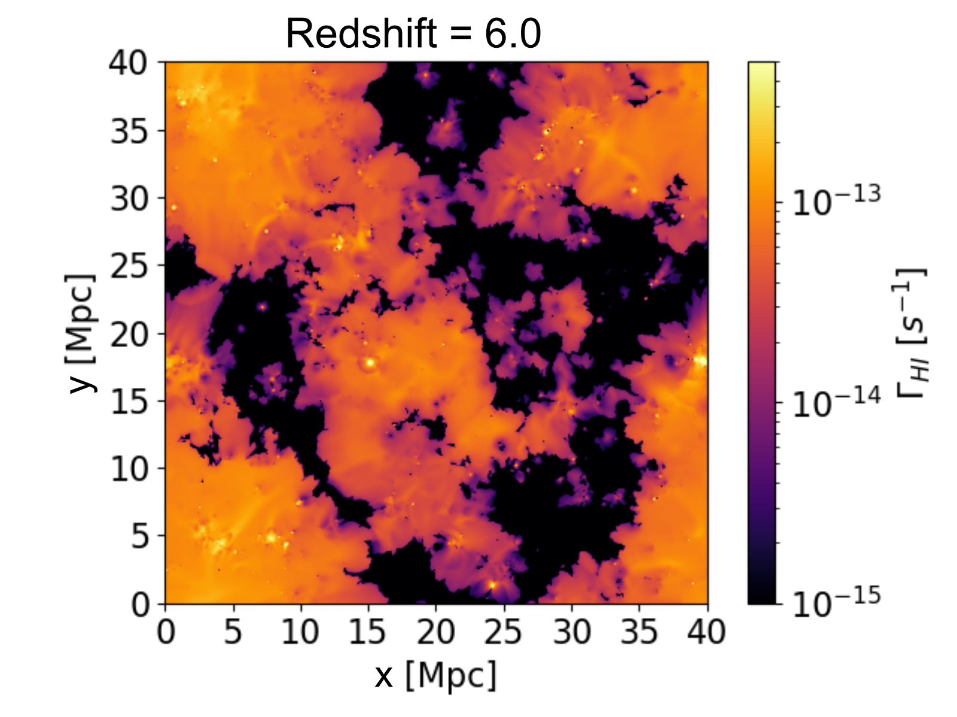
Reionization ends late
https://www.nottingham.ac.uk/astronomy/sherwood-relics/
Puchwein et al. 2023
Motivated by Lyα observations
(Becker et al. 2015, Eilers et al. 2018)
Seem to require reionization completed by z<5.5
(Kulkarni et al. 2019, Keating et al. 2020, Bosman et al. 2022, Zhu et al. 2023)
Large islands of HI persist until z≈6
Possibility of detecting 21-cm forest
(Šoltinský et al. 2021)
Ionized
Ionized
y [cMpc/h]
Neutral
x [cMpc/h]

Slide 8
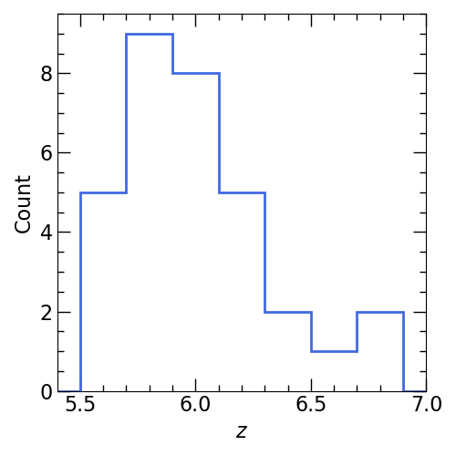
New high-z radio-loud quasars detected
Wolf et al. 2024
Bañados et al. 2023
Ighina et al. 2023
Endsley et al. 2022
Gloudemans et al. 2022
Shao et al. 2022
Bañados et al. 2021
Connor et al. 2021
Ighina et al. 2021
Liu et al. 2021
Belladitta et al. 2020
Bañados et al. 2018
Bañados et al. 2015
Frey et al. 2011
Zeimann et al. 2011
Willot et al. 2010
Jiang et al. 2009
McGreer et al. 2006
Fan et al. 2001
32 RLQSOs
at z>5.5
WEAVE-LOFAR
spectroscopic z
(Smith et al. 2016)
Šoltinský et al. in prep.

Slide 9
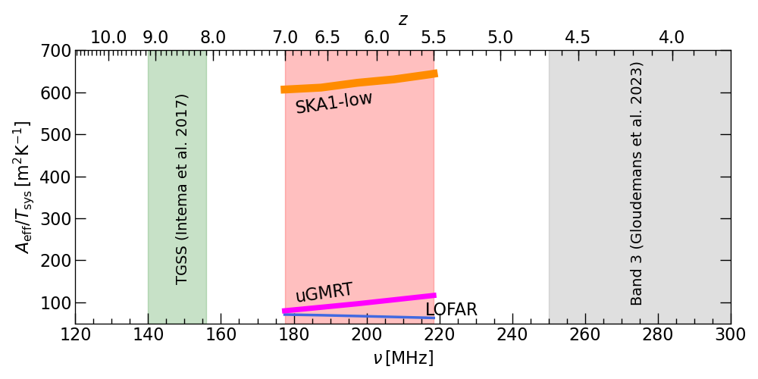
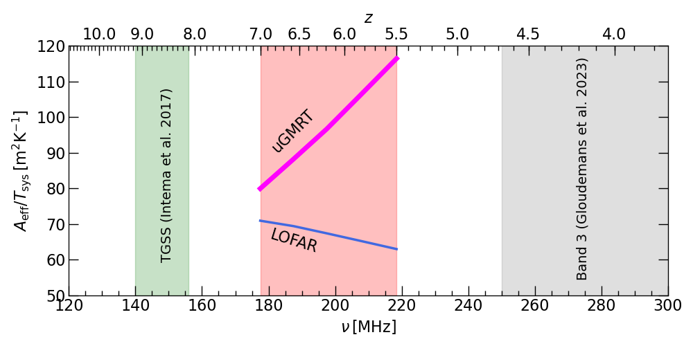
Sensitivity of uGMRT is superior
but looking forward to SKA
Better
Sensitivity
Observed frequency [MHz]
Braun et al. 2019

Slide 10
How?

Slide 11
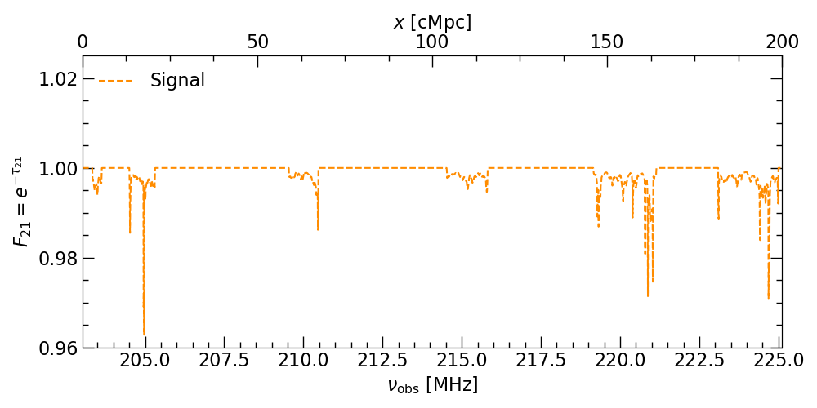
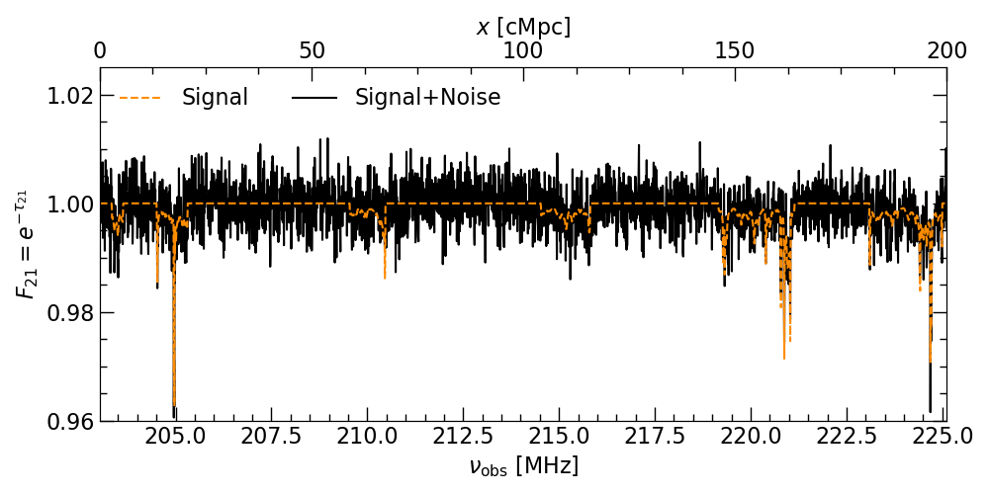

21-cm forest spectrum
$$z=6$$
21cmFAST
uGMRT
$$dν=8kHz$$
$$t_{int}=500hr$$
$$S_{147}=64.2mJy$$
$$α_{R}=−0.44$$
Šoltinský et al. in prep.

Slide 12
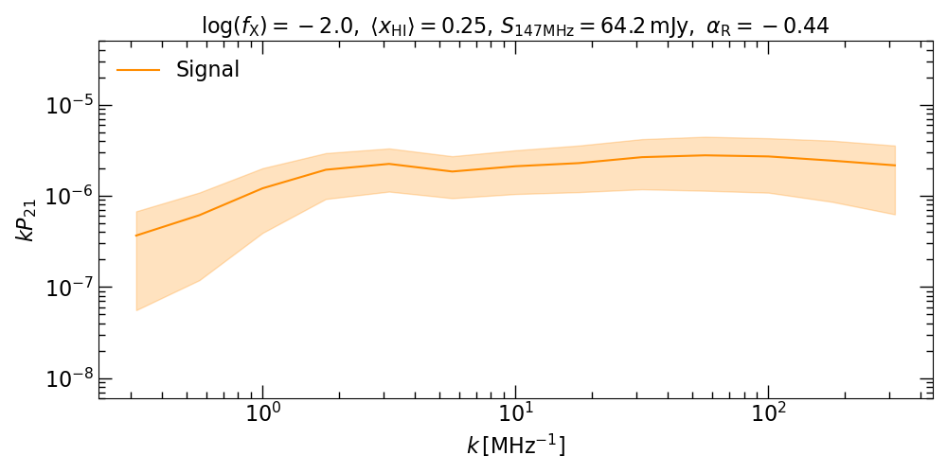
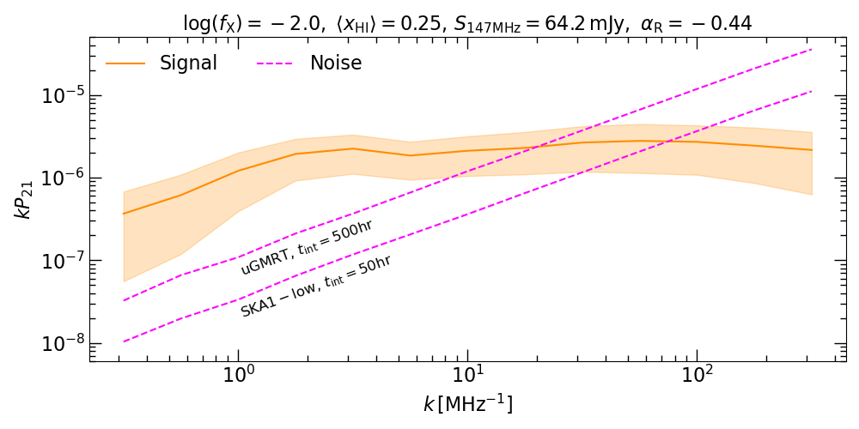
21-cm forest power spectrum
Thermal state of the IGM
Ionization state of the IGM
Šoltinský et al. in prep.
Large scales
Small scales

Slide 13
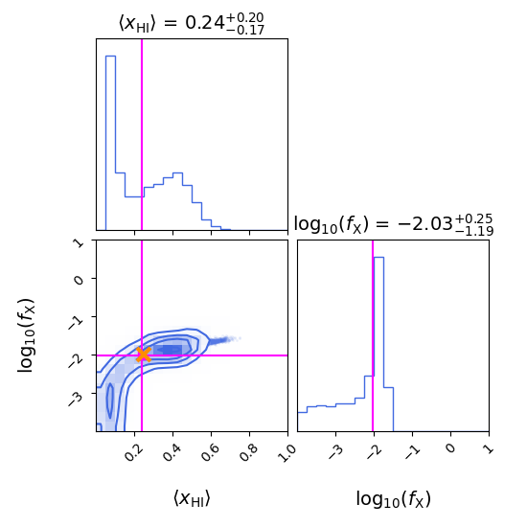
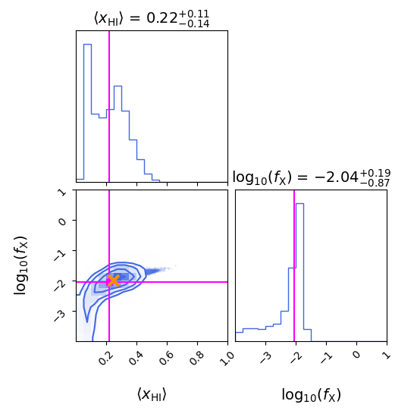


Constrain thermal and ionization state of the IGM at the same time
Observation of
10 spectra
of 200cMpc at z=6
Δν=22.1MHz
True values
$$\left\langle x_{HI}\right\rangle =0.25$$
$$log\left(f_{X}\right)=−2$$
uGMRT
$$t_{int}=500hr$$
True values
$$\left\langle x_{HI}\right\rangle =0.25$$
$$log\left(f_{X}\right)=−2$$
SKA1-low
$$t_{int}=50hr$$
Limiting factor is
SAMPLE VARIANCE
not telescope noise
Šoltinský et al. in prep.
PRELIMINARY

Slide 14
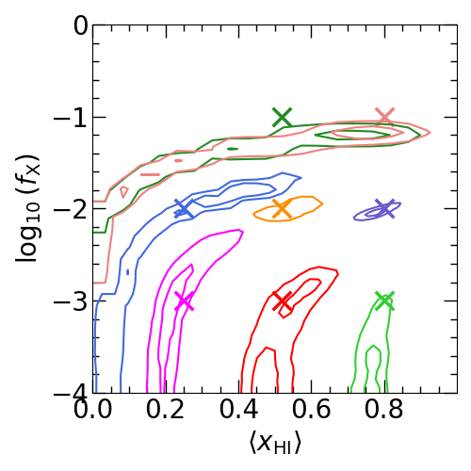
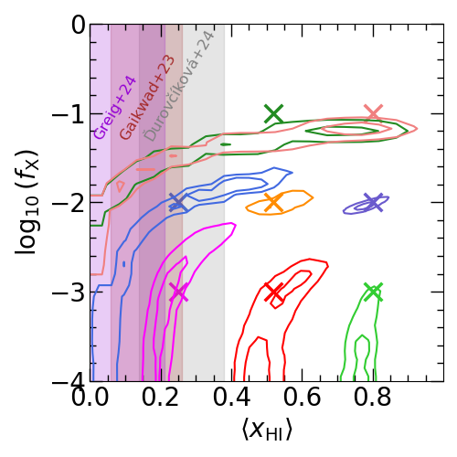

What about the rest of parameter space?
uGMRT, $t_{int}=500hr$
A null-detection disfavouring
these regions in parameter space?
Šoltinský et al. in prep.
PRELIMINARY

Slide 15
Summary
21-cm forest is a unique probe
Possibility of constraining the thermal and ionization state of the IGM
Prospects of detecting the 21-cm forest are improving
Working on the possibility of statistical detection of the 21-cm forest with uGMRT and SKA
Sample variance dominates over the telescope noise
tomas.soltinsky@tifr.res.in
www.tomassoltinsky.github.io

Slide 16
APPENDIX

Slide 17
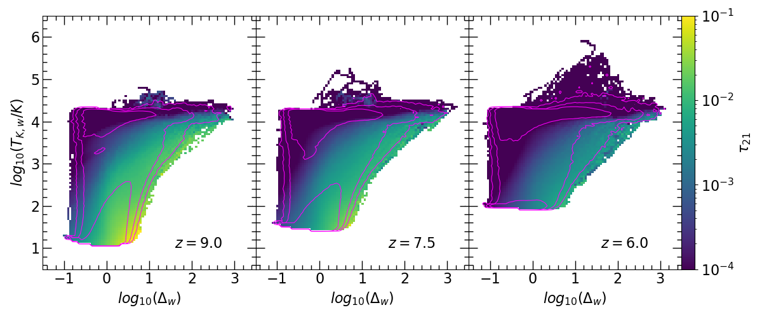
21-cm absorbers nature
Cold diffuse IGM
T_{K}<100K
3<Δ<10
Strongest absorbers rare
~100 times less abundant than the bulk of cold, neutral gas
Šoltinský et al. 2021

Slide 18
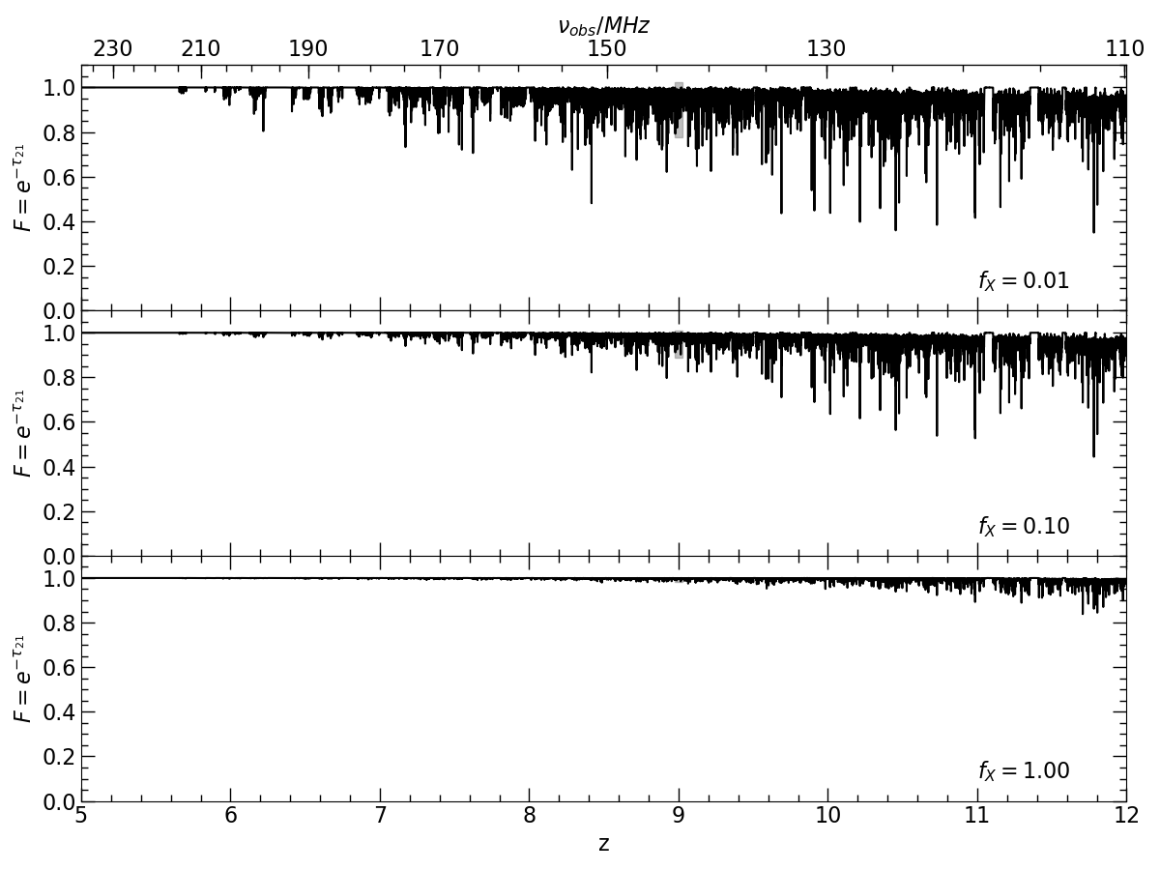

X-ray background radiation suppresses the signal
$$L_{X}{∝f}_{X}×SFR$$
(Furlanetto 2006)
Šoltinský et al. 2021
(but see also Xu et al. 2011,
Mack & Wyithe 2012)

Slide 19
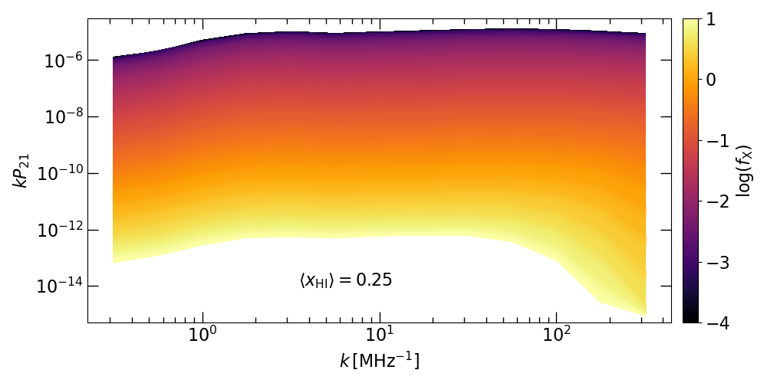
Sensitivity to X-ray background radiation
Šoltinský et al. in prep.
Large scales
Small scales

Slide 20
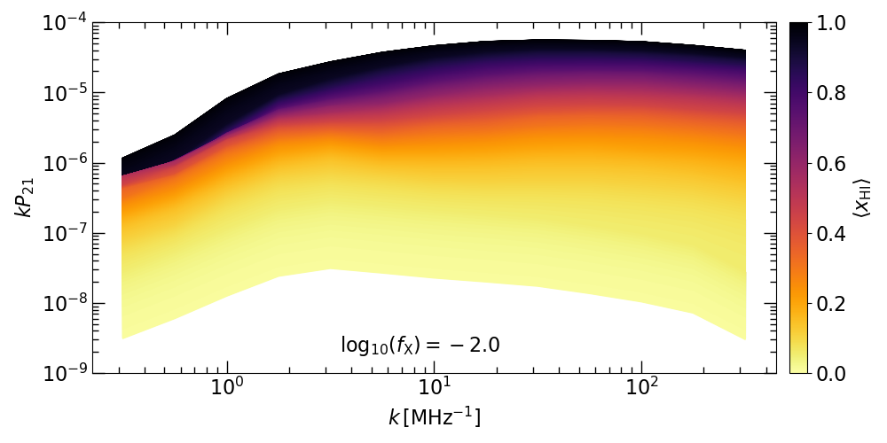
Sensitivity to HI fraction
Šoltinský et al. in prep.
Large scales
Small scales

Slide 21
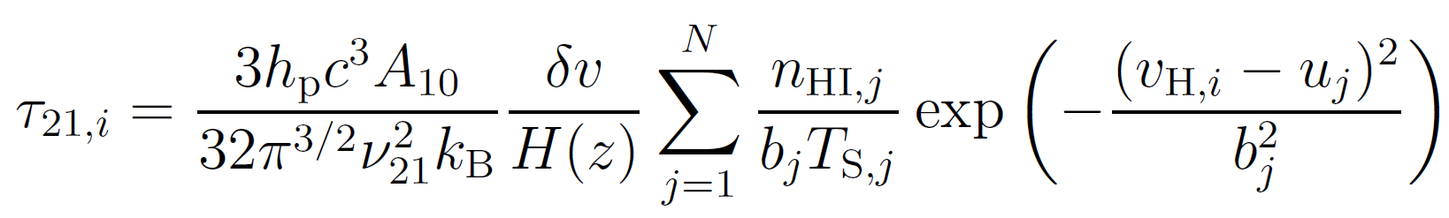
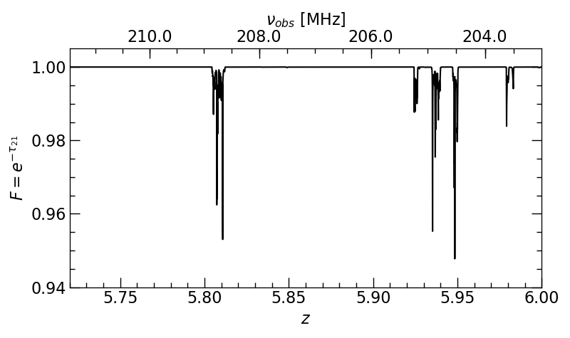
21-cm forest spectrum
z = 6
Šoltinský et al. 2021

Slide 22
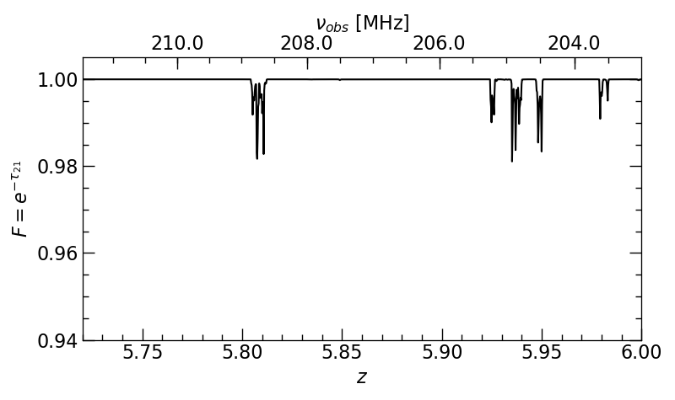
21-cm forest spectrum
Spectral resolution
z = 6
Δ𝛎 = 8kHz
Convolution
over fixed
boxcar function
Šoltinský et al. 2021

Slide 23
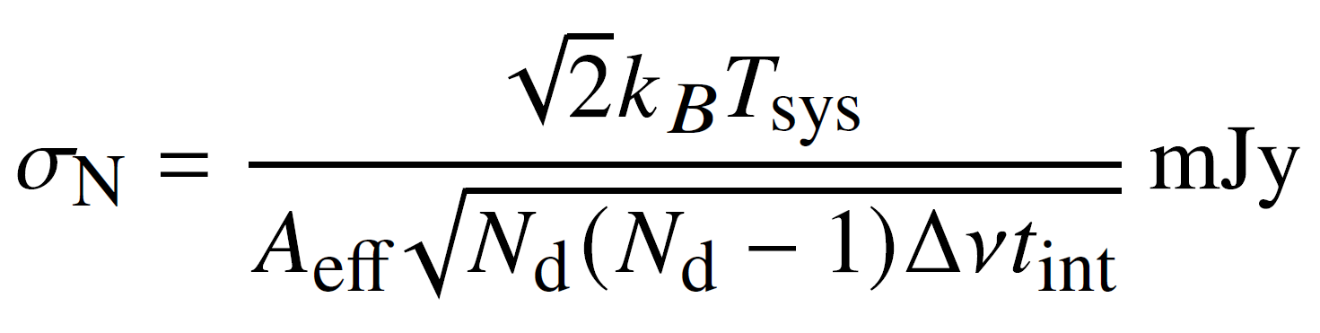
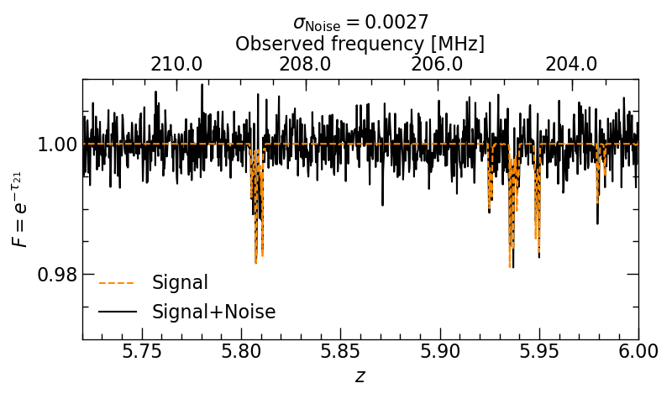
21-cm forest spectrum
Telescope noise
(Modified Datta et al. 2007)
≈
z = 6
Gaussian white
noise
Included also
intrinsic RLQSO
radio spectrum
as a single
power law
Šoltinský et al. in prep.

Slide 24
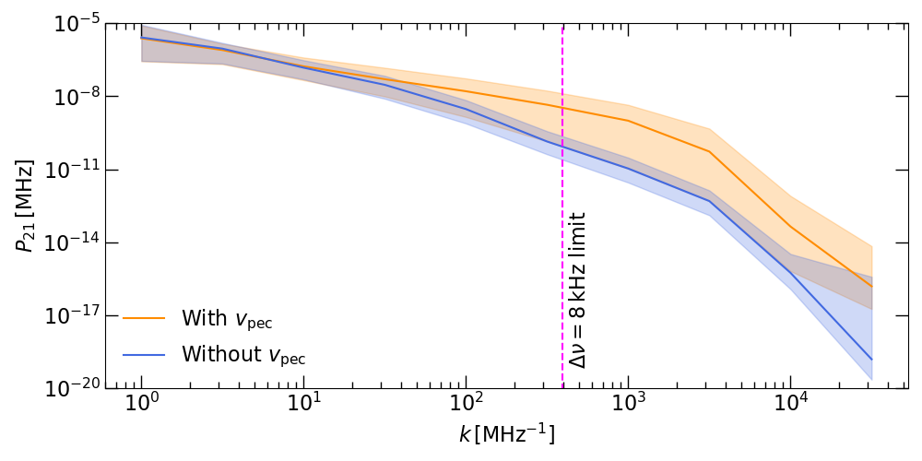
Effect of peculiar velocities

Slide 25
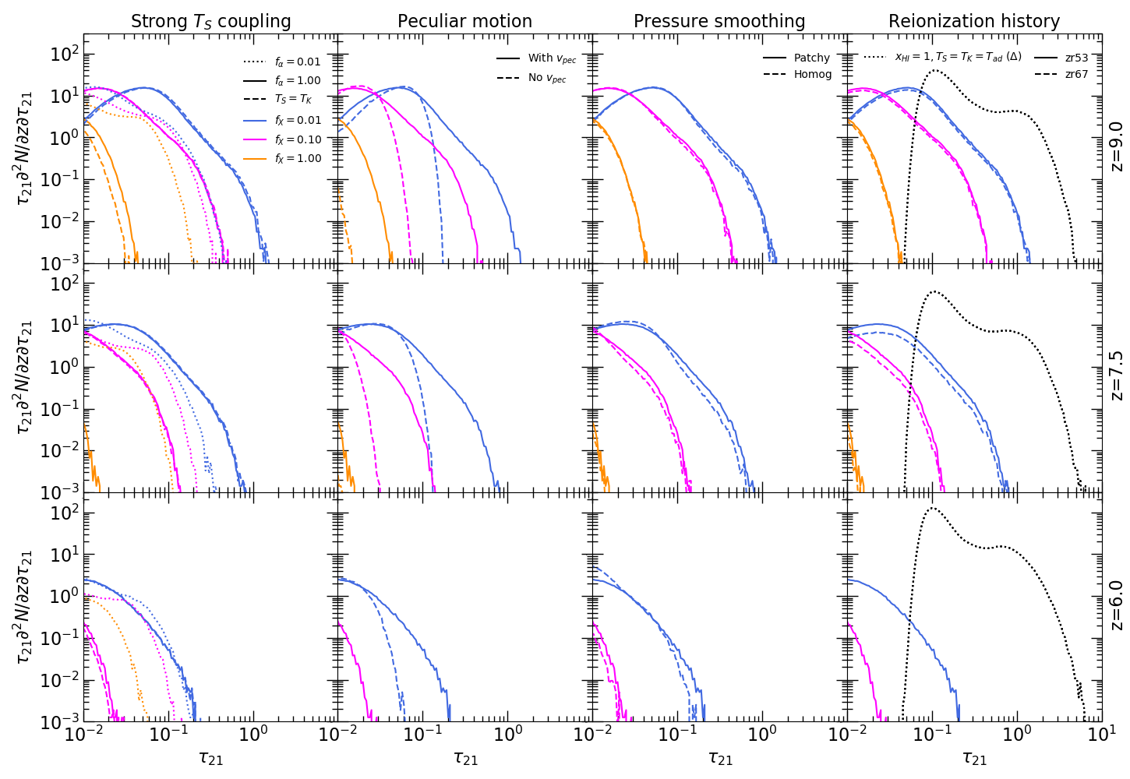
21-cm absorption lines distribution
Šoltinský et al. 2021

Slide 26
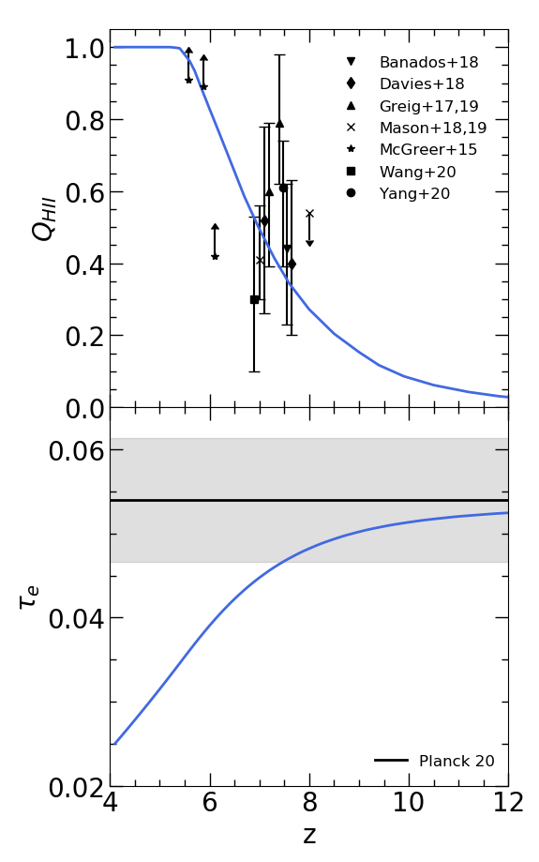
Reionization ends late
Motivated by recent Lyman photon observations:
Large spatial fluctuations in the Lyα forest opacity at z>5 (Becker et al. 2015, Bosman et al. 2022)
Deficit of Lyα emitting galaxies around extended Lyα absorption troughs (Kashino et al. 2020, Keating et al. 2020, Christenson et al. 2021)
Clustering of Lyα emitters (Weinberger et al. 2019)
Thermal widths of Lyα forest transmission spikes at z>5 (Gaikwad et al. 2020)
Mean free path of ionizing photons at z=6 (Becker et al. 2021, Cain et al. 2021, Zhu et al. 2023, Gaikwad et a. 2023)
Lyα equivalent widths (Nakane et al. 2023)
Long dark gaps in the Lyα (Zhu et al. 2021) and Lyβ forest (Zhu et al. 2022)
Šoltinský et al. 2021

Slide 27
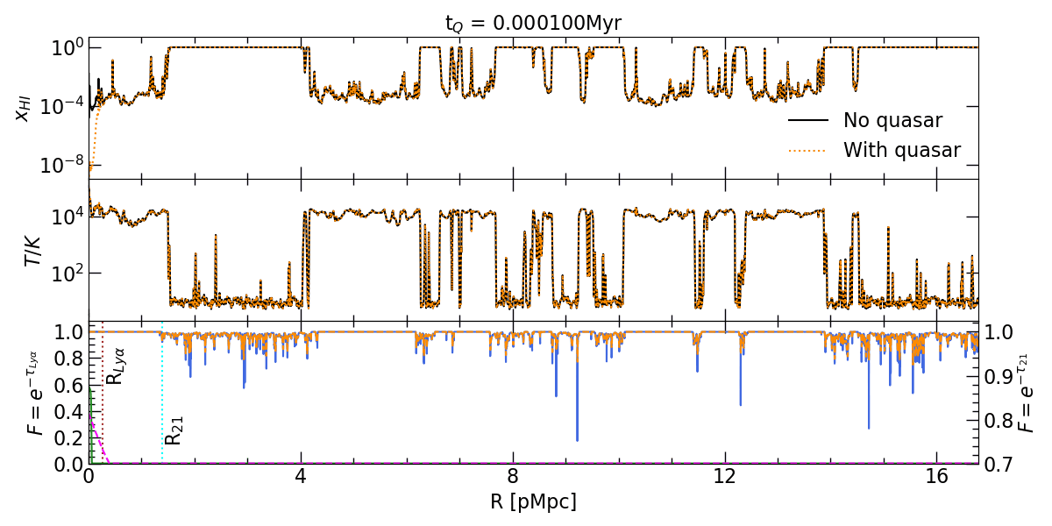
Time evolution
UV Ionises surrounding gas
Lyα forest observable
X-rays Heat up the gas
21-cm forest
suppressed at
larger distances
Šoltinský et al. 2023

Slide 28
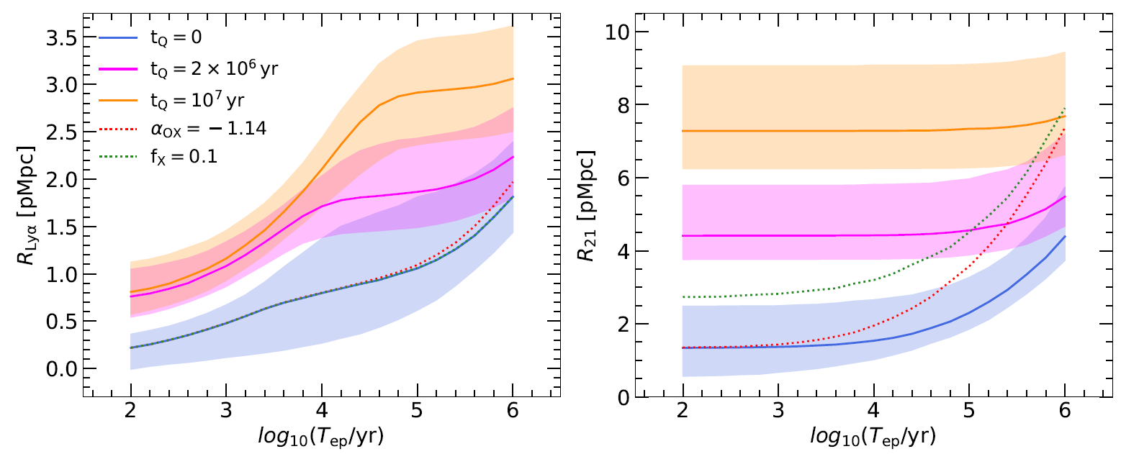

Young vs flickering quasar
Can reproduce small $R_{Lyα}$ in both cases
21-cm forest might discern between these cases
Šoltinský et al. 2023

