Slide 1
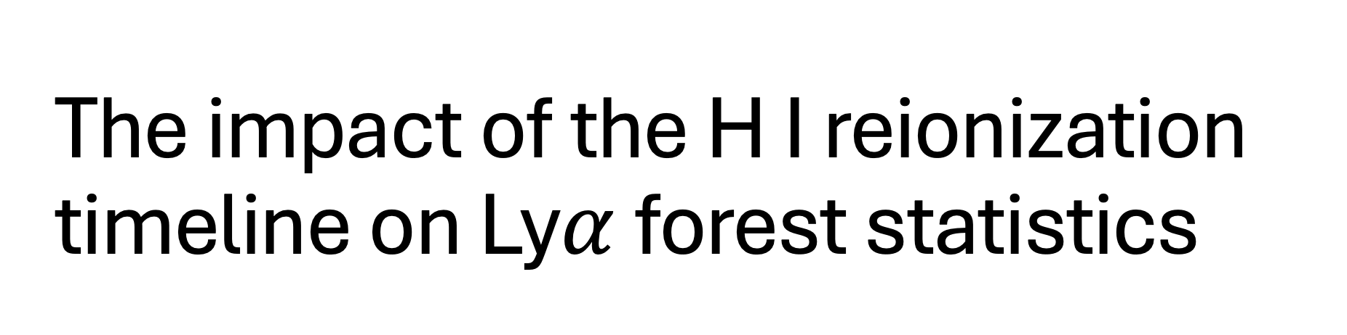
The impact of the H I reionization timeline on Ly$α$ forest statistics
(And how to constrain the timeline using emulation)
Caitlin C. Doughty
Leiden Observatory

Slide 2
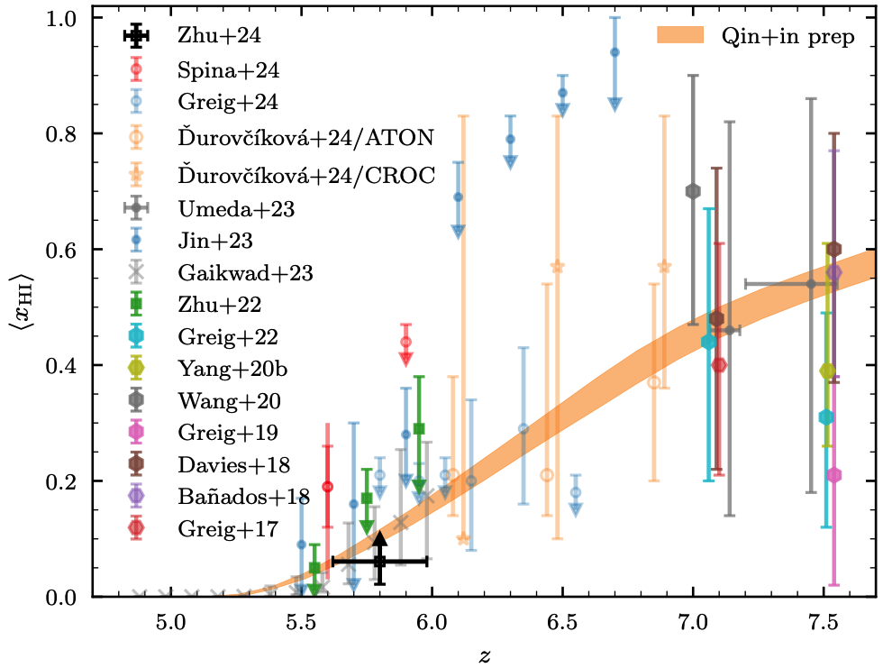
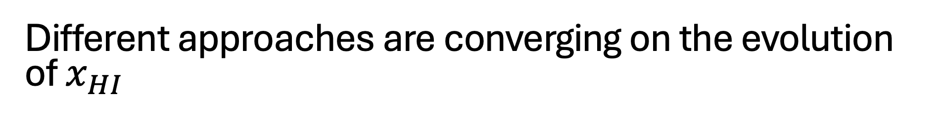
Different approaches are converging on the evolution of $x_{HI}$
Zhu et al. 2024
Notes:
there’s been a lot of work put into measuring the progression of hydrogen reionization at z>5
in combination these are contributing to a shrinking range of likely neutral fractions for z<8.
damping wings in quasar spectra at higher redshifts
upper and lower limits at very late times based on among other things dark gaps in the lyman alpha or lyman beta forest.

Slide 3
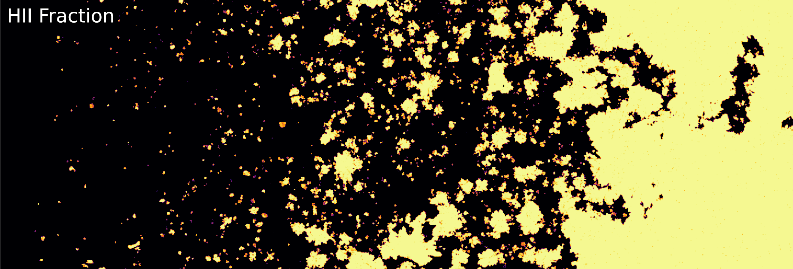
Simulating reionization
On-the-fly radiative transfer (e.g. THESAN, Kannan et al. 2022; CoDa III, Ocvirk et al. 2016; CROC, Gnedin et al. 2014; Technicolor Dawn, Finlator et al. 2018; others)
Post-processing radiative transfer
  terminal (e.g. Chardin et al. 2015, Keating et al. 2018, Kulkarni et al. 2019)
  re-integrate into simulations (Sherwood Relics, Puchwein et al. 2023)
Semi-numerical (e.g. 21cm FAST, Mesinger et al. 2011)
THESAN
Notes:
Fully coupled radiative transfer hydrodynamic sims most ideal
Most accurate in terms of physics, they quite expensive
To avoid the cost, you can also post-process simulation outputs with radiative transfer codes
Terminal or to re-integrate
Semi-numerical approaches cheaper

Slide 4
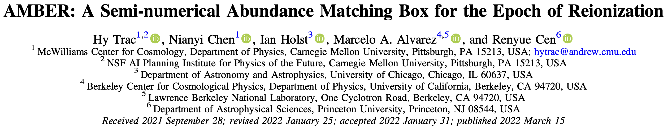
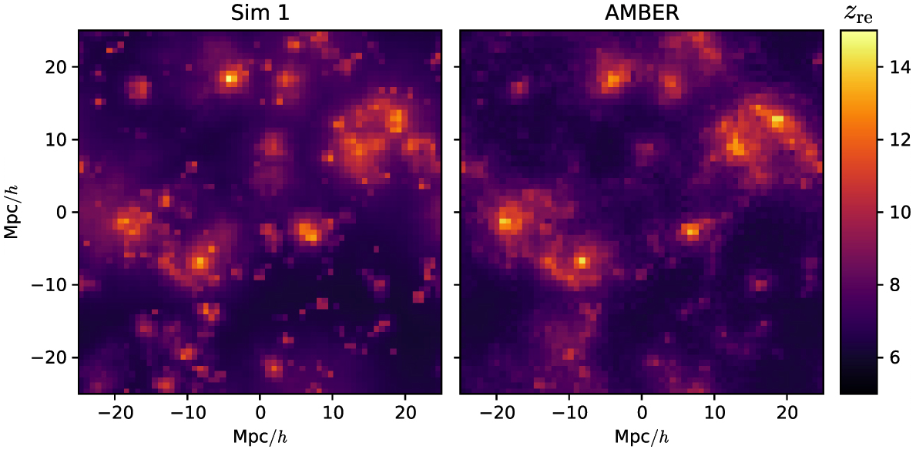
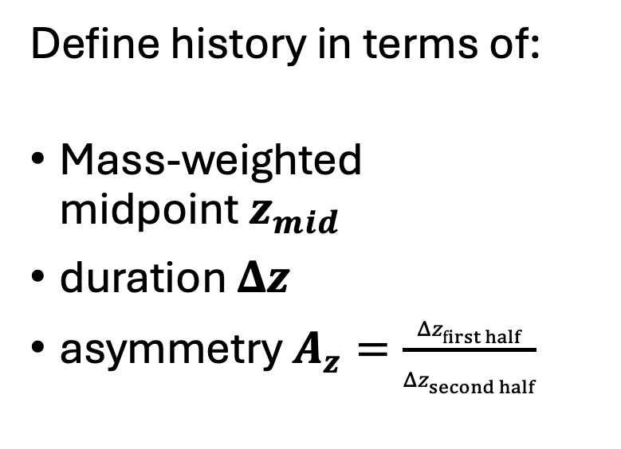
AMBER reionization histories
https://github.com/hytrac/amber.git
RadHydro
Define history in terms of:
Mass-weighted
midpoint $z_{mid}$
duration $Δz$
asymmetry $A_{z}=\frac{Δz_{first half}}{Δz_{second half}}$
Trac et al. 2022
Notes:
Another semi-numerical model is AMBER framework from Trac et al. 2022
Available on github
Parametrizes the reionization history primarily using three numbers: a midpoint, duration, and asymmetry
The premise of this method is that IGM gas in higher density regions will reionize earlier than gas in lower density ones because they are exposed to larger amounts of ionizing photons.
Based on the density field and the desired input reionization history, the code will ionize voxels to achieve a particular ionized fraction at a given redshift.
This approach was calibrated using a series of radiative transfer simulations, and you can see a comparison zreion field here

Slide 5
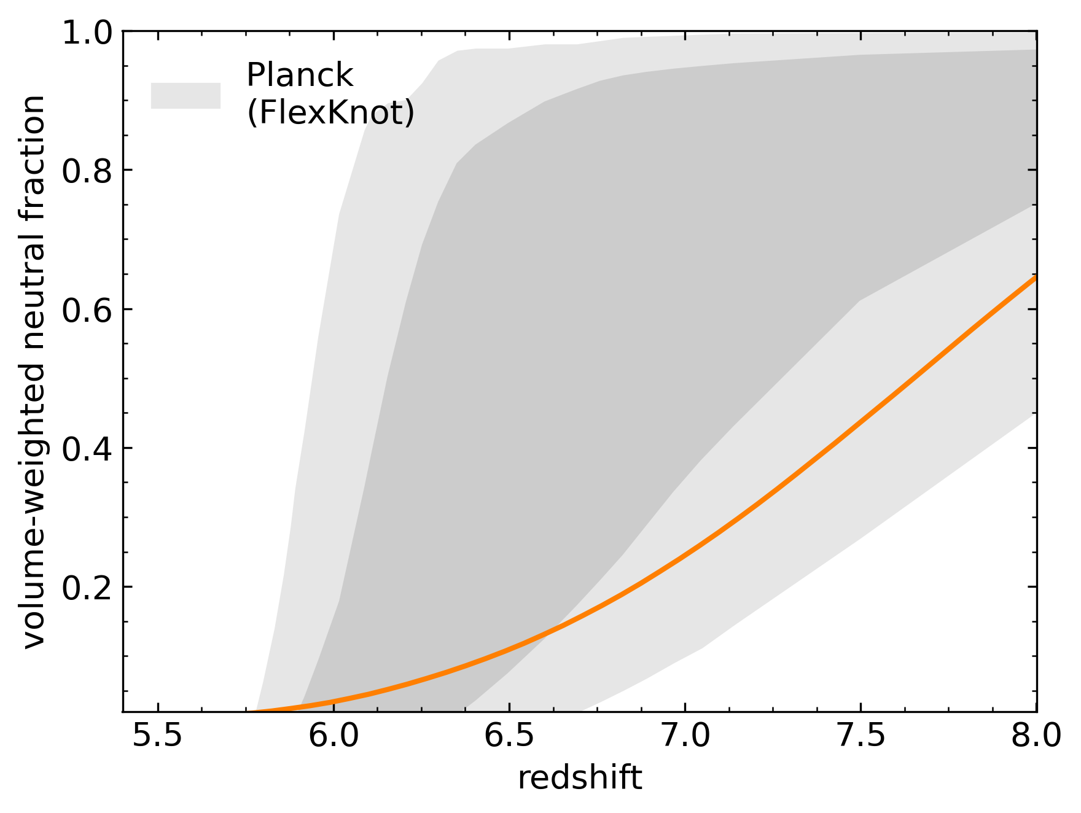
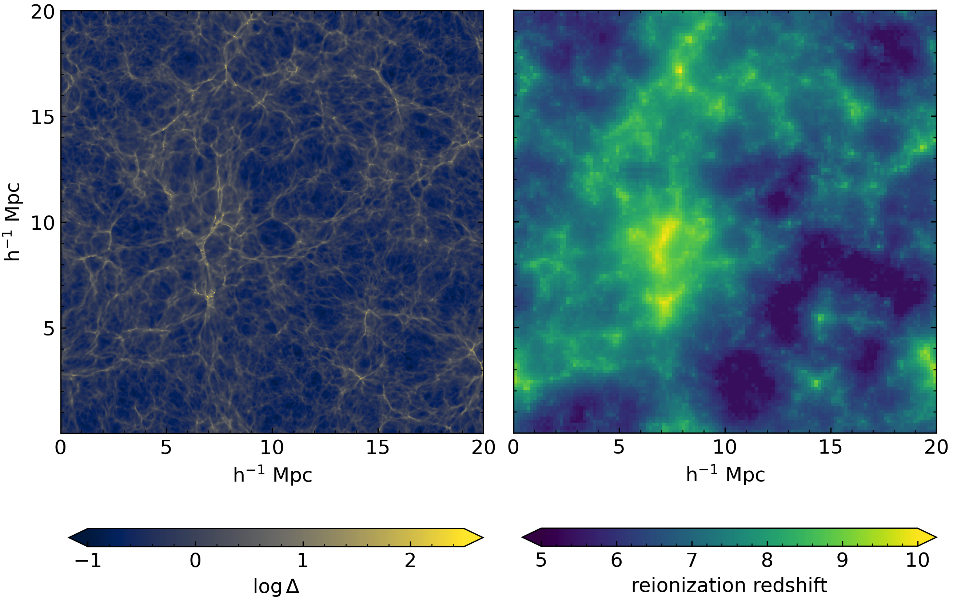

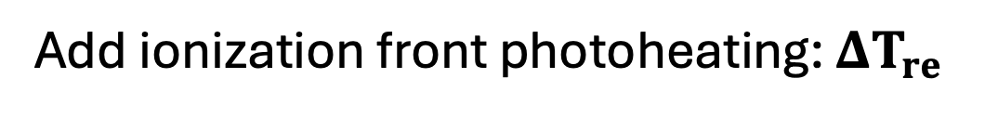

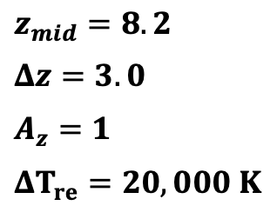
AMBER reionization histories in Nyx
Add ionization front photoheating: $ΔT_{re}$
Log $δ$
Reionization redshift
$$z=5.5$$
Box: 20 h⁻¹ cMpc,
Res: 10 h⁻¹ ckpc
$z_{mid}=8.2$
$Δz=3.0$
$A_{z}=1$
$ΔT_{re}=20,000 K$
AMBER model midpoint $z_{mid}$, duration $Δz$, and asymmetry $A_{z}$
Doughty et al. 2024
Notes:
Implement into a hydrodynamic simulation
Self-consistently capture the pressure smoothing and temperature fluctuations from patchy reionization process
We use the Nyx code
Need to include heat injection from photoheating as the ionization front passes through the IGM, which we call Delta Tre.
For this example history, you can see an overdensity projection on the left at z=5.5

Slide 6
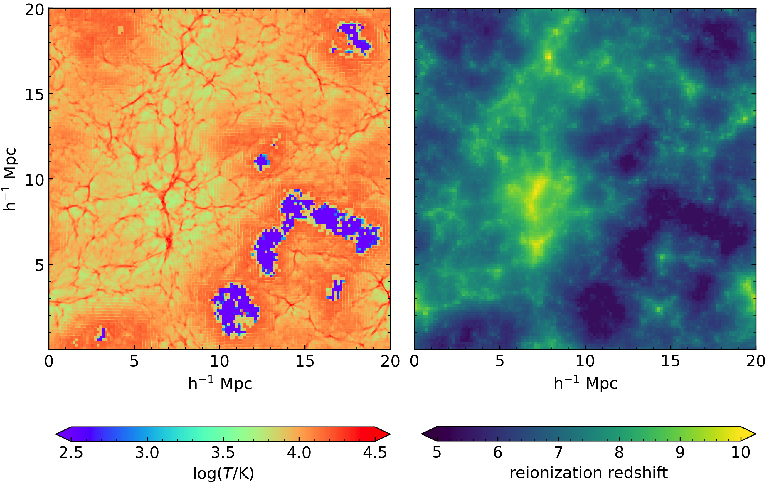


AMBER reionization histories in Nyx
Add ionization front photoheating: $ΔT_{re}$
Log $T$
Reionization redshift
$$z=5.5$$
Box: 20 h⁻¹ cMpc,
Res: 10 h⁻¹ ckpc
$z_{mid}=8.2$
$Δz=3.0$
$A_{z}=1$
$ΔT_{re}=20,000 K$
AMBER model midpoint $z_{mid}$, duration $Δz$, and asymmetry $A_{z}$
Doughty et al. 2024
Notes:
Temperature projection, for the same snapshot
Regions with higher zre are colder
So now I’m going to show how these parameters impact the IGM, and especially the LAF statistics

Slide 7
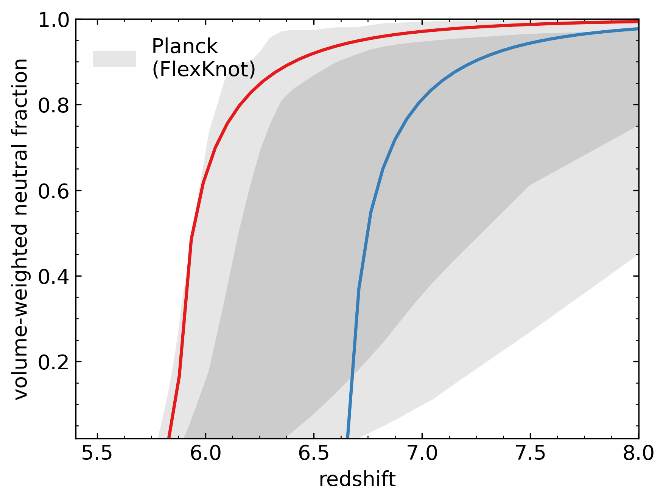
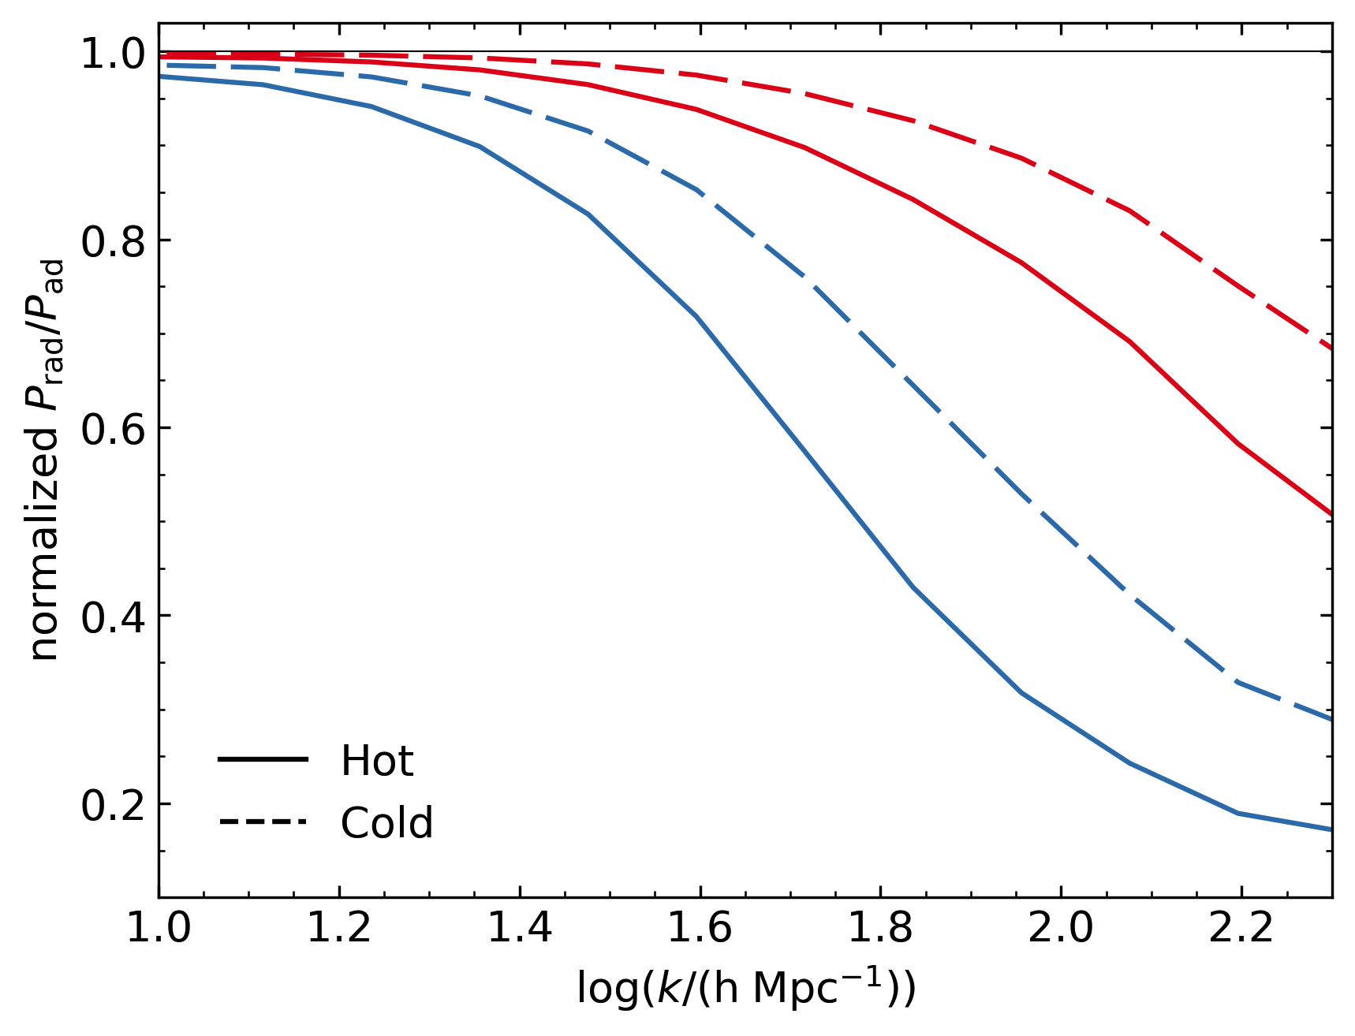

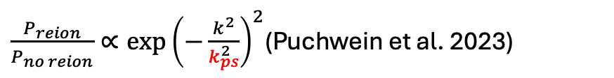




Baryon power spectrum sensitive to $z_{mid}$ and $ΔT_{re}$
Ratio of power in reionized to un-reionized simulation
$$z=5.5$$
$$P_{reion}/P_{no reion}$$
$$z_{mid}=6.1$$
$$z_{mid}=6.9$$
($ΔT_{re}=\text{20,000 }\text{K}$)
($ΔT_{re}=\text{1}\text{0,000 }\text{K}$)
Fit for pressure smoothing scale:
$\frac{P_{reion}}{P_{no reion}}∝{\exp\left(−\frac{k^{2}}{k_{ps}^{2}}\right)}^{2}$(Puchwein et al. 2023)
Doughty et al. 2024
Notes:
Midpoint is important because of the pressure smoothing from i-front photoheating
This is the ratio of the 3D density power spectrum in four reionized simulations with respect to a single unreionized one.
These red and blue models have different midpoints, but the same duration and asymmetry.
Solid and dashed are the amount of heat injection
Earlier midpoint has less high k power for the same photoheating
For the same midpoint, higher heating results in less high k power
Possible to fit this ratio to find a characteristic pressure smoothing scale

Slide 8
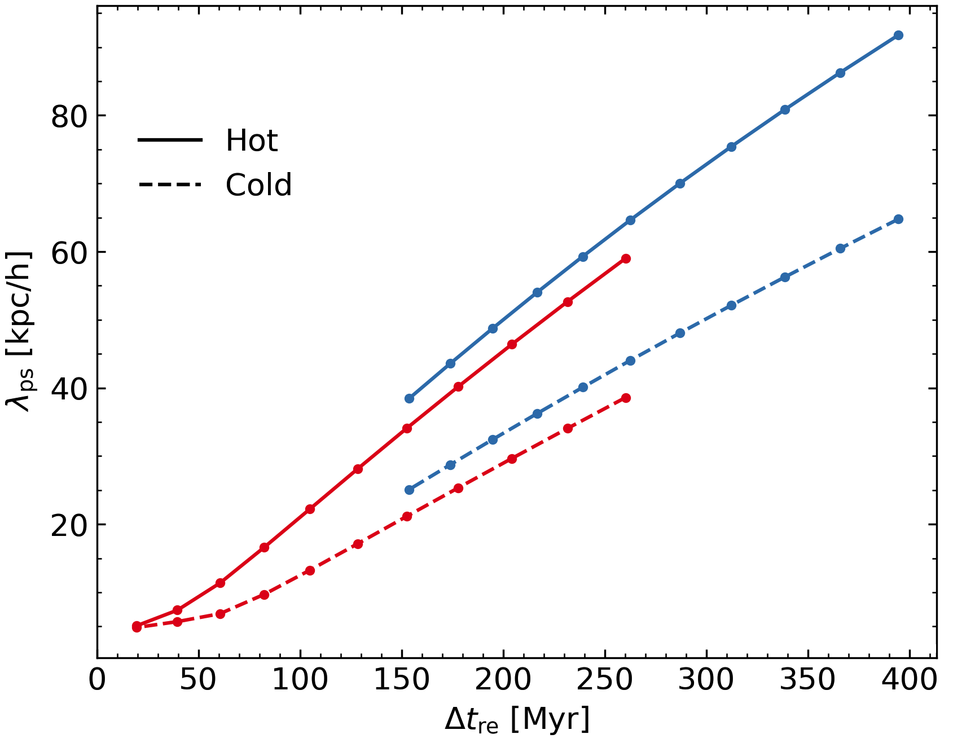
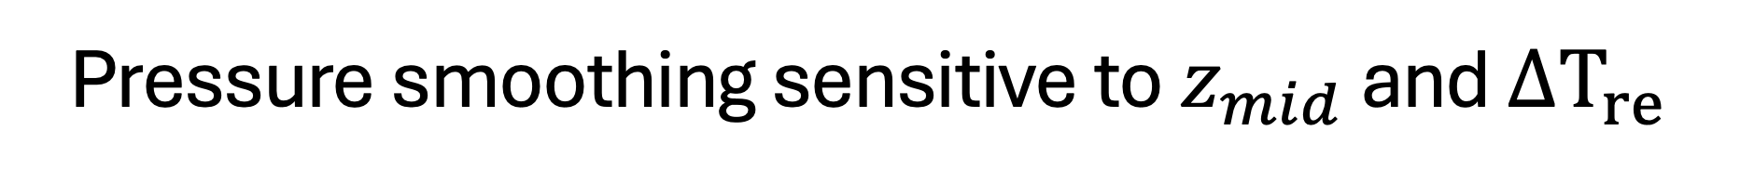


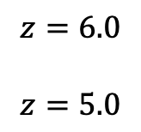

Pressure smoothing sensitive to $z_{mid}$ and $ΔT_{re}$
$$z_{mid}=6.1$$
$$z_{mid}=6.9$$
($ΔT_{re}=\text{20,000 }\text{K}$)
($ΔT_{re}=\text{1}\text{0,000 }\text{K}$)
$$z=6.0$$
$$z=5.0$$
Fit for pressure smoothing scale:
$\frac{P_{reion}}{P_{no reion}}∝{\exp\left(−\frac{k^{2}}{k_{ps}^{2}}\right)}^{2}$(Puchwein et al. 2023)
(time since reionization midpoint)
Doughty et al. 2024
Notes:
Fitting at several redshifts between z=6 and 5 for these models, this scale increases with time since reionization.
Essentially, from the time that this heat is injected in the IGM, small structures start expanding.
Models with higher midpoints have larger smoothing scale for a given redshift, and lose more high k power
Higher heat injection models also have larger smoothing scales, because they expand faster, so they also lose more high k power
LAF power spectrum is matter tracer, so is this reflected there?

Slide 9
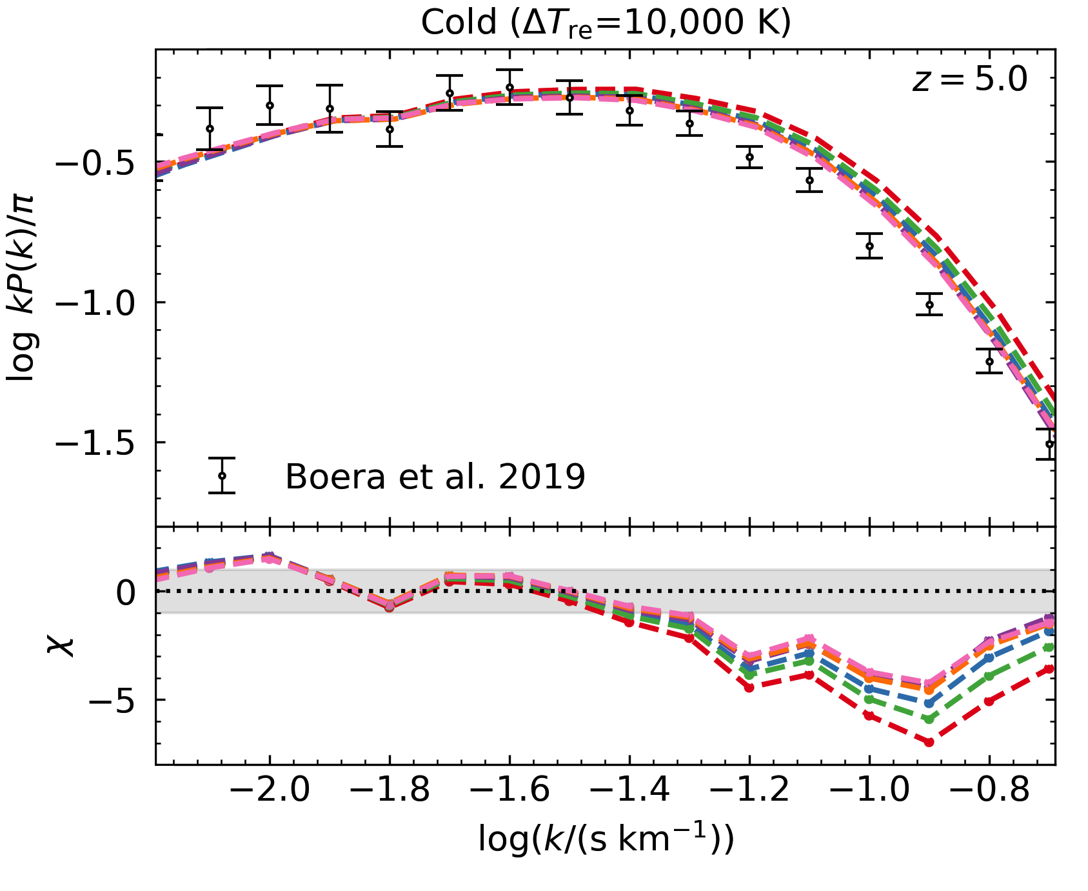
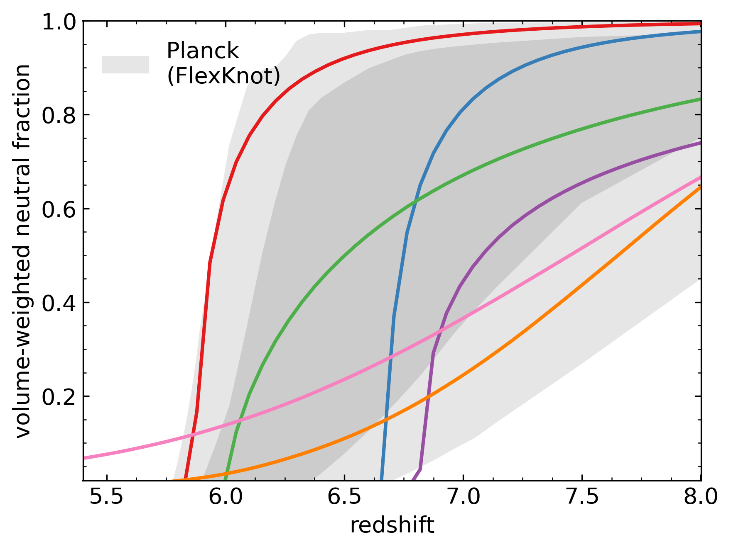
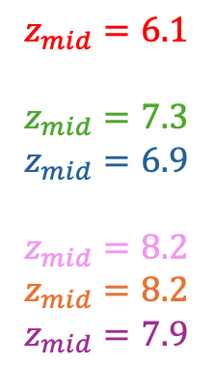
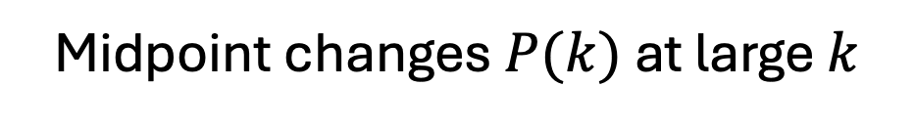
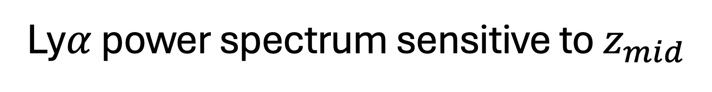
Ly$α$ power spectrum sensitive to $z_{mid}$
Midpoint changes $P(k)$at large $k$
$$z_{mid}=6.1$$
$$z_{mid}=7.3$$
$$z_{mid}=6.9$$
$$z_{mid}=8.2$$
$$z_{mid}=8.2$$
$$z_{mid}=7.9$$
See also
Oñorbe et al. 2019
Doughty et al. 2024
Notes:
Considering the power spectra for those red and blue models, plus a few more with different midpoints, there is a general trend that the high k end has more power for a later midpoint. These histories have other parameters and there is some variation due to those values, but the midpoint seems to be the main driver of this trend.
And other works have found this same result, so it isn’t too surprising.
These are for cold models, and the high k power overall is very high compared to the observations

Slide 10
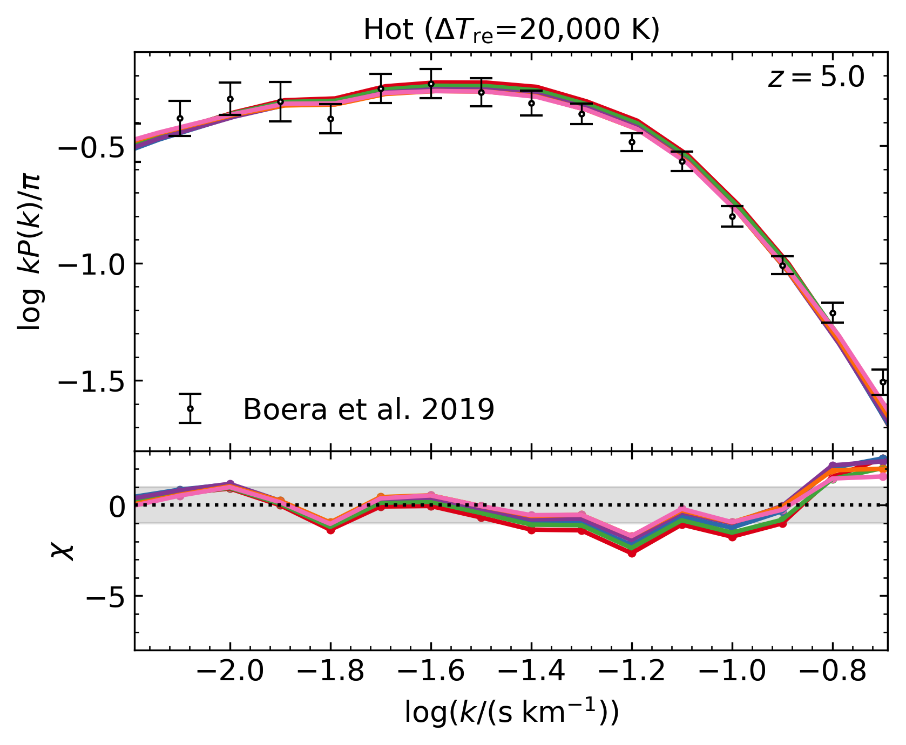
Ly$α$ power spectrum sensitive to $z_{mid}$
But also sensitive to ionization front photoheating
$$z_{mid}=6.1$$
$$z_{mid}=7.3$$
$$z_{mid}=6.9$$
$$z_{mid}=8.2$$
$$z_{mid}=8.2$$
$$z_{mid}=7.9$$
See also
Wu et al. 2019
Doughty et al. 2024
Notes:
For same histories with a more likely Delta T_reion of 20,000 K, the differences disappear.
So the actual loss of small scale power is obscured by thermal broadening, important to vary this heating parameter
These hotter models are also a better match to the observations.

Slide 11
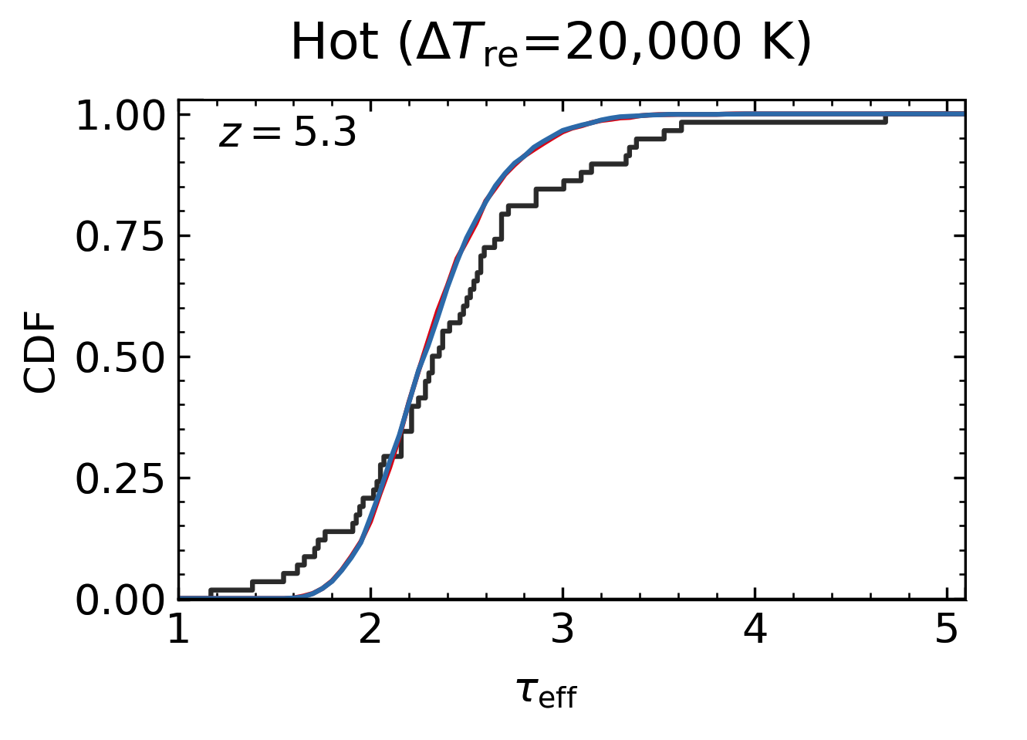
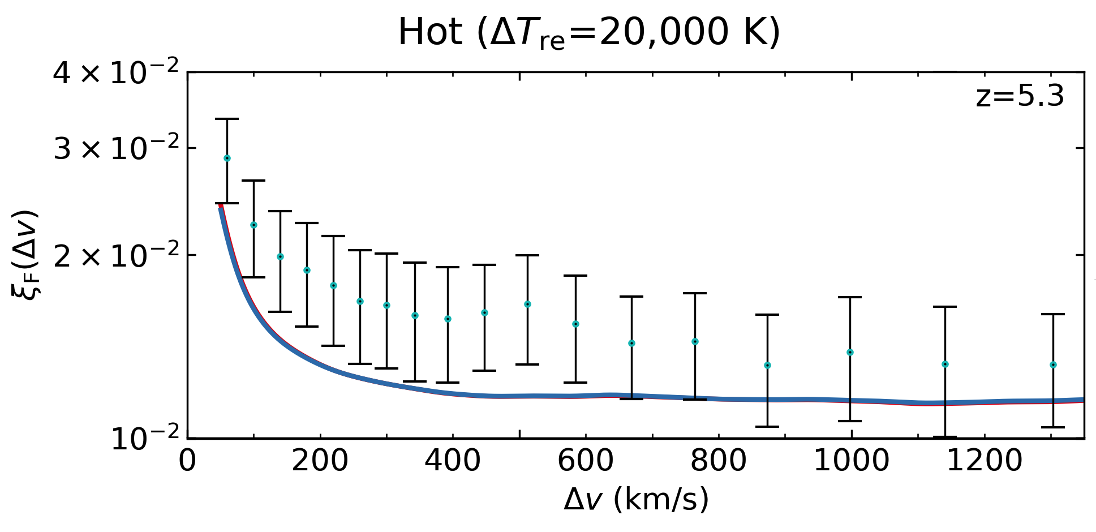
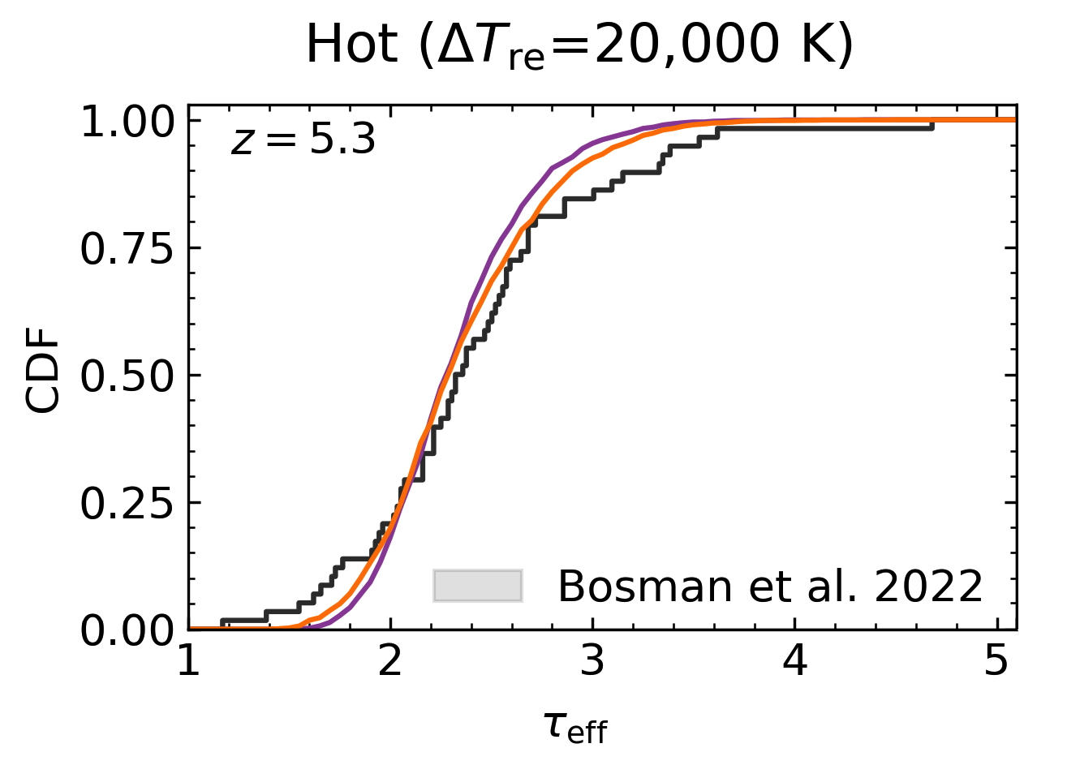
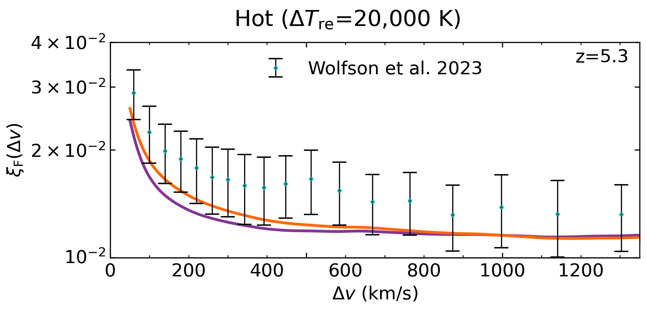
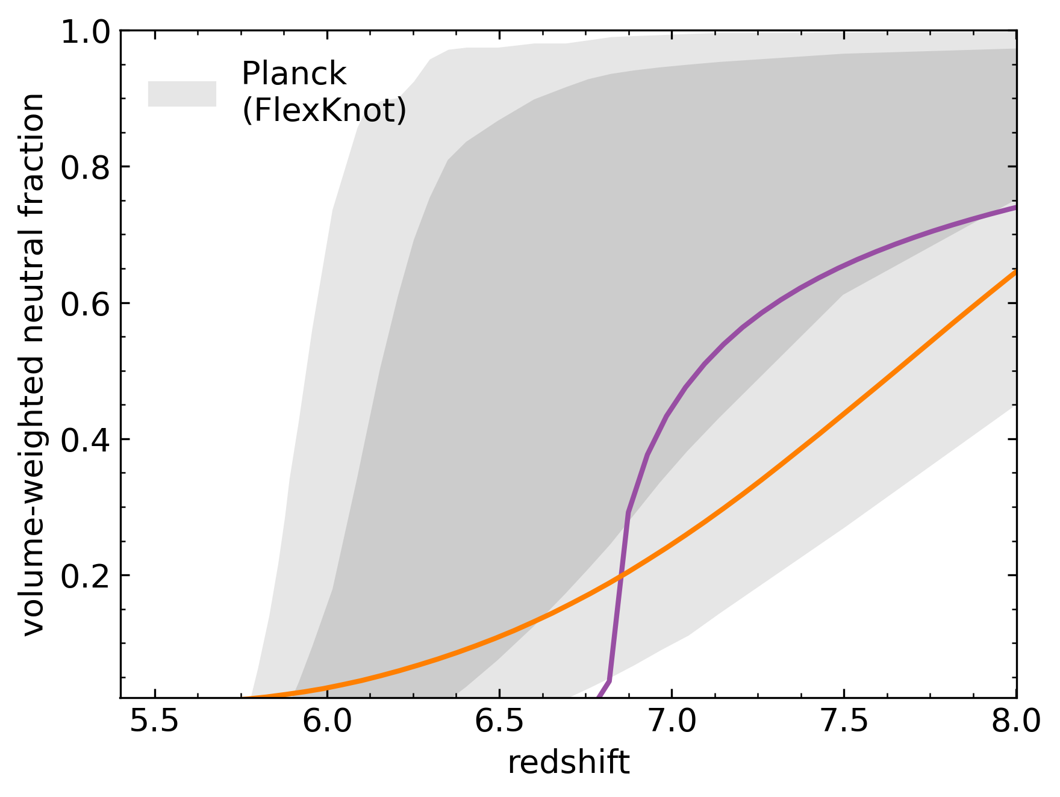

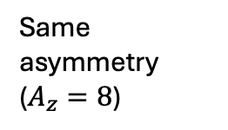

Distribution of reionization redshifts is also important
Related to asymmetry ($A_{z}=Δz_{first half}/Δz_{second half}$)
Sightline effective optical depths
Autocorrelation function
Same asymmetry
($A_{z}=8$)
$$z_{mid}=6.1$$
$$z_{mid}=6.9$$
$$z_{mid}=8.2, A_{z}=1$$
$$z_{mid}=7.9, A_{z}=13$$
Different asymmetry
Notes:
Power spectrum is not the only statistic
Sightline effective optical depth distribution or the Lyman alpha flux autocorrelation function.
For the effective optical depths, these are calculated as means along 20 Mpc skewers.
The cumulative distributions for the red and blue models with different midpoints are identical
These orange and purple models have similar midpoints, but that have very different asymmetries.
Orange is symmetric and undergoes a gradual reionization process, and has a slightly wider distribution.
The purple model is very asymmetric, and so has a burst of cells getting ionized all at once, and is a bit narrower and more similar to the models on top
The autocorrelation function in the middle column where at the smaller lags the autocorrelation functions are identical for the red and blue models, but differ between the orange and purple one.

Slide 12
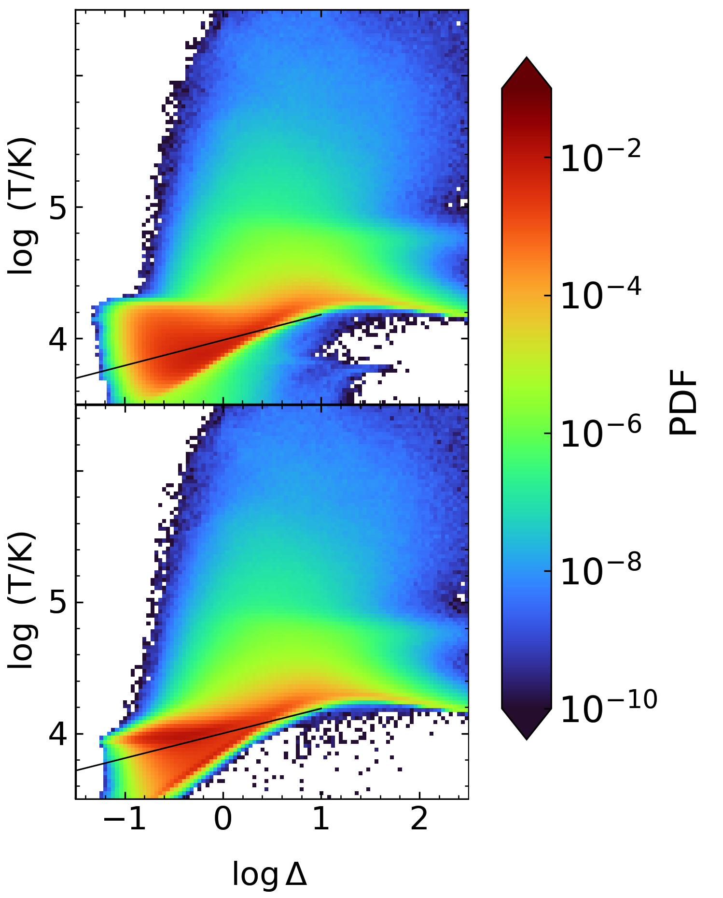



Distribution of reionization redshifts is also important
Related to asymmetry ($A_{z}=Δz_{first half}/Δz_{second half}$)
$$z=5.5$$
Autocorrelation function
$$z_{mid}=8.2, A_{z}=1$$
Impact of temperature distribution?
$$z_{mid}=7.9, A_{z}=13$$
Notes:
I have a suspicion that this is a result of the asymmetries impacting the distribution of temperatures
In this phase diagram, with symmetric model on top and asymmetric on the bottom
In the red regions of these diagram associated with laf, the symmetric model has a smooth temperature distribution
Asymmetric has a blob at higher temperatures, so a temperature field less variation might contribute to a lower autocorrelation signal
We can see that the model parameters can change LAF observables
But they also interact with each other
Here you can see that the asymmetry makes a burst of ionization happen at once, but you can also imagine that this will happen also if you had a very short duration.
So this is messy, and I don’t have very many models populating the whole parameter space that I should be considering

Slide 13
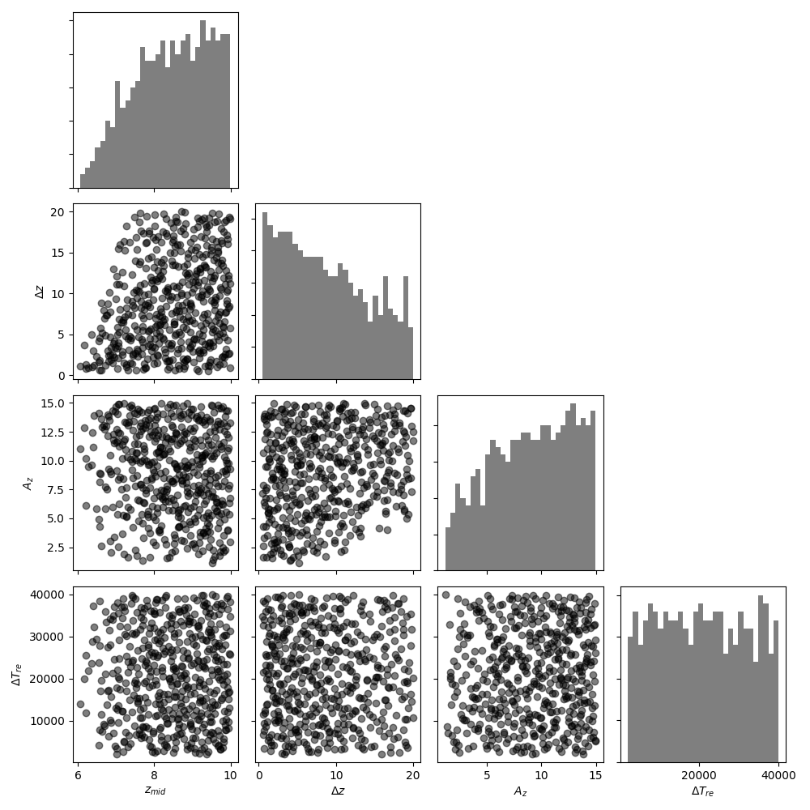
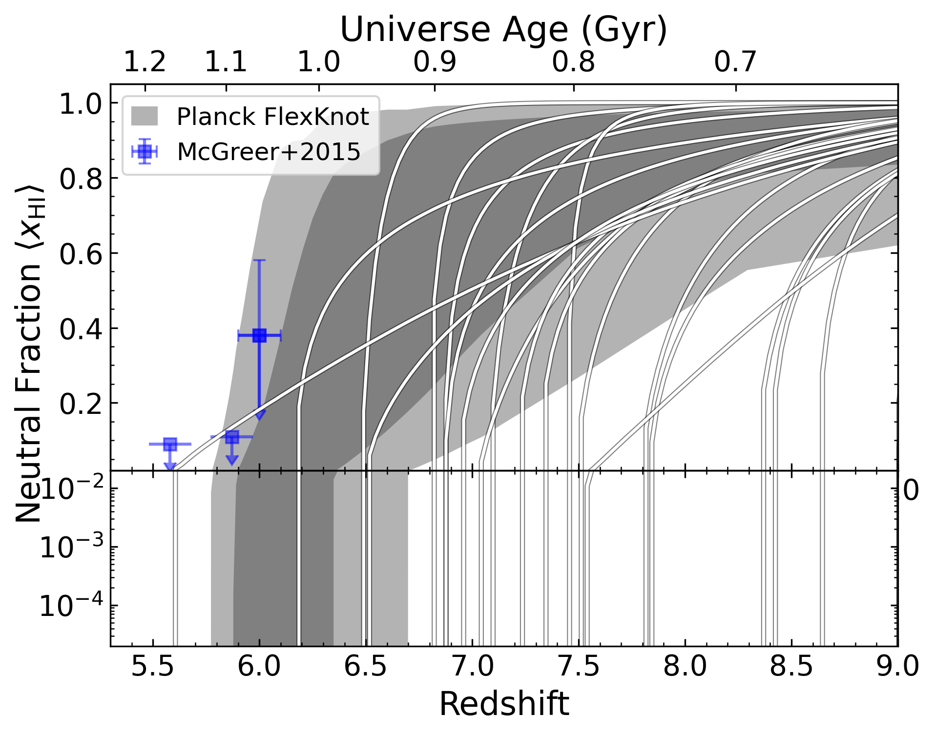

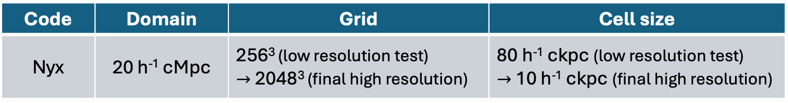
Improve this process with emulation
Better explore parameter space describing possible reionization timelines and other physics
Code | Domain | Grid | Cell size
Nyx | 20 h⁻¹ cMpc | 256³ (low resolution test) $→$ 2048³ (final high resolution) | 80 h⁻¹ ckpc (low resolution test) $→$ 10 h⁻¹ ckpc (final high resolution)
10 random simulated power spectra
González Hernández
et al. 2024 in prep.
Notes:
To address this, we want to use an emulator
Instead of sort of semi-arbitrarily selecting parameter combinations that we think might be realistic or limiting,
Train a neural network emulator to predict a laf stat like the power spectrum from a grid of simulations
Initially we are working with a grid of low resolution Nyx simulations and will switch to high resolution ones based on those preliminary results
Then from those emulated power spectra, we will try to infer some of these timing and heating parameters

Slide 14
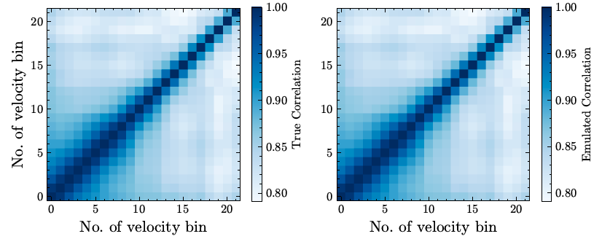
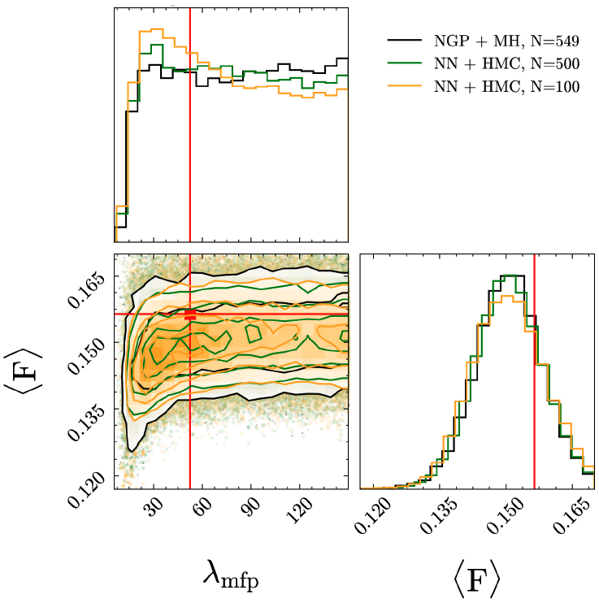

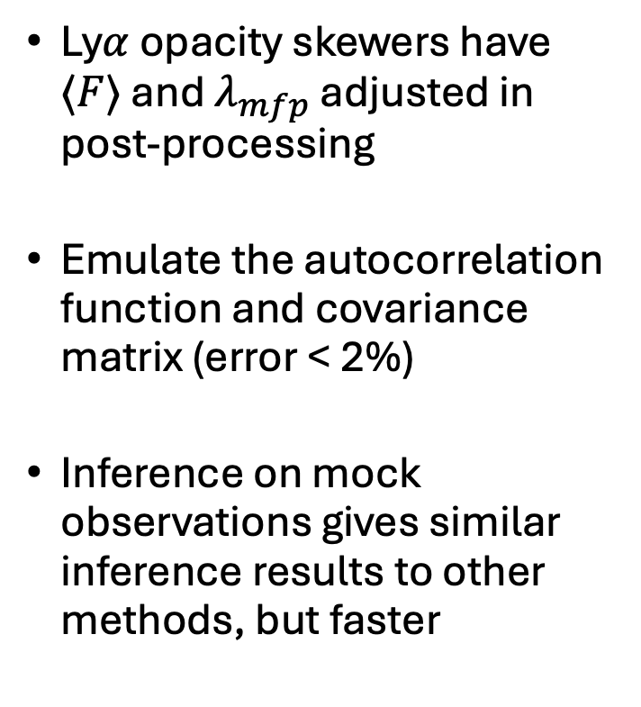
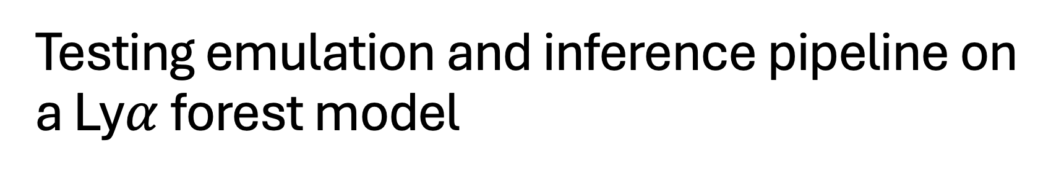
Testing emulation and inference pipeline on a Ly$α$ forest model
True
Emulated
Ly$α$ opacity skewers have $⟨F⟩$ and $λ_{mfp}$ adjusted in post-processing
Emulate the autocorrelation function and covariance matrix (error < 2%)
Inference on mock observations gives similar inference results to other methods, but faster
NGP + MH,
$N_{models}=549$
NN + HMC,
$N_{models}=500$
NN + HMC,
$N_{models}=100$
González Hernández
et al. 2024 in prep.
Notes:
Diego has tested the pipeline on another reionization model
These are using skewers from a different Nyx simulation, where the Lyman alpha opacities are adjusted in post-processing to reflect a different mean flux and mean free path
The autocorrelation functions were calculated from these adjusted skewers, and you can see some examples of how they change in response to different mean fluxes
For this version of the pipeline, the emulator was trained to predict the autocorrelation function from those two parameters and achieves errors when predicting the autocorrelations for the test set
We also have to emulate the covariance matrix of that function, which is necessary for evaluating the likelihood in the inference procedure.
Both of these emulators are getting errors of less than 2 percent, which is promising

Slide 15
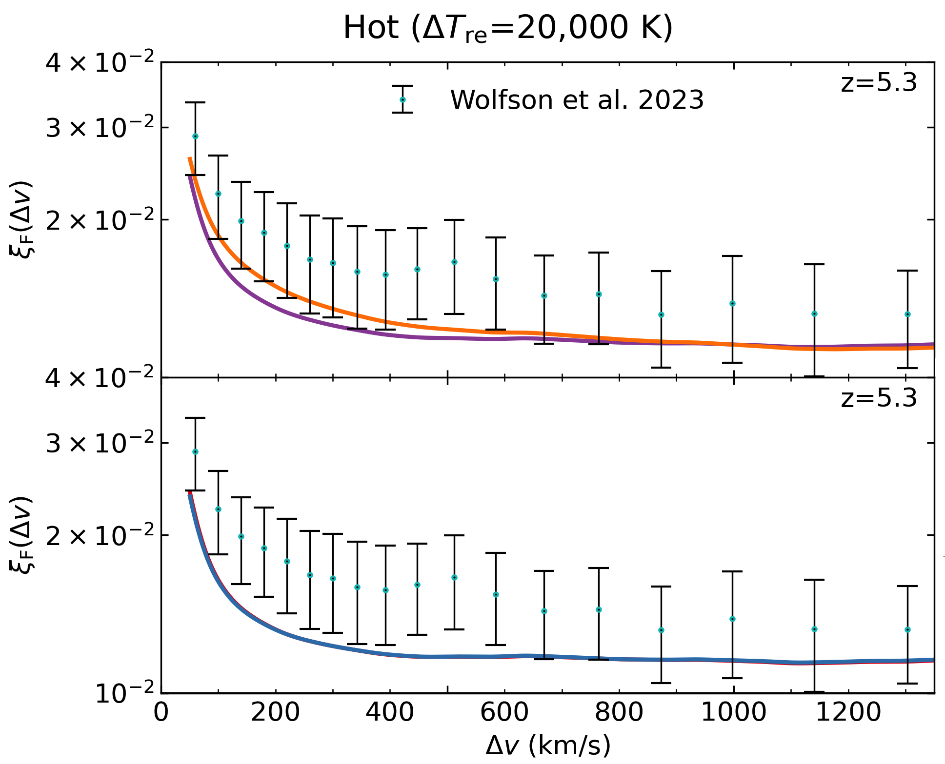
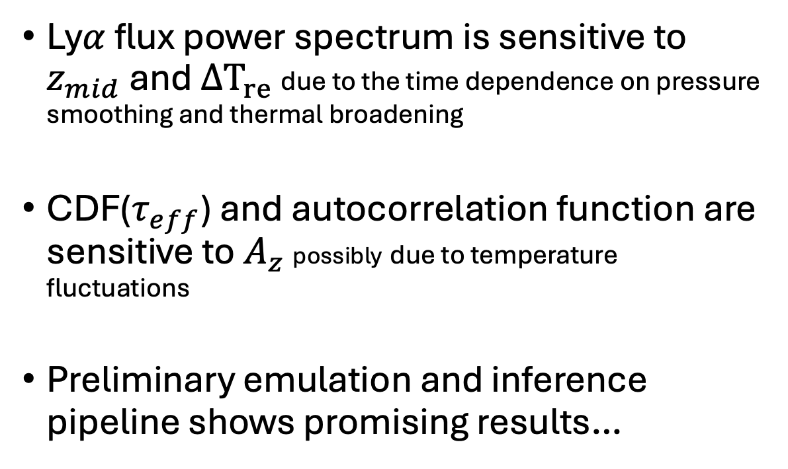



Summary
$$z=5.5$$
Ly$α$ flux power spectrum is sensitive to $z_{mid}$ and $ΔT_{re}$ due to the time dependence on pressure smoothing and thermal broadening
CDF($τ_{eff}$) and autocorrelation function are sensitive to $A_{z}$ possibly due to temperature fluctuations
Preliminary emulation and inference pipeline shows promising results…
$$P_{reion}/P_{no reion}$$
$$z_{mid}=6.1$$
$$z_{mid}=6.9$$

