Slide 1
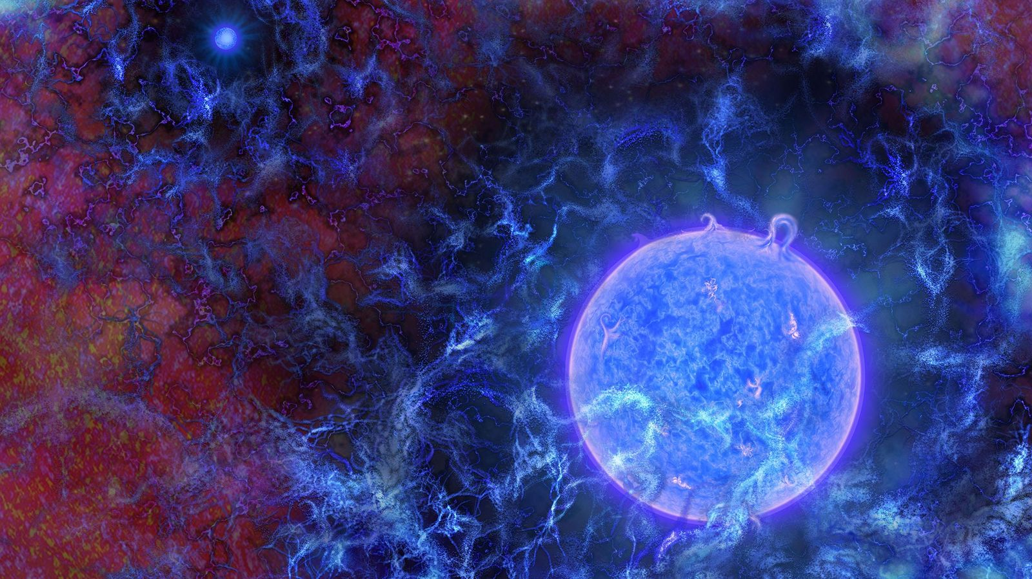

First Stars and Binaries
PHOTOGRAPH BY ILLUSTRATION BY N.R.FULLER (NSF)
Anastasia Fialkov
24.06.2024

Slide 2
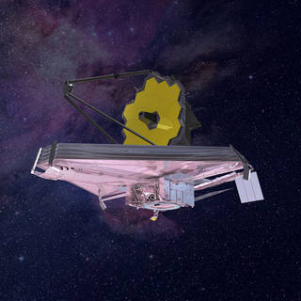
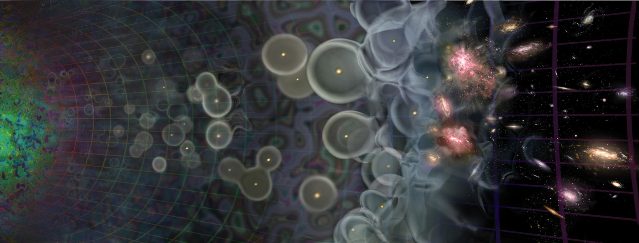
JWST is pushing the observational frontier and explores bright galaxies at the Epoch of Reionization (EoR), z~14.
Exciting news and indication for an early onset of star formation!
SDSS II
6dFGS
WiggleZ
BOSS
DESI
CHIME
JWST
Image credit: NASA
Credit: Seth Siegel

Slide 3
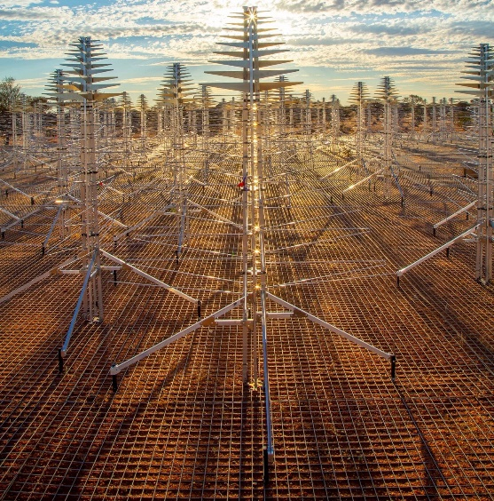
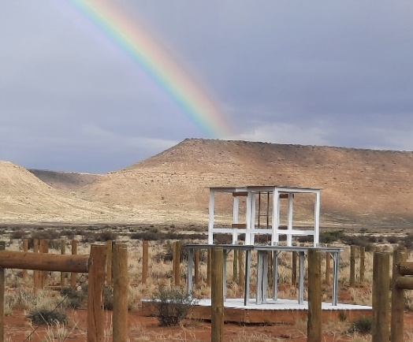
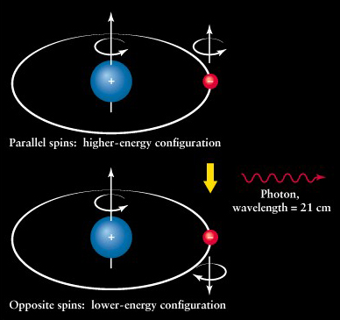
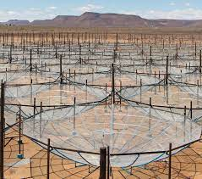

Hydrogen 21-cm signal will probe statistical properties of typical populations of sources.

Slide 4
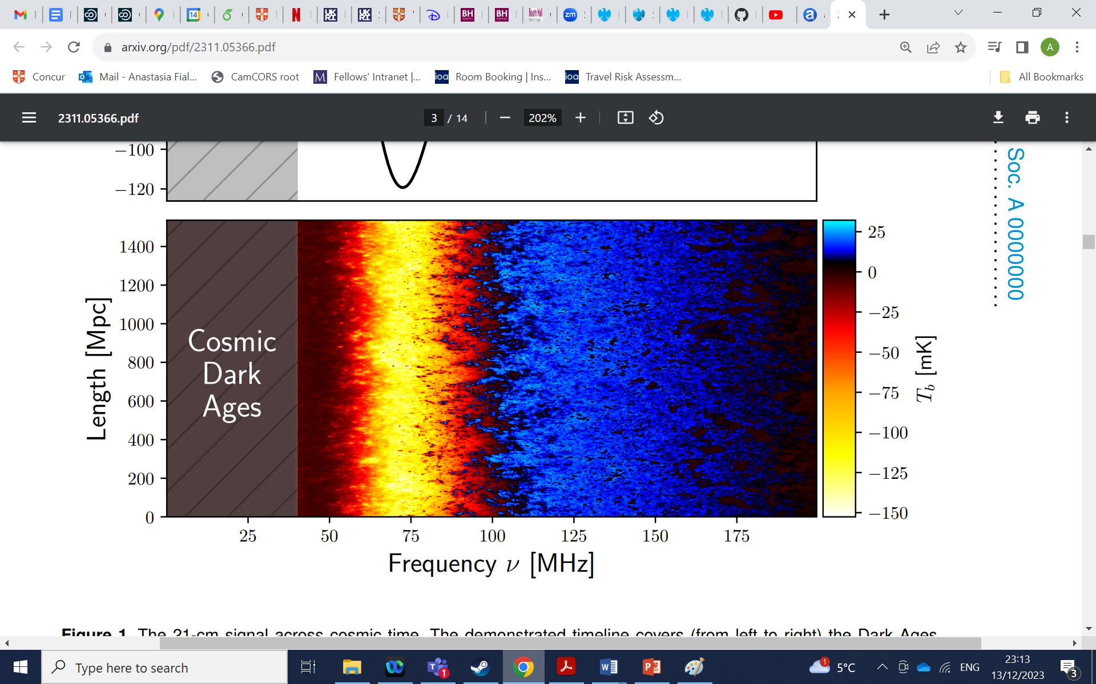
21-cm is Rich in Astrophysics and Cosmology
Epoch of Reionization
Massive galaxies and quasars
Cosmic Dawn
First stars and black holes
Dark Ages
Fialkov et al. 2023
Plot credit: Dhandha
Dark matter and cosmology

Slide 5

Unconverged IMF of PopIII Stars
How Big Were the First Stars?
Klessen and Glower (2023)

Slide 6

Impact of PopIII IMF on the 21-cm Signal
Lyman-band effects: WF coupling, LW feedback, Ly-𝛼 heating
Emission spectra for different Z = 0 IMFs, integrate over the lifetime
Evolutionary tracks MESA, Z= 0
Stellar atmospheres TLUSTY, Z = 0
Evolutionary tracks of individual Z=0 stars. Effective temperature 𝑇eff vs logarithm of surface gravity 𝑔.
Stellar Ly-band fluxes for BB approximation and the TLUSTY stellar atmosphere code.
Gessey-Jones, Sartorio, Fialkov et al. 2022

Slide 7
Photon Emission Rate per Stellar Baryon for Different IMFs
Gessey-Jones, Sartorio, Fialkov et al. 2022

Slide 8
Signature of PopIII Stellar Masses
The 21-cm signal is sensitive to typical stellar mass if M < 20 solar
Weaker Ly-a coupling at lower M due to the increase in lifetimes of Pop III stars (emission spread over a longer time).
Global signal
Power Spectrum
Gessey-Jones, Sartorio, Fialkov et al. 2022

Slide 9
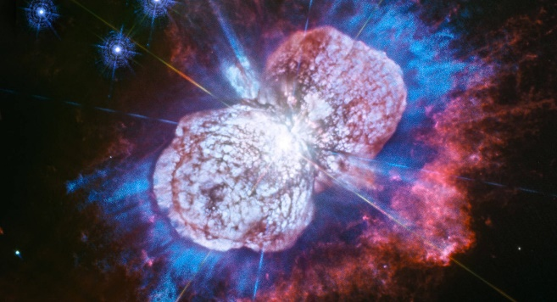
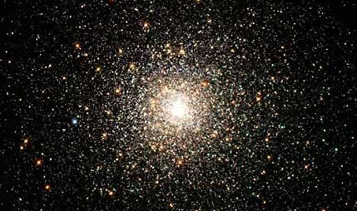
PopIII -> PopII Transition
First Supernovae and the
Process of Metal Enrichment
Fraction of PopII halos
Magg et al. 2022

Slide 10
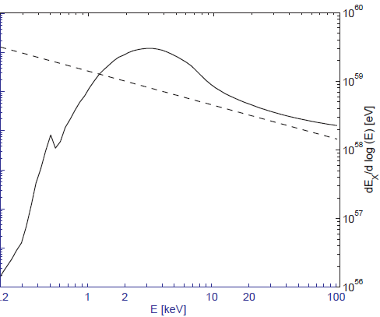
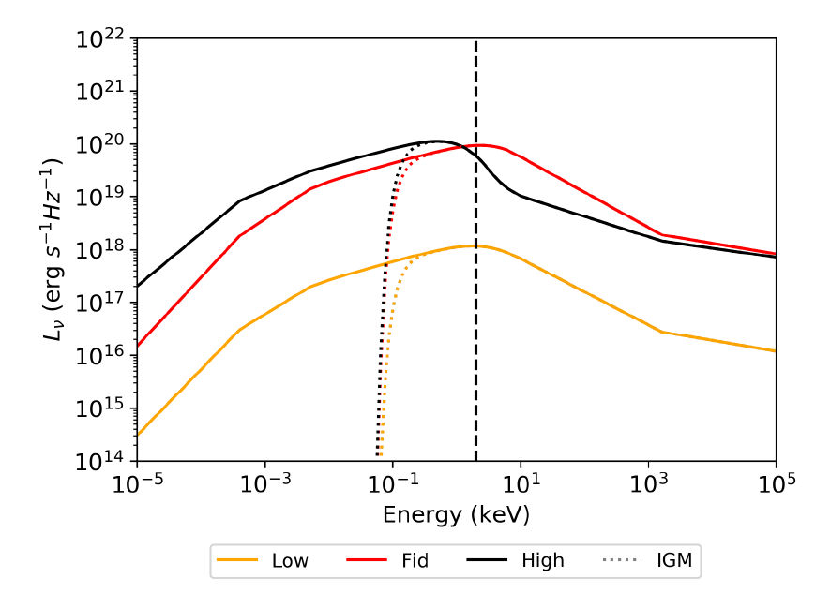
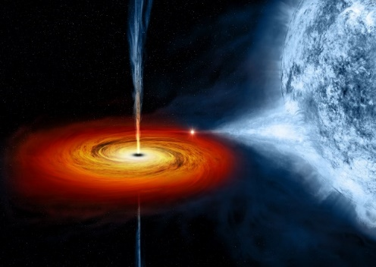
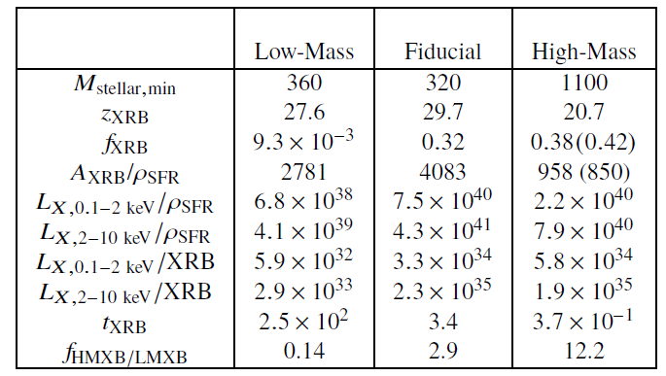
First (Z=0) X-ray Binaries
Binary population synthesis + X-ray modelling
X-ray SEDs averaged over the XRB population for each one of the considered IMFs
PopII SED
(Fragos et al. 2013)
Sartorio, Fialkov, Hartwig et al. 2023

Slide 11
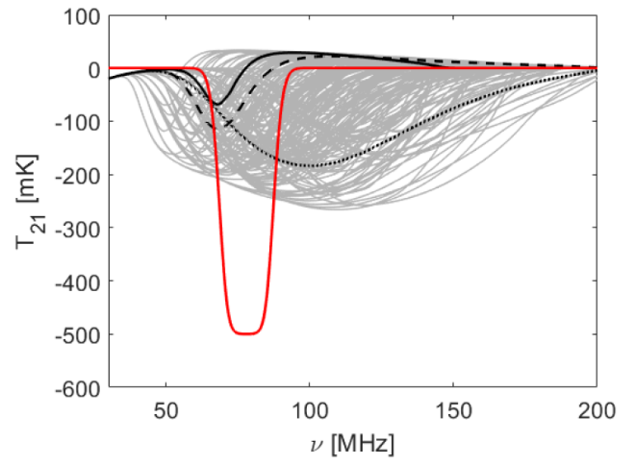
Excess radio photons at high-z
EDGES
Astro
Cohen, et al. (2017)
Radio background T_{rad} (T_{CMB})
Thermal history, T_{K}
Extra radio background
Reis, Fialkov, Barkana (2020)
B-DM interactions
Barkana, et al. (2023)

Slide 12
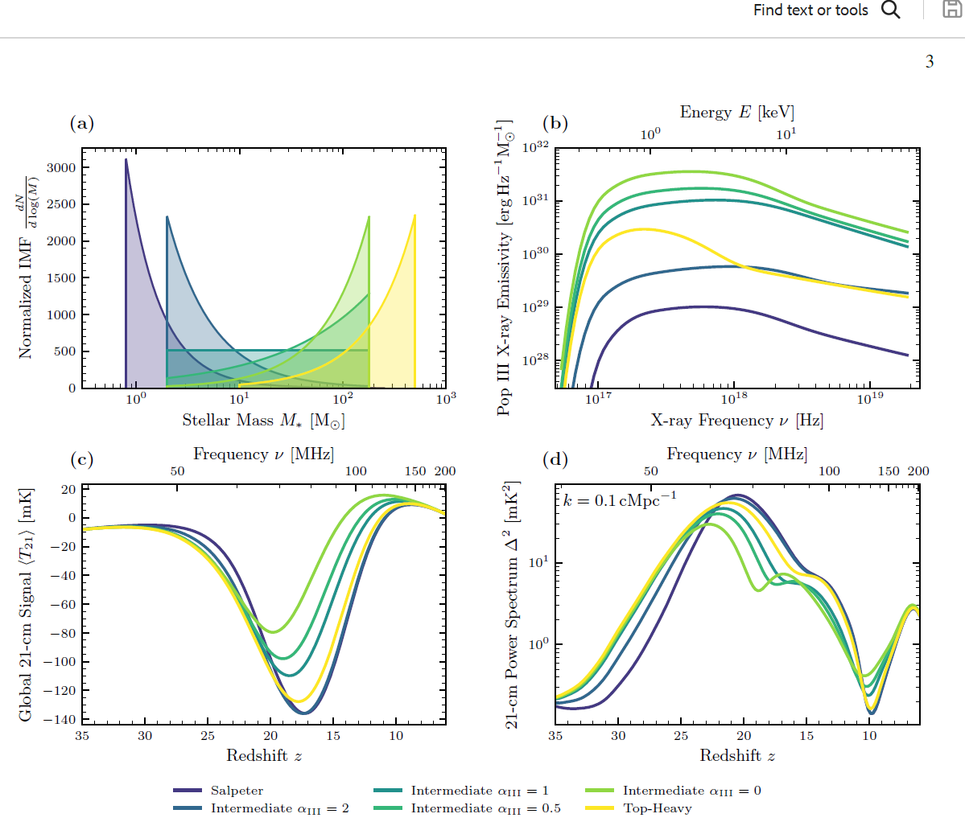
Total signature of PopIII IMF in 21-cm signal
(Ly-band + X-rays)
PRELIMINARY
Gessey-Jones et al. in prep

Slide 13
Next gen experiments are expected to do much better and even identify the PopIII IMF!
PRELIMINARY
Gessey-Jones et al. in prep

Slide 14
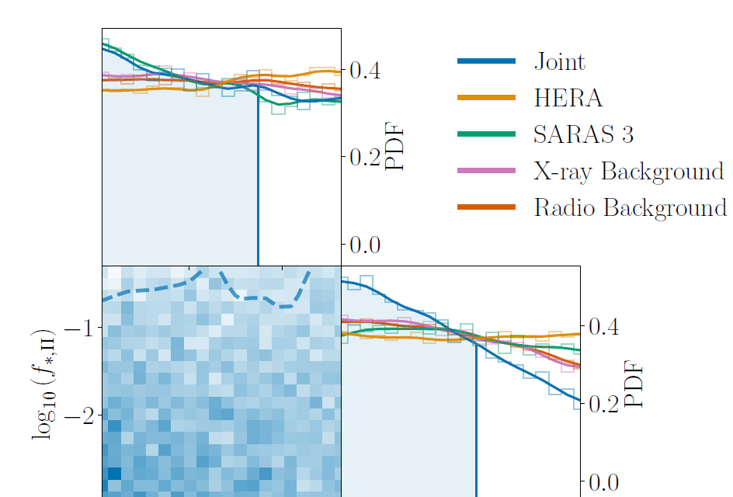

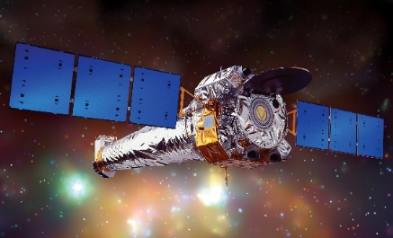
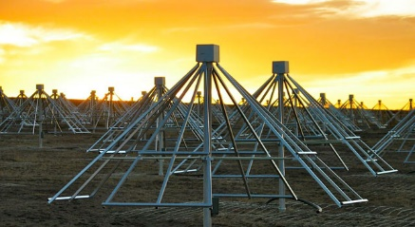
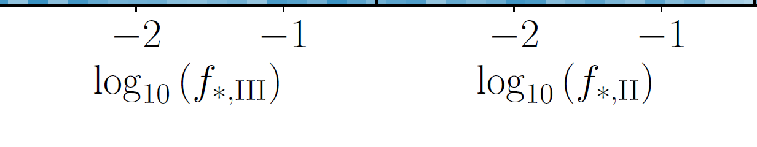
Constraints on Pop III and Pop II Stars
with Existing Data
Pochinda et al. (2023)

Slide 15
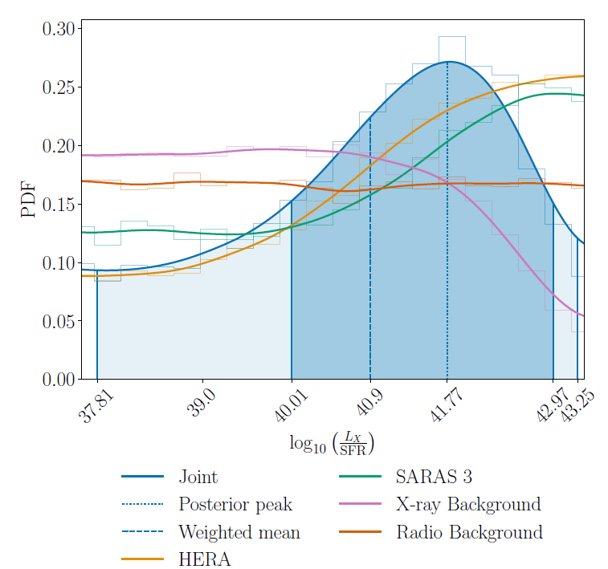
X-ray luminosity with Existing Data
Pochinda et al. (2023)

Slide 16
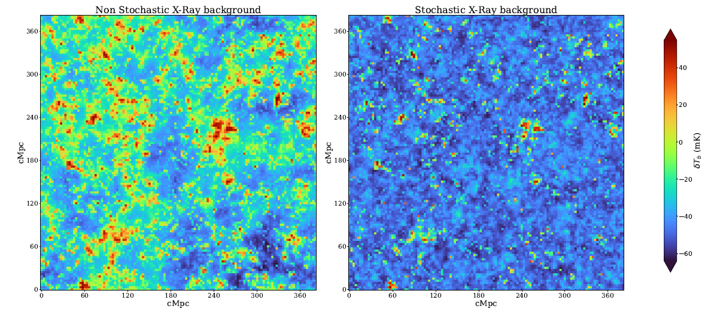
Stochastic Binaries
PRELIMINARY
Dasgupta et al. in prep.

Slide 17

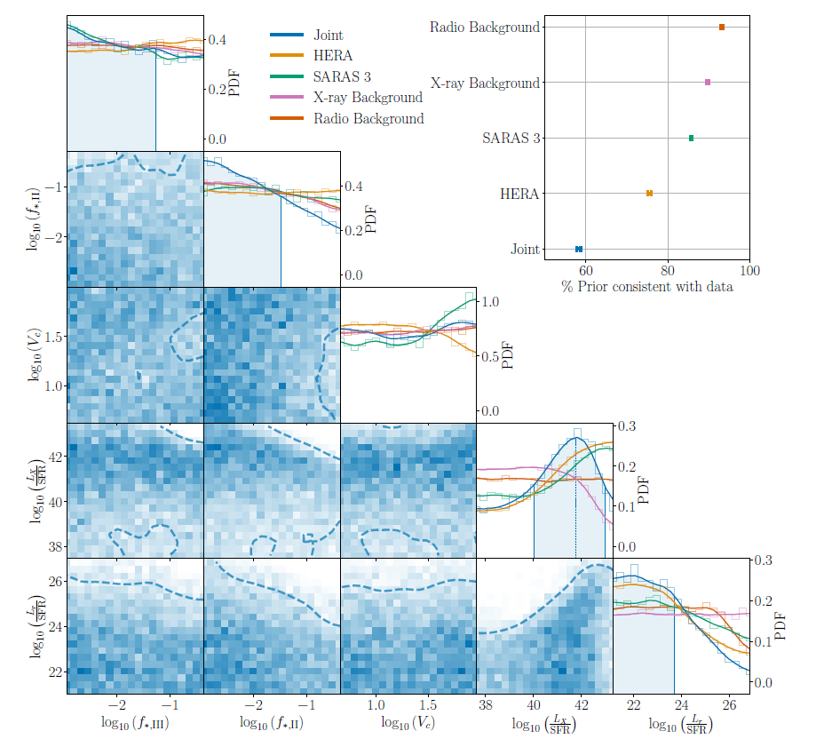
Conclusions:
21-cm is a very promising probe of cosmic dawn physics!
Stellar IMF and first supernovae
Heating processes
Exotic physics
Next Gen experiments will probe PopIII IMF
Current limits from HERA, SARAS 3, X-ray and radio background.
Rule out bright radio sources that are inefficient in heating the gas.
Rule out efficient heaters.
Constraints on Pop III star formation!
Thank you!

