Slide 1
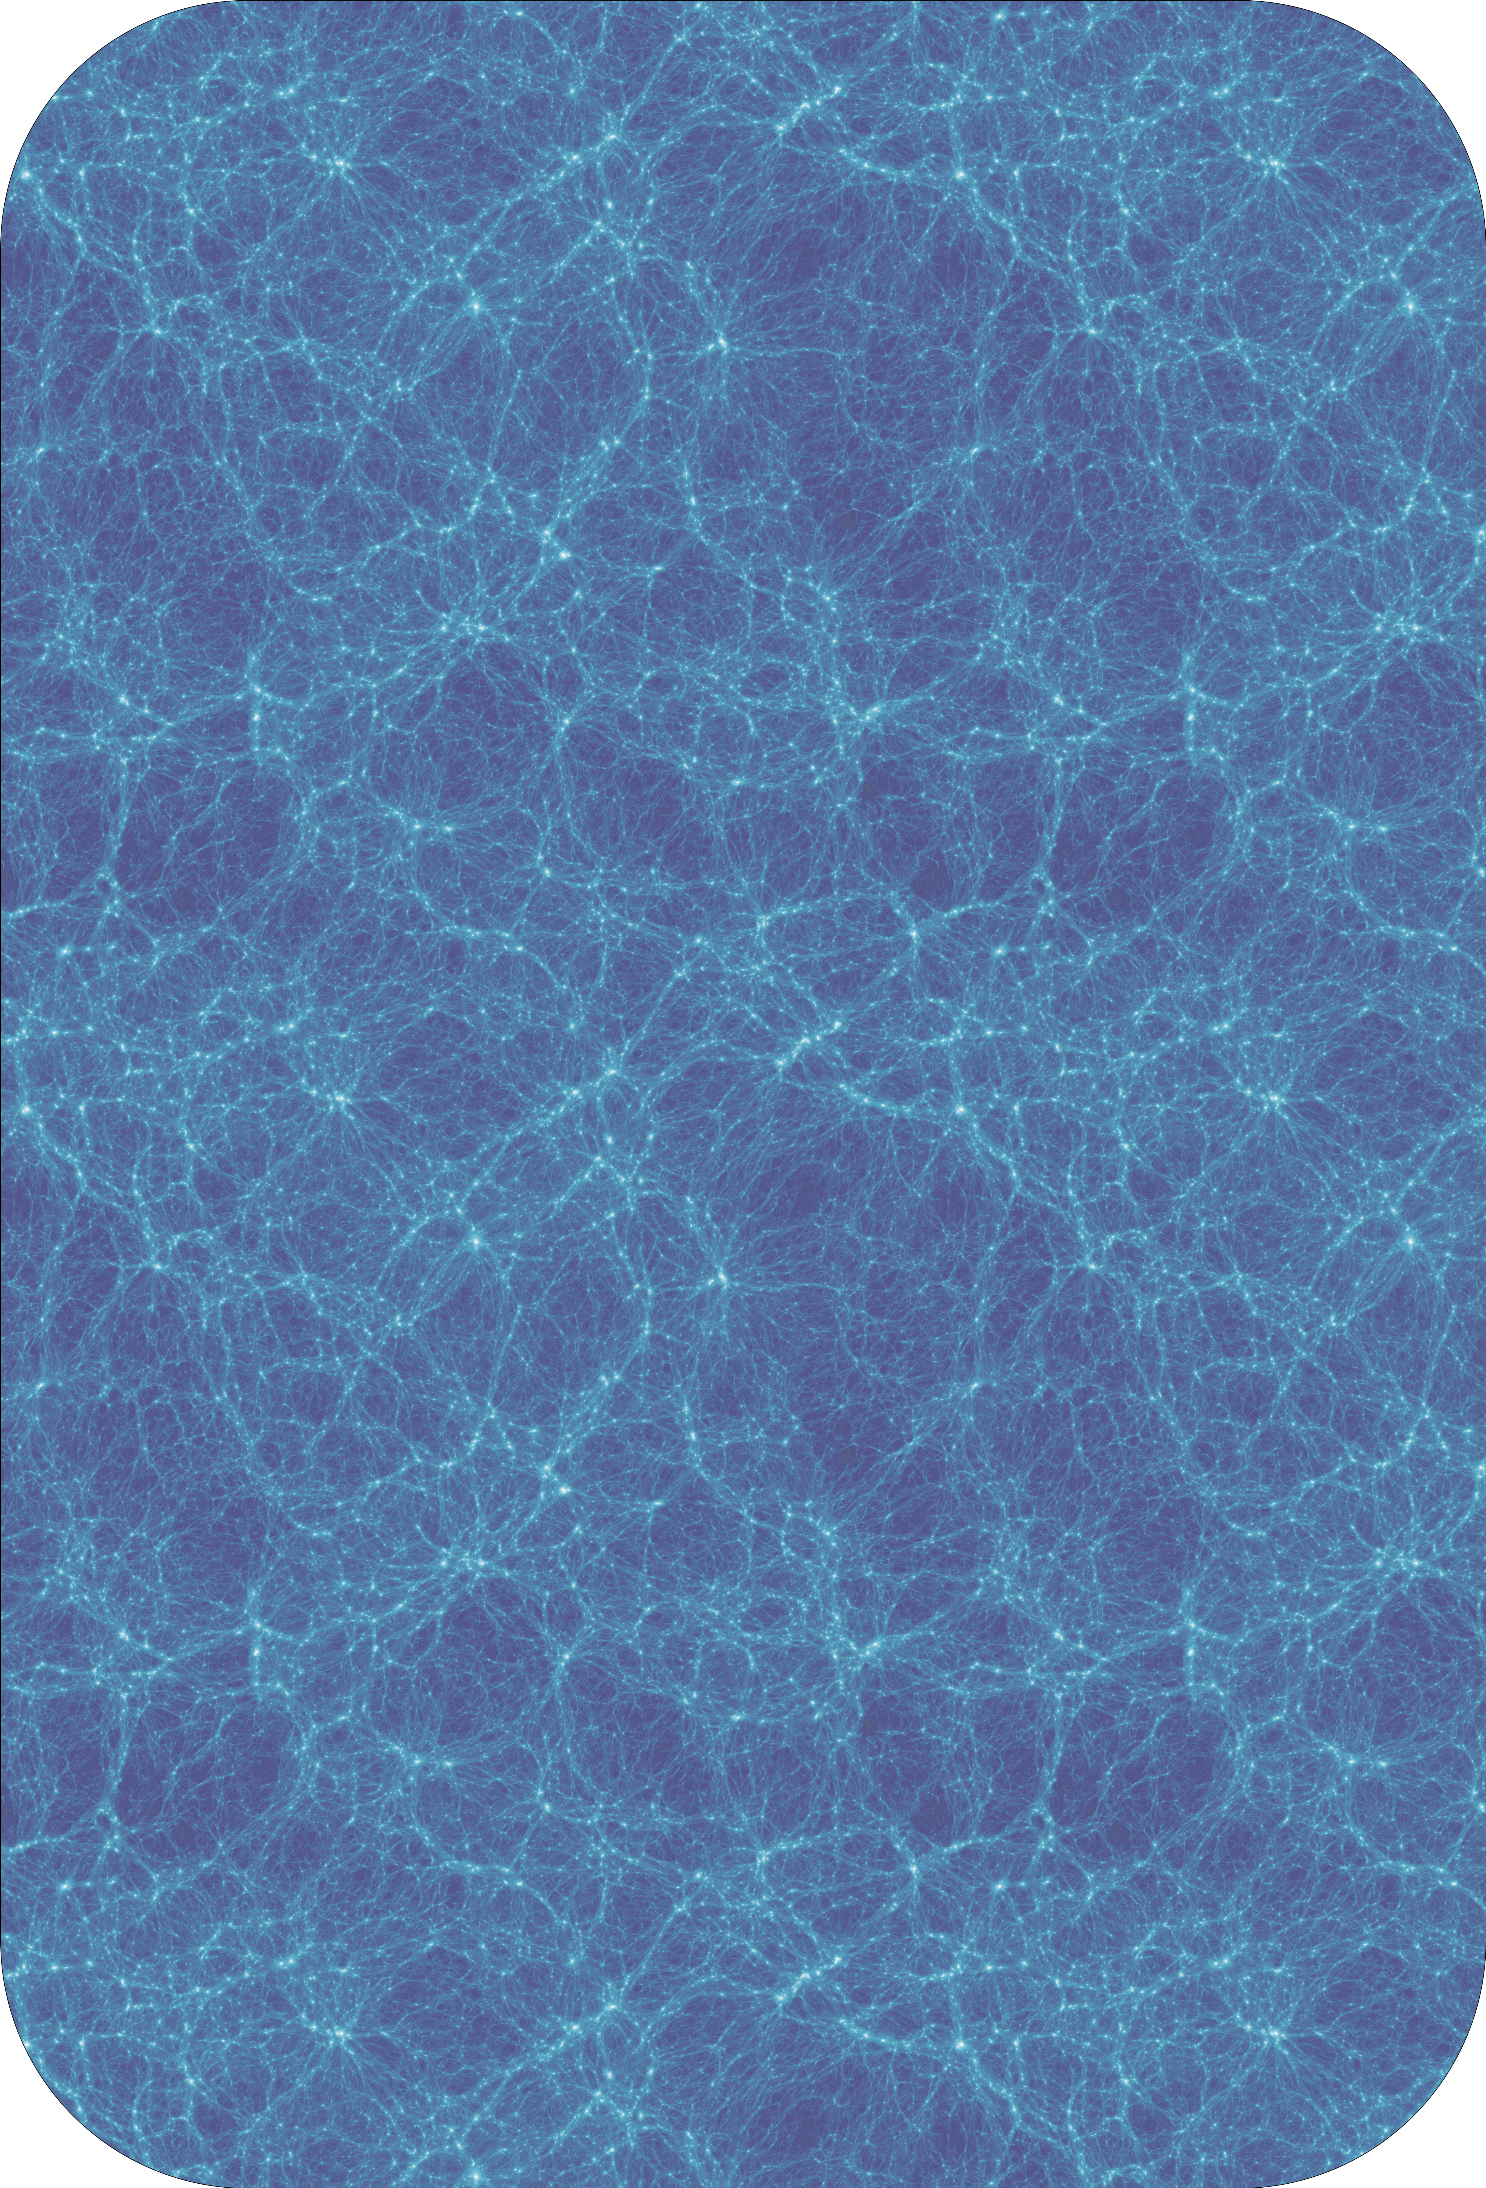

Behaviour of $Ly−α$ damping wings as a function of reionisation topology
Cosmic Dawn at High Latitudes, 24-28 June 2024
Yash mohan sharma
Max-Planck-Institut für Astronomie, Heidelberg
Background Credits: Diemer & Mansfield

Slide 2
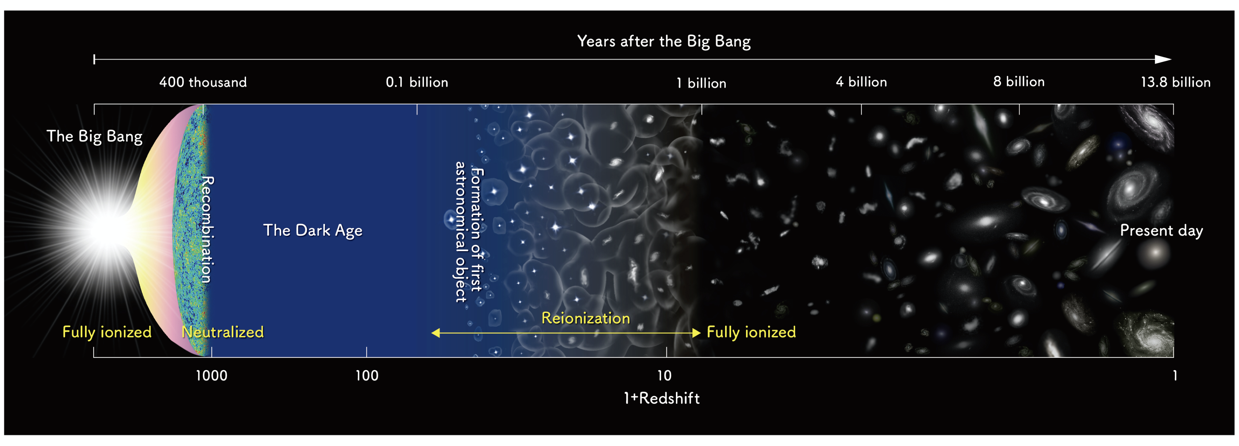
The Epoch of Reionization

Slide 3
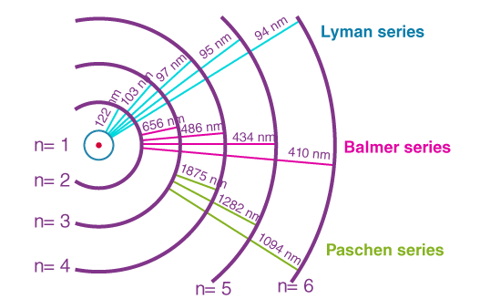
Damping wings
Wang et al., 2020
Willott (2010)

Slide 4
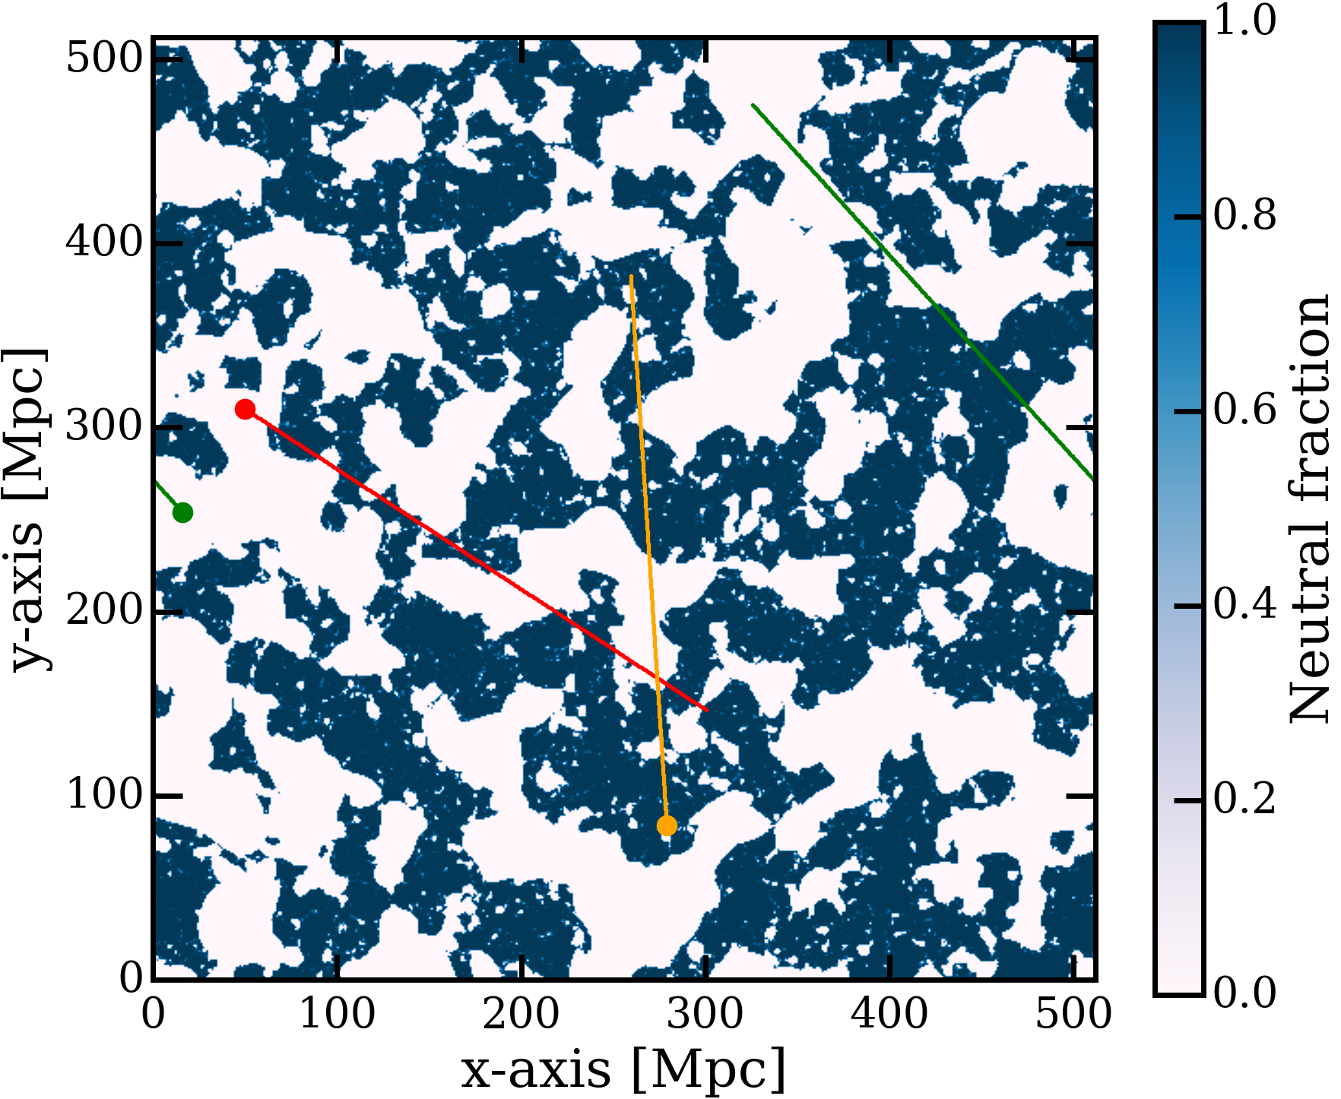
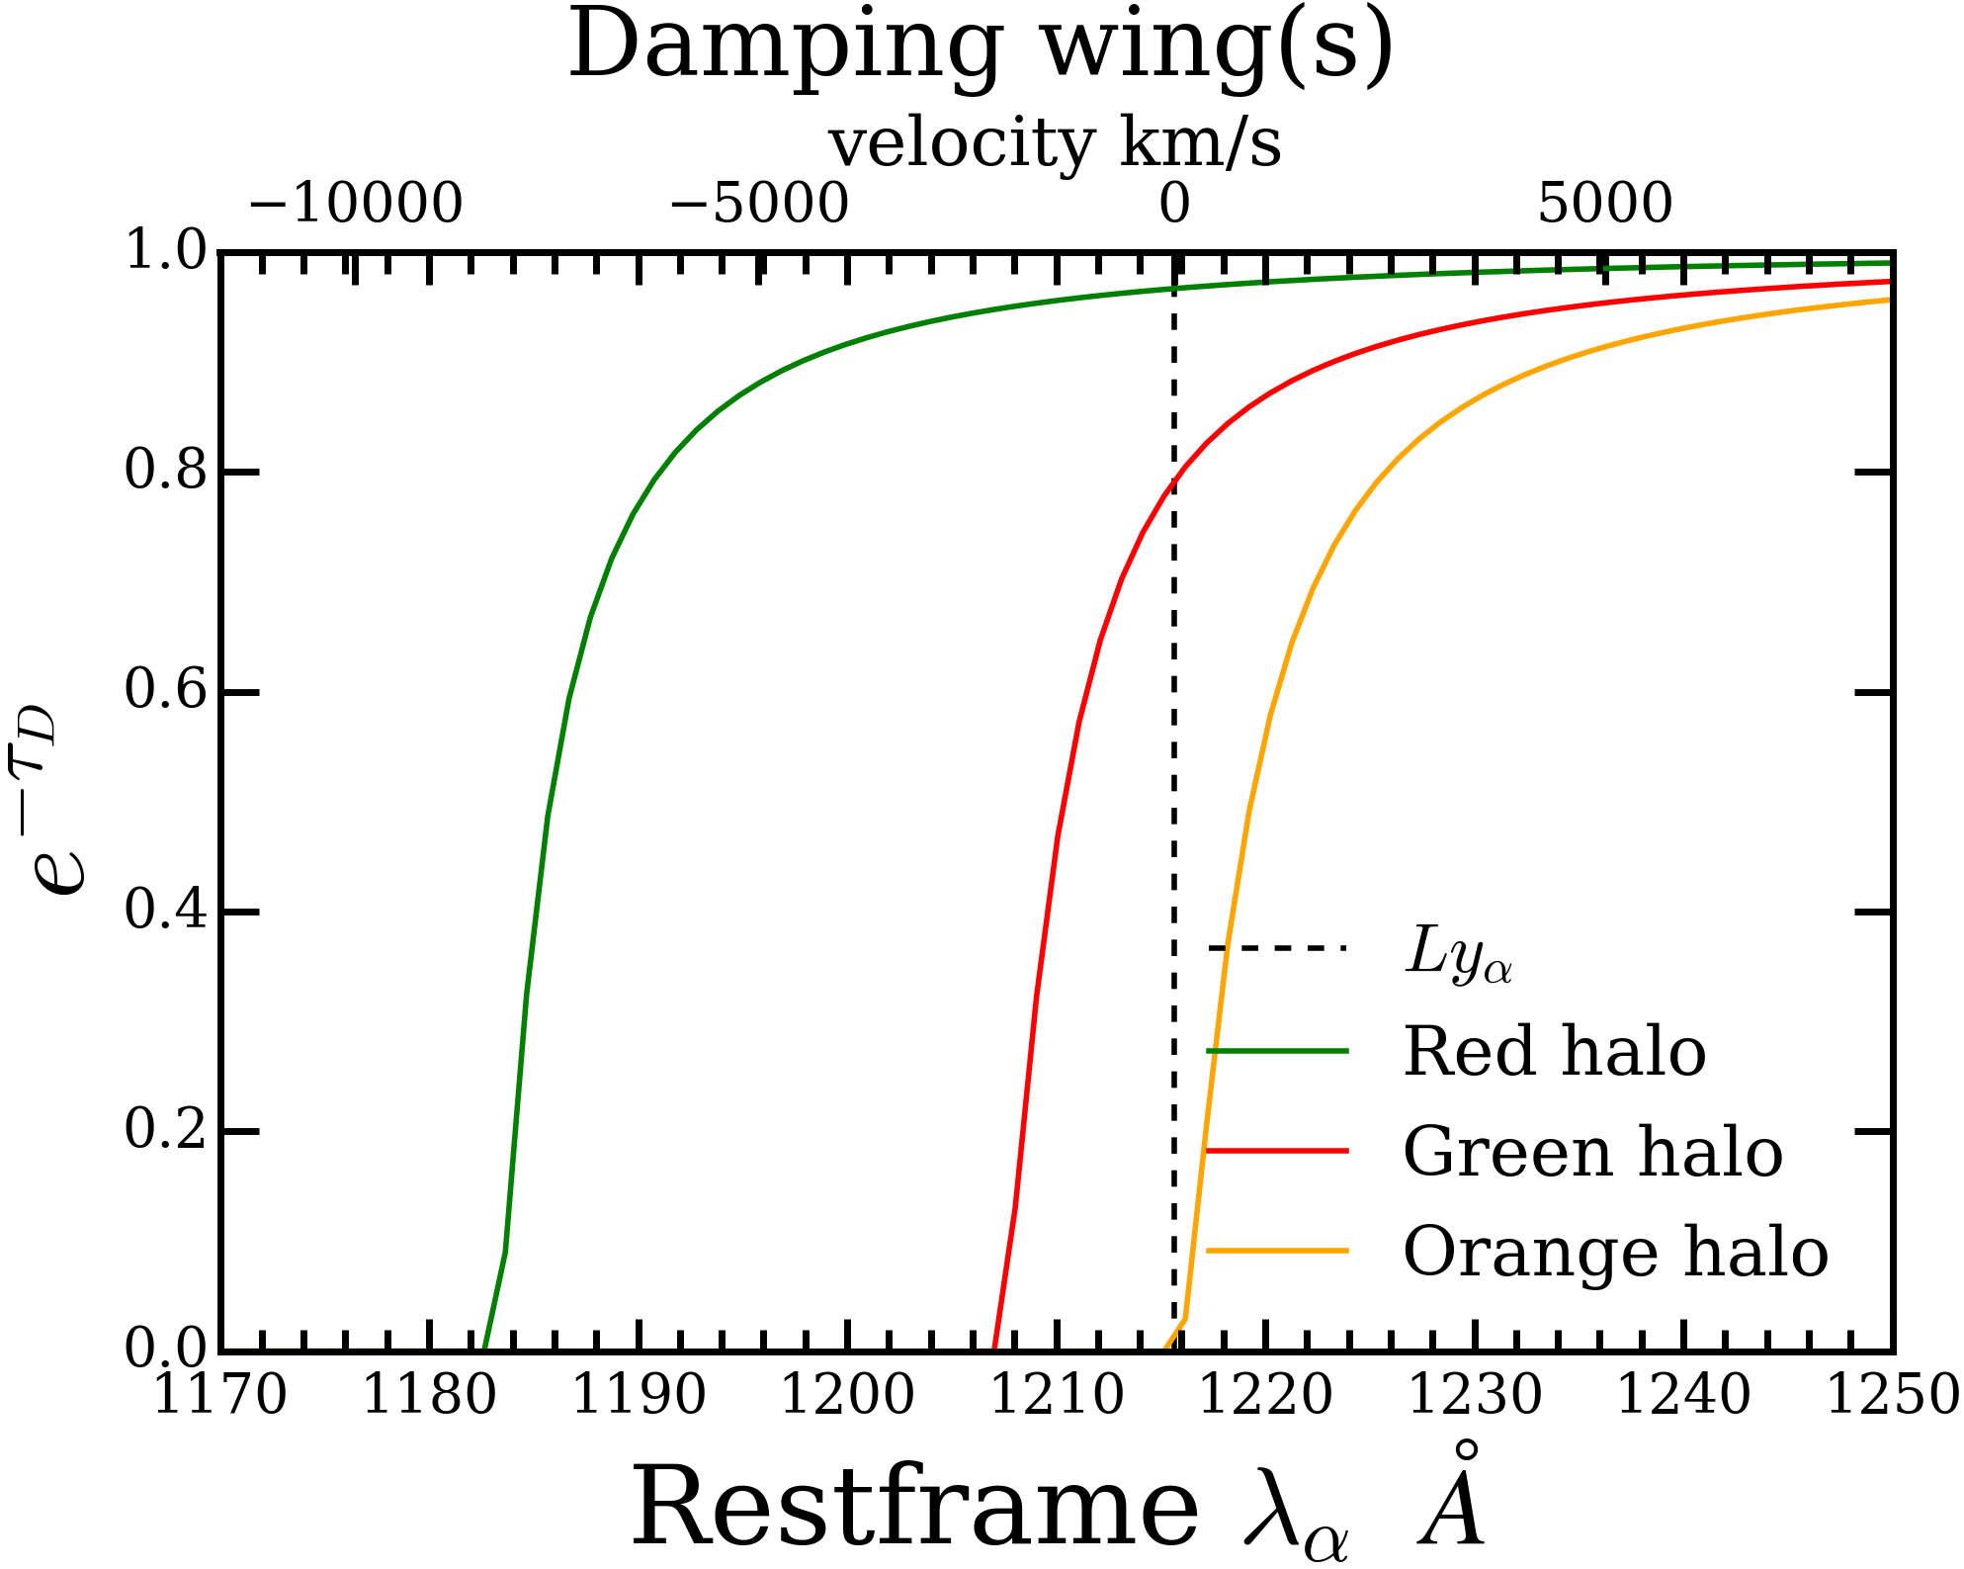
Damping wing profile along the sightline

Slide 5
What do we want to study?
How damping wings are influenced by the reionization topolgy, and which parameters we can constrain using them.
HOW ARE WE GOING TO STUDY?
Using 21cmFast*, which is a semi-numerical cosmological simulation, to generate large ionised boxes of desired astrophysical parameters.
Once we have the ionised box, locate halos in the ionised box.
Treating the halo as a host of quasar, we shoot a sightline along some random direction.
Treating this sightline as our line of sight, we computed the damping wing profile along it.
https://github.com/21cmfast/21cmFAST/

Slide 6
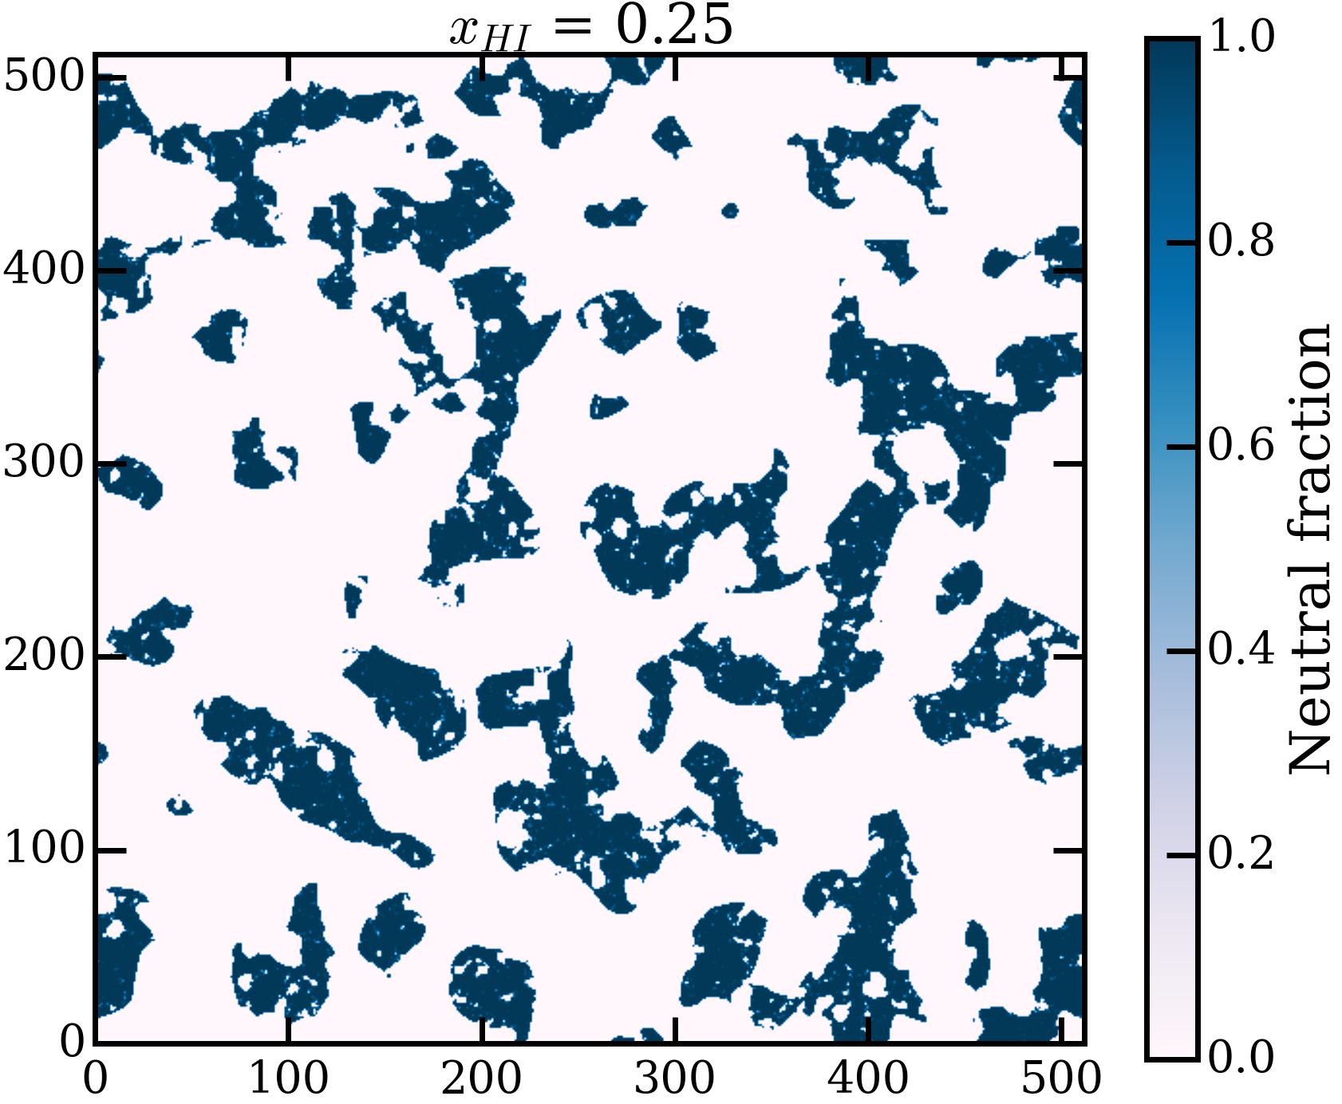
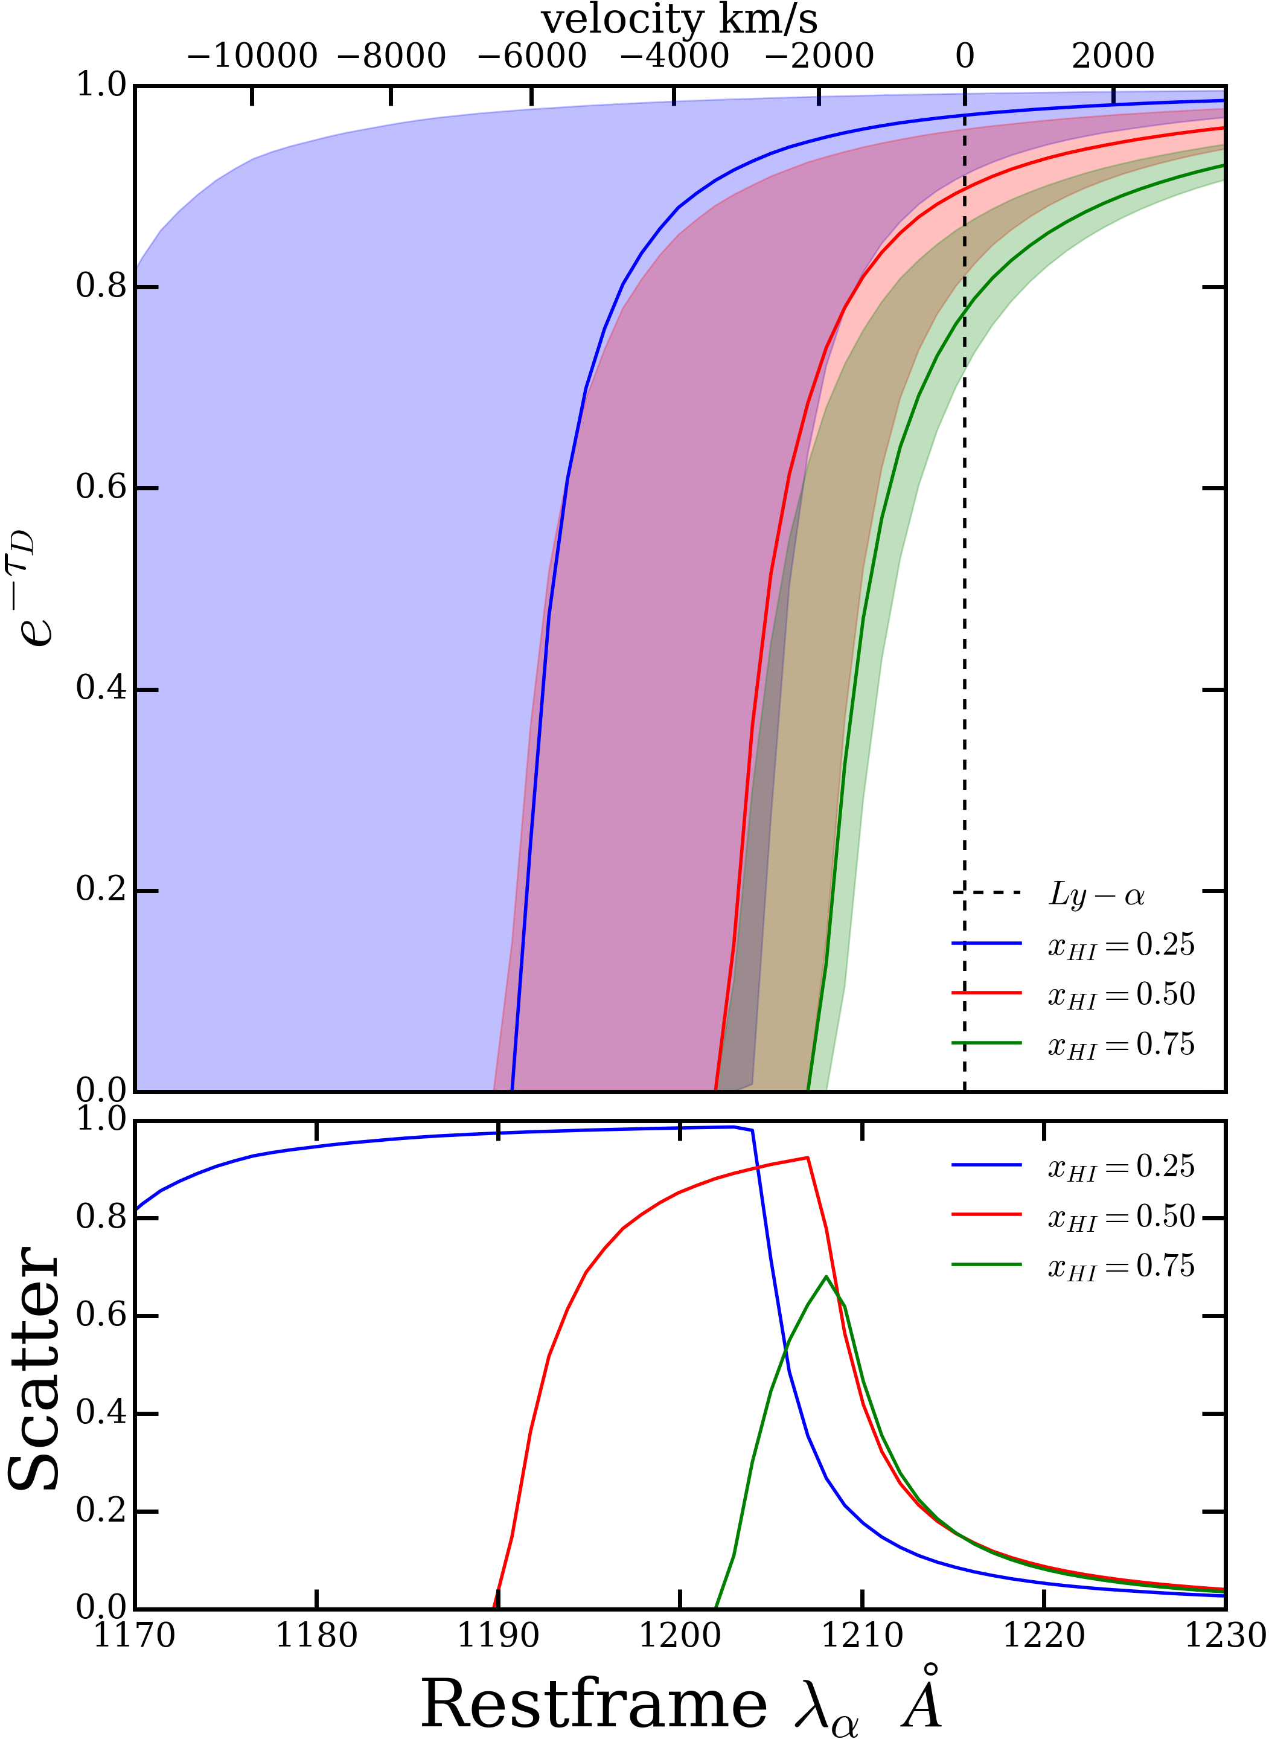
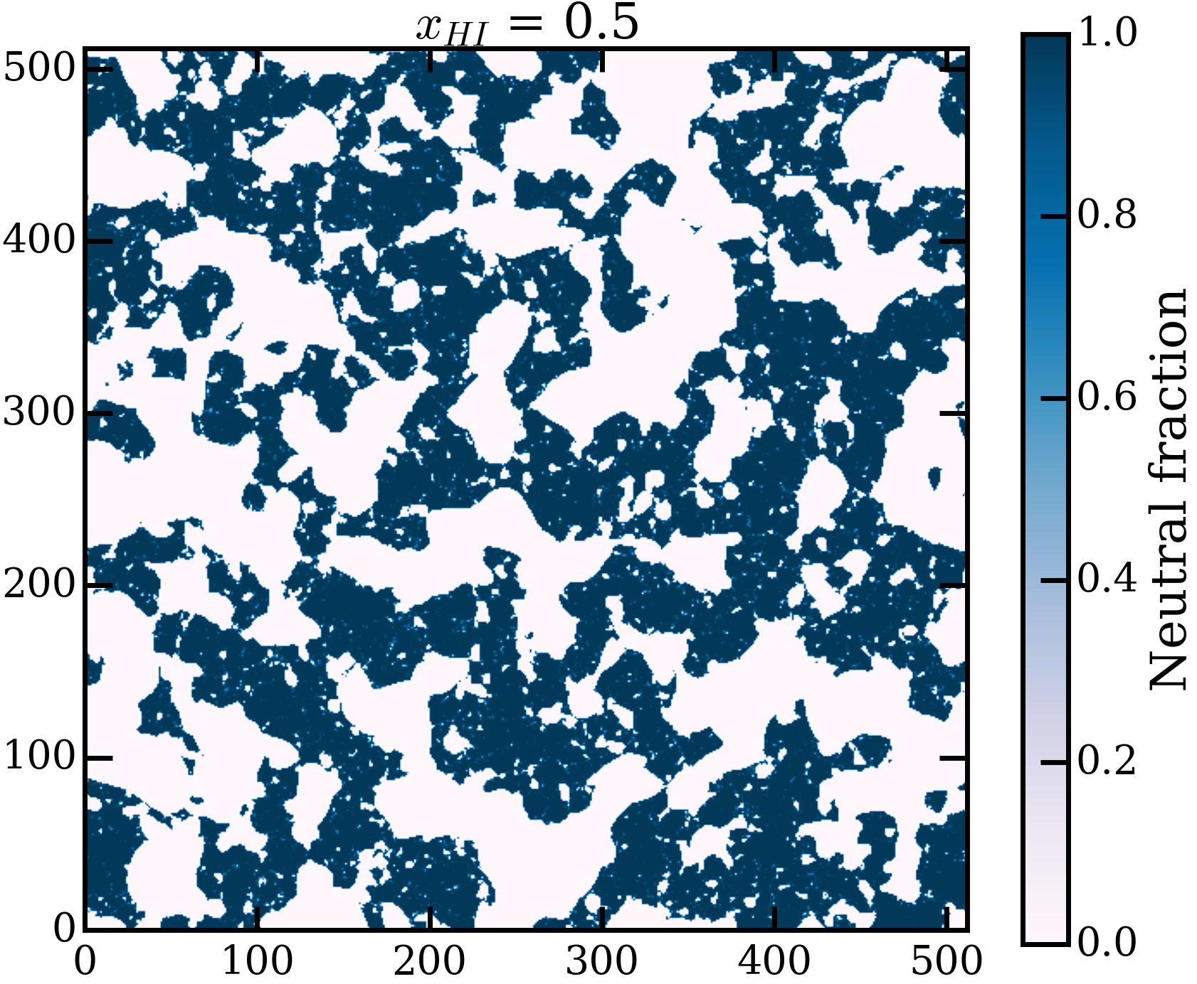
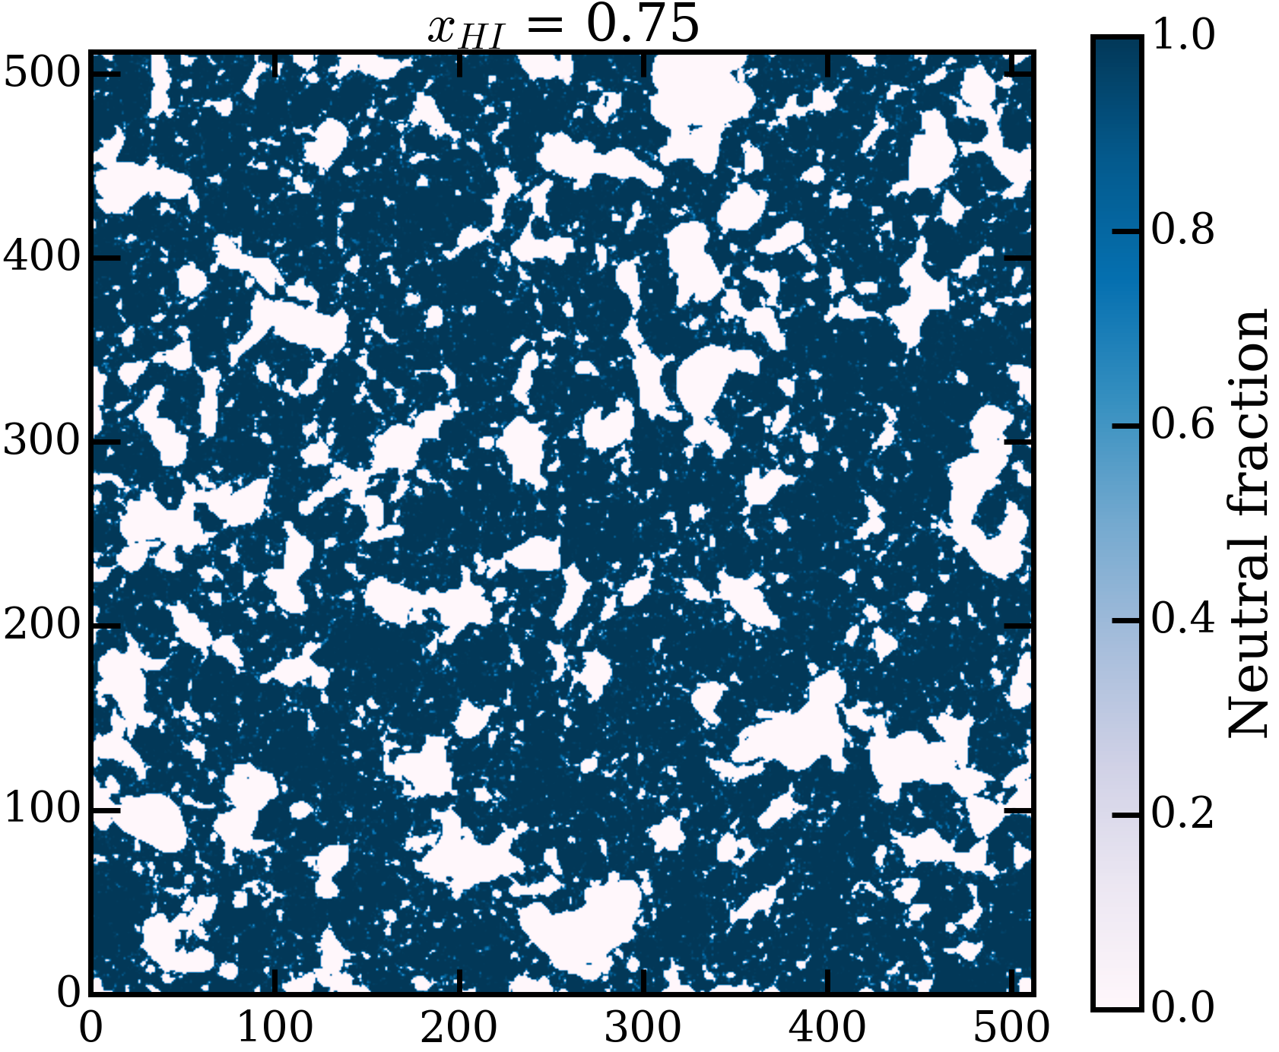
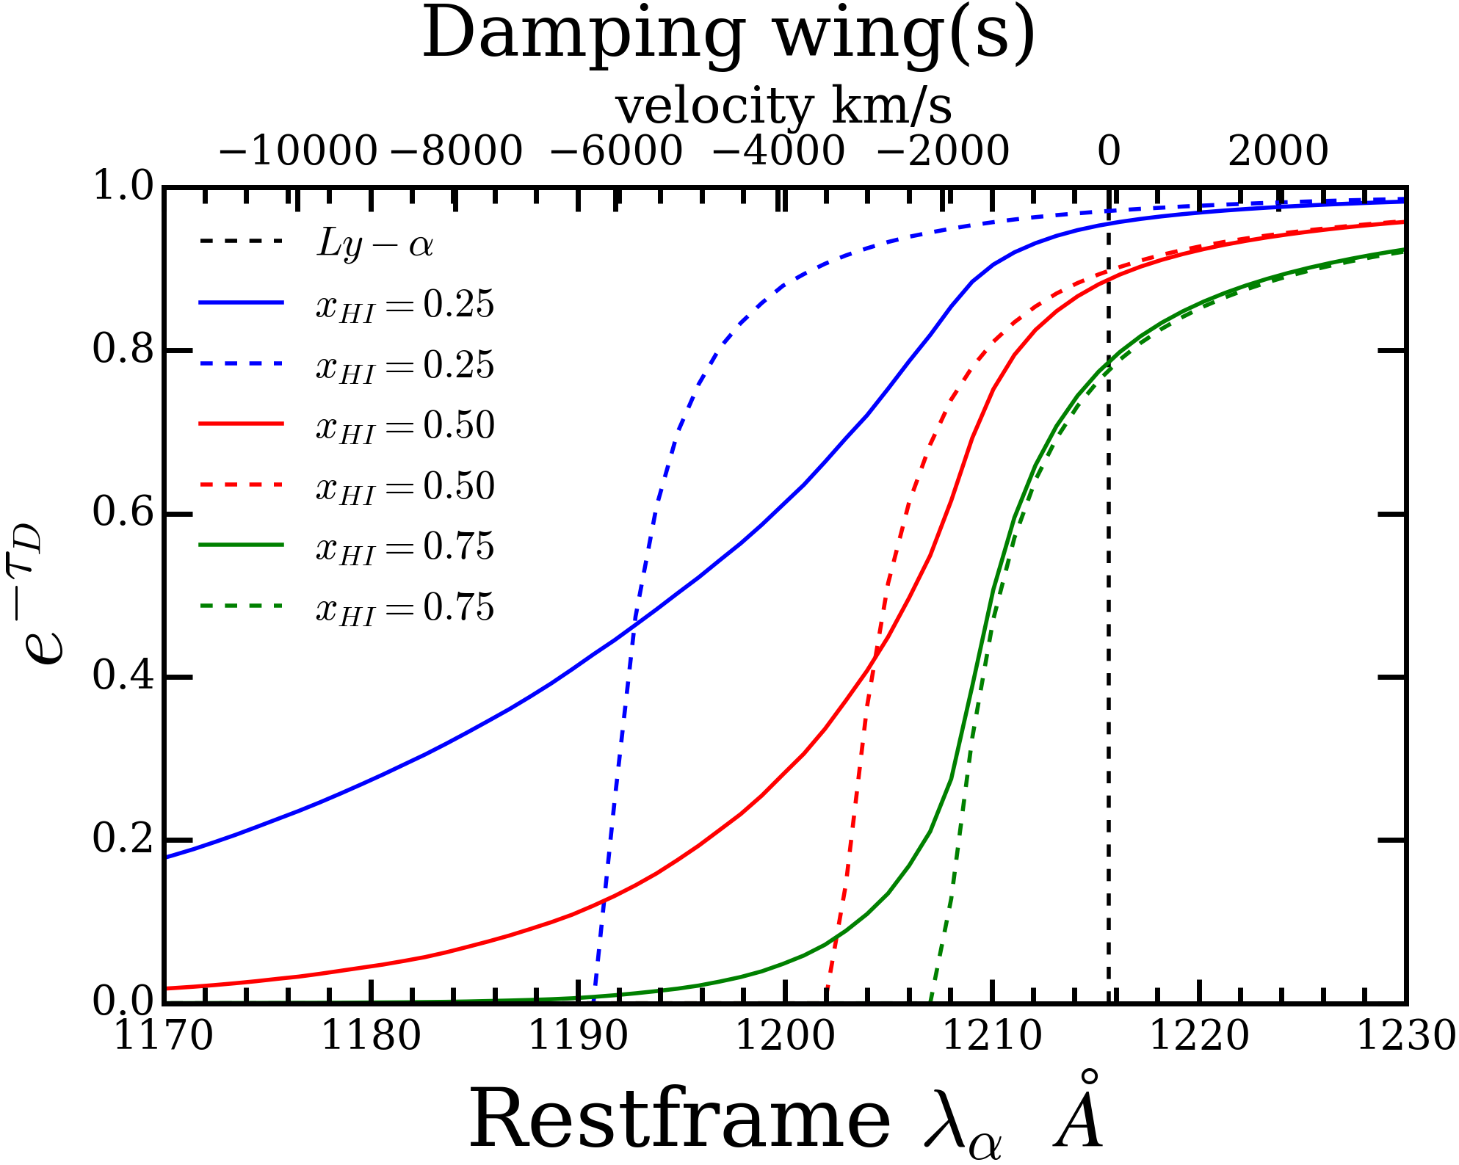
Slices of ionized boxes for different $x_{HI}$ and the corresponding damping wings

Slide 7
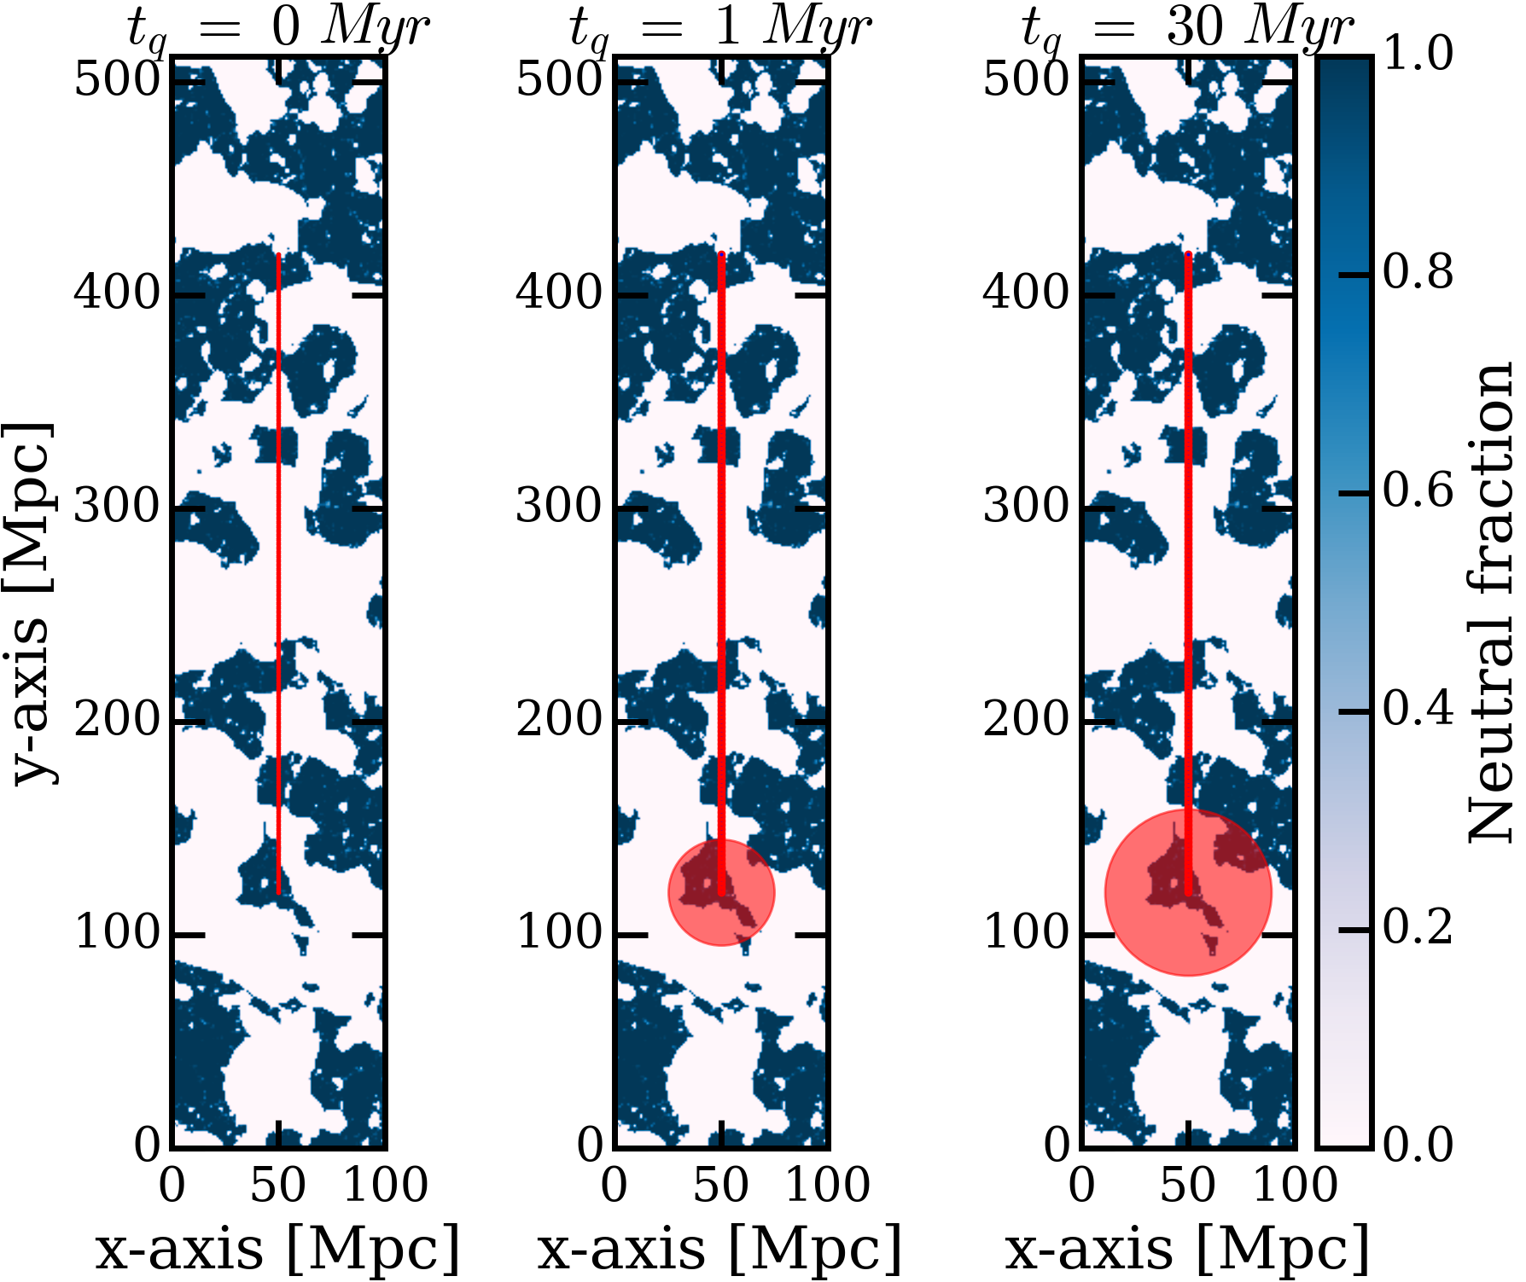
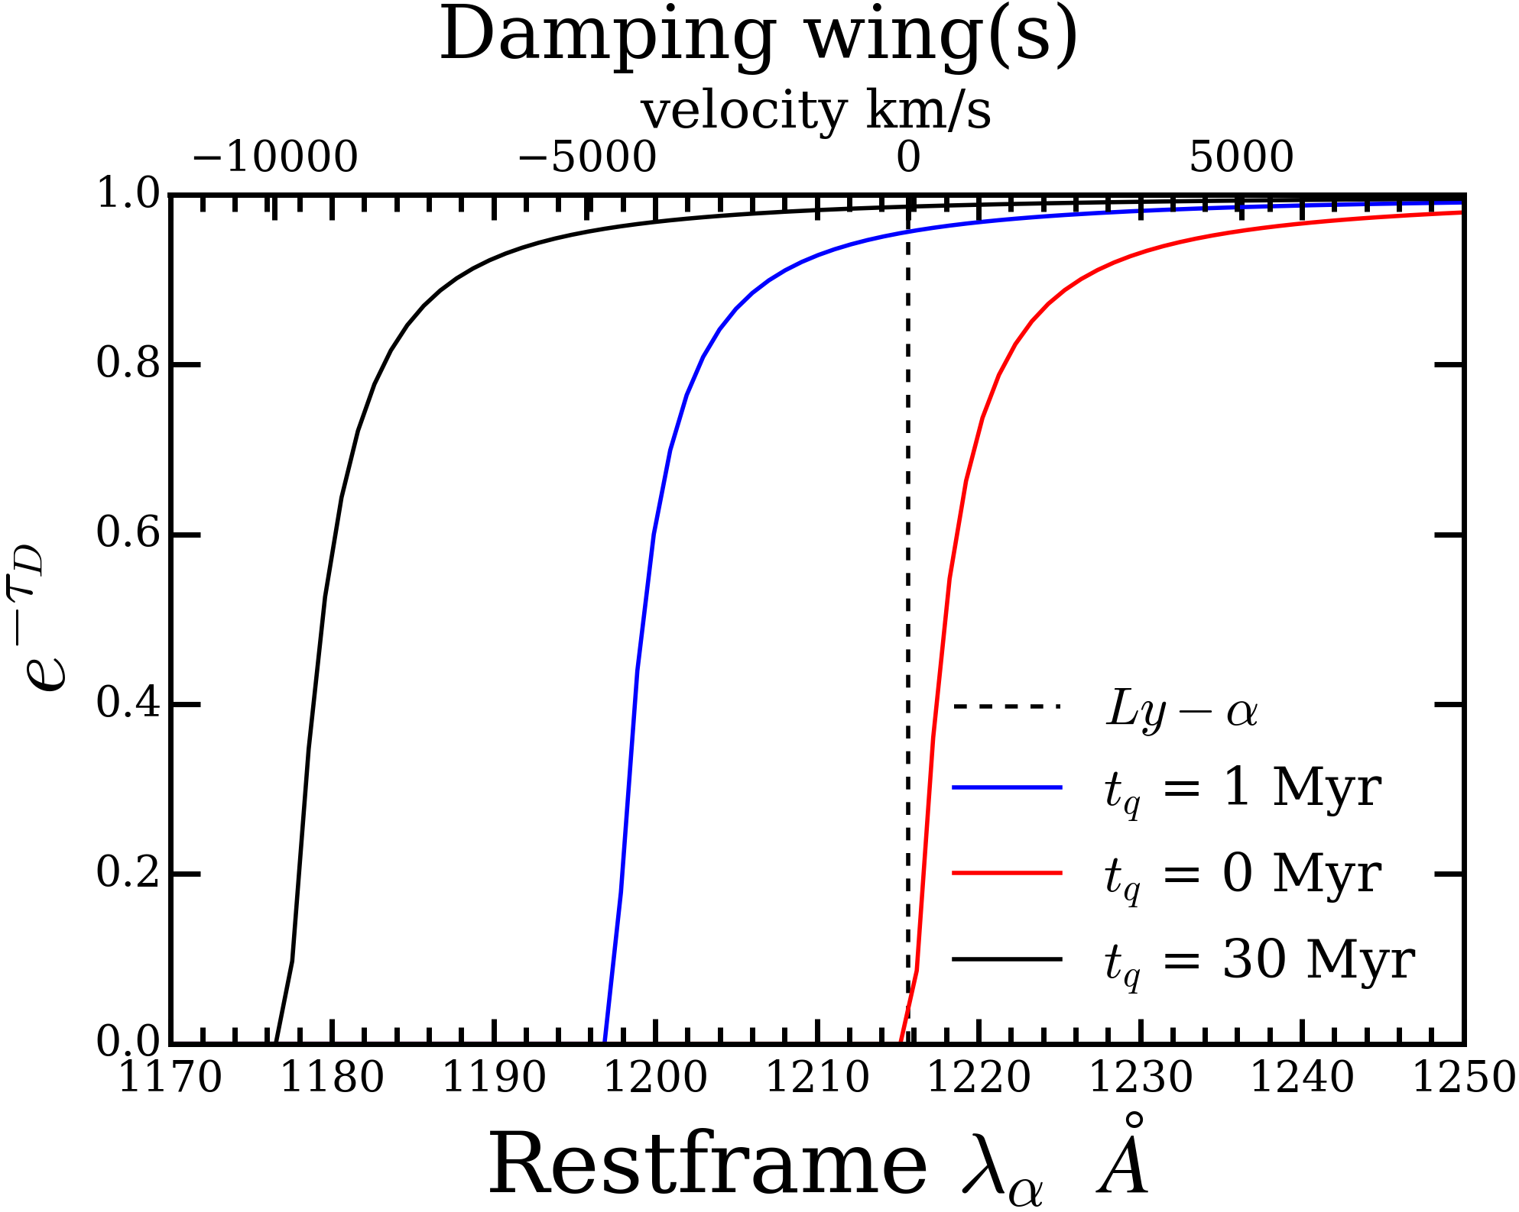
Damping wings as a function of quasar lifetime

Slide 8
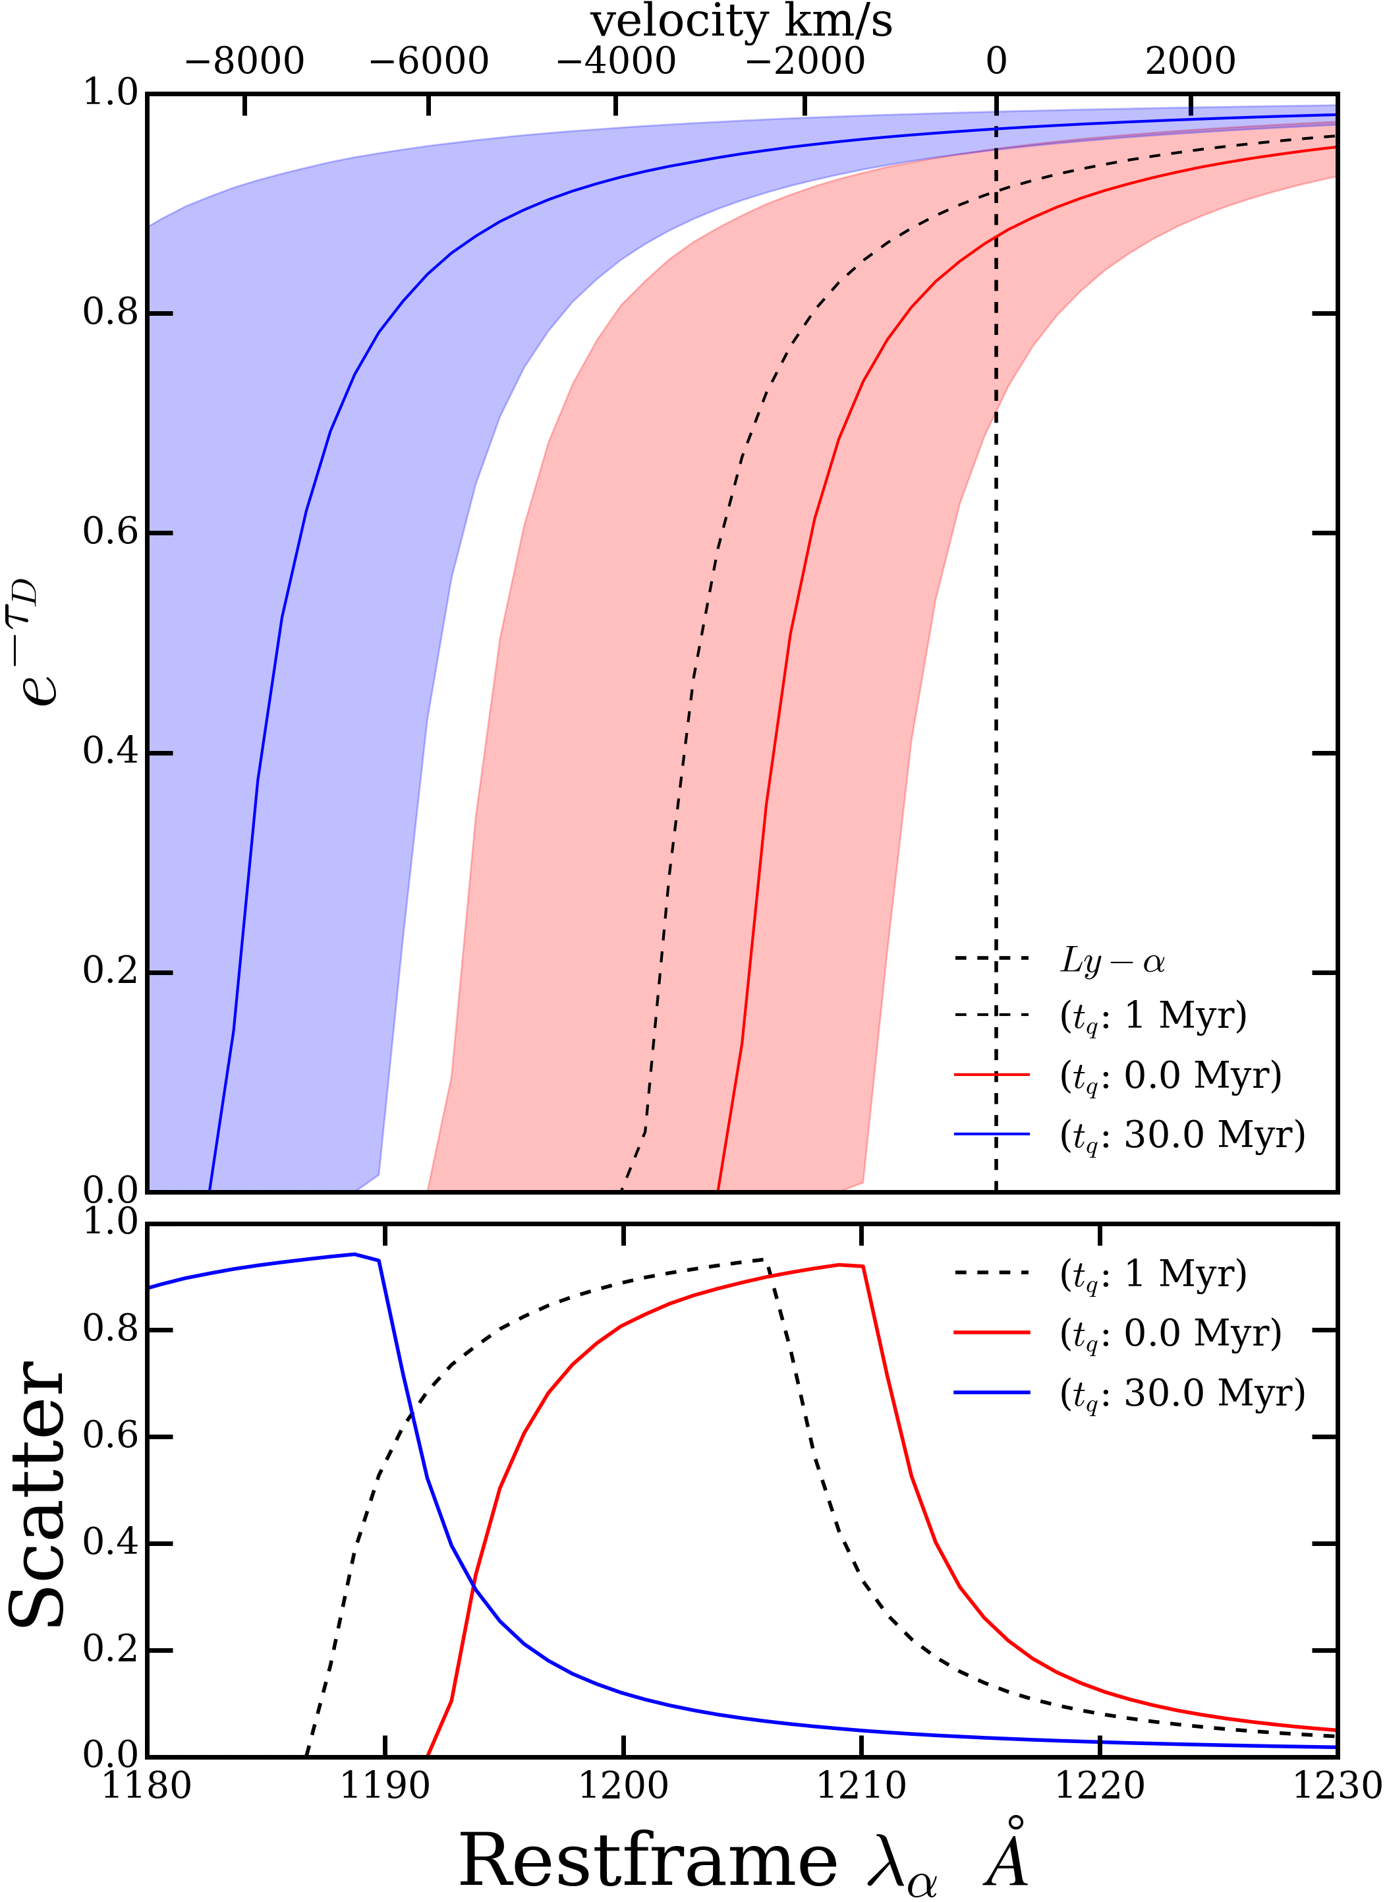
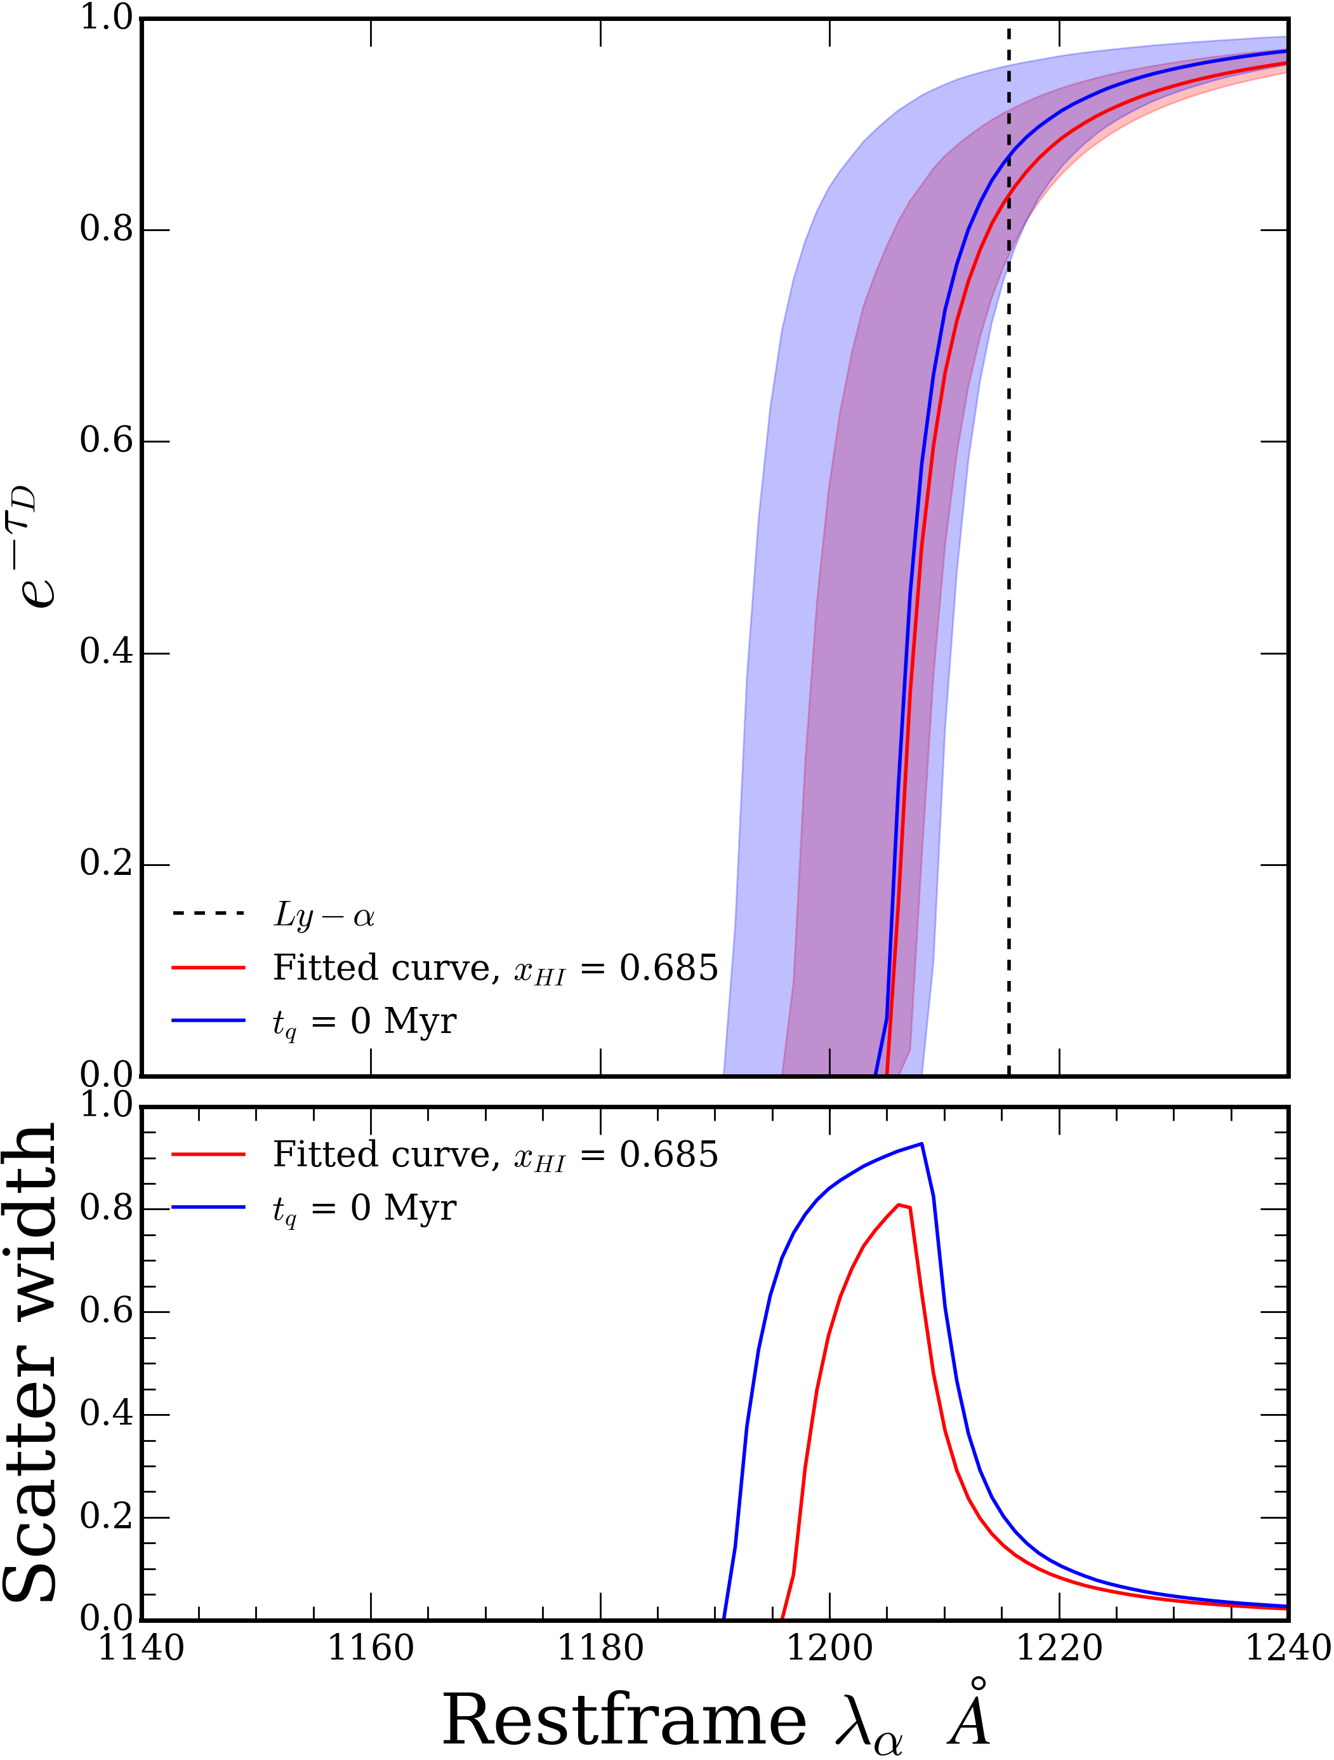
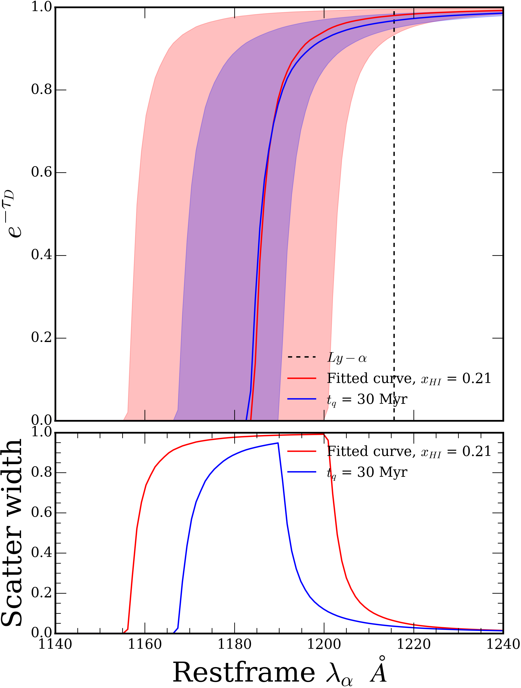
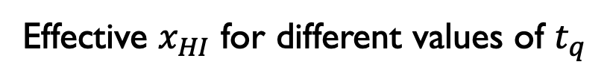
Damping wings as a function of quasar lifetime
Effective $x_{HI}$ for different values of $t_{q}$

Slide 9
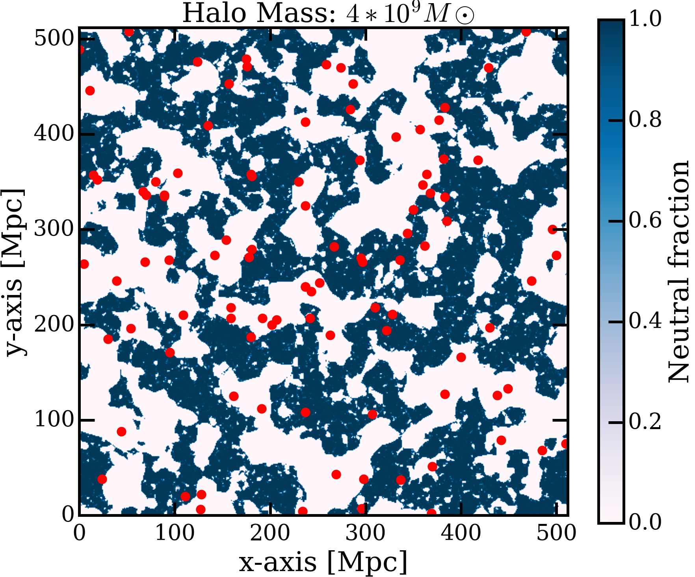
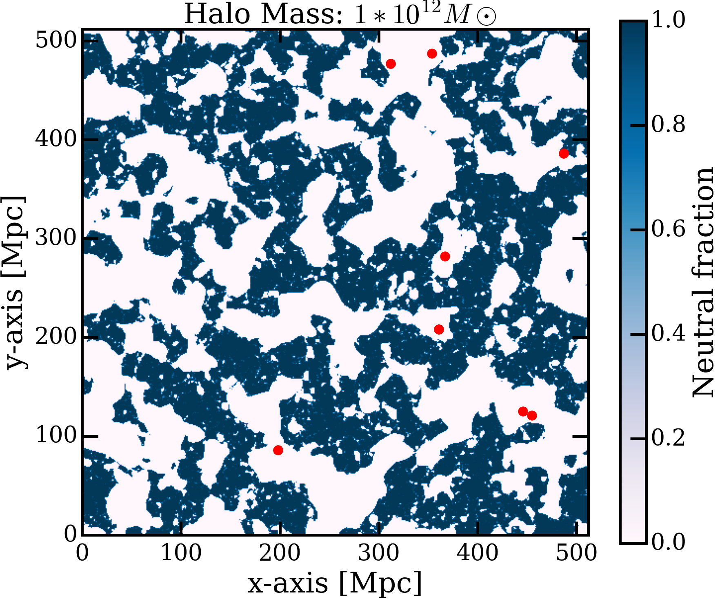
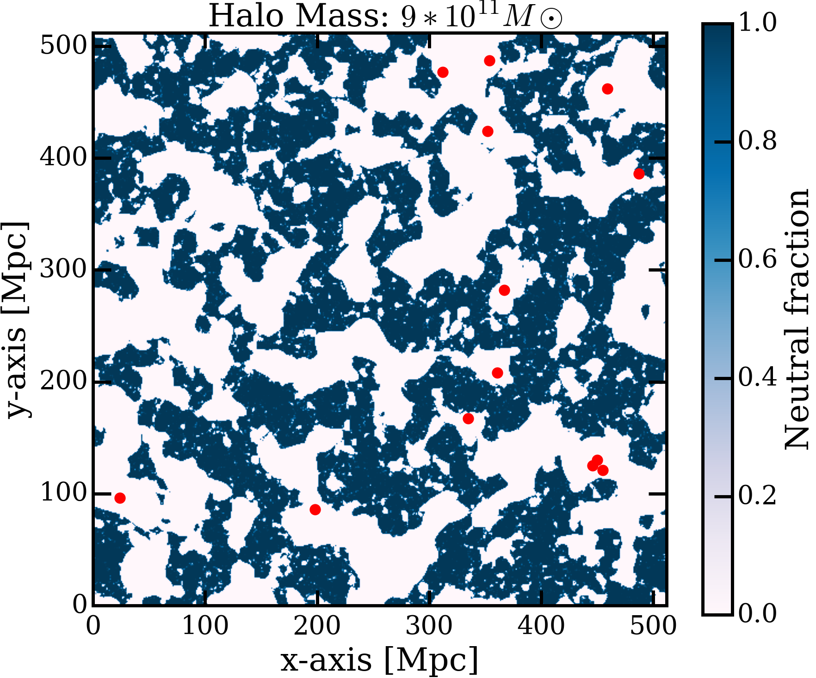
Distribution of low and high mass halos throughout the box

Slide 10
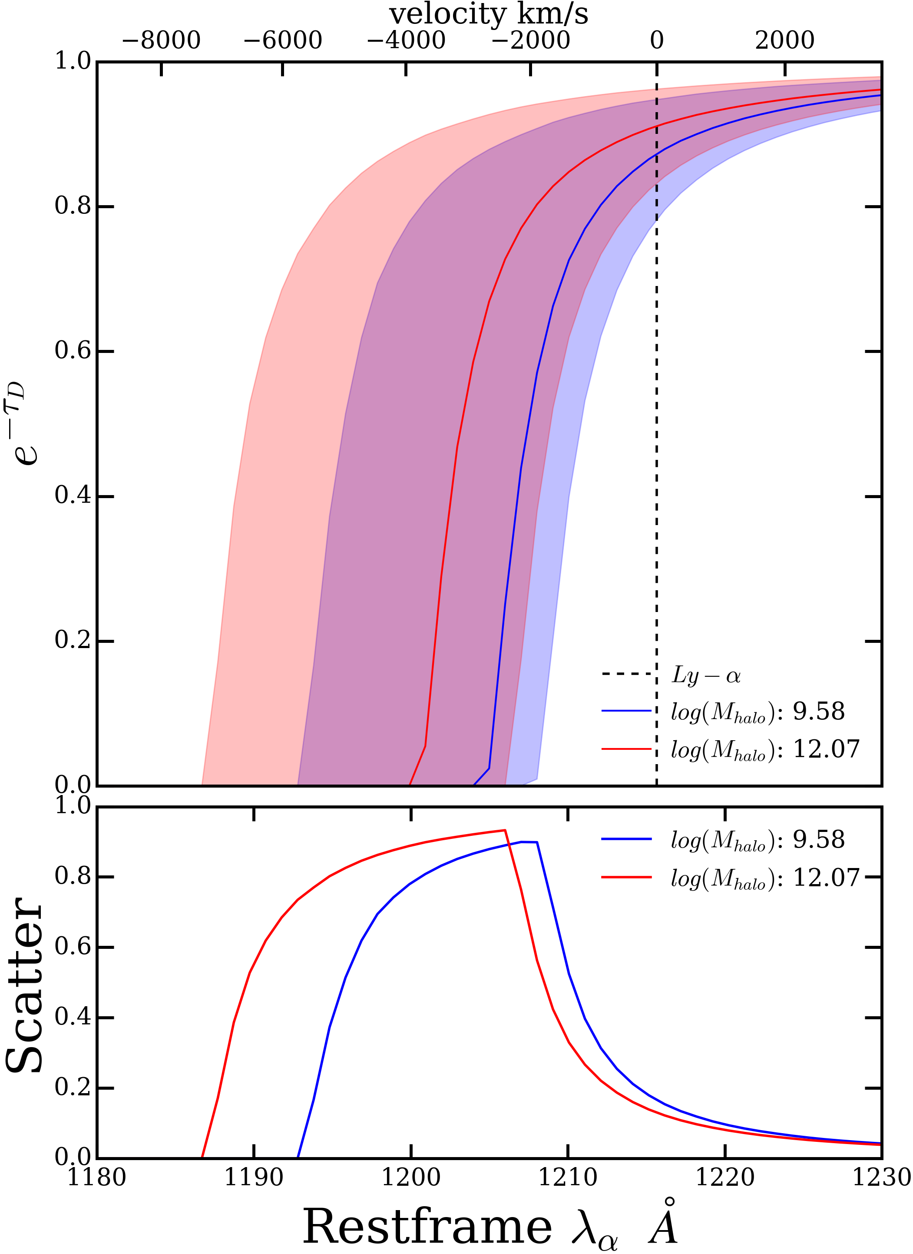
Damping wings as a function of mass of the halo hosting the quasar

Slide 11
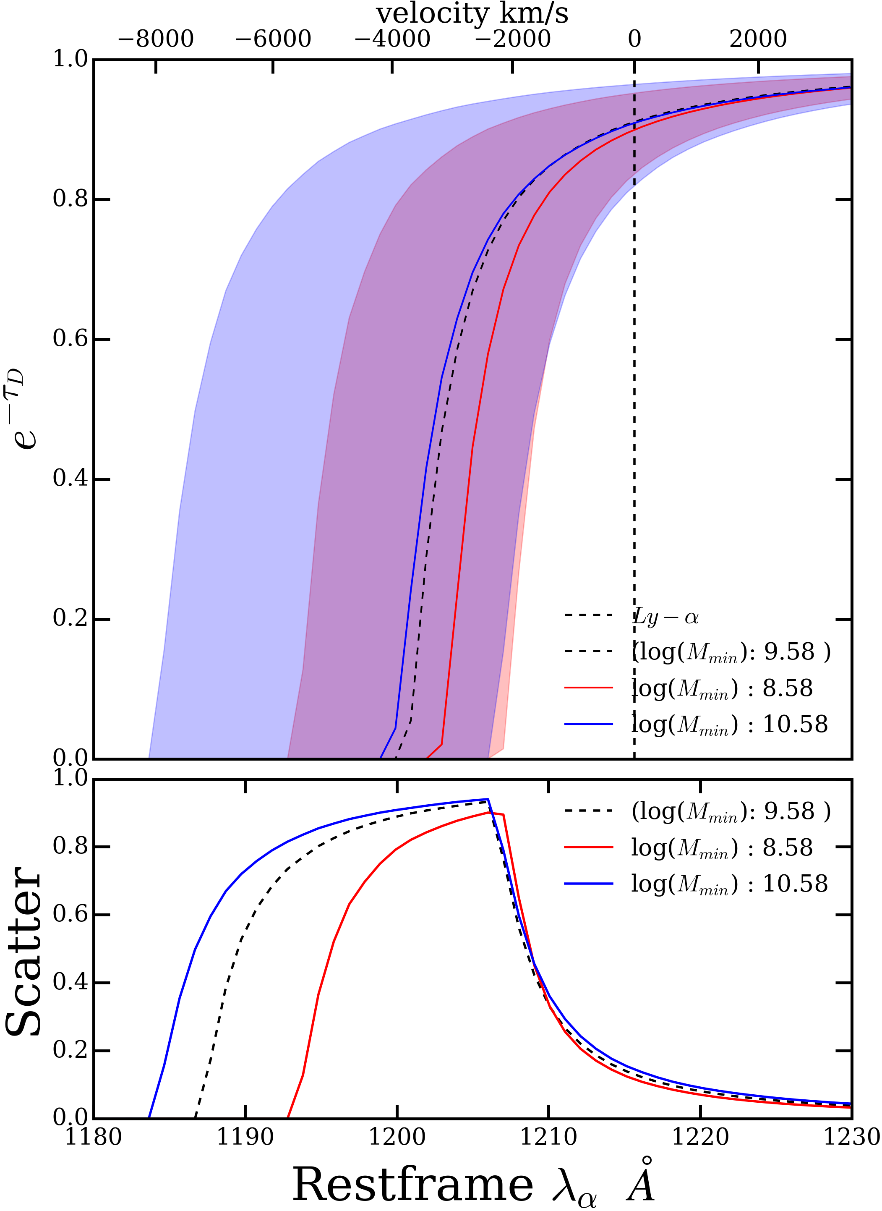
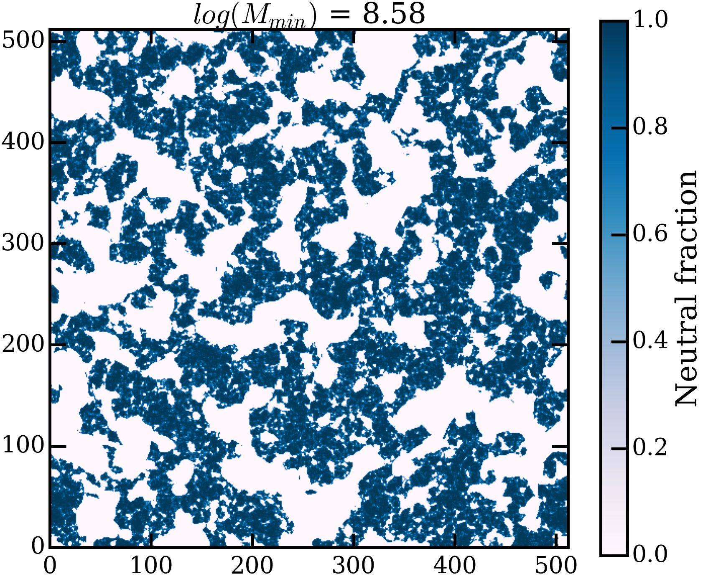
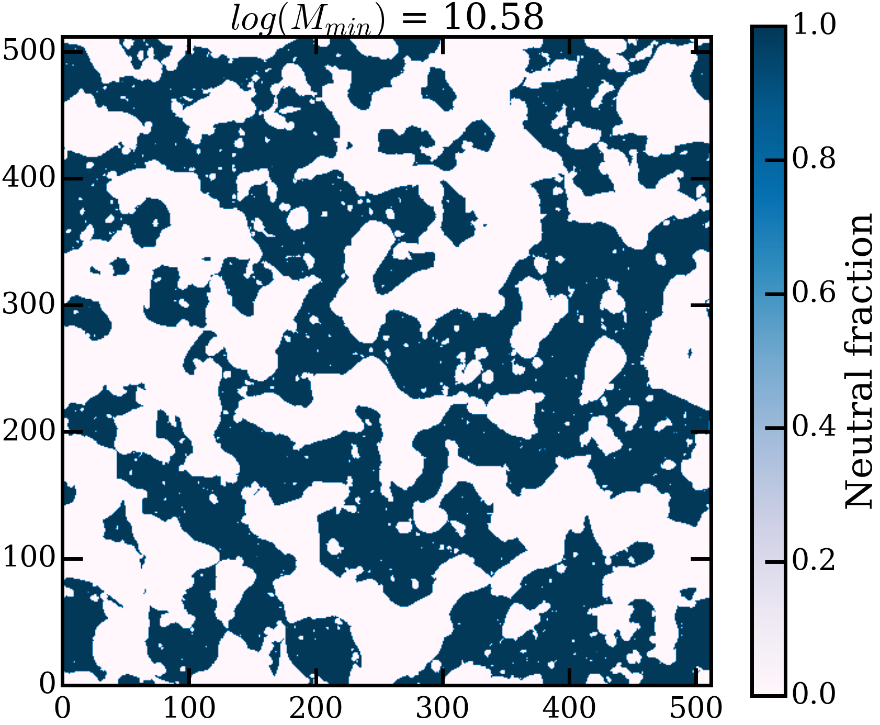
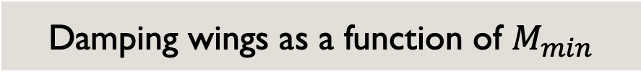
Damping wings as a function of $M_{min}$

Slide 12
Behaviour of damping wings as a function of various parameters.

Slide 13
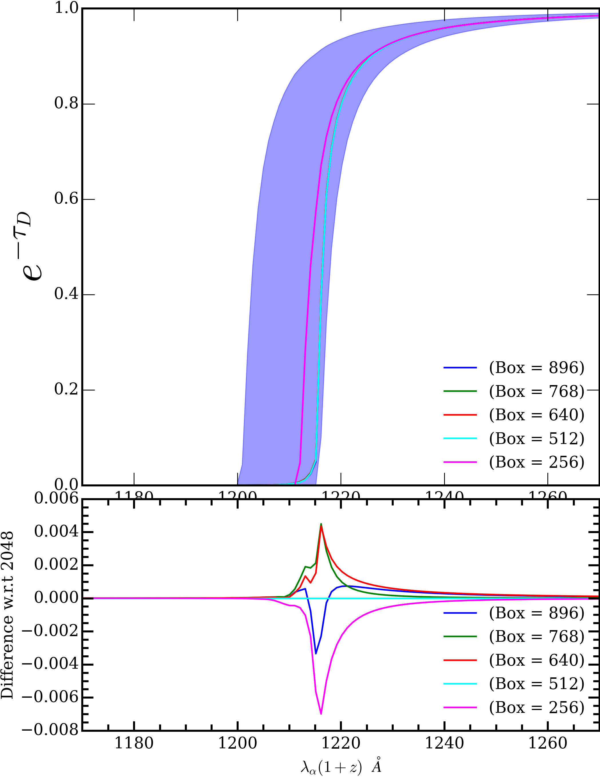
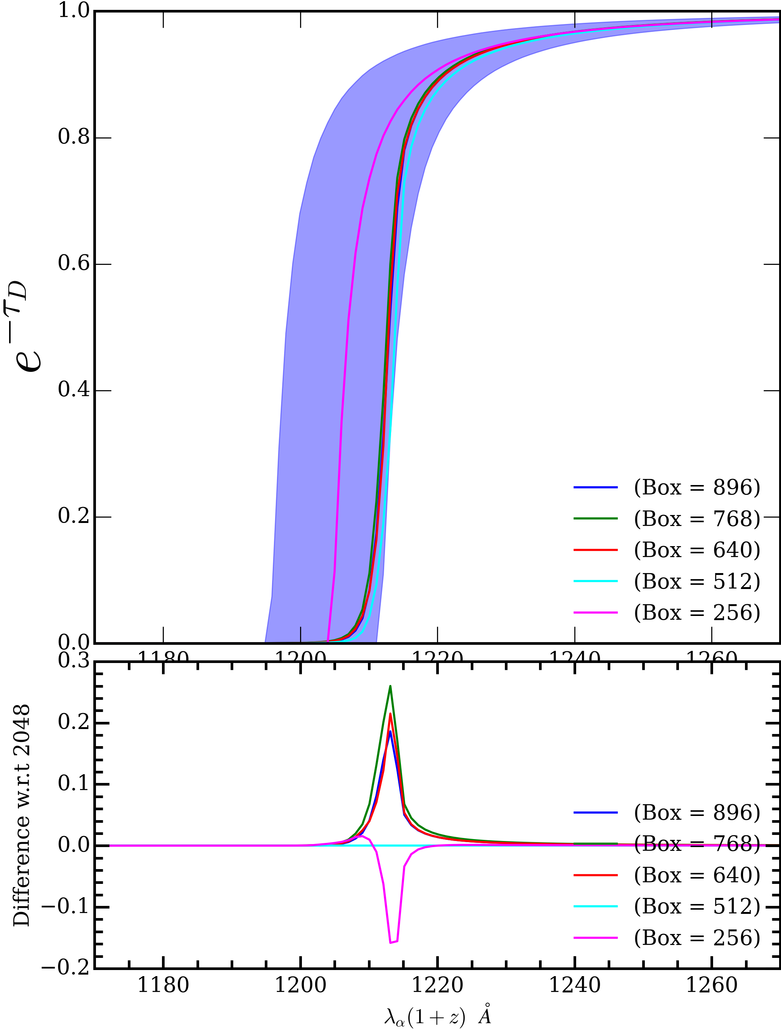


Convergence test for $M_{halo}=4 × {10}^{9} M⨀$
Convergence test for $M_{halo}=1 × {10}^{12} M⨀$

Slide 14
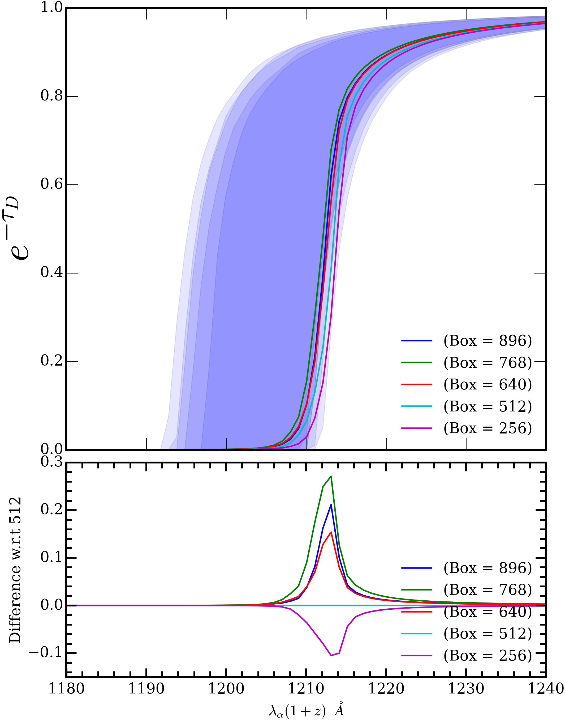
Damping wing signals for 100 most massive halos from each box, averaged over 6 different initial conditions per box.

Slide 15
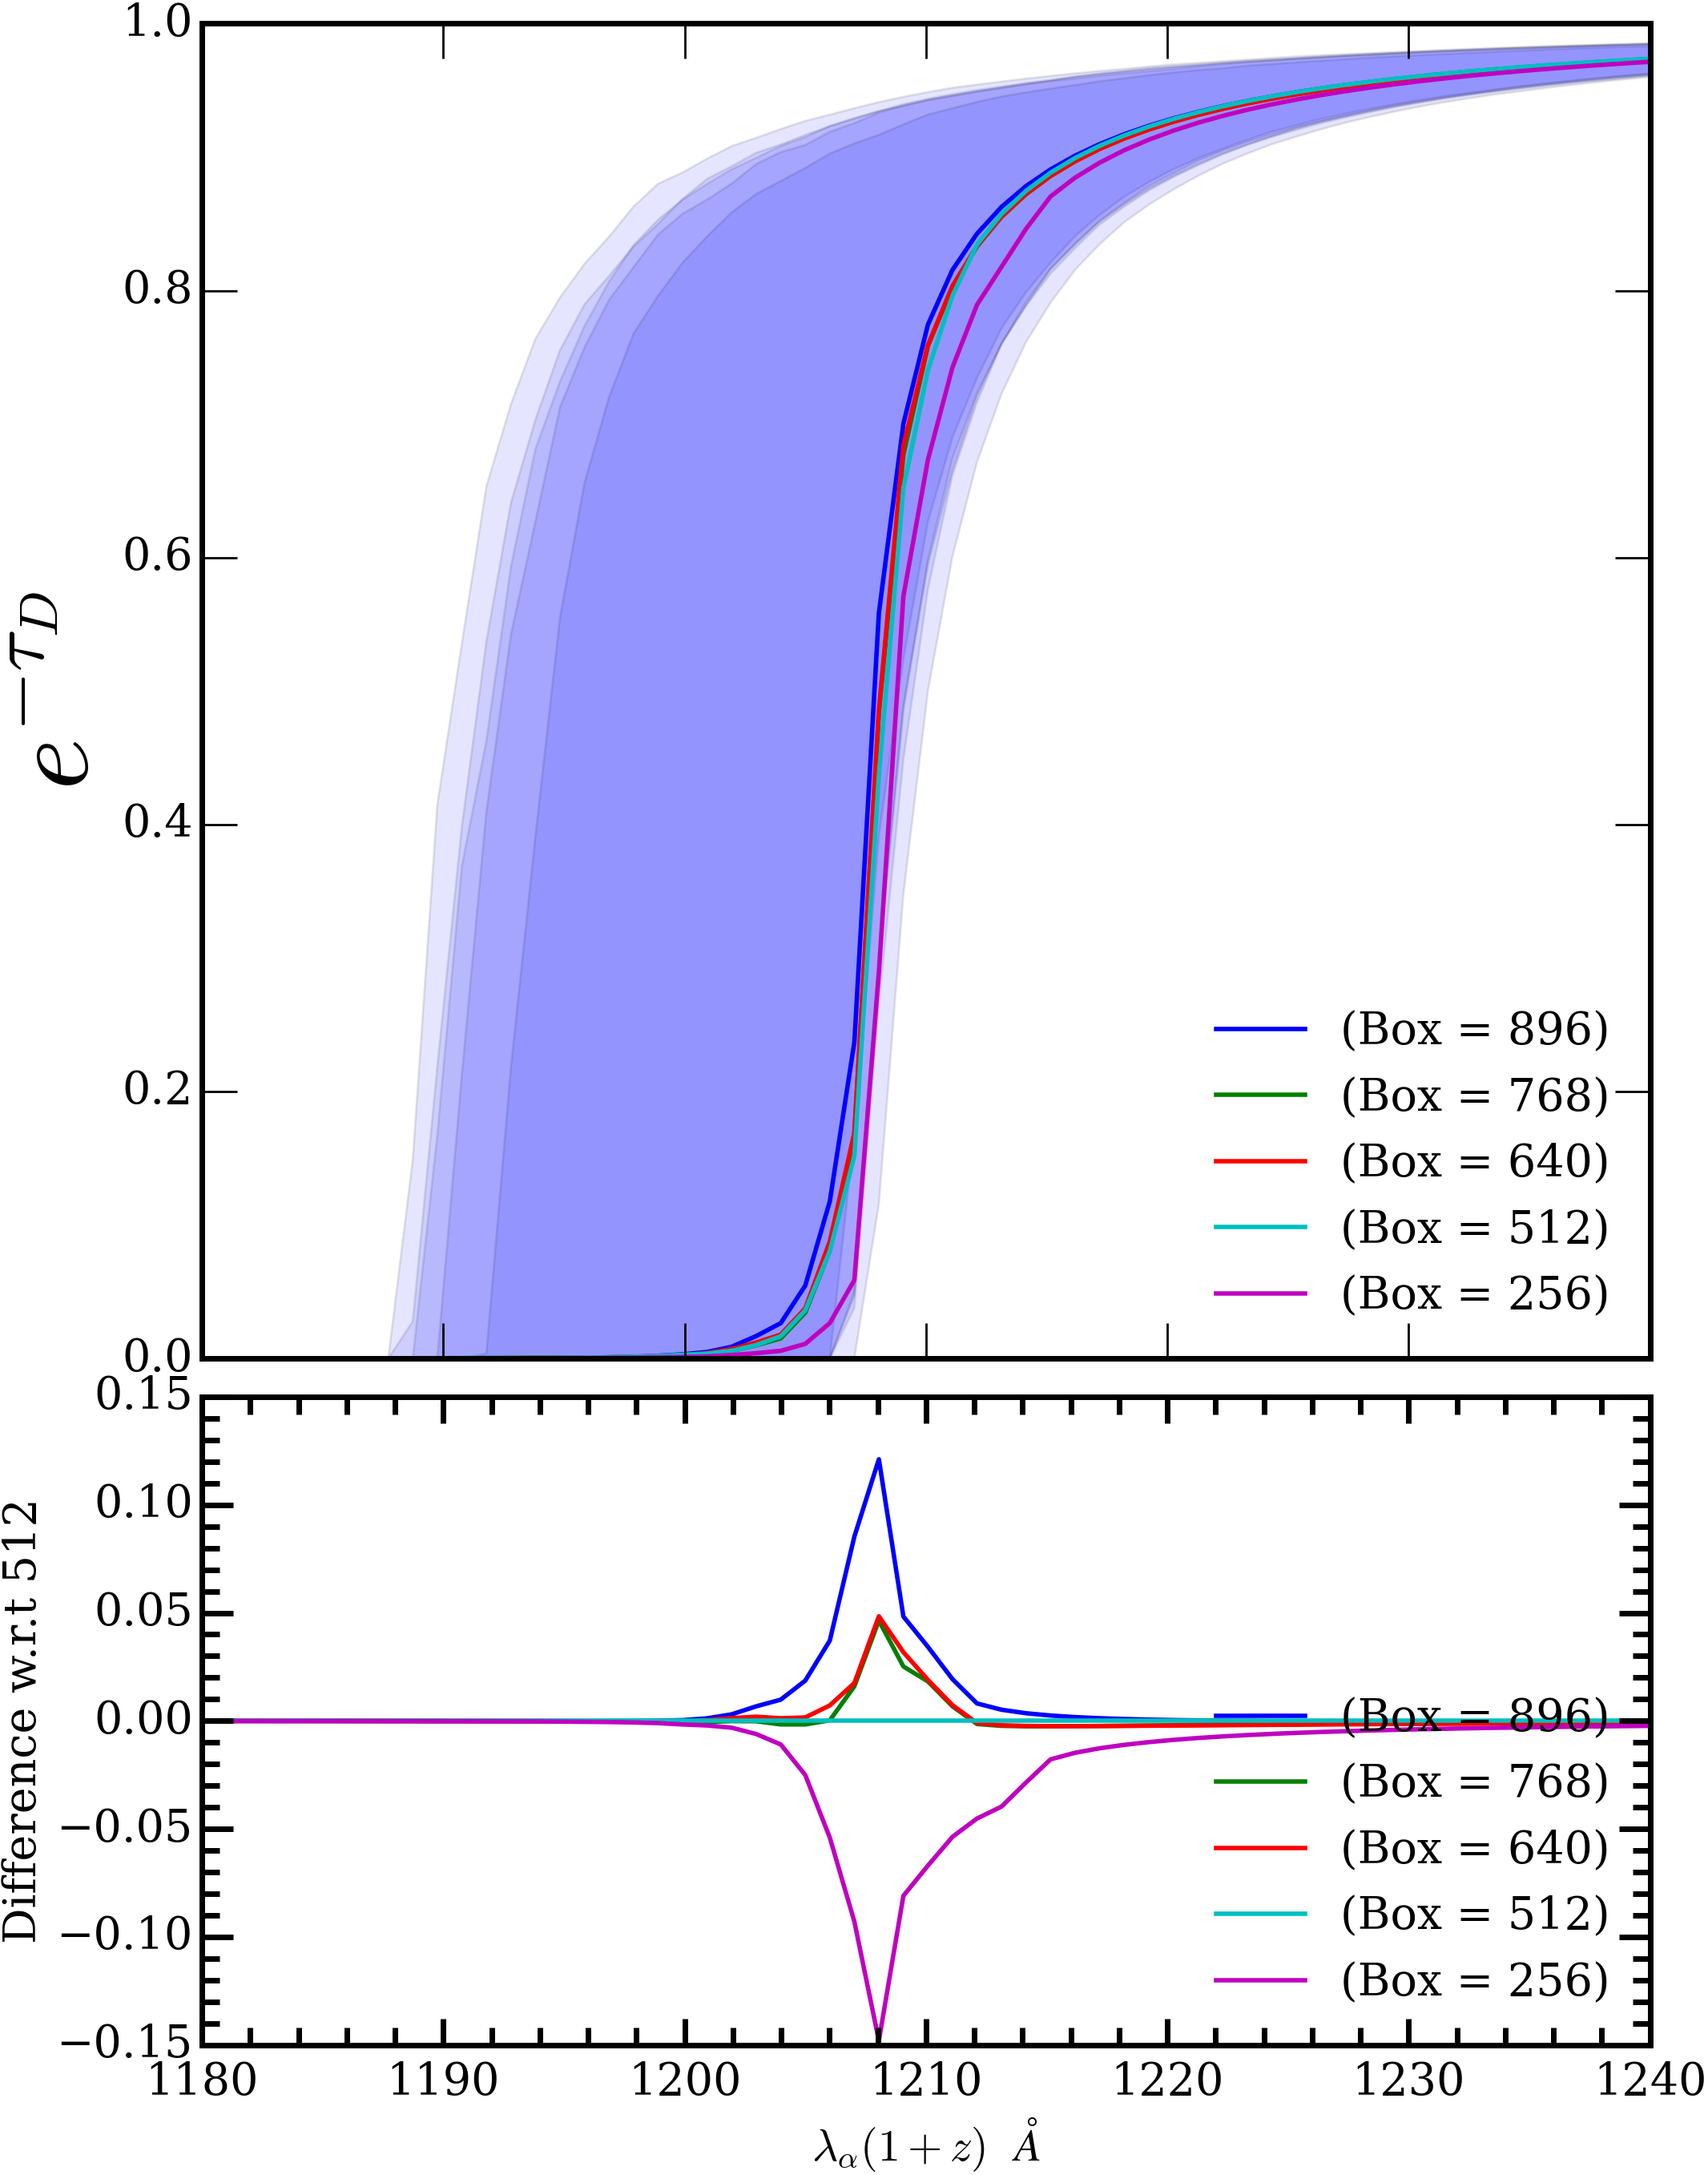
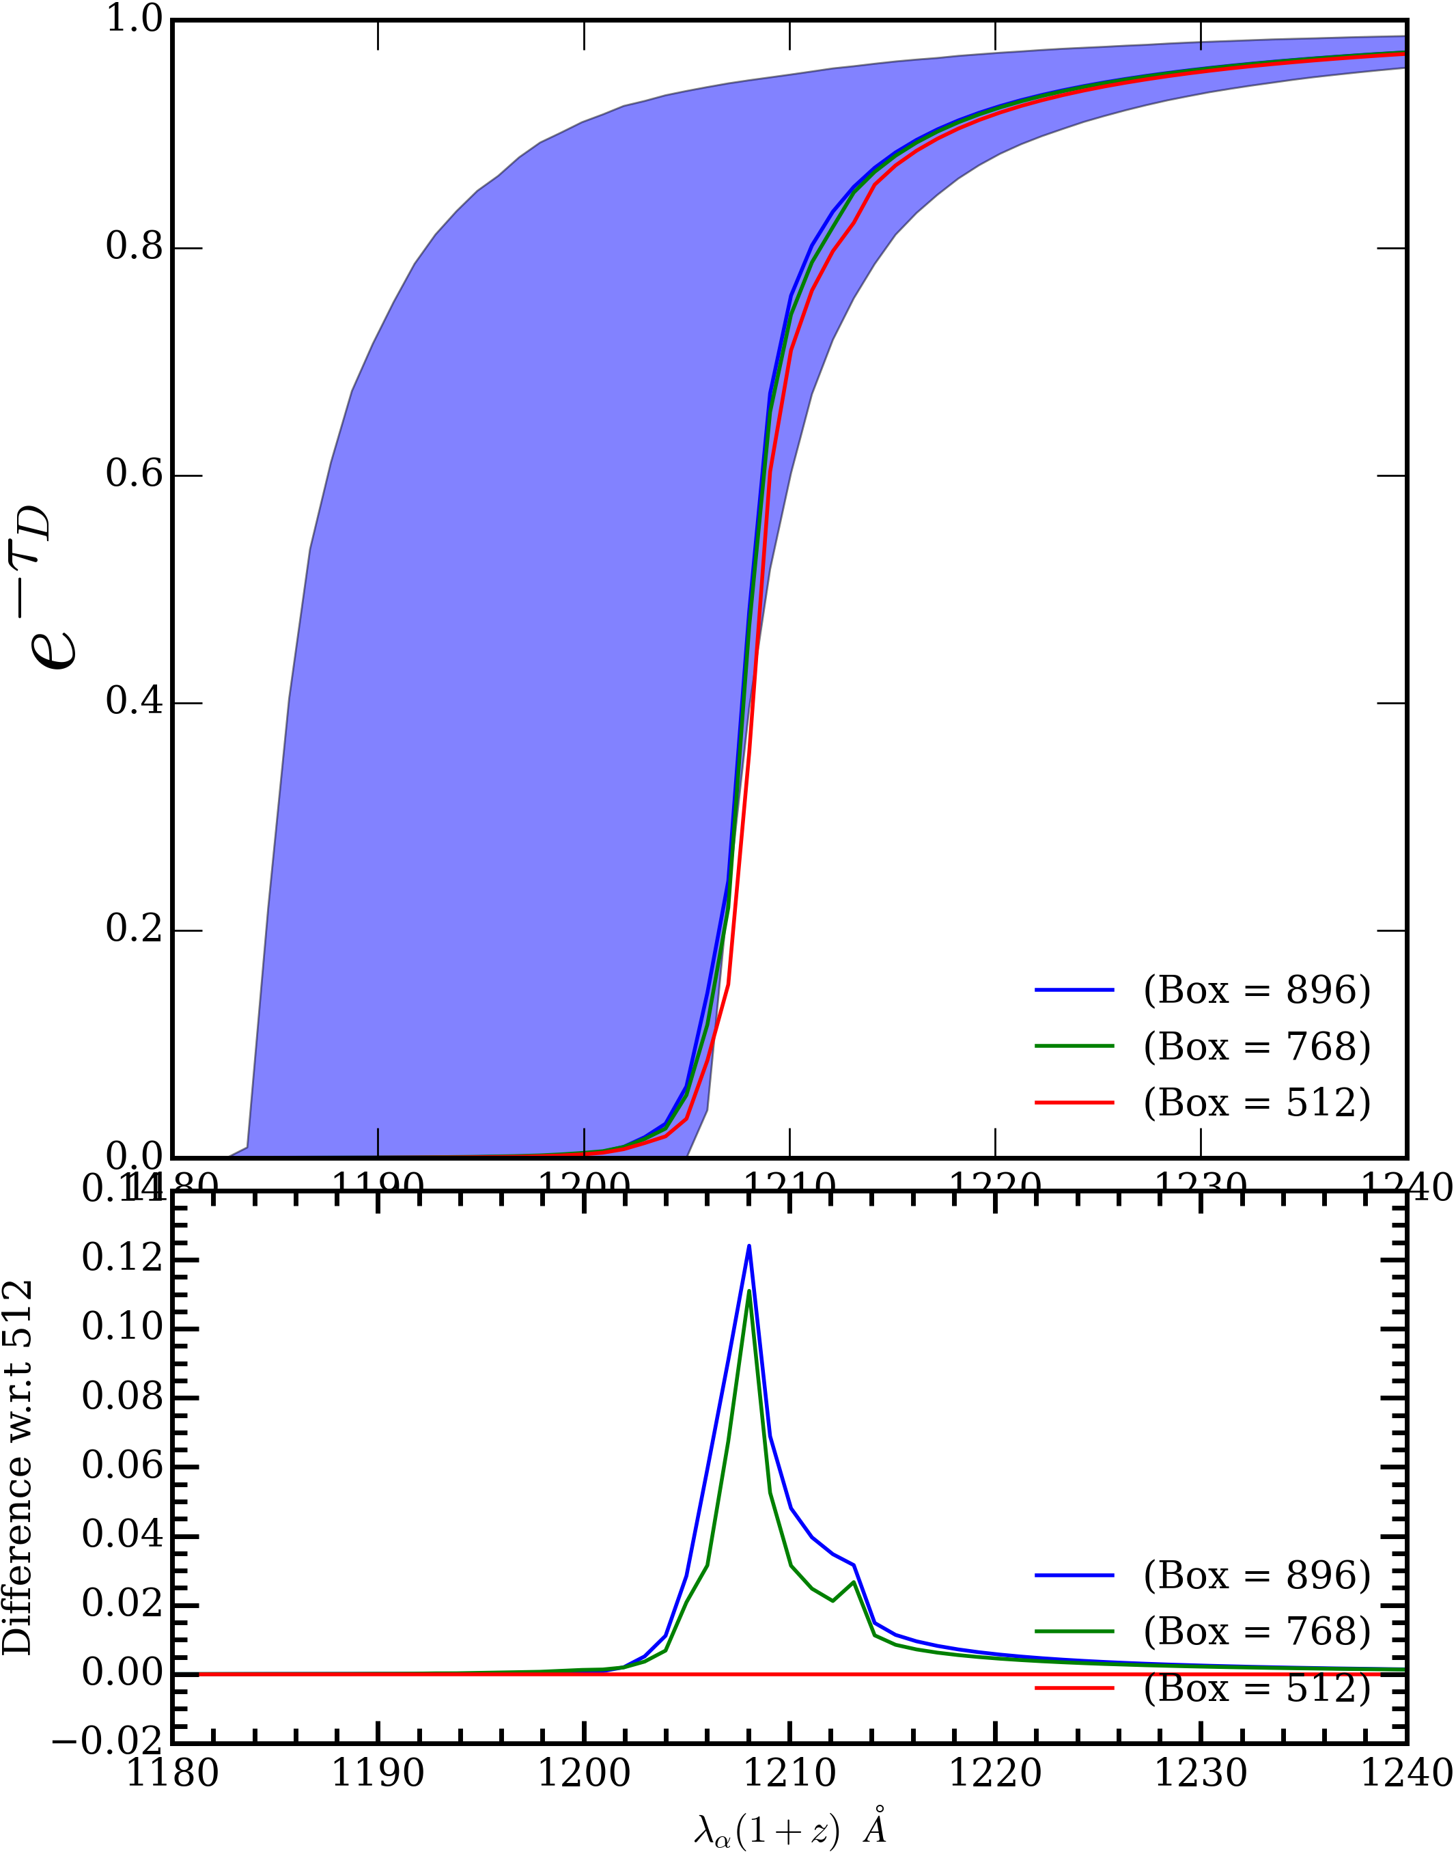


Convergence test for $t_{q}=1 Myr$
Convergence test for $M_{min}= {10}^{11} M⨀$

Slide 16
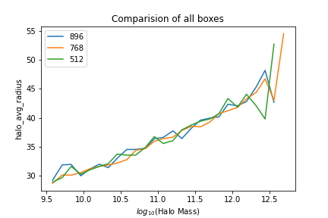
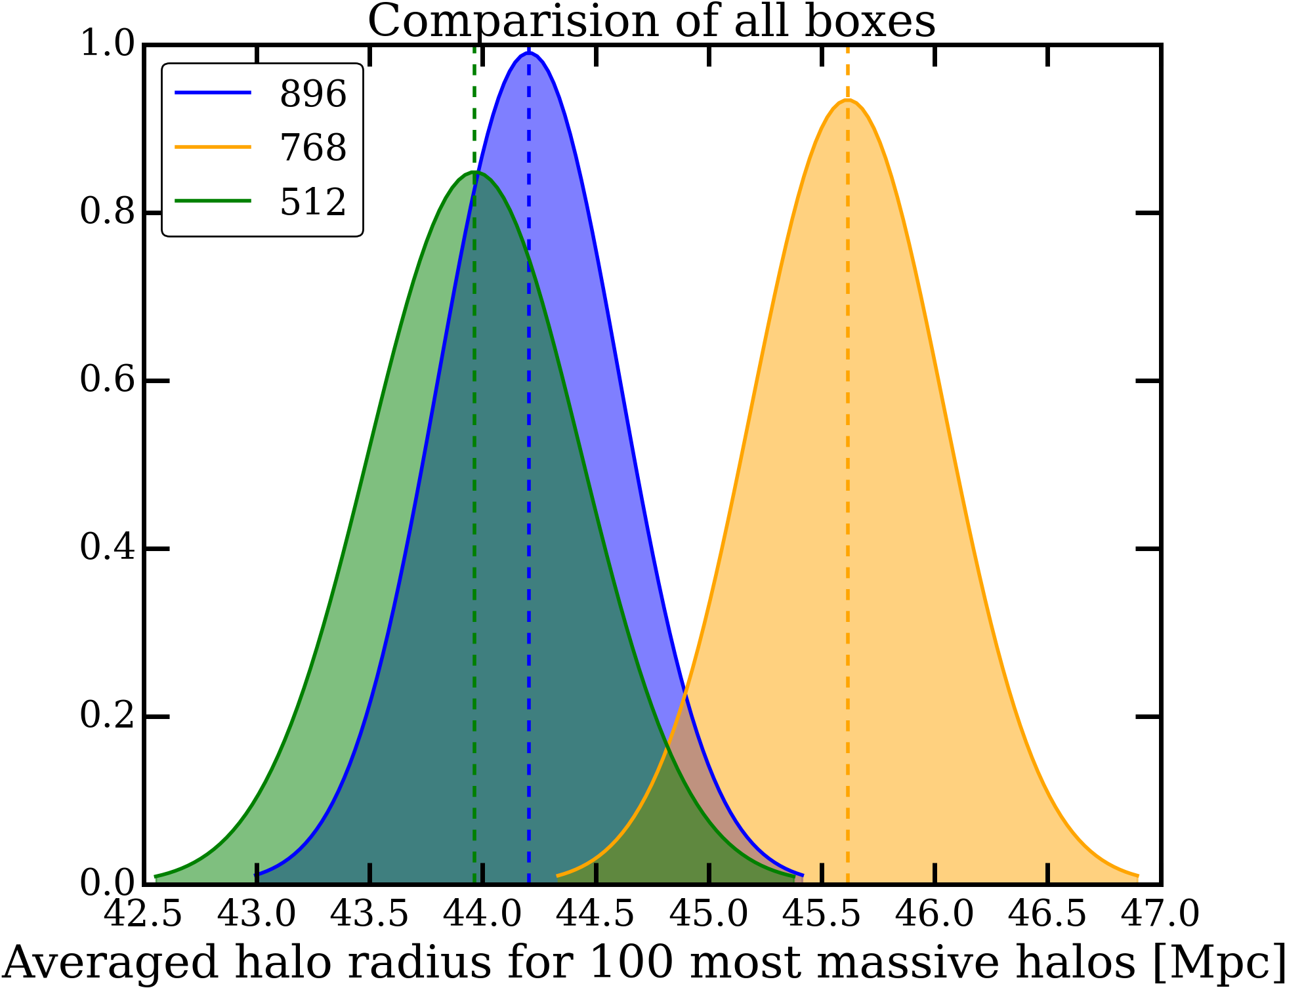
Ionized bubble size distribution
Theory Error?

Slide 17
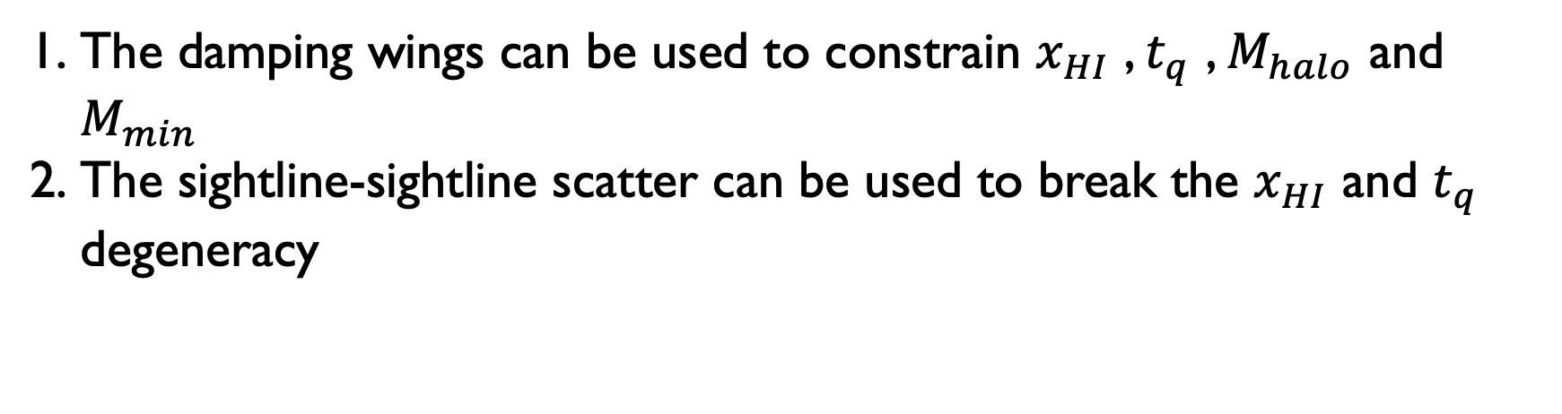
Conclusion:
The damping wings can be used to constrain $x_{HI}$ , $t_{q}$ , $M_{halo}$ and $M_{min}$
The sightline-sightline scatter can be used to break the $x_{HI}$ and $t_{q}$ degeneracy
Thank You

Slide 18
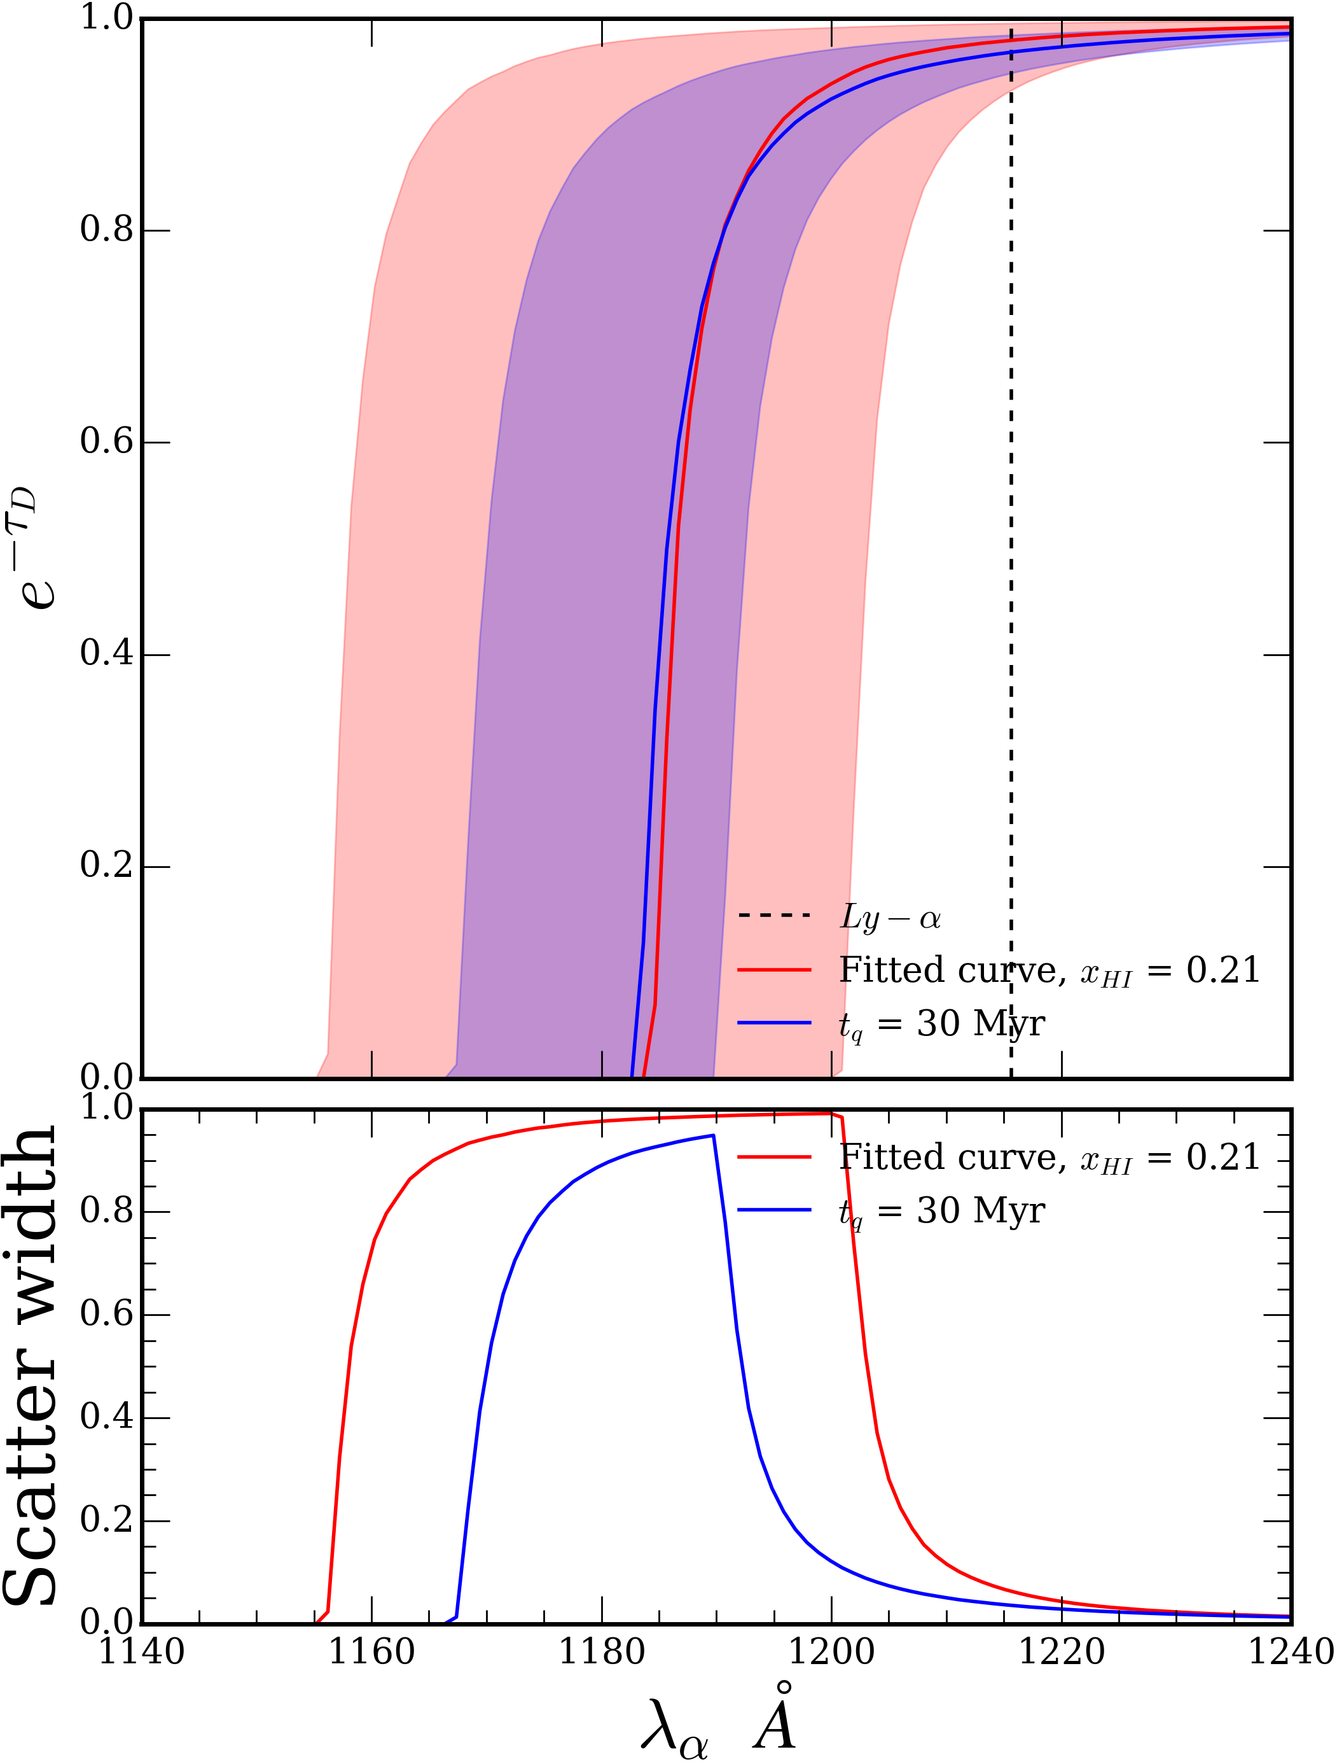
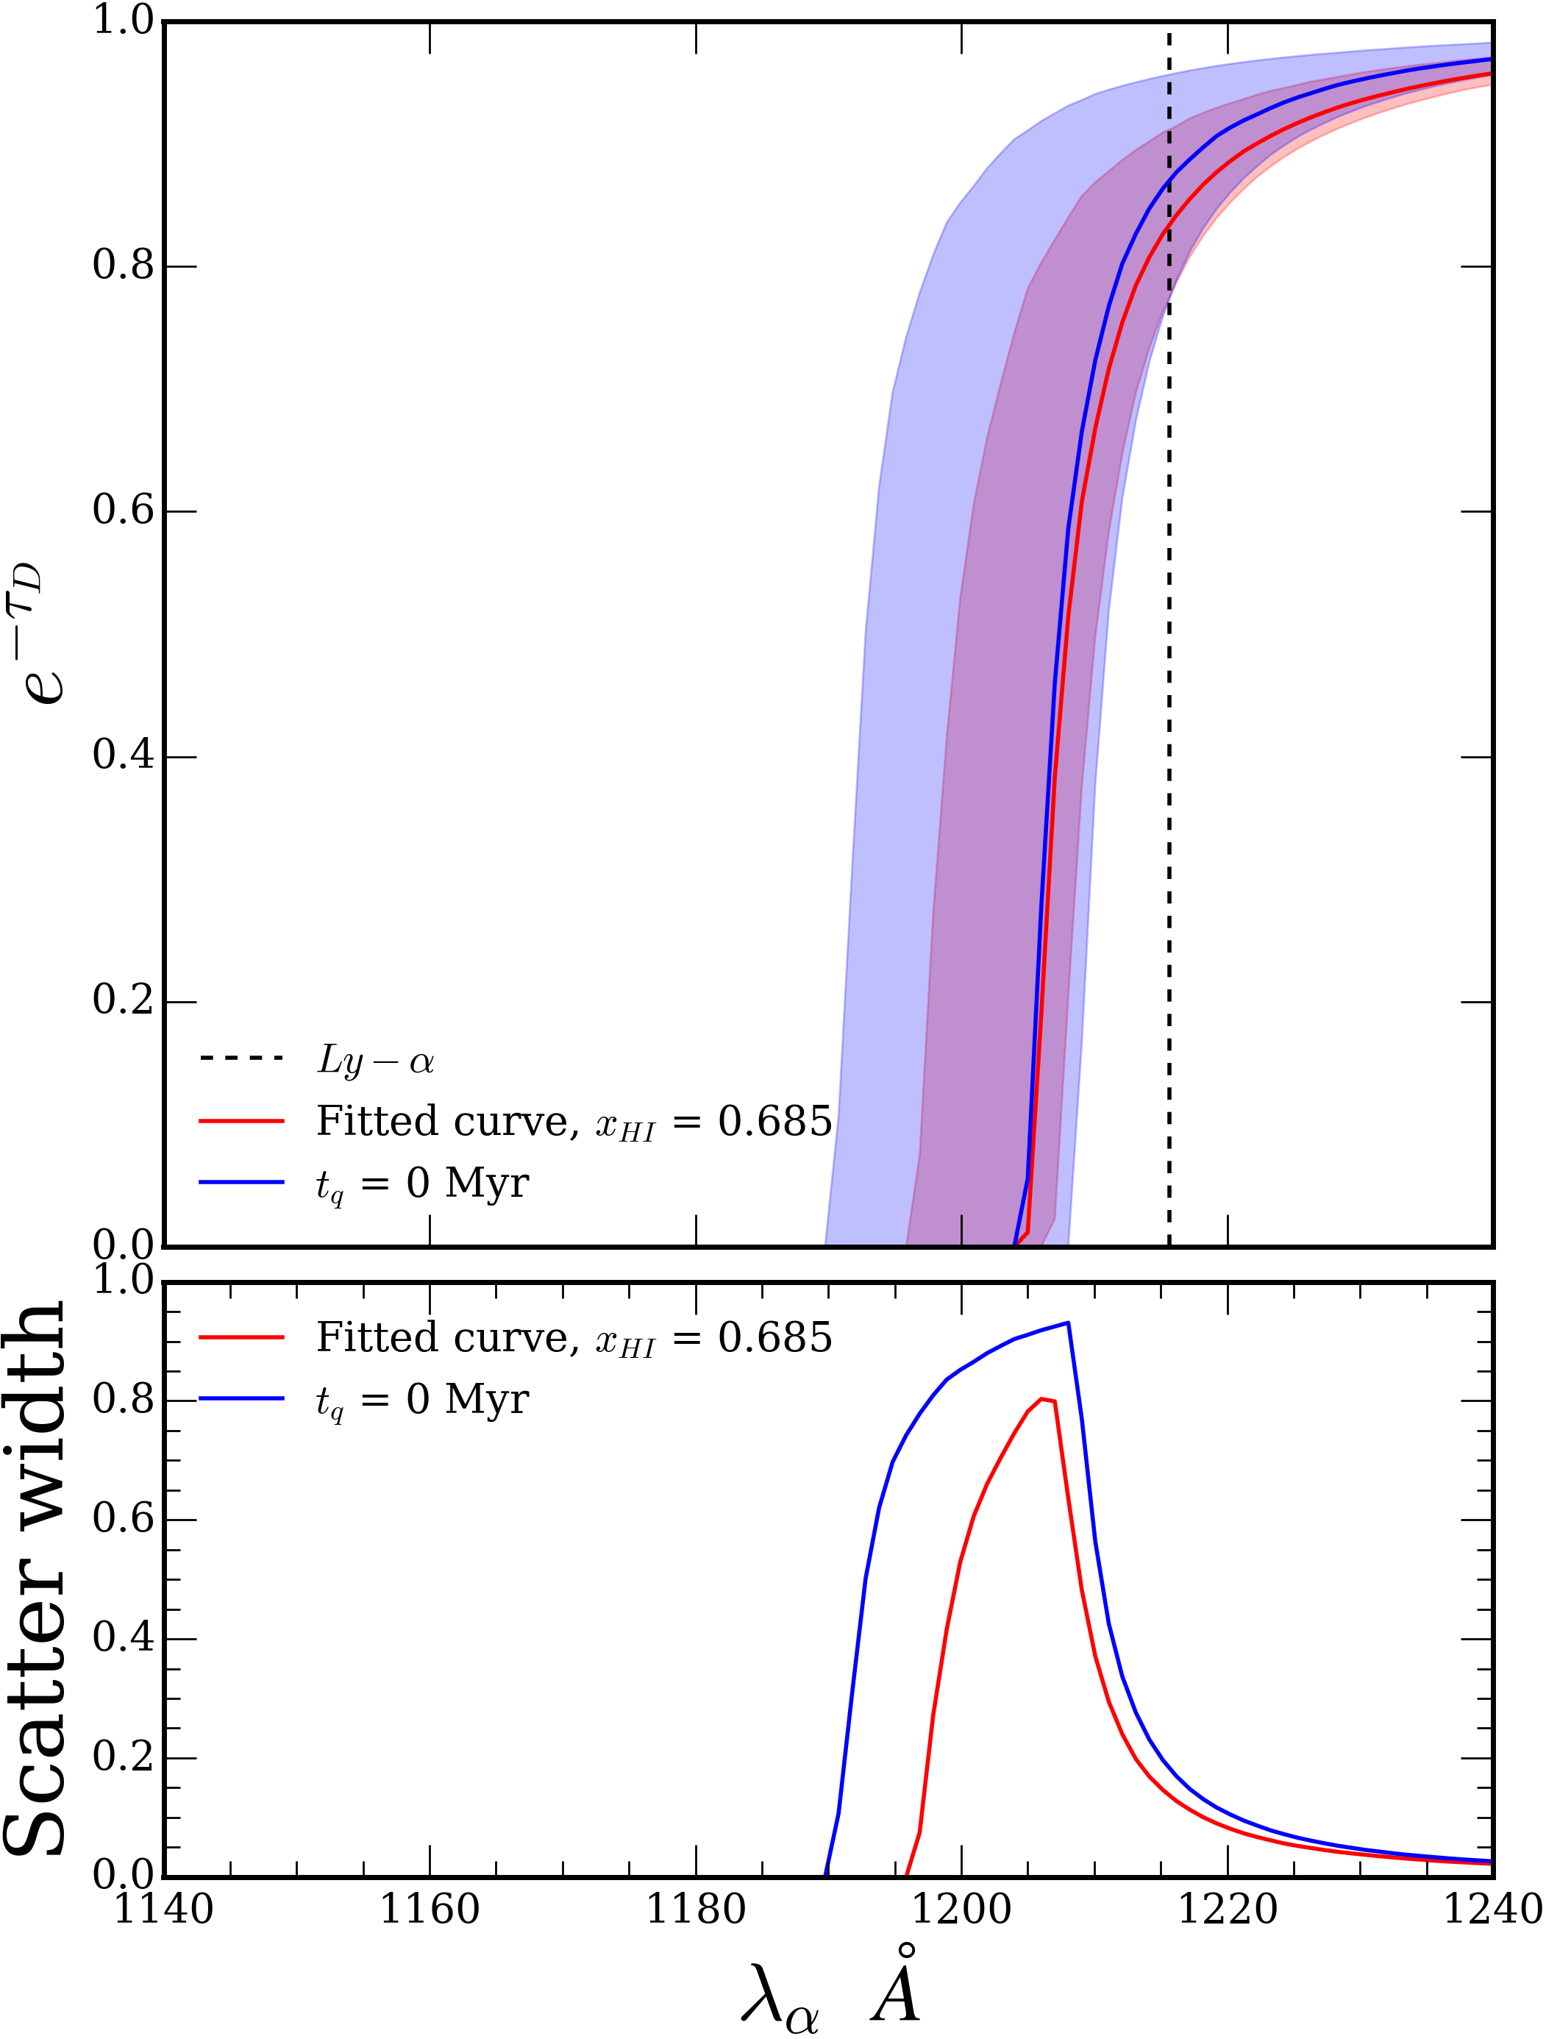
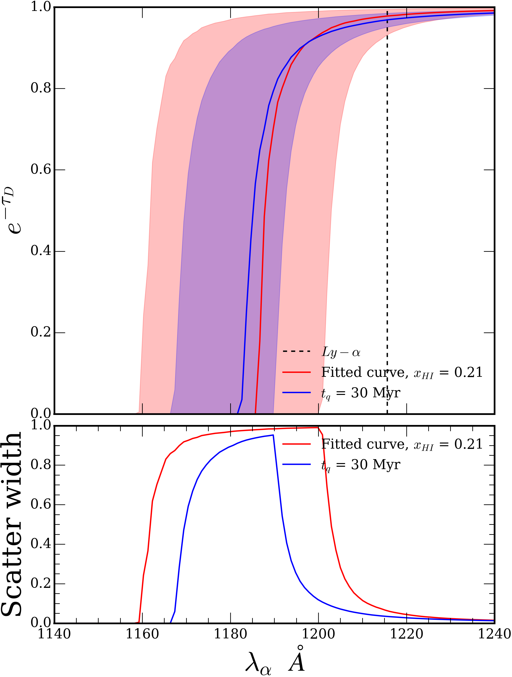

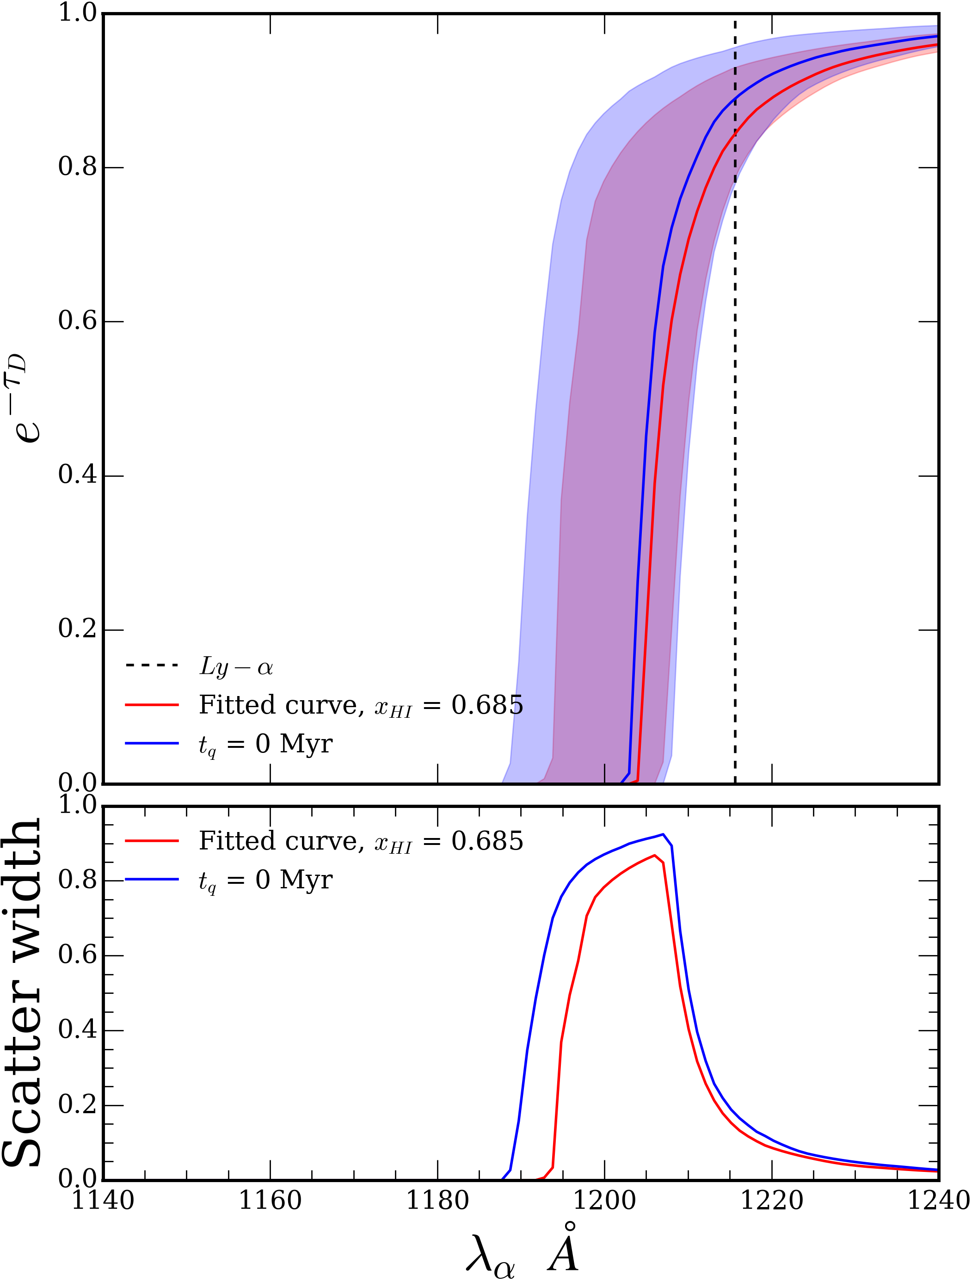
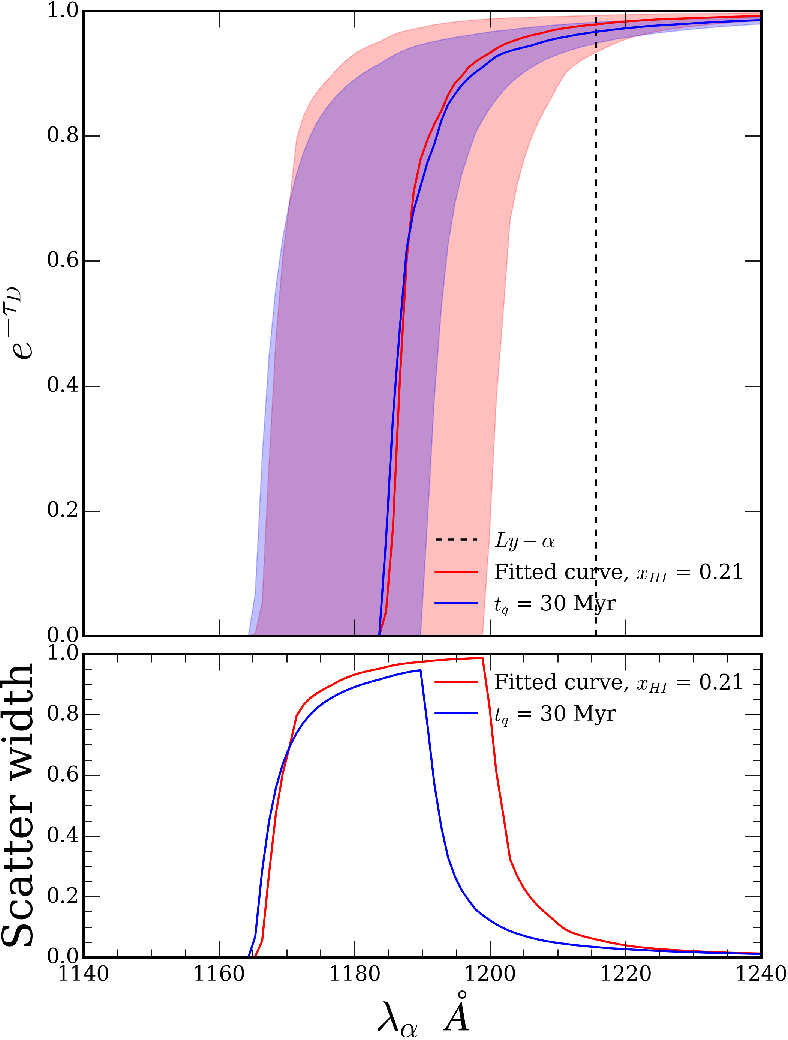

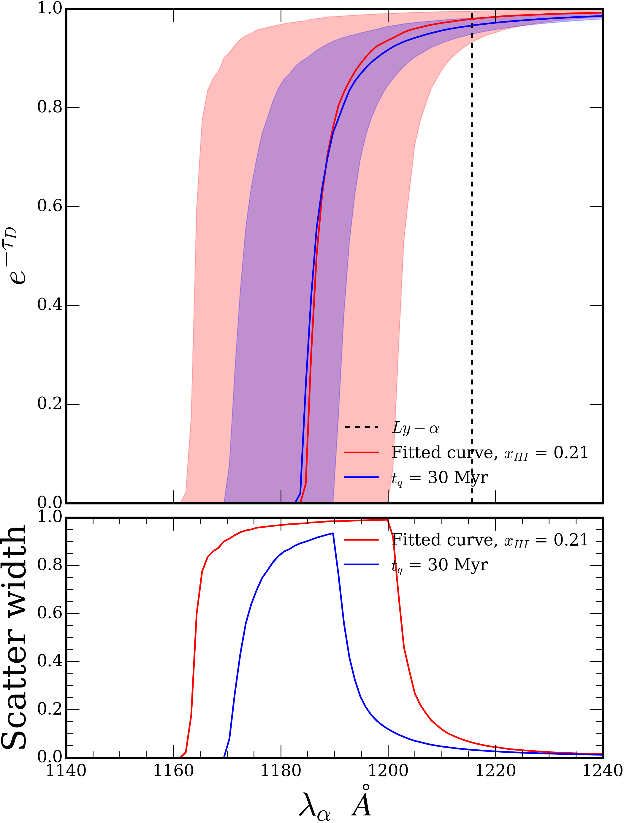




Eff $x_{HI}$ with 100 sightlines
Eff $x_{HI}$ with 500 sightlines
Eff $x_{HI}$ with 1000 sightlines
Eff $x_{HI}$ with 5000 sightlines

