Slide 1
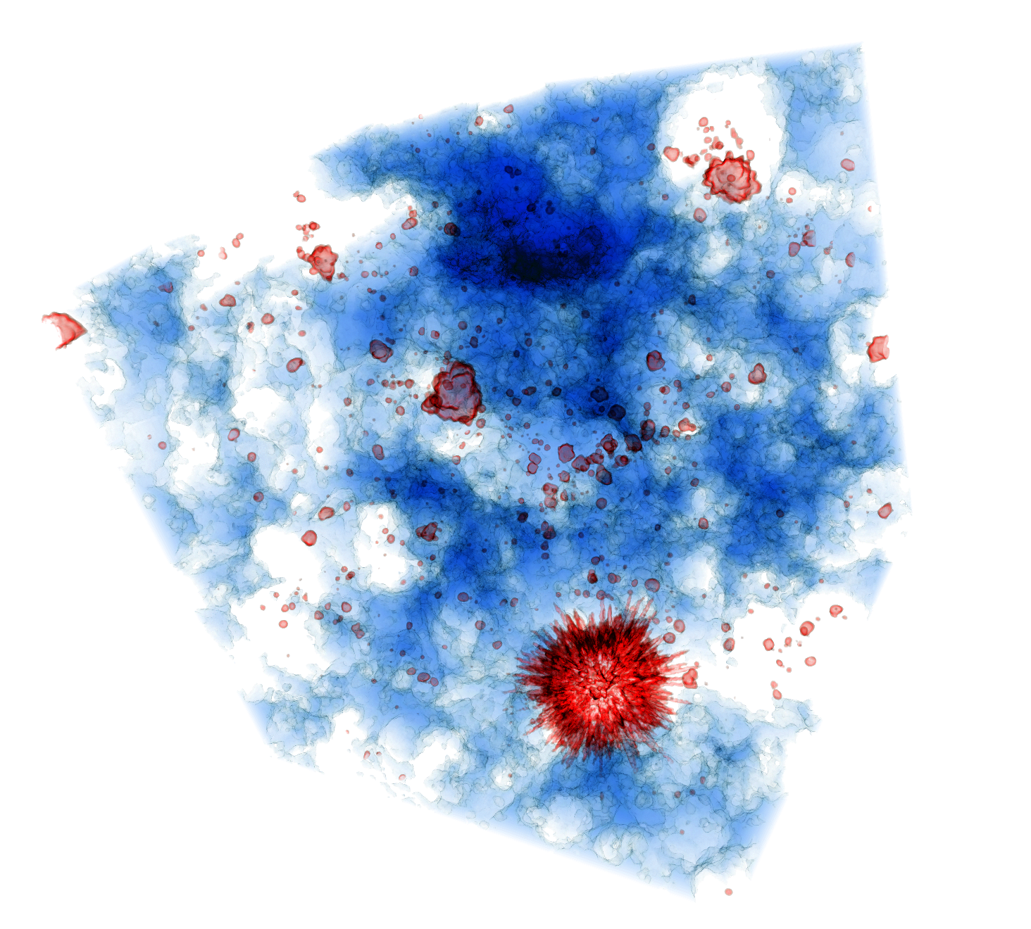
Cosmic Dawn at High Latitudes, Stockholm, Sweden, June 24-28 2024
21cm line from the high-z IGM
Eide+ 2020
Benedetta Ciardi
Max Planck Institute for Astrophysics

Slide 2
Overview
General introduction on the 21cm line from HI in the high-z IGM
What can we learn comparing our models of 21cm signal to observations?
What have we learnt from 21cm observations?

Slide 3
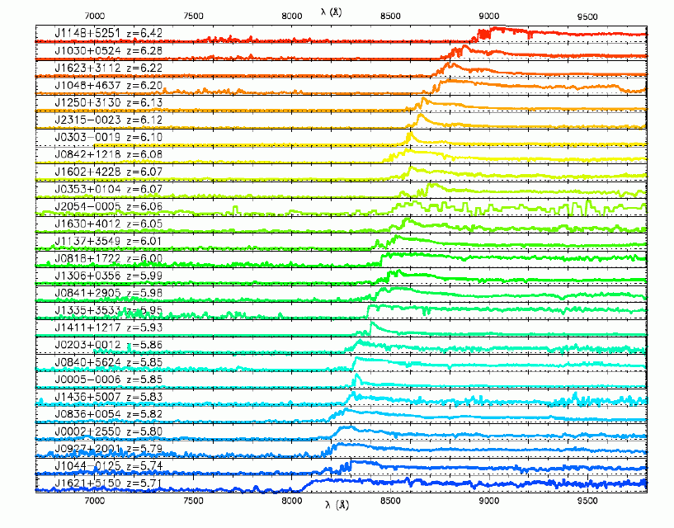
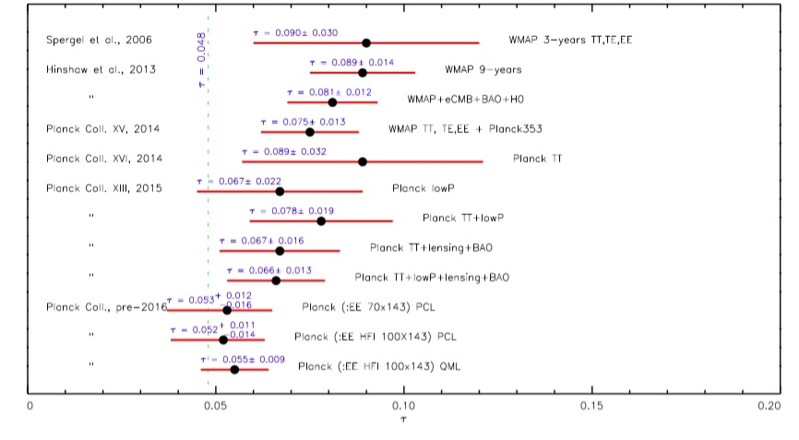
Constraints on the reionization process
High-z QSOs →
latest stages of reionization at z~6-7
Fan
Luminosity functions →
amount of HI
Morales+ 2021
CMB anisotropies →
global amount of electrons
Planck Collaboration 2016

Slide 4
Constraints on the reionization process
High-z QSOs →
latest stages of reionization at z~6-7
How did the reionization process evolve?
Fan
Luminosity functions →
amount of HI
Morales+ 2021
CMB anisotropies →
global amount of electrons
Planck Collaboration 2016

Slide 5
21cm line: basics
HI ground state
n₁
21 cm
Ideal probe of neutral H at high-z
different observed frqs. → different z
n₀

Slide 6
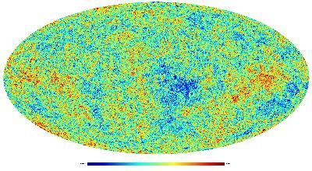
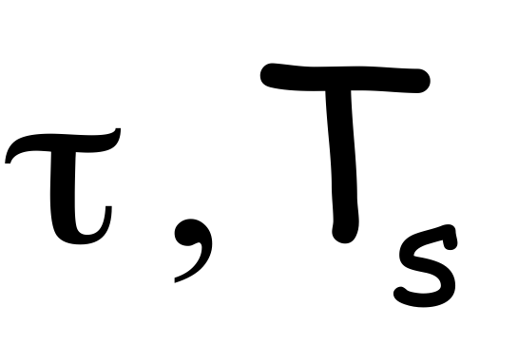
21cm line: basics
HI ground state
n₁
21 cm
n₁/n₀= g₁/g₀ exp(-hν/k_{B}T_{S}) = 3 exp(-0.068K/T_{S})
n₀
Differential brightness temperature:
no signal
absorption
emission
The value of T_{s} is critical

Slide 7
21cm line: basics
HI ground state
n₁
21 cm
n₁/n₀= g₁/g₀ exp(-hν/k_{B}T_{S}) = 3 exp(-0.068K/T_{S})
n₀
Differential brightness temperature:
kinetic temperature of the gas
no signal
absorption
emission
Lyalpha scattering and collisional efficiency

Slide 8
21cm line: absorption vs emission
Collisions are efficient at very high redshift
In the absence of decoupling mechanisms, other than collisions, 21cm line will not be visible at z<20
BC+ 2007, 2010
z
Redshift
See also e.g. Chen & Miralda-Escude‘; Chuzoy & Shapiro; Fialkov+; Furlanetto+; Ghara & Mellema; Kamran+; Madau+; Mesinger+; Pritchard & Loeb; Roy+; Sasonov+; Warszawski+; Yajima & Li

Slide 9
21cm line: absorption vs emission
Collisions are efficient at very high redshift
In the absence of decoupling mechanisms, other than collisions, 21cm line will not be visible at z<20
BC+ 2007, 2010
Redshift
See also e.g. Chen & Miralda-Escude‘; Chuzoy & Shapiro; Fialkov+; Furlanetto+; Ghara & Mellema; Kamran+; Madau+; Mesinger+; Pritchard & Loeb; Roy+; Sasonov+; Warszawski+; Yajima & Li

Slide 10
21cm line: absorption vs emission
Collisions are efficient at very high redshift
In the absence of decoupling mechanisms, other than collisions, 21cm line will not be visible at z<20
Lyα photon scattering decouples Ts from TCMB → 21cm line can be observed
BC+ 2007, 2010
Redshift
See also e.g. Chen & Miralda-Escude‘; Chuzoy & Shapiro; Fialkov+; Furlanetto+; Ghara & Mellema; Kamran+; Madau+; Mesinger+; Pritchard & Loeb; Roy+; Sasonov+; Warszawski+; Yajima & Li

Slide 11
21cm line: absorption vs emission
Collisions are efficient at very high redshift
In the absence of decoupling mechanisms, other than collisions, 21cm line will not be visible at z<20
Lyα photon scattering decouples Ts from TCMB → 21cm line can be observed
Lyα photon scattering heats the gas → 21cm line can be observed in emission
Lyα heating
BC+ 2007, 2010
Redshift
See also e.g. Chen & Miralda-Escude‘; Chuzoy & Shapiro; Fialkov+; Furlanetto+; Ghara & Mellema; Kamran+; Madau+; Mesinger+; Pritchard & Loeb; Roy+; Sasonov+; Warszawski+; Yajima & Li

Slide 12
21cm line: absorption vs emission
Collisions are efficient at very high redshift
In the absence of decoupling mechanisms, other than collisions, 21cm line will not be visible at z<20
Lyα photon scattering decouples Ts from TCMB → 21cm line can be observed
Lyα photon scattering heats the gas → 21cm line can be observed in emission
Lyα heating
Other heating sources: x-ray photons (e.g. BHs, XRBs); cosmic rays; DM annihilation & decay
BC+ 2007, 2010
δT_{b} ≈ n_{HI}(1-T_{CMB}/T_{S})
T_{S}>>T_{CMB} → δT_{b} ≈ n_{HI}
Redshift
See also e.g. Chen & Miralda-Escude‘; Chuzoy & Shapiro; Fialkov+; Furlanetto+; Ghara & Mellema; Kamran+; Madau+; Mesinger+; Pritchard & Loeb; Roy+; Sasonov+; Warszawski+; Yajima & Li

Slide 13
21cm line: absorption vs emission
Collisions are efficient at very high redshift
In the absence of decoupling mechanisms, other than collisions, 21cm line will not be visible at z<20
Lyα photon scattering decouples Ts from TCMB → 21cm line can be observed
Lyα photon scattering heats the gas → 21cm line can be observed in emission
Lyα heating
Other heating sources: x-ray photons (e.g. BHs, XRBs); cosmic rays; DM annihilation & decay
BC+ 2007, 2010
Very powerful probe of HI in the IGM
Redshift
See also e.g. Chen & Miralda-Escude‘; Chuzoy & Shapiro; Fialkov+; Furlanetto+; Ghara & Mellema; Kamran+; Madau+; Mesinger+; Pritchard & Loeb; Roy+; Sasonov+; Warszawski+; Yajima & Li

Slide 14
21cm line observations

Slide 15
21cm line observations
Global signal: heating sources; radio background
Imaging: topology of HII regions; source properties; timing of reionization
δT_{b} fluctuations and Power Spectrum (higher order statistics): statistical estimates
21cm forest: information on HI along the l.o.s.
Cross-correlation: confirm origin of signal; reduce systematic effects; information on sources
e.g. Shaver+ 1999 • BC+ 2007, 2010 • Valdes+ 2012 • Mirocha+ 2013 • Yajima & Khochfar 2014 • Singh+ 2015 • Cohen+ 2016 • Venumadhav+ 2016 • Breysee+ 2018 • Kaurov+ 2018 • Madau 2018 • Munoz+ 2018 • Raste & Sethi 2018 • Xu+ 2018 • Fialkov & Barkana 2019 • Ghara & Mellema 2019 • Leo+ 2019 • Liu+ 2019 • Mebane+ 2019 • Minoda+ 2019 • Mondalve+ 2019 • Nebrin+ 2019 • Datta+ 2020 • Mittal & Kulkarni 2020 •
Tanaka & Hasegawa 2020 • Villanueva-Domingo+ 2020 • Yoshiura+ 2020 • Bevin+ 2021 • Chatterjiee+ 2021 • Dhuria+ 2021 • Melia+ 2021 •
Reis+ 2021 • Bera+ 2022 • Mirabel+ 2022 • Gessey-Jones+ 2023 • Ventura+ 2023
e.g. Tozzi+ 2000 • BC & Madau 2003 • Furlanetto+ 2004 • Mellema+ 2006 •
Valdes+ 2006 • Santos+ 2008 • Baek+ 2009 • Geil & Wyithe 2009 • Zaroubi+ 2012 • Malloy & Lidz 2013 •
Ghara+ 2016, 2019 • Giro+ 2017 • Ross+ 2017 • Semelin+ 2017 • Gillet+ 2018 • Hassan+ 2018 •
Davies+ 2020 • Gazagnes+ 2020 • Ma+ 2020 • Mangena+ 2020 • Reis+ 2020 • Giri & Mellema 2021
e.g. Madau+ 1997 • Shaver+ 1999 • Tozzi+ 2000 • BC & Madau 2003 • Furlanetto+2004 • Mellema+ 2006; Valdes+ 2006 • Datta+ 2008 •
Pritchard & Loeb 2008 • Santos+ 2008 • Baek+ 2009 • Geil & Wyithe 2009 • Mesinger+ 2010; • Patil+ 2014 • Watkinson & Pritchard 2014 •
Greig+ 2015 • Yoshiura+ 2015 • Kubota+ 2016 • Kulkarni+ 2016 • Shimabukuro+ 2016 • Kaurov+ 2017 • Kern+ 2017 • Kittiwisit+ 2017 •
Hoffmann+ 2018 • Hutter+ 2019 • DeepKaur+ 2020 • Jennings+ 2020 • Majumdar+ 2020 • Watkinson+ 2020 • Mondal+ 2021 • Tiwari+ 2021 •
Kamran+ 2022 • Doussot & Semelin 2022 • Ma&Peng 2023
e.g. Carilli+ 2002 • Furlanetto 2006 • Xu+ 2009 • Mack & Wyithe 2011 • Meiksin 2011 •
Xu+ 2011 • BC+ 2013 • Vasiliev & Shchekinov 2012 • Ewall-Wice at al. 2014 •
BC+ 2015 • Semelin 2016 • Thyagarajan+ 2020 • Soltinsky+ 2021 • Kadota+ 2022
e.g. Salvaterra+ 2005 • Tashiro+ 2008 • Lidz+ 2009 • Jelic+ 2010 • Wierma+ 2013 • Fernandez+2014 • Mao 2014 • Colafrancesco+ 2016 •
Fialkov+ 2016 • Vrbanec+ 2016 • Sobacchi+ 2016 • Feng+ 2017 • Hutter+ 2017 • Neben+ 2017 • Beane & Lidz 2018 • Kubota+ 2018 •
Ma+ 2018a,b • Yoshiura+ 2018 • Morikawi+ 2019 • Roy+ 2019 • Heneka & Mesinger 2020 • LaPlante+ 2020 • Vrbanec+ 2020 •
Weingerger+ 2020 • Ji+ 2021 • Trott+ 2021 • Begin+ 2022 • Cox+ 2022 • LaPlant+ 2022 • Hutter+ 2023 • Georgiev+ 2024

Slide 16
Global signal
e.g. Shaver+ 1999 • BC+ 2007, 2010 • Valdes+ 2012 • Mirocha+ 2013 • Yajima & Khochfar 2014 • Singh+ 2015 • Cohen+ 2016 • Venumadhav+ 2016 • Breysee+ 2018 • Kaurov+ 2018 • Madau 2018 • Munoz+ 2018 • Raste & Sethi 2018 • Xu+ 2018 • Fialkov & Barkana 2019 • Ghara & Mellema 2019 • Leo+ 2019 • Liu+ 2019 • Mebane+ 2019 • Minoda+ 2019 • Mondalve+ 2019 • Nebrin+ 2019 • Datta+ 2020 • Mittal & Kulkarni 2020 •
Tanaka & Hasegawa 2020 • Villanueva-Domingo+ 2020 • Yoshiura+ 2020 • Bevin+ 2021 • Chatterjiee+ 2021 • Dhuria+ 2021 • Melia+ 2021 •
Reis+ 2021 • Bera+ 2022 • Mirabel+ 2022 • Gessey-Jones+ 2023 • Ventura+ 2023

Slide 17
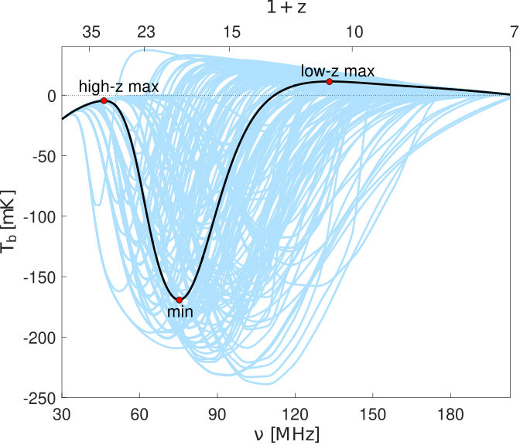
Global signal
atomic/molecular cooling
star formation efficiency
X-ray heating efficiency
X-ray SED
…
information processes which determine the
absorption feature, e.g. heating sources
Cohen+ 2017

Slide 18
Imaging
e.g. Tozzi+ 2000 • BC & Madau 2003 • Furlanetto+ 2004 • Mellema+ 2006 •
Valdes+ 2006 • Santos+ 2008 • Baek+ 2009 • Geil & Wyithe 2009 • Zaroubi+ 2012 • Malloy & Lidz 2013 •
Ghara+ 2016, 2019 • Giro+ 2017 • Ross+ 2017 • Semelin+ 2017 • Gillet+ 2018 • Hassan+ 2018 •
Davies+ 2020 • Gazagnes+ 2020 • Ma+ 2020 • Mangena+ 2020 • Reis+ 2020 • Giri & Mellema 2021

Slide 19
Imaging
HI fraction at z=8
L=7.5 cGpc, 6400³ grid
excursion set formalism
MWA 25ºx25º
HERA 8ºx8º
L [cMpc]
LOFAR 4ºx4º
SKA 3ºx3º
Greig+ 2022
L [cMpc]

Slide 20
Imaging
Stars
Stars, BHs
Stars, XRBs
Stars, ISM
All
z=11
z=8
δT_{21cm} [mK]
z=7
Ma+ 2021
L=150 cMpc
hydrodynamic simulations + Monte Carlo multi-frequency RT
various source types

Slide 21
Imaging
Stars
Stars, BHs
Stars, XRBs
Stars, ISM
All
z=11
z=8
δT_{21cm} [mK]
z=7
information on sources, HII topology,
reionization history …
Ma+ 2021

Slide 22
Statistical estimates
e.g. Madau+ 1997 • Shaver+ 1999 • Tozzi+ 2000 • BC & Madau 2003 • Furlanetto+2004 • Mellema+ 2006; Valdes+ 2006 • Datta+ 2008 •
Pritchard & Loeb 2008 • Santos+ 2008 • Baek+ 2009 • Geil & Wyithe 2009 • Mesinger+ 2010; • Patil+ 2014 • Watkinson & Pritchard 2014 •
Greig+ 2015 • Yoshiura+ 2015 • Kubota+ 2016 • Kulkarni+ 2016 • Shimabukuro+ 2016 • Kaurov+ 2017 • Kern+ 2017 • Kittiwisit+ 2017 •
Hoffmann+ 2018 • Hutter+ 2019 • DeepKaur+ 2020 • Jennings+ 2020 • Majumdar+ 2020 • Watkinson+ 2020 • Mondal+ 2021 • Tiwari+ 2021 •
Kamran+ 2022 • Doussot & Semelin 2022 • Ma&Peng 2023

Slide 23
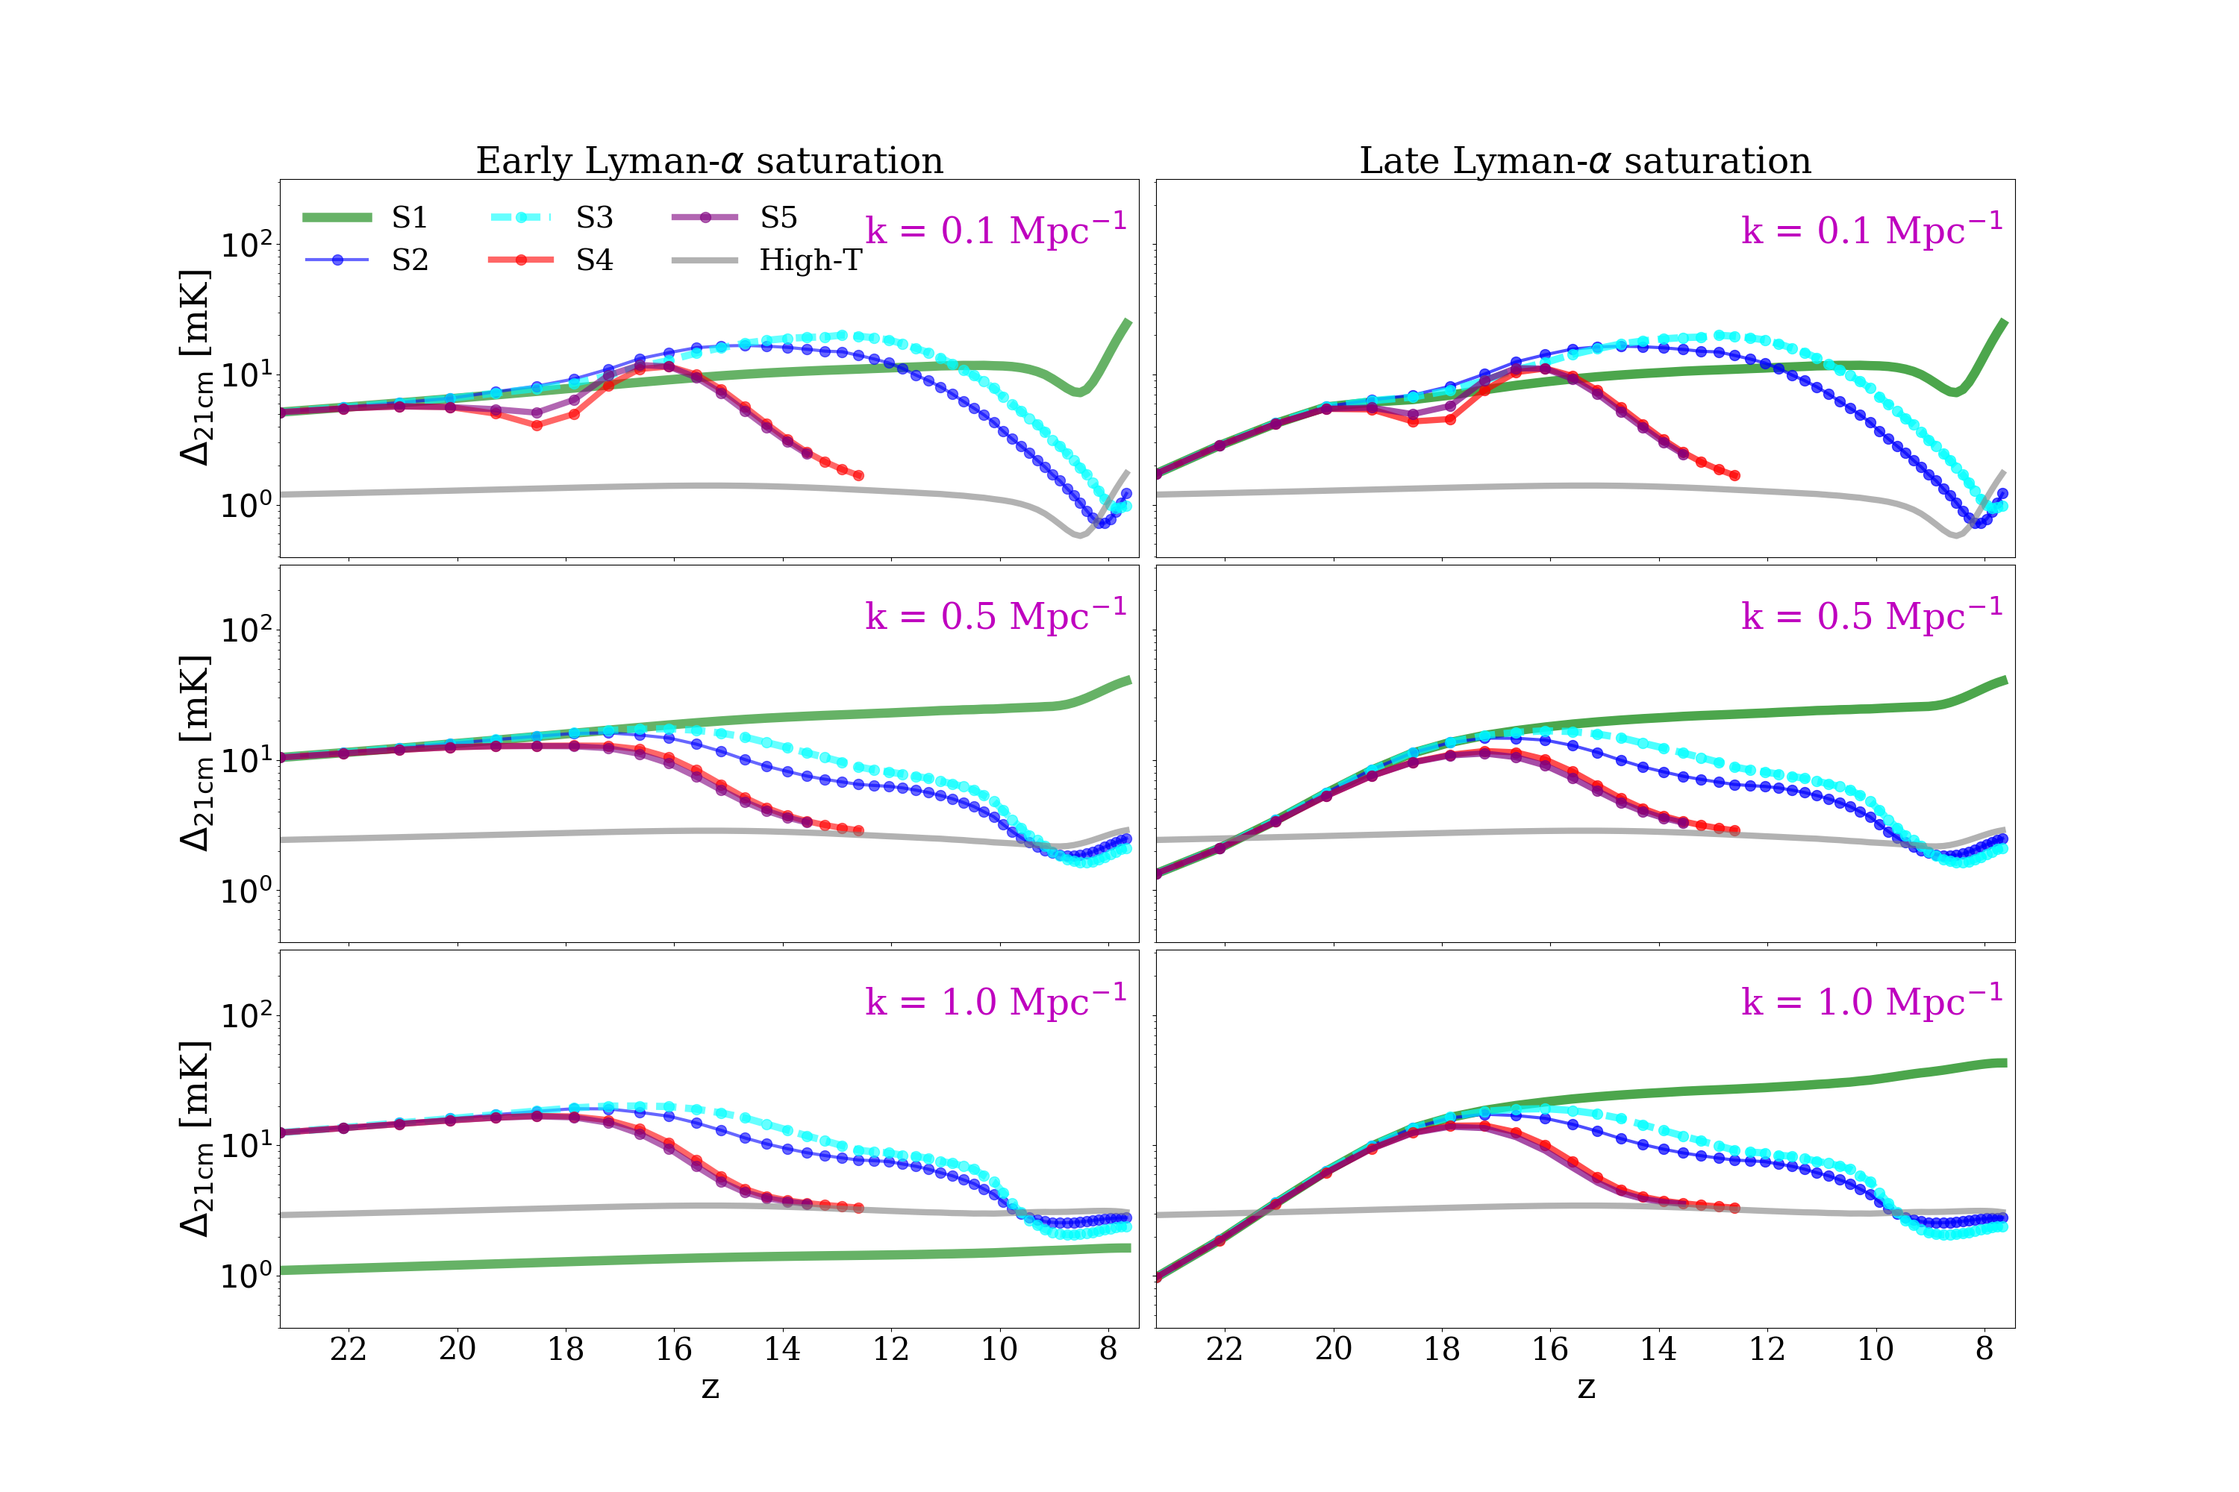
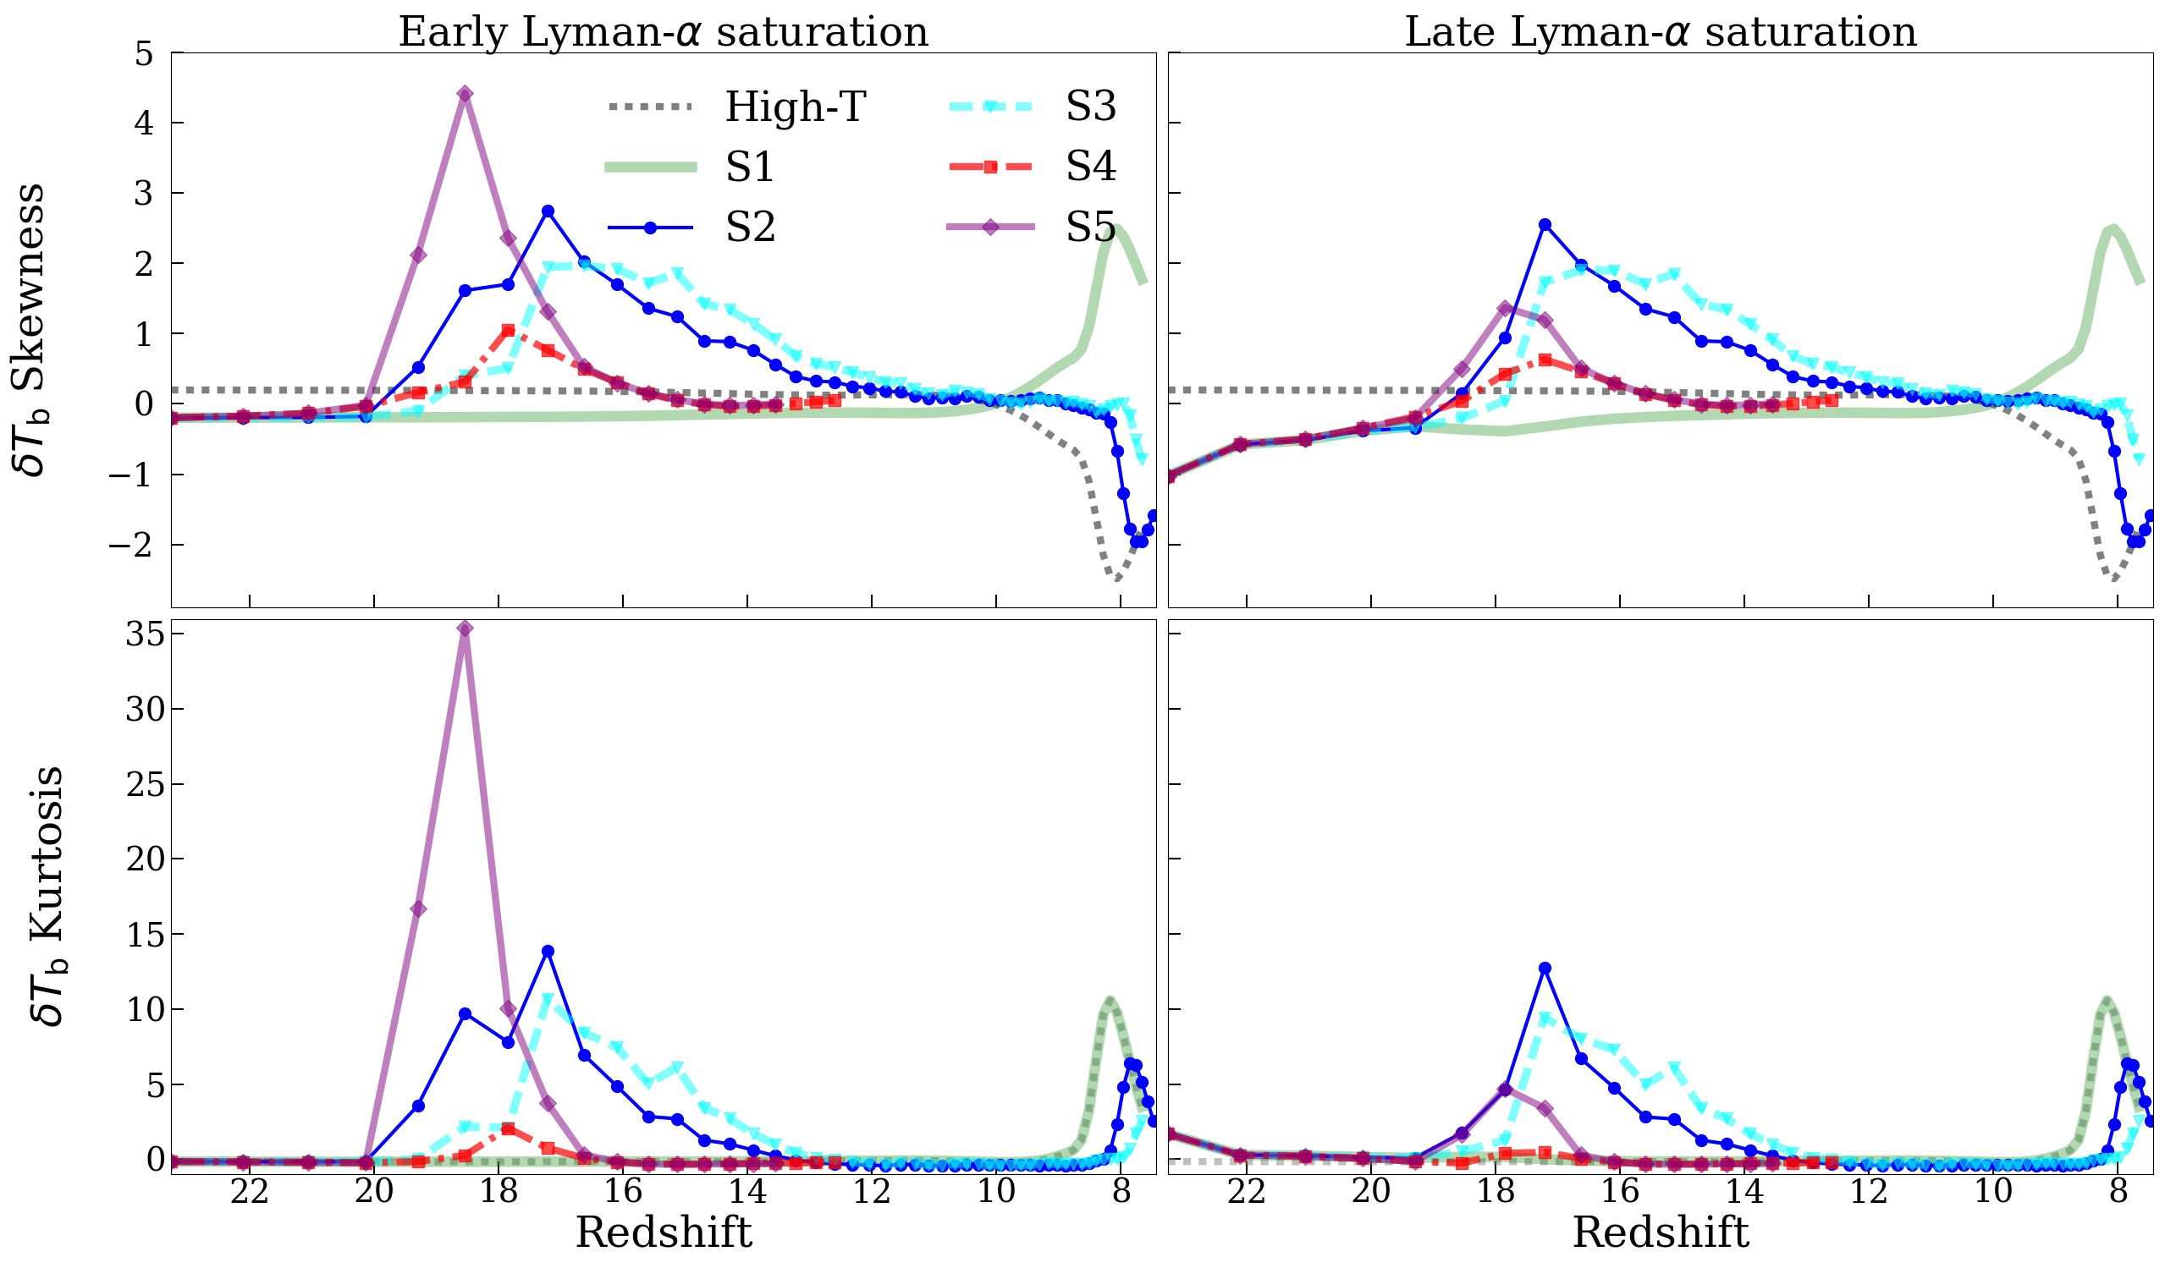
Statistical estimates
k=0.5 Mpc⁻¹
L=350 cMpc N-body simulation
RT on a 250³ grid
various source properties
stars
Power spectrum [mK]
stars+QSOs
stars+XRBs
Skewness
information on IGM (and source)
properties
Kurtosis
Ross+ 2019

Slide 24
21cm forest
e.g. Carilli+ 2002 • Furlanetto 2006 • Xu+ 2009 • Mack & Wyithe 2011 • Meiksin 2011 •
Xu+ 2011 • BC+ 2013 • Vasiliev & Shchekinov 2012 • Ewall-Wice at al. 2014 •
BC+ 2015 • Semelin 2016 • Thyagarajan+ 2020 • Soltinsky+ 2021 • Kadota+ 2022

Slide 25
21cm forest
Neutral fraction
Temperature
Kulkarni+ 2019

Slide 26
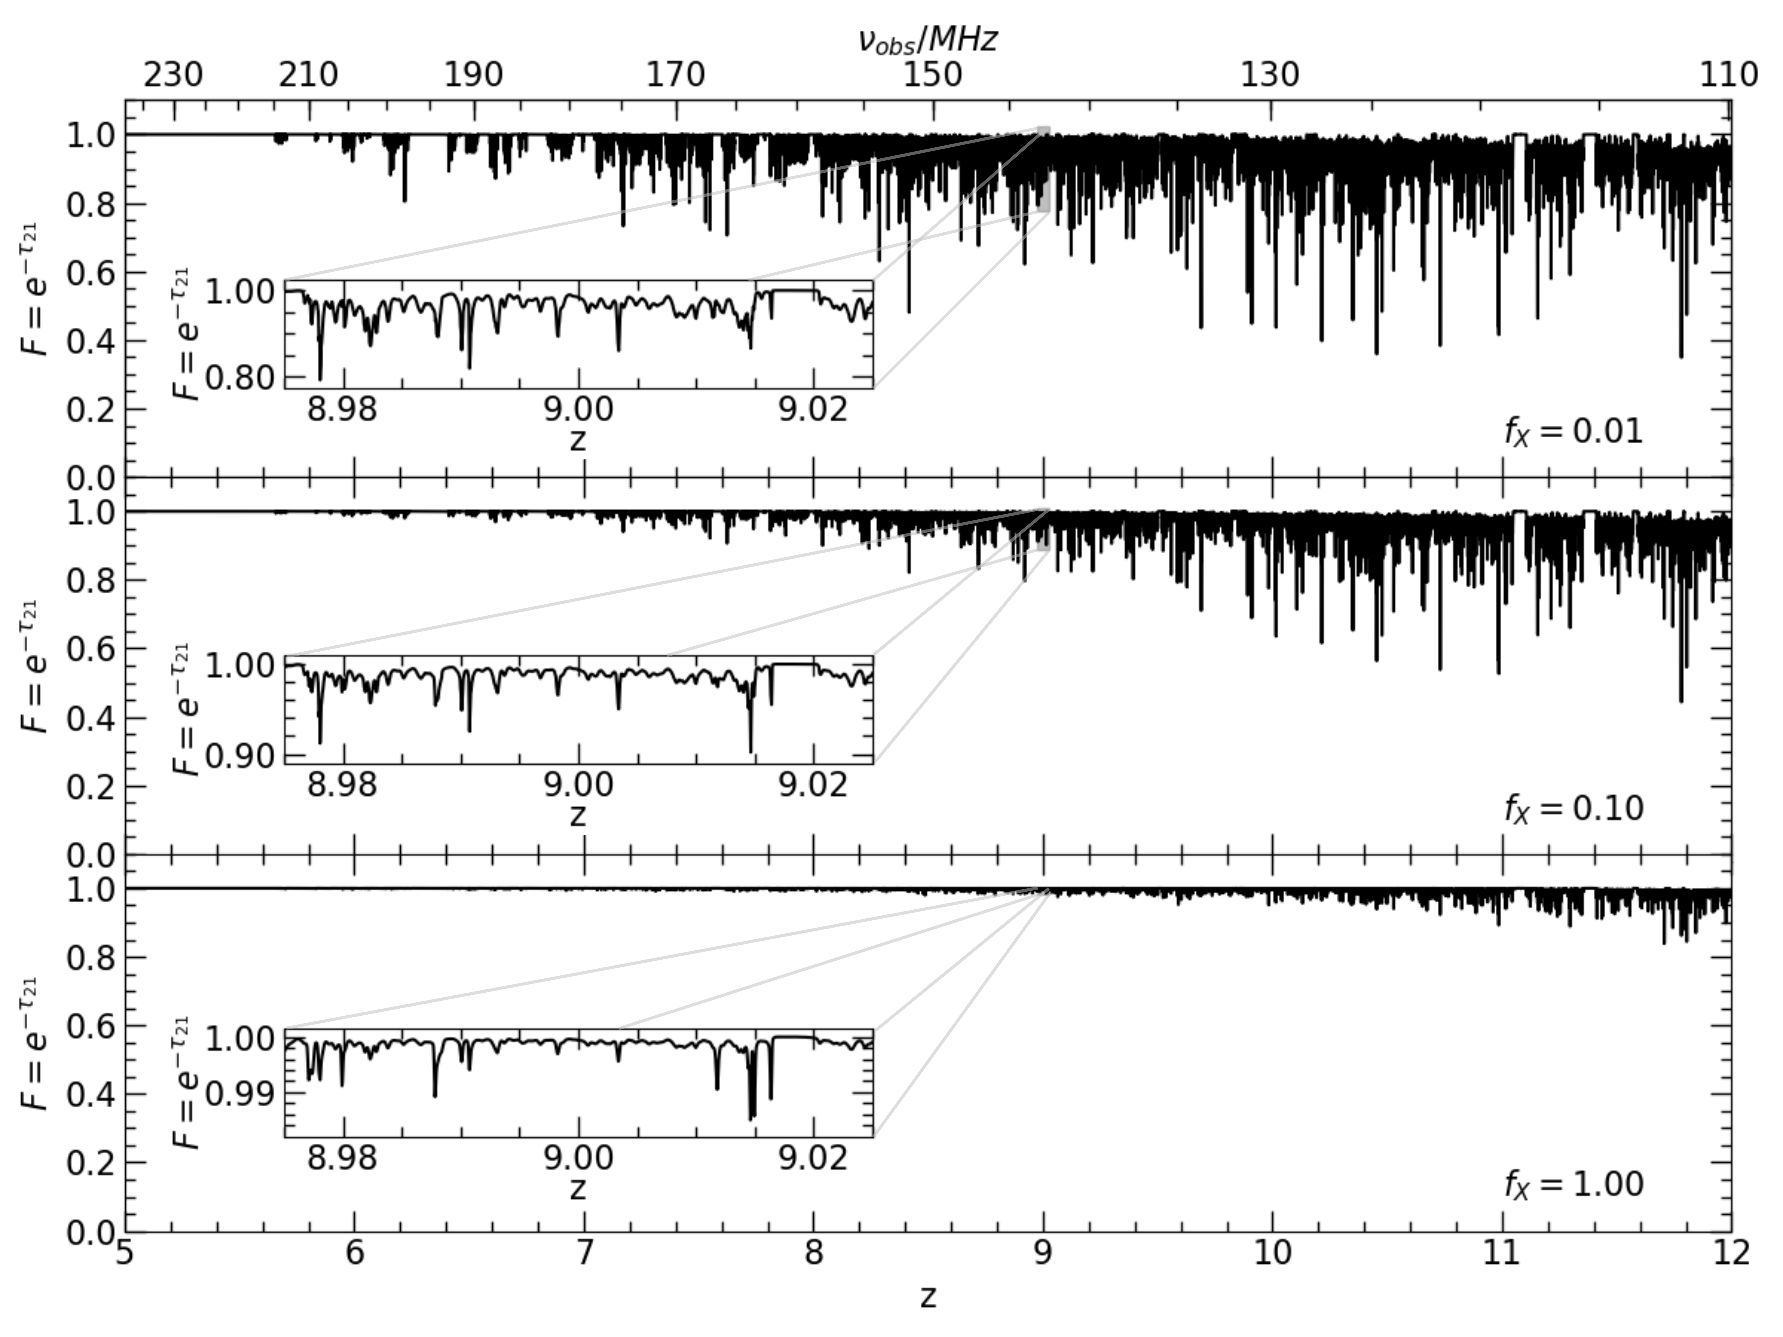
21cm forest
Soltinsky+ 2021
L=60 cMpc
hydrodynamic simulations + mono-chromatic moment-based RT
spatially uniform X-ray background

Slide 27
21cm forest
z=7.6, S_{QSO}~50 mJy
QSO spectrum
BW=5 kHz, t_{obs}=1000 h
spectrum
observed
with LOFAR
QSO spectrum
+
IGM absorption
BC+ 2013, 2015
Information on x_{HI} and T along the line of sight
Radio loud QSO:
z=6.82 & S~5 mJy at 150MHz
(Banados+ 2021)

Slide 28
Cross-correlations
e.g. Salvaterra+ 2005 • Tashiro+ 2008 • Lidz+ 2009 • Jelic+ 2010 • Wierma+ 2013 • Fernandez+2014 • Mao 2014 • Colafrancesco+ 2016 •
Fialkov+ 2016 • Vrbanec+ 2016 • Sobacchi+ 2016 • Feng+ 2017 • Hutter+ 2017 • Neben+ 2017 • Beane & Lidz 2018 • Kubota+ 2018 •
Ma+ 2018a,b • Yoshiura+ 2018 • Morikawi+ 2019 • Roy+ 2019 • Heneka & Mesinger 2020 • LaPlante+ 2020 • Vrbanec+ 2020 •
Weingerger+ 2020 • Ji+ 2021 • Trott+ 2021 • Begin+ 2022 • Cox+ 2022 • LaPlant+ 2022 • Hutter+ 2023 • Georgiev+ 2024

Slide 29
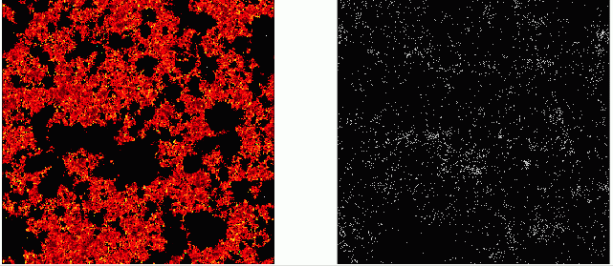
Cross-correlations
resolved galaxies (Lyα, metal lines)
21cm
galaxies
Lidz+ 2009
large-scale anti-correlations → typical dimension of HII regions

Slide 30
Cross-correlations
resolved galaxies (Lyα, metal lines)
unresolved galaxies (NIR & Xray backgrounds)
CMB
21cm
galaxies
Lidz+ 2009
Cross-correlations are fundamental to confirm origin of signal, reduce systematic effects, provide information on typical dimension of HII regions and source properties

Slide 31
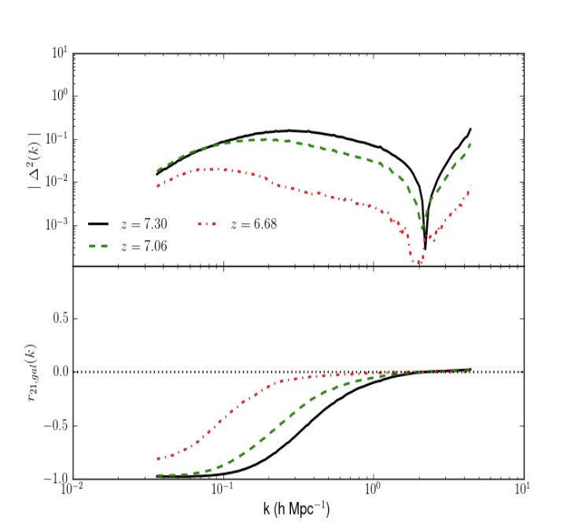
Cross-correlations
3D spherically averaged cross power spectrum (21cm-LAEs)
Intensity of the power spectrum →
volume average HI
Correlation coefficient →
typical dimension of the HII regions
Wiersma+ 2013; Vrbanec+ 2016;, 2020
Cross-correlations are fundamental to confirm origin of signal, reduce systematic effects, provide information on sources

Slide 32
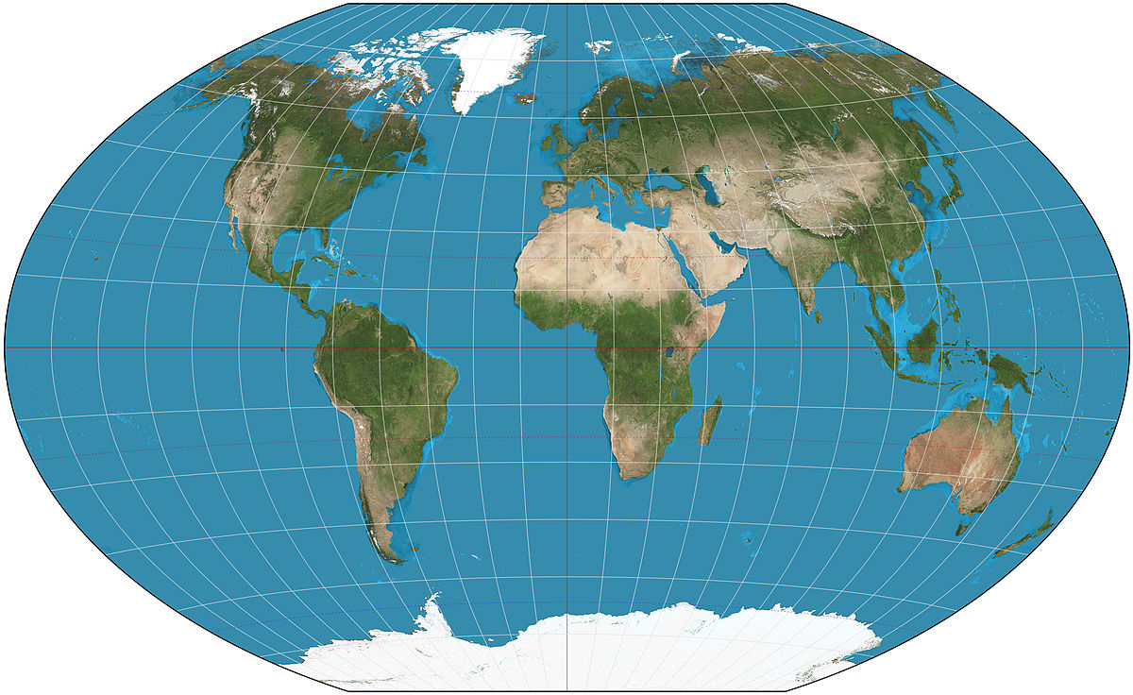
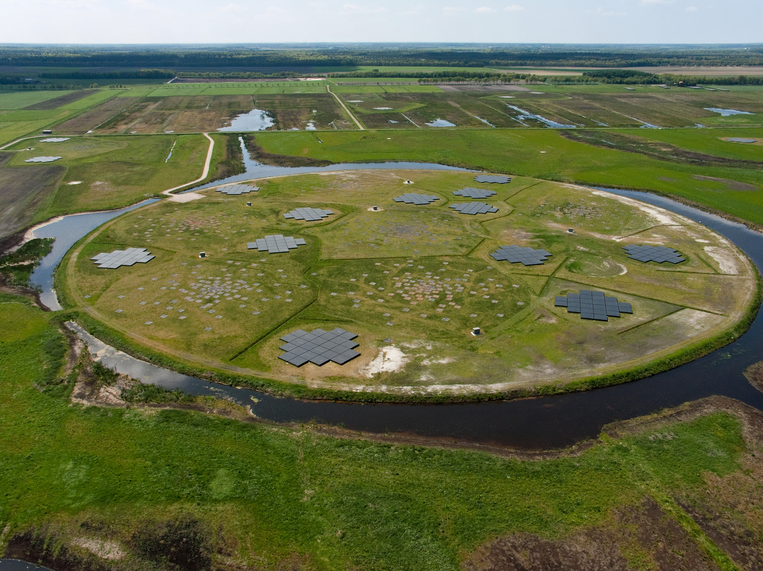
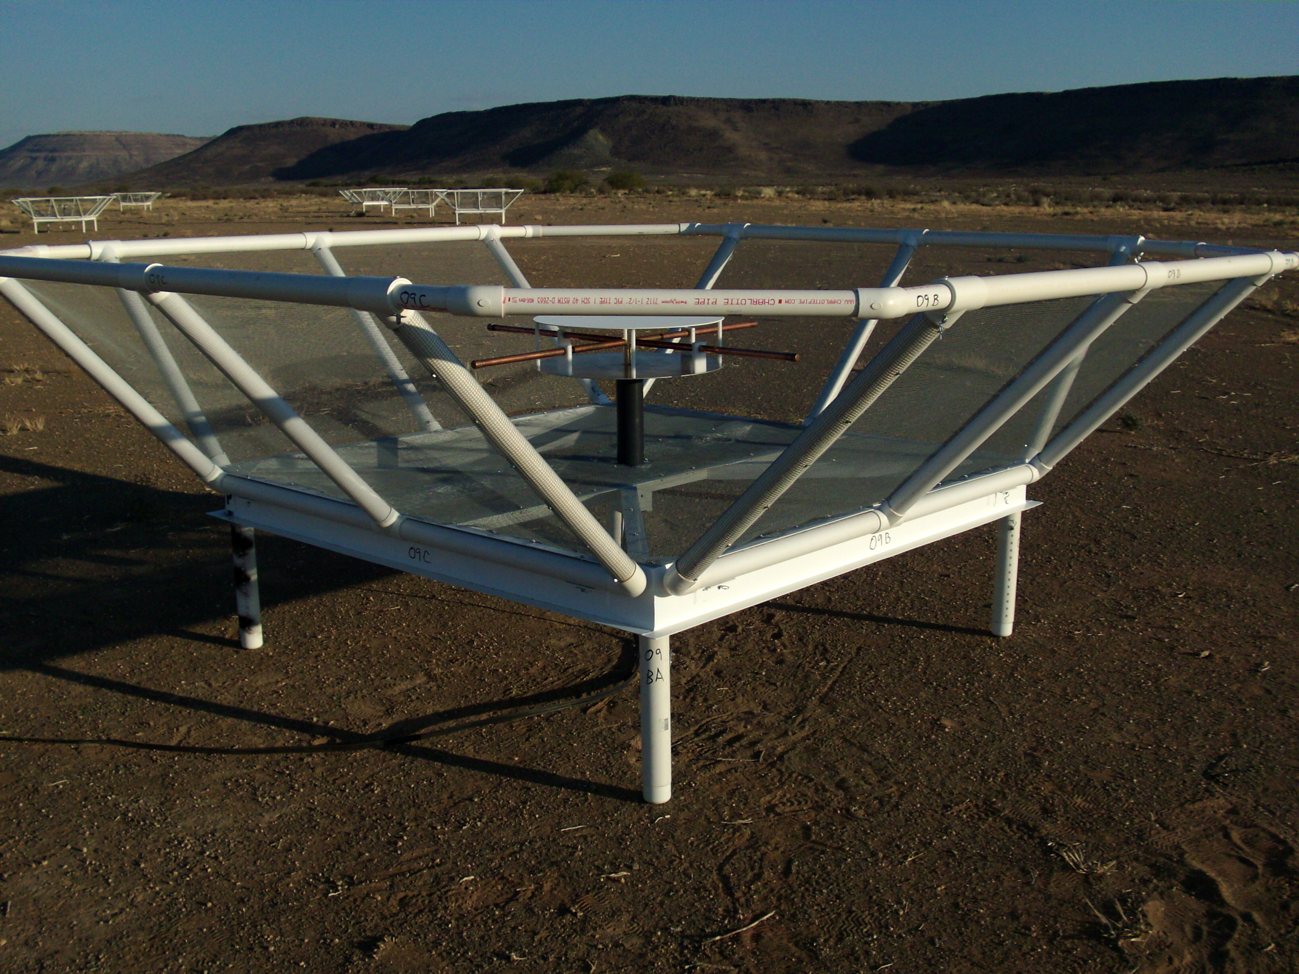
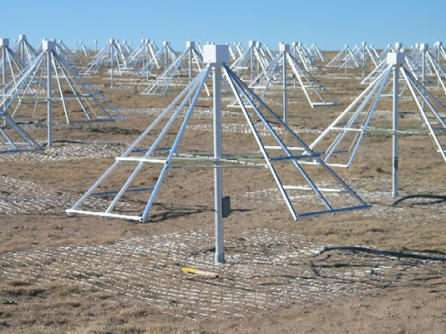
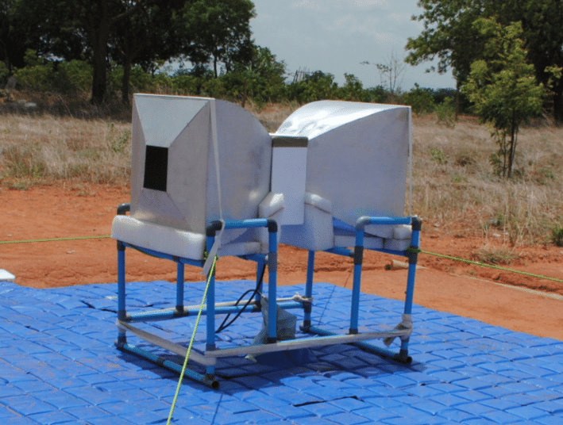
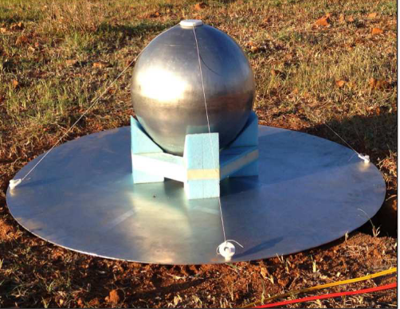
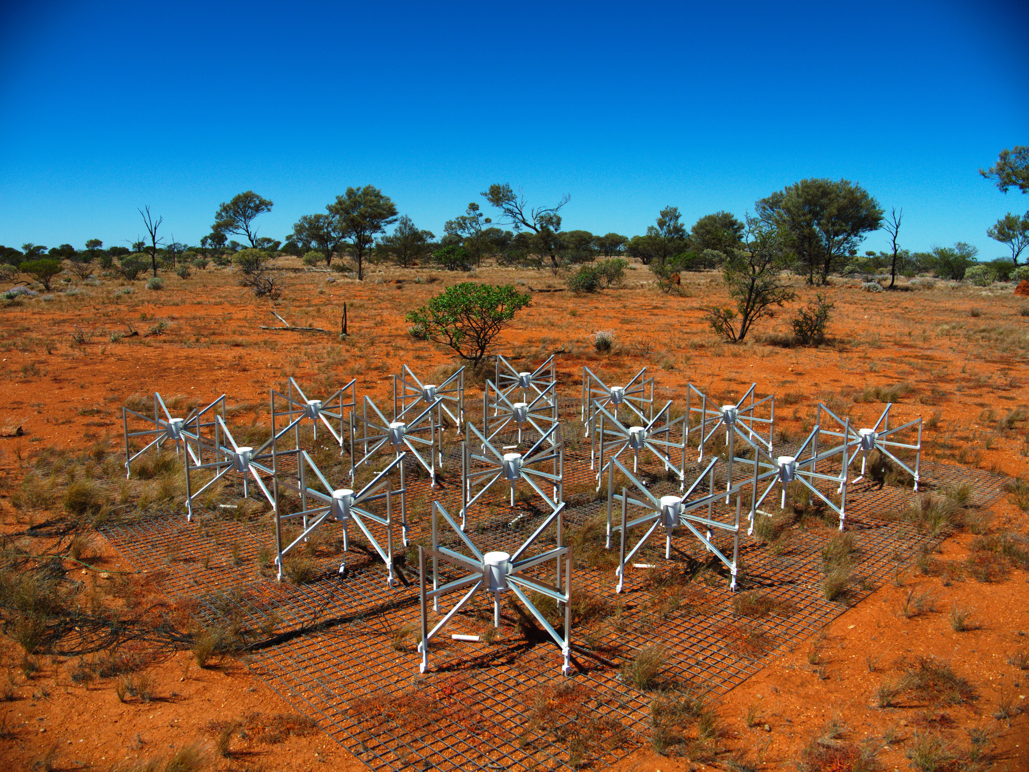
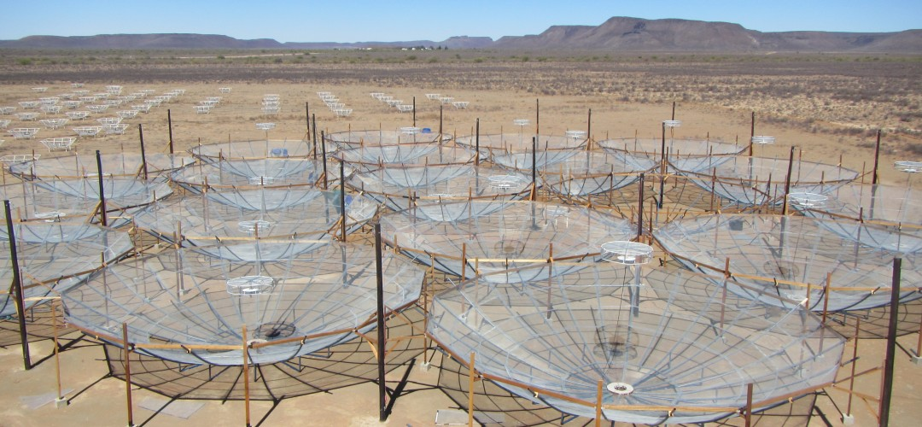
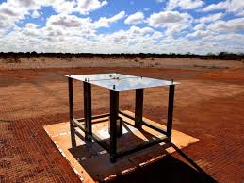
LOFAR
LWA
PAPER
LWA
SARAS
HERA &
PAPER
MWA &
EDGES
RADIO TELESCOPE FOR EPOCH OF REIONIZATION

Slide 33
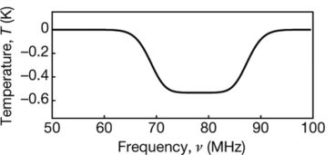
Global signal
EDGES
Recovered best-fitting 21cm model
ν = 78 ± 1 MHz
δT_{b} = 500⁺⁵⁰⁰₋₂₀₀ mK
S/N = 37
Bowman+ 2018
Physical origin: excess radio background, b-DM scattering, DM coupled to photons, interacting DE, different residual e⁻ fraction at recombination…
Constraints: DM annihilation, DM interactions, DM decay, WDM, primordial BHs…
Absorption feature not real

Slide 34
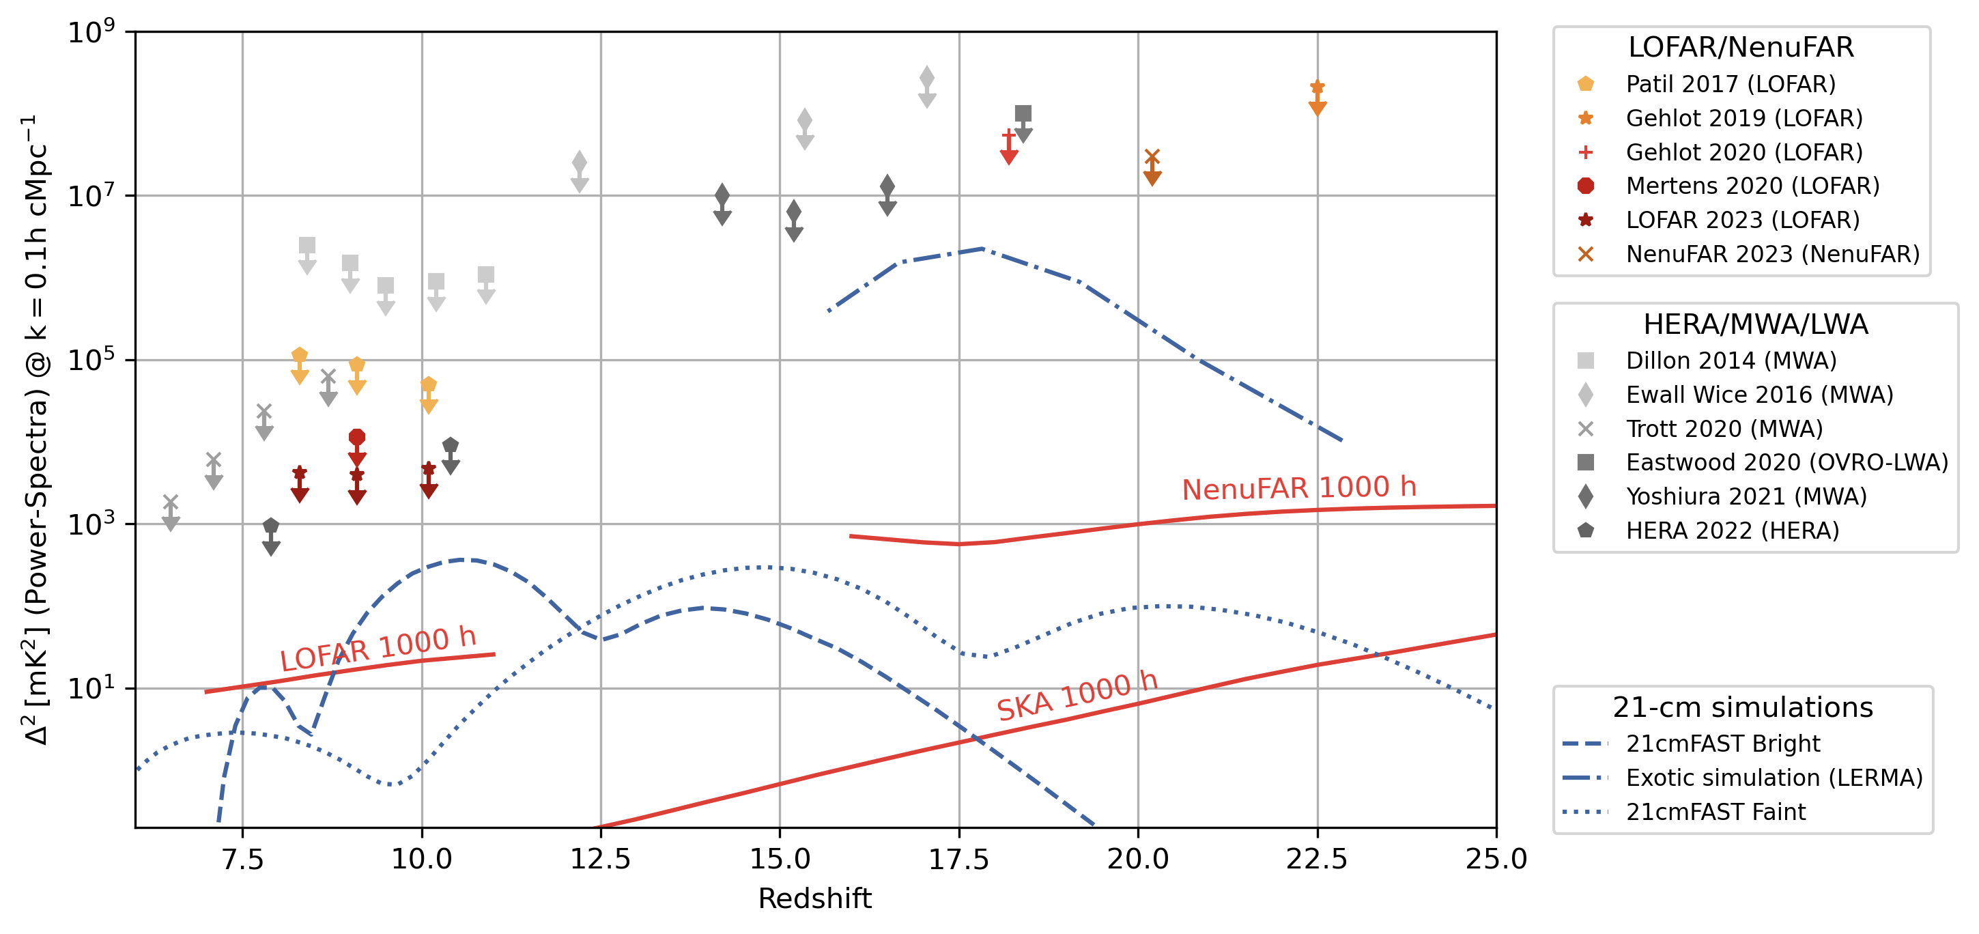
Statistical estimates: power spectrum
Upper limit on power spectrum
Credit: F. Mertens

Slide 35
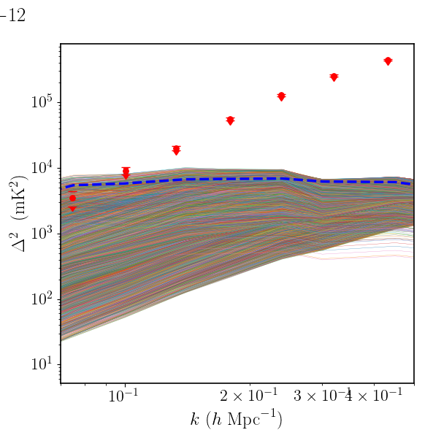
Statistical estimates: power spectrum
141h with LOFAR at z=9.1
(Mertens+ 2020)
216h with HERA at z=8, 10
(HERA 2022)
HERA 2022;
Some reionization models can
already been excluded!!!
Ghara+ 2020;
453h with MWA
(Trott+ 2020)
Cold IGM models disfavored
limits on X-ray heating
Greig+ 2021;

Slide 36
Conclusions
I can’t wait to have better data!

