Slide 1


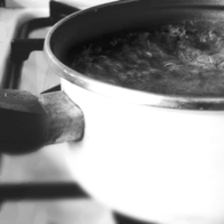
Dynamics of first-order phase transitions in holographic theories
Oscar Henriksson
Åbo Akademi University &
Helsinki Institute of Physics

Slide 2
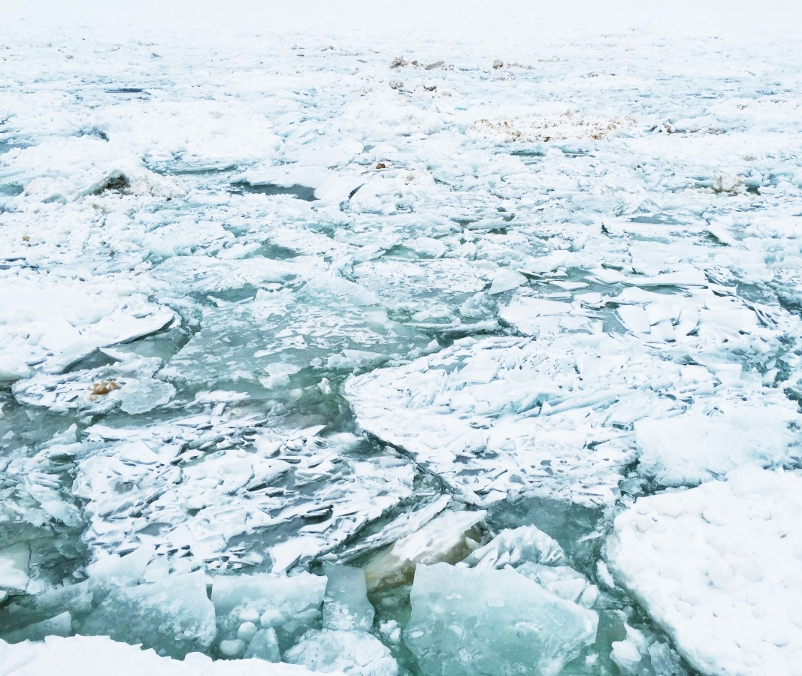
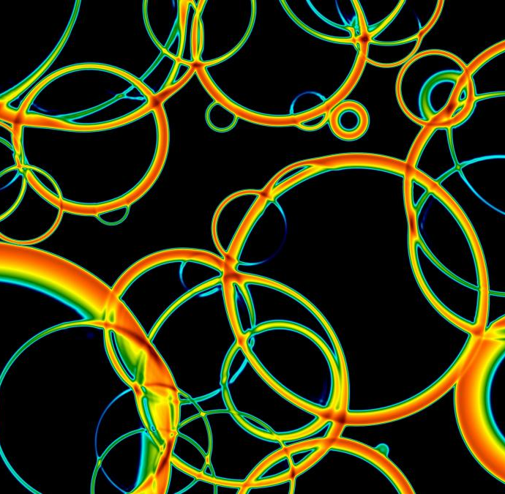
First-order phase transitions
Rich physics!
Bubble nucleation, spinodal decomposition, critical phenomena, ...
Important in all areas of physics! Example: Cosmology
Occured in early universe?? → bubble collisions produce
grav. waves → sign of BSM physics!!
Dynamics of transitions include complicated out-of-equilibrium behavior
Difficult to study, even at weak coupling...
Holographic duality → window into these processes
at strong coupling!
Figure by David Weir

Slide 3
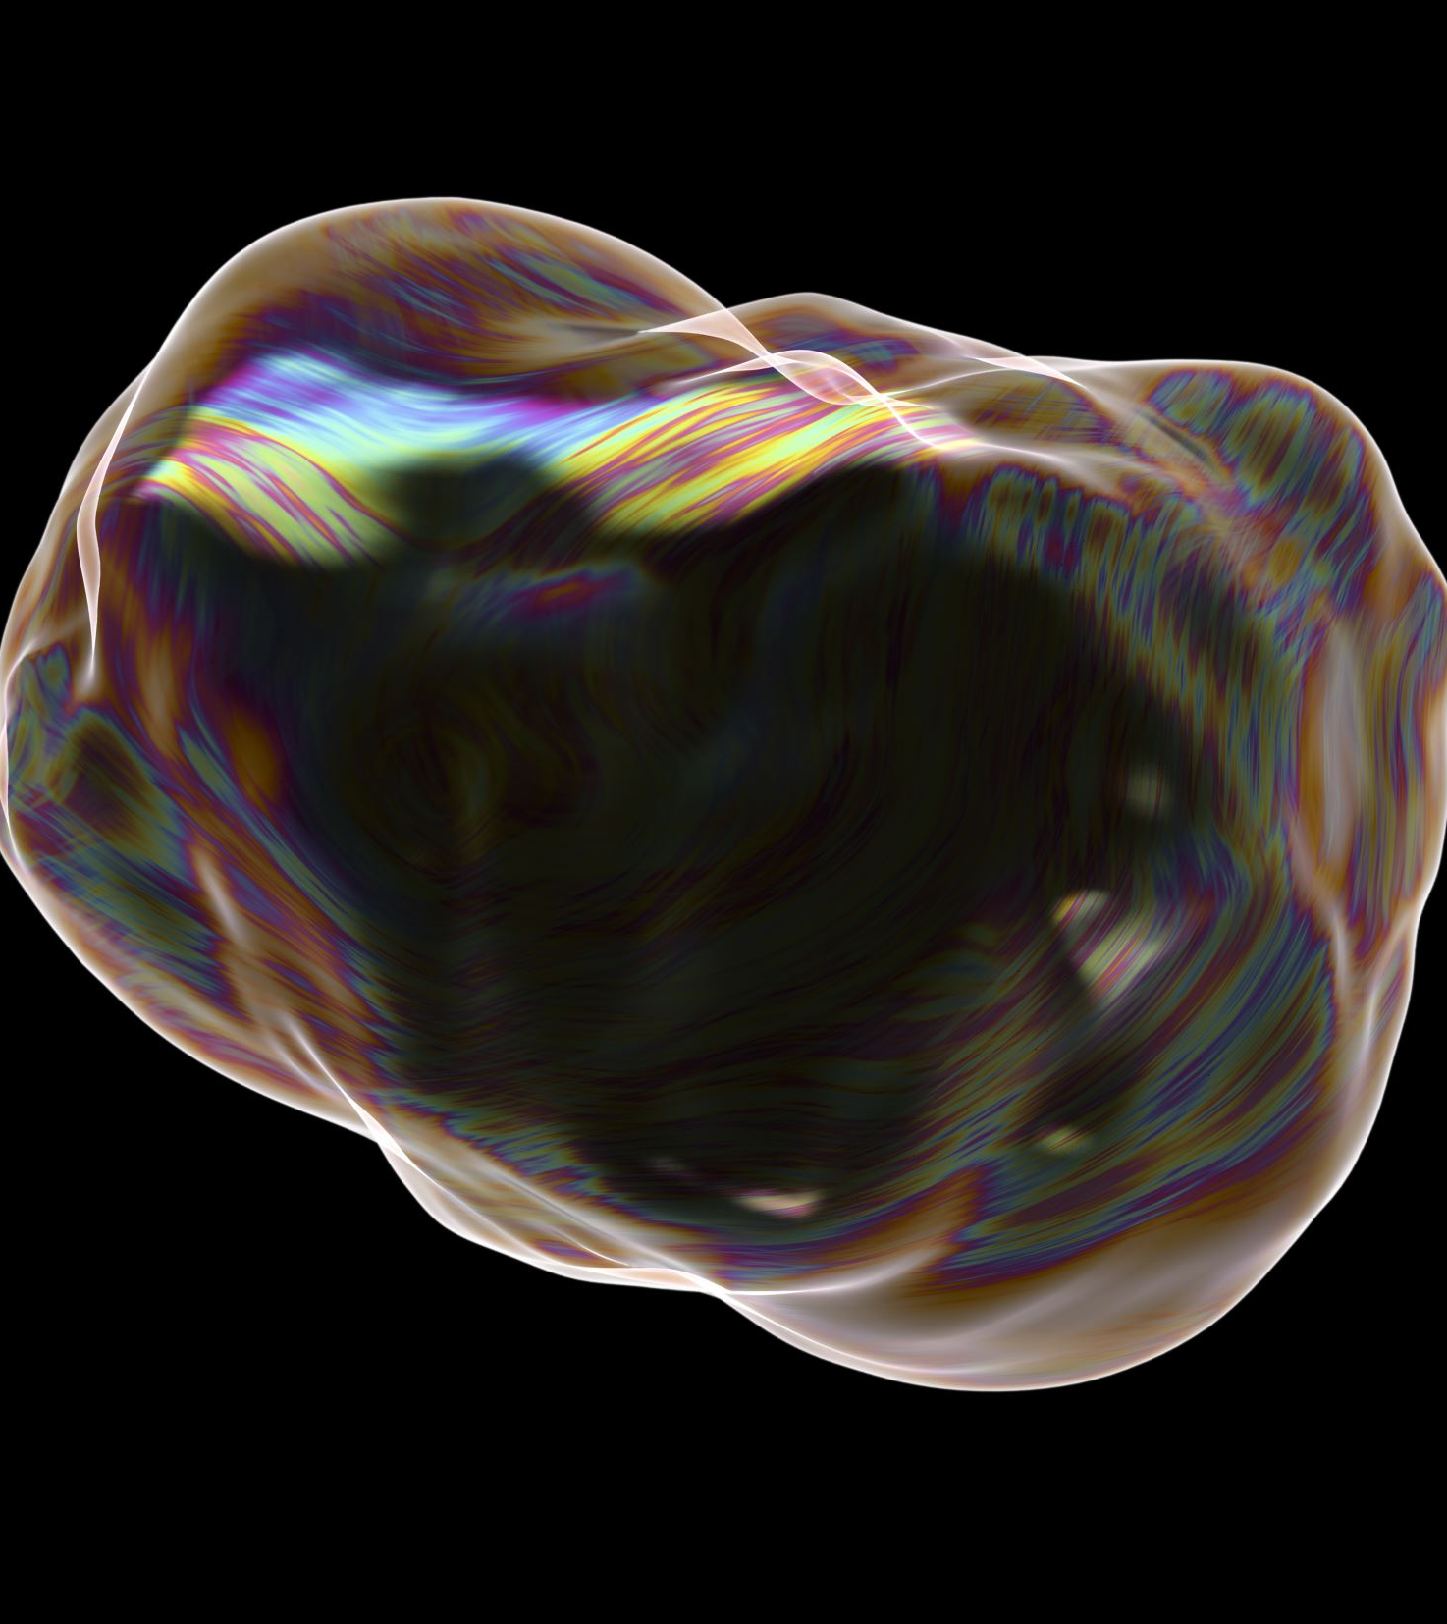
Outline
A simple holographic model for studying phase transitions
First order transitions and bubble nucleation
When nucleation is suppressed – approaching the spinodal
Based on…
2109.13784 and 2110.14442 with Fëanor Reuben Ares, Mark Hindmarsh, Carlos Hoyos & Niko Jokela.
2406.15297, with Alessio Caddeo, Carlos Hoyos & Mikel Sanchez-Garitaonandia.

Slide 4
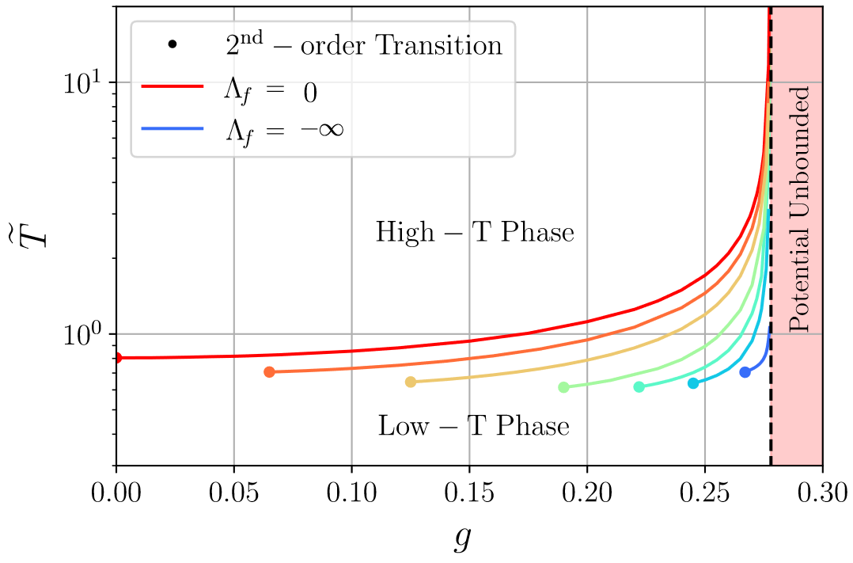
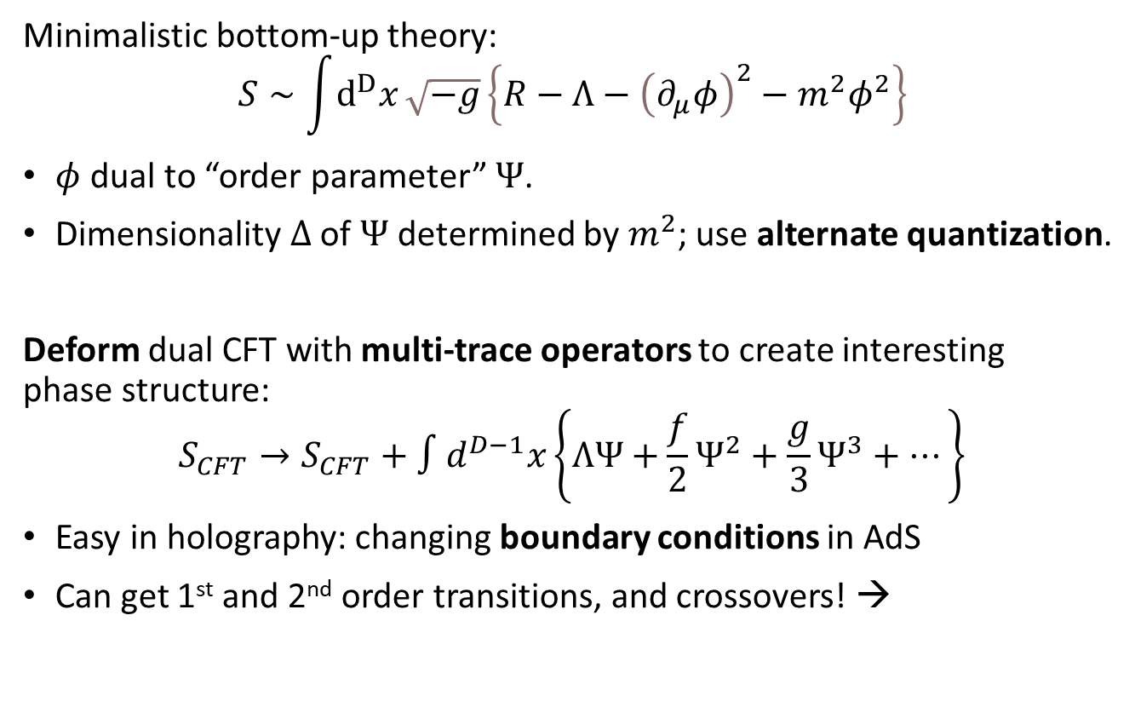
A simple holographic toy model
Minimalistic bottom-up theory:
$$S∼\int{ⅆ^{D}x}\sqrt{−g}\left\{R−Λ−{\left(∂_{μ}φ\right)}^{2}−m^{2}φ^{2}\right\}$$
$φ$ dual to “order parameter” $Ψ$.
Dimensionality $Δ$ of $Ψ$ determined by $m^{2}$; use alternate quantization.
Deform dual CFT with multi-trace operators to create interesting
phase structure:
$$S_{CFT}→S_{CFT}+∫d^{D−1}x\left\{ΛΨ+\frac{f}{2}Ψ^{2}+\frac{g}{3}Ψ^{3}+…\right\}$$
Easy in holography: changing boundary conditions in AdS
Can get 1st and 2nd order transitions, and crossovers! →

Slide 5
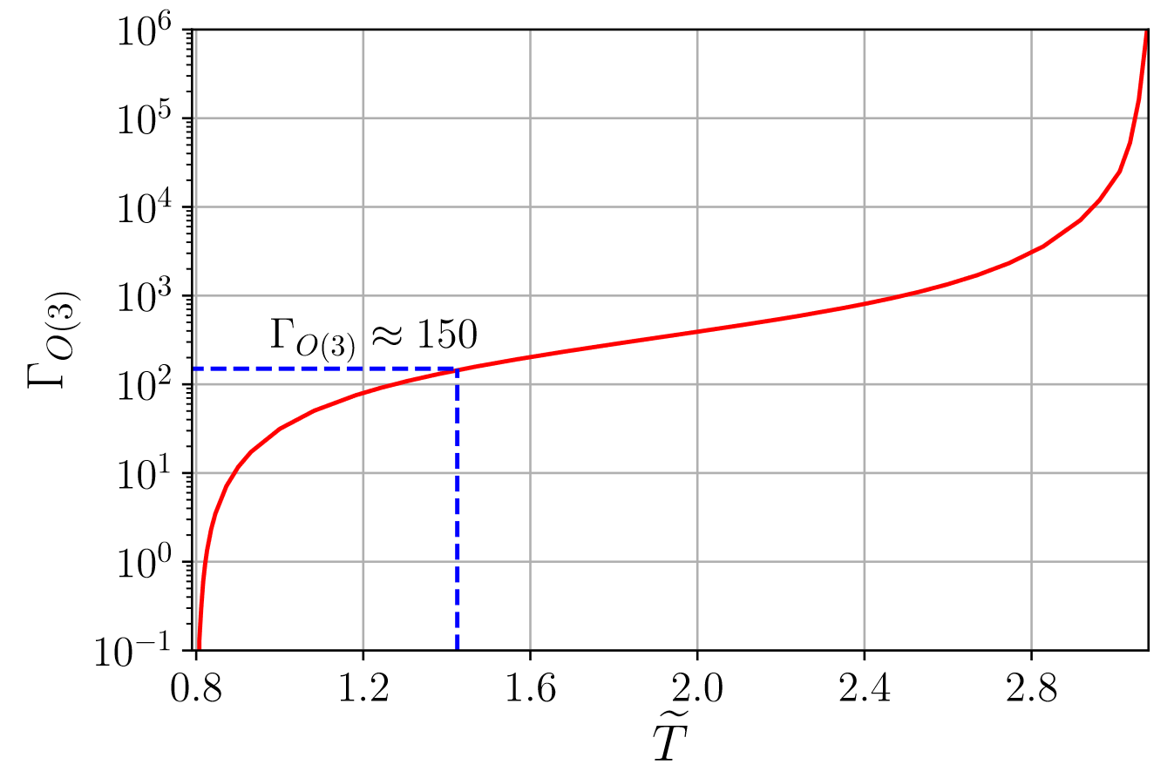
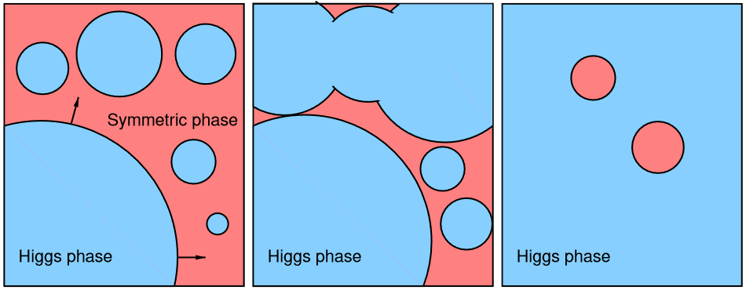
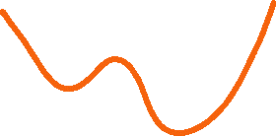

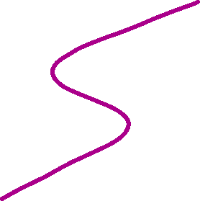





First-order transitions & bubble nucleation
Figure from Hindmarsh et al. 2008.09136
Callan, Coleman (‘77); Linde (‘81):
Find critical bubble from effective action
Bubble action gives nucleation rate →

Slide 6
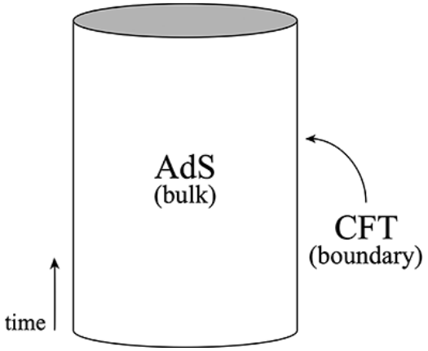
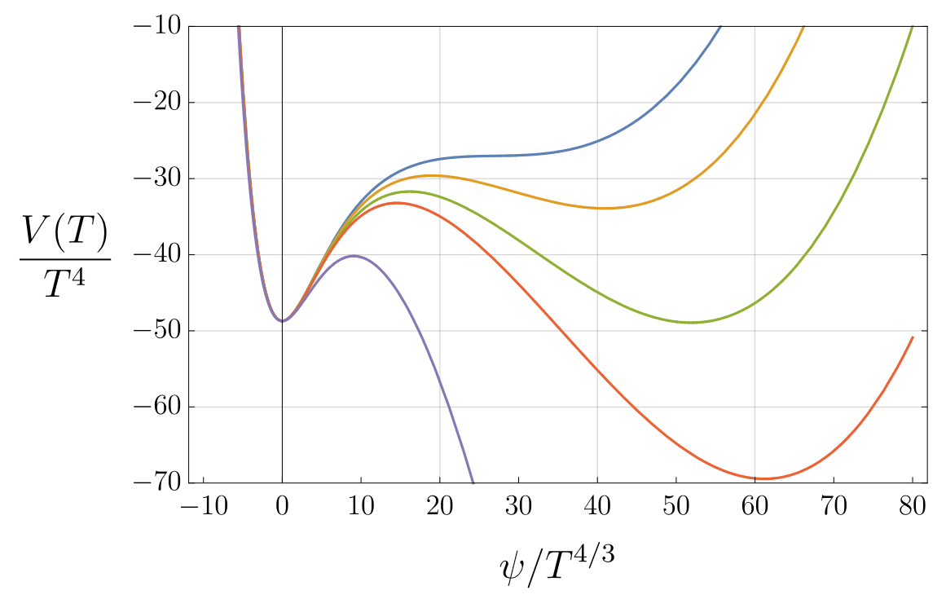
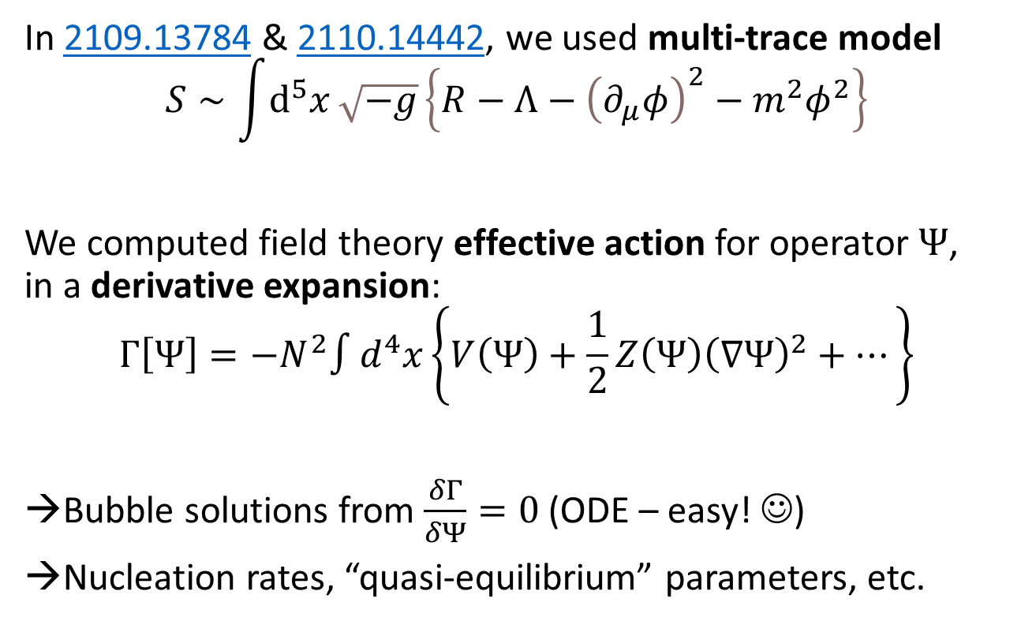
Bubbles in holographic theories
In 2109.13784 & 2110.14442, we used multi-trace model
$$S∼\int{ⅆ^{5}x}\sqrt{−g}\left\{R−Λ−{\left(∂_{μ}φ\right)}^{2}−m^{2}φ^{2}\right\}$$
We computed field theory effective action for operator $Ψ$,
in a derivative expansion:
$$Γ\left[Ψ\right]={−N}^{2}∫d^{4}x\left\{V\left(Ψ\right)+\frac{1}{2}Z\left(Ψ\right){\left(∇Ψ\right)}^{2}+…\right\}$$
Bubble solutions from $\frac{δΓ}{δΨ}=0$ (ODE – easy! ☺)
Nucleation rates, “quasi-equilibrium” parameters, etc.

Slide 7

What if bubble nucleation is suppressed?

Slide 8


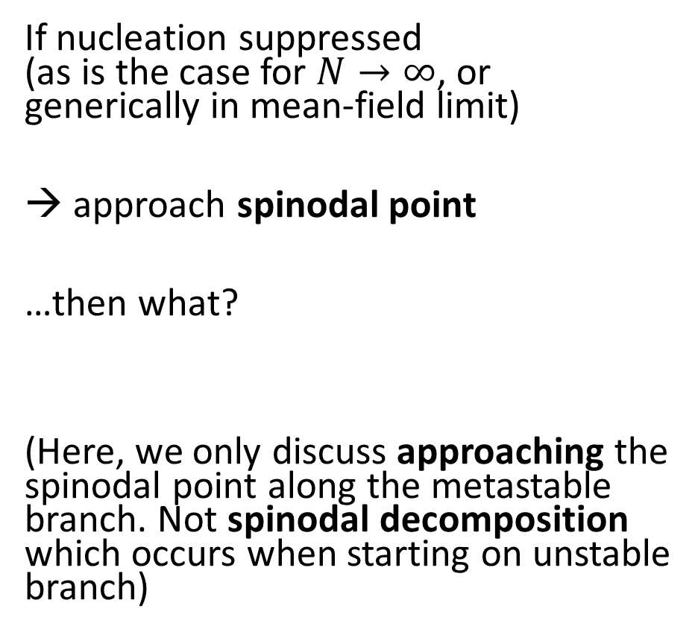


Spinodal approach
If nucleation suppressed
(as is the case for $N→∞$, or generically in mean-field limit)
→ approach spinodal point
…then what?
(Here, we only discuss approaching the spinodal point along the metastable branch. Not spinodal decomposition which occurs when starting on unstable branch)

Slide 9
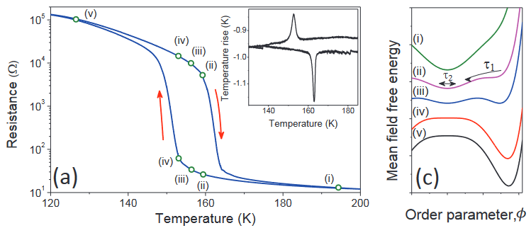
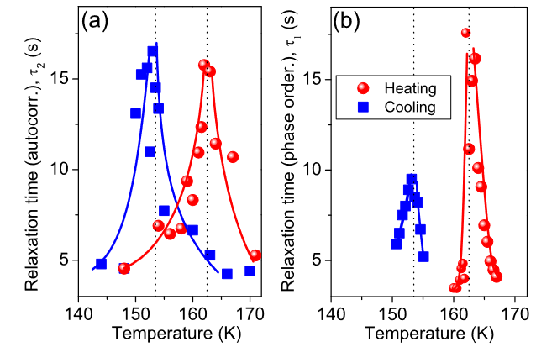
Spinodal & critical points
Spinodal points share similarities with second order critical points!
Susceptibilities diverge
Critical behavior, scaling
Effects of spinodals can be seen in cond-mat experiments!
e.g. Kundu et al. 2023 on V₂O₃

Slide 10


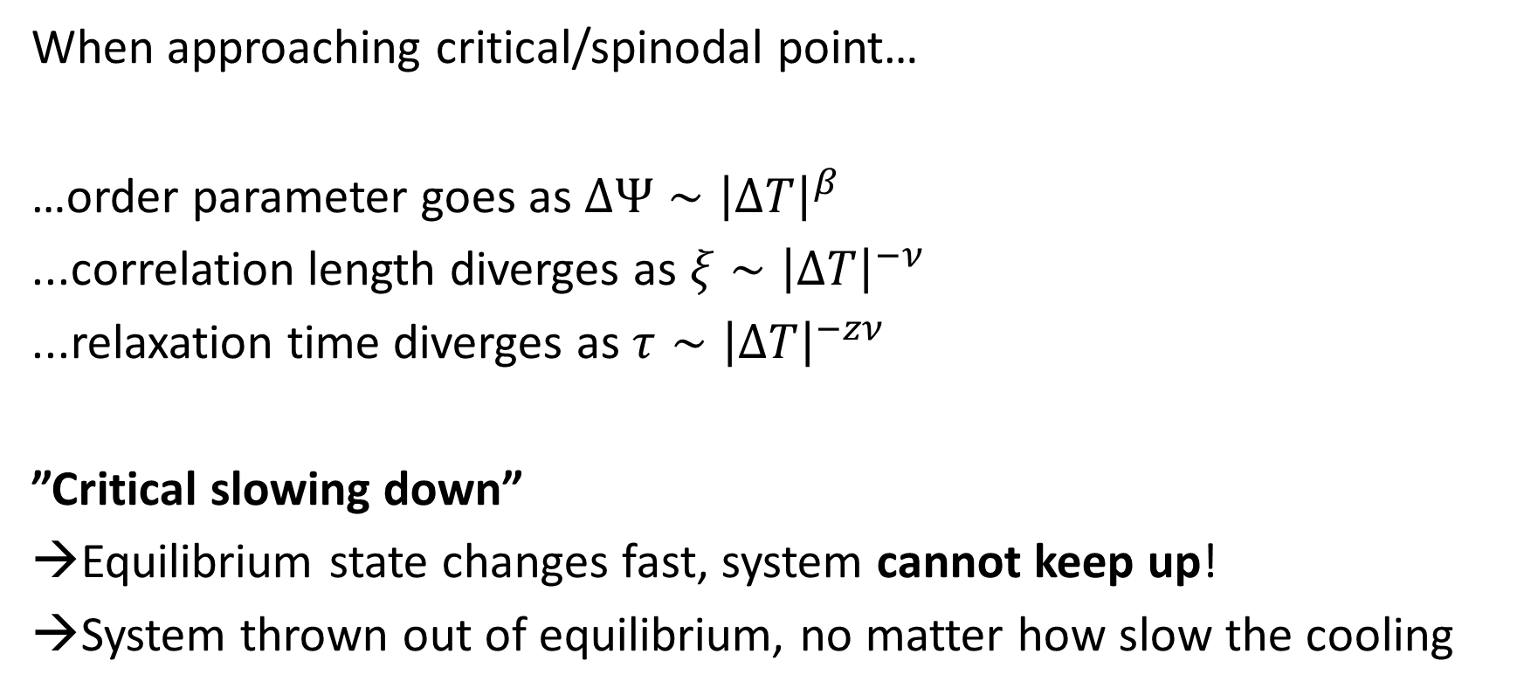

Spinodal & critical points
When approaching critical/spinodal point…
…order parameter goes as $ΔΨ∼{\left|ΔT\right|}^{β}$
...correlation length diverges as $ξ∼{\left|ΔT\right|}^{−ν}$
...relaxation time diverges as $τ∼{\left|ΔT\right|}^{−zν}$
”Critical slowing down”
Equilibrium state changes fast, system cannot keep up!
System thrown out of equilibrium, no matter how slow the cooling

Slide 11
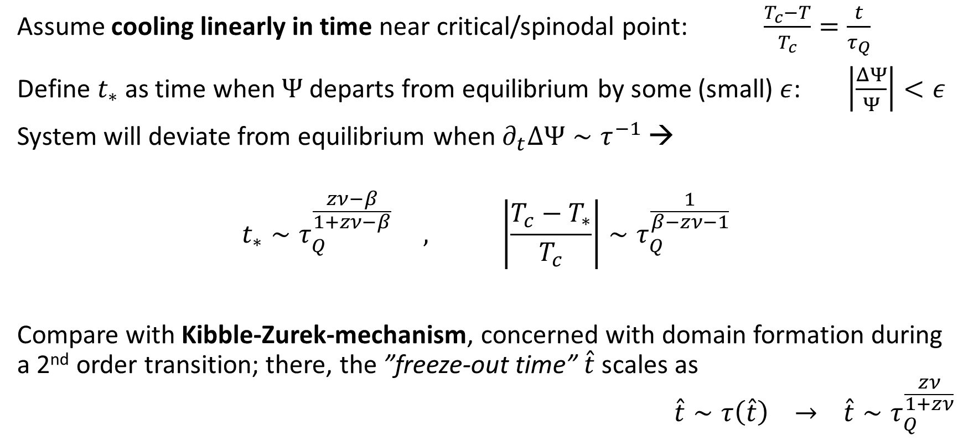
Spinodal & critical points
Assume cooling linearly in time near critical/spinodal point: $\frac{T_{c}−T}{T_{c}}=\frac{t}{τ_{Q}}$
Define $t_{∗}$ as time when $Ψ$ departs from equilibrium by some (small) $ε$: $\left|\frac{ΔΨ}{Ψ}\right|<ε$
System will deviate from equilibrium when $∂_{t}ΔΨ∼τ^{−1}$ →
$$t_{∗}∼τ_{Q}^{\frac{zν−β}{1+zν−β}} , \left|\frac{T_{c}−T_{∗}}{T_{c}}\right|∼τ_{Q}^{\frac{1}{β−zν−1}}$$
Compare with Kibble-Zurek-mechanism, concerned with domain formation during a 2nd order transition; there, the ”freeze-out time” $\hat{t}$ scales as
$$\hat{t}∼τ\left(\hat{t}\right) → \hat{t}∼τ_{Q}^{\frac{zν}{1+zν}}$$

Slide 12
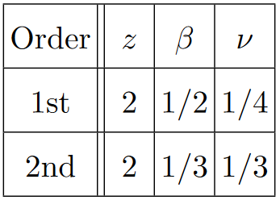
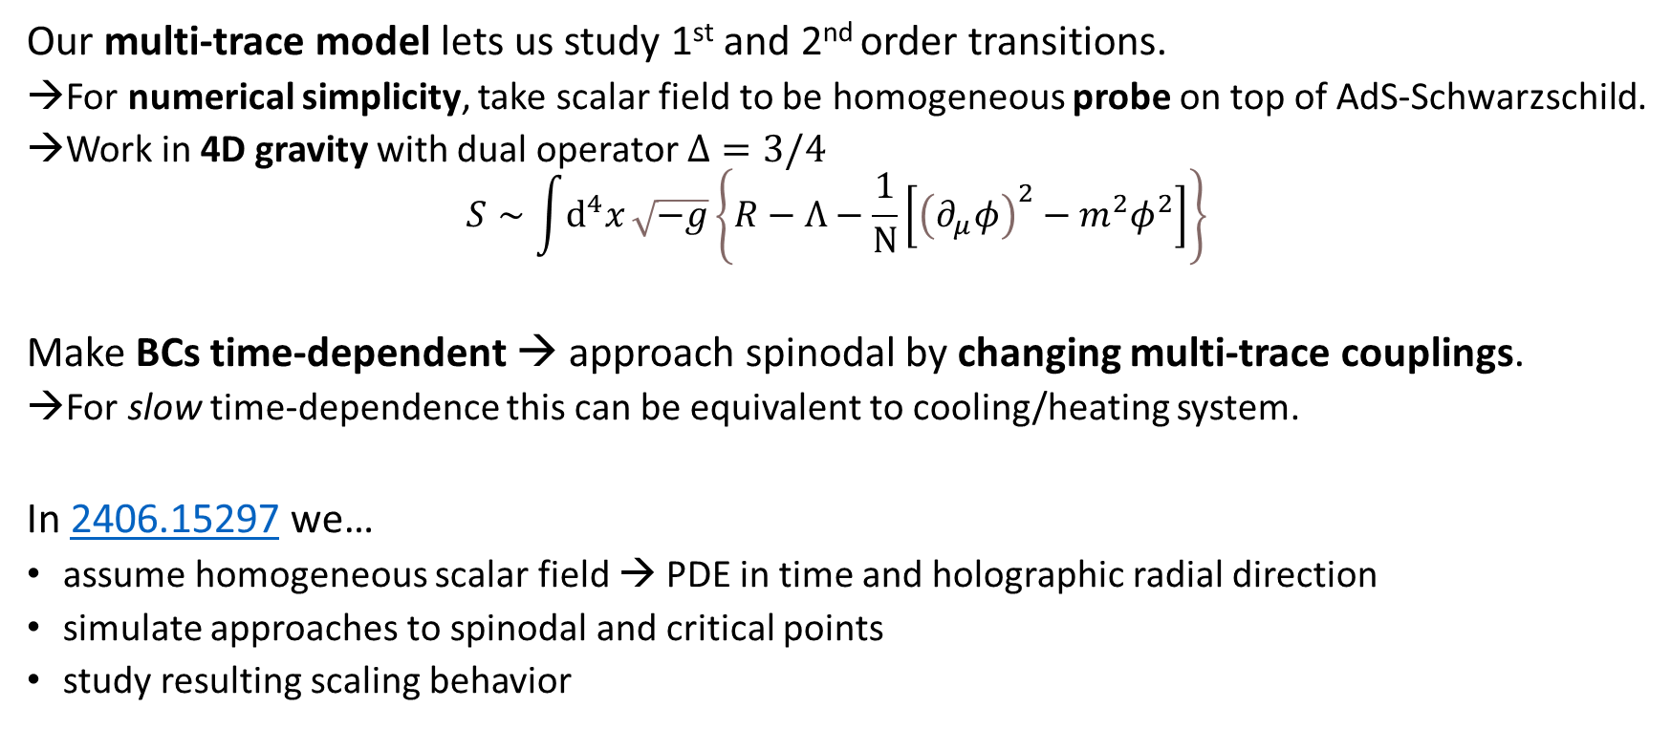
Approaching spinodal/critical point
Our multi-trace model lets us study 1st and 2nd order transitions.
For numerical simplicity, take scalar field to be homogeneous probe on top of AdS-Schwarzschild.
Work in 4D gravity with dual operator $Δ=3/4$
$$S∼\int{ⅆ^{4}x}\sqrt{−g}\left\{R−Λ−\frac{1}{N}\left[{\left(∂_{μ}φ\right)}^{2}−m^{2}φ^{2}\right]\right\}$$
Make BCs time-dependent → approach spinodal by changing multi-trace couplings.
For slow time-dependence this can be equivalent to cooling/heating system.
In 2406.15297 we…
assume homogeneous scalar field → PDE in time and holographic radial direction
simulate approaches to spinodal and critical points
study resulting scaling behavior

Slide 13
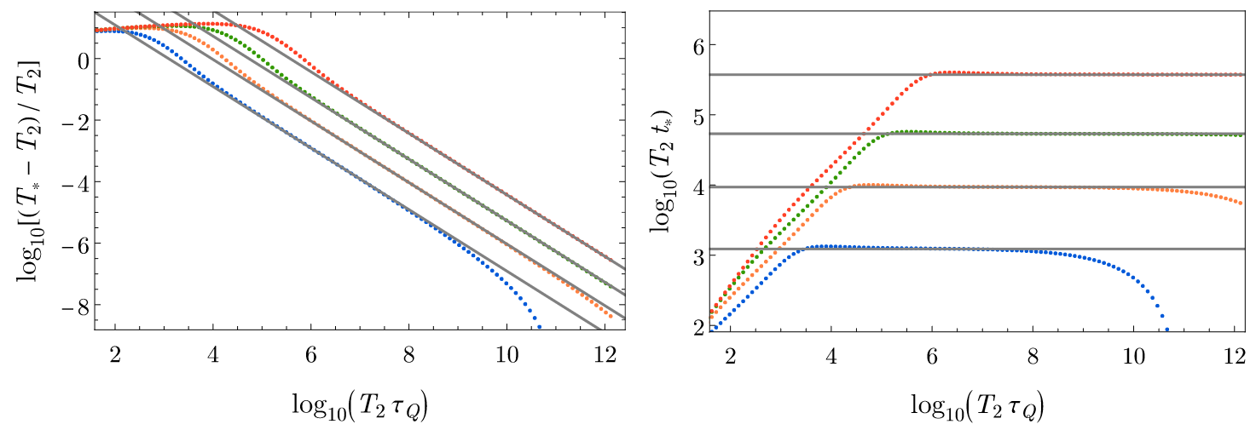

Numerical results – first-order transition
We find good agreement with predicted dynamic critical exponents!
$$\left|\frac{T_{c}−T_{∗}}{T_{c}}\right|∼τ_{Q}^{−1} , t_{∗}∼τ_{Q}^{0}$$

Slide 14
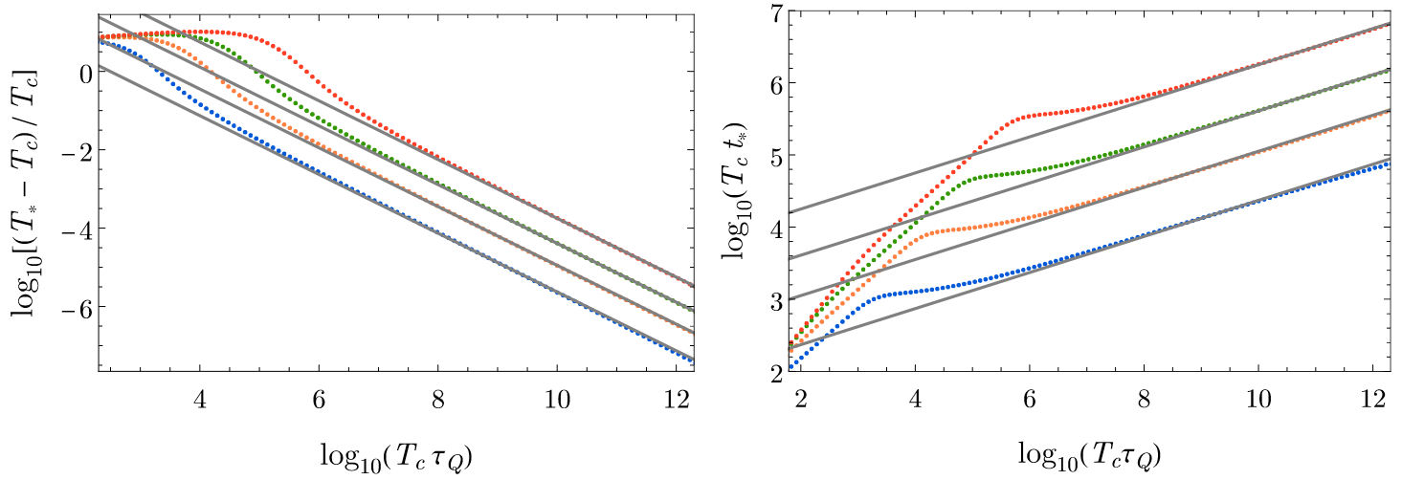

Numerical results – second-order transition
We find good agreement with predicted dynamic critical exponents!
$$\left|\frac{T_{c}−T_{∗}}{T_{c}}\right|∼τ_{Q}^{−3/4} , t_{∗}∼τ_{Q}^{1/4}$$

Slide 15
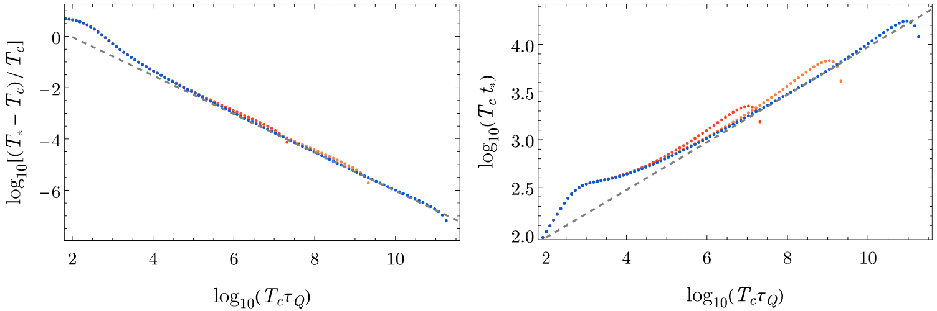
Strong crossover – traces of the critical point
At a strong crossover – close to a 2nd order critical point – we see traces of the critical exponents!

Slide 16
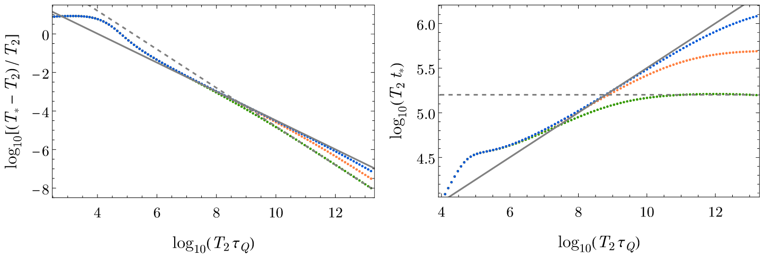
Weak first-order transitions
For weak first-order transitions – close to a 2nd order critical point – we see traces of both critical and spinodal exponents.

Slide 17
Summary
1st order PTs typically proceed through bubble nucleation
  Can treat in holography by computing QFT effective action in derivative expansion
When nucleation is supressed, approach spinodal point
  Critical phenomena similar to 2nd order transitions
  System ”thrown out of” equilibrium
  We derived and numerically studied dynamic critical exponents
  Also saw scaling for 2nd order transitions, crossovers
All this within a simple holographic model where multi-trace deformations tune phase structure
Much left to do! One example: add spatial dependence to probe model
  Study defect formation; compare with Kibble-Zurek
  Real-time simulations of nucleation

