Slide 1


An eye for an saturates the two-point functions
Vyshnav Mohan
University of Iceland

Slide 2


In collaboration with
Lárus Thorlacius
Friðrik Freyr Gautason
University of Iceland
University of Southampton

Slide 3
The discovery of AdS/CFT correspondence definitively resolved
the black hole information paradox

Slide 4
The discovery of AdS/CFT correspondence definitively resolved
the black hole information paradox
albeit in a rather trivial way.

Slide 5

[Maldacena 97]
Quantum Gravity in AdS
[Witten 98]
[Gubser et al. 98]
CFT

Slide 6
[Maldacena 97]
Quantum Gravity in AdS
[Witten 98]
[Gubser et al. 98]
CFT
Unitary

Slide 7
[Maldacena 97]
Must be Unitary!
Quantum Gravity in AdS
[Witten 98]
[Gubser et al. 98]
CFT
Unitary

Slide 8
[Maldacena 97]
Must be Unitary!
Quantum Gravity in AdS
[Witten 98]
[Gubser et al. 98]
CFT
Unitary
Fine-grained information is preserved in the bulk

Slide 9
[Susskind Thorlacius Uglum 93]
The principle of black hole complementarity helps us understand the semiclassical limit.

Slide 10
[Susskind Thorlacius Uglum 93]
The principle of black hole complementarity helps us understand the semiclassical limit.
For “simple” observers, QFT on the black hole background is a good enough description.
Quantities that probe the finer structure of the bulk quantum gravity Hilbert space require us to go beyond perturbation theory around the black hole spacetime.

Slide 11
2pt functions in TFD

Slide 12
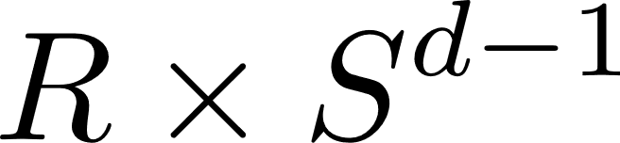


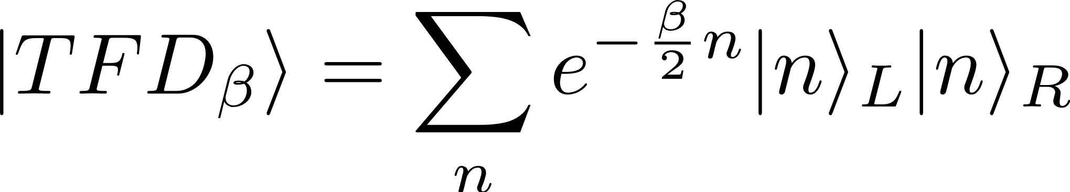
2pt functions in TFD
Thermofield double state (TFD)

Slide 13
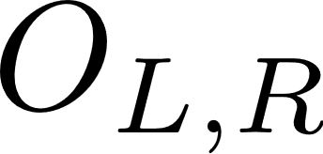

2pt functions in TFD
Let be operators of scaling dimension . We can define two-sided two-point function as follows:

Slide 14
The 2pt functions, at late times, oscillate erratically around a constant value.

Slide 15

The 2pt functions, at late times, oscillate erratically around a constant value.
In the coarse-grained, semiclassical limit, the 2pt functions generically decay exponentially!
The exponential decay is closely related to the existence of a black hole in the dual bulk relation.
Decay rate
Quasi-normal modes

Slide 16
The 2pt functions, at late times, oscillate erratically around a constant value.
In the coarse-grained, semiclassical limit, the 2pt functions generically decay exponentially!
The exponential decay is closely related to the existence of a black hole in the dual bulk relation.
Decay rate
Quasi-normal modes
Maldacena’s Information Paradox
[Maldacena 01]

Slide 17
Corrected Semiclassical limit

Slide 18
Corrected Semiclassical limit
Black holes are chaotic objects.
The emergence of chaos requires the energy levels to display level repulsion, and coarse-graining over states removes this information.
We can fix this by treating the semiclassical limit as a random matrix theory (RMT).
[Shenker Stanford 13]
[Cotler et al. 16]
[Maldacena et al. 15]
[McDonald Kaufman 79]
[Berry 81]
[Bohigas et al. 84]

Slide 19
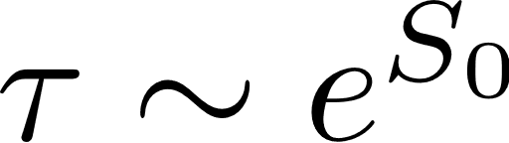
When we add the universal RMT corrections, called the sine-kernel, the 2pt functions stops decaying and saturates to a constant!
The saturation occurs at .

Slide 20

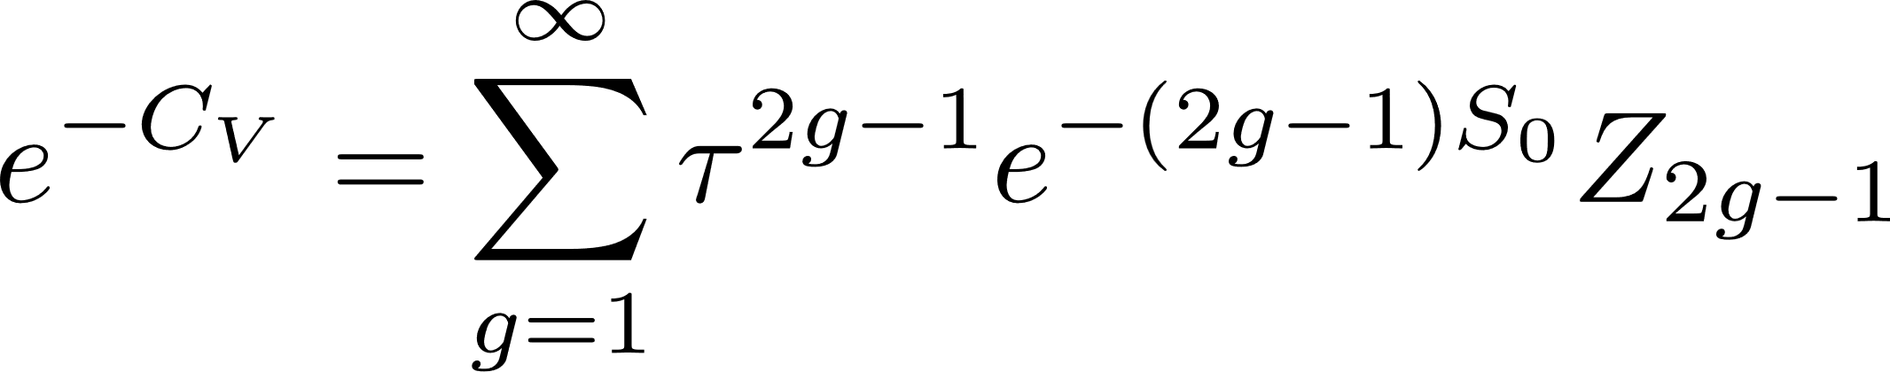
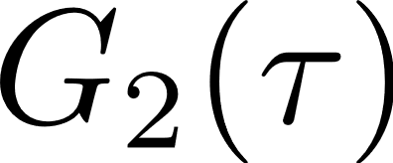
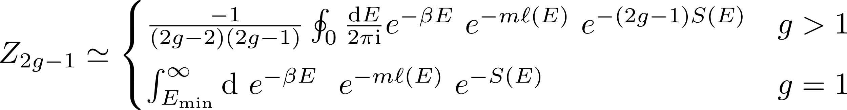
Late-time Expansion
Let us zoom in on the saturation by taking the limit:
We find that
where
scaling limit

Slide 21
Can we reproduce this series from a bulk calculation?

Slide 22
Bulk calculation reduces to a geodesic calculation!

Slide 23
Geodesics in JT
(d=1 case)

Slide 24
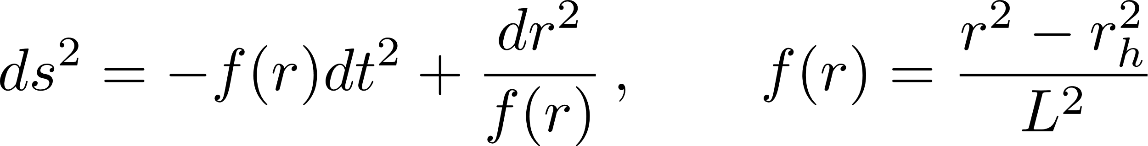
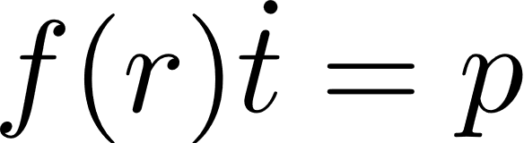

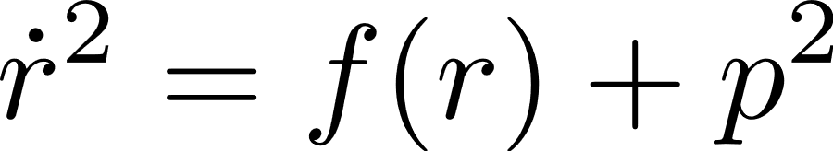

Geodesics in JT
(d=1 case)
The metric is given by
The geodesic equations are given by
The dot is w.r.t. the proper time along the curve.
Conserved quantity

Slide 25
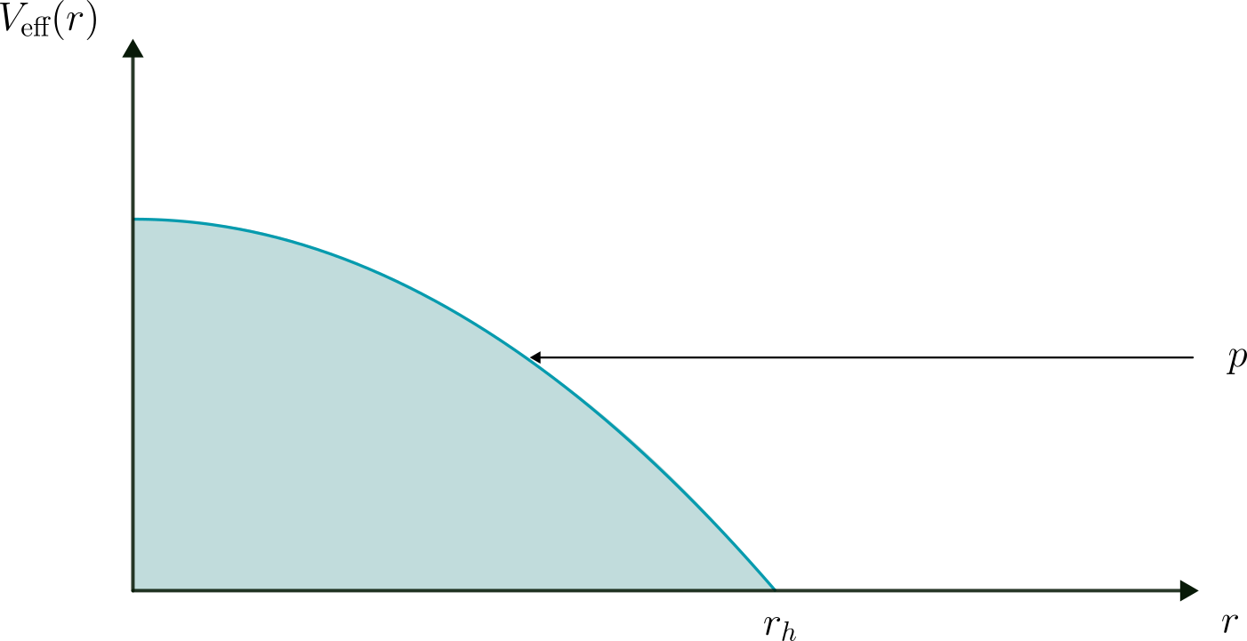

Slide 26
Quantizing the geodesics

Slide 27
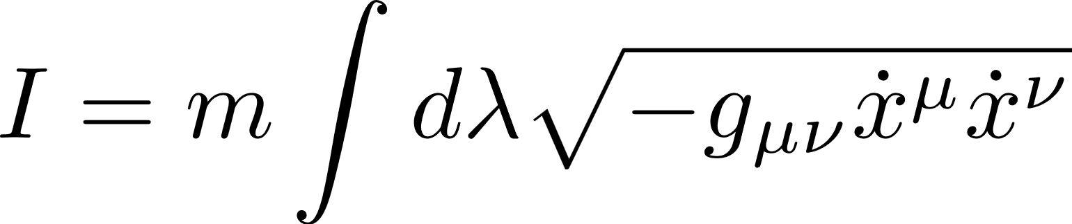
Quantizing the geodesics
We can study the geodesics by treating it as a 2d particle with the action
Note that the action is imaginary for spacelike geodesics.

Slide 28
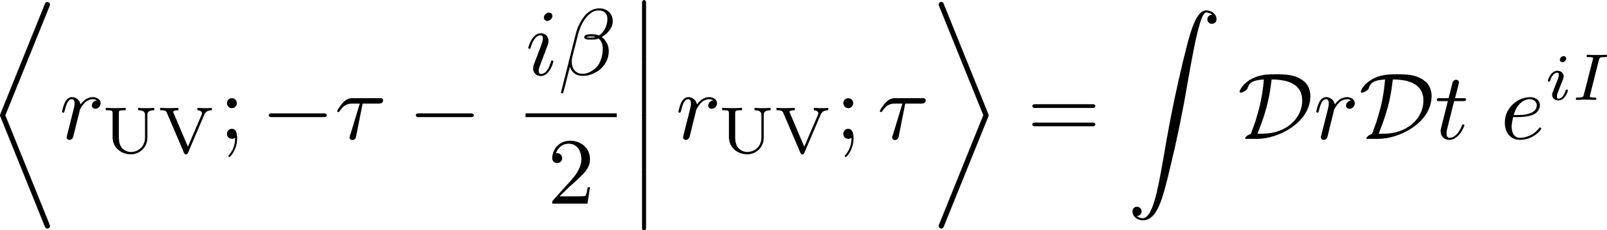
Let us look at the boundary-to-boundary propagator of this particle:

Slide 29
Let us look at the boundary-to-boundary propagator of this particle:
In the semiclassical approximation, we can evaluate the path integral using a saddle point approximation.

Slide 30

Let us look at the boundary-to-boundary propagator of this particle:
In the semiclassical approximation, we can evaluate the path integral using a saddle point approximation.
Only classical saddle points contribute
Propagator decays exponentially!

Slide 31
Constrained instantons
When we quantize the 2d particle, there will be a non-zero probability of the particle tunnelling through the effective potential.
The tunnelling solutions can be obtained by Wick rotating the proper time.

Slide 32
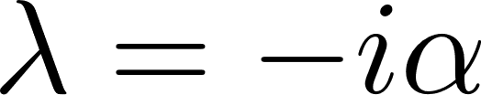
Wick rotating the proper time,
we get tunnelling solutions.
The solutions do not anchor to the cutoff surface in the asymptotic region!

Slide 33
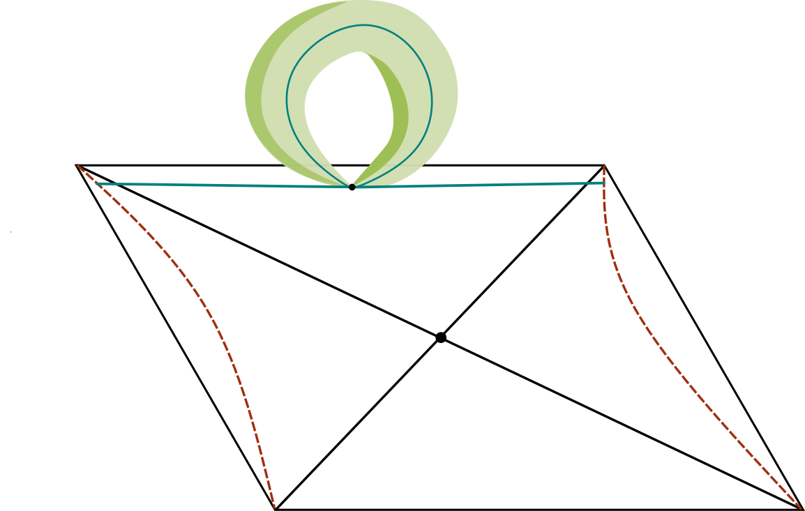

Slide 34

Baby universe emission

Slide 35
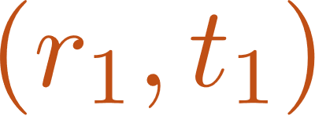
Labelled by the location of the junction

Slide 36
1- instanton

Slide 37
These configurations are called constrained instantons.
These configurations can be shown to contribute to the path integral by the insertion of a constraint.
[Affleck 1981]

Slide 38
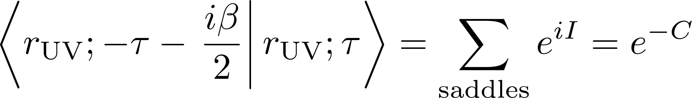
Semiclassical propagator
In the semiclassical limit, we have

Slide 39
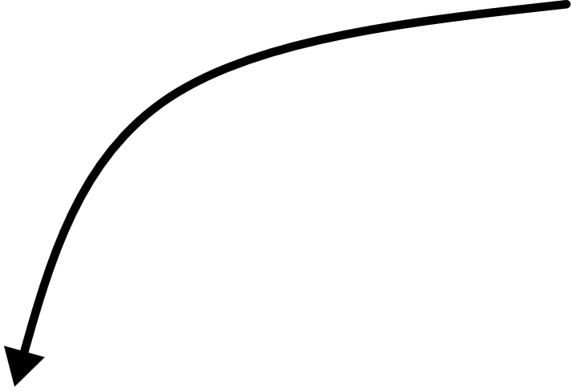
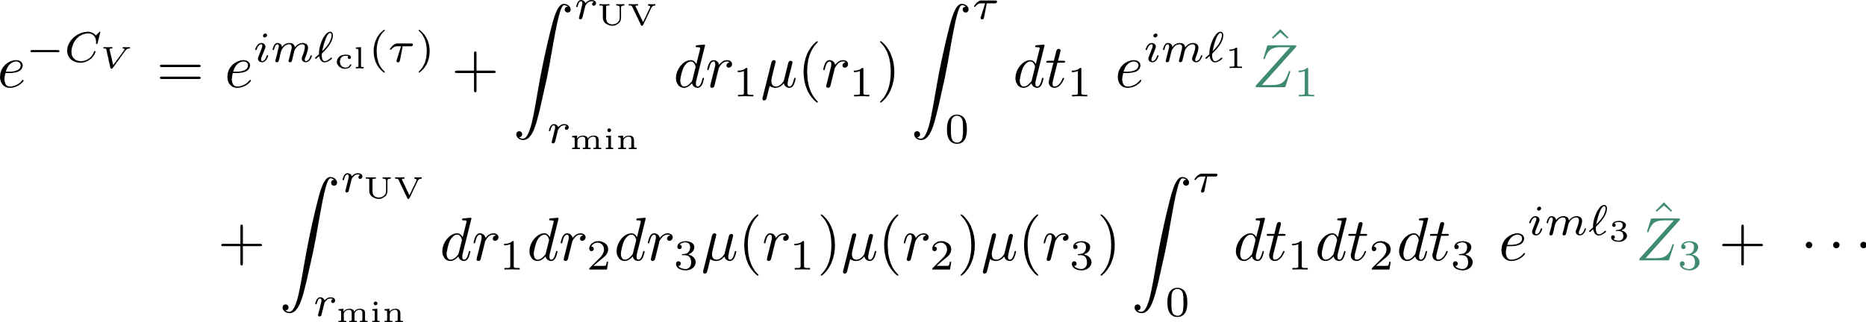
Semiclassical propagator
In the semiclassical limit, we have
Plugging in everything we get
One-loop fluctuations around the solution

Slide 40

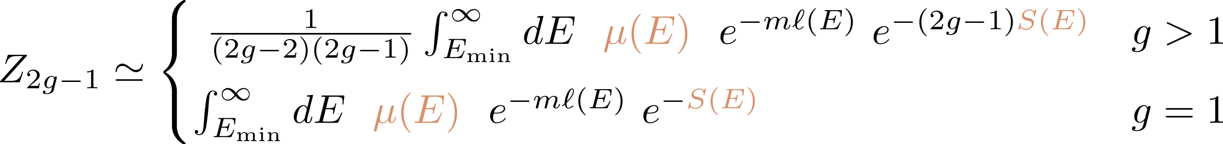
Massaging the expression, and taking the -scaling limit, we get
with

Slide 41
Relation to Schwinger effect
[Schwinger 51]
Increasing the electric field E results in the unsuppressed production of e⁻e⁺ pairs
The boundary time plays the role of E and the baby universes play the role of the e⁻e⁺ pair.
Worldline Instantons
[Dunne Schubert 05]

Slide 42
Discussion
The calculation will go through in higher dimensions.
We have found a systematic way of including baby universe/ higher topology corrections that works in any theory of gravity.

Slide 43
Thank you for listening!

Slide 44
Backup Slides

Slide 45

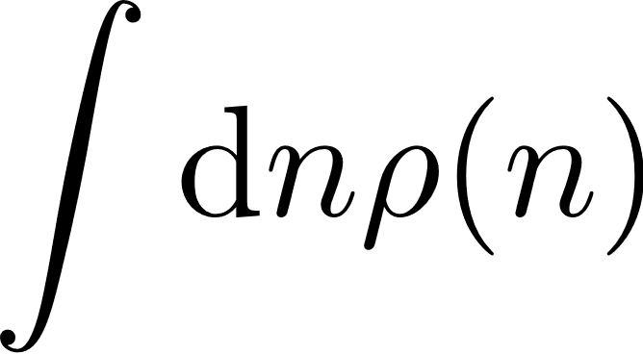


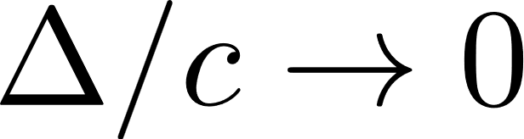
The 2pt functions, at late times, oscillate erratically around a constant value.
In the coarse-grained semiclassical limit, we have
and
, with

Slide 46
In the limit:
The density of states picks up the following universal correction.
scaling limit
Sine-kernel

Slide 47
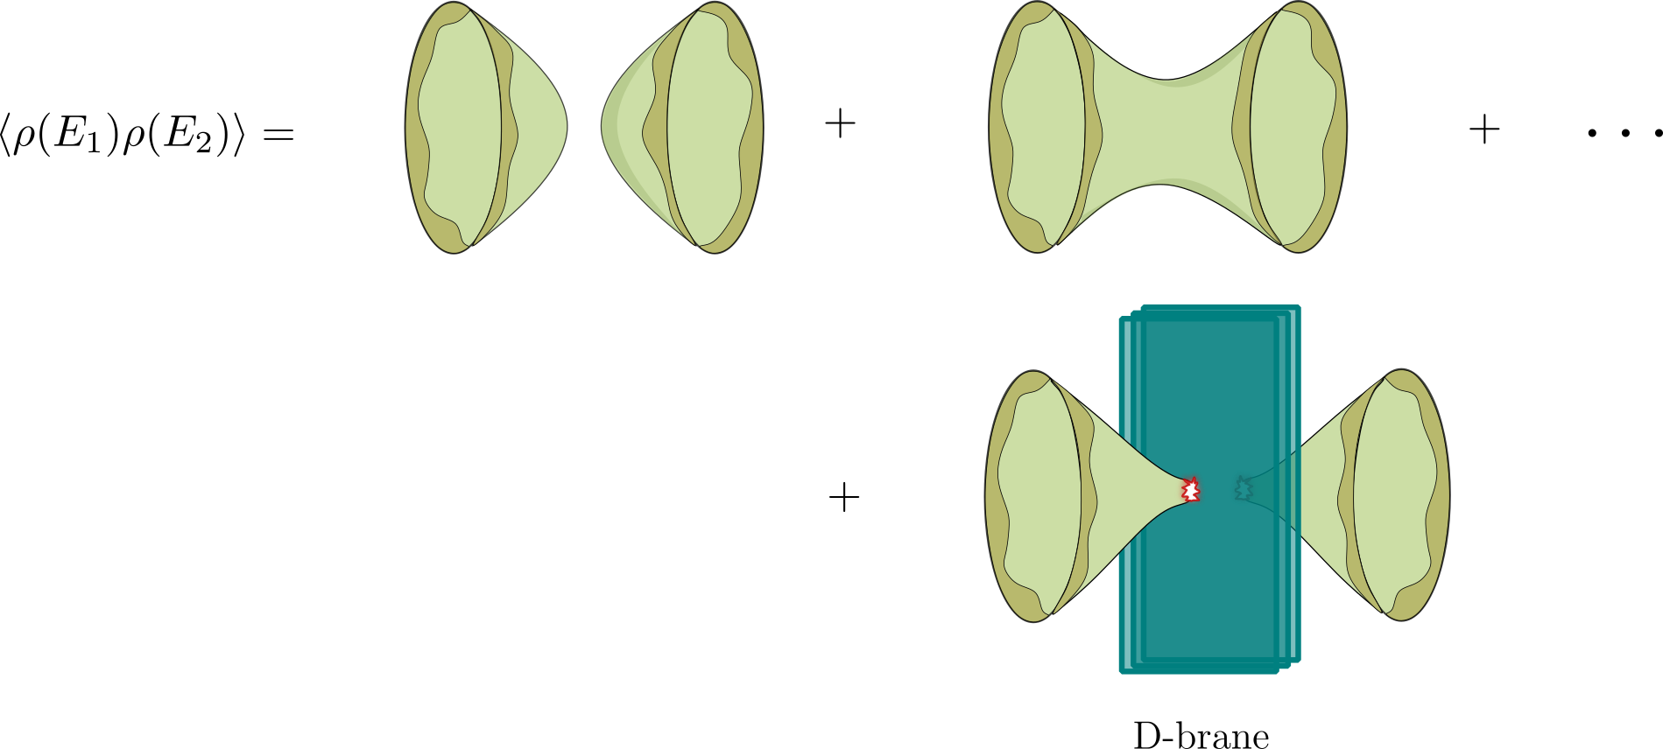
JT gravity
Let us look at the d=1 case. The bulk theory reduces to JT gravity. Using the explicit matrix model description, we have

Slide 48
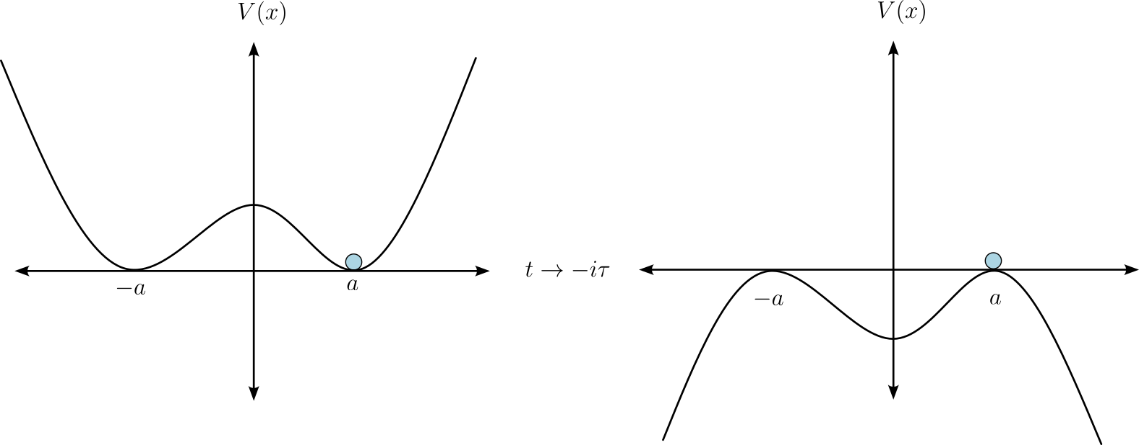
[Coleman 1977]
[Callan, Coleman 1977]

Slide 49
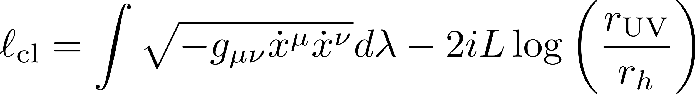
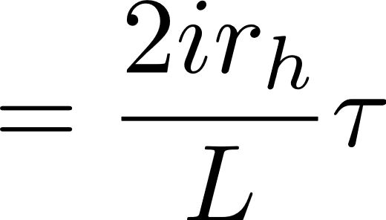

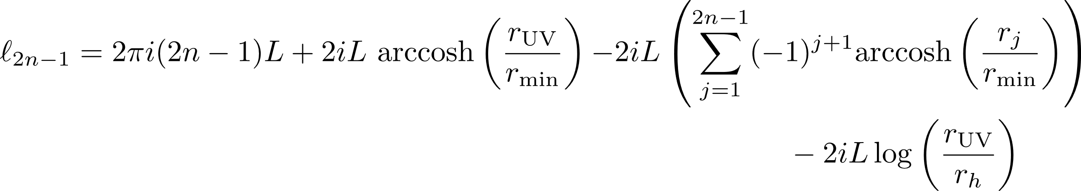
Length of trajectories
The classical geodesics have the length
The (2n-1)-instanton will have the length
Independent of

Slide 50
These hybrid configurations are not true saddle points of the length functional.
These configurations are called constrained instantons.
These configurations can be shown to contribute to the path integral by the insertion of a constraint.
QFT
Gravity
Cosmology
[Affleck 1981]
[Frishman Yankielowicz 1979]
[Cotler Jensen 2020]
[Hawking Turok 1998]

Slide 51
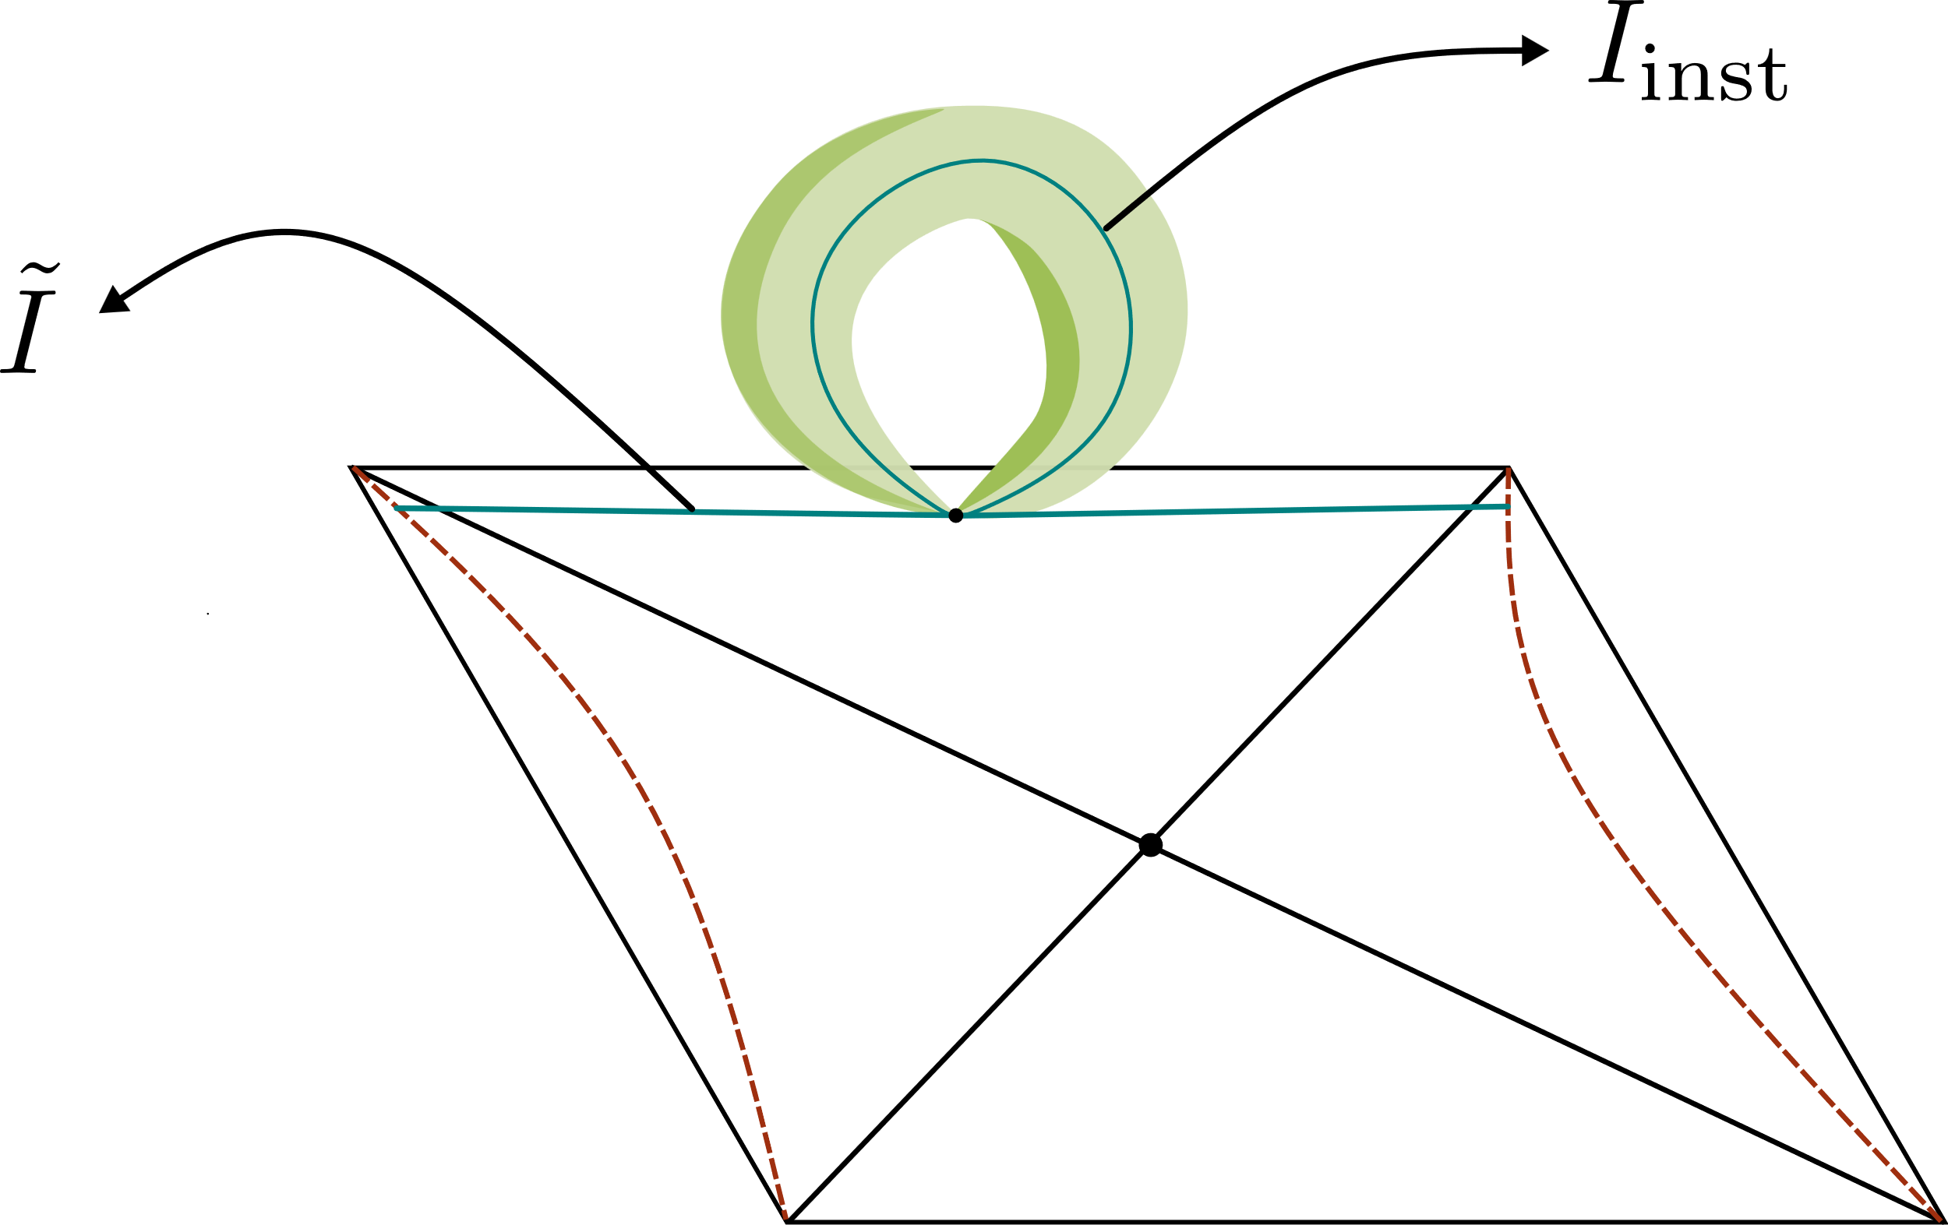
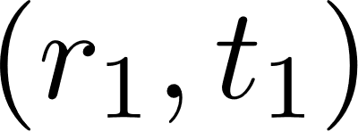
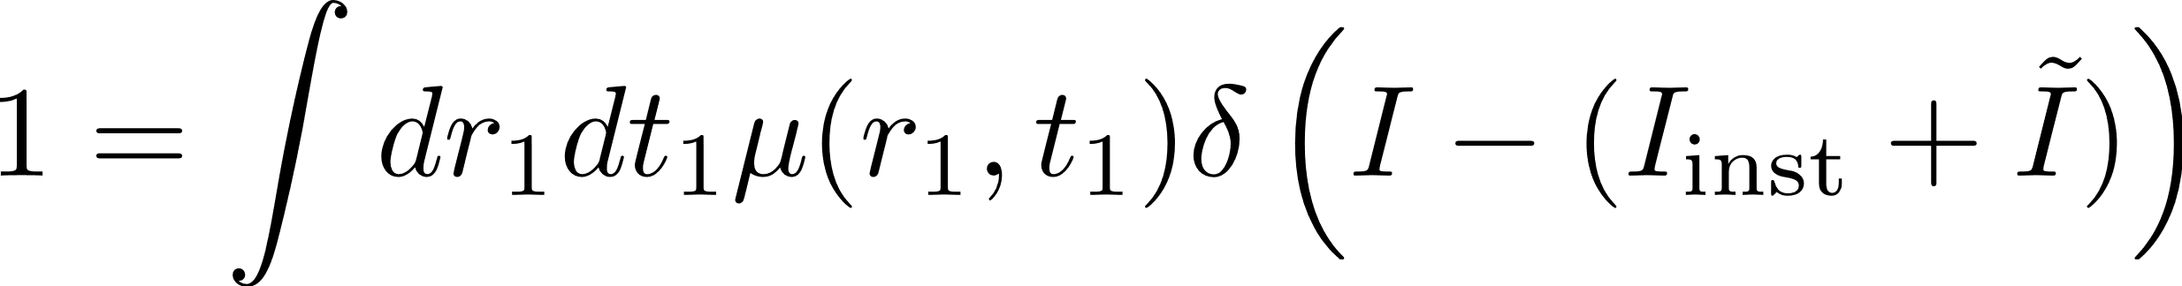
Picking up constrained instantons
Consider two points in the Penrose diagram symmetric w.r.t the t=0 line. We will label these points by .
We can resolve the identity as follows

Slide 52
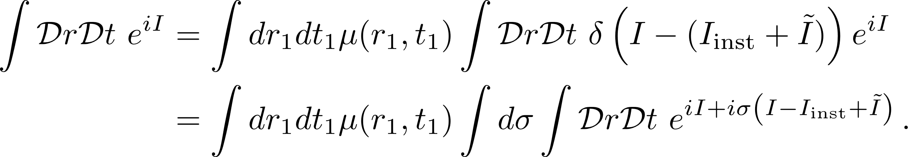

Inserting this into the path integral, we get
Let us look at the saddle points of the new path integral. When we vary all the parameters, we will get the equation
However, if we keep fixed and vary the remaining parameters, we obtain our hybrid instanton configurations.

