Slide 1

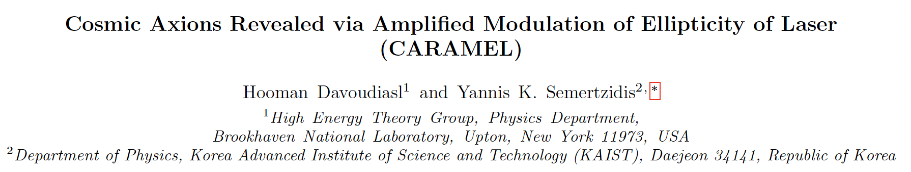
Toward Quantum-Limited Axion Detection: A Mitigation Strategy
Yannis K. Semertzidis, KAIST
Axions in Stockholm, Nordita, Stockholm, Sweden
June 23 to Jully 11, 2025
July 1, 2025
“Cosmic Axions Revealed via Amplified Modulation of Ellipticity of Laser (CARAMEL),”
Based on EO detection of the axion induced electric field in microwave cavity plus probing
A new approach to reading out axion haloscopes could increase the axion frequency scanning rate by more than an order of magnitude, enabling its detection or exclusion in less than five years (axions after inflation).

Slide 2
Major recent breakthroughs in axion dark matter research
Josephson parametric amplifiers with noise near quantum limit
High field, large volume magnets
Large volume cavities cooled to <30mK
New resonating geometries/concepts: high frequency resonances made available for large volume microwave cavities
High quality factors at high magnetic fields using HTS tapes
CAPP contributed to all of the above successes (yes, the field is ready for large scale effort).
Nonetheless, we still need a few decades to completely cover all interesting frequencies at DFSZ sensitivities.
With CARAMEL, we aim to help reach better than DFSZ sensitivity with less than 3s integration time per step. Covering interesting range in <5 years.

Slide 3
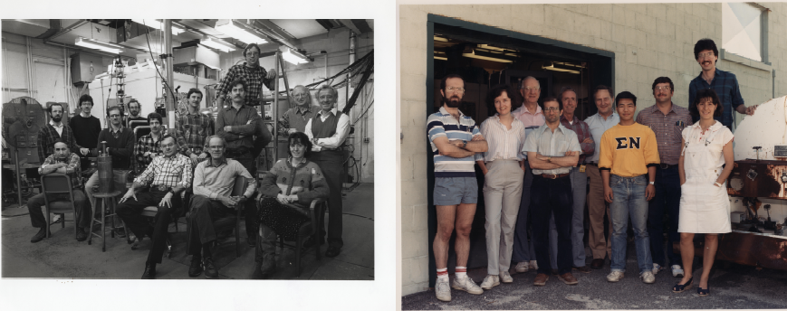
Rochester Brookhaven Fermilab axion dark matter search
The RBF-dark matter axion group, circa 1990
Under the leadership of Adrian C. Melissinos (Rochester), 1929-2022, a daring pioneer, full of energy, a great teacher.

Slide 4
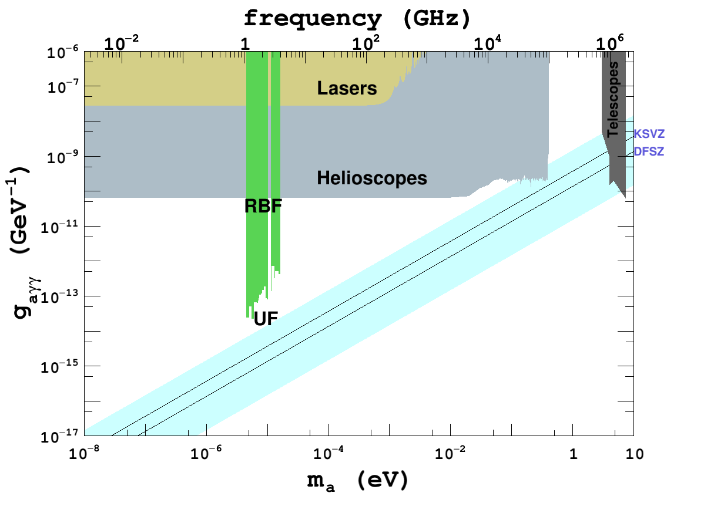
First haloscope limits:
Rochester, Brookhaven, Fermilab.
Then
University of
Florida

Slide 5
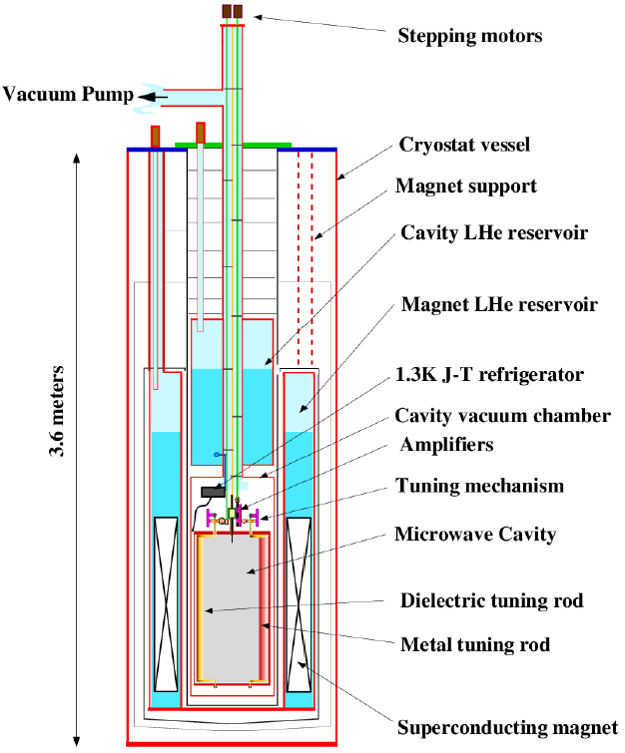
Axion Dark Matter eXperiment
Cryogenics (0.1K)
Superconducting magnet (>7.5 T)
Large volume cavity (140l)
Low noise amplifiers
  From 12K to 1K
  Currently SQUID and JPA (<1K)

Slide 6
Axion dark matter reviews

Slide 7
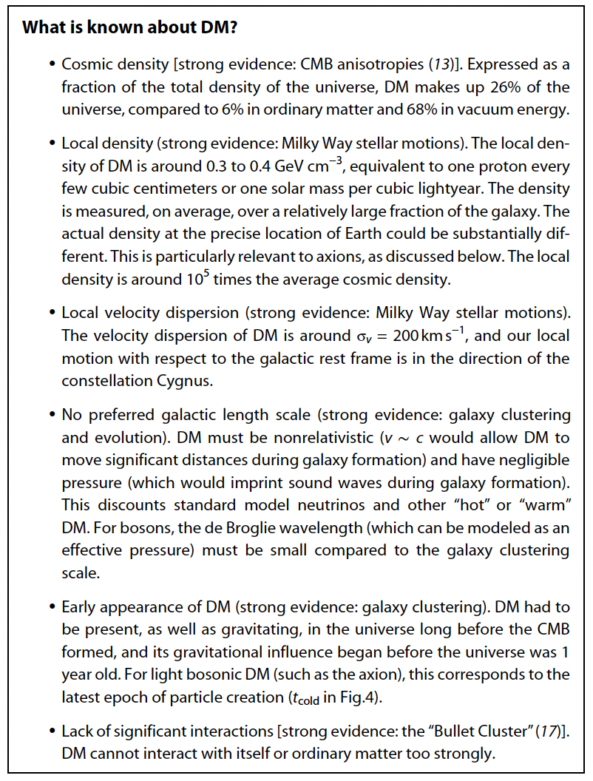
Axion dark matter review articles, theory and experiments
Axion dark matter: What is it and why now?
By Francesca Chadha-Day, John Ellis,
David J.E. Marsh, Sci. Adv. 8, eabj3618 (2022)
Axion dark matter: How to see it?
By YkS and SungWoo Youn, Sci. Adv. 8, eabm9928 (2022)
What can solve the Strong CP problem?
By David E. Kaplan, Tom Melia, Surjeet Rajendran, arXiv: 2505.08358

Slide 8
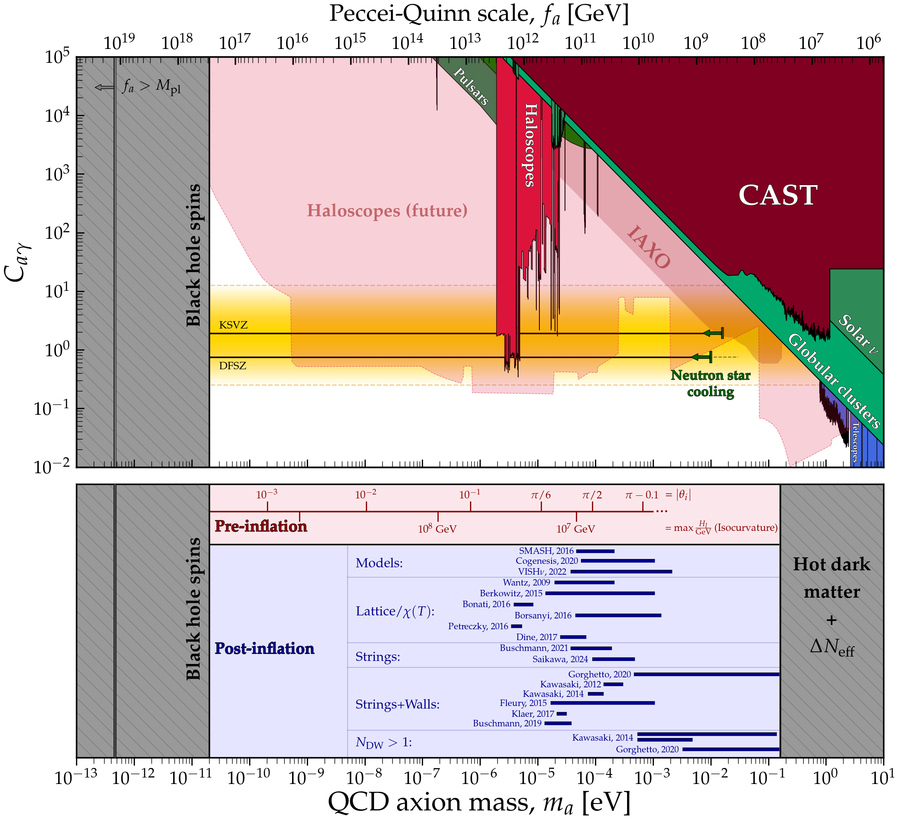
Axion mass predictions
C. O’Hare, cajohare/axionlimits: https://cajohare.github.io/AxionLimits/
Lattice QCD recently became more
powerful, see, e.g., muon g-2 hadronic
correction (still needs to be confirmed).

Slide 9
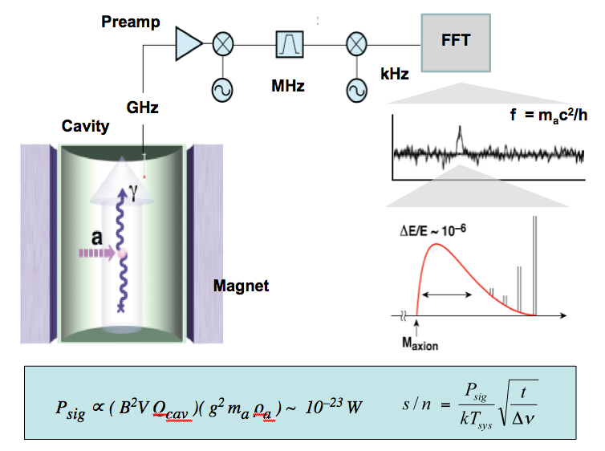
Haloscope method method suggested by Pierre Sikivie (1983)

Slide 10
State of the art axion haloscopes
The ability to scan fast depends on B-field, Volume, Temperature, and Q₀
Most sensitive method
Running Haloscope
Experiments:
CAPP→DMAG
ADMX
HAYSTAC

Slide 11
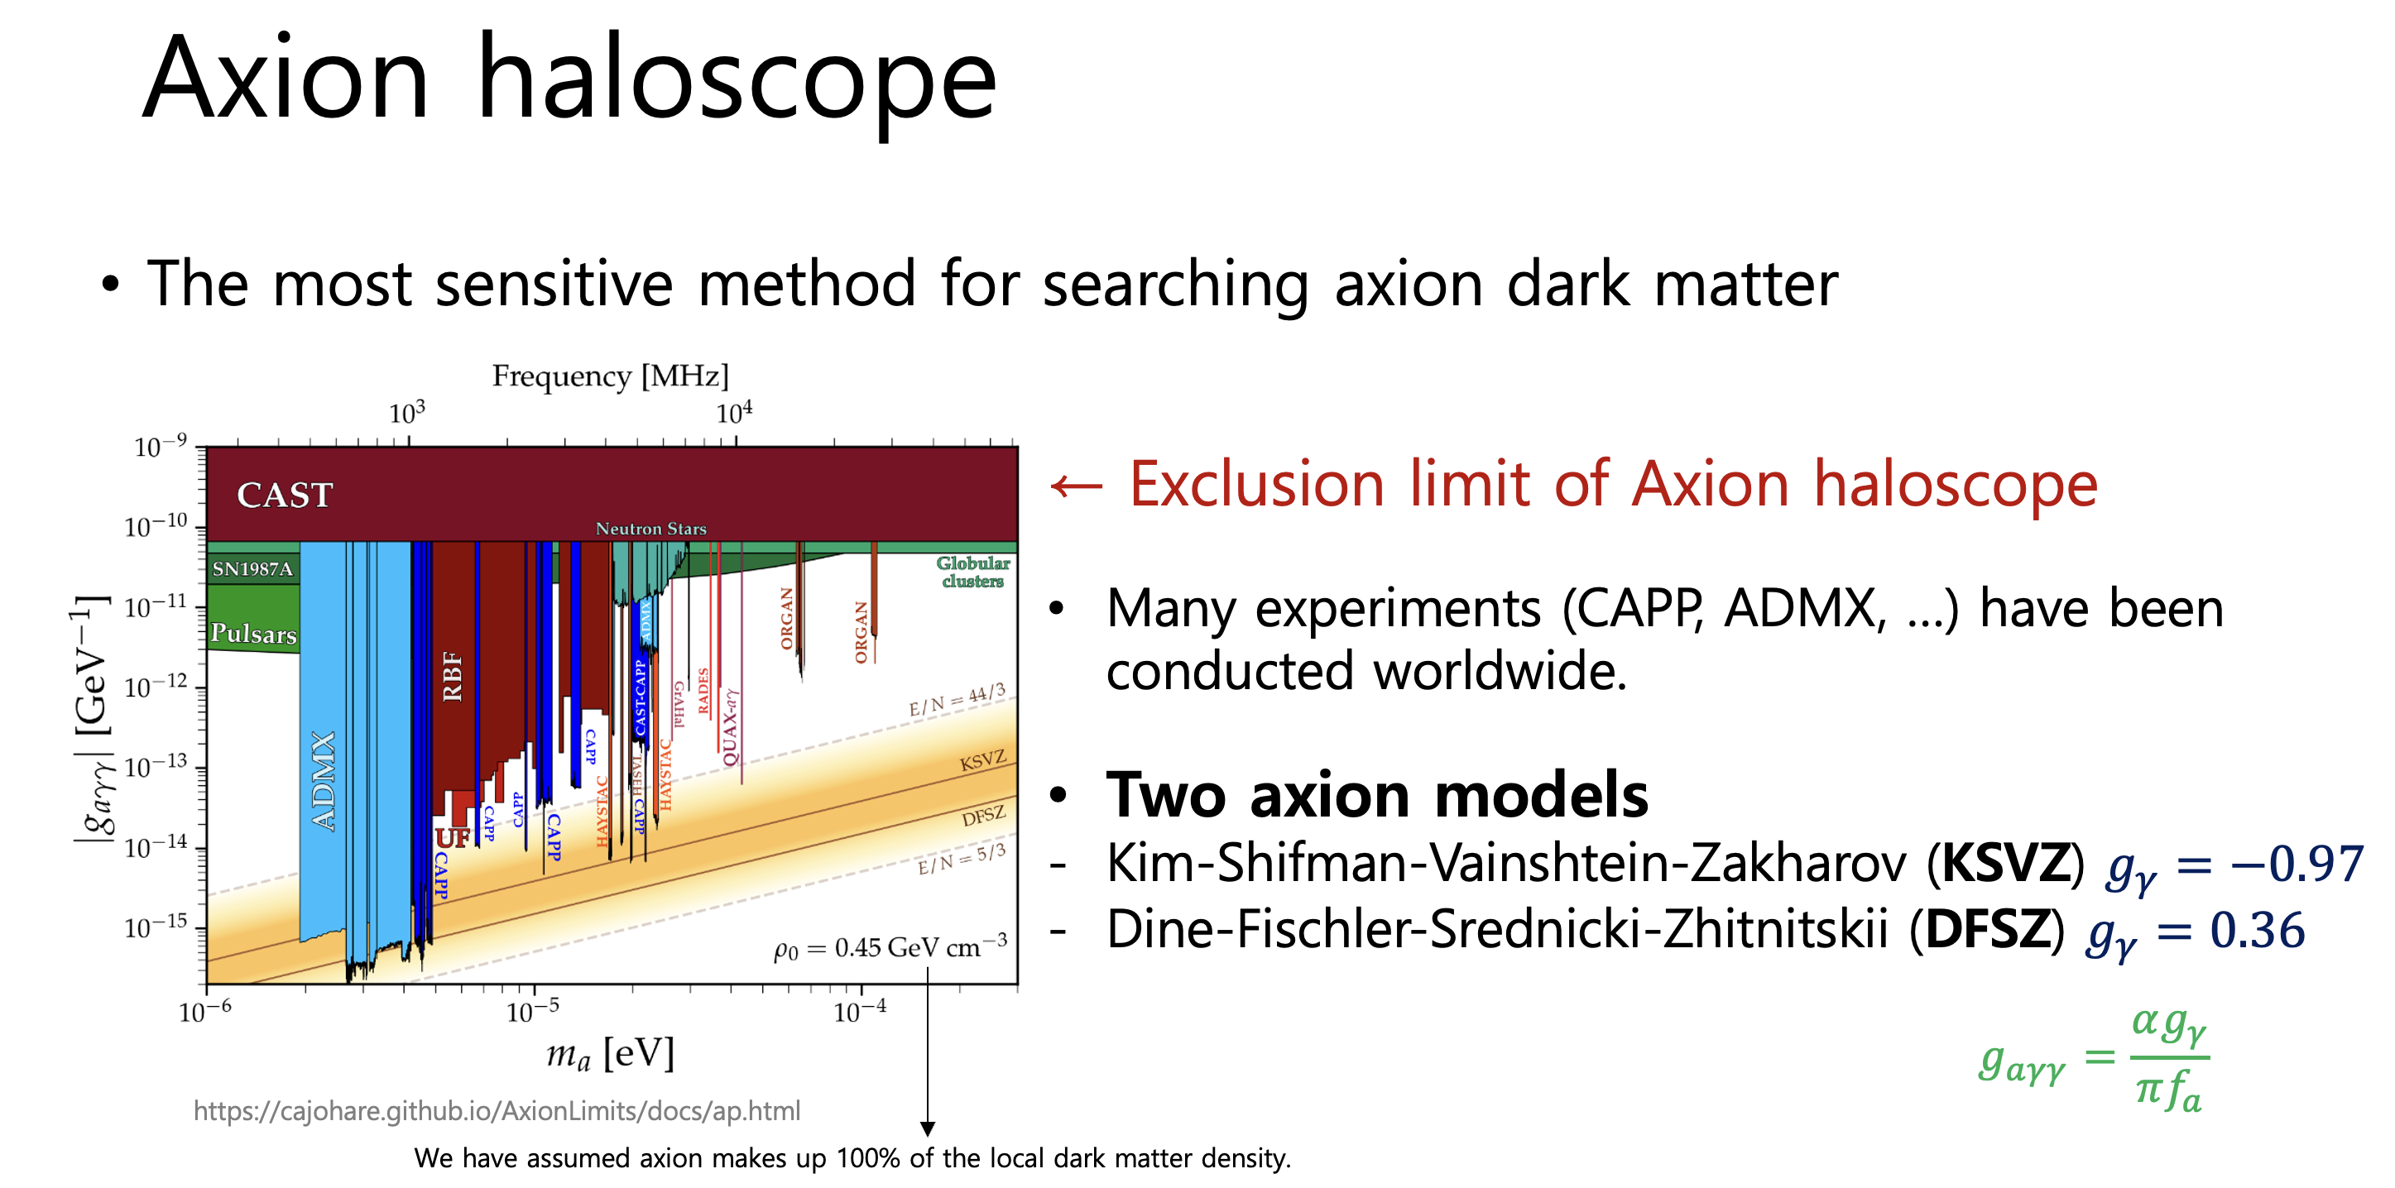
Limits in medium axion frequencies (up to 2024)
Slide by Jiwon Lee,
KAIST, PhD work (ongoing)

Slide 12
Major activities
ADMX (UW, microwave cavity)
HAYSTAC (Yale, microwave cavity)
IBS/CAPP→DMAG (CULTASK, multiple microwave cavities, 1-10GHz)
ORGAN (UWA, high frequency)
QUAX (INFN, microwave cavity)
KLASH (Large volume magnet in Frascati, microwave cavity)
MADMAX (DESY, dielectric interfaces)
ALPHA (Sweden, plasmonic resonance)
BabyIAXO (DESY, axion helioscope)
ALPs (DESY, coupled FP resonators)
CAST-CAPP (CERN, rectangular cavities-TE modes)
GrAHol-CAPP/DMAG (large volume magnet)
Dark Matter RADIO and many more, new exciting experiments…!

Slide 13
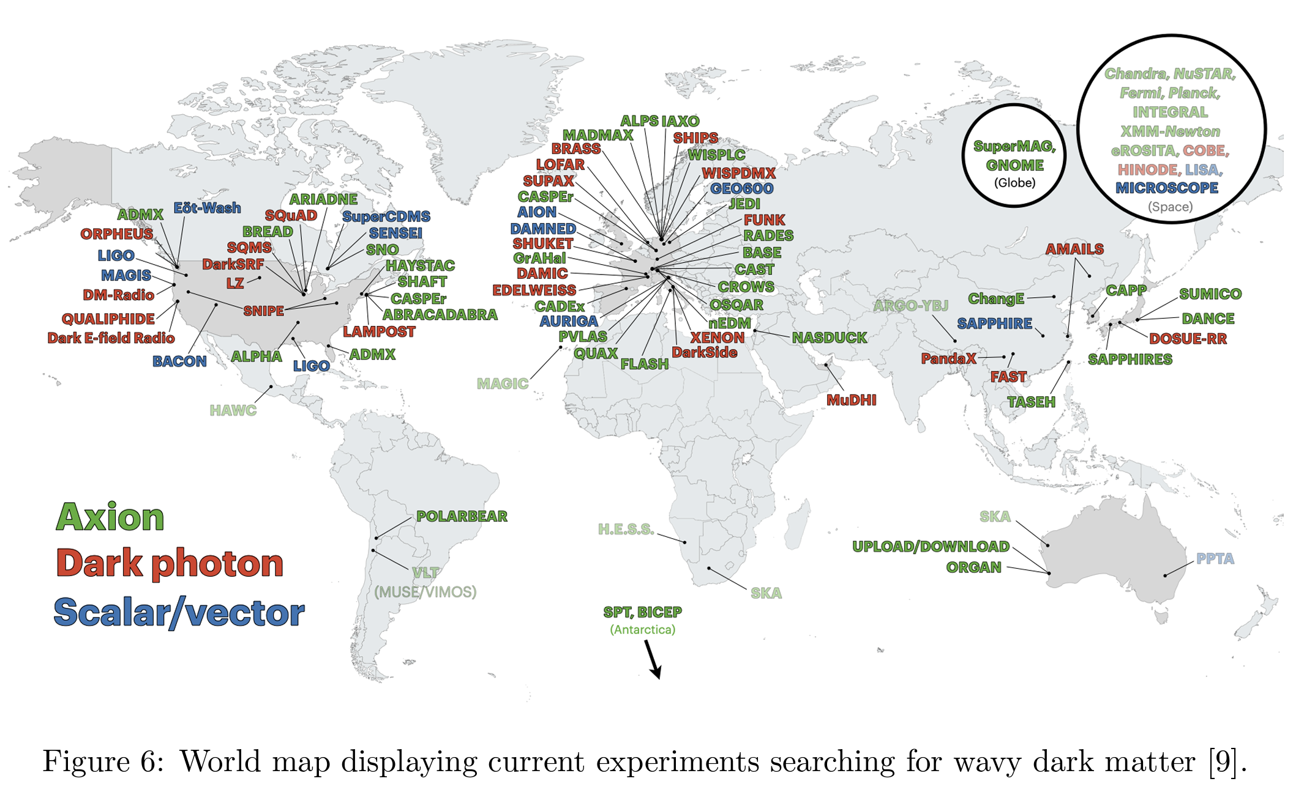
World map of current experiments on wavy dark matter

Slide 14
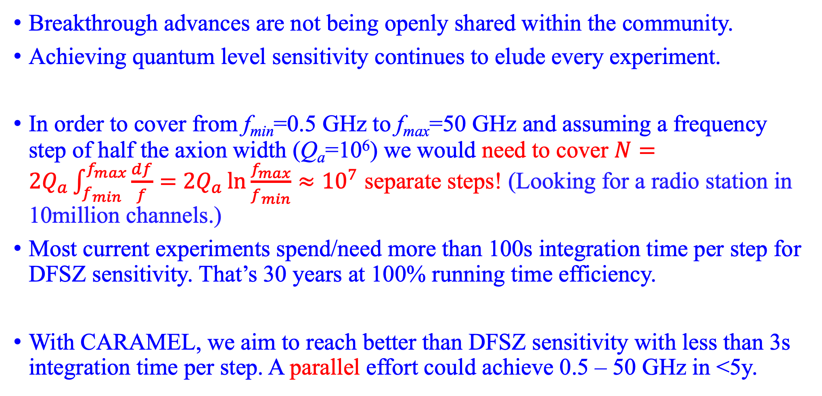
There are two major issues with axion research and possibly one solution
Breakthrough advances are not being openly shared within the community.
Achieving quantum level sensitivity continues to elude every experiment.
In order to cover from f_{min}=0.5 GHz to f_{max}=50 GHz and assuming a frequency step of half the axion width (Q_{a}=10⁶) we would need to cover $N=2Q_{a}\int_{f_{min}}^{f_{max}}{\frac{df}{f}}=$ $2Q_{a}\ln{\frac{f_{max}}{f_{min}}≈{10}^{7}}$ separate steps! (Looking for a radio station in 10million channels.)
Most current experiments spend/need more than 100s integration time per step for DFSZ sensitivity. That’s 30 years at 100% running time efficiency.
With CARAMEL, we aim to reach better than DFSZ sensitivity with less than 3s integration time per step. A parallel effort could achieve 0.5 – 50 GHz in <5y.

Slide 15
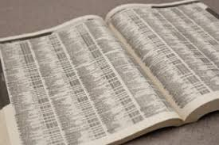
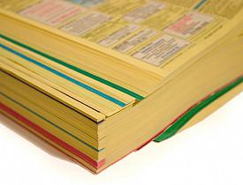
Axion dark matter search
The axion mass is unknown, like any number in a phone book in New York. The way we look for it:
Once it’s discovered, anyone will be able to dial in… and listen to it.

Slide 16
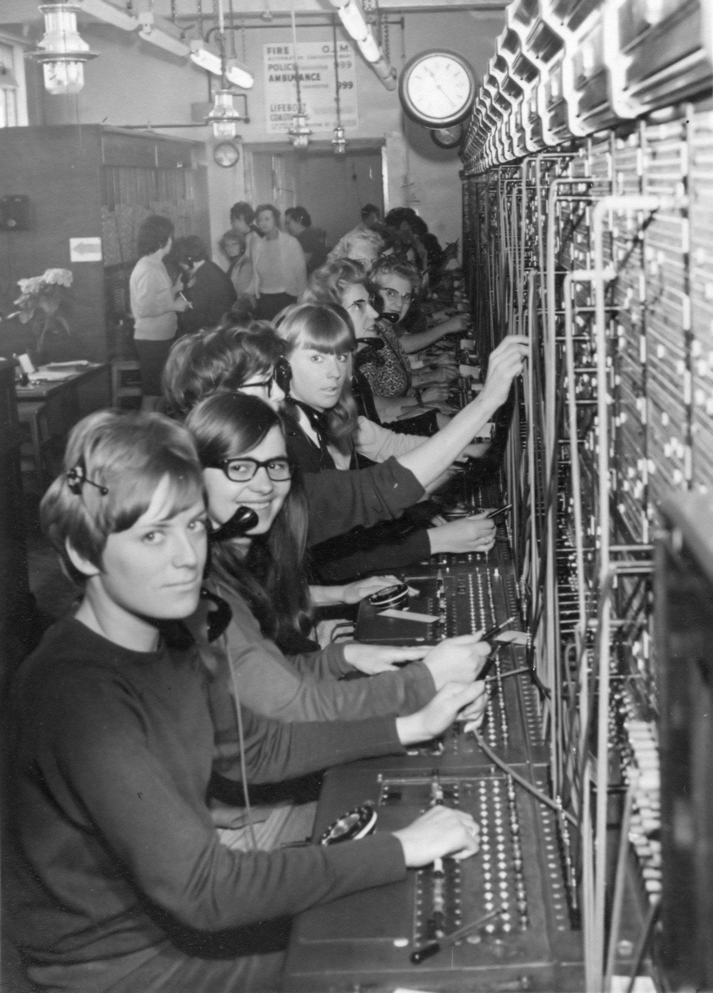
Axion dark matter search
Once it’s discovered, anyone will be able to dial in… and listen to it.

Slide 17
Axion dark matter search
We need to speed up the dial by developing new, simpler technologies/know-how.

Slide 18
The currently best readout system: Josephson parametric amplifiers (JPA)

Slide 19
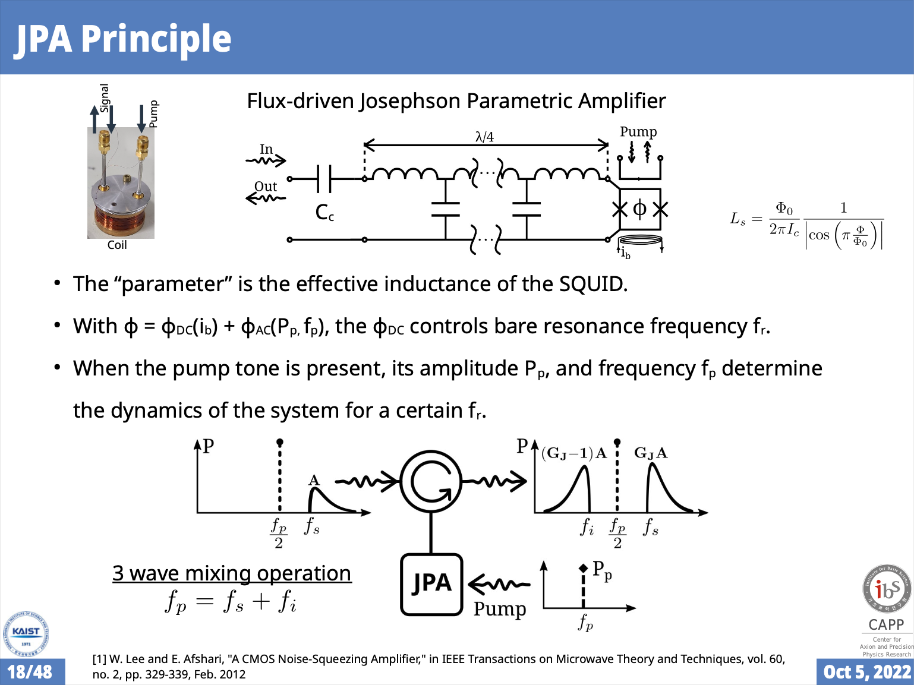
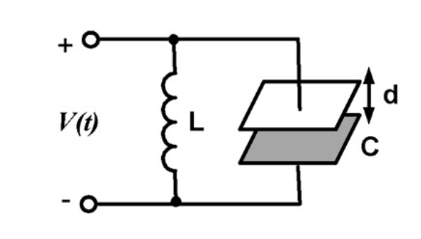
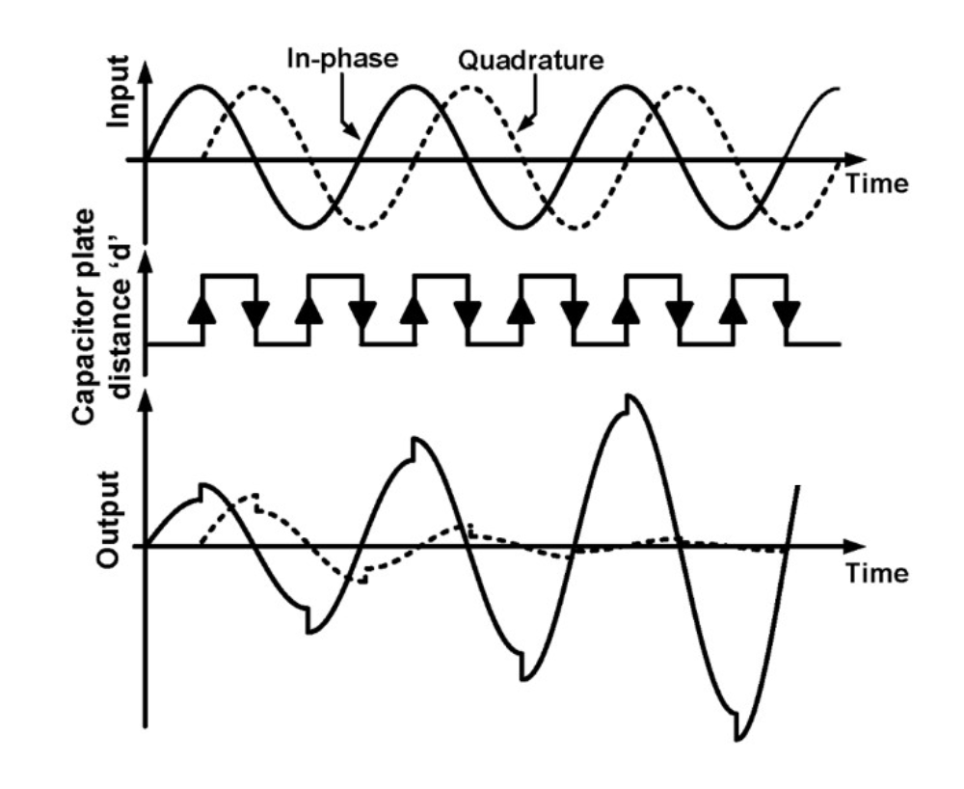
JPA Principle
(Caglar Kutlu’s slide,
Sergey Uchaikin et al.)
(no resistors)
Caglar is now
with a quantum
computing startup
in Switzerland

Slide 20
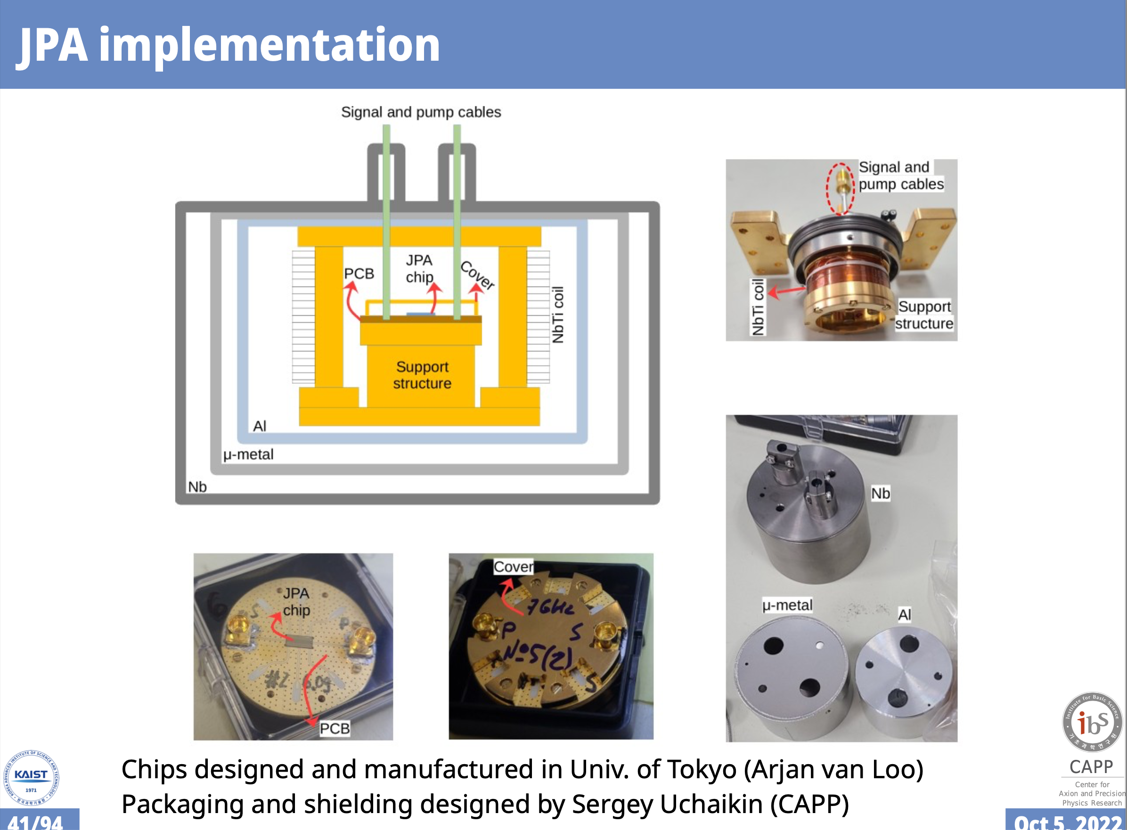
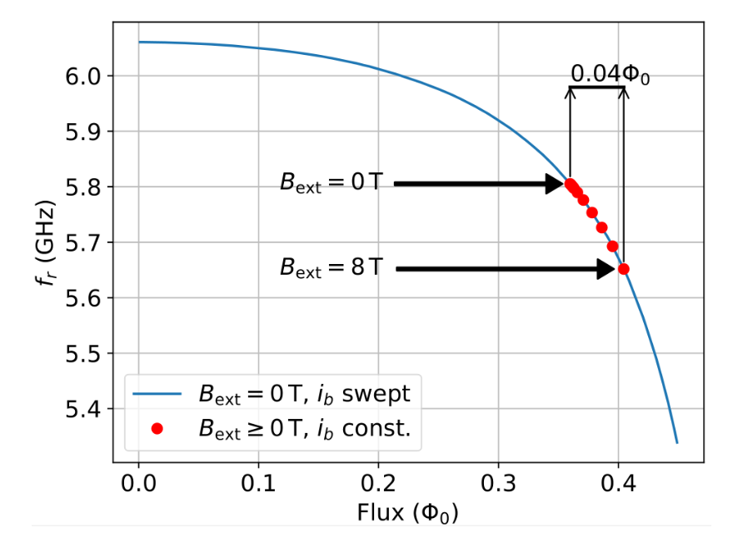
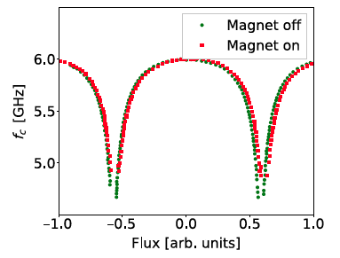
Caglar Kutlu’s slide
JPA packaging design: Sergey Uchaikin

Slide 21
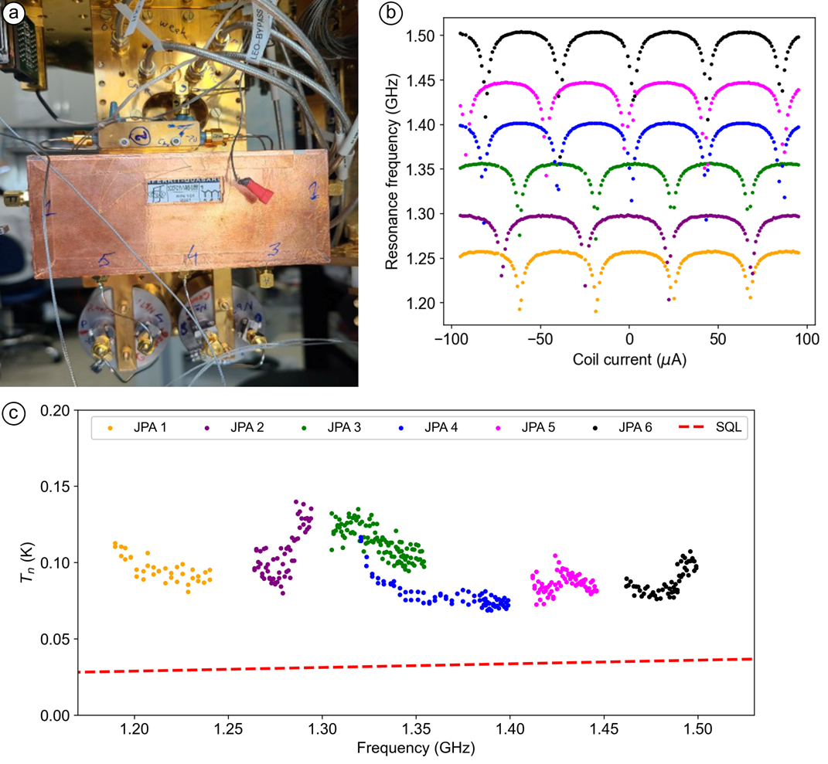
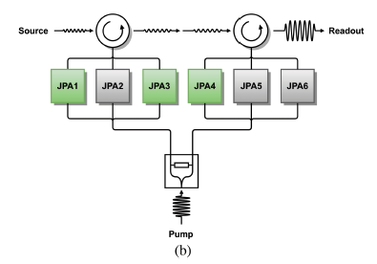
CAPP-MAX, JPA-bundle development testing
Added system noise (JPA+ HEMT noise).
Chips by Tokyo (Nakamura et al.)
Development at CAPP:
Sergey Uchaikin et al.
Combining JPAs to achieve high sensitivity in 1.2 - 1.5 GHz, running at low temperature <30mK

Slide 22
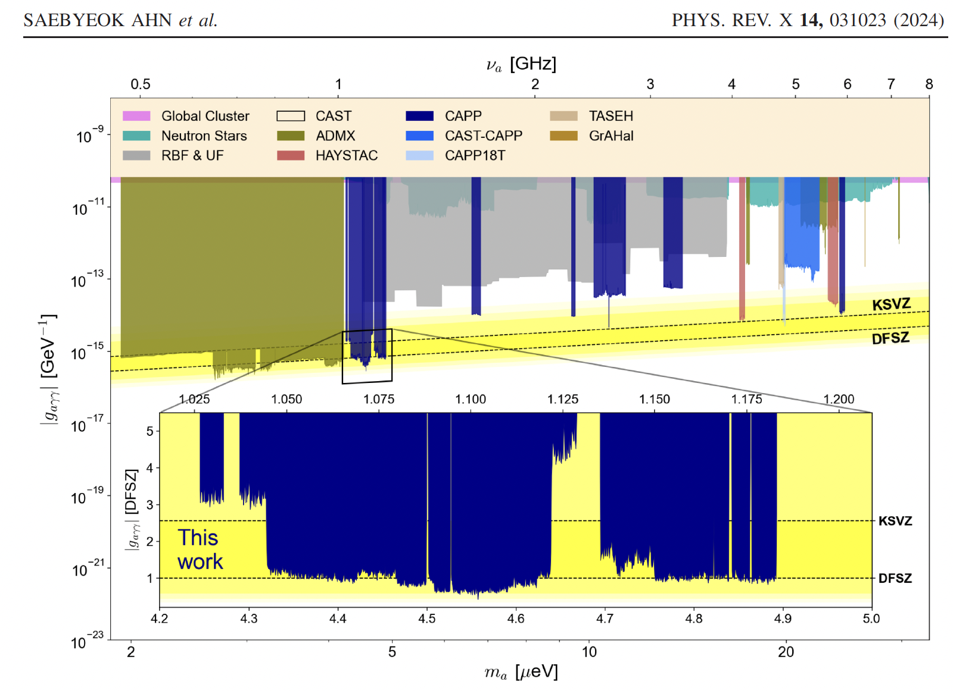
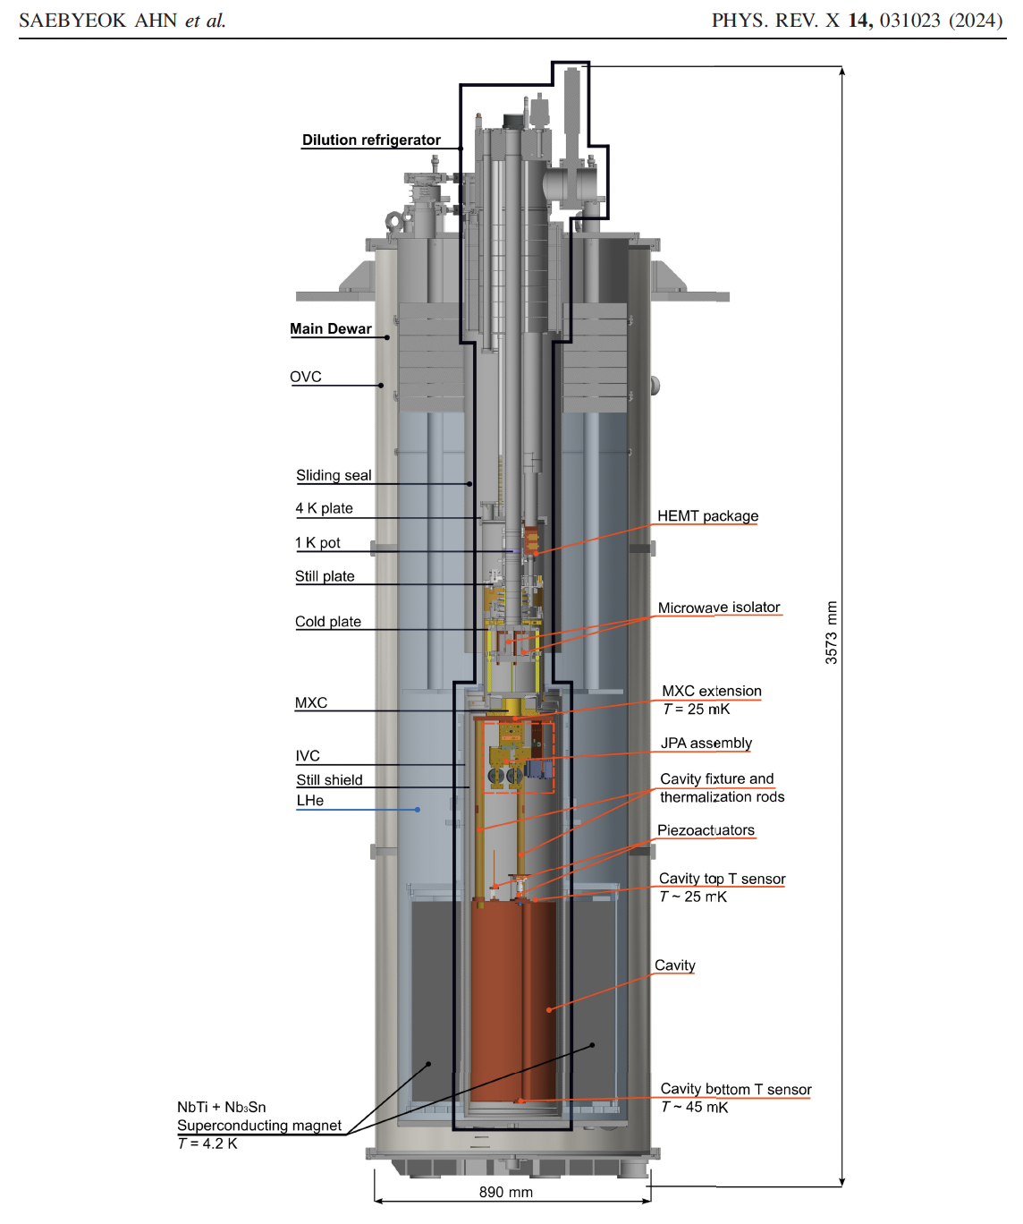
IBS-CAPP at DFSZ sensitivity, scanning 1-4 GHz
S. Ahn et al., PRX (2024) from CAPP.
A 32 page reference paper on how to achieve DFSZ sensitivity.
Axions->photons: ~10² RF-photons/s
Noise: ~4×10³ RF-photons/s, at best

Slide 23
The best JPAs today
Their average noise is between 3-5 times the quantum noise level
Their frequency BW is limited, and they are labor intensive
Require < 50mK cooling for best performance (at CAPP we had a best physical temp. ~22mK, with more common 25-40mK). The total system noise was ~220mK, requiring >100 s of integration time over the axion BW.

Slide 24
Cavities made of High Temperature Superconducting (HTS) tapes

Slide 25
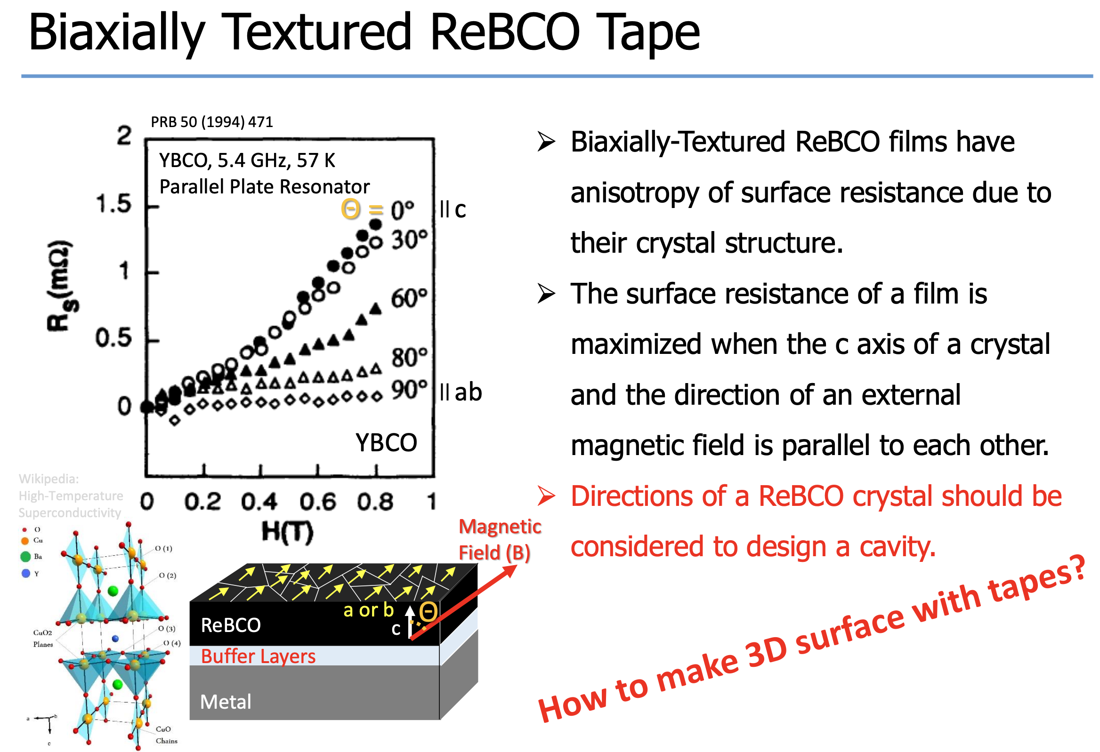
Danho Ahn’s slide

Slide 26
HTS superconducting cavity in large B-field!
First and best in the world!
Phys. Rev. Applied 17, L061005 – Published 28 June 2022

Slide 27
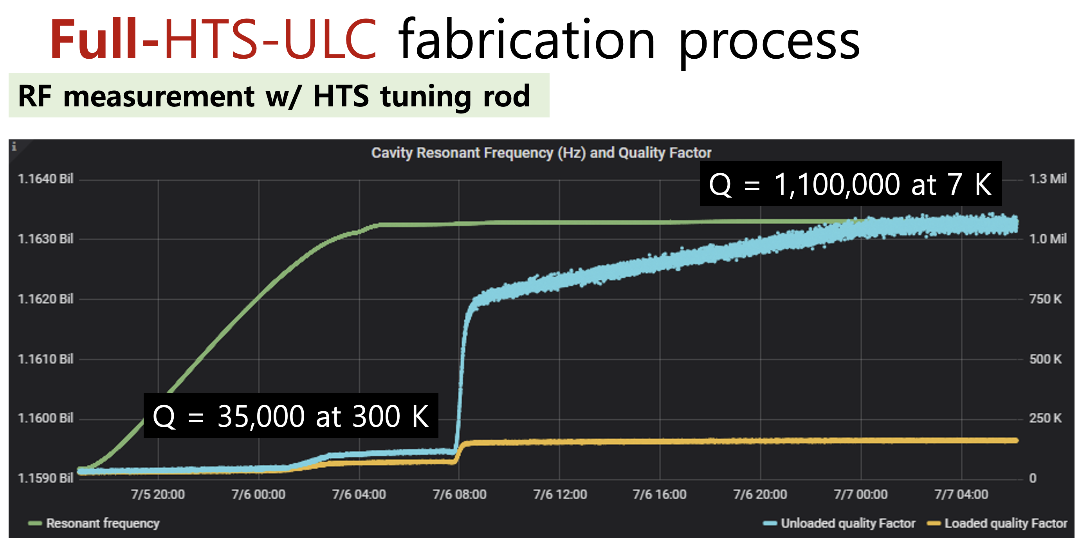
CAPP summer 2024, unique achievement, 34 liter cavity!
Jiwon Lee’s slide

Slide 28
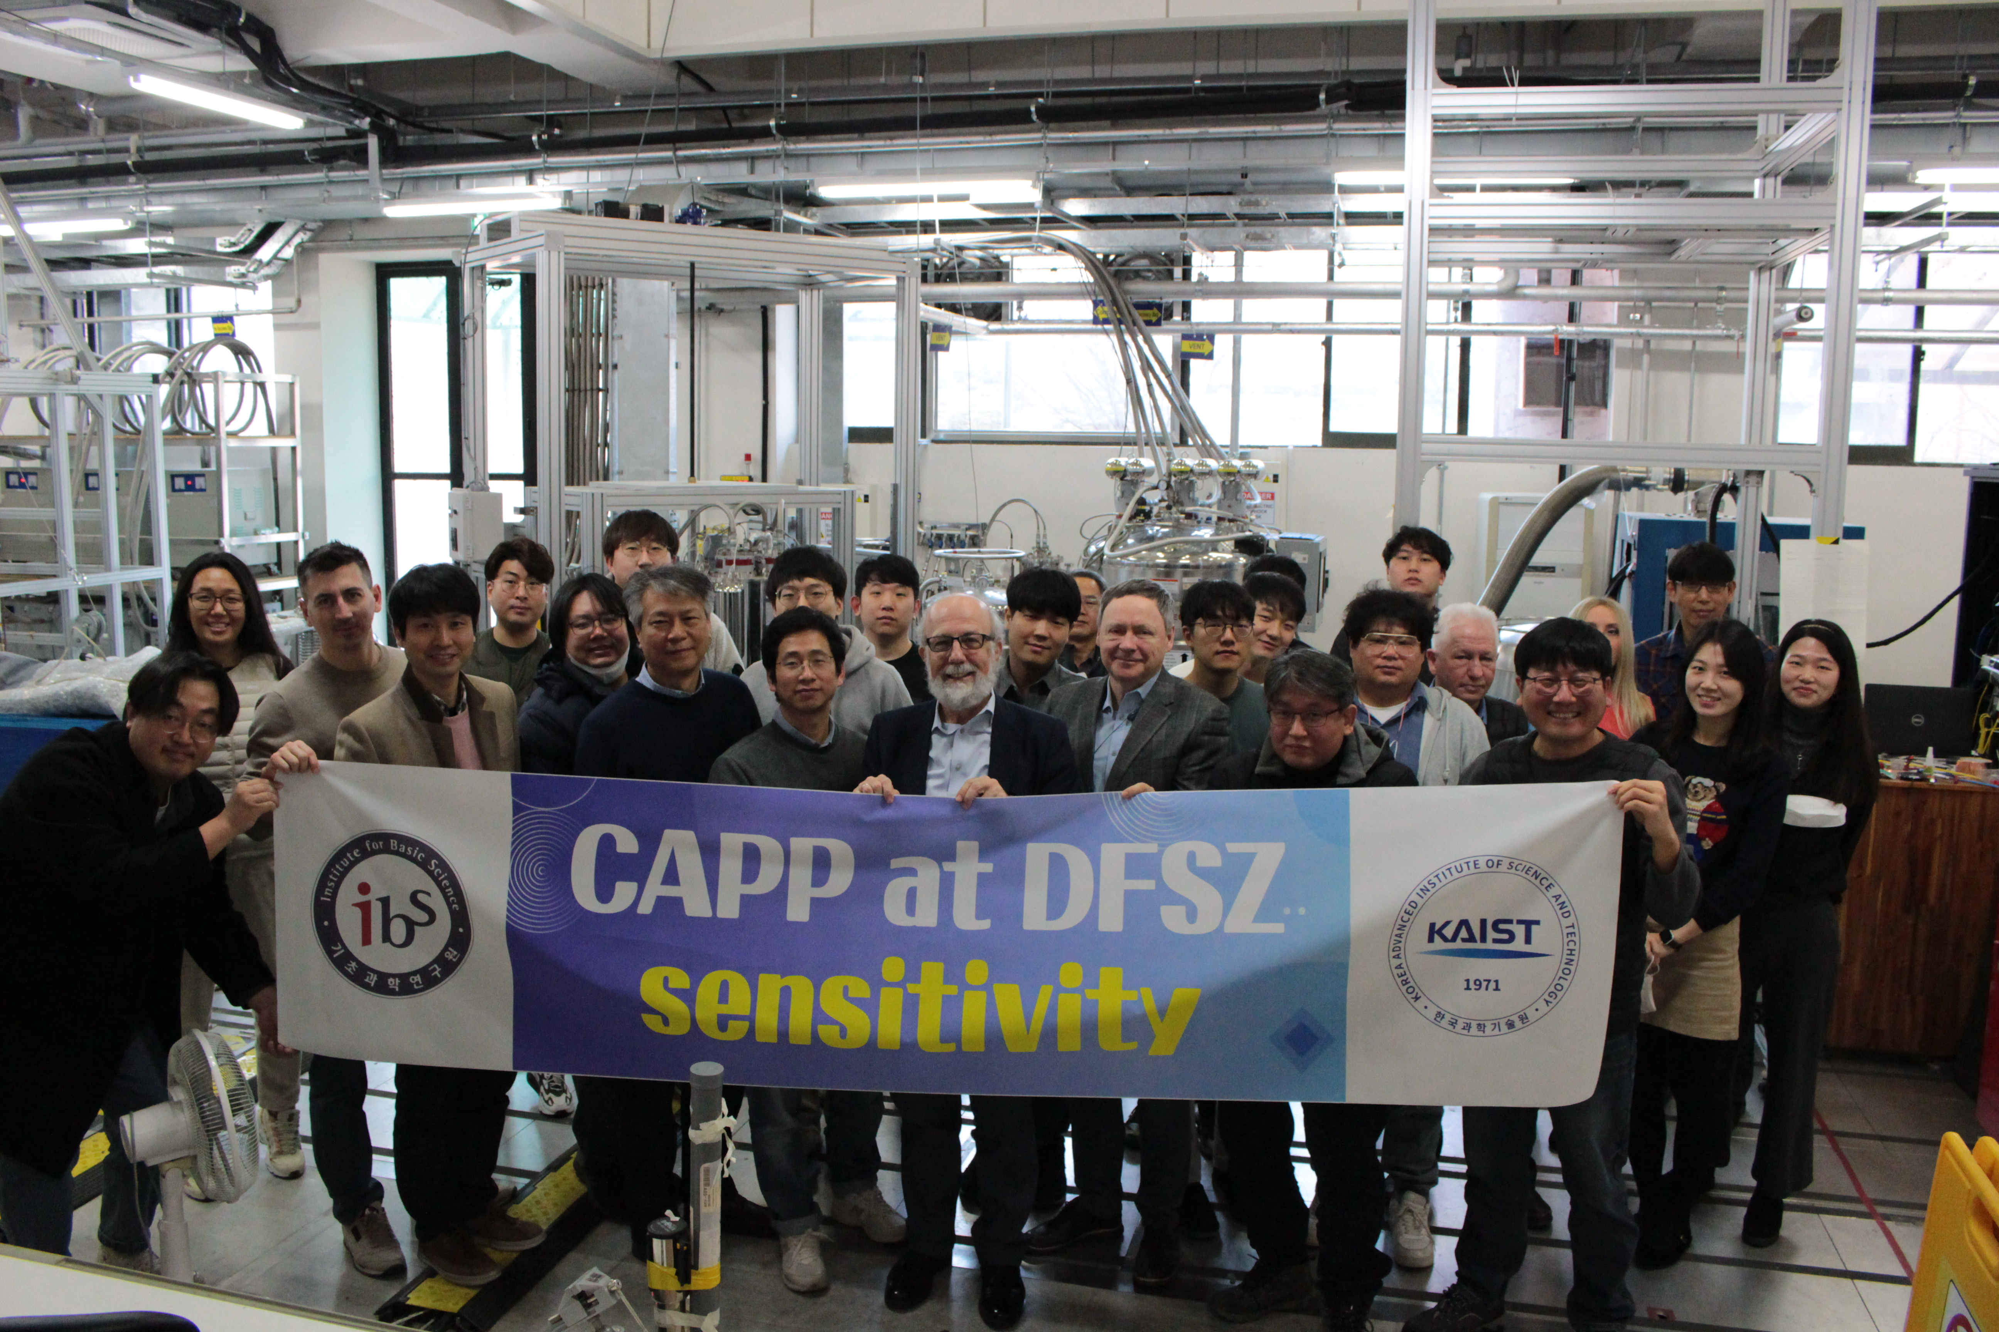
Institute for Basic Science, 2011:
Major Investment to Basic Sciences in South Korea.
IBS-CAPP (est. 2013) scanned at DFSZ sensitivity for axions over 1 GHz in 2022, first time in the world.
Since summer 2024, a 34liter HTS cavity in 12T, with better than DFSZ sensitivity and able for >3MHz/day scanning rate.
IBS-CAPP is now operating under another name: IBS-DMAG (Dark Matter Axion Group), under the leadership of SungWoo Youn
Photo: KAIST Munji Campus, January 2023

Slide 29
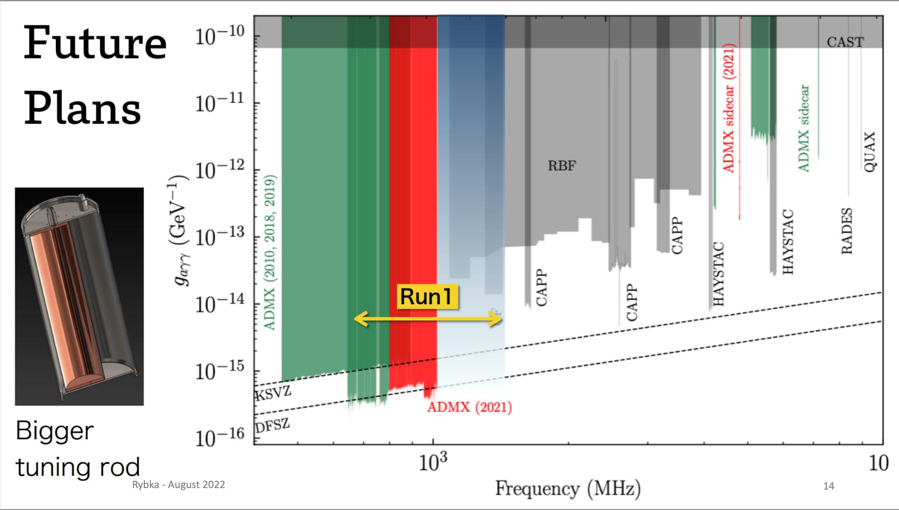
ADMX plan

Slide 30
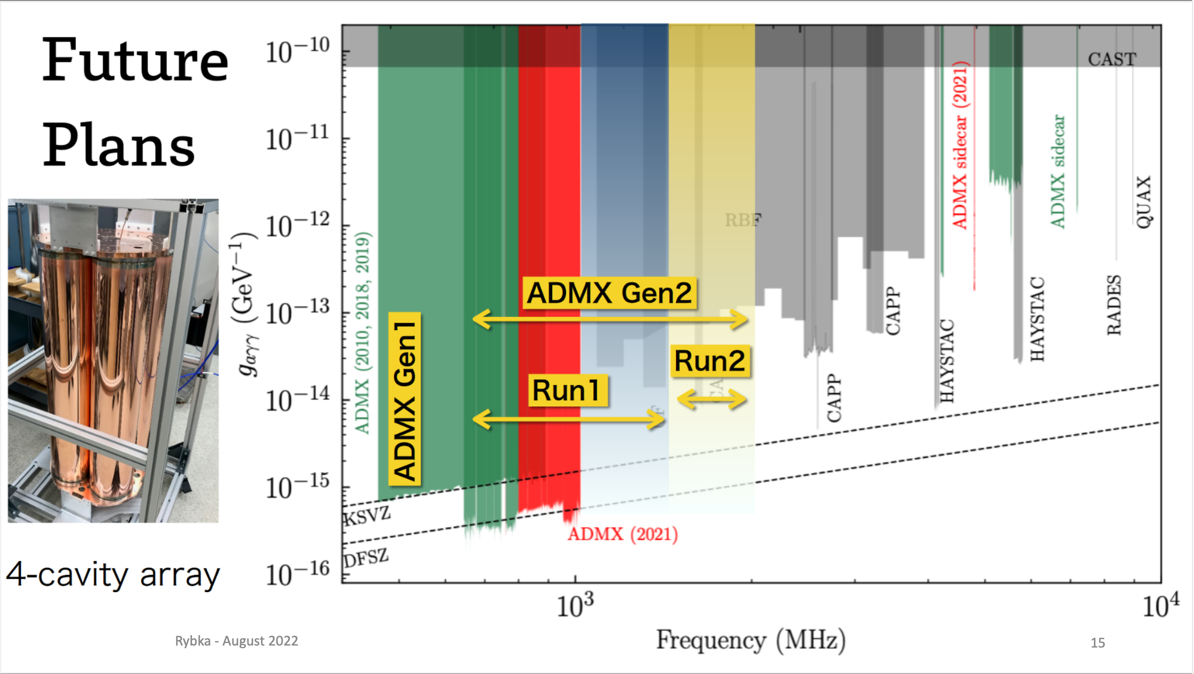
ADMX plan

Slide 31
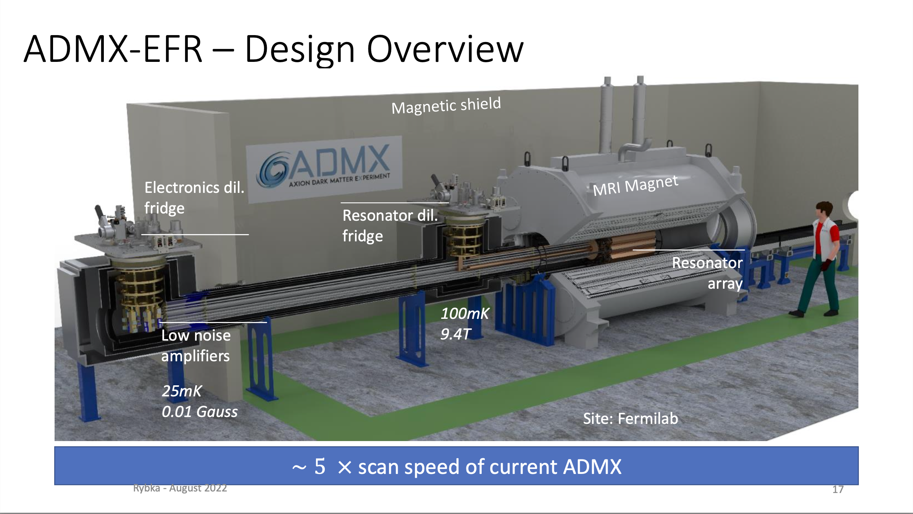
ADMX: Rybka, August 2022
Large-volume MRI magnet
moved to Fermilab

Slide 32
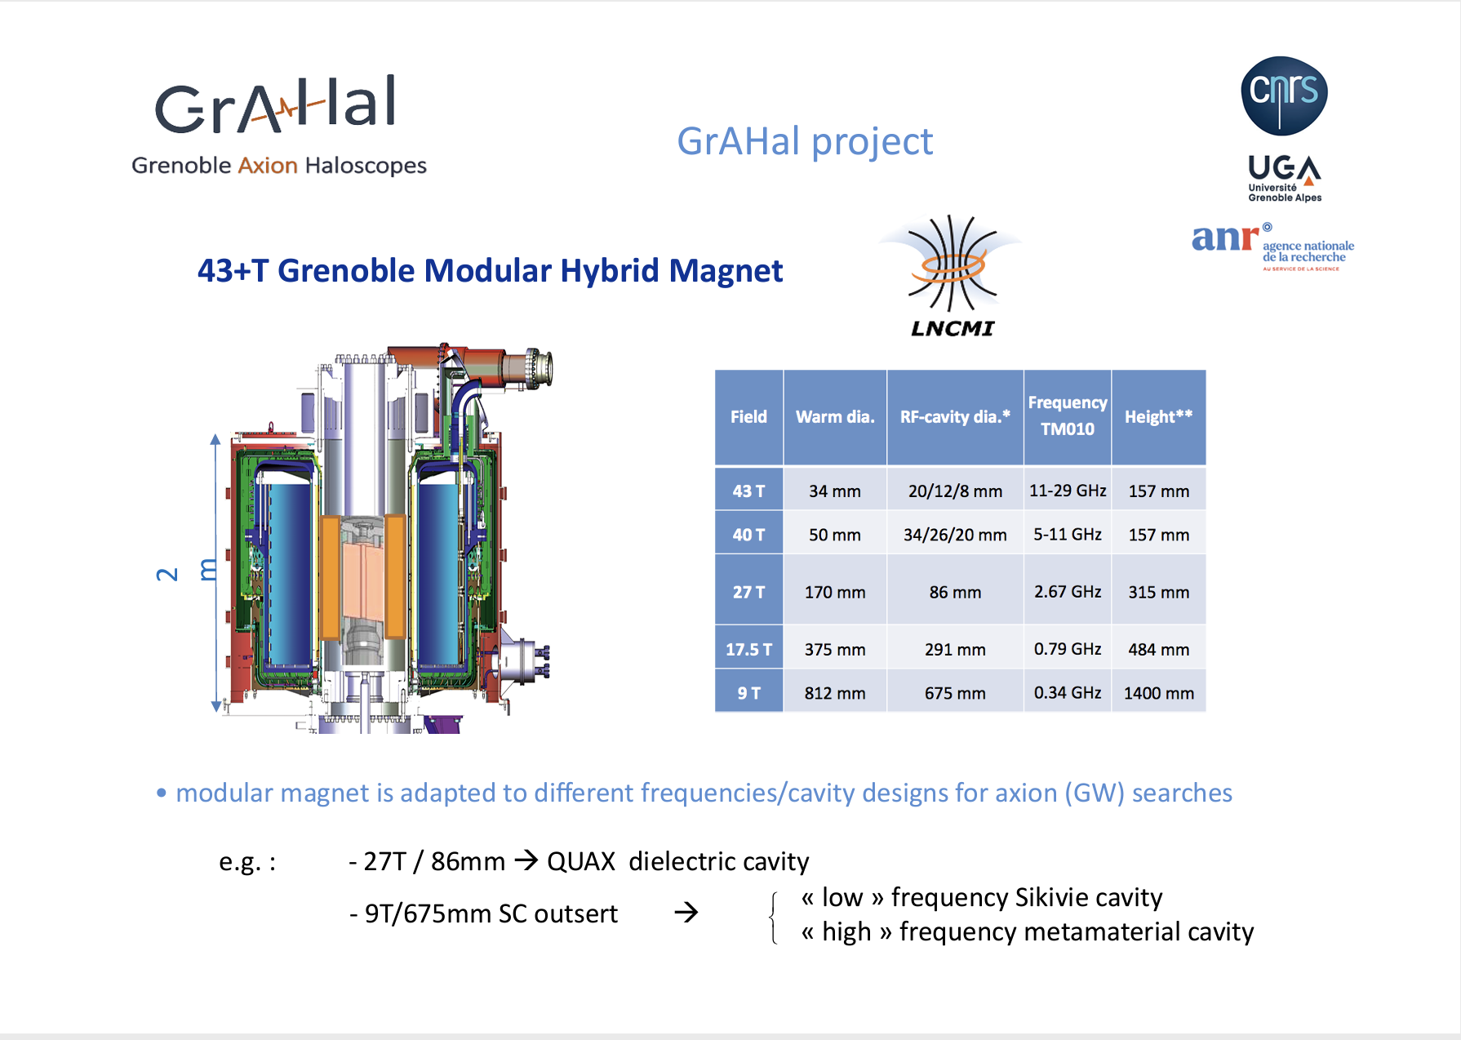
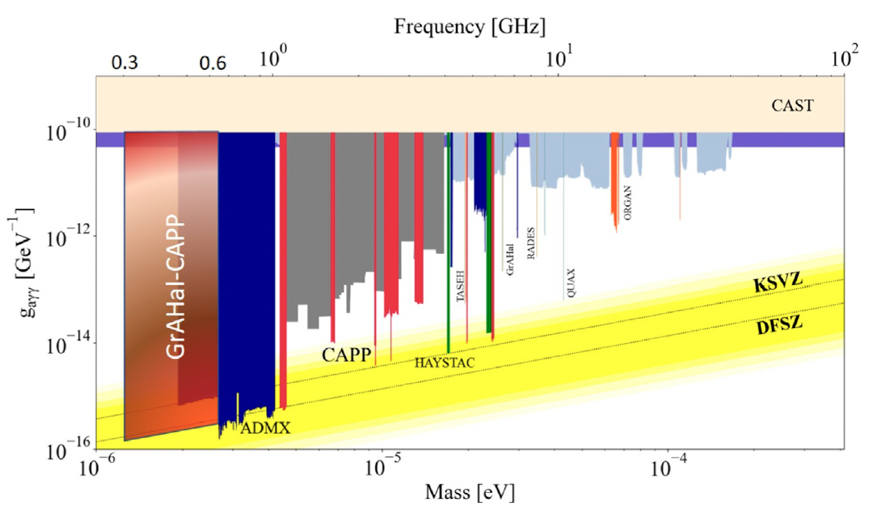
Grenoble Axion
Haloscope and CAPP (~500 l cavity)
First target 300-600 MHz axion frequency.

Slide 33
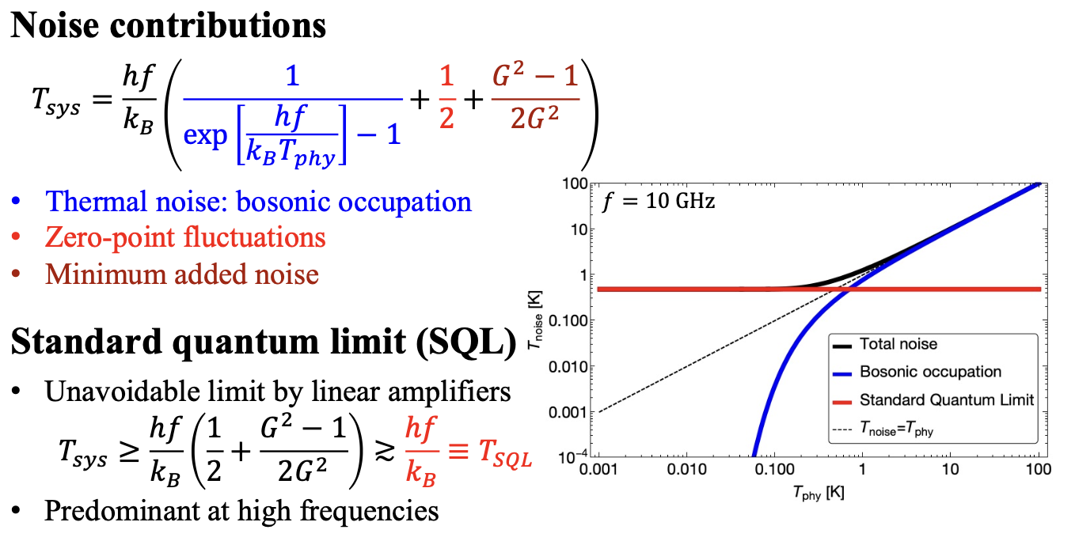
Equivalent noise temperature
Slide by SungWoo Youn
The uncertainty principle limits the lowest equivalent electronic noise of the system (quantum noise limited amplifiers). Single photon detectors (in blue) would be perfect, but they are still …far away from competing (however, see next).

Slide 34
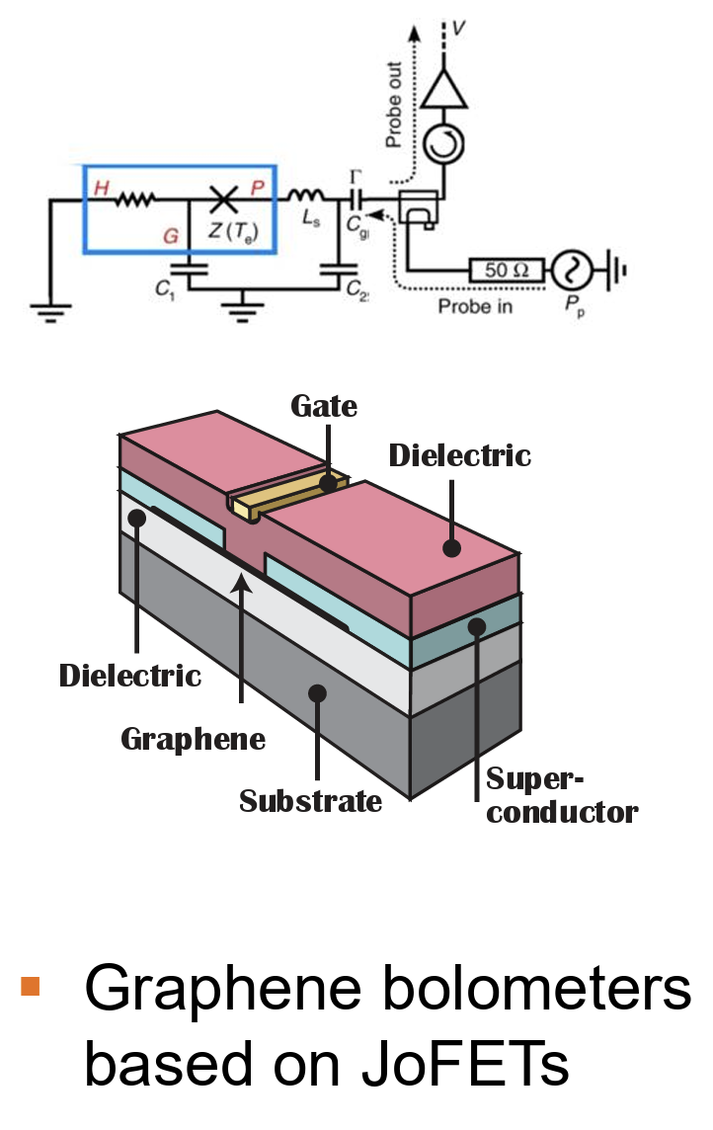
Single RF-photon detector!
A dream come true:
  Lescanne et al., PRX (2020)
  Albertinale et al., Nature (2021)
  Wang et al., Nature (2023)
Qubits or bolometers combined with HTS cavities pave the path to the high frequency. It’s getting very close to a major running system. See also yesterday’s talk by Klaara Viisanen
Nature 586, 47 (2020)

Slide 35
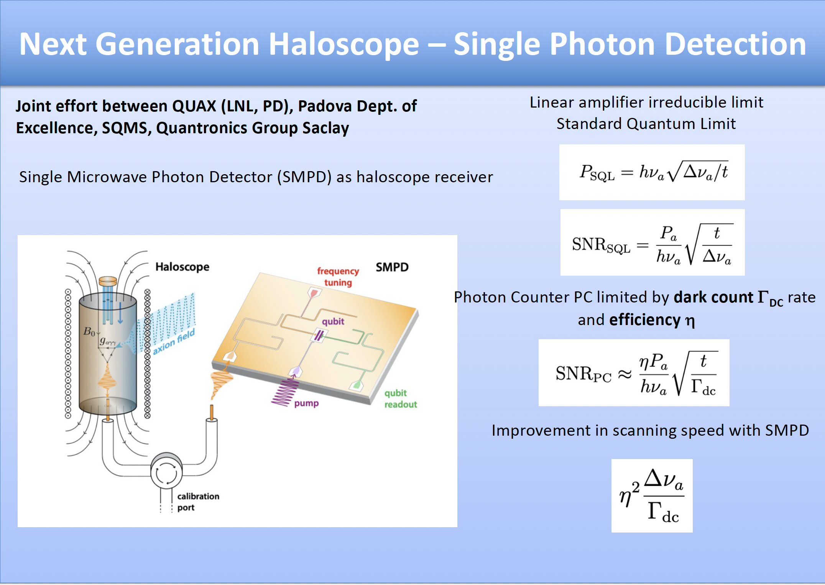
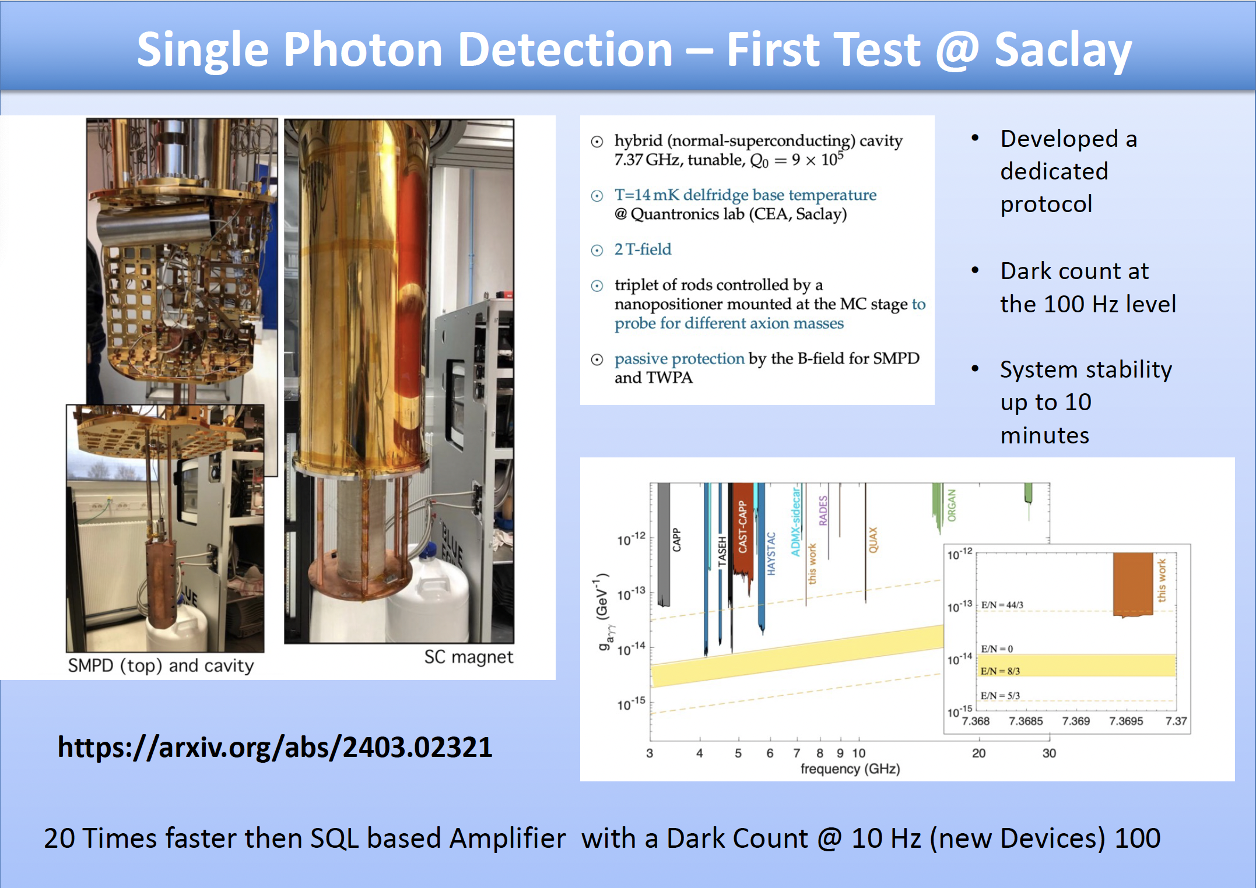
QUAX experiment in Italy
Significant progress in single photon detection
Cresini et al., PRL 124, 171801 (2020)
Braggio et al., PRX 15, 021031 (2025)

Slide 36
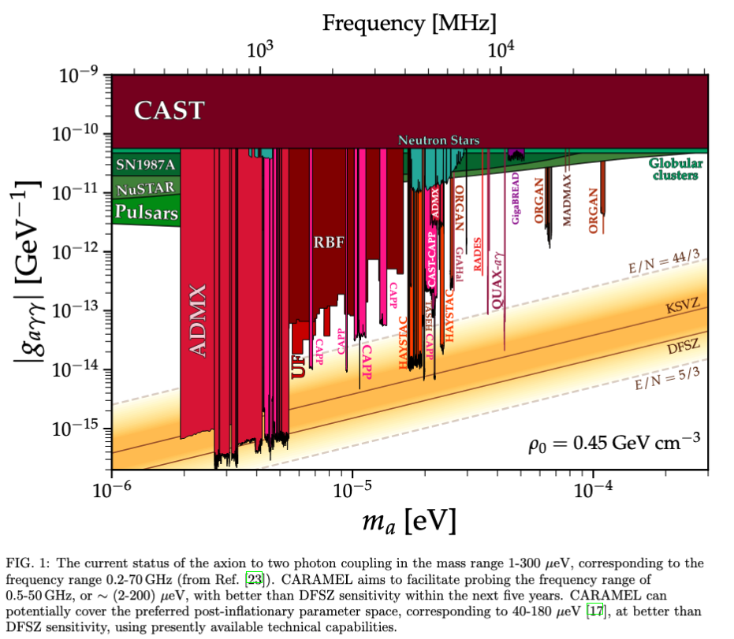
Prospects of scanning the whole axion frequency range
From Lattice QCD and requiring axions as dark matter the preferred mass range is: 40-180 µeV
M. Buschmann et al., Dark matter from axion strings with adaptive mesh refinement, Nature Commun. 13, 1049 (2022), arXiv:2108.05368 [hep-ph].
With current methods we are still looking at a few decades before scanning the whole viable axion frequency.
With CARAMEL we aim to achieve DFSZ sensitivity in the 40-180 µeV (10-45 GHz) range with a (nominal) year’s running time.

Slide 37
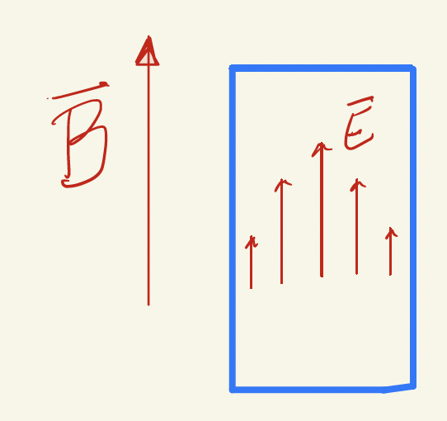
Electro optic detection of axion induced electric fields in microwave cavities

Slide 38
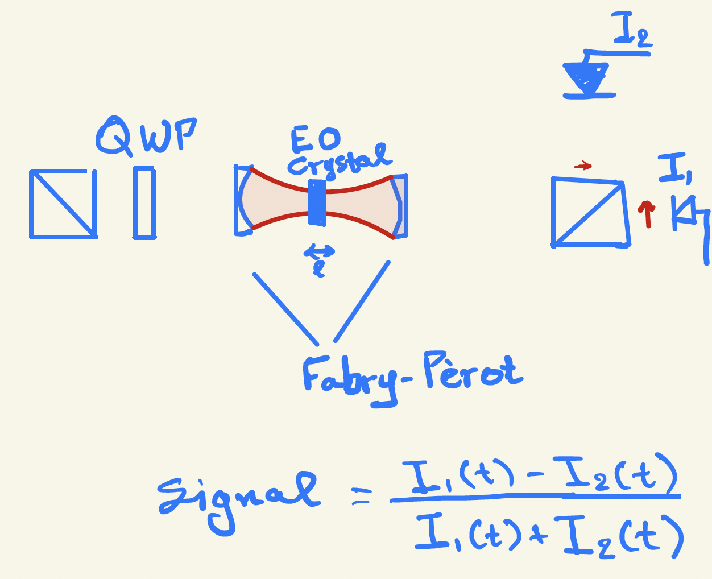
Electro optic detection of axion induced electric fields in microwave cavities
P
A

Slide 39
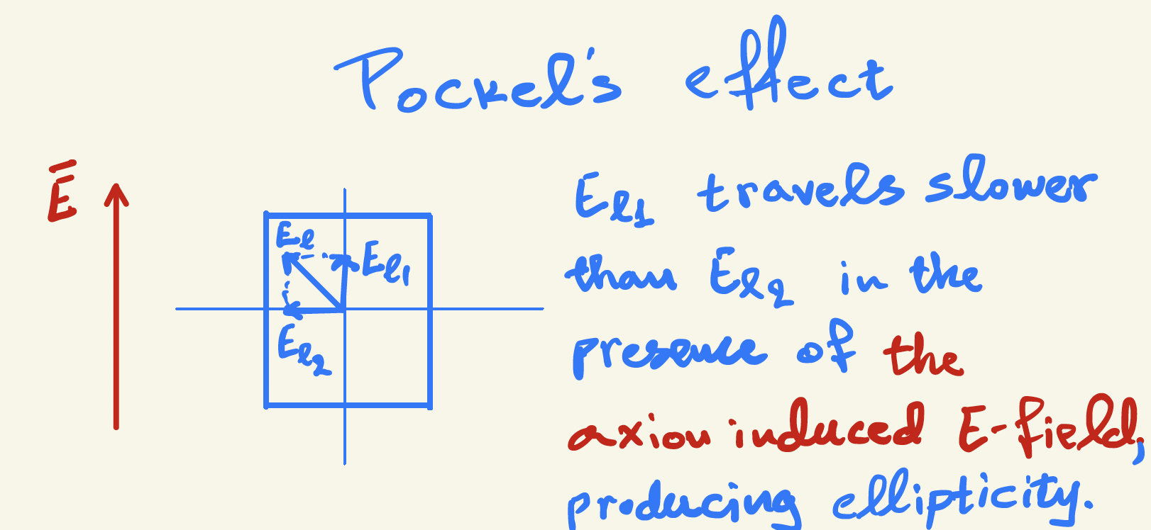
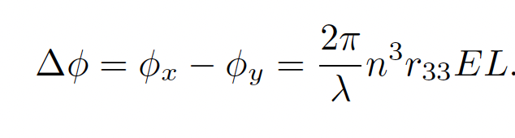
Electro optic detection of axion induced electric fields in microwave cavities
For LiNbO₃ crystal:
n=2.2, r₃₃ = 3.1 × 10⁻¹¹ m/V

Slide 40
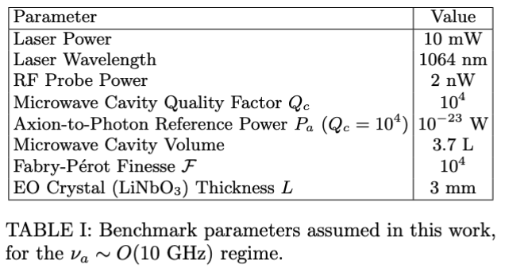
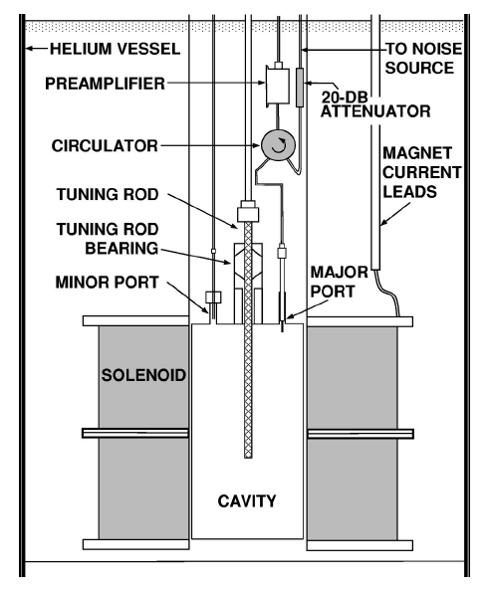
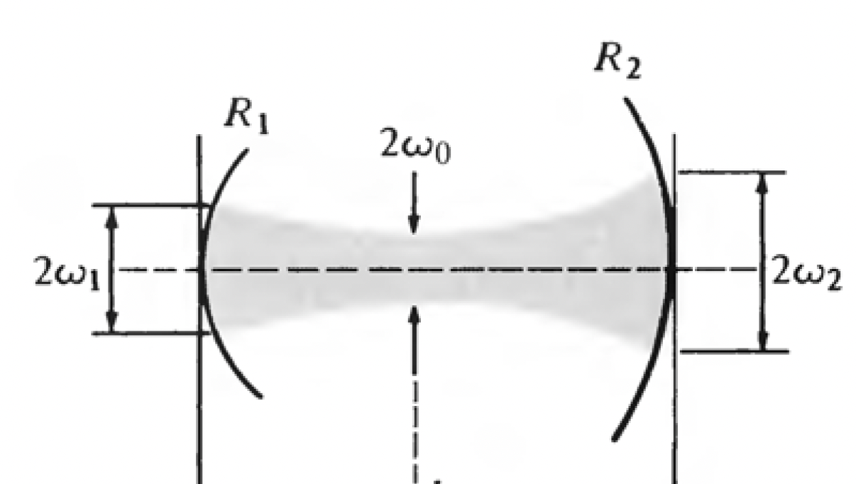
Electro optic (EO) readout using a Fabry Perot resonator plus heterodyning (probing, PRD 107, 103005 (2023)).
EO crystal
Figure 2

Slide 41
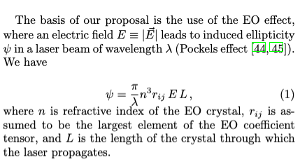
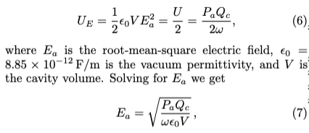
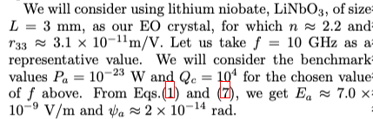
EO measurement using a Fabry-Perot resonator alone
Axion induced electric field oscillation amplitude (for Q_{c}=10⁴): E_{a}=7nV/m.
Ellipticity induced for a single pass 𝜓 ~ 2×10⁻¹⁴ rad
With a Fabry-Perot and 10⁴ finesse 𝜓_{FP} ~ 1.3×10⁻¹⁰ rad. Laser shot noise: 𝜓_{LSN} ~ 3.5×10⁻⁹ rad (3s integration time)
Not quite enough. We need to do better…

Slide 42
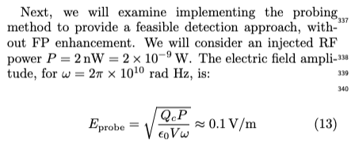
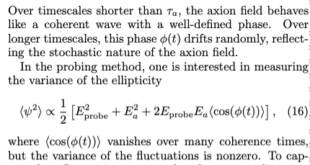
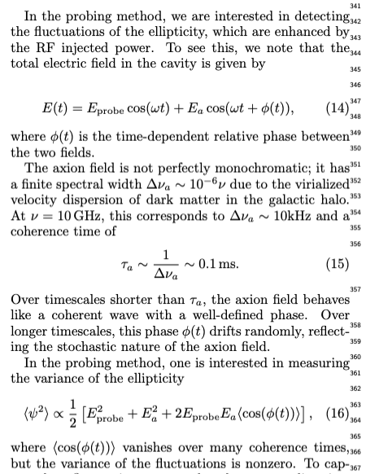
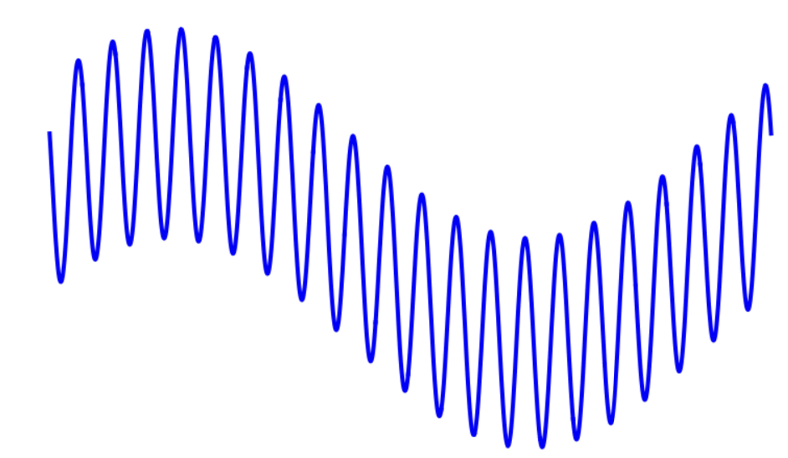
EO measurement using a Fabry-Perot plus heterodyning (probing)
Axion field at 10 GHz is coherent for ~0.1ms, the laser noise is incoherent.

Slide 43




Heterodyne-variance method, Omarov, Jeong, YkS: PRD107, 103005 (2023)
Injecting photons into the microwave cavity can enhance the axion detection rate
Adapted from Junu Jeong’s slides
Instead of the power detector, we propose to use
the EO effect and a Fabry-Perot resonator

Slide 44

Heterodyne-variance method: PRD107, 103005 (2023)
Can always reach QNL performance even when the power detectors (bolometers) are noisy
Junu Jeong’s slide

Slide 45


EO measurement using a Fabry-Perot plus heterodyning (probing)
Heterodyning (probing) enhances the axion signal by sqrt(E_{probe}/E_{a})~3×10³
The axion induced ellipticity is now ~ 5×10⁻⁷ rad at 10 GHz with 10kHz modulation.
We can see this in less than 3s.

Slide 46



The dominant noise
Thermal and vacuum (quantum) induced noise.
(In the current experiments the dominant noise comes from the readout electronics)

Slide 47

Frequency dependence
We can achieve DFSZ sensitivity even for 50 GHz for just 3s integration time per bin.
The frequency range shown includes the favorite range for after inflation PQ scale (10-45 GHz), Buschmann (2022).

Slide 48
Higher frequency than the “natural” one:
CAPP/DMAG and ALPHA

Slide 49


Doing high frequency efficiently
Slide by Junu Jeong,
SungWoo Youn et al.

Slide 50








Kirigami tessellations
Nature material 18, 999
Nature communication 9, 4594
c
Kirigami

Slide 51
Performance comparison
Physical Review D Vol. 107, No. 1, 015012-1-015012-8(2023)
F.O.M. = C²V²Q

Slide 52

Alpha collaboration

Slide 53

Alpha collaboration

Slide 54
Can we do better than quantum noise?

Slide 55


Axion Dark Matter: a Cosmic MASER
De Broglie wavelength of axions
$$λ≈300m×\left(\frac{1μeV}{m_{a}}\right)$$

Slide 56

EO-heterodyne readout
Having (N) multiple cavities, located within the axion coherence length. The gain in SNR is proportional to √N, and in scanning time N.
The challenge: Design the experiments so that the total axion induced signal is higher than quantum noise (QN).
EO-heterodyning readout noise will be less than QN with 3s integration time.
The opportunity is indeed great. Using existing technology that can scale up easily.

Slide 57
Summary
ALPHA, ADMX, CAPP→DMAG, GrAHal, HAYSTAC, QUAX,… are mature experiments, scheduled to complete the full frequency range in a few decades.
HTS cavities can help, but the readout electronics is still the bottleneck.
Electro-optic heterodyning (probing) readout method with Fabry-Perot resonators can enhance the scanning speed by more than an order of magnitude:
  Great SNR, quantum noise limitations are mitigated with multiple cavities
  Use a uniform readout system for the favorite frequency range 10 GHz < f < 45 GHz.
The new approach can be applied in the 0.5 to 50 GHz, achieving DFSZ sensitivity faster than present readouts. We can work together (in parallel) to help cover the whole range in less than 5-10 years.

Slide 58
Extra slides

Slide 59
Superconducting cavities in strong B-fields

Slide 60



The CAPP-MAX, our flagship experiment based on the LTS-12T/320mm magnet
Axion to photon conversion power at 1.15 GHz
  KSVZ: 6.2×10⁻²² W or ~10³ photons/s generated
  DFSZ: 0.9×10⁻²² W or ~10² photons/s generated
With total system noise of 300mK, Q₀=10⁵, eff. = 0.80
  KSVZ: 25 GHz/year
  DFSZ: 0.5 GHz/year
With total system noise of 200mK (250mK), Q₀=10⁵
  KSVZ: 50 GHz/year (35 GHz/year)
  DFSZ: 1 GHz/year (0.64 GHz/year)
With total system noise of 125mK, Q₀=1×10⁶
  DFSZ: 1-2 GHz/year for 20% of dark matter as axions
  DFSZ: 2-4 GHz/year, 4-8 GHz/year, 20% ADM

Slide 61
QUAX, INFN

Slide 62

QUAX experiment in Italy
Using innovation and quantum RF-readout to make progress

Slide 63

QUAX
Projection at 8.5 -11 GHz

Slide 64

Axion coupling vs. axion mass
ALPs:
Axion
Like
Particles
A unique feature: There’s a bottom line
Axions here solve the
Strong CP-problem

Slide 65

QUAX
Current status at 8.5 -11 GHz

Slide 66
The low-frequency domain

Slide 67


Dark-Matter Radio, probing the low frequency axions at SLAC/USA
Low frequencies (long Compton wavelength)
favor induction coil detection

Slide 68


Dark Matter Radio, 2203.11246

Slide 69


A new haloscope at Grenoble: GrAHal
B²V wins (GrAHal-CAPP plans to scan 0.2-0.6 GHz at better than DFSZ)
New experimental effort!
9 T in 810 mm warm bore

Slide 70

Heterodyne-variance method, 2209.07022
Intermediate method before low-noise single photon detection
Junu Jeong’s slide

Slide 71
David Tanner

Slide 72

Axion Couplings
Gauge fields:
  Electromagnetic fields (microwave cavities: CAPP, ADMX,…)
  Gluon Fields (Oscillating EDM: CASPEr, storage ring EDM)
Fermions (coupling with axion field gradient, pseudomagnetic field, CASPEr-Electric, ARIADNE; GNOME)

