Slide 1
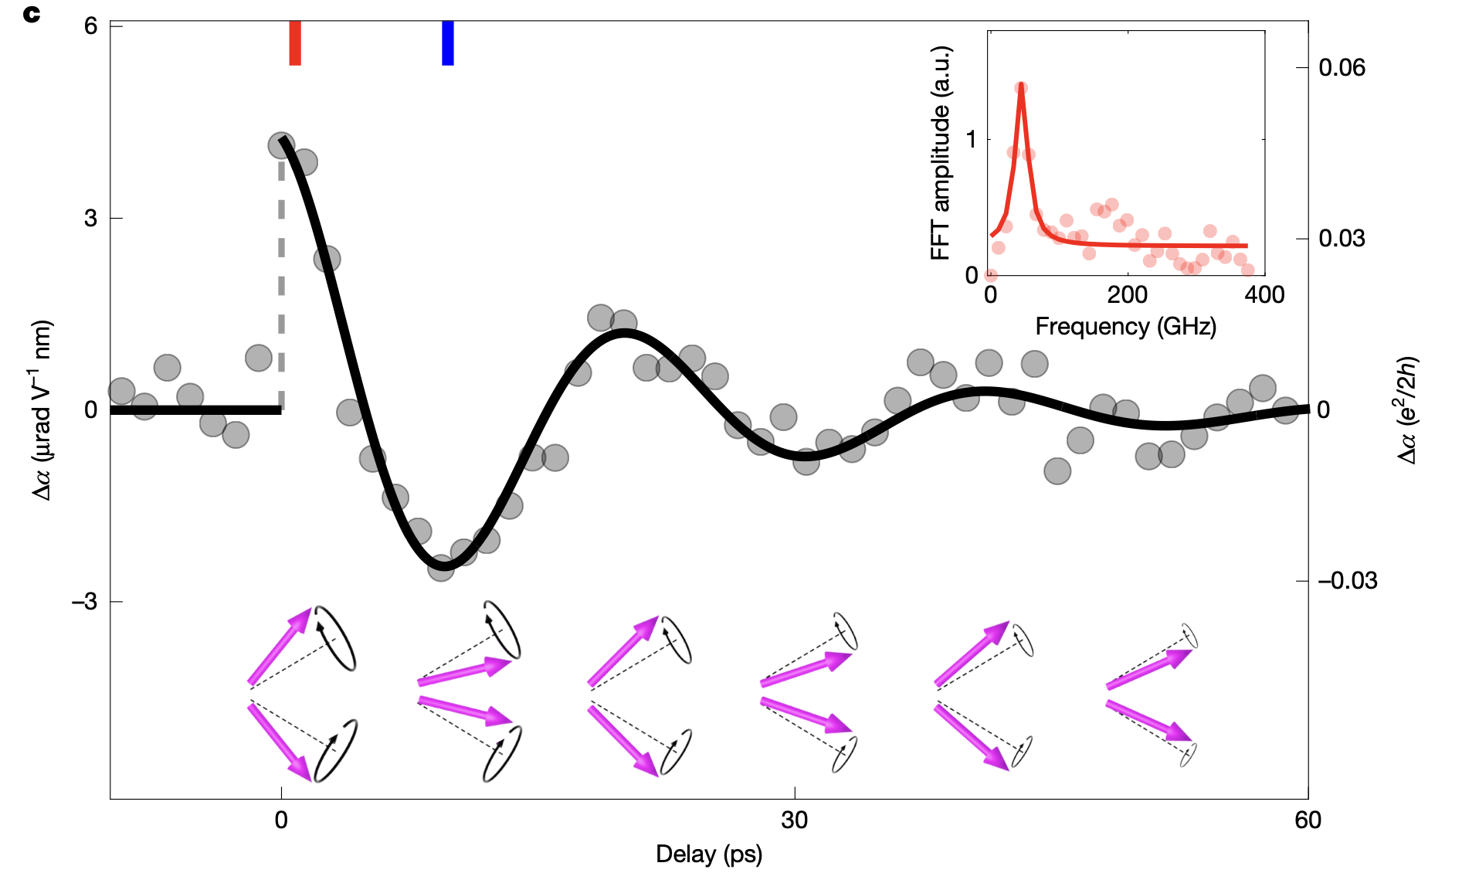


Detecting axions, and detecting axions with axions
David J. E. Marsh
“Axions in Stockholm”, July 2025
Based on Qiu, DJEM et al (Nature, 2025)

Slide 2
Outline
Dynamical axion quasiparticles (DAQs)
Detecting quasiparticles with lasers
Detecting axions with axions

Slide 3
Axion quasiparticles
AQ, also “dynamical axion quasiparticle”, DAQ

Slide 4
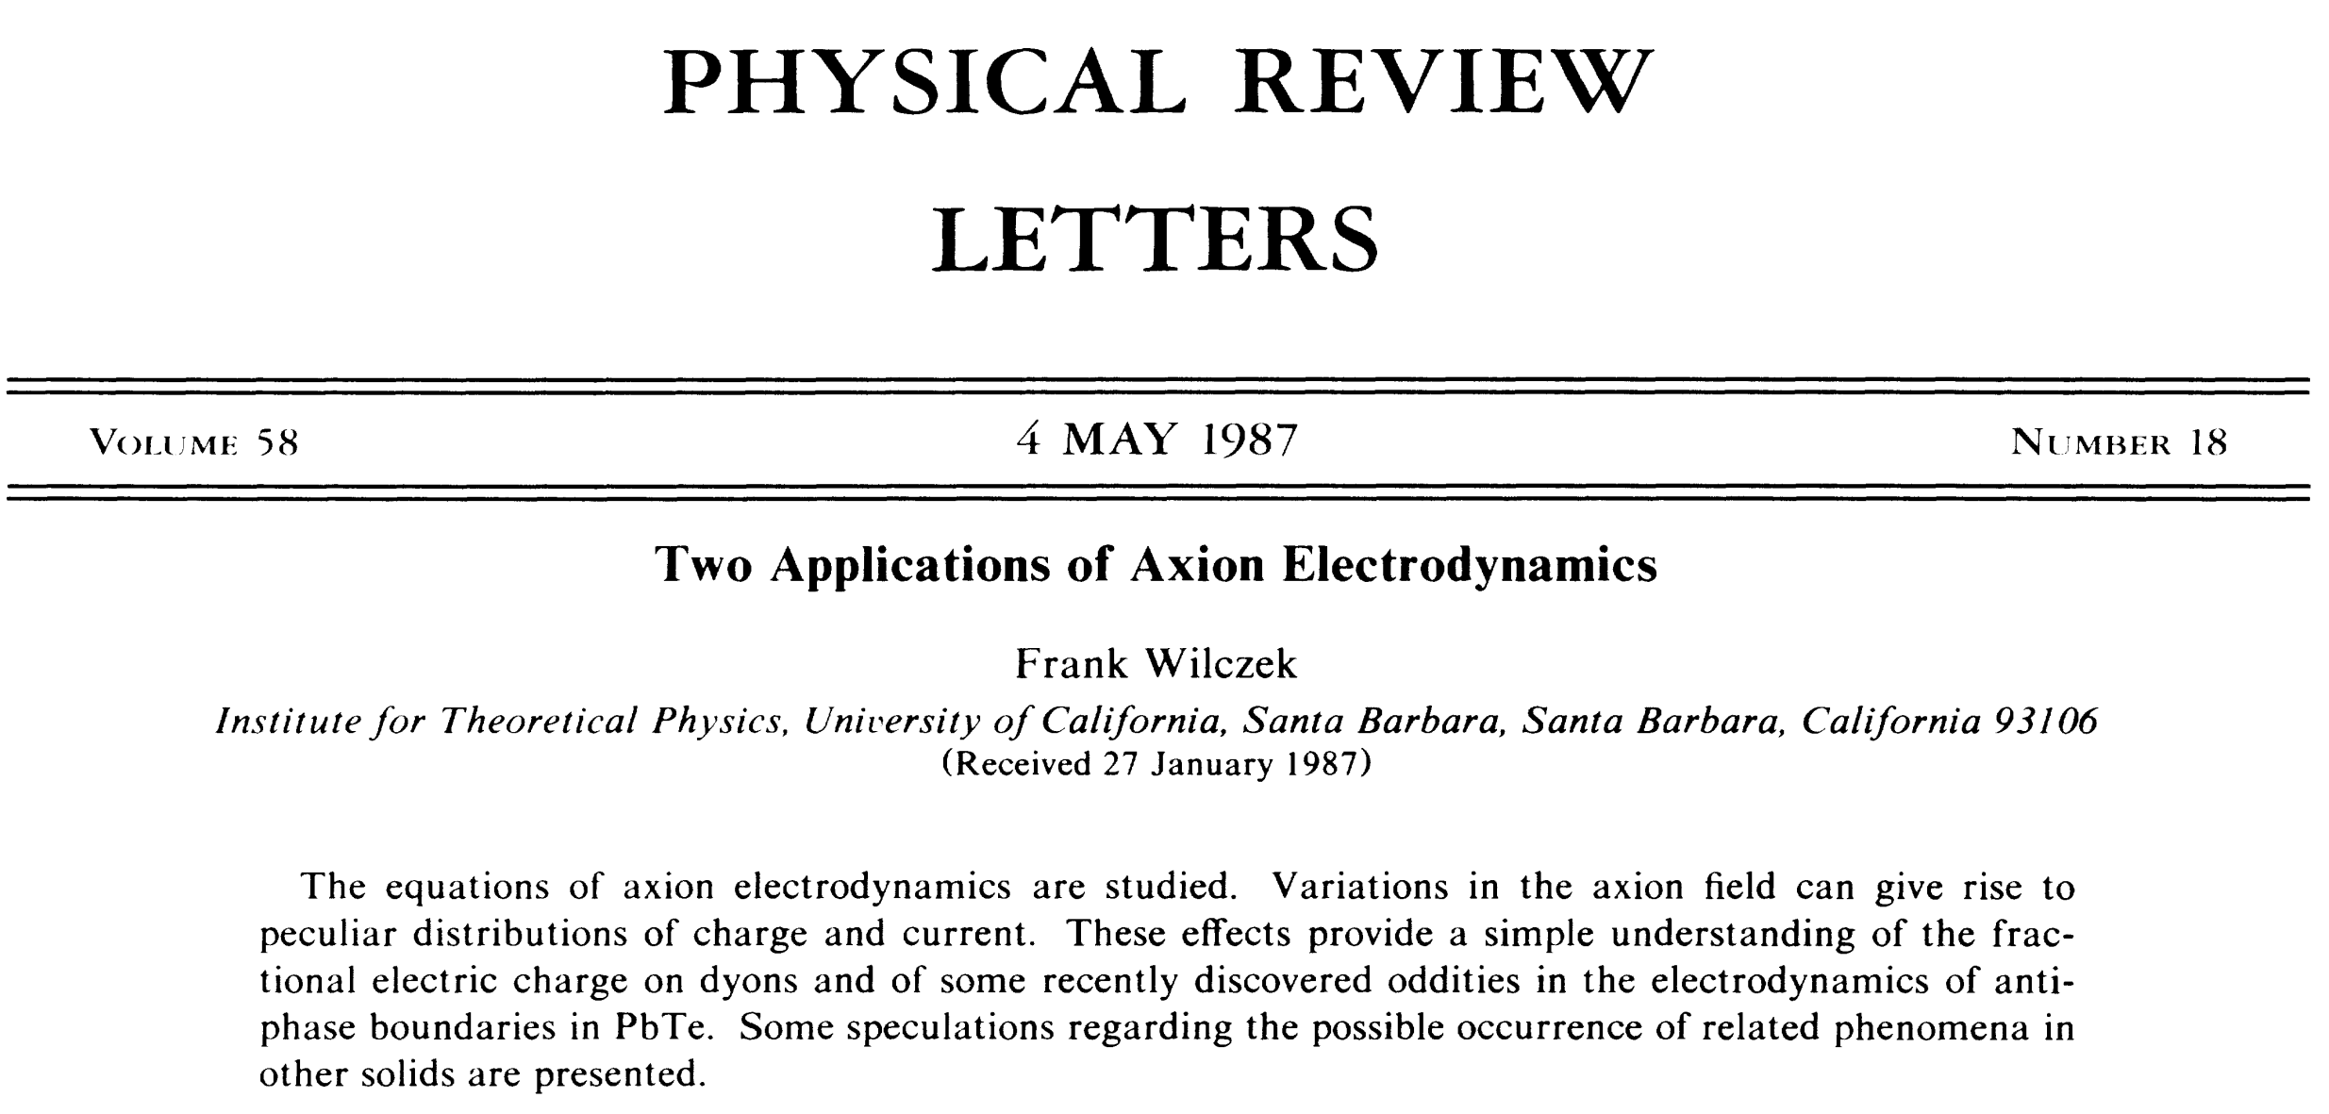
I was 2 weeks old when this came out!

Slide 5
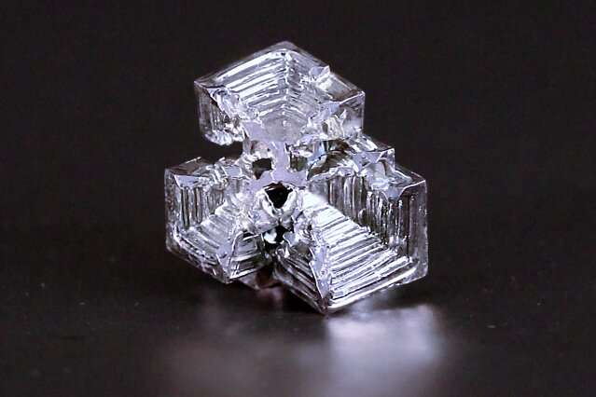
Topological Insulators
e.g. Kane & Mele (2005)
Materials based on Bismuth (e.g. Bi₂Se₃, Bi₂Te₃), and Antimony (e.g. Sb₂Te₃)
A crystal of Bismuth

Slide 6
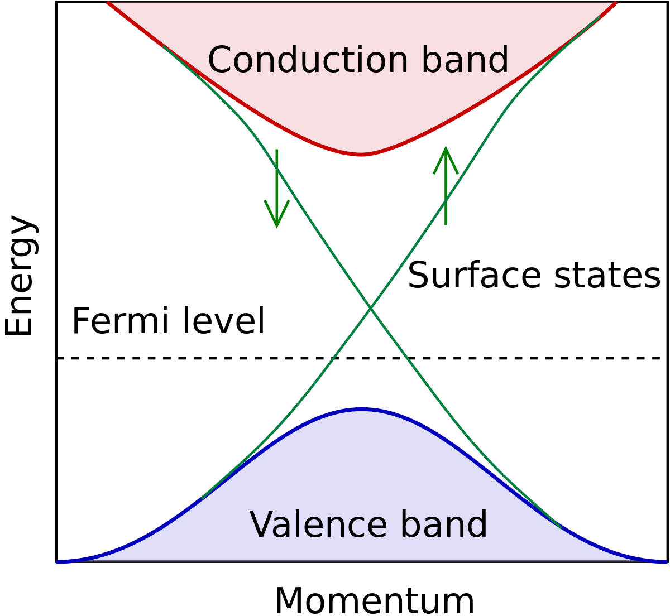
Topological Insulators
e.g. Kane & Mele (2005)
Fig: Wikipedia
Class of materials with insulating bulk and conducting surface.
Surface Hall currents described by electromagnetic Θ-term, with Θ=π.
Static Θ=π (T-symmetry)→ only affects EM on surface.

Slide 7
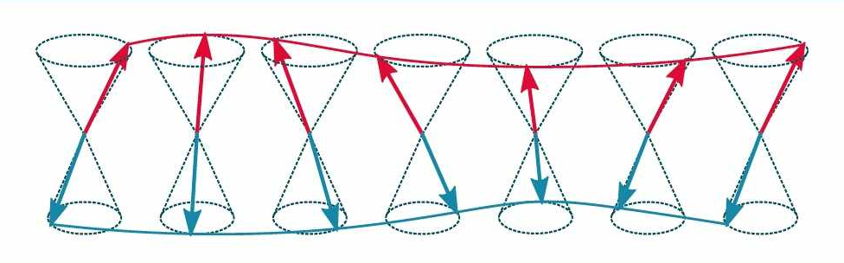
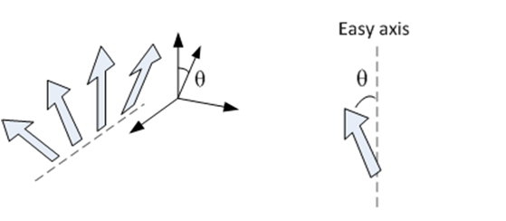
Antiferromagnetic Magnons
A-lattice
External field → spin precession → “spin wave”
B-lattice
Antiferromagnetic “magnetization” below Neel temp T_{N}:
Figs: Joel Cramer; Wikiwand.com
Spins have magnetic fields→ interact via “exchange” with each other, and “anisotropy” to “easy axis” in crystal.
Anisotropy:
Exchange:

Slide 8
e.g. Haldane (1983), Hofmann (1998)
Antiferromagnetic Magnons
Mean field theory Heisenberg model in crystal. Use Noether’s theorem.
Magnetic order breaks SO(3) and T → goldstone bosons magnons (spin waves).
Terms in Lagrangian (and scattering amplitudes!) just like pions and axions:
n live on coset space:
G/H = SO(3)/U(1) = S²
Frequency given by exchange, anisotropy and applied fields → O(meV):
Spin wave “mass”
“Kittel shift”
“Gell-Mann-Oakes-Renner relation”
(spontaneous) * (explicit) symmetry breaking
Spin wave “stiffness”

Slide 9
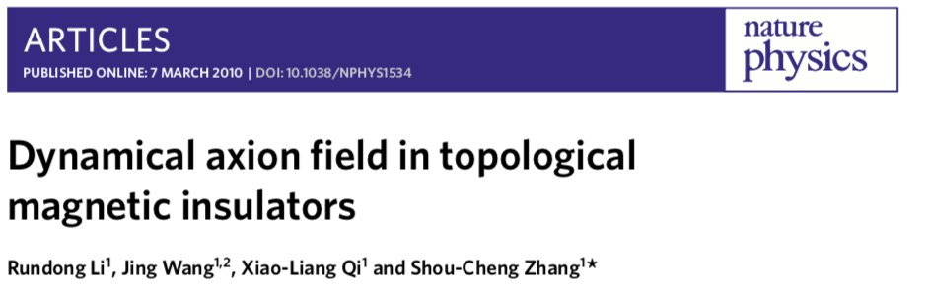
Review: Sekine & Nomura (2021)
Fluctuating AFM order couples to E.B → axion ~ magnetoelectric coupling α_{ii}.
Need to break T and P symmetries. Original idea: AFM amplitude mode.
“Integrate in” dynamics for the order parameter M₅ =L=Un ~ θ(x,t).

Slide 10
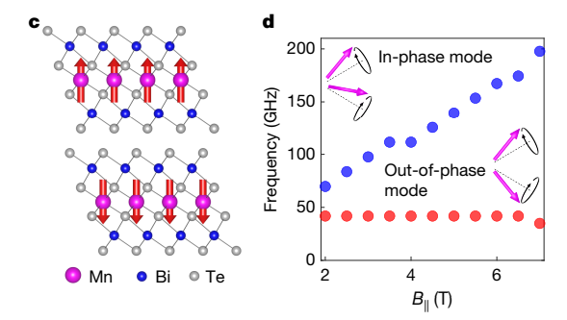
The amplitude mode is difficult to excite. Need particular symmetries.
New insight: in-plane B tilts spins → effective order parameter fluctuation.
This can be achieved in well understood even-layer MnBi₂Te₄ “axion insulator”.
Experimental measurements
(different set up to main)
Zhu et al (2021); Qiu, DJEM et al (2025)

Slide 11
Detecting quasiparticles with lasers

Slide 12
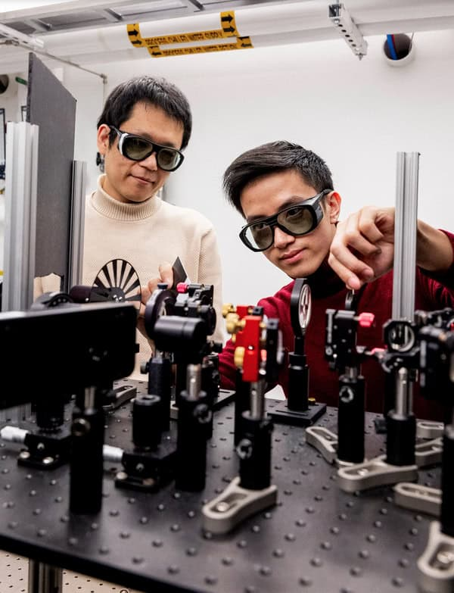
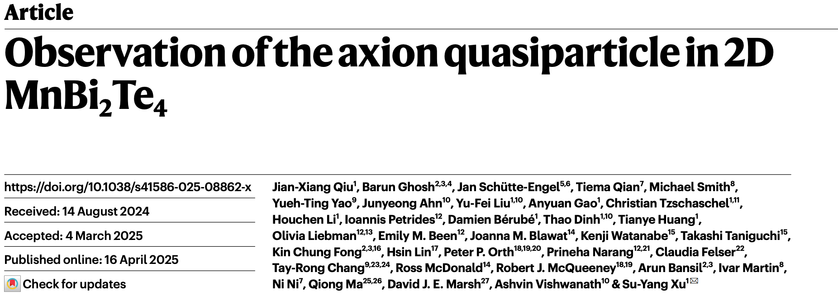
Su-Yang Xu
Jian-Xiang Qiu

Slide 13
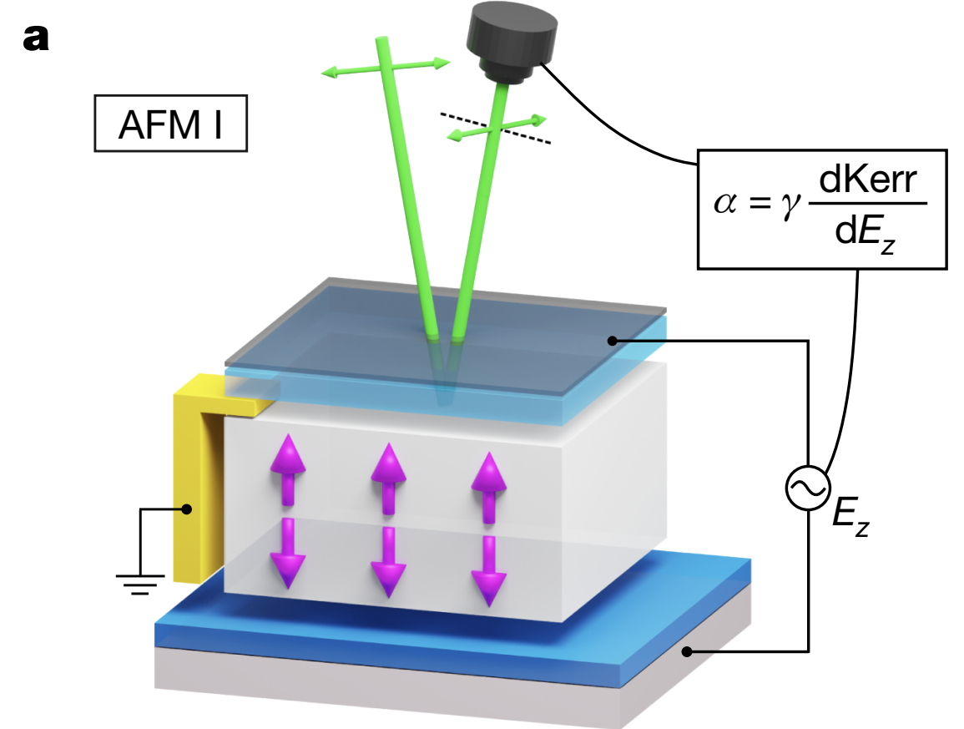
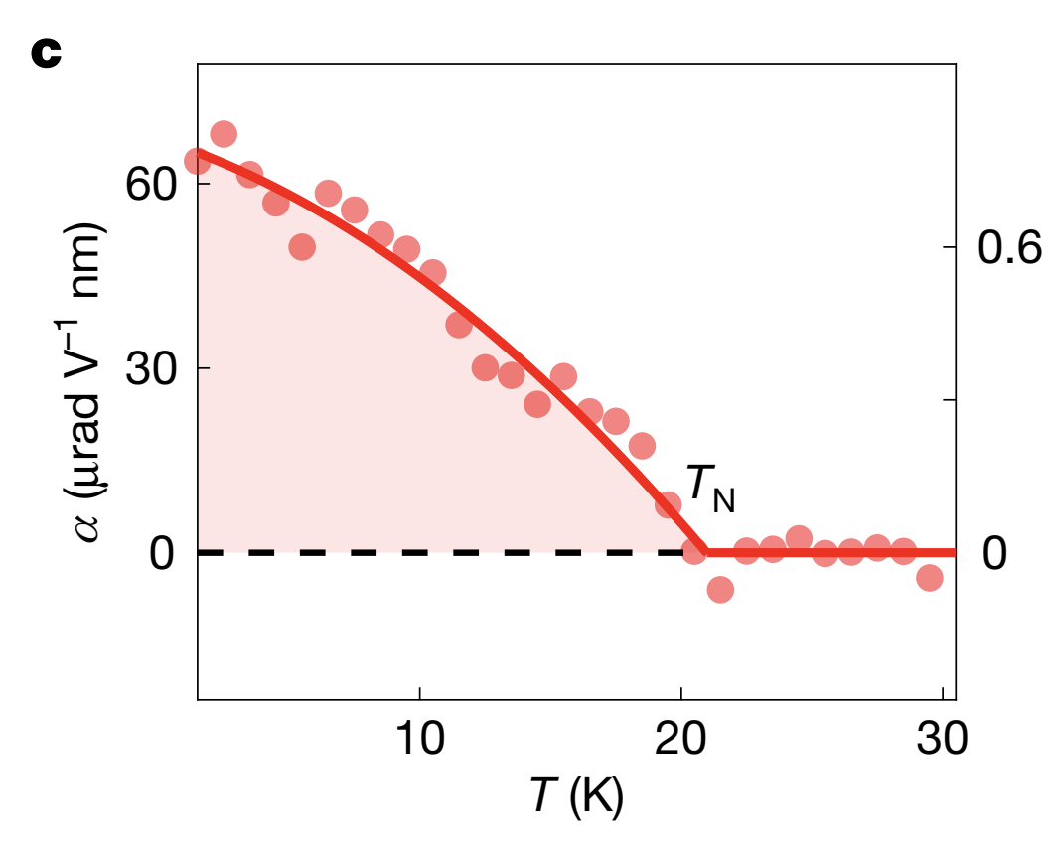
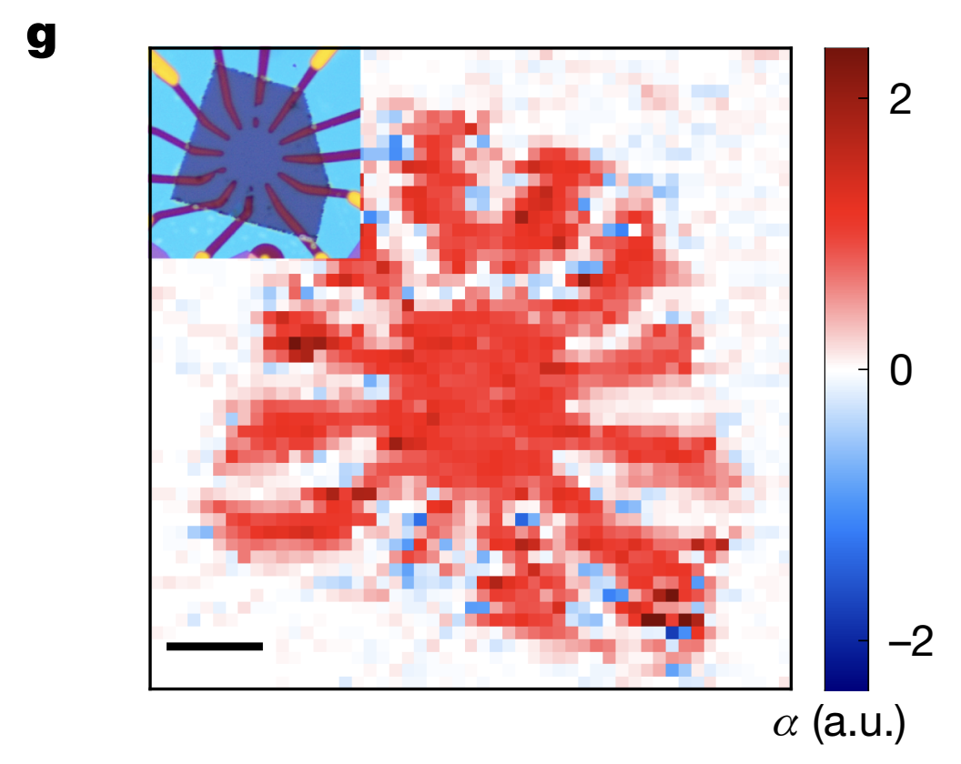
First, measure the static magnetoelectric effect…
E-induced magnetization = magnetoelectric effect, α. “Kerr effect”: K→ rotation of laser ~ magnetization M_{z}.
Vary E-gate → dK/dE = dM/dE = α.
Mapping α on the device
10 μm

Slide 14
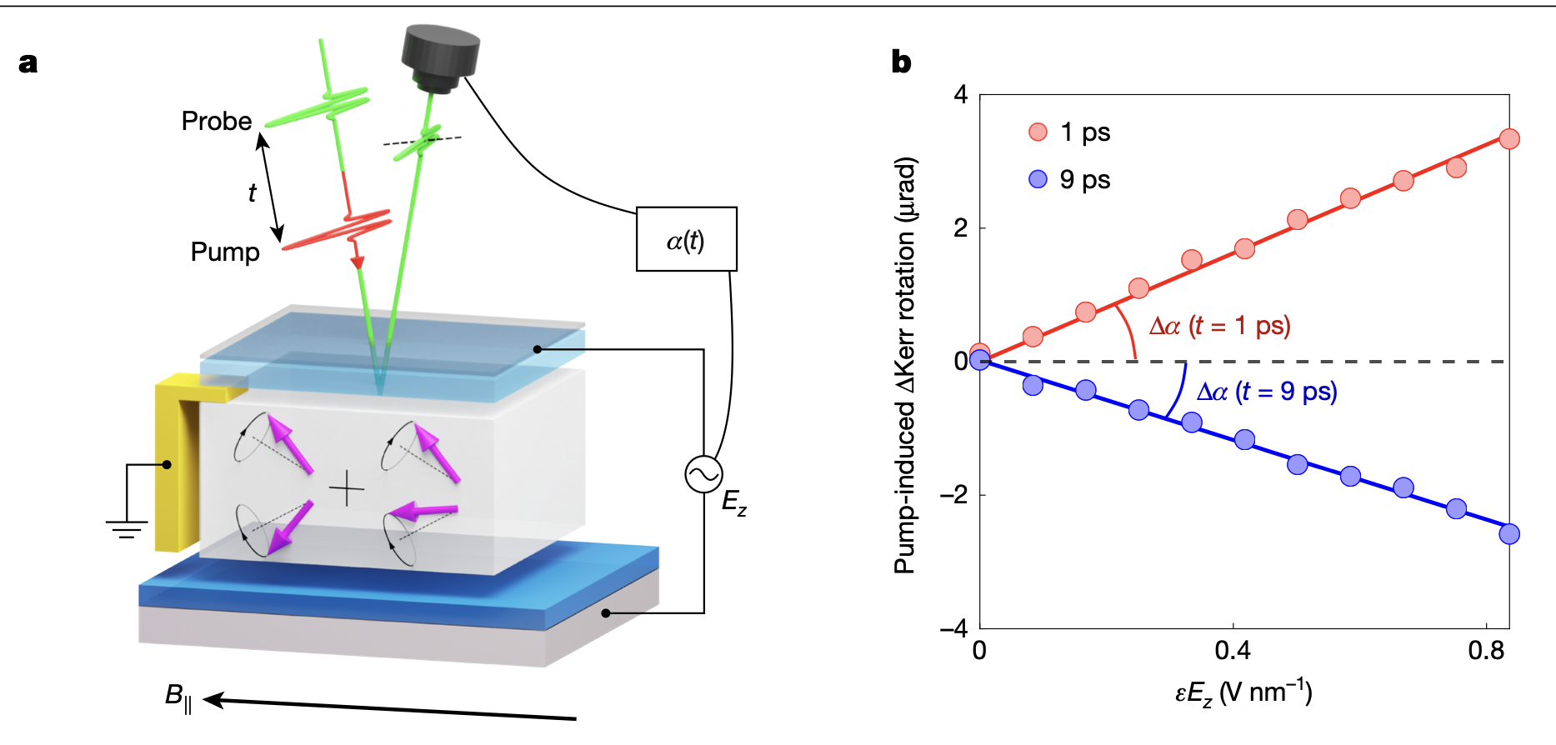
Now let’s measure the dynamics of α…
α(t) = α_{stat} +Δα(t)
Pump laser, 515 nm, excites the magnon modes → oscillating axion.
Axion-photon coupling causes probe laser polarization angle to oscillate.

Slide 15
Oscillation Δα ~ 0.12 α_{stat}.
Δα [μrad V⁻¹ nm]
Δα [e²/2h]
Delay time [ps]
NB: looks v. low Q resonance. This is optically driven off resonance.

Slide 16
WE HAVE DISCOVERED THE AXION (QUASIPARTICLE) AND ITS FREQUENCY IS 44 GHZ (0.18 meV)

Slide 17
Axion quasiparticle parameters
Qiu, DJEM et al (2025)
Schütte-Engel, DJEM et al (2021)
Measurement, plus first principles DFT calculations with VASP (enabled by concrete realization!)
AQ mass
Measured
0.18 meV
Decay constant (spin wave stiffness)
DFT
82 eV
Refractive index
DFT
6.4
Resistivity → conductive losses
DFT
0.2 * 10⁻³
Magnetic impurity-induced losses
Estimated from δL/L
Micron impurities
0.7 * 10⁻³
Bayrackci et al (2006)
These inferences validate earlier work and provide critical new insights for the future…

Slide 18
Detecting axions with axions
See also: DJEM et al (PRL, 2019); Schütte-Engel, DJEM et al (JCAP, 2021)
The idea [formerly?] known as “TOORAD”

Slide 19
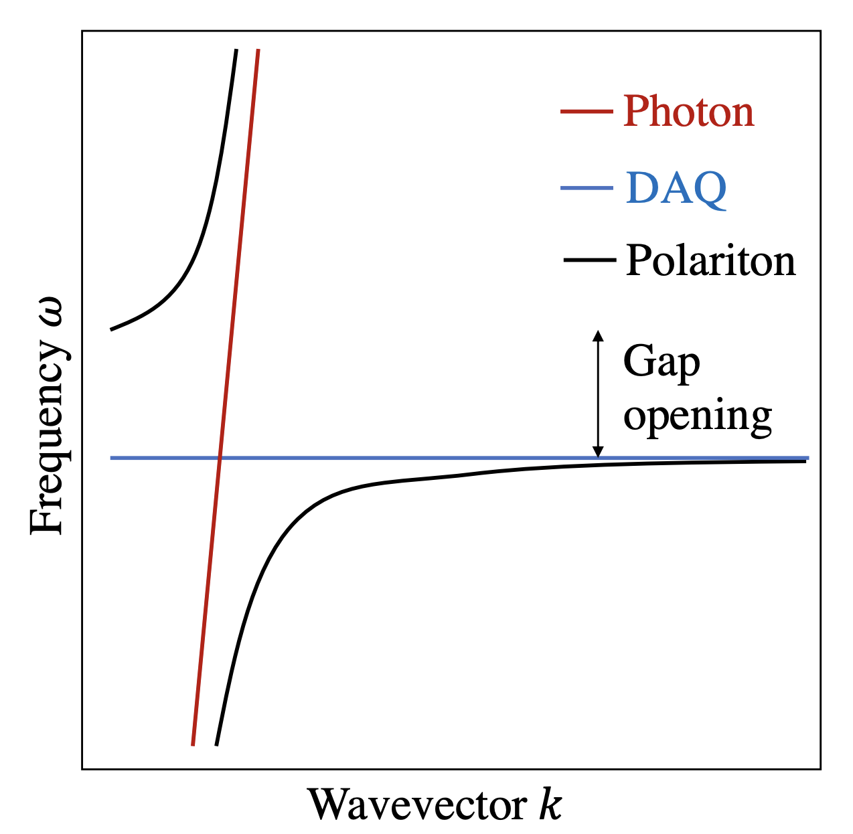
The basic idea
DJEM et al (PRL, 2019)
Bulk resonance AQ-photon mixing (polariton) → decouple resonant frequency from volume.
“Replace pump laser with axion dark matter, on resonance”
c.f. ALPHA
AQ-photon mass mixing
DM driving force
Diagonalise → “polaritons”
(linear comb. θ and E)
AQ-polaritons give tunable axion DM detector in ~meV. Power estimate: bulk res. with given Q.

Slide 20
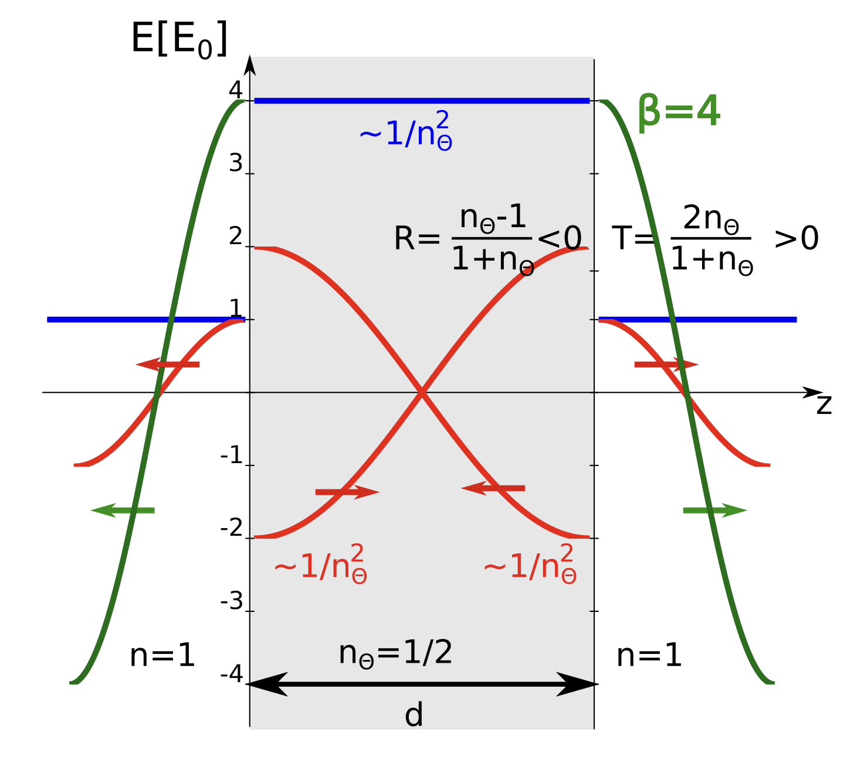
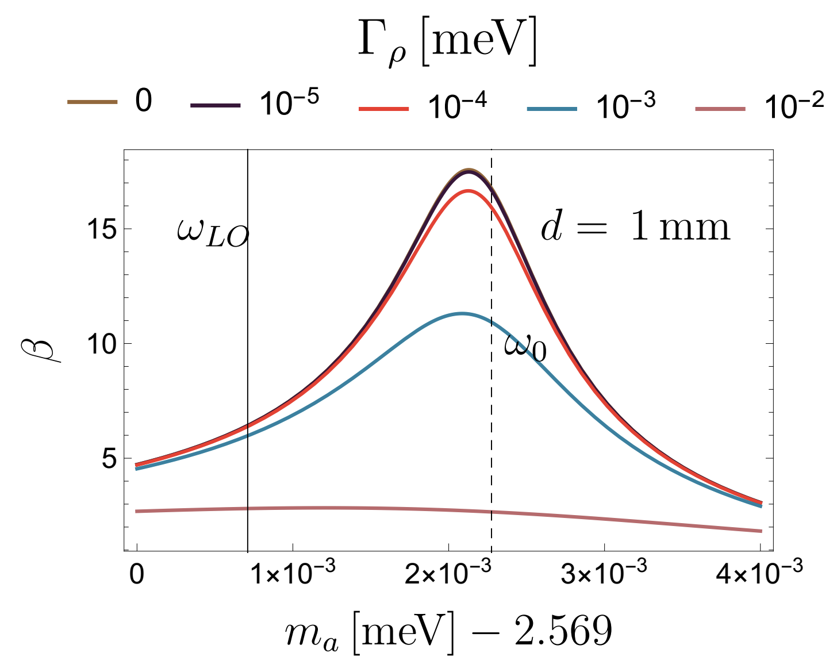
Computing the sensitivity
Schütte-Engel, DJEM et al (2021)
Complete treatment: 1d layer model, define “boost factor” β, cf MADMAX.
Include conductance losses for E, Γ_{ρ}, and impurity losses for magnons, Γ_{m}.
Effective refractive index in polariton material
n goes to zero on res. c.f. Andrew Long’s talk

Slide 21
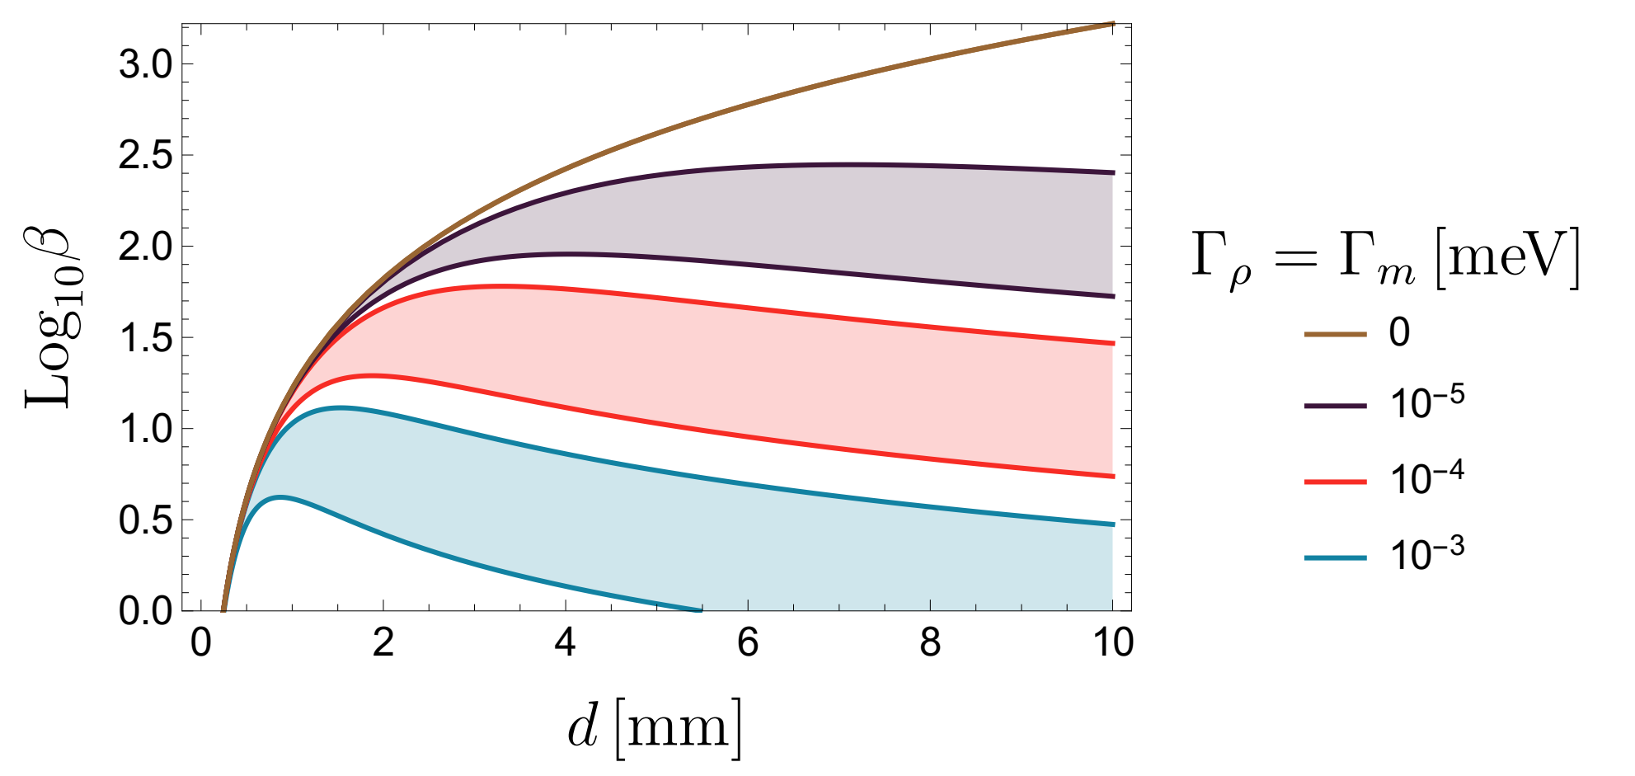
The boost factor depends on sample thickness , material losses and refractive index.
B=2 T
Lower: n=3
Upper: n=7
Schütte-Engel, DJEM et al (2021)
Measured+DFT parameters → β² ~100 in MnBi₂Te₄.
Search/engineer materials with lower losses. Coatings/layers to control the refractive index.

Slide 22
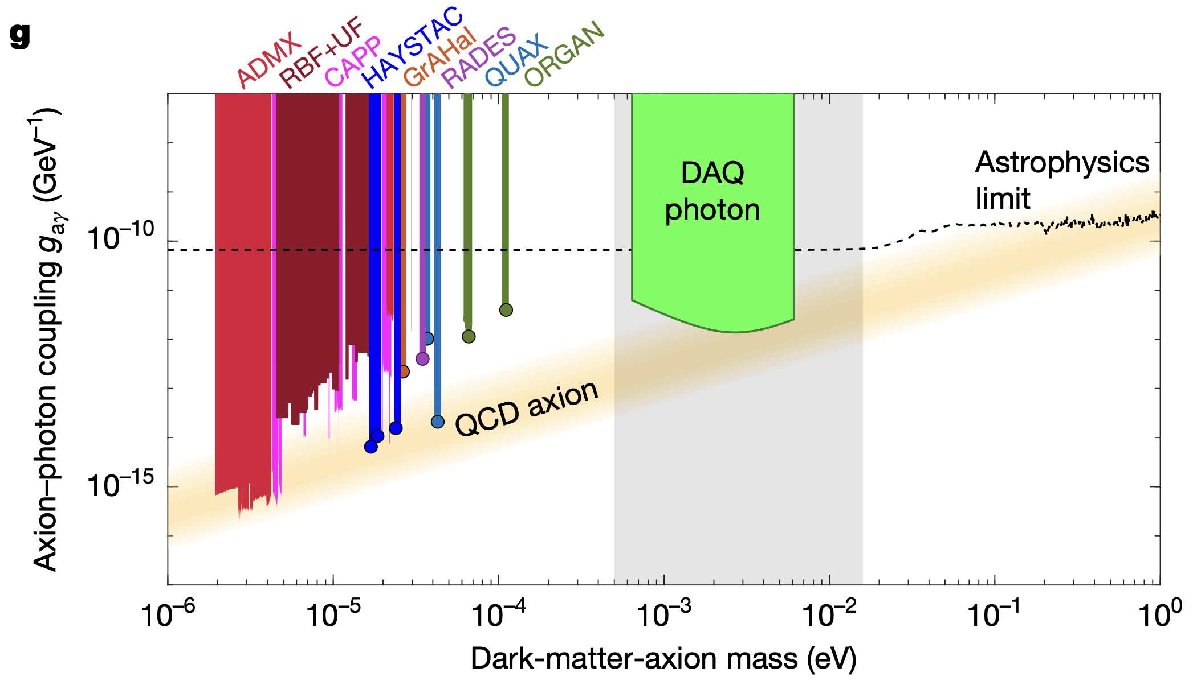
Sample size ~ (40cm)² *(1 mm). Integration per ν~1 h, total ~ 3 years. Dark count 10⁻⁵ s⁻¹
Propose to grow thick samples of a repeating superlattice of six-layer MnBi2Te4 and spacer layer.
Magnetic tuning 0.1 to 10 T → “rip across frequencies” with current tech (Karl’s dream). Complementary to broad band searches in same range (BRASS/BREAD).

Slide 23
Comments on the road ahead

Slide 24
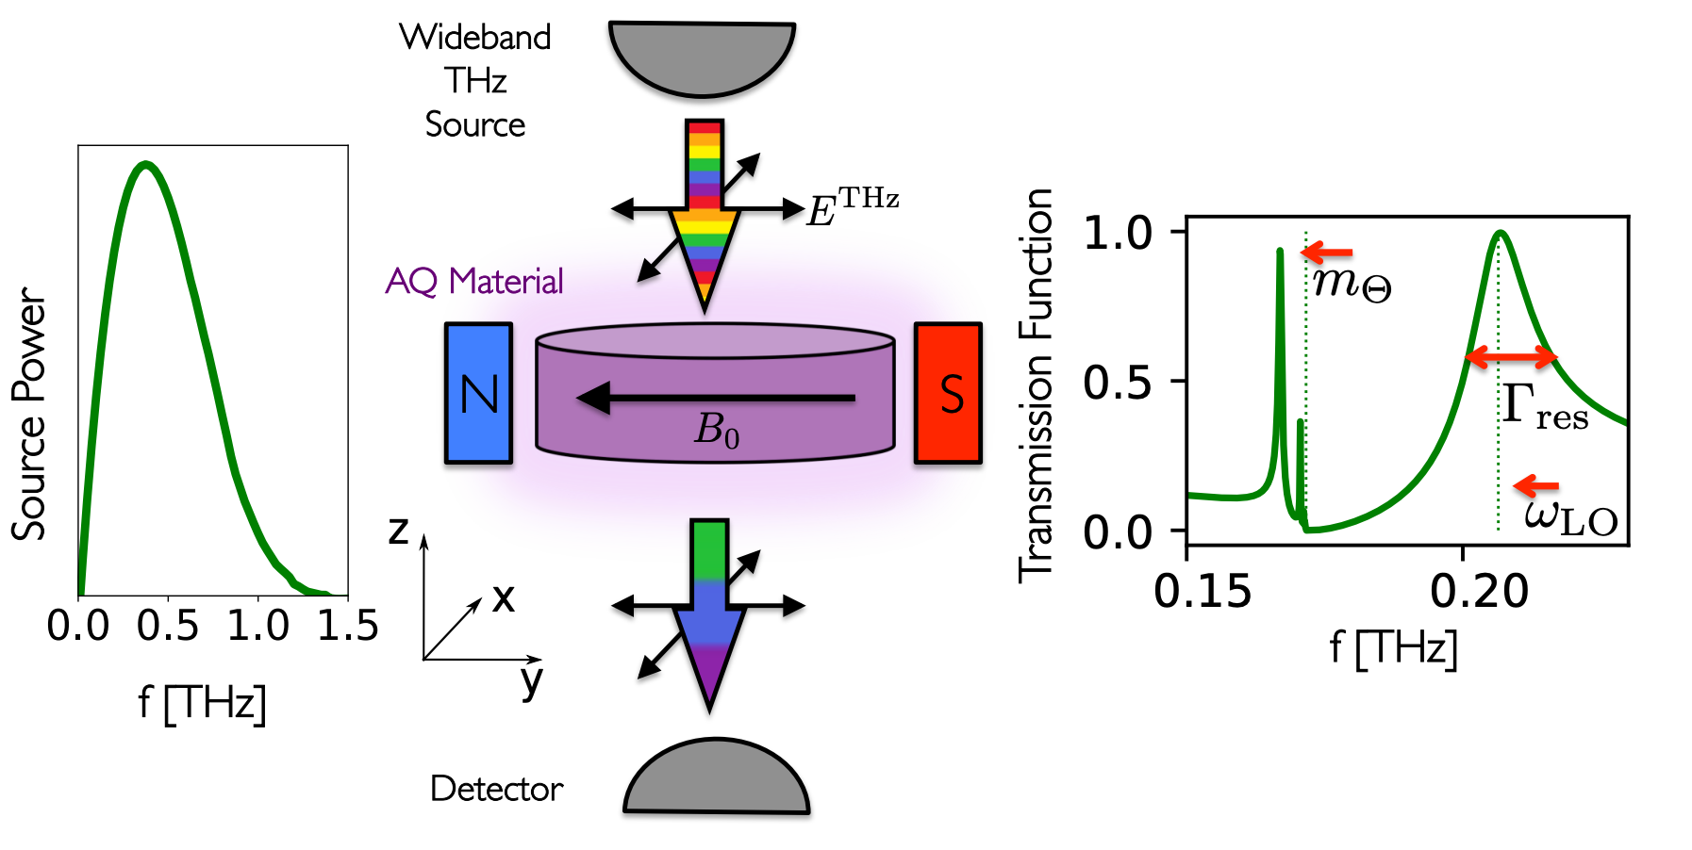
Measuring Polariton Losses
Need to detect the axion polariton in transmission to measure loss parameters.
Schütte-Engel, DJEM et al (2021)

Slide 25
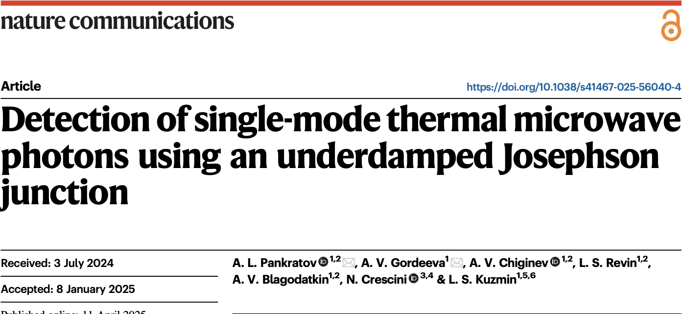
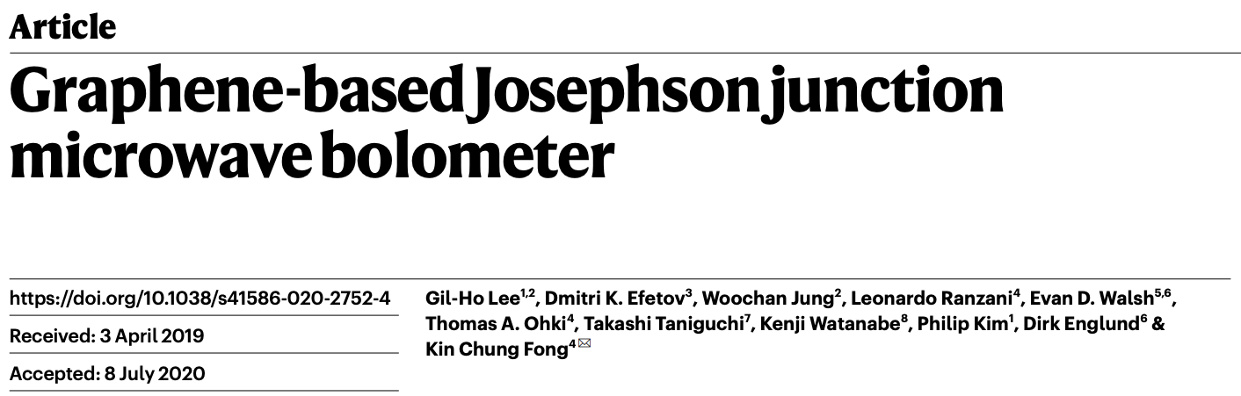
Low dark count >40 GHz SPDs
Should be possible to scale up these ideas to ~50-100 GHz.
Proof of concept at low AQ-polariton frequencies seems possible.
Paraphrasing Nico Crescini:
“If you build it, they will come”

Slide 26
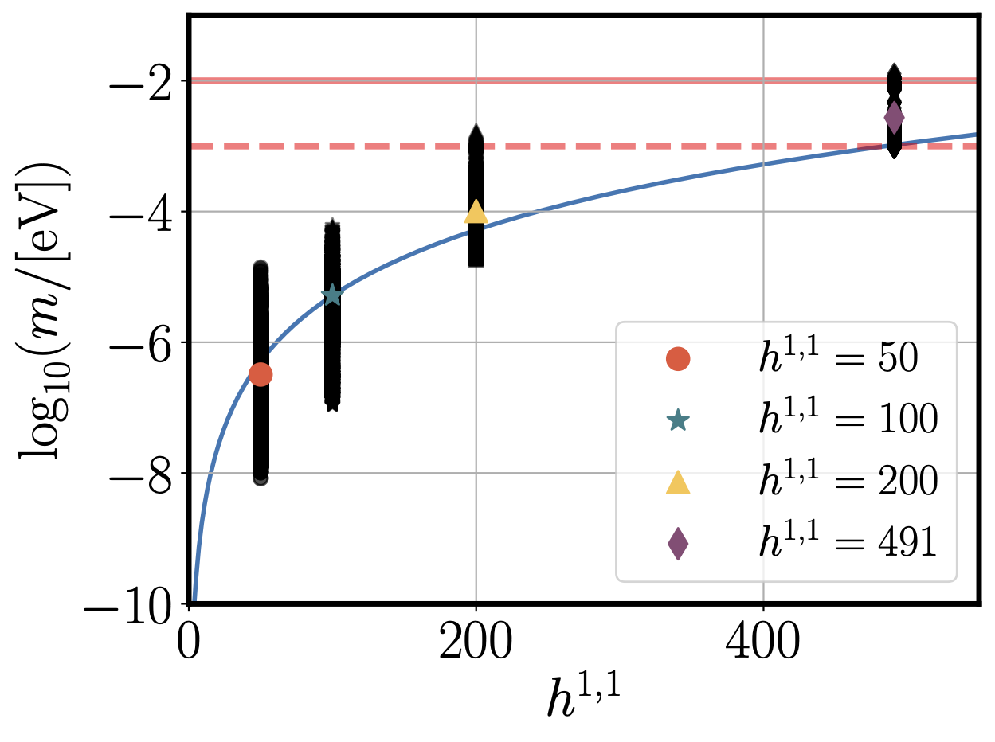
meV QCD axion in string theory
Axion decay constants strongly correlated with topology:
See Liam’s talk
meV QCD axion arises at largest h11=491 which likely dominates the set of all Calabi-Yaus.
Currently only good understanding of closed string sector → pre-inflation axions → need to tune θi~π for abundance.
Number of axions, N = h^{1,1}
Unless level crossing is important!
Gendler, DJEM et al (2023)

Slide 27
Gendler & DJEM (PRL, 2025)
If AQ materials don’t detect the QCD axion, we could falsify parts of the landscape!

Slide 28
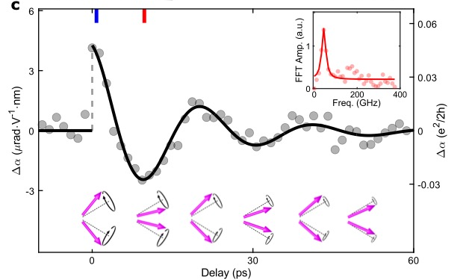
Axion quasiparticles exist. In MnBi₂Te₄, frequency is 44 GHz.
Mixing with the photon → polariton. Frequency tunable with B.
Predicted losses ~ 10⁻³ → (boost)² ~ 100.
(40 cm)² * (1 mm) sample → meV DM detector capable of reaching QCD band.

Slide 29
Backup slides

Slide 30
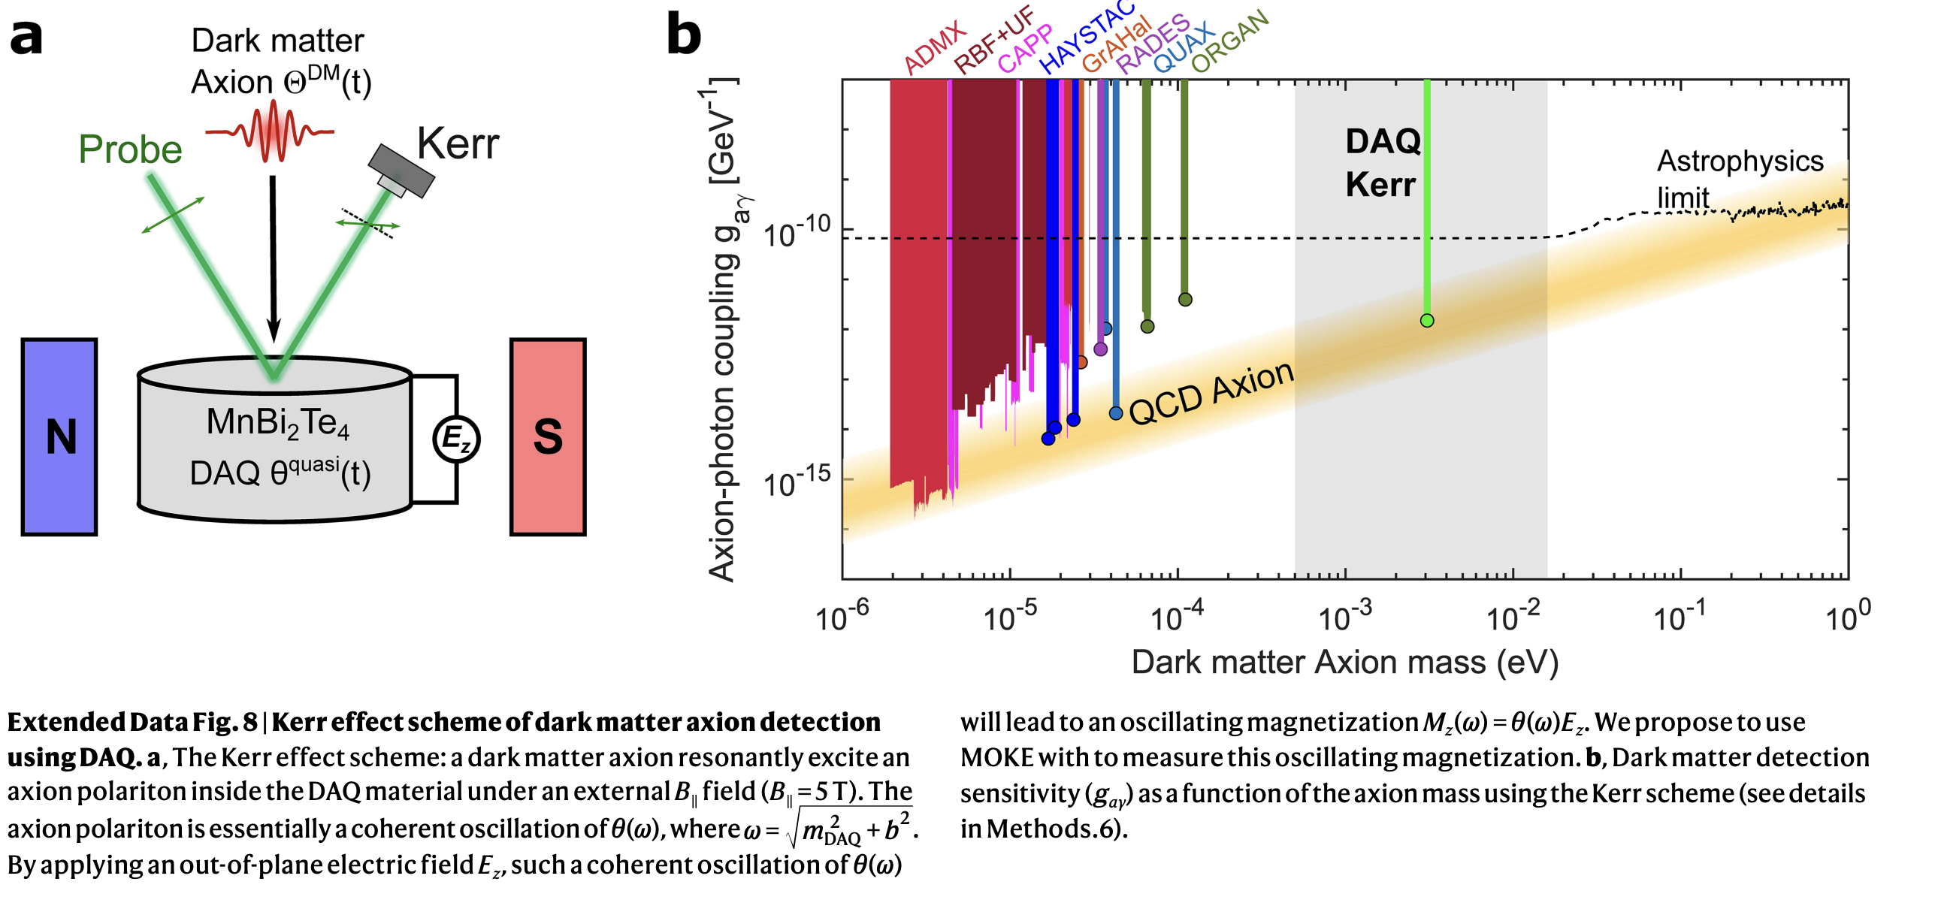
Kerr effect for DM detection
Does not need thick sample (volume independent like NMR). 0.7 nrad/Hz^{1/2} sensitivity assumed.
Integrate ~3months → not practically tunable. Only depends on magnetic losses.

Slide 31
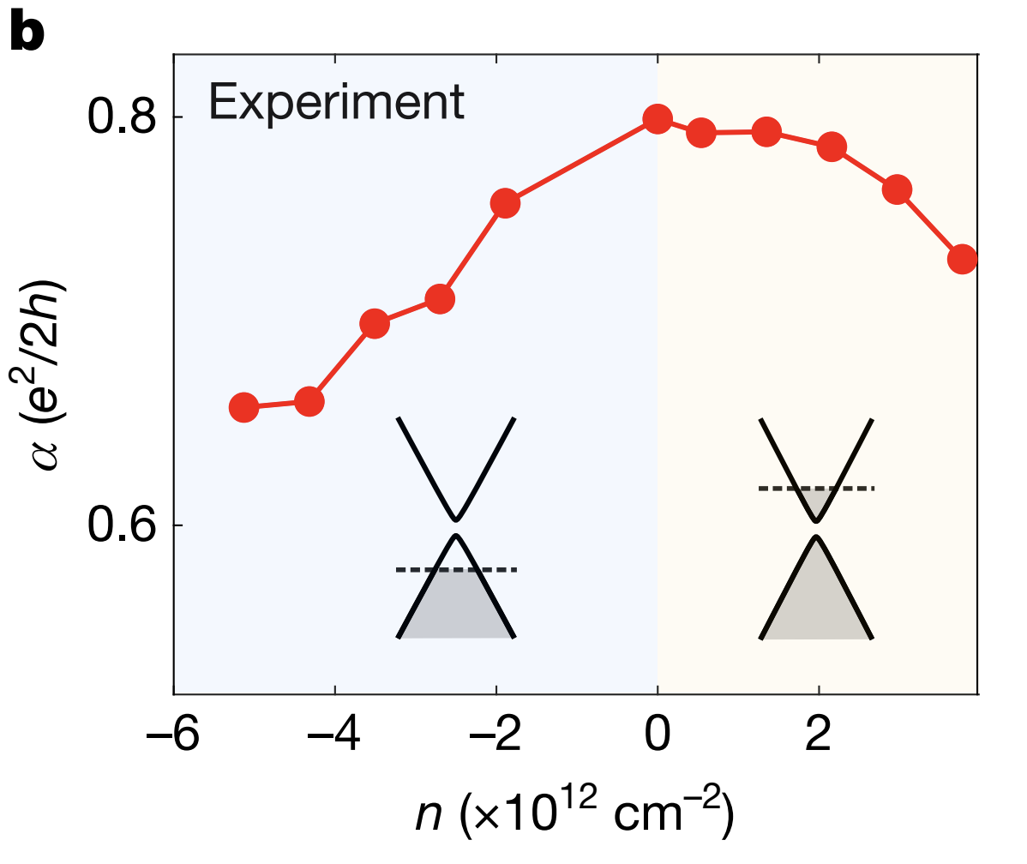
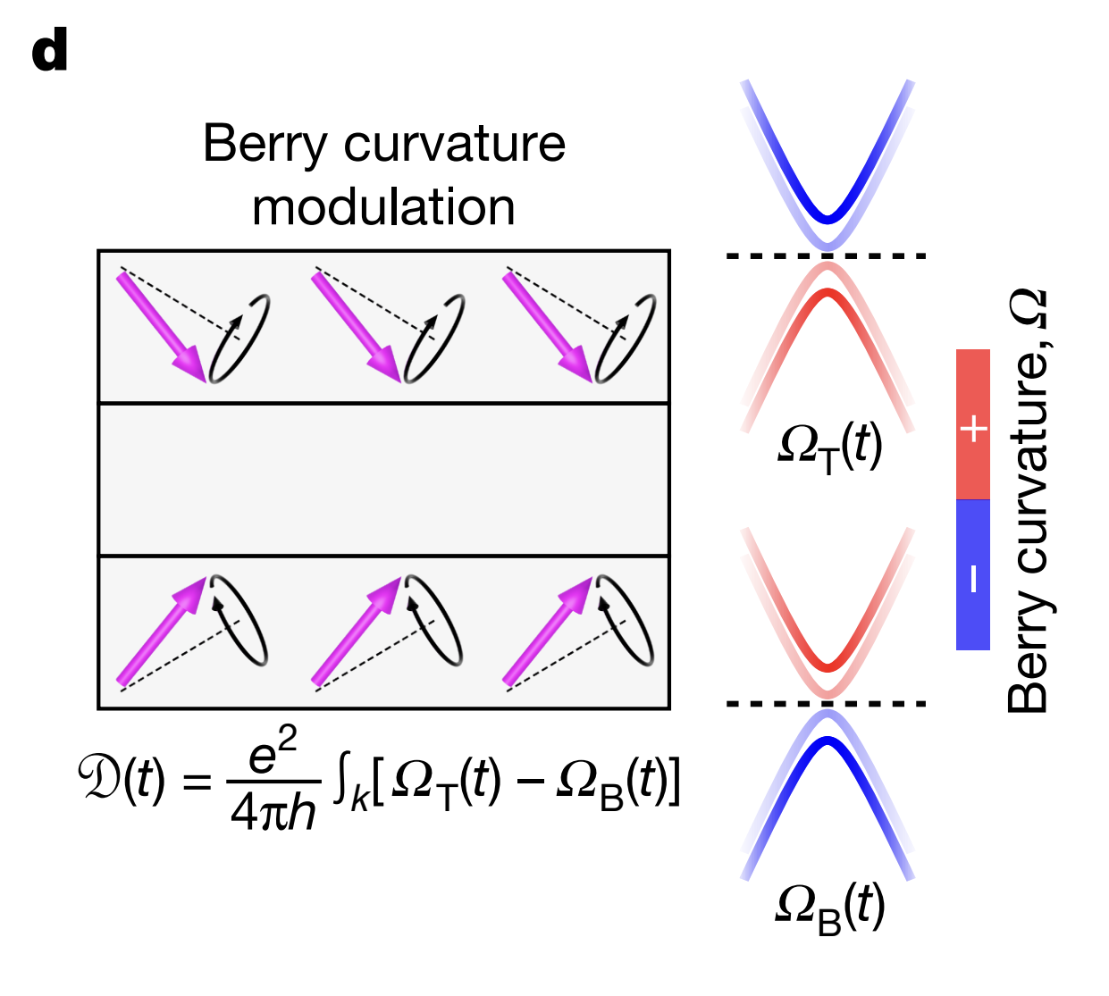
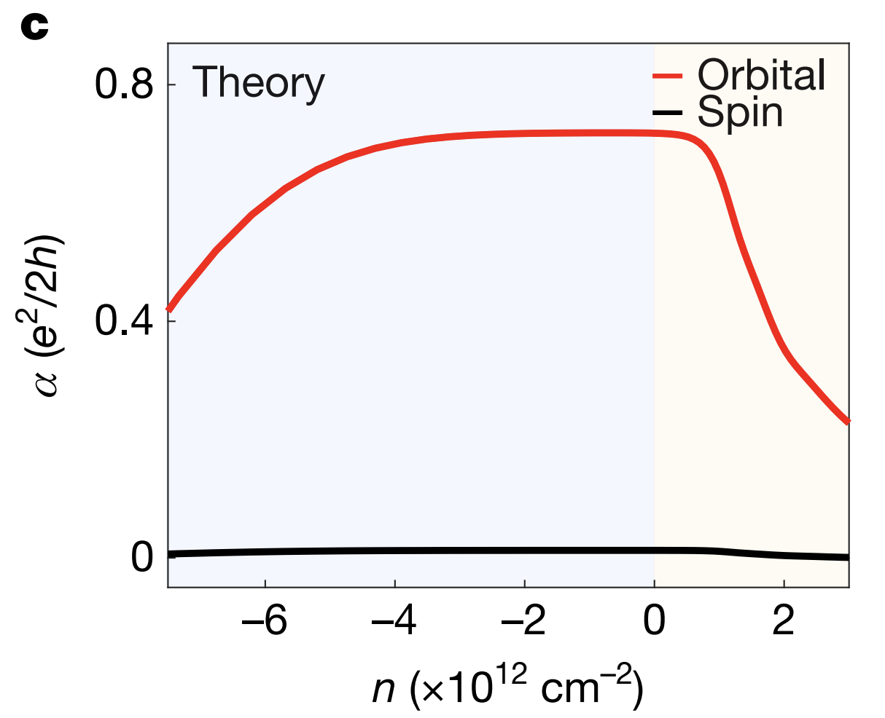
Microscopic Theory of AQ
The magnetoelectric coupling α has two contributions: spin and Berry curvature. The spin part comes from the localized magnetic ions; the Berry curvature part comes from the orbital motion of itinerant electrons
Charge density
A topological insulator features Dirac fermions on the top and bottom surfaces, which are gapped by the AFM order, resulting in opposite Berry curvatures on opposite surfaces → real-space dipole, D ~ α.

Slide 32
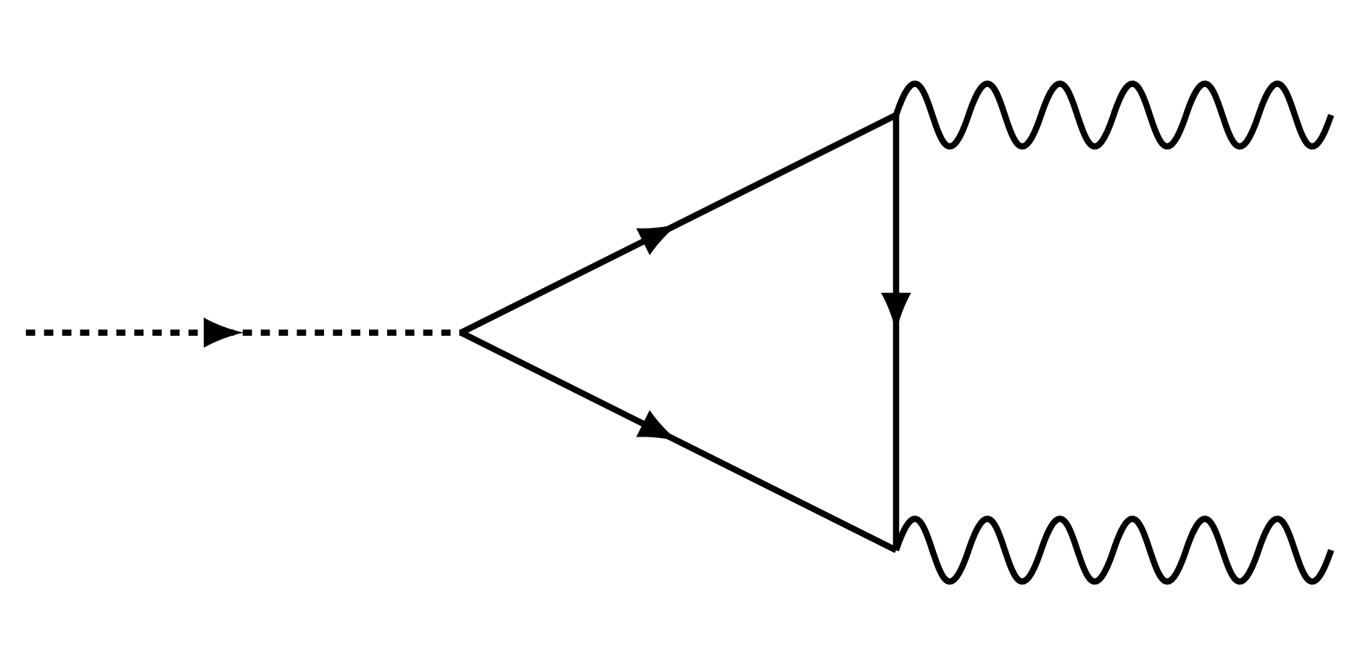
Axion Quasiparticles
“Hubbard-Stratonovich transformation”
Axion quasiparticle is the longitudinal (amplitude) magnon mode.
“Integrate in” dynamics for the order parameter M₅=Un. Loop → E.B coupling.

Slide 33
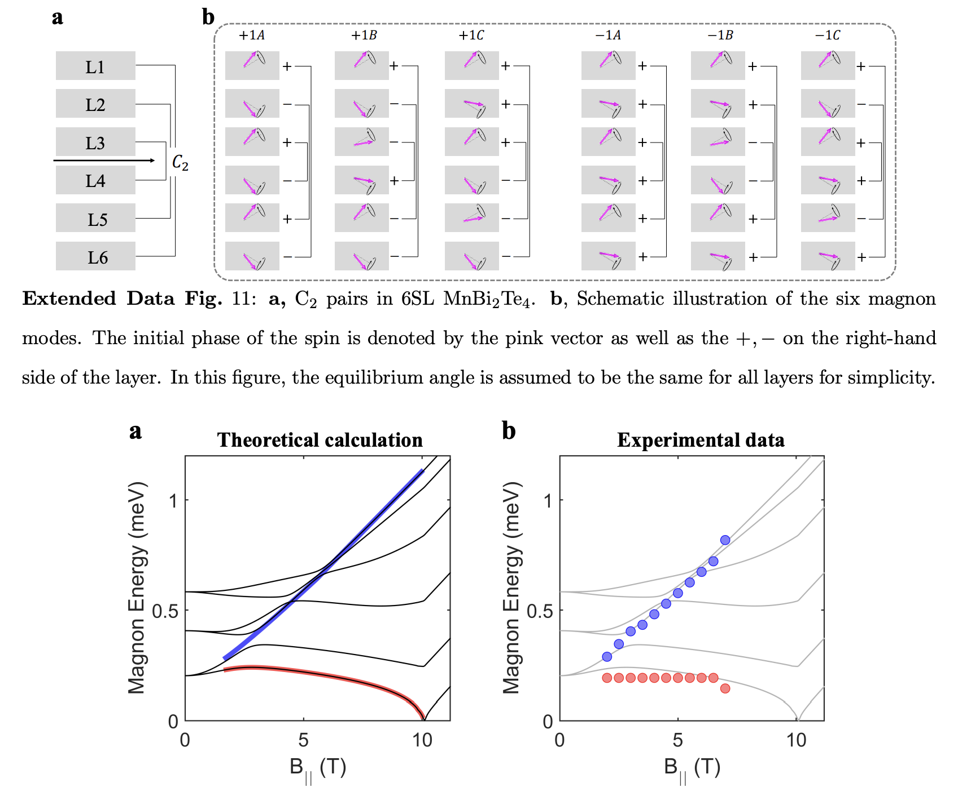

Slide 34
