Slide 1
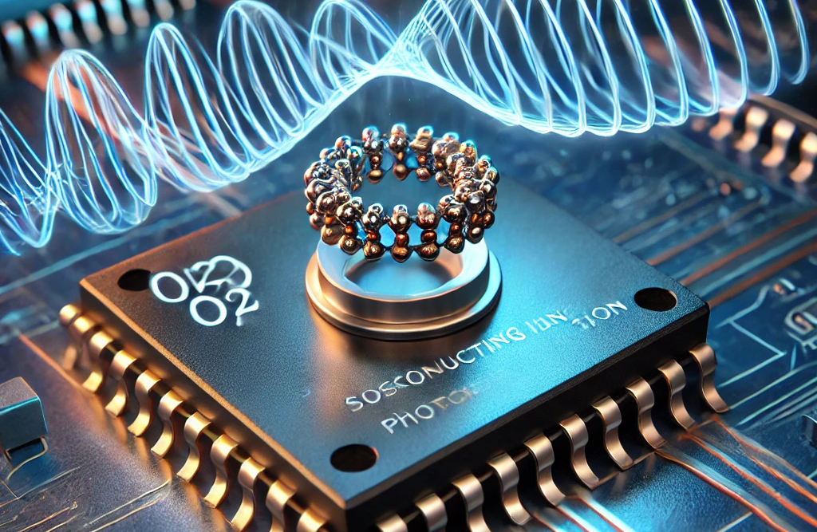

High-sensitivity detectors and readout technologies for axions searches
Claudio Gatti
LNF INFN

Slide 2
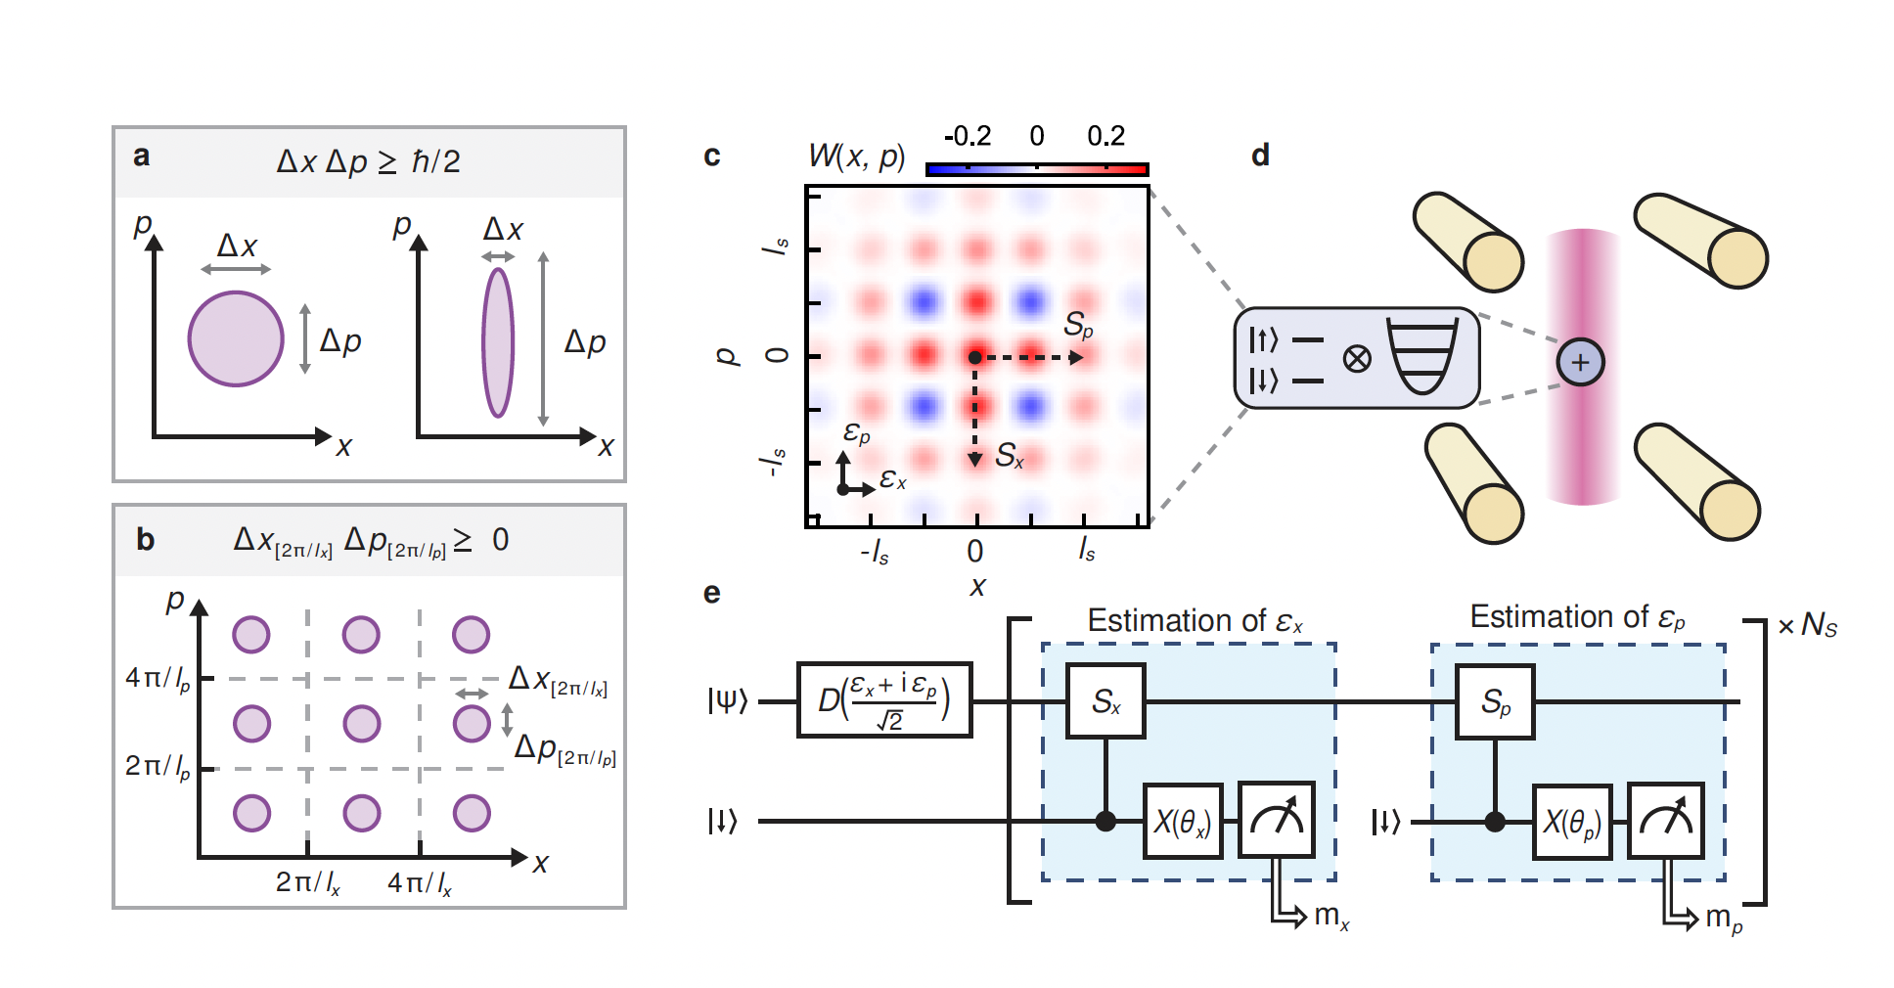


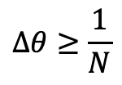
Outline
Quantum limit #1
Parametric Amplifiers
TWPA
Beyond Quantum Limit #1: Squeezing; Quantum Sensing
Single Qubit Sensors
Multi Qubit Sensors
Sensing with Non Classical States
Combining Squeezing and Counting
Coherent Sum of Signals
Operating in a Strong Magnetic Field
Quantum limit #2
$$Δθ≥\frac{1}{\sqrt{N}}$$
Standard Quantum Limit
$$Δθ≥\frac{1}{N}$$
Heisenberg Limit
Number of measurements N
Root mean squared error $Δθ$

Slide 3
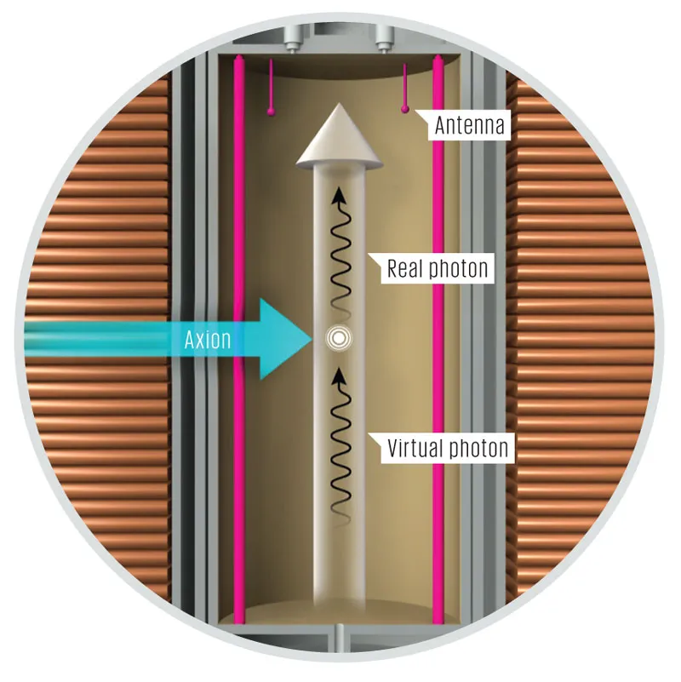
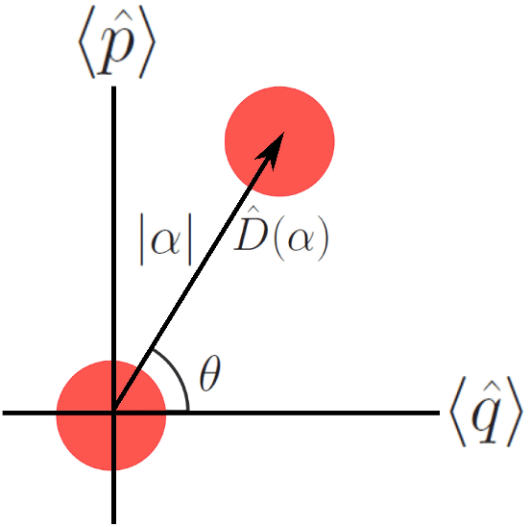
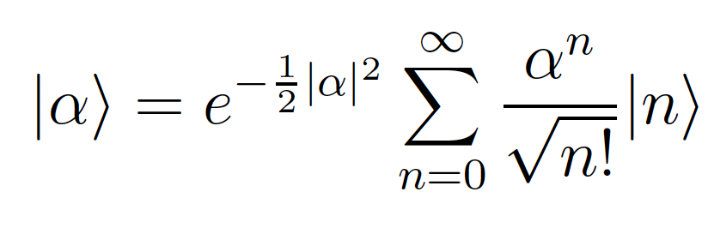
Axion Interaction in a Microwave Cavity
Displacement operator acting on a vacuum state to create a coherent state:
https://spectrum.ieee.org/the-hunt-for-the-invisible-axion

Slide 4
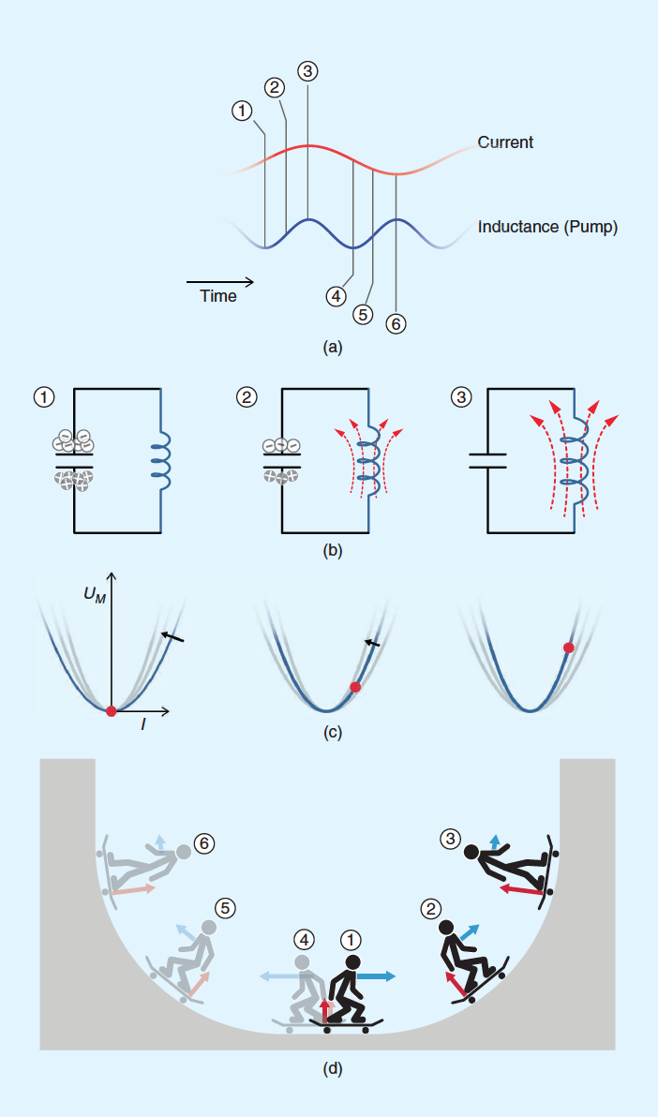
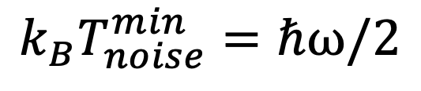
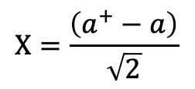
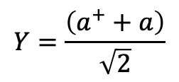
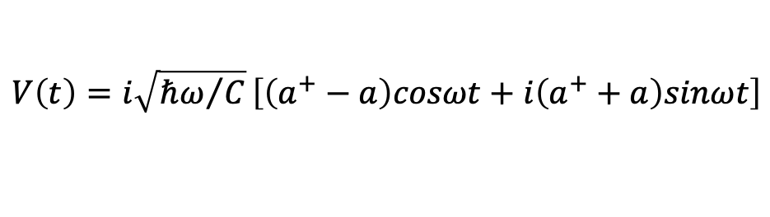
Parametric Amplification
Parametric amplification is obtained by modifying the parameters of an oscillating system.
In electrical circuits is obtained by modulating capacitances or inductors with “pump” currents.
In lossless superconducting circuits parametric amplification allows to reach the noise at the quantum limit.
$$V\left(t\right)=i\sqrt{{ℏω}/C}\left[\left(a^{+}−a\right)cosωt+i\left(a^{+}+a\right)sinωt\right]$$
$$Y=\frac{\left(a^{+}+a\right)}{\sqrt{2}}$$
$$k_{B}T_{noise}^{min}=ℏω/2$$
$$X=\frac{\left(a^{+}−a\right)}{\sqrt{2}}$$
J. Aumentado IEEE Microwave Magazine

Slide 5
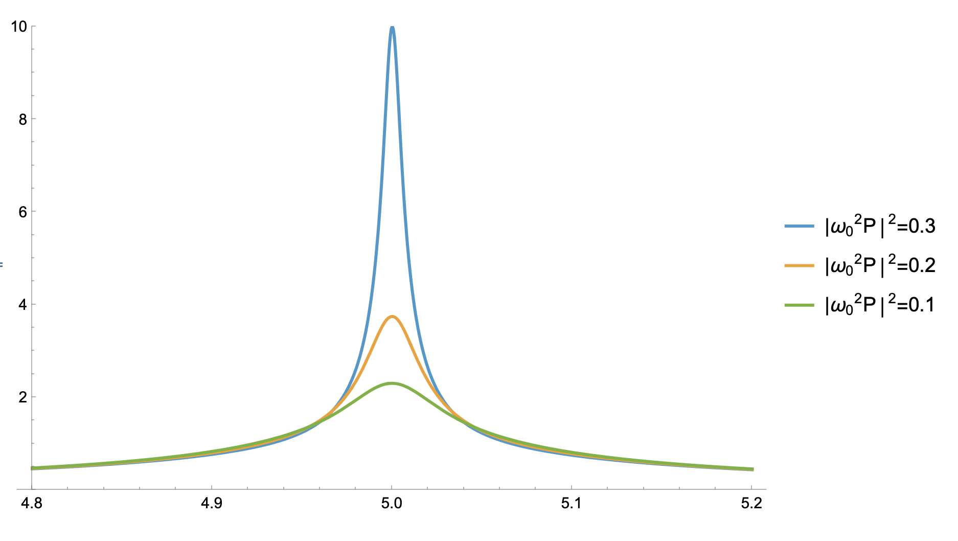

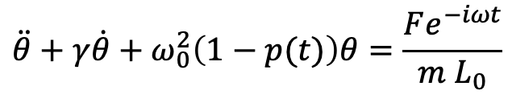

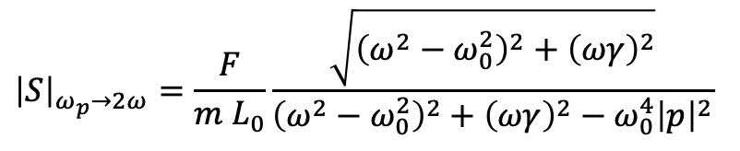
Parametric Amplification
$${\left|S\right|}_{ω_{p}→2ω}=\frac{F}{m L_{0}}\frac{\sqrt{{\left(ω^{2}−ω_{0}^{2}\right)}^{2}+{\left(ωγ\right)}^{2}}}{{\left(ω^{2}−ω_{0}^{2}\right)}^{2}+{\left(ωγ\right)}^{2}−{ω_{0}^{4}\left|p\right|}^{2}}$$
L=L₀+ΔL(t)
θ
Gain
m
F
-mg
Loss
Pump
$$\ddot{θ}+γ\dot{θ}+ω_{0}^{2}\left(1−p(t)\right)θ=\frac{Fe^{−iωt}}{m L_{0}}$$
$p\left(t\right)=\frac{ΔL\left(t\right)}{L_{0}}=p e^{−iω_{p}t}$+c.c.

Slide 6
Parametric Amplification
$${\left|S\right|}_{ω_{p}→2ω}=\frac{F}{m L_{0}}\frac{\sqrt{{\left(ω^{2}−ω_{0}^{2}\right)}^{2}+{\left(ωγ\right)}^{2}}}{{\left(ω^{2}−ω_{0}^{2}\right)}^{2}+{\left(ωγ\right)}^{2}−{ω_{0}^{4}\left|p\right|}^{2}}$$
L=L₀+ΔL(t)
θ
Effective increase in Q
Gain
m
F
-mg
Loss
Pump
$$\ddot{θ}+γ\dot{θ}+ω_{0}^{2}\left(1−p(t)\right)θ=\frac{Fe^{−iωt}}{m L_{0}}$$
$p\left(t\right)=\frac{ΔL\left(t\right)}{L_{0}}=p e^{−iω_{p}t}$+c.c.

Slide 7
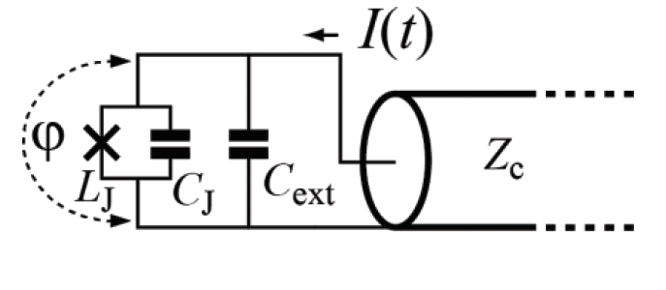
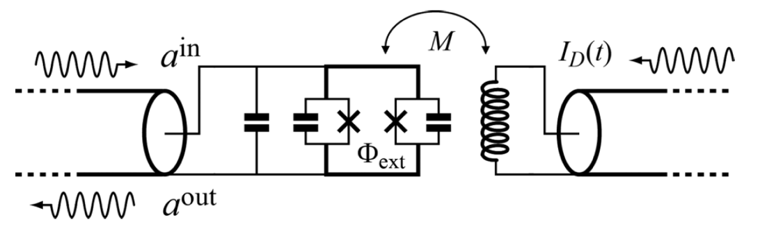
Josephson Parametric Amplifier
Quantum limited parametric amplification is obtained by driving non-linear non-dissipative elements such as Josephson junctions
Current Driven
Flux Driven
Parametric amplification achieved by modulating the bias current in the JJ: ω_{pump}~ω_{signal} 4 wave mixing
Parametric amplification achieved by modulating the flux in the DC-Squid: ω_{pump}~2ω_{signal} 3 wave mixing
ROY DEVORET PHYSICAL REVIEW B 98, 045405 (2018)

Slide 8
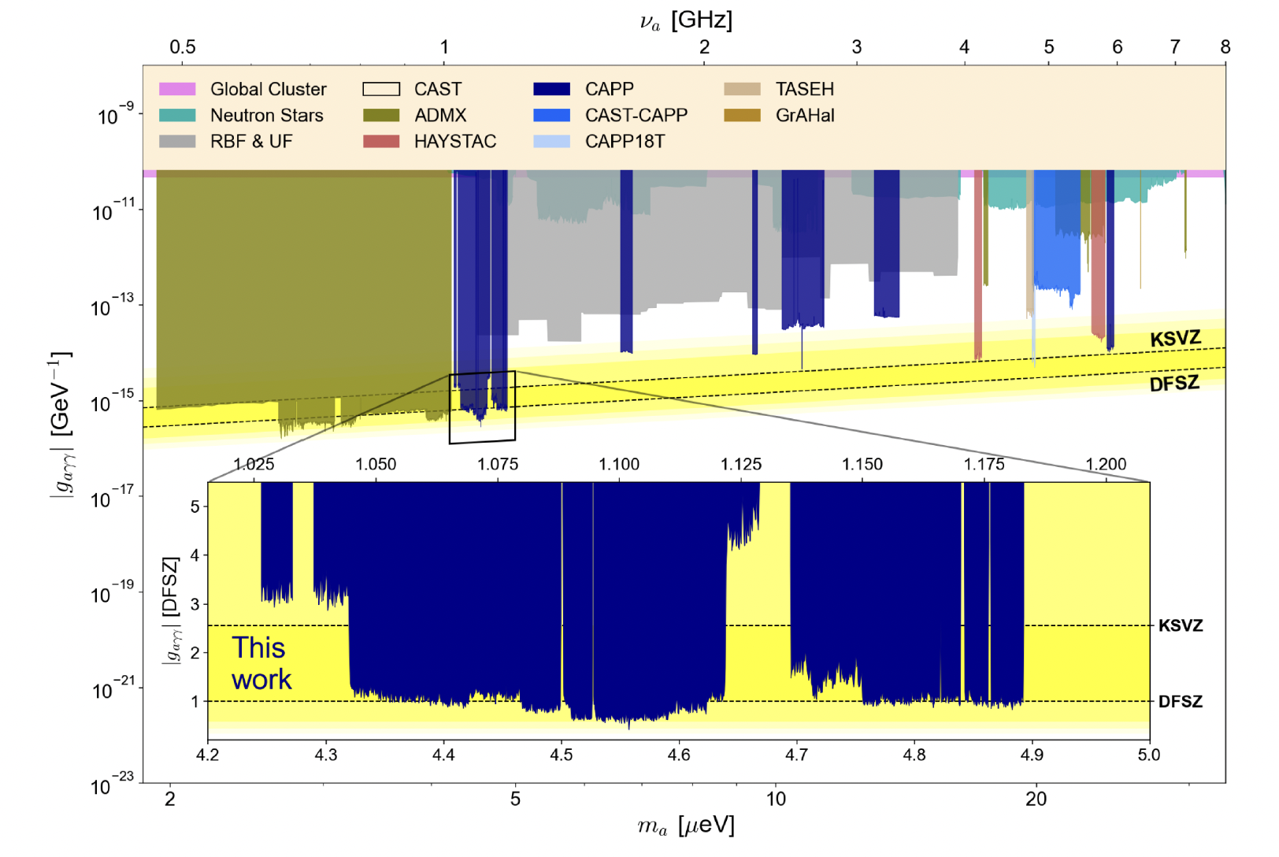
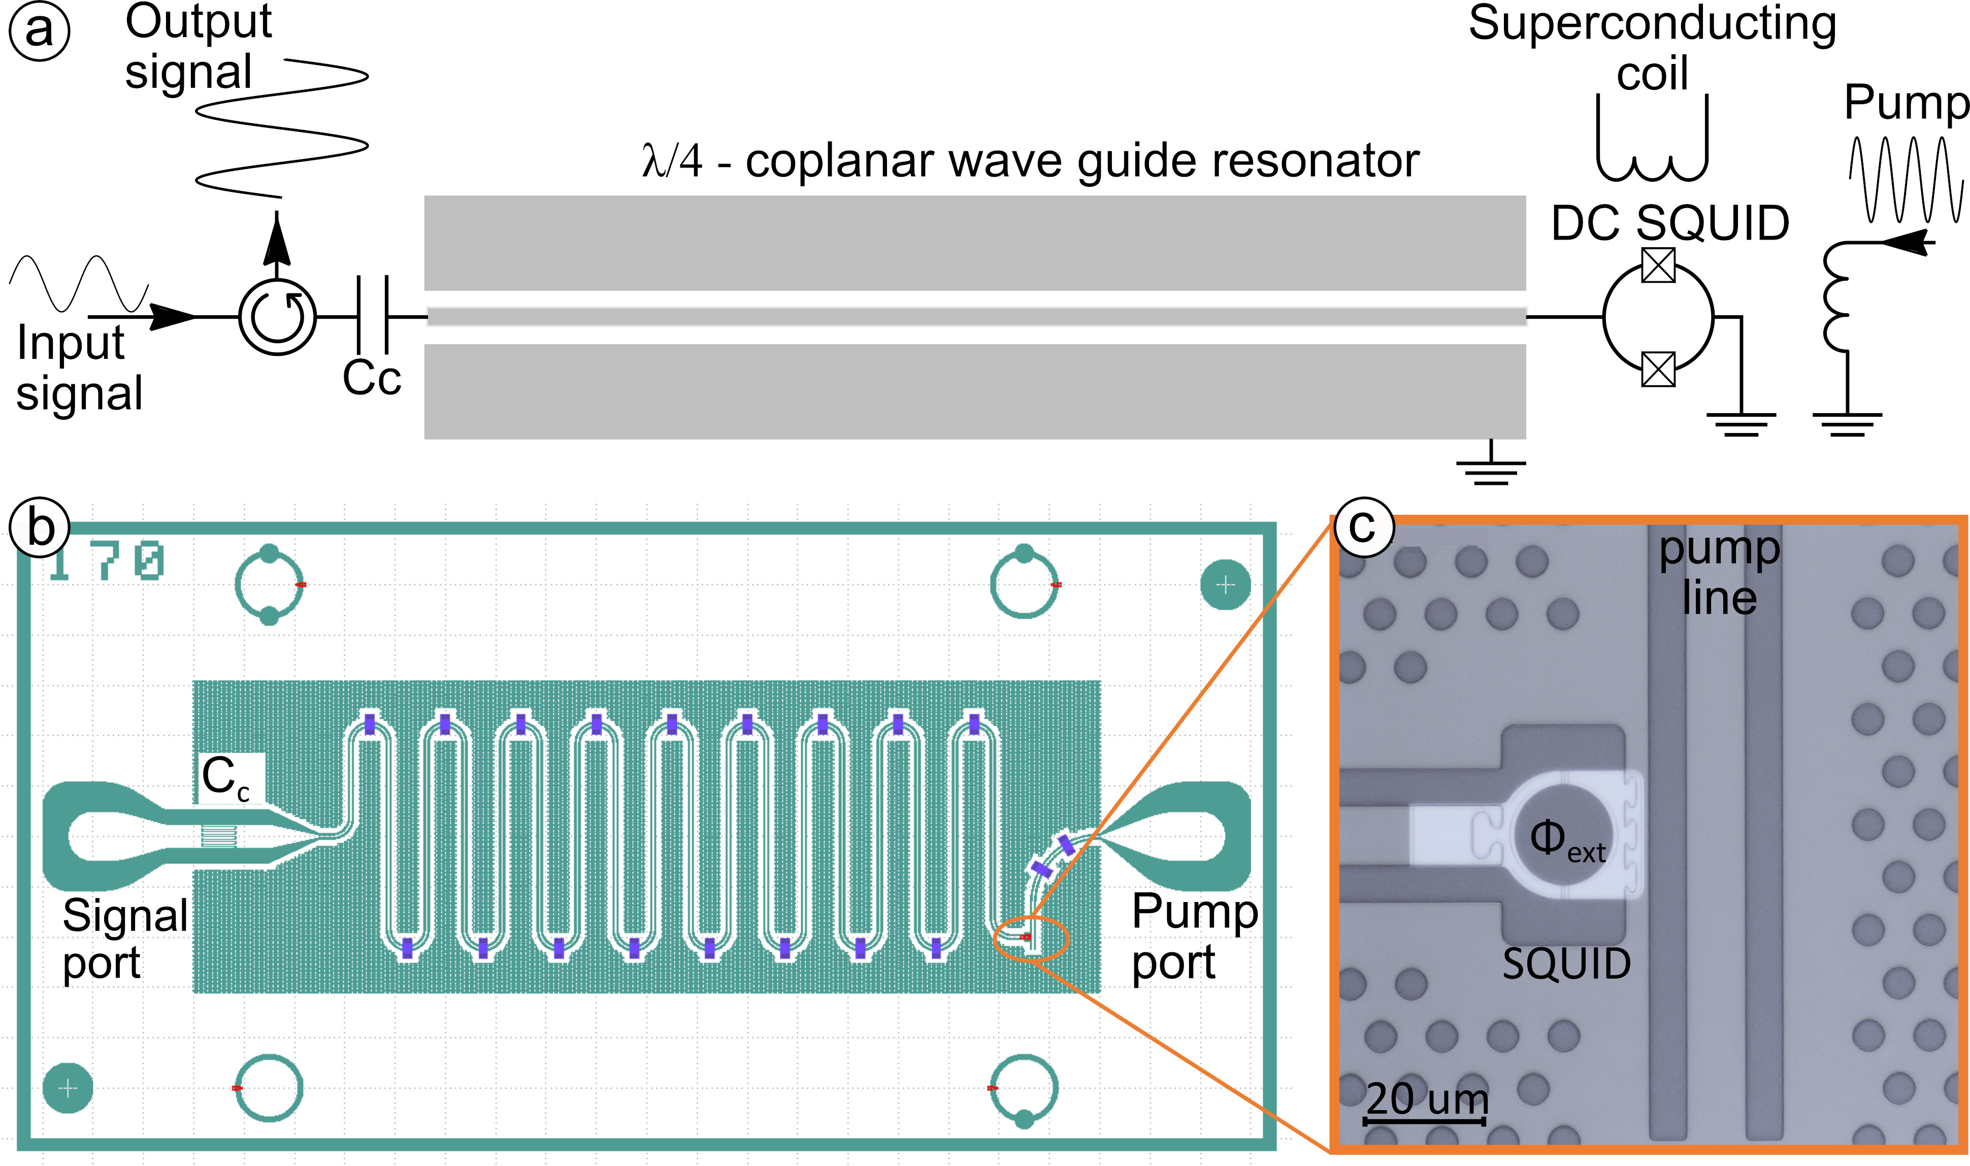
IBS-CAPP – Flux Driven JPA
T_{add noise} | 120 mK
mixing | 3 wave
Gain | 20 dB
BW | 100 kHz
Tunability | 100 MHz
PHYSICAL REVIEW X 14, 031023 (2024)
Superconductor Science and Technology, Volume 34, Number 8

Slide 9
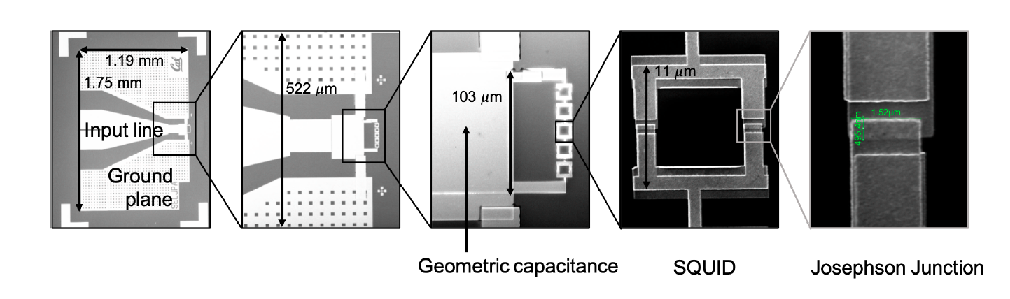
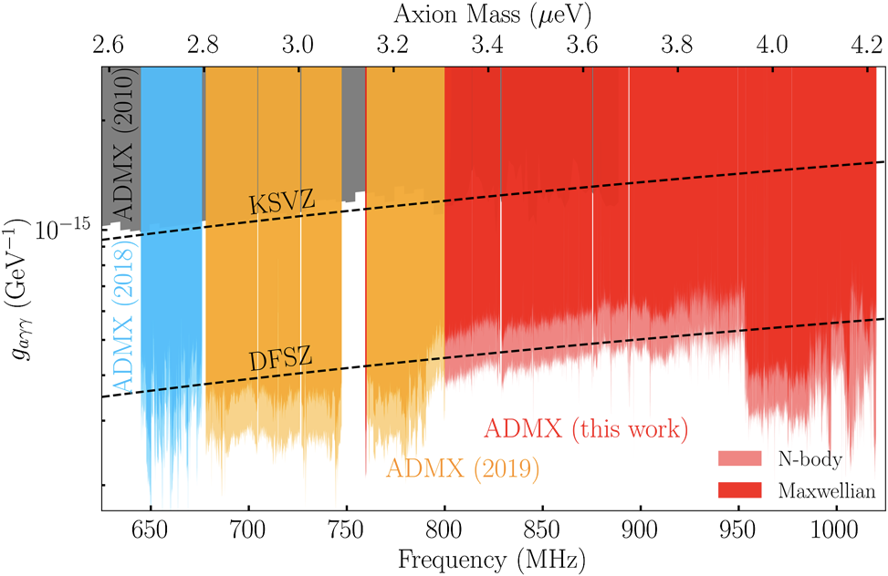
ADMX – JPA
See talk of Yanjie Qiu et al at Workshop on Microwave Cavities and Detectors for Axion Research
ADMX operates a 4 wave mixing JPA in a phase insensitive mode by pumping with a microwave tone 375 kHz detuned from the cavity resonance.
UCBerkeley
T_{JPA} | 250 mK
mixing | 4 wave
Gain | 20 dB
BW | 10 MHz
Tunability | 500 MHz
FERMILAB-PUB-20-331-AD-E-QIS Arxiv:2010.00169
PHYSICAL REVIEW LETTERS 127, 261803 (2021)

Slide 10
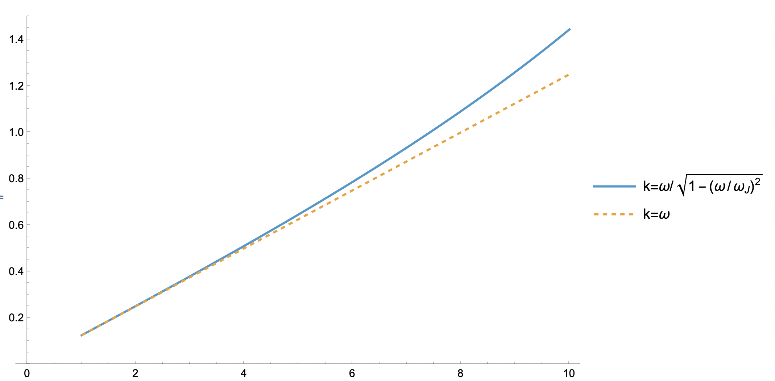
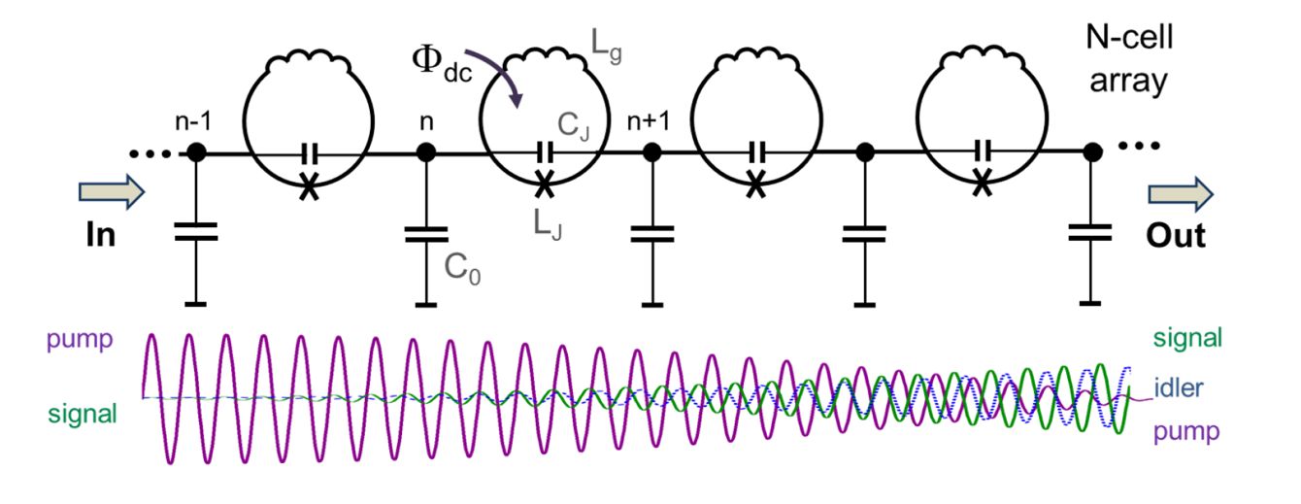
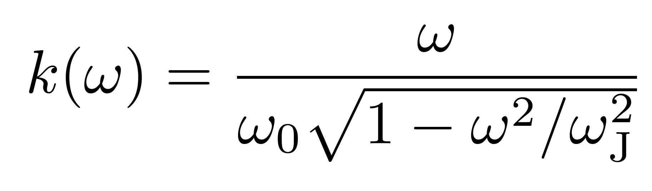
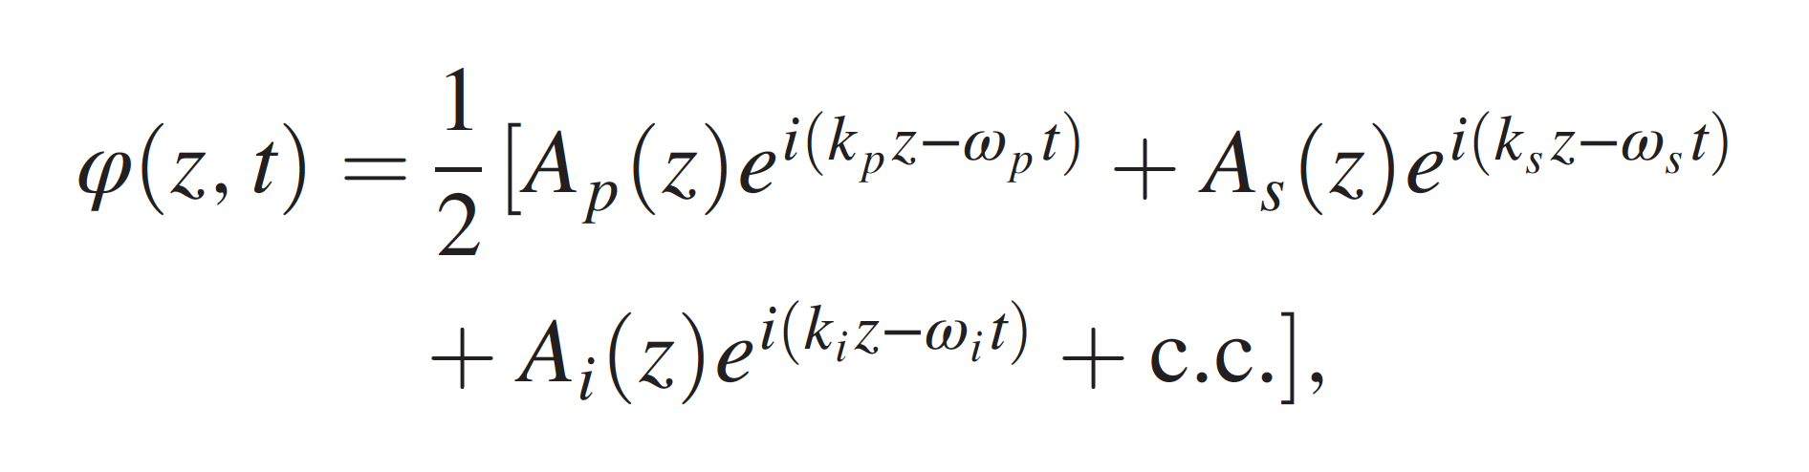


Traveling Wave Parametric Amplifier
κ
Pump
Signal
ω
$$ω_{s}+ω_{i}=2ω_{p}$$
Idler
$$2k_{p}≠k_{s}+k_{i}$$

Slide 11
Traveling Wave Parametric Amplifier
κ
signal
pump
idler
Pump
Signal
ω
$$ω_{s}+ω_{i}=2ω_{p}$$
Techniques like gap engineering are used to modify the dispersion relation and recover momentum conservation
Idler
$$2k_{p}≠k_{s}+k_{i}$$

Slide 12
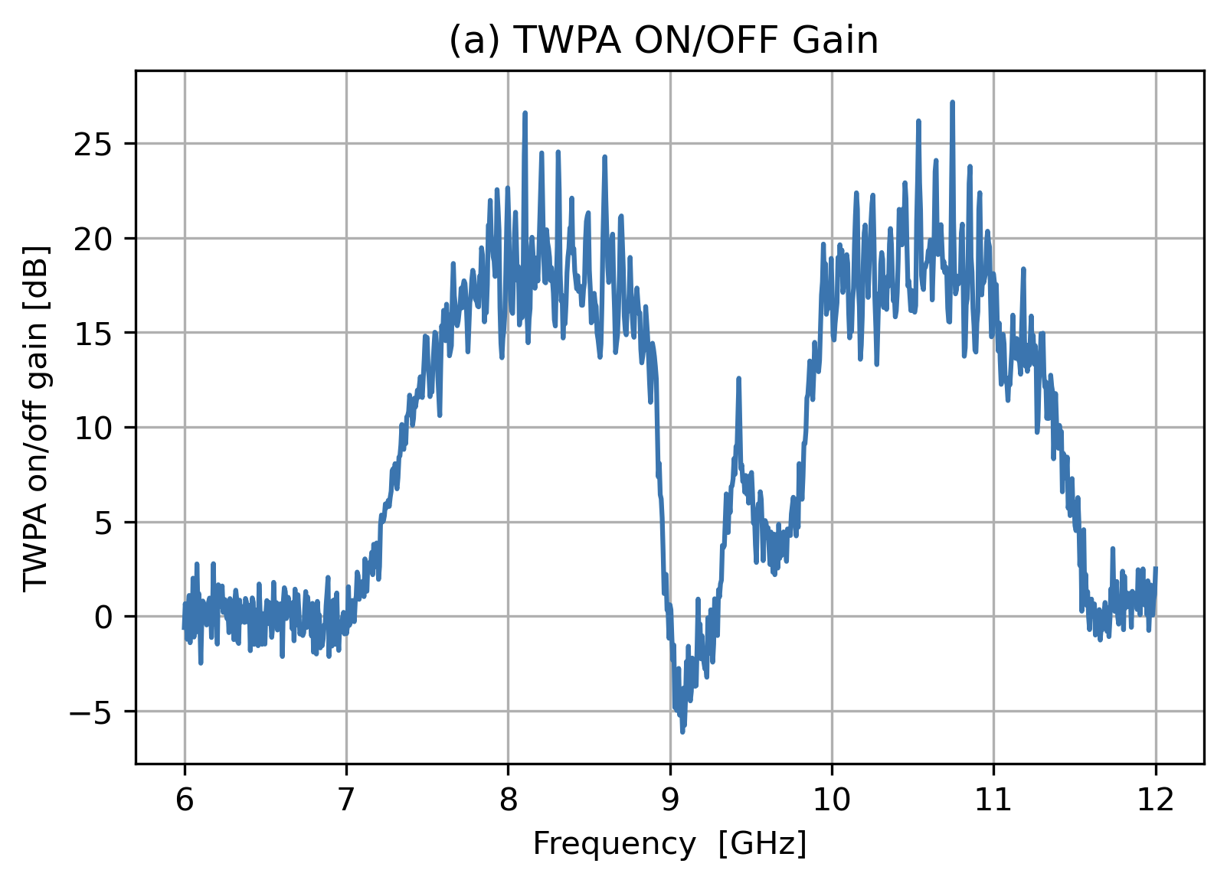
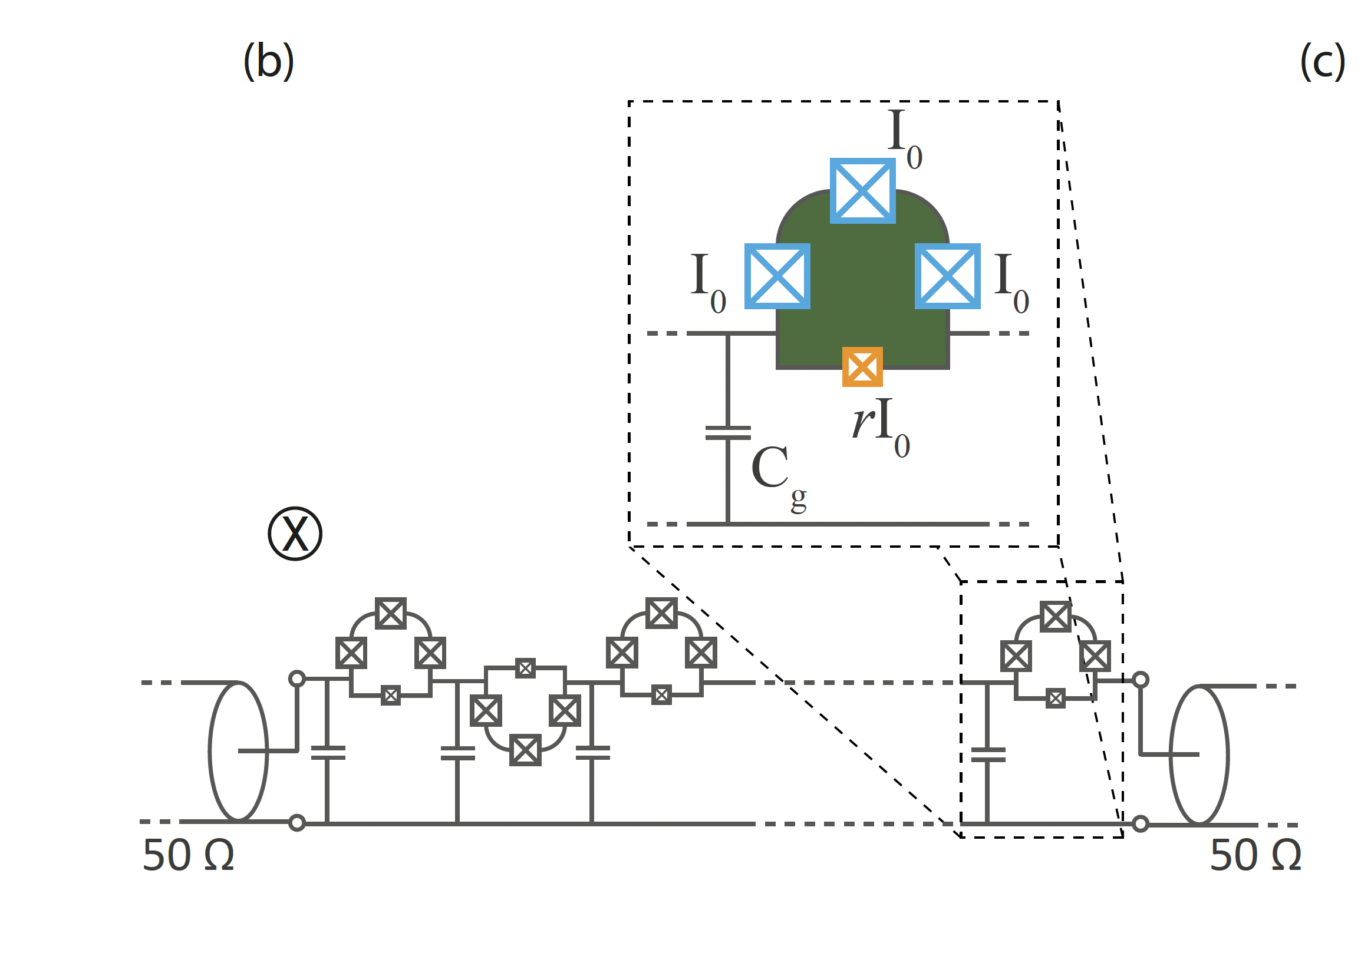

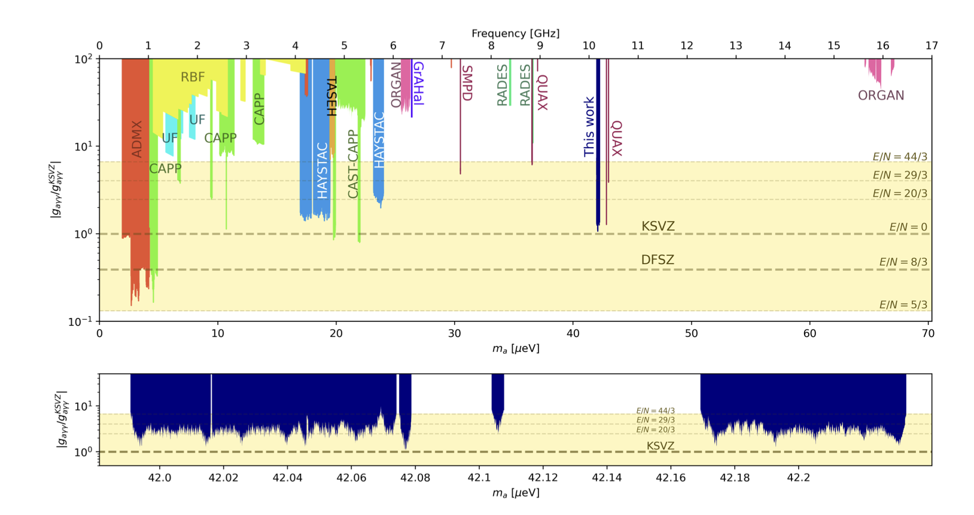
QUAX - TWPA
6 mm transmission line composed by 700 cells made of superconducting nonlinear asymmetric inductive elements (SNAIL)
T_{sys}=1.1K
arXiv:2506.11589

Slide 13
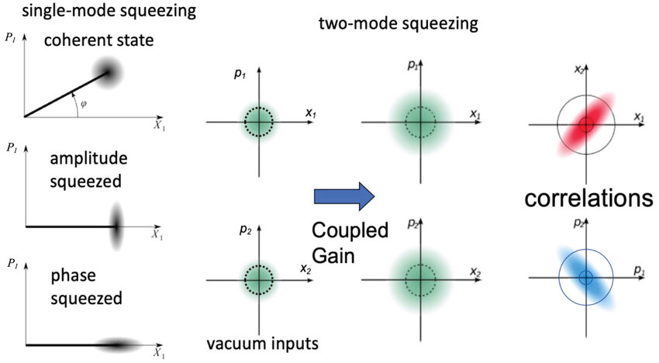
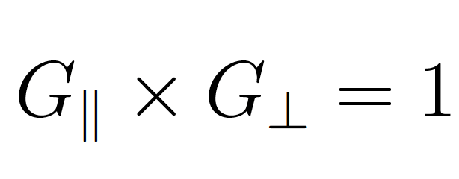
Beyond Quantum Limit #1: Squeezing
JPA are phase sensitive amplifiers:
They can be used to amplify in one direction and attenuate in the orthogonal direction.
arXiv:1607.02529
Quentin Glorieux et al 2023 New J. Phys. 25 051201

Slide 14
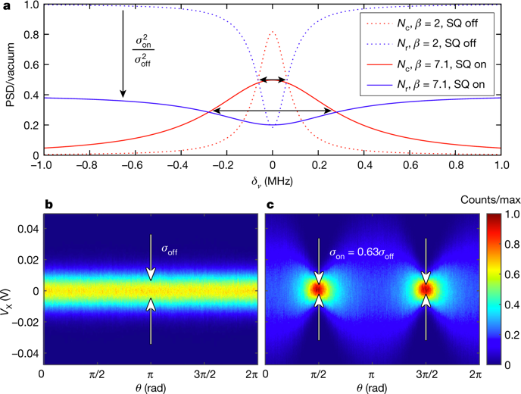
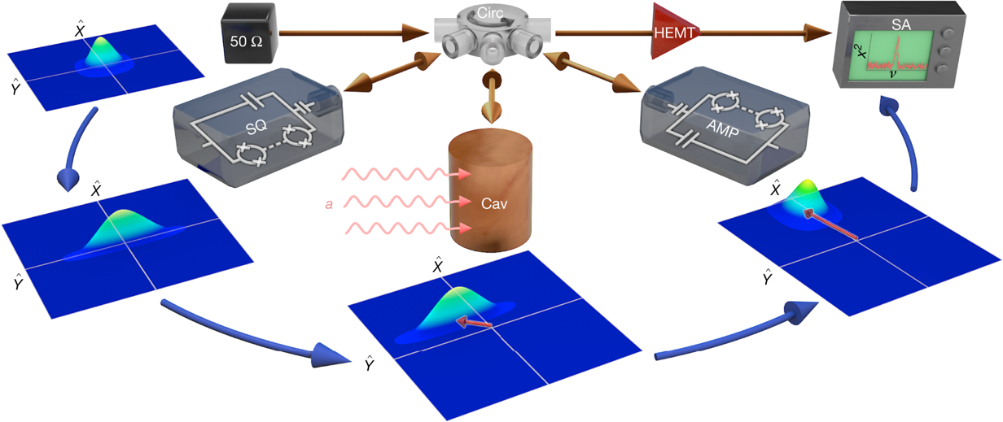
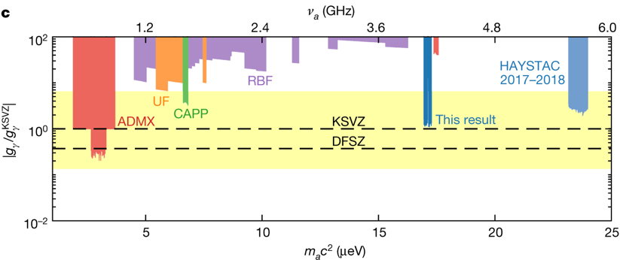
HAYSTAC – A Squeezed State Receiver With JPA
50 ohm noise T 60 mK
Variance
Backes et al. A quantum enhanced search for dark matter axions. Nature 590, 238–242 (2021).
JPA operated as phase sensitive amplifier
Amplify Y quadrature and squeeze along X
P_{X}^{out} = (n_{T}+1/2)/G |S₁₁|²+ (n_{T}+1/2 + n_{Axion})|Χ(w)|²
Squeeze along Y and amplify along X
Scan rate increases by a factor 2 thanks to lower noise/larger bandwidth

Slide 15
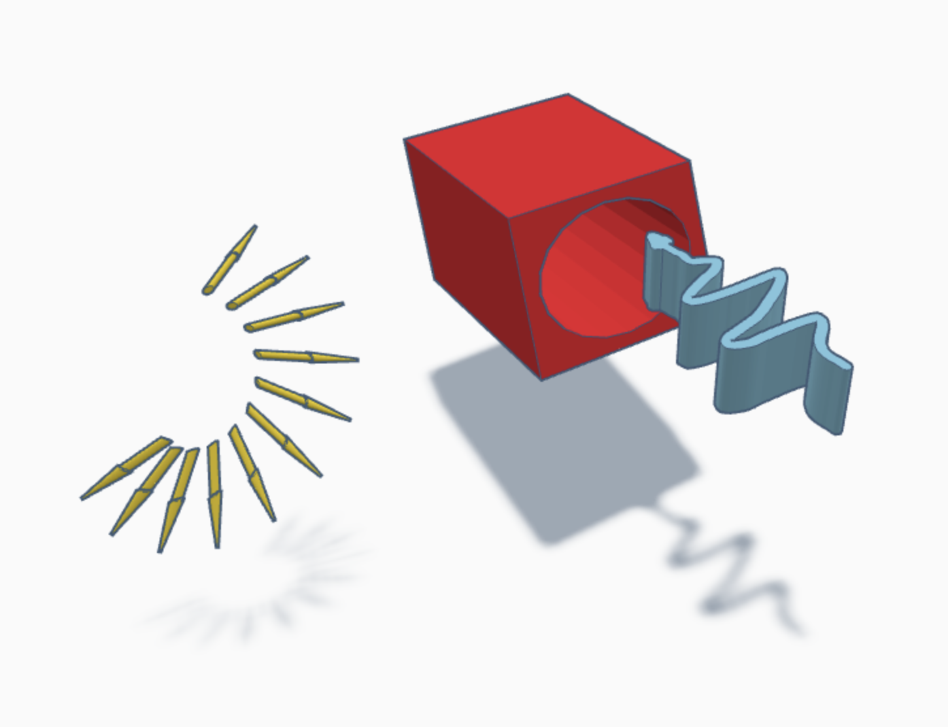
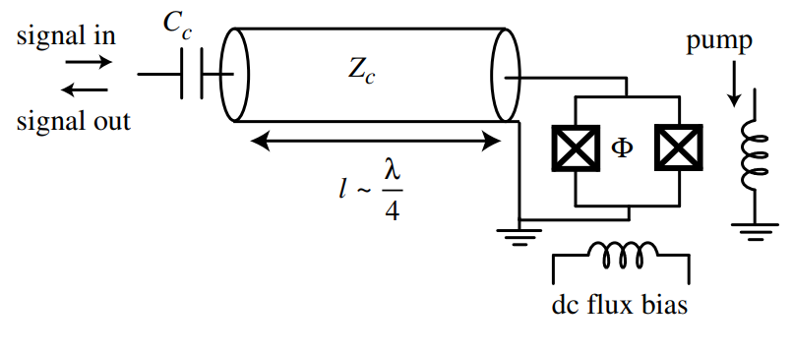
Beyond Quantum Limit #1: Quantum Sensing
Counter based on superconducting qubits
SQUID
arXiv:1607.02529
PHYSICAL REVIEW D 88, 035020 (2013)
JPA

Slide 16
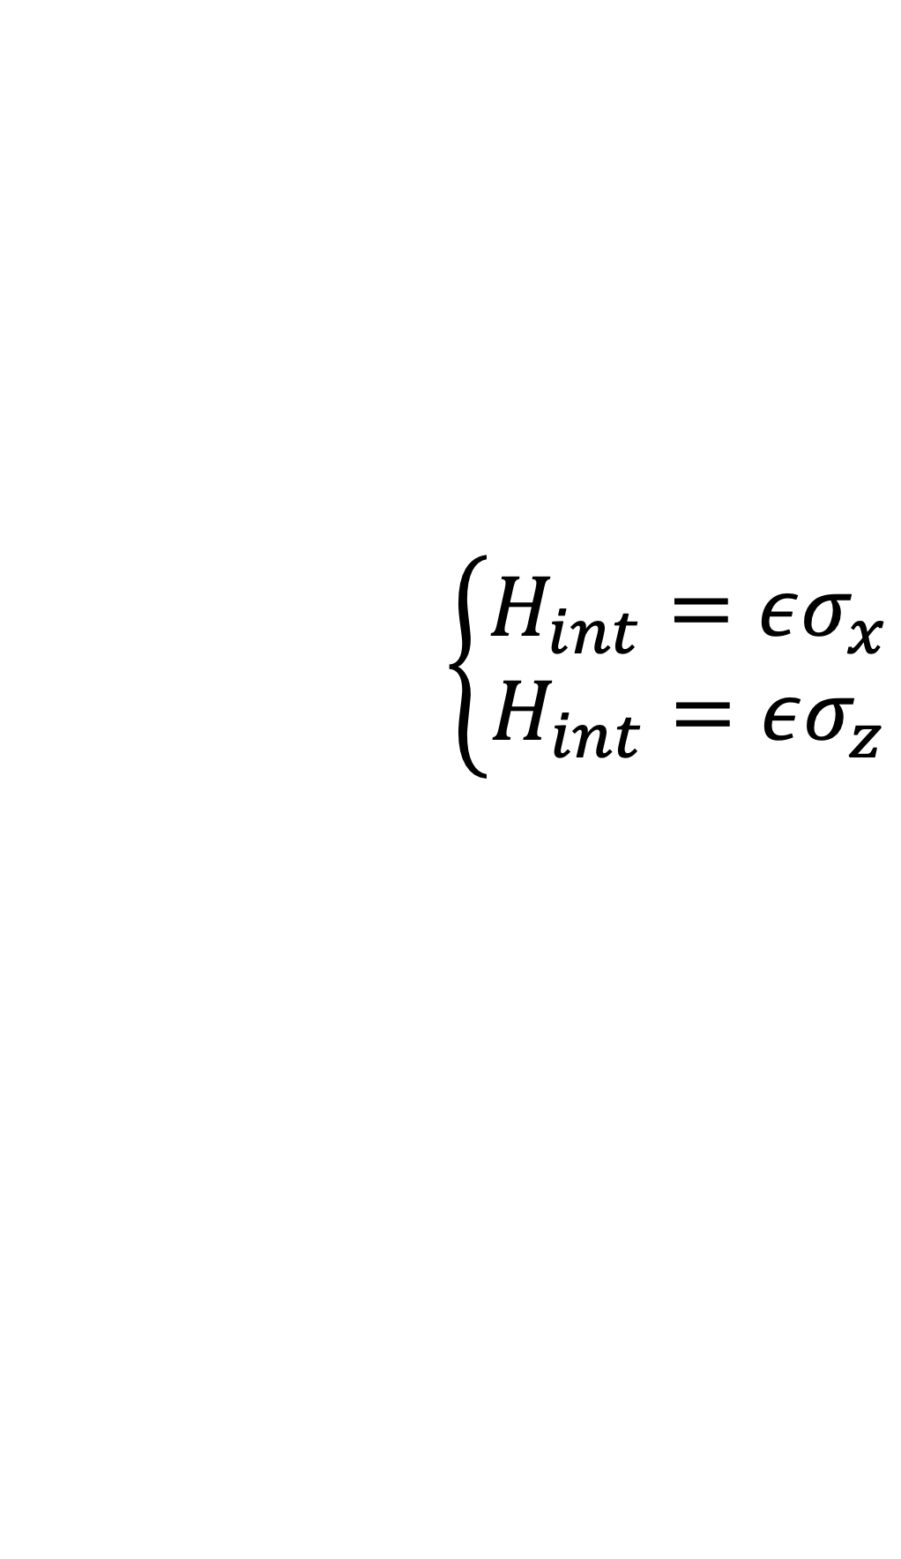
Single Qubit Sensors
$$\left\{\begin{aligned}H_{int}=εσ_{x} \\ H_{int}=εσ_{z}\end{aligned}\right.$$
Excitation
Phase Rotation

Slide 17
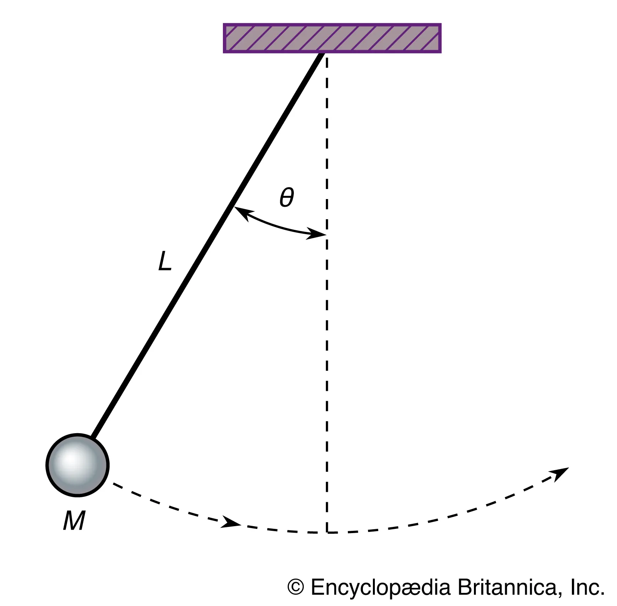
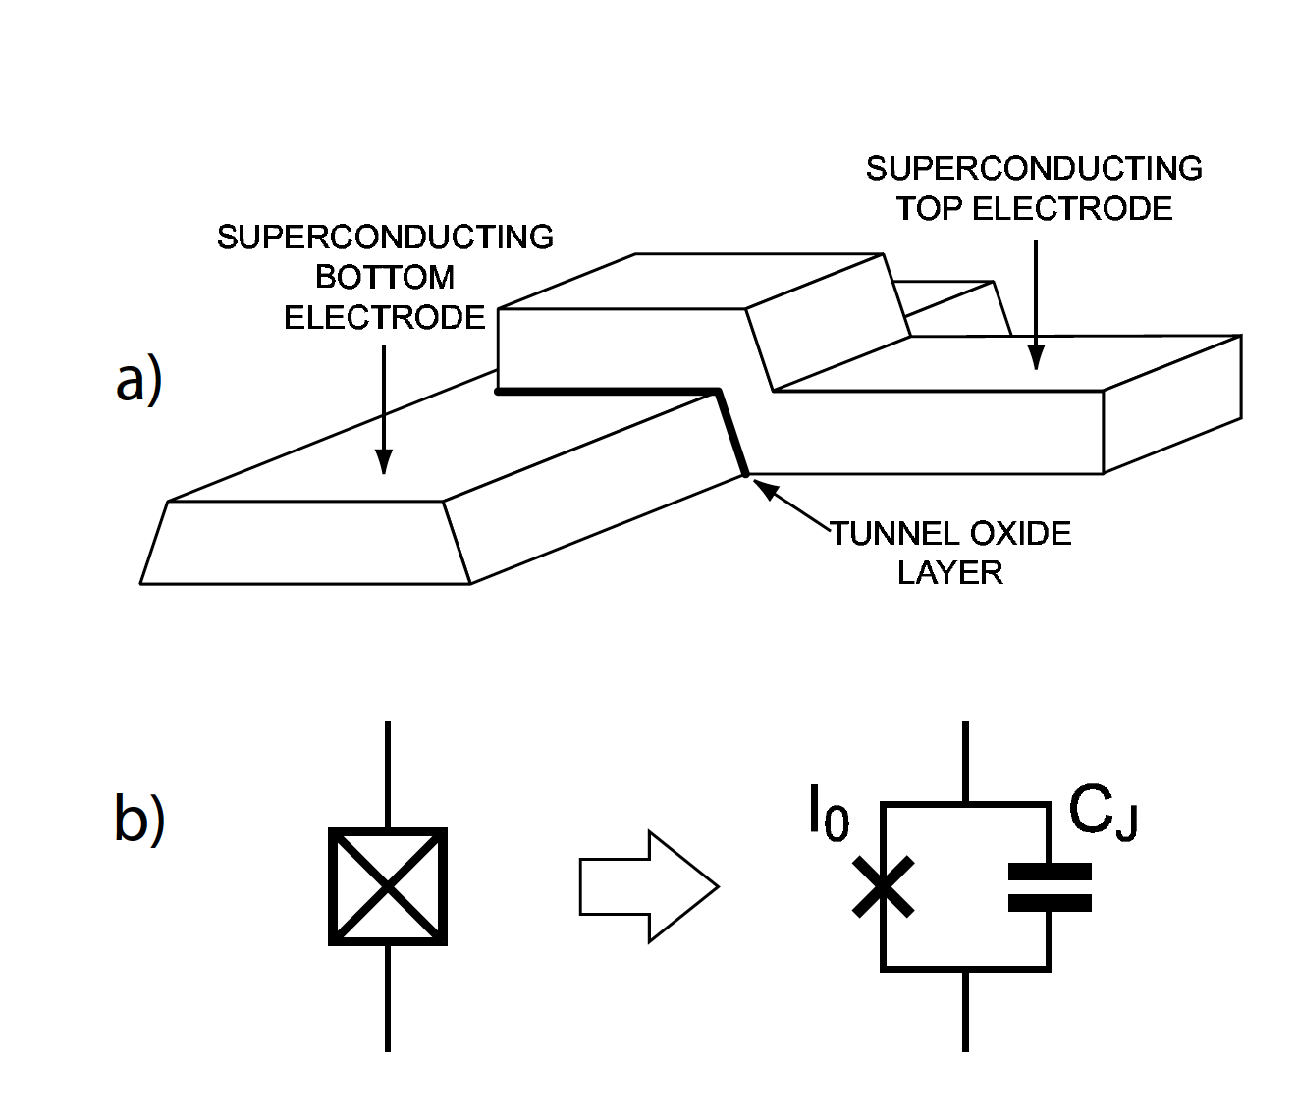
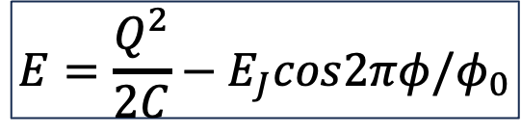
The Superconducting Qubit
C_{S}
JJ
1
0
$$E=\frac{Q^{2}}{2C}−E_{J}cos2πφ/φ_{0}$$
J Koch Phys. Rev. A 76 042319 (2007)

Slide 18

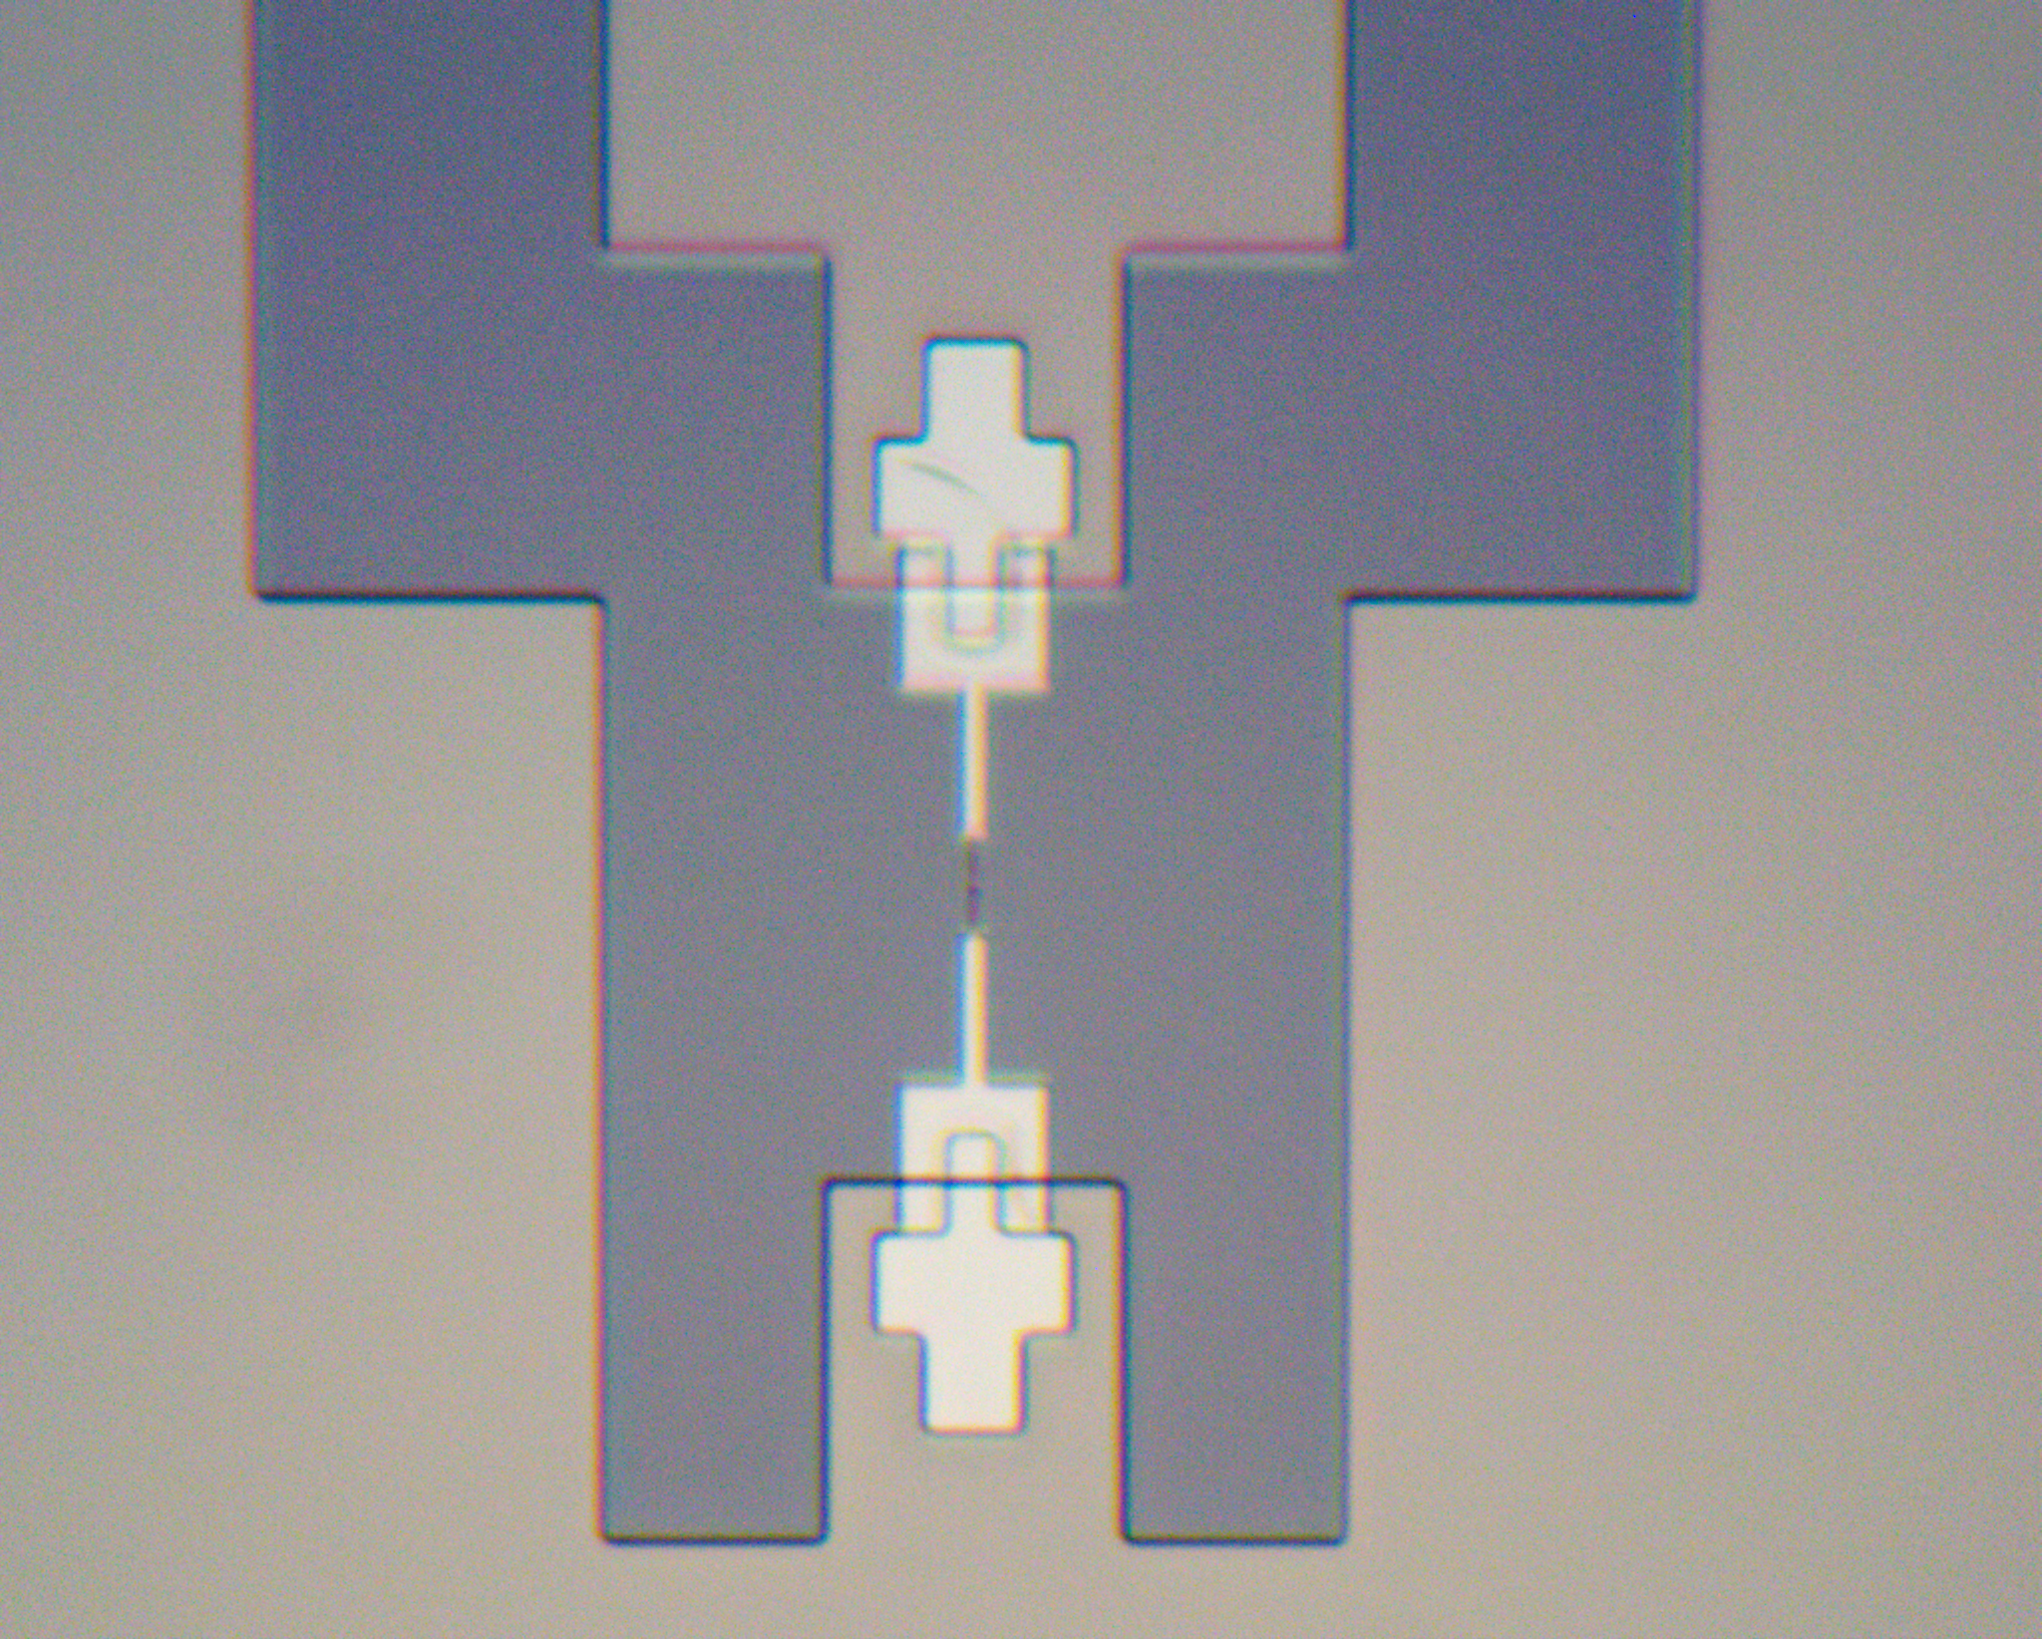
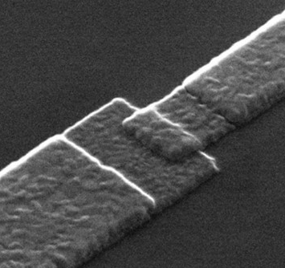
Superconducting Qubits
C_{S}
JJ
JJ
JJ Area
100×100 nm²
Cs
10 μm
1 μm
JJ
https://arxiv.org/abs/2409.05988

Slide 19
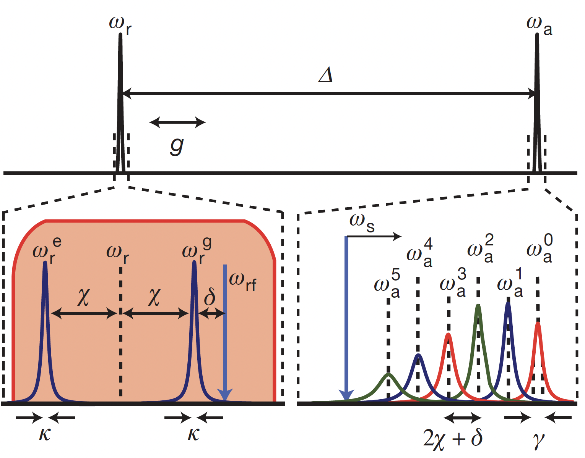
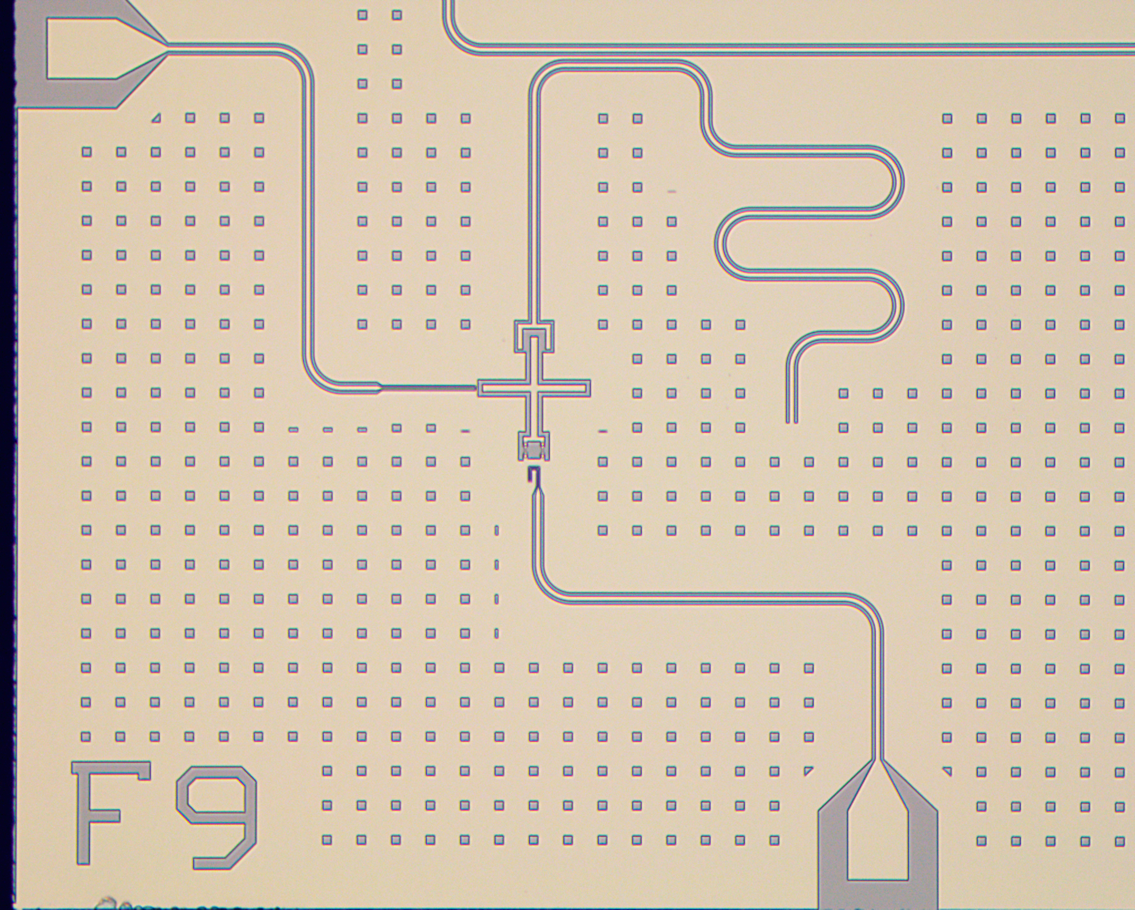
Resolving Photon Number States in a Superconducting Circuit
doi:10.1038/nature05461

Slide 20
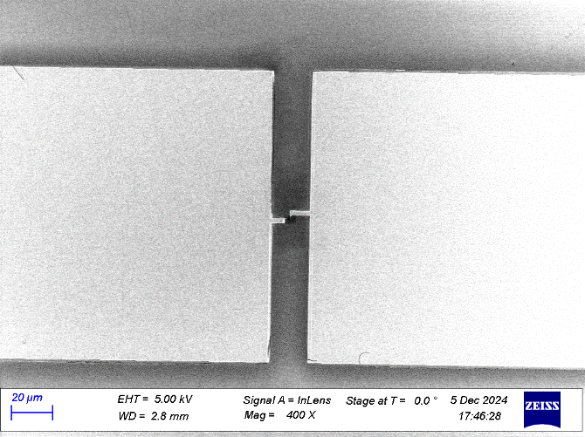
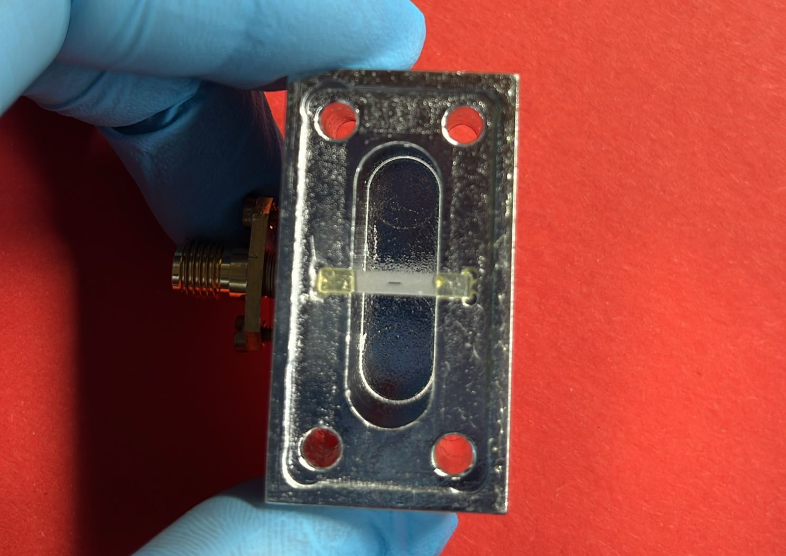
3D Qubit

Slide 21

Resolving Photon Number States in a Superconducting Circuit
$${ω′}_{q}=ω_{q}+2n_{γ}χ$$
Photon number in resonator
2χ
Appl. Sci. 2024, 14(4), 1478

Slide 22
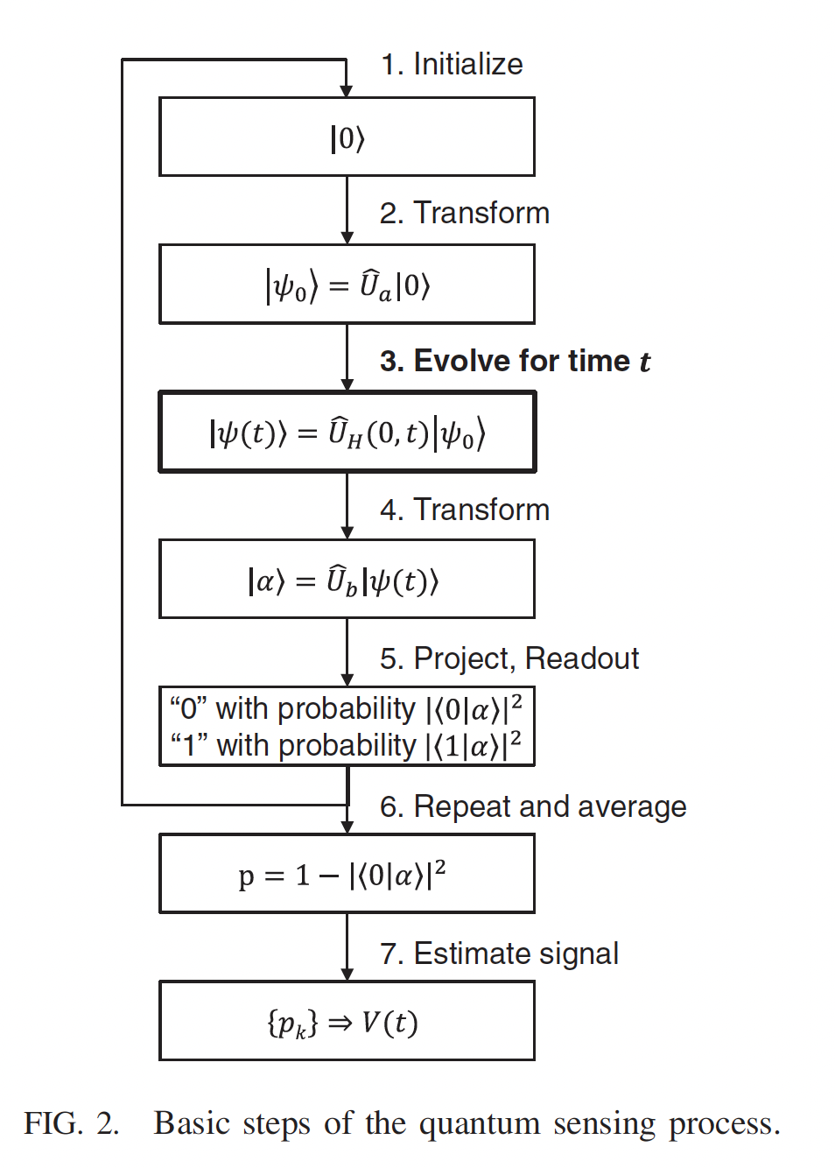



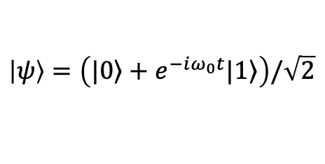
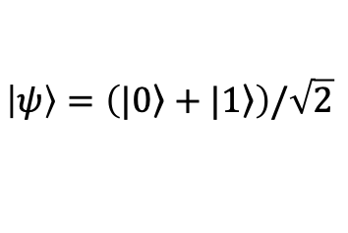
Quantum Sensing
Ramsey Measurement
$$H_{int}=εσ_{z}$$
$$\left|ψ\right\rangle =|0⟩$$
$$\left|ψ\right\rangle =\left(\left.|0\right\rangle +|\left.1\right\rangle \right)/\sqrt{2}$$
$$\left|ψ\right\rangle =\left(\left.|0\right\rangle +e^{−iω_{0}t}|\left.1\right\rangle \right)/\sqrt{2}$$
$$P(1)=1−{\left|\left\langle 0 | ψ\right\rangle \right|}^{2}=\sin^{2}\left(\frac{ω_{0}t}{2}\right)$$
REVIEWS OF MODERN PHYSICS, VOLUME 89 (2017)

Slide 23



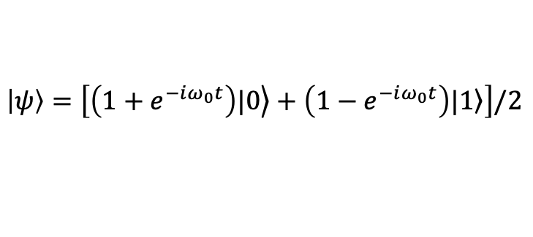
Quantum Sensing
Rabi Measurement
$$H_{int}=εσ_{x}$$
$$\left|ψ\right\rangle =|0⟩$$
$$\left|ψ\right\rangle =\left[\left.\left({1+e}^{−iω_{0}t}\right)|0\right\rangle +\left({1−e}^{−iω_{0}t}\right)|\left.1\right\rangle \right]/2$$
$$P(1)=1−{\left|\left\langle 0 | ψ\right\rangle \right|}^{2}=\sin^{2}\left(\frac{ω_{0}t}{2}\right)$$
REVIEWS OF MODERN PHYSICS, VOLUME 89 (2017)

Slide 24
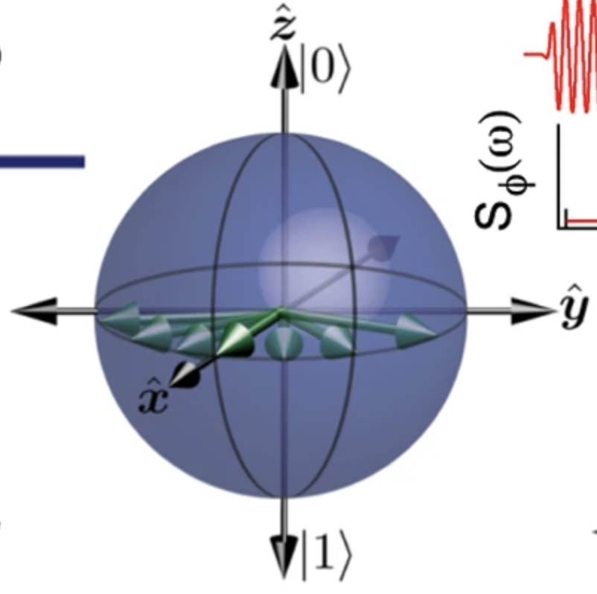




Searching for Dark Matter with a Superconducting Qubit
Photon detection by repeated Ramsey measurements
$$Δω_{q}=2n_{γ}χ$$
$${{\overline{S}}_{x}=cosΔω_{q}t \atop {\overline{S}}_{y}=sinΔω_{q}t}$$
$$Γ_{DarkCounts}\sim \frac{1}{T_{2}}$$
PHYSICAL REVIEW LETTERS 126, 141302 (2021)

Slide 25



Searching for Dark Matter with a Superconducting Qubit
QND allows repeated measurements
No photons
One photon
PHYSICAL REVIEW LETTERS 126, 141302 (2021)

Slide 26



Detecting Hidden Photon Dark Matter Using the Direct Excitation of Transmon Qubits
Dark Photon detection by repeated Rabi measurements
PHYSICAL REVIEW LETTERS 131, 211001 (2023)

Slide 27





Irreversible Qubit-Photon Coupling for the Detection of Itinerant Microwave Photons
Itinerant
photon
$$ε\sim 47\%$$
$$bw\sim 0.7 MHz$$
$$Γ_{DarkCounts}\sim \frac{n_{q,th}}{T_{1}}\sim 85Hz$$
Irreversible process, no photon reflection
PHYSICAL REVIEW X 10, 021038 (2020)

Slide 28


Quantum-Enhanced Sensing of Axion Dark Matter with a Transmon-Based Single Microwave Photon Counter
Phys. Rev. X 15, 021031

Slide 29

Quantum Non-Demolition Detection of an Itinerant Microwave Photon
Itinerant
photon
https://doi.org/10.1038/s41567-018-0066-3

Slide 30

Multi Qubit Sensors

Slide 31




Error Correction with Two Qubits
$$|\left.1,1\right\rangle$$
Probability P(11)
Probability |$\left.1,1\right\rangle$
Input photon
$$|\left.0,0\right\rangle$$
Reduced dark counts:
$$Error rate∝p{\left(1 | 0\right)}^{2}$$
Appl. Sci. 2024, 14(4), 1478
https://doi.org/10.1016/j.nima.2024.170010

Slide 32




Sensing with Multiqubit Entangled States
Greenberger–Horne–Zeilinger (GHZ) state
$$\left|ψ\right\rangle =\left(\left.|000000…\right\rangle +|\left.111111…\right\rangle \right)/\sqrt{2}$$
$$\left|ψ\right\rangle =\left(\left.|000000…\right\rangle +e^{−i{Nω}_{0}t}|\left.1111111 …\right\rangle \right)/\sqrt{2}$$
$$P=1−{\left|\left\langle 0 | ψ\right\rangle \right|}^{2}=\sin^{2}\left(N\frac{ω_{0}t}{2}\right)$$
REVIEWS OF MODERN PHYSICS, VOLUME 89 (2017)

Slide 33


Quantum Enhancement in Dark Matter Detection with Quantum Computation
Use n_{q} entangled qubit state to enhance dark matter sensing by n_{q}²
PHYSICAL REVIEW LETTERS 133, 021801 (2024)

Slide 34


Optimized Quantum Sensor Networks for Ultralight Dark Matter Detection
Multi-qubit systems, optimizing both state preparation and measurement using a variational quantum metrology framework
arXiv:2505.2118

Slide 35

Non Classical States

Slide 36

Fock States
X

Slide 37


Fock States
$$|\left.n+1\right\rangle$$
Enhancement of the signal by (n+1)

Slide 38


Stimulated Emission of Signal Photons from Dark Matter Waves
30 repeated qubit measurements
PHYSICAL REVIEW LETTERS 132, 140801 (2024)

Slide 39



Stimulated Emission of Signal Photons from Dark Matter Waves
Stimulated emission enhancement
$$n_{meas}\sim η\left(n+1\right)α^{2}$$
PHYSICAL REVIEW LETTERS 132, 140801 (2024)

Slide 40





Heisenberg-Limited Single-Mode Quantum
Metrology in a Superconducting Circuit
Maximum Variance State
$$\left|ψ(N)\right\rangle =\left(\left.|0\right\rangle +i |\left.N\right\rangle \right)/\sqrt{2}$$
Heisenberg Scaling Limit
$$δθ\sim 1/N$$
https://doi.org/10.1038/s41467-019-12290-7

Slide 41


Quantum Sensing of Displacements with GKP States
Gottesman-Kitaev-Preskill (GKP) State
Due to the translation invariant property of the GKP state in phase space, it is possible to simultaneously and precisely measure both quadrature variables, Q and P, modulo $\sqrt{2π}$.
arXiv:2412.04865
arXiv:2506.20627
PRX QUANTUM 3, 030333 (2022)

Slide 42

Combining Squeezing and Photon Counting
npj Quantum Information ( 2025) 11:48
npj Quantum Information (2023) 9:27

Slide 43




Coherently Sum Signals
Pizza cavity
Hybrid couplers
With N cavities
PRX QUANTUM 3, 030333 (2022)

Slide 44

Operating in a Strong Magnetic Field
B₀

Slide 45






Superconducting Cavities
f=7 GHz
f=3.9 GHz
G. Marconato et al., "NbTi Thin-Film SRF Cavities for Dark Matter Search," in IEEE Transactions on Applied Superconductivity, vol. 34, no. 7, (2024).
S. Posen et al. PHYS. REV. APPLIED 20, 034004 (2023)
Danho Ahn 18th Patras Workshop

Slide 46

Can we Build a Magnetically Resilient Qubit?
B//
https://doi.org/10.1038/nphys3538
NbSe2 : Transition-metal dichalcogenide (TMD) superconductors
Thin NbSe₂ (niobium diselenide) retains superconductivity at a high inplane magnetic field up to 30 T! Spins pinned on the orthogonal directioin by strong spin orbit coupling insensitive to inplane magnetic field.
*See https://journals.aps.org/prd/pdf/10.1103/PhysRevD.110.115021 for axion searches with resilient qubits.

Slide 47


NbSe₂ van der Waals Josephson Junctions
https://doi.org/10.1103/PhysRevB.104.214512
The layered structure of NbSe2 allows it to be exfoliated into thin flakes. When the vdW interface has a misalignment, decoupling becomes sufficiently large and the superconducting state of the NbSe2 crystal cannot be described by a single-order parameter.
https://doi.org/10.1038/ncomms10616

Slide 48








NbSe₂ 3D qubit
$$Junction Area∼80μm^{2}$$
Principal Investigator: A. D’Elia (LNF INFN)

Slide 49


Rabi-Like Oscillation in NbSe₂ 3D qubit
$$ν_{qubit}=12.6 GHz$$
$T_{1}∼6μs$
Rabi pulse sequence
Principal Investigator: A. D’Elia (LNF INFN)

Slide 50

Towards an optimal detector for Axions and HFGW
An advanced quantum sensor leveraging superconducting qubits that utilizes entanglement, quantum error correction, and high-photon-number Fock states (large N) to significantly boost the sensitivity for detecting weak coherent states.
Maybe in 10 years:
Signal $∝\left(n_{Fock}+1\right){×n}_{qubits}^{2}{×N}_{Detectors}^{ \left(2\right)}→\left(10+1\right)×100×100={10}^{5}$

