Slide 1

Amplitudes for Gravitational Waves
David A. Kosower
Institut de Physique Théorique, CEA–Saclay
Amplitudes, Strong-Field Gravity, and Resummation,
Nordita, Stockholm
April 13–17, 2026

Slide 2
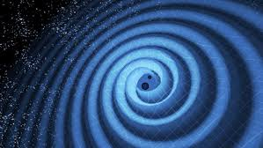
Gravitational Waves
LIGO

Slide 3
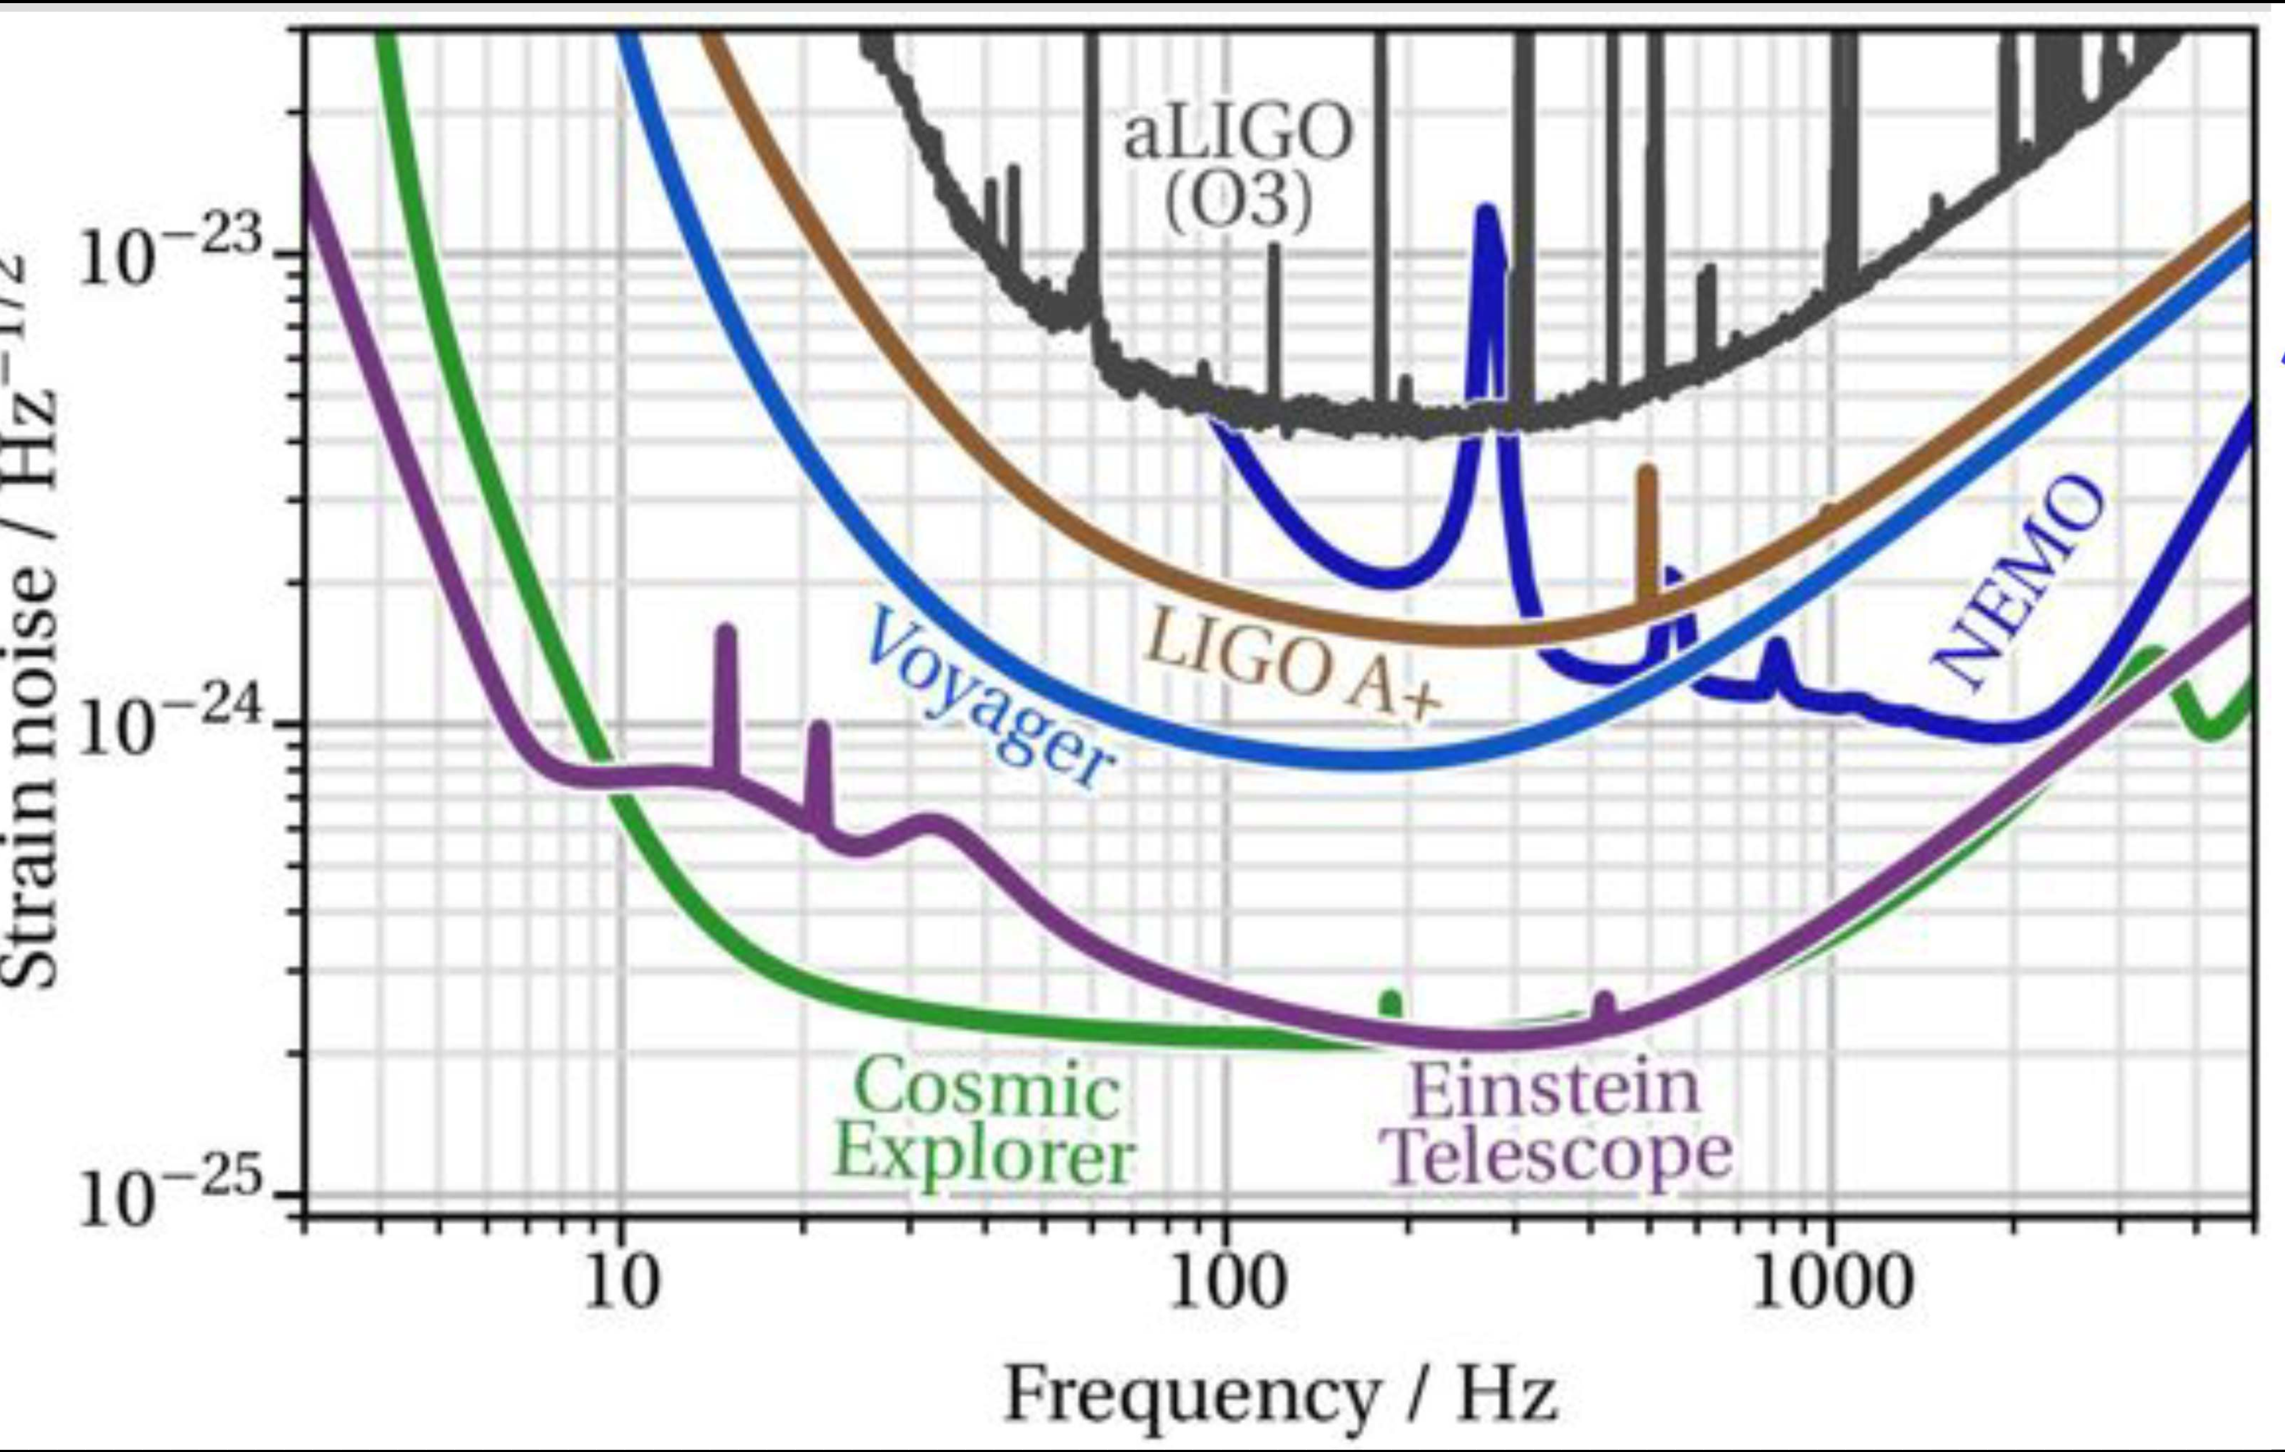
Future Terrestrial GWOs
Path to higher precision
Barsotti

Slide 4
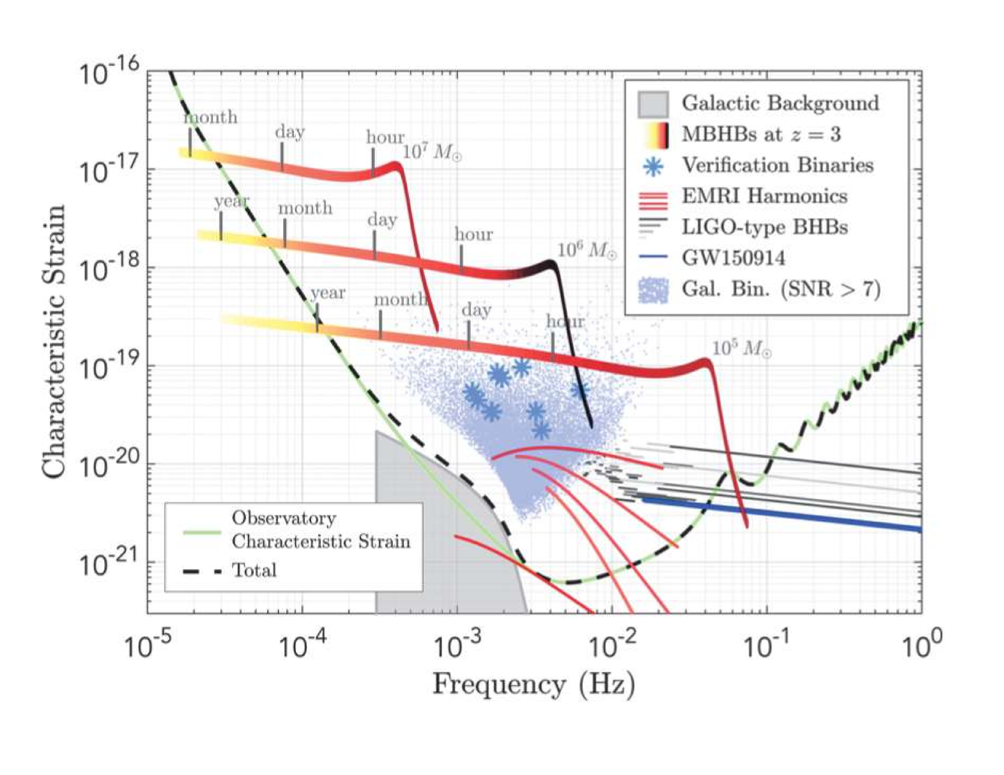
LISA
From LISA L3 Mission proposal (via Robson–Cornish–Liu [1803.01944])

Slide 5
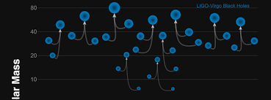
Science Goals
Determine presence and distribution of heavy compact objects
  Already discovered unexpected class of black hole binaries
  More surprises?
Neutron stars
  Determine equation of state
  Contribution to transferric element production
Measure Hubble constant
  Bright candles as individual events
  Dark candles statistically
Limits on exotic compact objects
Precision strong-field tests of Einstein gravity
Insight into quantum gravity [in the LISA/TaiJi & TianQin era]?

Slide 6
Theorists
Waveform Templates
Detection
  Extended mass/spin range for standard events
  Fainter events
  New classes of events (IMRIs, EMRIs)
  Exotic events (capture, early phase, supernovae, …)
Measurement
  Parameter extraction

Slide 7
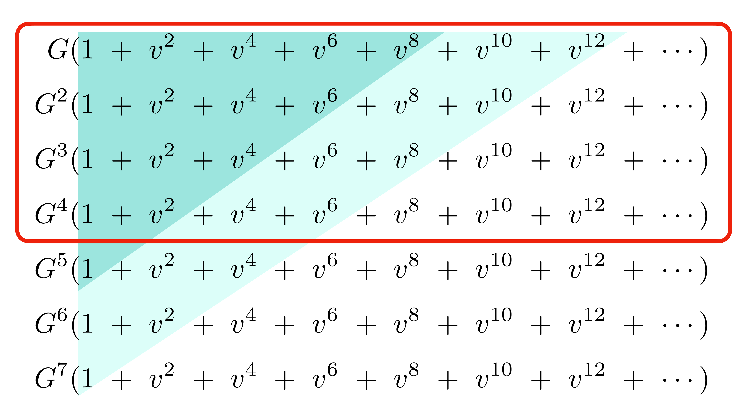
What Do We Need?
Snowmass White Paper: Buonanno, Khalil, O’Connell, Roiban, Solon, Zeng (2022)
More is better

Slide 8
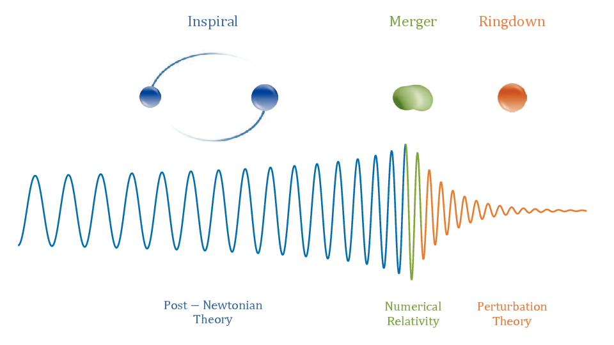
Basic Setup in Mergers
Two slowly inspiralling
compact objects
  Ringdown
  Merger
Inspiral
  Weak-field perturbation theory
Relativistic perturbative expansion in the scattering domain
“Post-Minkowskian Expansion”
Relativistic Perturbation Theory (RP)
Antelis et al

Slide 9
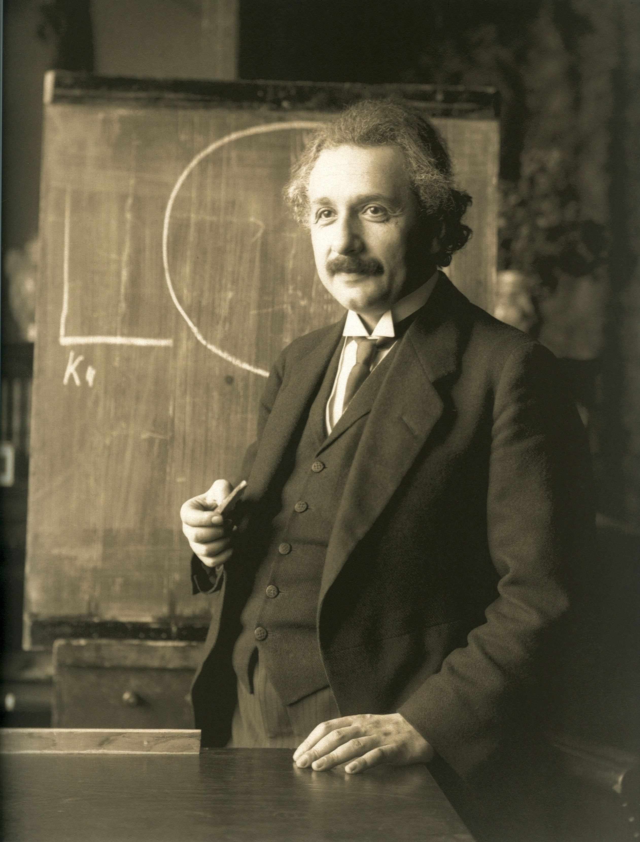
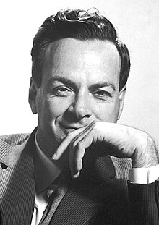
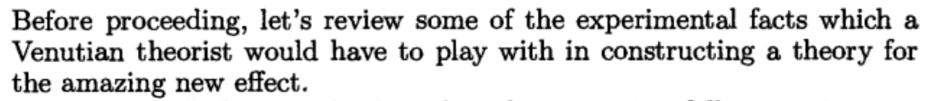
Scattering Amplitudes Approach
Gravitation = General Relativity ← geometry
Inspiration from Feynman
Gravitation = spin-2 field theory

Slide 10
Analysis Pipelines
Vallisneri
Three dominant pipelines
  Phenomenological: post-Newtonian (PN) based, Numerical Relativity (NR) calibrated
  Surrogate: interpolated NR
  Effective One-Body (EOB): resummed PN, NR calibrated, self-force (SF) matched
EOB only one (so far) to use relativistic perturbative (RP) information

Slide 11
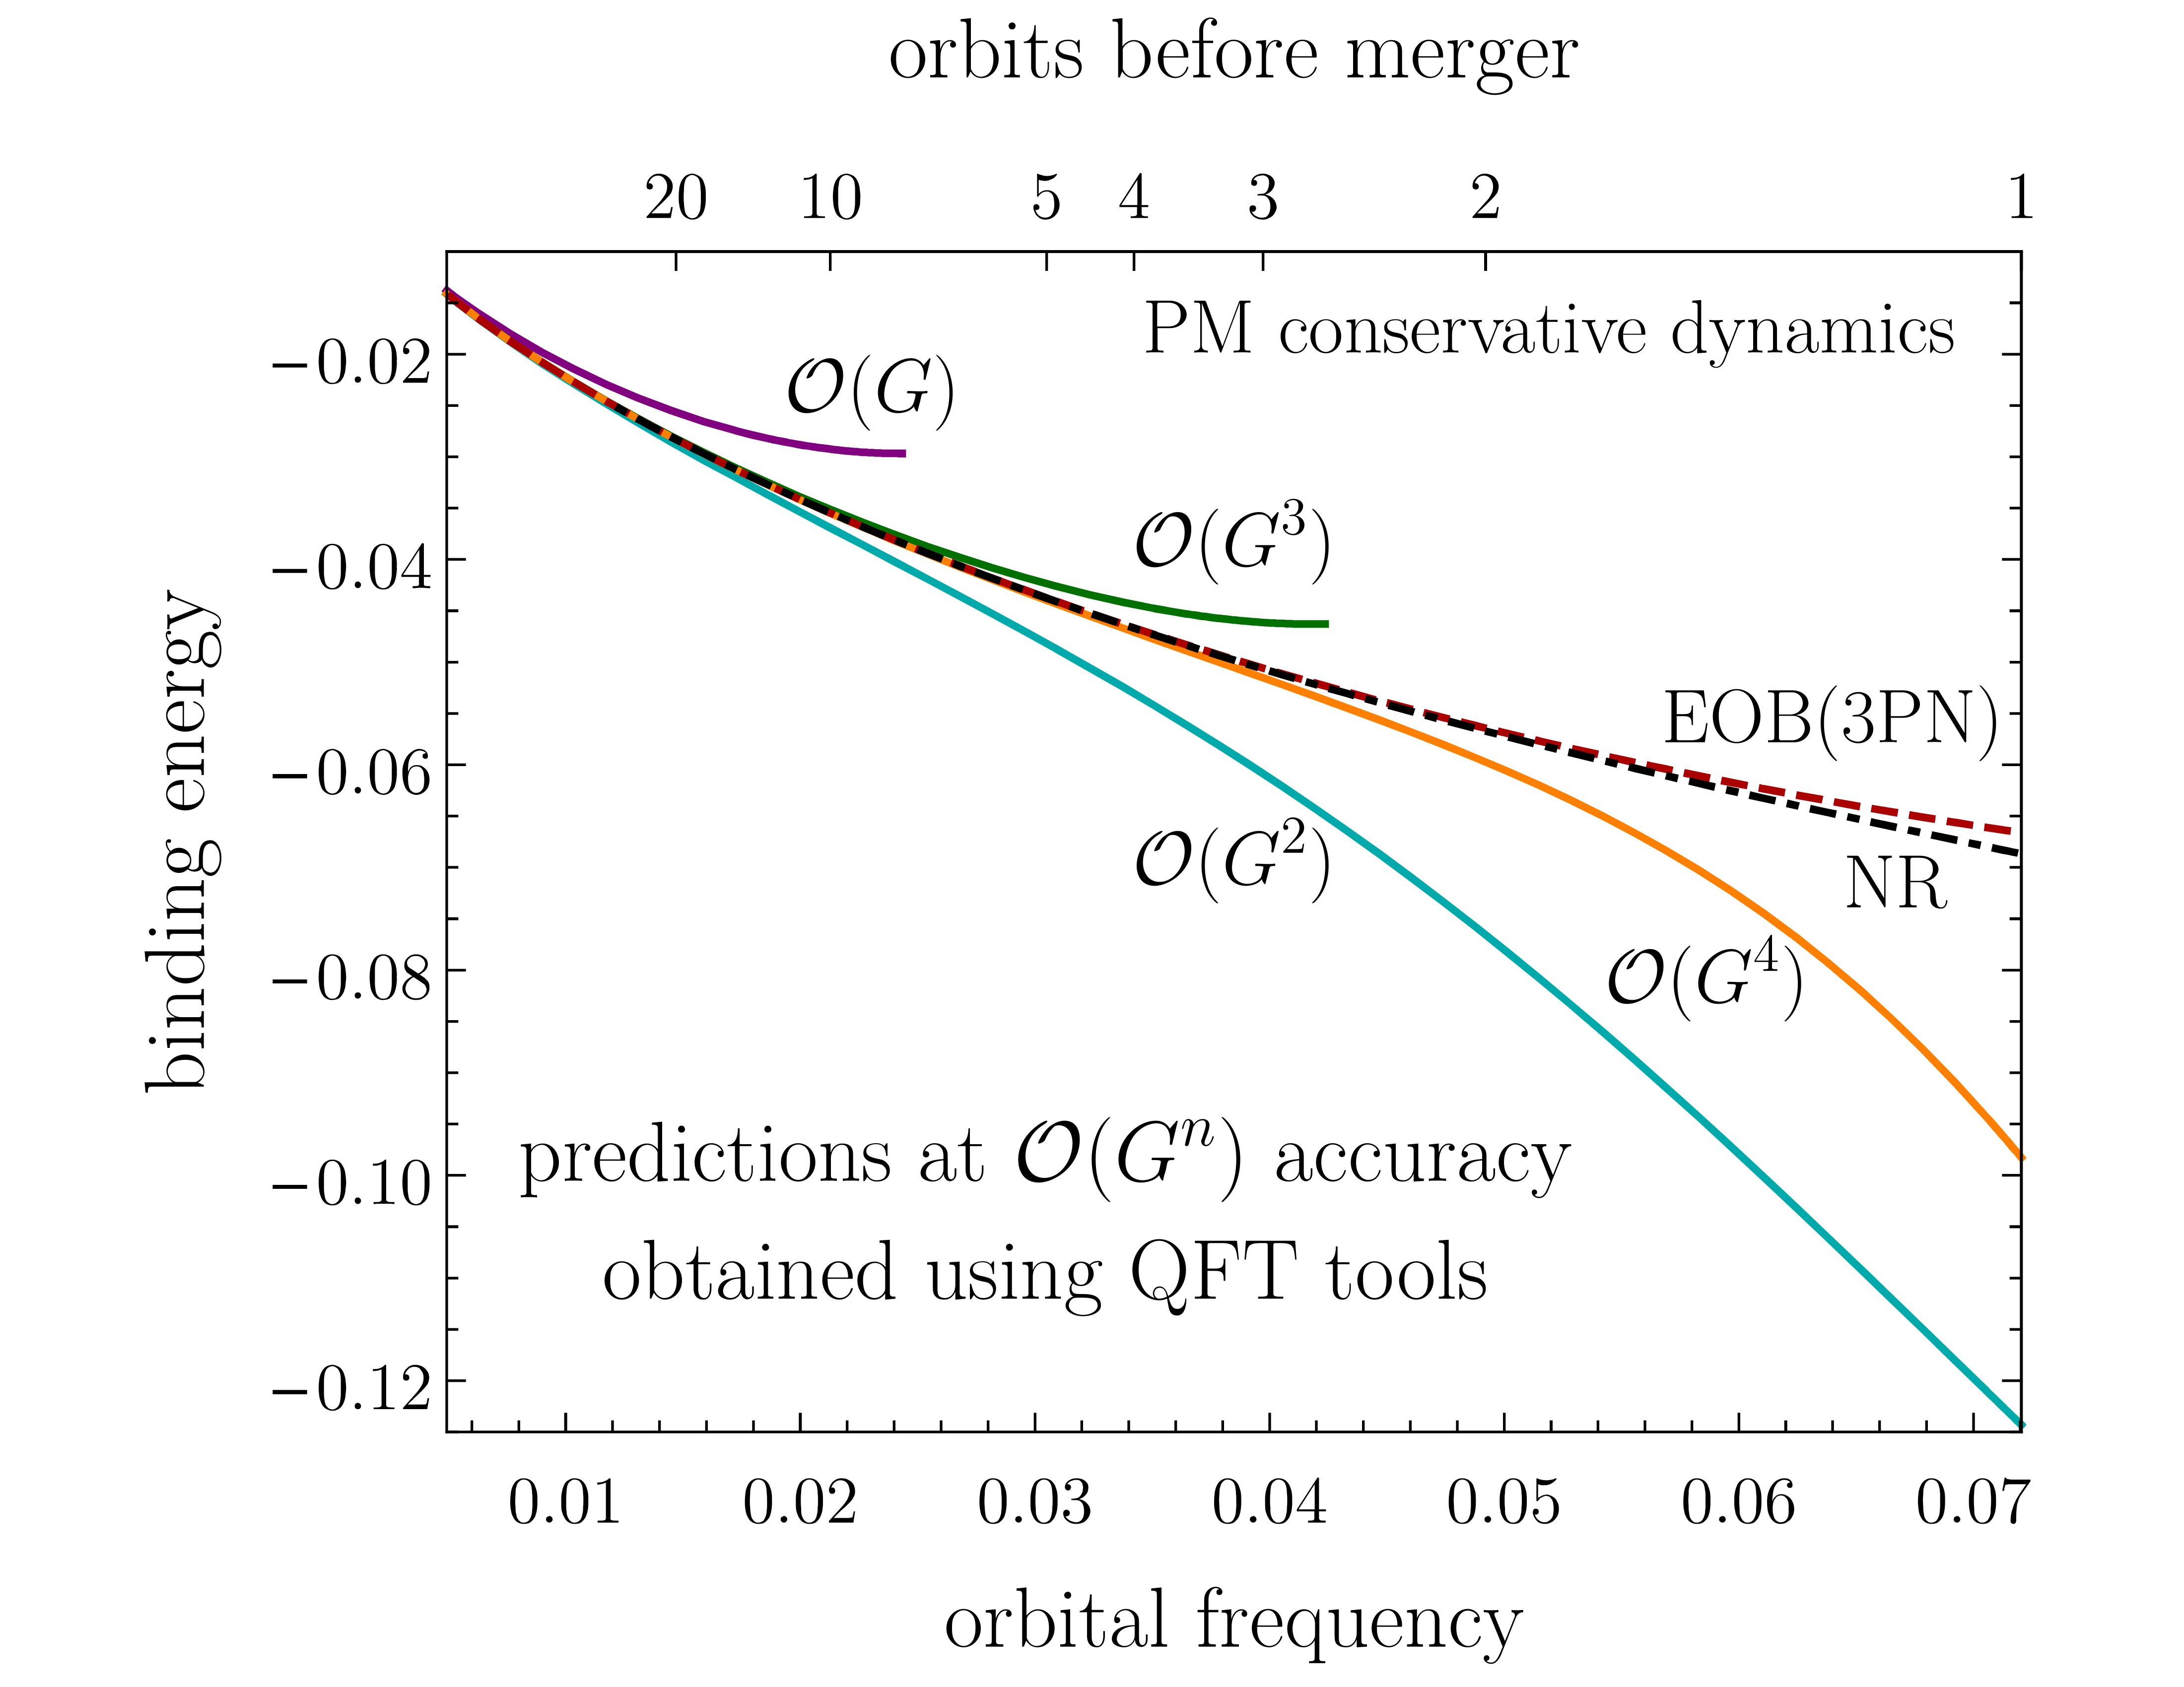
Proof of the Pudding
Incorporating input from RP gets binding energy predictions closer to the “gold standard” (NR)
Buonanno, Khalil, O’Connell, Roiban, Solon, Zeng (2022)

Slide 12
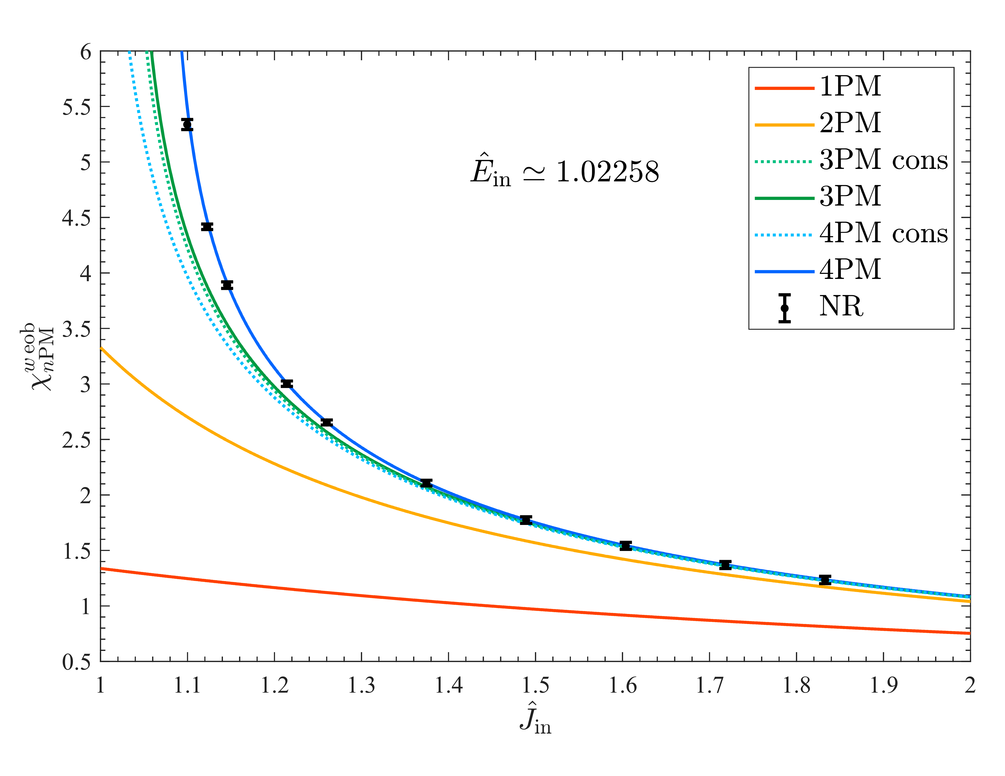
Proof of the Pudding
Gets EOB resummation closer to the “gold standard” in scattering
Damour, Rettegno (2022)

Slide 13
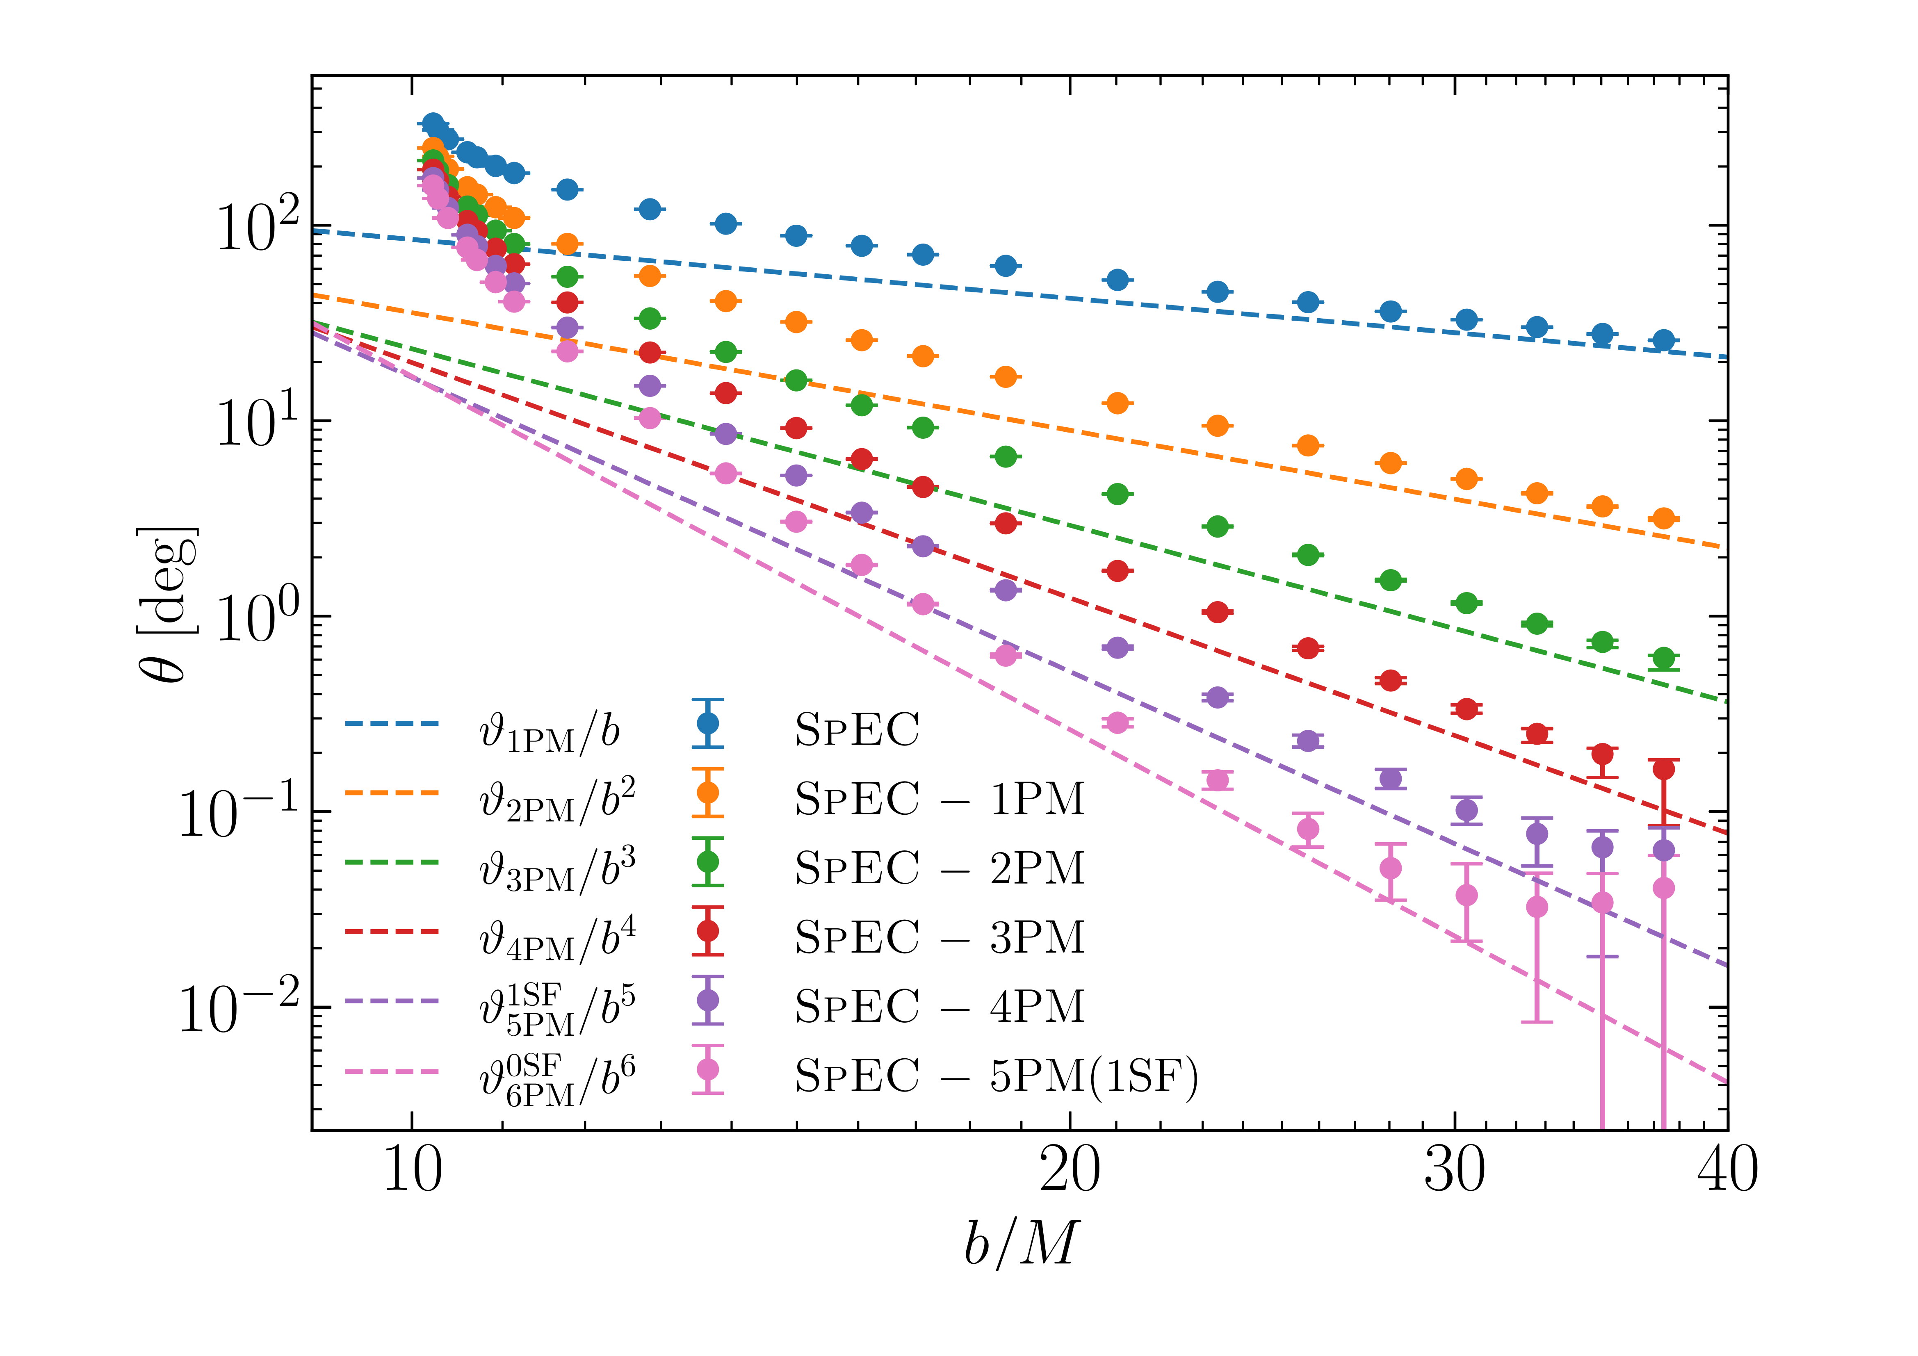
Proof of the Pudding
Scattering angle residuals
Long, Pfeiffer, Kidder, & Scheel (2025)
⇒ Pfeiffer’s talk

Slide 14
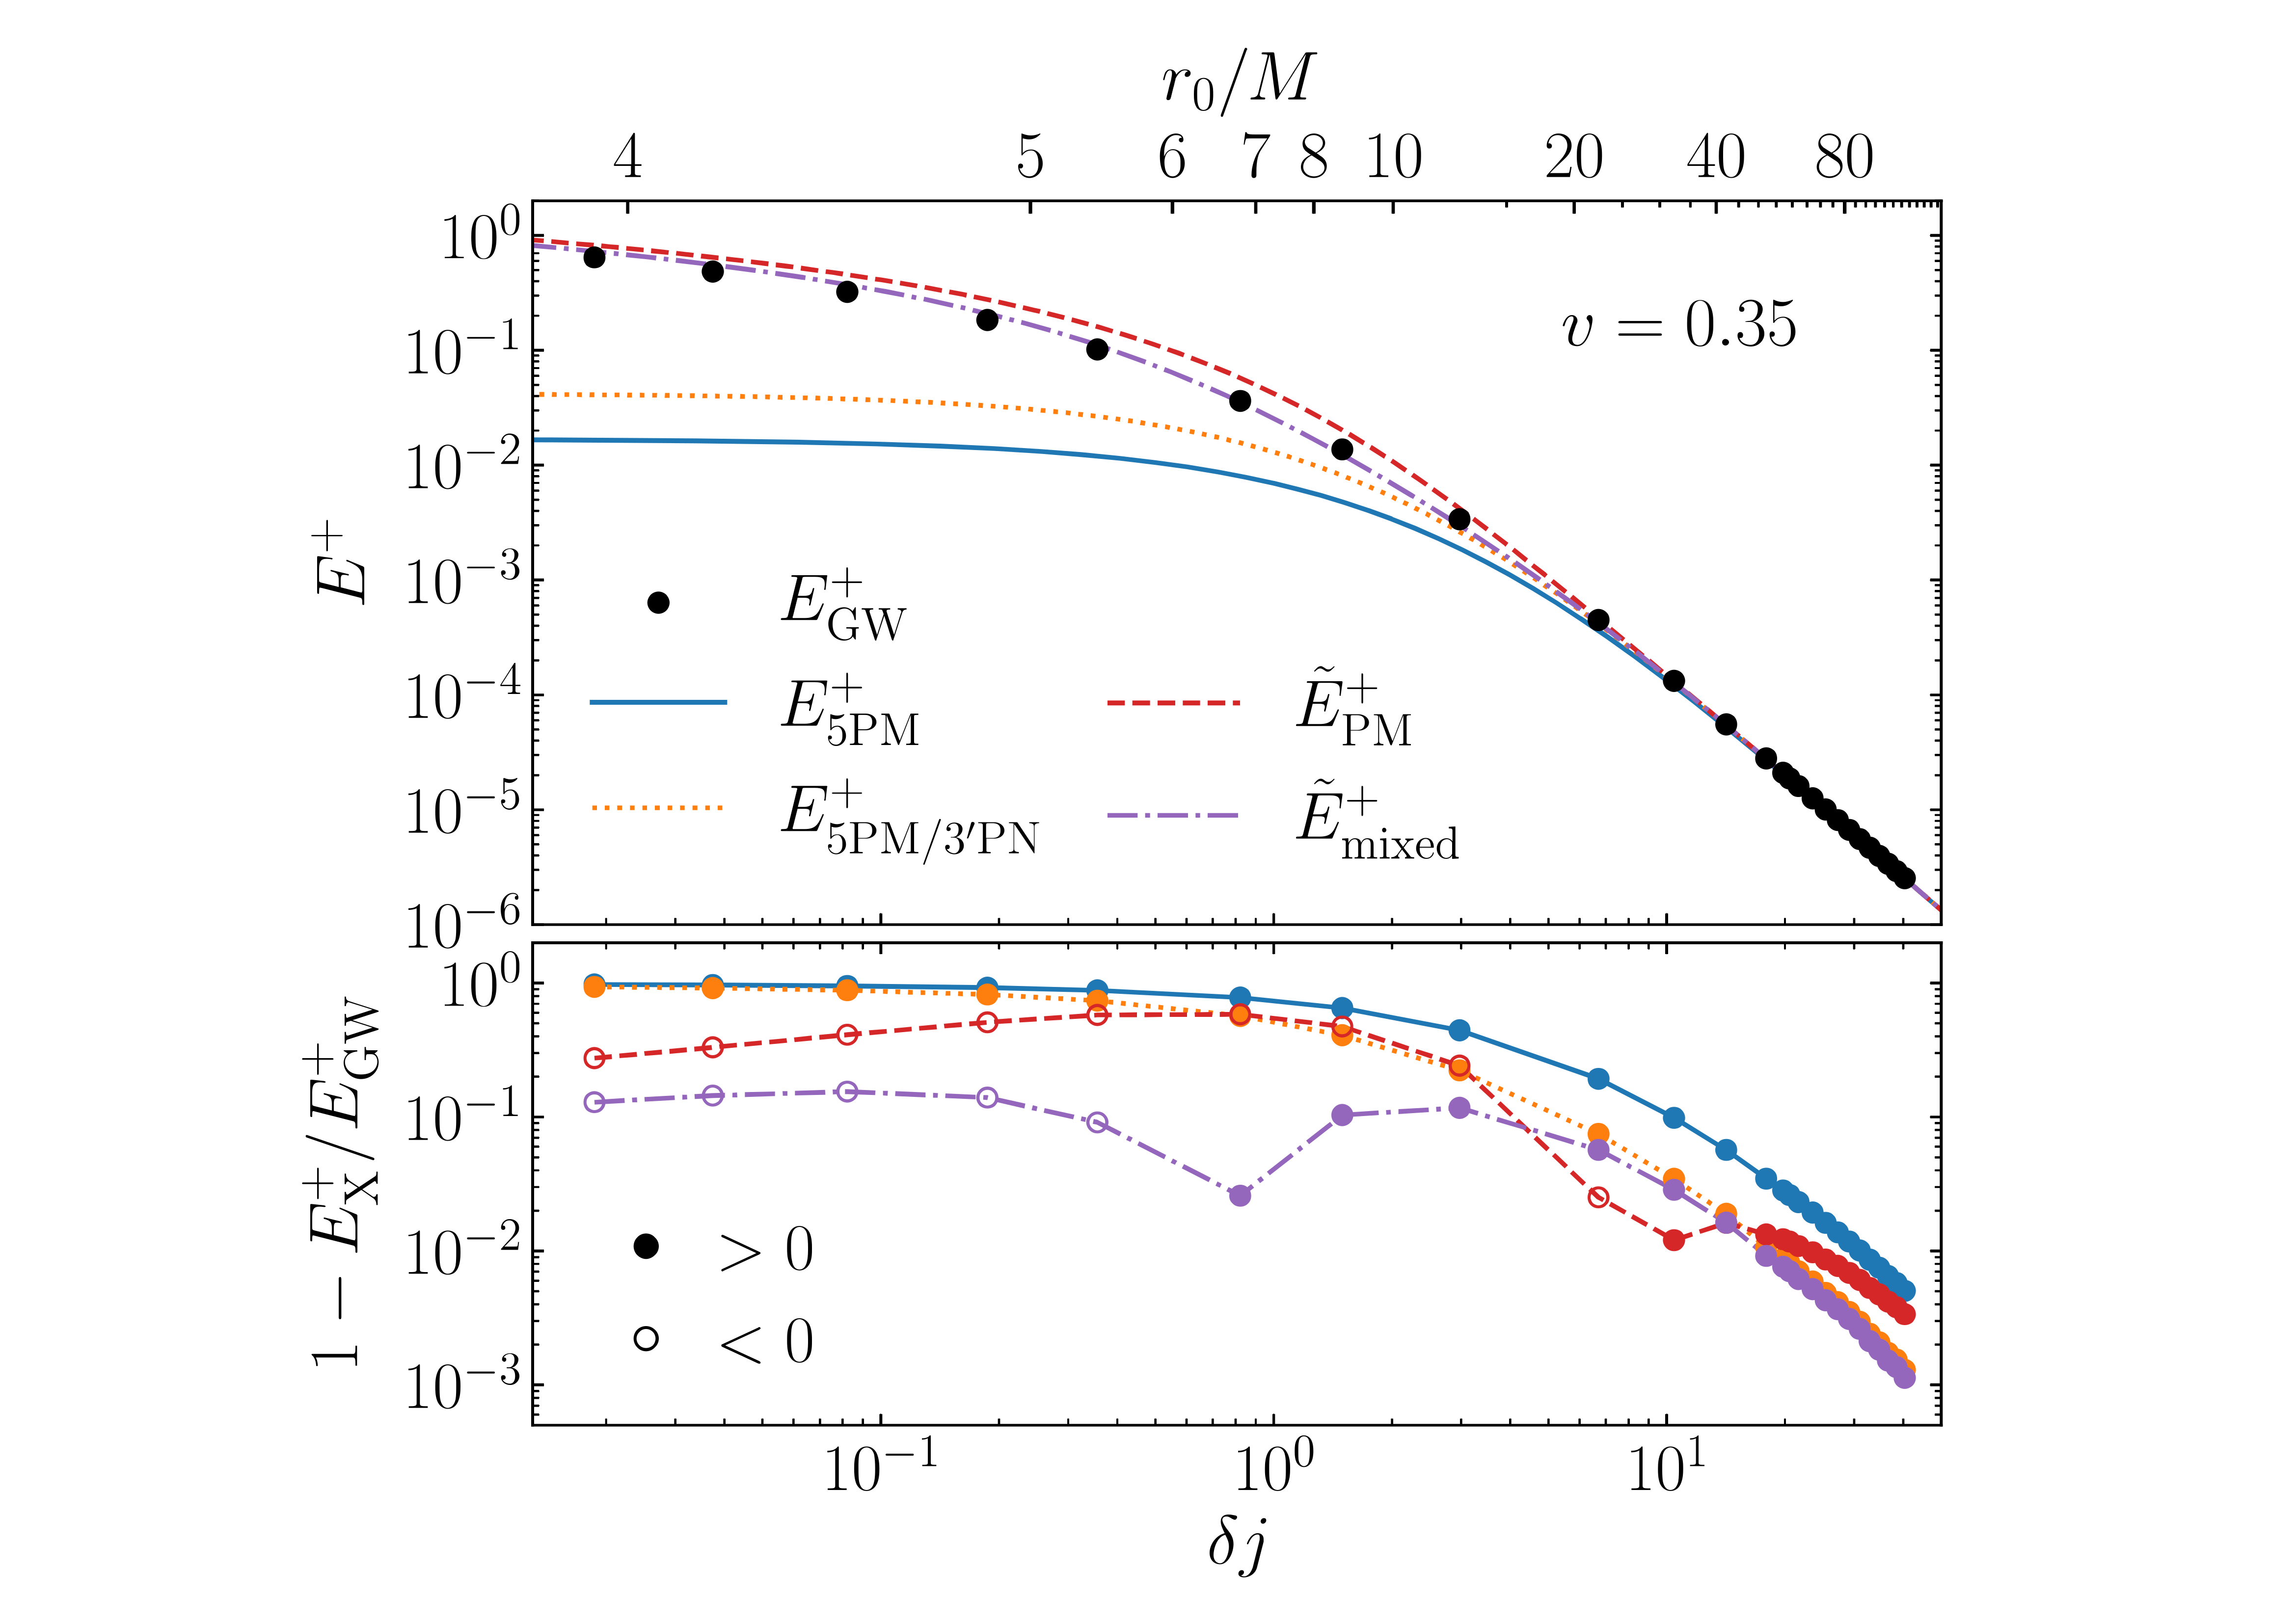
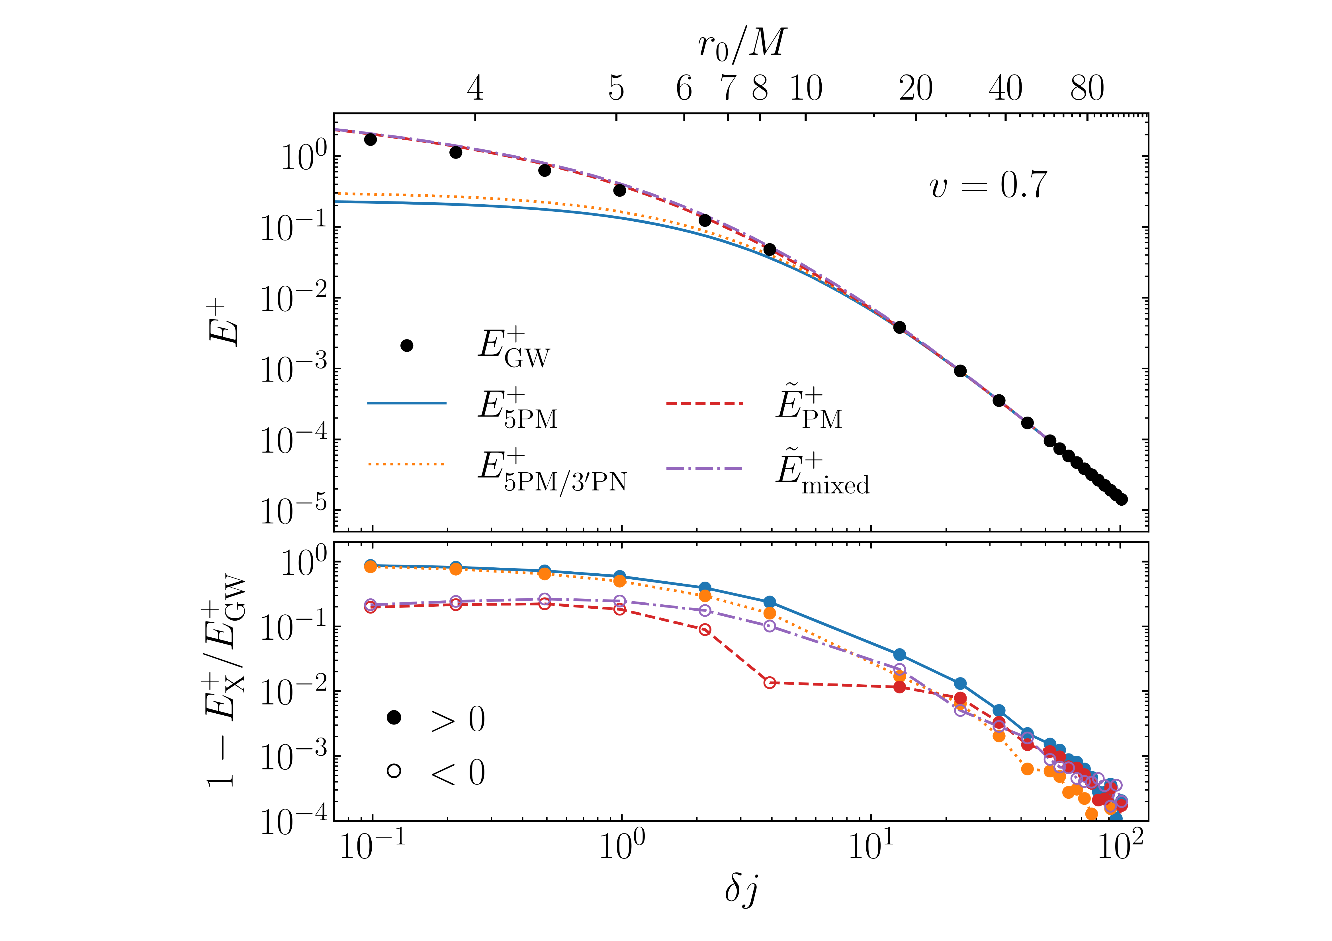
Proof of the Pudding
Emitted energy in scattering with (non-EOB) resummation
Barack, Gonzo, Leather, Long, & Warburton

Slide 15
What About the Bound Domain?
Towards waveform mapping
Gonzo and Mogull
More to come in the next 6–12 months…

Slide 16
Set-up
Scatter two massive objects, treated as point particles
impact parameter b
distinguishable particles

Slide 17
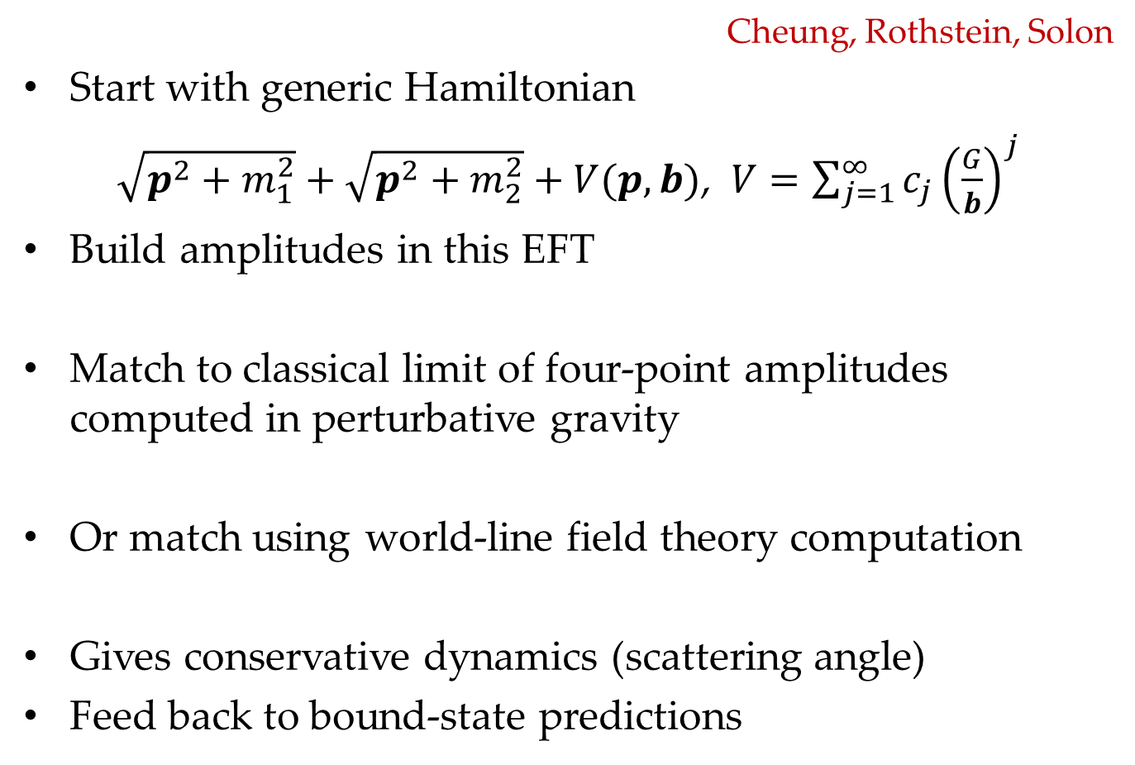
EFT Matching
Cheung, Rothstein, Solon
Start with generic Hamiltonian
$\sqrt{p^{2}+m_{1}^{2}}+\sqrt{p^{2}+m_{2}^{2}}+V(p,b)$, $V=\sum_{j=1}^{∞}{c_{j}{\left(\frac{G}{b}\right)}^{j}}$
Build amplitudes in this EFT
Match to classical limit of four-point amplitudes computed in perturbative gravity
Or match using world-line field theory computation
Gives conservative dynamics (scattering angle)
Feed back to bound-state predictions

Slide 18
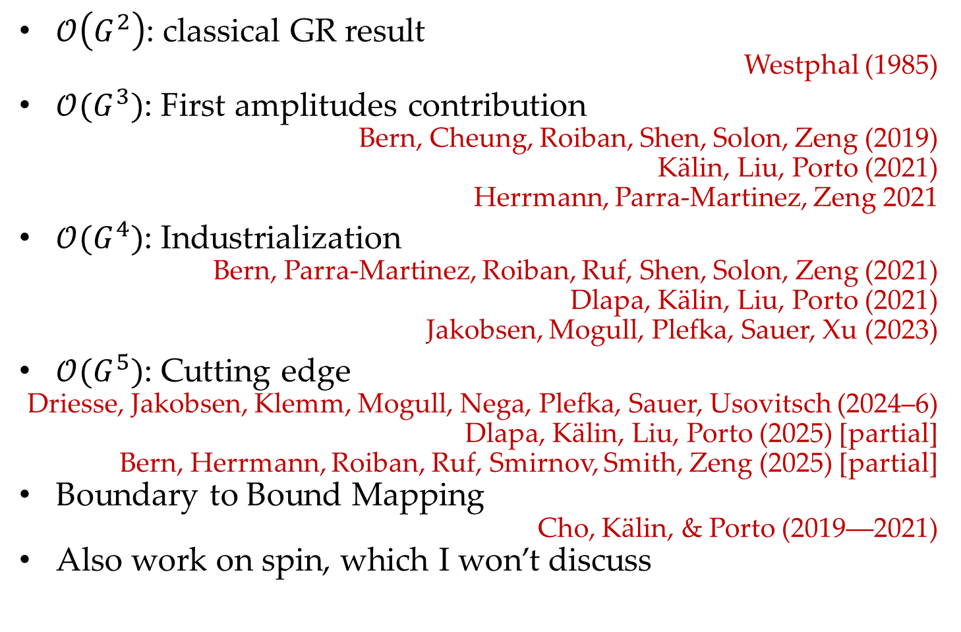
Progress
$𝒪\left(G^{2}\right)$: classical GR result
Westphal (1985)
$𝒪(G^{3})$: First amplitudes contribution
Bern, Cheung, Roiban, Shen, Solon, Zeng (2019)
Kälin, Liu, Porto (2021)
Herrmann, Parra-Martinez, Zeng 2021
$𝒪(G^{4})$: Industrialization
Bern, Parra-Martinez, Roiban, Ruf, Shen, Solon, Zeng (2021)
Dlapa, Kälin, Liu, Porto (2021)
Jakobsen, Mogull, Plefka, Sauer, Xu (2023)
$𝒪(G^{5})$: Cutting edge
Driesse, Jakobsen, Klemm, Mogull, Nega, Plefka, Sauer, Usovitsch (2024–6)
Dlapa, Kälin, Liu, Porto (2025) [partial]
Bern, Herrmann, Roiban, Ruf, Smirnov, Smith, Zeng (2025) [partial]
Boundary to Bound Mapping
Cho, Kälin, & Porto (2019––2021)
Also work on spin, which I won’t discuss

Slide 19
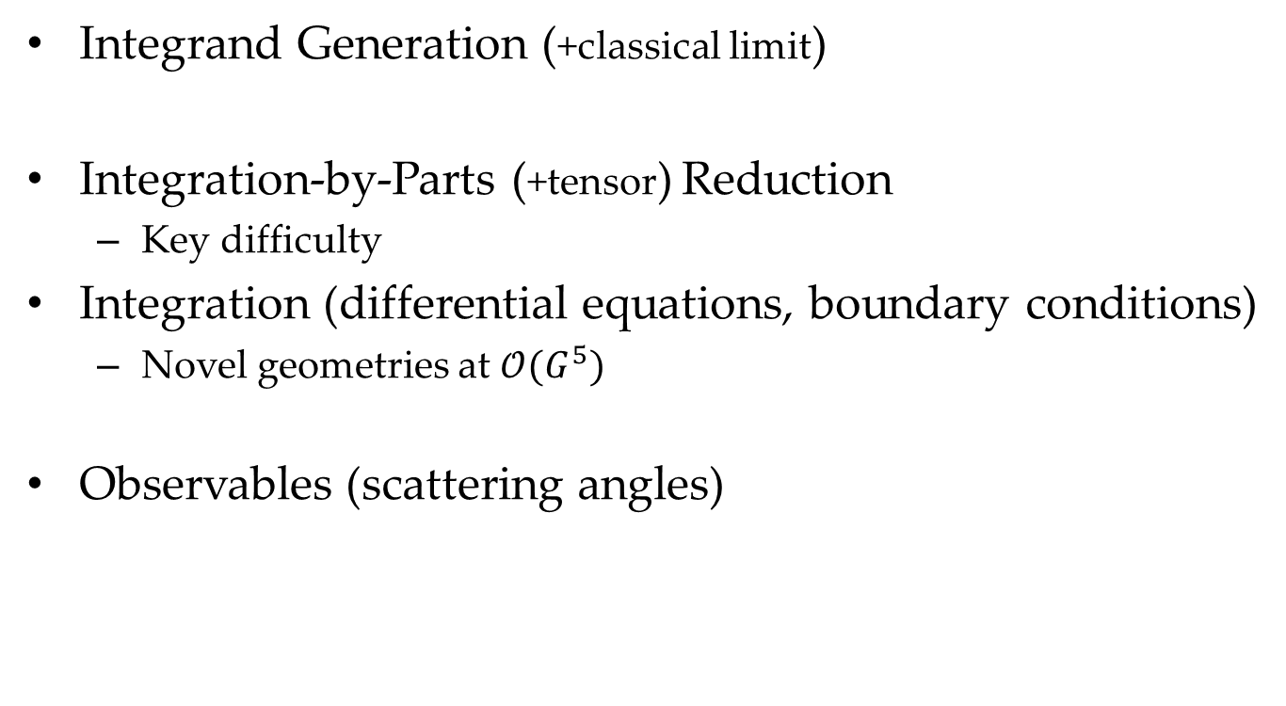
Workflow
Integrand Generation (+classical limit)
Integration-by-Parts (+tensor) Reduction
  Key difficulty
Integration (differential equations, boundary conditions)
  Novel geometries at $𝒪(G^{5})$
Observables (scattering angles)

Slide 20
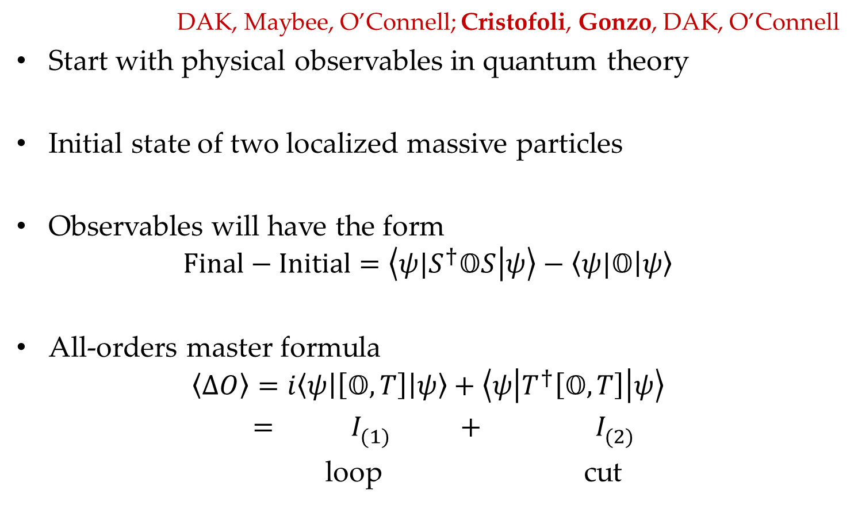
KMOC Approach
DAK, Maybee, O’Connell; Cristofoli, Gonzo, DAK, O’Connell
Start with physical observables in quantum theory
Initial state of two localized massive particles
Observables will have the form
$$Final−Initial=\left\langle {ψ|S}^{†}𝕆S | ψ\right\rangle −\left\langle ψ|𝕆 | ψ\right\rangle$$
All-orders master formula
$$\left\langle ΔO\right\rangle =i\left\langle ψ\left|\left[𝕆, T\right]\right|ψ\right\rangle +\left\langle ψ\left|T^{†}\left[𝕆, T\right]\right|ψ\right\rangle$$
$$= I_{(1)}^{} + I_{(2)}^{}$$
loop cut

Slide 21
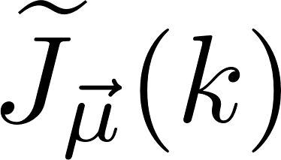
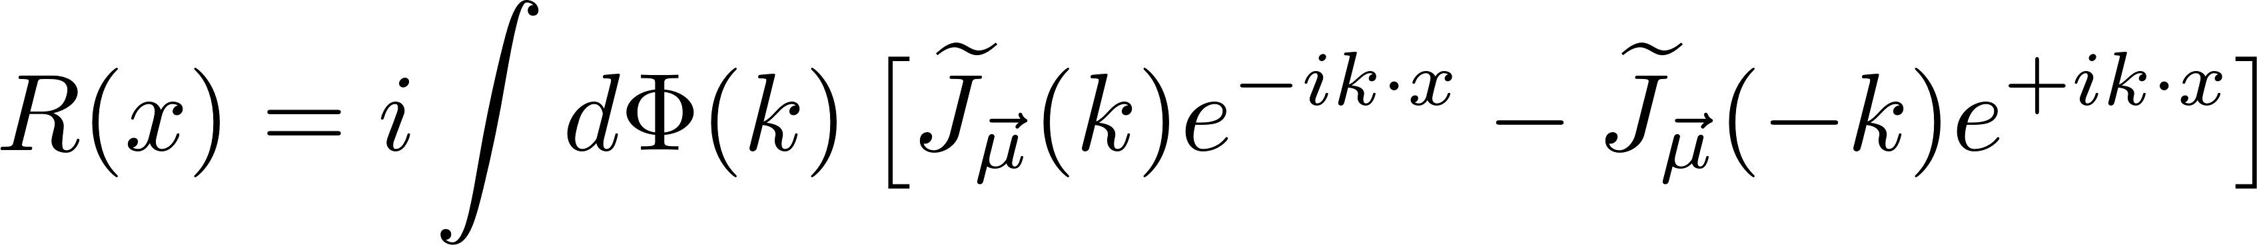
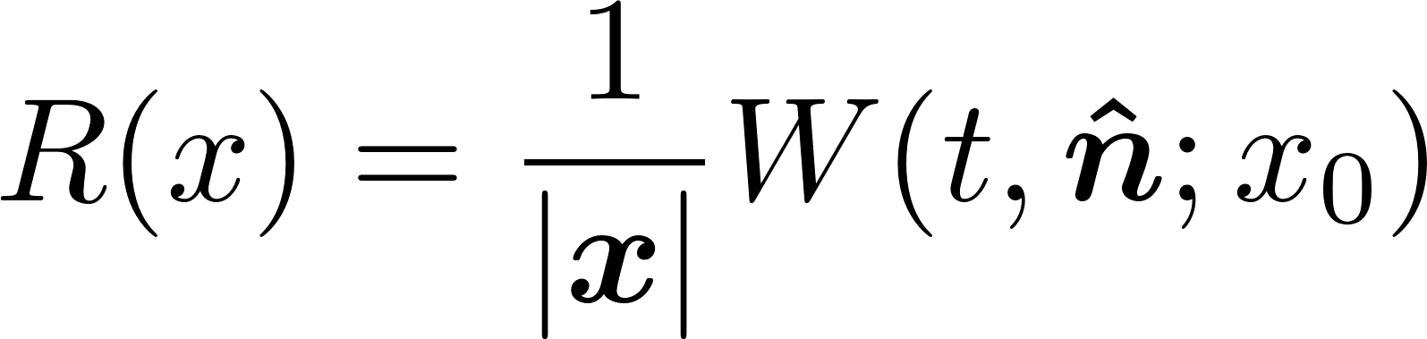
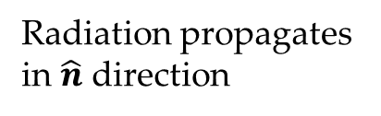
Local Observables
Local radiation observable
Waveform is leading large-distance behavior
Radiation propagates in $\hat{n}$ direction
Scattering region

Slide 22
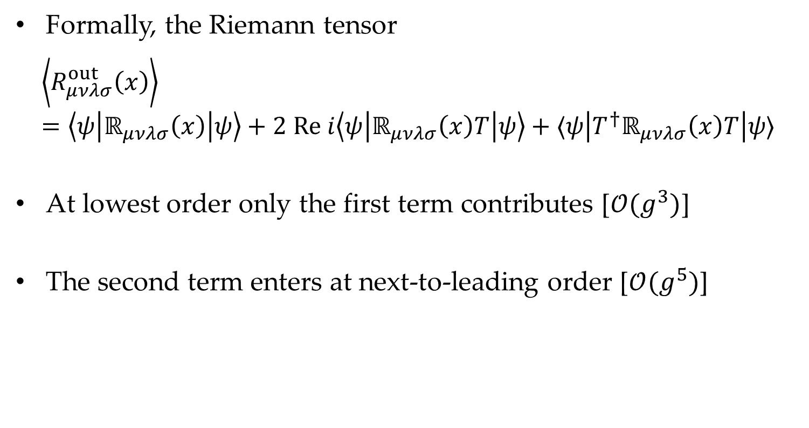
Waveform
Formally, the Riemann tensor
$$\left\langle R_{μνλσ}^{out}\left(x\right)\right\rangle =\left\langle ψ\left|ℝ_{μνλσ}\left(x\right)\right|ψ\right\rangle +2 Re i\left\langle ψ\left|ℝ_{μνλσ}\left(x\right)T\right|ψ\right\rangle +⟨ψ\left|T^{†}ℝ_{μνλσ}\left(x\right)T\right|ψ⟩$$
At lowest order only the first term contributes [$𝒪(g^{3})$]
The second term enters at next-to-leading order [$𝒪(g^{5})$]

Slide 23
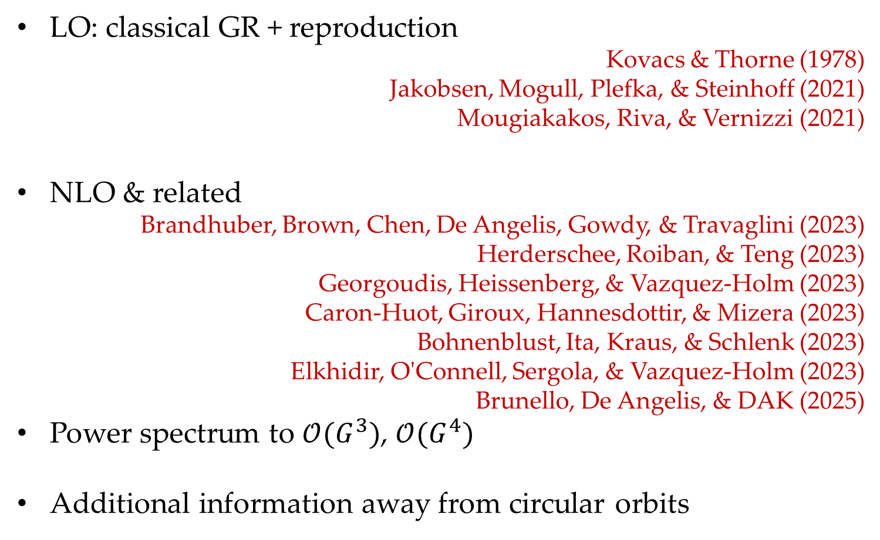
Waveform
LO: classical GR + reproduction
Kovacs & Thorne (1978)
Jakobsen, Mogull, Plefka, & Steinhoff (2021)
Mougiakakos, Riva, & Vernizzi (2021)
NLO & related
Brandhuber, Brown, Chen, De Angelis, Gowdy, & Travaglini (2023)
Herderschee, Roiban, & Teng (2023)
Georgoudis, Heissenberg, & Vazquez-Holm (2023)
Caron-Huot, Giroux, Hannesdottir, & Mizera (2023)
Bohnenblust, Ita, Kraus, & Schlenk (2023)
Elkhidir, O'Connell, Sergola, & Vazquez-Holm (2023)
Brunello, De Angelis, & DAK (2025)
Power spectrum to $𝒪(G^{3})$, $𝒪(G^{4})$
Additional information away from circular orbits

Slide 24
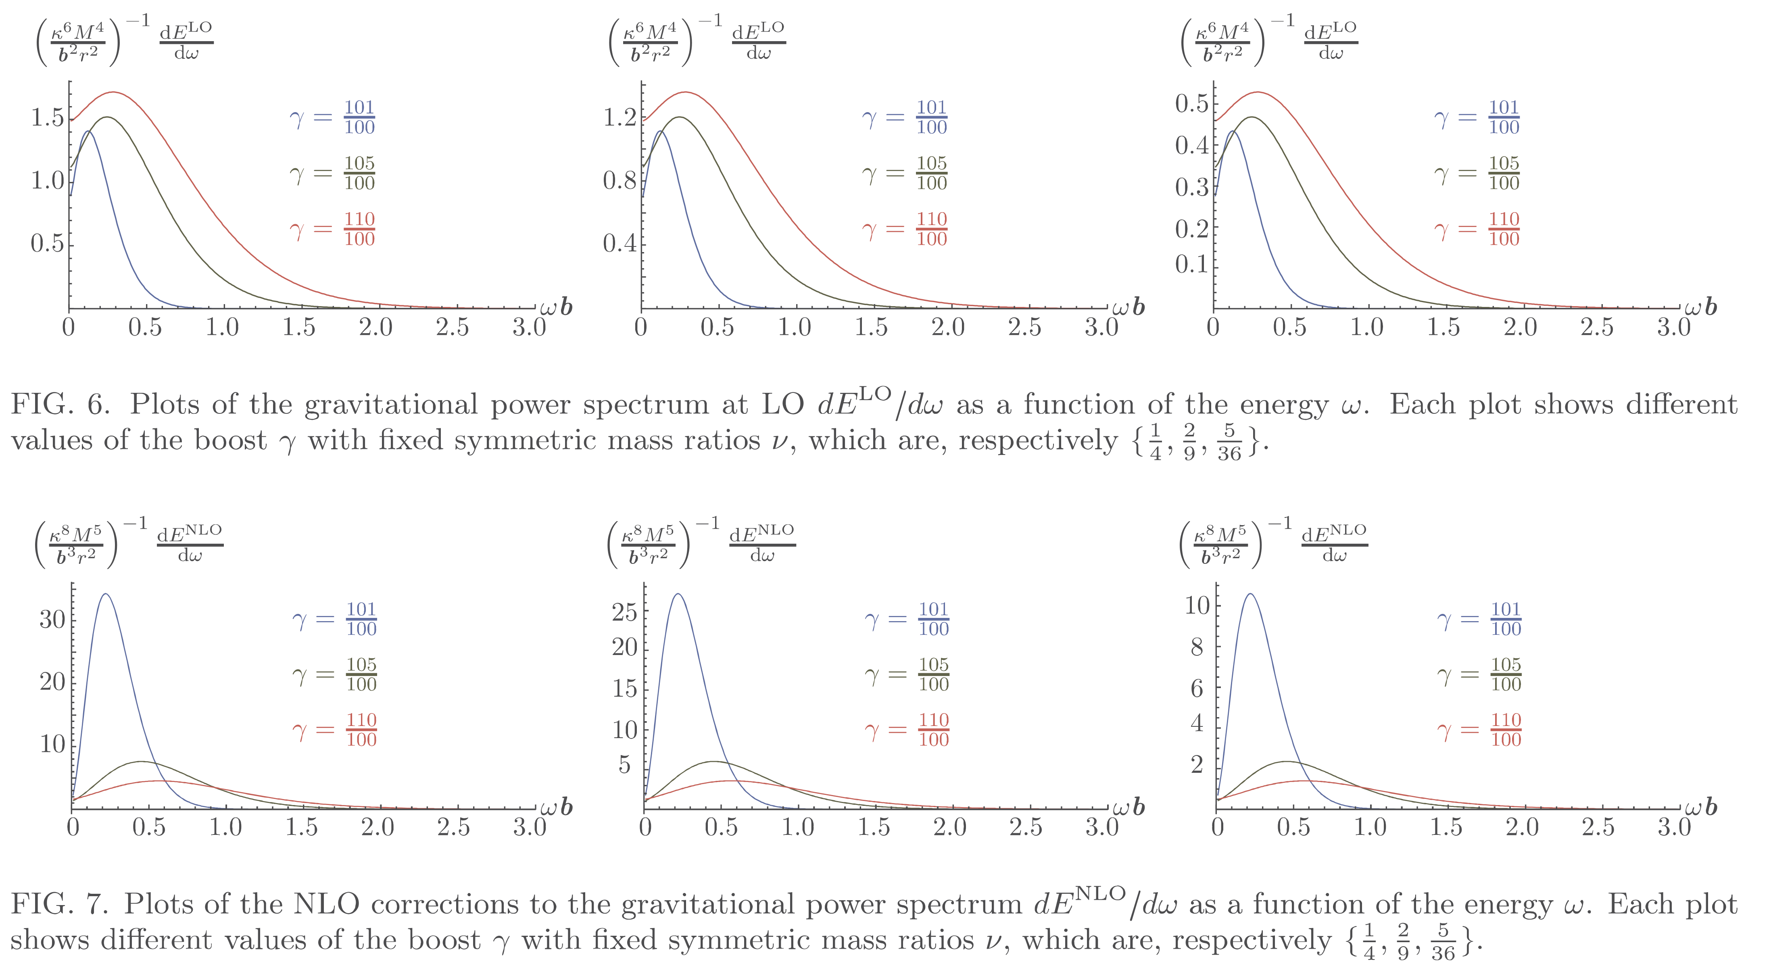

LO vs NLO power spectra $\frac{dE}{dω}=\frac{2}{κ^{2}}∫dΩ \sum_{h}{{\left|ω 𝒲_{h}\left(ω,Ω\right)\right|}^{2}}$

Slide 25
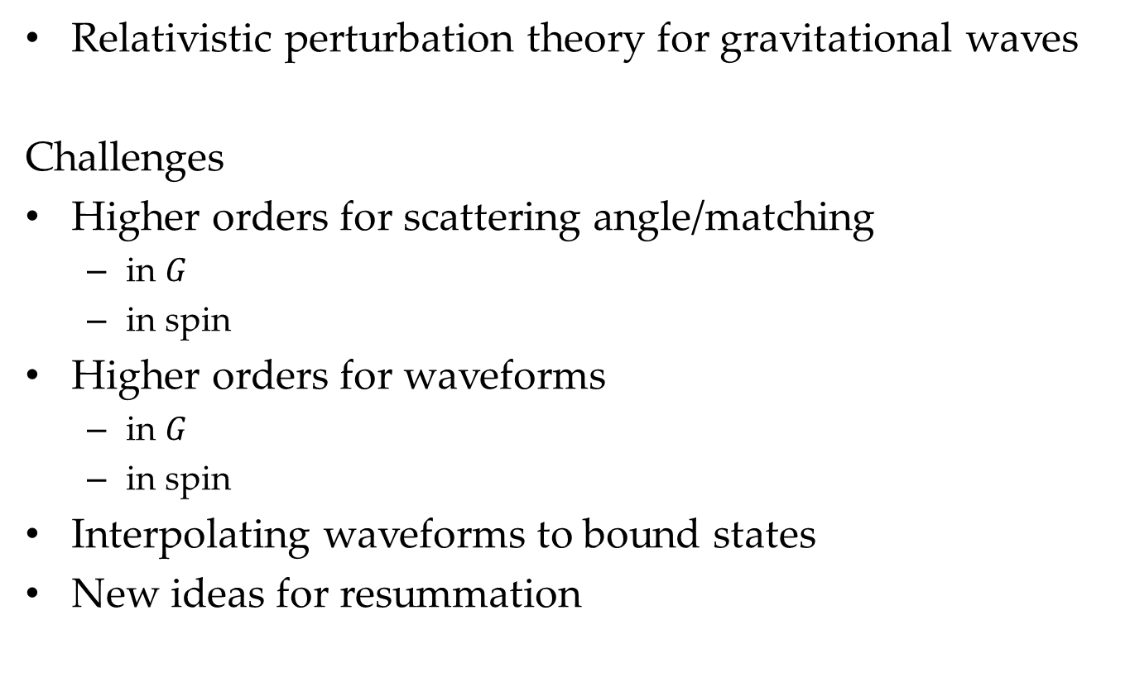
Summary & Outlook
Relativistic perturbation theory for gravitational waves
Challenges
Higher orders for scattering angle/matching
  in $G$
  in spin
Higher orders for waveforms
  in $G$
  in spin
Interpolating waveforms to bound states
New ideas for resummation

