Slide 1
Strong-to-weak Symmetry Breaking (SW-SSB) in Dynamics of Open Quantum Systems
Nordita Workshop, Stockholm
6/23/26
MPA Fisher
t
Dynamics of noisy (open) quantum system with U(1) symmetry:
Quantum mechanics lost at long times
But, can have finite-time (SW-SSB) transition as classical hydrodynamics emerges
0
x
0
t
Short-time quantum-dynamics
Emergent classical hydrodynamics at long-times
Experimental observation of SW-SSB Phase Transition

Slide 2








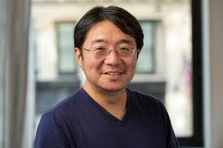
Theory Collaborators (arXiv:2602.16045)
Kaixiang Su
Hyunsoo Ha
Jake Hauser
Jerome Lloyd
Thomas Kiely
Abhi Sarma
Cenke Xu
Sarang Gopalakrishnan
Romain Vasseur

Slide 3

Experimental Collaborators
Immanuel Bloch and (some) members of his group
I. Bloch, Si Wang, J. Obermeyer, M. Barendregt, P. Bojovic, D. Tell, P. Preiss, T. Franz,
A. Sarma, T. Kieley, C. Xu, MPAF, arXiv:2604.16137

Slide 4
Symmetry breaking in Open Quantum System
Focus: Global U(1) Symmetry
+
Unitary
Decoherence
Bath

Slide 5
Strong-vs-weak symmetries (Buca+Prosen 2012)
Unitary symmetry generator
Ex: U(1) for “rotors”
Pure state
Mixed States
Strong Symmetry
Mixture of pure states in the
same symmetry sector (canonical ensemble)
Mixture of pure states in
different symmetry sectors
(Grand canonical ensemble)
Weak Symmetry
(Strong symmetry implies weak symmetry, but not vice versa)
These symmetries can be spontaneously broken (SSB) under dynamics

Slide 6
Focus: Strong-to-weak spontaneous symmetry breaking (SW-SSB)
Density matrix of open system can undergo phase transition
where a strongly symmetric state evolves into a state with the strong –
but not weak – symmetry spontaneously broken (SW-SSB)
SW-SSB transitions are
Information-theoretic phase transitions (cf MIPT)
Transitions in decodability (cf QEC thresholds)
Transitions where classical hydrodynamics emerges
SW-SSB Transition
0
t
Short-time quantum-dynamics
Emergent classical hydrodynamics at long-times

Slide 7
Road Map
1. ODLRO
5. Experiment
SW-SSB
2. Decodability,
Learnability
4. Emergence and duality
of hydrodynamics
3. Emergent
Indistinguishability

Slide 8
Correlators for U(1) Symmetry Breaking (s=1/2)
ODLRO: Ordinary Spontaneous Symmetry Breaking (SSB)
Off-diagonal correlator linear in the density matrix, develops long-ranged order
Strong to weak SSB (SW-SSB)
Jong Yeon Lee, Chao-Ming Jian and Cenke Xu arXiv 2301:05238
Renyi-2 correlator (non-linear in the density matrix) develops
long-ranged order

Slide 9
Other (better) SW-SSB Correlators
Fidelity Correlator
L.A. Lessa, R. Ma, JH Zhang, Z. Bi, M.Cheng and C. Wang arXiv 2405.03639
Renyi-1 Correlator
Zack Weinstein arXiv 2410.23512
Stability Theorem: A state with LRO in Fidelity and Renyi-1 Correlators
cannot be evolved into a state without LRO by a
strongly symmetric finite-depth channel (not true for Renyi-2)

Slide 10
Dynamics in Open system with Symmetry
Unitary dynamics: Hamiltonian
Strongly symmetric if
Decohering (dissipative) dynamics: Lindblad equation
for mixed state density matrix
Jump operators,
Strongly symmetric if
Weakly symmetric if

Slide 11
Outline: Evidence for SW-SSB
1.) Lindbladian dynamics s=1/2 Model with XY Symmetry
(Finite-time transition where “strong” U(1) symmetry spontaneously breaks)
2.) Lindbladian and coherent dynamics for Boson “rotor” model
(Emergence of classical hydrodynamics at a finite time transition)
3.) Experimental Observation of SW-SSB

Slide 12
Toy s=1/2 model w/ strong U(1) Symmetry
S=1/2 Model with XY symmetry (hard-core bosons hopping)
Open system dynamics; Lindblad
Jump operators; Incoherent Boson hopping
Strong U(1) Symmetry

Slide 13
Transform to Double-Hilbert space representation
Density operator represented as pure state in doubled space (Choi representation)
Lindbladian dynamics gives “effective” Hamiltonian on 2-leg ladder
Ket
Bra
Strong symmetry transformation;
Forward path (ket) only
Weak Symmetry transformation

Slide 14
Explore Lindbladian Dynamics of Toy Model
Lindbladian dynamics gives “effective” Hermitian Hamiltonian on 2-leg ladder
Ket
Bra
Project into diagonal Hilbert space (classical), which is closed under the dynamics
Define “rung” Bosons
Gives 1d Ferromagnetic Heisenberg Hamiltonian

Slide 15








Classical diffusion
Define density-density correlation fcn
“imaginary” time dynamics
w/ initial pure state
and maximally mixed final state
Boson World lines in “imaginary” time,
t
Classical Diffusion
“Symmetric Exclusion Process” (SSEP)
0
$$⋯$$
$$↑$$
$$↓$$
$$↑$$
$$↓$$
$$↑$$
$$↓$$
$$↑$$
$$⋯$$

Slide 16




Strong-to-weak SSB
(Lee, Jian, Xu 2023)
Renyi-2 strong-to-weak correlator
(in diagonal sector)
$$⋯$$
$$↑$$
$$↓$$
$$↑$$
$$↓$$
$$↑$$
$$↓$$
$$↑$$
$$⋯$$
$$⟨⟨ρ_{0}|$$
Imaginary-time dynamics
w/ periodic bc
$$|ρ_{0}⟩⟩$$
$$⋯$$
$$↑$$
$$↓$$
$$↑$$
$$↓$$
$$↑$$
$$↓$$
$$↑$$
$$⋯$$
Off-diagonal correlator

Slide 17
ODLRO in “Particle” picture
Note: Density matrix diagonal in S^{z} basis, describes a
Classical probability distribution function
View classical probability distribution function as the square of a “wavefunction”
over the particle coordinates
x₁ x₂ x₃ x₄
t
0
“Familiar” Off-diagonal correlator in terms of real, positive wavefunction,
ODLRO shows that moving a particle across system produces a
mixed state that is indistinguishable from the initial state

Slide 18
Strong-to-weak SSB in 3d
Imaginary-time dynamics for
Heisenberg FM
Time sets the effective temperature
d=3; Heisenberg FM orders at finite temperature, implying
a finite time transition where SW-SSB occurs, with ODLRO
SW-SSB
t
0
t_{c}
Strong symmetry broken
Symmetric

Slide 19
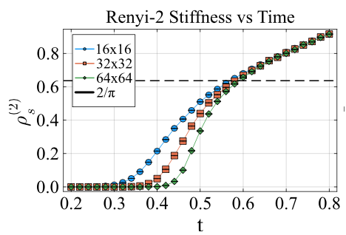
Renyi-2 Quasi-ODLRO in 2d
d=2; Heisenberg FM does not order at any finite temperature
But, initial state at t=0 breaks Heisenberg down to XY symmetry
Might expect a finite time Kosterlitz-Thouless “symmetry breaking” transition
into a phase with power law Quasi-ODLRO
Stochastic Series Expansion (Quantum Monte Carlo) result verifies this

Slide 20
Renyi-2 Correlator in 1d
For 1d Heisenberg/XY FM correlation length diverges only at zero temperature
ballistic growth of correlation length; SW-SSB only in infinite-time steady-state
Connections with Conditional Mutual Information (CMI)
Markov length, expect
ballistic growth
A
B
C
If
there exists a Petz recovery map (reconstruct A w/out using C)
Expect that decodability is possible

Slide 21
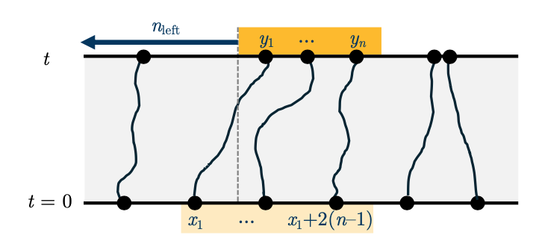
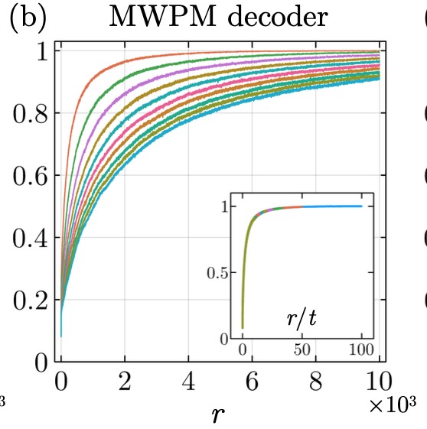
Decodability in 1d
A
B=r
C
Measure final positions of particles in B;
Infer how many particles left A?
Use a “minimal-weight” matching scheme
MWPM decoder selects n consecutive
sites {x1, x1 + 2, ..., x1 + 2(n−1)} that best
matches particles observed in B=r by minimizing
total distance, D.
Success
probability
Inset reveals that decoder length
grows ballistically
All lengths grow ballistically with time!

Slide 22
Summary: Dynamics Toy U(1) s=1/2 Lindbladian
For d=2,3 a finite time, t_{c}, strong-to-weak SSB transition;
0
t_{c}
t
Classical particles
are distinguishable
(decodable)
Classical particles
are indistinguishable
(exchanges important – not-decodable)
Strong-to-weak SSB

Slide 23
Outline: Evidence for SW-SSB
1.) Lindbladian dynamics s=1/2 Model with XY Symmetry
(Finite-time transition where “strong” U(1) symmetry spontaneously breaks)
2.) Lindbladian and coherent dynamics for Boson “rotor” model
(Emergence of classical hydrodynamics at a finite time transition)
(Boson/Vortex duality description)
3.) Experimental Observation of SW-SSB

Slide 24
Rotor model w/ decoherence and unitary dynamics
Bose Hubbard Model (lattice 4-He/ cold-atoms); Rotor representation
Set-up Lindbladian dynamics to target Gibbs steady-states
Express via Keldysh double path-integral
Explore SW-SSB

Slide 25
Add Decoherence to rotor dynamics
(A) Target Gibbs steady state
Shifts
Appropriate Lindblad jump operators
“weighted” by change in
“free-energy”
(B) Target second Gibbs steady state
Appropriate Lindblad jump operators
Hops a Boson, weighted
by change in “free-energy”
F_{n}

Slide 26
Full Lindbladian Dynamics with Strong U(1) Symmetry
Strongly U(1) Symmetric Dynamics
since all jump operators
commute with symmetry generator

Slide 27

Lindbladian Dynamics via (Keldysh) Double Path integral
t
Forward/backward Paths
coupled by dissipation
Define Classical/Quantum fields:
Berry’s Phase term in action
Canonically conjugate pairs
Classical-phi/quantum-n
Quantum-phi/classical-n
Classical/classical commute
Quantum/quantum commute

Slide 28
Symmetry Transformations
Classical/Quantum fields:
Strong Symmetry transformation:
(quantum field transforms)
Weak Symmetry transformation:
(classical but not quantum
transform)

Slide 29
Possible Symmetry Breaking Patterns
(A) Neither strong nor weak symmetry breaking:
Short-range order in both
and
(B) Strong, but not weak, symmetry breaking:
Short-range order in
Long-range order in
(Strong-to-weak SSB, via “condensing” quantum phase-field)
(C) Strong and weak symmetry breaking:
Long-range order in both
(a ``classical” superfluid/condensate)
and

Slide 30
Behavior of rotor model with unitary and decohering dynamics
Expectation
Initialize in pure state Mott insulator
For d=2,3 expect a finite time, t* , strong-to-weak SSB transition;
Mott insulator in pure state
0
t
Short-time “quantum”-dynamics
Dynamics at long-times??

Slide 31
Examine dynamics for t>t*
(a) Have SW-SSB
has long-ranged order
(no vortices/vortex-loops in
quantum phase field)
(b) Perform spin-wave expansion
Quantum Phase field becomes
non-compact, conjugate classical
density, n, lives on reals not integers
(c) Decouple terms by introducing noise fields
(d) Integrate out
giving two coupled Langevin equations
Quantum Keldysh to classical Martin-Siggia-Rose

Slide 32
Classical hydrodynamics emerges (Model F)
Classical steady-state distribution function
“Normal” fluid: noisy diffusion equation
Superfluid; Spin-wave expansion (weak SSB), under-damped Goldstone mode

Slide 33
Summary: Emergent Hydrodynamics
At long-times with decoherence present classical dynamics emerges
SW-SSB
0
t*
t
Short-time quantum-dynamics,
no SSB
Classical hydrodynamics emerges
after SW-SSB (Model F)
Particle discreteness important
Particle density replaced by a
continuous field, n(x)
Strong-to-weak SSB;
Finite time transition where classical hydrodynamics emerges!

Slide 34
Model A Hydrodynamics for normal/superfluid
Recall Model A hydro
(has no conserved density):
In Normal fluid - no slow mode; In superfluid - diffuses (no Goldstone mode)
Obtain Model A from quantum Lindbladian for rotors?
Add charge-non-conserving jump operators
Explicitly breaks strong down to weak U(1)_{c} 0-form symmetry
Perform “spin-wave” expansion in Keldysh action
“recovers” normal phase of Model A - density relaxing quickly.
Transition into superfluid, WT-SSB_{c} , gives diffusion of as in Model A
Quantum-to-classical is a *crossover* for Model A (cf Model F)
0
t
Mott insulator
Normal fluid

Slide 35
Boson-Vortex Duality for Emergent Hydrodynamics
2+1 D Bosons (rotors)
2+1 D vortices – coupled to non-compact A
Symmetries:
0-form charge
0-form vortex- “charge” symmetry
Phases:
Mott insulator,
strong
ST-SSB_{v} of zero form
symmetry
(vortex-condensation)
(b) Normal Fluid
SW-SSB_{c}
SW-SSB_{v}
of
symmetry
Density diffuses
Magnetic field diffuses
(c) Superfluid ST-SSB_{c}
Strong
symmetry
Goldstone Mode
(Dual) Photon

Slide 36
Dual Vortex Theory has electric 1-form symmetry
Symmetries:
0-form charge
1-form “electric” symmetry
Phases:
Mott insulator,
strong
No
symmetry
(b) Normal Fluid
SW-SSB_{c}
W*T-SSB_{e}
Emergent weak 1-form SSB to trivial
Magnetic field diffuses
Density diffuses
(c) Superfluid ST-SSB_{c}
S*T-SSB_{e}
Emergent strong 1-form SSB to trivial
Goldstone Mode
(Dual) Photon

Slide 37
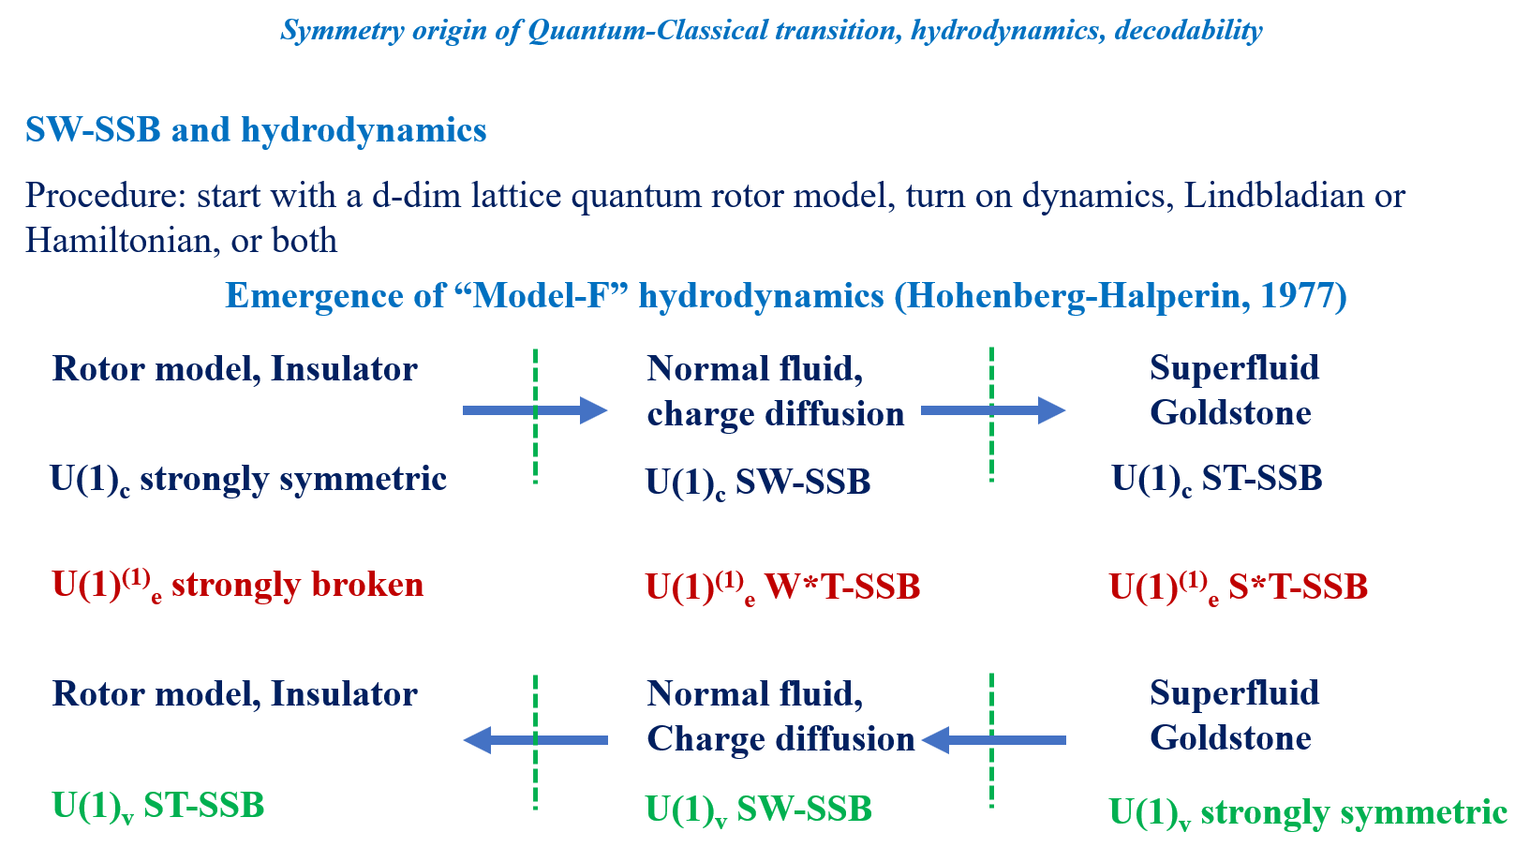
Boson-Vortex Duality for Model F

Slide 38
Outline Evidence for SW-SSB
1.) Lindbladian dynamics s=1/2 Model with XY Symmetry
(Finite-time transition where “strong” U(1) symmetry spontaneously breaks)
2.) Lindbladian and coherent dynamics for Boson “rotor” model
(Emergence of classical dynamics at a finite time transition)
3.) Experimental Observation of SW-SSB

Slide 39
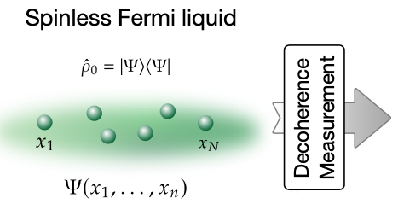
SW-SSB in Experiment: Cold fermionic atoms
I. Bloch, Si Wang, J. Obermeyer, M. Barendregt, P. Bojovic, D. Tell, P. Preiss, T. Franz,
A. Sarma, T. Kieley, C. Xu, MPAF, arXiv:2604.16137
Weakly interacting spin-1/2 Fermi gas (Li-6) in optical lattice.
Ideally, prepare a pure state for one-spin species
In practice a mixed state
Use quantum gas microscope to make site-resolved position measurements
of one spin species, and repeat – to obtain many “snapshots”, bit strings
Prepares a fully de-phased density matrix

Slide 40
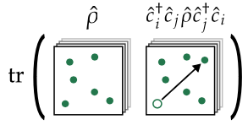
Renyi-Correlators for dephased density matrix
Obtain n’ from n by moving particle from i to j
Quantum-Classical Cross correlators
(Garrat, Weinstein, Altman, 2022)
Best Gaussian state prepared on classical computer, by minimizing KL Divergence,
using experimental snapshots
Check for quality by comparing with

Slide 41
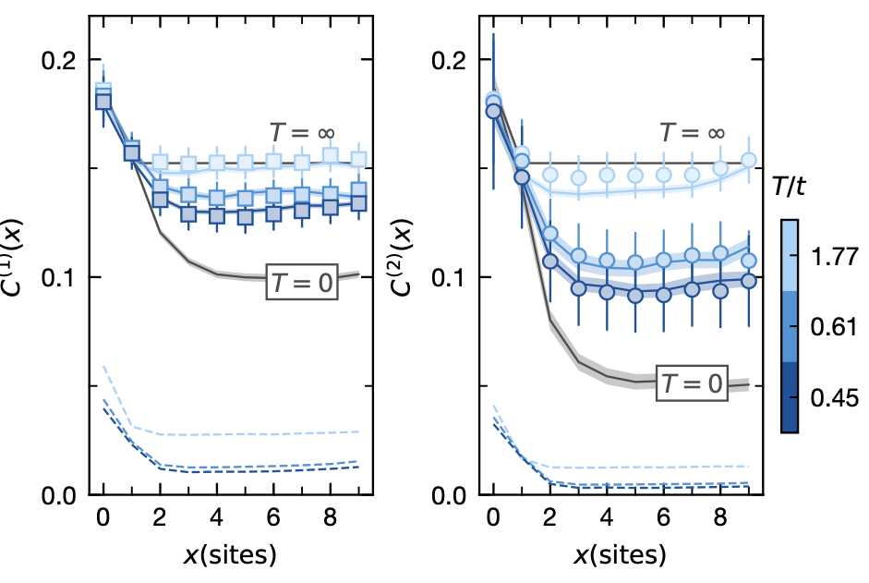
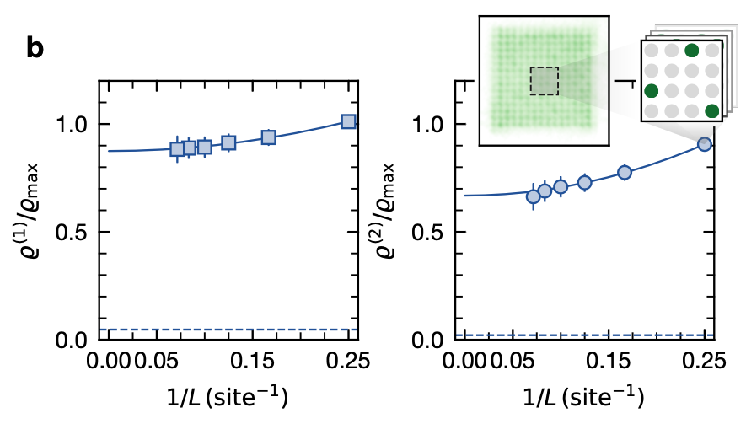
Experimental Data for Dephased Fermi-sea
Boxes/Dots: QC-correlator
Solid lines: CC-correlator
Evidence for SW-SSB?
Define Condensate Density
Finite-size scaling

Slide 42
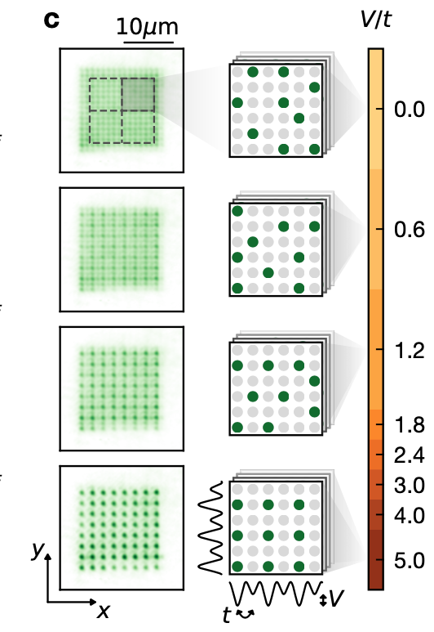
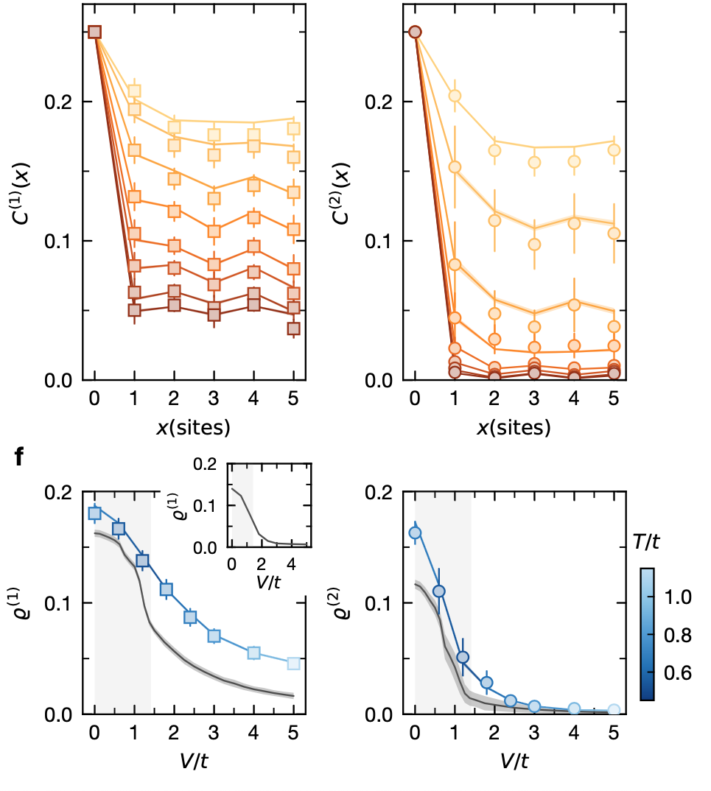
SW-SSB *Phase Transition*
Put on a super-lattice potential of strength V with 4-sites per unit cell;
Tune through Fermi-sea to Band-Insulator State at ¼ filling
After measurement/dephasing; Renyi Correlators
Condensate Density
“vanishes” across
SW-SSB Phase Transition

Slide 43
Summary
t
Lindbladian dynamics for s=1/2 w/ XY symmetry; SW-SSB at
finite time in classical probability distribution function
(ii) Rotor Lindbladian targeting classical steady state
Finite-time SW-SSB transition signals emergence of classical (Model F) hydrodynamics
0
x
0
t
Short-time quantum-dynamics
Emergent classical hydrodynamics at long-times
(iii) Rotor Lindbladian with charge-non-conserving jump operators (weakly symmetric dynamics)
Emergence of classical Model A hydrodynamics is a crossover
Outlook
Further Connections with CMI and Markov length (power law in 2d?)
SW-SSB as a decodability transition in 2d and 3d
Emergent hydrodynamics for Non-Abelian symmetries
Emergent hydrodynamics for Navier-Stokes equation
Other Experiments; e.g. Dirac Fermions, dynamical growth of SW-SSB

Slide 44
Summary
1. ODLRO
5. Experiment
SW-SSB
2. Decodability,
Learnability
4. Emergence and duality
of hydrodynamics
3. Emergent
Indistinguishability

Slide 45
Boson-Vortex Duality for Model F

Slide 46
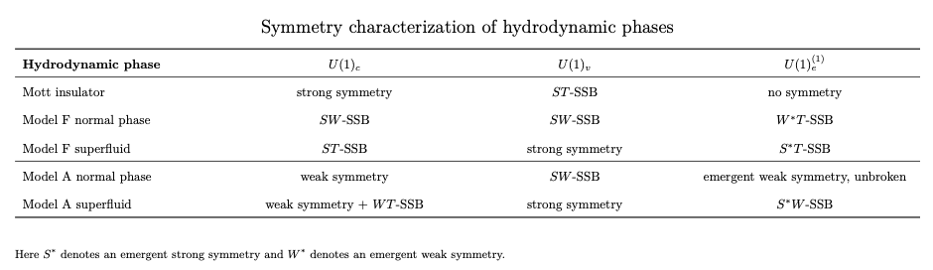
Boson-Vortex Duality for Model F and Model A

