Slide 1
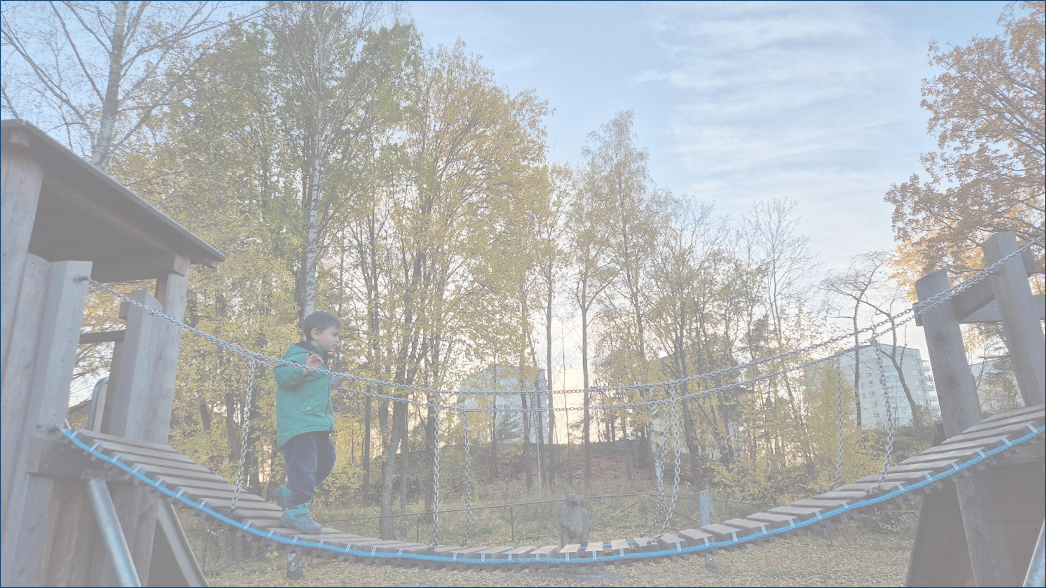



Quantum causal structures
and quantum memory
Fabio Costa
NoQIP
Stockholm, 26/11/2025

Slide 2

Foundations of causality
Quantum spacetime
Quantum causal structures
“Process matrix formalism”
Time travel
Memory in open quantum systems

Slide 3

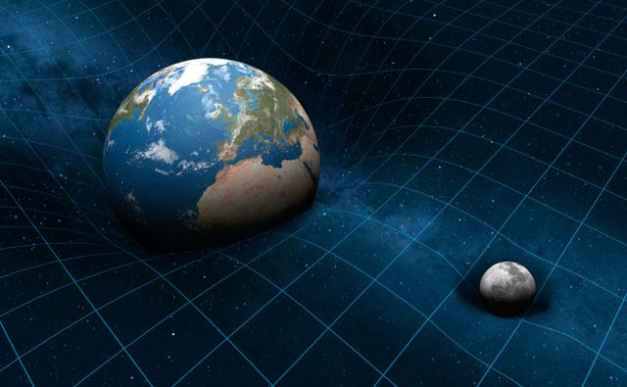

Quantum + gravity
Indefinite causal structure
$$t$$

Slide 4

Quantum theory without global causal structure
Events:
Geometric: locations in spacetime
Operational: “something that happens”

Slide 5

Quantum theory without global causal structure
Local quantum theory:
events as in ordinary quantum theory (quantum operations), no given background.
?
$$⟹$$
Global causal order
O Oreshkov, FC, Č Brukner Nat Comm 3, 1092 (2012)

Slide 6


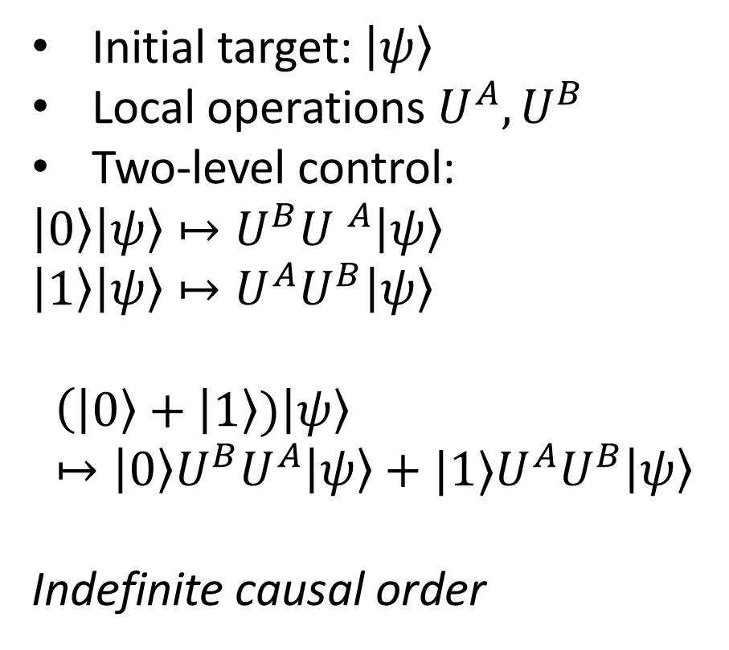



Quantum switch
Initial target: $\left|ψ\right\rangle$
Local operations $U^{A}, U^{B}$
Two-level control:
$\left|0\right\rangle \left|ψ\right\rangle ↦U^{B}{U }^{A}\left|ψ\right\rangle$
$\left|1\right\rangle \left|ψ\right\rangle ↦U^{A}U^{B}\left|ψ\right\rangle$
$$\left(\left|0\right\rangle + | 1\right\rangle )\left|ψ\right\rangle \\ ↦\left|0\right\rangle U^{B}U^{A}\left|ψ\right\rangle +|1⟩U^{A}U^{B}\left|ψ\right\rangle$$
Indefinite causal order
$$A$$
$$B$$
$$\left|0\right\rangle$$
$$\left|ψ\right\rangle$$
$$\left|1\right\rangle$$
G Chiribella, G M D’Ariano, P Perinotti, B Valiron Phys. Rev. A 88, 022318 (2013)

Slide 7



Gravitational quantum switch
Events at fixed clock time
B
A
A
A
B
B
Mass slows down clocks
Causal relations depend on position of mass
Superposition of masses $→$quantum switch
M Zych, FC, I Pikovski, Č Brukner Nat Comm 10, 3772 (2019)

Slide 8
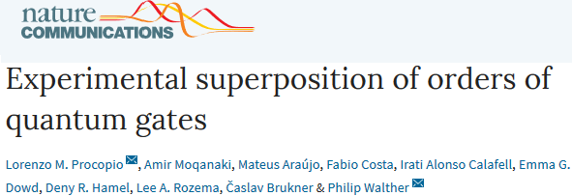
Quantum switch in the lab
Potential resource for quantum information processing

Slide 9

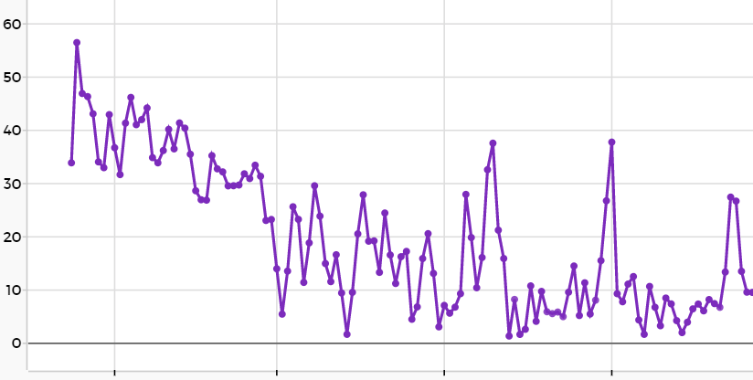


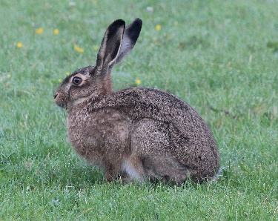
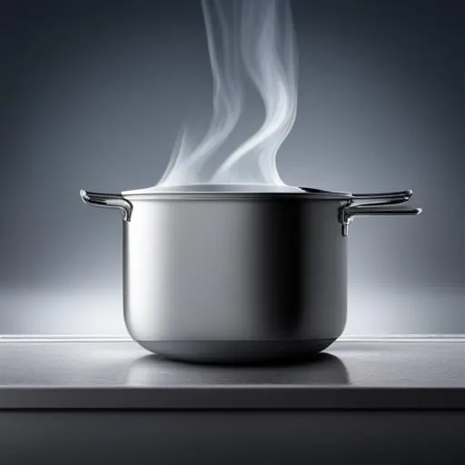
Open systems
carrotness
time
Best description?

Slide 10



Time-evolving state
$$X_{0}↦X\left(t\right)=T_{t}(X_{0})$$

Slide 11

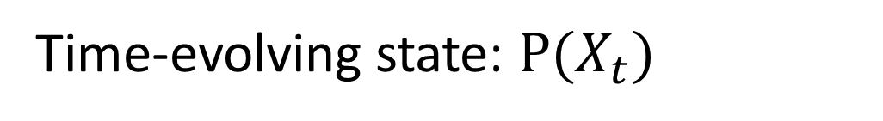
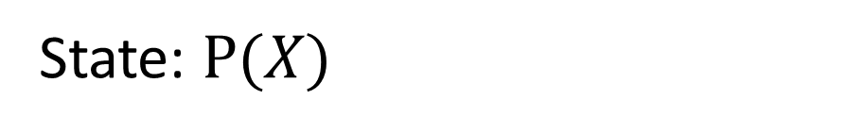
Open systems
State: $P(X)$
Time-evolving state: $P(X_{t})$

Slide 12
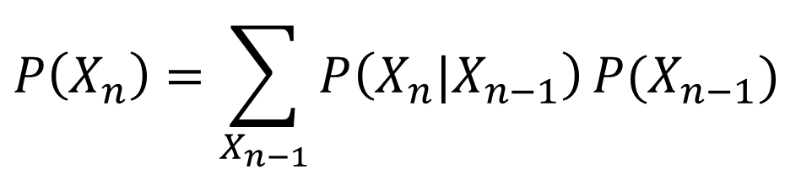
Markov condition
$$P\left(X_{n},X_{n−1},…,X_{1}\right)=P\left(X_{n}|X_{n−1}\right)…P\left(X_{2}|X_{1}\right)P\left(X_{1}\right)$$
“state evolution”:
$$P\left(X_{n}\right)=\sum_{X_{n−1}}{P\left(X_{n}|X_{n−1}\right)}P(X_{n−1})$$

Slide 13
Open systems with memory
Multi-time correlations
Causal influence

Slide 14

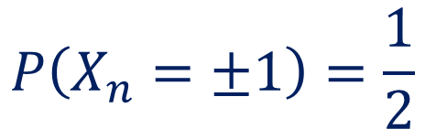

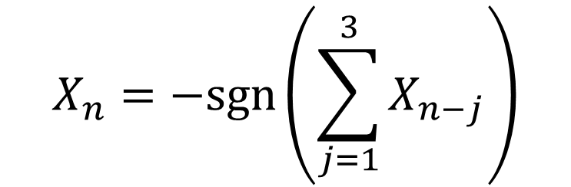
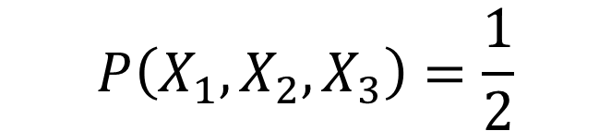


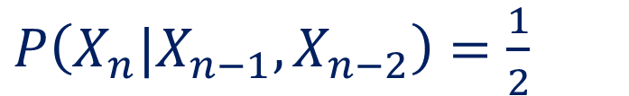
Multi-time correlations
Example: walk with memory
$$P\left(X_{1},X_{2},X_{3}\right)=\frac{1}{2}$$
Memory visible only in multi-time correlations
$$X=$$
$$−1$$
$$+1$$
$$X_{n}=−sgn⁡\left(\sum_{j=1}^{3}{X_{n−j}}\right)$$
$$P\left(X_{n}=±1\right)=\frac{1}{2}$$
$P\left(X_{n}|X_{n−1},X_{n−2}\right)=\frac{1}{2}$

Slide 15
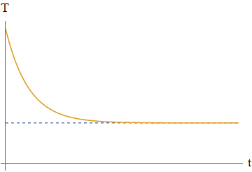

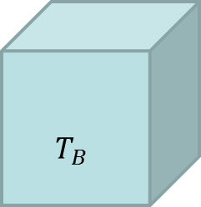
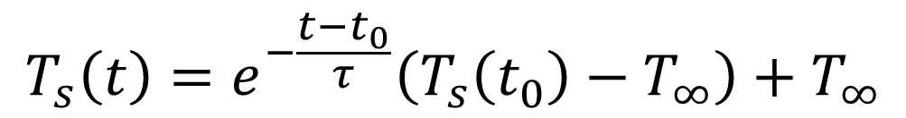
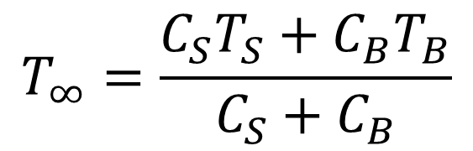
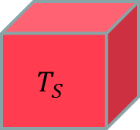

Causal influence
Example: system with finite thermal bath
$$T_{B}$$
$$T_{S}$$
Markovian:
$$T$$
$$T_{s}\left(t\right)=e^{−\frac{t−t_{0}}{τ}}\left(T_{s}\left(t_{0}\right)−T_{∞}\right)+T_{∞}$$
$$T_{∞}=\frac{C_{S}T_{S}+C_{B}T_{B}}{C_{S}+C_{B}}$$
$$t$$

Slide 16
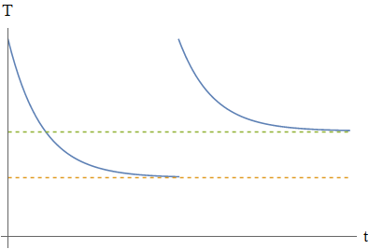
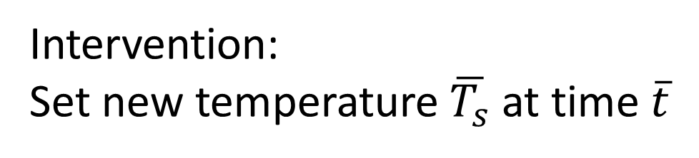
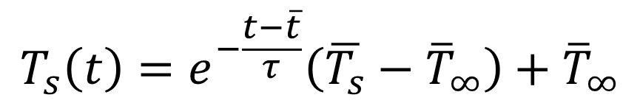
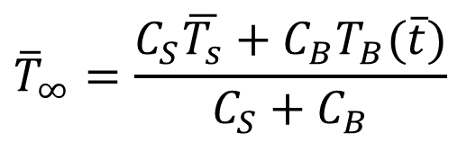


Causal influence
Example: system with finite thermal bath
$$T_{B}$$
Intervention:
Set new temperature$\overline{T_{s}}$ at time $\overline{t}$
$$T_{S}$$
$$T_{s}\left(t\right)=e^{−\frac{t−\overline{t}}{τ}}\left(\overline{T_{s}}−{\overline{T}}_{∞}\right)+{\overline{T}}_{∞}$$
$$T$$
$${\overline{T}}_{∞}=\frac{C_{S}\overline{T_{s}}+C_{B}T_{B}(\overline{t})}{C_{S}+C_{B}}$$
Memory visible only through intervention!
$$t$$

Slide 17
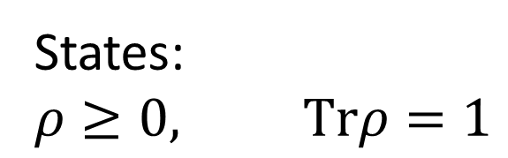
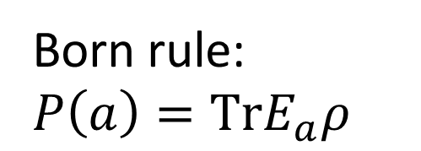
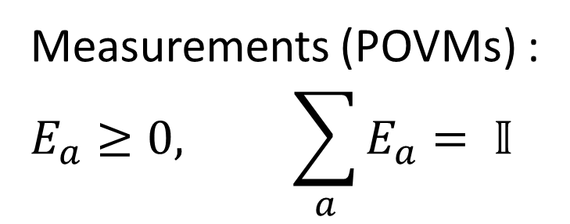
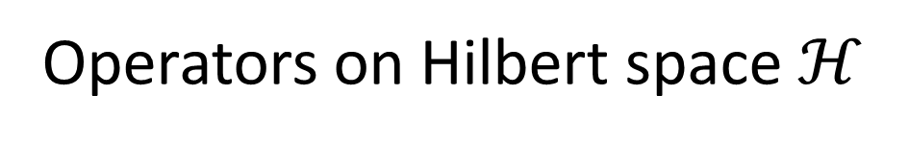
Quantum
Operators on Hilbert space $ℋ$
States: $$ρ≥0, Trρ=1$$
Born rule:
$$P\left(a\right)=TrE_{a}ρ$$
Measurements (POVMs) :
$$E_{a}≥0, \sum_{a}{E_{a}}= 𝕀$$

Slide 18



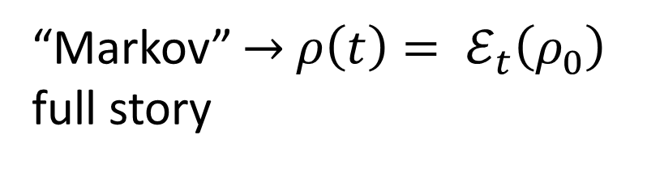

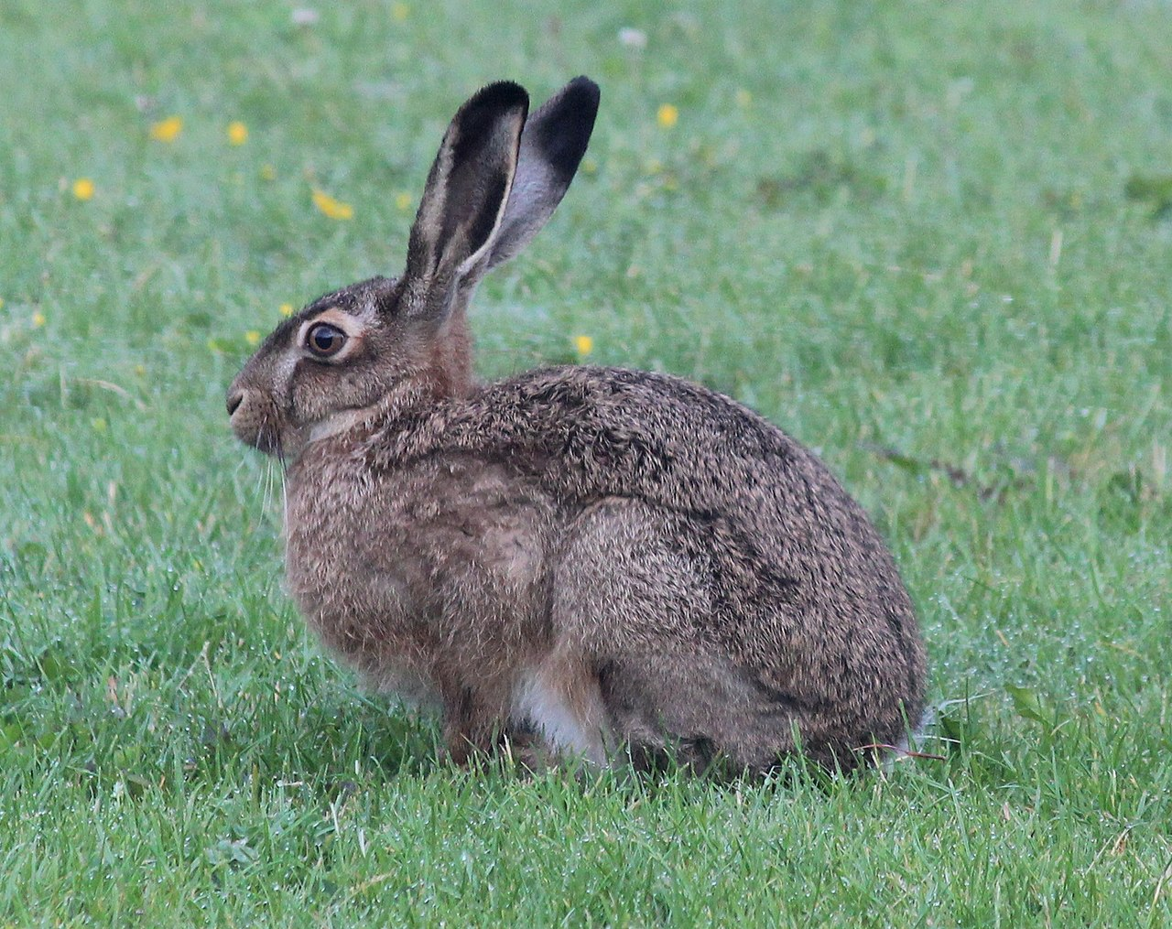



Time evolving quantum state:
One measurement per experiment
$$ρ(t_{n})$$
$$t_{n}$$
“Markov” $→$ $ρ\left(t\right)= ℰ_{t}\left(ρ_{0}\right)$ full story
$$…$$
$$t_{2}$$
$$ρ\left(t_{2}\right)$$
$$t_{2}$$
$$t_{1}$$
$$ρ\left(t_{1}\right)$$
$$t_{1}$$

Slide 19
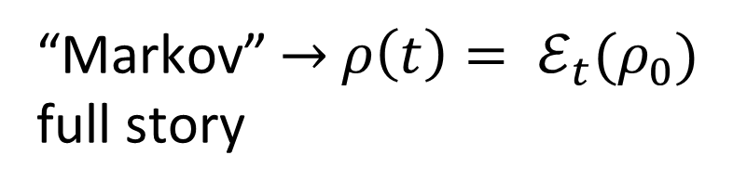
Time evolving state:
One measurement per experiment
$$ρ(t_{n})$$
$$t_{n}$$
“Markov” $→$ $ρ\left(t\right)= ℰ_{t}(ρ_{0})$ full story
$$…$$
$$t_{2}$$
Multi-time correlations?
$$ρ\left(t_{2}\right)$$
$$t_{2}$$
$$t_{1}$$
$$ρ\left(t_{1}\right)$$
$$t_{1}$$

Slide 20
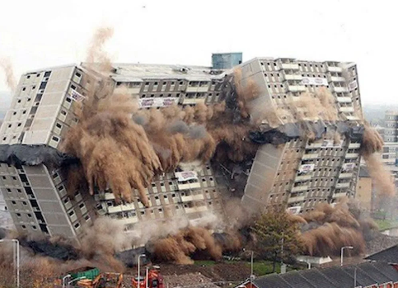
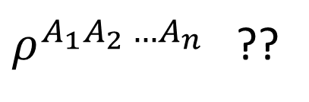

What is a quantum (stochastic) process?
Problems
State at a given time
Classical limit
$$P(a_{1},a_{2},…,a_{n})$$
$ρ^{A_{1}A_{2} …A_{n}}$ ??
“collapse”!!!
Measurements disturb system
Must include causal influence

Slide 21

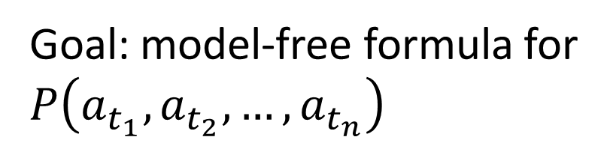

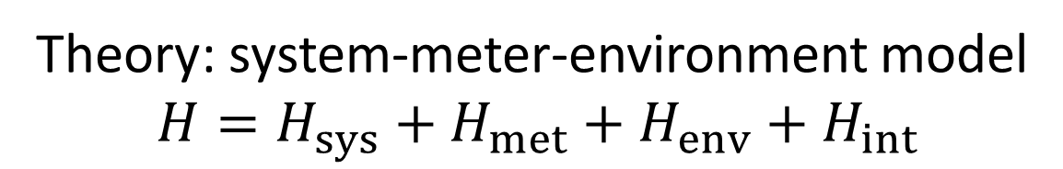

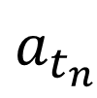

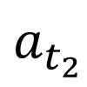

General quantum process
$$a_{t_{n}}$$
Theory: system-meter-environment model
$$H=H_{sys}+H_{met}+H_{env}+H_{int}$$
$$t_{n}$$
$$a_{t_{2}}$$
Tomography? Of what?
$$t_{2}$$
Goal: model-free formula for $P\left(a_{t_{1}},a_{t_{2}},…,a_{t_{n}}\right)$
$$a_{t_{1}}$$
$$t_{1}$$
Outcomes of quantum operations

Slide 22

What is a quantum (stochastic) process?
Causal influence:
$$t_{n}$$
Choice of intervention
$$P(a_{1},…,a_{n}|x_{1},…,x_{n})$$
Classical limit
$$…$$
“Classical causal model”
$$t_{2}$$
$$t_{2}$$
Quantum intervention:
Choice of quantum operation
$$t_{1}$$
$$t_{1}$$

Slide 23



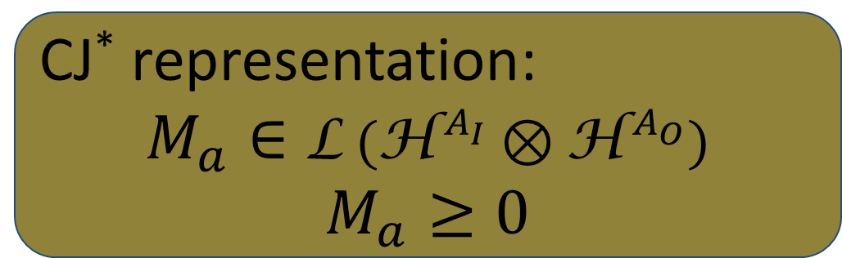
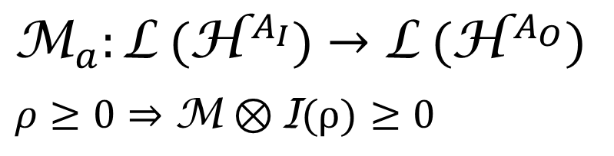
Quantum operations
$$\text{L} \text{(}{\text{H}}^{{ A}_{O}})$$
CP map
(Completely Positive)
$$a$$
$${\text{M}}_{a}:\text{L} \text{(}{\text{H}}^{{ A}_{I}})→\text{L} \text{(}{\text{H}}^{{ A}_{O}})$$ $$ρ≥0⇒\text{M}⊗\text{I}\text{(}ρ\text{)}≥0$$
$$\text{L} \text{(}{\text{H}}^{{ A}_{I}})$$
CJ* representation:
$$M_{a}∈\text{L} \text{(}{\text{H}}^{{ A}_{I}}⊗{\text{H}}^{{ A}_{O}})$$
$$M_{a}≥0$$
*Choi-Jamiołkovski

Slide 24

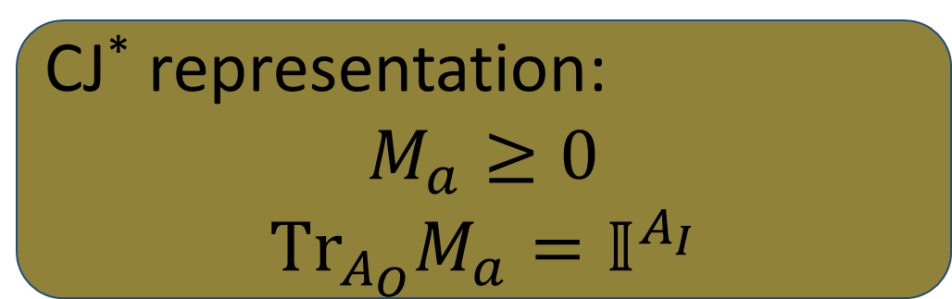

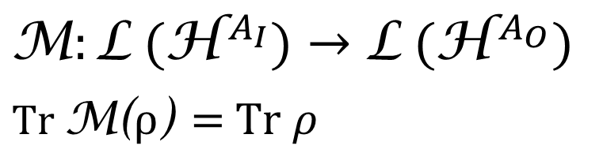
Deterministic quantum operations
$$\text{L} \text{(}{\text{H}}^{{ A}_{O}})$$
CPTP map
(Completely Positive Trace Preserving)
$$\text{M}:\text{L} \text{(}{\text{H}}^{{ A}_{I}})→\text{L} \text{(}{\text{H}}^{{ A}_{O}})$$ $Tr$ $\text{M}\text{(}ρ\text{) }\text{= }\text{Tr} ρ$
$$\text{L} \text{(}{\text{H}}^{{ A}_{I}})$$
CJ* representation:
$$M_{a}≥0$$
$${Tr}_{A_{O}}M_{a}=𝕀^{A_{I}}$$

Slide 25
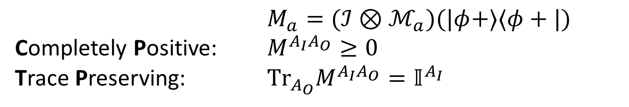
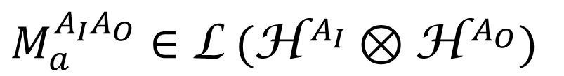
Quantum operations
$$\text{L} \text{(}{\text{H}}^{{ A}_{O}})$$
$$a$$
Choi-Jamiołkowski representation:
$$\text{L} \text{(}{\text{H}}^{{ A}_{I}})$$
$$M_{a}^{A_{I}A_{O}}∈\text{L} \text{(}{\text{H}}^{{ A}_{I}}⊗{\text{H}}^{{ A}_{O}})$$
$M_{a}=(ℐ⊗ℳ_{a})(|φ+⟩⟨φ+|)$
Completely Positive: $M^{A_{I}A_{O}}≥0$
Trace Preserving: ${Tr}_{A_{O}}M^{A_{I}A_{O}}=𝕀^{A_{I}}$

Slide 26

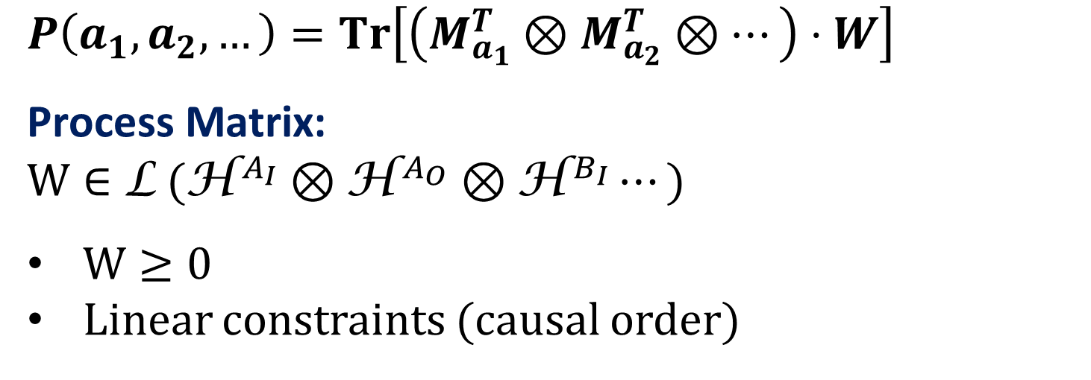



Quantum process (causally ordered, discrete time)
$$P\left(a_{1},a_{2},…\right)=Tr\left[\left(M_{a_{1}}^{T}⊗M_{a_{2}}^{T}⊗…\right)⋅W\right]$$
$\text{Process} \text{Matrix}$:
$$W∈\text{L} \text{(}{\text{H}}^{{ A}_{I}}⊗{\text{H}}^{{ A}_{O}}⊗{\text{H}}^{{ B}_{I}}⋯)$$
$W≥0$
Linear constraints (causal order)
$$a_{n}$$
$$a_{2}$$
$$W$$
$$a_{1}$$
Quantum strategy
Comb Multi-time process
Superdensity operator
…

Slide 27


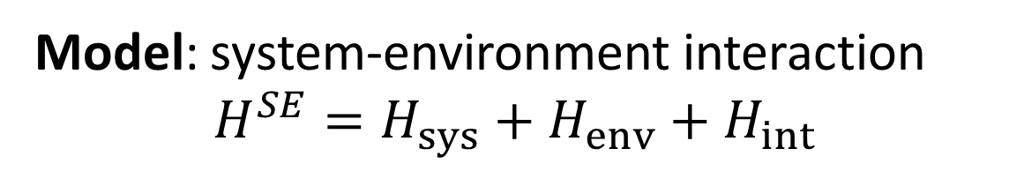


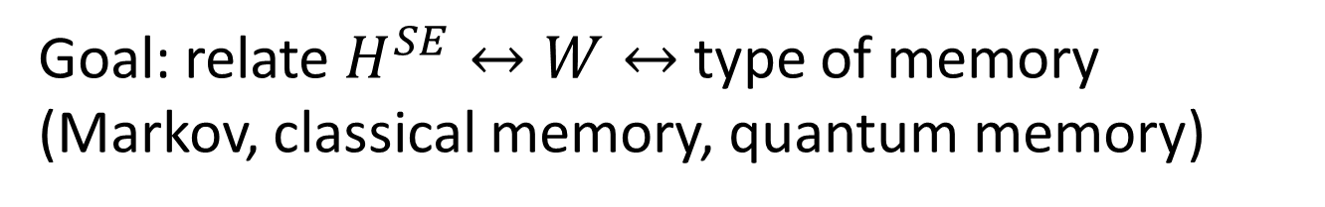
Quantum process (causally ordered, discrete time)
$$a_{n}$$
Model: system-environment interaction
$$H^{SE}=H_{sys}+H_{env}+H_{int}$$
$$t_{n}$$
$$a_{2}$$
$$t_{2}$$
Goal: relate $H^{SE}↔W↔$ type of memory (Markov, classical memory, quantum memory)
$$a_{1}$$
$$t_{1}$$

Slide 28

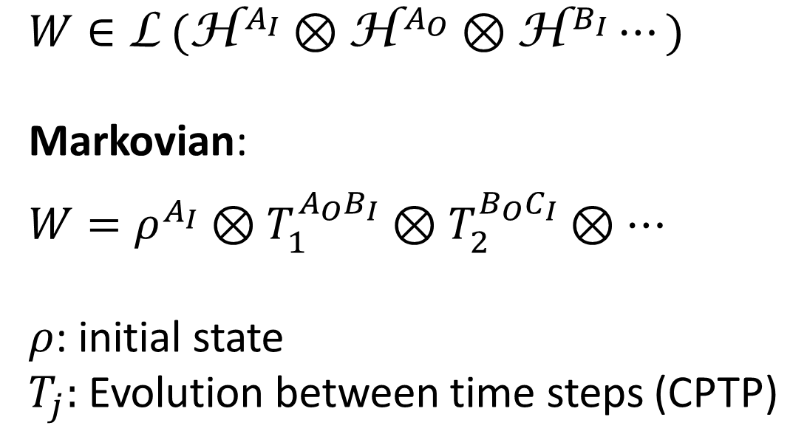



Process matrix
$W∈\text{L} \text{(}{\text{H}}^{{ A}_{I}}⊗{\text{H}}^{{ A}_{O}}⊗{\text{H}}^{{ B}_{I}}⋯)$
Markovian:
$$W=ρ^{A_{I}}⊗T_{1}^{A_{O}B_{I}}⊗T_{2}^{B_{O}C_{I}}⊗⋯$$
$ρ$: initial state
$T_{j}:$ Evolution between time steps (CPTP)
$$T_{3}$$
$$T_{2}$$
$$W$$
$$T_{1}$$
$$ρ$$

Slide 29

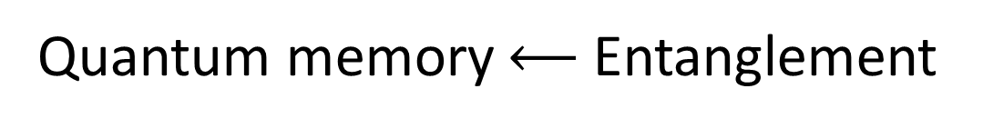

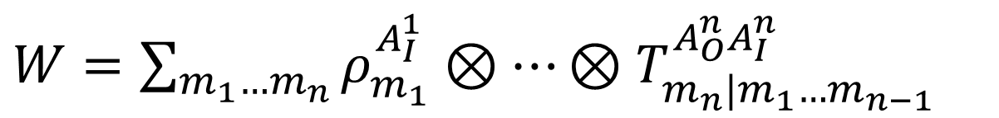



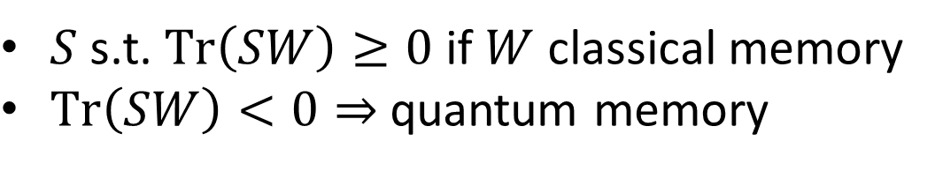
Classical memory
$$T_{3}$$
$W=\sum_{m_{1}…m_{n}}{ρ_{m_{1}}^{A_{I}^{1}}⊗⋯⊗T_{m_{n}|m_{1}…m_{n−1}}^{A_{O}^{n}A_{I}^{n}}}$
$$T_{2}$$
Quantum memory $⟵$ Entanglement
from entanglement import witness
$$T_{1}$$
$S$ s.t. $Tr\left(SW\right)≥0$ if $W$ classical memory
$Tr\left(SW\right)<0⇒$ quantum memory
$$ρ$$
C Giarmatzi, FC, Quantum 5, 440 (2021).

Slide 30
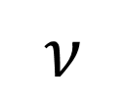






Hamiltonian characterisation
$$U_{ν}^{3}$$
$$H^{SE}=\sum_{ν}{H_{ν}^{S}⊗\left|ν\right\rangle {\left\langle ν\right|}^{E}}$$
“Quantum controlled” Hamiltonian
$$U_{ν}^{2}$$
$$⇒W=\sum_{n}{p(ν)}ρ_{ν}⊗\left[\left[U_{ν}^{1}\right]\right]⊗⋯⊗\left[\left[U_{ν}^{N}\right]\right]$$
$$U_{ν}^{1}$$
“classical common cause”
$$ρ_{ν}$$
$$ν$$
K Goswami et al, arXiv:2412.01998 [quant-ph]

Slide 31









Hamiltonian characterisation - example
$$H^{SE}=H^{S}+H^{E}+L^{S}⊗H^{E}$$
$$H^{E}\left|ν\right\rangle =E_{ν}\left|ν\right\rangle$$
$$U_{n}^{3}$$
$$H_{ν}^{S}=H^{S}+E_{ν}L^{S}$$
$${\left|ψ\right\rangle }^{E}→P\left(ν\right)={\left|\left\langle ν | ψ\right\rangle \right|}^{2}$$
$$U_{n}^{2}$$
e.g.:
$$H^{SE}=Ω {(b^{†}b)}^{S}+ {ω(a^{†}a)}^{E}+λ(a^{†}a)(b^{†}+b)$$
(radiation pressure)
$$U_{n}^{1}$$
Strong non-Markovianty (Lindblad ME poor approximation)
Simple: random (multi-time) unitary
$$ρ_{n}$$
$$ν$$

Slide 32



Teaser: Continuous operations and processes
$$t_{f}$$
Functional Born rule (coherent states):
$$P\left[r\right]=∫𝔇\left[α,\overline{α}\right]e^{i\int_{t_{i }}^{t_{f}}{Im[{\dot{α}}^{∗}α−{\dot{\overline{α}}}^{∗}\overline{α}]}}ℳ_{r}[α,\overline{α}]𝒲[α,\overline{α}]$$
Process functional (Feynmann-Vernon)
Operation functional
$$t_{i}$$
FC, Jing Yang, coming soon

Slide 33


Outlook
Join the action!
Quantum theory without time-evolving states:
Process matrices
Indefinite causal order/non-markovian processes
Characterisation of non-Markovianity
No memory $∼$ product states
Classical memory $∼$ separable states
Hamiltonian characterisation:
Quantum control $→$ classical memory
In progress:
Multi-time quantumness—experiments
Continuous-time operations/processes
Causality in QFT measurements
…
CA23115 – Relativistic Quantum Information
https://www.cost.eu/actions/CA23115/
WG3: Time, causality, and memory in quantum physics

