Slide 1
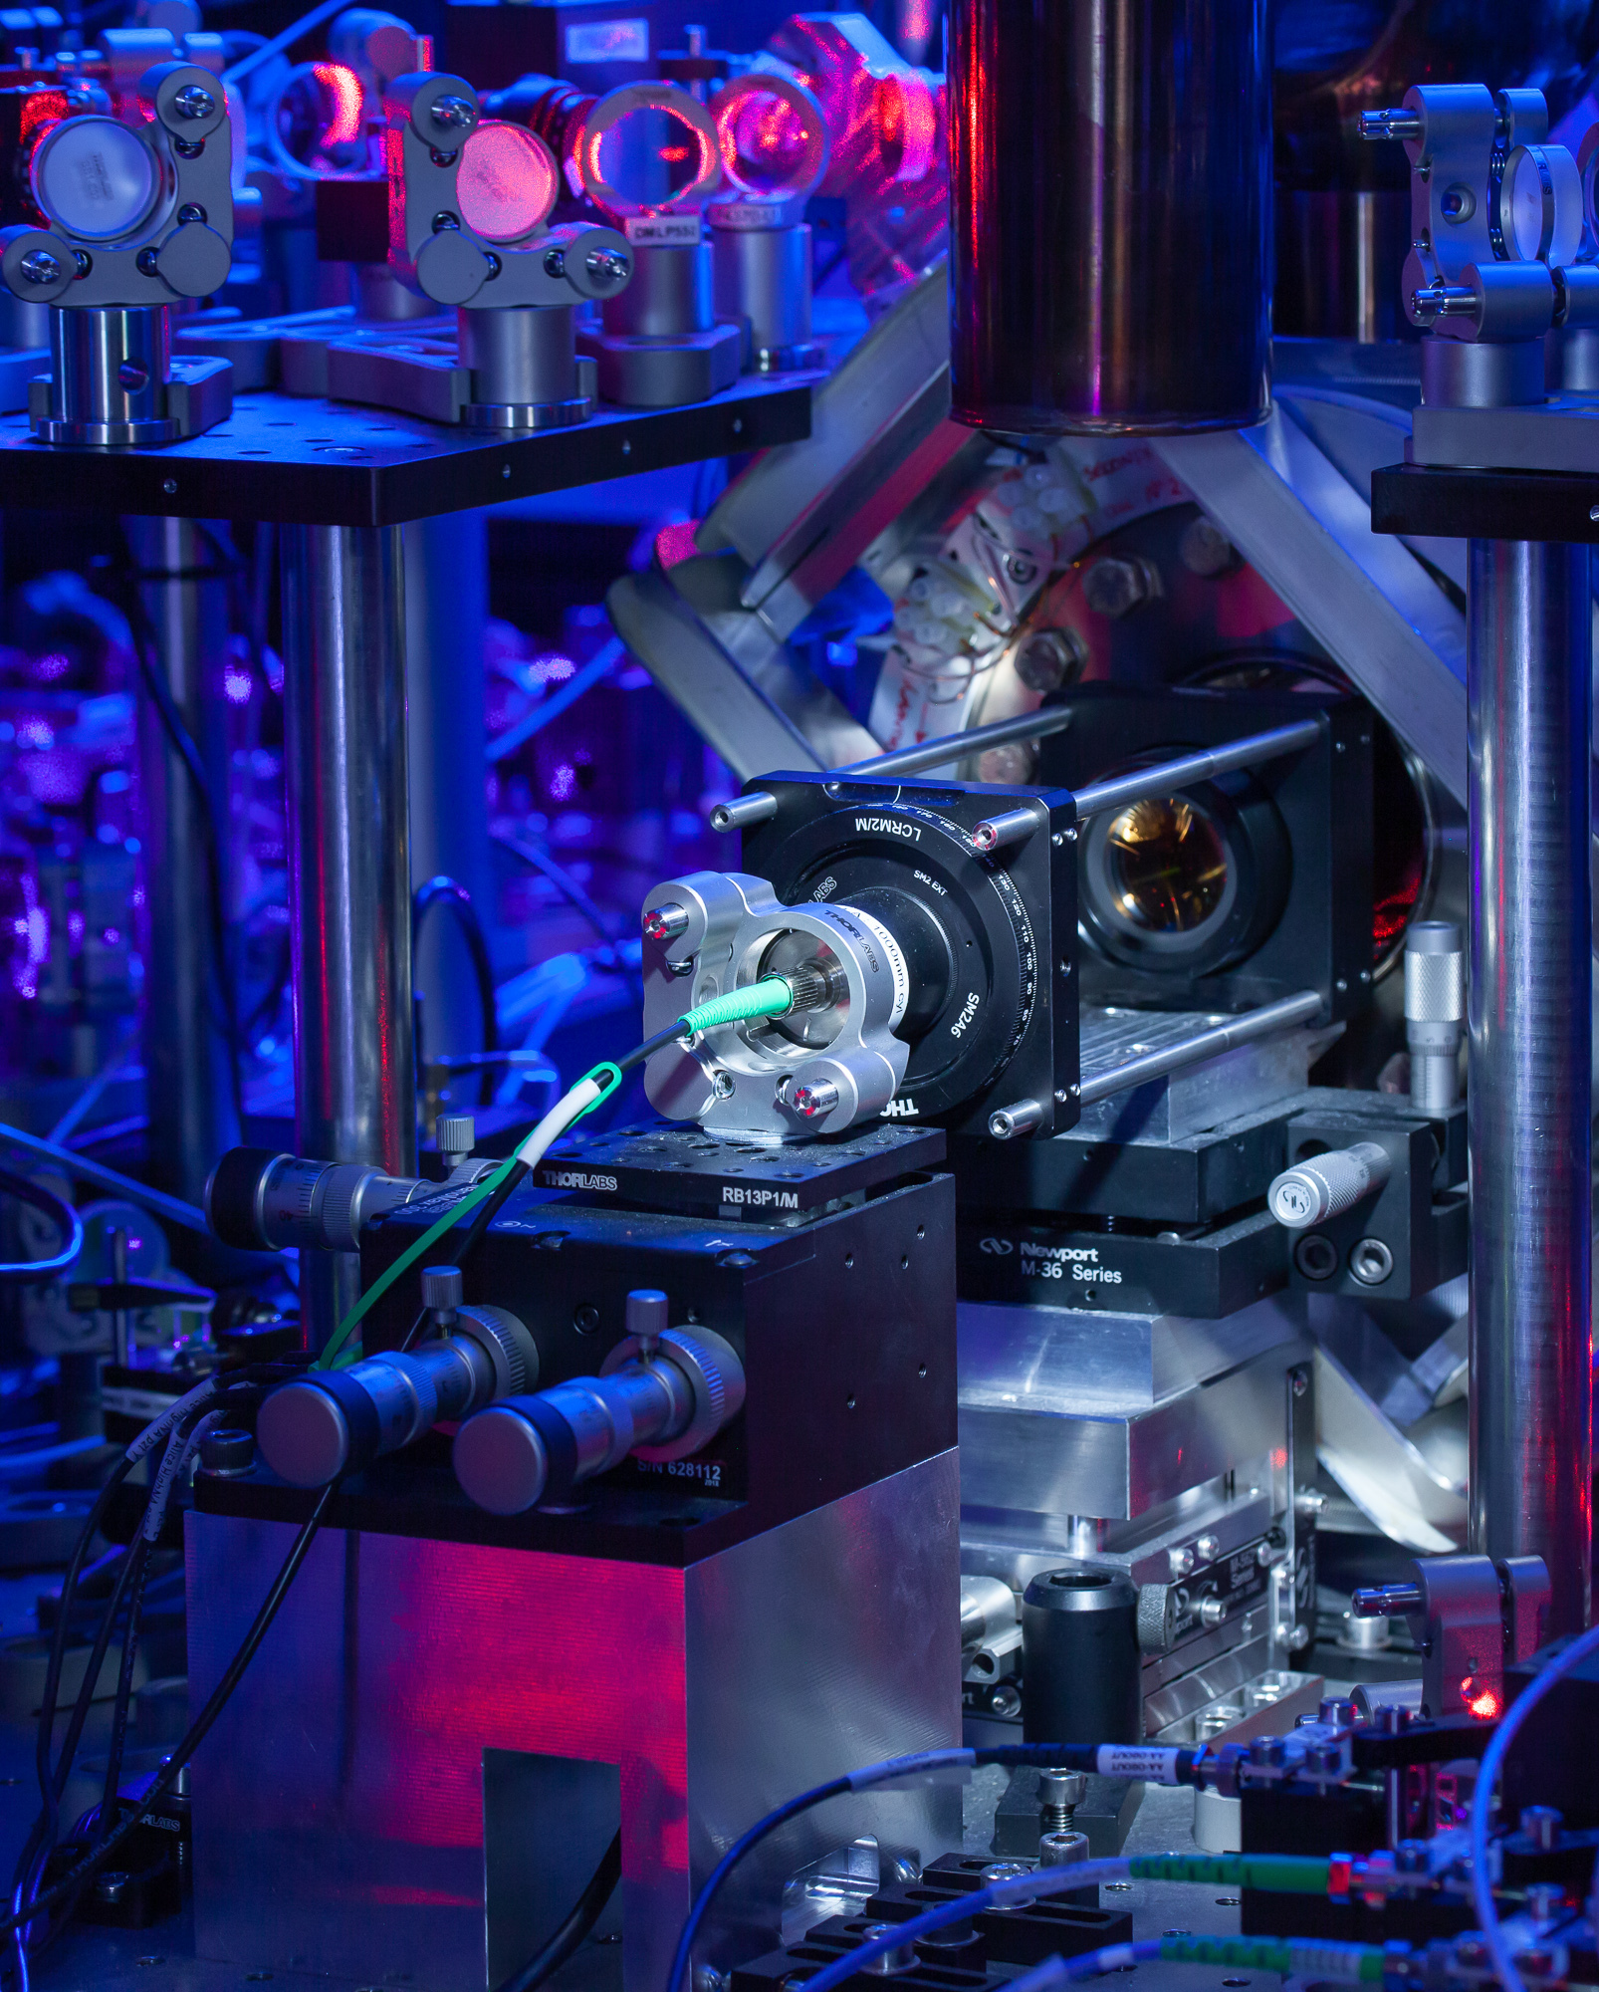
A network of ⁴³Ca⁺
optical clocks for entanglement-enhanced metrology
A. Agrawal*, S. Chen, E. M. Ainley, A. R. Martinez,
E. Malinowski, J. A. Blackmore, M. Mallweger, D. P. Nadlinger, P. Drmota, G. Araneda, D. M. Lucas, R. Srinivas
ECCTI, 9 Sep 2026
Notes:
Hello everyone, I’m with the quantum networking event with the ion trap group here at Oxford – Ellis has already spoken about our results with error detection across a network, and we’ve had some posters earlier. I’ll be presenting something a bit different – using our network for entanglement-enhanced metrology

Slide 2
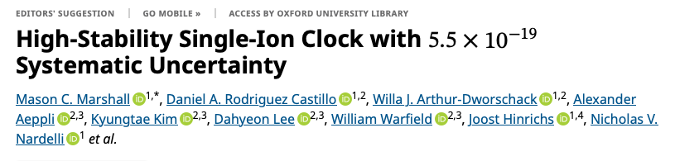
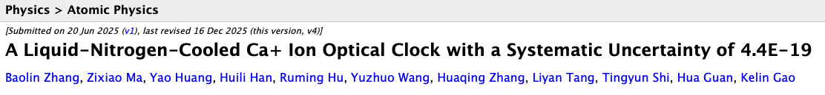
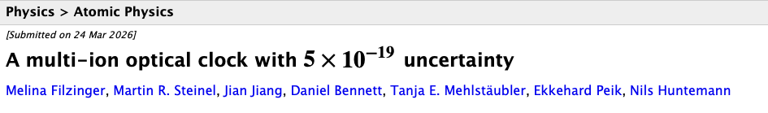
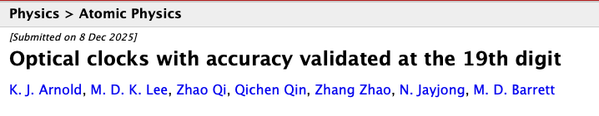
Optical atomic clocks
Notes:
As you're all aware, optical atomic clocks are some of our most accurate and precise tools for measuring anything humans have ever built.
The last year has been especially competitive, with multiple groups reporting systematic uncertainties at the 10^-19 level.
(please pardon me if I’ve missed your result)

Slide 3
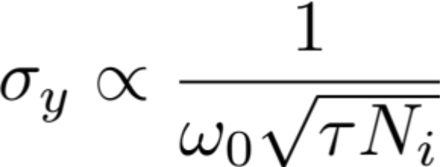
Ion clocks
Low systematic uncertainty: ~ 10⁻¹⁹ ^{[1]}
Higher instabilities (statistical noise)
Entanglement-enhancement: improve from SQL to Heisenberg limit
[1] M. C. Marshall et al, Phys. Rev. Lett. 135, 033201
Notes:
- The performance of an atomic clock is characterised by two main parameters:
- the systematic uncertainty (in the observed laboratory frequency compared to that of an isolated atom)
- and the instability (tells you how long you need to measure to average down your measurement),
ion clocks: easier to isolate from environment, have some of the lowest systematic uncertainties (as shown on previous slide).
But usually only have one or two atoms, short-term instabilities are generally 2-3 orders of magnitude larger than systematics.
Without entanglement, clock stability given by SQL (1/sqrt(N)). With entanglement, Heisenberg limit (1/N), giving gain of sqrt(N)

Slide 4
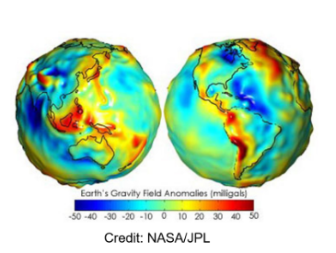
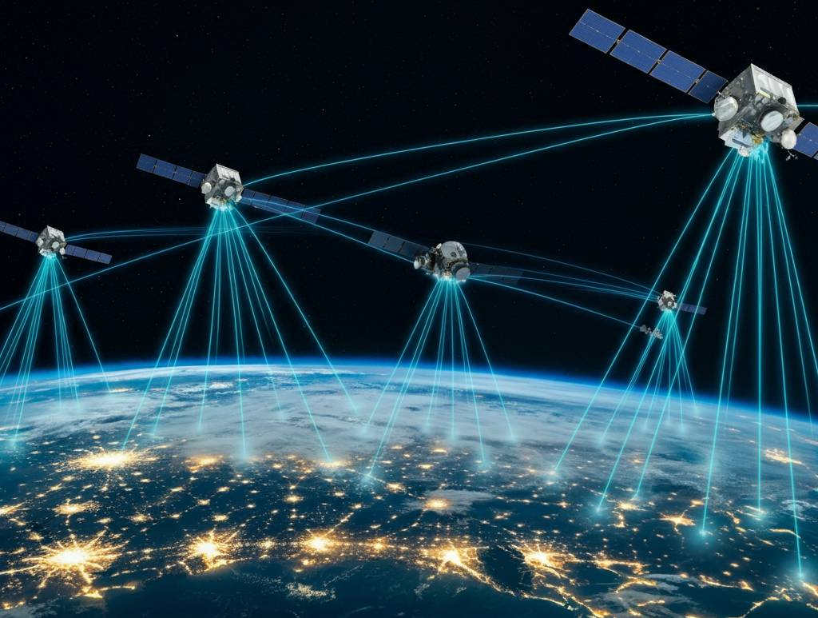



Differential spectroscopy
Need ability to compare time and frequency!
  Navigation
  Properties of dark matter ^{[1]}
  Variation of fundamental constants ^{[2]}
  Relativistic geodesy ^{[3]}
$$|e⟩$$
ω(α)
$$|g⟩$$
$$α(t)$$
Changing constants
[1] A. Derevianko and M. Pospelov. Nat. Phys., 10(12):933–936, 2014
[2] Safronova et al., Rev. Mod. Phys. 90, 025008 (2018)
[3] McGrew et al., Nature 564, 87 (2018)
Notes:
In many cases, you need another equally stable reference to compare your clock to -- either for cross-validation, or because it is the inherent quantity of interest in sensing applications, e.g. for navigation, geodesy or fundamental physics searches.
And this is what we are going to focus on today -- frequency comparisons between two independent clock systems

Slide 5
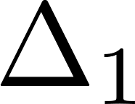
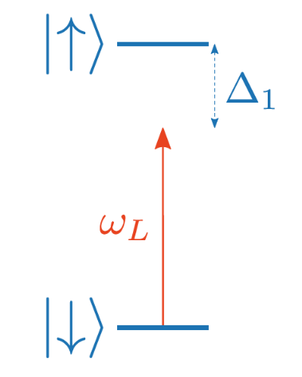
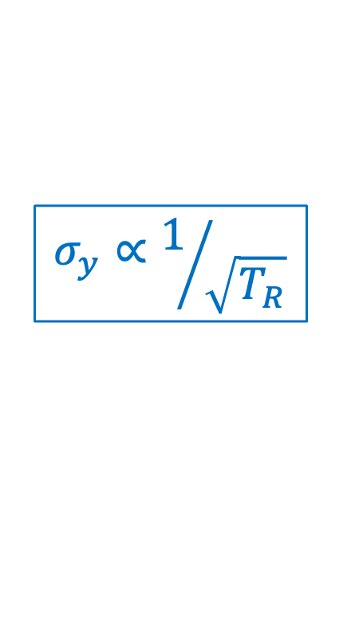


Ramsey spectroscopy
$\frac{π}{2}$pulse
$\frac{π}{2}$pulse
$$σ_{y}∝1/{\sqrt{T_{R}}}$$
Limited by laser phase noise
Notes:
I’m sure you all already know about Ramsey spectroscopy
Goal is to measure the detuning of a light field (such as a laser) from a narrow-linewidth transitions
Start with a pi/2 pulse, creating a superposition of the excited and ground state.
Let it evolve for a probe duration T, accumulating a phase proportional to the detuning
Finally closing pi/2 pulse to complete the interferometry, followed by state detection
The clock stability scales as inversely with the Ramsey duration -- longer probe durations give you higher sensitivity.
Can in principle measure the absolute detuning of each clock individually. The difference frequency stability adds in quadratures.
In practice, unless you have a fancy silicon cavity, laser dephasing generally limits the probe duration to 10s of ms (unless you have a fancy silicon
cavity)

Slide 6
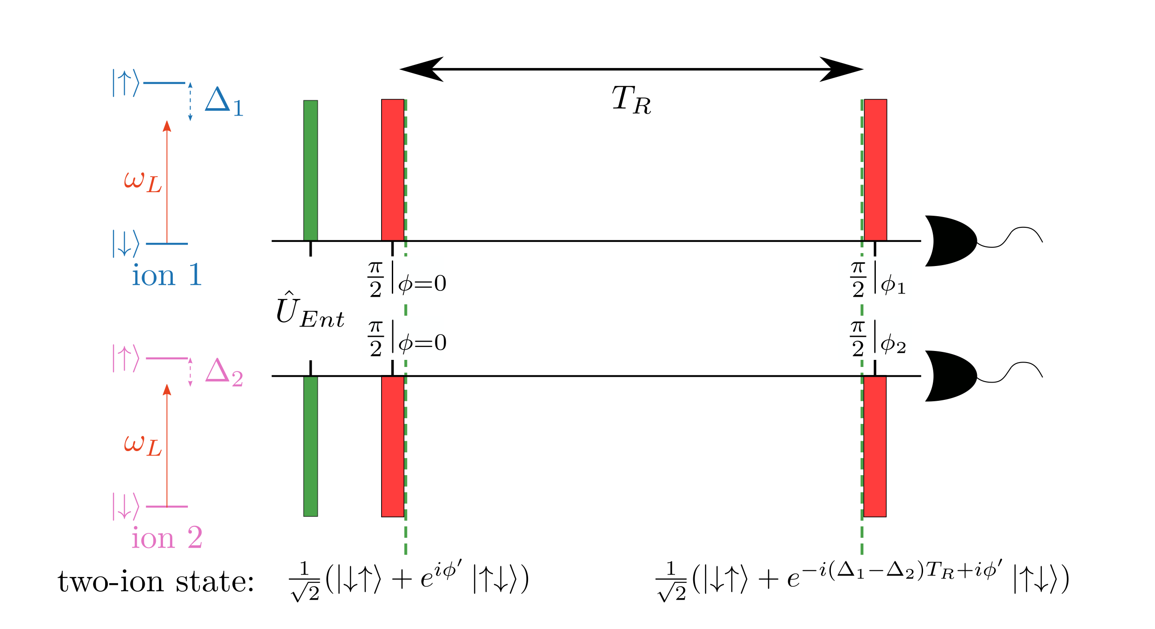




Correlation spectroscopy
Common
probe laser
Sacrifice contrast for resistance to common laser phase noise
$$ω_{L}$$
Notes:
For frequency difference comparisons, it is possible to get around laser phase noise limitations using a technique known as correlation spectroscopy.
Interrogate both clocks with the same laser with a simultaneous Ramsey. LPN becomes common-mode to both clocks, and causes 0 and 2 excitation components to dephase. The single excitation subspace, however, is insensitive to common-mode noise.
This evolves with the difference frequency of the two atoms. This enables probes much beyond laser coherence limit by sacrificing 50% contrast (as only half the state participates in this)
Been used in many measurement campaigns to interrogate at lifetime limit

Slide 7

Entangled correlation spectroscopy
Ramsey delay
Common
probe laser
$$ω_{L}$$
Notes:
Now, if only the single-excitation component of the state contributes to difference frequency, why not just directly probe the Psi+ bell state?
We then slightly adapt the Ramsey protocol --
Instead of a product state, we start by entangling the two clocks into a Bell state.
We then let it evolve for some probe duration as usual. Then, as with conventional x-spec, use the same laser to do a second Pi/2 pulse and measure the spin parity sigma_z cross sigma_z. and measure the two-atom parity

Slide 8
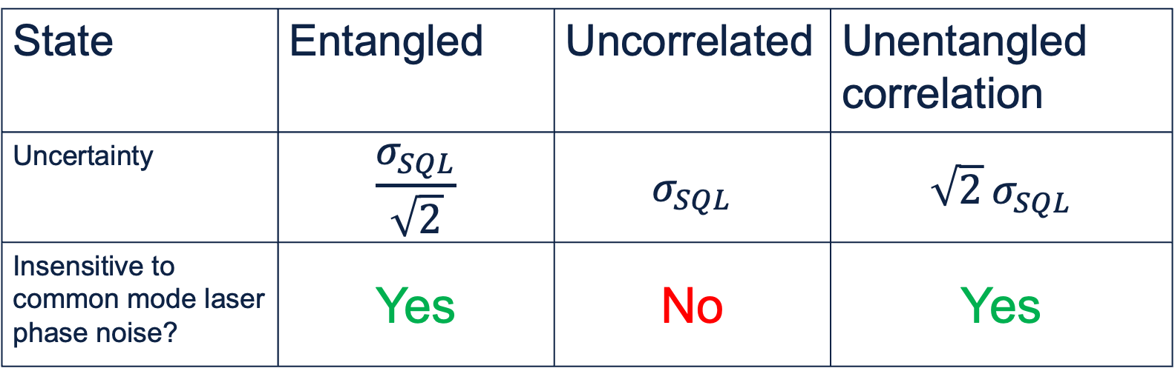
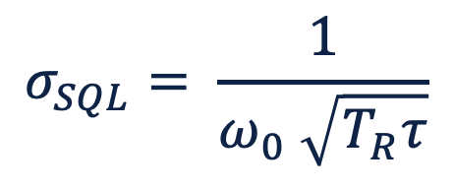

Comparison methods
$$σ_{SQL}= \frac{1}{ω_{0} \sqrt{T_{R}τ}}$$
State | Entangled | Uncorrelated | Unentangled correlation
Uncertainty | $$\frac{σ_{SQL}}{\sqrt{2}}$$ | $$σ_{SQL}$$ | $$\sqrt{2}{ σ}_{SQL}$$
Insensitive to common mode laser phase noise? | Yes | No | Yes
Notes:
So the entangled state gives best of both worlds
1. maintains LPN insensitivity, enabling long probe times like the unentangled x-spec and
2. Doesn't sacrifice contrast
But also,
3. The correlations in the state give a further improvement of sqrt(2) from the Heisenberg limit over the SQL
In practice, can gain >20x over uncorrelated clocks (in our setup) from the Ramsey duration

Slide 9
Quantum networks
Entanglement enhancement demonstrated locally^{[1-3]}
Entanglement over a network is hard
  High-fidelity (contrast ≈1)
  High-speed generation (maximise duty cycle)
98% fidelity at 300 Hz!
[1] D. Leibfried et al. Science 304, 1476–1478, (2004)
[2] C. F. Roos et al. Nature 443, 316–319 (2006)
[3] E. Pedrozo-Peñafiel et al. Nature 588, 414–418 (2020)
Notes:
Entanglement enhancement has been demonstrated within a single system many times
However, doing it over a network is hard:
1. need...
Thankfully, we can do both in our lab – producing an entangled Bell state of 98% between our two nodes at a rate of up to 300 Hz

Slide 10
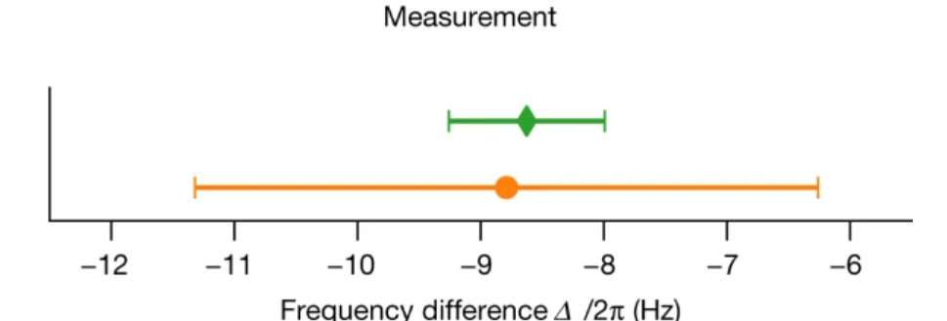
Previous work: ⁸⁸Sr⁺ clocks
Heisenberg scaling with entangled ⁸⁸Sr⁺ clocks^{[1]}
Limited by magnetic field noise
~10⁻¹⁵ level
entangled
unentangled
[1] B.C. Nichol, R. Srinivas et al., Nature 609, 689–694 (2022)
Notes:
Did this with two entangled Sr88 clocks a few years ago:
Did show Heisenberg scaling
See on the right, get a much tighter measurement bound with the entangled (green) vs unentangled (orange)
Measurement at 1e-15 level: Hz resolution
Great proof of principle but probe duration severely limited (~15 ms), duty cycle

Slide 11
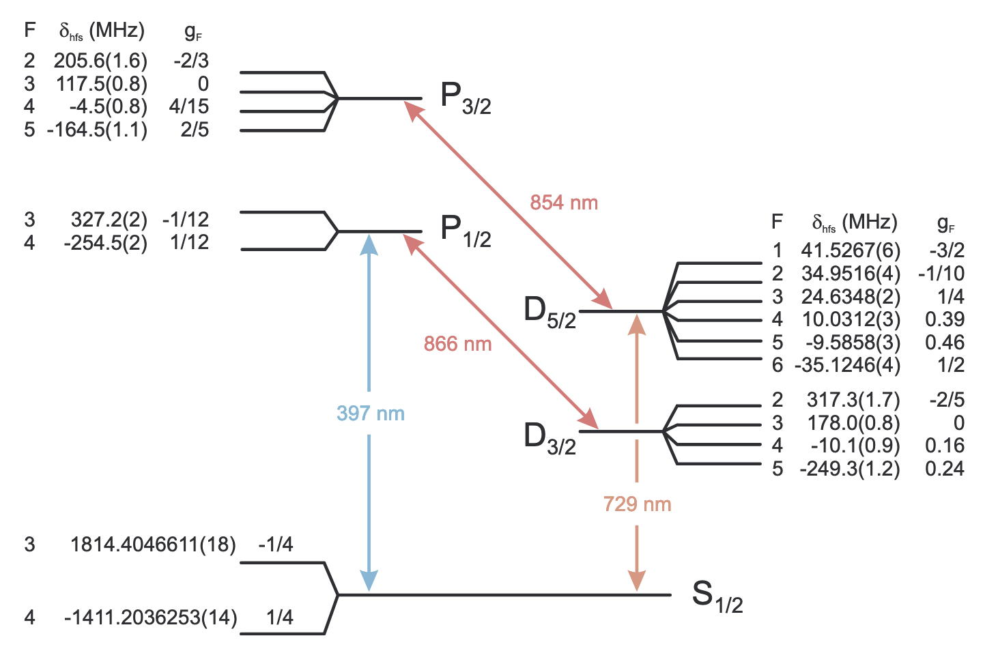
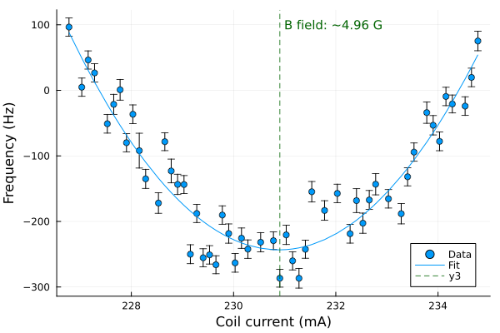

⁴³Ca⁺ Clocks
 | Sr | Ca
Transition wavelength | 674 nm | 729 nm
Sensitivity | ~10 Hz/nT | ~ 0
Ramsey duration | 12 ms | ~ 500 ms
Entanglement generation duration | 9 ms | ~ 30 ms
Stability at 1s | ~10⁻¹⁴ | ~ 10⁻¹⁵
729 nm
Benhelm et al., Phys. Rev. A 75, 032506
Notes:
- Now extending it to Ca43 clocks on the optical S1/2 to D5/2 transition (point to transition) at 729 nm
- rich hyperfine structure
- intermediate field regime even at 5 Gauss, field-insensitive clock transition (shown on the right)
- much longer coherence time
- [next animation] Enables probes at much longer Ramsey durations, expect to be limited by excited state lifetime, which is ~1.1 s.
- Massively improves duty cycle, even though slower more cooling
(for data, 80 ms but definitely reduce massively < 30ms)
improvement of 1 order of magnitude in clock stability.
Expect to average down to 1e-17 from a preliminary evaluation of our drifts
- Enables resolution of gravitational time dilation shifts at the 10 cm height difference.
Long term: first test of GR using entanglement, if GR changes quantum phase? Don't expect to see any deviations, but never been done before

Slide 12
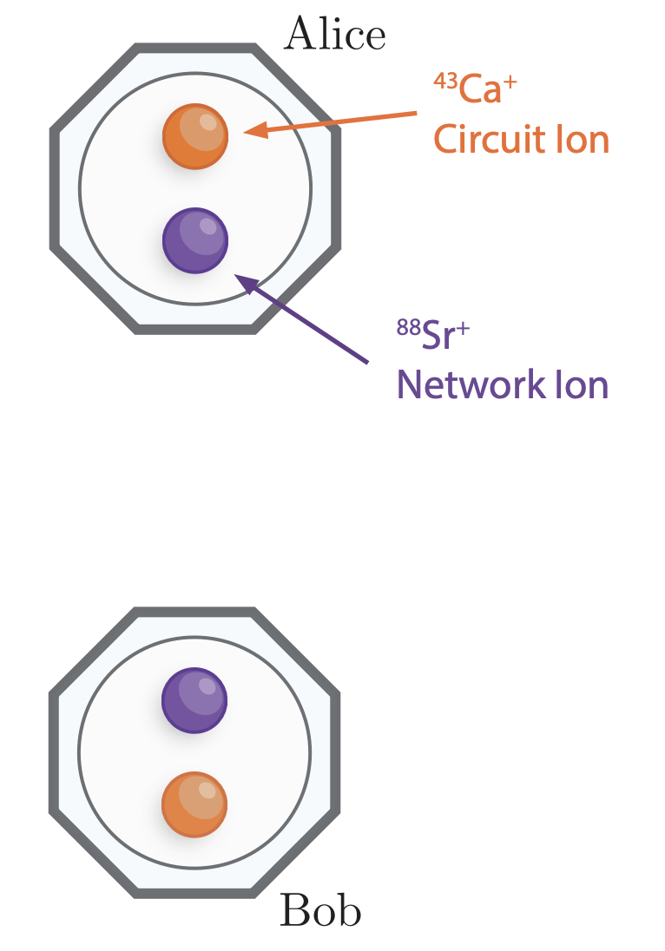
Entanglement scheme
Two nodes
Co-trapped ⁸⁸Sr⁺ and ⁴³Ca⁺
  Strontium – networking qubit
  Calcium – memory/clock qubit
Notes:
Some of you may remember our setup from Ellis’ talk on Monday, but just to re-introduce it: we have two nodes: alice & bob
each node has 2 co-trapped ions
88Sr: simple energy level structure, good for networking. But b field sensitive, bad for coherence
43Ca: Hyperfine structure, good for storing quantum information and will be used as our clock
All communication across nodes is between the Sr
Ca only interacts directly within the same node with the Sr

Slide 13
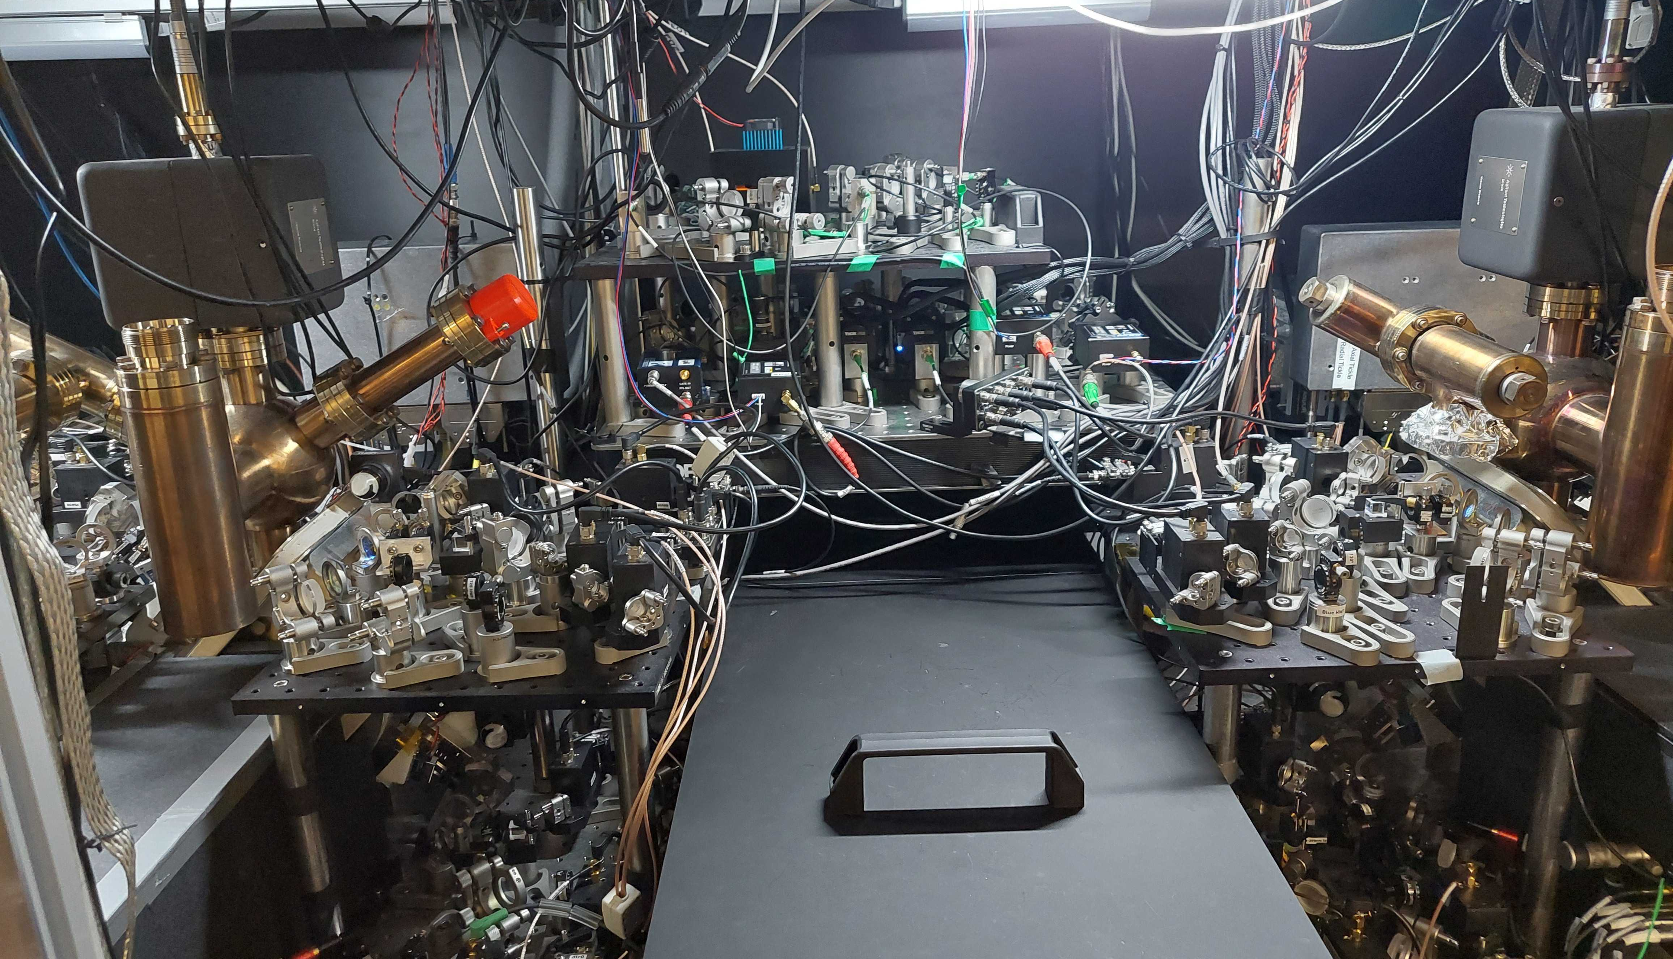
Entangling station
Bob
Alice
~ 2 m
Notes:
This is what our apparatus looks like:
See alice and bob on either side, approx 2 m free space (3m fibre) apart.
Entangling station with the Bell state analyzer in the back

Slide 14
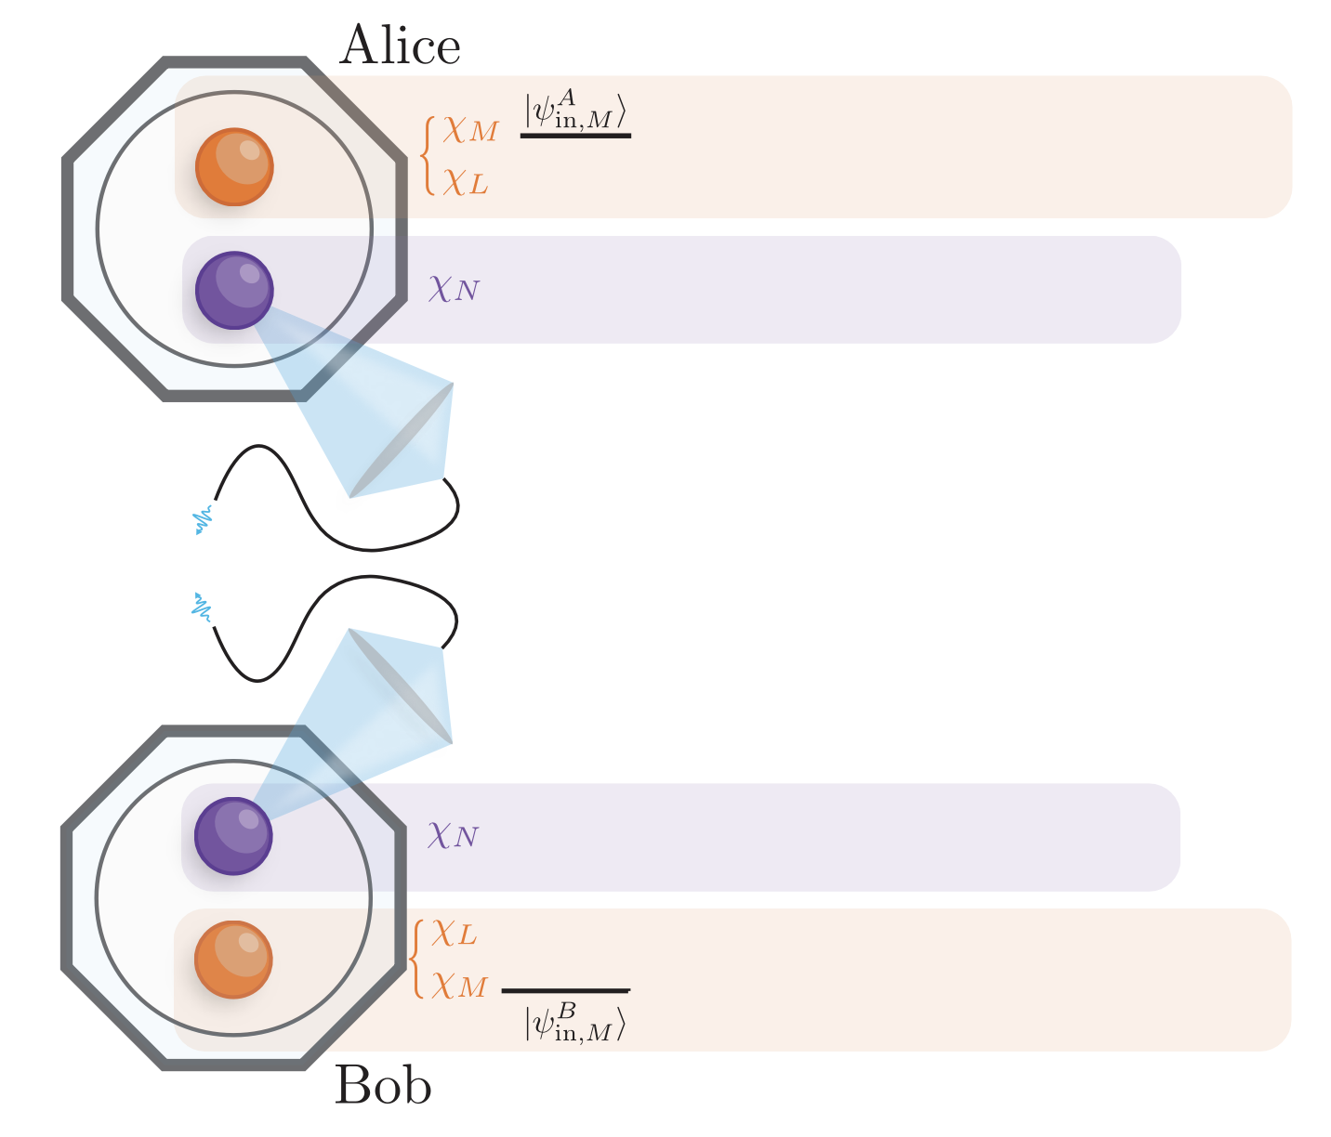





Entanglement scheme
Ion-photon entanglement
Ca
Sr
5P_{1/2}
422 nm $σ^{+}$
$$σ^{+}$$
~5 ps
$$π$$
Sr
5S_{1/2}
Ca
Notes:
To generate entanglement between Sr, we prepare Sr in ground state
ps excitation pulse to P1/2 state
Decays back to ground state, emitting a photon
Photon polarisation entangled with Sr state

Slide 15
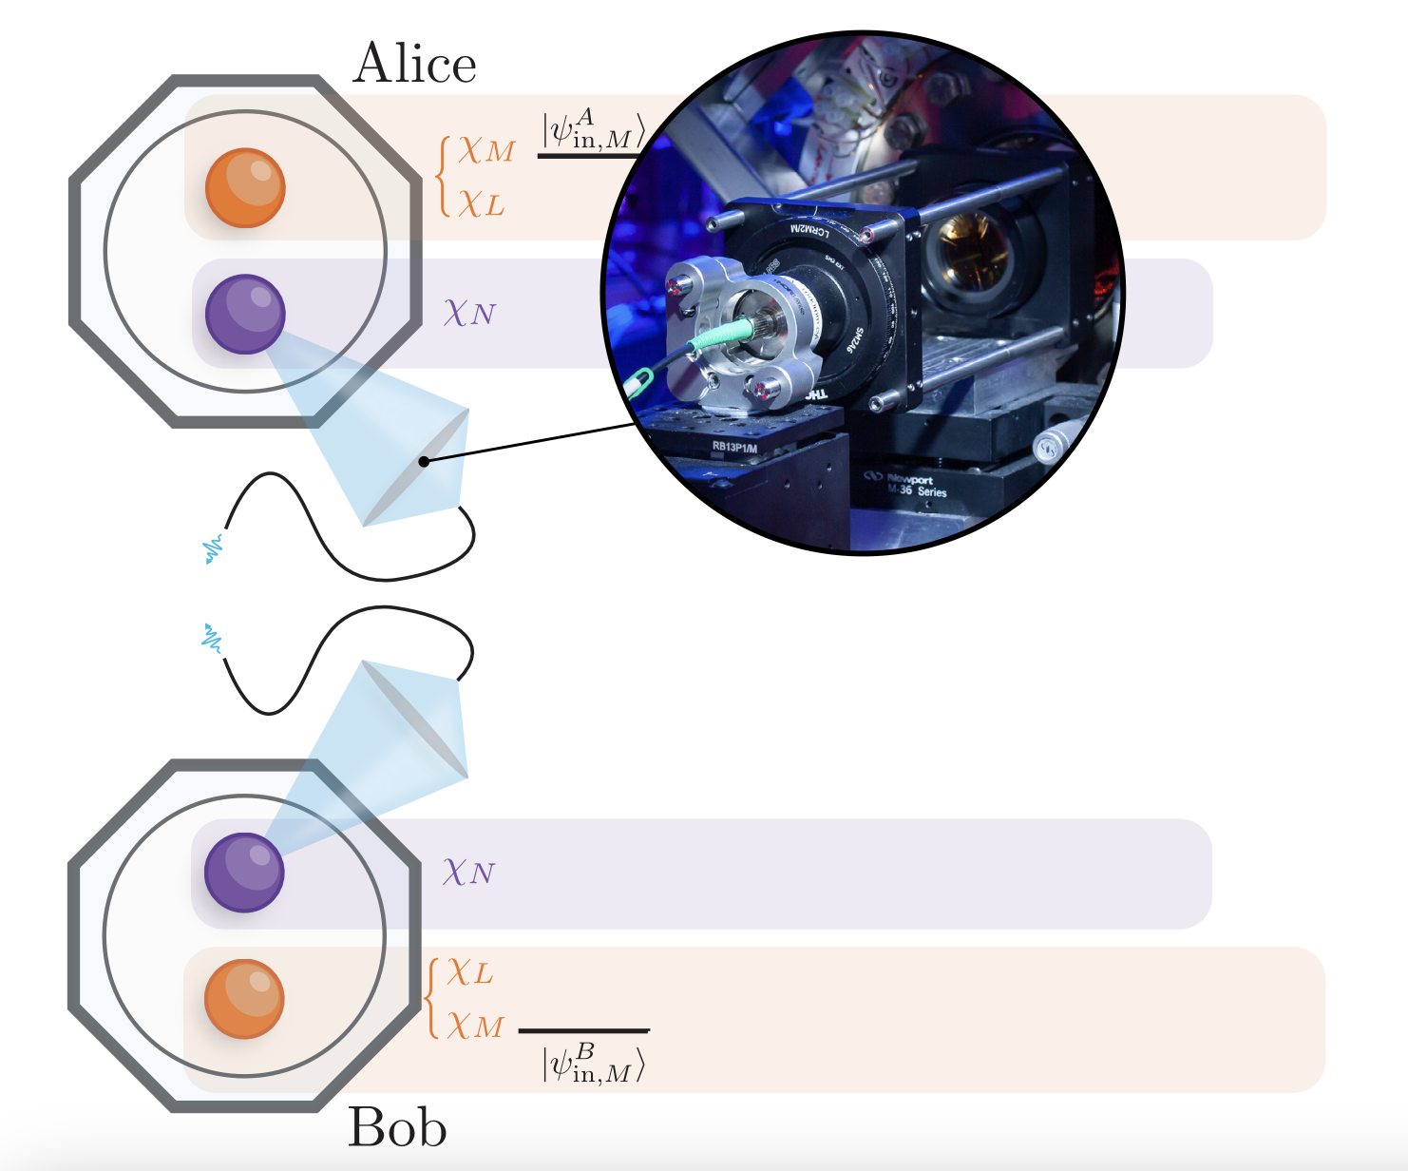
Entanglement scheme
Ion-photon entanglement
Collect photons with high-NA
Notes:
Then collect single photons via a high NA lens focused into an optical fibre with about ~2% efficiency in each node
Done simultaneously in Alice and Bob – giving us two of ion-photon Bell pairs from each trap

Slide 16
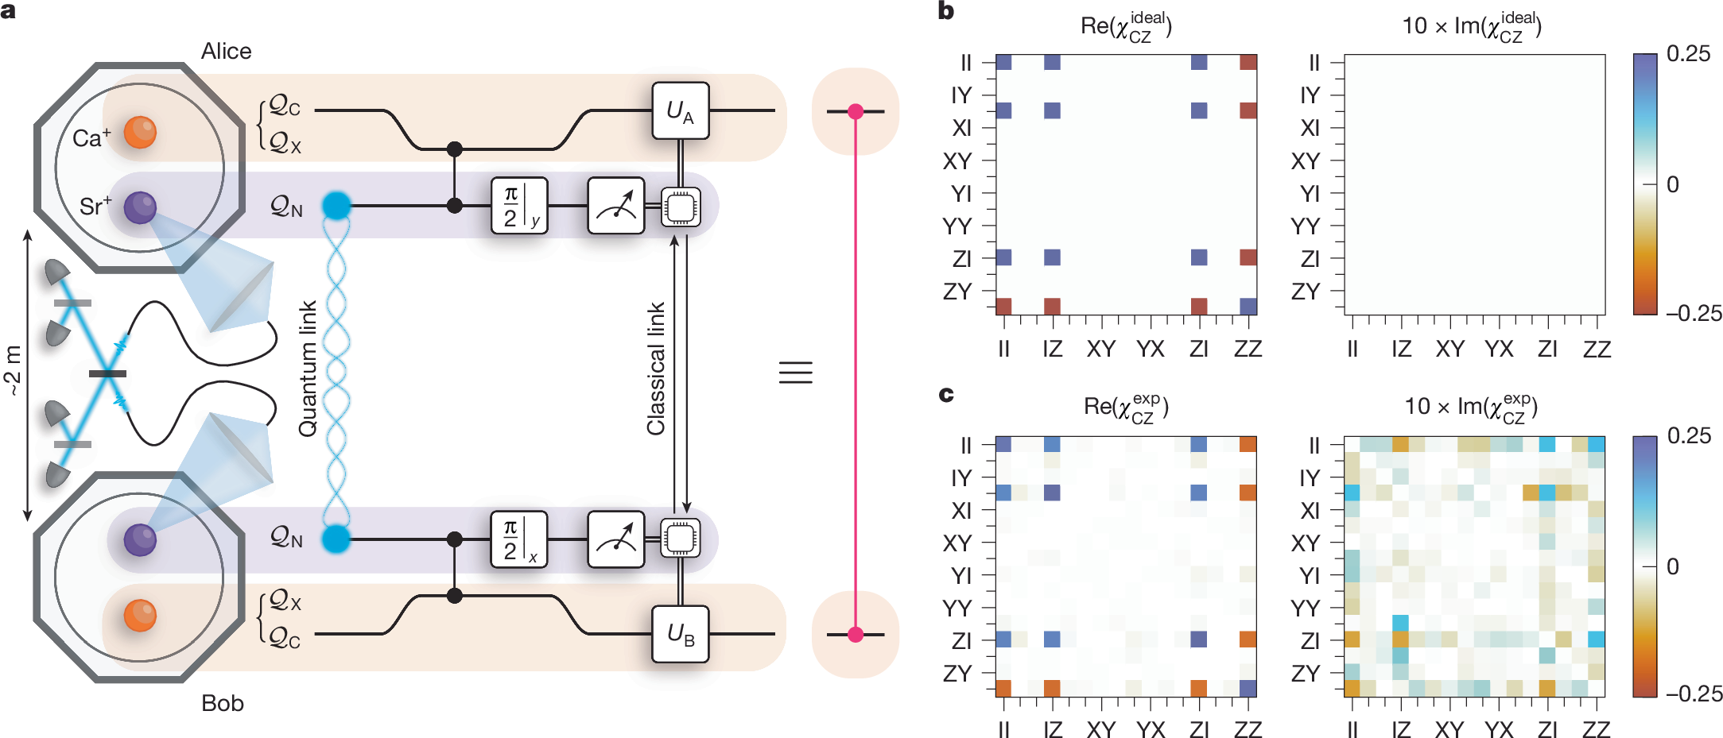
Entanglement scheme
Ion-photon entanglement
Collect photons with high-NA
Photon bell-state measurement
Project Sr-Sr onto Bell state
Notes:
Then do entanglement-swapping protocol:
- Measure photons with a bell state analyzer
- collapses the two Sr into a Bell state

Slide 17
Entanglement scheme
Ion-photon entanglement
Collect photons with high-NA
Photon bell-state measurement
Local entangling gate maps entanglement to Ca-Ca
Local SWAP gate
Local SWAP gate
Notes:
Then do local entangling gates to map Sr bell state onto two Ca ions

Slide 18




Entanglement scheme
Ion-photon entanglement
Collect photons with high-NA
Photon bell-state measurement
Local entangling gate maps entanglement to Ca-Ca
Map to optical transition
Local SWAP gate
Clock transition
Local SWAP gate
Notes:
The Ca-Ca entanglement is in the microwave qubit, we now map this onto the optical qubit
[animation]
[animation]
finally left with an entangled Bell state between the optical clock qubits

Slide 19
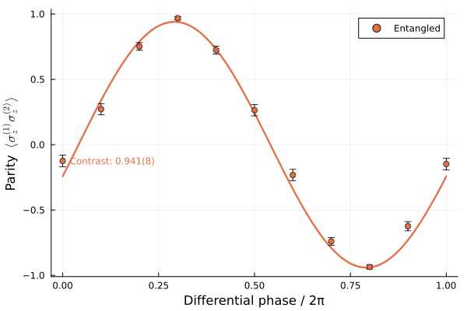
Optical qubit entanglement
Remote Ca-Ca entanglement with 93% fidelity on microwave qubit ^{[1]}
Map to optical transition with 729 nm laser
Prepared bell state
[1] D. Main et al., arXiv:2506.14334 (2025)
Notes:
Starting with Sr-Sr 98%
Have shown 93% fidelity on microwave
We've now set up the quadrupole 729 nm laser for the optical mapping, and preliminarily we see 94% parity contrast on the optical entangled state

Slide 20
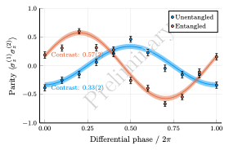
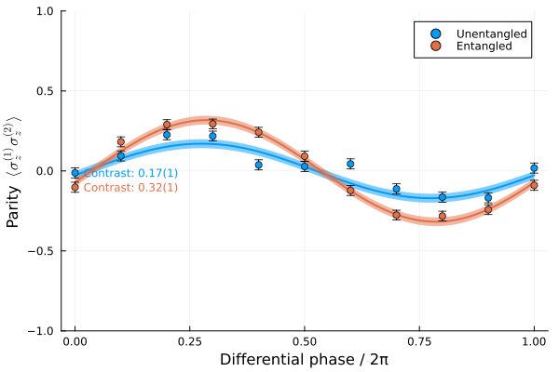
Preliminary results
Ca
125 ms Ramsey duration
Sr
15 ms Ramsey duration
Coherence > 125 ms
~2x higher contrast with entanglement
Notes:
We have some preliminary results that we took earlier this year
Blue curve is unentangled correlation spectroscopy, orange with entanglement. See parity contrast is almost 2x
In this plot, you can see almost ~60% contrast at durations of up to 125 ms, well beyond the laser coherence time (measured ~5ms).
[animation]
Compare this to our previous Sr results, where we had lower contrast at 10x shorter probe, so it's a clear step forward

Slide 21
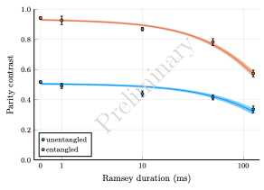
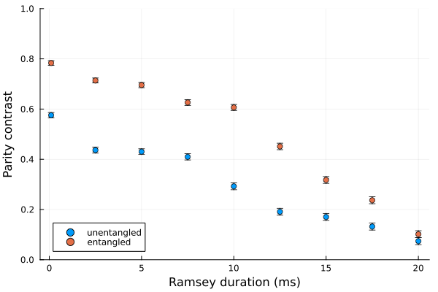
Preliminary results
Ca
Sr
Initial contrast | 94.1(8) %
Coherence time | 130 ~250 ms
Notes:
This is plot of the contrast vs ramsey duration
As mentioned earlier, start with approx 94% contrast
The contrast decays much faster than expected from the excited state lifetime – expect 85% contrast at this point. Some of the error here comes from our horrible motional heating rates (few 1000 q/s), leading to carrier suppression for the closing pi/2 pulse. These Ca figures are a few months old – we’ve since managed to push this out further by roughly a factor of two by sympathetically cooling the Ca ion at the end of the Ramsey, but we’re still trying to figure out where the rest of the contrast is going.
But even then, comparing to our previous results using Sr, significantly longer coherence and better starting fidelity

Slide 22

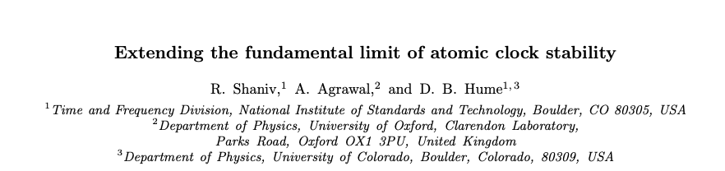
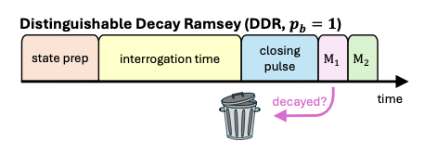
Detecting spontaneous decay
Entangled state decays faster
  Same limit when no laser dephasing
Adds projection noise, no signal
Detection can improve stability by 2x
arXiv
Notes:
[check time]
A subtlety to note about the entangled state near the lifetime limit:
- entangled state decays 2x as fast, so loses the factor of sqrt(2) gain over uncorrelated clocks when excluding laser decoherence
[animation x2]
- If you can detect the decay, improve sensitivity by further 2
by discarding those points.
- This improvement exists both with and without entanglement, although the gain is slightly higher in the entangled state.
Details are in a paper on the arxiv with collaborators at NIST

Slide 23
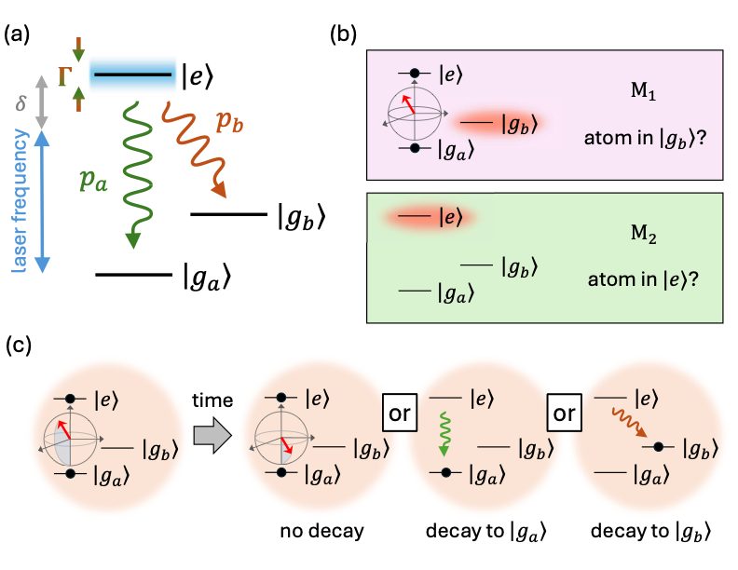
Detecting spontaneous decay
Real atoms have multiple levels – detect decay outside clock subspace
  85% branching ratio outside clock subspace for us
  65% higher max stability
Notes:
The main idea here is that real atoms consist of more than two levels, so the excited state can decay outside the clock subspace. This can be used to herald and discard spontaneous emission events.
In our clock, the excited state has an 85% branching ratio outside clock subspace, which can further improve the stability by 65%.
In principle, one could also use a series of pulses to interrogate a transition where the excited state cannot directly decay to the clock ground state, allowing detection of all decay events.

Slide 24
Summary and outlook
Show entanglement is a practical way to improve frequency comparisons
  Proof of principle with ⁸⁸Sr⁺
  True enhancement with ⁴³Ca⁺, pushing to 500 ms
Evaluating systematics…
Larger networks with longer distances??

Slide 25
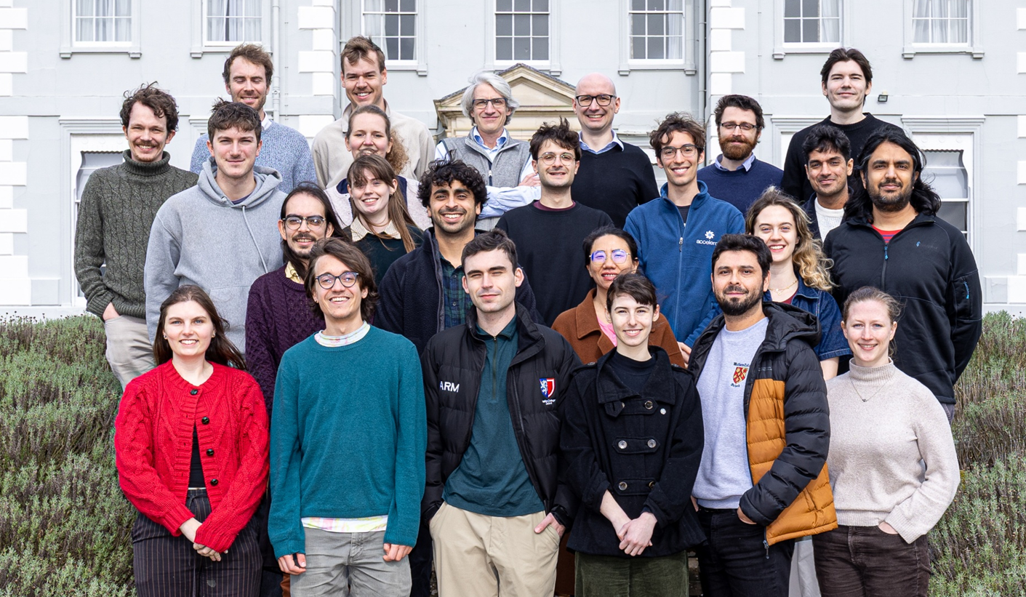

Quantum networking team:
Ayush Agrawal Ellis Ainley Adam Martinez Erin Malinowski
Shuying Chen Jacob Blackmore Marion Mallweger
Peter Drmota David Nadlinger Gabriel Araneda
David Lucas Raghu Srinivas
People and Funding

Slide 26
Teleported gate
Ion-ion entanglement
Local Ca-Sr entangling gate
Measure Sr + local corrections

Slide 27
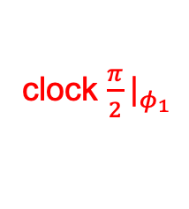



Cooling + State prep
Herald
S (F=4) → D
$$T_{R}$$
Ca
SWAP gate
Readout
Alice
S (F=3)
→ S (F=4)
clock $\frac{π}{2}{\left.​\right|}_{φ_{1}}$
Readout
Sr
Entanglement generation attempt
Map to correct Bell state
abort?
$$T_{R}$$
Ca
SWAP gate
Bob
clock $\frac{π}{2}{\left.​\right|}_{φ_{2}}$
Sr
cooling
…
cooling
…
State prep
ps pulse

Slide 28
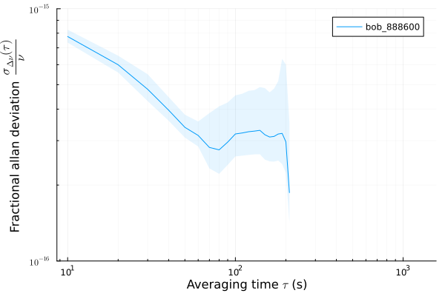
Allan deviation

Slide 29
Fidelities
Pair | Fidelity (%)
Sr-photon | 97.2(2)
Ca-photon | 93(2)
Sr-Ca (local) | 98.0(2)
Sr-Sr (remote) | 96.6(2)
Sr-Ca (remote) | 94.0(5)
Ca-Ca (remote) | 92.9(7)

Slide 30
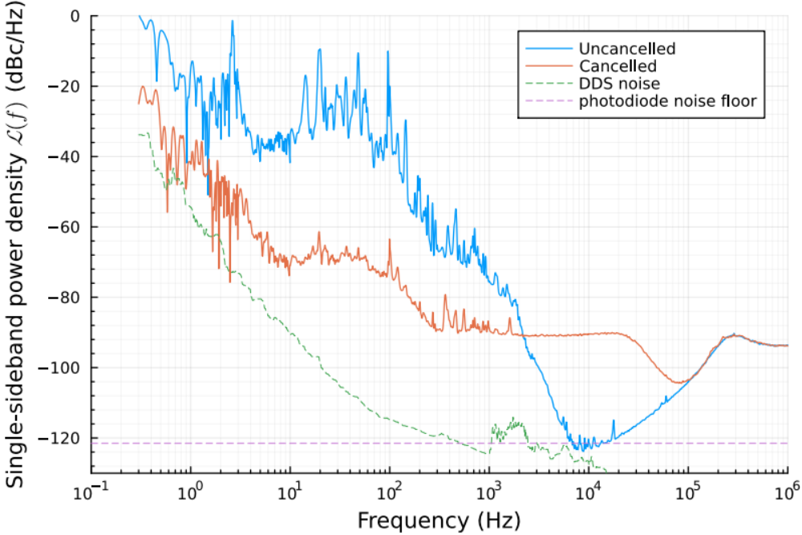
Performance
Power spectrum
 | Free-running | Stabilized
Linewidth broadening | ~20 Hz | < 0.3 Hz
Coherence time | ~50 ms | > 3 s
Integrated phase noise* | 1.33 rad | 0.058 rad
Jitter* | 2.6 ns | 0.01 ns
*Integrated from 0.3 Hz to 1 MHz
Notes:
The key performance parameters are summarised in the table on the slide.
We see that the integrated phase noise reaches 1 rad when integrated above ~20 Hz,
whereas with the cancellation enabled, the noise is still only ~58 mrad when integrated above 0.3 Hz, implying a coherence time of over 3 s between the fibre output and input.
We think that this performance is limited by the internal clock of the feedback electronics driving the DDS, and that it may be possible to boost performance further by switching to an external reference Rubidium clock and adjusting some of the multiplier settings on the electronics. However, as the cancellation we got was already better than other limiting factors, we did not try this in the lab.

Slide 31
Entanglement loop
State preparation
Pulsed Excitation
Photon emission
~1 µs
Detector click(s)?
NO
YES
Entanglement!

Slide 32
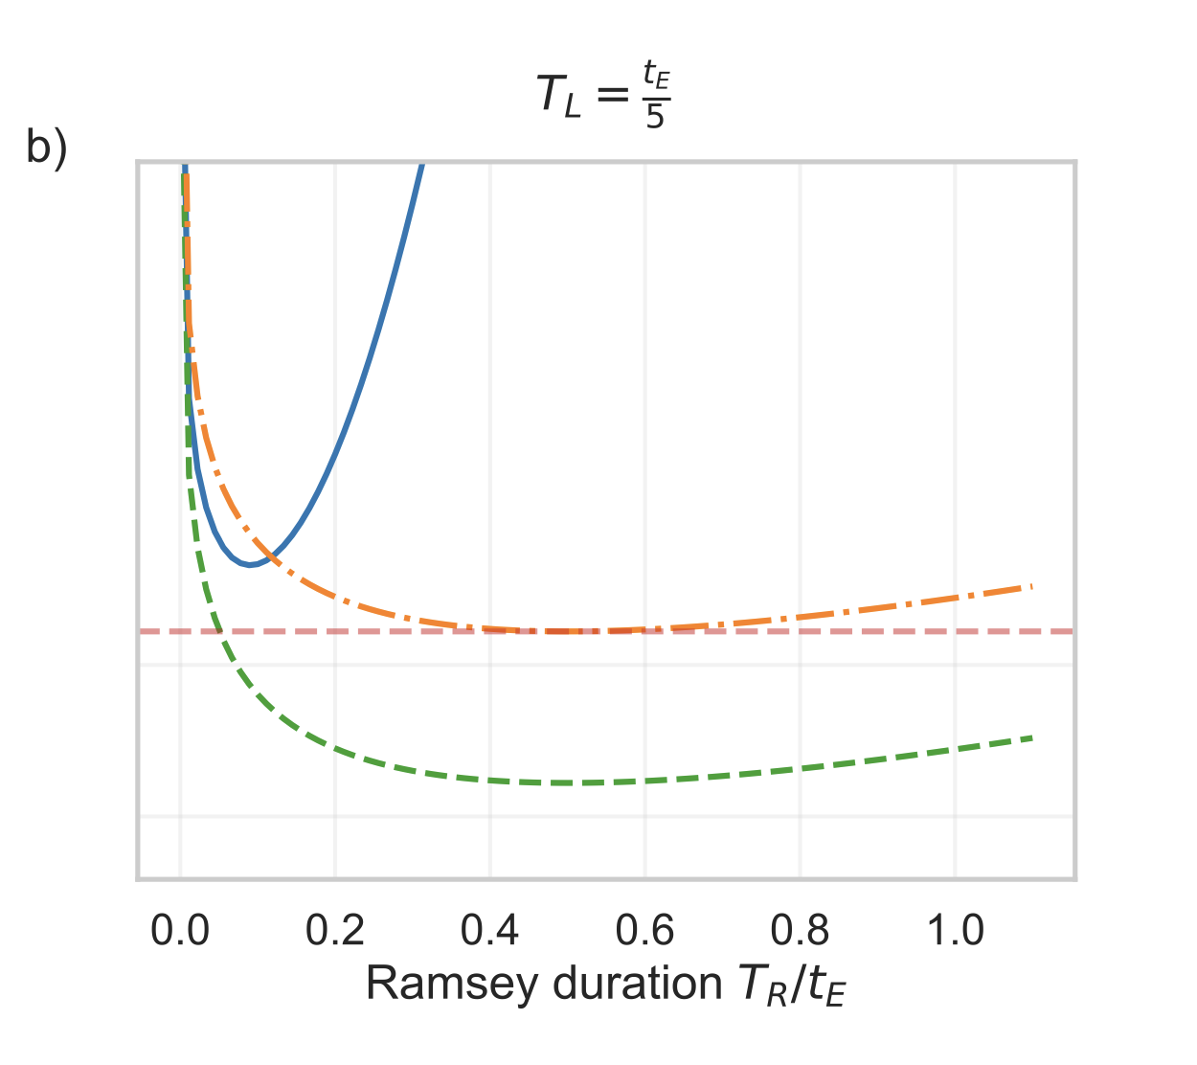
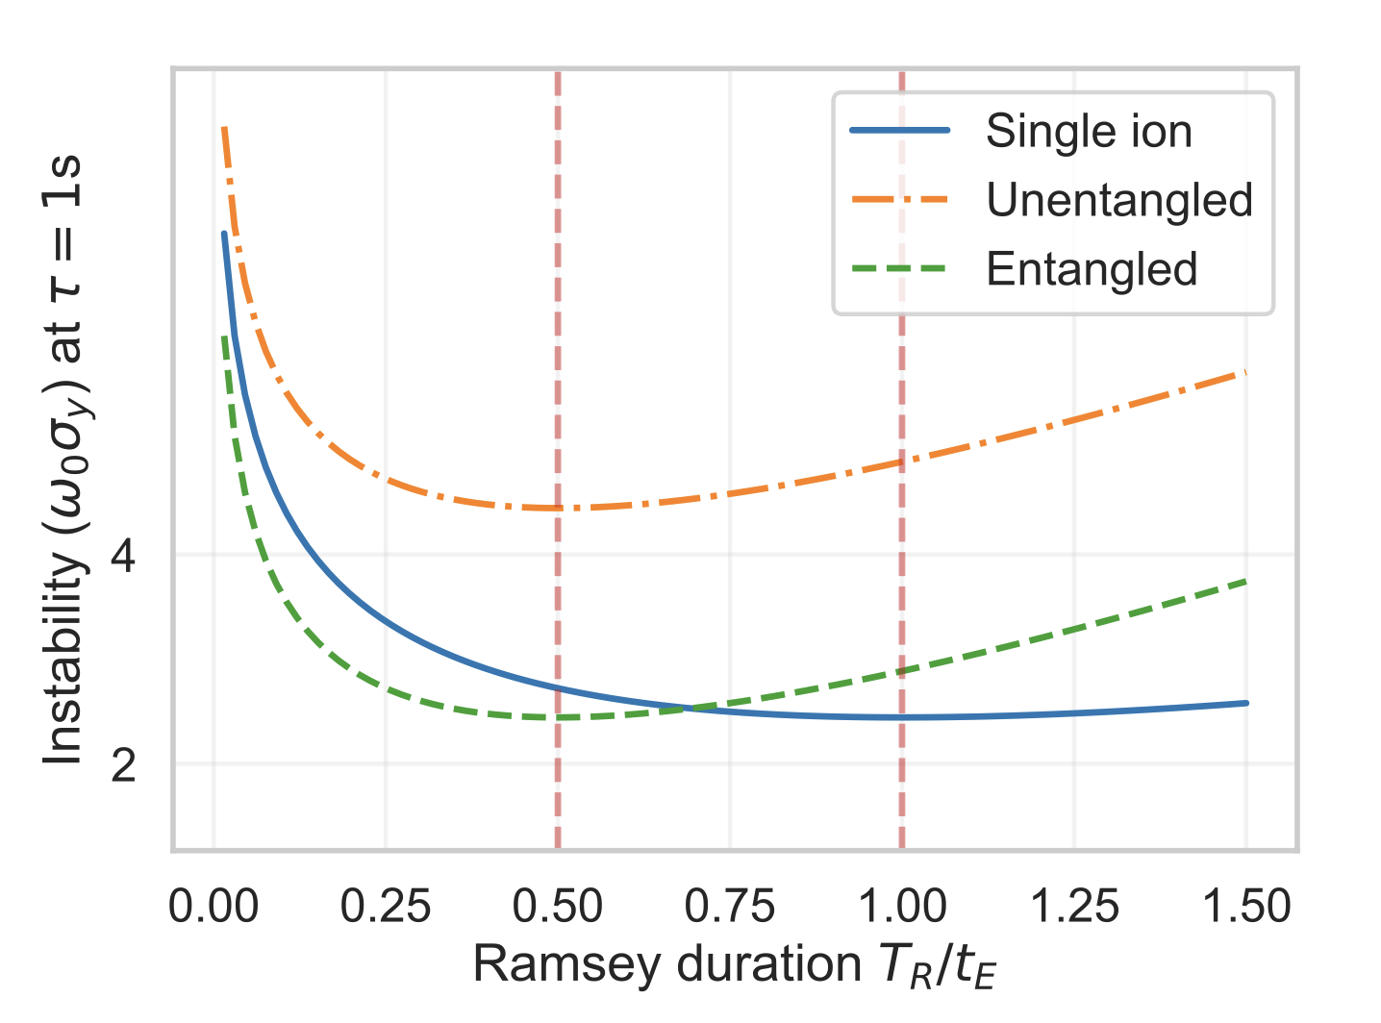
Measurement instability
Without laser phase noise
With laser phase noise
a)
Nichol, B. (2022), Doctoral Thesis
Notes:
Plots show the stability enhancement from entanglement (green line) over conventional unentangled techniques (plotted in blue and orange).
See that entanglement improves stability, although its minimum instability is the same as without entanglement as the state decay rate is also twice as high.
A practical system however, is severely limited by laser phase noise on the laser, in the presence of which the enhancement provided by entanglement is much more substantial, as the entangled state produced is resistant to common-mode phase phase errors.

