Slide 1
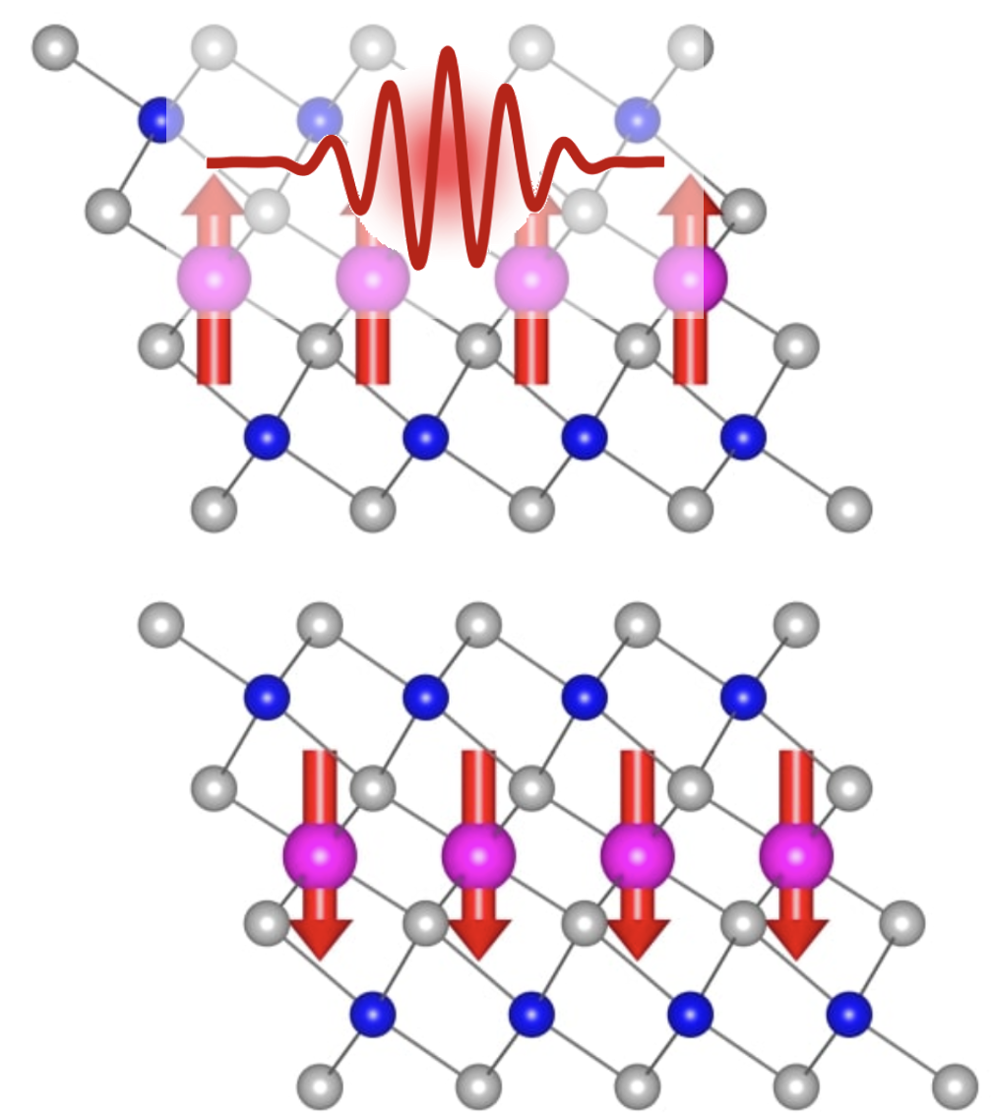

Axion quasiparticles in MnBi₂Te₄
Axion particle
Axion quasiparticle

Slide 2
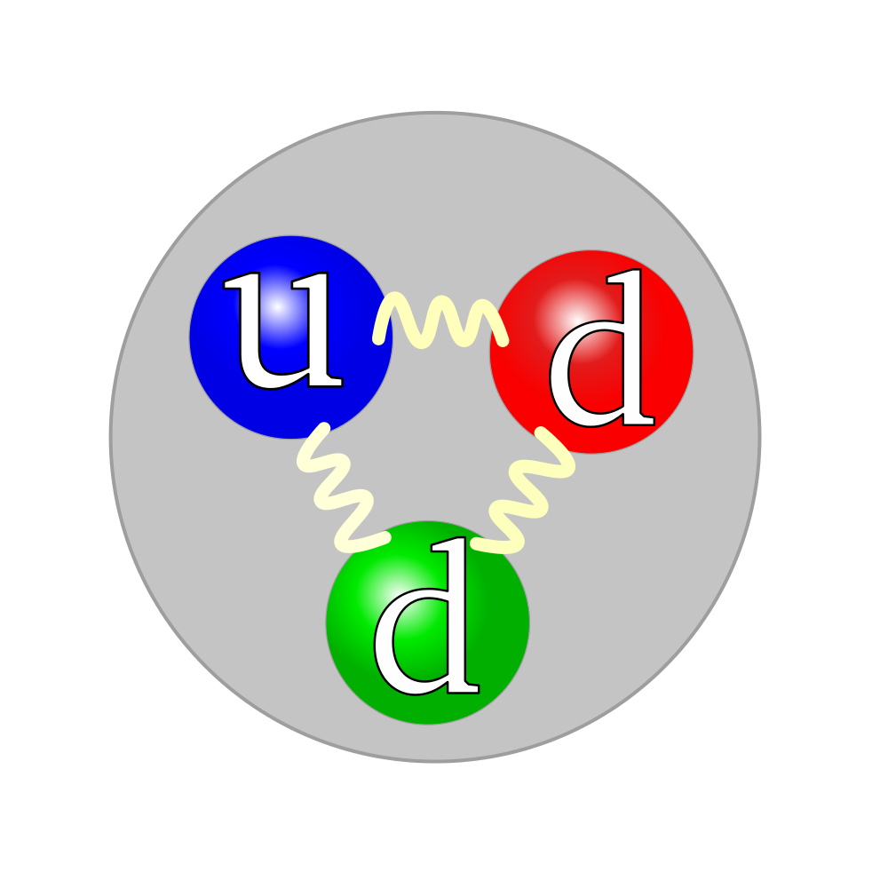
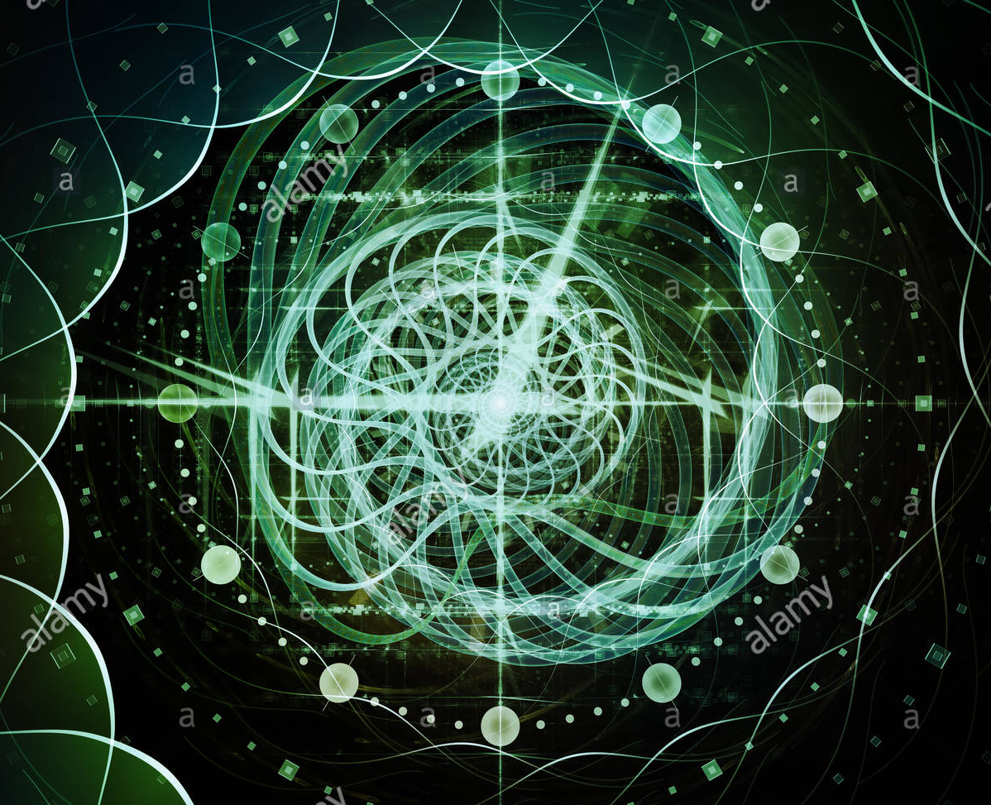

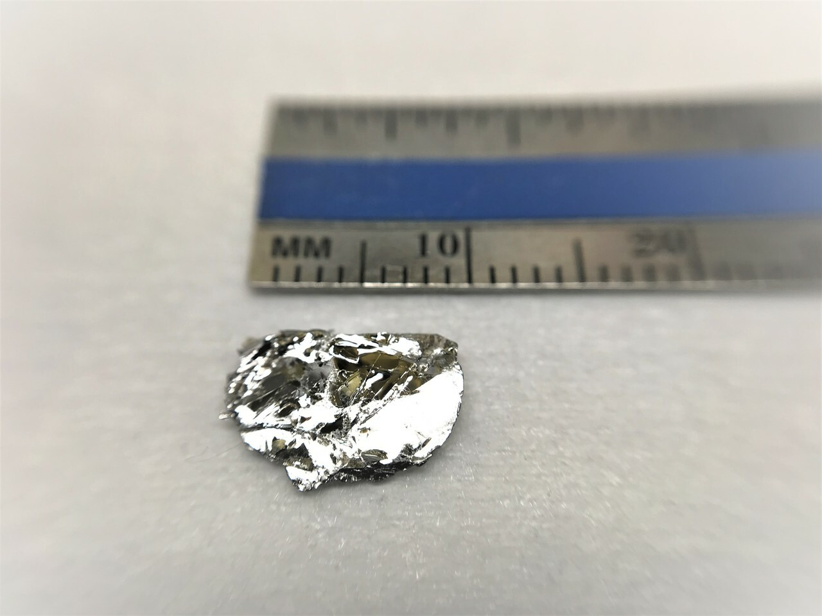
Strong force
Fundamental symmetry
Laundry powder
Quantum materials

Slide 3

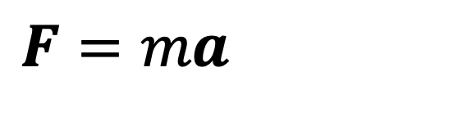
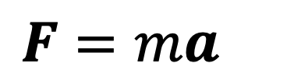
Symmetry of physical laws
$$F=ma$$
$$F=ma$$

Slide 4
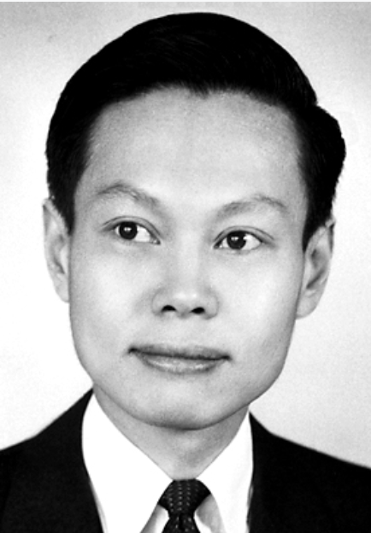

Parity breaking in weak force
Mirror
B
B
Co
Co
What about strong force?
Chen-Ning yang
Tsung-Dao Lee
CP symmetry also broken for weak force (other experiments)
Physical Review. 104 (1): 254–258 (1956).

Slide 5
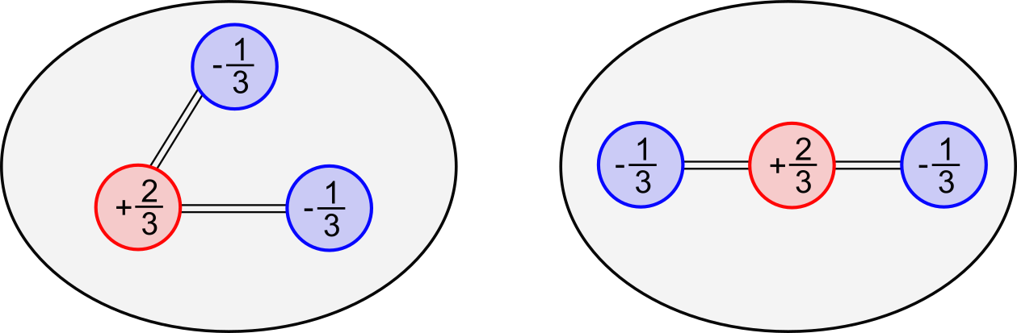
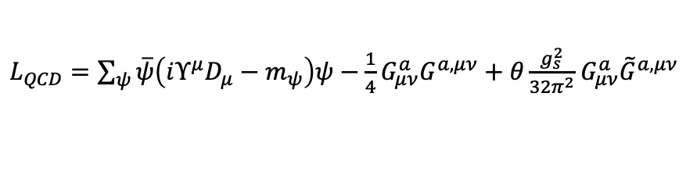
The strong CP problem
Theory QCD: CP violation
Experiment: No CP violation
CP symmetry broken
CP symmetric
$L_{QCD}=\sum_{ψ}{\overline{ψ}\left(iΥ^{μ}D_{μ}−m_{ψ}\right)ψ−\frac{1}{4}G_{μν}^{a}G^{a,μν}+θ\frac{g_{s}^{2}}{32π^{2}}}$ $G_{μν}^{a}{\tilde{G}}^{a,μν}$
Neutron
Neutron
The strong CP problem
Axions
P breaking, T breaking

Slide 6
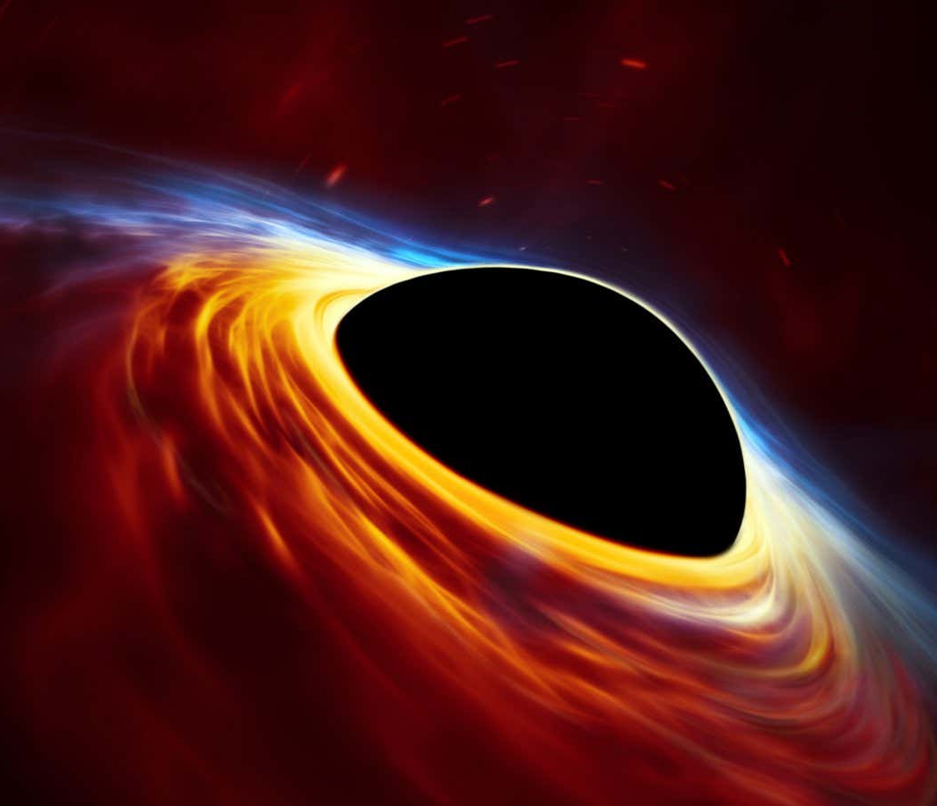
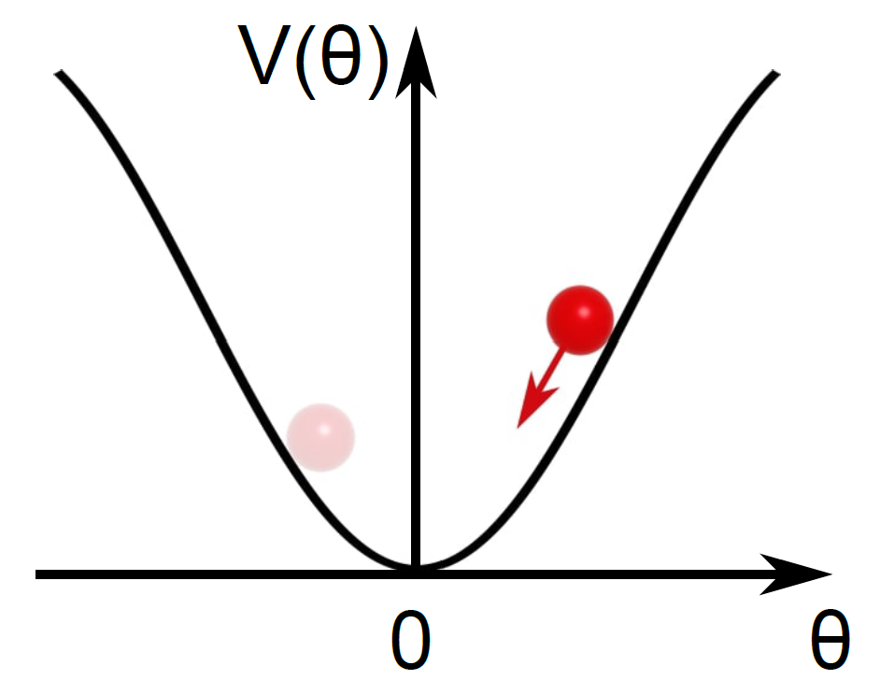
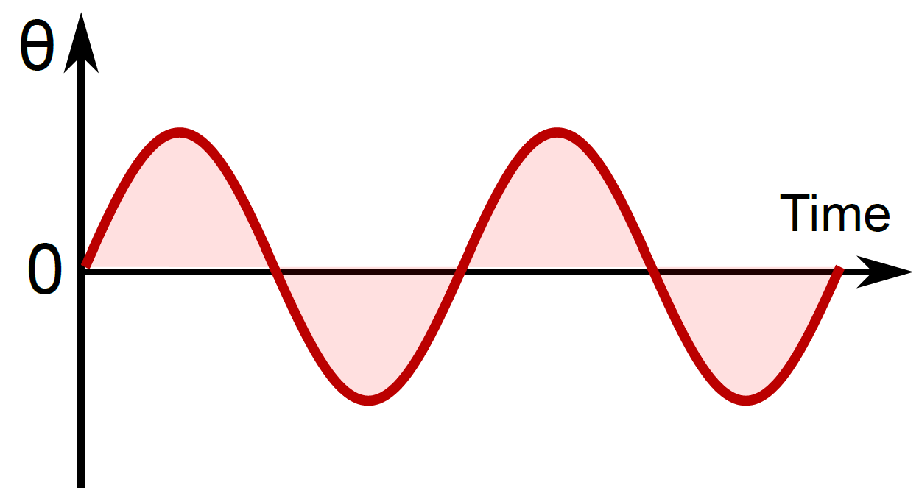
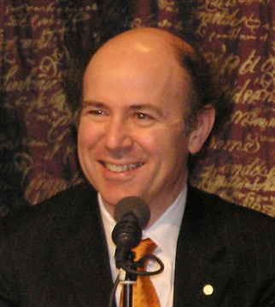
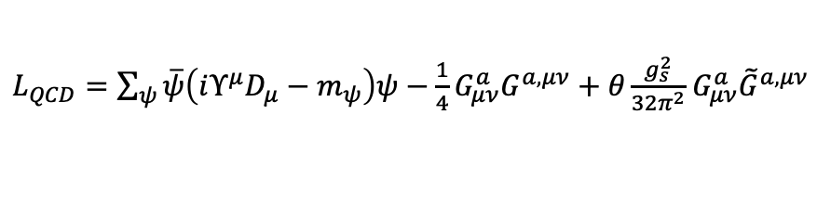
Axion
Known matter: Strong CP problem
Dark matter candidate
$L_{QCD}=\sum_{ψ}{\overline{ψ}\left(iΥ^{μ}D_{μ}−m_{ψ}\right)ψ−\frac{1}{4}G_{μν}^{a}G^{a,μν}+θ\frac{g_{s}^{2}}{32π^{2}}}$ $G_{μν}^{a}{\tilde{G}}^{a,μν}$
Axion particles
Clean up
Frank Wilczek

Slide 7
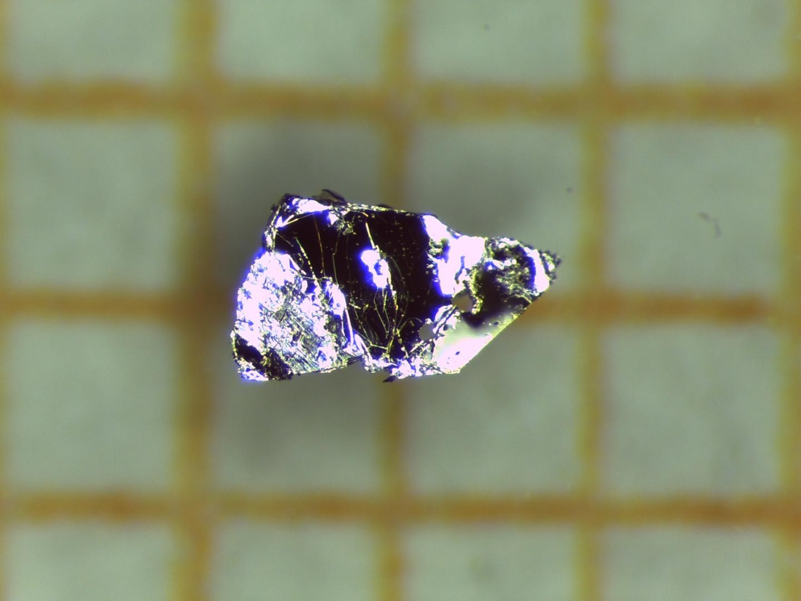
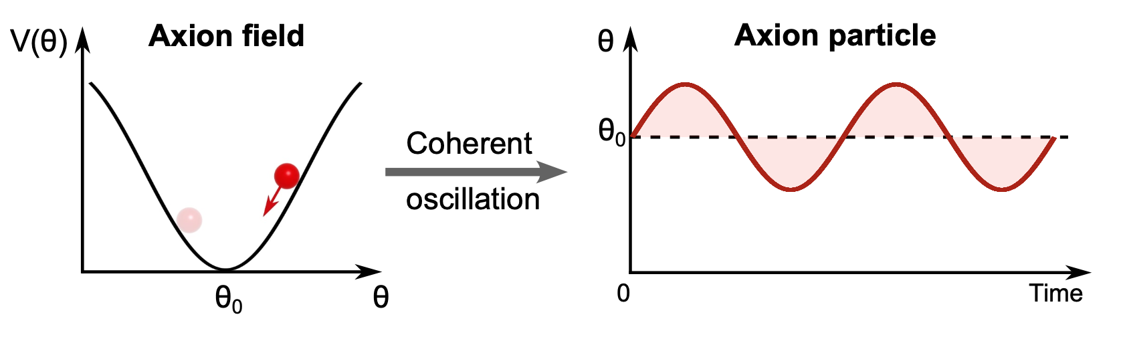
Axion particle and quasi-particle
1mm
Axion quasiparticle
Theory : Li et al. Nature Phys. 6, 284 (2010)
Notes:
Axion insulator (theta=pi, preserve P or T), Dynamical Axion (theta < pi), theta can be modulate, xy plot (P, T break),
Bulk MBT Thin MBT, coherent mode
Axion detector, real particle, hit on MBT

Slide 8
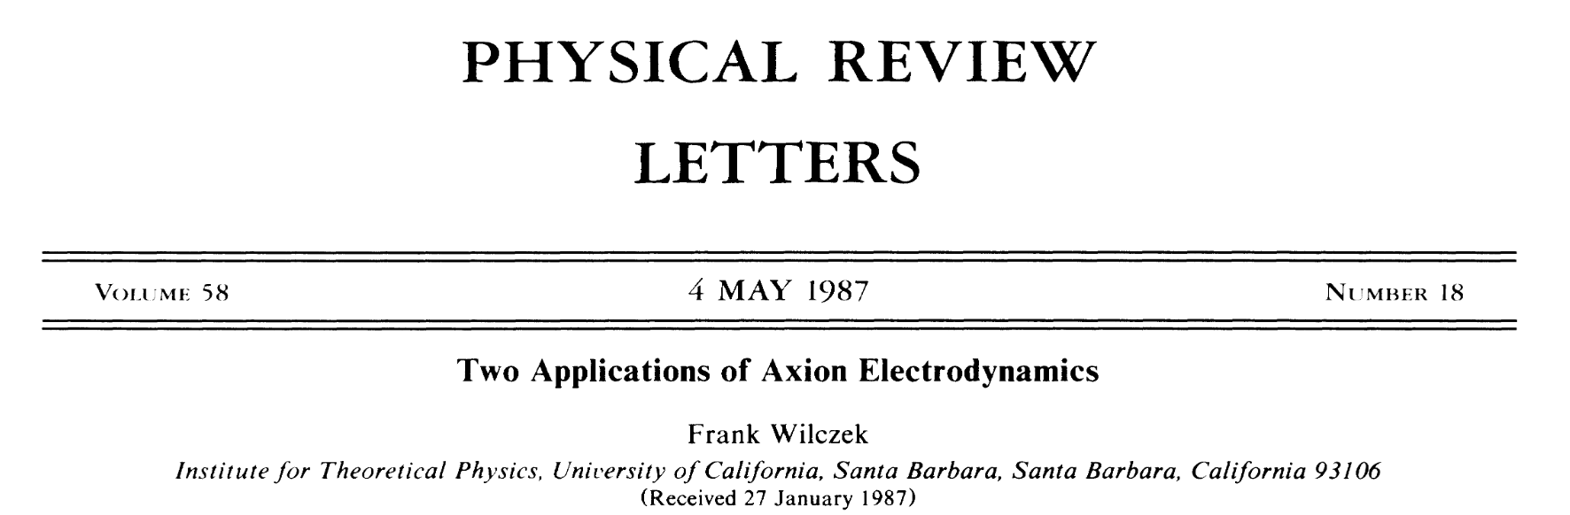


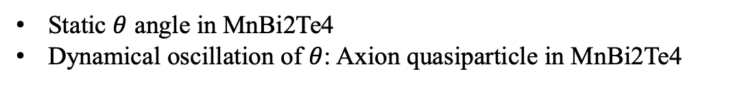
$θ$in materials:
Static $θ$ angle in MnBi2Te4
Dynamical oscillation of $θ$: Axion quasiparticle in MnBi2Te4

Slide 9





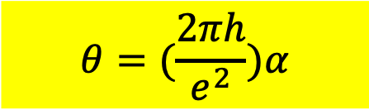
$θ$in materials: Magnetoelectric coupling
E
M
$$θ=(\frac{2πh}{e^{2}})α$$
$$M=αE$$
Time-reversal
$$M=αE$$
Inversion symmetry
$$−M=αE$$
$$M=α(−E)$$
$α$ requires T breaking and P breaking

Slide 10
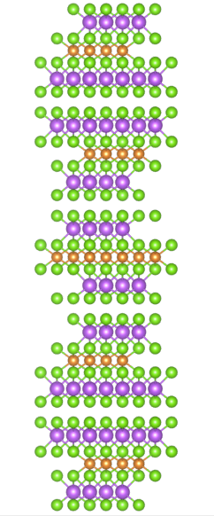

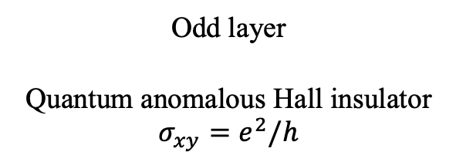
MnBi₂Te₄ -- Intrinsic, vdW, antiferromagnetic TI
Te
Odd layer
Quantum anomalous Hall insulator
$$σ_{xy}=e^{2}/h$$
Bi
Mn
1mm
Even layer
Axion insulator
$$σ_{xy}=0$$
$$θ=π−δ$$

Slide 11

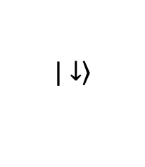
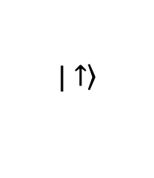
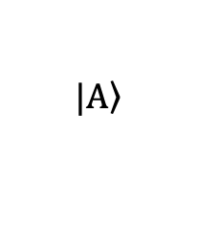
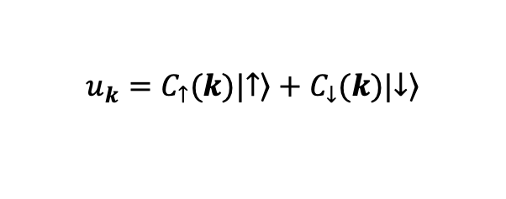
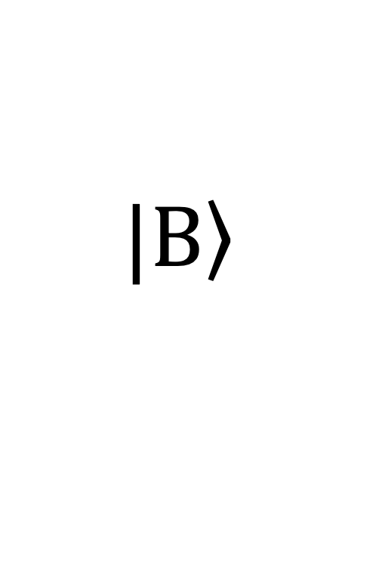
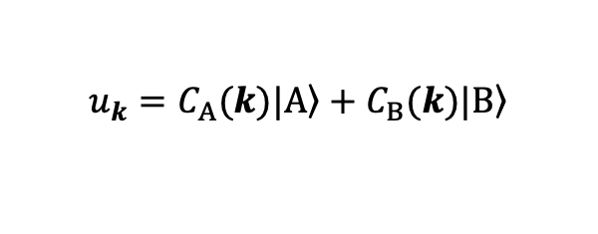
Quantum geometry
in graphene
Quantum geometry
in topological insulator
$$\left.|A\right\rangle$$
$$\left.|↑\right\rangle$$
$$\left.|B\right\rangle$$
$$\left.|↓\right\rangle$$
$$u_{k}=C_{A}(k)|\left.A\right\rangle +C_{B}(k)|\left.B\right\rangle$$
$$u_{k}=C_{↑}(k)|\left.↑\right\rangle +C_{↓}(k)|\left.↓\right\rangle$$

Slide 12
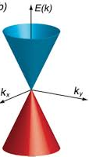
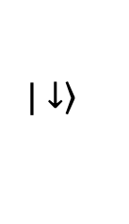
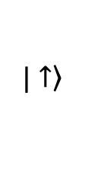
Nonmagnetic TI quantum geometry
$$\left.|↑\right\rangle$$
TI is characterized by spin-momentum locking
Top surface
$$\left.|↓\right\rangle$$
ky
Top surface
kx
Space inversion
Bottom surface
Bottom surface
ky
kx

Slide 13
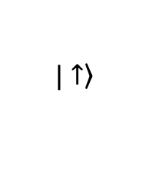
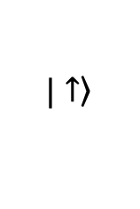
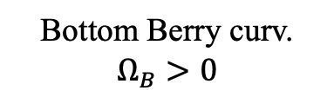
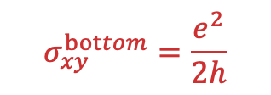
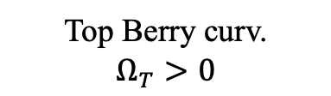
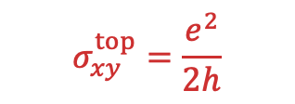
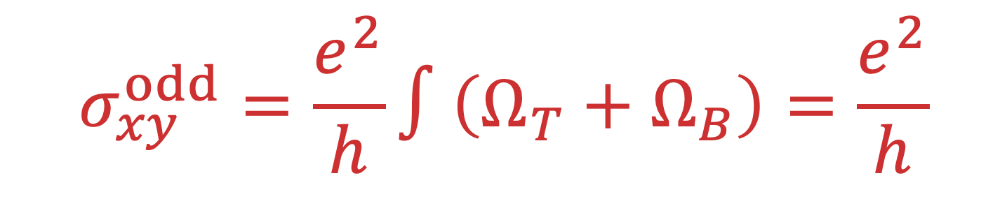
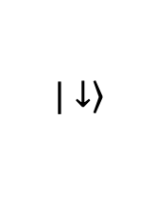
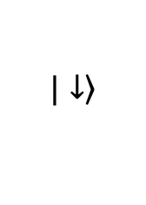
Odd layer MnBi2Te4 quantum geometry
$$\left.|↑\right\rangle$$
1
Top Berry curv.
$$Ω_{T}>0$$
$$σ_{xy}^{top}=\frac{e^{2}}{2h}$$
$$σ_{xy}^{odd}=\frac{e^{2}}{h}∫\left(Ω_{T}+Ω_{B}\right)=\frac{e^{2}}{h}$$
Top surface
2
3
$$\left.|↓\right\rangle$$
$$σ_{xy}^{bottom}=\frac{e^{2}}{2h}$$
$$\left.|↑\right\rangle$$
Bottom surface
Bottom Berry curv.
$$Ω_{B}>0$$
1
2
$$\left.|↓\right\rangle$$
3

Slide 14
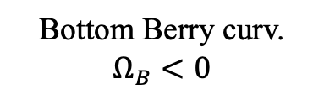
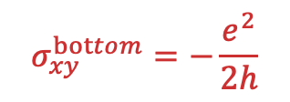
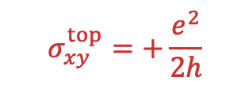
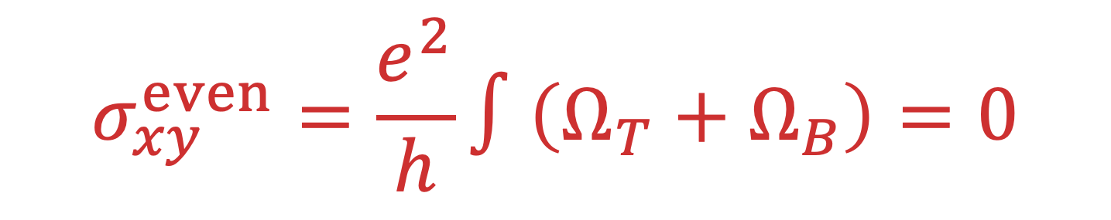
Even layer MnBi2Te4 quantum geometry
$$\left.|↑\right\rangle$$
1
Top Berry curv.
$$Ω_{T}>0$$
$$σ_{xy}^{top}=+\frac{e^{2}}{2h}$$
$$σ_{xy}^{even}=\frac{e^{2}}{h}∫\left(Ω_{T}+Ω_{B}\right)=0$$
Top surface
2
3
$$\left.|↓\right\rangle$$
$$σ_{xy}^{bottom}=−\frac{e^{2}}{2h}$$
$$\left.|↑\right\rangle$$
Bottom surface
Bottom Berry curv.
$$Ω_{B}<0$$
1
2
$$\left.|↓\right\rangle$$
3

Slide 15

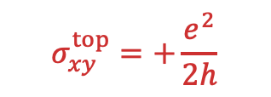



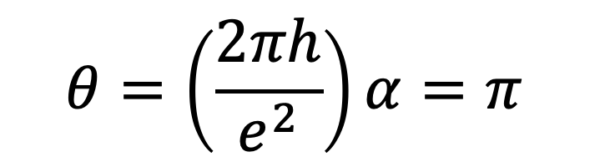
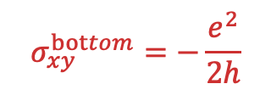
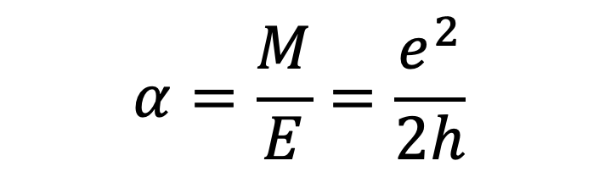
Even layer --- topological magnetoelectric effect
Even MnBi2Te4
$$σ_{xy}^{top}=+\frac{e^{2}}{2h}$$
$$J_{y}^{T}$$
$$M_{x}$$
$$E_{x}$$
$$σ_{xy}^{bottom}=−\frac{e^{2}}{2h}$$
$$J_{y}^{B}$$
$$α=\frac{M}{E}=\frac{e^{2}}{2h}$$
$$θ=\left(\frac{2πh}{e^{2}}\right)α=π$$

Slide 16
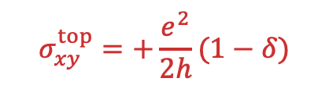
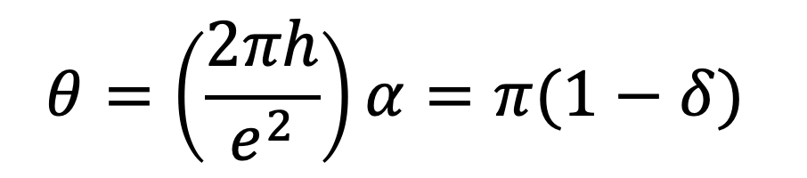


Even layer --- topological magnetoelectric effect
Even MnBi2Te4 (thin)
$$σ_{xy}^{top}=+\frac{e^{2}}{2h}(1−δ)$$
Top and bottom hybridization
$σ_{xy}^{bottom}=−\frac{e^{2}}{2h}$ $(1−δ)$
$$α=\frac{M}{E}=\frac{e^{2}}{2h}(1−δ)$$
$$θ=\left(\frac{2πh}{e^{2}}\right)α=π(1−δ)$$

Slide 17

Even layer --- topological magnetoelectric effect
Even MnBi2Te4 (thin)
$$θ=\left(\frac{2πh}{e^{2}}\right)α=π(1−δ)$$
Top and bottom hybridization
Magnetization
Nontrivial gap
Competition between magnetization and T-B hybridization
Trivial gap
Top-Bottom Hybrication

Slide 18








QUANTIZED topological magnetoelectric effect
$θ$ is T-odd and P-odd
$Under T or P$, $θ=0$or $θ=±π$
Bulk perspective
Surface perspective
Infinite TI
Nonmagnetic TI
Magnetic surfaces
Magnetic surfaces
$$θ=+π or−π$$
$$θ=+π or−π$$
$$θ=+π$$
$$θ=−π$$
$$α=\frac{M}{E}=\frac{e^{2}}{2h}$$
$$α=\frac{M}{E}=−\frac{e^{2}}{2h}$$
A strange bulk-boundary correspondence: Calculation of bulk topological invariant $θ$ cannot distinguish $+π or−π$. Only surface condition can tell.

Slide 19








Axion quasiparticle
Theory : Li et al. Nature Phys. 6, 284 (2010)
AFM TI gives large $θ$
AFM TI
$$θ=π(1−δ)$$
A$FM amplitude mode$
Time
$$θ$$
Time

Slide 20


Magnon simulates AFM amplitude mode
Mag. field
Even MnBi2Te4 (thin)
B//
Laser excitation

Slide 21





Magnon simulates AFM amplitude mode
$$M_{z}$$
$$M_{z}^{T}$$
$$θ$$
Even MnBi2Te4 (thin)
B//
Time
$$M_{z}^{B}$$
$$θ=π(1−δ)$$
Time
$δ$ depends on competition between magnetization and T-B hybridization

Slide 22




Static $θ$ measurement
Kerr rotation $∝M$
6L MnBi2Te4
$$θ$$

Slide 23



$θ(t)$ at fs time scale
Launching magnon
Measure $θ$

Slide 24








Coherent oscillation of $θ$
$$0.06$$
44 GHz
$$0.03$$
$Δθ$ ($π$)
$$0.00$$
$$−0.03$$
$$−0.06$$
Axion quasiparticle
Notes:
Lifetime of high energy mode

Slide 25


Systematic dependences
Temperature dependence
B-field dependence
Pump polarization
Notes:
Dynamical axion quasiparticles, exist the

Slide 26




Axion electrodynamics
Dark Matter Axion
$$Δθ\sim {10}^{−18}$$
$$Δθ\sim 0.03 π$$
Notes:
Can generalize to other materials

Slide 27





Axion detector!!
DM Axion
$$θ^{DM}(t)$$
MnBi₂Te₄
$$θ^{quasi}(t)$$
Single photon detector
Notes:
Can generalize to other materials

Slide 28




Axion polariton
Photon
Axion quasiparticle
Photon-like
Frequency $ω$
Gap $∝B$
44 GHz
Wavevector $k$
Wavevector $k$

Slide 29






Axion dark matter detector!!
$$+$$
DM Axion $θ^{DM}$
$$B field$$
THz photon $E^{ω}$
Axion polariton
MnBi₂Te₄ $θ^{quasi}$
Amplified THz photon
Single photon detector
The Axion quasiparticle serves as a naturall cavity whose freq (axion mass) is B field tunable
Notes:
Can generalize to other materials

Slide 30




Estimation of sensitivity
$B_{//}$ field
Axion quasiparticle
meV range – Hard for artificial cavities
Scan mass
Economy No need for a giant magnet
David Marsh
Jan Schuette-Engle

Slide 31











Acknowledgement
Jianxiang Qiu
Ni Ni
Ashvin Vishwanath
Arun Bansil
David Marsh
Jan Schuette-Engle
Qiu et al. Nature (2025)

