Slide 1
Quantum geometry nonlinearity
Suyang Xu
Chemistry and Chemical Biology, Harvard

Slide 2
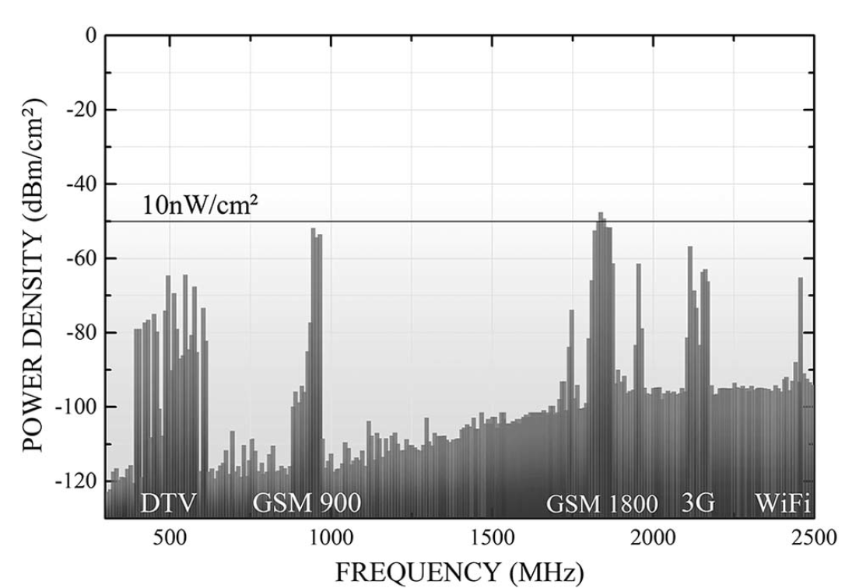
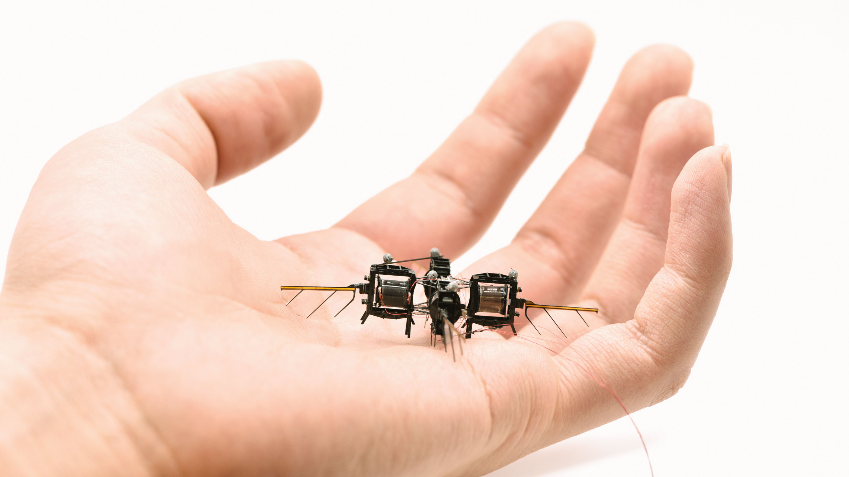
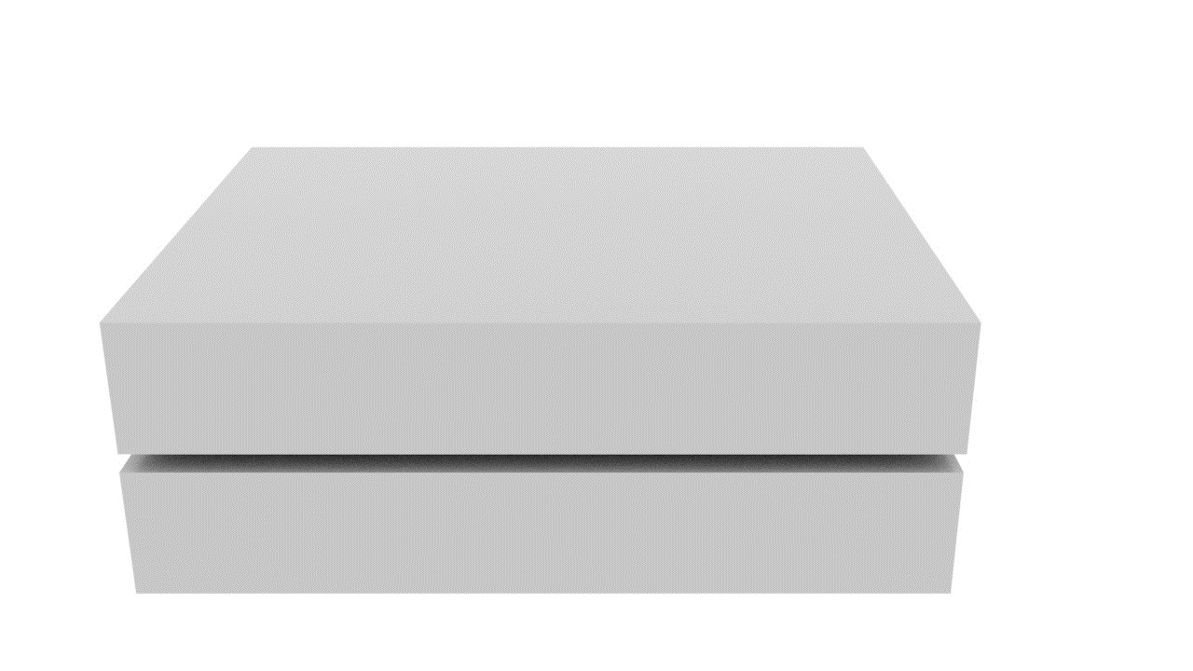
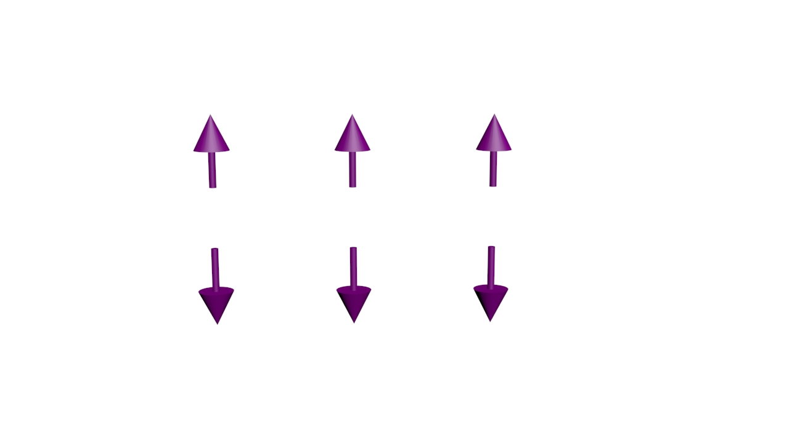


Microwave Wireless energy harvesting
$$J^{DC}$$
Rectifier

Slide 3
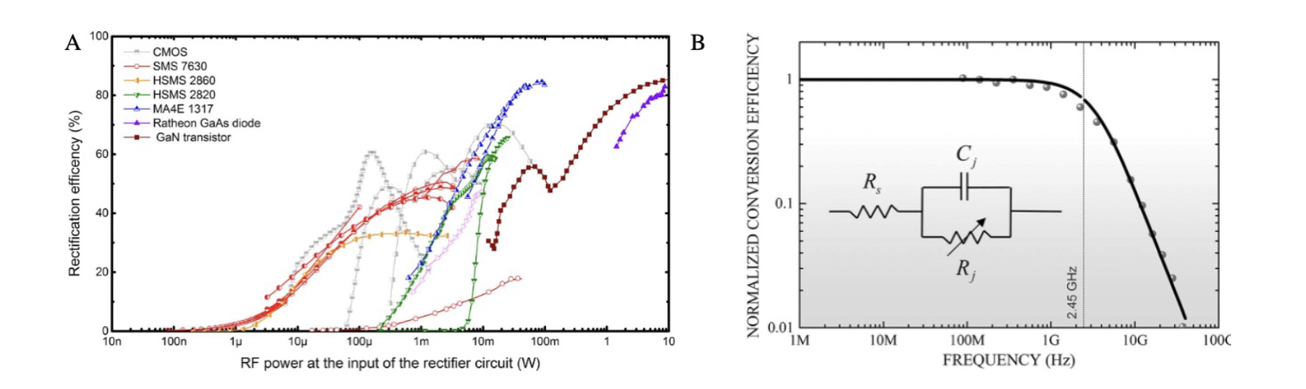
Fundamental limits of diodes

Slide 4
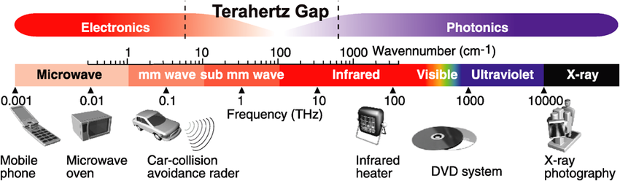
Solar cell + photodetector
Solar cell: 33% efficiency Shockley–Queisser limit
Replace the PN diode by a quantum material
J
Photodetector: the THz gap

Slide 5
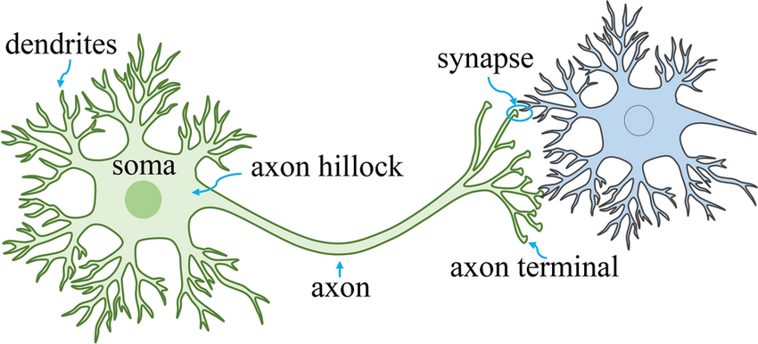
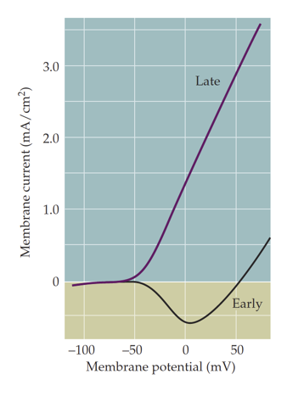

Artificial intelligence
Neuron activation
Nonlinearity

Slide 6
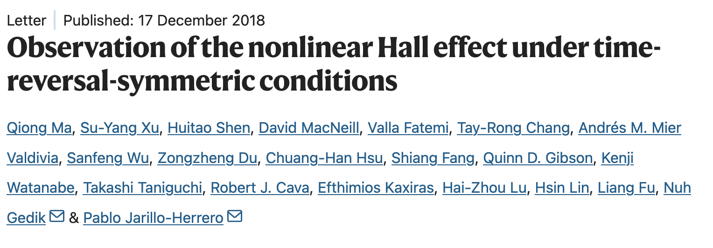
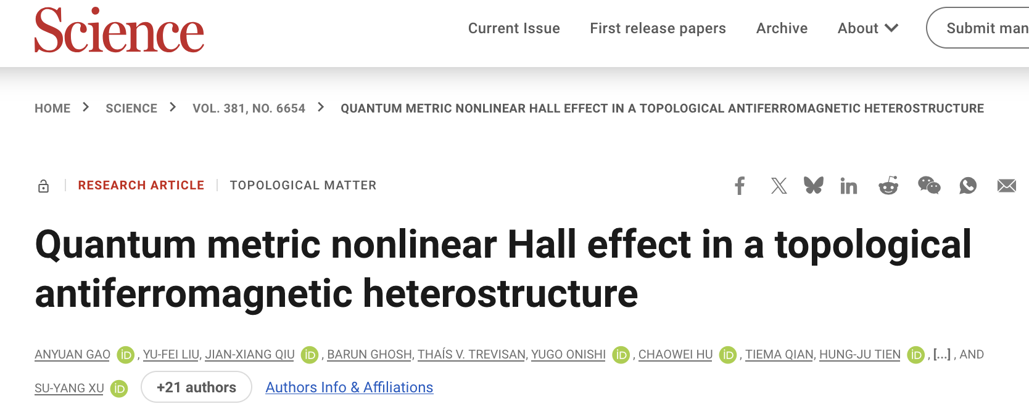

Nonlinearity of quantum materials
The existence of $σ^{(2)}$ requires the breaking of inversion symmetry P
The amplitude of $σ^{(2)}$ depends on the Berry curvature (quantum geometry)
$$J=σ^{(1)}E+σ^{(2)}E^{2}$$

Slide 7
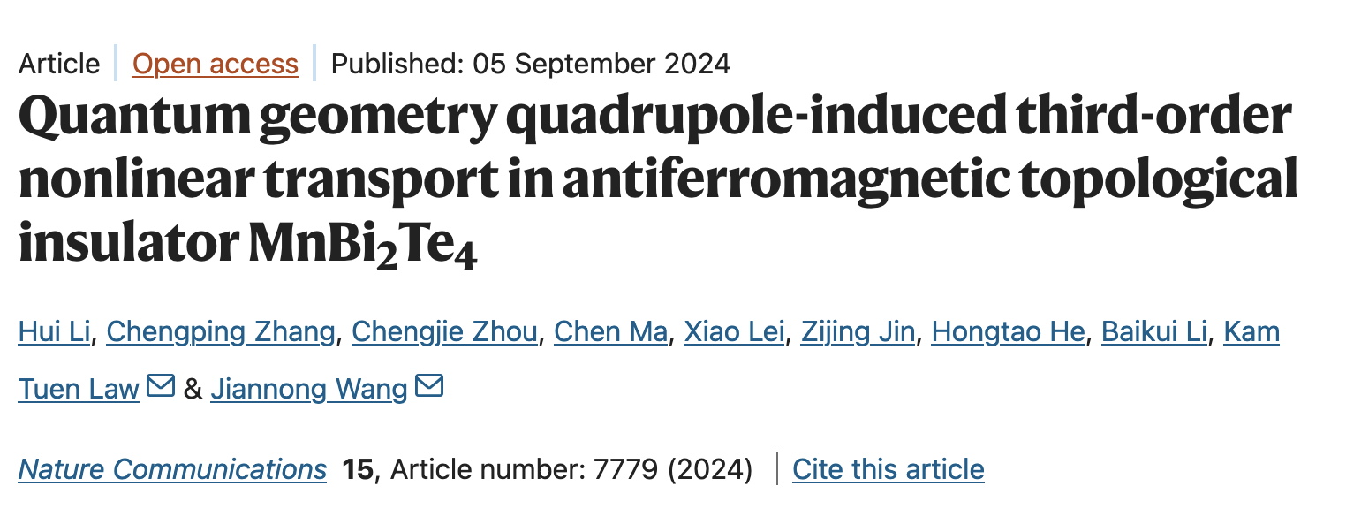
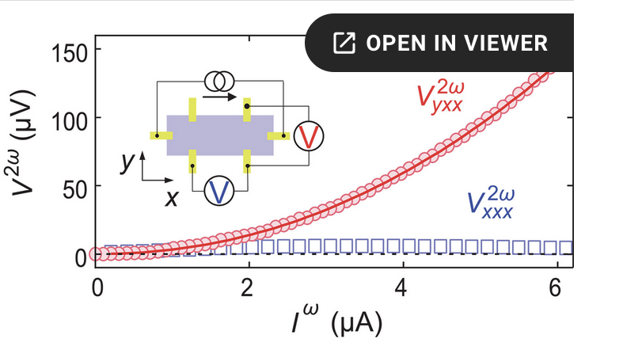
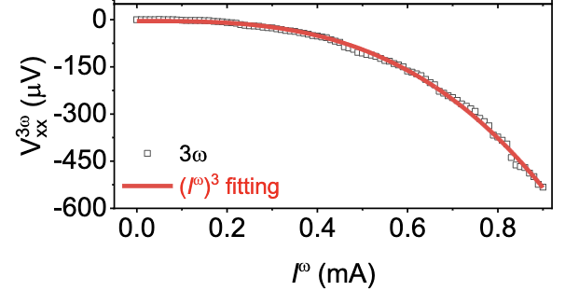
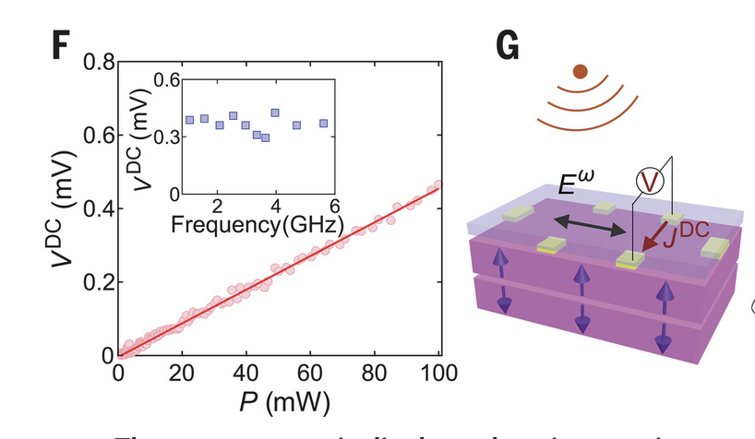



Nonlinear Hall effects
V
$V^{2ω}$, $V^{3ω}$
$$\sim$$
$$I^{ω}$$

Slide 8
A recent work:
Higher harmonic Hall near a quantum geometry singularity

Slide 9
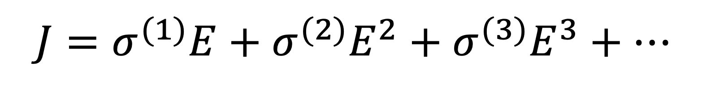
Current nonlinear response: Perturbation theory
$$J=σ^{(1)}E+σ^{(2)}E^{2}+σ^{(3)}E^{3}+…$$
Breakdown of perturbation
New theory? Nonperturbative, nonanalytical
Critical point!

Slide 10
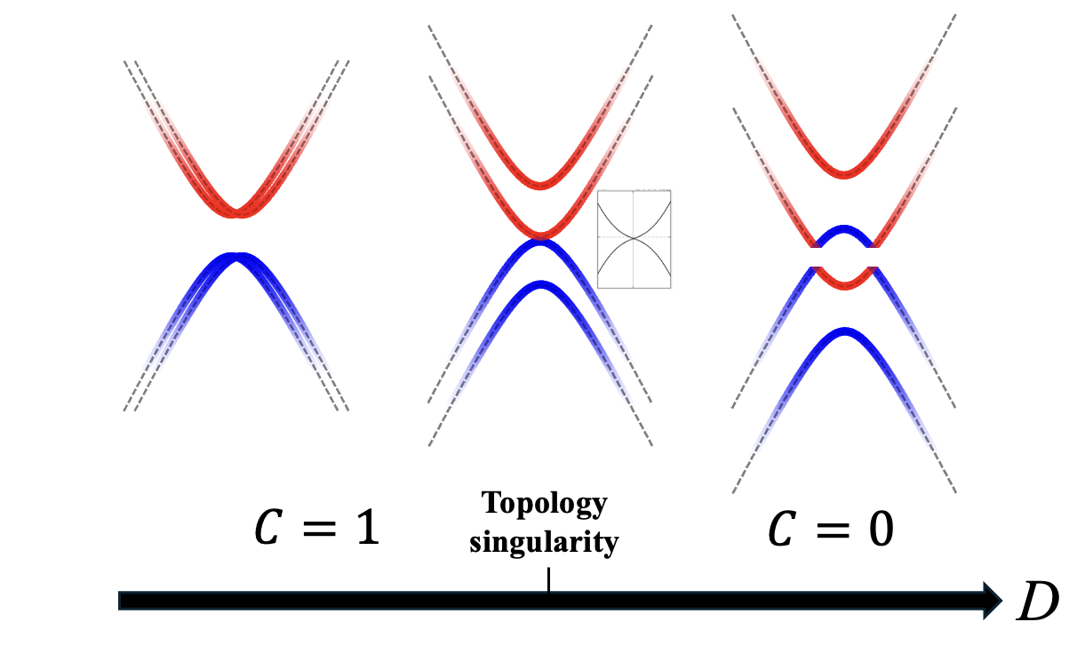
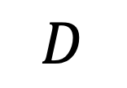
Topological critical point
Topological
C=1
Trivial
C=0
$$D$$
Diverging Berry curvature,
Diverging quantum metric

Slide 11
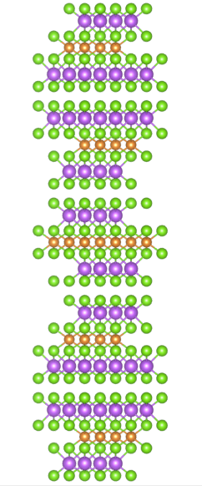
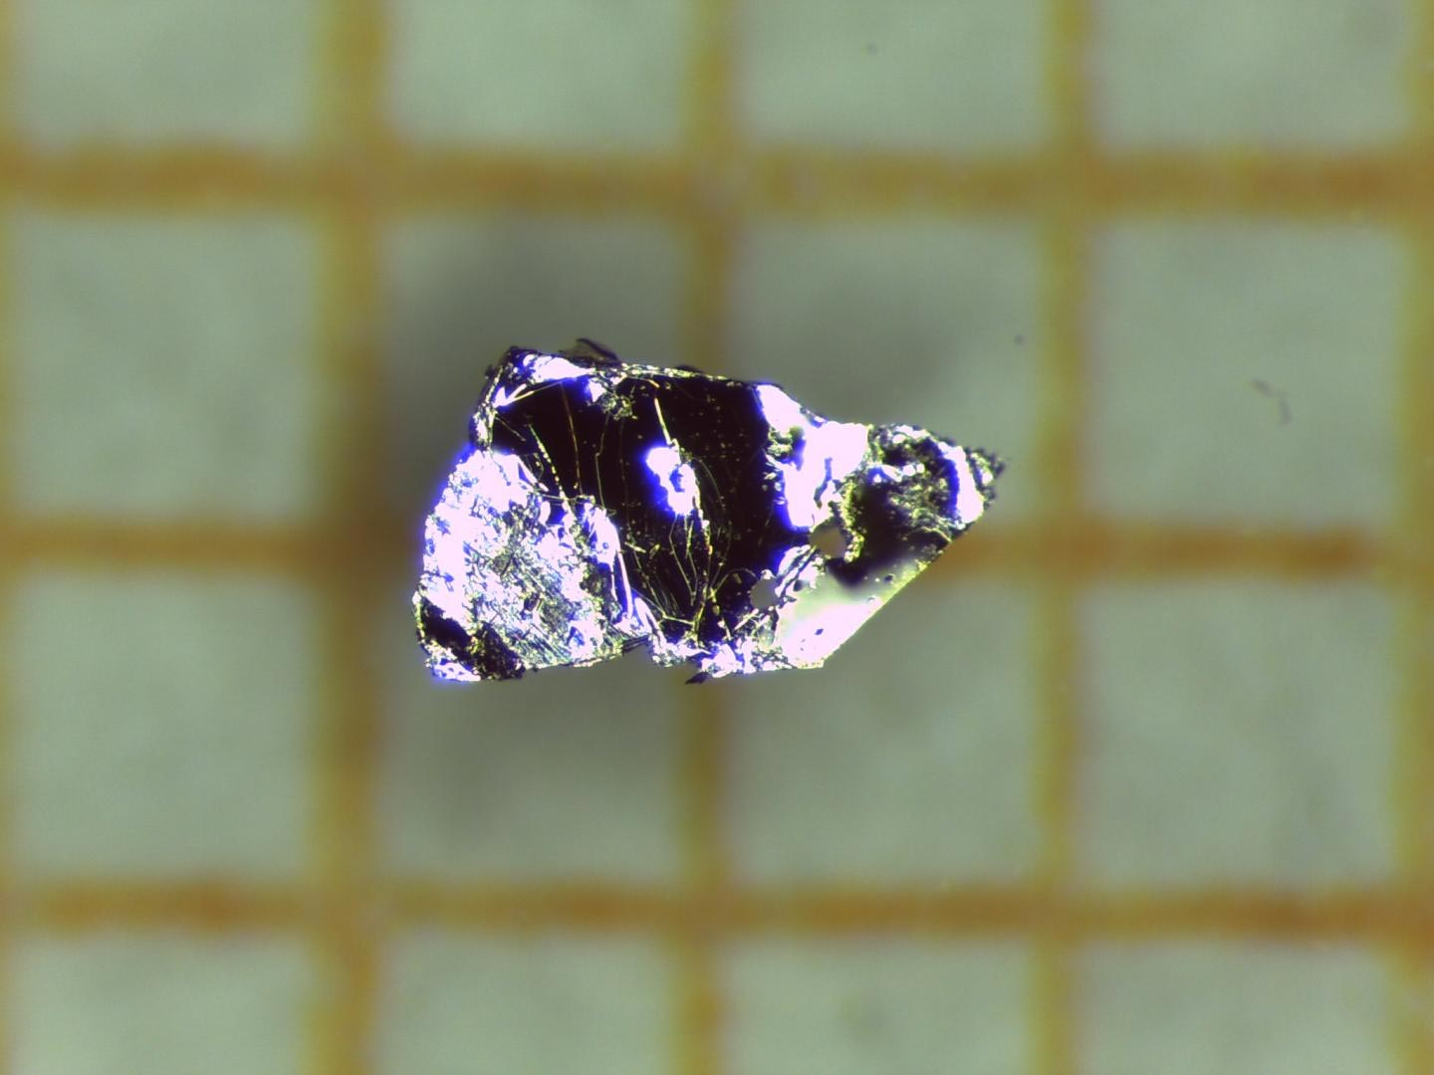
MnBi₂Te₄ -- Intrinsic, vdW, antiferromagnetic TI
Te
Bi
Mn
1mm

Slide 12
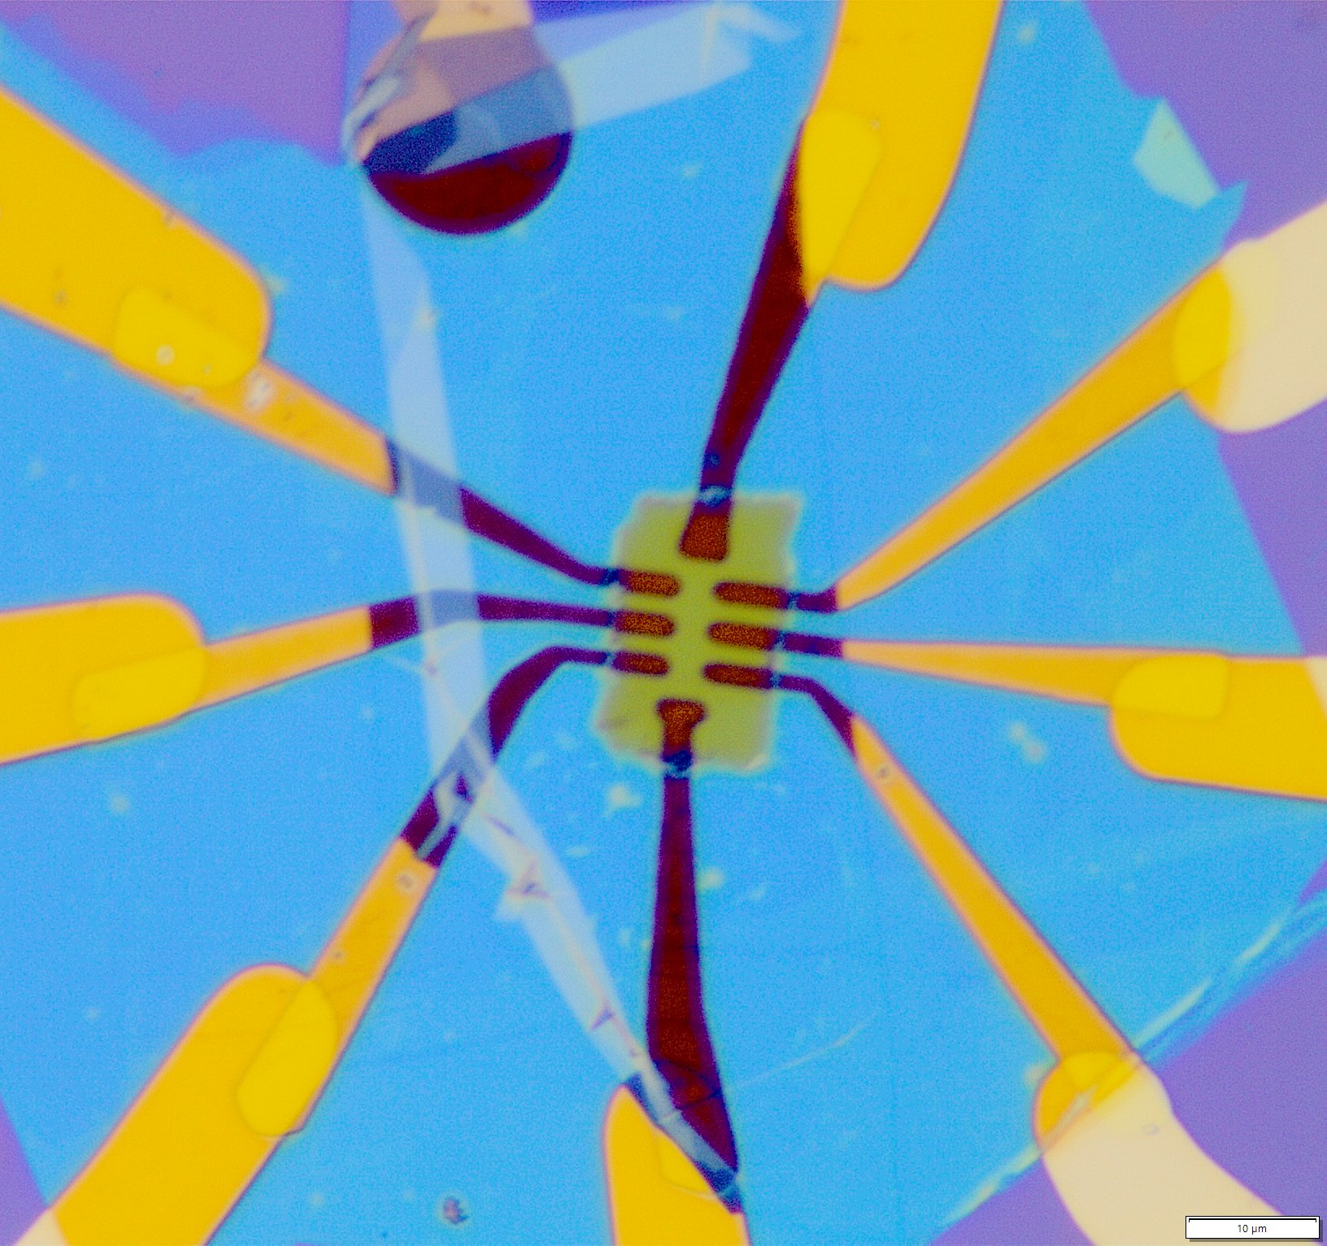
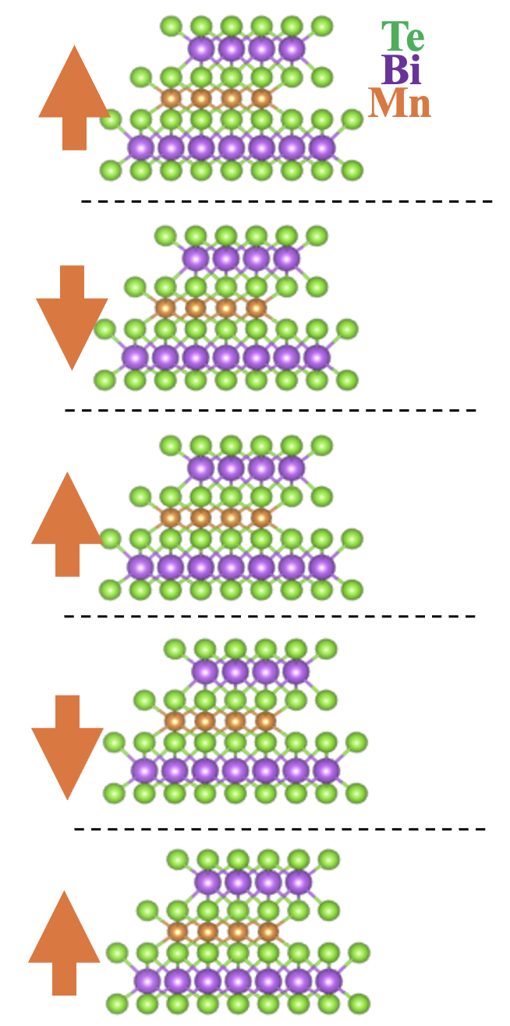
5SL MnBi2Te4
Topological (Quantum anomalous Hall effect)
0.37 T

Slide 13
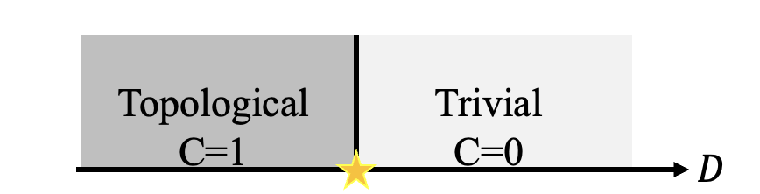
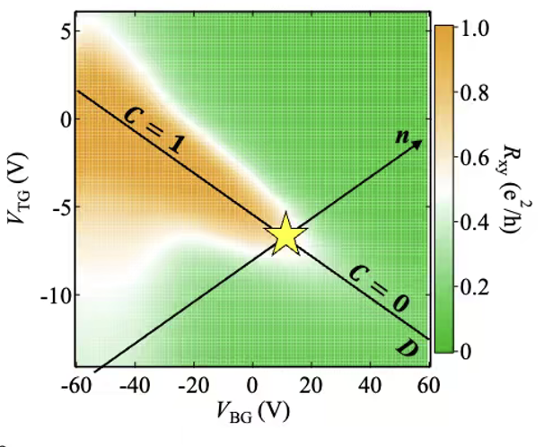
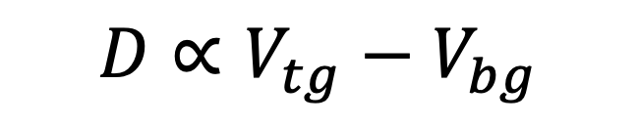

Top gate
5SL MnBi2Te4
Bottom gate
$$D∝V_{tg}−V_{bg}$$
$$n∝V_{tg}+V_{bg}$$

Slide 14
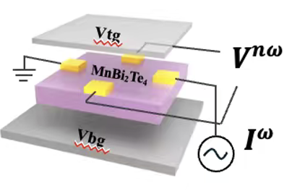
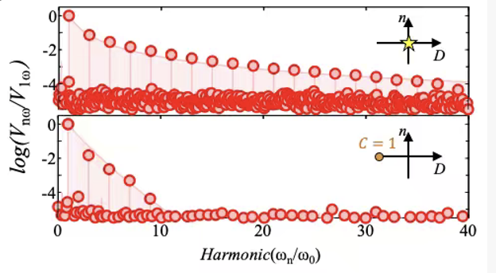
Strongly amplified nonlinearity

Slide 15
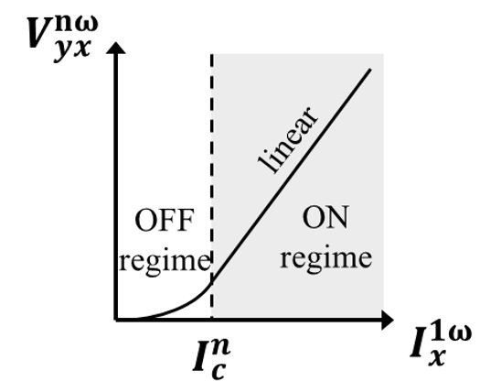
I-V dependence
New regime enabled by critical point

Slide 16
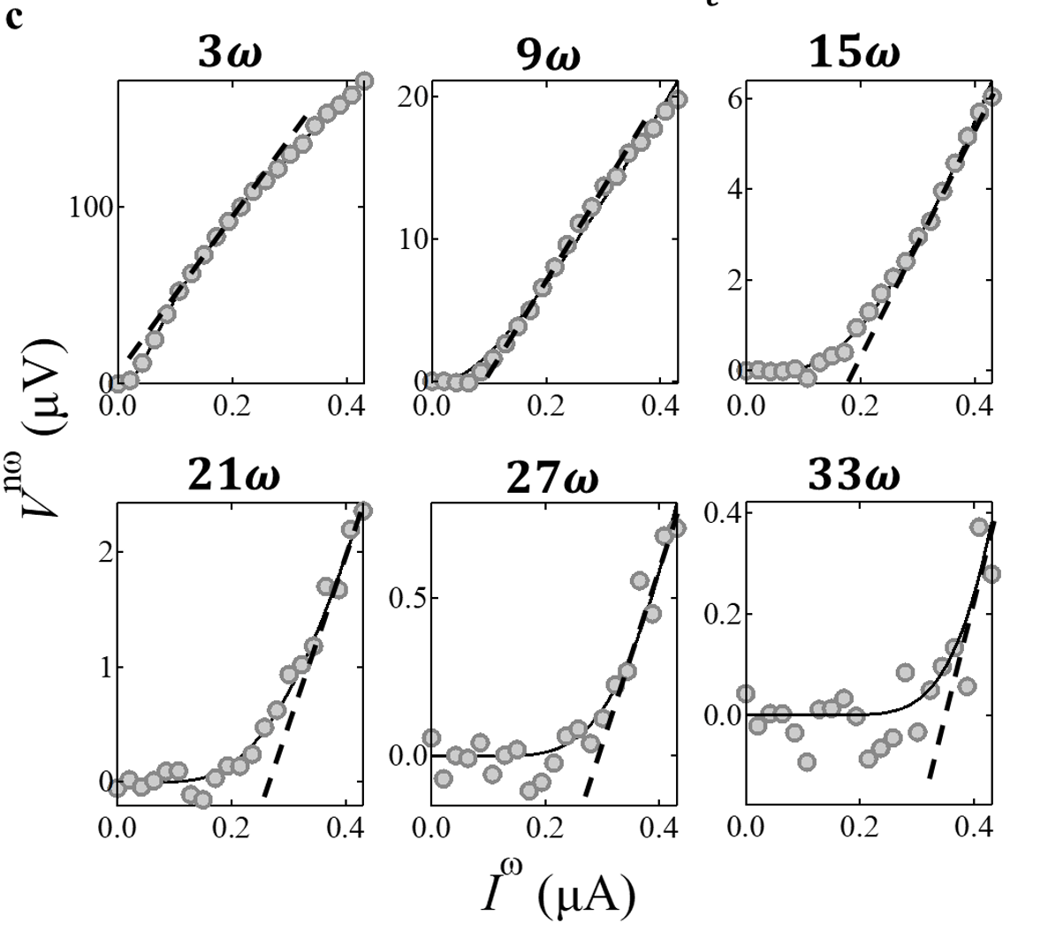
Tunneling like IV

Slide 17
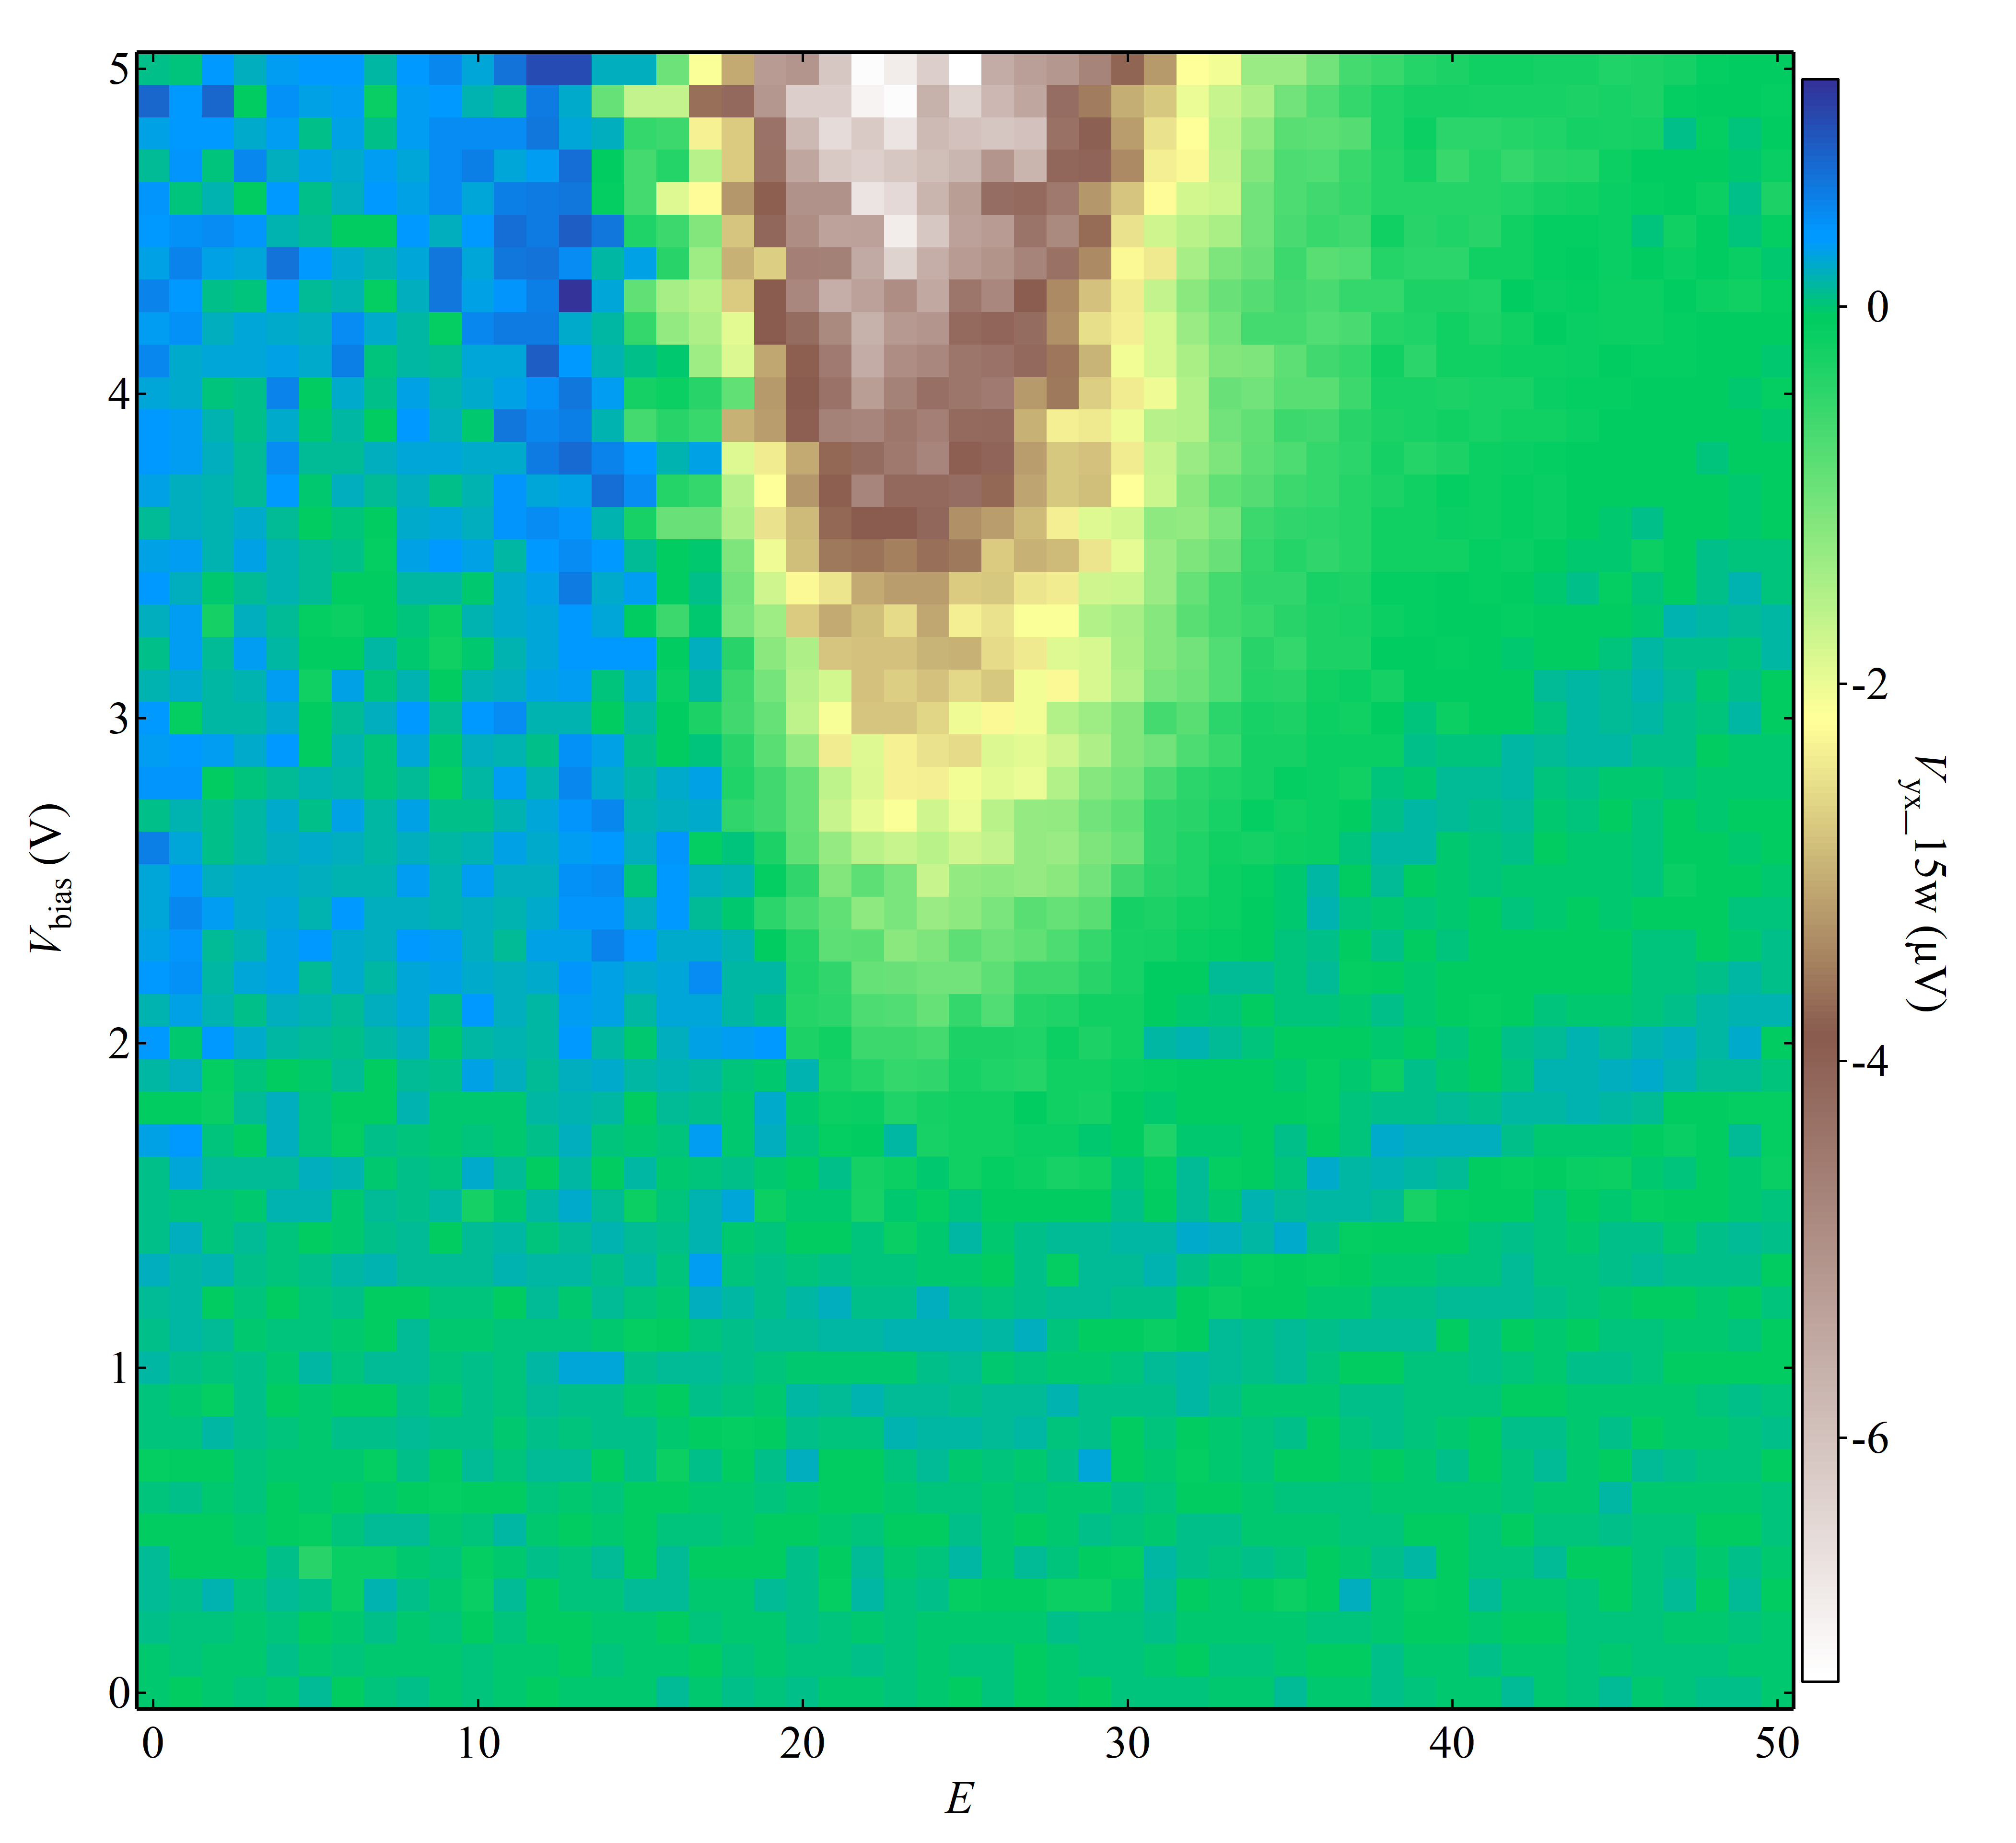
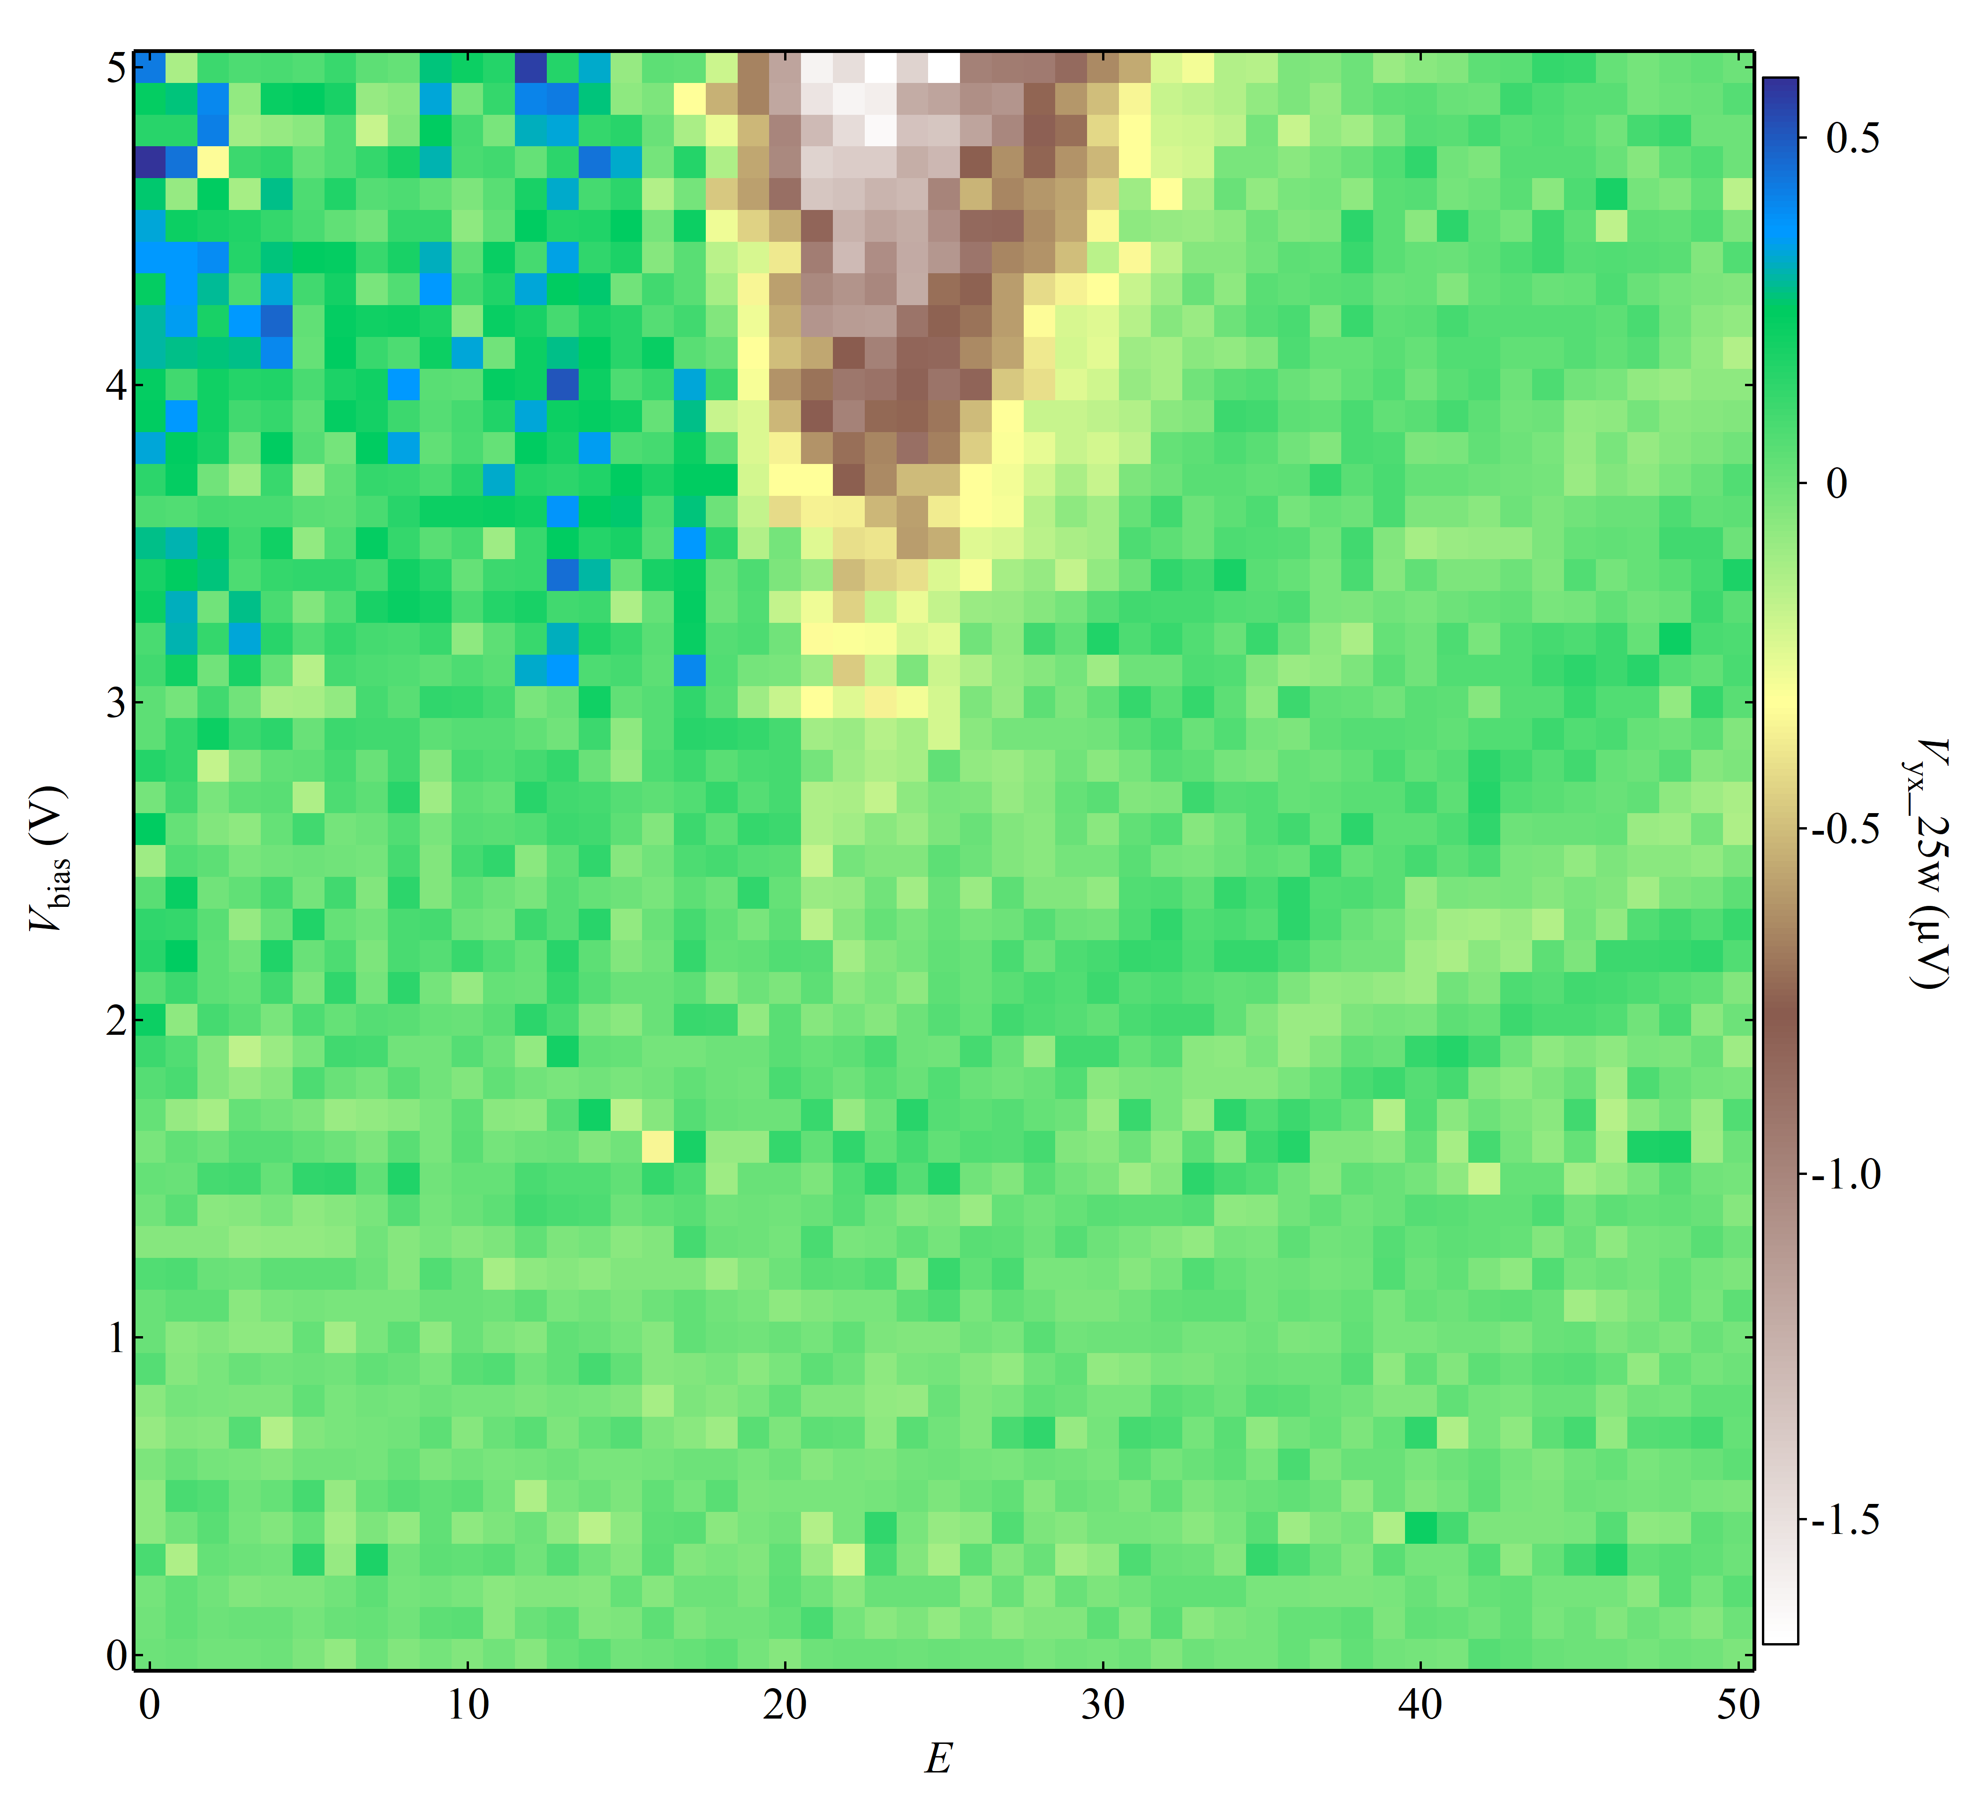
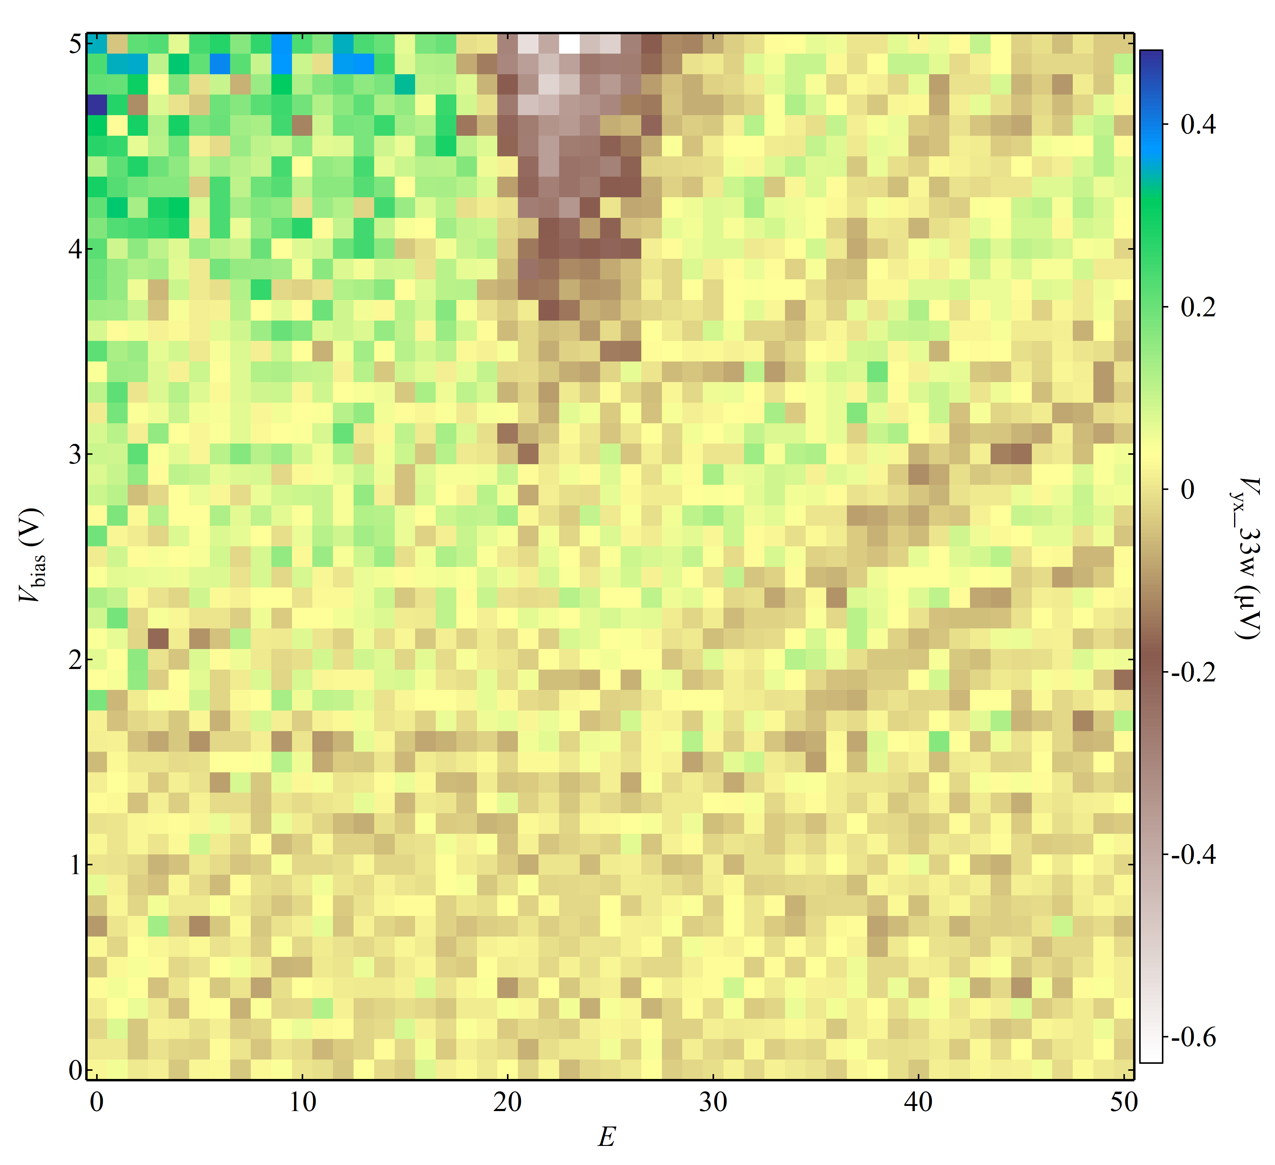

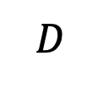
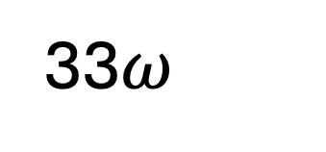
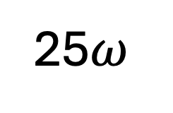
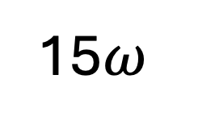


Topological
C=1
Trivial
C=0
$$D$$
D
$$I^{ω} (100 nA)$$
$$I^{ω} (100 nA)$$
$$I^{ω} (100 nA)$$
Oscillating pattern resembles Landau fan!!!
Only shows up in the C=0 side
Dc
Dc
Dc
C=1
C=0
C=1
25$ω$
C=0
C=1
33$ω$
15$ω$
C=0

Slide 18
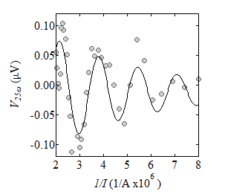
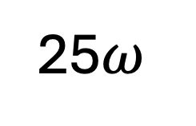
nc
25$ω$
hole
electron

Slide 19

Summary of key experiment signatures
Enhanced nonlinearity up to 39th order at critical point
Tunneling like I-V curve
Oscillation of $V−\frac{1}{I}$ (interference)

Slide 20
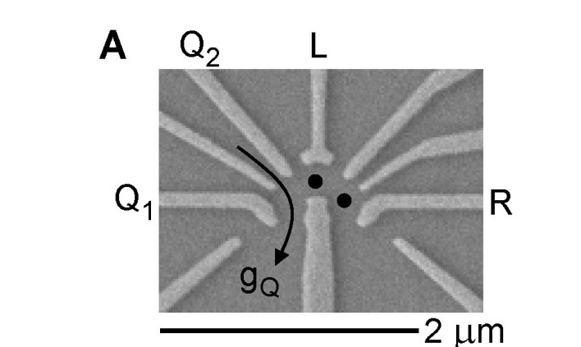
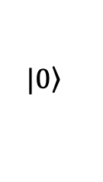
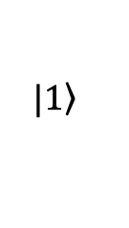


Landau Zener tunneling
$$\left.|1\right\rangle$$
Drive fast enough (nonadiabatic)
Landau Zener tunnel
$$\left.|0\right\rangle$$
$$λ$$
$$H=\left(\begin{matrix}ε(λ(t)) & Δ \\ Δ & −ε(λ(t))\end{matrix}\right)$$

Slide 21
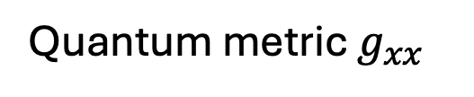
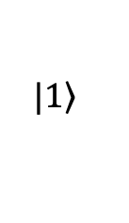

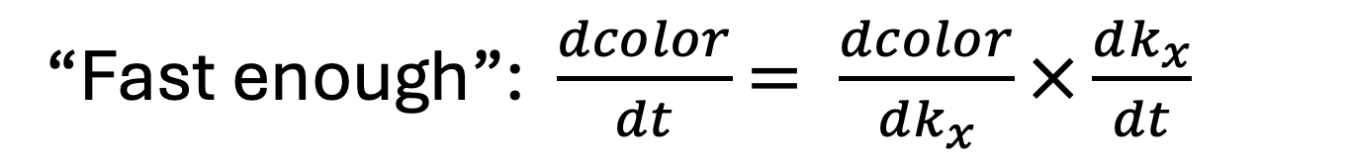

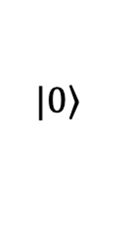
Landau Zener tunneling in electron bands
$$\left.|1\right\rangle$$
Drive fast enough (nonadiabatic)
Landau Zener tunnel
$$\left.|0\right\rangle$$
$$k_{x}$$
“Fast enough”: $\frac{dcolor}{dt}$ $= \frac{dcolor}{dk_{x}}×\frac{dk_{x}}{dt}$
$$\frac{dk_{x}}{dt}=E_{x}∝I_{x}$$
Quantum metric $g_{xx}$

Slide 22

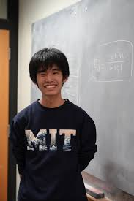
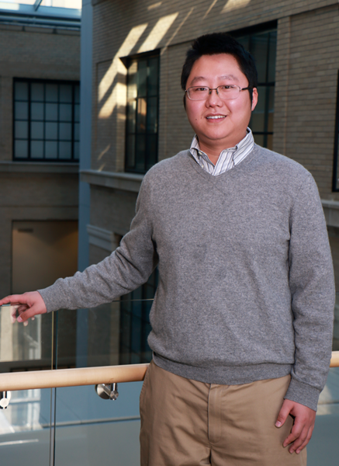
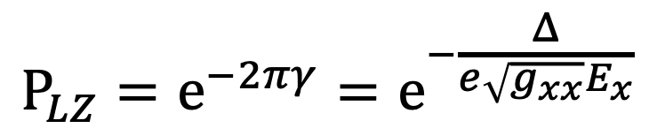
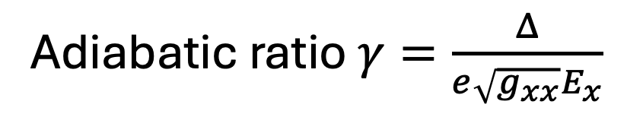


Landau Zener tunneling
Adiabatic ratio $γ=\frac{Δ}{e\sqrt{g_{xx}}E_{x}}$
$$P_{LZ}=e^{−2πγ}=e^{−\frac{Δ}{e\sqrt{g_{xx}}E_{x}}}$$
$$E_{x}$$
Nonanalytical
$$k_{x}$$
Yugo Onishi
Liang Fu

Slide 23
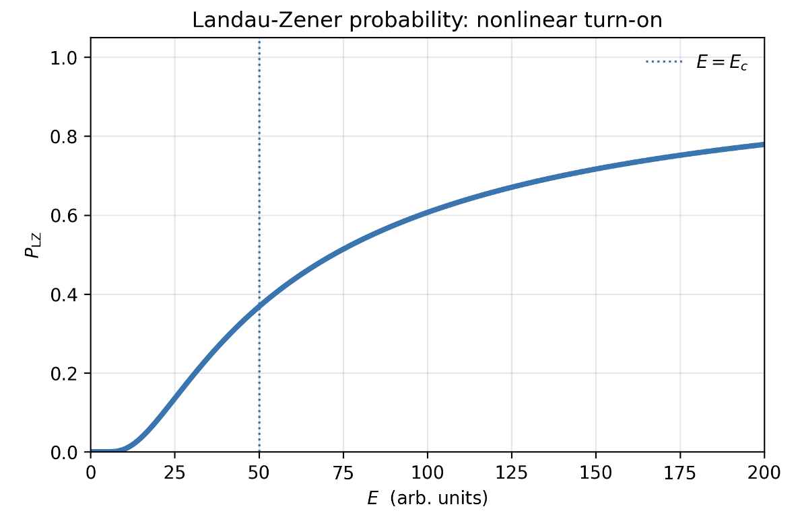

Landau Zener provides turning on threshold and nonlinearity
$$E_{x}$$

Slide 24
Hall current HHG from LZ tunneling
Landau Zener tunneled electron contributes Hall current before relaxation
$$J_{H}\left(t\right)∝E_{x}ΩP_{LZ}\left(E_{x}\right)$$

Slide 25


Hall current HHG from LZ tunneling
$$J_{H}\left(t\right)∝E_{x}ΩP_{LZ}\left(E_{x}\right)\underset{→}{E_{x}\left(t\right)=E_{0}sinωt}=E_{0}sinωt Ω e^{−\frac{Δ}{e\sqrt{g_{xx}}E_{0}sinωt}}$$

Slide 26

Tunneling I-V relationship
Saturation
Linear on
Off

Slide 27










AI help theory discovery
Data
LZ theory
LZS in qubits
$E_{x}\left(t\right)=E_{0}sinωt$ $ω\sim GHz$
$$t_{1}$$
$$t_{2}$$
PLZ
PLZ
$$E_{x}$$
$$E_{x}$$
$$k_{x}$$
$$k_{x}$$
But our $ω$ is only a few Hz ☹

Slide 28
Momentum space Mach–Zehnder interferometer:
Beam splitter1
Beam splitter2
We need two, separated beamsplitters!
Passage A
Interference between two passages
Passage B
Oscillation occurs on the C=0 side, not C=1
Mirror
Mirror

Slide 29




Two avoided crossings (+,-k1) at D>Dc
Spin-down
Somerfield quantization of E,k loop
PathA
$ε$_{F}
E
PathB
Spin-up
LZ1 at –k1
LZ2 at +k1
n=0, D>Dc (trivial side)
$$φ = \frac{\int_{−k1}^{+k1}{Δε(k)dk}}{{eE}_{x}}∝\frac{1}{I_{x}}$$

Slide 30




$$I^{ω} (100 nA)$$
$$Fix m$$
Dc
C=1
C=0
$$φ = \frac{\int_{−k1}^{+k1}{Δε(k)dk}}{{eE}_{x}}=2π∗m$$

Slide 31
Outlooks

Slide 32




Nonlinear microwave applications
Higher harmonic generation
$$nω_{1}$$
$$ω_{1}$$
Entangled
5$m$

Slide 33


Microwave photon entanglement
PathA
3$ω_{1}$
5$ω_{1}$
E
PathB
LZ1 at –k1
LZ2 at +k1

Slide 34


$$J=e^{−\frac{E_{c}}{E_{x}}}\cos{(\frac{Λ}{E})}\underset{→}{S=E_{c}+iΛ}=e^{−S_{j}/E}$$
…

Slide 35




Instanton
$$J=e^{−\frac{E_{c}}{E_{x}}}\cos{(\frac{Λ}{E})}\underset{→}{S=E_{c}+iΛ}=\sum_{quantum paths}{A_{j} e^{−S_{j}/E}}$$
Higher harmonics strongly amplified with strong LZ

Slide 36


Instanton
$$J=e^{−\frac{E_{c}}{E_{x}}}\cos{(\frac{Λ}{E})}\underset{→}{S=E_{c}+iΛ}=\sum_{quantum paths}{A_{j} e^{−S_{j}/E}}$$
Nonanalytical
Nonlinearity at the critical point
Interference

Slide 37
Instanton
$$J=e^{−\frac{E_{c}}{E_{x}}}\cos{(\frac{Λ}{E})}\underset{→}{S=E_{c}+iΛ}=\sum_{quantum paths}{A_{j} e^{−S_{j}/E}}$$
Energy
Parameter
Quantum phase transition is a fertile place for macro-instantons, especially through the Landau Zener effect (fast drive).
Diverging quantum fluctuation (CMP) <-> Enhancing “quantumness” (quantum tech).

Slide 38
Neuromorphic computing?
Neuron activation
Quantum metric I-V curve
Landau Zener activiation

Slide 39









Acknowledgement
Jinchen Liu
Ted Liu
Yugo Onishi
Liang Fu

Slide 40


Two Fermi crossings (+,-kf) at n>0
E
PathA
LZ2 at +kf
E_{F}
PathB
LZ forbidden between +,-kf due toPauli Blockade
LZ1 at –kf
LZ1 at –kf

Slide 41




Slide 42
Chern pocket

Slide 43


35$ω$
Similar trend: power law at low current and linear response at large current
Highest observable order up to 39 $ω$
Transition current increases with higher harmonic

Slide 44







Lock-in scan
High Harmonic Generation E-n map
Critical point
1$ω$
3$ω$
9$ω$

Slide 45






Oscillating pattern appears at high order
15$ω$
25$ω$
33$ω$

Slide 46






Scan electric field along CNP
Critical point
X axis is E scan along n=0
1$ω$
3$ω$
9$ω$
15$ω$
25$ω$
33$ω$

Slide 47
FWHM vs harmonic Vbias=4V
R^2 >= 0.9

Slide 48



X axis is
carrier density
Scan carrier density cross
critical point
Critical point
1$ω$
3$ω$
9$ω$
15$ω$
25$ω$
33$ω$

Slide 49


Resurgence and large-order perturbation theory
Berry curvature dipole
Berry curvature quadrupole
$$J=σ^{(1)}E+σ^{(2)}E^{2}+σ^{(3)}E^{3}+…$$
Diverge at critical point

Slide 50



The simplest scenario for HHG from LZ tunneling
$$P_{LZ}$$

Slide 51
Critical point

Slide 52





n
Critical point
$$I^{ω} (100 nA)$$
nc
nc
nc
hole
electron
25$ω$
33$ω$
15$ω$
hole
electron
hole
electron

Slide 53
AI help theory discovery

Slide 54




Microscopic Mechanism
AFM TI (odd)
Topology singularity
$$C=1$$
$$C=0$$
Berry Curvature $Ω$
D
-
0
+
Notes:
How it is related to topology and magnetism

Slide 55


Measurement geometry
Inject: $I^{ω}$ ($ω=7.7$ Hz )
Measure: $V^{Nω}$
Tried from 1Hz to 100Hz so far

Slide 56

High Harmonic Generation at non-perturbative criticality
Critical point strongly enhance nonlinearity
Critical point
3
5
13
21
31
Critical point -> Nonperturbative
Critical point FFT
using 400s of acquired data
Clear HHG peak up to 39 $ω$
39

