Slide 1
Topological Quantum Materials
Chemical approach to ☺
Suyang Xu
Chemistry and Chemical Biology, Harvard

Slide 2
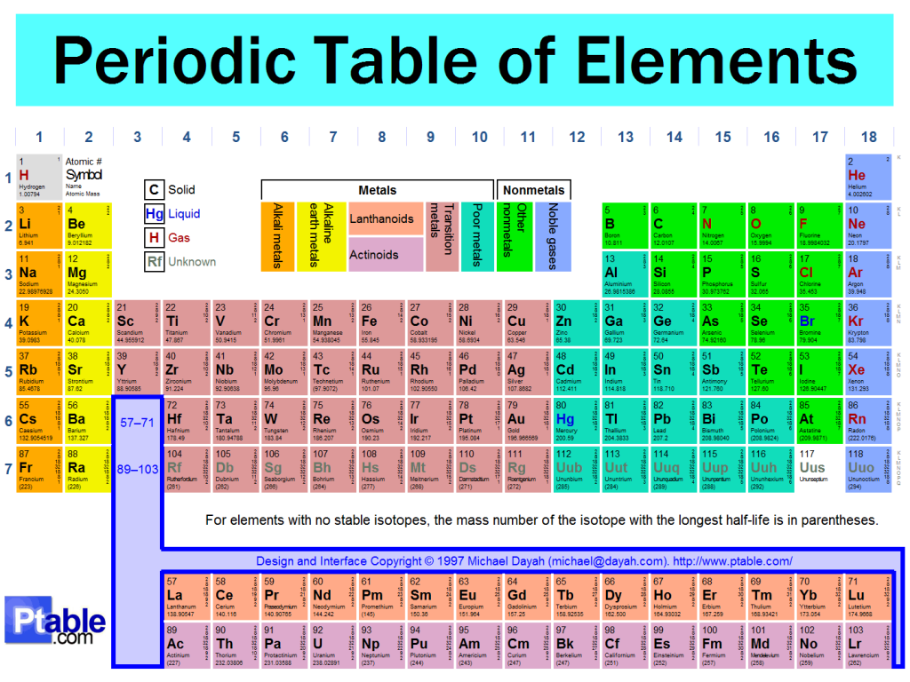
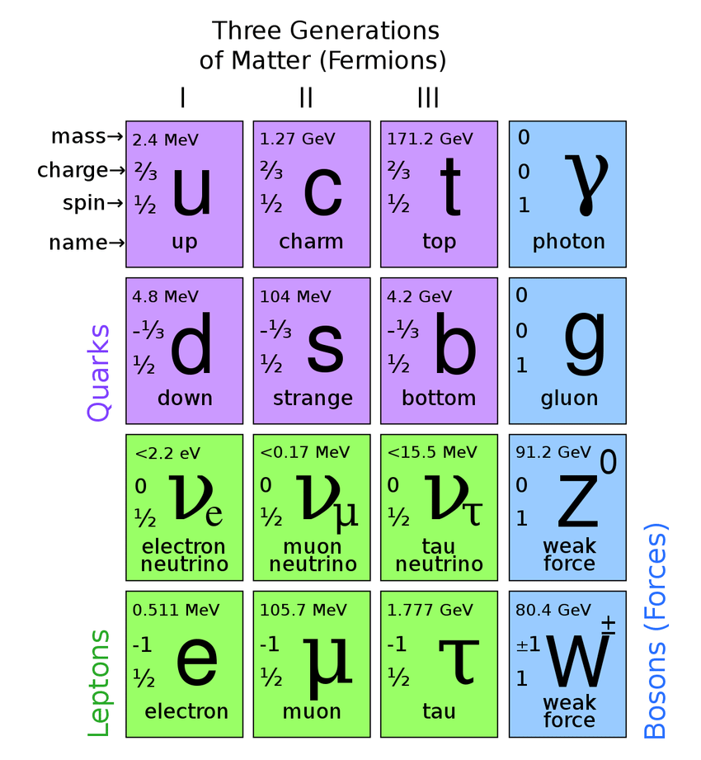
Searching for new phases of matter
Top down
The Standard Model
Emergence
H₂O
Notes:
This is an analogue to atoms in a solid

Slide 3
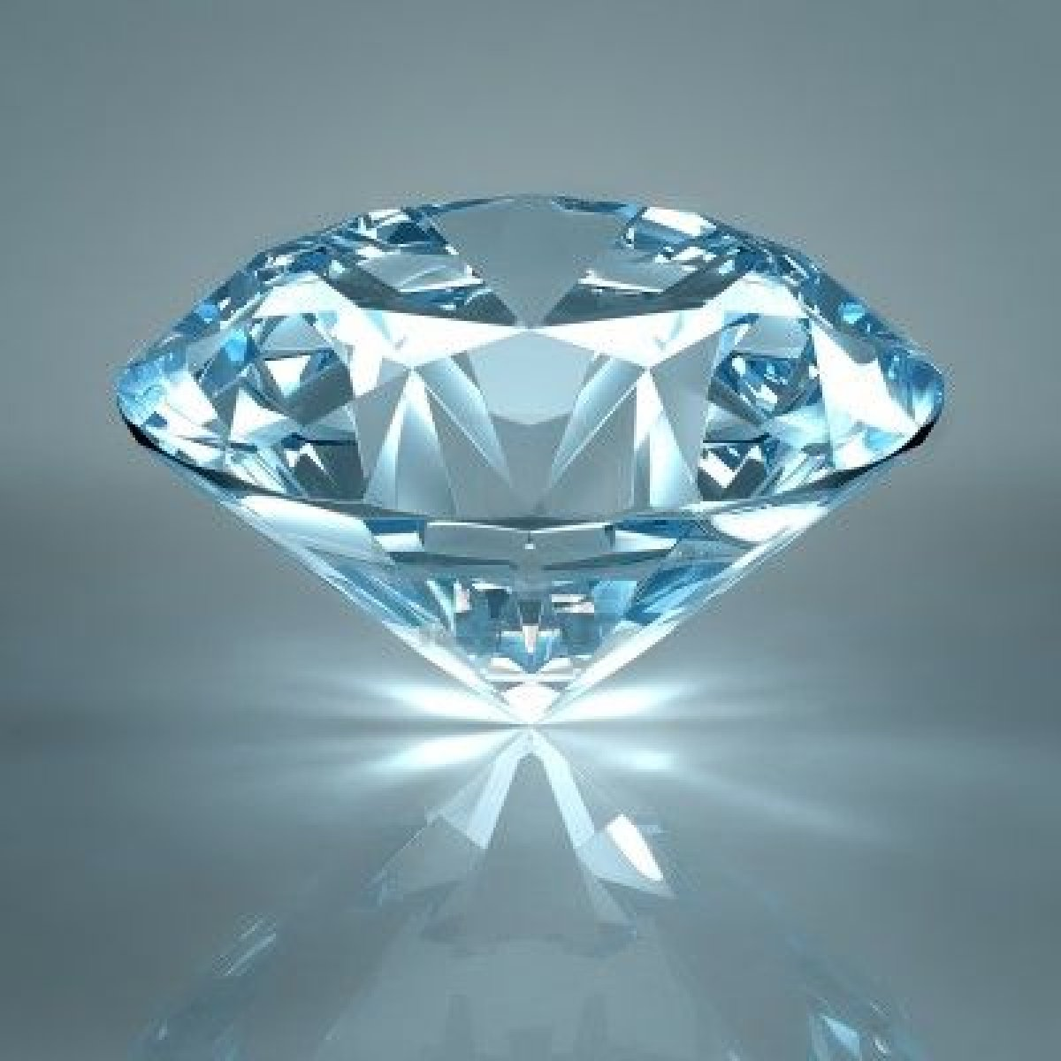
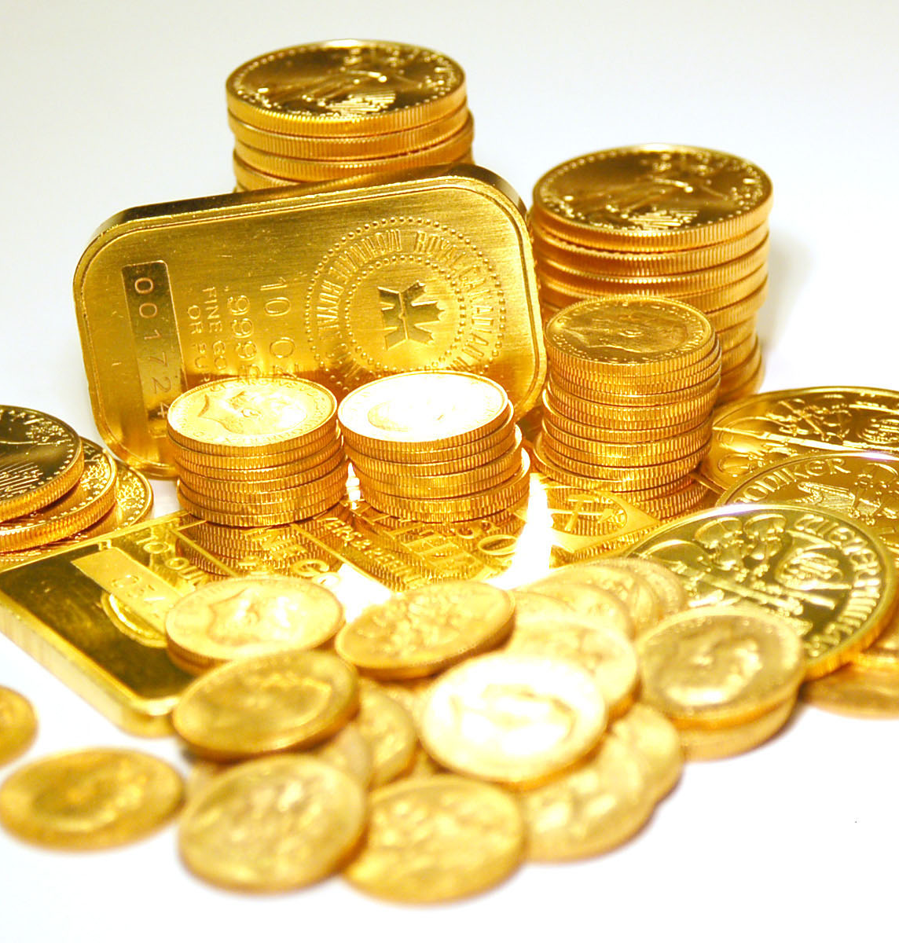
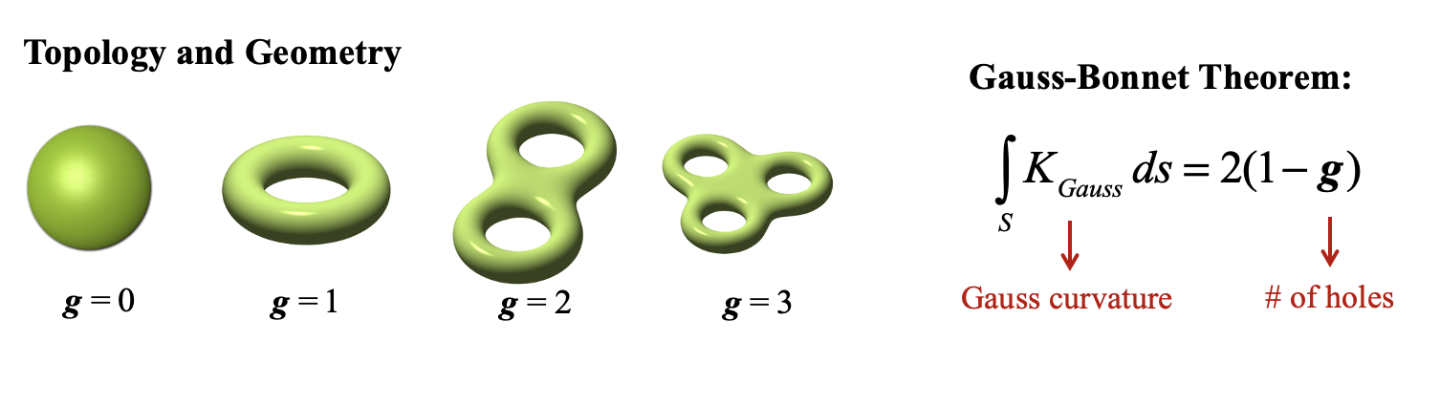
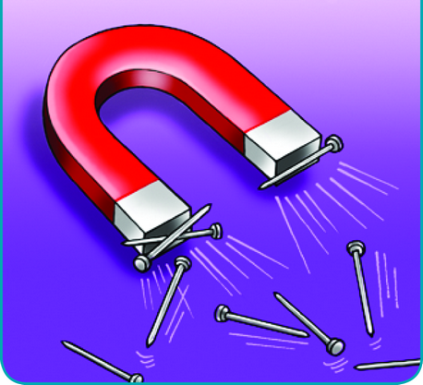
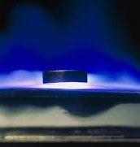
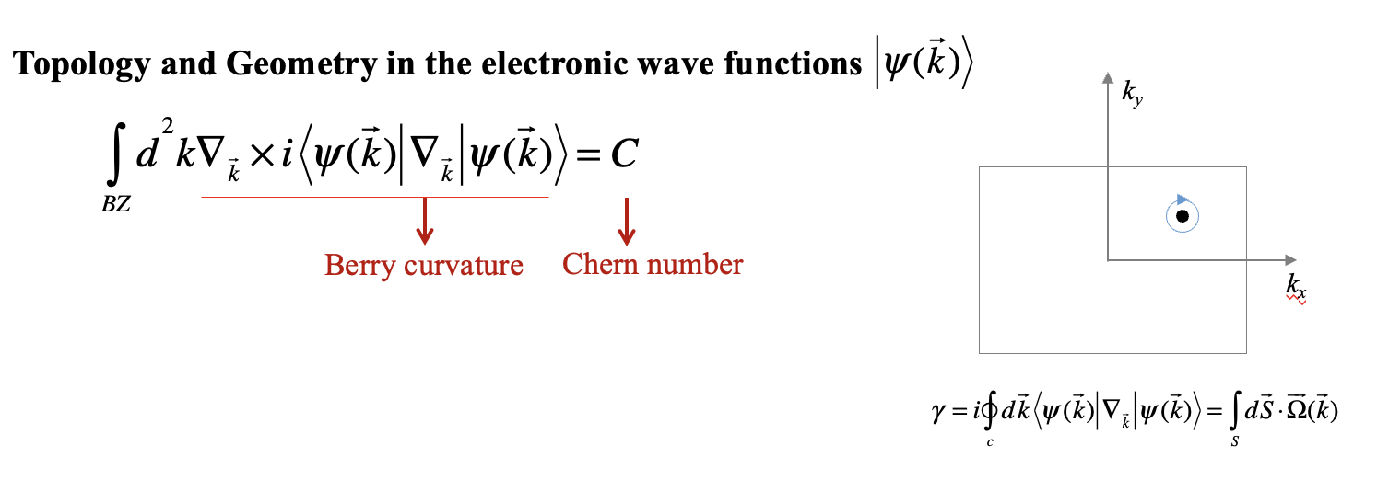
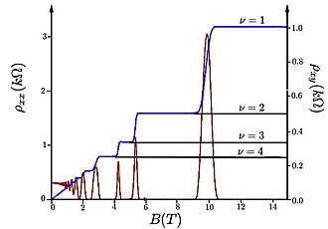
Discovering Topological Phases of Matter
Conventional Phases of Matter
Symmetry Landau order parameter
Topological Phases of Matter
Insulator
Metal
Magnet
Superconductor
Hall conductivity $σ_{xy}=Ce^{2}/h$

Slide 4
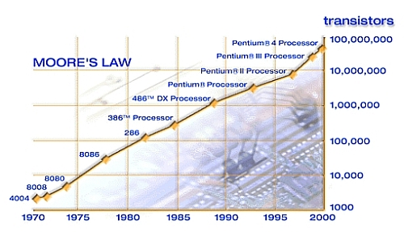

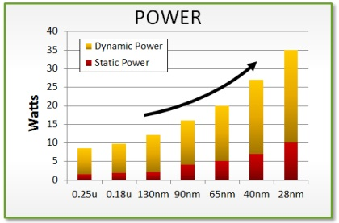
Computation, information
2nm ☺
2026

Slide 5
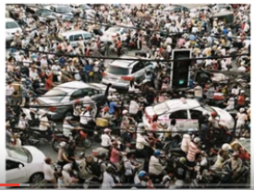

Topology: Making electrons robust
Separating the left and right movers
Topological insulator: Insulating in the bulk; Metalic edge states

Slide 6
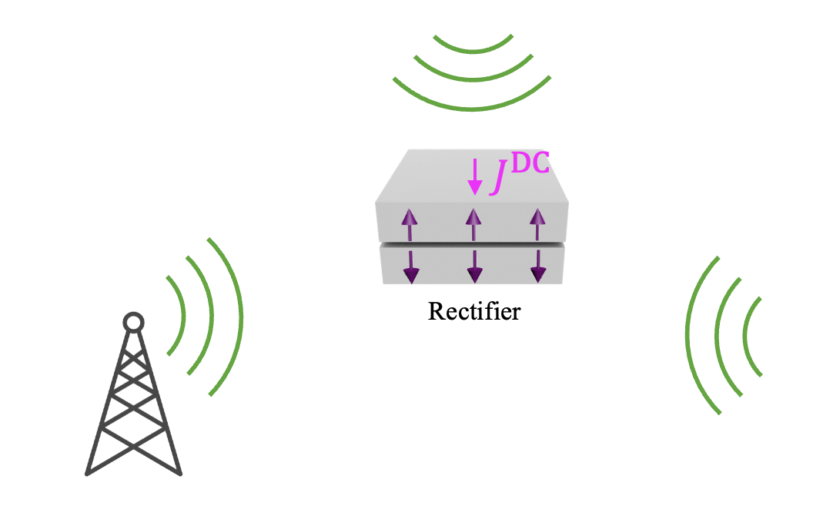
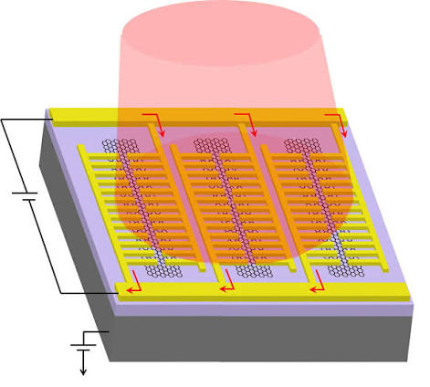

_{Nonlinearity}
$$J^{DC}=σ^{(2)}E^{ω}E^{−ω}$$
Energy harvestor
Photodetector
_{Instanton ☺}

Slide 7
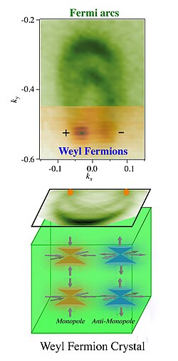
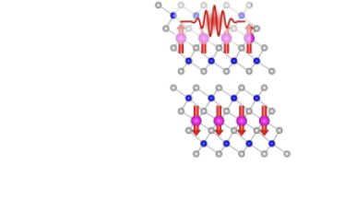
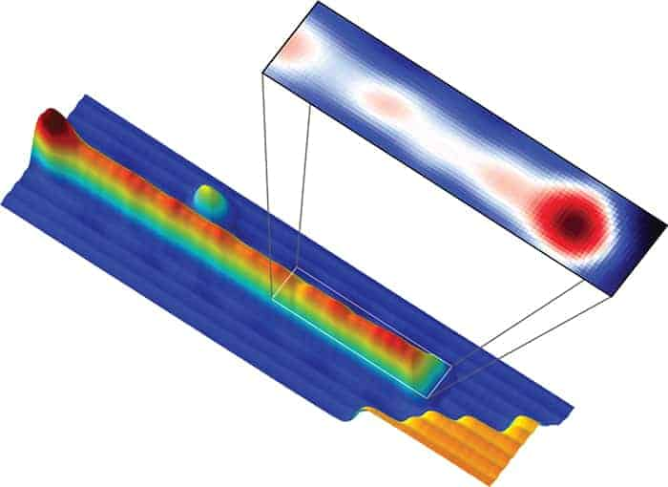
_{Exotic quasiparticles}
Axion quasiparticle
Weyl fermions
Majorana

Slide 8
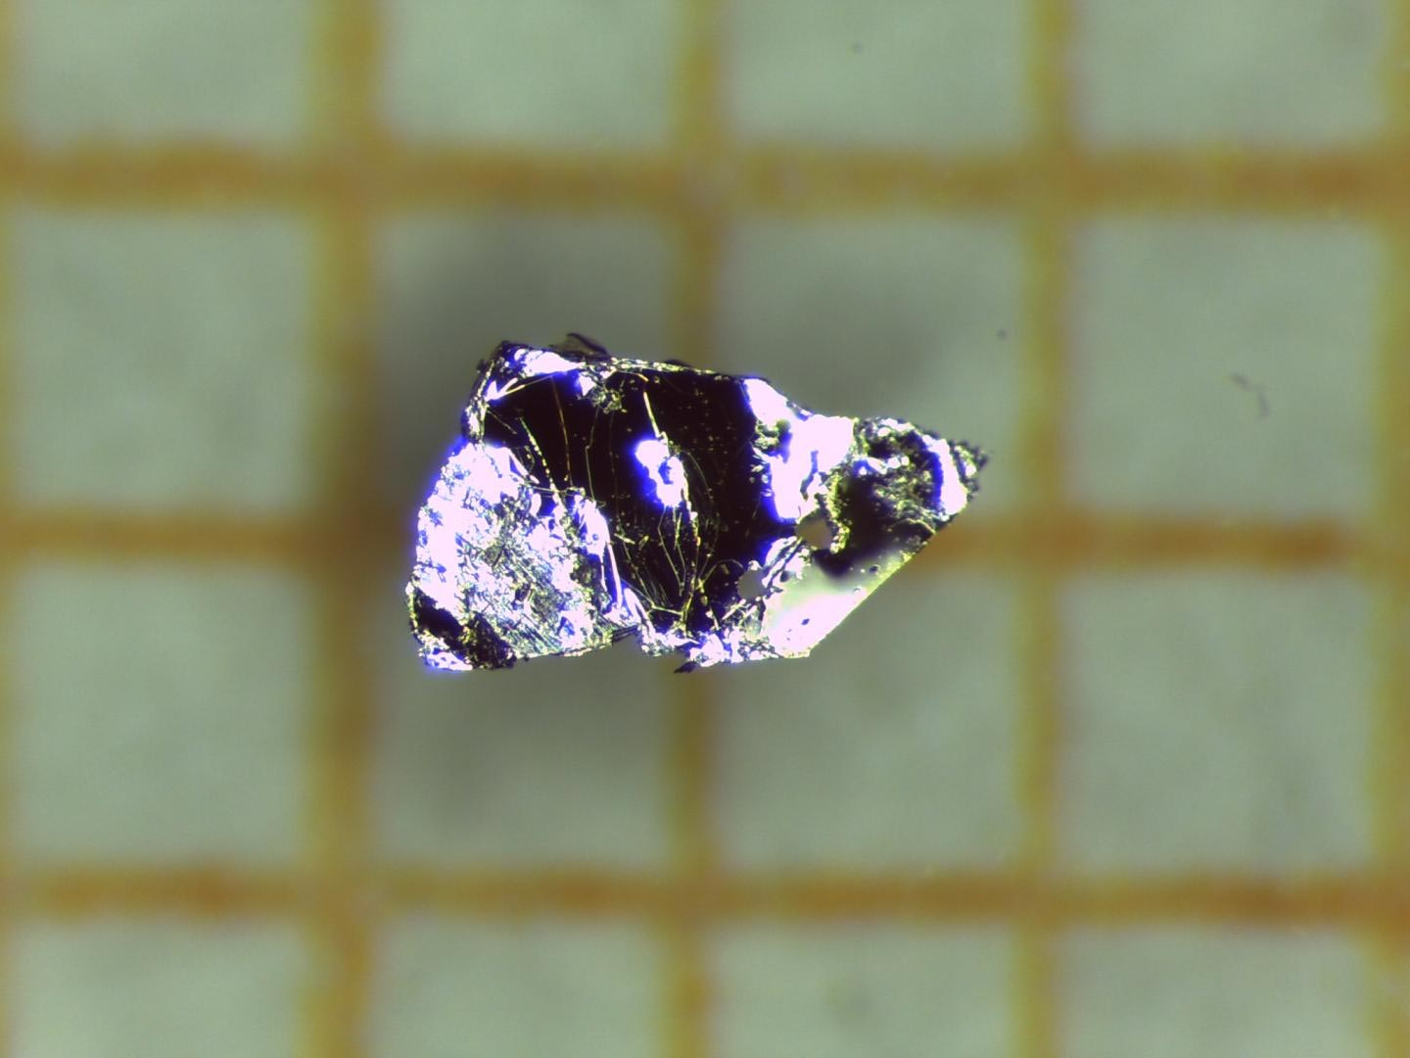


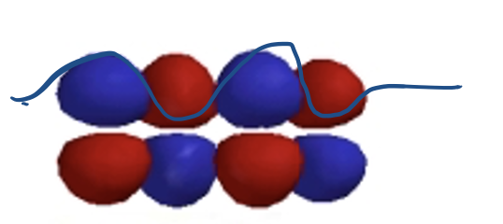
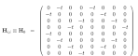
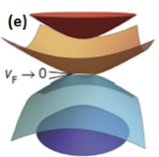
Physicist
Chemist
Topological materials
Write Hamiltonian and solve it in momentum space!
Draw orbital, bond and symmetry in real space
Band structure, Fermi surface …

Slide 9
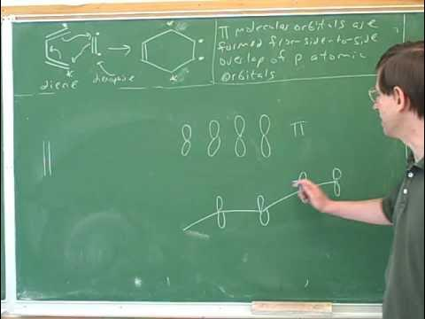
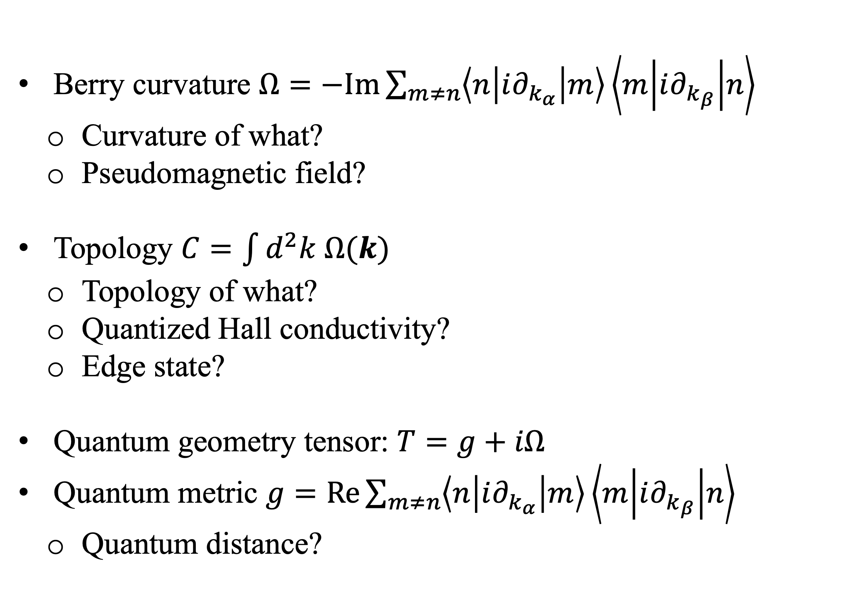
Berry curvature $Ω=−Im\sum_{m≠n}{\left\langle n | i∂_{k_{α}} | m\right\rangle \left\langle m | i∂_{k_{β}} | n\right\rangle }$
  Curvature of what?
  Pseudomagnetic field?
Topology $C=\int{d^{2}k Ω(k)}$
  Topology of what?
  Quantized Hall conductivity?
  Edge state?
Quantum geometry tensor: $T=g+iΩ$
Quantum metric $g=Re\sum_{m≠n}{\left\langle n | i∂_{k_{α}} | m\right\rangle \left\langle m | i∂_{k_{β}} | n\right\rangle }$
  Quantum distance?
Draw orbitals

Slide 10
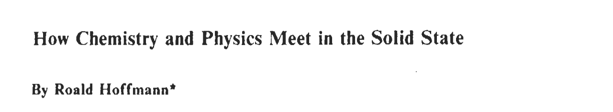
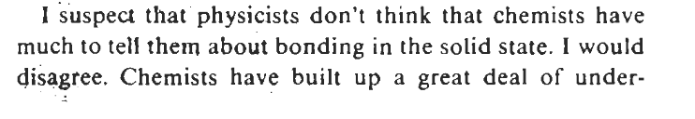
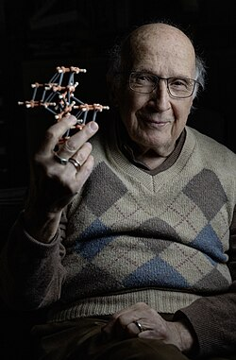
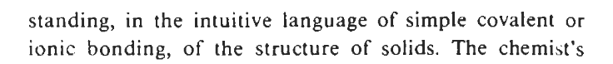
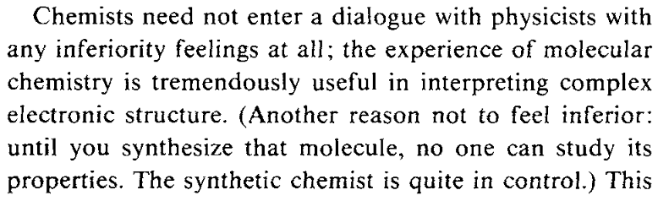
Ronald Hoffmann
Nobel Prize in Chemistry (1981)

Slide 11
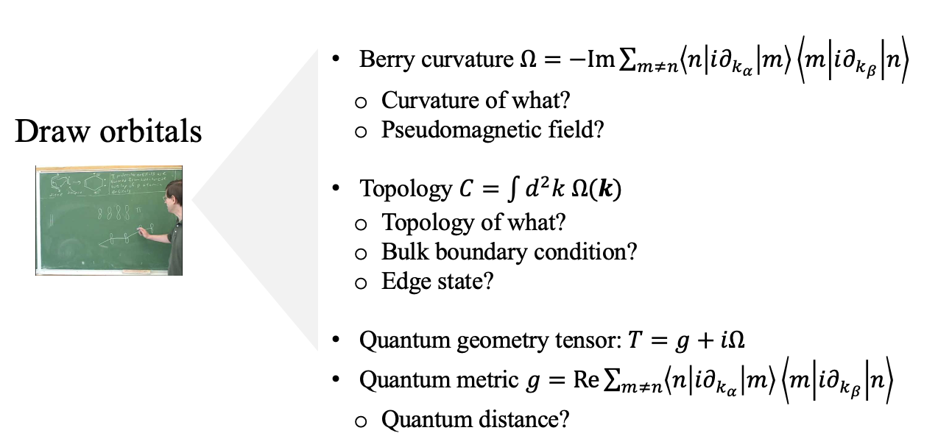
Outline
Lecture 1 2
Chemical approach of topology and quantum geometry
Lecture 3 & 4
Quantum geometry nonlinearity
Axion quasiparticle in quantum materials

Slide 12
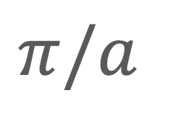
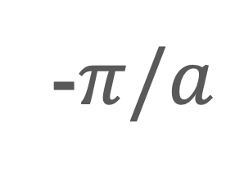
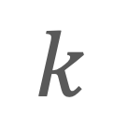

1D chain of H atoms
E
$$k$$
-$π/a$
$$0$$
$$π/a$$
Antibonding
CW
CCW
bonding

Slide 13

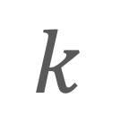
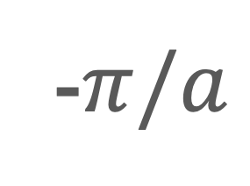


Band structures
E
E
$$k$$
$$k$$
-$π/a$
$$0$$
$$π/a$$
-$π/a$
$$0$$
$$π/a$$

Slide 14
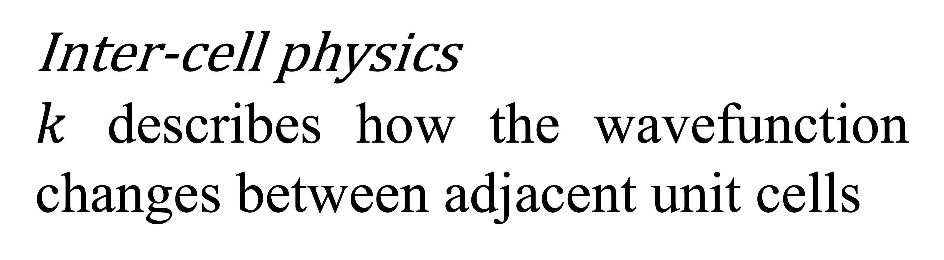
Inter-cell physics
$k$ describes how the wavefunction changes between adjacent unit cells
Intra-cell??
Multiple basis <-> Multiple bands -> Topology & Berry curvature

Slide 15
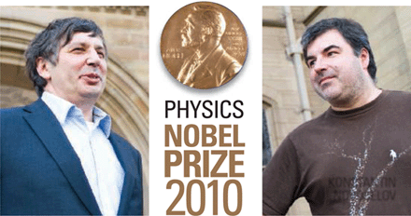
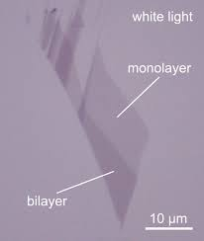
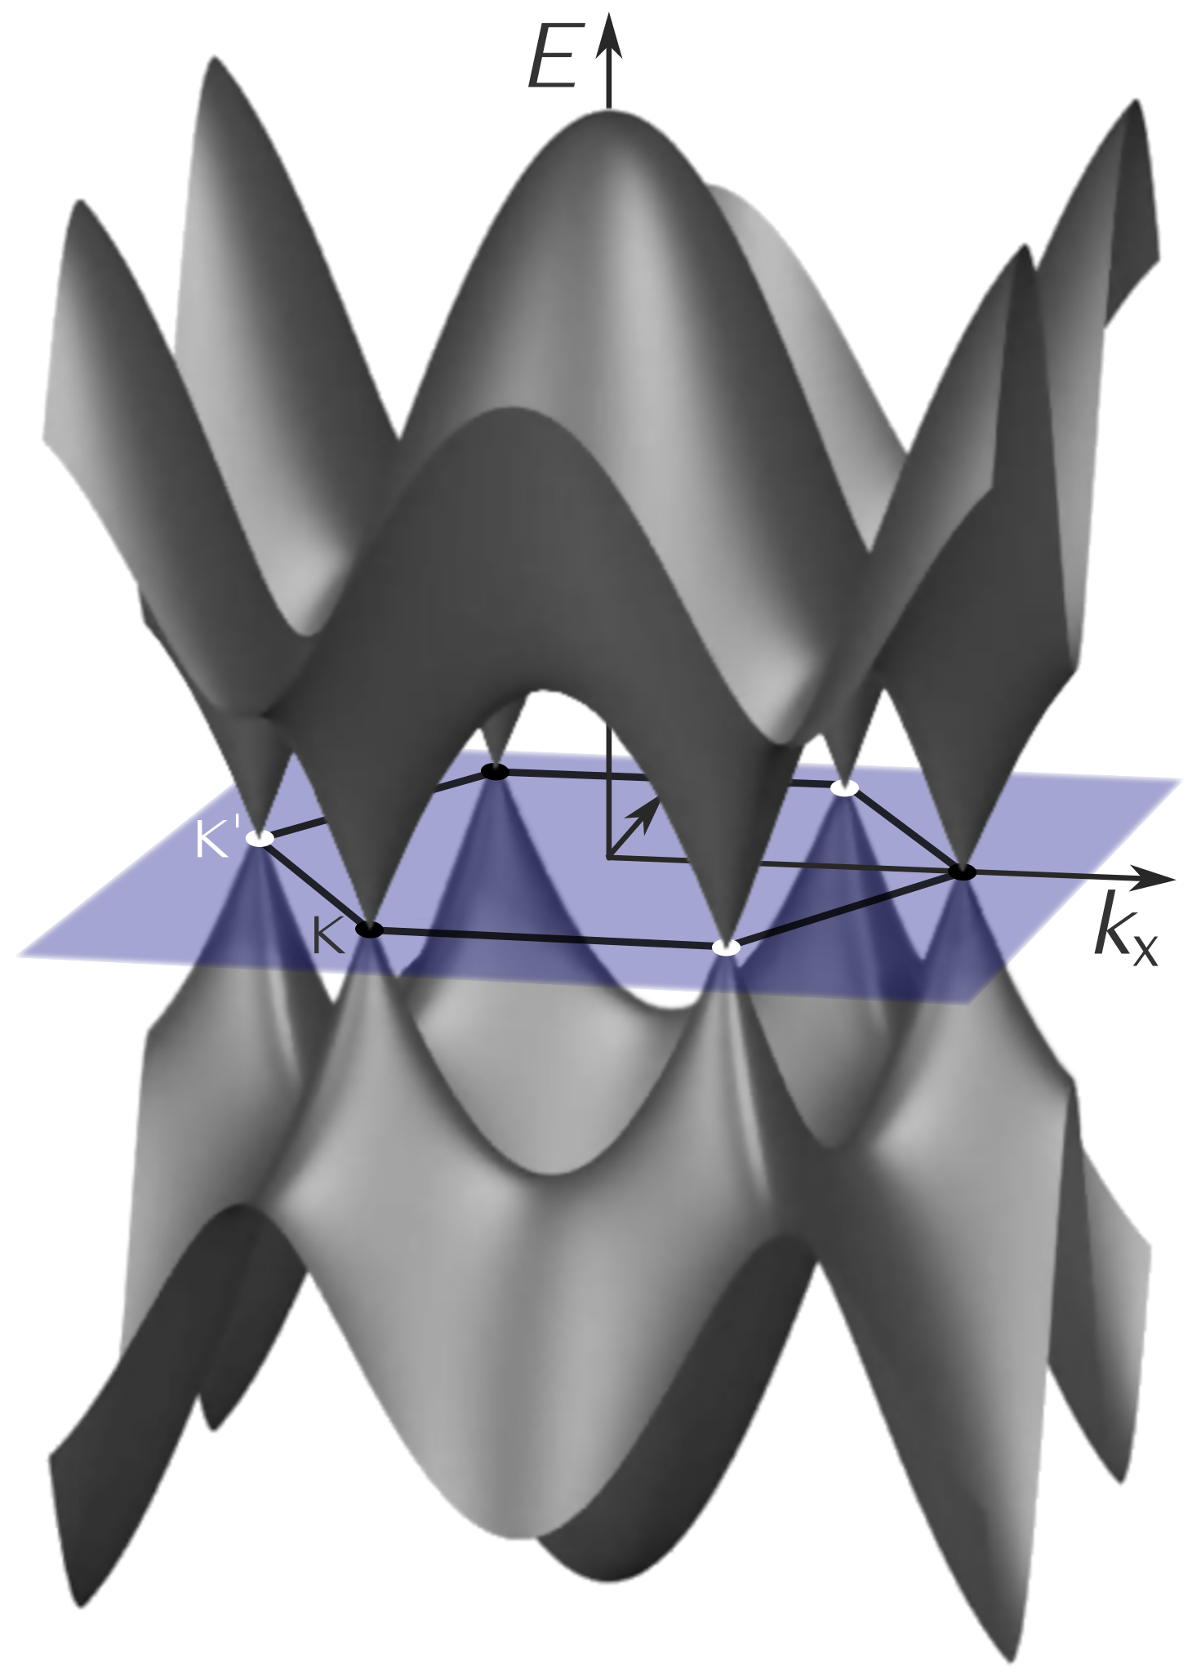
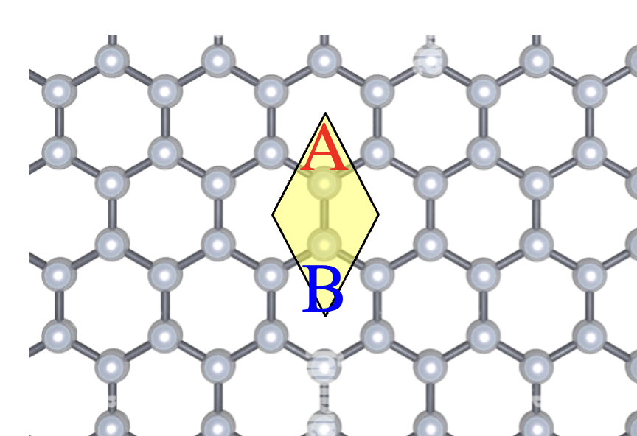
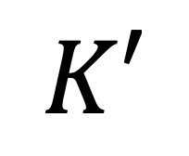
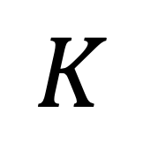
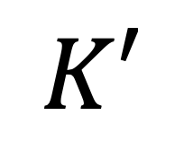
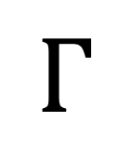
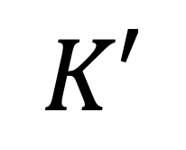
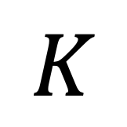
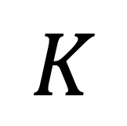
Graphene
Honeycomb lattice -> two carbon atoms (each contributes pz)
Two Pz orbitals -> two bands.
$$K′$$
$$K$$
$$Γ$$
$$K$$
$$K′$$
$$K′$$
$$K$$

Slide 16
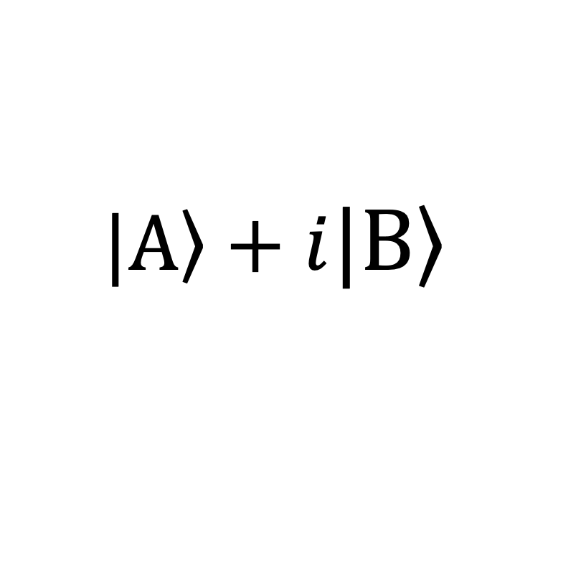
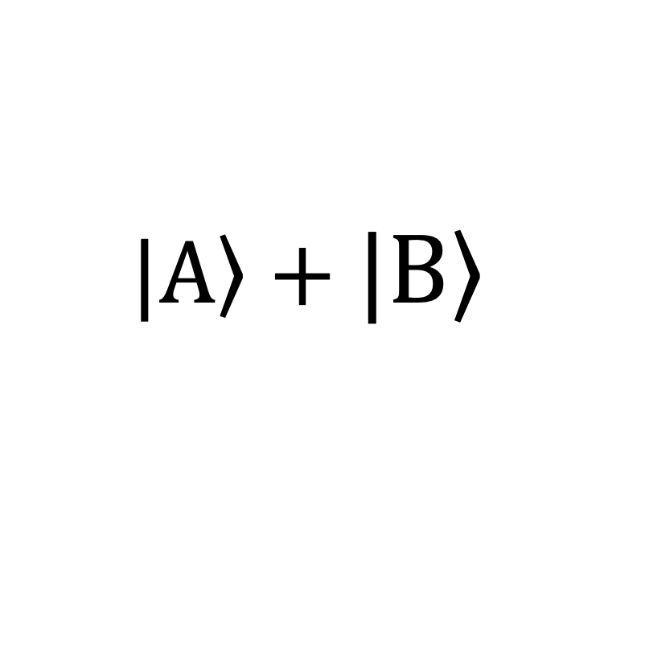
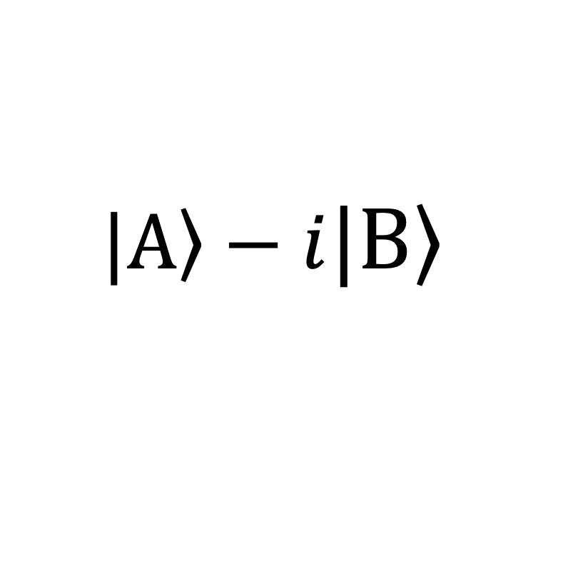
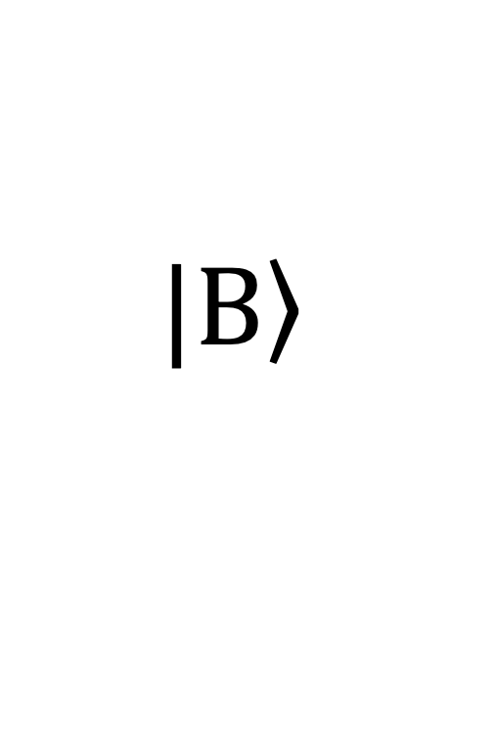



Electron wavefunction in graphene
$$\left.|A\right\rangle$$
$$|\left.A\right\rangle −i|\left.B\right\rangle$$
$$|\left.A\right\rangle −|\left.B\right\rangle$$
$$|\left.A\right\rangle +|\left.B\right\rangle$$
$$u_{k}=C_{A}(k)|\left.A\right\rangle +C_{B}(k)|\left.B\right\rangle$$
$$|\left.A\right\rangle +i|\left.B\right\rangle$$
$$\left.|B\right\rangle$$
A and B are identical carbon atoms,
Any wavefunction must be equal-weight superposition of A and B
-> Equater of the Bloch sphere

Slide 17





Electron wavefunction in graphene
$$\left.|A\right\rangle$$
ky
$$|\left.A\right\rangle −i|\left.B\right\rangle$$
$$|\left.A\right\rangle −|\left.B\right\rangle$$
$$|\left.A\right\rangle +|\left.B\right\rangle$$
kx
$$|\left.A\right\rangle +i|\left.B\right\rangle$$
$$\left.|B\right\rangle$$
One-to-one correspondence between Fermi contour (k space) and equator of Bloch sphere

Slide 18






Electron wavefunction in graphene
$$|\left.A\right\rangle −i|\left.B\right\rangle$$
$$|\left.A\right\rangle −|\left.B\right\rangle$$
$$|\left.A\right\rangle −|\left.B\right\rangle$$
$$K′$$
$$K$$
$$|\left.A\right\rangle +i|\left.B\right\rangle$$
Time-reversal symmetry
Winding number
-1
Winding number +1

Slide 19
Electron wavefunction in graphene

Slide 20




Electron wavefunction in graphene
$$\left.|A\right\rangle$$
Breaking the A-B sublattice symmetry, making the two carbon atoms different
$$θ$$
$$φ$$
$$\left.|B\right\rangle$$
Out-of-plane
Original in-plane widing

Slide 21


Electron wavefunction in graphene
$$K′$$
$$K$$

Slide 22


Berry curvature
Berry curvature
$$Ω=−Im\sum_{m≠n}{\left\langle n | i∂_{k_{α}} | m\right\rangle \left\langle m | i∂_{k_{β}} | n\right\rangle }$$
Berry curvature is the amount of solid angle (area on the Bloch sphere) for a contour in k space.

Slide 23

Berry curvature
Berry curvature
$$Ω=−Im\sum_{m≠n}{\left\langle n | i∂_{k_{α}} | m\right\rangle \left\langle m | i∂_{k_{β}} | n\right\rangle }$$
Activity: proves that the K’ valley has opposite Berry curvature

Slide 24





Berry curvature– effective magnetic field
Valley Hall effect
Chern number $C=\int{d^{2}k Ω\left(k\right)=0}$
Breaking inversion (AB) symmetry leads to a topological trivial state in graphenen

Slide 25




Breaking A-B sublattice symmetry – Trivial insulator
$$K′$$
$$K$$
$$K′$$
$$K$$
$$K′$$
$$K$$
Map to the equator
Almost north hemi
Shrinks towards north pole
Topology -> Number of times covering the entire Bloch sphere.

Slide 26









Haldane model
Breaking time-reversal symmetry but preserve the A-B sublattice symmetry
B
A
$$K′$$
$$K$$
P
T
$$K′$$
$$K$$
$$K′$$
$$K$$
Covering the entire bloch sphere, topological!

Slide 27



Haldane model
$$K′$$
$$K$$
Activity: proves that the K’ valley has SAME Berry curvature

Slide 28




Haldane model
Breaking time-reversal symmetry but preserve the A-B sublattice symmetry
$$K′$$
$$K$$
$$K′$$
$$K$$
Chern number $C=\int{d^{2}k Ω\left(k\right)=1}$
Hall conductivity $σ_{xy}=Ce^{2}/h$

Slide 29


Quantum metric
Quantum metric
$$g=−Re\sum_{m≠n}{\left\langle n | i∂_{k_{α}} | m\right\rangle \left\langle m | i∂_{k_{β}} | n\right\rangle }$$
(3)
2
1
1
2
$$g_{13}=0$$
$g_{12}$ is large
3
Quantum metric is the distance on the Bloch sphere for adjacent k points.

Slide 30


Slide 31


Slide 32


Slide 34


Slide 35




Berry curvature $Ω=−Im\sum_{m≠n}{\left\langle n | i∂_{k_{α}} | m\right\rangle \left\langle m | i∂_{k_{β}} | n\right\rangle }$
  Curvature of what?
  Pseudomagnetic field?
Topology $C=\int{d^{2}k Ω(k)}$
  Topology of what?
  Quantized Hall conductivity?
Quantum geometry tensor: $T=g+iΩ$
Quantum metric $g=Re\sum_{m≠n}{\left\langle n | i∂_{k_{α}} | m\right\rangle \left\langle m | i∂_{k_{β}} | n\right\rangle }$
  Quantum distance?
Draw orbitals

Slide 36
Outline
Lecture 1 2
Chemical approach of topology and quantum geometry
Lecture 3 & 4
Quantum geometry nonlinearity
Axion quasiparticle in quantum materials

Slide 37

Inversion symmetry
Examples
Atomic orbitals
Molecular orbital
p
s
Symmetry of bands?

Slide 38

Symmetry of 1D band
Same 1D lattice but think about it in a slightly different way:
Previously, (atom -> lattice) we periodically arranged atoms to form a band.
Now, we first draw a 1D unit cell, treat the unit cell as a “container”, recognize its “special points” to form bands.
1a
1b
x
Examples
s_{1a} band: Put s orbital at every 1a position
s_{1b}: Put s orbital at every 1b position
p_{1a} band: Put p orbital at every 1a position
p_{1b} band: Put p orbital at every 1b position

Slide 39










Symmetry of 1D s_{1a} band
$$ε$$
1a
1b
x
$$k$$
$$k=0$$
-$π/l$
$$0$$
$$π/l$$
$$k=π$$
$$k=0$$
$$k=π$$
s_{1a}

Slide 40


Symmetry of 1D s_{1b} band
$$ε$$
1a
1b
x
$$k$$
$$k=0$$
-$π/l$
$$0$$
$$π/l$$
$$k=π$$
$$k=0$$
$$k=π$$
s_{1b}

Slide 41
Symmetry of 1D s_{1b} band
$$ε$$
1a
1b
x
$$k$$
$$k=0$$
-$π/l$
$$0$$
$$π/l$$
$$k=π$$
$$k=0$$
$$k=π$$
s_{1b}

Slide 42

In-class activity: p_{1a} and p_{1b} band
$$ε$$
1a
1b
x
$$k$$
$$k=0$$
-$π/l$
$$0$$
$$π/l$$
$$k=π$$
$$k=0$$
$$k=π$$

Slide 43



In-class activity: 1D bands
$$k=0$$
$$k=π$$
s_{1a}
s_{1b}
p_{1a}
p_{1b}
While we used s_{1a}, s_{1b}, p_{1a} and p_{1b} as example, but the results are entirely general. We can put N orbitals (let them be s, p, d, f) at any position in the lattice, which will form N bands. But if we only care about the inversion eigenvalues of the band, then every band will be one of the above four.
In other words, we can use the inversion eigenvalue to classify 1D bands. (just like we can use the number of holes to classify shapes)

Slide 44
Symmetry of 2D band
1b
1d
1c
1a
Examples
s_{1a}: Put s orbital at every 1a position
s_{1b}: Put s orbital at every 1b position
s_{1c}: Put s orbital at every 1c position
s_{1d}: Put s orbital at every 1d position
p_{1a} band: Put p orbital at every 1a position
p_{1b} band: Put p orbital at every 1b position
p_{1c} band: Put p orbital at every 1c position
p_{1d} band: Put p orbital at every 1d position

Slide 45






Symmetry of 2D s_{1a} band
$$\left(0,π\right)$$
$$(π,π)$$
1b
1d
1c
1a
$$(0,0)$$
$$(π,0)$$
$$k=(0,0)$$
1b
1d
1c
1a

Slide 46


Symmetry of 2D s_{1a} band
$$k=(π,0)$$
$$\left(0,π\right)$$
$$(π,π)$$
1b
1d
1c
1a
$$(0,0)$$
$$(π,0)$$
$$k=(0,π)$$
1b
1d
1c
1a

Slide 47





Symmetry of 2D s_{1a} band
$$k=(π,π)$$
$$\left(0,π\right)$$
$$(π,π)$$
1b
1d
1c
1a
$$(0,0)$$
$$(π,0)$$
$$(0,0)$$
$$(π,0)$$
$$(0,π)$$
$$(π,π)$$
s_{1a}

Slide 48






















Symmetry of 2D bands
$$(0,0)$$
$$(π,0)$$
$$(0,π)$$
$$(π,π)$$
s_{1a}
s_{1b}
s_{1c}
s_{1d}
_{p1a}
_{p1b}
_{p1c}
_{p1d}
$$+$$
$$+$$
$$+$$
$$+$$
$$+$$
$$−$$
$$+$$
$$−$$
$$+$$
$$+$$
$$−$$
$$−$$
$$+$$
$$−$$
$$−$$
$$+$$
$$−$$
$$−$$
$$−$$
$$−$$
$$−$$
$$+$$
$$−$$
$$+$$
$$−$$
$$−$$
$$+$$
$$+$$
$$−$$
$$+$$
$$+$$
$$−$$
Similar to the 1D case, we can use the inversion eigenvalues here to classify the 2D bands. Interestingly, we only got bands with even numbers of “+” and So how about the bands with odd numbers of “+” and “-”. ? Those are the topological bands!

Slide 49







Topological 2D bands
The bands with odd numbers of “+” and “-” are the topological bands!
(----)
(+---)
$$k_{y}$$
$$+$$
$$+$$
$$k_{x}$$
(++++)
(-+++)
$$−$$
$$+$$

Slide 50








Topological 2D bands
$$k_{y}$$
$$+$$
$$+$$
$$y$$
$$k_{x}$$
$$+$$
$$+$$
1b
1a
1b
(++++)
0
pi
$$k_{x}$$
Momentum space
Hybrid space
kx,ky
kx,y

Slide 51







Trivial 2D bands
The bands with odd numbers of “+” and “-” are the topological bands!
$$k_{y}$$
$$y$$
$$+$$
$$+$$
$$k_{x}$$
$$+$$
$$+$$
1b
1a
1b
0
pi
$$k_{x}$$
Where is the center of the charge in y axis at different kx vaues

Slide 52
Topological 2D bands
The bands with odd numbers of “+” and “-” are the topological bands!
(----)
(+---)
$$k_{y}$$
$$+$$
$$+$$
$$k_{x}$$
(++++)
(-+++)
$$−$$
$$+$$

Slide 53
Topological 2D bands
The bands with odd numbers of “+” and “-” are the topological bands!
$$k_{y}$$
$$y$$
$$+$$
$$+$$
1b
$$k_{x}$$
1a
$$−$$
$$+$$
0
pi
$$k_{x}$$
(-+++)
As we scan through k space, charge is NOT localized within a single unit cell. Rather, it shifts transversely by one unit cell, this is the quantized Hall conductance. At the edge, the transverse motion is terminated, giving rise to the edge states.

Slide 54


A trivial band is localized within a single unit cell – can be constructed by placing an atomic orbital at a particular site
A topological band can NOT be localized within a single unit cell
- NOT be constructed by placing an atomic orbital at a particular site.
Moving from kx = -pi to pi, we have to pump a single charge from –y boundary to +y boundary, which is the quantized Hall effect.
The local slope is the Berry curvature.

Slide 55



Lect. 1 and 2
Lect. 3
Lect. 4

Slide 56
Building band from atoms
Single H atom
Discrete Energy levels
H2
H chain = infinite ring
…
Continuous Energy “Band”

Slide 57
H2
H2

Slide 58
In-class activity: H3
H3

Slide 59

Symmetry eigenvalues
$$C_{3}Ψ=αΨ$$

Slide 60
In-class activity: H4
H4

Slide 61
H chain
H chain (N atoms)

Slide 62




P orbital lattice
E
-$π/a$
$$0$$
$$π/a$$
$$k$$

Slide 63




2D band structure
$$\left(0,π\right)$$
$$(π,π)$$
ky
$$(0,0)$$
$$(π,0)$$
kx

Slide 64
Outline
Lecture 1
Chemical approach of electron band structure
Chemical approach of Berry curvature and quantum geometry
Chemical approach of topology
Symmetry of bands
Lecture 2
Quantum geometry application I: Nonlinear Hall effect
Quantum geometry application II: Axion quasiparticle in quantum materials

Slide 65



Graphene
z
z

Slide 66


2D graphene wavefunction
Lattice
Band
E(kx,ky)
Wavefunction
A
B
Quantum geometry is encoded in the wavefunction

Slide 67


2D band structure
$$\left(0,π\right)$$
$$(π,π)$$
ky
$$(0,0)$$
$$(π,0)$$
kx

